Slide 1
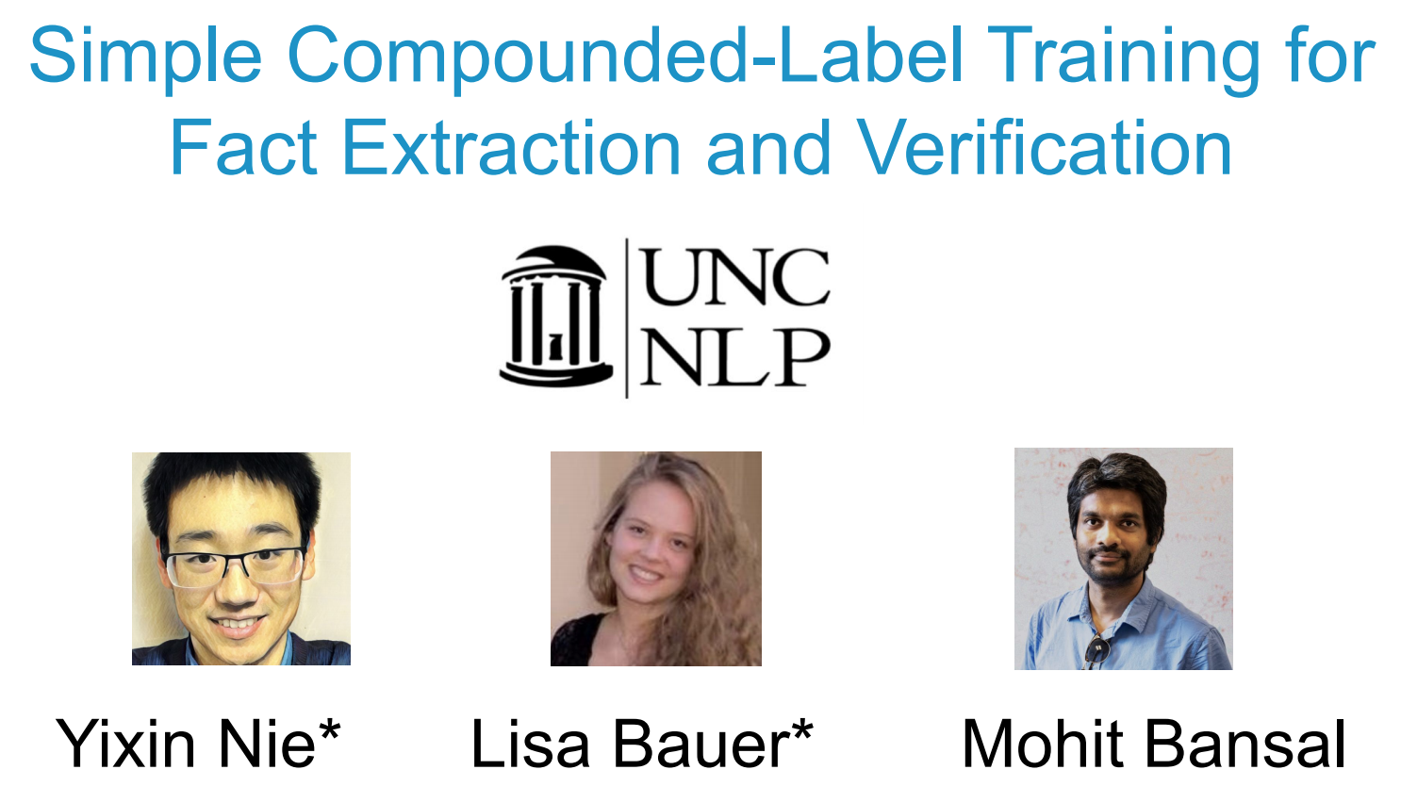

Slide 5
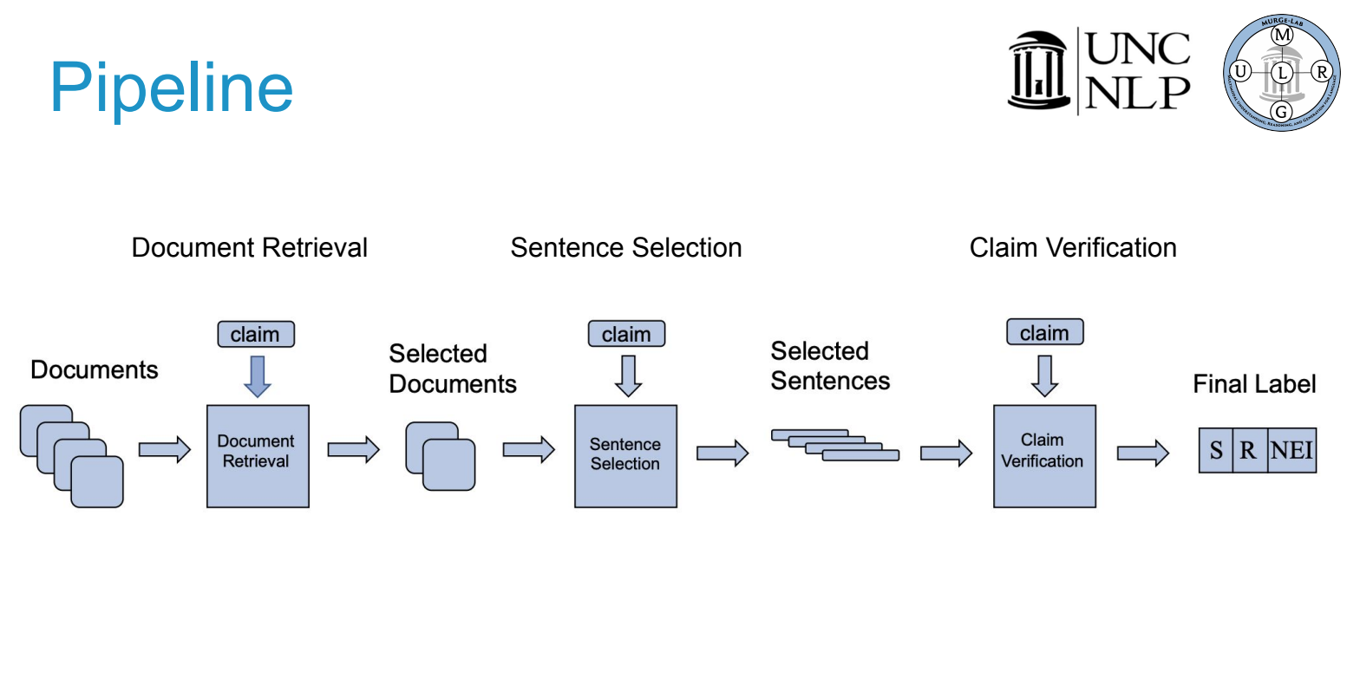

Slide 6
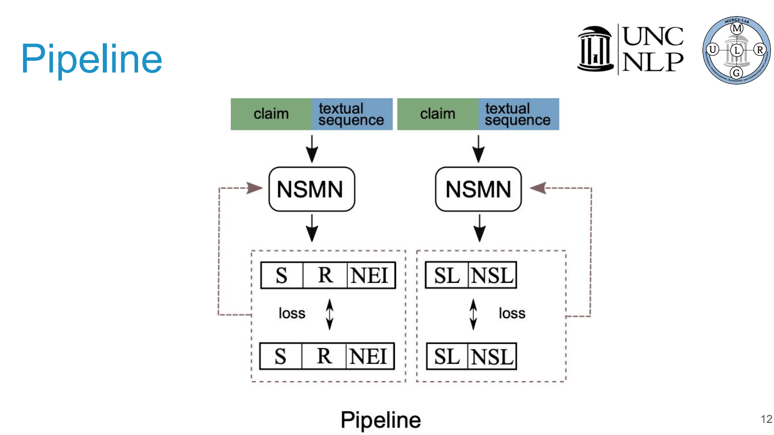

Slide 11
DeSePtion: Dual Sequence Prediction and Adversarial Examples for Improved Fact-Checking
Christopher Hidey, Tuhin Chakrabarty, Tariq Alhindi, Siddharth Varia, Kriste Krstovski, Mona Diab, Smaranda Muresan
Notes:
With the rise of misinformation...

Slide 12
Motivation and Background
Why do we need fact-checking?
Misinformation/disinformation on the rise (Ireton, 2018)
Journalists must examine “check-worthy” claims for truth (Hassan et al, 2017)
Related Work
Fact-checking websites (Vlachos and Reidel, 2014; Alhindi et al., 2018)
News articles (Pomerleau and Rao, 2017)
Community forums (Mihaylova et al., 2018)

Slide 13
Challenges
Professional fact-checking organizations need to synthesize evidence from multiple sources (Graves, 2018)
Numerical comparatives alone are indicative of truthful statements (Rashkin et al., 2017) but temporal reasoning is challenging (Mirza and Tonnelli, 2016)
Fact-checking is sensitive to ambiguous entities (Thorne and Vlachos, 2018) or lexical features (Nakashole and Mitchell, 2014)

Slide 14
Towards Addressing these Challenges
Data
Methods
Development of adversarial claims
Development of fact-checking system with targeted improvements

Slide 15
Data
Murda Beatz’s real name is Marshall Mathers.
[Murda Beatz]
Shane Lee Lindstrom, known professionally as Murda Beatz ...
REFUTES
Notes:
and its in this framework that we conduct our experiments

Slide 16
Data
FEVER 1.0(Thorne et al. 2018)
FEVER 2.0(Thorne et al. 2019)
adversarial “attacks” submitted by participants
evaluated against FEVER systems
Notes:
and its in this framework that we conduct our experiments

Slide 17
Data: Adversarial Claims
Multiple propositions
CONJUNCTION
Janet Leigh was from New York. Janet Leigh was an author.
Notes:
Checkworth claims often contain multiple propositions joined by conjunction

Slide 18
Data: Adversarial Claims
Multiple propositions
CONJUNCTION
Janet Leigh was from New York and Janet Leigh was an author.
Notes:
Checkworth claims often contain multiple propositions joined by conjunction

Slide 19
Data: Adversarial Claims
Multiple propositions
CONJUNCTION
MULTI-HOP REASONING
[The Nice Guys]
The Nice Guys is a 2016 action comedy film.

Slide 20
Data: Adversarial Claims
Multiple propositions
CONJUNCTION
MULTI-HOP REASONING
[The Nice Guys]
The Nice Guys is a 2016 action comedy film directed by a
Danish screenwriter known for the 1987 action film Lethal Weapon.
[Shane Black]

Slide 21
Data: Adversarial Claims
Multiple propositions
CONJUNCTION
MULTI-HOP REASONING
ADDITIONAL UNVERIFIABLE PROPOSITIONS
Duff McKagan is an American citizen.

Slide 22
Data: Adversarial Claims
Multiple propositions
CONJUNCTION
MULTI-HOP REASONING
ADDITIONAL UNVERIFIABLE PROPOSITIONS
Duff McKagan is an American citizen born in Seattle.

Slide 23
Data: Adversarial Claims
Multiple propositions
CONJUNCTION
MULTI-HOP REASONING
ADDITIONAL UNVERIFIABLE PROPOSITIONS
Temporal reasoning
DATE MANIPULATION
Artpop was Gaga’s second consecutive number one record in the
United States in 2009.

Slide 24
Data: Adversarial Claims
Multiple propositions
CONJUNCTION
MULTI-HOP REASONING
ADDITIONAL UNVERIFIABLE PROPOSITIONS
Temporal reasoning
DATE MANIPULATION
Artpop was Gaga’s second consecutive number one record in the
United States in 2009 before 2010.

Slide 25
Data: Adversarial Claims
Multiple propositions
CONJUNCTION
MULTI-HOP REASONING
ADDITIONAL UNVERIFIABLE PROPOSITIONS
Temporal reasoning
DATE MANIPULATION
MULTI-HOP TEMPORAL REASONING
[William Henry Harrison] [Indiana Territory]
The first governor of the Indiana Territory lived long enough to see it become a state.
Notes:
William Henry Harrison (1841)
Admitance of Indiana Territory (1816)

Slide 26
Data: Adversarial Claims
Multiple propositions
CONJUNCTION
MULTI-HOP REASONING
ADDITIONAL UNVERIFIABLE PROPOSITIONS
Temporal reasoning
DATE MANIPULATION
MULTI-HOP TEMPORAL REASONING
[William Henry Harrison] [Indiana Territory]
The first governor of the Indiana Territory lived long enough to see it become a state. (death 1841)
(admittance 1816)
Notes:
William Henry Harrison (1841)
Admitance of Indiana Territory (1816)

Slide 27
Data: Adversarial Claims
Multiple propositions
CONJUNCTION
MULTI-HOP REASONING
ADDITIONAL UNVERIFIABLE PROPOSITIONS
Temporal reasoning
DATE MANIPULATION
MULTI-HOP TEMPORAL REASONING
Ambiguity and lexical variation
ENTITY DISAMBIGUATION
Kate Hudson is a left wing political activist.
[Kate Hudson]

Slide 28
Data: Adversarial Claims
Multiple propositions
CONJUNCTION
MULTI-HOP REASONING
ADDITIONAL UNVERIFIABLE PROPOSITIONS
Temporal reasoning
DATE MANIPULATION
MULTI-HOP TEMPORAL REASONING
Ambiguity and lexical variation
ENTITY DISAMBIGUATION
Kate Hudson is a left wing political activist.
[Kate Hudson] [Kate Hudson (activist)]

Slide 29
Data: Adversarial Claims
Multiple propositions
CONJUNCTION
MULTI-HOP REASONING
ADDITIONAL UNVERIFIABLE PROPOSITIONS
Temporal reasoning
DATE MANIPULATION
MULTI-HOP TEMPORAL REASONING
Ambiguity and lexical variation
ENTITY DISAMBIGUATION
LEXICAL SUBSTITUTION
The Last Song began filming in 2009.

Slide 30
Data: Adversarial Claims
Multiple propositions
CONJUNCTION
MULTI-HOP REASONING
ADDITIONAL UNVERIFIABLE PROPOSITIONS
Temporal reasoning
DATE MANIPULATION
MULTI-HOP TEMPORAL REASONING
Ambiguity and lexical variation
ENTITY DISAMBIGUATION
LEXICAL SUBSTITUTION
The Last Song began filming shooting in 2009.

Slide 31
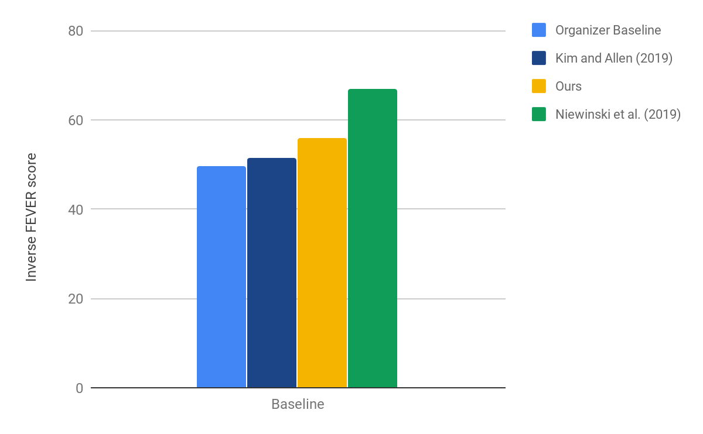
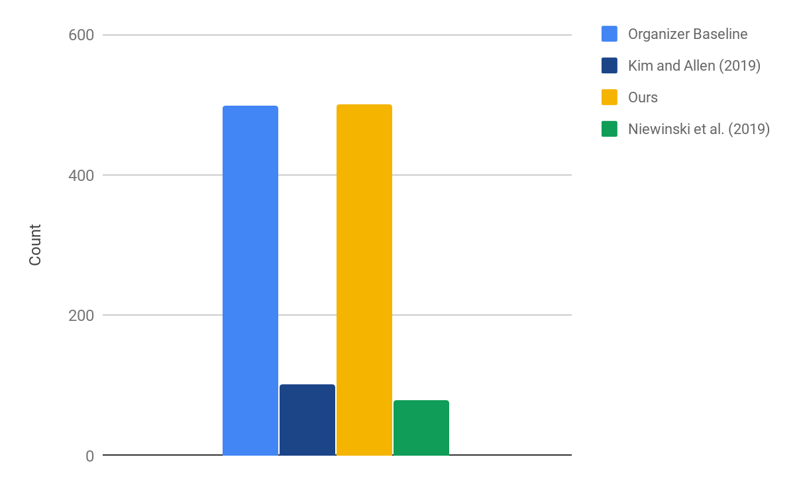
Evaluation: Data

Slide 32
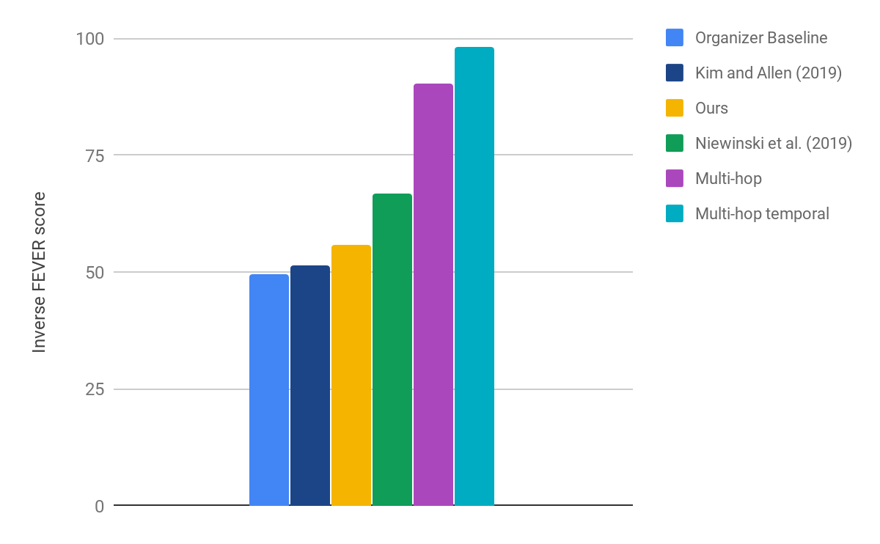
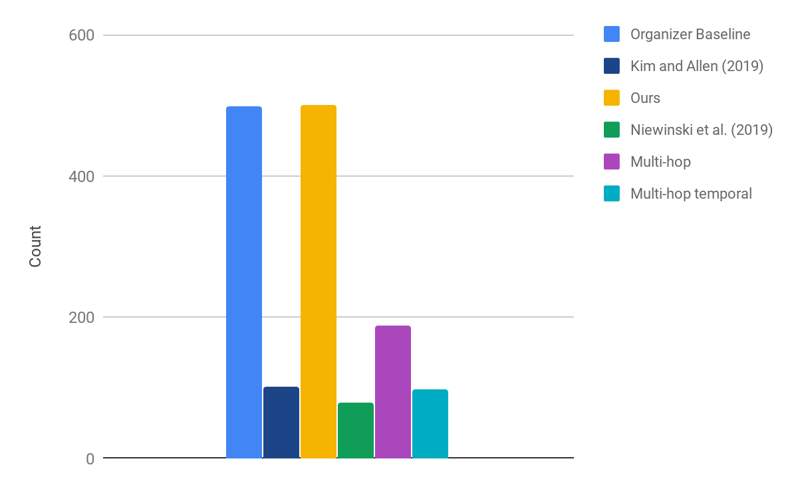
Evaluation: Data

Slide 33
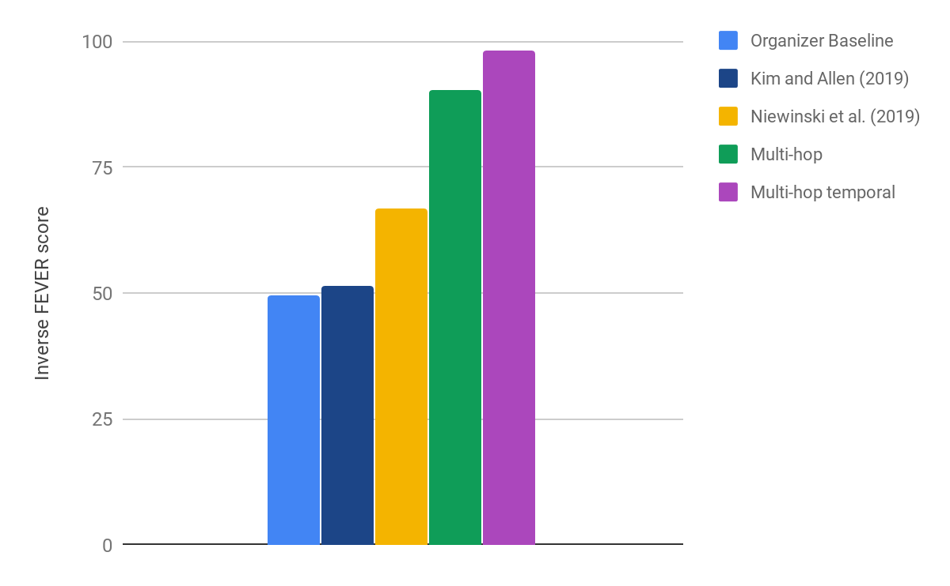
Evaluation: Data

Slide 34
Evaluation: Data

Slide 35
Methods: Fact-Checking System
Candidate Document Selection
1a
Google
TF-IDF
NER
POS

Slide 36
Methods: Fact-Checking System
Candidate Document Selection
Document Ranking
1b
1a
Pointer Network
Google
TF-IDF
NER
POS
Overgenerate and re-rank to handle ambiguity

Slide 37
Methods: Fact-Checking System
Candidate Document Selection
Document Ranking
Sentence Ranking
Relation Prediction
1b
2
3
1a
Pointer Network
Joint Pointer Network
Google
TF-IDF
NER
POS
Sequence prediction to handle multiple propositions
Overgenerate and re-rank to handle ambiguity

Slide 38
Methods: Fact-Checking System
Post-processing to handle temporal relations
Candidate Document Selection
Document Ranking
Sentence Ranking
Relation Prediction
1b
2
3
1a
Pointer Network
Joint Pointer Network
Google
TF-IDF
NER
POS
Sequence prediction to handle multiple propositions
Overgenerate and re-rank to handle ambiguity

Slide 39
Methods: Pointer Network
Candidate documents or sentences
Evidence
e₀
e₁
e₂
e₃
Claim
c: Michelle Obama’s husband was born in Kenya.

Slide 40
Methods: Pointer Network
Fine-tuned on gold claim and evidence pairs
BERT
Claim
c
c
c
c
Evidence
e₀
e₁
e₂
e₃
c: Michelle Obama’s husband was born in Kenya.

Slide 41
Methods: Pointer Network
Document Ranking
e₃
:[Michelle Obama]
Pointer Network
BERT
Claim
c
c
c
c
Evidence
e₀
e₁
e₂
e₃
c: Michelle Obama’s husband was born in Kenya.

Slide 42
Methods: Pointer Network
Document Ranking
e₁
: [Barack Obama]
e₃
:[Michelle Obama]
Pointer Network
BERT
Claim
c
c
c
c
Evidence
e₀
e₁
e₂
e₃
c: Michelle Obama’s husband was born in Kenya.

Slide 43
Methods: Pointer Network
Joint Sentence Selection and Relation Prediction
Pointer Network
e₁: Obama… born in Hawaii
NOT ENOUGH INFO
BERT
Claim
c
c
c
c
Evidence
e₀
e₁
e₂
e₃
c: Michelle Obama’s husband was born in Kenya.

Slide 44
Methods: Pointer Network
Joint Sentence Selection and Relation Prediction
e₀: Michelle…married Barack
REFUTES
Pointer Network
e₁: Obama… born in Hawaii
NOT ENOUGH INFO
BERT
Claim
c
c
c
c
Evidence
e₀
e₁
e₂
e₃
c: Michelle Obama’s husband was born in Kenya.

Slide 45
Methods: Pointer Network
Post-processing for temporal reasoning
e₀: Michelle…married Barack
REFUTES
Pointer Network
e₁: Obama… born in Hawaii
NOT ENOUGH INFO
BERT
Claim
c
c
c
c
Evidence
e₀
e₁
e₂
e₃
c: Michelle Obama’s husband was born in Kenya.

Slide 46
Methods: Temporal Post-processing
Extract with Open IE and normalize:
The Latvian Soviet Socialist Republic was a republic of the Soviet Union 3 years after 2009.
Compare only dates in retrieved evidence:
The Soviet Union … existed from 1922 to 1991.

Slide 47
Evaluation: Data

Slide 48
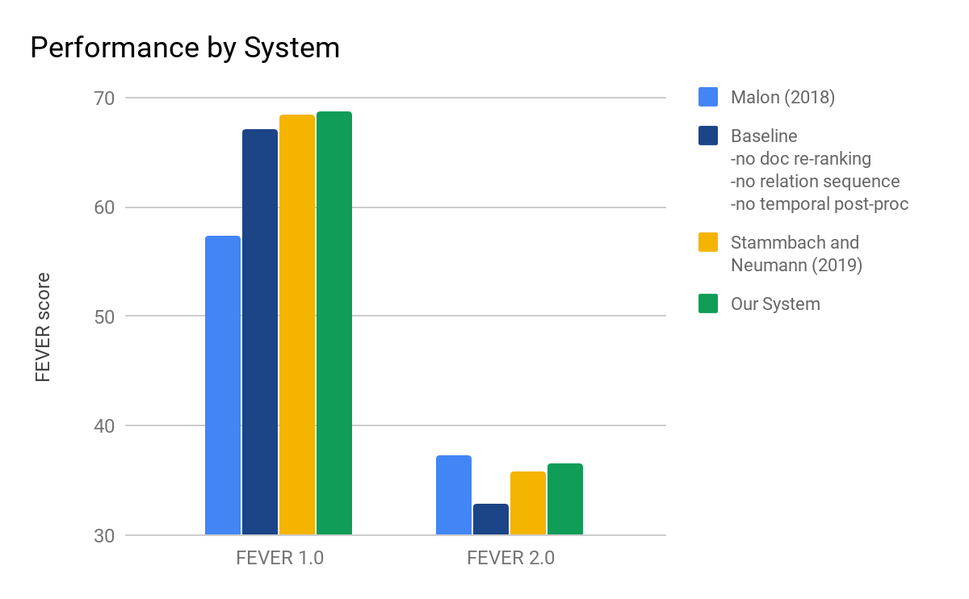
Evaluation: Methods
Notes:
mention why we selected the baseline - similar but without document re-ranking, date post-processing, label sequence prediction
this way we don’t need to mention ablation

Slide 49
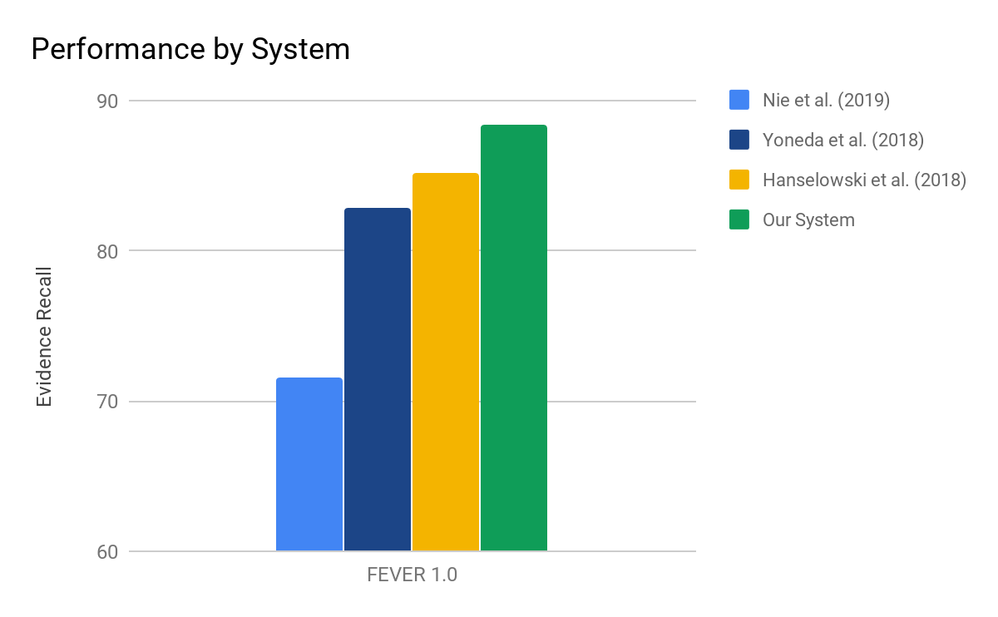
Evaluation: Methods
Notes:
mention why we selected the baseline - similar but without document re-ranking, date post-processing, label sequence prediction
this way we don’t need to mention ablation

Slide 50
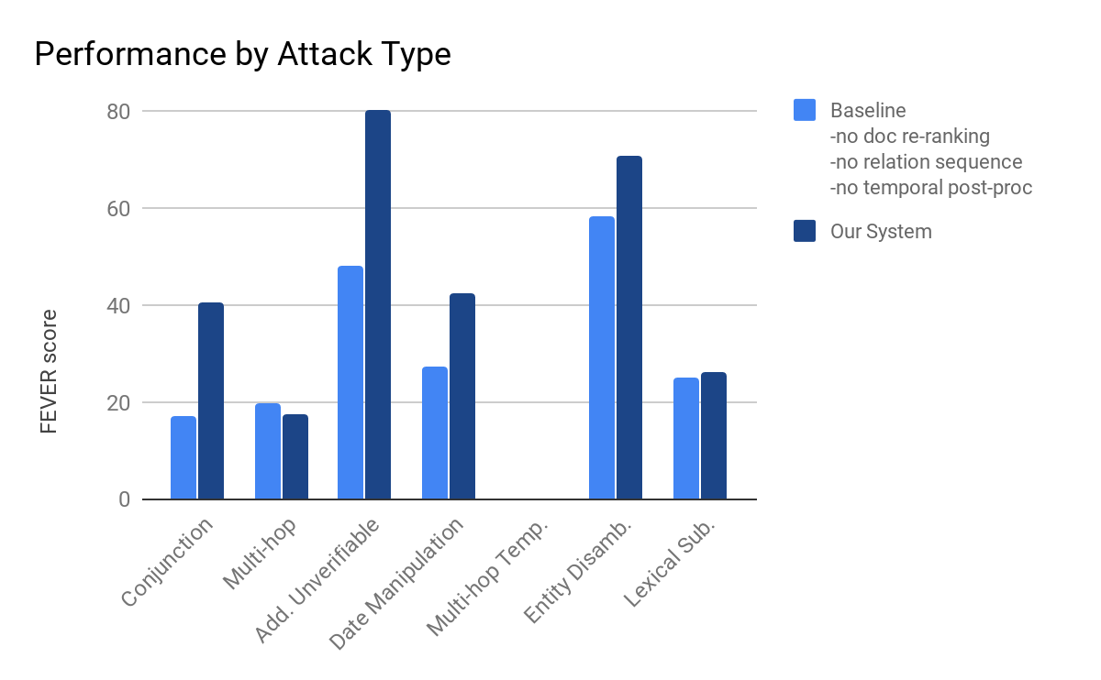
Evaluation: Attack Types

Slide 51
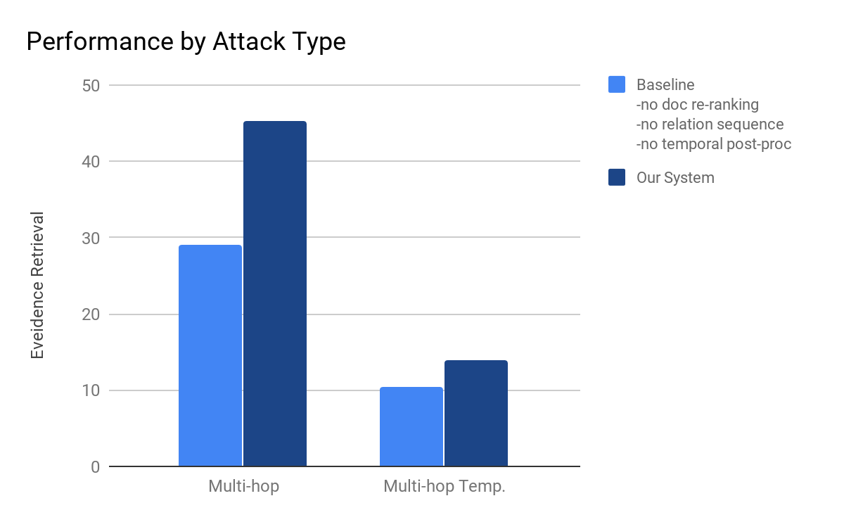
Evaluation: Attack Types

Slide 52
Evaluation: Qualitative Analysis
Baseline:
Honeymoon is a major-label record by Elizabeth Woolridge Grant.
[Honeymoon] [Lana del Rey]
SUPPORTS
✓
✓

Slide 53
Evaluation: Qualitative Analysis
Our System:
Honeymoon is a major-label record by Elizabeth Woolridge Grant.
[Honeymoon (Lana del Rey album)] [Lana del Rey]
SUPPORTS
✓
✓
✓

Slide 54
Evaluation: Qualitative Analysis
Baseline:
The MVP of the 1976 Canada Cup tournament was born before the tournament was first held.
[Bobby Orr] [World Cup of Hockey] [Canada Cup]
REFUTES
✓

Slide 55
Evaluation: Qualitative Analysis
Our System:
The MVP of the 1976 Canada Cup tournament was born before the tournament was first held.
[Bobby Orr] [1976 Canada Cup]
NOT ENOUGH INFO
✓
✓
Notes:
SUPPORTS

Slide 56
Questions?
Come join our discussion slot(s):
Wednesday July 8, 2020 14B NLP Applications-11 18:00 UTC+0
Wednesday July 8, 2020 15B NLP Applications-12 21:00 UTC+0

Slide 58
Evaluation: Ablation
System | FEVER 1.0 Dev | FEVER 2.0 Dev
Builders | 69.2 | 36.2
Ptr+rel.seq.loss | 73.17 | 39.86
+doc. rank | - | 41.91
+dateProc (Fixers) | - | 43.36

Slide 59
Evaluation: Data
Team | # | Potency
Baseline | 498 | 49.68
Kim and Allen (2019) | 102 | 51.54
Ours | 501 | 55.79
Niewinski et al. (2019) | 79 | 66.83
Multi-hop | 188 | 90.34
Multi-hop Temporal | 55 | 98

Slide 60
Evaluation: Methods
Team | FEVER 1.0 | FEVER 2.0
Athene | 61.58 | 25.35
UNC | 64.21 | 30.47
Our Baseline - RL | 67.08 | 32.92
Dominiks | 68.46 | 35.82
UCL MR | 62.52 | 35.83
Our System | 68.8 | 36.61
Papelo | 57.36 | 37.31
Notes:
mention why we selected the baseline - similar but without document re-ranking, date post-processing, label sequence prediction
this way we don’t need to mention ablation

