Slide 1
relation EXTRACTION
Heng Ji
hengji@illinois.edu

Slide 2
Relation Extraction: Task
relation: a semantic relationship between two entities
  ACE relation type example
  Agent-Artifact Rubin Military Design, the makers of the Kursk
  Discourse each of whom
  Employment/ Membership Mr. Smith, a senior programmer at Microsoft
  Place-Affiliation Salzburg Red Cross officials
  Person-Social relatives of the dead
  Physical a town some 50 miles south of Salzburg
  Other-Affiliation Republican senators

Slide 3
Typical Symbolic Relation Extraction Features
Lexical
  Heads of the mentions and their context words, POS tags
Entity
  Entity and mention type of the heads of the mentions
  Entity Positional Structure
  Entity Context
Syntactic
  Chunking
  Premodifier, Possessive, Preposition, Formulaic
  The sequence of the heads of the constituents, chunks between the two mentions
  The syntactic relation path between the two mentions
  Dependent words of the mentions
Semantic Gazetteers
  Synonyms in WordNet
  Name Gazetteers
  Personal Relative Trigger Word List
Wikipedia
  If the head extent of a mention is found (via simple string matching) in the predicted Wikipedia article of another mention
References: Kambhatla, 2004; Zhou et al., 2005; Jiang and Zhai, 2007; Chan and Roth, 2010,2011
Notes:
IE’s application

Slide 4

Using Background Knowledge (Chan and Roth, 2010)
David
Cone
,
a
Kansas
City
native
,
was
originally
signed
by
the
Royals
and
broke
into
the
majors
with
the
team
David Brian Cone (born January 2, 1963) is a former Major League Baseball pitcher. He compiled an 8–3 postseason record over 21 postseason starts and was a part of five World Series championship teams (1992 with the Toronto Blue Jays and 1996, 1998, 1999 & 2000 with the New York Yankees). He had a career postseason ERA of 3.80. He is the subject of the book A Pitcher's Story: Innings With David Cone by Roger Angell. Fans of David are known as "Cone-Heads."
Cone lives in Stamford, Connecticut, and is formerly a color commentator for the Yankees on the YES Network.^{[1]}
Contents
[hide]
1 Early years
2 Kansas City Royals
3 New York Mets
Partly because of the resulting lack of leadership, after the 1994 season the Royals decided to reduce payroll by trading pitcher David Cone and outfielder Brian McRae, then continued their salary dump in the 1995 season. In fact, the team payroll, which was always among the league's highest, was sliced in half from $40.5 million in 1994 (fourth-highest in the major leagues) to $18.5 million in 1996 (second-lowest in the major leagues)
4
Notes:
I can better decide if I know something about the two mentions, for instance by mapping each mention to their respective Wikipedia pages.
4

Slide 5
Typical DNN Models using Distributional Embedding Features (Shi et al., 2018)
Notes:
IE’s application

Slide 6

Bootstrapping for Relation Extraction
Computer servers at Microsoft’s
headquarters in Redmond…
In mid-afternoon trading, share of
Redmond-based Microsoft fell…
The Armonk-based IBM introduced
a new line…
The combined company will operate
from Boeing’s headquarters in Seattle.
Intel, Santa Clara, cut prices of its
Pentium processor.
Occurrences of
seed tuples:
Initial Seed Tuples
Occurrences of Seed Tuples
Generate New Seed Tuples
Augment Table
Generate Extraction Patterns

Slide 7
Bootstrapping for Relation Extraction (Cont’)
<STRING1>’s headquarters in <STRING2>
<STRING2> -based <STRING1>
<STRING1> , <STRING2>
Learned
Patterns:
Initial Seed Tuples
Occurrences of Seed Tuples
Generate New Seed Tuples
Augment Table
Generate Extraction Patterns

Slide 8
Bootstrapping for Relation Extraction (Cont’)
Generate
new seed
tuples;
start new
iteration
Initial Seed Tuples
Occurrences of Seed Tuples
Generate New Seed Tuples
Augment Table
Generate Extraction Patterns

Slide 9
Distant Supervision
(Mintz et al., ACL2009)
Entry in knowledge base: <film-director, Steven Spielberg, Saving Private Ryan>
Project them to texts and use the noisy annotations for training:
Notes:
IE’s application

Slide 10
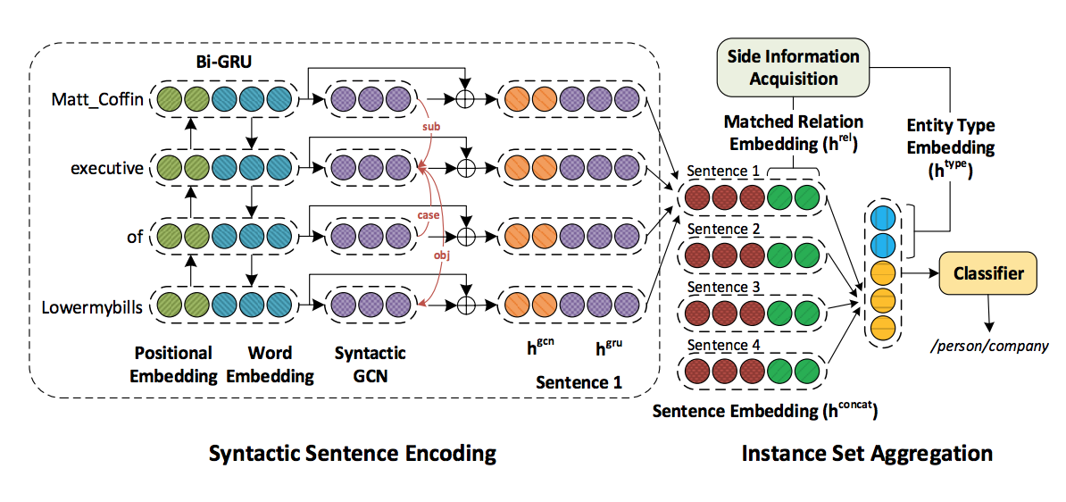
Adding Syntactic Relation
(Vashishth et al., EMNLP2018)
Notes:
IE’s application

Slide 11
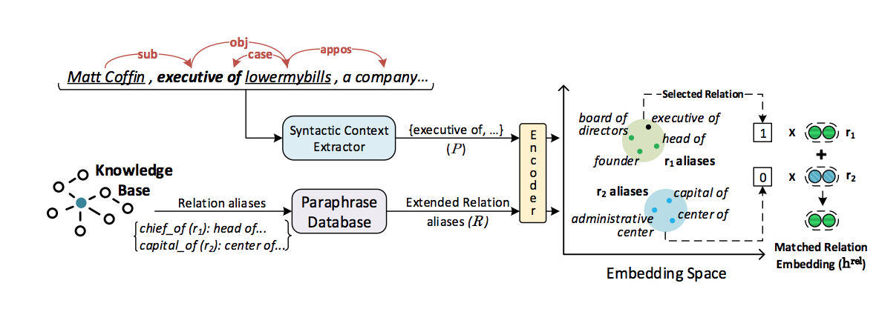
Adding Syntactic Relation
(Vashishth et al., EMNLP2018)
Notes:
IE’s application

Slide 12
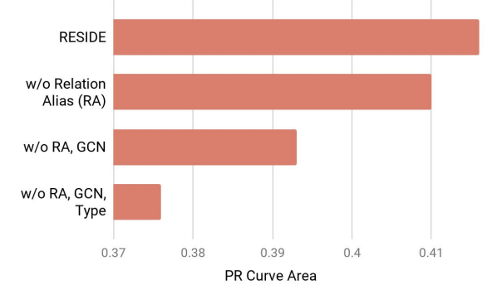
Adding Syntactic Relation
(Vashishth et al., EMNLP2018)
Notes:
IE’s application

Slide 13
Cross-document Relation Extraction Task
Task
https://competitions.codalab.org/competitions/20717#learn_the_details-overview
Data and baseline code
  https://github.com/thunlp/DocRED
Paper
  https://www.aclweb.org/anthology/P19-1074
Task
Notes:
IE’s application

Slide 14
Data
Notes:
IE’s application

Slide 15
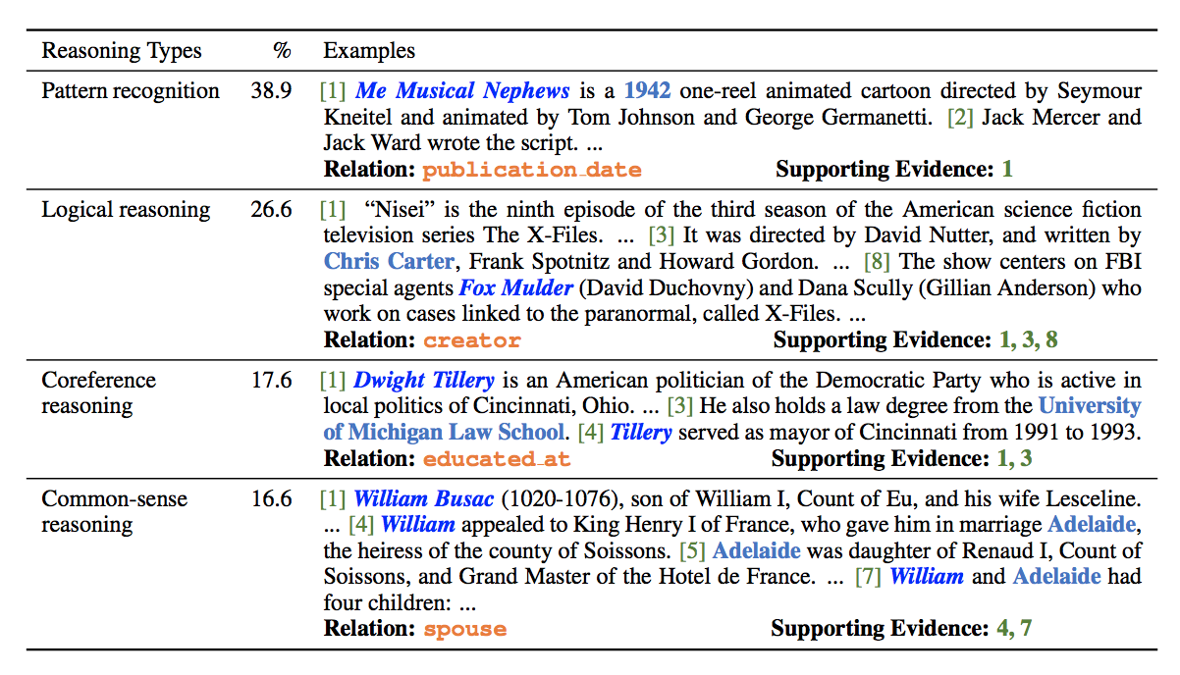
Types of Reasoning Required
Notes:
IE’s application

Slide 16
Data
Notes:
IE’s application

Slide 17
Data
Notes:
IE’s application

Slide 18
Evaluation Metric
Relation Extraction F-score
Evidence F-score
Notes:
IE’s application

Slide 19
Baseline Performance
Notes:
IE’s application

Slide 20
Baseline Performance
Notes:
IE’s application

Slide 21
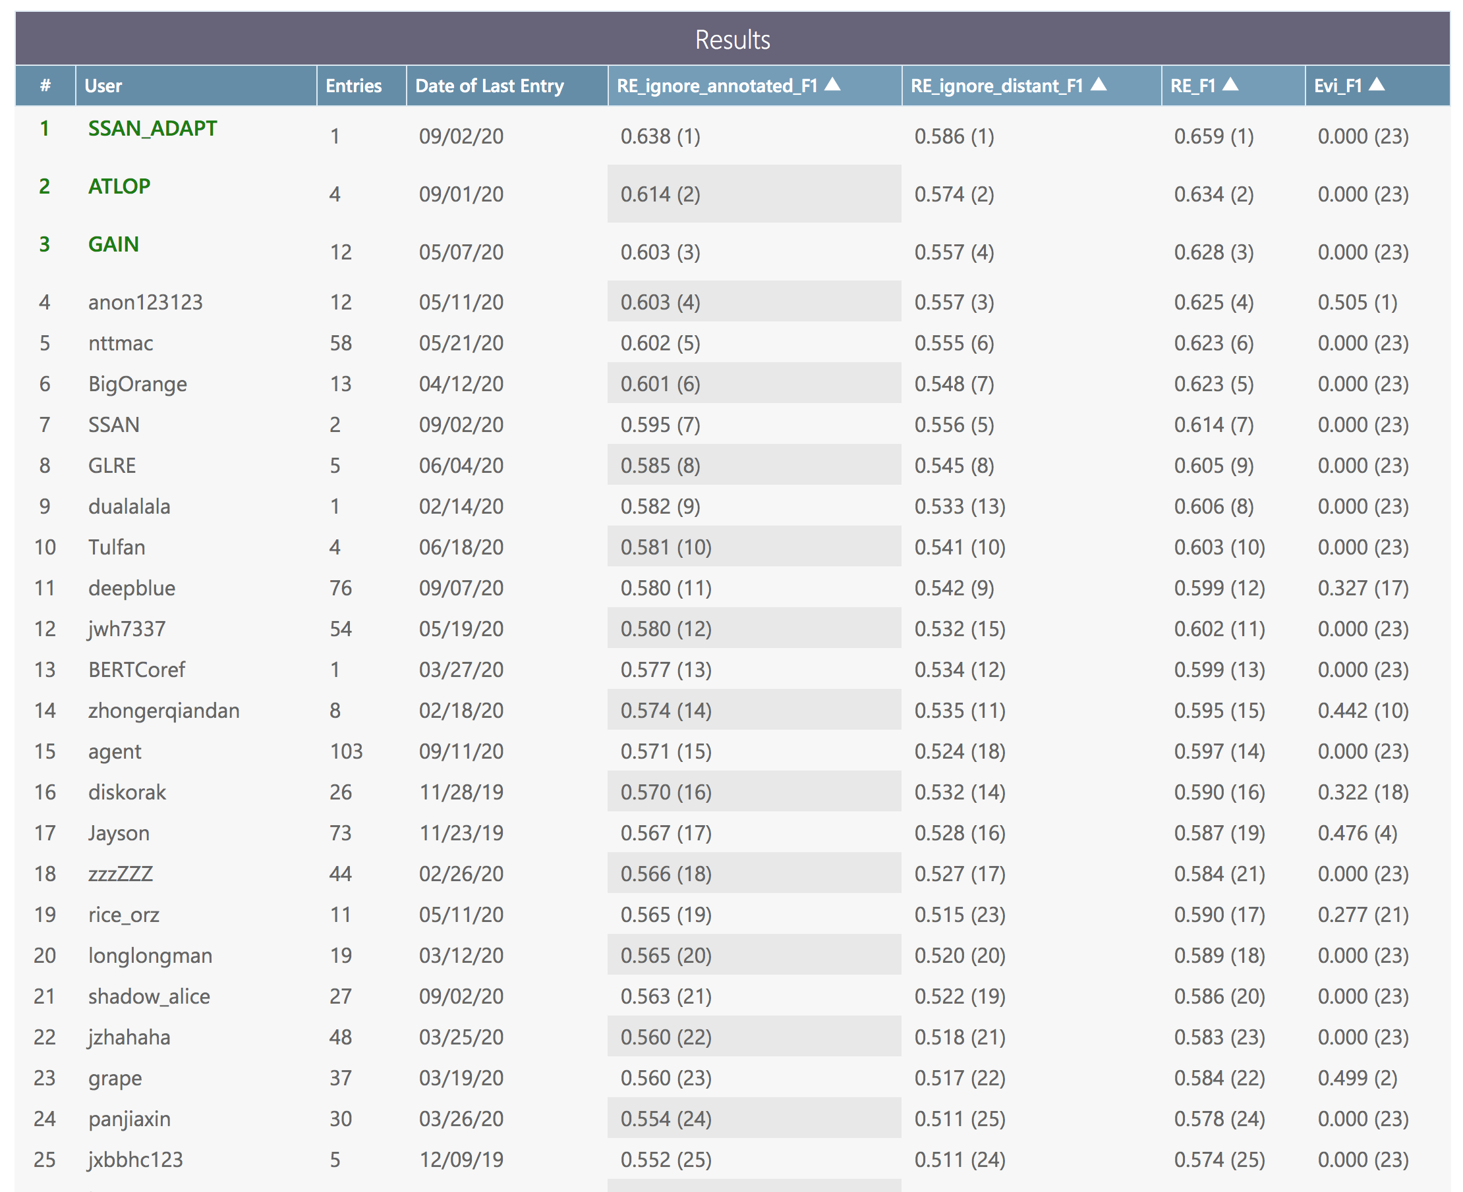
Current Team Performance
Notes:
IE’s application

Slide 22
Possible Ways to Improve
Joint Entity and Relation Extraction (Bekoulis et al., EMNLP2018)
Notes:
IE’s application

Slide 23
Possible Ways to Improve
Add Linguistic Features
Add better embeddings
Add entity coreference resolution
Add entity linking
Joint Relation and Event Extraction
Notes:
IE’s application

Slide 24
Challenges
Notes:
IE’s application

Slide 25
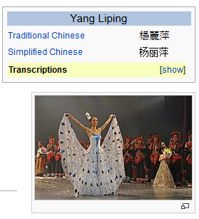

A similar task: Slot Filling (Ji and Grishman, ACL2011)
KB
<query id="SF14_CMN_030">
<name>杨丽萍</name>
<enttype>PER</enttype>
<docid>cmn-WL-10-92952-6628135</docid>
<beg>157</beg>
<end>159</end>
</query>
Source Collection
State/Province-of-Residence: 云南
13岁以前的杨丽萍，是云南一个山村小镇里光着脚丫到处拾麦穗的乡下小姑娘，在洱海之源过着艰苦而又不无乐趣的童年生活。十几年后，她摇身一变，成为舞台 上最绚丽的“孔雀”…而关于杨丽萍的感情问题，曾经有个爆料人称，杨丽萍的前夫是中央民 族歌舞团里的才子，一直帮着杨丽萍策划舞蹈，但后来，一个叫做托尼的美籍台湾人(刘淳晴)出现后，把杨丽萍给撬走了。
Spouse: 刘淳晴
Title: dancer, director, choreographer
Now, Ms. Yang, one of China's best-known dancers, is the director, choreographer and star of a new show that is drawing sellout crowds all over the country.

Slide 26
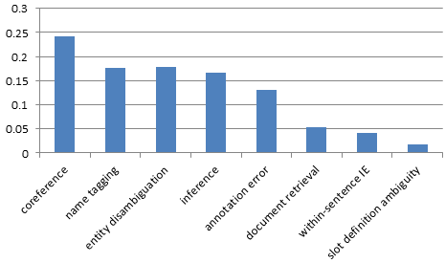
Have the Error Sources Changed over Years?
(Min and Grishman, 2011)
2010
(Yu and Ji, 2014)
2014

Slide 27

Blame Ourselves First…
Non-verb and multi-word expression as triggers
  his men back to their compound
Knowledge scarcity - Long-tail
  A suicide bomber detonated explosives at the entrance to a crowded
  medical teams carting away dozens of wounded victims
  Today I was let go from my job after working there for 4 1/2 years.
  Possible solution: increase coverage with FrameNet (Li et al., 2014)
Global context
  I didn't want to hurt him . I miss him to death.
  I threw stone out of the window. vs. I threw him out of the window.
  Ellison to spend $10.3 billion to get his company.
  We believe that the likelihood of them using those weapons goes up.
  Fifteen people were killed and more than 30 wounded Wednesday as a suicide bomber blew himself up on a student bus in the northern town of Haifa
  Possible solution: joint modeling between triggers and arguments (Li et al., 2013)

Slide 28
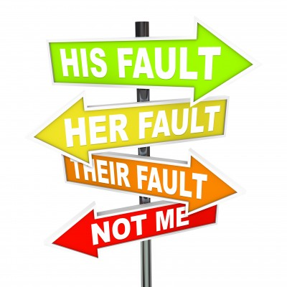
Then Blame Others…
Fundamental language problem – ambiguity and variety
Coreference, coreference, coreference…(more at Dan’s talk)
  25% of the examples involve coreference which is beyond current system capabilities, such as nominal anaphors and non-identity coreference
  Almost overnight, he became fabulously rich, with a $3-million book deal, a $100,000 speech making fee, and a lucrative multifaceted consulting business, Giuliani Partners. … His consulting partners included seven of those who were with him on 9/11, and in 2002 Alan Placa, his boyhood pal, went to work at the firm.
  After successful karting career in Europe, Perera became part of the Toyota F1 Young Drivers Development Program and was a Formula One test driver for the Japanese company in 2006.
  “a woman charged with running a prostitution ring … her business, Pamela Martin and Associates”

Slide 29
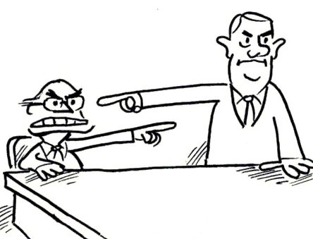
Then Blame Others…
Paraphrase, paraphrase, paraphrase…
“employee/member”:
  Sutil, a trained pianist, tested for Midland in 2006 and raced for Spyker in 2007 where he scored one point in the Japanese Grand Prix.
  Daimler Chrysler reports 2004 profits of $3.3 billion; Chrysler earns $1.9 billion.
  In her second term, she received a seat on the powerful Ways and Means Committee
  Jennifer Dunn was the face of the Washington state Republican Party for more than two decades
  Buchwald lied about his age and escaped into the Marine Corps.
  By 1942, Peterson was performing with one of Canada's leading big bands, the Johnny Holmes Orchestra.
“spouse”:
  Buchwald 's 1952 wedding -- Lena Horne arranged for it to be held in London 's Westminster Cathedral -- was attended by Gene Kelly , John Huston , Jose Ferrer , Perle Mesta and Rosemary Clooney , to name a few

Slide 30
Then Blame Others…
Inference, Inference, Inference…
  systems would benefit from specialists which are able to reason about times, locations, family relationships, and employment relationships.
  People Magazine has confirmed that actress Julia Roberts has given birth to her third child a boy named Henry Daniel Moder. Henry was born Monday in Los Angeles and weighed 8 lbs. Roberts, 39, and husband Danny Moder, 38, are already parents to twins Hazel and Phinnaeus who were born in November…
  He [Pascal Yoadimnadji] has been evacuated to France on Wednesday after falling ill and slipping into a coma in Chad, Ambassador Moukhtar Wawa Dahab told The Associated Press. His wife, who accompanied Yoadimnadji to Paris, will repatriate his body to Chad, the amba. → is he dead? in Paris?
  Until last week, Palin was relatively unknown outside Alaska… → does she live in Alaska?
  The list says that the state is owed $2,665,305 in personal income taxes by singer Dionne Warwick of South Orange, N.J., with the tax lien dating back to 1997. → does she live in NJ?

Slide 31
What we will do next week
Each student gives 2mins lighting talk presentation about your model and plans to improve the baseline, send slides to TA srw5@illinois.edu before 5pm next Tuesday
Notes:
IE’s application

Slide 32
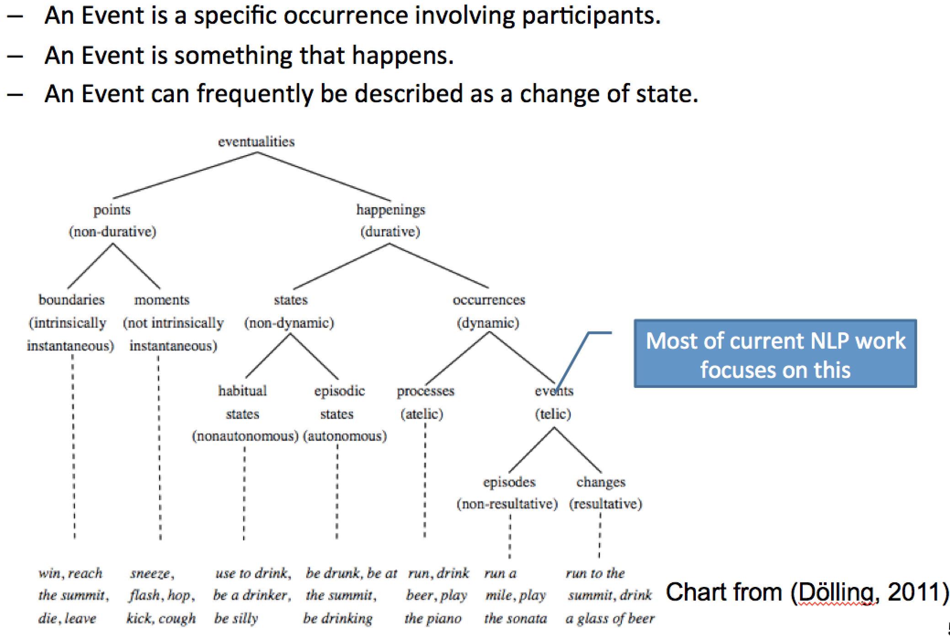
What is an event?

Slide 33
Event Extraction
Extract structured event information from unstructured data of heterogeneous data types, in various domains, genres, languages, and data modalities
place
place
target
victim
instrument
instrument
target
In Baghdad, a cameraman died when a combat tank fired on the Palestine Hotel.
LOC
PER
VEH
FAC
O
O
O
O
Die
O
O
O
O
Attack
O
O
O
O
Provide downstream building blocks for downstream tasks such as knowledge reasoning, question answering and summarization

Slide 34
Event Causality Tracking

Slide 35
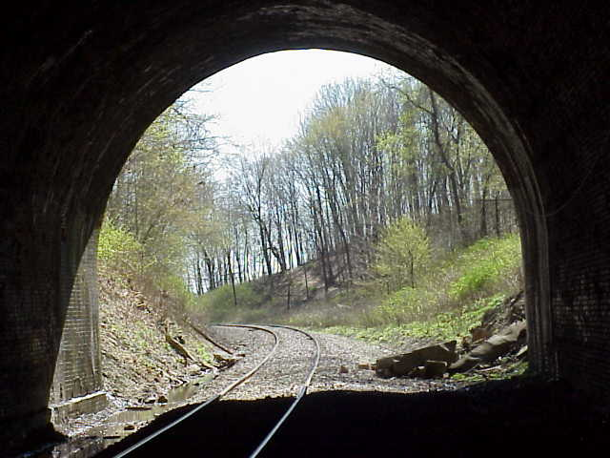
Where are we? State-of-the-art Supervised Models for Limited Types
Event Trigger Labeling (Identification + Event Type Classification) on automatically detected entities
  P = 73.9%; R = 67.8%; F= 70.7% (Zhang et al., 2018)
Event Argument Labeling (Identification + Role Classification)
  P = 55.6%; R = 48.7%; F= 51.9% (Zhang et al., 2018)
Within-document Temporal Event Ordering on all verbs
  P = 69.1%; R = 65.5%; F= 67.2% (Ning et al., EMNLP2017)
Temporal Event Tracking
  Many data sets and resources have been developed (RED, EER, TimeBank, etc)
  Relatively fewer tasks and new algorithms developed
  Need more support to attract community research
  efforts again
35

Slide 36

Where are we? State-of-the-art Unsupervised Models for Open Types
Zero-shot Learning (from a few old types to thousands of new types)
  Event Trigger Labeling F = 49%; Argument Labeling F= 16% (Huang et al., ACL2018)
Open IE
  Argument slot Filling F-score 72%-86%, closer to relation extraction (Etzioni et al., IJCAI2011)
36

Slide 37
“Old” Days: Supervised Learning with Hand-crafed Features
Staged classifiers
  Trigger Classifier
    to distinguish event instances from non-events, to classify event instances by type
  Argument Classifier
    to distinguish arguments from non-arguments
  Role Classifier
    to classify arguments by argument role
  Reportable-Event Classifier
    to determine whether there is a reportable event instance
Can choose any supervised learning methods such as MaxEnt and SVMs
(Ji and Grishman, 2008)

Slide 38
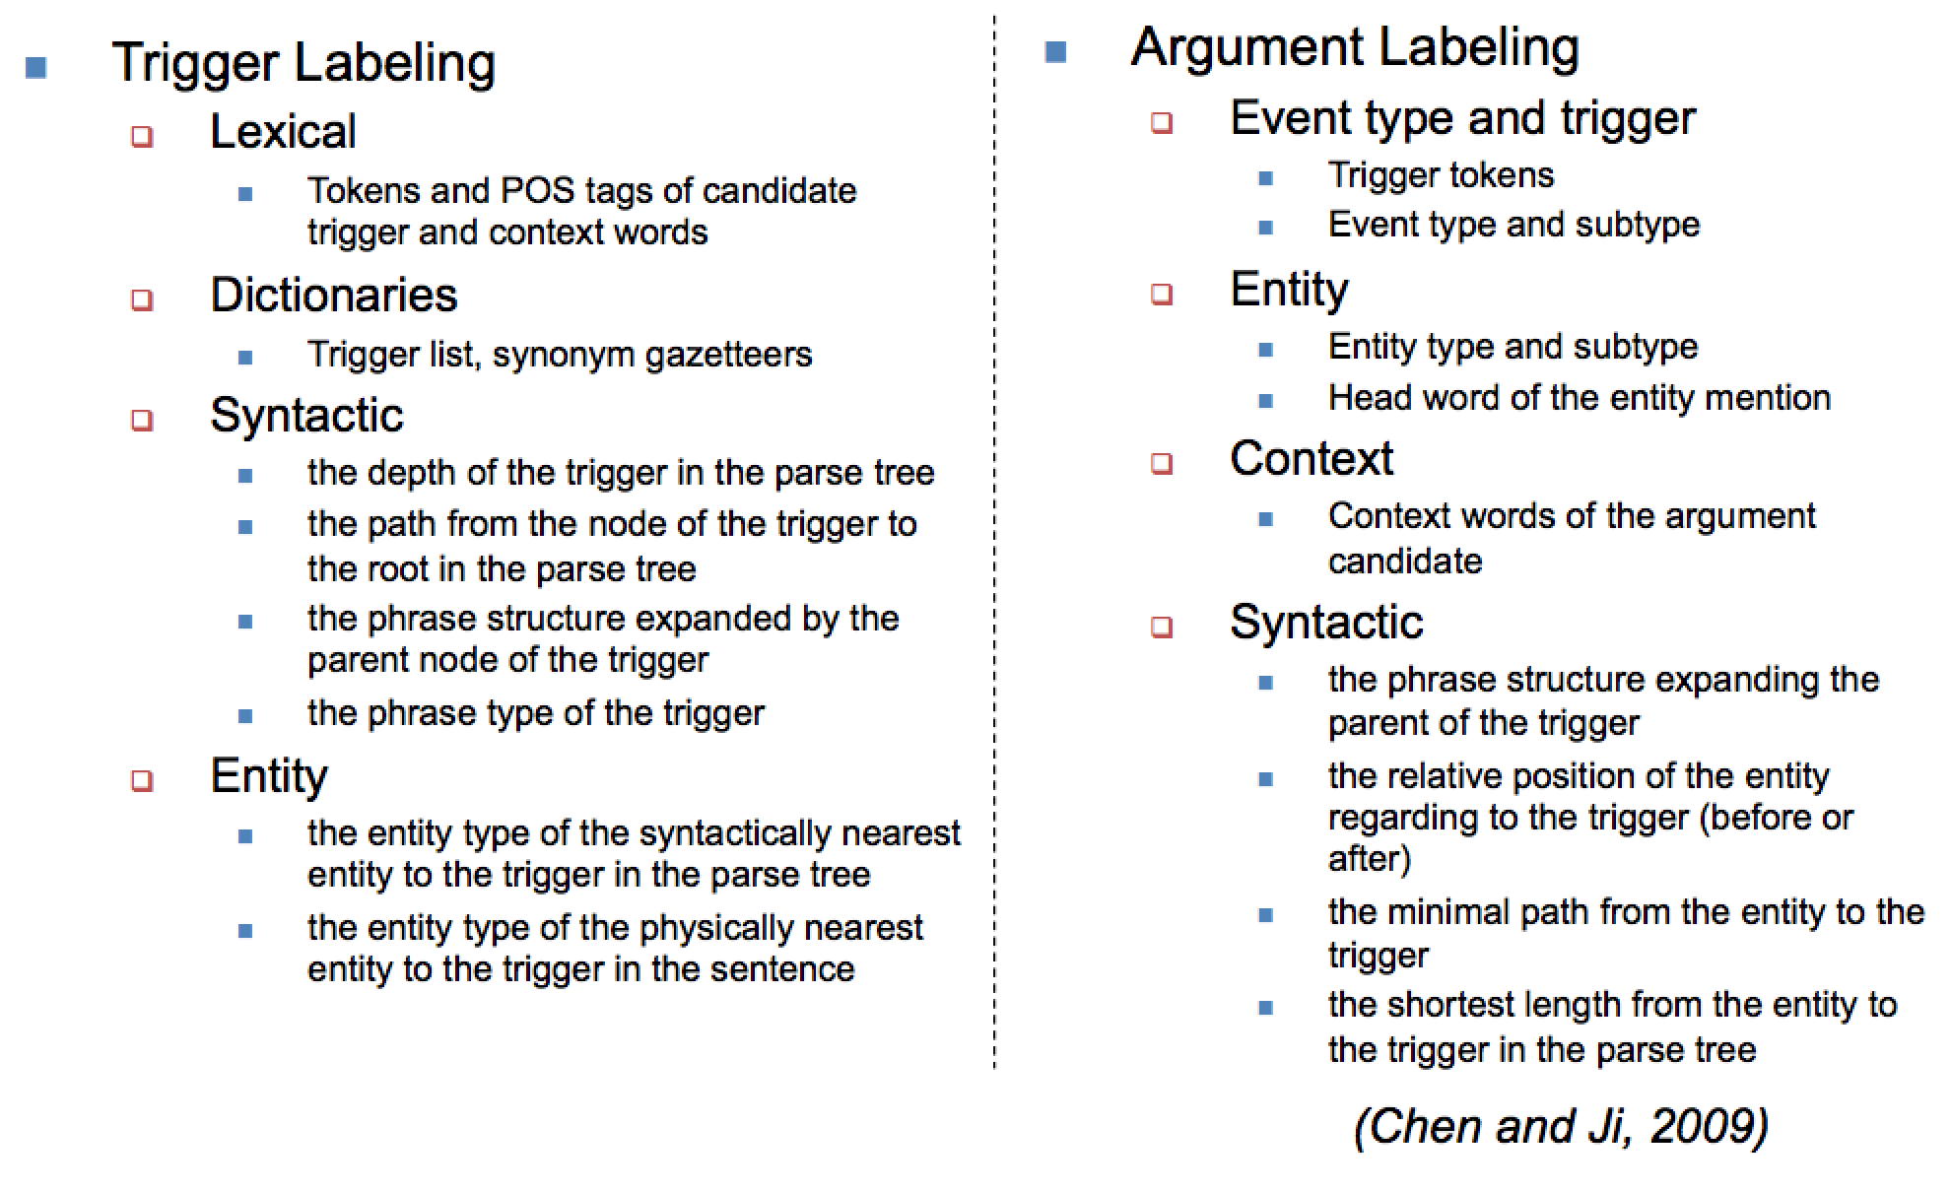
“Old” Days: Supervised Learning with Hand-crafed Features
38

Slide 39
A More “Modern” Neural Event Extractor
SoftMax
Event Trigger
Event Trigger
Event Trigger
Concatenate
with CNN
Word
Representation
U_{V}
L_{V}
C₂
C₃
U_{V}
L_{V}
C₂
C₃
U_{V}
L_{V}
C₂
C₃
F_{V}
B_{V}
LSTM_{U}
LSTM_{U}
LSTM
LSTM
LSTM
LSTM
LSTM
LSTM
LSTM
LSTM_{L}
LSTM
LSTM
LSTM
LSTM
LSTM
LSTM
LSTM
LSTM
Look up
The European Unit release 20 million euros ….... Iraq.
Reduce feature engineering efforts to some extent (Feng et al., 2016)
But still rely on human annotated clean training data still fragile to noise in training data
39

Slide 40
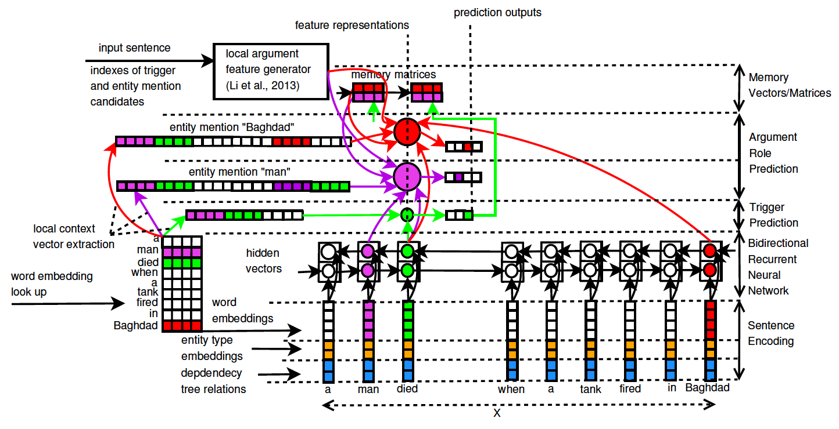
Or Put them Together…
(Nguyen et al., 2016)
40

Slide 41
Zero-shot Learning: Grounding Mentions to Event Types and Argument Roles
41

Slide 42
How to Represent Words?
Distributional Semantics Theory: a word is characterized by the company it keeps (Harris, 1954) → represent each word as a vector distribution of its contextual words
But let’s distinguish senses of an ambiguous word
Word Sense based General Embeddings
Fire-1 | Score
firing cannon grenades grenade gun arm explosive point-blank projectile misfired … | 0.829 0.774 0.767 0.760 0.757 0.755 0.742 0.740 0.748 0.729 …
Fire-2 | Score
rehired hire-1 resign-1 rehire sacked quit-1 sack-1 quits hiring dismissal … | 0.790 0.626 0.618 0.618 0.596 0.591 0.565 0.563 0.551 0.546 …
Injure-1 | Score
injures hurt harm maim injuring endanger dislocate kill injured ravage skyscrapers harming reinjure … | 0.602 0.593 0.592 0.571 0.561 0.543 0.529 0.527 0.516 0.502 0.501 0.497 …
“attack”
“end-position”
42

Slide 43
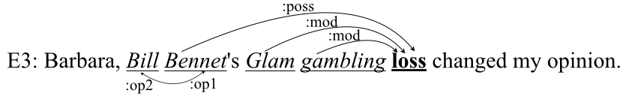
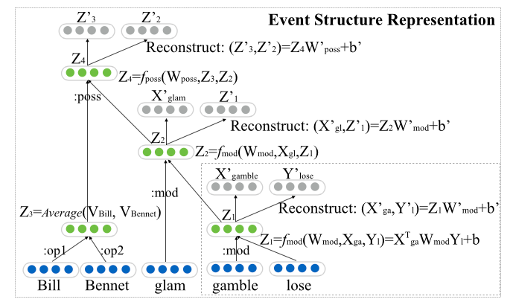
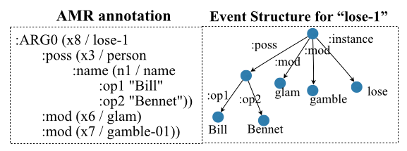
But Local Context Matters
Borrow meanings from related concepts in local contexts → Context-specific Embeddings
But not all words are related: Use Abstract Meaning Representation (AMR) (Banarescu et al., 2013) (150 semantic relations) to choose related concepts
Use Tensor based Recursive Auto Encoder to compose embeddings of related concepts
Life-die? No
43

Slide 44
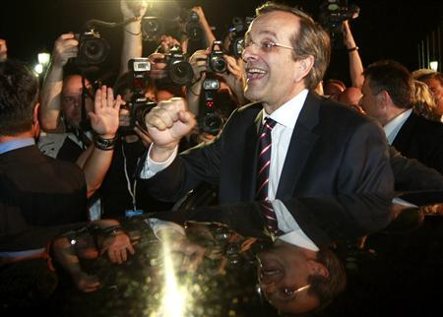
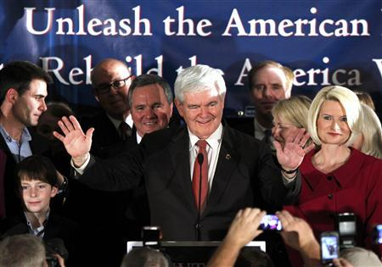
Also Need External Knowledge
Election
Leader of conservative New Democracy party Antonis Samaras is cheered by supporters after his statement on the election results in Athens June 17, 2012.
Turkey’s Foreign Minister Ahmet Davutoglu greets his supports during an election rally of his ruling AK Party in Konya, central Turkey, March 28, 2014.
DBPedia: Antonis Samarás
Properties:
Party, profession, religion, occupation, successor, residence …
Type Labels: Person, Agent, Politician, President …
DBPedia: New Democracy Party
Properties:
Country, headquarter, president, logo, founder…
Type Labels: Organization, PoliticalParty, SocialGroup …
DBPedia: Justice and Development Party
Properties:
Country, headquarter, leaderName, position …
Type Labels: Organization, PoliticalParty, Agent …
DBPedia: Ahmet Davutoğlu
Properties:
birthDate, birthPlace, deputy, party, president, successor, religion …
Type Labels: Person, Agent, Politician, Leader, Writer, President, Minister …
44

Slide 45
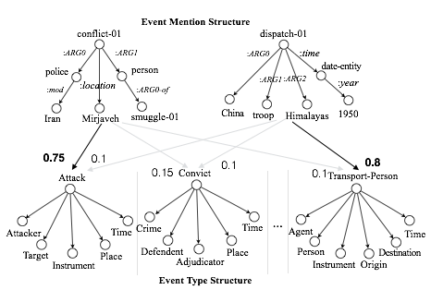
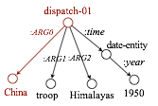
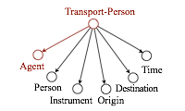
Grounding Mention into Schema/Ontology
Event Semantics Theory (Pustejovsky, 1991): the semantics of an event structure can be generalized and mapped to event mention structures in a systematic and predictable way
The mapping function for grounding is independent of event types, so we can re-use resources of seen types for new types, without any additional annotations
Iranian state television stated that the conflict between the Iranian police and the drug smugglers took place near the town of mirjaveh.
The Government of China has ruled Tibet since 1951 after dispatching troops to the Himalayan region in 1950.
0.1
Compute Similarity
Event Ontology
45
Notes:
Learning a regression function between object (e.g., image, entity) semantic space and label semantic space based on annotated data for seen labels;
The regression model can be used to predict the unseen labels for any given image;

Slide 46
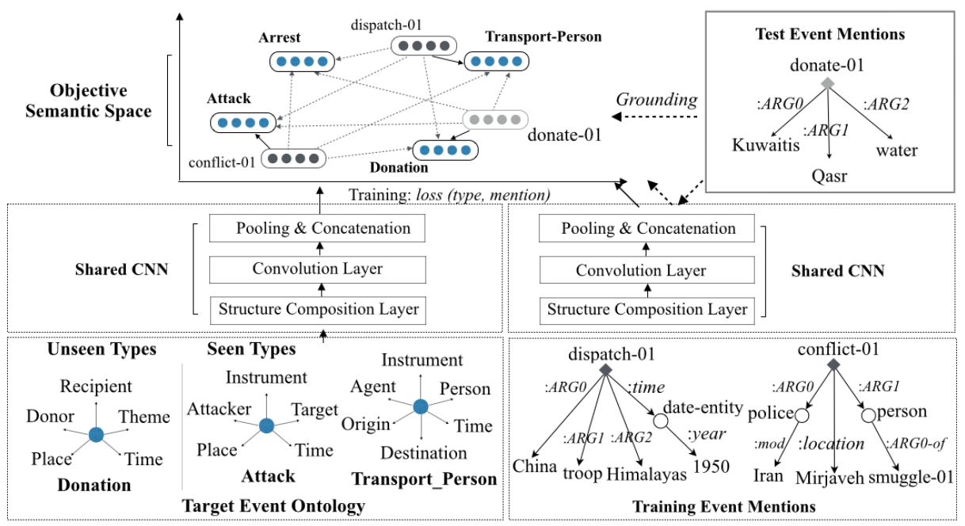
Zero-shot Learning
Borrow Zero Shot Transfer Learning from Vision (Frome et al., 2013; Norouzi et al., 2013; Socher et al., 2013)
46

Slide 47
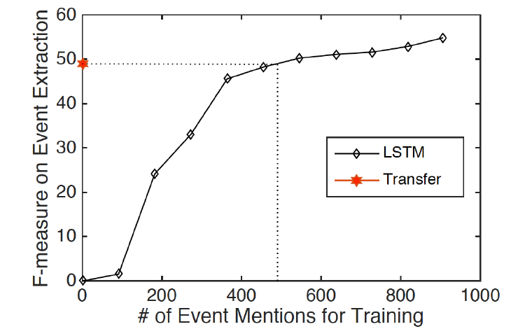
Comparison with Traditional Supervised Model
10 popular “seen” event types and 23 new “unseen” types
Supervised Model: train and test on unseen types
Zero-shot: no training data for unseen types
Without any annotated mentions, our approach can achieve performance comparable to that of LSTM, which is trained on 3,000 sentences with 500 annotated event mentions (Huang et al., ACL2018)
47

Slide 48
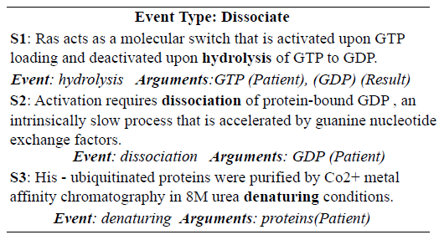
Move to any New Domain
Biomedical literature: 83.1% precision
48

Slide 49
Summary of Event Extraction Methods
IE Methods |  | Supervised Learning | Bootstrapping | Distant Supervision | Open IE/ Zero-shot | Schema/ Discovery
Approach Overview |  | Learn rules or supervised model from labeled data | Send seeds to extract common patterns from unlabeled data | Project large database entries into unlabeled data to obtain annotations | Open-domain IE based on syntactic patterns | Automatically discover scenarios, event types and templates
Requirement of labeled data |  | Large unstructured labeled data | Small seeds | Large seeds | Small unstructured labeled data | Little labeled data
Quality | Precision | High | Moderate | Low | Moderate | Moderate
 | Recall | High | Difficult to measure | Moderate | Low | Moderate
Portability |  | Poor | Moderate | Moderate | Good | Good
Scalability |  | Poor | Moderate | Moderate | Good | Good

Slide 50
Event Extraction Challenges: Scene Understanding
Three Young Boys,ages 2, 5 and 10 survived and are in critical [injure] condition after spending in 18 hours in the cold.
This was the Italian ship that was taken -- that was captured [transfer-ownership] by Palestinian terrorists back in 1985 [die_time] and some may remember the story of Leon clinghover, he was in a cheal chair and the terrorists shot him and pushed him over the side of the ship into the Mediterranean [die_place] where he [die_victim] obviously, died.
Then police say the baby's mother pulled out a kitchen knife [die_instrument] opinion on the 911 tape you can hear Williams tape say "go ahead kill me."
50
Notes:
Two most popular previous event representations
Inheritance is a way to describe the roadmap of event hierarchy; the property of the child is inherited from its parent
50

Slide 51
Uncommon Ways to Express Triggers
Non-verb and multi-word expression as triggers
  his men back to their compound
Knowledge scarcity - Long-tail
  A suicide bomber detonated explosives at the entrance to a crowded
  medical teams carting away dozens of wounded victims
  Today I was let go from my job after working there for 4 1/2 years.
  This morning in Michigan, a second straight night and into this morning, hundreds of people have been rioting in Benton harbor.
Possible solutions
  Increase coverage with FrameNet, Propbank, VerbNet etc
  Joint trigger word and entity embedding learning

Slide 52
Uncommon Ways to Express Arguments
We've seen in the past in Bosnia for example, you held elections and all of the old ethnic thugs [election_person] get into power because they have organization and they have money and they stop the process of genuine building of democracy.
I was born four years too late to have slept with JFK [born_time]?
He called the case and I'm quoting now, a judge's worst nightmare, but he noted that Maryland Parole Boards and the facility where Michael Serious was held, the institution made what the judge called the final decision on whether to release serious [release-parole_person].
Last week Williamson, a mother of four, was found stabbed to death at a condominium [die_place] in Greenbelt, Maryland.
A source tell US Enron is considering suing its own investment bankers for giving it bad financial advice [Sue_crime].

Slide 53
Need more joint inference between trigger and arguments
I didn't want to hurt him . I miss him to death.
I threw stone out of the window. vs. I threw him out of the window.
Ellison to spend $10.3 billion to get his company.
Airlines are getting [transport] flyers to destinations ontime more often.
We believe that the likelihood of them using those weapons goes up.
Fifteen people were killed and more than 30 wounded Wednesday as a suicide bomber blew himself up on a student bus in the northern town of Haifa

Slide 54
More Trigger Spurious and Classification Errors
I want to take [transport] this opportunity to stand behind the Mimi and proclaim my solidarity.
He's left [transport] a lot on the table.
Stewart has found the road to fortune wherever she has traveled [transport].
And it's hard to win back that sort of brand equity that she's lost [end-position].
Still hurts [attack] me to read this.
We happen to be at a very nice spot by the beach where this is a chance for people to get [transport] away from CNN coverage, everything, and kind of relax .
He bought the machinery, moved [transport] to a new factory, rehired some of the old workers and started heritage programs.
Blasphemy is punishable by death [die → execute] under the Pakistan Penal Code.
Possible Solutions
  Joint inference between argument labeling and trigger labeling
  Apply metaphor detection?
54
Notes:
Two most popular previous event representations
Inheritance is a way to describe the roadmap of event hierarchy; the property of the child is inherited from its parent
54

Slide 55
More Argument Spurious and Classification Errors
He's been in Libya and he's been living under the protection of Saddam Hussein in Baghdad [die_place], but he is wanted for murder in Italy.
The EU foreign ministers met hours after U.S. President George W. Bush [meet_entity] gave Saddam 48 hours to leave Iraq or face invasion.
A cruise ship [instrument → target] is being searched off the Hawaii coast after two notes threatening terrorist attack were found on board.
Possible solutions
  Deep understanding of structure to capture wide contexts
55
Notes:
Two most popular previous event representations
Inheritance is a way to describe the roadmap of event hierarchy; the property of the child is inherited from its parent
55

