Slide 1
Knowledge-driven Natural Language Generation
Heng Ji
hengji@illinois.edu
Deliberately constructing a natural language text in order to meet specified communicative goals
Acknowledgement: many slides from Yoav Goldberg INLG2018 tutorial

Slide 2
Some logistics & mutual introductions
Course website:
http://blender.cs.illinois.edu/course/spring20/nlg.html
We will setup a mailing list and find a TA soon
This is a course designed for PhD students who have taken NLP/ML courses
If you get lost from lecture 1 and 2 and the first reading assignment, please consider dropping the course
My lab page (I’m hiring RAs)
http://blender.cs.illinois.edu/index.html
An awesome resource list:
https://github.com/topics/natural-language-generation
2
Notes:
Change low resource IL to a language which is not in wikipedia
Word-level: from bi-lingual dicts and alignment; structure-level comes from wals; multi-level alignment

Slide 3
What is NLG?
Deliberately constructing a natural language text in order to meet specified communicative goals
Input: some semantic representation of information
Output: documents, reports, messages, papers, etc
3
Notes:
Change low resource IL to a language which is not in wikipedia
Word-level: from bi-lingual dicts and alignment; structure-level comes from wals; multi-level alignment

Slide 4
Why it’s useful? : Chit-Chat
https://www.youtube.com/watch?v=WnzlbyTZsQY (2011)
https://www.youtube.com/watch?v=mpw_FB2QrjQ (2017)
https://www.bilibili.com/video/av6567466/
4
Notes:
Change low resource IL to a language which is not in wikipedia
Word-level: from bi-lingual dicts and alignment; structure-level comes from wals; multi-level alignment

Slide 5
Application: Autonomous Car
(Qin et al., EMNLP2019)
5
Notes:
Change low resource IL to a language which is not in wikipedia
Word-level: from bi-lingual dicts and alignment; structure-level comes from wals; multi-level alignment

Slide 6
Application: PaperRobot
(Wang et al., ACL2019)

Slide 7
Application: Therapist
7
Notes:
Change low resource IL to a language which is not in wikipedia
Word-level: from bi-lingual dicts and alignment; structure-level comes from wals; multi-level alignment

Slide 8
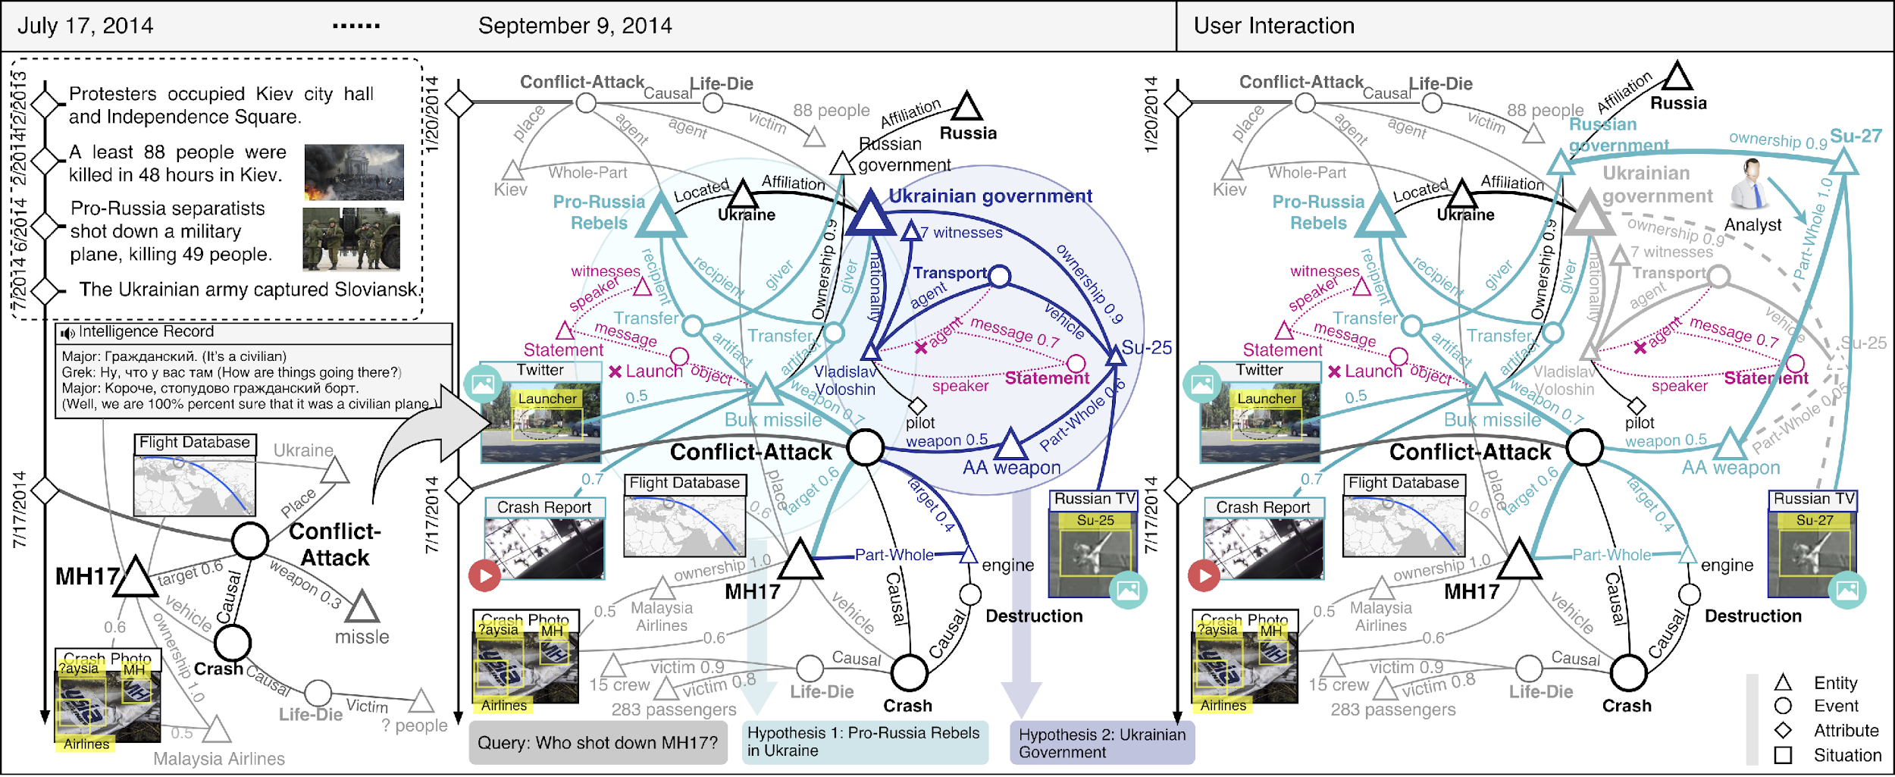
Information Seeking
8
Notes:
Change low resource IL to a language which is not in wikipedia
Word-level: from bi-lingual dicts and alignment; structure-level comes from wals; multi-level alignment

Slide 9
Visions of dialogue from science fiction
Hal “2001: A Space Odyssey” (1968)
Naturally conversing computer
Star Trek (original 1966)
Natural language command and control
Her (2013)
A virtual partner with natural dialogue capabilities

Slide 10
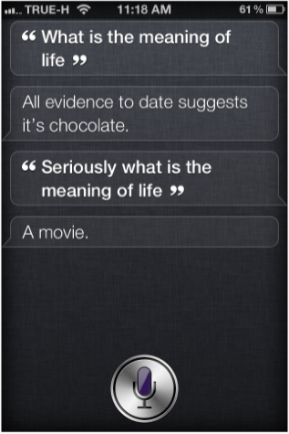
Examples of modern Virtual Assistant dialogue systems
Apple Siri (2010)
Supports questions in a set of domains
Answers open-end questions
Cute “Easter egg” responses

Slide 11
Examples of modern Virtual Assistant dialogue systems
Android Google Now (2013)
Predictive search assistant
Windows Cortana (2014)
Works across different Windows devices
Aims to be able to “talk about anything”

Slide 12
Embedded devices with dialogue capabilities
Amazon Echo (2014) – home assistant device
Plays music
With voice commands
Question answering
Get weather, news
More complex questions, like
“how many spoons are in a cup?”
Setting timer
Manages TODO lists

Slide 13
Why I’m interested in NLG
NLG = opposite of IE
Alexa Judge & Amazon Scholar
Qingyun Wang has made us very famous
13
Notes:
Change low resource IL to a language which is not in wikipedia
Word-level: from bi-lingual dicts and alignment; structure-level comes from wals; multi-level alignment

Slide 14
Google Assistant
14
Notes:
Change low resource IL to a language which is not in wikipedia
Word-level: from bi-lingual dicts and alignment; structure-level comes from wals; multi-level alignment

Slide 15
Describing or Generating a Painting
15
Notes:
Change low resource IL to a language which is not in wikipedia
Word-level: from bi-lingual dicts and alignment; structure-level comes from wals; multi-level alignment

Slide 16
How did people do it in old days?
Template Filling
16
Notes:
Change low resource IL to a language which is not in wikipedia
Word-level: from bi-lingual dicts and alignment; structure-level comes from wals; multi-level alignment

Slide 17
How did people do it in old days?
Template Filling
17
Notes:
Change low resource IL to a language which is not in wikipedia
Word-level: from bi-lingual dicts and alignment; structure-level comes from wals; multi-level alignment

Slide 18
More Modern Methods
18
Notes:
Change low resource IL to a language which is not in wikipedia
Word-level: from bi-lingual dicts and alignment; structure-level comes from wals; multi-level alignment

Slide 19
Toward Knowledge-driven NLG
19
Notes:
Change low resource IL to a language which is not in wikipedia
Word-level: from bi-lingual dicts and alignment; structure-level comes from wals; multi-level alignment

Slide 20
We will study basic neural NLG models
20
Notes:
Change low resource IL to a language which is not in wikipedia
Word-level: from bi-lingual dicts and alignment; structure-level comes from wals; multi-level alignment

Slide 21
We will study basic neural NLG models
21
Notes:
Change low resource IL to a language which is not in wikipedia
Word-level: from bi-lingual dicts and alignment; structure-level comes from wals; multi-level alignment

Slide 22
Building Blocks
Neural Networks
22
Notes:
Change low resource IL to a language which is not in wikipedia
Word-level: from bi-lingual dicts and alignment; structure-level comes from wals; multi-level alignment

Slide 23
Building Blocks
Neural Networks
23
Notes:
Change low resource IL to a language which is not in wikipedia
Word-level: from bi-lingual dicts and alignment; structure-level comes from wals; multi-level alignment

Slide 24
Building Blocks
Neural Networks
24
Notes:
Change low resource IL to a language which is not in wikipedia
Word-level: from bi-lingual dicts and alignment; structure-level comes from wals; multi-level alignment

Slide 25
Building Blocks
Combining Vectors: multi-layer RNN
25
Notes:
Change low resource IL to a language which is not in wikipedia
Word-level: from bi-lingual dicts and alignment; structure-level comes from wals; multi-level alignment

Slide 26
We will study basic neural NLG models
Copy mechanism
Variational autoencoder
Flow
BERT generator
26
Notes:
Change low resource IL to a language which is not in wikipedia
Word-level: from bi-lingual dicts and alignment; structure-level comes from wals; multi-level alignment

Slide 27
Then encoders
How to encode a list?
How to encode a table?
How to encode a tree?
How to encode a knowledge graph?
27
Notes:
Change low resource IL to a language which is not in wikipedia
Word-level: from bi-lingual dicts and alignment; structure-level comes from wals; multi-level alignment

Slide 28
Then many applications
Pick one as your term project
Biography generation
News timeline generation/abstractive summarization/history book generation
Knowledgeable Dialog Generation
Image/Video/Painting to Text and the other way around
Scientific Hypotheses Generation (PaperRobot) and ReviewRobot
28
Notes:
Change low resource IL to a language which is not in wikipedia
Word-level: from bi-lingual dicts and alignment; structure-level comes from wals; multi-level alignment

Slide 29
Or solve a theory problem: why neural generation produces so many duplicates
Before: Background: The aim of this study was to compare the clinical outcome of myocardial infarction (MI) in patients with acute ST segment elevation (MI). Methods: We retrospectively reviewed the clinical records of patients with acute ST segment elevation of acute ST elevation myocardial infarction (MI). Patients with acute ST elevation myocardial infarction (MI), and acute ST elevation myocardial infarction (MI), were included in this study. The primary endpoint was the proportion of patients with acute ST elevation myocardial infarction (MI) and coronary artery disease (CAD).
After: Background The aim of this study was to compare the prevalence of myocardial infarction (MI) in patients with acute ST. Methods : The primary endpoint was the first time of the left anterior descending coronary artery , and to evaluate the clinical utility of Protocol . We performed a retrospective analysis of a prospective, randomized controlled trial. Patients were divided into two groups (n=6). The median follow-up period was defined as the presence of the right ventricle, and the level of cardiac catheterization was evaluated .
29
Notes:
Change low resource IL to a language which is not in wikipedia
Word-level: from bi-lingual dicts and alignment; structure-level comes from wals; multi-level alignment

Slide 30
Grading
Three assignments and one project
Rank based + extra credits based on novelty/soundness
30
Notes:
Change low resource IL to a language which is not in wikipedia
Word-level: from bi-lingual dicts and alignment; structure-level comes from wals; multi-level alignment

