Slide 1
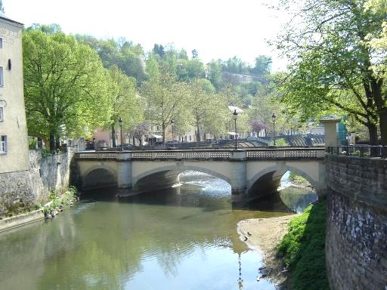
Big Data Driven Generation
An old bridge over dirty green water.
One of the many stone bridges in town that carry the gravel carriage roads.
A stone bridge over a peaceful river.
Generate natural sounding descriptions using existing captions
Ordonez et al, NIPS11
Notes:
With that much data we can now generate natural sounding descriptions for a wide variety of image contents.
For example for this query image, we might produce a caption like “an old gray bridge over dirty green water. Or “a stone bridge over a peaceful river”

Slide 2
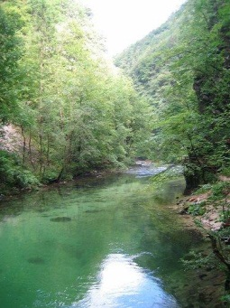
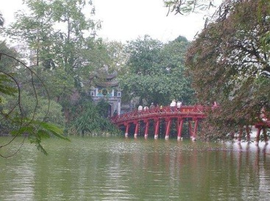
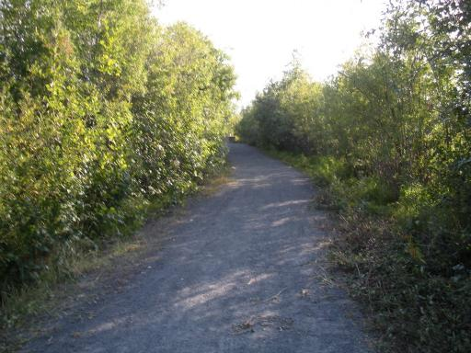
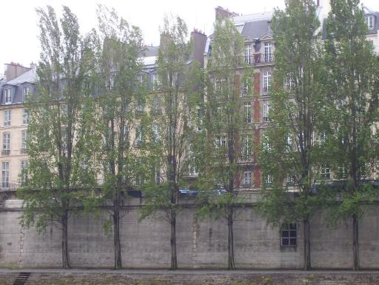
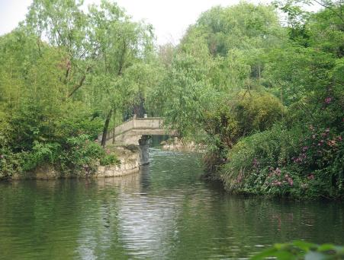
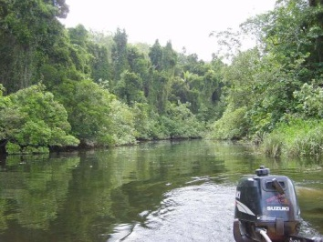
Harness the Web!
Global Matching (GIST + Color)
SBU Captioned Photo Dataset
1 million captioned images!
Bridge to temple in Hoan Kiem lake.
A walk around the lake near our house with Abby.
The water is clear enough to see fish swimming around in it.
Transfer Caption(s)
e.g. “The water is clear enough to see fish swimming around in it.”
Smallest house in paris between red (on right) and beige (on left).
Hangzhou bridge in West lake.
The daintree river by boat.
…
Ordonez et al, NIPS11
Notes:
We tried a number of methods from really simple tricks like gist and color based global matching for retrieval.
here we might caption the query with “the water is clear enough to see fish swimming around in it”

Slide 3
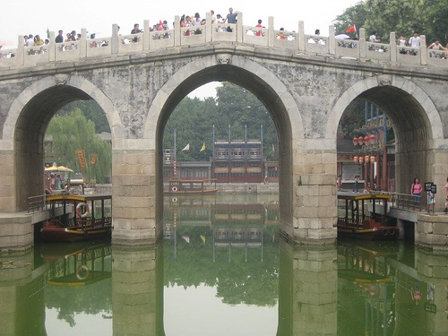
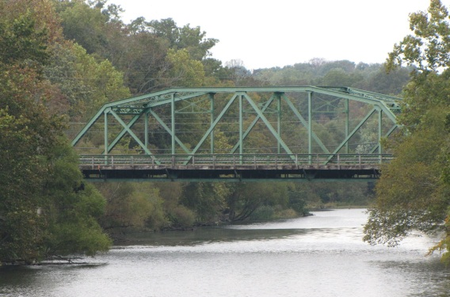
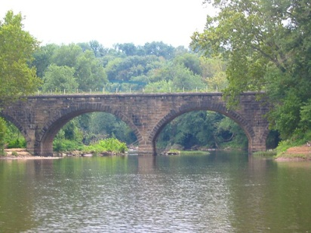
Use High Level Content to Rerank (Objects, Stuff, People, Scenes, Captions)
The bridge over the lake on Suzhou Street.
Iron bridge over the Duck river.
Transfer Caption(s)
e.g. “The bridge over the lake on Suzhou Street.”
The Daintree river by boat.
Bridge over Cacapon river.
. . .
Ordonez et al, NIPS11
Notes:
Once we have a small set of globally matched images, we also try to re-rank this set using text based measures from the matched set, as well as more computationally intensive visual recognition predictions like detection and visual similarity of objects, stuff, scene, or activities. For this query we now generate for example “the bridge over the lake on Suzhhou Street”

Slide 4
Storytelling task
4
Notes:
Change low resource IL to a language which is not in wikipedia
Word-level: from bi-lingual dicts and alignment; structure-level comes from wals; multi-level alignment

Slide 5
Storytelling task
5
Notes:
Change low resource IL to a language which is not in wikipedia
Word-level: from bi-lingual dicts and alignment; structure-level comes from wals; multi-level alignment

Slide 6
Storytelling task
6
Notes:
Change low resource IL to a language which is not in wikipedia
Word-level: from bi-lingual dicts and alignment; structure-level comes from wals; multi-level alignment

Slide 7
Storytelling task
7
Notes:
Change low resource IL to a language which is not in wikipedia
Word-level: from bi-lingual dicts and alignment; structure-level comes from wals; multi-level alignment

Slide 8
Visual Storytelling: Exercise
Write a story about:
8
Notes:
Change low resource IL to a language which is not in wikipedia
Word-level: from bi-lingual dicts and alignment; structure-level comes from wals; multi-level alignment

Slide 9
Visual Storytelling: Exercise
Write a story about:
9
Notes:
Change low resource IL to a language which is not in wikipedia
Word-level: from bi-lingual dicts and alignment; structure-level comes from wals; multi-level alignment

Slide 10
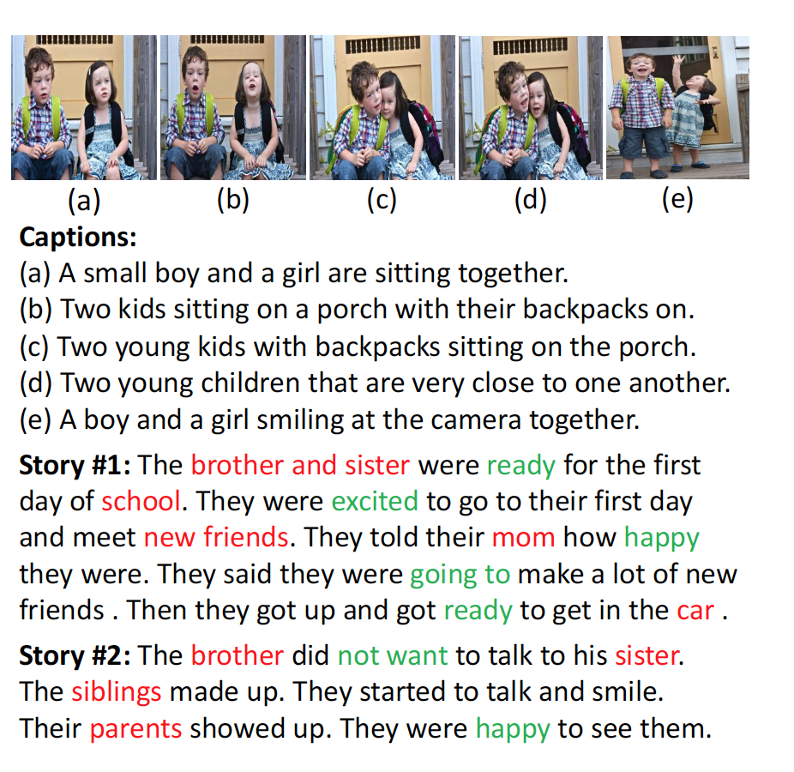
Visual Storytelling: Exercise
10
Notes:
Change low resource IL to a language which is not in wikipedia
Word-level: from bi-lingual dicts and alignment; structure-level comes from wals; multi-level alignment

Slide 11
Visual Storytelling
11
Notes:
Change low resource IL to a language which is not in wikipedia
Word-level: from bi-lingual dicts and alignment; structure-level comes from wals; multi-level alignment

Slide 12
Visual Storytelling
12
Notes:
Change low resource IL to a language which is not in wikipedia
Word-level: from bi-lingual dicts and alignment; structure-level comes from wals; multi-level alignment

Slide 13
Visual Storytelling
13
Notes:
Change low resource IL to a language which is not in wikipedia
Word-level: from bi-lingual dicts and alignment; structure-level comes from wals; multi-level alignment

Slide 14
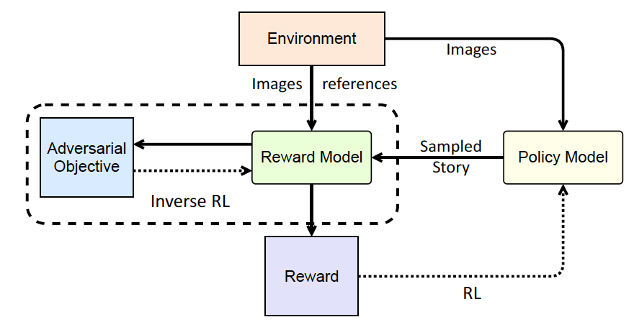
Visual Storytelling
Baseline:
14
Notes:
Change low resource IL to a language which is not in wikipedia
Word-level: from bi-lingual dicts and alignment; structure-level comes from wals; multi-level alignment

Slide 15
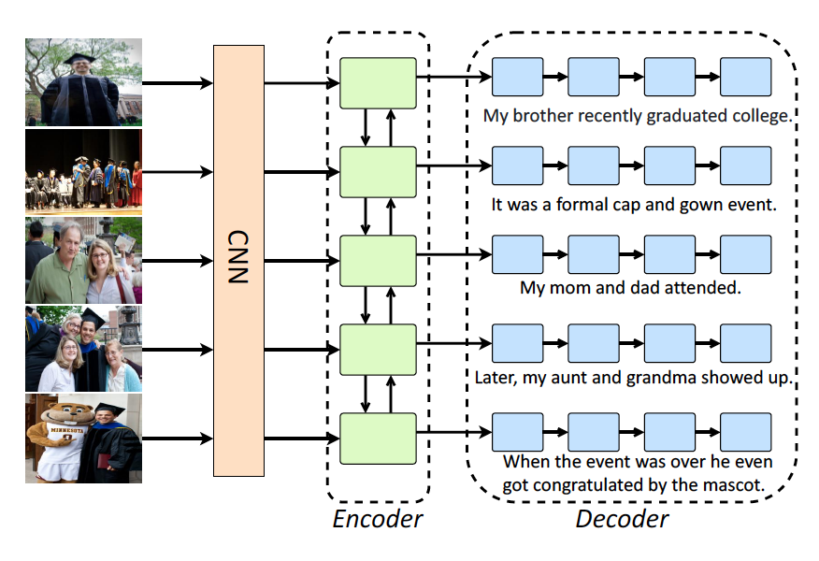
Policy Model (Wang et al., ACL2018)
15
Notes:
Change low resource IL to a language which is not in wikipedia
Word-level: from bi-lingual dicts and alignment; structure-level comes from wals; multi-level alignment

Slide 16
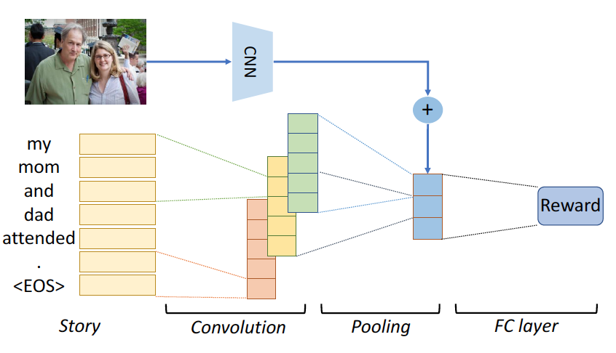
Reward Model (Wang et al., ACL2018)
16
Notes:
Change low resource IL to a language which is not in wikipedia
Word-level: from bi-lingual dicts and alignment; structure-level comes from wals; multi-level alignment

Slide 17
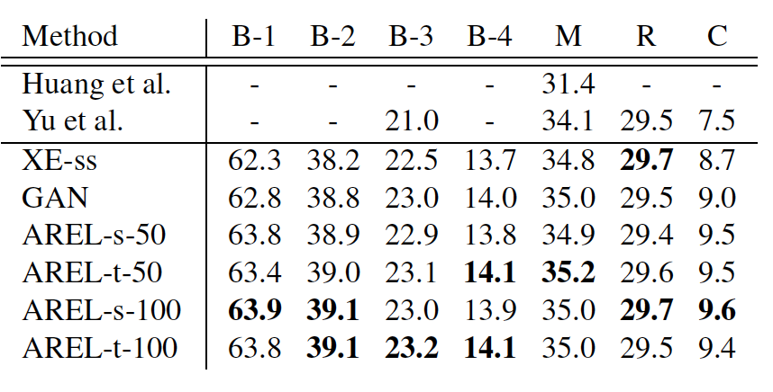
Automatic Evaluation
17
Notes:
Change low resource IL to a language which is not in wikipedia
Word-level: from bi-lingual dicts and alignment; structure-level comes from wals; multi-level alignment

Slide 18
Human Evaluation
18
Notes:
Change low resource IL to a language which is not in wikipedia
Word-level: from bi-lingual dicts and alignment; structure-level comes from wals; multi-level alignment

Slide 19
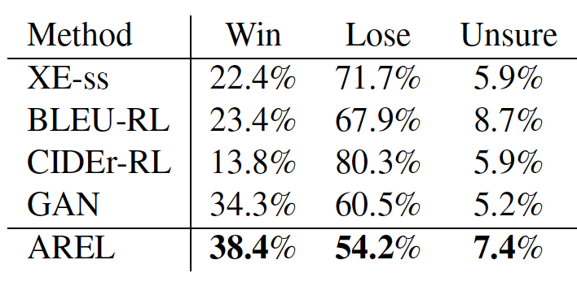
Turing Test
19
Notes:
Change low resource IL to a language which is not in wikipedia
Word-level: from bi-lingual dicts and alignment; structure-level comes from wals; multi-level alignment

Slide 20
Output Example
20
Notes:
Change low resource IL to a language which is not in wikipedia
Word-level: from bi-lingual dicts and alignment; structure-level comes from wals; multi-level alignment

Slide 21
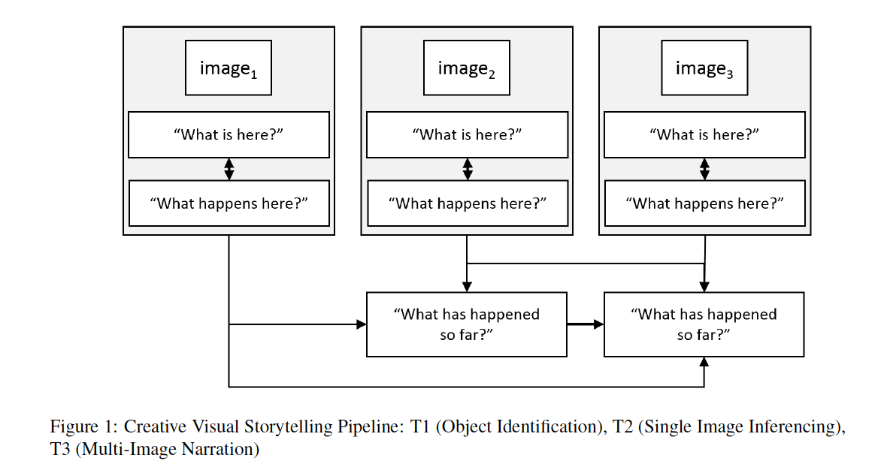
A Pipeline Method (Lukin et al., 2018)
21
Notes:
Change low resource IL to a language which is not in wikipedia
Word-level: from bi-lingual dicts and alignment; structure-level comes from wals; multi-level alignment

Slide 22
A Pipeline Method (Lukin et al., 2018)
22
Notes:
Change low resource IL to a language which is not in wikipedia
Word-level: from bi-lingual dicts and alignment; structure-level comes from wals; multi-level alignment

Slide 23
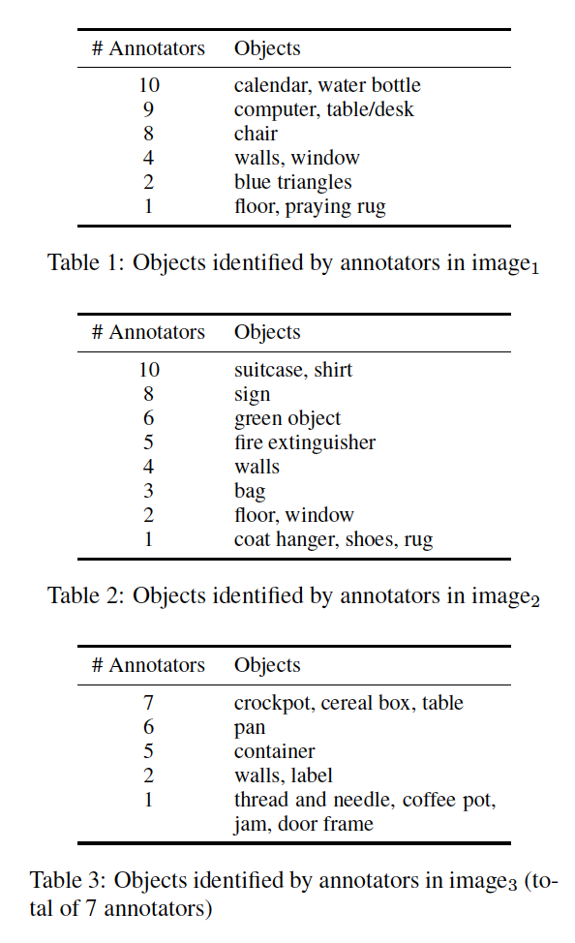
Object Detection
23
Notes:
Change low resource IL to a language which is not in wikipedia
Word-level: from bi-lingual dicts and alignment; structure-level comes from wals; multi-level alignment

Slide 24
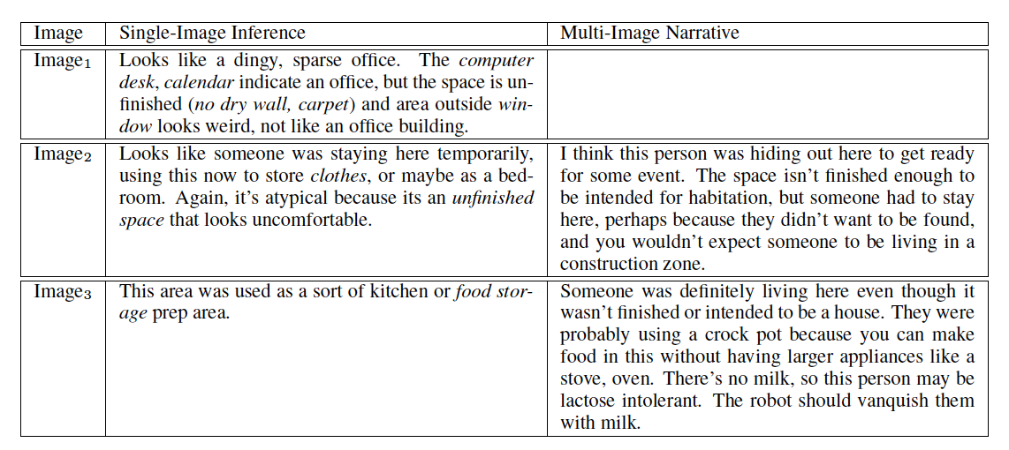
Inference and Narrative
24
Notes:
Change low resource IL to a language which is not in wikipedia
Word-level: from bi-lingual dicts and alignment; structure-level comes from wals; multi-level alignment

Slide 25
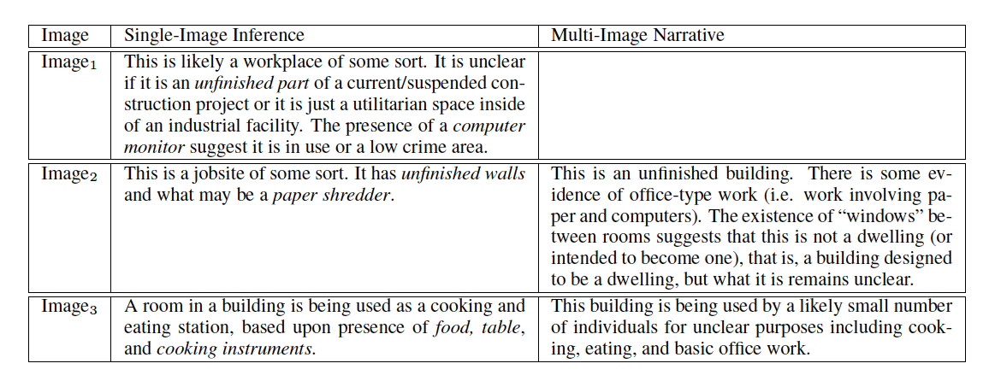
Inference and Narrative
25
Notes:
Change low resource IL to a language which is not in wikipedia
Word-level: from bi-lingual dicts and alignment; structure-level comes from wals; multi-level alignment

Slide 26
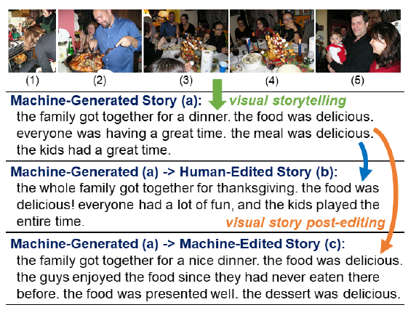
Post-Editing (Hsu et al., 2019)
26
Notes:
Change low resource IL to a language which is not in wikipedia
Word-level: from bi-lingual dicts and alignment; structure-level comes from wals; multi-level alignment

Slide 27
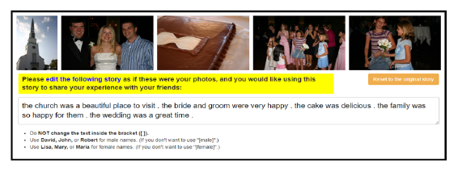
Post-Editing Interface (Hsu et al., 2019)
27
Notes:
Change low resource IL to a language which is not in wikipedia
Word-level: from bi-lingual dicts and alignment; structure-level comes from wals; multi-level alignment

Slide 28
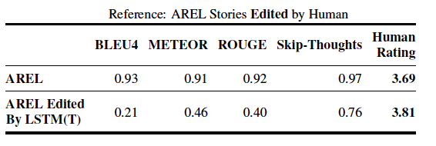
Evaluation Results
28
Notes:
Change low resource IL to a language which is not in wikipedia
Word-level: from bi-lingual dicts and alignment; structure-level comes from wals; multi-level alignment

Slide 29
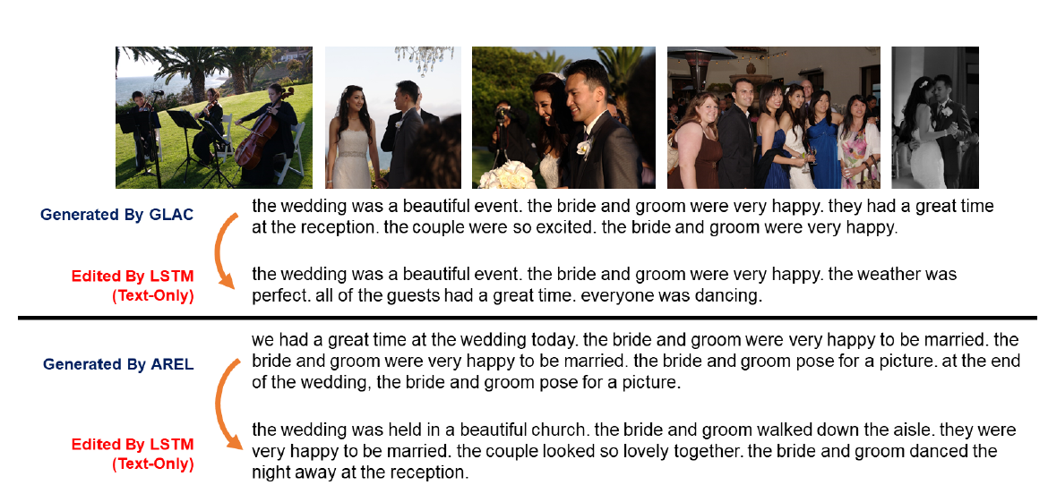
Output Example
29
Notes:
Change low resource IL to a language which is not in wikipedia
Word-level: from bi-lingual dicts and alignment; structure-level comes from wals; multi-level alignment

Slide 30
What is Missing?
Emotions
Imagination – Connecting Dots
30
Notes:
Change low resource IL to a language which is not in wikipedia
Word-level: from bi-lingual dicts and alignment; structure-level comes from wals; multi-level alignment

Slide 31
Error Categories (Modi and Parde, 2019)
Grammatical Errors: Incorrect use of verbs and tenses and/or subject-verb disagreements.
Contradictions: Presence of inconsistent ideas within the same story (e.g., two substories that are the opposite of each other).
Repetitions: These errors were further subdivided into the following categories.
– Repetitions within Story: Recurrence of the same sentence(s) within a story.
– Repetitions within Sentence: Recurrence of the same phrase(s) within a substory.
– Repetitive Subject: The sub-stories have the same subject and differ only in the adjective used to describe it.
– Repetitive Sentence Structure: Most sentences start with “the [noun] was/were/is [adjective].” This leads to monotonous and unoriginal stories.
31
Notes:
Change low resource IL to a language which is not in wikipedia
Word-level: from bi-lingual dicts and alignment; structure-level comes from wals; multi-level alignment

Slide 32
Error Categories
Description in Isolation: Most sub-stories start with “This is a picture of....” Sentences of this nature sound more like single image captions than contextual stories.
Singular/Plural Disagreement: The same story has one sentence with a singular noun and another sentence with the same noun but in plural form.
Ghost Entities: Some sub-stories make use of a pronoun that has no antecedent at all (e.g., referring to a new person who was not introduced formally in the preceding substories).
Personification: The attribution of humanlike qualities to something non-human due to lack of common sense knowledge.
Absurdity: Nonsensical stories or substories.
Incomplete Stories: Stories that have less than 5 sentences.
Point-of-View Inconsistency: The narrative point of view randomly changes within the story (e.g., first person to second person), creating confusion.
Excessive Paraphrasing: Presence of substories that have similar meanings but are expressed using different words or phrases.
32
Notes:
Change low resource IL to a language which is not in wikipedia
Word-level: from bi-lingual dicts and alignment; structure-level comes from wals; multi-level alignment

Slide 33
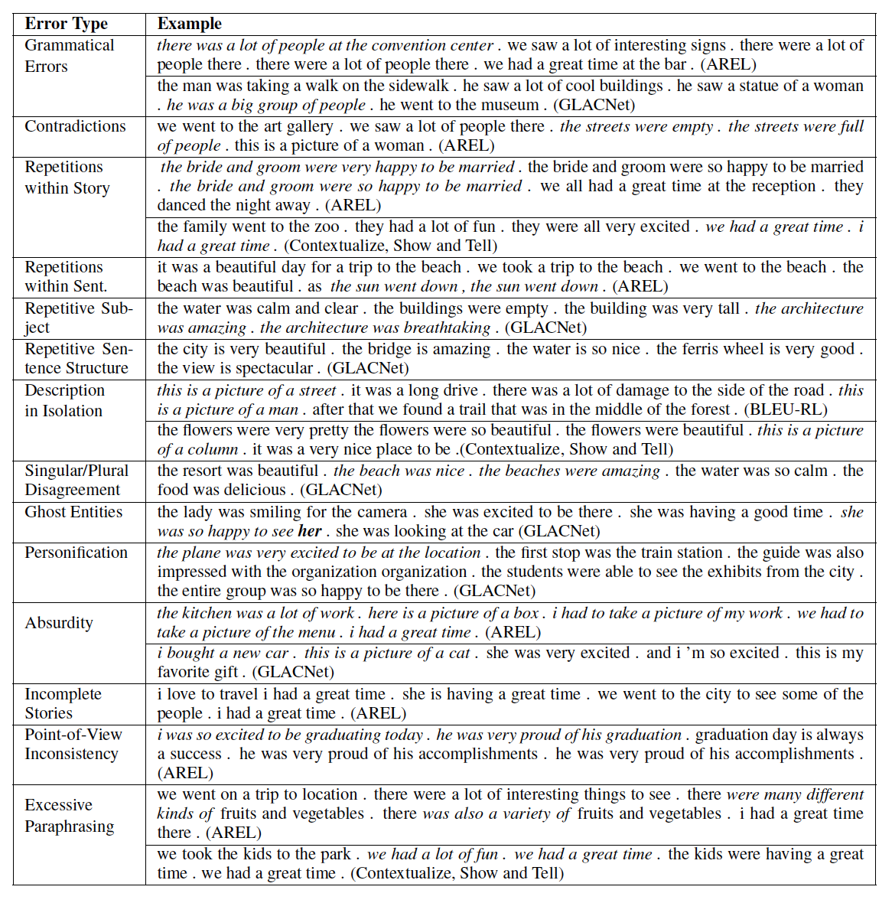
Error Examples
33
Notes:
Change low resource IL to a language which is not in wikipedia
Word-level: from bi-lingual dicts and alignment; structure-level comes from wals; multi-level alignment

Slide 34
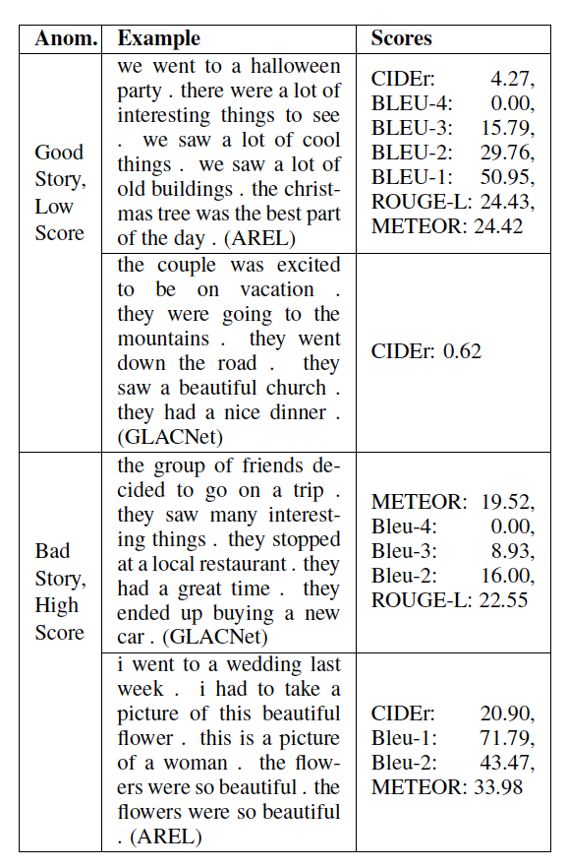
Problem on Evaluation
34
Notes:
Change low resource IL to a language which is not in wikipedia
Word-level: from bi-lingual dicts and alignment; structure-level comes from wals; multi-level alignment

