Slide 1
Knowledge-aware Dialogue Generation and Morph Generation
Heng Ji
hengji@illinois.edu

Slide 2
Recap: End-to-End Dialogue System
2
Notes:
Change low resource IL to a language which is not in wikipedia
Word-level: from bi-lingual dicts and alignment; structure-level comes from wals; multi-level alignment

Slide 3
Semantic Controlled LSTM cell
(Wen et al., EMNLP2015)
3
Notes:
Change low resource IL to a language which is not in wikipedia
Word-level: from bi-lingual dicts and alignment; structure-level comes from wals; multi-level alignment

Slide 4
Deep LSTM generator
Stack multiple LSTM layers on top of DA cell
4
Notes:
Change low resource IL to a language which is not in wikipedia
Word-level: from bi-lingual dicts and alignment; structure-level comes from wals; multi-level alignment

Slide 5
Pre-defined Ontologies
5
Notes:
Change low resource IL to a language which is not in wikipedia
Word-level: from bi-lingual dicts and alignment; structure-level comes from wals; multi-level alignment

Slide 6
Negotiation Dialogue
Lewis et al., EMNLP2017
6
Notes:
Change low resource IL to a language which is not in wikipedia
Word-level: from bi-lingual dicts and alignment; structure-level comes from wals; multi-level alignment

Slide 7
Negotiation Dialogue
Tokens are predicted conditioned on previous words and the input, then the output is predicted using attention over the complete dialogue
In supervised training, train the model to predict the tokens of both agents
During decoding and reinforcement learning some tokens are sampled from the model, but some are generated by the other agent and are only encoded by the model
7
Notes:
Change low resource IL to a language which is not in wikipedia
Word-level: from bi-lingual dicts and alignment; structure-level comes from wals; multi-level alignment

Slide 8
Negotiation Dialogue
8
Notes:
Change low resource IL to a language which is not in wikipedia
Word-level: from bi-lingual dicts and alignment; structure-level comes from wals; multi-level alignment

Slide 9
Adding Speakers
Li et al., ACL2016
9
Notes:
Change low resource IL to a language which is not in wikipedia
Word-level: from bi-lingual dicts and alignment; structure-level comes from wals; multi-level alignment

Slide 10
Adding Speakers
Li et al., ACL2016
10
Notes:
Change low resource IL to a language which is not in wikipedia
Word-level: from bi-lingual dicts and alignment; structure-level comes from wals; multi-level alignment

Slide 11
Adding Speakers
Li et al., ACL2016
11
Notes:
Change low resource IL to a language which is not in wikipedia
Word-level: from bi-lingual dicts and alignment; structure-level comes from wals; multi-level alignment

Slide 12
Adding Speakers
Li et al., ACL2016
12
Notes:
Change low resource IL to a language which is not in wikipedia
Word-level: from bi-lingual dicts and alignment; structure-level comes from wals; multi-level alignment

Slide 13
Overall Framework
13
Notes:
Change low resource IL to a language which is not in wikipedia
Word-level: from bi-lingual dicts and alignment; structure-level comes from wals; multi-level alignment

Slide 14
Overall Framework
14
Notes:
Change low resource IL to a language which is not in wikipedia
Word-level: from bi-lingual dicts and alignment; structure-level comes from wals; multi-level alignment

Slide 15
Overall Framework
15
Notes:
Change low resource IL to a language which is not in wikipedia
Word-level: from bi-lingual dicts and alignment; structure-level comes from wals; multi-level alignment

Slide 16
Overall Framework
16
Notes:
Change low resource IL to a language which is not in wikipedia
Word-level: from bi-lingual dicts and alignment; structure-level comes from wals; multi-level alignment

Slide 17
Overall Framework
17
Notes:
Change low resource IL to a language which is not in wikipedia
Word-level: from bi-lingual dicts and alignment; structure-level comes from wals; multi-level alignment

Slide 18
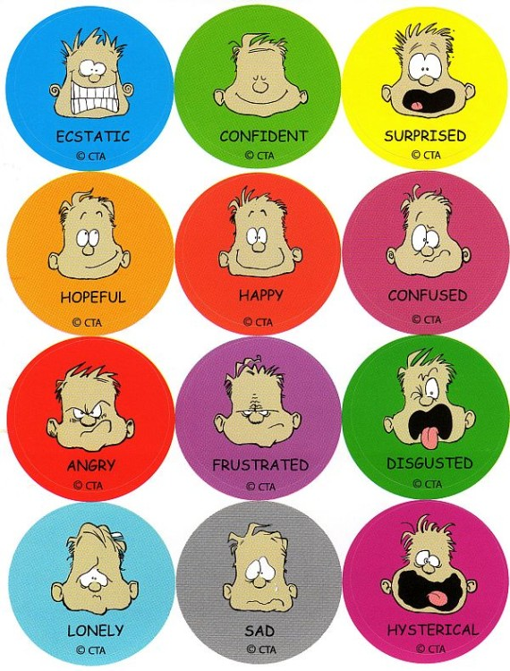
Is That Really You?
People communicate and behave differently online vs. offline [Wilcox and Stephen, 2012]
Censorship, social multiplicity, recordability
The influence of the group
Reduced sensations
Temporal and identity flexibility

Slide 19
Creative Language Generation
Avoid Internet censorship
Share sensitive information
Express strong sentiment or emotion
Plan for secret actions
Trade illegal products
Convert regular intent to fun and interesting languages
Our goals
Systematically categorize human-created obfuscated language on various levels, investigate their basic mechanisms
Overview on automated techniques needed to simulate human encoding
Summarize remaining challenges for future research on coded language processing, and the interaction between NLP and encryption

Slide 20
Creative Language Encoding under Censorship
67% of netizens live in countries where criticism of the government, military, or ruling family is subject to censorship
https://www.youtube.com/watch?v=zUuhT3nb1NQ
孤立墙(isolated wall) →
柏林墙(Berlin wall)
艳阳雪(sunshine and
snow) →
六月雪(snow fell in June, an idiom that indicates injustice)
Notes:
false alarms and filters regular posts. For example, on July 22, 2012, a heavy rainstorm in Beijing killed
77 people partially due to the slow response from the government. General terms such as 事故(accident)
were added into the blacklisted word lists, and thus all posts about any accidents were removed. As another
example, on April 20, 2018, a popular humorous video app Neihan Duanzi with more than 100 million
users was permanently shut down. Angered by the closure, many protests organized online as flash-mobs,
using secret signals to allow Duanzi friends to recognize each other: a car-horn beeped in a specific longshort-
short rhythm Di...di di, a double-flash of the headlights, and a coded song sung at the same time
across the country by replacing 孤立墙(isolated wall) with 柏林墙(Berlin wall), 艳阳雪(sunshine and
snow) with 六月雪(snow fell in June, an idiom that indicates injustice).
In this paper we overview how humans and machines encode intent into appropriate, interesting, and
adoptable language to enable netizens to evade censorship and freely communicate with general netizens.
These techniques attack a fundamentally challenging problem in automatically understanding fastevolving
social media language, especially for netizens without culture-specific knowledge. Coded words
have made human language evolve faster than ever, on a daily basis, due to the tension between encoding
and decoding objectives. This opens an unexplored area of coded language processing.

Slide 21
Human Encoding

Slide 22
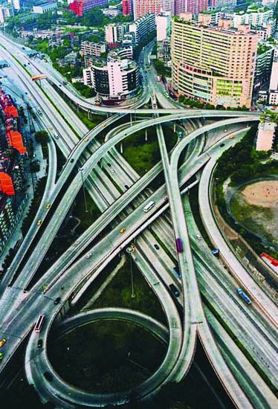
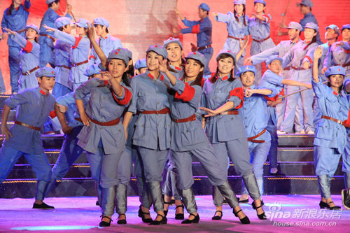
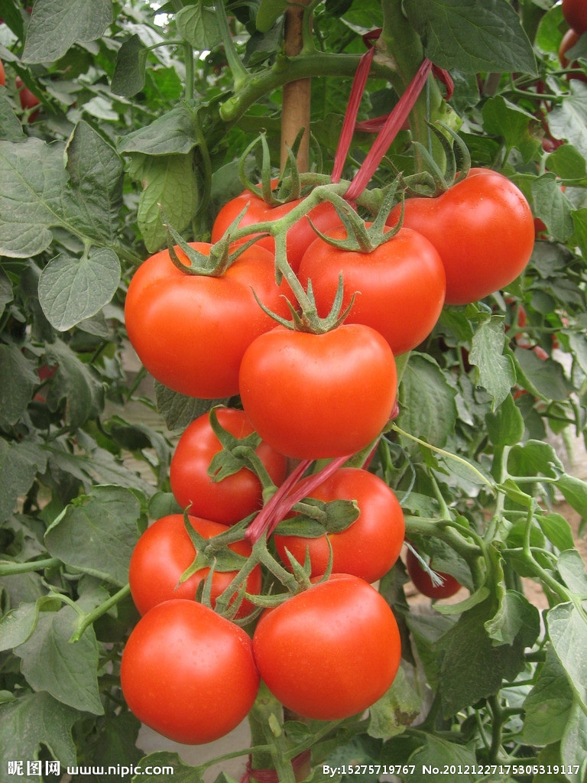
Human Encoding: Purposes
Discussing sensitive information and evading censorship
重庆 (Chongqing)
西红市 (West Red City)
西红柿 (Tomato)

Slide 23
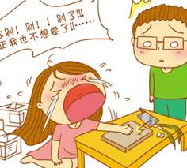
Human Encoding: Purposes
Plain slang in a particular domain, community, youth language, or cutesy language
In sports gambling, getting down = placing a bet
Japanese cartoon and games: 電波(Radio wave) =weird but charming characters who mind-control others by doing unexpected things
Teens’ secret language, ABFL = a big fat lady, POTS = parents over the shoulder
Expressing strong emotion and sentiment, or making fun
剁手党(hand-chopping party) = a group of people who are addicted to online shopping.
Notes:
. In the dark web for human trafficking, arms dealing, and drug dealing,
research chemical or RC is euphemistically used to discuss psychoactive chemicals that are not yet
scheduled as narcotics.
The majority regret their shopping sprees and vow in vain to chop off their hands should they spend their money so easily again.

Slide 24
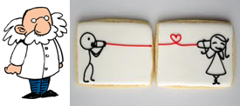
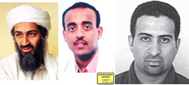
Human Encoding Purposes: Terror plots
To German girlfriend:
“The first semester commences in three weeks.
Two high schools and two universities...
This summer will surely be hot ...
19 certificates for private education and four exams.
Regards to the professor.
Goodbye.
boyfriend
Ramzi bin al-Shibh
on September 11
World Trade Center
Pentagon and Capitol
19 hijackers
four planes
Bin Laden
Abu Abdul Rahman

Slide 25
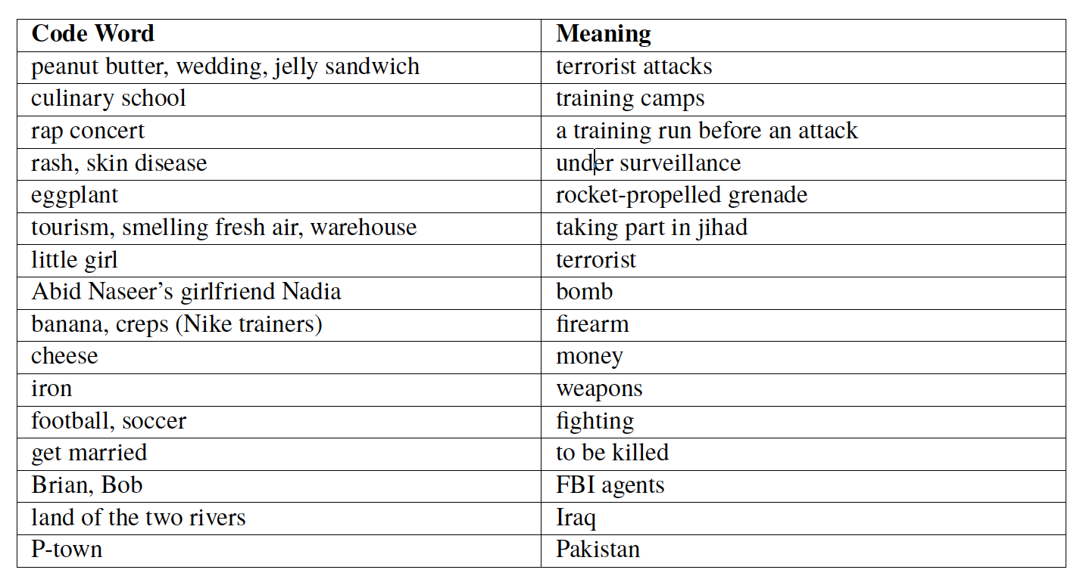
Example of Terror Code Words

Slide 26
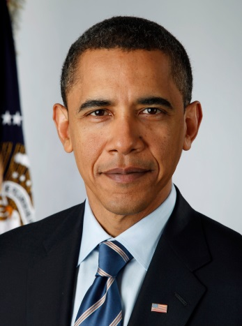
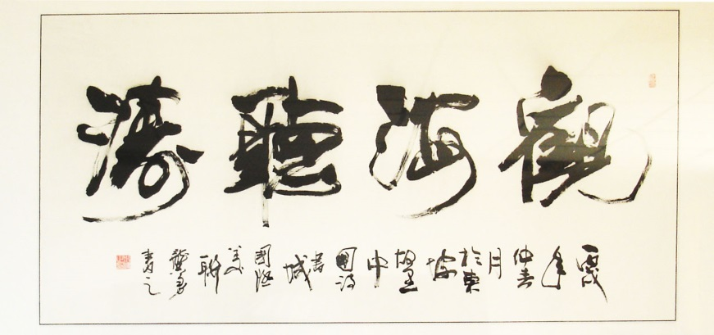
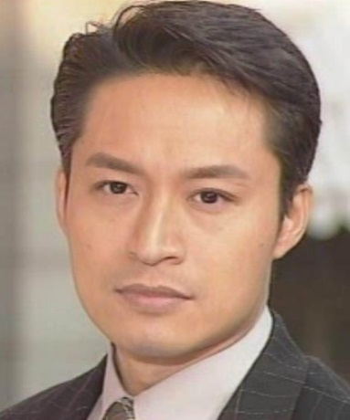
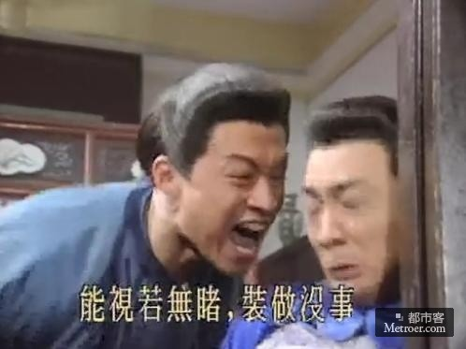
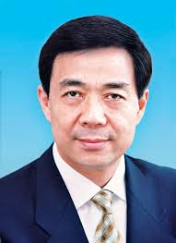
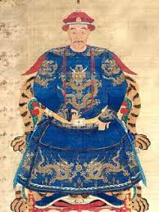
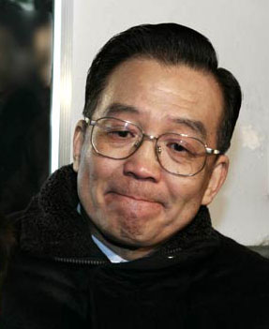
Human Entity Encoding
26% of human encoded entity mentions are based on the entity’s reputation and public perception, and 21% of them are based on modeling the entity’s characteristics
In 1,500 randomly sampled tweets that include 10,098 unique terms, there are 1,342 coded mentions that refer to 250 unique entities
奥巴马 (Obama)
观海 (Staring at the sea)
马景涛 (Ma Jingtao)
咆哮教主 (Roar Bishop)
Calligraphy
“Staring at the sea, listening to the surf”
薄熙来 (Bo Xilai)
平西王 (Conquer West King)
温家宝 (Wen Jiabao)
宝宝 (Baby)

Slide 27
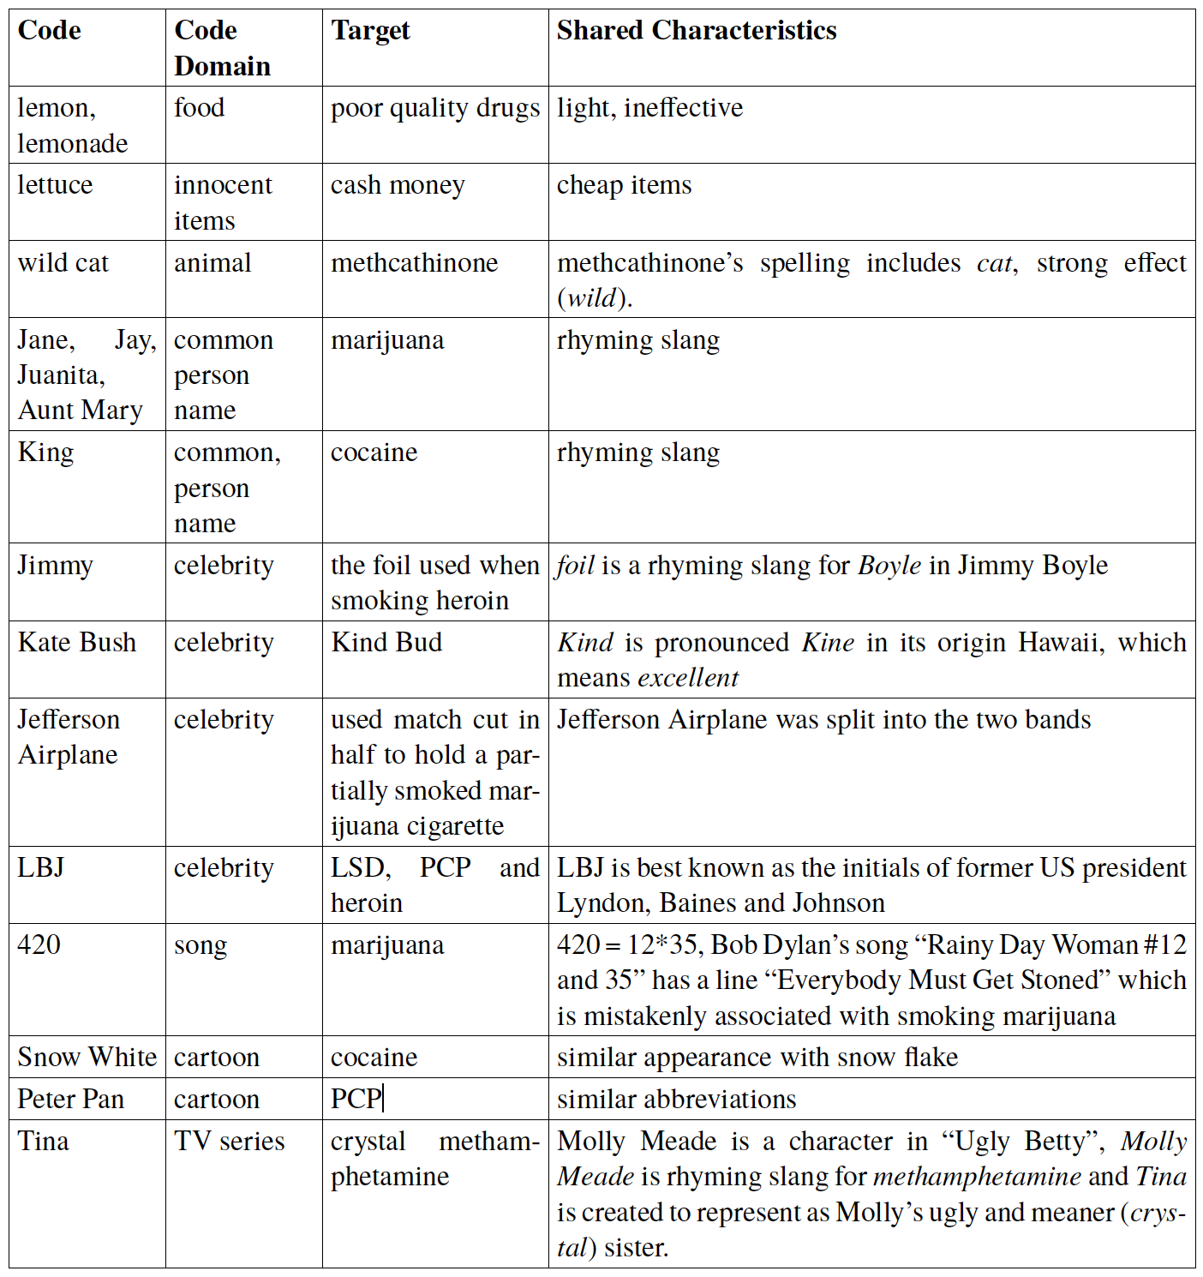
Domain Mapping Examples for Drug Dealing
Henpicking = searching on their hands and legs for drugs
Bulls = police
Ice cream habit = occasional use of drugs
Big John = police
Notes:
Zhang et al. (2014) did a preliminary study on categorizing methods to create code words that refer to
entities. The surface forms of human created code words usually appear quite different from their target
names.
From these examples we can see that the most popular
code domains are food, celebrity, animal, and cartoon. These code words tend to be innocent, cute,
vivid, impressive, and easy to remember. The incongruity theory (Mulder and Nijholt, 2002) states that
humor is perceived at the moment of realization of incongruity between a concept involved in a certain
situation and the real objects thought to be in some relation to the concept. Code words created by domain
mapping naturally match this theory because of the domain shifts between code words and the contexts.
For example, kiwi is the most popular code word referring to Chris Evans, due to his bearded face. So
a post like “kiwi took off his shoes!” is funnier than “Chris took off his shoes!”. Many code words are
created based on archetypes, i.e., innate, universal prototypes. When such prototypes can be observed
among celebrities, their names will be directly used as code words. For example, 楚霸王(Xiangyu, king
of western Chu) is often used to refer to brave people. When no proper names could be easily found
to represent a prototype, a new code name will be created. For example, 朝阳群众(The people of
Chaoyang district) refers to anonymous volunteer security patrols in Beijing. They began to gain fame
on social media after being credited by police as leading to the arrests of several celebrities involved in
drug-related crimes.
When using the domain-mapping strategy, code words in the same thread tend to be consistently derived
from the same domain, and thus they are topically coherent. For instance, in a thread when ice is used to
refer to methylamphetamine, then ice or snow related code words will be used for other drugs (e.g., Lady
Snow for cocaine) and actions (ice cream habit for occasional use of drugs). In contrast, when juice is
used to refer to drugs, then Pepsi habit will be used instead. Similarly when animals are used to refer
to drugs, then chicken scratching and henpicking are used to describe a crack addict searching on their
hands and knees for drugs; and bulls instead of the more common Big John will be used to refer to the
police.

Slide 28
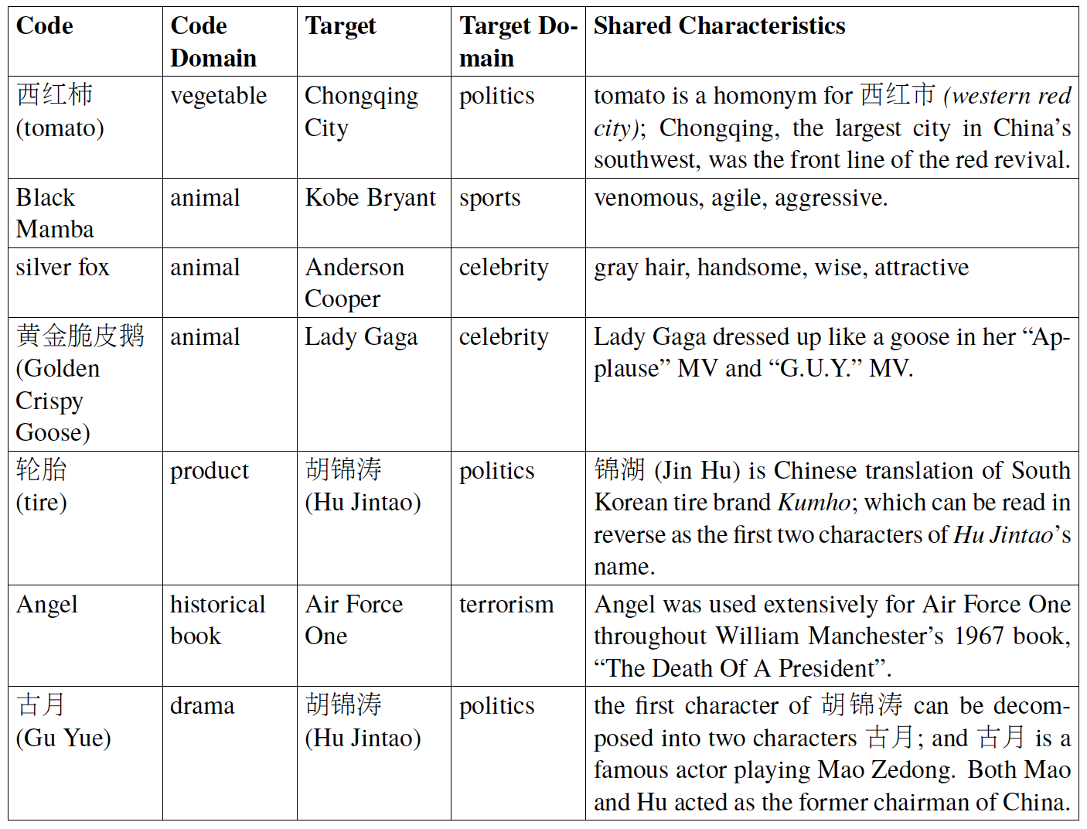
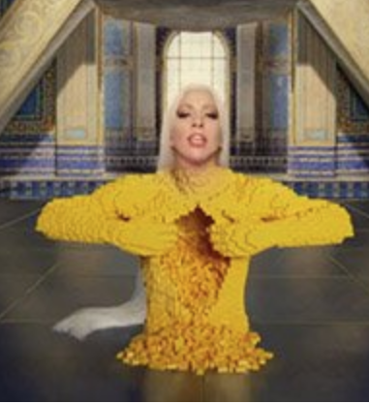
Domain Mapping Examples for Other Purposes

Slide 29
Challenges for Decoding/Censorship
Synonymy and Polysemy
Defeats most contextual features used by IE, metaphor detection and word sense disambiguation techniques
Large number of candidates
Coded language effectively hides in plain sight because anything can be a candidate to the decoder
Moreover, common words and phrases are often used as code words to avoid censorship
姐夫(jie fu, brother‐in‐law) = Medvedev
Lack of labeled data
Manual code annotations require native speakers who have cultural background: 真红女王(Truly Red Queen) = 江青(Jiang Qing)
Notes:
Likewise it is difficult to resolve to real targets
, a major political figure during the
Cultural Revolution by Chinese Communist Party; because the color red is associated with communism,
and she was the fourth wife of Mao Zedong, the first Chairman of China (queen).
is a main character in Rozen Maiden, a
Japanese manga series. It is used as a code name for
. No sufficient mention-level code annotations exist for training an end-to-end
= who was a historical
figure four hundreds years ago who governed the same region as Bo and also suffered from a downfall
and an arrest at the end of his career.
encoder or decoder.
after they are identified. Entity Linking techniques such as (Pan et al., 2015) resolve entity ambiguity by
linking mentions to an external knowledge base (KB), while there is no existing KB that covers a wide
range of target entities, implicit concepts and events referred by code words.
Less-mature metaphor detection (Wang et al., 2006; Tsvetkov, 2013; Heintz et al., 2013) techniques also have trouble with abstract coded language
whose name’s Chinese transliteration ends with syllables that have similar pronunciations as jie fu

Slide 30
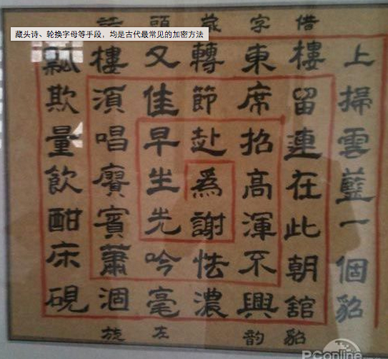
Story Encoding: Acrostic Poems
From Tang Dynasty
By Edgar Allan Poe (1809-1849)
Elizabeth it is in vain you say "Love not"—thou sayest it in so sweet a way: In vain those words from thee or L.E.L. Zantippe's talents had enforced so well: Ah! if that language from thy heart arise, Breath it less gently forth—and veil thine eyes. Endymion, recollect, when Luna tried To cure his love—was cured of all beside— His follie—pride—and passion—for he died.

Slide 31
Story Encoding: Acrostic Poems
薄熙来锒铛入狱 (Bo Xilai is put in jail).
Automatic generators:
Chinese: http://www.guabu.com/cangtoushi/
English: http://www.acrosticpoem.org/
薄暮人争渡口船,
熙熙万国屡丰年,
来时畏有他人上,
郎年五十封公侯,
铛脚三州何处会,
入洞夏里披貂裘,
狱成冤雪晚云开.
狐裘不暖锦衾薄，
冲虚道士陈熙明。
海北蛮夷来舞蹈，
况复萧郎有情思。
二升铛内煮山川，
欲入中门泪满巾。
狱成冤雪晚云开，
蛾眉半敛千金薄，
晨陶陶兮暮熙熙。
遥闻语笑自天来，
有时风卷鼎湖浪。
鼻似烟窗耳似铛，
楼上舟中声暗入。
斗间紫气龙埋狱，

Slide 32
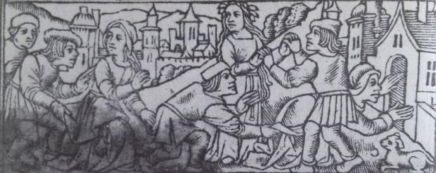
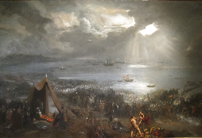
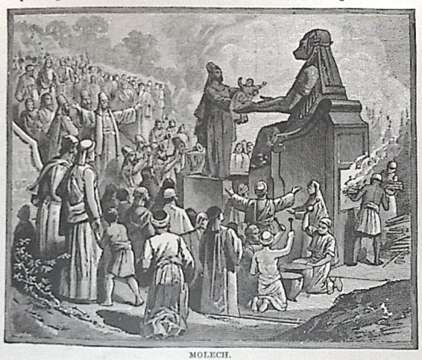
New Morphing: Nursery Rhymes
London Bridge is Falling Down
1014 Viking attack? Child Sacrifice?

Slide 33
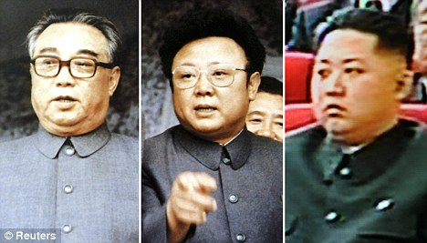
Story Encoding: Nursery Rhymes
Satirical Song “Three Bears” in North Korea, referring to the Kim family:
Three bears in a house, pocketing everything; grandpa bear, papa bear and baby bear. Grandpa Bear is fat, Papa Bear is fat, too, and Baby Bear is a doofus
Notes:
XXX replace with pics
Obfuscated language is also used to encode an entire paragraph, especially for planning certain activities.
For example, North Korean people changed the well-known rhythm song “Three Bears” to include
satirical references to the Kim family dynasty:
• Original version: Three bears in a house, papa bear, mama bear and baby bear. Papa Bear is fat,
Mama Bear is thin, Baby Bear is too cute.
Modified version: Three bears in a house, pocketing everything; grandpa bear, papa bear and
baby bear. Grandpa Bear is fat, Papa Bear is fat, too, and Baby Bear is a doofus.

Slide 34
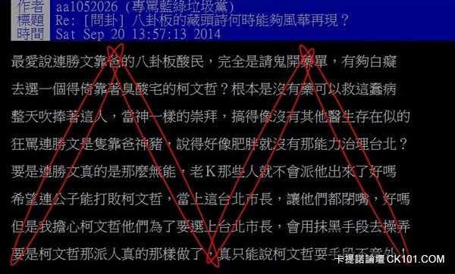
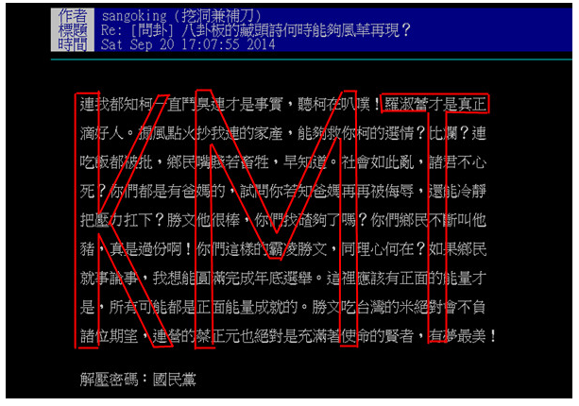
Story Encoding: Acrostic Articles
These documents contain a lot of positive comments about some politicians in Taiwan
But the characters within the red boxes (“KMT” means Kuo Min Tang, a political party in Taiwan) are all negative comments

Slide 35
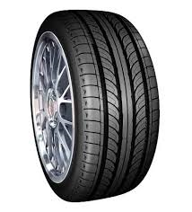
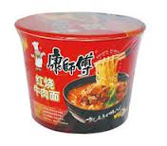
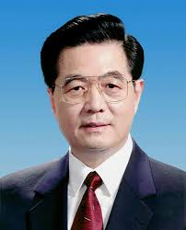
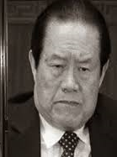
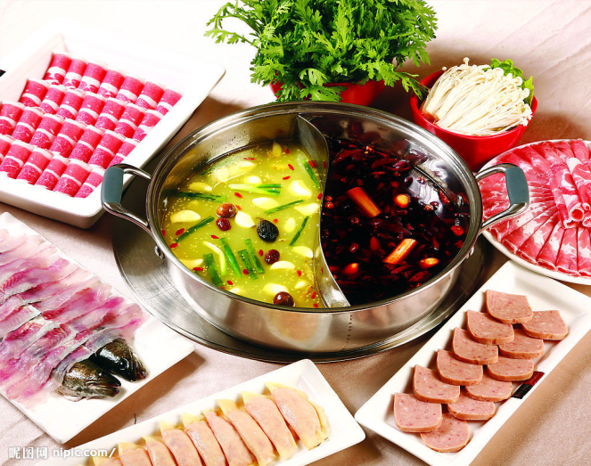
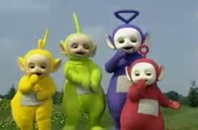
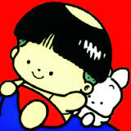
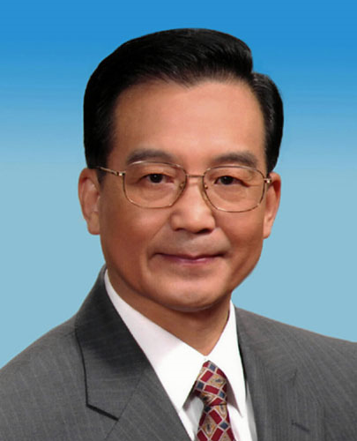
Story Encoding: Hotpot Party → Political Fight
A few days ago, Beijing was hosting an innovative tug-of-war for the elderly; this game has nine contestants in all. The first round of the contest is still intense …The teletubby team noticeably has the advantage and, relatively, the Master Kang team is obviously falling short.
Tomato has retreated; what flavour will Master Kang still have?
Notes:
From vision

Slide 36
System Encoding

Slide 37
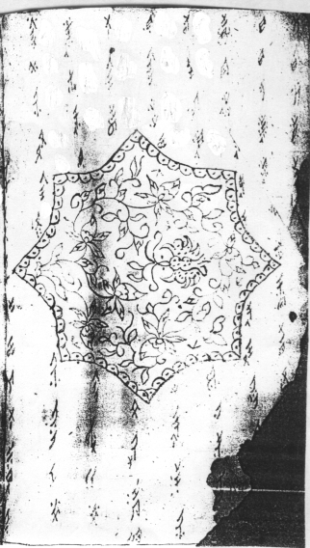
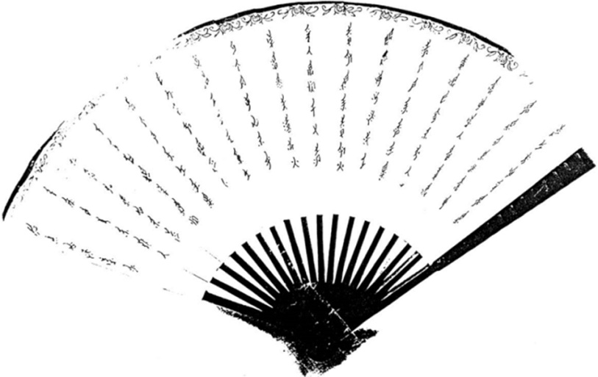
Cipher for Encoding: Constructed Languages
Nyushu (“women’s writing”) was specially created by & for women in the ancient Hunan province of China to communicate with each other
It appeared as normal decoration to men who did not understand or know of the existence of Nyushu
Translate Nyushu (Zhang et al., 2015)
心 (heart)
Dongba: a pictogram language
good
family
dead
Notes:
Traditional text encryption techniques focus on alphabetic substitution or transposition based on lexical
level (Franceschini and Mukherjee, 1996; Venkateswaran and Sundaram, 2010), synonyms (Chang
and Clark, 2014) or image-adaptive public watermarking (Sun et al., 2008). Cipher systems can also
be potentially developed and mutated to encode messages, including compare sophisticated ciphers such
as historical ones (Knight et al., 2011) and simple mutations such as Leet10 and Martian script11. Further
strategies need to be developed to make them easy and fun for target human comprehension and
widespread adoption, and difficult for automatic decoding

Slide 38
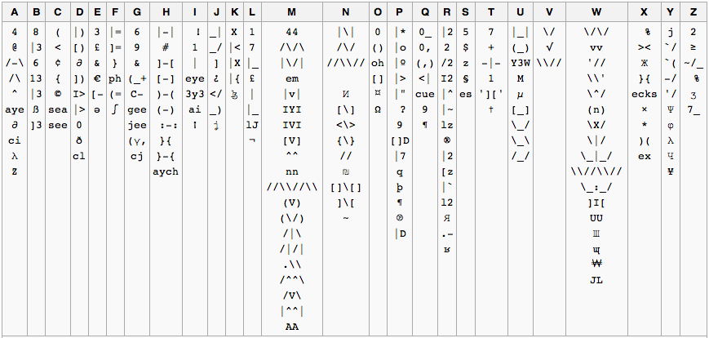
Cipher for Encoding: Constructed Languages
Can new ones be developed and mutated quickly?
Notes:
Traditional text encryption techniques focus on alphabetic substitution or transposition based on lexical
level (Franceschini and Mukherjee, 1996; Venkateswaran and Sundaram, 2010), synonyms (Chang
and Clark, 2014) or image-adaptive public watermarking (Sun et al., 2008). Cipher systems can also
be potentially developed and mutated to encode messages, including compare sophisticated ciphers such
as historical ones (Knight et al., 2011) and simple mutations such as Leet10 and Martian script11. Further
strategies need to be developed to make them easy and fun for target human comprehension and
widespread adoption, and difficult for automatic decoding.

Slide 39
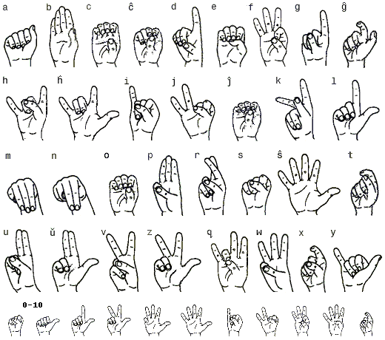
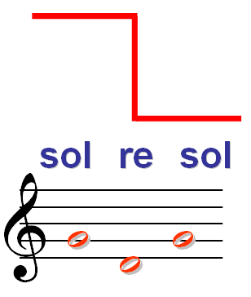
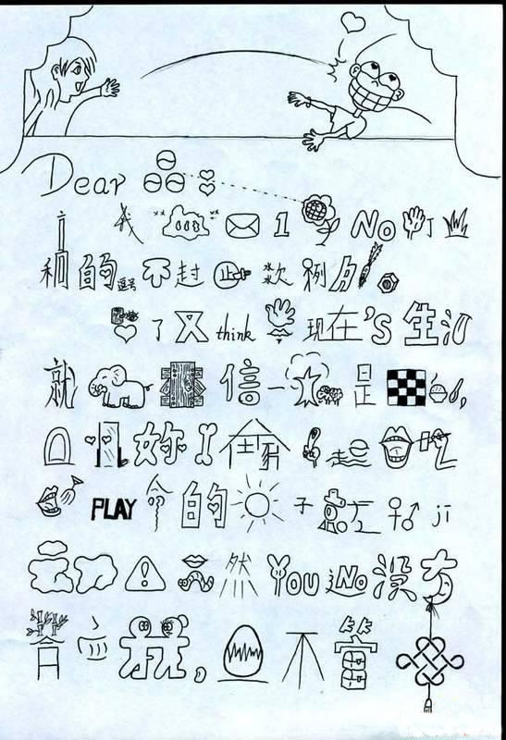
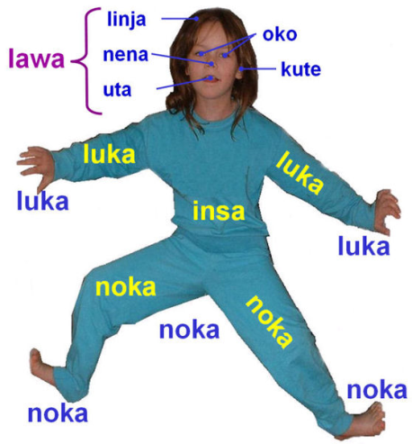
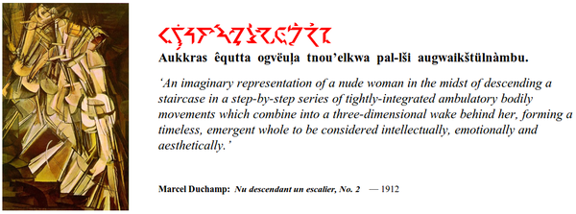
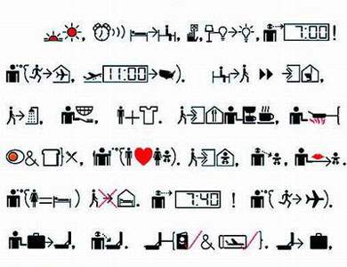
Cipher for Encoding: Constructed Languages

Slide 40
Natural Language Generation for Encoding
Portmanteau neologism creation (Deri and Knight, 2015)
Frenemy = friend + enemy
暖男(warm + man)
渣男(dirt + man)
Poetry passwords (Ghazvininejad and Knight, 2015)
a random 60-bit password -> The legendary Japanese // subsidiaries overseas
Adversarial passage creation (Brennan et al., 2012)
obfuscation, imitation, translation (not very effective)
Potash et al. (2015) develop a GhostWriter system that can take a given artist’s rap lyrics and generate similar yet unique lyrics

Slide 41
Natural Language Generation for Encoding: “Chinglish”
Speak a foreign language in your own language (Shi et al., 2014)
Chinese people can write English using Chinese characters!
machines can even assist with production of such "Chinglish", starting from original Chinese:
Very fun for users!
Foils Language ID -- it looks like people are writing Chinese, not English
Machines cannot currently process such text
It would be great to extend this to other languages
Side benefit: with this technology, a US soldier could use his own voice to say whatever he wants, in any language
Chinese: 明天下午三点到鼓楼大街集合。
English translation: Let’s gather together at the Bell Tower Street at three pm tomorrow.
Pronounce English in Chinese phonetic system (pinyin): Laici galete tegaile ate de beier taoer sijute aite teli piaimu temoluo.
Morph: spell out pinyin:来此盖乐特盖乐爱特得贝尔套儿思聚特爱特特例皮埃姆特摩罗。

Slide 42
Encoding based on Foreign Languages
Netizens can use foreign language as a cipher
US armed forces used Navajo code talkers
Censors can use Language ID, but they may not have human resources to understand the content
Censors can use Machine Translation (MT)
What can netizens do to foil MT systems, while still being able to communicate?
Plenty!
E.g., MT systems can translate Greek, but maybe not misspelled, romanized Greek?
Understanding how users can foil MT is an important topic in its own right
Restricted to subgroups who speak another language or dialect

Slide 43
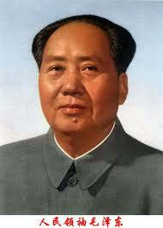
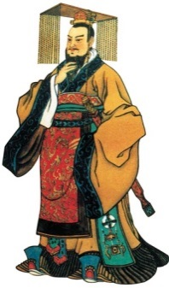
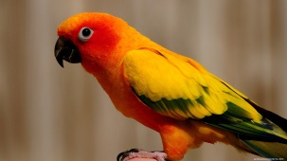
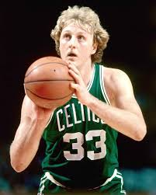
Entity Encoding
(Zhang et al., ACL2014)
Chairman Mao
Bird
First emperor
Larry Bird
Notes:
Here is a pie chart showing different morph encoding categories that we analyzed from human created morphs. We could see the methods are various and have different distribution. These two examples are from social media.

Slide 44
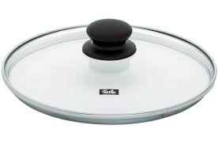
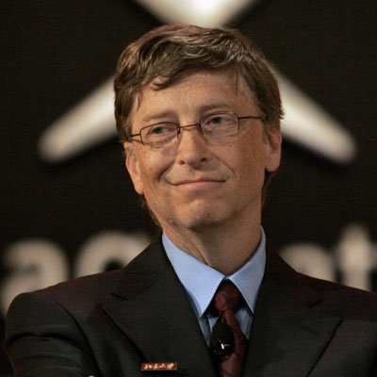
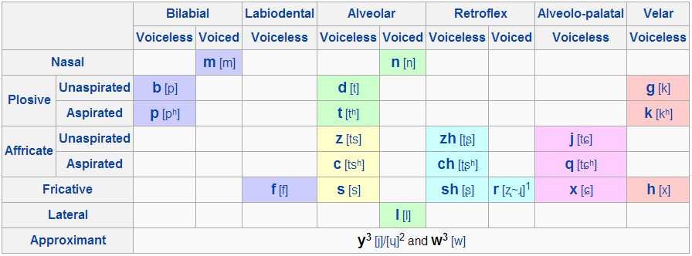
Entity Encoding: Phonetic Substitution
比尔盖茨 (Bill Gates)
比尔盖子 (Bill Lid)
[Bi Er Gai Ci]
[Bi Er Gai Zi]
Gai Zi
less common word
盖子 (Lid)
same pronunciation
[Gai Zi]
term frequency table
Replace the phonetically similar part of the entity name
Prefer candidates including more negative words (derived from HowNet (Dong and Dong, 1999)) or rare words (Valitutti et al., 2013)
Notes:
The first category is phonetic substitution. In the example, bill gates is encoded to bill lid. What we do here is we first get the chinese phonetic transcription, and then look up in a term frequency table to find words that have same pronunciation. Then based on Valituti’s paper that saying less common word is more humourous, we pick the one with less frequency, lid, and append it after Bill. And we get the new morph, bill lid.
The table below is sylable mapping table used when comparing pronunciation.

Slide 45
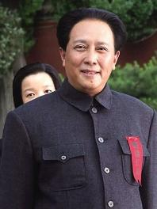
Entity Encoding: Spelling Decomposition
胡锦涛 (Hu Jintao)
古月 (Gu Yue)
胡 (Hu)
胡 (Hu)
character radical decomposition table
Decompose complex character to simple radicals; or intentional mis-spellings
Nickname Generation
杨幂 (Yang Mi)
幂 幂 (Mimi)
repeat character
In baby talk, parents give kids lovely nick name by repeating the last character of the name.
Notes:
The third category is nickname generation. It originates from baby talk. Because in baby talk, parents tend to give kids lovely nick name by repeating the last character. Usually the nickname reflects affection and adoration.

Slide 46
Entity Encoding: Translation & Transliteration
Translated to English
Translated back to Chinese
布什 (Bush)
Bush
bush
灌木 (shrub)
Semantic Interpretation
日
太阳(sun)
金太阳 (Kim Sun)
金日成
(Kim Il-sung)
成
成功(success)
金成功 (Kim Success)
Chinese character dictionary
Interprete one character of the entity name based on Xinhua character dictionary.

Slide 47
Entity Encoding: Characteristics Modeling
姚明 (Yao Ming)
金正恩 (Kim Jong-un)
姚奇才 (Yao Wizard)
金胖子 (Kim Fat)
=
杨幂 (Yang Mi)
嫩牛五方 (Tender Beef Pentagon)
Notes:
For this category, we’ll be using google’s word2vec tool to measure entity and candidate similarity. First we collect a positive and negative corpora, and then use word2vec to compute the semantic similarity between the query entity and each word from the corpora. We then obtained a positive or negative word that well describes the query entity, finally append the word to entity’s family name to form a new morph.

Slide 48
System Decoding

Slide 49
System Decoding
Detect word obfuscation in adversarial communication (Roussinov et al., 2007; Fong et al., 2008; Jabbari et al., 2008; Deshmukh et al., 2014; Agarwal and Sureka, 2015) using existing commonsense knowledge bases such as ConceptNet (Agarwal and Sureka, 2015)
Entity Decoding based on distributional semantics (Zhang et al., 2015)
Notes:
XXX only keep some interesting examples from later
Huang et al. (2013), Zhang et al. (2014) and Zhang et al. (2015) study a problem of encoding and decoding
entity morph, which is a special case of coded name alias to hide the original entities for expressing strong
sentiment or evading censorship in Chinese social media. They propose a variety of novel approaches to
automatically encode proper and interesting morphs (Zhang et al., 2014), including Phonetic Substitution,
Spelling Decomposition, Nickname Generation, Translation and Transliteration and Historical Figure
Mapping, which can effectively pass decoding tests. They also develop an effective morph decoder,
which can automatically identify and resolve entity morphs to their real targets (Huang et al., 2013; Zhang
et al., 2015) and released manually annotated data sets for encoding12 and decoding13 experiments. They
capture implicit attributes of entities using word embeddings. For example, they automatically encode 姚
明(Yao Ming) as 姚奇才(Yao Wizard). However, this simple approach based on general distributional
semantics only receives 52% overall human satisfaction rate, which is significantly lower than that of human
encoding methods (77%). They found that human methods are much better than automatic methods
12http://nlp.cs.rpi.edu/data/morphencoding.tar.gz
13http://nlp.cs.rpi.edu/data/morphdecoding.zip
Figure 1: Encoding and Decoding as Prisoners Problem
at quickly picking up the best attributes for encoding, as well as connecting dots (seemingly irrelevant
attributes) for decoding.

Slide 50
Target Candidate Identification
Notes:
In order to further narrow down the target scope, we can use temporal correlation, the idea is the morph and target should have strong temporal correltaion across sources. E.g. here not thick highly correlates with its target boxilai.

Slide 51
Further Narrow down by Social Correlation
Notes:
We can also explore social media by checking whether the users posted the morph and the target candidate have close social correlation. The social distance can be computed from explicit social networks, but it can be also inferred by checking the content similarity of the message the users posted. By checking the temporal and social corelations, we can reduce the number of candidates into 1%, but keep the correct targets in the pool.

Slide 52
Cross-genre Comparable Corpora
Conquer West King from Chongqing fell from power, still need to sing red songs?
There is no difference between that guy’s plagiarism and Buhou’s gang crackdown.
Remember that Buhou said that his family was not rich at the press conference a few days before he fell from power. His son Bo Guagua is supported by his scholarship.
Bo Xilai: ten thousand letters of accusation have been received during Chongqing gang crackdown.
The webpage of “Tianze Economic Study Institute” owned by the liberal party has been closed. This is the first affected website of the liberal party after Bo Xilai fell from power.
Bo Xilai gave an explanation about the source of his son, Bo Guagua’s tuition.
Bo Xilai led Chongqing city leaders and 40 district and county party and government leaders to sing red songs.
Weibo (censored)
Twitter and Chinese News (uncensored)
Notes:
So that means, in most cases, the morphs are about some ongoing hot topics. So we can find the candidate targets in other sources which are not under censorship. E.g. english twitter or news. E.g. we can see the morphs have corresponding targets in other genres. Blind man refers to chen guangcheng, etc.

Slide 53
Constructing Heterogeneous Information Networks
Affiliation
Justice
Conquer
West King
Earth
Common
Member
Top-employee
Children
Best
Actor
Bo
Guagua
Top_employee
GPE
China
PER
Chongqing
GPE
Located
Top_employee
Bo Xilai
Wen
Jiabao
Children
CCP
Top-employee
Member
PER
Justice
PER
ORG
Affiliation
Each node is an entity
An edge: a semantic relation, event, sentiment, semantic role, dependency relation or co-occurrence, associated with confidence values
Graph walk based similarity measures for resolution
Notes:
Now we can compute the similarity between the morph and each target candidate. We try to use the meta-path idea, but we extract the labels of the links using all kinds of NLP techniques, such as semantic relations, events, sentimen, semantic role, dependency relation, etc. e.g. the morph peace west king can be connected to its target boxilai by multiple paths.
Semantic Feature: content analysis may provide additional evidence beyond surface feature

Slide 54
Remaining Problems

Slide 55
Remaining Problems: Prisoners Problem

Slide 56
Remaining Problems: Make Code Words Representative
Code words should be unique, expressive, discriminative, vivid to indicate what the target is well-known for
They must be up-to-date for a certain burst event, topic, life snapshot, domain, or reputation during a certain time period
Code Words | Target | Motivation
Blind Man (瞎子) | Chen Guangcheng(陈光诚) | Sensitive
First Emperor (元祖) | Mao Zedong (毛泽东) | Vivid
Kimchi Country (泡菜国) | Korea (韩国) | Vivid
Rice Country (米国) | United States (美国) | Pronunciation
Kim Third Fat (金三胖) | Kim Jong-un (金正恩) | Negative
Miracle Brother (奇迹哥) | Wang Yongping (王勇平) | Irony
Notes:
, and easy to remember. For example, Kimchi Country is a good code name for
South Korea. Terror code words often use the names of fruits and vegetables for weapons of similar
shapes. (Lin et al., 2015) ranked the attributes in a typical human created knowledge base based on how
well each attribute can distinguish entities. The top ranked ones include a person’s social security number
or an organization’s website. However, such attributes will be easily caught by an automatic decoder.
XXX put in two videos
Many interesting challenges remain to be explored for effective crezative language encoding.
Prisoners Problem: The first basic goal is to make sure the target human receiver (e.g., Bob in Figure 1)
can successfully receive and decode the code words from the sender (Alice) by passing the censor (Willie).
Creative language is used to communicate confidential information without encryption. Shannon’s maxim
“the enemy knows the system” does not always hold. There is usually no chance for the sender and the
potential recipient to agree on a common code-book or secret key in advance. A smart encoder should
go far beyond surface changes on spellings or pronunciations. It must be on-topic, containing clues for a
human receiver to understand without specialized background knowledge.

Slide 57
Remaining Problems: Make Code Words Adoptable
Popular code words tend to include unusual combinations of characters or words, negative sentiment and sarcasm
They are usually simple, cute and easy to remember
苏亚雷斯(Suarez)
苏牙(Su-tooth)
Notes:
This is also a very interesting category. Morph could be created either from a story or entity’s public reputation and perception. Suarez is a forward in Uruguay. By using weapon of mass destruction, his teeth, he bite the soccer player of Itatly on World Cup yesterday, and finally ensured his team to the next round.

Slide 58
Remaining Problems: Time-sensitivity
Notes:
Time-sensitivity: Figure 2 shows the code frequency change for targets Bo Xilai at Sina Weibo. We can
see the drops in the frequency of code words around sensitive dates (June 4, the anniversary of Tiananmen
Square protests of 198914, etc). The censorship system is highly flexible. Certain code words may be
blocked during politically-sensitive periods of the year, while others may be blacklisted for just a short
time due to some contemporary relevant issue.

Slide 59
Morph Decoding and Encoding Co-Evolution
Code words need to rapidly co-evolve with machine or human decoder over time, as some code words are discovered and blocked by censorship and newly created code words emerge
A never-ending learning component is needed to discover and select novel, salient and anomaly entities and events, update their profiles over time, rank and select the most discriminative characteristics of the targets for encoding

Slide 60
Remaining Problems: Personalization and Multi-lingual
An ideal encoder should act as a friend instead of a servant or a co-worker
It should be a user-oriented, real-time, interactive encoding framework customized for both the sender and the receiver
The encoder should also incorporate the target reader’s cultural background and psychological traits
Extend encoding methods to a wide range of languages in countries and regions with Internet censorship such as Arabic, Burmese, Farsi, Russian, Turkish, Uyghur, Urdu, and Vietnamese
Notes:
(gender, origin, education, moral value, power, belief, religion, social norm, current interests, culture, sense of humor, work intensity, etc), as recognized by user profile, social network information, target log history, previous posts, location, and time, into the encoder’s short-term memory

