Slide 1
Abstractive summarization
Heng Ji
hengji@illinois.edu
April 3, 2020

Slide 2
Bottom-up Abstractive Summarization
(Gerhrmann et al., EMNLP2018)
Current state-of-the-art neural abstractive summarization models combine extractive and abstractive techniques by using pointer generator style models which can copy words from the source document (Gu et al., 2016; Seeet al., 2017)
These end-to-end models produce fluent abstractive summaries but have had mixed success in content selection, i.e. deciding what to summarize, compared to fully extractive models.
Notes:
300 papers… every day… impossible to read… keyword search… abstract doesn’t reflect… results; ignore most of them. Cancer and surgery… 3 days… walk through all posters.. In our field papers that were published twenty years ago are not that important…
including mining PubMed bibliographic data, research papers in PubMed, clinical data sets and numerous bio-medical websites and social media related to medical sciences, where data related to diseases, drugs, treatments, chemical compounds, proteins, genes, biological pathways can be integrated and extracted from text data and their characteristics and relationships can be mined from such datasets as well
. Older literature is often extremely important (and overlooked), and indeed, often provides a rich source of information that can lead to new hypotheses. This makes the information overload problem event more serious, because we need distill and connect knowledge from papers that may cover 70 years.

Slide 3
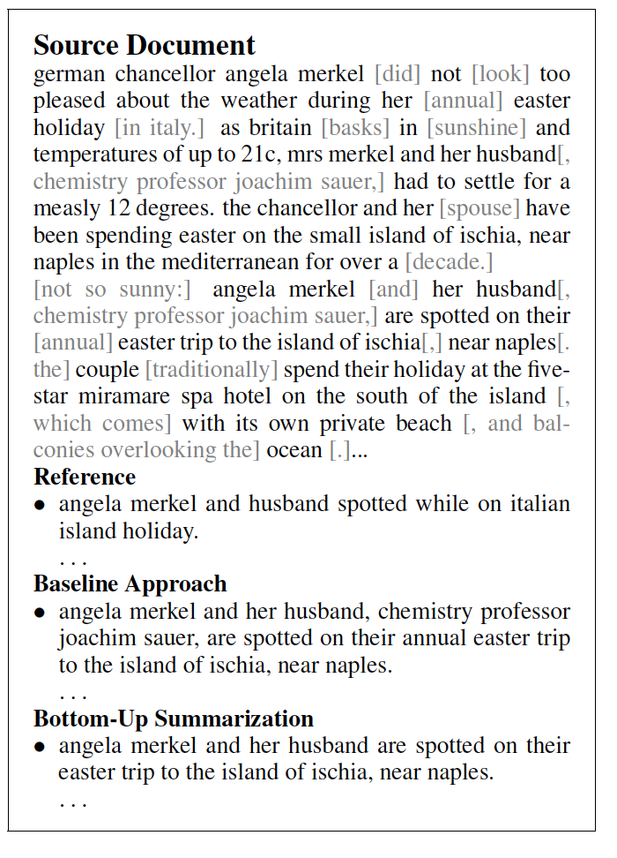
Bottom-up Abstractive Summarization
Notes:
300 papers… every day… impossible to read… keyword search… abstract doesn’t reflect… results; ignore most of them. Cancer and surgery… 3 days… walk through all posters.. In our field papers that were published twenty years ago are not that important…
including mining PubMed bibliographic data, research papers in PubMed, clinical data sets and numerous bio-medical websites and social media related to medical sciences, where data related to diseases, drugs, treatments, chemical compounds, proteins, genes, biological pathways can be integrated and extracted from text data and their characteristics and relationships can be mined from such datasets as well
. Older literature is often extremely important (and overlooked), and indeed, often provides a rich source of information that can lead to new hypotheses. This makes the information overload problem event more serious, because we need distill and connect knowledge from papers that may cover 70 years.

Slide 4
Content Selection Method
How to select content?
Incorporate a separate content selection system to decide on relevant aspects of the source document →
Frame this selection task as a sequence-tagging problem, with the objective of identifying tokens from a document that are part of its summary
Content selection model that builds on contextual word embeddings (Peters et al., 2018) can identify correct tokens with a recall of over 60%, and a precision of over 50%
Define a word x_{i} as copied if (1) it is part of the longest possible subsequence of tokens s = x_{i-j:i:i+k}, for integers j<=i; k <= (n-i), if s is part of x and y (2) there exists no earlier sequence u with s = u.
LSTM for sequence labeling
Notes:
300 papers… every day… impossible to read… keyword search… abstract doesn’t reflect… results; ignore most of them. Cancer and surgery… 3 days… walk through all posters.. In our field papers that were published twenty years ago are not that important…
including mining PubMed bibliographic data, research papers in PubMed, clinical data sets and numerous bio-medical websites and social media related to medical sciences, where data related to diseases, drugs, treatments, chemical compounds, proteins, genes, biological pathways can be integrated and extracted from text data and their characteristics and relationships can be mined from such datasets as well
. Older literature is often extremely important (and overlooked), and indeed, often provides a rich source of information that can lead to new hypotheses. This makes the information overload problem event more serious, because we need distill and connect knowledge from papers that may cover 70 years.

Slide 5
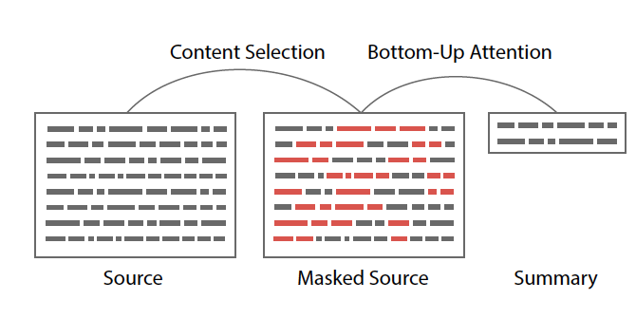
How to Incorporate Content Selection?
Employ masking to constrain copying words to the selected parts of the text, which produces grammatical outputs
Notes:
300 papers… every day… impossible to read… keyword search… abstract doesn’t reflect… results; ignore most of them. Cancer and surgery… 3 days… walk through all posters.. In our field papers that were published twenty years ago are not that important…
including mining PubMed bibliographic data, research papers in PubMed, clinical data sets and numerous bio-medical websites and social media related to medical sciences, where data related to diseases, drugs, treatments, chemical compounds, proteins, genes, biological pathways can be integrated and extracted from text data and their characteristics and relationships can be mined from such datasets as well
. Older literature is often extremely important (and overlooked), and indeed, often provides a rich source of information that can lead to new hypotheses. This makes the information overload problem event more serious, because we need distill and connect knowledge from papers that may cover 70 years.

Slide 6
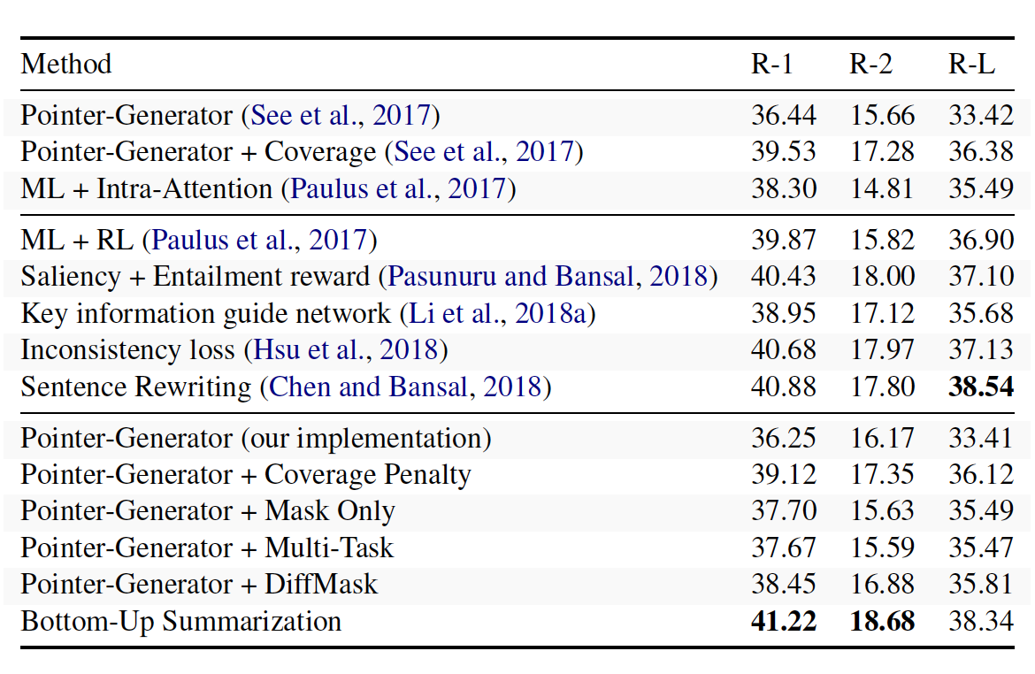
Results
Employ masking to constrain copying words to the selected parts of the text, which produces grammatical outputs
Notes:
300 papers… every day… impossible to read… keyword search… abstract doesn’t reflect… results; ignore most of them. Cancer and surgery… 3 days… walk through all posters.. In our field papers that were published twenty years ago are not that important…
including mining PubMed bibliographic data, research papers in PubMed, clinical data sets and numerous bio-medical websites and social media related to medical sciences, where data related to diseases, drugs, treatments, chemical compounds, proteins, genes, biological pathways can be integrated and extracted from text data and their characteristics and relationships can be mined from such datasets as well
. Older literature is often extremely important (and overlooked), and indeed, often provides a rich source of information that can lead to new hypotheses. This makes the information overload problem event more serious, because we need distill and connect knowledge from papers that may cover 70 years.

Slide 7
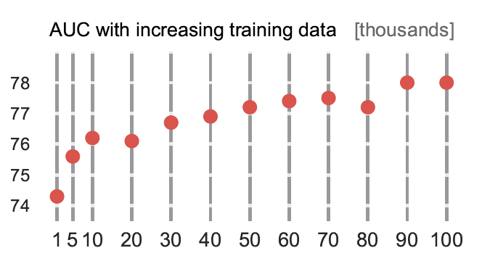
AUC of Content Selection
Employ masking to constrain copying words to the selected parts of the text, which produces grammatical outputs
Notes:
300 papers… every day… impossible to read… keyword search… abstract doesn’t reflect… results; ignore most of them. Cancer and surgery… 3 days… walk through all posters.. In our field papers that were published twenty years ago are not that important…
including mining PubMed bibliographic data, research papers in PubMed, clinical data sets and numerous bio-medical websites and social media related to medical sciences, where data related to diseases, drugs, treatments, chemical compounds, proteins, genes, biological pathways can be integrated and extracted from text data and their characteristics and relationships can be mined from such datasets as well
. Older literature is often extremely important (and overlooked), and indeed, often provides a rich source of information that can lead to new hypotheses. This makes the information overload problem event more serious, because we need distill and connect knowledge from papers that may cover 70 years.

Slide 8
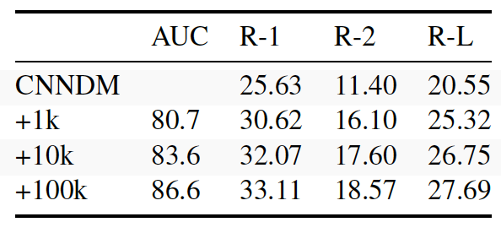
Domain Transfer Results
Add various size of NYT data
Notes:
300 papers… every day… impossible to read… keyword search… abstract doesn’t reflect… results; ignore most of them. Cancer and surgery… 3 days… walk through all posters.. In our field papers that were published twenty years ago are not that important…
including mining PubMed bibliographic data, research papers in PubMed, clinical data sets and numerous bio-medical websites and social media related to medical sciences, where data related to diseases, drugs, treatments, chemical compounds, proteins, genes, biological pathways can be integrated and extracted from text data and their characteristics and relationships can be mined from such datasets as well
. Older literature is often extremely important (and overlooked), and indeed, often provides a rich source of information that can lead to new hypotheses. This makes the information overload problem event more serious, because we need distill and connect knowledge from papers that may cover 70 years.

Slide 9
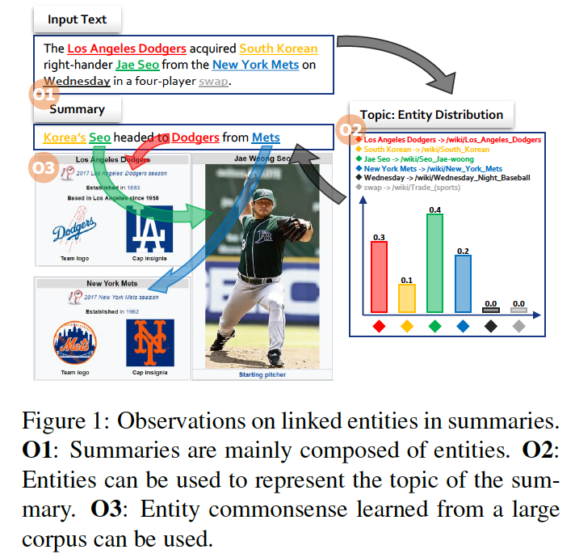
Incorporating Entity Commonsense
(Gerhrmann et al., EMNLP2018)
transforms a list of entities into a vector representation of the topic of the summary.
Notes:
300 papers… every day… impossible to read… keyword search… abstract doesn’t reflect… results; ignore most of them. Cancer and surgery… 3 days… walk through all posters.. In our field papers that were published twenty years ago are not that important…
including mining PubMed bibliographic data, research papers in PubMed, clinical data sets and numerous bio-medical websites and social media related to medical sciences, where data related to diseases, drugs, treatments, chemical compounds, proteins, genes, biological pathways can be integrated and extracted from text data and their characteristics and relationships can be mined from such datasets as well
. Older literature is often extremely important (and overlooked), and indeed, often provides a rich source of information that can lead to new hypotheses. This makes the information overload problem event more serious, because we need distill and connect knowledge from papers that may cover 70 years.

Slide 10
Method
Encodes the entities extracted from the original text by an entity linking system (ELS), constructs a vector representing the topic of the summary to be generated, and informs the decoder about the constructed topic vector
Problem: Due to the imperfections of current ELS’s, the extracted linked entities may be too ambiguous and coarse to be considered relevant to the summary
Solution: use entity encoders with selective disambiguation, topic vectors using firm attention.
Notes:
300 papers… every day… impossible to read… keyword search… abstract doesn’t reflect… results; ignore most of them. Cancer and surgery… 3 days… walk through all posters.. In our field papers that were published twenty years ago are not that important…
including mining PubMed bibliographic data, research papers in PubMed, clinical data sets and numerous bio-medical websites and social media related to medical sciences, where data related to diseases, drugs, treatments, chemical compounds, proteins, genes, biological pathways can be integrated and extracted from text data and their characteristics and relationships can be mined from such datasets as well
. Older literature is often extremely important (and overlooked), and indeed, often provides a rich source of information that can lead to new hypotheses. This makes the information overload problem event more serious, because we need distill and connect knowledge from papers that may cover 70 years.

Slide 11
Method
Encodes the entities extracted from the original text by an entity linking system (ELS), constructs a vector representing the topic of the summary to be generated, and informs the decoder about the constructed topic vector
Problem: Due to the imperfections of current ELS’s, the extracted linked entities may be too ambiguous and coarse to be considered relevant to the summary
Solution: use entity encoders with selective disambiguation, topic vectors using firm attention.
Notes:
300 papers… every day… impossible to read… keyword search… abstract doesn’t reflect… results; ignore most of them. Cancer and surgery… 3 days… walk through all posters.. In our field papers that were published twenty years ago are not that important…
including mining PubMed bibliographic data, research papers in PubMed, clinical data sets and numerous bio-medical websites and social media related to medical sciences, where data related to diseases, drugs, treatments, chemical compounds, proteins, genes, biological pathways can be integrated and extracted from text data and their characteristics and relationships can be mined from such datasets as well
. Older literature is often extremely important (and overlooked), and indeed, often provides a rich source of information that can lead to new hypotheses. This makes the information overload problem event more serious, because we need distill and connect knowledge from papers that may cover 70 years.

Slide 12
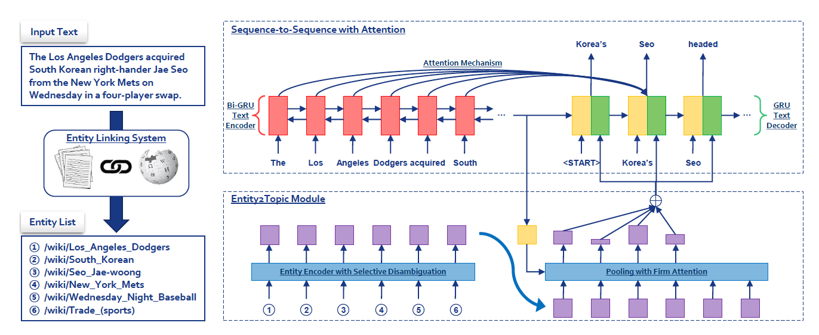
Method
Notes:
300 papers… every day… impossible to read… keyword search… abstract doesn’t reflect… results; ignore most of them. Cancer and surgery… 3 days… walk through all posters.. In our field papers that were published twenty years ago are not that important…
including mining PubMed bibliographic data, research papers in PubMed, clinical data sets and numerous bio-medical websites and social media related to medical sciences, where data related to diseases, drugs, treatments, chemical compounds, proteins, genes, biological pathways can be integrated and extracted from text data and their characteristics and relationships can be mined from such datasets as well
. Older literature is often extremely important (and overlooked), and indeed, often provides a rich source of information that can lead to new hypotheses. This makes the information overload problem event more serious, because we need distill and connect knowledge from papers that may cover 70 years.

Slide 13
Entity Encoding Submodule
Notes:
300 papers… every day… impossible to read… keyword search… abstract doesn’t reflect… results; ignore most of them. Cancer and surgery… 3 days… walk through all posters.. In our field papers that were published twenty years ago are not that important…
including mining PubMed bibliographic data, research papers in PubMed, clinical data sets and numerous bio-medical websites and social media related to medical sciences, where data related to diseases, drugs, treatments, chemical compounds, proteins, genes, biological pathways can be integrated and extracted from text data and their characteristics and relationships can be mined from such datasets as well
. Older literature is often extremely important (and overlooked), and indeed, often provides a rich source of information that can lead to new hypotheses. This makes the information overload problem event more serious, because we need distill and connect knowledge from papers that may cover 70 years.

Slide 14
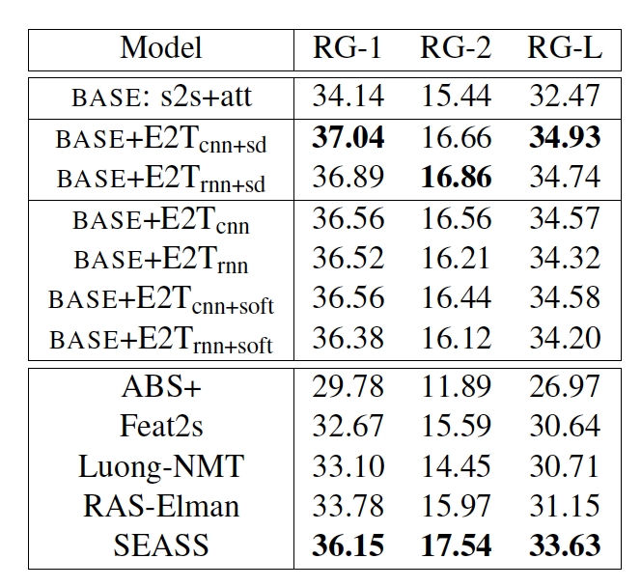
Results
Notes:
300 papers… every day… impossible to read… keyword search… abstract doesn’t reflect… results; ignore most of them. Cancer and surgery… 3 days… walk through all posters.. In our field papers that were published twenty years ago are not that important…
including mining PubMed bibliographic data, research papers in PubMed, clinical data sets and numerous bio-medical websites and social media related to medical sciences, where data related to diseases, drugs, treatments, chemical compounds, proteins, genes, biological pathways can be integrated and extracted from text data and their characteristics and relationships can be mined from such datasets as well
. Older literature is often extremely important (and overlooked), and indeed, often provides a rich source of information that can lead to new hypotheses. This makes the information overload problem event more serious, because we need distill and connect knowledge from papers that may cover 70 years.

Slide 15
Human Evaluation
Notes:
300 papers… every day… impossible to read… keyword search… abstract doesn’t reflect… results; ignore most of them. Cancer and surgery… 3 days… walk through all posters.. In our field papers that were published twenty years ago are not that important…
including mining PubMed bibliographic data, research papers in PubMed, clinical data sets and numerous bio-medical websites and social media related to medical sciences, where data related to diseases, drugs, treatments, chemical compounds, proteins, genes, biological pathways can be integrated and extracted from text data and their characteristics and relationships can be mined from such datasets as well
. Older literature is often extremely important (and overlooked), and indeed, often provides a rich source of information that can lead to new hypotheses. This makes the information overload problem event more serious, because we need distill and connect knowledge from papers that may cover 70 years.

Slide 16
Example output
Notes:
300 papers… every day… impossible to read… keyword search… abstract doesn’t reflect… results; ignore most of them. Cancer and surgery… 3 days… walk through all posters.. In our field papers that were published twenty years ago are not that important…
including mining PubMed bibliographic data, research papers in PubMed, clinical data sets and numerous bio-medical websites and social media related to medical sciences, where data related to diseases, drugs, treatments, chemical compounds, proteins, genes, biological pathways can be integrated and extracted from text data and their characteristics and relationships can be mined from such datasets as well
. Older literature is often extremely important (and overlooked), and indeed, often provides a rich source of information that can lead to new hypotheses. This makes the information overload problem event more serious, because we need distill and connect knowledge from papers that may cover 70 years.

Slide 17
Example output
Notes:
300 papers… every day… impossible to read… keyword search… abstract doesn’t reflect… results; ignore most of them. Cancer and surgery… 3 days… walk through all posters.. In our field papers that were published twenty years ago are not that important…
including mining PubMed bibliographic data, research papers in PubMed, clinical data sets and numerous bio-medical websites and social media related to medical sciences, where data related to diseases, drugs, treatments, chemical compounds, proteins, genes, biological pathways can be integrated and extracted from text data and their characteristics and relationships can be mined from such datasets as well
. Older literature is often extremely important (and overlooked), and indeed, often provides a rich source of information that can lead to new hypotheses. This makes the information overload problem event more serious, because we need distill and connect knowledge from papers that may cover 70 years.

Slide 18
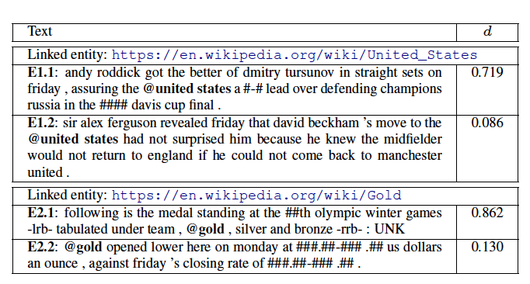
Example output
Examples with highest/lowest disambiguation gate d values of two example entities (United States and gold).
Notes:
300 papers… every day… impossible to read… keyword search… abstract doesn’t reflect… results; ignore most of them. Cancer and surgery… 3 days… walk through all posters.. In our field papers that were published twenty years ago are not that important…
including mining PubMed bibliographic data, research papers in PubMed, clinical data sets and numerous bio-medical websites and social media related to medical sciences, where data related to diseases, drugs, treatments, chemical compounds, proteins, genes, biological pathways can be integrated and extracted from text data and their characteristics and relationships can be mined from such datasets as well
. Older literature is often extremely important (and overlooked), and indeed, often provides a rich source of information that can lead to new hypotheses. This makes the information overload problem event more serious, because we need distill and connect knowledge from papers that may cover 70 years.

Slide 19
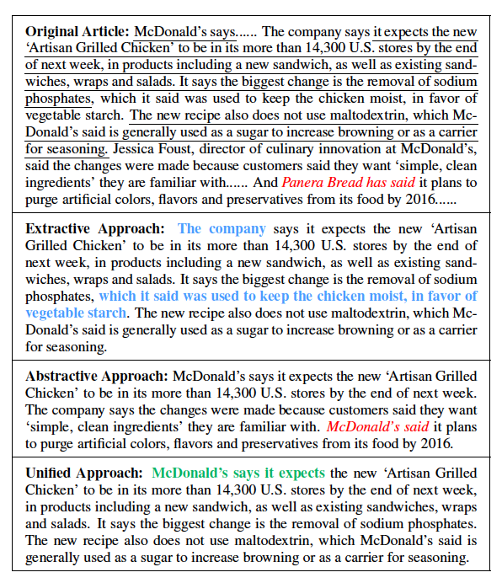
Unifying Extractive and Abstractive Summarization
(Hsu et al., ACL2018)
Notes:
300 papers… every day… impossible to read… keyword search… abstract doesn’t reflect… results; ignore most of them. Cancer and surgery… 3 days… walk through all posters.. In our field papers that were published twenty years ago are not that important…
including mining PubMed bibliographic data, research papers in PubMed, clinical data sets and numerous bio-medical websites and social media related to medical sciences, where data related to diseases, drugs, treatments, chemical compounds, proteins, genes, biological pathways can be integrated and extracted from text data and their characteristics and relationships can be mined from such datasets as well
. Older literature is often extremely important (and overlooked), and indeed, often provides a rich source of information that can lead to new hypotheses. This makes the information overload problem event more serious, because we need distill and connect knowledge from papers that may cover 70 years.

Slide 20
Combining Attentions
Notes:
300 papers… every day… impossible to read… keyword search… abstract doesn’t reflect… results; ignore most of them. Cancer and surgery… 3 days… walk through all posters.. In our field papers that were published twenty years ago are not that important…
including mining PubMed bibliographic data, research papers in PubMed, clinical data sets and numerous bio-medical websites and social media related to medical sciences, where data related to diseases, drugs, treatments, chemical compounds, proteins, genes, biological pathways can be integrated and extracted from text data and their characteristics and relationships can be mined from such datasets as well
. Older literature is often extremely important (and overlooked), and indeed, often provides a rich source of information that can lead to new hypotheses. This makes the information overload problem event more serious, because we need distill and connect knowledge from papers that may cover 70 years.

Slide 21
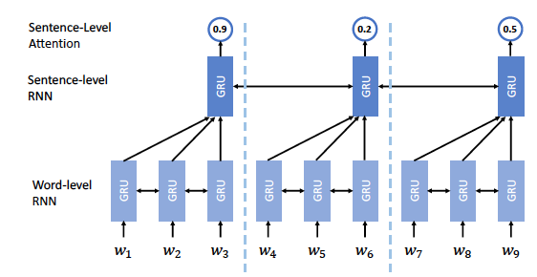
Architecture of Extractor
Notes:
300 papers… every day… impossible to read… keyword search… abstract doesn’t reflect… results; ignore most of them. Cancer and surgery… 3 days… walk through all posters.. In our field papers that were published twenty years ago are not that important…
including mining PubMed bibliographic data, research papers in PubMed, clinical data sets and numerous bio-medical websites and social media related to medical sciences, where data related to diseases, drugs, treatments, chemical compounds, proteins, genes, biological pathways can be integrated and extracted from text data and their characteristics and relationships can be mined from such datasets as well
. Older literature is often extremely important (and overlooked), and indeed, often provides a rich source of information that can lead to new hypotheses. This makes the information overload problem event more serious, because we need distill and connect knowledge from papers that may cover 70 years.

Slide 22
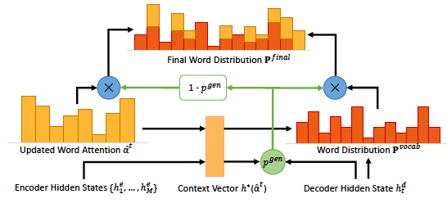
Decoding in Abstractor
Notes:
300 papers… every day… impossible to read… keyword search… abstract doesn’t reflect… results; ignore most of them. Cancer and surgery… 3 days… walk through all posters.. In our field papers that were published twenty years ago are not that important…
including mining PubMed bibliographic data, research papers in PubMed, clinical data sets and numerous bio-medical websites and social media related to medical sciences, where data related to diseases, drugs, treatments, chemical compounds, proteins, genes, biological pathways can be integrated and extracted from text data and their characteristics and relationships can be mined from such datasets as well
. Older literature is often extremely important (and overlooked), and indeed, often provides a rich source of information that can lead to new hypotheses. This makes the information overload problem event more serious, because we need distill and connect knowledge from papers that may cover 70 years.

Slide 23
Results of Extracted Sentences
Notes:
300 papers… every day… impossible to read… keyword search… abstract doesn’t reflect… results; ignore most of them. Cancer and surgery… 3 days… walk through all posters.. In our field papers that were published twenty years ago are not that important…
including mining PubMed bibliographic data, research papers in PubMed, clinical data sets and numerous bio-medical websites and social media related to medical sciences, where data related to diseases, drugs, treatments, chemical compounds, proteins, genes, biological pathways can be integrated and extracted from text data and their characteristics and relationships can be mined from such datasets as well
. Older literature is often extremely important (and overlooked), and indeed, often provides a rich source of information that can lead to new hypotheses. This makes the information overload problem event more serious, because we need distill and connect knowledge from papers that may cover 70 years.

Slide 24
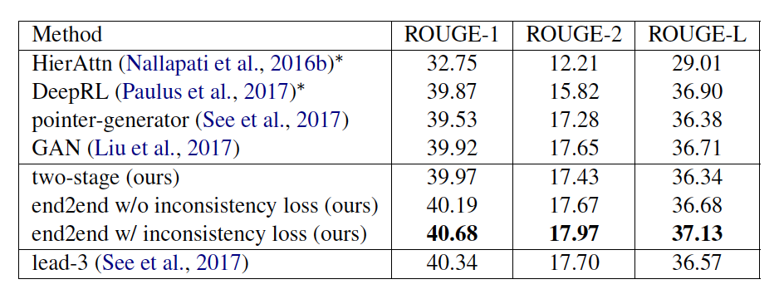
Results of Abstractive Summaries
Notes:
300 papers… every day… impossible to read… keyword search… abstract doesn’t reflect… results; ignore most of them. Cancer and surgery… 3 days… walk through all posters.. In our field papers that were published twenty years ago are not that important…
including mining PubMed bibliographic data, research papers in PubMed, clinical data sets and numerous bio-medical websites and social media related to medical sciences, where data related to diseases, drugs, treatments, chemical compounds, proteins, genes, biological pathways can be integrated and extracted from text data and their characteristics and relationships can be mined from such datasets as well
. Older literature is often extremely important (and overlooked), and indeed, often provides a rich source of information that can lead to new hypotheses. This makes the information overload problem event more serious, because we need distill and connect knowledge from papers that may cover 70 years.

Slide 25
Human Evaluation
Notes:
300 papers… every day… impossible to read… keyword search… abstract doesn’t reflect… results; ignore most of them. Cancer and surgery… 3 days… walk through all posters.. In our field papers that were published twenty years ago are not that important…
including mining PubMed bibliographic data, research papers in PubMed, clinical data sets and numerous bio-medical websites and social media related to medical sciences, where data related to diseases, drugs, treatments, chemical compounds, proteins, genes, biological pathways can be integrated and extracted from text data and their characteristics and relationships can be mined from such datasets as well
. Older literature is often extremely important (and overlooked), and indeed, often provides a rich source of information that can lead to new hypotheses. This makes the information overload problem event more serious, because we need distill and connect knowledge from papers that may cover 70 years.

Slide 26
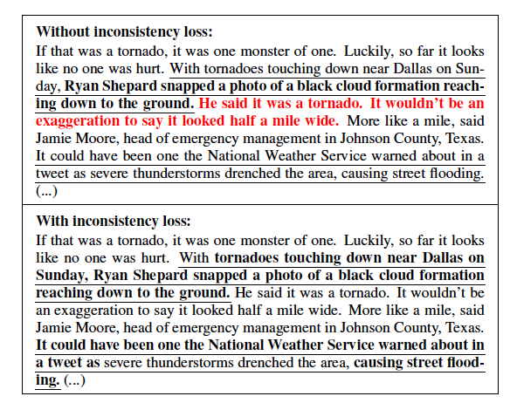
Consistency between Sentence and Word Attentions
Notes:
300 papers… every day… impossible to read… keyword search… abstract doesn’t reflect… results; ignore most of them. Cancer and surgery… 3 days… walk through all posters.. In our field papers that were published twenty years ago are not that important…
including mining PubMed bibliographic data, research papers in PubMed, clinical data sets and numerous bio-medical websites and social media related to medical sciences, where data related to diseases, drugs, treatments, chemical compounds, proteins, genes, biological pathways can be integrated and extracted from text data and their characteristics and relationships can be mined from such datasets as well
. Older literature is often extremely important (and overlooked), and indeed, often provides a rich source of information that can lead to new hypotheses. This makes the information overload problem event more serious, because we need distill and connect knowledge from papers that may cover 70 years.

Slide 27
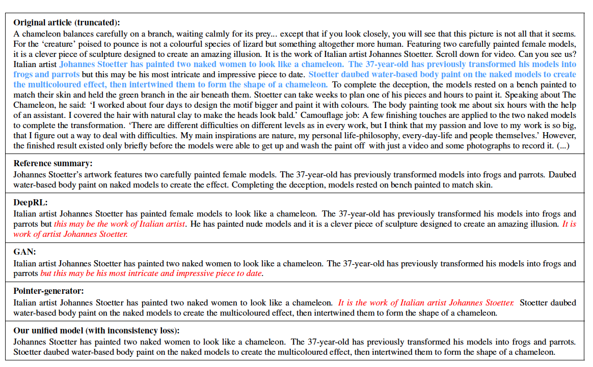
Output Example
Notes:
300 papers… every day… impossible to read… keyword search… abstract doesn’t reflect… results; ignore most of them. Cancer and surgery… 3 days… walk through all posters.. In our field papers that were published twenty years ago are not that important…
including mining PubMed bibliographic data, research papers in PubMed, clinical data sets and numerous bio-medical websites and social media related to medical sciences, where data related to diseases, drugs, treatments, chemical compounds, proteins, genes, biological pathways can be integrated and extracted from text data and their characteristics and relationships can be mined from such datasets as well
. Older literature is often extremely important (and overlooked), and indeed, often provides a rich source of information that can lead to new hypotheses. This makes the information overload problem event more serious, because we need distill and connect knowledge from papers that may cover 70 years.

Slide 28
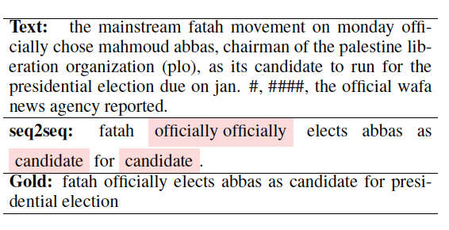
Global Encoding for Abstractive Summarization
(Lin, ACL2018)
Repetitions in attention based seq2seq model
Notes:
300 papers… every day… impossible to read… keyword search… abstract doesn’t reflect… results; ignore most of them. Cancer and surgery… 3 days… walk through all posters.. In our field papers that were published twenty years ago are not that important…
including mining PubMed bibliographic data, research papers in PubMed, clinical data sets and numerous bio-medical websites and social media related to medical sciences, where data related to diseases, drugs, treatments, chemical compounds, proteins, genes, biological pathways can be integrated and extracted from text data and their characteristics and relationships can be mined from such datasets as well
. Older literature is often extremely important (and overlooked), and indeed, often provides a rich source of information that can lead to new hypotheses. This makes the information overload problem event more serious, because we need distill and connect knowledge from papers that may cover 70 years.

Slide 29
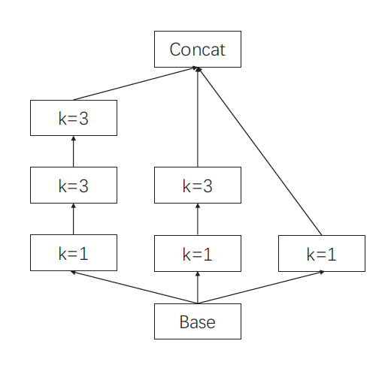
Convolutional Gated Unit
1-dimensional convolution over the output of RNN encoder
K = kernel size
Notes:
300 papers… every day… impossible to read… keyword search… abstract doesn’t reflect… results; ignore most of them. Cancer and surgery… 3 days… walk through all posters.. In our field papers that were published twenty years ago are not that important…
including mining PubMed bibliographic data, research papers in PubMed, clinical data sets and numerous bio-medical websites and social media related to medical sciences, where data related to diseases, drugs, treatments, chemical compounds, proteins, genes, biological pathways can be integrated and extracted from text data and their characteristics and relationships can be mined from such datasets as well
. Older literature is often extremely important (and overlooked), and indeed, often provides a rich source of information that can lead to new hypotheses. This makes the information overload problem event more serious, because we need distill and connect knowledge from papers that may cover 70 years.

Slide 30
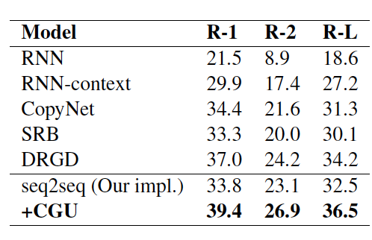
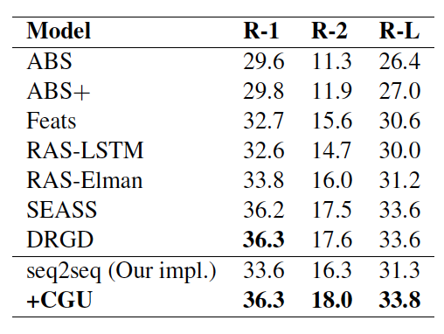
Results
Notes:
300 papers… every day… impossible to read… keyword search… abstract doesn’t reflect… results; ignore most of them. Cancer and surgery… 3 days… walk through all posters.. In our field papers that were published twenty years ago are not that important…
including mining PubMed bibliographic data, research papers in PubMed, clinical data sets and numerous bio-medical websites and social media related to medical sciences, where data related to diseases, drugs, treatments, chemical compounds, proteins, genes, biological pathways can be integrated and extracted from text data and their characteristics and relationships can be mined from such datasets as well
. Older literature is often extremely important (and overlooked), and indeed, often provides a rich source of information that can lead to new hypotheses. This makes the information overload problem event more serious, because we need distill and connect knowledge from papers that may cover 70 years.

Slide 31
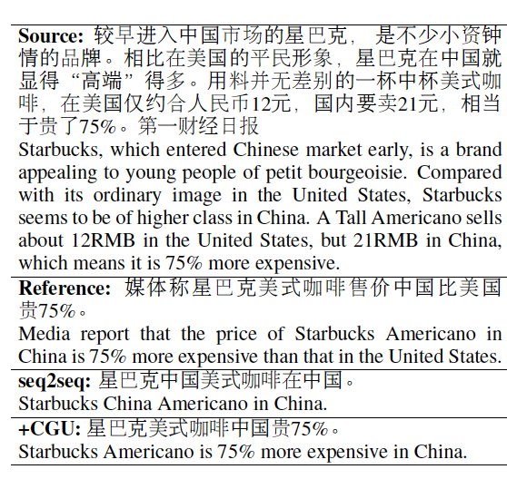
Example Output
Notes:
300 papers… every day… impossible to read… keyword search… abstract doesn’t reflect… results; ignore most of them. Cancer and surgery… 3 days… walk through all posters.. In our field papers that were published twenty years ago are not that important…
including mining PubMed bibliographic data, research papers in PubMed, clinical data sets and numerous bio-medical websites and social media related to medical sciences, where data related to diseases, drugs, treatments, chemical compounds, proteins, genes, biological pathways can be integrated and extracted from text data and their characteristics and relationships can be mined from such datasets as well
. Older literature is often extremely important (and overlooked), and indeed, often provides a rich source of information that can lead to new hypotheses. This makes the information overload problem event more serious, because we need distill and connect knowledge from papers that may cover 70 years.

Slide 32
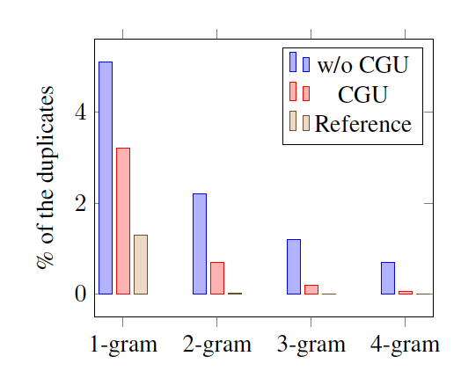
Percentage of Duplicates
Notes:
300 papers… every day… impossible to read… keyword search… abstract doesn’t reflect… results; ignore most of them. Cancer and surgery… 3 days… walk through all posters.. In our field papers that were published twenty years ago are not that important…
including mining PubMed bibliographic data, research papers in PubMed, clinical data sets and numerous bio-medical websites and social media related to medical sciences, where data related to diseases, drugs, treatments, chemical compounds, proteins, genes, biological pathways can be integrated and extracted from text data and their characteristics and relationships can be mined from such datasets as well
. Older literature is often extremely important (and overlooked), and indeed, often provides a rich source of information that can lead to new hypotheses. This makes the information overload problem event more serious, because we need distill and connect knowledge from papers that may cover 70 years.

