Slide 1
Semantic-Driven Text Summarization and Generation
Lu Wang
Assistant Professor
Khoury College of Computer Sciences
Northeastern University
Website: http://www.ccs.neu.edu/home/luwang/

Slide 2
Problems for Existing Neural Abstractive Summarization Models
Input Article:
A plan by the City Sanitation Department to build a trash-transfer station at the site of a former incinerator on the Bensonhurst waterfront was denounced yesterday by Assemblyman William Colton, the chairman of the State Legislative Commission on Solid Waste Management.
…
The new facility would require repeated dredging of the bay, which Mr. Colton said would stir up toxins and harm birds and aquatic creatures.
…
Abstractive summary by a popular neural model:
Assemblyman William Colton, chairman of State Legislative Commission on Solid Waste Management, denounced by New York City Sanitation Department to build trash-transfer station at site of former incinerator on Bensonhurst waterfront.
Notes:
Fabricated content, near-extract, focus on the beginning of the article

Slide 3
Problems for Existing Neural Abstractive Summarization Models
Fabricated content
  About 30% of the summaries contain unfaithful information by state-of-the-art models (Cao et al, 2018)
Near-extractive and limited correct paraphrasing (See et al., 2017; Kryscinski et al., 2018)
Relying on position information, e.g. hardly including salient content from later part of the articles
Poor linguistic quality, e.g. lack of coherence

Slide 4
Near-extractive Summaries
Seq2seq: sequence-to-sequence model with regular attention
Chen & Bansal: Reinforcement learning-based model
Point-gen: pointer-generator model with copying mechanism added on seq2seq

Slide 5
Near-extractive Summaries
Seq2seq: sequence-to-sequence model with regular attention
Chen & Bansal: Reinforcement learning-based model
Point-gen: pointer-generator model with copying mechanism added on seq2seq
Also contain fabricated information!

Slide 6
Problems for Existing Neural Abstractive Summarization Models
Fabricated content
  About 30% of the summaries contain unfaithful information by state-of-the-art models (Cao et al, 2018)
Near-extractive and limited correct paraphrasing (See et al., 2017; Kryscinski et al., 2018)
Relying on position information, e.g. hardly including salient content from later part of the articles
Poor linguistic quality, e.g. lack of coherence

Slide 7
Summary-worthy Content and its Position in News

Slide 8
Problems for Existing Neural Abstractive Summarization Models
Fabricated content
  About 30% of the summaries contain unfaithful information by state-of-the-art models (Cao et al, 2018)
Near-extractive and limited correct paraphrasing (See et al., 2017; Kryscinski et al., 2018)
Relying on position information, e.g. hardly including salient content from later part of the articles
Poor linguistic quality, e.g. lack of coherence

Slide 9
Outline
Problems for Existing Neural Abstractive Summarization Models
Multi-task Learning with Semantic Parsing as Auxiliary Task
Entity-Driven Abstractive Summarization

Slide 10
Outline
Problems for Existing Neural Abstractive Summarization Models
Multi-task Learning with Semantic Parsing as Auxiliary Task
Entity-Driven Abstractive Summarization

Slide 11
Our Models
The idea: allow the model to learn semantic interpretation over salient content
Input: the Senate proposed a tax bill on Tuesday
Output:
  Semantic structure:
    proposed <ARG0> the Senate <ARG1> tax bill
  Summary:
    Senate proposes bill

Slide 12
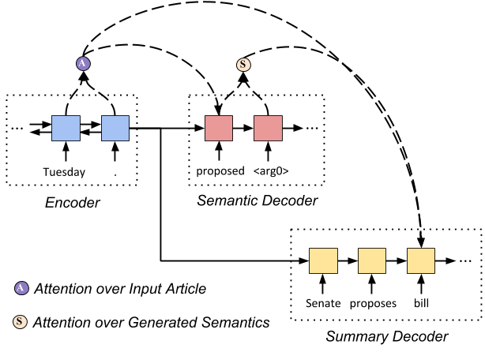
Our Models
Input: the Senate proposed a tax bill on Tuesday
Output:
  Semantic structure:
    proposed <ARG0> the Senate <ARG1> tax bill
  Summary:
    Senate proposes bill

Slide 13
Our Models
Input: a sequence of tokens from the article
Output:
  Semantic:
  Summary:
Encoder: Bi-LSTM (same structure as in prior work)
Decoders: LSTM

Slide 14
Dual Attention
Consider both input and semantics for summary generation
Attention over input:
Additional attention over semantic structures:
Extension with multi-heads
h_{i} is the encoder state, c_{t}^{inp} is the context of input
s_{t} is the decoder state
s^{s}_{j} is the semantic decoder state
adding attention over semantic information

Slide 15
Our Models
Loss function
Loss on summary
Loss on semantic structure

Slide 16
Our Models
Loss function
Semantic structures are extracted from summaries with semantic parsing.
Loss on summary
Loss on semantic structure

Slide 17
Reranking-based Decoder
Regular beam search chooses the hypotheses for the next timestep solely based on conditional likelihood → repetition!
We rerank for every R timestamp (R=10), based on
Percentage of words in semantic structure is reused in the summary
LRS: longest repeating substring
Notes:
If a summary contains long repeating text, it should be penalized
We also consider whether the current generation has reflected the previously generated semantic information

Slide 18
Datasets
New York Times annotated corpus
  About 589K articles annotated with human-written abstracts
  Each article is labeled with topic information, e.g. politics, business, sports, arts, …
CNN/DailyMail
  About 312k articles with summaries (bullet points)
  The URL contains topic information, e.g. https://www.cnn.com/2018/10/23/politics/donald-trump-mid-term-election-immigration-ted-cruz/index.html

Slide 19
Comparisons
Seq2seq: sequence-to-sequence model with regular input attention
Pointer-generator: seq2seq model that allows copying words directly from input (See et al., 2017)

Slide 20
Evaluation against Adversarial Information
Input Article:
For years Joe DiMaggio was always introduced at Yankee Stadium as “baseball’s greatest living player.” But with his memory joining those of Babe Ruth, Lou Gehrig, Mickey Mantle and Miller Huggins. Canada’s Minister of Defense resigned today, a day after an army official testified that top military officials had altered documents to cover up responsibility for the beating death of a Somali teen-ager at the hands of Canadian peacekeeping troops in 1993. Defense minister David Collenette insisted that his resignation had nothing to do with the Somalia scandal. Ted Williams was the first name to come to mind, and he’s the greatest living hitter. ...
(The rest of the article with additional 300 words is all about David Collenette’s resignation.)
Irrelevant sentences (e.g. basketball game) are inserted into the articles (e.g. about politics).
If a summarization model really understands the input, it would ignore the inserted off-topic information.

Slide 21
Evaluation against Adversarial Information
Input Article:
For years Joe DiMaggio was always introduced at Yankee Stadium as “baseball’s greatest living player.” But with his memory joining those of Babe Ruth, Lou Gehrig, Mickey Mantle and Miller Huggins. Canada’s Minister of Defense resigned today, a day after an army official testified that top military officials had altered documents to cover up responsibility for the beating death of a Somali teen-ager at the hands of Canadian peacekeeping troops in 1993. Defense minister David Collenette insisted that his resignation had nothing to do with the Somalia scandal. Ted Williams was the first name to come to mind, and he’s the greatest living hitter. ...
(The rest of the article with additional 300 words is all about David Collenette’s resignation.)
5000 articles from CNN/DailyMail test set and 5000 articles from NYT (labeled with topic politics)
  Each article is inserted with n (1-4) sentences collected from the beginning of another article labeled with topic arts, sports, or technology

Slide 22
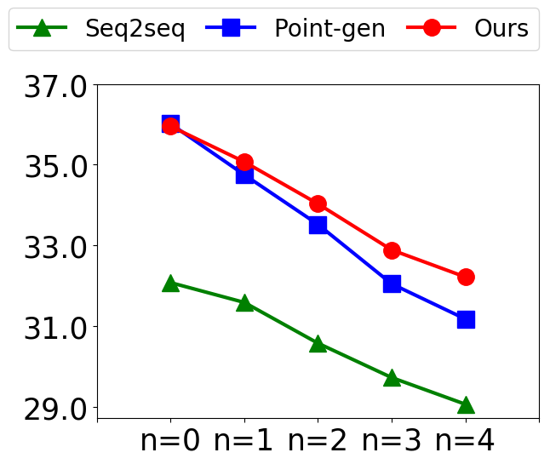
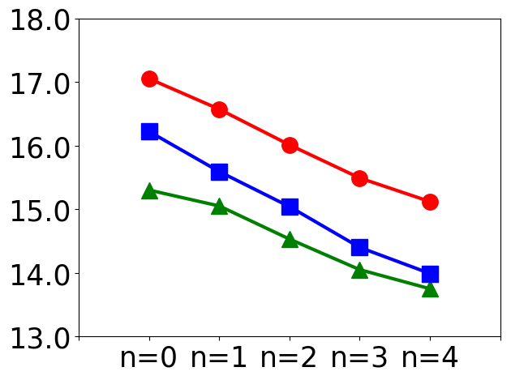
Evaluation against Adversarial Information
On CNN/DailyMail
ROUGE-L
METEOR

Slide 23
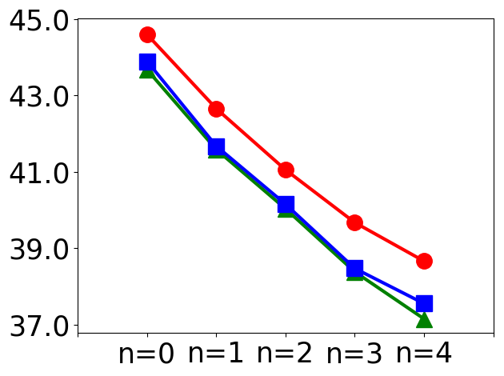
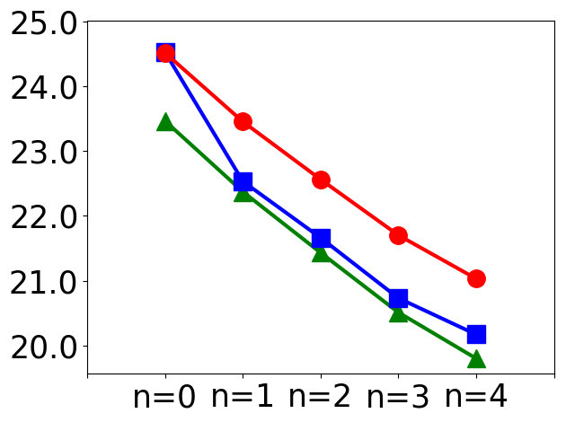
Evaluation against Adversarial Information
On CNN/DailyMail
ROUGE-L
METEOR
On NYT
ROUGE-L
METEOR

Slide 24
Evaluation against Adversarial Information
Input Article:
For years Joe DiMaggio was always introduced at Yankee Stadium as “baseball’s greatest living player.” But with his memory joining those of Babe Ruth, Lou Gehrig, Mickey Mantle and Miller Huggins. Canada’s Minister of Defense resigned today, a day after an army official testified that top military officials had altered documents to cover up responsibility for the beating death of a Somali teen-ager at the hands of Canadian peacekeeping troops in 1993. Defense minister David Collenette insisted that his resignation had nothing to do with the Somalia scandal. Ted Williams was the first name to come to mind, and he’s the greatest living hitter. ...
(The rest of the article with additional 300 words is all about David Collenette’s resignation.)
Seq2seq+attention:
George Vecsey sports of The Times column on New York State’s naming of late baseball legend Joe DiMaggio as “baseball’s greatest living player,” but with his memory joining those of Babe Ruth, Lou Gehrig, Mickey Mantle and Miller Huggins.
Pointer-generator:
Joe DiMaggio is first name to come to mind, and Ted Williams is first name to come to mind, and he’s greatest living hitter; he will be replaced by human resources minister, Doug Young, and will keep his Parliament seat for governing Liberal Party.
Our Model:
Former Canadian Defense Min David Collenette resigns day after army official testifies that top military officials altered documents to cover up responsibility for beating death of Somali teen-ager at hands of Canadian peacekeeping troops in 1993.

Slide 25
Human Evaluation (Initial Results)
 | Non-Redundancy | Fluency | Faithfulness | Informativeness
Human | 1.4 ± 0.7 | 1.5 ± 0.7 | 1.5 ± 0.8 | 1.6 ± 0.8
Seq2seq | 2.0 ± 0.8 | 2.4 ± 0.7 | 2.1 ± 0.8 | 2.4 ± 0.7
Our Model | 1.6 ± 0.7 | 2.1 ± 0.8 | 1.9 ± 0.7 | 2.0 ± 0.7
Two human judges read and ranked summaries: lower→ better.

Slide 26
So far
Enforcing semantic understanding is useful for
  separating irrelevant information from relevance content
  generating more informative summaries

Slide 27
Outline
Problems for Existing Neural Abstractive Summarization Models
Multi-task Learning with Semantic Parsing as Auxiliary Task
Entity-Driven Abstractive Summarization

Slide 28
Role of Entities in Summarization
Entities in a text carry useful contextual information
………….
………….
………….
Extractive fragments from input are underlined. Repeated entities indicating discourse structure are highlighted in respective colors.
* Image source : Flair: State-of-the-Art Natural Language Processing (NLP)
Sample CNN/Daily Mail News Summary
An explosion rocks a chemical plant in China’s southeastern Fujian province for the second time in two years. Six were injured after the explosion and are being hospitalized. The explosion was triggered by an oil leak, though local media has not reported any toxic chemical spills.
Sample BIGPATENT Summary
A shoelace cover incorporating an interchangeable fashion panel for covering the shoelaces of a gym shoe. The shoelace cover is secured to the shoe by a number of straps threaded through slots in the shoelace cover. These straps secured to each side of the gym shoe include a loop and hook material such that the straps can be disengaged and the shoelace cover can be drawn back to expose the shoelaces. . .
Sample CNN/Daily Mail News Summary
An explosion rocks a chemical plant in China’s southeastern Fujian province for the second time in two years. Six were injured after the explosion and are being hospitalized. The explosion was triggered by an oil leak, though local media has not reported any toxic chemical spills.
Sample BIGPATENT Summary
A shoelace cover incorporating an interchangeable fashion panel for covering the shoelaces of a gym shoe. The shoelace cover is secured to the shoe by a number of straps threaded through slots in the shoelace cover. These straps secured to each side of the gym shoe include a loop and hook material such that the straps can be disengaged and the shoelace cover can be drawn back to expose the shoelaces. . .
Sample CNN/Daily Mail News Summary
An explosion rocks a chemical plant in China’s southeastern Fujian province for the second time in two years. Six were injured after the explosion and are being hospitalized. The explosion was triggered by an oil leak, though local media has not reported any toxic chemical spills.
Sample BIGPATENT Summary
A shoelace cover incorporating an interchangeable fashion panel for covering the shoelaces of a gym shoe. The shoelace cover is secured to the shoe by a number of straps threaded through slots in the shoelace cover. These straps secured to each side of the gym shoe include a loop and hook material such that the straps can be disengaged and the shoelace cover can be drawn back to expose the shoelaces. . .
BIGPATENT has richer discourse structure with entities recurring in multiple subsequent sentences.
BIGPATENT has richer discourse structure with entities recurring in multiple subsequent sentences.
Benchmarking BIGPATENT with baselines and popular summarization models
Benchmarking BIGPATENT with baselines and popular summarization models
Noticeably lower ROUGE scores on BIGPATENT than on the news datasets.
Irrelevant discourse entities excessively repeated.
Fabricated information.
Notes:
Make sense of what’s going on

Slide 29
How human writes summary?
. . .
Prime Minister Bertie Ahern of Ireland called Sunday for a general election on May 24. Mr. Ahern and his centrist party have governed in a coalition government since 1197
. . .
Under Irish law, which requires legislative elections every five years, Mr. Ahern had to call elections by midsummer. On Sunday, he said he would base his campaign for reelection on his work to strengthen the economy and efforts to revive Northern Ireland’s stalled peace process this year. Political analysts said they expected Mr. Ahern’s work in Northern Ireland to be an asset . . .
1) Prime Minister Bertie Ahern of Ireland calls for general election on May 24.
2) He is required by law to call elections by midsummer.
3) Opinion polls suggest his centrist government is in danger of losing its majority in Parliament because of public disgruntlement about overburdened public services.
4) Ahern says he would base his campaign for reelection on his work to strengthen economy and his efforts to revive Northern Ireland’s stalled peace process.
5) Analysts expect his work in Northern Ireland to be asset.
Snippet from an input article
Summary for the input article
Notes:
Firstly, frequently mentioned entities from the input, along with their contextual information, underscores the salient content of the article (Nenkova, 2008). Mentions of the same entity are colored.

Slide 30
Sample from New York Times corpus
. . .
Prime Minister Bertie Ahern of Ireland called Sunday for a general election on May 24. Mr. Ahern and his centrist party have governed in a coalition government since 1197
. . .
Under Irish law, which requires legislative elections every five years, Mr. Ahern had to call elections by midsummer. On Sunday, he said he would base his campaign for reelection on his work to strengthen the economy and efforts to revive Northern Ireland’s stalled peace process this year. Political analysts said they expected Mr. Ahern’s work in Northern Ireland to be an asset . . .
1) Prime Minister Bertie Ahern of Ireland calls for general election on May 24.
2) He is required by law to call elections by midsummer.
3) Opinion polls suggest his centrist government is in danger of losing its majority in Parliament because of public disgruntlement about overburdened public services.
4) Ahern says he would base his campaign for reelection on his work to strengthen economy and his efforts to revive Northern Ireland’s stalled peace process.
5) Analysts expect his work in Northern Ireland to be asset.
Snippet from an input article
Summary for the input article
Notes:
the human often optimizes on conciseness by referring to entities with pronouns (e.g., “he”) or last names (e.g., “Ahern”) without losing clarity.

Slide 31
Sample from New York Times corpus
1) Prime Minister Bertie Ahern of Ireland calls for general election on May 24.
2) He is required by law to call elections by midsummer.
3) Opinion polls suggest his centrist government is in danger of losing its majority in Parliament because of public disgruntlement about overburdened public services.
4) Ahern says he would base his campaign for reelection on his work to strengthen economy and his efforts to revive Northern Ireland’s stalled peace process.
5) Analysts expect his work in Northern Ireland to be asset.
. . .
Prime Minister Bertie Ahern of Ireland called Sunday for a general election on May 24. Mr. Ahern and his centrist party have governed in a coalition government since 1197
. . .
Under Irish law, which requires legislative elections every five years, Mr. Ahern had to call elections by midsummer. On Sunday, he said he would base his campaign for reelection on his work to strengthen the economy and efforts to revive Northern Ireland’s stalled peace process this year. Political analysts said they expected Mr. Ahern’s work in Northern Ireland to be an asset . . .
Snippet from an input article
Summary for the input article
Notes:
For instance, a human writer places the underlined sentence in the input article next to the first sentence in the summary to improve topical coherence as they are about the same topic (“elections”). Moreover,

Slide 32
Sample from New York Times corpus
1) Prime Minister Bertie Ahern of Ireland calls for general election on May 24.
2) He is required by law to call elections by midsummer.
3) Opinion polls suggest his centrist government is in danger of losing its majority in Parliament because of public disgruntlement about overburdened public services.
4) Ahern says he would base his campaign for reelection on his work to strengthen economy and his efforts to revive Northern Ireland’s stalled peace process.
5) Analysts expect his work in Northern Ireland to be asset.
. . .
Prime Minister Bertie Ahern of Ireland called Sunday for a general election on May 24. Mr. Ahern and his centrist party have governed in a coalition government since 1197
. . .
Under Irish law, which requires legislative elections every five years, Mr. Ahern had to call elections by midsummer. On Sunday, he said he would base his campaign for reelection on his work to strengthen the economy and efforts to revive Northern Ireland’s stalled peace process this year. Political analysts said they expected Mr. Ahern’s work in Northern Ireland to be an asset . . .
So how do we emulate this human way of summarizing?
Snippet from an input article
Summary for the input article

Slide 33




What do we do?
Entity-based document modelling + linguistic qualities of summaries
Global Content Modeling
Discourse-aware Text Planning
Informativeness
Abstractiveness
Readability
Coherence

Slide 34

System for ENtity drivEn Coherent Abstractive summarization framework

Slide 35
Input Article
Prime Minister Bertie Ahern of Ireland called Sunday for a general election on May 24. Mr. Ahern and his centrist party have governed in a coalition government since 1197. . .Under Irish law, which requires legislative elections every five years, Mr. Ahern had to call elections by midsummer. On Sunday, he said he would base his campaign for reelection on his work to strengthen the economy and efforts to revive Northern Ireland’s stalled peace process this year. Political analysts said they expected Mr. Ahern’s work in Northern Ireland to be an asset . . .
Entity Mention Cluster
{Prime Minister Bertie Ahern, Mr. Ahern, he,
he, his, Mr. Ahern’s}
{Ireland, Northern Ireland, Northern Ireland’s}
Extracted Entity Mention Clusters
Notes:
We therefore propose a two-step neural abstractive summarization framework to emulate the way humans construct summaries with the goal of improving both informativeness and coherence of the generated abstracts. As shown in Fig. 2, an entityaware content selection component first selects important sentences from the input that includes references to salient entities. An abstract generation component then produces coherent summaries by conducting cross-sentence information ordering, compression, and revision.

Slide 36
Input Article
Salient sentence extraction
Prime Minister Bertie Ahern of Ireland called Sunday for a general election on May 24. Mr. Ahern and his centrist party have governed in a coalition government since 1197. . .Under Irish law, which requires legislative elections every five years, Mr. Ahern had to call elections by midsummer. On Sunday, he said he would base his campaign for reelection on his work to strengthen the economy and efforts to revive Northern Ireland’s stalled peace process this year. Political analysts said they expected Mr. Ahern’s work in Northern Ireland to be an asset . . .
Entity-aware Content Selector
Entity Mention Cluster
Extracted Sentences
{Prime Minister Bertie Ahern, Mr. Ahern, he,
he, his, Mr. Ahern’s}
{Ireland, Northern Ireland, Northern Ireland’s}
Political analysis …
On Sunday, he said …
Mr. Ahern and his …
Notes:
Diagram of the framework
We therefore propose a two-step neural abstractive summarization framework to emulate the way humans construct summaries with the goal of improving both informativeness and coherence of the generated abstracts. As shown in Fig. 2, an entityaware content selection component first selects important sentences from the input that includes references to salient entities. An abstract generation component then produces coherent summaries by conducting cross-sentence information ordering, compression, and revision.

Slide 37
Input Article
Prime Minister Bertie Ahern of Ireland called Sunday for a general election on May 24. Mr. Ahern and his centrist party have governed in a coalition government since 1197. . .Under Irish law, which requires legislative elections every five years, Mr. Ahern had to call elections by midsummer. On Sunday, he said he would base his campaign for reelection on his work to strengthen the economy and efforts to revive Northern Ireland’s stalled peace process this year. Political analysts said they expected Mr. Ahern’s work in Northern Ireland to be an asset . . .
Entity-aware Content Selector
Entity Mention Cluster
Extracted Sentences
{Prime Minister Bertie Ahern, Mr. Ahern, he,
he, his, Mr. Ahern’s}
{Ireland, Northern Ireland, Northern Ireland’s}
Political analysis …
Coherent abstract generation
On Sunday, he said …
Mr. Ahern and his …
Output Summary
prime min bertie ahern of ireland calls for general election on may 0. ahern and his centrist party, have governed in coalition government since 0. … ahern says he would base his campaign for re-election on his work to strengthen economy and his efforts to revive northern ireland’s stalled peace process.
Abstract Generator
Notes:
Diagram of the framework
We therefore propose a two-step neural abstractive summarization framework to emulate the way humans construct summaries with the goal of improving both informativeness and coherence of the generated abstracts. As shown in Fig. 2, an entityaware content selection component first selects important sentences from the input that includes references to salient entities. An abstract generation component then produces coherent summaries by conducting cross-sentence information ordering, compression, and revision.

Slide 38
Input Article
Prime Minister Bertie Ahern of Ireland called Sunday for a general election on May 24. Mr. Ahern and his centrist party have governed in a coalition government since 1197. . .Under Irish law, which requires legislative elections every five years, Mr. Ahern had to call elections by midsummer. On Sunday, he said he would base his campaign for reelection on his work to strengthen the economy and efforts to revive Northern Ireland’s stalled peace process this year. Political analysts said they expected Mr. Ahern’s work in Northern Ireland to be an asset . . .
Entity-aware Content Selector
Entity Mention Cluster
Extracted Sentences
{Prime Minister Bertie Ahern, Mr. Ahern, he,
he, his, Mr. Ahern’s}
{Ireland, Northern Ireland, Northern Ireland’s}
Political analysis …
On Sunday, he said …
Mr. Ahern and his …
Output Summary
prime min bertie ahern of ireland calls for general election on may 0. ahern and his centrist party, have governed in coalition government since 0. … ahern says he would base his campaign for re-election on his work to strengthen economy and his efforts to revive northern ireland’s stalled peace process.
Abstract Generator
Notes:
We design our content selection component to capture the interaction between entity mentions and the input article. Our model learns to identify salient content by aligning entity mentions and their contexts with human summaries. Concretely, we employ two encoders: one learns entity representations by encoding their mention clusters and the other learns sentence representations. A pointer-network-based decoder (Vinyals et al., 2015b) selects a sequence of important sentences by jointly attending to the entities and the input, as depicted in Fig. 3.

Slide 39
Entity Encoder
Input Article
Stanford CoreNLP to extract entities from input article.
Construct the mention clusters for all the mentions of each entity in that article
Filter salient mention clusters:
  mention clusters with entities appearing in the first three sentences of the article
  top k clusters containing most numbers of mentions (k = 6)
Prime Minister Bertie Ahern of Ireland…..
Mr. Ahern and his centrist party…..
On Sunday, he said he……
Political analysts said they….
Entity Mention Cluster
Prime Minister Bertie Ahern <MENT>, Mr. Ahern <MENT>, he <MENT>, he <MENT>, his <MENT>, Mr. Ahern’s <MENT>
Ireland <MENT>, Northern Ireland <MENT>
, Northern Ireland’s <MENT>
Notes:
Diagram of the extractor- entity part
Getting the entities. (this slides)
entity representations ei for the i-th entity by encoding each cluster via a temporal convolutional model
Stanford CoreNLP (Manning et al., 2014) on the input articles to extract entities, each represented as a cluster of mentions. Specifically, from each input article, we extract the coreferenced entities, and construct the mention clusters for all the mentions of each entity in that article. We also consider non coreferenced entity mentions as singleton entity mention clusters. Among all these mention clusters, for our experiments, we only consider salient entity mention clusters. We label clusters as “salient” based on two rules: (1) mention clusters with entities appearing in the first three sentences of the article, and (2) top k clusters containing most numbers of mentions. We experimented with different values of k and found that k = 6 gives us the best set of salient mention clusters having an optimal overlap with entity mentions in the ground truth summary

Slide 40
Entity Encoder
Input Article
Get entity representations by encoding each cluster via a temporal convolutional model
Prime Minister Bertie Ahern of Ireland…..
Mr. Ahern and his centrist party…..
On Sunday, he said he……
Political analysts said they….
Entity Mention Cluster
Prime Minister Bertie Ahern <MENT>, Mr. Ahern <MENT>, he <MENT>, he <MENT>, his <MENT>, Mr. Ahern’s <MENT>
Ireland <MENT>, Northern Ireland <MENT>
, Northern Ireland’s <MENT>
e₁
CONV
e₂
Notes:
Diagram of the extractor – entity part
entity representations ei for the i-th entity by encoding each cluster via a temporal convolutional model

Slide 41
Input Sentence Encoder
Input Article
Prime Minister Bertie Ahern of Ireland…..
Mr. Ahern and his centrist party…..
On Sunday, he said he……
Political analysts said they….
h₁
h₂
CONV
bi-LSTM
h₃
h₄
Learn sentence representations by encoding words in a sentence with temporal convolutional model
Use a bi-LSTM to aggregate sentences into a sequence of hidden states.
Notes:
Diagram of the extractor- sentence part
Input Article Encoder (this slides)
Sentence Selection Decoder

Slide 42
Sentence Selection Decoder
Input Article
Prime Minister Bertie Ahern of Ireland…..
Mr. Ahern and his centrist party…..
On Sunday, he said he……
Political analysts said they….
h₁
h₂
CONV
bi-LSTM
h₃
h₄
Entity Mention Cluster
Prime Minister Bertie Ahern <MENT>, Mr. Ahern <MENT>, he <MENT>, he <MENT>, his <MENT>, Mr. Ahern’s <MENT>
Ireland <MENT>, Northern Ireland <MENT>
, Northern Ireland’s <MENT>
e₁
CONV
e₂
Notes:
Diagram of the extractor- sentence part
Input Article Encoder
Sentence Selection Decoder (this slides)

Slide 43
Sentence Selection Decoder
Input Article
Prime Minister Bertie Ahern of Ireland…..
Mr. Ahern and his centrist party…..
On Sunday, he said he……
Political analysts said they….
h₁
h₂
CONV
bi-LSTM
h₃
h₄
Entity Mention Cluster
Prime Minister Bertie Ahern <MENT>, Mr. Ahern <MENT>, he <MENT>, he <MENT>, his <MENT>, Mr. Ahern’s <MENT>
Ireland <MENT>, Northern Ireland <MENT>
, Northern Ireland’s <MENT>
e₁
CONV
e₂
Extracted Sentences
h₂
1
Political analysis …
On sunday, he said …
LSTM
h₃
2
Mr. Ahern and his …
h₄
3

Slide 44
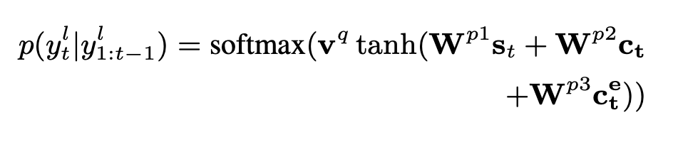
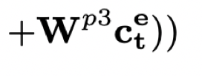
Sentence Selection Decoder
Sentence extraction probabilities using both entity and input context
are calculated as:
input context vector
entity context vector
Notes:
Diagram of the extractor- sentence part
Input Article Encoder
Sentence Selection Decoder
Selection Label Construction (this slides)

Slide 45
Input Article
Prime Minister Bertie Ahern of Ireland called Sunday for a general election on May 24. Mr. Ahern and his centrist party have governed in a coalition government since 1197. . .Under Irish law, which requires legislative elections every five years, Mr. Ahern had to call elections by midsummer. On Sunday, he said he would base his campaign for reelection on his work to strengthen the economy and efforts to revive Northern Ireland’s stalled peace process this year. Political analysts said they expected Mr. Ahern’s work in Northern Ireland to be an asset . . .
Entity-aware Content Selector
Entity Mention Cluster
Extracted Sentences
{Prime Minister Bertie Ahern, Mr. Ahern, he,
he, his, Mr. Ahern’s}
{Ireland, Northern Ireland, Northern Ireland’s}
Political analysis …
On sunday, he said …
Mr. Ahern and his …
Output Summary
prime min bertie ahern of ireland calls for general election on may 0. ahern and his centrist party, have governed in coalition government since 0. … ahern says he would base his campaign for re-election on his work to strengthen economy and his efforts to revive northern ireland’s stalled peace process.
Abstract Generator

Slide 46
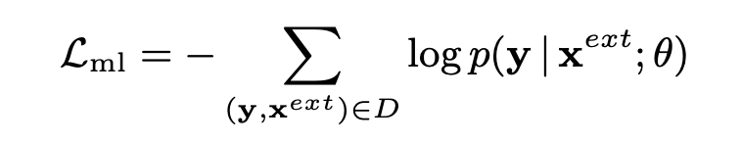
Abstract Generation with Reinforcement Learning
Output Summary
prime min bertie ahern of ireland calls for general election on may 0. ahern and his centrist party, have governed in coalition government since 0. … ahern says he would base his campaign for re-election on his work to strengthen economy and his efforts to revive northern ireland’s stalled peace process.
Extracted Sentences
Abstract Generator
Political analysis …
On sunday, he said …
Mr. Ahern and his …
Sequence-to-sequence network with attention over input
Copying mechanism used to allow out-of-vocabulary words to appear in the output.
First trained with ML loss using teacher forcing algorithm :
Notes:
General Formulation

Slide 47
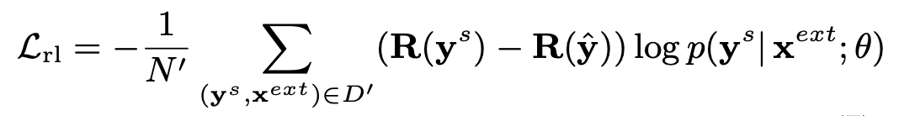
Abstract Generation with Reinforcement Learning
Output Summary
prime min bertie ahern of ireland calls for general election on may 0. ahern and his centrist party, have governed in coalition government since 0. … ahern says he would base his campaign for re-election on his work to strengthen economy and his efforts to revive northern ireland’s stalled peace process.
Extracted Sentences
Abstract Generator
Political analysis …
On sunday, he said …
Mr. Ahern and his …
Additional training with policy-based reinforcement learning
  Use self-critical training algorithm based on policy gradients to use discrete metrics (average of ROUGE-L and ROUGE-2) as rewards.
Notes:
General Formulation

Slide 48
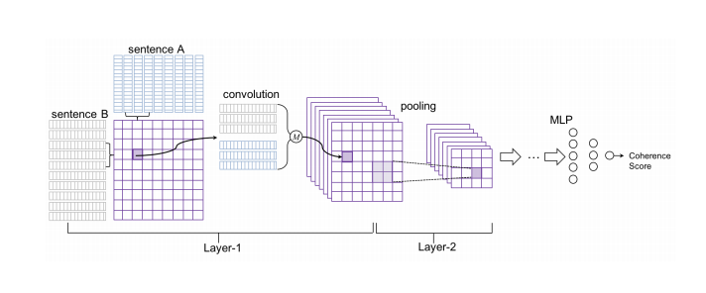


Abstract Generation with Reinforcement Learning + Coherence
Entity-Based Coherence Reward (R_{Coh})
Train separate coherence model to score summaries to capture both entity distribution patterns and topical continuity.
Adopt architecture of neural coherence model developed by Wu and Hu (2018).
  Build coherence model on top of local coherence estimation for pairwise sentence.
  Training data contains positive (S_{A} and S_{B}⁺) and negative pairs (S_{A} and S_{B}⁻) for the same target (S_{A})
* Image Source : Wu and Hu (2018).
Notes:
We use a separately trained coherence model to score summaries and guide our abstract generator to produce more coherent outputs by adding a reward RCoh in the aforementioned RL training process. The new reward takes the following form

Slide 49
Abstract Generation with Reinforcement Learning + Coherence
Entity-Based Coherence Reward (R_{Coh})
Training samples construction altered to enable coherence modeling based on entity presence and their context.
Consider:
  S_{A} and S_{B}⁺ must be adjacent and S_{A} and S_{B}⁻ are at most 9 sentences away with S_{B}⁻ randomly picked.
  S_{A} and S_{B}⁺ have at least one coreferred entity and S_{B}⁻ does not.
  Adding S_{A} as S_{B}⁻
Average of pairwise coherence scores of all adjacent sentence pairs’.
Notes:
We use a separately trained coherence model to score summaries and guide our abstract generator to produce more coherent outputs by adding a reward RCoh in the aforementioned RL training process. The new reward takes the following form

Slide 50

Abstract Generation with Reinforcement Learning + Coherence
Output Summary
prime min bertie ahern of ireland calls for general election on may 0. ahern and his centrist party, have governed in coalition government since 0. … ahern says he would base his campaign for re-election on his work to strengthen economy and his efforts to revive northern ireland’s stalled peace process.
Extracted Sentences
Abstract Generator
Political analysis …
On sunday, he said …
Mr. Ahern and his …
Coherence
The new RL reward becomes
Notes:
We use a separately trained coherence model to score summaries and guide our abstract generator to produce more coherent outputs by adding a reward RCoh in the aforementioned RL training process. The new reward takes the following form

Slide 51
Abstract Generation with Reinforcement Learning
With Linguistic Quality Rewards
Pronominal Referential Clarity (R_{Ref})
Referential pronouns occurring without the antecedents in a summary decreases its readability.
Improper usage - presence of a third personal pronoun or a possessive pronoun before any noun phrase occurs.
  Incorrect : When he was called for a costly technical foul in overtime Saturday. He screamed at a referee.
  Correct: When David was called for a costly technical foul in overtime Saturday. He screamed at a referee.
Summary given a score of −1 for such improper usage, or give 0 otherwise.
Notes:
Linguistic Quality Rewards(RRef & RApp). We further consider two linguistically-informed rewards to further improve summary clarity and conciseness by penalizing (1) improper usage of referential pronouns, and (2) redundancy introduced by non-restrictive appositives and relative clause

Slide 52
Abstract Generation with Reinforcement Learning
With Linguistic Quality Rewards
Apposition (R_{App})
Non-restrictive appositives and relative clauses carry noncritical information and reduce summary conciseness.
Sentence contains a non-restrictive appositives or relative clauses if
  it contains two commas and,
  the word after first comma is a possessive pronoun or a determinant, or a wh-word.
  Non-restrictive appositive : Amanda, my friend, is on the honor roll again.
  Relative clauses : The play, which debuted last week, has been sold out last night.
Summary given a score of −1 for using non-restrictive appositives and relative clauses, or give 0 otherwise.
Notes:
Linguistic Quality Rewards(RRef & RApp). We further consider two linguistically-informed rewards to further improve summary clarity and conciseness by penalizing (1) improper usage of referential pronouns, and (2) redundancy introduced by non-restrictive appositives and relative clause

Slide 53


Abstract Generation with Reinforcement Learning
With Linguistic Quality Rewards
Output Summary
prime min bertie ahern of ireland calls for general election on may 0. ahern and his centrist party, have governed in coalition government since 0. … ahern says he would base his campaign for re-election on his work to strengthen economy and his efforts to revive northern ireland’s stalled peace process.
Extracted Sentences
Abstract Generator
Political analysis …
On sunday, he said …
Mr. Ahern and his …
Readability
Pronominal Referential Clarity (R_{Ref})
Apposition (R_{App})
The new RL reward becomes
The new RL reward becomes
Notes:
We use a separately trained coherence model to score summaries and guide our abstract generator to produce more coherent outputs by adding a reward RCoh in the aforementioned RL training process. The new reward takes the following form

Slide 54
Connecting Selection and Abstraction
Input Article
Prime Minister Bertie Ahern of Ireland called Sunday for a general election on May 24. Mr. Ahern and his centrist party have governed in a coalition government since 1197. . .Under Irish law, which requires legislative elections every five years, Mr. Ahern had to call elections by midsummer. On Sunday, he said he would base his campaign for reelection on his work to strengthen the economy and efforts to revive Northern Ireland’s stalled peace process this year. Political analysts said they expected Mr. Ahern’s work in Northern Ireland to be an asset . . .
Entity-aware content selection component extracts salient sentences.
Abstract generation component compresses and paraphrases them.
Now, connect these two networks by training them together via the self-critical learning algorithm based on policy gradient
  If content selector accurately selects salient sentences, the abstract generator would produce a high quality summary.
  Otherwise, action resulting in inferior selections is discouraged.
Entity-aware Content Selector
Entity Mention Cluster
Extracted Sentences
{Prime Minister Bertie Ahern, Mr. Ahern, he,
he, his, Mr. Ahern’s}
{Ireland, Northern Ireland, Northern Ireland’s}
Political analysis …
On sunday, he said …
Mr. Ahern and his …
Output Summary
prime min bertie ahern of ireland calls for general election on may 0. ahern and his centrist party, have governed in coalition government since 0. … ahern says he would base his campaign for re-election on his work to strengthen economy and his efforts to revive northern ireland’s stalled peace process.
Abstract Generator
Notes:
Diagram of the framework
We therefore propose a two-step neural abstractive summarization framework to emulate the way humans construct summaries with the goal of improving both informativeness and coherence of the generated abstracts. As shown in Fig. 2, an entityaware content selection component first selects important sentences from the input that includes references to salient entities. An abstract generation component then produces coherent summaries by conducting cross-sentence information ordering, compression, and revision.

Slide 55
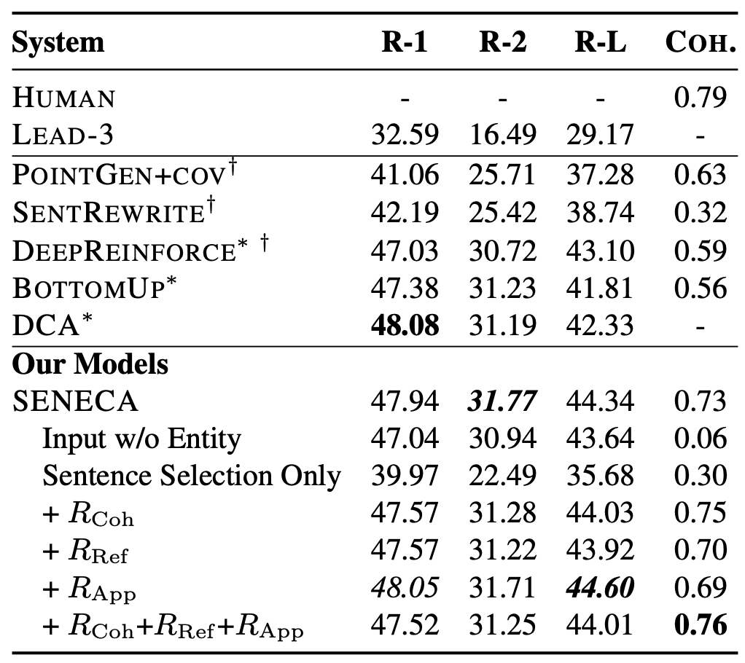
Automatic Summary Evaluation
New York Times Dataset

Slide 56
Automatic Summary Evaluation
New York Times Dataset
New State-of-the-Art
on Rouge-2 and Rouge-L (by EMNLP camera-ready)
Notes:
We first will evaluate the coherence model and then our whole system against other systs.

Slide 57
Automatic Summary Evaluation
New York Times Dataset
SENECA models are more coherent!
Notes:
We first will evaluate the coherence model and then our whole system against other systs.

Slide 58
Automatic Summary Evaluation
New York Times Dataset
Entity guidance is useful.
Notes:
We first will evaluate the coherence model and then our whole system against other systs.

Slide 59
Automatic Summary Evaluation
New York Times Dataset
Notice increase in coherence and Rouge-L
Notes:
We first will evaluate the coherence model and then our whole system against other systs.

Slide 60
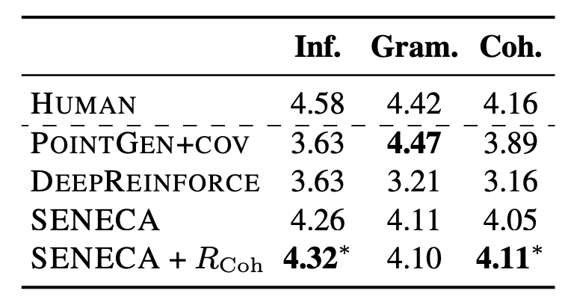
Human Evaluation
New York Times Dataset
Human evaluation on informativeness (Inf.), grammaticality (Gram.) and coherence (Coh.). Best results among systems are in bold

Slide 61
Conclusion
It is important to explicitly model and evaluate various aspects of text summarization models (not only informativeness, but also linguistic qualities).
Separating content selection and abstract generation is useful for improving neural abstractive summarization. Better interpretability too!
Future work: knowledge-grounded summarization and generation.
Papers and project page URLs can be found at
http://www.ccs.neu.edu/home/luwang/publications.html
https://github.com/luyang-huang96/EntityDrivenSumm

