Slide 1
Convince Me If You Can:
Argument Generation with Content Planning and Style Specification
Lu Wang
Assistant Professor
Khoury College of Computer Sciences
Northeastern University
Website: http://www.ccs.neu.edu/home/luwang/

Slide 2
Outline
Why study arguments?
Prior work on argument mining and generation
Argument generation with content selection and style control

Slide 3
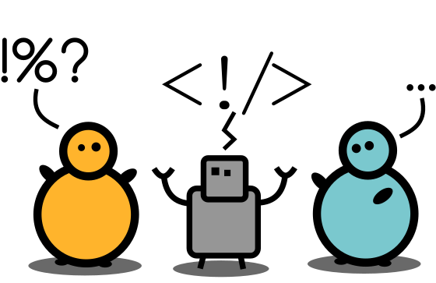
What is an Argument?
Argument: a reason or set of reasons given with the aim of persuading others that an action or an idea is right or wrong
Notes:
So let’s start with a brief discussion on what makes an argument. Informally, an argument usually contains reasons to persuade others on whether an action or an idea is right or wrong.

Slide 4
What is an Argument?
Argument: a reason or set of reasons given with the aim of persuading others that an action or an idea is right or wrong
  From online discussion forum:
More gun control laws would reduce gun deaths. There were 572,537 total gun deaths between 1999 and 2016: 336,579 suicides (58.8% of total gun deaths); 213,175 homicides (37.2%); and 11,428 unintentional deaths (2.0%). A study in the New England Journal of Medicine found that firearms were the second leading cause of deaths for children, responsible for 15% of child deaths compared to 20% in motor vehicle crashes.
Notes:
So let’s start with a brief discussion on what makes an argument. Informally, an argument usually contains reasons to persuade others on whether an action or an idea is right or wrong.

Slide 5
What is an Argument?
Argument: a reason or set of reasons given with the aim of persuading others that an action or an idea is right or wrong
Arguments vs. Opinions
  Related concepts
  An opinion does not have to be supportable
  An argument is an assertion that is supported with concrete, real-world evidence
Notes:
Arguments are closely related with opinions. The key difference is that an opinion can be one’s own personal feelings, which means it does not have to be supportable. An argument is an assertion or a claim that is supported with concrete, real-world evidence.

Slide 6
What is an Argument?
Argument: a reason or set of reasons given with the aim of persuading others that an action or an idea is right or wrong
Why do we study arguments?
  Problem-solving and decision-making
    Which disease treatment to follow?
    Which product to purchase?
    Or should I watch that new movie?
Notes:
Argument understanding, assessment, and construction are crucial elements for decision-making processes.
If we think about it, even for making a very simple decision such as which movie to watch, the reasons can be multidimensional, for instance, we’ll want to know the genre, the cast, the plot, the rating.

Slide 7
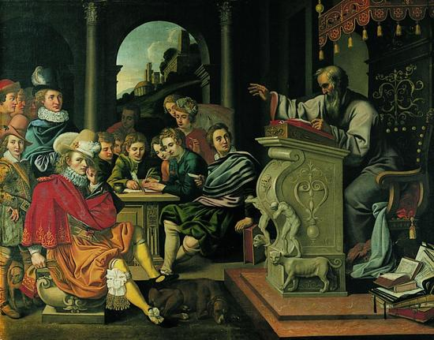
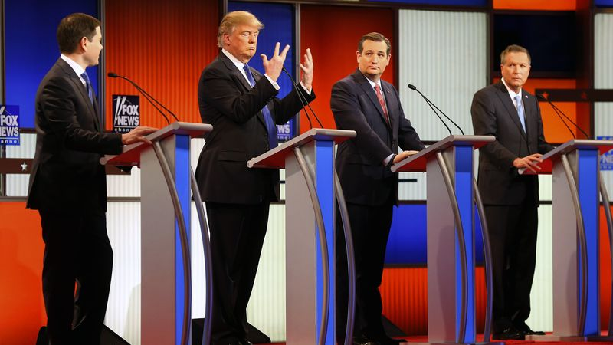
What is an Argument?
Argument: a reason or set of reasons given with the aim of persuading others that an action or an idea is right or wrong
Why do we study arguments?
  Problem-solving and decision-making
    Which disease treatment to follow?
    Which product to purchase?
    Or should I watch that new movie?
  Arguments are everywhere
    Reviews
    Patents
    Supreme court arguments
    Debates
    Deliberation
Notes:
Arguments are prevalent, we can find them in online product reviews, patent documents, they help us understand court decisions, we hear arguments in political campaigns to decide which presidential candidate to vote for
Over time, they help us form our opinions on complex and controversial issues

Slide 8
Argumentation
The process where arguments are constructed, exchanged and evaluated in light of their interactions with other arguments.
An desired ability for machine intelligence.
  Synthesize information and evidence from massive amount of data
  Perform reasoning and argumentation
Notes:
Arguments usually don’t exist by themselves, but rather interact with other arguments. The process where arguments are constructed, exchanged and evaluated along with other arguments is called argumentation.
If we want to make the machines to be more intelligent, I believe it would be necessary to teach them to synthesize information and evidence from massive amount of data, based on which also perform reasoning and argumentation.

Slide 9
Applications of Argumentation Study
A refined search engine
Understand and classify certain types of misinformation (e.g. with unsupported claims)
Debate coaching
For education: essay writing, critical thinking, …
Notes:
argumentation research has many applications, such as building refined search engine, detecting misinformation with unsupported claims, debate coaching, and improve critical thinking in general.

Slide 10
Research Goal
How can we teach a machine to argue like a human?
Notes:
In the project our group is working on, our goal is to teach machines to reason and argue like a human.

Slide 11
Outline
Why study arguments?
Prior work on argument mining and generation
Argument generation with content selection and style control

Slide 12
Existing Work
Argument understanding
  a new research area: Argument Mining
  Argument components: what types of information is used in an argument? (Stab and Gurevych, 2014)
  Argument structure: how is the information organized? (Park and Cardie, 2014; Niculae et al, 2017)
Argument generation
  Retrieval-based argument generation (Sato et al., 2015; Reisert et al., 2015; Yanase et al., 2015)
  IBM Project Debater: real-time debate with human
Notes:
The first one tries to understand what are important components for an argument. And this is a relatively new research area in NLP, which is called argument mining. It studies the classification of major components in an argument, such as propositions and evidence. It also studies how the components are used together to make a coherent argument.
The second direction is called argument generation, where text generation models are built to automatically construct arguments as done by human. typically
produce a collection of sentences from disparate sources, thus fall short of coherence and conciseness.
Recently, IBM project debater has shown that machines can have real-time debate with human on limited topics. The debate system consists of many components that cover different aspects of arguments.
I’m going to focus on this direction.

Slide 13
IBM Debater Demo
  https://www.youtube.com/watch?v=m3u-1yttrVw
Notes:
The first one tries to understand what are important components for an argument. And this is a relatively new research area in NLP, which is called argument mining. It studies the classification of major components in an argument, such as propositions and evidence. It also studies how the components are used together to make a coherent argument.
The second direction is called argument generation, where text generation models are built to automatically construct arguments as done by human. typically
produce a collection of sentences from disparate sources, thus fall short of coherence and conciseness.
Recently, IBM project debater has shown that machines can have real-time debate with human on limited topics. The debate system consists of many components that cover different aspects of arguments.
I’m going to focus on this direction.

Slide 14
Our Project: Counter-argument Generation
Input: a statement of belief on some controversial topic
Output: a counterargument refuting the statement

Slide 15
Our Project: Counter-argument Generation
Input: Death penalty is more rational than life in prison.
Output: In theory I agree with you. But in reality we will never have a perfect justice system. Unreliable evidence is used when there is no witnesses, which could result in wrongful convictions. In the US, there had been 156 death row inmates who were exonerated since 1973. If we execute them, we can never undo it.
Notes:
As we can tell, this is not an easy task. It requires the collection of relevant knowledge and the properly organizing the information. How is a machine supposed to know what information can be used to counterargue a statement? And importantly, where can we learn this behavior?

Slide 16


[U1] Because if the US government did, then really bad shit would happen, in short.
[U2] Foreign aid allows for allies in places that are economically advantageous. …
Δ
I saved this answer for a Reddit Gold. It did change my opinion - I never thought that…
Notes:
We leverage arguments from Reddit subcommunity change my view. It’s a community that focuses on facilitating open discussions on a wide range of disputed issues.
Specifically, CMV is structured as discussion threads, where the original post starts with a viewpoint on a controversial topic, followed with detailed reasons, then other users reply with counter-arguments and try to persuade OP to change her opinion.
So we want to leverage this type of argument and counter-argument pairs to learn the generation model.
Concretely, the OP will become our input statement
And the high quality human arguments will be treated as learning target for generation.

Slide 17
Input Statement
[U1] Because if the US government did, then really bad shit would happen, in short.
[U2] Foreign aid allows for allies in places that are economically advantageous. …
Δ
I saved this answer for a Reddit Gold. It did change my opinion - I never thought that…
Notes:
We leverage arguments from Reddit subcommunity change my view. It’s a community that focuses on facilitating open discussions on a wide range of disputed issues.
Specifically, CMV is structured as discussion threads, where the original post starts with a viewpoint on a controversial topic, followed with detailed reasons, then other users reply with counter-arguments and try to persuade OP to change her opinion.
So we want to leverage this type of argument and counter-argument pairs to learn the generation model.
Concretely, the OP will become our input statement
And the high quality human arguments will be treated as learning target for generation.

Slide 18
[U1] Because if the US government did, then really bad shit would happen, in short.
[U2] Foreign aid allows for allies in places that are economically advantageous. …
Target Argument
Δ
I saved this answer for a Reddit Gold. It did change my opinion - I never thought that…
Notes:
We leverage arguments from Reddit subcommunity change my view. It’s a community that focuses on facilitating open discussions on a wide range of disputed issues.
Specifically, CMV is structured as discussion threads, where the original post starts with a viewpoint on a controversial topic, followed with detailed reasons, then other users reply with counter-arguments and try to persuade OP to change her opinion.
So we want to leverage this type of argument and counter-argument pairs to learn the generation model.
Concretely, the OP will become our input statement
And the high quality human arguments will be treated as learning target for generation.

Slide 19
[U1] Because if the US government did, then really bad shit would happen, in short.
[U2] Foreign aid allows for allies in places that are economically advantageous. …
~286K Input and target argument pairs.
Δ
I saved this answer for a Reddit Gold. It did change my opinion - I never thought that…
Notes:
We leverage arguments from Reddit subcommunity change my view. It’s a community that focuses on facilitating open discussions on a wide range of disputed issues.
Specifically, CMV is structured as discussion threads, where the original post starts with a viewpoint on a controversial topic, followed with detailed reasons, then other users reply with counter-arguments and try to persuade OP to change her opinion.
So we want to leverage this type of argument and counter-argument pairs to learn the generation model.
Concretely, the OP will become our input statement
And the high quality human arguments will be treated as learning target for generation.

Slide 20
Outline
Why study arguments?
Prior work on argument mining and generation
Argument generation with content selection and style control

Slide 21
Our Objectives
Objective 1: enrich the content (combating generic generations)
Objective 2: better control over generation (improving relevance)

Slide 22


Our Proposed Pipeline
Argument Retrieval
External passages from major news media and Wikipedia
US should cut off
foreign aid completely!
2011 saw 49.5B in spending on foreign aid. Why is the US government taking money from citizens and spending it on others?
Argument Generation
It can be a useful political bargaining chip. US threatened to cut off financial aid to Uganda. Because it planed to criminalize homosexuality. Please consider change your mind!

Slide 23
Our Proposed Pipeline
Argument Retrieval
External passages from major news media and Wikipedia
US should cut off
foreign aid completely!
2011 saw 49.5B in spending on foreign aid. Why is the US government taking money from citizens and spending it on others?
Argument Generation
It can be a useful political bargaining chip. US threatened to cut off financial aid to Uganda. Because it planed to criminalize homosexuality. Please consider change your mind!

Slide 24
Argument Retrieval
We want to leverage resources with both subjective and factual content to form talking points.

Slide 25
Argument Retrieval
Indexed data:
Source | # documents
Wikipedia | 5,743,901
Washington Post | 1,109,672
The New York Times | 1,952,446
Reuters | 1,052,592
Wall Street Journal | 2,059,128
Total | 11,917,739
Notes:
To achieve this we collect a variety of online resources, which totals 12 million documents.

Slide 26
Argument Retrieval
Indexed data:
Source | # documents
Wikipedia | 5,743,901
Washington Post | 1,109,672
The New York Times | 1,952,446
Reuters | 1,052,592
Wall Street Journal | 2,059,128
Total | 11,917,739
Objective, fact-based
Notes:
We consider a generally fact based corpus from Wikipedia

Slide 27
Argument Retrieval
Indexed data:
Source | # documents
Wikipedia | 5,743,901
Washington Post | 1,109,672
The New York Times | 1,952,446
Reuters | 1,052,592
Wall Street Journal | 2,059,128
Total | 11,917,739
Objective, fact-based
Left
Right
By https: //www.adfontesmedia.com/
Notes:
And four news portals which are more subjective, sorted from left to right based on their political leanings

Slide 28
Ranking and Filtering
Step 1: Documents are segmented into passages (of 3 sentences).
President Donald J. Trump has repeatedly called for deep cuts to foreign assistance programs. It raises pointed questions about the role the United States should play around the world. There has long been broad bipartisan agreement on the moral and strategic significance of foreign aid. Aid levels rose sharply after the 9/11 attacks. Policymakers see global economic development as a way to promote U.S. national security.
Notes:
To facilitate retrieval, we first break down the documents into passages of 3 sentences with a sliding window of 2 sentences

Slide 29
Ranking and Filtering
Step 1: Documents are segmented into passages (of 3 sentences).
President Donald J. Trump has repeatedly called for deep cuts to foreign assistance programs. It raises pointed questions about the role the United States should play around the world. There has long been broad bipartisan agreement on the moral and strategic significance of foreign aid. Aid levels rose sharply after the 9/11 attacks. Policymakers see global economic development as a way to promote U.S. national security.
Notes:
To facilitate retrieval, we first breakdown the documents into passages of 3 sentences with a sliding window of 2 sentences

Slide 30
Ranking and Filtering
Step 1: Documents are segmented into passages (of 3 sentences).
President Donald J. Trump has repeatedly called for deep cuts to foreign assistance programs. It raises pointed questions about the role the United States should play around the world. There has long been broad bipartisan agreement on the moral and strategic significance of foreign aid. Aid levels rose sharply after the 9/11 attacks. Policymakers see global economic development as a way to promote U.S. national security.
Notes:
To facilitate retrieval, we first breakdown the documents into passages of 3 sentences with a sliding window of 2 sentences

Slide 31
Ranking and Filtering
Step 1: Documents are segmented into passages (of 3 sentences).
Step 2: Passages are retrieved and ranked based on input queries.
INPUT SENT
QUERY
PASSAGES
US should cut off foreign aid completely.
US cut foreign aid
-----------------------------------------------
-----------------------------------------------
-----------------------------------------------
-----------------------------------------------
BM25

Slide 32
Ranking and Filtering
Step 1: Documents are segmented into passages (of 3 sentences).
Step 2: Passages are retrieved and ranked based on input queries.
Step 3: Passages with wrong stance are discarded.
INPUT SENT
PASSAGES
US should cut off foreign aid completely.
President Trump has criticized foreign aid in general, cutting aid to Palestinian refugees and three Central American countries, among others.

Slide 33
Our Proposed Pipeline
Argument Retrieval
External passages from major news media and Wikipedia
US should cut off
foreign aid completely!
2011 saw 49.5B in spending on foreign aid. Why is the US government taking money from citizens and spending it on others?
Argument Generation
It can be a useful political bargaining chip. US threatened to cut off financial aid to Uganda. Because it planed to criminalize homosexuality. Please consider to change your mind!

Slide 34
Argument Generation
US should cut off
foreign aid completely!
Keyphases are extracted based on topic signatures.
cut financial aid
make homosexuality a crime
uganda
…
political bargaining chip

Slide 35
Argument Generation
Sentence 1: [political bargaining chip]
Sentence 2: [cut financial aid; uganda]
Sentence 3: [make homosexuality a crime]
Sentence 4: [NULL]
US should cut off
foreign aid completely!
cut financial aid
make homosexuality a crime
uganda
…
political bargaining chip
Notes:
A text planner that selects talking points to cover for each sentence to be generated

Slide 36
Argument Generation
Sentence 1: [political bargaining chip]
Sentence 2: [cut financial aid; uganda]
Sentence 3: [make homosexuality a crime]
Sentence 4: [NULL]
US should cut off
foreign aid completely!
Sentence 1: It can be a useful political bargaining chip.
Notes:
Realization component that produces a fluent argument sentence by sentence to reflect decisions made by the text planner

Slide 37
Argument Generation
Sentence 1: [political bargaining chip]
Sentence 2: [cut financial aid; uganda]
Sentence 3: [make homosexuality a crime]
Sentence 4: [NULL]
US should cut off
foreign aid completely!
Sentence 1: It can be a useful political bargaining chip.
Sentence 2: US threatened to cut off financial aid to Uganda.

Slide 38
Argument Generation
Sentence 1: [political bargaining chip]
Sentence 2: [cut financial aid; uganda]
Sentence 3: [make homosexuality a crime]
Sentence 4: [NULL]
US should cut off
foreign aid completely!
Sentence 1: It can be a useful political bargaining chip.
Sentence 2: US threatened to cut off financial aid to Uganda.
Sentence 3: Because it planed to criminalize homosexuality.

Slide 39
Argument Generation
Sentence 1: [political bargaining chip]
Sentence 2: [cut financial aid; uganda]
Sentence 3: [make homosexuality a crime]
Sentence 4: [NULL]
US should cut off
foreign aid completely!
Sentence 1: It can be a useful political bargaining chip.
Sentence 2: US threatened to cut off financial aid to Uganda.
Sentence 3: Because it planed to criminalize homosexuality.
Sentence 4: Please consider to change your mind!

Slide 40
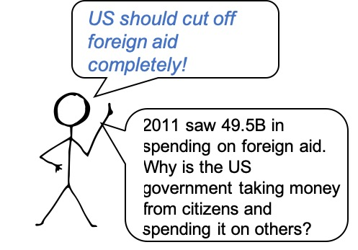
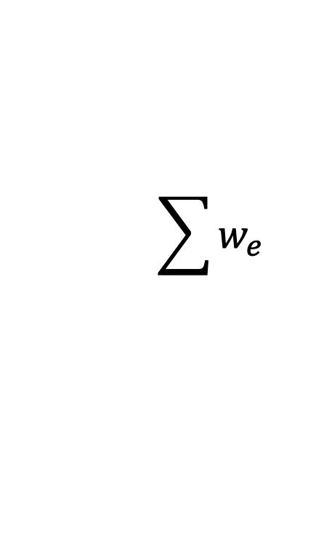
Argument Generation Model
Planner
Input encoder
…
…
$$\sum{w_{e}}$$
Realizer
Phrase encoder

Slide 41
Argument Generation Model
Planner
Input encoder
…
…
$$\sum{w_{e}}$$
Realizer
Phrase encoder

Slide 42
Content Planning
Sentence 1: [political bargaining chip]

Slide 43

Content Planning
$$s_{j}$$
Planner’s hidden states
Sentence 1: [political bargaining chip]

Slide 44
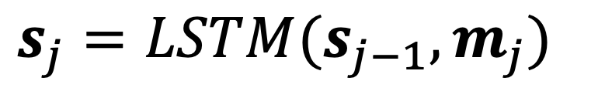
Content Planning
$$s_{j}$$
Sentence 1: [political bargaining chip]
$$s_{j}=LSTM(s_{j−1},m_{j})$$

Slide 45
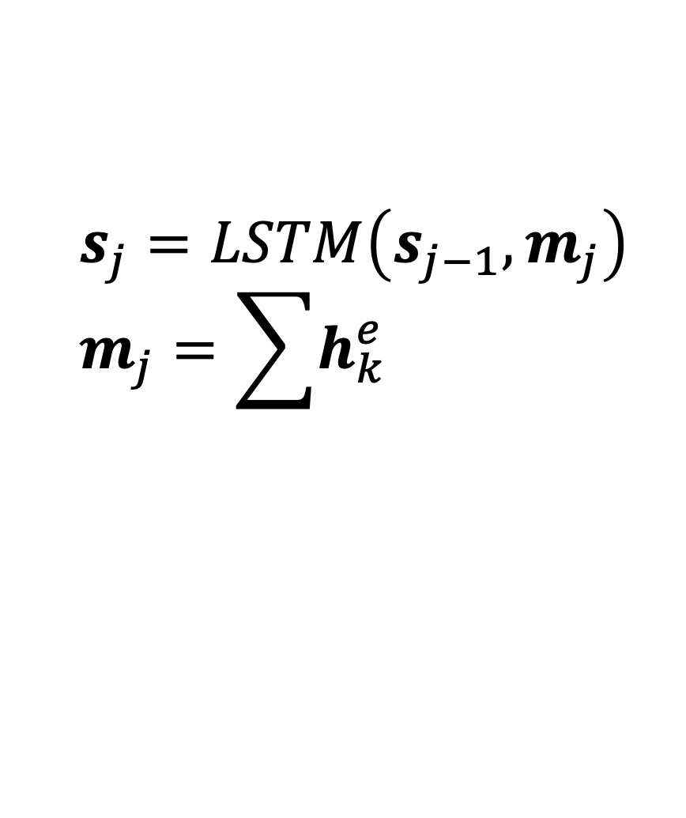
Content Planning
$$s_{j}$$
Sentence 1: [political bargaining chip]
$$s_{j}=LSTM\left(s_{j−1},m_{j}\right)$$
$$m_{j}=\sum{h_{k}^{e}}$$
Selected
keyphrases

Slide 46
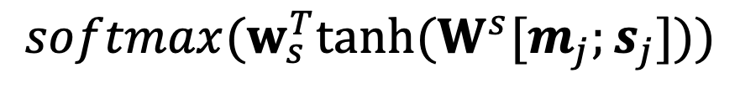
Content Planning
CLAIM
PREMISE
$$softmax(w_{s}^{T}tanh⁡(W^{s}[m_{j};s_{j}]))$$
FUNCTIONAL
Style specification
Sentence 1: [political bargaining chip]
Sentence 2: [cut financial aid; uganda]

Slide 47
Content Planning
CLAIM
PREMISE
$$softmax(w_{s}^{T}tanh⁡(W^{s}[m_{j};s_{j}]))$$
FUNCTIONAL
Style specification
CLAIM: “I believe foreign aid is a useful bargaining chip.”
Sentence 1: [political bargaining chip]
Sentence 2: [cut financial aid; uganda]

Slide 48
Content Planning
CLAIM
PREMISE
$$softmax(w_{s}^{T}tanh⁡(W^{s}[m_{j};s_{j}]))$$
FUNCTIONAL
Style specification
PREMISE: “In 2014, the US cuts aid to Uganda over anti-gay law.”
Sentence 1: [political bargaining chip]
Sentence 2: [cut financial aid; uganda]

Slide 49
Content Planning
CLAIM
PREMISE
$$softmax(w_{s}^{T}tanh⁡(W^{s}[m_{j};s_{j}]))$$
FUNCTIONAL
Style specification
FUNCTIONAL: “Please change your mind!”
Sentence 1: [political bargaining chip]
Sentence 2: [cut financial aid; uganda]

Slide 50
Content Planning
CLAIM
PREMISE
FUNCTIONAL
Sentence 1: [political bargaining chip]
Sentence 2: [cut financial aid; uganda]
Keyphrase selection
$$P\left(v_{j+1,k}=1|v_{1:j}\right)=σ(w_{v}^{T}s_{j}+q_{j}W^{c}h_{k}^{e})$$
select k-th phrase in (j+1)-th sentence

Slide 51
Content Planning
CLAIM
PREMISE
FUNCTIONAL
Sentence 1: [political bargaining chip]
Sentence 2: [cut financial aid; uganda]
Keyphrase selection
$$P\left(v_{j+1,k}=1|v_{1:j}\right)=σ(w_{v}^{T}s_{j}+q_{j}W^{c}h_{k}^{e})$$
Selection history

Slide 52
Content Planning
CLAIM
PREMISE
PREMISE
FUNCTIONAL
Content selection decoding
Sentence 1: [political bargaining chip]
Sentence 2: [cut financial aid; uganda]
Sentence 3: [make homosexuality a crime]
Sentence 4: [NULL]

Slide 53
Planner
Input encoder
…
…
$$\sum{w_{e}}$$
Realizer
Phrase encoder

Slide 54
Surface Realization
Sentence 1: [political bargaining chip]
Sentence 2: [cut financial aid; uganda]
Sentence 3: [make homosexuality a crime]
Sentence 4: [NULL]
…
US threatened to cut off financial aid to Uganda.

Slide 55

Surface Realization
Sentence 1: [political bargaining chip]
Sentence 2: [cut financial aid; uganda]
Sentence 3: [make homosexuality a crime]
Sentence 4: [NULL]
…
$$z_{t}$$
US threatened to cut off financial aid to Uganda.
$$z_{t}=LSTM(z_{t−1},tanh⁡(W^{ws}s_{J\left(t\right)}+W^{ww}y_{t−1}))$$

Slide 56
Surface Realization
Sentence 1: [political bargaining chip]
Sentence 2: [cut financial aid; uganda]
Sentence 3: [make homosexuality a crime]
Sentence 4: [NULL]
…
$$z_{t}$$
US threatened to cut off financial aid to Uganda.
$$z_{t}=LSTM(z_{t−1},tanh⁡(W^{ws}s_{J\left(t\right)}+W^{ww}y_{t−1}))$$
Content control

Slide 57
Surface Realization
Sentence 1: [political bargaining chip]
Sentence 2: [cut financial aid; uganda]
Sentence 3: [make homosexuality a crime]
Sentence 4: [NULL]
…
US threatened to cut off financial aid to Uganda.
Output layer
$$P\left(y_{t} | y_{1:t−1}\right)=softmax(tanh⁡(W^{o}[z_{t};c_{t};t_{J(t)}]))$$
Style control

Slide 58
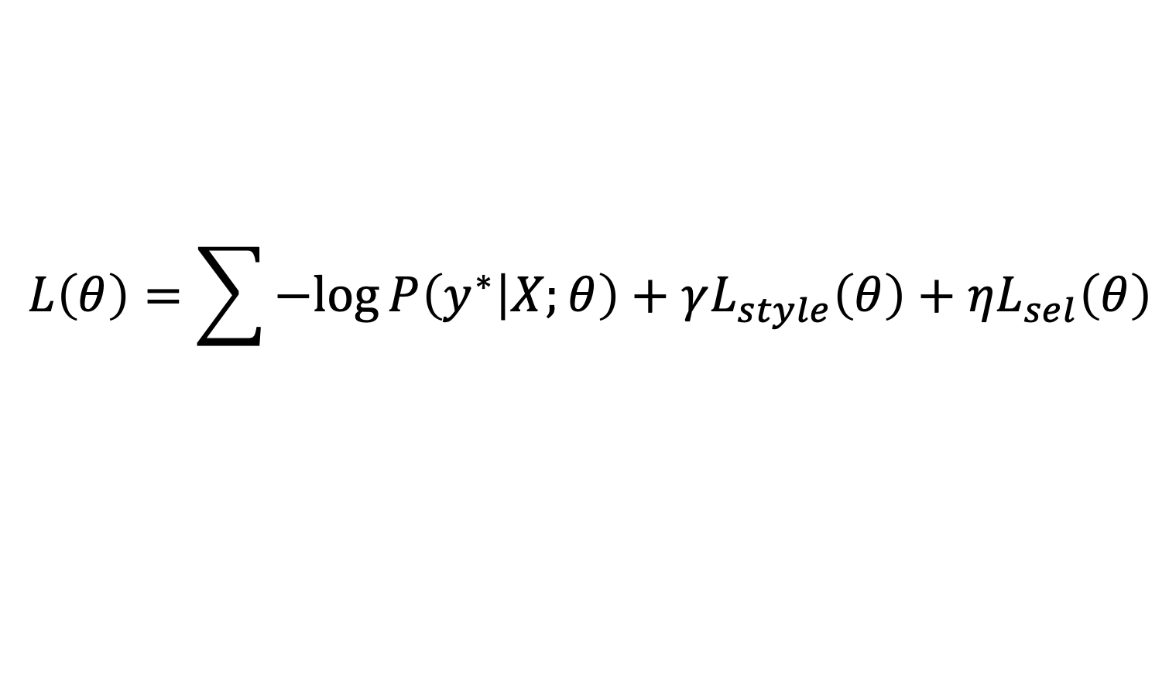
Argument Generation
Training objective
$$L\left(θ\right)=\sum{−log{P\left(y^{∗} | X;θ\right)}+γL_{style}\left(θ\right)+ηL_{sel}\left(θ\right)}$$

Slide 59
Argument Generation
Training objective
$$L\left(θ\right)=\sum{−log{P\left(y^{∗} | X;θ\right)}+γL_{style}\left(θ\right)+ηL_{sel}\left(θ\right)}$$
Token level cross-entropy
Style
cross-entropy
Selection, binary cross-entropy

Slide 60
Experiments
Dataset: input statement-argument pairs from /r/ChangeMyView community
217K pairs for train, 33K and 36K for dev and test
LM pre-training: an extended set of replies (353K)

Slide 61
Experiments
Dataset: input statement-argument pairs from /r/ChangeMyView community
217K pairs for train, 33K and 36K for dev and test
LM pre-training: an extended set of replies (353K)
Topics: politics and policy making related
Keyphrases: noun phrases/verb phrases that contains a Wikipedia title OR a topic signature word [Lin and Hovy, 2000]

Slide 62
Experiments
Input
Average # words per statement | 383.7
Average # words per argument | 66.0
Average # passage | 4.3
Average # keyphrase | 57.1
Output
Additional Input

Slide 63
Experiments
Comparisons
  RETRIEVAL: returns the highest ranked passage as output
  SEQ2SEQ: encodes input and keyphrases
  Our ACL 2018 model (Multi-task Gen.): generates keyphrases as an auxiliary task

Slide 64
Automatic Evaluation
 | BLEU-2 | ROUGE-L | METEOR | Length
RETRIEVAL | 7.81 | 15.68 | 10.59 | 150.0
SEQ2SEQ | 3.64 | 19.00 | 9.85 | 51.7
Multi-task Gen. | 5.73 | 14.44 | 3.82 | 36.5
Ours | 13.19 | 20.15 | 10.42 | 65.5
w/o Style | 12.61 | 20.28 | 9.03 | 62.6
w/ Oracle Plan | 16.30 | 20.25 | 11.61 | 65.5
Human argument length is 66.0.

Slide 65
Automatic Evaluation
 | BLEU-2 | ROUGE-L | METEOR | Length
RETRIEVAL | 7.81 | 15.68 | 10.59 | 150.0
SEQ2SEQ | 3.64 | 19.00 | 9.85 | 51.7
Multi-task Gen. | 5.73 | 14.44 | 3.82 | 36.5
Ours | 13.19 | 20.15 | 10.42 | 65.5
w/o Style | 12.61 | 20.28 | 9.03 | 62.6
w/ Oracle Plan | 16.30 | 20.25 | 11.61 | 65.5
Human argument length is 66.0.

Slide 66
Automatic Evaluation
 | BLEU-2 | ROUGE-L | METEOR | Length
RETRIEVAL | 7.81 | 15.68 | 10.59 | 150.0
SEQ2SEQ | 3.64 | 19.00 | 9.85 | 51.7
Multi-task Gen. | 5.73 | 14.44 | 3.82 | 36.5
Ours | 13.19 | 20.15 | 10.42 | 65.5
w/o Style | 12.61 | 20.28 | 9.03 | 62.6
w/ Oracle Plan | 16.30 | 20.25 | 11.61 | 65.5
Adding style control in general leads to better generation. The outputs are also more fluent.

Slide 67
Automatic Evaluation
 | BLEU-2 | ROUGE-L | METEOR | Length
RETRIEVAL | 7.81 | 15.68 | 10.59 | 150.0
SEQ2SEQ | 3.64 | 19.00 | 9.85 | 51.7
Multi-task Gen. | 5.73 | 14.44 | 3.82 | 36.5
Ours | 13.19 | 20.15 | 10.42 | 65.5
w/o Style | 12.61 | 20.28 | 9.03 | 62.6
w/ Oracle Plan | 16.30 | 20.25 | 11.61 | 65.5
Better planning can further improve performance.

Slide 68
Human Evaluation
Grammaticality (1-5): fluency, free of grammar errors
Correctness (1-5): non-contradictory, right stance
Content richness (1-5): coverage of relevant points (too generic generation will also get low scores)
30 topics
 | Gram. | Corr. | Cont.
HUMAN | 4.81 | 3.90 | 3.48
Ours | 3.99 | 2.78 | 2.61
w/o Style | 3.03 | 2.26 | 2.03

Slide 69
Sample Argument Output
Input: Aborting a fetus has some non-zero negative moral implications.
SEQ2SEQ: I’m not going to try to change your view here, but I don’t want to change your position. I don’t think it’s fair to say that a fetus is not a per- son. It’s not a matter of consciousness.
OURS: TL;DR: I agree with you, but I think it’s important to note that fetuses are not fully developed. I don’t know if this is the case, but it doesn’t seem to be a compelling argument to me at all, so I’m not going to try to change your view by saying that it should be illegal to kill.
OURS w/o Style: Now, I don’t think it’s fair to say that it’s okay to kill someone. If you don’t want to die, you shouldn’t be able to do that for the sake of the mother and the fetus.

Slide 70
Other Applications
Abstract generation for scientific papers
Title: Semantic Embeddings from Hashtags
Entities:
short textual posts
document recommendation task
hastag prediction task
…
convolutional neural network
Abstract: We describe a convolutional neural network that learns feature representations for short textual posts using hashtags as a supervised signal. The proposed approach is …

Slide 71
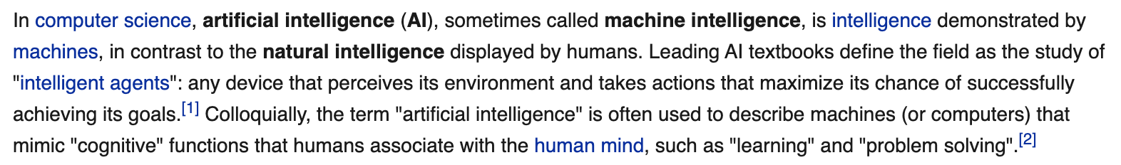
Other Applications
Wikipedia paragraph generation
  First paragraphs of Wikipedia articles
computer science
artificial intelligence
machine intelligence
…
perceives its environment

Slide 72


Other Applications
Model needs to capture the interplay between style and content.
Wikipedia paragraph generation
  First paragraphs of Wikipedia articles
In computer science, (…) any device that perceives its environment and takes actions that maximize its chance of successfully achieving its goals (…) that mimic "cognitive" functions that humans…
Artificial intelligence is the ability of a computer program or a machine to think and learn. (…) which tries to make computers "smart". (...) John McCarthy came up with the name (...)

Slide 73
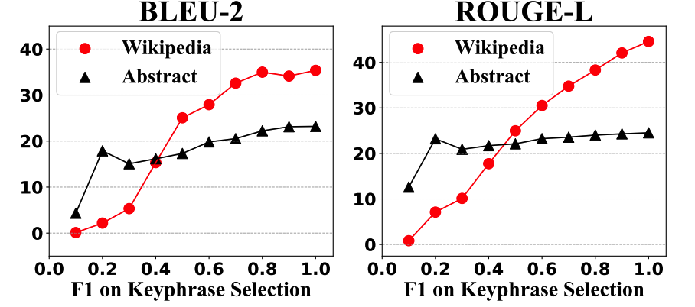
Effect of Content Selection
F1 on Keyphrase Selection
Notes:
The x axis label only show once

Slide 74
Conclusion
Explicit modeling of content selection and style control is useful for neural argument generation. Better interpretability too!
But the current generations still lack of coherence and focus, and can generate contradictory content.
Future directions: working with large pre-trained language models, and adding controllability for better generation.
Papers and project page URLs can be found at
http://www.ccs.neu.edu/home/luwang/publications.html
http://www.ccs.neu.edu/home/luwang/nsf_argument.html
Notes:
Discourse
Knowledge
Controllability

Slide 75
Acknowledgements
Thanks to my students (Xinyu Hua, Zhe Hu, Varun Raval) who did the work in this talk.
  Sentence-Level Content Planning and Style Specification for Neural Text Generation, EMNLP 2019
  Argument Generation with Retrieval, Planning, and Realization, ACL 2019
The research is partially funded by National Science Foundation (1813341).

Slide 76
Thank you!
Feel free to email questions to: luwang@ccs.neu.edu

Slide 77
Sample Argument Output
Input: All alleged crimes or infractions involving a police officer should be investigated by a higher-level agency.
SEQ2SEQ: If you look at the history of history, there was a time when the founding fathers didn’t understand the history of the world. They didn’t want to go to war. It wasn’t be cause they didn’t exist.
OURS: Jail sentences for example are a result of negligence. If you don’t like it, you’re going to have to deal with a lot of bad lawyers, and you’ll have to prove your’re guilty of a crime in the first place and you’re not going to be able to sue for damages if you’re in jail.
OURS w/o Style: The biggest problem with this is that this is a huge problem. The problem is that there are a lot of cases where the defendant is innocent, and the defendant has the power to prove that the defendant didn’t want to go to trial, (…)

Slide 78
Sample Wikipedia Output
TITLE: Breaking Bad STYLE: Simple Wikipedia
SEQ2SEQ: Breaking is an American television soap opera that aired on CBS from September 26, 2007 to April 19, 2009. The series is set in main, New South Wales, in the United Kingdom. It is a spin-off of the ”breaking” series, and was produced by colloquialism productions and broadcast from the television series “ “.
OURS: Breaking bad is an American television series set in Albuquerque, New Mexico. It was started by January 2008 and ended on September 2013 after being cancelled shortly thereafter.
OURS w/o Style: Bad breaking is an American television series set in Albuquerque, New Mexico on cable channel from 2007 to 2013.

