Slide 1
LONG TEXT (NARRATIVE generation)
Heng Ji
hengji@illinois.edu

Slide 2
Challenges on Long Text Generation
(Xu et al., EMNLP2018)
Keep text coherent
Notes:
300 papers… every day… impossible to read… keyword search… abstract doesn’t reflect… results; ignore most of them. Cancer and surgery… 3 days… walk through all posters.. In our field papers that were published twenty years ago are not that important…
including mining PubMed bibliographic data, research papers in PubMed, clinical data sets and numerous bio-medical websites and social media related to medical sciences, where data related to diseases, drugs, treatments, chemical compounds, proteins, genes, biological pathways can be integrated and extracted from text data and their characteristics and relationships can be mined from such datasets as well
. Older literature is often extremely important (and overlooked), and indeed, often provides a rich source of information that can lead to new hypotheses. This makes the information overload problem event more serious, because we need distill and connect knowledge from papers that may cover 70 years.

Slide 3
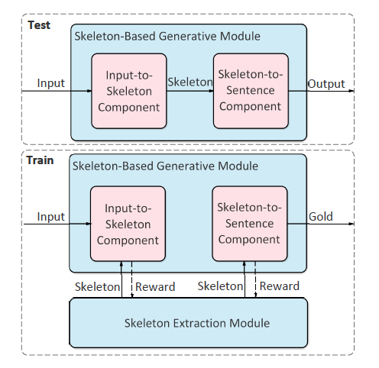
Method Overview
Notes:
300 papers… every day… impossible to read… keyword search… abstract doesn’t reflect… results; ignore most of them. Cancer and surgery… 3 days… walk through all posters.. In our field papers that were published twenty years ago are not that important…
including mining PubMed bibliographic data, research papers in PubMed, clinical data sets and numerous bio-medical websites and social media related to medical sciences, where data related to diseases, drugs, treatments, chemical compounds, proteins, genes, biological pathways can be integrated and extracted from text data and their characteristics and relationships can be mined from such datasets as well
. Older literature is often extremely important (and overlooked), and indeed, often provides a rich source of information that can lead to new hypotheses. This makes the information overload problem event more serious, because we need distill and connect knowledge from papers that may cover 70 years.

Slide 4
Input to Skeleton
Represent each sentence with LSTM
Given the compressed vector h, attention-based decoder imagines a Skelton
Formulate skeleton extraction as a sentence compression problem and use a sentence compression dataset to train this module. In sentence compression, the compressed sentence is required to be grammatical and convey the most important information
Notes:
300 papers… every day… impossible to read… keyword search… abstract doesn’t reflect… results; ignore most of them. Cancer and surgery… 3 days… walk through all posters.. In our field papers that were published twenty years ago are not that important…
including mining PubMed bibliographic data, research papers in PubMed, clinical data sets and numerous bio-medical websites and social media related to medical sciences, where data related to diseases, drugs, treatments, chemical compounds, proteins, genes, biological pathways can be integrated and extracted from text data and their characteristics and relationships can be mined from such datasets as well
. Older literature is often extremely important (and overlooked), and indeed, often provides a rich source of information that can lead to new hypotheses. This makes the information overload problem event more serious, because we need distill and connect knowledge from papers that may cover 70 years.

Slide 5
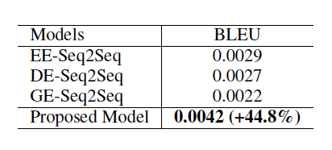
Results
EE: Entity enhanced
DE: Dependency enhanced
GE: template enhanced
Notes:
300 papers… every day… impossible to read… keyword search… abstract doesn’t reflect… results; ignore most of them. Cancer and surgery… 3 days… walk through all posters.. In our field papers that were published twenty years ago are not that important…
including mining PubMed bibliographic data, research papers in PubMed, clinical data sets and numerous bio-medical websites and social media related to medical sciences, where data related to diseases, drugs, treatments, chemical compounds, proteins, genes, biological pathways can be integrated and extracted from text data and their characteristics and relationships can be mined from such datasets as well
. Older literature is often extremely important (and overlooked), and indeed, often provides a rich source of information that can lead to new hypotheses. This makes the information overload problem event more serious, because we need distill and connect knowledge from papers that may cover 70 years.

Slide 6
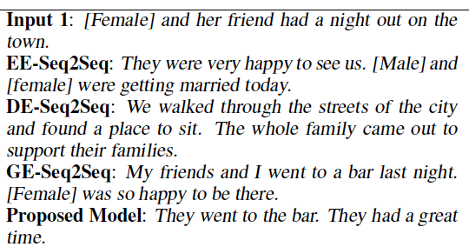
Results
Notes:
300 papers… every day… impossible to read… keyword search… abstract doesn’t reflect… results; ignore most of them. Cancer and surgery… 3 days… walk through all posters.. In our field papers that were published twenty years ago are not that important…
including mining PubMed bibliographic data, research papers in PubMed, clinical data sets and numerous bio-medical websites and social media related to medical sciences, where data related to diseases, drugs, treatments, chemical compounds, proteins, genes, biological pathways can be integrated and extracted from text data and their characteristics and relationships can be mined from such datasets as well
. Older literature is often extremely important (and overlooked), and indeed, often provides a rich source of information that can lead to new hypotheses. This makes the information overload problem event more serious, because we need distill and connect knowledge from papers that may cover 70 years.

Slide 7
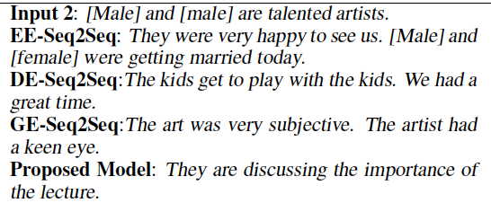
Results
Notes:
300 papers… every day… impossible to read… keyword search… abstract doesn’t reflect… results; ignore most of them. Cancer and surgery… 3 days… walk through all posters.. In our field papers that were published twenty years ago are not that important…
including mining PubMed bibliographic data, research papers in PubMed, clinical data sets and numerous bio-medical websites and social media related to medical sciences, where data related to diseases, drugs, treatments, chemical compounds, proteins, genes, biological pathways can be integrated and extracted from text data and their characteristics and relationships can be mined from such datasets as well
. Older literature is often extremely important (and overlooked), and indeed, often provides a rich source of information that can lead to new hypotheses. This makes the information overload problem event more serious, because we need distill and connect knowledge from papers that may cover 70 years.

Slide 8
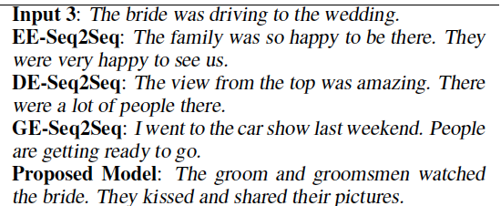
Results
Notes:
300 papers… every day… impossible to read… keyword search… abstract doesn’t reflect… results; ignore most of them. Cancer and surgery… 3 days… walk through all posters.. In our field papers that were published twenty years ago are not that important…
including mining PubMed bibliographic data, research papers in PubMed, clinical data sets and numerous bio-medical websites and social media related to medical sciences, where data related to diseases, drugs, treatments, chemical compounds, proteins, genes, biological pathways can be integrated and extracted from text data and their characteristics and relationships can be mined from such datasets as well
. Older literature is often extremely important (and overlooked), and indeed, often provides a rich source of information that can lead to new hypotheses. This makes the information overload problem event more serious, because we need distill and connect knowledge from papers that may cover 70 years.

Slide 9
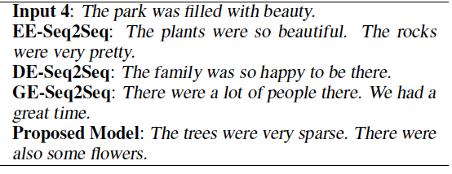
Results
Notes:
300 papers… every day… impossible to read… keyword search… abstract doesn’t reflect… results; ignore most of them. Cancer and surgery… 3 days… walk through all posters.. In our field papers that were published twenty years ago are not that important…
including mining PubMed bibliographic data, research papers in PubMed, clinical data sets and numerous bio-medical websites and social media related to medical sciences, where data related to diseases, drugs, treatments, chemical compounds, proteins, genes, biological pathways can be integrated and extracted from text data and their characteristics and relationships can be mined from such datasets as well
. Older literature is often extremely important (and overlooked), and indeed, often provides a rich source of information that can lead to new hypotheses. This makes the information overload problem event more serious, because we need distill and connect knowledge from papers that may cover 70 years.

