Slide 1
Story GENERATION, POEM generation, LYRIC generation
Heng Ji
hengji@illinois.edu

Slide 2
Coherent Story Generation
(Zhai et al., ACL2019)
Notes:
300 papers… every day… impossible to read… keyword search… abstract doesn’t reflect… results; ignore most of them. Cancer and surgery… 3 days… walk through all posters.. In our field papers that were published twenty years ago are not that important…
including mining PubMed bibliographic data, research papers in PubMed, clinical data sets and numerous bio-medical websites and social media related to medical sciences, where data related to diseases, drugs, treatments, chemical compounds, proteins, genes, biological pathways can be integrated and extracted from text data and their characteristics and relationships can be mined from such datasets as well
. Older literature is often extremely important (and overlooked), and indeed, often provides a rich source of information that can lead to new hypotheses. This makes the information overload problem event more serious, because we need distill and connect knowledge from papers that may cover 70 years.

Slide 3
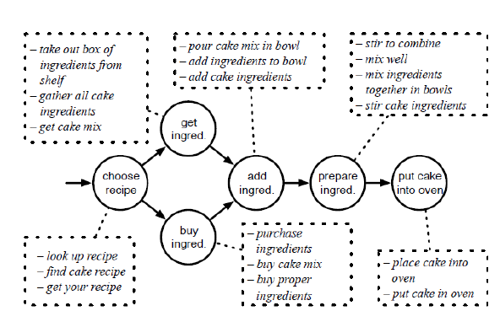
Temporal Script Graphs
Notes:
300 papers… every day… impossible to read… keyword search… abstract doesn’t reflect… results; ignore most of them. Cancer and surgery… 3 days… walk through all posters.. In our field papers that were published twenty years ago are not that important…
including mining PubMed bibliographic data, research papers in PubMed, clinical data sets and numerous bio-medical websites and social media related to medical sciences, where data related to diseases, drugs, treatments, chemical compounds, proteins, genes, biological pathways can be integrated and extracted from text data and their characteristics and relationships can be mined from such datasets as well
. Older literature is often extremely important (and overlooked), and indeed, often provides a rich source of information that can lead to new hypotheses. This makes the information overload problem event more serious, because we need distill and connect knowledge from papers that may cover 70 years.

Slide 4
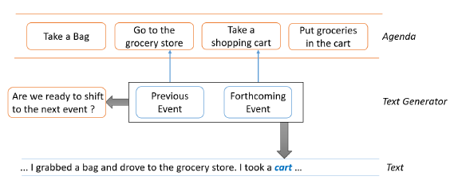
Surface Realization Model
Produces two outputs: a distribution over the vocabulary that predicts the successive word, and a boolean-valued variable that indicates whether the generation should move to the next event
Notes:
300 papers… every day… impossible to read… keyword search… abstract doesn’t reflect… results; ignore most of them. Cancer and surgery… 3 days… walk through all posters.. In our field papers that were published twenty years ago are not that important…
including mining PubMed bibliographic data, research papers in PubMed, clinical data sets and numerous bio-medical websites and social media related to medical sciences, where data related to diseases, drugs, treatments, chemical compounds, proteins, genes, biological pathways can be integrated and extracted from text data and their characteristics and relationships can be mined from such datasets as well
. Older literature is often extremely important (and overlooked), and indeed, often provides a rich source of information that can lead to new hypotheses. This makes the information overload problem event more serious, because we need distill and connect knowledge from papers that may cover 70 years.

Slide 5
Surface Realization Model
Exploits a multi-task learning framework: it outputs the distribution over the next token d_{t} , as well as a_{t} , which determines whether to shift to the next event
Notes:
300 papers… every day… impossible to read… keyword search… abstract doesn’t reflect… results; ignore most of them. Cancer and surgery… 3 days… walk through all posters.. In our field papers that were published twenty years ago are not that important…
including mining PubMed bibliographic data, research papers in PubMed, clinical data sets and numerous bio-medical websites and social media related to medical sciences, where data related to diseases, drugs, treatments, chemical compounds, proteins, genes, biological pathways can be integrated and extracted from text data and their characteristics and relationships can be mined from such datasets as well
. Older literature is often extremely important (and overlooked), and indeed, often provides a rich source of information that can lead to new hypotheses. This makes the information overload problem event more serious, because we need distill and connect knowledge from papers that may cover 70 years.

Slide 6
Results
Notes:
300 papers… every day… impossible to read… keyword search… abstract doesn’t reflect… results; ignore most of them. Cancer and surgery… 3 days… walk through all posters.. In our field papers that were published twenty years ago are not that important…
including mining PubMed bibliographic data, research papers in PubMed, clinical data sets and numerous bio-medical websites and social media related to medical sciences, where data related to diseases, drugs, treatments, chemical compounds, proteins, genes, biological pathways can be integrated and extracted from text data and their characteristics and relationships can be mined from such datasets as well
. Older literature is often extremely important (and overlooked), and indeed, often provides a rich source of information that can lead to new hypotheses. This makes the information overload problem event more serious, because we need distill and connect knowledge from papers that may cover 70 years.

Slide 7
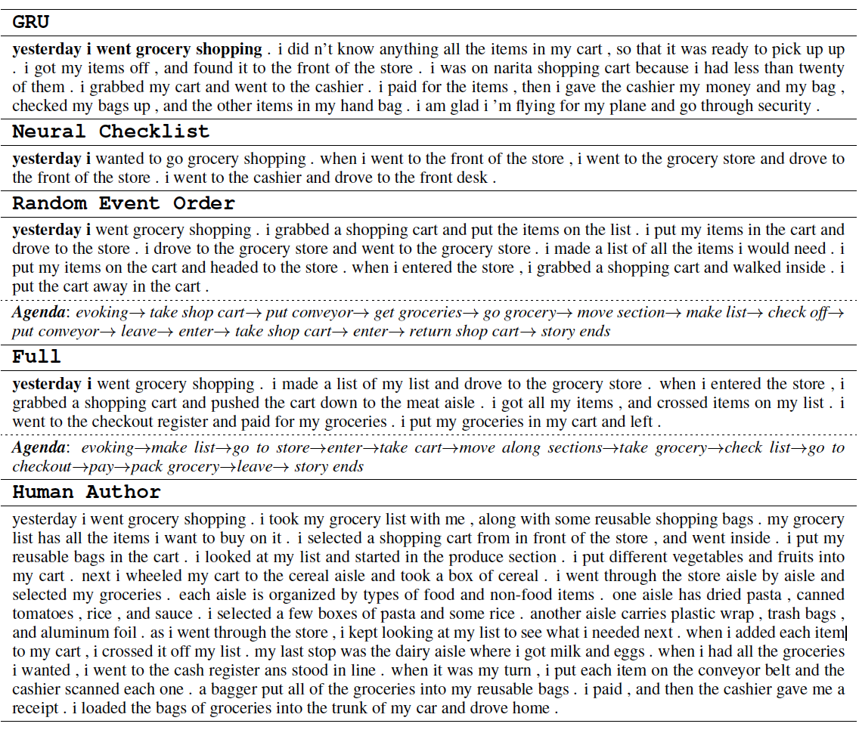
Sample Generation Output
Notes:
300 papers… every day… impossible to read… keyword search… abstract doesn’t reflect… results; ignore most of them. Cancer and surgery… 3 days… walk through all posters.. In our field papers that were published twenty years ago are not that important…
including mining PubMed bibliographic data, research papers in PubMed, clinical data sets and numerous bio-medical websites and social media related to medical sciences, where data related to diseases, drugs, treatments, chemical compounds, proteins, genes, biological pathways can be integrated and extracted from text data and their characteristics and relationships can be mined from such datasets as well
. Older literature is often extremely important (and overlooked), and indeed, often provides a rich source of information that can lead to new hypotheses. This makes the information overload problem event more serious, because we need distill and connect knowledge from papers that may cover 70 years.

Slide 8
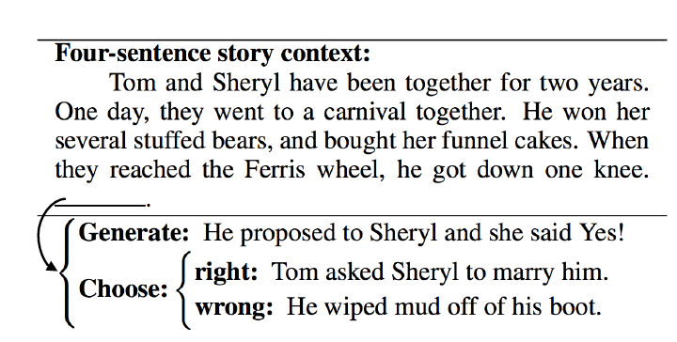
Story Ending Generation
(Li et al., COLING2018)
Notes:
300 papers… every day… impossible to read… keyword search… abstract doesn’t reflect… results; ignore most of them. Cancer and surgery… 3 days… walk through all posters.. In our field papers that were published twenty years ago are not that important…
including mining PubMed bibliographic data, research papers in PubMed, clinical data sets and numerous bio-medical websites and social media related to medical sciences, where data related to diseases, drugs, treatments, chemical compounds, proteins, genes, biological pathways can be integrated and extracted from text data and their characteristics and relationships can be mined from such datasets as well
. Older literature is often extremely important (and overlooked), and indeed, often provides a rich source of information that can lead to new hypotheses. This makes the information overload problem event more serious, because we need distill and connect knowledge from papers that may cover 70 years.

Slide 9
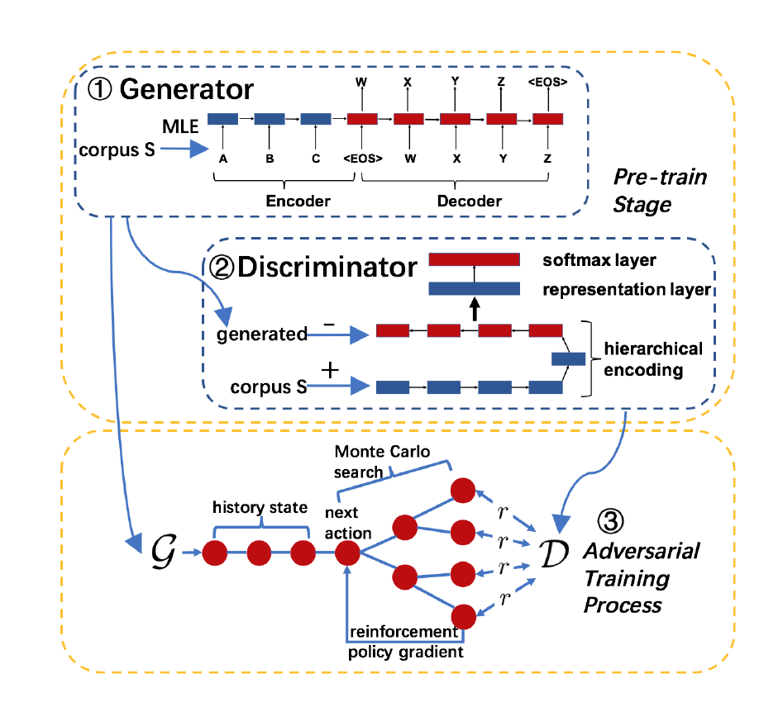
Method
Notes:
300 papers… every day… impossible to read… keyword search… abstract doesn’t reflect… results; ignore most of them. Cancer and surgery… 3 days… walk through all posters.. In our field papers that were published twenty years ago are not that important…
including mining PubMed bibliographic data, research papers in PubMed, clinical data sets and numerous bio-medical websites and social media related to medical sciences, where data related to diseases, drugs, treatments, chemical compounds, proteins, genes, biological pathways can be integrated and extracted from text data and their characteristics and relationships can be mined from such datasets as well
. Older literature is often extremely important (and overlooked), and indeed, often provides a rich source of information that can lead to new hypotheses. This makes the information overload problem event more serious, because we need distill and connect knowledge from papers that may cover 70 years.

Slide 10
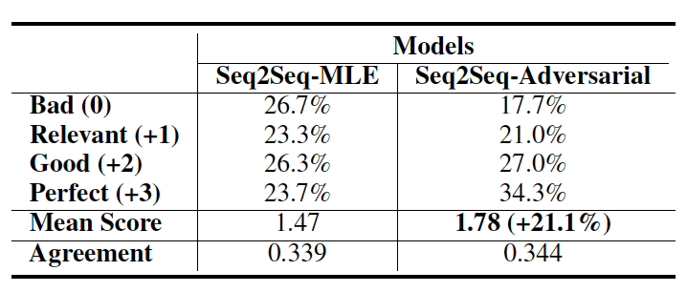
Results
(Li et al., COLING2018)
Notes:
300 papers… every day… impossible to read… keyword search… abstract doesn’t reflect… results; ignore most of them. Cancer and surgery… 3 days… walk through all posters.. In our field papers that were published twenty years ago are not that important…
including mining PubMed bibliographic data, research papers in PubMed, clinical data sets and numerous bio-medical websites and social media related to medical sciences, where data related to diseases, drugs, treatments, chemical compounds, proteins, genes, biological pathways can be integrated and extracted from text data and their characteristics and relationships can be mined from such datasets as well
. Older literature is often extremely important (and overlooked), and indeed, often provides a rich source of information that can lead to new hypotheses. This makes the information overload problem event more serious, because we need distill and connect knowledge from papers that may cover 70 years.

Slide 11
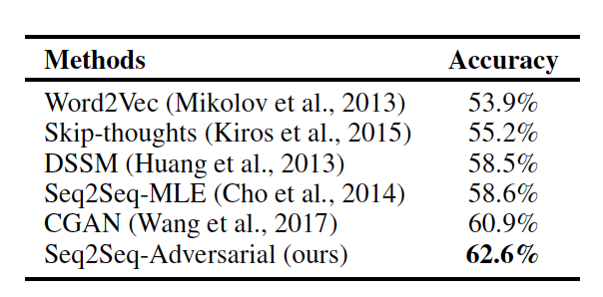
Results
Story Cloze Prediction
Notes:
300 papers… every day… impossible to read… keyword search… abstract doesn’t reflect… results; ignore most of them. Cancer and surgery… 3 days… walk through all posters.. In our field papers that were published twenty years ago are not that important…
including mining PubMed bibliographic data, research papers in PubMed, clinical data sets and numerous bio-medical websites and social media related to medical sciences, where data related to diseases, drugs, treatments, chemical compounds, proteins, genes, biological pathways can be integrated and extracted from text data and their characteristics and relationships can be mined from such datasets as well
. Older literature is often extremely important (and overlooked), and indeed, often provides a rich source of information that can lead to new hypotheses. This makes the information overload problem event more serious, because we need distill and connect knowledge from papers that may cover 70 years.

Slide 12
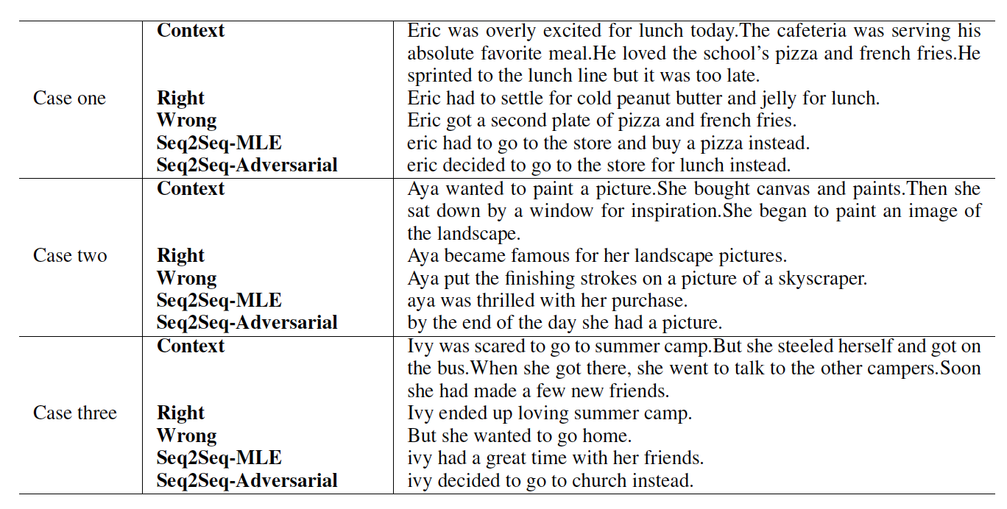
Example Output
Notes:
300 papers… every day… impossible to read… keyword search… abstract doesn’t reflect… results; ignore most of them. Cancer and surgery… 3 days… walk through all posters.. In our field papers that were published twenty years ago are not that important…
including mining PubMed bibliographic data, research papers in PubMed, clinical data sets and numerous bio-medical websites and social media related to medical sciences, where data related to diseases, drugs, treatments, chemical compounds, proteins, genes, biological pathways can be integrated and extracted from text data and their characteristics and relationships can be mined from such datasets as well
. Older literature is often extremely important (and overlooked), and indeed, often provides a rich source of information that can lead to new hypotheses. This makes the information overload problem event more serious, because we need distill and connect knowledge from papers that may cover 70 years.

Slide 13
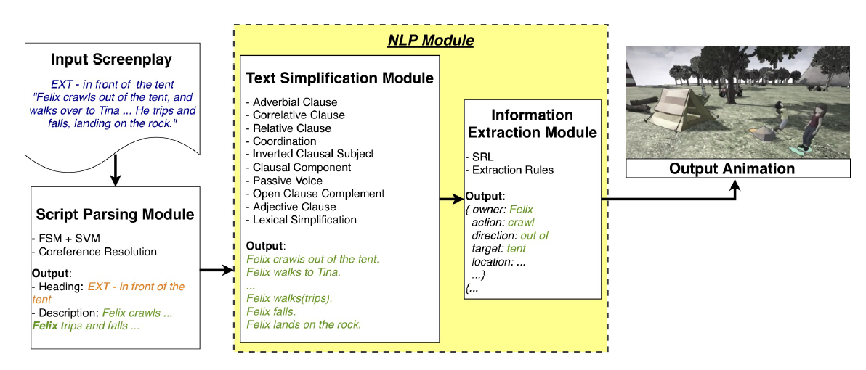
Animation Generation
(Zhang et al., SEM2019)
Text-to-animation to handle complex sentences
Notes:
300 papers… every day… impossible to read… keyword search… abstract doesn’t reflect… results; ignore most of them. Cancer and surgery… 3 days… walk through all posters.. In our field papers that were published twenty years ago are not that important…
including mining PubMed bibliographic data, research papers in PubMed, clinical data sets and numerous bio-medical websites and social media related to medical sciences, where data related to diseases, drugs, treatments, chemical compounds, proteins, genes, biological pathways can be integrated and extracted from text data and their characteristics and relationships can be mined from such datasets as well
. Older literature is often extremely important (and overlooked), and indeed, often provides a rich source of information that can lead to new hypotheses. This makes the information overload problem event more serious, because we need distill and connect knowledge from papers that may cover 70 years.

Slide 14
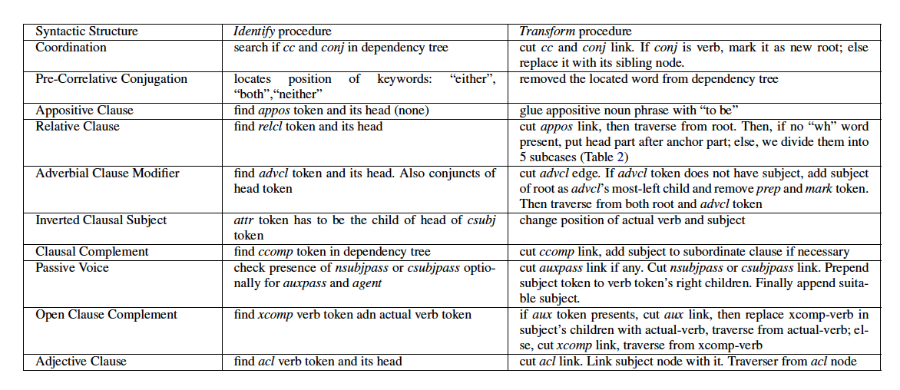
Text Simplification
Notes:
300 papers… every day… impossible to read… keyword search… abstract doesn’t reflect… results; ignore most of them. Cancer and surgery… 3 days… walk through all posters.. In our field papers that were published twenty years ago are not that important…
including mining PubMed bibliographic data, research papers in PubMed, clinical data sets and numerous bio-medical websites and social media related to medical sciences, where data related to diseases, drugs, treatments, chemical compounds, proteins, genes, biological pathways can be integrated and extracted from text data and their characteristics and relationships can be mined from such datasets as well
. Older literature is often extremely important (and overlooked), and indeed, often provides a rich source of information that can lead to new hypotheses. This makes the information overload problem event more serious, because we need distill and connect knowledge from papers that may cover 70 years.

Slide 15
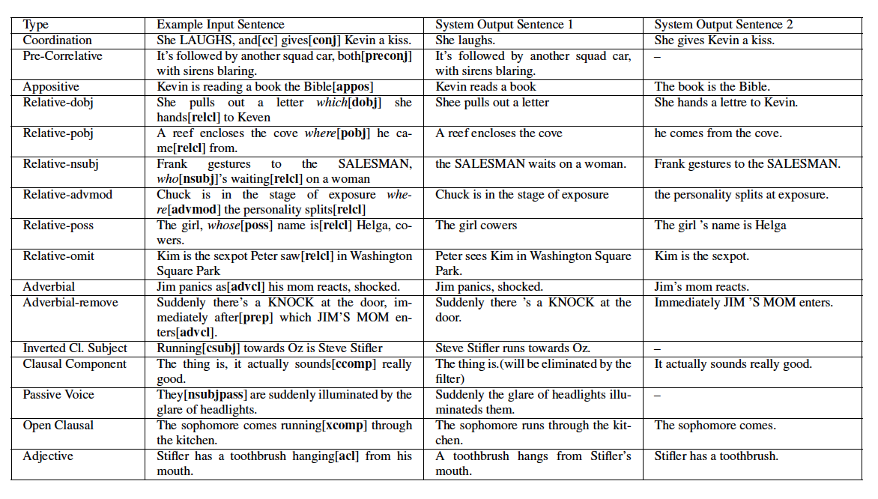
Text Simplification
Notes:
300 papers… every day… impossible to read… keyword search… abstract doesn’t reflect… results; ignore most of them. Cancer and surgery… 3 days… walk through all posters.. In our field papers that were published twenty years ago are not that important…
including mining PubMed bibliographic data, research papers in PubMed, clinical data sets and numerous bio-medical websites and social media related to medical sciences, where data related to diseases, drugs, treatments, chemical compounds, proteins, genes, biological pathways can be integrated and extracted from text data and their characteristics and relationships can be mined from such datasets as well
. Older literature is often extremely important (and overlooked), and indeed, often provides a rich source of information that can lead to new hypotheses. This makes the information overload problem event more serious, because we need distill and connect knowledge from papers that may cover 70 years.

Slide 16
Text Simplification
Firstly the dependency links of cc and conj are cut
Then we look for a noun in the left direct children of the original root LAUGHS and link the new root gives with it
In-order traverse from the original root and the new root will result in simplified sentences
Notes:
300 papers… every day… impossible to read… keyword search… abstract doesn’t reflect… results; ignore most of them. Cancer and surgery… 3 days… walk through all posters.. In our field papers that were published twenty years ago are not that important…
including mining PubMed bibliographic data, research papers in PubMed, clinical data sets and numerous bio-medical websites and social media related to medical sciences, where data related to diseases, drugs, treatments, chemical compounds, proteins, genes, biological pathways can be integrated and extracted from text data and their characteristics and relationships can be mined from such datasets as well
. Older literature is often extremely important (and overlooked), and indeed, often provides a rich source of information that can lead to new hypotheses. This makes the information overload problem event more serious, because we need distill and connect knowledge from papers that may cover 70 years.

Slide 17
User Study Results
Notes:
300 papers… every day… impossible to read… keyword search… abstract doesn’t reflect… results; ignore most of them. Cancer and surgery… 3 days… walk through all posters.. In our field papers that were published twenty years ago are not that important…
including mining PubMed bibliographic data, research papers in PubMed, clinical data sets and numerous bio-medical websites and social media related to medical sciences, where data related to diseases, drugs, treatments, chemical compounds, proteins, genes, biological pathways can be integrated and extracted from text data and their characteristics and relationships can be mined from such datasets as well
. Older literature is often extremely important (and overlooked), and indeed, often provides a rich source of information that can lead to new hypotheses. This makes the information overload problem event more serious, because we need distill and connect knowledge from papers that may cover 70 years.

Slide 18
Interactive Creative Story Generation
Can you tell a story about an athlete ran a race?
Sam was a star athlete.
He ran track at college.
There was a big race coming up.
Everyone was sure he would win.
Sam got first place.
Sam was a star athlete.
He ran track at college.
There was a big race coming up.
Everyone was sure he would win.
Sam got very nervous and lost the game.
Nice story! But can you make the ending sad?
Notes:
More concretely, I made some cartoon about what we want for controllable and creative generation

Slide 19
Poem Generation
https://www.poem-generator.org.uk

Slide 20
Poem Generation

Slide 21
Poem Generation
(Astigarraga et al., ACL2017)
Input
a set of sentences, a rhyme checker and a syllable-counter.
Procedure
lexical exploratory analysis
semantic exploratory analysis
poem generation

Slide 22
Lexical Exploratory Analysis
Count the number of potential verses.
Find the number of verses which do not adjust to the rhyming convention, and show their endings.
Find the number of verses which rhyme with a given word, and list them.
Compute the number of rhyming equivalence classes of the set of verses. A rhyming equivalence class is a set of verses which share the same rhyming pattern.
Compute the number of rhyming equivalence classes of the set of verses that have more elements than the minimum number of rhyming verses in a poem.
This is the number of valid equivalence classes, in the sense that elements from the other equivalence classes cannot form part of a poem.
Create a list with a verse from every equivalence class along with the number of elements in such equivalence class.
Plot the number of verses in each equivalence class.
Plot the logarithm of the number of verses in each equivalence class
Plot the histogram of the number of equivalence classes according to the equivalence class size
Plot the histogram of the number of equivalence classes according to the logarithm of the equivalence class size.

Slide 23
Semantic Analysis
Build a semantic model from the set of documents Ds provided by the user
Find the verses more similar to a given theme according to the semantic models.
Find the verses more similar to a given theme according to the semantic models and that also rhyme with a sentence.

Slide 24
Poetry Generation
Ignore equivalence classes with fewer elements that the minimum needed
In this step the equivalence classes from which a poem cannot be created are ignored
Compute the best poems given a theme according to a goodness function
Goodness functions are available to create poems

Slide 25
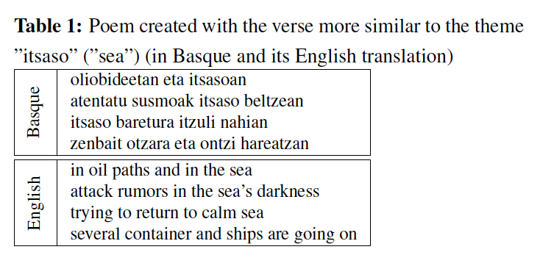
Output Example

Slide 26
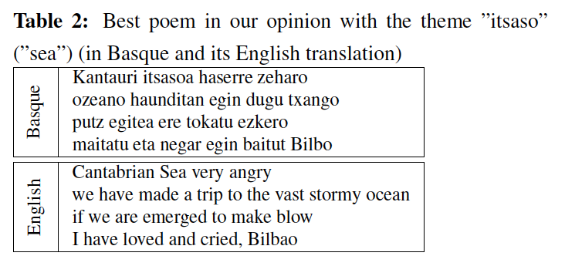
Output Example

Slide 27
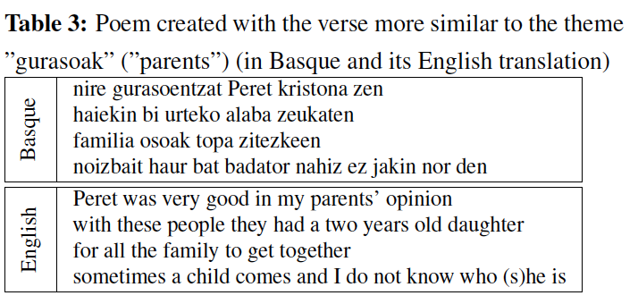
Output Example

Slide 28
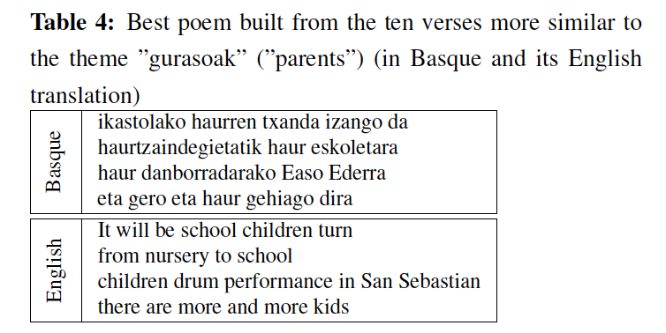
Output Example

Slide 29
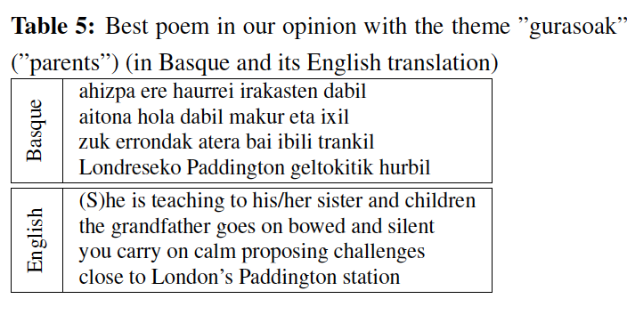
Output Example

Slide 30
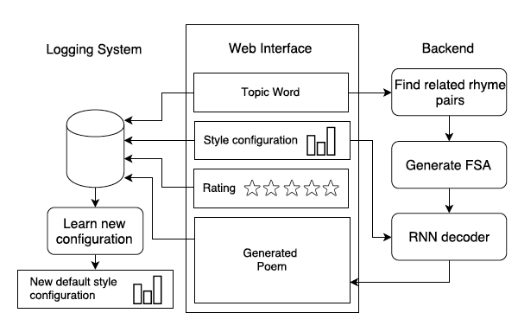
Poem Generation Demo
(Ghazvininejad et al., ACL2017)

Slide 31
Style Control Features
Encourage/discourage words. User can input words that they would like in the poem, or words to be banned.
Curse words. We pre-build a curse-word list Vcurse, and f(w) = I(w, Vcurse).
Repetition. To control the extent of repeated words in the poem. For each beam, we record the current generated words Vhistory, and f(w) = I(w, Vhistory).
Alliteration. To control how often adjacent non-function words start with the same consonant sound.
Word length. To control a preference for longer words in the generated poem.
Topical words. For each user-supplied topic words, we generate a list of related words Vtopical.
Sentiment. We pre-build a word list together with its sentiment scores based on Senti-WordNet (Baccianella et al., 2010).
Concrete words. We pre-build a word list together with a score to reflect its concreteness based on Brysbaert et al. (2014)

Slide 32
Rap Lyric Generation
(Manjavacas et al., ACL2019 workshop)
Character-level, syllable-level and a hierarchical LM (HLM) that integrates both levels
Consider syllable-level instead of word-level based on two-fold reasoning:
(i) similar to sub-word models — such as those induced through Byte-Pair-Encoding (Sennrich et al., 2016) or SentencePiece (Kudo and Richardson, 2018) —, syllable-level segmented input helps limiting the exploding vocabulary size of noisy corpora.
(ii) Syllables play a more central role than words in a particularly rhythmic genre like Hip-Hop in which, moreover, a tendency towards monosyllabic words reduces the vocabulary differences for word-level modeling.

Slide 33
Conditional Templates
Rhythm
Condition LMs on a a measure of verse length
count the number of syllables of each line in the erse and bucket them according to the following ranges: < 10, (10 -15), (15 - 20) and > 20
Rhyme
the rhyme-based condition corresponding to the line ‘unite around the corner’ is AO1-ERO — i.e. the ARPABET representations corresponding to the stressed syllabic nuclei of ‘cor-’ and ‘-ner’

Slide 34
Example Output

Slide 35
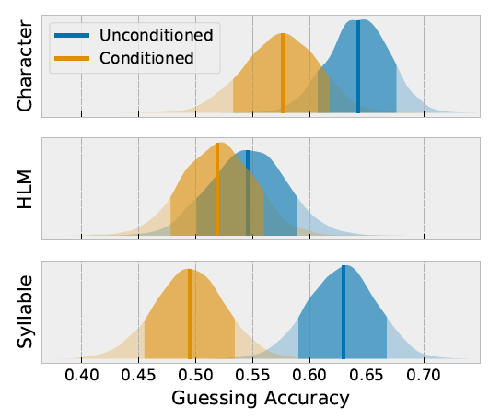
Results
Participants were shown Hip-Hop samples of lengths of 3
to 4 lines and were tasked to guess whether the dis306
played text was generated or real in 15 seconds.

Slide 36
How to evaluate creative generation?
(Potash et al., ACL2018 workshop)
Fluency/Coherence Evaluation: Given a generated verse, we ask annotators to determine the fluency and coherence of the lyrics.
The goal of the style matching annotation is to determine how well a given verse captures the style of the target artist.

Slide 37
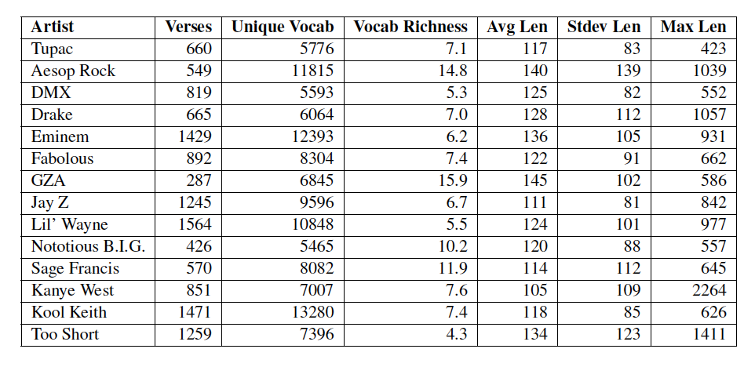
Rap Lyrics dataset statistics

Slide 38
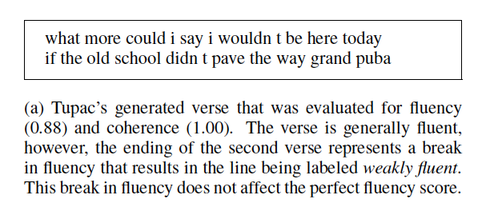
Results

Slide 39
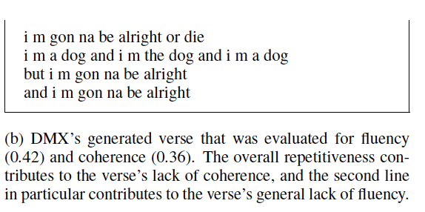
Results

Slide 40
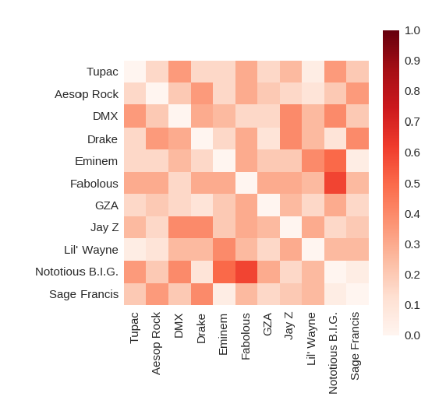
Artist Confusion

