Slide 1
GRAPH SUMMARIZATION and PATH HYPOTHESIS GENERATION
Heng Ji
hengji@illinois.edu
Acknowledgement: slides from Koutra et al. ICDM18 tutorial and Hanghang Tong

Slide 2
Notes:
300 papers… every day… impossible to read… keyword search… abstract doesn’t reflect… results; ignore most of them. Cancer and surgery… 3 days… walk through all posters.. In our field papers that were published twenty years ago are not that important…
including mining PubMed bibliographic data, research papers in PubMed, clinical data sets and numerous bio-medical websites and social media related to medical sciences, where data related to diseases, drugs, treatments, chemical compounds, proteins, genes, biological pathways can be integrated and extracted from text data and their characteristics and relationships can be mined from such datasets as well
. Older literature is often extremely important (and overlooked), and indeed, often provides a rich source of information that can lead to new hypotheses. This makes the information overload problem event more serious, because we need distill and connect knowledge from papers that may cover 70 years.

Slide 3
Notes:
300 papers… every day… impossible to read… keyword search… abstract doesn’t reflect… results; ignore most of them. Cancer and surgery… 3 days… walk through all posters.. In our field papers that were published twenty years ago are not that important…
including mining PubMed bibliographic data, research papers in PubMed, clinical data sets and numerous bio-medical websites and social media related to medical sciences, where data related to diseases, drugs, treatments, chemical compounds, proteins, genes, biological pathways can be integrated and extracted from text data and their characteristics and relationships can be mined from such datasets as well
. Older literature is often extremely important (and overlooked), and indeed, often provides a rich source of information that can lead to new hypotheses. This makes the information overload problem event more serious, because we need distill and connect knowledge from papers that may cover 70 years.

Slide 4
Notes:
300 papers… every day… impossible to read… keyword search… abstract doesn’t reflect… results; ignore most of them. Cancer and surgery… 3 days… walk through all posters.. In our field papers that were published twenty years ago are not that important…
including mining PubMed bibliographic data, research papers in PubMed, clinical data sets and numerous bio-medical websites and social media related to medical sciences, where data related to diseases, drugs, treatments, chemical compounds, proteins, genes, biological pathways can be integrated and extracted from text data and their characteristics and relationships can be mined from such datasets as well
. Older literature is often extremely important (and overlooked), and indeed, often provides a rich source of information that can lead to new hypotheses. This makes the information overload problem event more serious, because we need distill and connect knowledge from papers that may cover 70 years.

Slide 5
Notes:
300 papers… every day… impossible to read… keyword search… abstract doesn’t reflect… results; ignore most of them. Cancer and surgery… 3 days… walk through all posters.. In our field papers that were published twenty years ago are not that important…
including mining PubMed bibliographic data, research papers in PubMed, clinical data sets and numerous bio-medical websites and social media related to medical sciences, where data related to diseases, drugs, treatments, chemical compounds, proteins, genes, biological pathways can be integrated and extracted from text data and their characteristics and relationships can be mined from such datasets as well
. Older literature is often extremely important (and overlooked), and indeed, often provides a rich source of information that can lead to new hypotheses. This makes the information overload problem event more serious, because we need distill and connect knowledge from papers that may cover 70 years.

Slide 6
Notes:
300 papers… every day… impossible to read… keyword search… abstract doesn’t reflect… results; ignore most of them. Cancer and surgery… 3 days… walk through all posters.. In our field papers that were published twenty years ago are not that important…
including mining PubMed bibliographic data, research papers in PubMed, clinical data sets and numerous bio-medical websites and social media related to medical sciences, where data related to diseases, drugs, treatments, chemical compounds, proteins, genes, biological pathways can be integrated and extracted from text data and their characteristics and relationships can be mined from such datasets as well
. Older literature is often extremely important (and overlooked), and indeed, often provides a rich source of information that can lead to new hypotheses. This makes the information overload problem event more serious, because we need distill and connect knowledge from papers that may cover 70 years.

Slide 7
Notes:
300 papers… every day… impossible to read… keyword search… abstract doesn’t reflect… results; ignore most of them. Cancer and surgery… 3 days… walk through all posters.. In our field papers that were published twenty years ago are not that important…
including mining PubMed bibliographic data, research papers in PubMed, clinical data sets and numerous bio-medical websites and social media related to medical sciences, where data related to diseases, drugs, treatments, chemical compounds, proteins, genes, biological pathways can be integrated and extracted from text data and their characteristics and relationships can be mined from such datasets as well
. Older literature is often extremely important (and overlooked), and indeed, often provides a rich source of information that can lead to new hypotheses. This makes the information overload problem event more serious, because we need distill and connect knowledge from papers that may cover 70 years.

Slide 8
Notes:
300 papers… every day… impossible to read… keyword search… abstract doesn’t reflect… results; ignore most of them. Cancer and surgery… 3 days… walk through all posters.. In our field papers that were published twenty years ago are not that important…
including mining PubMed bibliographic data, research papers in PubMed, clinical data sets and numerous bio-medical websites and social media related to medical sciences, where data related to diseases, drugs, treatments, chemical compounds, proteins, genes, biological pathways can be integrated and extracted from text data and their characteristics and relationships can be mined from such datasets as well
. Older literature is often extremely important (and overlooked), and indeed, often provides a rich source of information that can lead to new hypotheses. This makes the information overload problem event more serious, because we need distill and connect knowledge from papers that may cover 70 years.

Slide 9
Notes:
300 papers… every day… impossible to read… keyword search… abstract doesn’t reflect… results; ignore most of them. Cancer and surgery… 3 days… walk through all posters.. In our field papers that were published twenty years ago are not that important…
including mining PubMed bibliographic data, research papers in PubMed, clinical data sets and numerous bio-medical websites and social media related to medical sciences, where data related to diseases, drugs, treatments, chemical compounds, proteins, genes, biological pathways can be integrated and extracted from text data and their characteristics and relationships can be mined from such datasets as well
. Older literature is often extremely important (and overlooked), and indeed, often provides a rich source of information that can lead to new hypotheses. This makes the information overload problem event more serious, because we need distill and connect knowledge from papers that may cover 70 years.

Slide 10
Notes:
300 papers… every day… impossible to read… keyword search… abstract doesn’t reflect… results; ignore most of them. Cancer and surgery… 3 days… walk through all posters.. In our field papers that were published twenty years ago are not that important…
including mining PubMed bibliographic data, research papers in PubMed, clinical data sets and numerous bio-medical websites and social media related to medical sciences, where data related to diseases, drugs, treatments, chemical compounds, proteins, genes, biological pathways can be integrated and extracted from text data and their characteristics and relationships can be mined from such datasets as well
. Older literature is often extremely important (and overlooked), and indeed, often provides a rich source of information that can lead to new hypotheses. This makes the information overload problem event more serious, because we need distill and connect knowledge from papers that may cover 70 years.

Slide 11
Notes:
300 papers… every day… impossible to read… keyword search… abstract doesn’t reflect… results; ignore most of them. Cancer and surgery… 3 days… walk through all posters.. In our field papers that were published twenty years ago are not that important…
including mining PubMed bibliographic data, research papers in PubMed, clinical data sets and numerous bio-medical websites and social media related to medical sciences, where data related to diseases, drugs, treatments, chemical compounds, proteins, genes, biological pathways can be integrated and extracted from text data and their characteristics and relationships can be mined from such datasets as well
. Older literature is often extremely important (and overlooked), and indeed, often provides a rich source of information that can lead to new hypotheses. This makes the information overload problem event more serious, because we need distill and connect knowledge from papers that may cover 70 years.

Slide 12
Notes:
300 papers… every day… impossible to read… keyword search… abstract doesn’t reflect… results; ignore most of them. Cancer and surgery… 3 days… walk through all posters.. In our field papers that were published twenty years ago are not that important…
including mining PubMed bibliographic data, research papers in PubMed, clinical data sets and numerous bio-medical websites and social media related to medical sciences, where data related to diseases, drugs, treatments, chemical compounds, proteins, genes, biological pathways can be integrated and extracted from text data and their characteristics and relationships can be mined from such datasets as well
. Older literature is often extremely important (and overlooked), and indeed, often provides a rich source of information that can lead to new hypotheses. This makes the information overload problem event more serious, because we need distill and connect knowledge from papers that may cover 70 years.

Slide 13
Notes:
300 papers… every day… impossible to read… keyword search… abstract doesn’t reflect… results; ignore most of them. Cancer and surgery… 3 days… walk through all posters.. In our field papers that were published twenty years ago are not that important…
including mining PubMed bibliographic data, research papers in PubMed, clinical data sets and numerous bio-medical websites and social media related to medical sciences, where data related to diseases, drugs, treatments, chemical compounds, proteins, genes, biological pathways can be integrated and extracted from text data and their characteristics and relationships can be mined from such datasets as well
. Older literature is often extremely important (and overlooked), and indeed, often provides a rich source of information that can lead to new hypotheses. This makes the information overload problem event more serious, because we need distill and connect knowledge from papers that may cover 70 years.

Slide 14
Notes:
300 papers… every day… impossible to read… keyword search… abstract doesn’t reflect… results; ignore most of them. Cancer and surgery… 3 days… walk through all posters.. In our field papers that were published twenty years ago are not that important…
including mining PubMed bibliographic data, research papers in PubMed, clinical data sets and numerous bio-medical websites and social media related to medical sciences, where data related to diseases, drugs, treatments, chemical compounds, proteins, genes, biological pathways can be integrated and extracted from text data and their characteristics and relationships can be mined from such datasets as well
. Older literature is often extremely important (and overlooked), and indeed, often provides a rich source of information that can lead to new hypotheses. This makes the information overload problem event more serious, because we need distill and connect knowledge from papers that may cover 70 years.

Slide 15
Notes:
300 papers… every day… impossible to read… keyword search… abstract doesn’t reflect… results; ignore most of them. Cancer and surgery… 3 days… walk through all posters.. In our field papers that were published twenty years ago are not that important…
including mining PubMed bibliographic data, research papers in PubMed, clinical data sets and numerous bio-medical websites and social media related to medical sciences, where data related to diseases, drugs, treatments, chemical compounds, proteins, genes, biological pathways can be integrated and extracted from text data and their characteristics and relationships can be mined from such datasets as well
. Older literature is often extremely important (and overlooked), and indeed, often provides a rich source of information that can lead to new hypotheses. This makes the information overload problem event more serious, because we need distill and connect knowledge from papers that may cover 70 years.

Slide 16
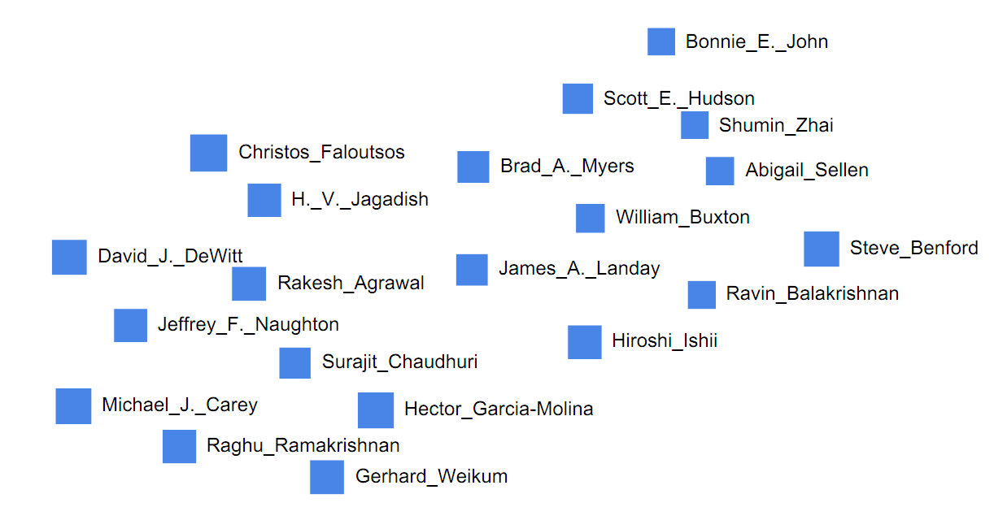
Mining Connection Pathways for Marked Nodes in Large Graphs
What can we say about this “list” of authors?
Use relational information

Slide 17
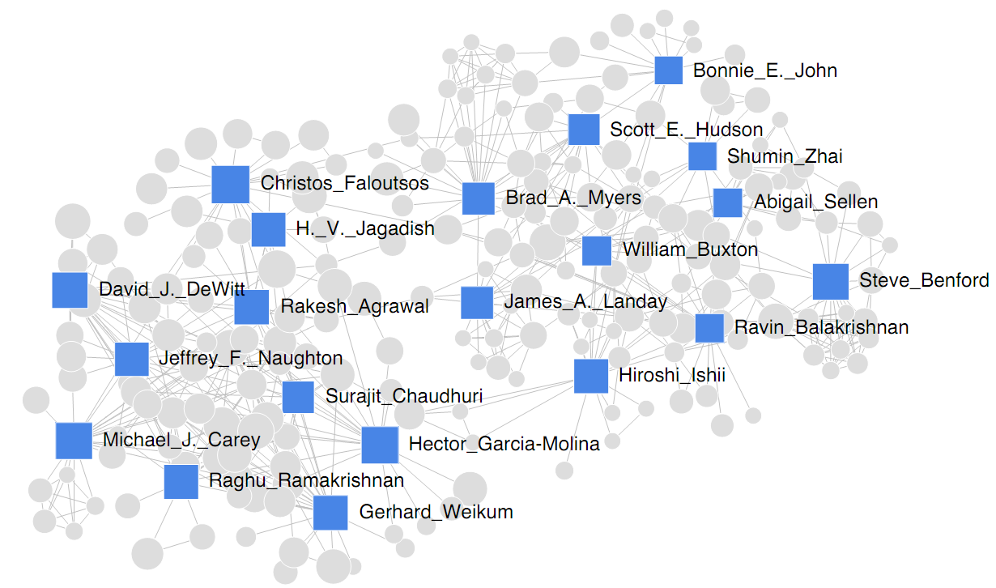
Example
Any patterns in the co-authorship graph?
Too cluttered

Slide 18
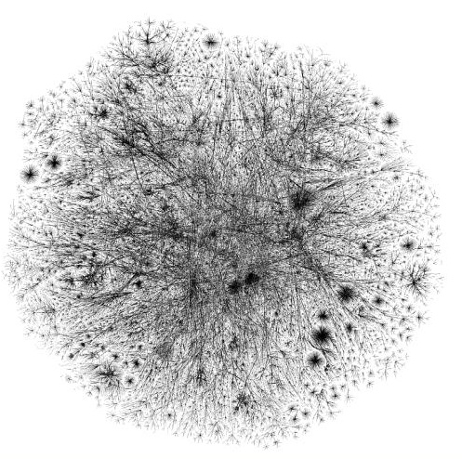
Problem
Given
a large graph G
a handful of nodes S marked by an external process
What can we say?
are S close by?
are S segregated?
how many groups do they form?
How can we connect them?
with “simple” paths
who are “good” connectors?

Slide 19
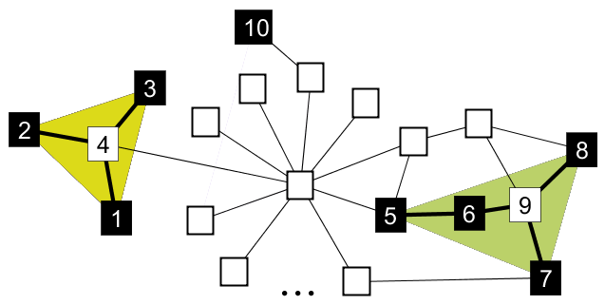
Our approach
Use the network structure to explain S
Partition S into groups of nodes, such that:
“simple” paths connect the nodes in each group,
nodes in different groups are “not easily reachable”
Use the Minimum Description Length principle
Best partitioning requires the “least number of bits”

Slide 20
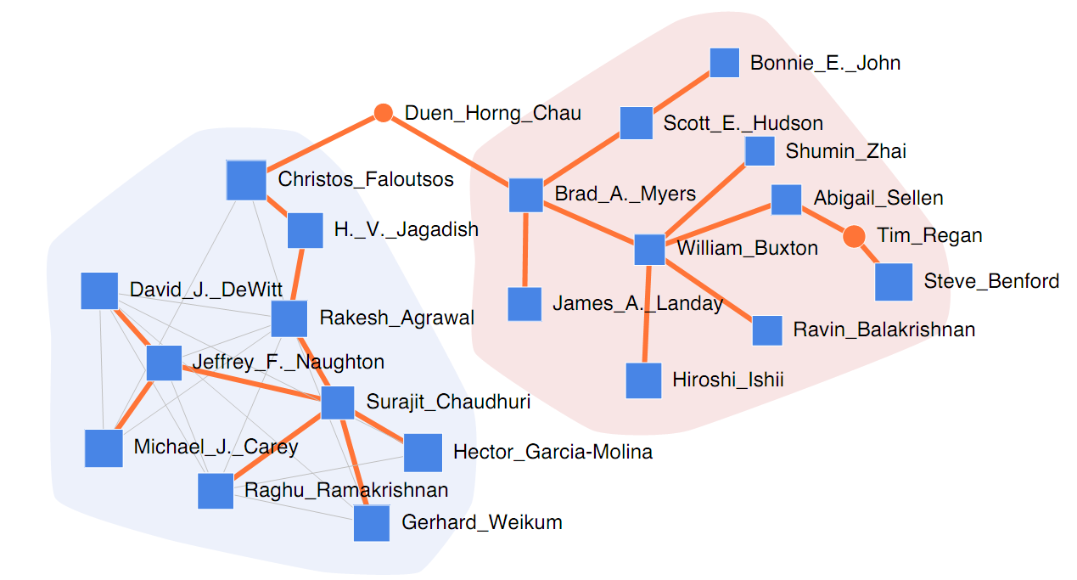
Example
“Simple” connection pathways
“good” connectors
better sensemaking
CHI
VLDB

Slide 21
Applications
1. Graph anomaly description/summarization
e.g. Terrorist network
Top-k
anomalies
Summarize top-k node anomalies by groups
Find connections/connectors among groups

Slide 22
Applications
2. Query summarization
e.g. Web network
Top-ranked
Web pages
Summarize top-k query pages by groups
Find connections/connectors among groups

Slide 23
Applications
3. Understanding dynamic events on graphs
e.g. Social network
Affected
people
Group people s.t. network structure can be associated with the spread of event
within groups (number of points of infection)
but not quite across groups

Slide 24
Applications
4. Understanding semantic coherence
e.g. Ontology network
Set of
words
Summarize words by semantically coherent groups
Find connectors (other relevant words) among groups

Slide 25
Applications
5. Understanding segregation (social science)
e.g. School-children friendship network
Students with
attributes
of interest
Summarize students by their social “circles”
Study groups (and groups within groups)

Slide 26
Roadmap
Problem description
Approach
Applications
Problem formulation
Problem definition
MDL intuition
Objective formulation
Algorithms
Experiments

Slide 27
Problem (formally)

Slide 28
Objective formulation (intuition)
Our key idea is to use an encoding scheme
Imagine a sender and a receiver. Assume:
Both sender and receiver know graph structure G
Only sender knows the set of marked nodes M
Goal of sender:
transmit to the receiver the info. of which nodes are marked, using as few bits as possible.
Why would encoding work?
Naïvely: encode ID of each marked node with bits
Better: exploit “close-by” nodes, restart for farther nodes
…
u
2 log |V| vs. log |V| + log(d(u))
…

Slide 29
Objective formulation (intuition)
We think of encoding as
hopping from node to node to encode close-by nodes
and flying to a new node to encode farther nodes
until all marked nodes are encoded. (hence Dot2Dot)
Simplicity (or the description length) of connection graph T (which is a tree) determined by:
number of unmarked nodes we visit
how easily per visited node we can identify which edge to follow next;
nodes with (very) high degree make the path more complex

Slide 30
Objective function
DETAILS
encode #partitions
encode each part:
encoding of tree of each part:
minimize
P, T_{i}
NP-hard
_{(reduces from the}
_{Steiner tree problem)}
identities of
marked nodes
root node
spanning tree
t of p_{i}
number of
marked nodes in p_{i}
recursively encode all tree nodes
#branches of node t
identities of branch nodes

Slide 31
Roadmap
Problem description
Approach
Applications
Problem formulation
Algorithms
Graph transformation
Finding bounded paths
Connected components
Minimum arborescences
Level-k trees
Experiments

Slide 32
Algorithms - preliminaries
Graph transformation
Given undirected unweighted G(V,E),
We transform it into directed weighted G’(V,E,W)
w(u,v) = log d(u) and w(v,u) = log d(v)
Given G’, problem becomes: ﬁnd the set of trees with minimum total cost on the marked nodes.
Finding bounded-length paths
(multiple) short paths of length up to log |V| between marked nodes in G’
employ BFS-like expansion

Slide 33
Algorithms
Connected components (CC)
find induced subgraph(s) on marked nodes in G’
find minimum cost directed tree(s)
Minimum arborescences (ARB)
construct transitive closure graph CG (with bounded paths)
add universal node u with out-edges w(u,m) = log |V|
find minimum cost directed tree(s), remove u
expand paths
u

Slide 34
Algorithms
Level-1 trees (L1)
find minimum cost depth-1 trees in CG
expand paths
Level-k trees (Lk)
refine level-(k-1) trees by finding intermediate node v’s
such that total cost (i.e. cost from root r to each v + costs of subtrees rooted at v’s) is less
v
v

Slide 35
Roadmap
Problem description
Approach
Applications
Problem formulation
Algorithms
Experiments

Slide 36
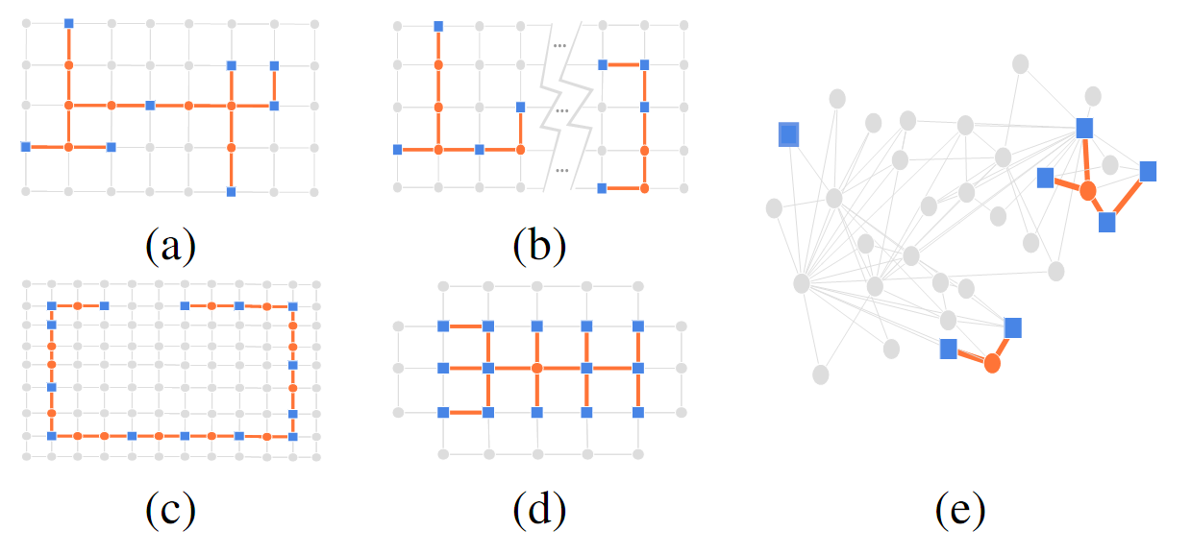
Experiments
Synthetic examples

Slide 37
Experiments
Comparing the algorithms
Real networks: Netscience, GoogleScholar, DBLP
Random walk sampling to mark k nodes:
pick a random node, visit its k’<k neighbors, mark them with prob. s, pick a random node already visited
More separated ← s → More close-by

Slide 38
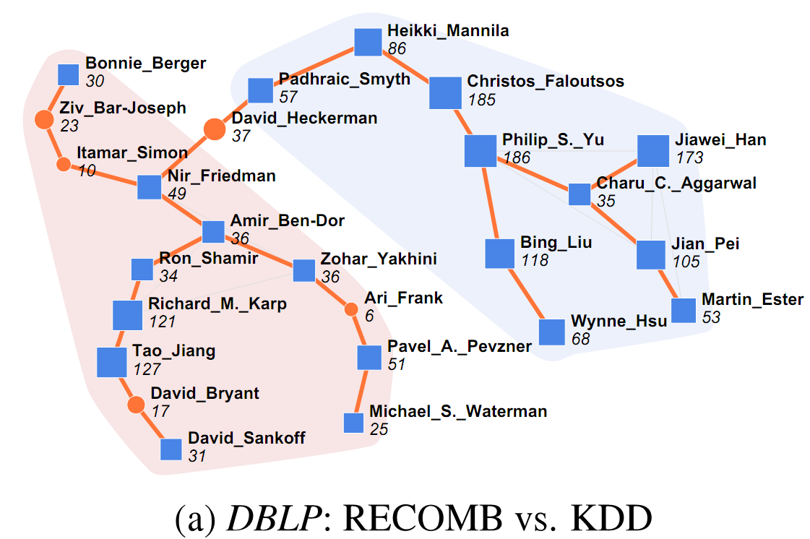
Experiments
Case studies on DBLP

Slide 39
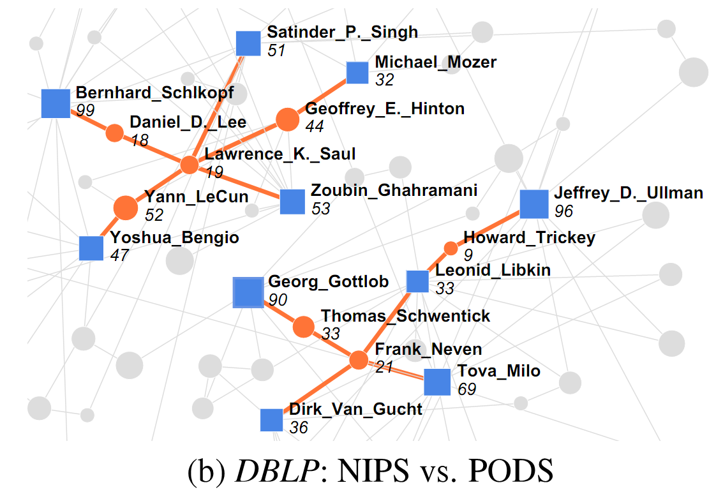
Experiments
Case studies on DBLP

Slide 40
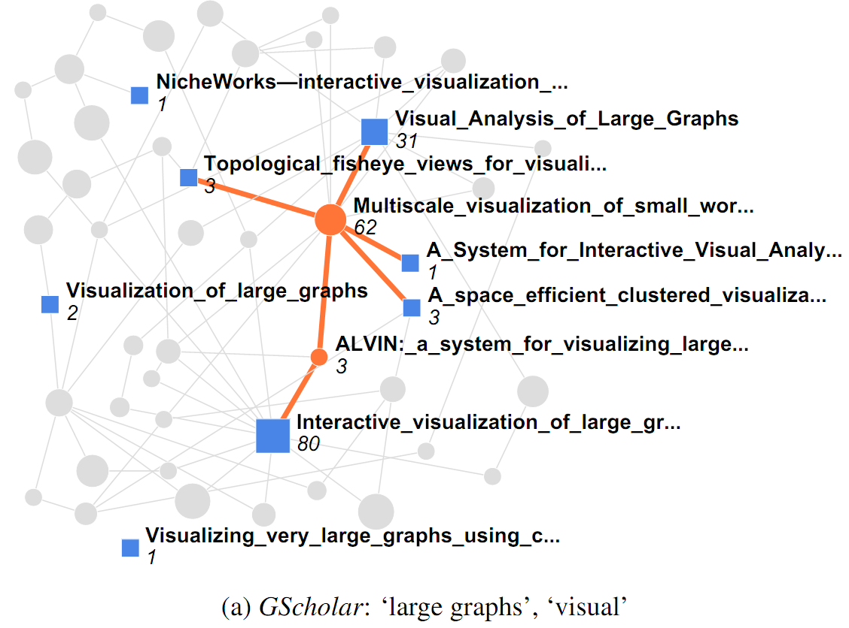
Experiments
Case studies on GoogleScholar

Slide 41
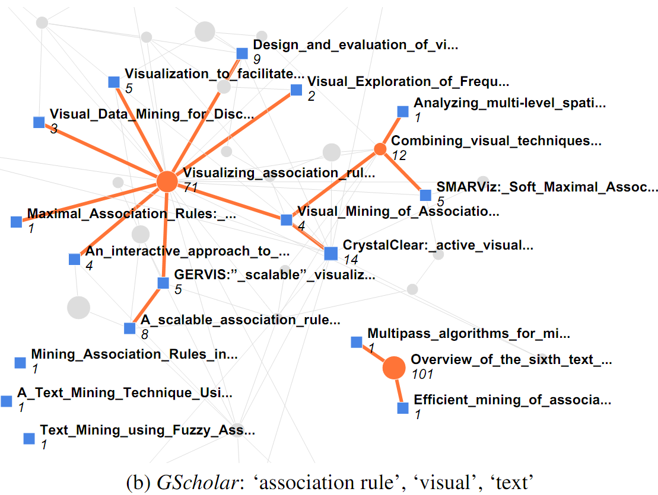
Experiments
Case studies on GoogleScholar

Slide 42
Summary
Dot2Dot: A principled framework to “describe” a set of marked nodes in large graphs
Many applications in the wild
Anomaly description/summarization
Query summarization
Understanding dynamic events on graphs
Understanding semantic coherence
Segregation studies
…
MDL formulation
NP-hardness
Fast algorithms
Experiments on real graphs
?
X
VLDB
CHI

