Slide 1
Neural Natural Language Generation:
Encoding, Decoding, Copy Mechamism
Heng Ji
hengji@illinois.edu
Deliberately constructing a natural language text in order to meet specified communicative goals
No manual features
  Acknowledgement: some slides from Kyunghyun Cho, Hal Daume III, Abigail See and Spencer Whitehead

Slide 2
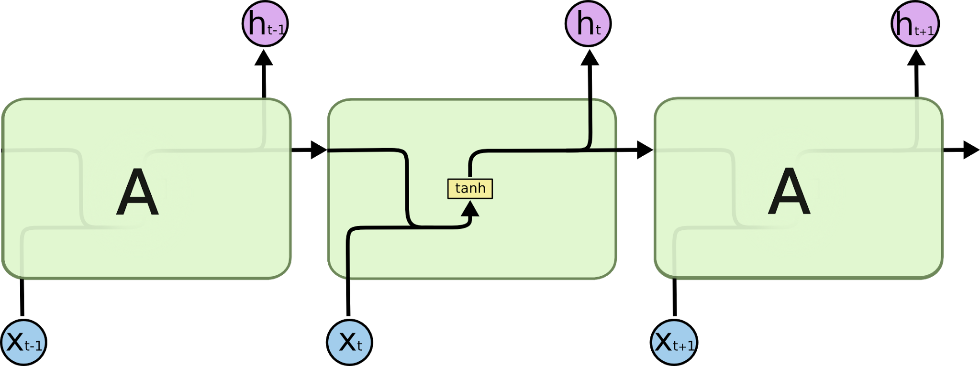
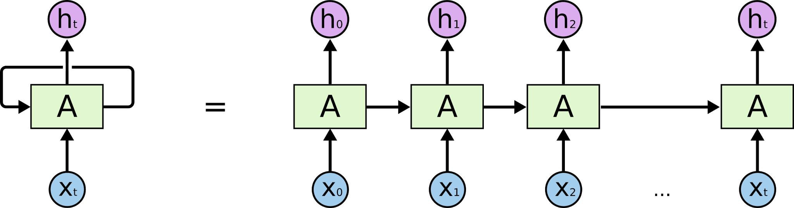
Recap: Recurrent Neural Network
Neural network with loops (output of previous step is input of next)
Maintains hidden state
  Tracks previous inputs
  Handle variable length input (sentences, video frames,...)
Single differentiable function from input words to output probabilities
h_{t} = f_{W}(h_{t-1}, x_{t})
h_{t} = tanh(W_{h}h_{t-1} + W_{x}x_{t})
y_{t} = W_{y}h_{t}
http://colah.github.io/posts/2015-08-Understanding-LSTMs/
Notes:
So, how does SGNS work?
Let’s say we have this sentence,
(This example was shamelessly taken from Marco Baroni)

Slide 3
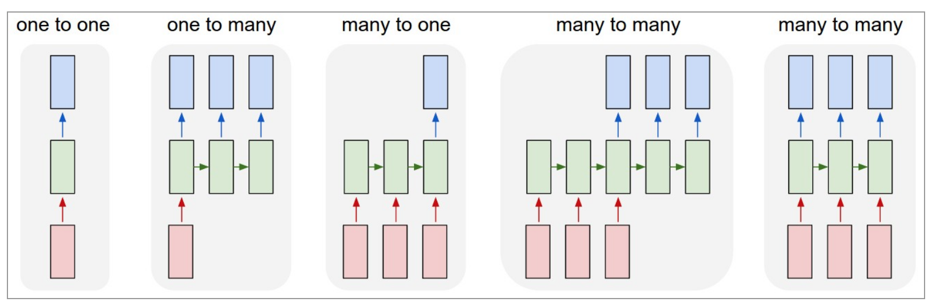
They are more exciting than CNN
Allow us to operate over sequences of vectors

Slide 4
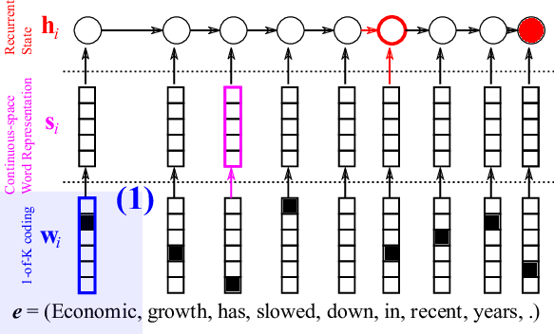
Recurrent Neural Network
Language modeling with RNN
  Embedding or hidden state can be word representation
    Embedding = general representation
    Hidden state = context specific representation
  Input is one-hot encoding of words
  Multiply by embedding matrix
  Output predicts probability distribution over vocabulary
P(next word|previous words)
Notes:
So, how does SGNS work?
Let’s say we have this sentence,
(This example was shamelessly taken from Marco Baroni)

Slide 5
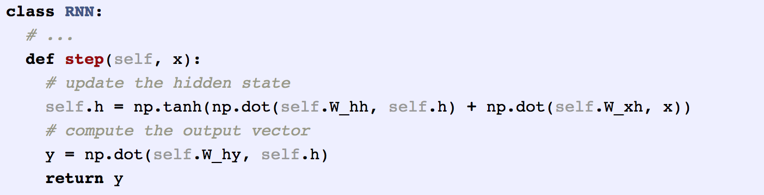

RNN to Train a Character Language Model
Vocabulary: four possible letters helo
Train RNN on sequence “hello”
http://karpathy.github.io/2015/05/21/rnn-effectiveness/
Notes:
So, how does SGNS work?
Let’s say we have this sentence,
(This example was shamelessly taken from Marco Baroni)

Slide 6
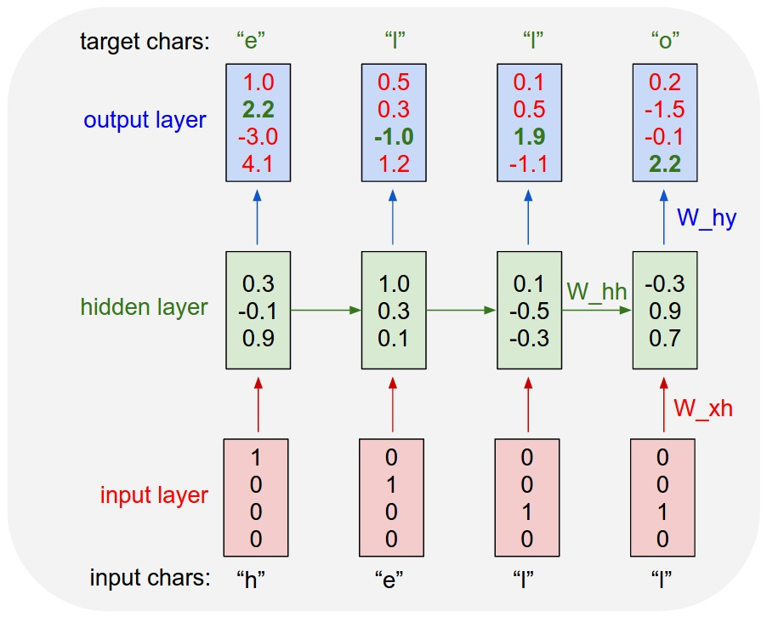
RNN to Train a Character Language Model
Notes:
So, how does SGNS work?
Let’s say we have this sentence,
(This example was shamelessly taken from Marco Baroni)

Slide 7
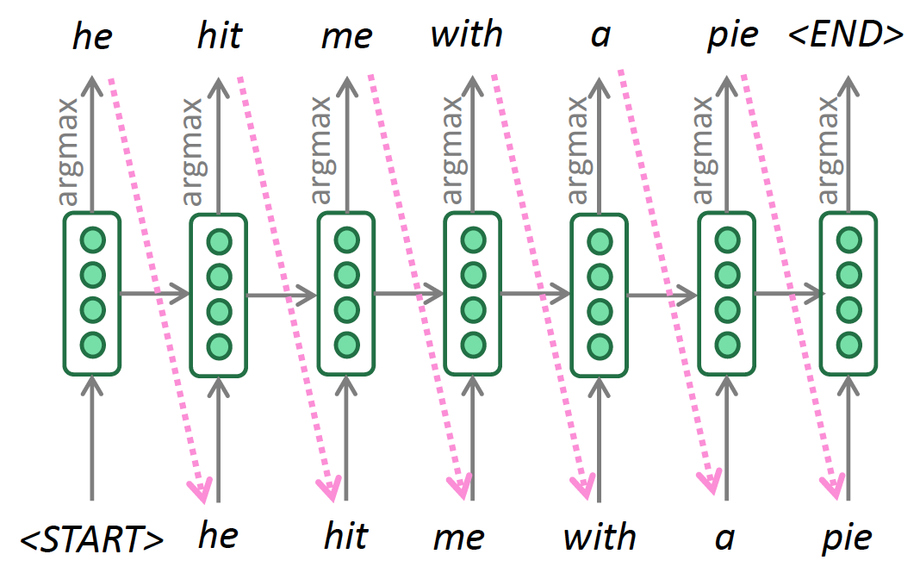
Decoding Algorithm: Greedy Decoding
At each step, take the most probable word (argmax)
Use that as the next word, feed it as input on the next step
Keep going until you produce the end token
Notes:
So, how does SGNS work?
Let’s say we have this sentence,
(This example was shamelessly taken from Marco Baroni)

Slide 8
An autoregressive model as a special case – (3)
Parametrization
  Encoder: encode the source X into a set of continuous vectors
  Decoder:
  (1) encode the prefix into a set of continuous vectors,
  (2) encoder X and prefix into a single vector, and
  (3) predict the next symbol
NLL
Encoder
Decoder

Slide 9
Parametrization – Recurrent Neural Nets
Following Bahdanau et al. [2015]
The encoder turns a sequence of tokens into a sequence of contextualized vectors.
The underlying principle behind recently successful contextualized embeddings
  ELMo [Peters et al., 2018], BERT [Devlin et al., 2019] and all the other muppets
NLL
Encoder
Decoder

Slide 10
Parametrization – Recurrent Neural Nets
Following Bahdanau et al. [2015]
The decoder consists of three stages
  Attention: attend to a small subset of source vectors
  Update: update its internal state
  Predict: predict the next token
Attention has become the core component in many recent advances
  Transformers [Vaswani et al., 2017], …
NLL
Encoder
Decoder

Slide 11
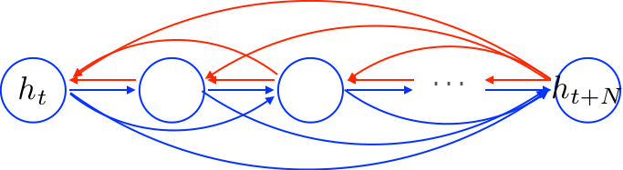
Side-note: gated recurrent units to attention
A key idea behind LSTM and GRU is the additive update
This additive update creates linear short-cut connections

Slide 12
Side-note: gated recurrent units to attention
What are these shortcuts?
If we unroll it, we see it’s a weighted combination of all previous hidden vectors:

Slide 13
Side-note: gated recurrent units to attention
0
Can we “free” these dependent weights?
Can we “free” candidate vectors?
Can we separate keys and values?
Can we have multiple attention heads?
1
2
3
4

Slide 14
Parametrization – Transformers
Stack multiple layers of attention to build a transformer
  Vaswani et al. [2017] – Attention is all you need
A transformer block consists of
  Multi-headed attention
  Residual connection
  Feedforward layer
  Point-wise nonlinearity
  Residual connection
  (Layer) normalization

Slide 15
Decoding Algorithm: Beam Search
A search algorithm which aims to find a high-probability
sequence (not necessarily the optimal sequence, though) by
tracking multiple possible sequences at once
Core idea: On each step of decoder, keep track of the k most
probable partial sequences (which we call hypotheses)
  • k is the beam size
• After you reach some stopping criterion, choose the sequence
with the highest probability (factoring in some adjustment for
Length)
Notes:
So, how does SGNS work?
Let’s say we have this sentence,
(This example was shamelessly taken from Marco Baroni)

Slide 16
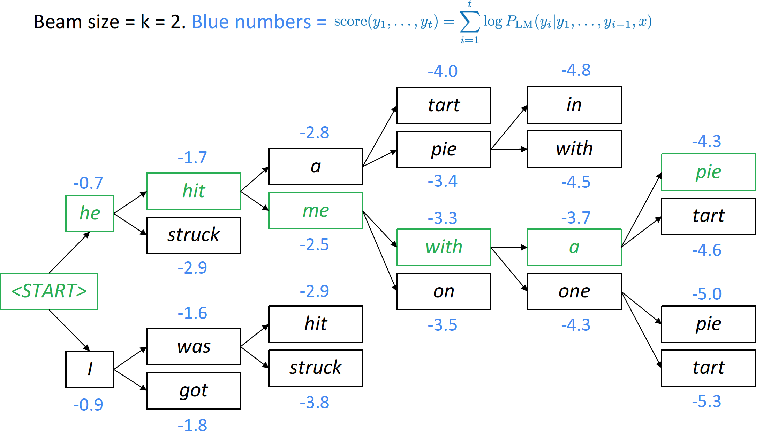
Decoding Algorithm: Beam Search
Notes:
So, how does SGNS work?
Let’s say we have this sentence,
(This example was shamelessly taken from Marco Baroni)

Slide 17
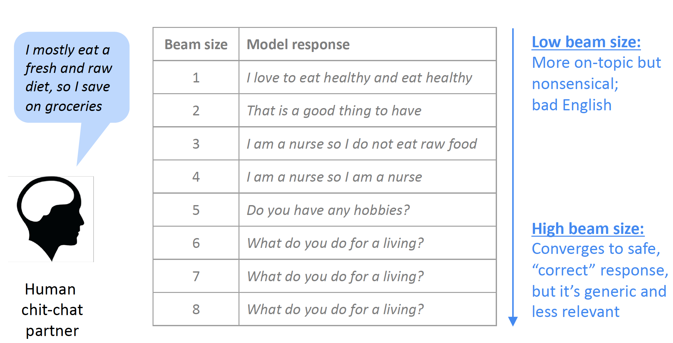
Impact of Beam Size
17
Notes:
Change low resource IL to a language which is not in wikipedia
Word-level: from bi-lingual dicts and alignment; structure-level comes from wals; multi-level alignment

Slide 18
Softmax temperature
It’s not a decoding algorithm – you should apply it in conjunction with a decoding algorithm
Notes:
So, how does SGNS work?
Let’s say we have this sentence,
(This example was shamelessly taken from Marco Baroni)

Slide 19
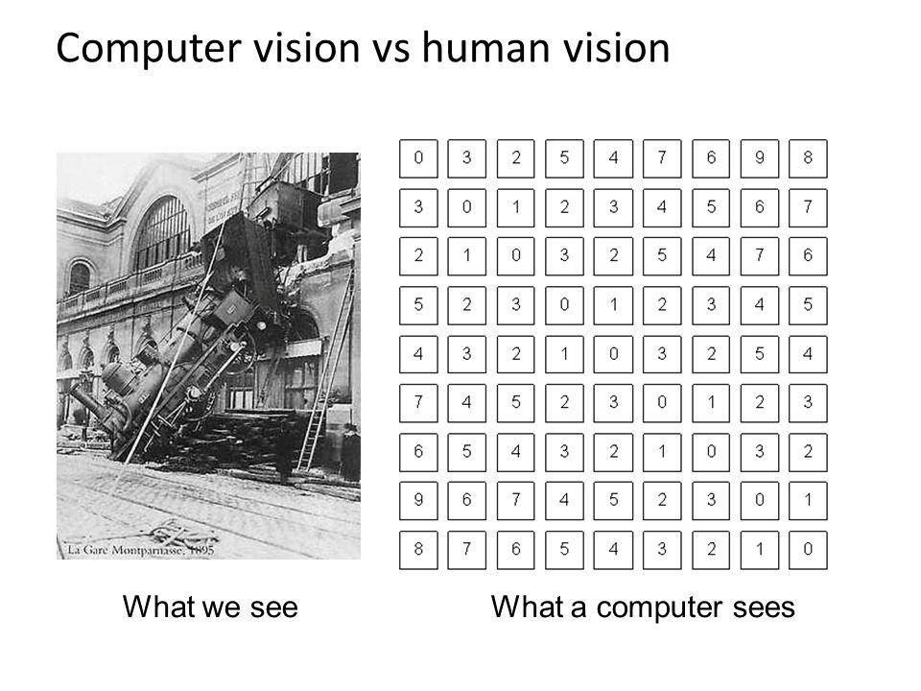
Why is this powerful?
Large number parameters ≈ higher model capacity
Fit complex functions
Representation learning!
  No manual features
  Operate on raw data
  Can compare and refine representations
    Similar Words → Similar sentences
      The wall is blue → the wall is red
    We can change multiple words
      The wall is blue → the ceiling is red

Slide 20
Why is this powerful?
Unsupervised machine translation
Machine comprehension
  https://demo.allennlp.org/machine-comprehension/NTc4MTY2
Visual grounding
Generative adversarial networks (GAN):
  Recycle-GAN: https://www.youtube.com/watch?v=VWXFqDdqLbE
  Nvidia’s celebrity face generation: https://www.youtube.com/watch?v=36lE9tV9vm0
Zero-shot learning
Notes:
So, how does SGNS work?
Let’s say we have this sentence,
(This example was shamelessly taken from Marco Baroni)

Slide 21
Why is this powerful?
Shared representations across tasks, languages, and modalities
Notes:
So, how does SGNS work?
Let’s say we have this sentence,
(This example was shamelessly taken from Marco Baroni)

Slide 22
Share: Cross-lingual Joint Entity and Word Embedding Learning
(Pan et al., DeepLo2019)
Code-switch cross-lingual entity/word data generation
Use English entities as anchor points to learn a mapping (rotation matrix) W which aligns distributions in IL and English
Notes:
Code-switch, english anchor link, learn rotation matrix to align two spaces. So now we get xiaomi is aligned to apple_inc, so we at least know it’s tech company

Slide 23
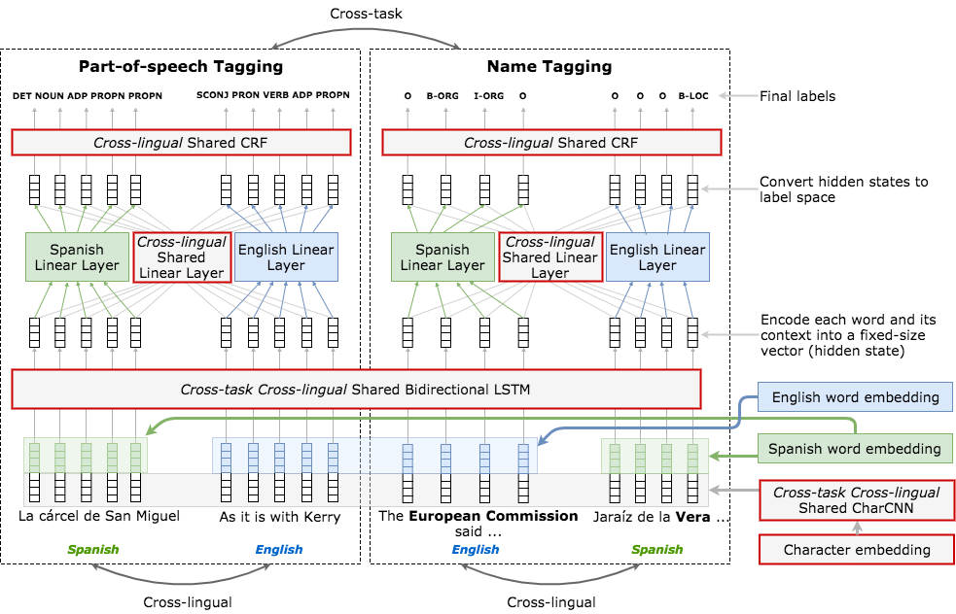
Or cross-task cross-language
(Lin et al., 2018)
Notes:
So, how does SGNS work?
Let’s say we have this sentence,
(This example was shamelessly taken from Marco Baroni)

Slide 24
Or cross-media
(Li et al., 2020submission)
Notes:
So, how does SGNS work?
Let’s say we have this sentence,
(This example was shamelessly taken from Marco Baroni)

Slide 25
Let’s apply Seq2Seq+Attention to Abstractive Summarization
Abstract summarization:
  Generate a summary to cover the important information in the source document
25
Notes:
Change low resource IL to a language which is not in wikipedia
Word-level: from bi-lingual dicts and alignment; structure-level comes from wals; multi-level alignment

Slide 26
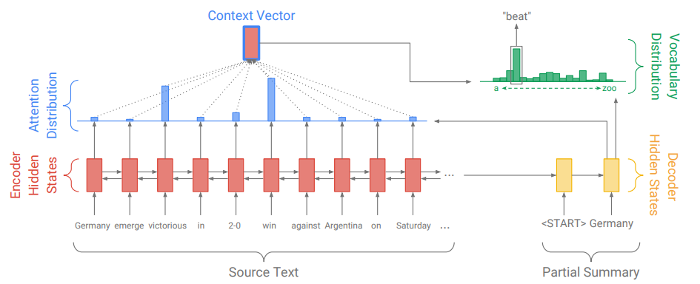
Abstractive Summarization
Problems?
  Out Of Vocabulary words

Slide 27
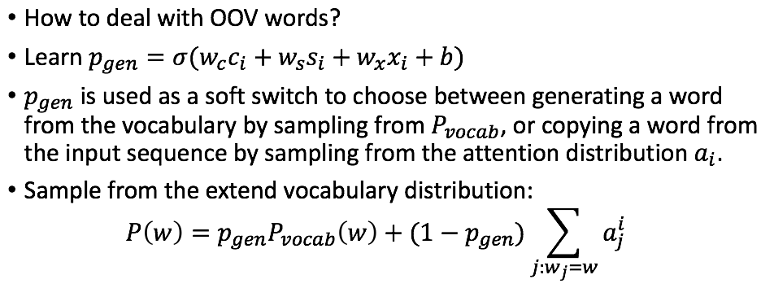
Pointer-Generator Network
(See et al., 2017)
Notes:
החלק הימני בנוסחה מעלה את ההסתברות לגנרט מילים שנמצאות במשפט בתוך הפ_ווקב.
ממש כמו שאני מכיר שעושים

Slide 28
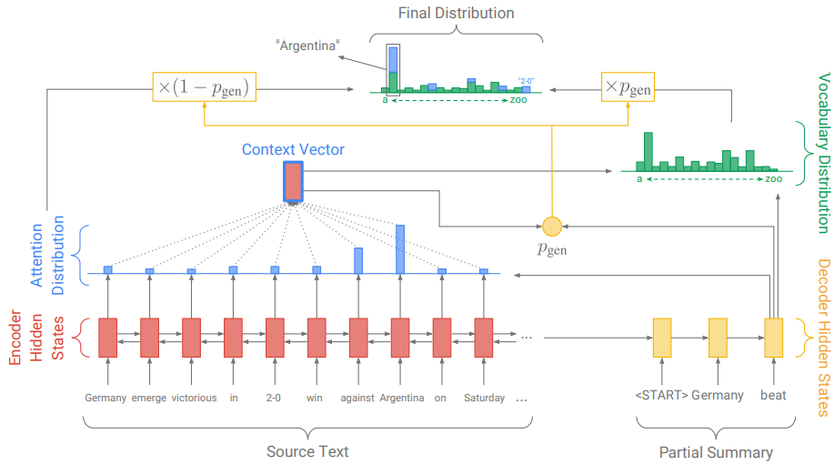
Pointer-Generator Network

Slide 29
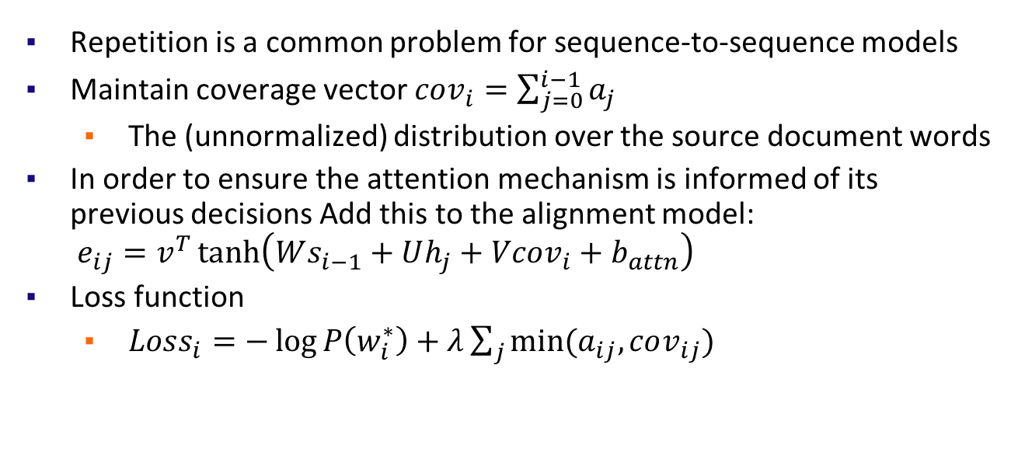
Coverage Mechanism
Repetition is a common problem for sequence-to-sequence models
Maintain coverage vector
  The (unnormalized) distribution over the source document words
In order to ensure the attention mechanism is informed of its previous decisions Add this to the alignment model:
Loss function
Tu et al., 2016
Notes:
בנוסחה האחרונה ג'יי זה ריצה על כל השורות של שני הווקטורים
ואני רוצה שהקטן מבינהם יהיה 0
למה? כי אם הייתי במקום כלשהו, אני לא רוצה להיות שם שוב, כלומר שיהיה אפס עכשיו.

Slide 30
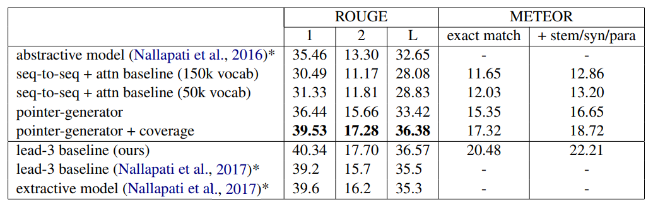
Results
ROUGE scores of the trained models on the CNN-Daily Mail dataset, computed on the test set.

Slide 31
Exercise: How to Encode Graphs?
How to distinguish Gary Johnson and Lyndon Johnson?
How to represent the relation between Mitt Romney and Gary Johnson?

Slide 32
Can we flatten graphs to sequence?

Slide 33
What that’s not enough &
Why is it hard?
Complex topographical structure (i.e., no spatial locality like grids)
No fixed node ordering or reference point (i.e., the isomorphism problem)
Often dynamic and have multimodal features
More complex for heterogeneous knowledge graphs

Slide 34
Next week we will cover
Encode tables
Graph Neural Networks
GNN based generatio

