Slide 1
Graph neural networks to represent knowledge
Heng Ji
jih@rpi.edu
February 5, 2020

Slide 2
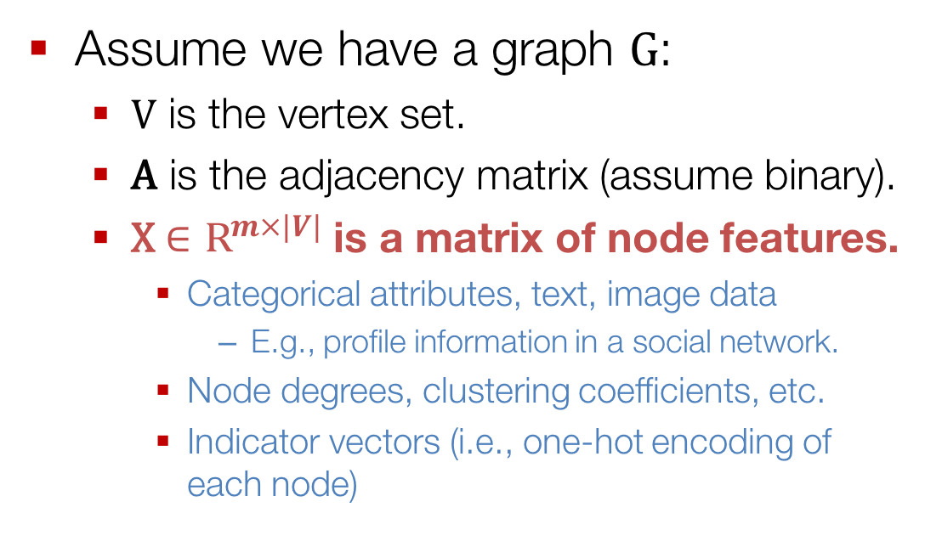
Setup
Assume we have a graph G:
  V is the vertex set.
  A is the adjacency matrix (assume binary).
  X $∈{\text{R}}^{m×|V|}$ is a matrix of node features.
    Categorical attributes, text, image data
      E.g., profile information in a social network.
    Node degrees, clustering coefficients, etc.
    Indicator vectors (i.e., one-hot encoding of each node)

Slide 3
Neighborhood Aggregation
Key idea: Generate node embeddings based on local neighborhoods.

Slide 4
Neighborhood Aggregation
Intuition: Nodes aggregate information from their neighbors using neural networks

Slide 5
Neighborhood Aggregation
Intuition: Network neighborhood defines a computation graph
Every node defines a unique computation graph!

Slide 6
Neighborhood Aggregation
Nodes have embeddings at each layer.
Model can be arbitrary depth.
“layer-0” embedding of node u is its input feature, i.e. x_{u}.
Layer-0
Layer-1
Layer-2

Slide 7
Neighborhood “Convolutions”
Neighborhood aggregation can be viewed as a center-surround filter.
Mathematically related to spectral graph convolutions (see Bronstein et al., 2017)

Slide 8
Neighborhood Aggregation
Key distinctions are in how different approaches aggregate information across the layers.
what’s in the box!?
?
???
?
?

Slide 9
Neighborhood Aggregation
Basic approach: Average neighbor information and apply a neural network.
1) average messages from neighbors
2) apply neural network

Slide 10
The Math
Basic approach: Average neighbor messages and apply a neural network.
Initial “layer 0” embeddings are equal to node features
previous layer embedding of v
kth layer embedding of v
non-linearity (e.g., ReLU or tanh)
average of neighbor’s previous layer embeddings

Slide 11
Training the Model
How do we train the model to generate “high-quality” embeddings?
Need to define a loss function on the embeddings, L(z_{u})!

Slide 12
Training the Model
trainable matrices (i.e., what we learn)
After K-layers of neighborhood aggregation, we get output embeddings for each node.
We can feed these embeddings into any loss function and run stochastic gradient descent to train the aggregation parameters.

Slide 13
Training the Model
Train in an unsupervised manner using only the graph structure.
Unsupervised loss function
  Random walks (node2vec, DeepWalk)
  Graph factorization
  i.e., train the model so that “similar” nodes have similar embeddings.

Slide 14
Training the Model
Alternative: Directly train the model for a supervised task (e.g., node classification):
Human or bot?
Human or bot?
e.g., an online social network

Slide 15
Training the Model
Alternative: Directly train the model for a supervised task (e.g., node classification):
classification weights
Human or bot?
output node embedding
node class label

Slide 16
Neighborhood Aggregation
Key distinctions are in how different approaches aggregate messages
What else can we put in the box?
?
???
?
?

Slide 17
Graph Convolutional Networks
Kipf et al.’s Graph Convolutional Networks (GCNs) are a slight variation on the neighborhood aggregation idea:

Slide 18
Graph Convolutional Networks
Basic Neighborhood Aggregation
VS.
GCN Neighborhood Aggregation
same matrix for self and neighbor embeddings
per-neighbor normalization

Slide 19
Graph Convolutional Networks
Empirically, they found this configuration to give the best results.
  More parameter sharing.
  Down-weights high degree neighbors.
use the same transformation matrix for self and neighbor embeddings
instead of simple average, normalization varies across neighbors

Slide 20
Application: Cross-lingual Relation and Event Transfer
(Subburathinam et al., EMNLP2019)
Hypothesis: Relational facts are typically expressed by identifiable patterns which are consistent across languages (Lin et al., 2017)
Language-universal symbolic representations
  POS tagging and dependency parsing are available for 84 languages (Nivre et al., 2018)
  Entity extraction is available for 282 languages (Pan et al., 2017)
Language-universal distributional representations
  multi-lingual word embedding is available for 44 languages (Bojanowski et al., 2017; Joulin et al., 2018)
Notes:
Relation and event requires structure. Dependency parsing. Convert a sentence into semantic syntactic. Dependency relations subj. modifier. Shallow graphs. Convert shallow graphs to information networks.

Slide 21
Toward more Structured Representations

Slide 22
Graph Convolutional Networks (GCN) Encoder
Extend the monolingual design (Zhang et al., 2018) to cross-lingual
  Convert a sentence with N tokens into N*N adjacency matrix A
  Node: token, each edge is a directed dependency edge
Initialization of each node’s representation
At the k^{th} layer, derive the hidden representation of each node from the representations of its neighbors at previous layer
Word embedding
POS tag
Dependency relation
Entity type

Slide 23
Application on Relation Extraction
  Task: Classify each pair of entity mentions into one of pre-defined relation types or NONE
  Max-pooling over the final node representations to obtain representations for sentence and two entity mentions, and concatenate them
  A softmax output layer for relation type classification

Slide 24
Application on Event Argument Extraction
  Task: Classify each pair of event trigger and entity mentions into one of pre-defined event argument roles or NONE
  Max-pooling over the final node representations to obtain representations for sentence, trigger and argument candidate, and concatenate them
  A softmax output layer for argument role labeling

Slide 26
Comparison with Supervised Approach
  Chinese Event Argument Extraction

Slide 27
GraphSAGE Idea
So far we have aggregated the neighbor messages by taking their (weighted) average, can we do better?
?
???
?
?

Slide 28
GraphSAGE Idea
Any differentiable function that maps set of vectors to a single vector.

Slide 29
GraphSAGE Differences
Simple neighborhood aggregation:
GraphSAGE:
concatenate self embedding and neighbor embedding
generalized aggregation

Slide 30
GraphSAGE Variants
Mean:
Pool
  Transform neighbor vectors and apply symmetric vector function.
LSTM:
  Apply LSTM to random permutation of neighbors.
element-wise mean/max

Slide 31
Gated GNN
Basic idea: Nodes aggregate “messages” from their neighbors using neural networks

Slide 32
Neighborhood Aggregation
GCNs and GraphSAGE generally only 2-3 layers deep.

Slide 33
Neighborhood Aggregation
But what if we want to go deeper?
10+ layers!?

Slide 34
Gated Graph Neural Networks
How can we build models with many layers of neighborhood aggregation?
Challenges:
  Overfitting from too many parameters.
  Vanishing/exploding gradients during backpropagation.
Idea: Use techniques from modern recurrent neural networks!

Slide 35
Gated Graph Neural Networks
Idea 1: Parameter sharing across layers.
same neural network across layers

Slide 36
Gated Graph Neural Networks
Idea 2: Recurrent state update.
RNN module!
RNN module

Slide 37
The Math
Intuition: Neighborhood aggregation with RNN state update.
  Get “message” from neighbors at step k:
  Update node “state” using Gated Recurrent Unit (GRU). New node state depends on the old state and the message from neighbors:
aggregation function does not depend on k

Slide 38
Gated Graph Neural Networks
RNN module
Can handle models with >20 layers.
Most real-world networks have small diameters (e.g., less than 7).
Allows for complex information about global graph structure to be propagated to all nodes.

Slide 39
Gated Graph Neural Networks
RNN module
Useful for complex networks representing:
  Logical formulas.
  Programs.

Slide 40
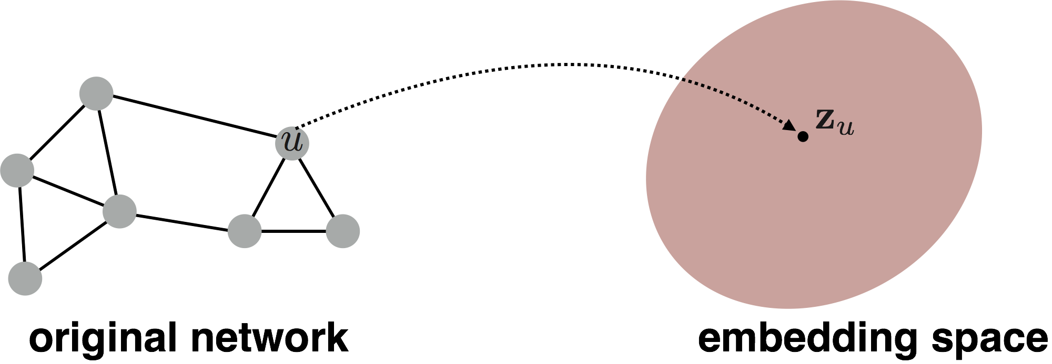
(Sub)graph Embeddings
So far we have focused on node-level embeddings…

Slide 41
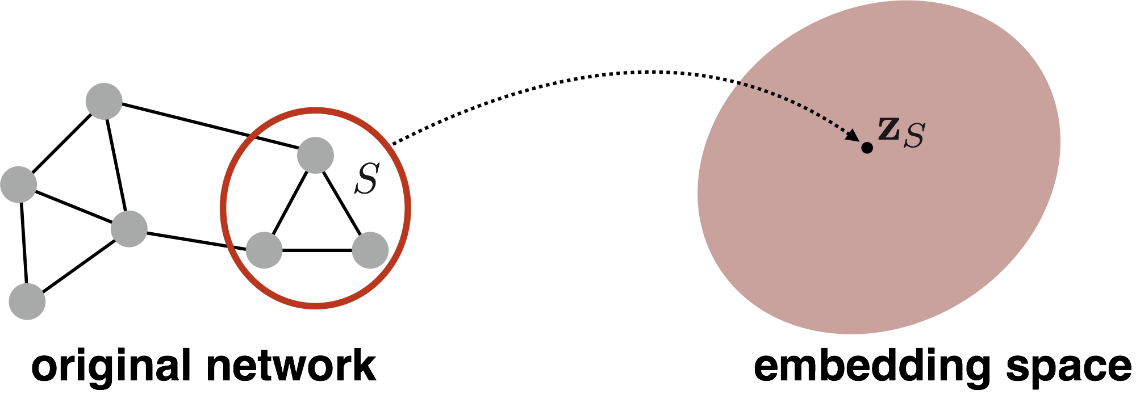
(Sub)graph Embeddings
But what about subgraph embeddings?

Slide 42
Approach 1
Simple idea: Just sum (or average) the node embeddings in the (sub)graph
Used by Duvenaud et al., 2016 to classify molecules based on their graph structure.

Slide 43

Approach 2
Idea: Introduce a “virtual node” to represent the subgraph and run a standard graph neural network.
Proposed by Li et al., 2016 as a general technique for subgraph embedding.

Slide 44
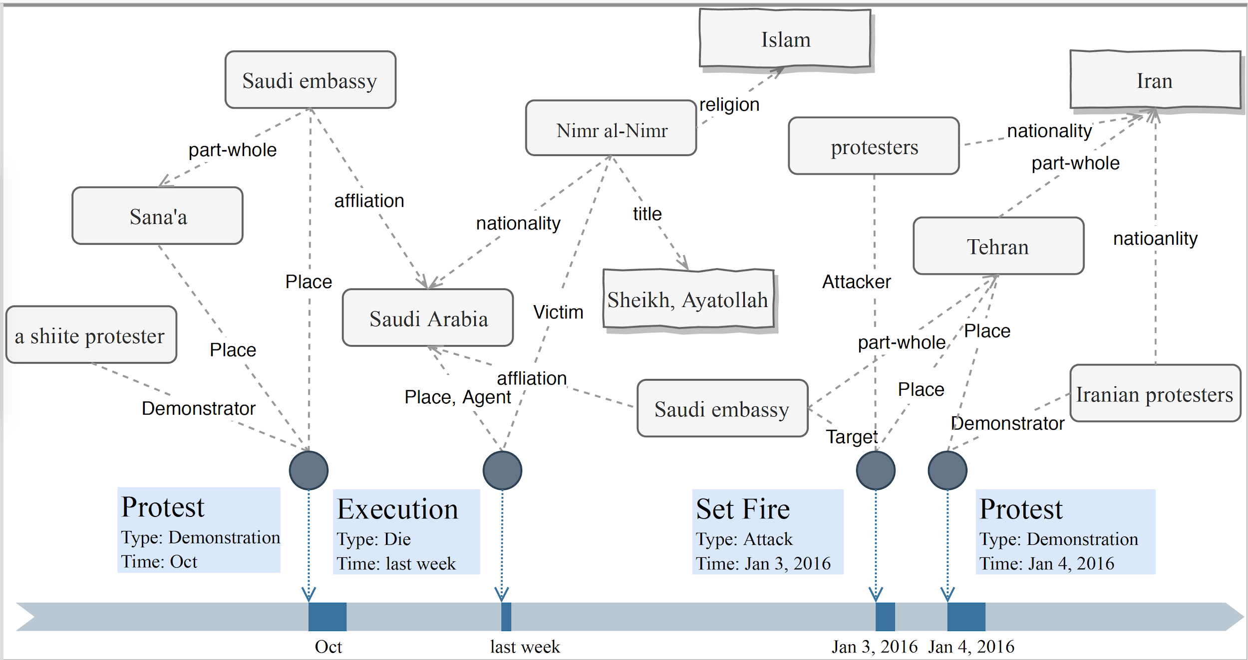
Exercise: Entity/Event Graph
How to include arguments for event representation?
How to use related events to help event representation?
How to improve entity representation based on events?
Role
Relation
Relation
Relation
Role
…
Event
Entity
Entity
Entity
Event
Notes:
Add wiki

