Slide 1
Knowledge-driven Natural Language Generation
Heng Ji
hengji@illinois.edu
Deliberately constructing a natural language text in order to meet specified communicative goals
Acknowledgement: many slides from Yoav Goldberg INLG2018 tutorial

Slide 2
Some logistics & mutual introductions
Course website:
http://blender.cs.illinois.edu/course/spring22/nlg.html
This is a course designed for PhD students who have taken NLP/ML courses
If you get lost from lecture 1 and 2 and the first reading assignment, please consider dropping the course
My lab page (I’m hiring RAs)
http://blender.cs.illinois.edu/index.html
Introduce yourself:
Research group/advisor name
One fun fact Google doesn’t know about you?
Are you a cat person or a dog person?
Use two adjectives to describe your mood right now
One question about the class
2
Notes:
Change low resource IL to a language which is not in wikipedia
Word-level: from bi-lingual dicts and alignment; structure-level comes from wals; multi-level alignment

Slide 3
What is NLG?
Deliberately constructing a natural language text in order to meet specified communicative goals
Input: some semantic representation of information
Output: documents, reports, messages, papers, etc
3
Notes:
Change low resource IL to a language which is not in wikipedia
Word-level: from bi-lingual dicts and alignment; structure-level comes from wals; multi-level alignment

Slide 4
Text generation is needed everywhere in our life!
Leveraging machine intelligence to make many things EASY and FAST
What should I wear outside today?
“... Her husband was one of 17 people killed in January’s terror attacks in Paris. ... Valerie Braham said to the assembled crowd. ...”
“… Philippe Braham was killed in the January’s terror attacks. …”
The temperature will be 85 at noon. You can wear short sleeve shorts.
Dialog systems
Summarization
“... The game ended with the umpire making a bad call, and if the call had gone the other way, the Blue Whales might have actually won the game. It wasn’t a victory, but I say the Blue Whales look like they have a shot at the championship, especially if they continue to improve.”
“... The match ended with the referee calling wrongly, and if the call went the other way, the Blue Whales could already win the match. It was not a victory, but I say that the Blue Whales seem to have a chance in the championship, especially if they keep improving.”
“... (Two years after, Maria was born ... ) …
Her brother gave her a hug. ...”
“… 她的哥哥给了她一个大大的拥抱. …”
Machine Translation
Paraphrasing
4

Slide 5
Knowledge is needed everywhere in text generation!
Mistakes may occur due to lack of knowledge.
“… Valerie Braham Philippe Braham was killed in the January’s terror attacks. …”
What should I wear outside today?
“... Her husband was one of 17 people killed in January’s terror attacks in Paris. ... Valerie Braham said to the assembled crowd. ...”
The temperature will be 65 85 at noon. You can wear short sleeve shorts.
Dialog systems
Summarization
“... The game ended with the umpire making a bad call, and if the call had gone the other way, the Blue Whales might have actually won the game. It wasn’t a victory, but I say the Blue Whales look like they have a shot at the championship, especially if they continue to improve.”
“... The match ended with the referee calling wrongly, and if the call went the other way, the Blue Whales could never already win the match. It was not a victory, but I say that the Blue Whales seem to have a chance in the championship, especially if they keep improving.”
“... (Two years after, Maria was born ... ) …
Her brother gave her a hug. ...”
“… 她的弟弟哥哥给了她一个大大的拥抱. …”
Machine Translation
Paraphrasing
5

Slide 6
Knowledge-Enriched Natural Language Generation (KE-NLG)
Key questions:
Where does the Knowledge come from? In other words, what are the Knowledge sources?
What are the data/representations of Knowledge?
What are the methods for integrating Knowledge into NLG models? How to utilize different types of Knowledge?
What are the concrete NLG models/techniques that have been enhanced by Knowledge? What are their advantages and disadvantages?
Where can we find benchmark datasets, code library, and hands-on tutorial for doing research on this topic?
What are the remaining challenges and future directions?
Knowledge
Model
Input text
Output text
6

Slide 7
Knowledge Guided NLG Survey and our EMNLP2021 tutorial
Website: https://kenlg-tutorial.github.io/
Schedule
Slides
Tutor information
A pre-print survey on the topic of Knowledge-enhanced NLG:
https://arxiv.org/abs/2010.04389
A reading list and a collection of open-source code:
https://github.com/wyu97/KENLG-Reading
An awesome resource list:
https://github.com/topics/natural-language-generation

Slide 8
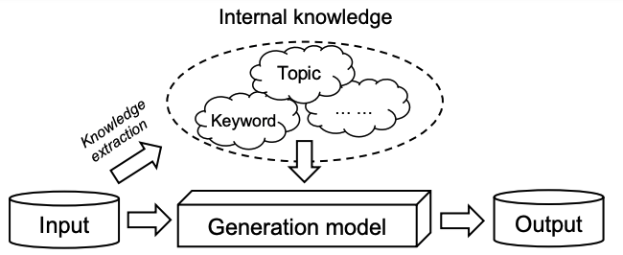
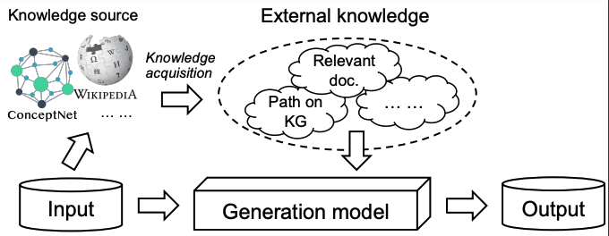
Knowledge-enhanced NLG (Overall)
Internal Knowledge-enhanced Methods
Knowledge-enhanced NLG Methods
Internal knowledge creation takes place within the input text(s)
External Knowledge-enhanced Methods
External knowledge acquisition occurs when knowledge is provided from outside sources

Slide 9
Knowledge-enhanced NLG (Overall)
knowledge
source
knowledge extraction and representation
Topic
E.g., LDA, CNN, Neural topic
Internal Knowledge-enhanced Methods
Keyword
E.g., Keyword assignment, keyword extraction
Linguistic
features
E.g., POS tag, NER tag,
Dependency parsing
Knowledge-enhanced NLG Methods
Knowledge
base
E.g., KB memory network,
KB related tasks
External Knowledge-enhanced Methods
Knowledge
graph
E.g., KGE, Path finding and reasoning, Graph neural network
Grounded
text
E.g., Retrieval-augmented, Background based methods

Slide 10
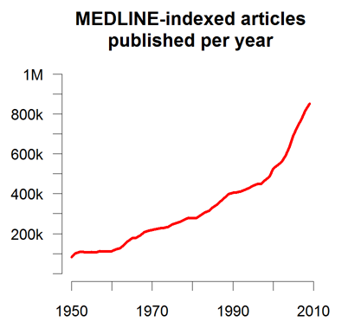
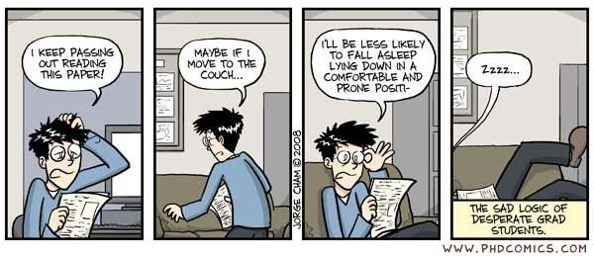
Application 1: Accelerating Scientific Discovery
Problems on Scientific Literatures
Quantity
More than 300+ papers are published every day in the biomedical domain, it’s impossible for scientists to keep tracking of all the progress
Human’s reading ability keeps almost the same across years: US scientists estimated that they read, on average, only 264 papers per year (1 out of 5000 available papers, the same across years)
Quality
Many research results are redundant, complementary, or even conflicting with each other
More than 60% of 6.4 million papers in biomedicine and chemistry published between 1934 and 2008 are incremental work

Slide 11
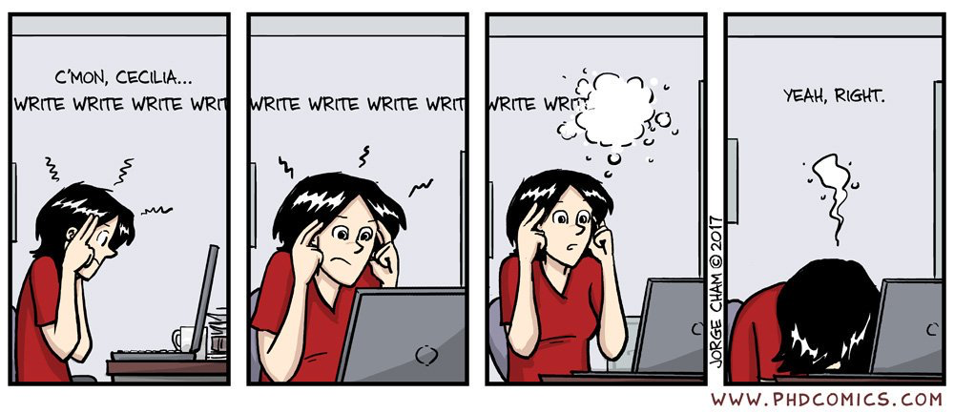
Application 1: Accelerating Scientific Discovery
Problems on Paper Writing
Many scientists are, in fact, bad writers (Pinker, 2014):
“I know many scholars who have nothing to hide and no need to impress. They do groundbreaking work on important subjects, reason well about clear ideas, and are honest, down-to-earth people. Still, their writing stinks.”

Slide 12
Example Results
Title | Snail transcription factor negatively regulates maspin tumor suppressor in human prostate cancer cells
Entities | Related: nasopharyngeal carcinoma; diallyl disulfide
Output | Human (Neal et al., 2012) | System
Abstract | Background: Maspin, a putative tumor suppressor that is down-regulated in breast and prostate cancer, has been associated with decreased cell motility. Snail transcription factor is a zinc finger protein that is increased in breast cancer and is associated with increased tumor motility and invasion by induction of epithelial-mesenchymal transition (EMT).We investigated the molecular mechanisms by which Snail increases tumor motility and invasion utilizing prostate cancer cells. Methods: Expression levels were analyzed by RT-PCR and western blot analyses. Cell motility and invasion assays were performed , while Snail regulation and binding to maspin promoter was analyzed by luciferase reporter and chromatin immunoprecipitation (ChIP) assays. Results: Snail protein expression was higher in different prostate cancer cells lines as compared to normal prostate epithelial cells. | Background: Snail is a multifunctional protein that plays an important role in the pathogenesis of prostate cancer. However, it has been shown to be associated with poor prognosis. The purpose of this study was to investigate the effect of negatively on the expression of maspin in human nasopharyngeal carcinoma cell lines. Methods: Quantitative real-time PCR and western blot analysis were used to determine whether the demethylating agent was investigated by quantitative RT-PCR (qRT-PCR) and Western blotting. Results showed that the binding protein plays a significant role in the regulation of tumor growth and progression.
Conclusion and Future work | Collectively, our results indicate for the first time that Snail can negatively regulate maspin through direct promoter repression resulting in increased migration and invasion in prostate cancer cells. This study reveals a novel mechanism of how Snail may function and show the importance of therapeutic targeting of Snail signaling in future. | In summary, our study demonstrates that Snail negatively inhibited the expression of Maspin in human nasopharyngeal carcinoma cell lines and in vitro. Our results indicate that the combination of the demethylating agent might be a potential therapeutic target for the treatment of prostate cancer.
New Title | Role of maspin in cancer (Berardi et al., 2013) | The role of nasopharyngeal carcinoma in the rat model of prostate cancer cells
https://github.com/EagleW/PaperRobot

Slide 13
Application 2: Intelligent Dialog Systems
Problems with dialog systems
Produce trivial responses with frequent words in the corpus
For example, a chatbot may say “I do not know”, “I see” too often
Lack of universal knowledge
Cannot deal with open-domain conversation
Require labeled data for each new goal
Generate off-topic replies even with dialogue history and knowledge
Overlook the selected knowledge
Fail to recognize dependencies in the long-range contexts
Ignore the inherent knowledge transitions
Lack of long-term memory

Slide 14
Example
Gupta, P., Bigham, J.P., Tsvetkov, Y., & Pavel, A. (2021). Controlling Dialogue Generation with Semantic Exemplars. NAACL.

Slide 15
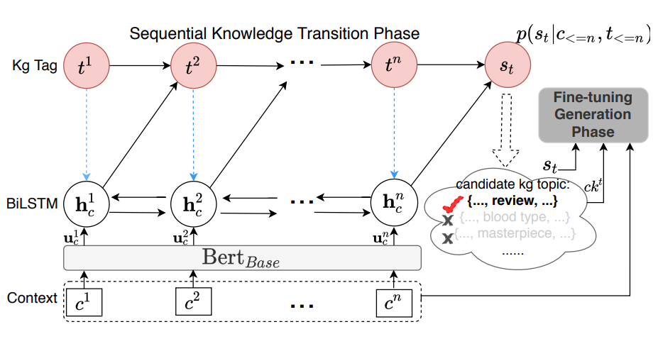
Sequential Knowledge Transition
Condition response on knowledge tag and knowledge content
Pretrain a knowledge-aware response generator based on the knowledge and its context sentence
Train a BiLSTM-CRF to select knowledge tag
Fine-tune the response generator with context utterance and selected knowledge tag
Zhan, H., Zhang, H., Chen, H., Ding, Z., Bao, Y., & Lan, Y. (2021). Augmenting Knowledge-grounded Conversations with Sequential Knowledge Transition. NAACL.

Slide 16
Example
Zhan, H., Zhang, H., Chen, H., Ding, Z., Bao, Y., & Lan, Y. (2021). Augmenting Knowledge-grounded Conversations with Sequential Knowledge Transition. NAACL.

Slide 17
Application 3: Narrative Question Answering
Problems with narrative question answering
Lack of external/commonsense knowledge
For example, without knowing any information about an Amazon product, it is hard to deliver satisfactory answers to the user questions such as “Does the laptop have a long battery life?” or “Is this refrigerator frost-free?”
Fail to recognize implicit relations which are not mentioned in the context
Drift away from a correct answer during generation
Without external guidance, generative models often generate answers semantically drifting away from the given passage and question

Slide 18
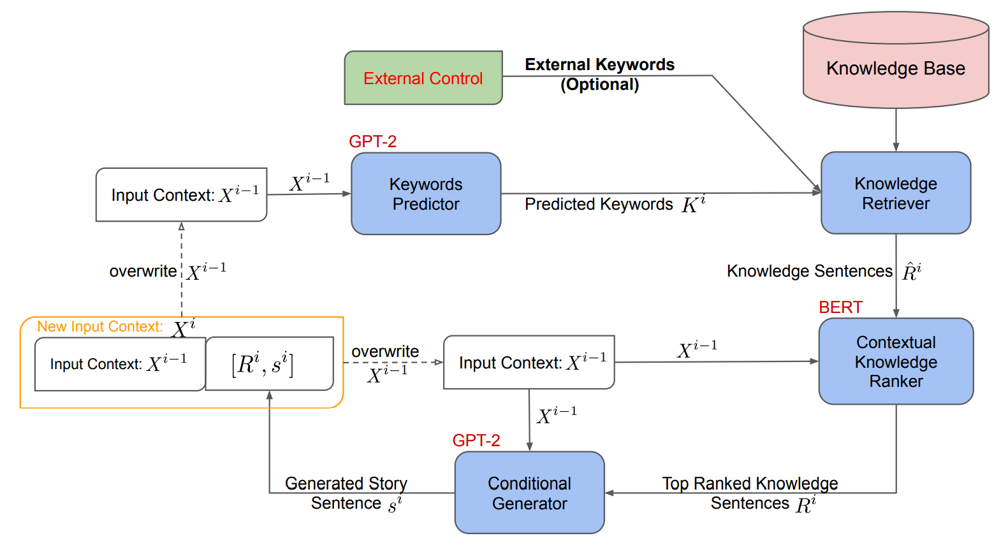
Application 5: Story Generation
Incorporate external knowledge base
Allow controllability by replacing the keyword prediction process with manual external keywords
Xu, P., Patwary, M.A., Shoeybi, M., Puri, R., Fung, P., Anandkumar, A., & Catanzaro, B. (2020). Controllable Story Generation with External Knowledge Using Large-Scale Language Models. EMNLP.

Slide 19
Example
Context | [MALE] and his friends are bored on a weekend day.
Guan et al. (2019) | they decided to sneak into a movie . they got a bunch of popcorn and a movie . then , they made it to a movie . now , they have a really good time .
MEGATRON-CNTRL-124M | keyword: go, decides it is going to be a big night. [MALE] and his friends decide to go out. they get drunk and have a great time. when they are done they feel happy.
MEGATRON-CNTRL-8B | keyword: go, decides they decided to go to the video game store. [MALE] picks out a new video game. [MALE] and his friends have fun playing the new video game. [MALE] is no longer bored.
MEGATRON-CNTRL-8B-ANT | keyword: come a new tv show begins to come on the local channel. [MALE] is excited to watch his favorite tv show. he watches his show and they all laugh together. [MALE] and his friends have a fun time watching their favorite show.
https://github.com/NVIDIA/Megatron-LM

Slide 20
Why it’s useful? : Chit-Chat
https://www.youtube.com/watch?v=WnzlbyTZsQY (2011)
https://www.youtube.com/watch?v=mpw_FB2QrjQ (2017)
https://www.bilibili.com/video/av6567466/
20
Notes:
Change low resource IL to a language which is not in wikipedia
Word-level: from bi-lingual dicts and alignment; structure-level comes from wals; multi-level alignment

Slide 21
Application: Autonomous Car
(Qin et al., EMNLP2019)
21
Notes:
Change low resource IL to a language which is not in wikipedia
Word-level: from bi-lingual dicts and alignment; structure-level comes from wals; multi-level alignment

Slide 22
Application: PaperRobot
(Wang et al., ACL2019)

Slide 23
Application: Therapist
23
Notes:
Change low resource IL to a language which is not in wikipedia
Word-level: from bi-lingual dicts and alignment; structure-level comes from wals; multi-level alignment

Slide 24
Visions of dialogue from science fiction
Hal “2001: A Space Odyssey” (1968)
Naturally conversing computer
Star Trek (original 1966)
Natural language command and control
Her (2013)
A virtual partner with natural dialogue capabilities

Slide 25
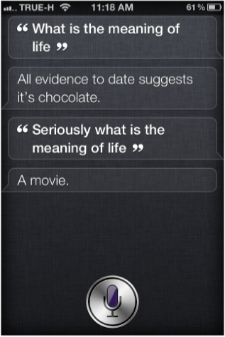
Examples of modern Virtual Assistant dialogue systems
Apple Siri (2010)
Supports questions in a set of domains
Answers open-end questions
Cute “Easter egg” responses

Slide 26
Examples of modern Virtual Assistant dialogue systems
Android Google Now (2013)
Predictive search assistant
Windows Cortana (2014)
Works across different Windows devices
Aims to be able to “talk about anything”

Slide 27
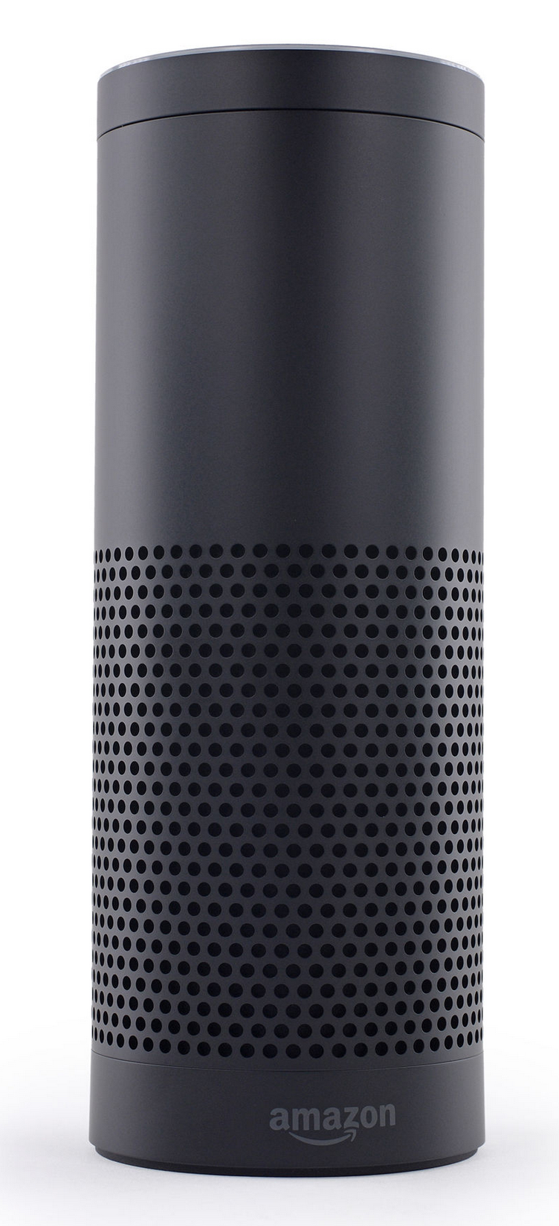
Embedded devices with dialogue capabilities
Amazon Echo (2014) – home assistant device
Plays music
With voice commands
Question answering
Get weather, news
More complex questions, like
“how many spoons are in a cup?”
Setting timer
Manages TODO lists

Slide 28
Google Assistant
28
Notes:
Change low resource IL to a language which is not in wikipedia
Word-level: from bi-lingual dicts and alignment; structure-level comes from wals; multi-level alignment

Slide 29
How did people do it in old days?
Template Filling
29
Notes:
Change low resource IL to a language which is not in wikipedia
Word-level: from bi-lingual dicts and alignment; structure-level comes from wals; multi-level alignment

Slide 30
How did people do it in old days?
Template Filling
30
Notes:
Change low resource IL to a language which is not in wikipedia
Word-level: from bi-lingual dicts and alignment; structure-level comes from wals; multi-level alignment

Slide 31
More Modern Methods
31
Notes:
Change low resource IL to a language which is not in wikipedia
Word-level: from bi-lingual dicts and alignment; structure-level comes from wals; multi-level alignment

Slide 32
Toward Knowledge-driven NLG
32
Notes:
Change low resource IL to a language which is not in wikipedia
Word-level: from bi-lingual dicts and alignment; structure-level comes from wals; multi-level alignment

Slide 33
We will study basic neural NLG models
33
Notes:
Change low resource IL to a language which is not in wikipedia
Word-level: from bi-lingual dicts and alignment; structure-level comes from wals; multi-level alignment

Slide 34
We will study basic neural NLG models
34
Notes:
Change low resource IL to a language which is not in wikipedia
Word-level: from bi-lingual dicts and alignment; structure-level comes from wals; multi-level alignment

Slide 35
Building Blocks
Neural Networks
35
Notes:
Change low resource IL to a language which is not in wikipedia
Word-level: from bi-lingual dicts and alignment; structure-level comes from wals; multi-level alignment

Slide 36
Building Blocks
Neural Networks
36
Notes:
Change low resource IL to a language which is not in wikipedia
Word-level: from bi-lingual dicts and alignment; structure-level comes from wals; multi-level alignment

Slide 37
Building Blocks
Neural Networks
37
Notes:
Change low resource IL to a language which is not in wikipedia
Word-level: from bi-lingual dicts and alignment; structure-level comes from wals; multi-level alignment

Slide 38
Building Blocks
Combining Vectors: multi-layer RNN
38
Notes:
Change low resource IL to a language which is not in wikipedia
Word-level: from bi-lingual dicts and alignment; structure-level comes from wals; multi-level alignment

