Slide 1
Abstractive summarization
Heng Ji
hengji@illinois.edu
February 18, 2021
Acknowledgement: many slides from Lu Wang

Slide 2
Problems for Existing Neural Abstractive Summarization Models
Input Article:
A plan by the City Sanitation Department to build a trash-transfer station at the site of a former incinerator on the Bensonhurst waterfront was denounced yesterday by Assemblyman William Colton, the chairman of the State Legislative Commission on Solid Waste Management.
…
The new facility would require repeated dredging of the bay, which Mr. Colton said would stir up toxins and harm birds and aquatic creatures.
…
Abstractive summary by a popular neural model:
Assemblyman William Colton, chairman of State Legislative Commission on Solid Waste Management, denounced by New York City Sanitation Department to build trash-transfer station at site of former incinerator on Bensonhurst waterfront.
Notes:
Fabricated content, near-extract, focus on the beginning of the article

Slide 3
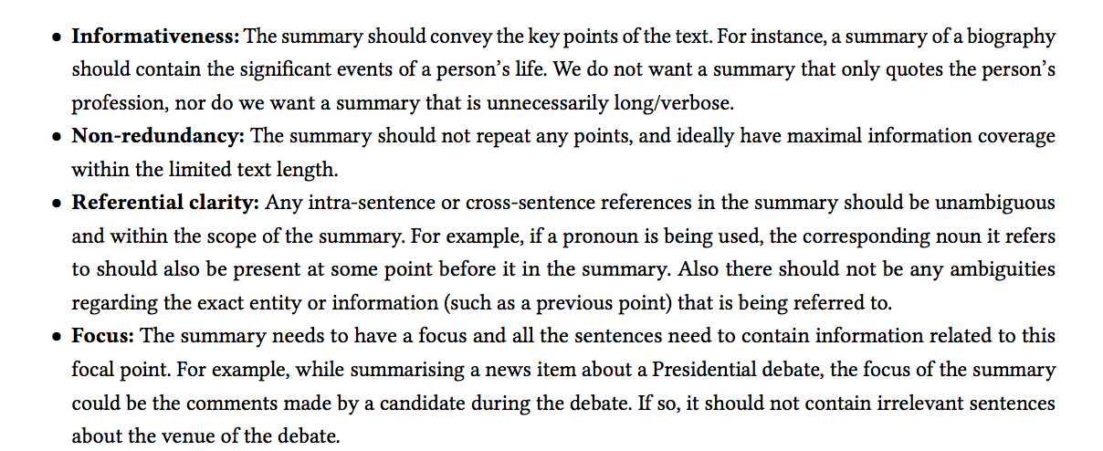
Evaluation Criteria

Slide 4
Problems for Existing Neural Abstractive Summarization Models
Fabricated content
  About 30% of the summaries contain unfaithful information by state-of-the-art models (Cao et al, 2018)
Near-extractive and limited correct paraphrasing (See et al., 2017; Kryscinski et al., 2018)
Relying on position information, e.g. hardly including salient content from later part of the articles
Poor linguistic quality, e.g. lack of coherence

Slide 5
Near-extractive Summaries
Seq2seq: sequence-to-sequence model with regular attention
Chen & Bansal: Reinforcement learning-based model
Point-gen: pointer-generator model with copying mechanism added on seq2seq

Slide 6
Near-extractive Summaries
Seq2seq: sequence-to-sequence model with regular attention
Chen & Bansal: Reinforcement learning-based model
Point-gen: pointer-generator model with copying mechanism added on seq2seq
Also contain fabricated information!

Slide 7
Summary-worthy Content and its Position in News

Slide 8
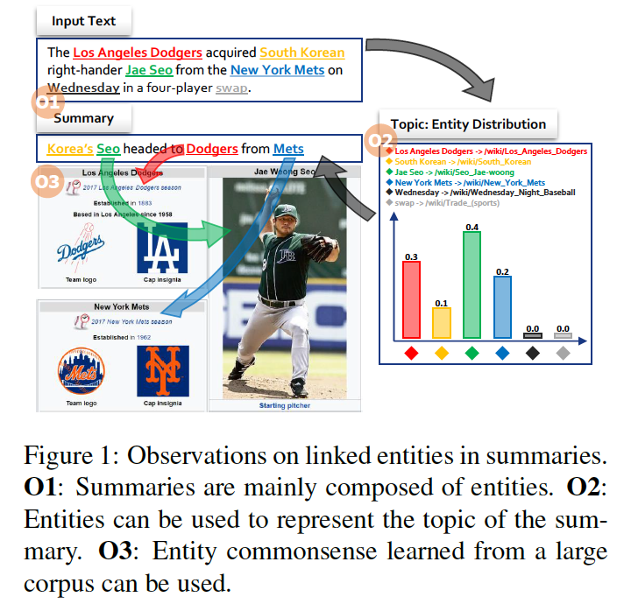
Incorporating Entity Commonsense
(Gerhrmann et al., EMNLP2018)
transforms a list of entities into a vector representation of the topic of the summary.
Notes:
300 papers… every day… impossible to read… keyword search… abstract doesn’t reflect… results; ignore most of them. Cancer and surgery… 3 days… walk through all posters.. In our field papers that were published twenty years ago are not that important…
including mining PubMed bibliographic data, research papers in PubMed, clinical data sets and numerous bio-medical websites and social media related to medical sciences, where data related to diseases, drugs, treatments, chemical compounds, proteins, genes, biological pathways can be integrated and extracted from text data and their characteristics and relationships can be mined from such datasets as well
. Older literature is often extremely important (and overlooked), and indeed, often provides a rich source of information that can lead to new hypotheses. This makes the information overload problem event more serious, because we need distill and connect knowledge from papers that may cover 70 years.

Slide 9
Method
Encodes the entities extracted from the original text by an entity linking system (ELS), constructs a vector representing the topic of the summary to be generated, and informs the decoder about the constructed topic vector
Problem: Due to the imperfections of current ELS’s, the extracted linked entities may be too ambiguous and coarse to be considered relevant to the summary
Solution: use entity encoders with selective disambiguation, topic vectors using firm attention.
Notes:
300 papers… every day… impossible to read… keyword search… abstract doesn’t reflect… results; ignore most of them. Cancer and surgery… 3 days… walk through all posters.. In our field papers that were published twenty years ago are not that important…
including mining PubMed bibliographic data, research papers in PubMed, clinical data sets and numerous bio-medical websites and social media related to medical sciences, where data related to diseases, drugs, treatments, chemical compounds, proteins, genes, biological pathways can be integrated and extracted from text data and their characteristics and relationships can be mined from such datasets as well
. Older literature is often extremely important (and overlooked), and indeed, often provides a rich source of information that can lead to new hypotheses. This makes the information overload problem event more serious, because we need distill and connect knowledge from papers that may cover 70 years.

Slide 10
Method
Encodes the entities extracted from the original text by an entity linking system (ELS), constructs a vector representing the topic of the summary to be generated, and informs the decoder about the constructed topic vector
Problem: Due to the imperfections of current ELS’s, the extracted linked entities may be too ambiguous and coarse to be considered relevant to the summary
Solution: use entity encoders with selective disambiguation, topic vectors using firm attention.
Notes:
300 papers… every day… impossible to read… keyword search… abstract doesn’t reflect… results; ignore most of them. Cancer and surgery… 3 days… walk through all posters.. In our field papers that were published twenty years ago are not that important…
including mining PubMed bibliographic data, research papers in PubMed, clinical data sets and numerous bio-medical websites and social media related to medical sciences, where data related to diseases, drugs, treatments, chemical compounds, proteins, genes, biological pathways can be integrated and extracted from text data and their characteristics and relationships can be mined from such datasets as well
. Older literature is often extremely important (and overlooked), and indeed, often provides a rich source of information that can lead to new hypotheses. This makes the information overload problem event more serious, because we need distill and connect knowledge from papers that may cover 70 years.

Slide 11
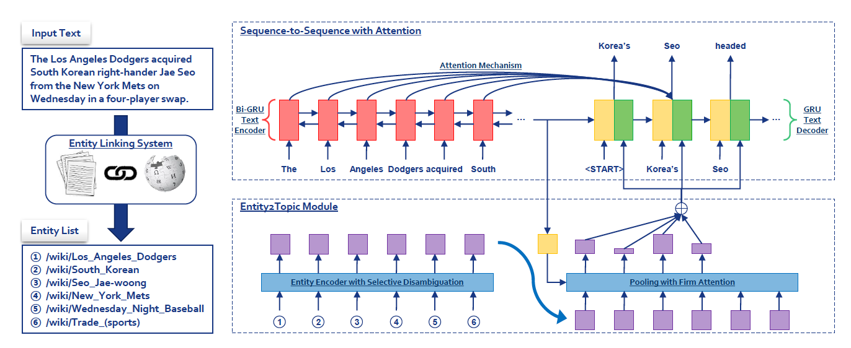
Method
Notes:
300 papers… every day… impossible to read… keyword search… abstract doesn’t reflect… results; ignore most of them. Cancer and surgery… 3 days… walk through all posters.. In our field papers that were published twenty years ago are not that important…
including mining PubMed bibliographic data, research papers in PubMed, clinical data sets and numerous bio-medical websites and social media related to medical sciences, where data related to diseases, drugs, treatments, chemical compounds, proteins, genes, biological pathways can be integrated and extracted from text data and their characteristics and relationships can be mined from such datasets as well
. Older literature is often extremely important (and overlooked), and indeed, often provides a rich source of information that can lead to new hypotheses. This makes the information overload problem event more serious, because we need distill and connect knowledge from papers that may cover 70 years.

Slide 12
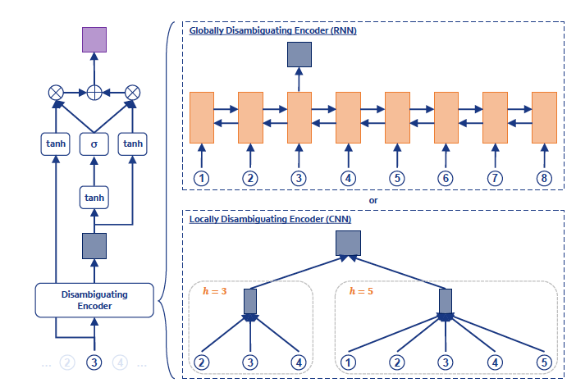
Entity Encoding Submodule
Notes:
300 papers… every day… impossible to read… keyword search… abstract doesn’t reflect… results; ignore most of them. Cancer and surgery… 3 days… walk through all posters.. In our field papers that were published twenty years ago are not that important…
including mining PubMed bibliographic data, research papers in PubMed, clinical data sets and numerous bio-medical websites and social media related to medical sciences, where data related to diseases, drugs, treatments, chemical compounds, proteins, genes, biological pathways can be integrated and extracted from text data and their characteristics and relationships can be mined from such datasets as well
. Older literature is often extremely important (and overlooked), and indeed, often provides a rich source of information that can lead to new hypotheses. This makes the information overload problem event more serious, because we need distill and connect knowledge from papers that may cover 70 years.

Slide 13
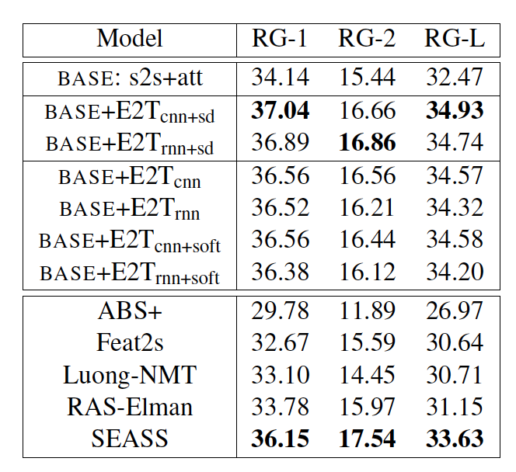
Results
Notes:
300 papers… every day… impossible to read… keyword search… abstract doesn’t reflect… results; ignore most of them. Cancer and surgery… 3 days… walk through all posters.. In our field papers that were published twenty years ago are not that important…
including mining PubMed bibliographic data, research papers in PubMed, clinical data sets and numerous bio-medical websites and social media related to medical sciences, where data related to diseases, drugs, treatments, chemical compounds, proteins, genes, biological pathways can be integrated and extracted from text data and their characteristics and relationships can be mined from such datasets as well
. Older literature is often extremely important (and overlooked), and indeed, often provides a rich source of information that can lead to new hypotheses. This makes the information overload problem event more serious, because we need distill and connect knowledge from papers that may cover 70 years.

Slide 14
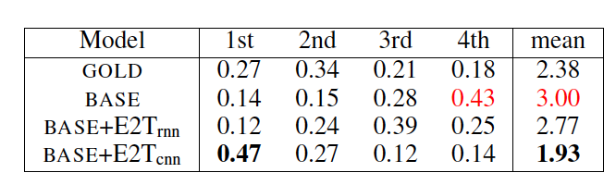
Human Evaluation
Notes:
300 papers… every day… impossible to read… keyword search… abstract doesn’t reflect… results; ignore most of them. Cancer and surgery… 3 days… walk through all posters.. In our field papers that were published twenty years ago are not that important…
including mining PubMed bibliographic data, research papers in PubMed, clinical data sets and numerous bio-medical websites and social media related to medical sciences, where data related to diseases, drugs, treatments, chemical compounds, proteins, genes, biological pathways can be integrated and extracted from text data and their characteristics and relationships can be mined from such datasets as well
. Older literature is often extremely important (and overlooked), and indeed, often provides a rich source of information that can lead to new hypotheses. This makes the information overload problem event more serious, because we need distill and connect knowledge from papers that may cover 70 years.

Slide 15
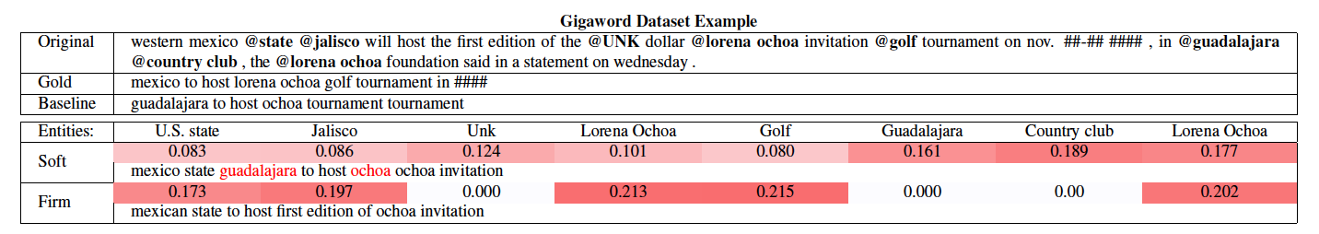
Example output
Notes:
300 papers… every day… impossible to read… keyword search… abstract doesn’t reflect… results; ignore most of them. Cancer and surgery… 3 days… walk through all posters.. In our field papers that were published twenty years ago are not that important…
including mining PubMed bibliographic data, research papers in PubMed, clinical data sets and numerous bio-medical websites and social media related to medical sciences, where data related to diseases, drugs, treatments, chemical compounds, proteins, genes, biological pathways can be integrated and extracted from text data and their characteristics and relationships can be mined from such datasets as well
. Older literature is often extremely important (and overlooked), and indeed, often provides a rich source of information that can lead to new hypotheses. This makes the information overload problem event more serious, because we need distill and connect knowledge from papers that may cover 70 years.

Slide 16
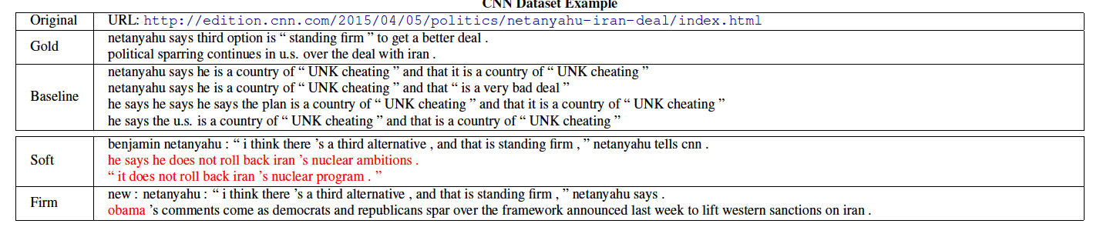
Example output
Notes:
300 papers… every day… impossible to read… keyword search… abstract doesn’t reflect… results; ignore most of them. Cancer and surgery… 3 days… walk through all posters.. In our field papers that were published twenty years ago are not that important…
including mining PubMed bibliographic data, research papers in PubMed, clinical data sets and numerous bio-medical websites and social media related to medical sciences, where data related to diseases, drugs, treatments, chemical compounds, proteins, genes, biological pathways can be integrated and extracted from text data and their characteristics and relationships can be mined from such datasets as well
. Older literature is often extremely important (and overlooked), and indeed, often provides a rich source of information that can lead to new hypotheses. This makes the information overload problem event more serious, because we need distill and connect knowledge from papers that may cover 70 years.

Slide 17
Challenge: Capturing Global Consistency
Inconsistency across Discourse
  Balanchine's "Mozartiana" (1981) is one of the best ballets in the world, but it is also one of his least interesting. The first movement, a Tchaikovsky Suite, is a bit of a mess, and the second movement is a little too easy. The third movement is too easy; the fourth, a Gigue, is too simple.
Inconsistency Analysis from [Modi and Parde, 2019]
  Contradictions in ideas within the same story
  Singular/Plural Disagreement
  Ghost Entities: Some sub-stories make use of a pronoun
  that has no antecedent at all
  Point-of-View Inconsistency: The narrative point of
  view randomly changes within the story
Inconsistency across Tables/Graphs
  Current methods are limited to encoding position information
Potential solutions
  Develop document-level or corpus-level information
  extraction methods to capture long-term dependencies
  Incorporate semantic parsing in encoding and decoding
  [Huang et al.2020]

Slide 18
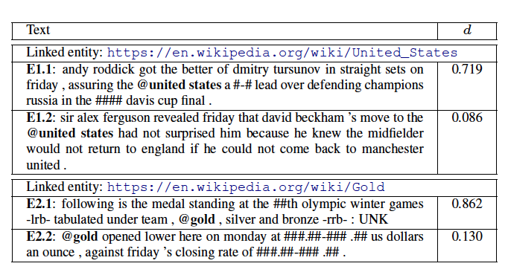
Example output
Examples with highest/lowest disambiguation gate d values of two example entities (United States and gold).
Notes:
300 papers… every day… impossible to read… keyword search… abstract doesn’t reflect… results; ignore most of them. Cancer and surgery… 3 days… walk through all posters.. In our field papers that were published twenty years ago are not that important…
including mining PubMed bibliographic data, research papers in PubMed, clinical data sets and numerous bio-medical websites and social media related to medical sciences, where data related to diseases, drugs, treatments, chemical compounds, proteins, genes, biological pathways can be integrated and extracted from text data and their characteristics and relationships can be mined from such datasets as well
. Older literature is often extremely important (and overlooked), and indeed, often provides a rich source of information that can lead to new hypotheses. This makes the information overload problem event more serious, because we need distill and connect knowledge from papers that may cover 70 years.

Slide 19
Multi-task Learning with Semantic Parsing as Auxiliary Task
The idea: allow the model to learn semantic interpretation over salient content
Input: the Senate proposed a tax bill on Tuesday
Output:
  Semantic structure:
    proposed <ARG0> the Senate <ARG1> tax bill
  Summary:
    Senate proposes bill

Slide 20
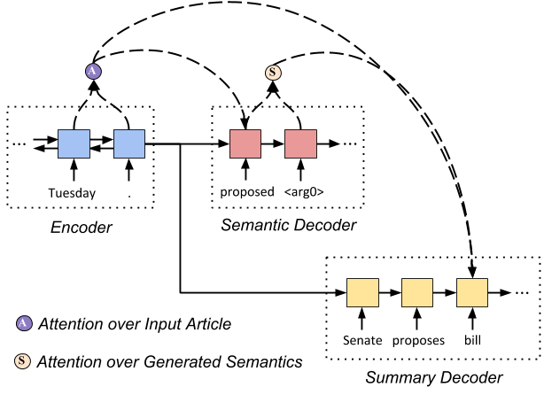
Our Models
Input: the Senate proposed a tax bill on Tuesday
Output:
  Semantic structure:
    proposed <ARG0> the Senate <ARG1> tax bill
  Summary:
    Senate proposes bill

Slide 21
Our Models
Input: a sequence of tokens from the article
Output:
  Semantic:
  Summary:
Encoder: Bi-LSTM (same structure as in prior work)
Decoders: LSTM

Slide 22
Dual Attention
Consider both input and semantics for summary generation
Attention over input:
Additional attention over semantic structures:
Extension with multi-heads
h_{i} is the encoder state, c_{t}^{inp} is the context of input
s_{t} is the decoder state
s^{s}_{j} is the semantic decoder state
adding attention over semantic information

Slide 23
Our Models
Loss function
Loss on summary
Loss on semantic structure

Slide 24
Our Models
Loss function
Semantic structures are extracted from summaries with semantic parsing.
Loss on summary
Loss on semantic structure

Slide 25
Reranking-based Decoder
Regular beam search chooses the hypotheses for the next timestep solely based on conditional likelihood → repetition!
We rerank for every R timestamp (R=10), based on
Percentage of words in semantic structure is reused in the summary
LRS: longest repeating substring
Notes:
If a summary contains long repeating text, it should be penalized
We also consider whether the current generation has reflected the previously generated semantic information

Slide 26
Datasets
New York Times annotated corpus
  About 589K articles annotated with human-written abstracts
  Each article is labeled with topic information, e.g. politics, business, sports, arts, …
CNN/DailyMail
  About 312k articles with summaries (bullet points)
  The URL contains topic information, e.g. https://www.cnn.com/2018/10/23/politics/donald-trump-mid-term-election-immigration-ted-cruz/index.html

Slide 27
Comparisons
Seq2seq: sequence-to-sequence model with regular input attention
Pointer-generator: seq2seq model that allows copying words directly from input (See et al., 2017)

Slide 28
Evaluation against Adversarial Information
Input Article:
For years Joe DiMaggio was always introduced at Yankee Stadium as “baseball’s greatest living player.” But with his memory joining those of Babe Ruth, Lou Gehrig, Mickey Mantle and Miller Huggins. Canada’s Minister of Defense resigned today, a day after an army official testified that top military officials had altered documents to cover up responsibility for the beating death of a Somali teen-ager at the hands of Canadian peacekeeping troops in 1993. Defense minister David Collenette insisted that his resignation had nothing to do with the Somalia scandal. Ted Williams was the first name to come to mind, and he’s the greatest living hitter. ...
(The rest of the article with additional 300 words is all about David Collenette’s resignation.)
Irrelevant sentences (e.g. basketball game) are inserted into the articles (e.g. about politics).
If a summarization model really understands the input, it would ignore the inserted off-topic information.

Slide 29
Evaluation against Adversarial Information
Input Article:
For years Joe DiMaggio was always introduced at Yankee Stadium as “baseball’s greatest living player.” But with his memory joining those of Babe Ruth, Lou Gehrig, Mickey Mantle and Miller Huggins. Canada’s Minister of Defense resigned today, a day after an army official testified that top military officials had altered documents to cover up responsibility for the beating death of a Somali teen-ager at the hands of Canadian peacekeeping troops in 1993. Defense minister David Collenette insisted that his resignation had nothing to do with the Somalia scandal. Ted Williams was the first name to come to mind, and he’s the greatest living hitter. ...
(The rest of the article with additional 300 words is all about David Collenette’s resignation.)
5000 articles from CNN/DailyMail test set and 5000 articles from NYT (labeled with topic politics)
  Each article is inserted with n (1-4) sentences collected from the beginning of another article labeled with topic arts, sports, or technology

Slide 30
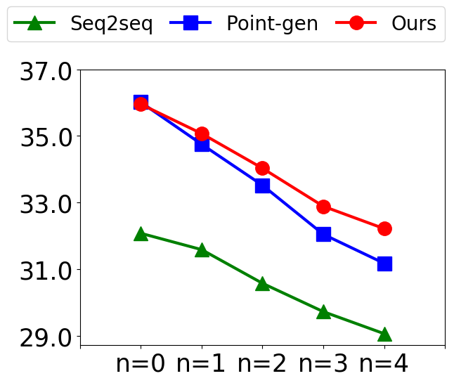
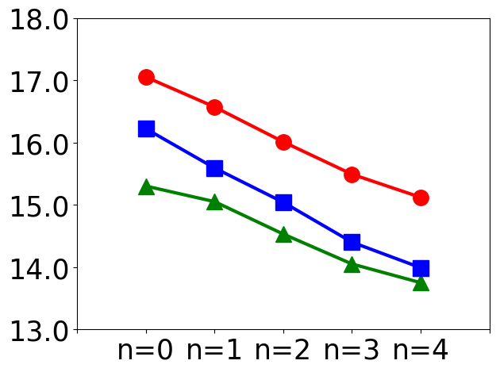
Evaluation against Adversarial Information
On CNN/DailyMail
ROUGE-L
METEOR

Slide 31
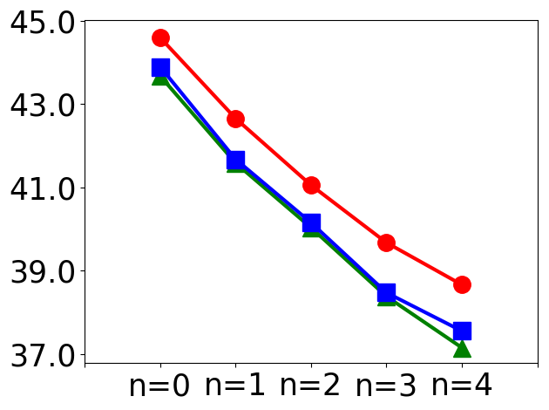
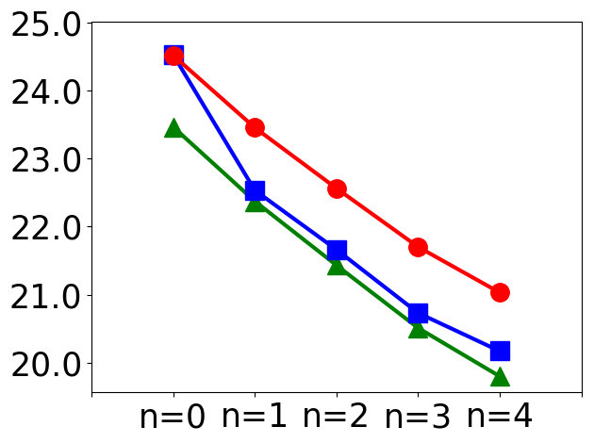
Evaluation against Adversarial Information
On CNN/DailyMail
ROUGE-L
METEOR
On NYT
ROUGE-L
METEOR

Slide 32
Evaluation against Adversarial Information
Input Article:
For years Joe DiMaggio was always introduced at Yankee Stadium as “baseball’s greatest living player.” But with his memory joining those of Babe Ruth, Lou Gehrig, Mickey Mantle and Miller Huggins. Canada’s Minister of Defense resigned today, a day after an army official testified that top military officials had altered documents to cover up responsibility for the beating death of a Somali teen-ager at the hands of Canadian peacekeeping troops in 1993. Defense minister David Collenette insisted that his resignation had nothing to do with the Somalia scandal. Ted Williams was the first name to come to mind, and he’s the greatest living hitter. ...
(The rest of the article with additional 300 words is all about David Collenette’s resignation.)
Seq2seq+attention:
George Vecsey sports of The Times column on New York State’s naming of late baseball legend Joe DiMaggio as “baseball’s greatest living player,” but with his memory joining those of Babe Ruth, Lou Gehrig, Mickey Mantle and Miller Huggins.
Pointer-generator:
Joe DiMaggio is first name to come to mind, and Ted Williams is first name to come to mind, and he’s greatest living hitter; he will be replaced by human resources minister, Doug Young, and will keep his Parliament seat for governing Liberal Party.
Our Model:
Former Canadian Defense Min David Collenette resigns day after army official testifies that top military officials altered documents to cover up responsibility for beating death of Somali teen-ager at hands of Canadian peacekeeping troops in 1993.

Slide 33
Human Evaluation (Initial Results)
 | Non-Redundancy | Fluency | Faithfulness | Informativeness
Human | 1.4 ± 0.7 | 1.5 ± 0.7 | 1.5 ± 0.8 | 1.6 ± 0.8
Seq2seq | 2.0 ± 0.8 | 2.4 ± 0.7 | 2.1 ± 0.8 | 2.4 ± 0.7
Our Model | 1.6 ± 0.7 | 2.1 ± 0.8 | 1.9 ± 0.7 | 2.0 ± 0.7
Two human judges read and ranked summaries: lower→ better.

Slide 34
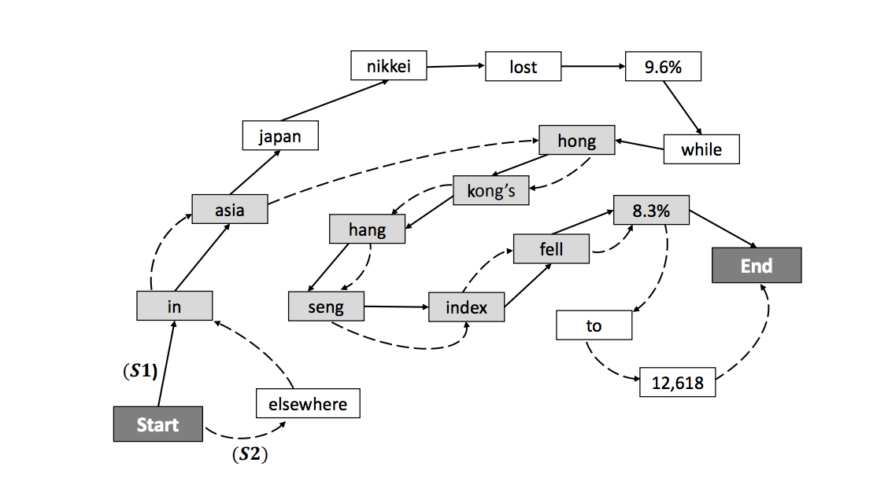
Graphs for Abstractive Summarization [Nayeem et al., 2018]

Slide 35

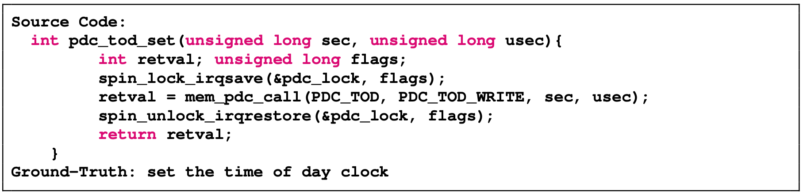
Code Summarization
Input
  A piece of code
Output
  A natural language sentence
Ref: https://www.queppelin.com/how-nlp-is-helping-in-automatic-text-summarization-2, https://www.fiverr.com/yosree22/summarize-any-long-text-or-article-for-you

Slide 36
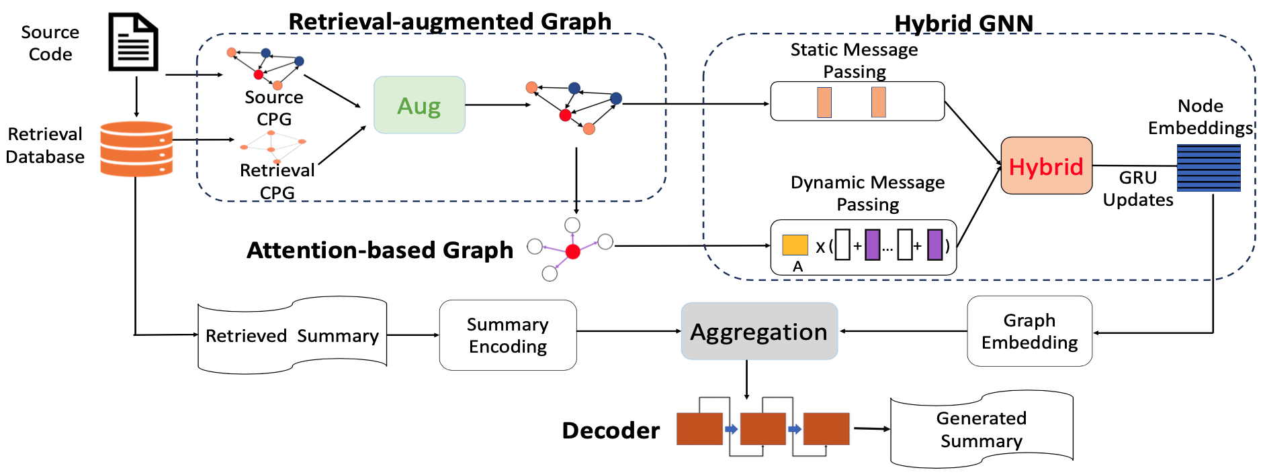
GNN for Code Summarization [Liu et al. ICLR’21]
Liu et al. “Retrieval-Augmented Generation for Code Summarization via Hybrid GNN”. ICLR 2021.
Notes:
This ICLR2021 paper also applied the GNN-based Graph2Seq framework for the code summarization task which aims to generate a natural language sentence to summarize the code.

Slide 37
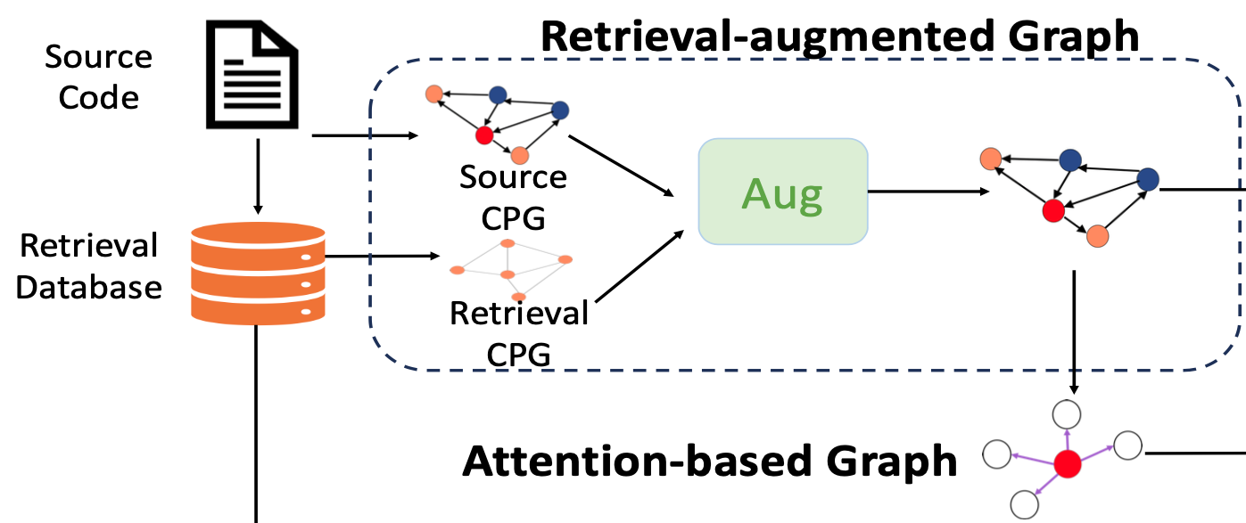

GNN for Code Summarization [Liu et al. ICLR’21]
Static CPG graph + attention-based dynamic graph
Notes:
As for graph construction, they proposed to (c)combine the static CPG graph and the attention-based dynamic graph.
(c)(c)As for the dynamic graph, they applied structure-aware similarity metric learning which utilizes the edge information of the static graph.
(c)They also combined the intrinsic static graph and the learned implicit graph for better performance.

Slide 38
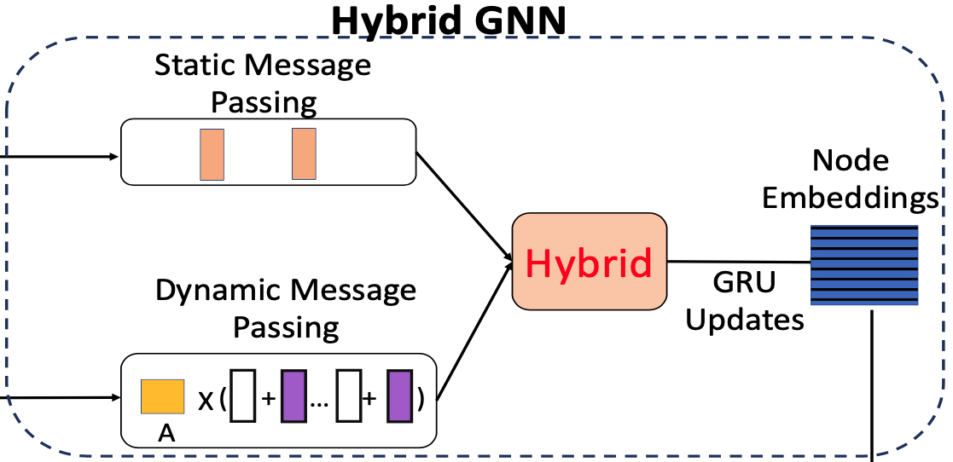
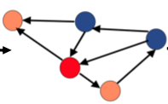

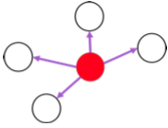
GNN for Code Summarization [Liu et al. ICLR’21]
Hybrid GNN running message passing on static & dynamic graphs
Notes:
As for graph representation learning, (c)because the constructed graph is a multi-relational graph, (c)they applied a multi-relational GNN to encode the graph.
Specifically, t(c)hey proposed a hybrid GNN which runs message passing on both static and dynamic graphs.

Slide 39
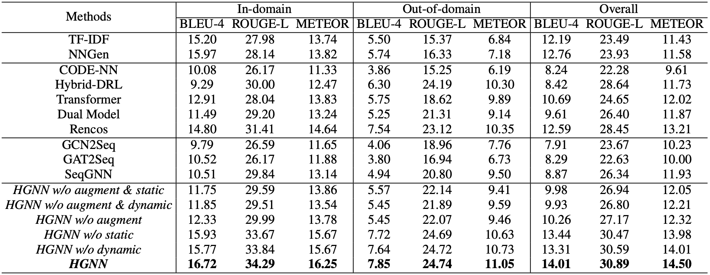
GNN for Code Summarization [Liu et al. ICLR’21]
Automatic evaluation results (in %) on the CCSD test set.
Combining static + dynamic graphs performs better

Slide 40
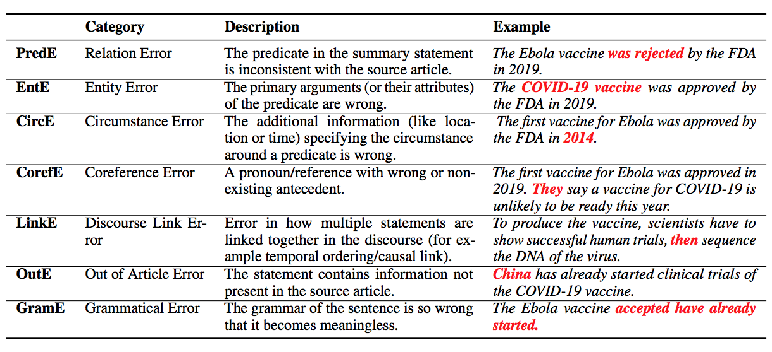
Factual Errors [Pagnoni et al., 2021]

Slide 41
LM Hallucination and Bias
  30% of abstractive summaries contain unfaithful information by state-of-the-art models (Cao et al, 2018)
  Examples of fabricated answers in movie question answering
    Q: What did Susie promise to one of the waiters at the Copacabana Club in return for smuggling her into the club for free?
    System: Susie promises to buy one of the men a drink after every act.
    Key: Susie promised him a prime slot for his singing act at the Gaslight Café for 2 weeks. Unfortunately Susie thinks his act is awful but keeps her word even since they had to watch the show from the kitchen.
    Q: What do Midge and Susie fight over?
    System: Their son.
    Key: With emotions on high, Susie confronts Midge about why she hired Herb. Midge felt Susie does not help and sabotaged her earlier because Susie rushed her on stage. Midge tells her she wants to quit and, after a few insults at each other, walks away.
    Q: What do Susie and Midge talk about when Midge visits Susie's home?
    System: Susie and midge talk about the upcoming moon landing.
    Key: Susie confronts Midge about her meeting with Randall and his agent. She tells Midge she does not need a man to help with her set and what she is doing is not stand-up, it's being the annoying party guest. Midge breaks down crying and tells Susie her life has been hard and if Susie wants to be her manager, she has to deal with Midge's personal matters and not run away. After this, Susie comforts Midge.
    Q: How were some of the Navy Seal members killed back in America?
    System: In a scuffle in france the four members of the navy were killed.
    Key: One was run over by a truck while throwing trash in the sideback. One was shot during a car drive.
  Bias from LM [Wang et al., INLG2018]
    “Silvi Jan (born 27 October 1973) is a former Israel. He played for Israel women‘s national football team,…”
  Potential solutions: filter out popularity bias, incorporate more scenario-specific/domain-specific knowledge

Slide 42
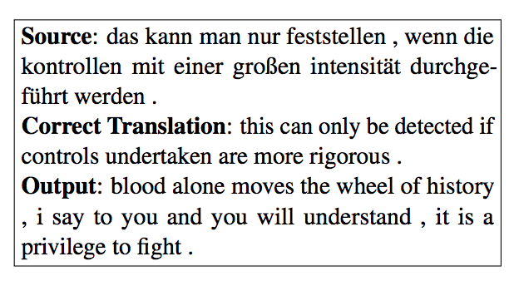
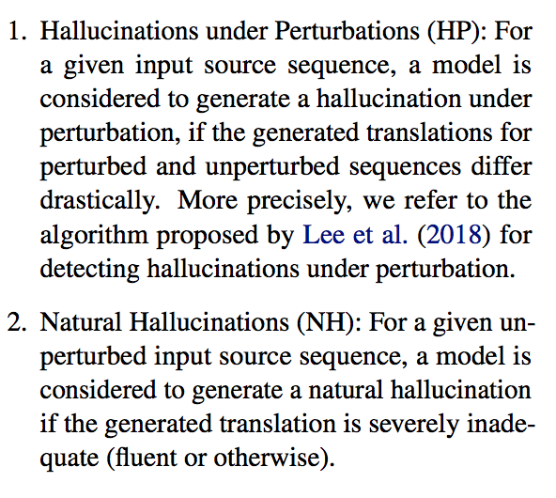
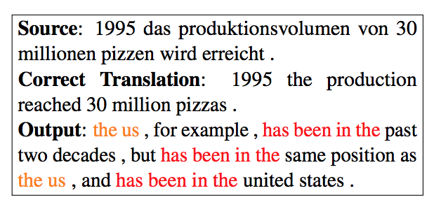
How is Hallucination Caused? [Raunak et al., 2021]

Slide 43
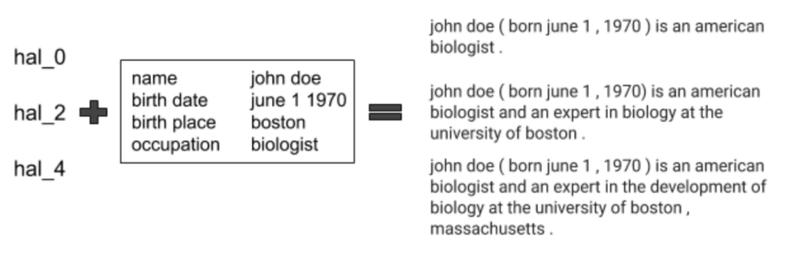
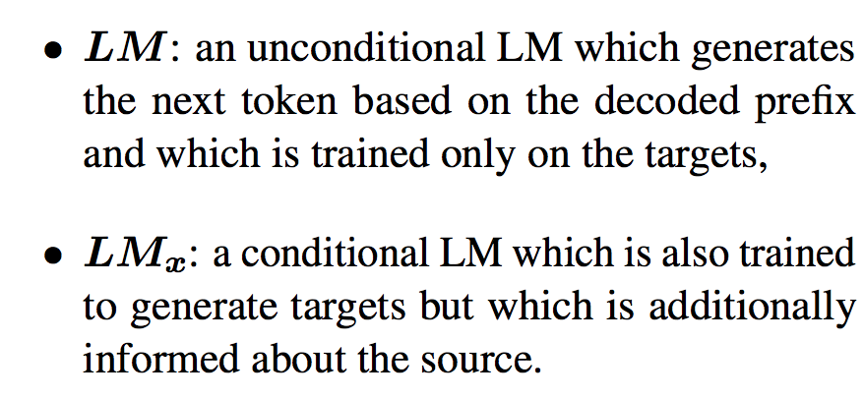
How to solve Hallucination problem?: Hallucination Knot [Fillippova et al., 2020]

Slide 44
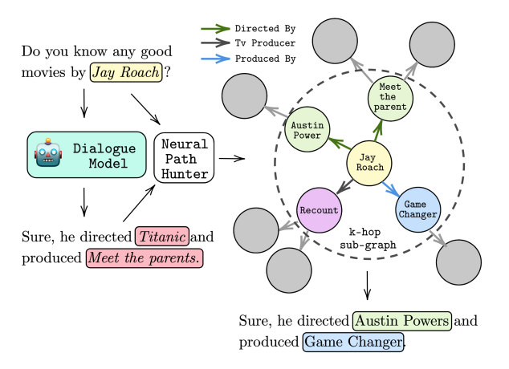
How to solve Hallucination problem?: Hallucination Knot [Dziri et, 2021]

Slide 45
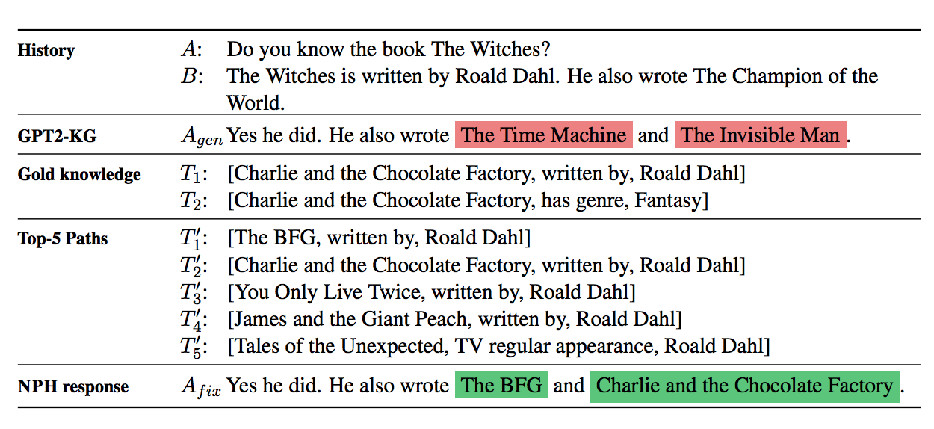
How to solve Hallucination problem?: Hallucination Knot [Dziri et, 2021]

Slide 46
Discussion: How to solve Hallucination problem?

