Slide 1
Timeline Summarization: Introducing Temporal Dimensions into Summarization
Manling Li
manling2@illinois.edu
Notes:
Hi I am Manling from UIUC, I am happy to introduce our work about timeline summarization using event graph compression.

Slide 2
Timeline Summarization (TLS)
Task: Summarize hundreds or thousands of input documents into a timeline.
Notes:
Timeline summarization aims to automatically generate a timeline for the given news documents. This timeline is organized by key dates, with a short event summary for each key date. It is a difficult task since the input document size can be very large like thousands of documents.

Slide 3
Key Challenges
It is not applicable to directly employ Multi-Document Summarization (MDS) models.
 | Multi-Document Summarization (MDS) | Timeline Summarization (TLS)
Size of Input Data | Tens of documents | Hundreds or thousands of long documents
Training Data | Available | No training set (due to annotation cost)
Temporal Dimension | None | Select key dates Capture the temporal interdependency across key stories
Knowledge Elements | Entities, relations, and events | Events are of higher priority
Notes:
As a result, traditional multi-document summarization models cannot fit this task well, since multi-document summarization only handles tens of documents. Another difficulty is the lack of training data. The annotation is extremely difficult for timeline summarization, due to the large input data size. Besides, timeline summarization requires the modeling of the temporal dimension to select key dates, while multi-doc sumarization fails to do so. Another thing is that timeline cares more about event knowledge, which is more difficult since events have structures, such as event arguments, and this kind of event structure need to be preserved. Prevous work employs various unsupervised summarization methods to tackle this task, however, they did not pay attention to event structures, and ignore the global event context of the entire corpus.

Slide 4
Method Overview: Key Challenge 1 - No Training Data
Where to get the supervision ?
Unsupervised methods
General summarization datasets
Other resources
Chieu and Lee (2004)
Martschat et al (2017, 2018)
Martschat et al (2019)
Trans et al (2013a, b)
Barrons et al (2019)
Wikipedia (Li et al, 2021)
Chen et al (2019)
Social Context (Wang et al, 2016)
Notes:
submodular functions

Slide 5
Method Overview: Key Challenge 2 - Large Input Size
Extractive Summary
Abstractive Summary
Martschat et al (2019)
Chieu and Lee (2004)
Trans et al (2013a, b)
Martschat and Markert (2017, 2018) ….
Chen et al (2019) …
Want at al (2016)

Slide 6
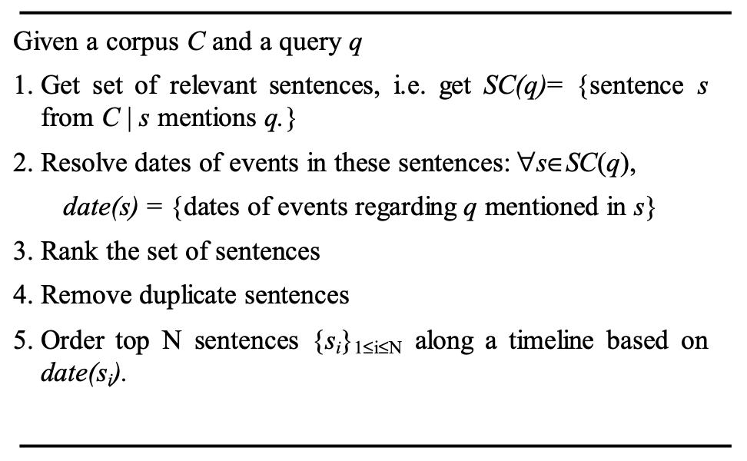
Query based Event Extraction along a Timeline
Ranking events
Ranking Metric: “Interest” (the number of sentences reporting the same event)
Ranking Metric: “Burstiness” (the number of reports of an event within and outside a date duration)
Hai Leong Chieu and Yoong Keok Lee. 2004. Query based event extraction along a timeline. SIGIR, pages 425–432. ACM.

Slide 7
A Temporally Sensitive Submodularity Framework
However, previous greedy methods do not have performance guarantees
Solution: Keeping MDS advantages such as modularity and performance guarantees
Martschat, Sebastian, and Katja Markert. "A temporally sensitive submodularity framework for timeline summarization." arXiv preprint arXiv:1810.07949 (2018).

Slide 8
A Temporally Sensitive Submodularity Framework
Submodular Function: the incremental value of adding a single element decreases as the size of the input set increases.
Fast Algorithms for Submodular Optimization. Yossi Azar, Iftah Gamzu and Ran Roth

Slide 9
A Temporally Sensitive Submodularity Framework
However, previous greedy methods do not have performance guarantees
Solution: Keeping MDS advantages such as modularity and performance guarantees
Take into account the temporal properties
(1) Revise objective function: add date selection and date interdependencies
Temporalizing Coverage based on date difference
Temporalizing Diversity based on temporal partition
Date Selection based on frequency patterns
(2) Add temporal constraints: specify the uniformity of the timeline daily summaries and date distribution
The total number of days should not exceed a given number
The length of the daily summary (in sentences) should not exceed a given number
Martschat, Sebastian, and Katja Markert. "A temporally sensitive submodularity framework for timeline summarization." arXiv preprint arXiv:1810.07949 (2018).

Slide 10
Timeline Summarization from Relevant Headlines
Key Idea: headlines are relevant (capturing the interactions between the input documents) → news graphs

Slide 11
Timeline Summarization from Relevant Headlines
Key Idea: The information provided in headlines is usually self-contained, timely and complete, and therefore suitable for creating coherent daily summaries.
Model: a headline selection algorithm based on a random walk
follows the personalized PageRank method
Aspects of Relevant Headlines
Informing: inform about a news event
Influence: be influential in what will happen in the future
Spread: the probability that two headlines report about the same event

Slide 12
Timeline Summarization via Event Graph Compression
Previous work (Chieu and Lee, 2004; Martschat and Markert, 2018; Steen and Markert, 2019) limits the document representations to local text features, ignoring the global context of the news collection.
How to make the summarization keep salient event information?
Notes:
Our idea is to take advantage of the success of information extraction systems, to construct an event graph first, and then do the graph compression to get the summary graph. In this way, we represent event knowledge using structured knowledge, instead of unstructured d.ata

Slide 13
Event-Aware Multi-Document Representation
Information Extraction:
Extracting entities, relations and events (Lin et al, 2021)
Performing entity linking and cross-document entity coreference (Lai et al, 2021)
Performing cross-document event coreference (Lai et al, 2021)
Extracting temporal attributes (Wen et al, 2021)
Extracting temporal relations (Wen et al, 2021)
Overall Information Extraction Performance:
Wen, Haoyang, et al. "RESIN: A Dockerized Schema-Guided Cross-document Cross-lingual Cross-media Information Extraction and Event Tracking System." NAACL. 2021.
Notes:
The event graphs are automatically constructed. We firstly extract entities, relations and events. after that, we run cross-document coreference for entities and events. finally, we extract the temporal attributes and temporal orderings between events.

Slide 14
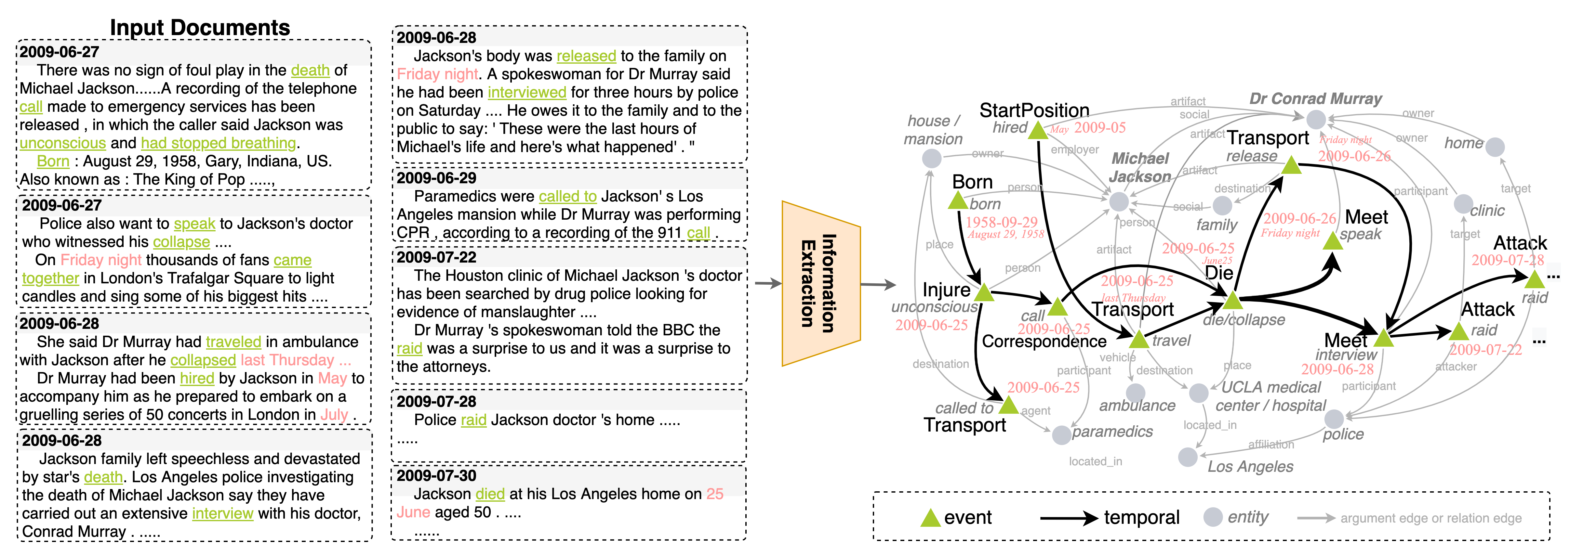
Event-Aware Multi-Document Representation
Coreferential entities or events are merged.
Event-event connections: (1) temporal orders (2) shared arguments (3) related arguments.
Notes:
This is an example of our constructed event graph. The green triangles are events, and the grey circles are entities. We merge co-referential entities or co-referential events, for example, the the house entity and the mansion entity are merged, also, the die event and the collapsed event are merged across documents.
The temporal edges are the black edges, for example, the born event is before the injure event. and they can organize events into a DAG. The grey edges are argument edges or relation edges. We include arguments in this graph, since the connections between events are not only about their temporal relations, but also their connections using arguments, for example, the born event and startposition event is not directly connected using temporal edges, but they have a shared argument Michael Jackson. There so also relations, such as the UCLA medical center is located in LA. In this way, the event-event connections include temporal orders, but also shared arguments, or related arguments.

Slide 15
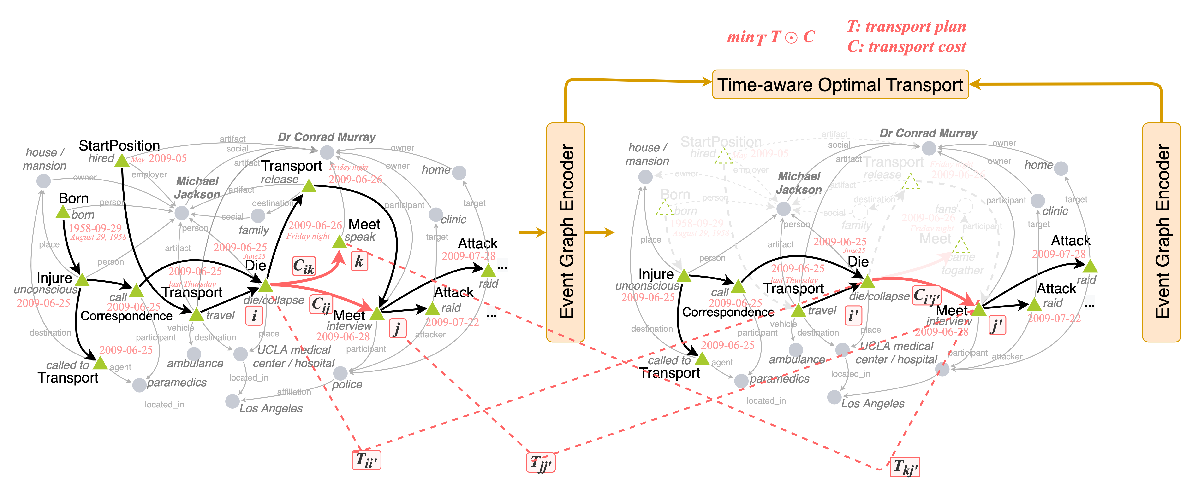
Event Graph Compression with Optimal Transport (OT)
We constrain the total number of event nodes to be kept in the summary, and optimize the summary graph to be close to the original graph using Optimal Transport.
To obtain the minimal distance with only m events kept, a global decision is learned to select salient but also diverse events.
Notes:
After we get the event graph, the next step is to compress the graph into a smaller graph. As a result, we select a certain number of top salient event nodes, and this certain number is given, or we can get the number using the target compression rate. Our goal is to make this small graph be close to the original graph. As a result, we use optimal transport to compute the distance between two graphs. So the question is how to define the transport distance. (click) The tranposrt distance can be regard as the multiply of transport plan T and the cost C. The transport plan is how much mass we want to transport from a node in the original graph to a node in a summary graph. The cost is evaluating how similar the two nodes are, based on the feature vectors of the two nodes.
Training objective: finding the optimal transport plan between input and summary graph that has the minimal transport distance.

Slide 16
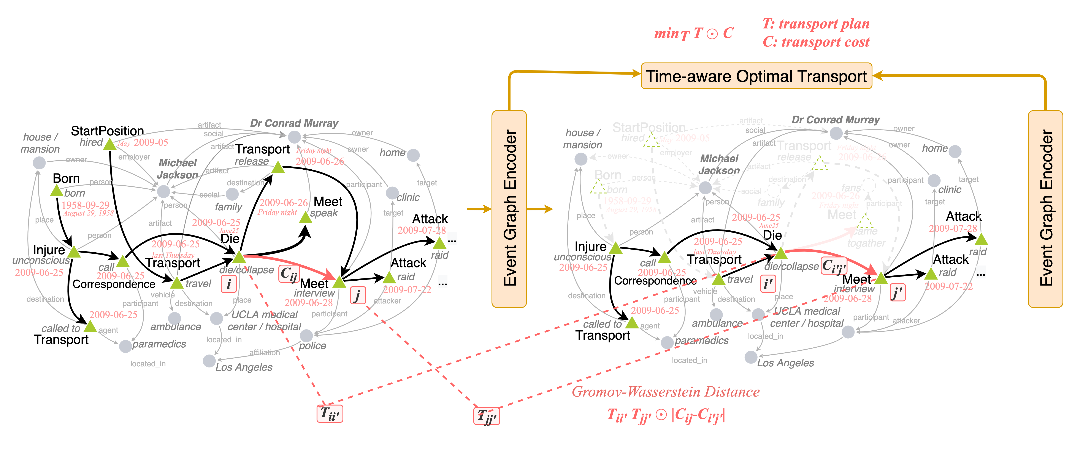
Event Graph Compression with Optimal Transport (OT)
Define Gromov-Wasserstein Distance over temporal edges
Notes:
However, this node-level transportation only, ignoring edge information. Timeline summarization cares more about events and their temporal dimensions, so we define Gromov-Wasserstein Distance to do the edge-level transportation, instead of node-level only. For example, here we are transporting <die, interview> node pair example,

Slide 17
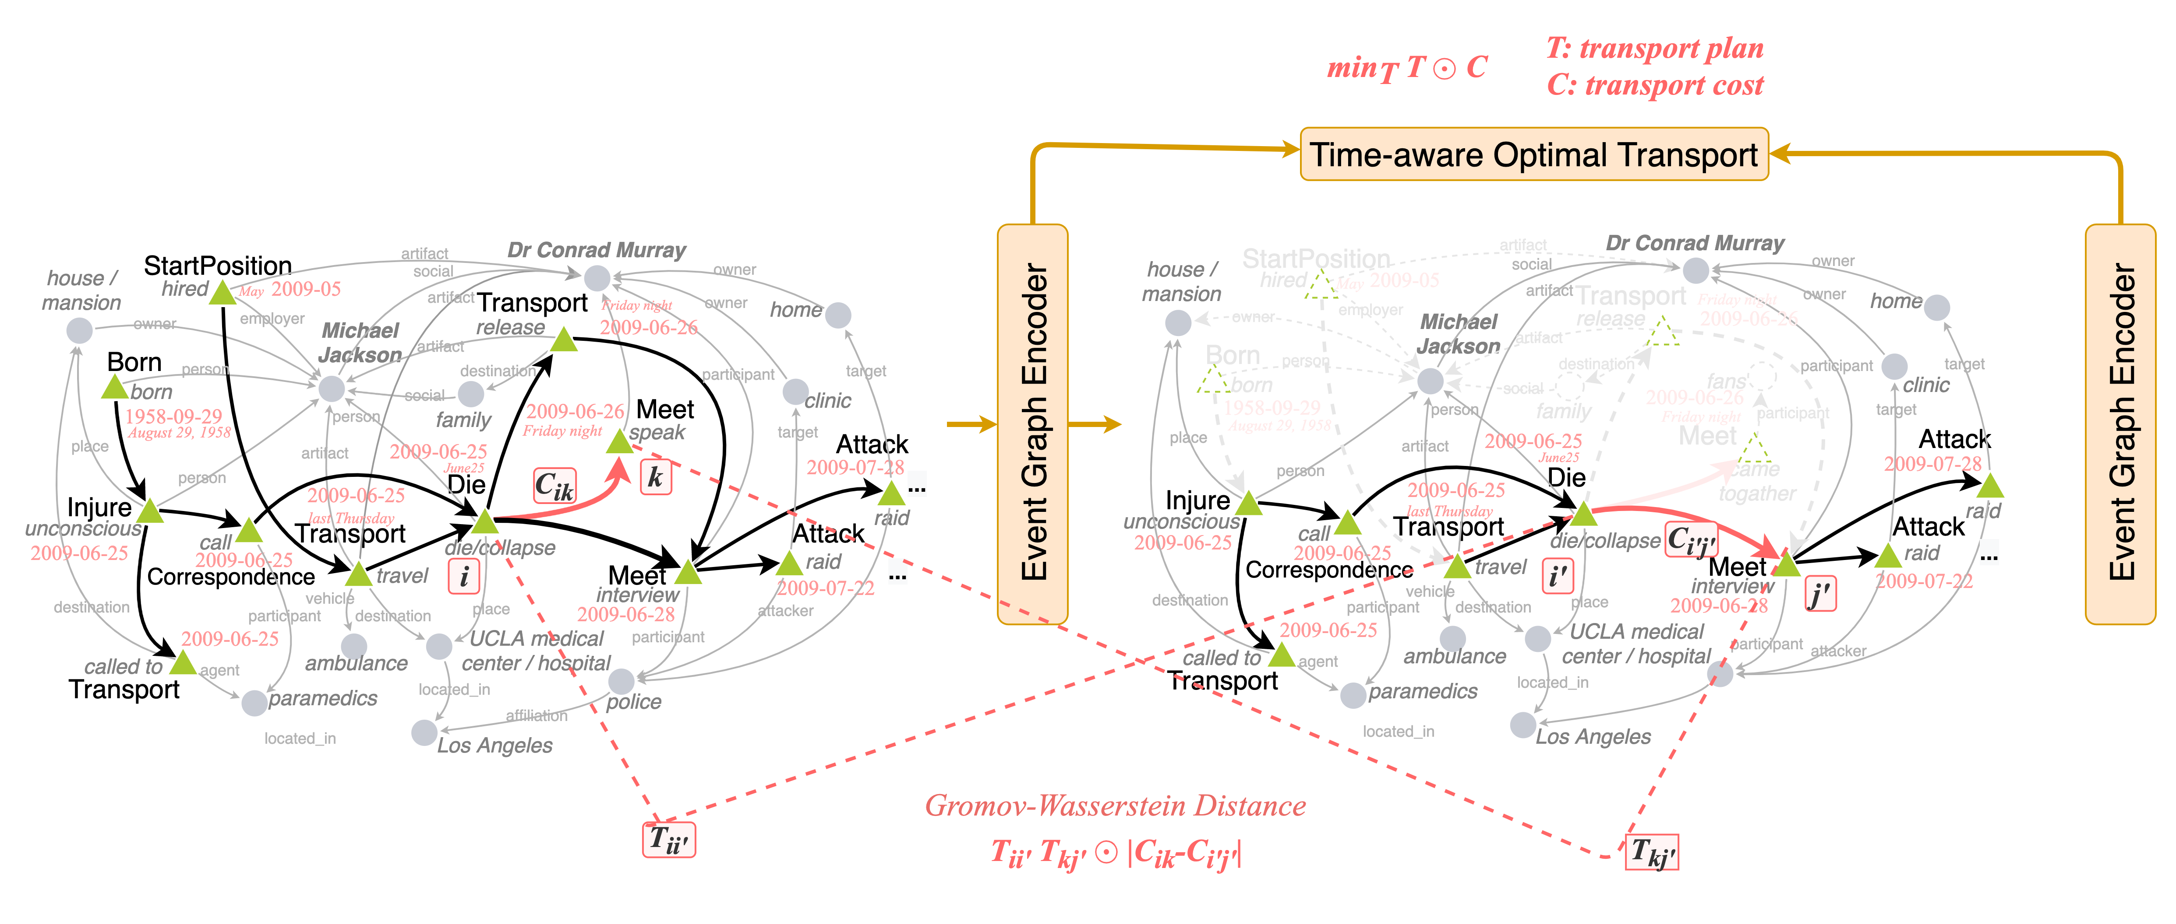
Event Graph Compression with Optimal Transport (OT)
Define Gromov-Wasserstein Distance over temporal edges
Notes:
Similarly, 〈die,speak〉can also be transported to〈die,interview〉in the summary graph with a small distance since they are similar. As a result,〈die,interview〉in the summary graph receives relatively large mass during the graph transport, since it has small distance with multiple node pairs inthe input graph, such as both〈die,speak〉 and <die, internview>, so it should be kept in the summary graph.

Slide 18
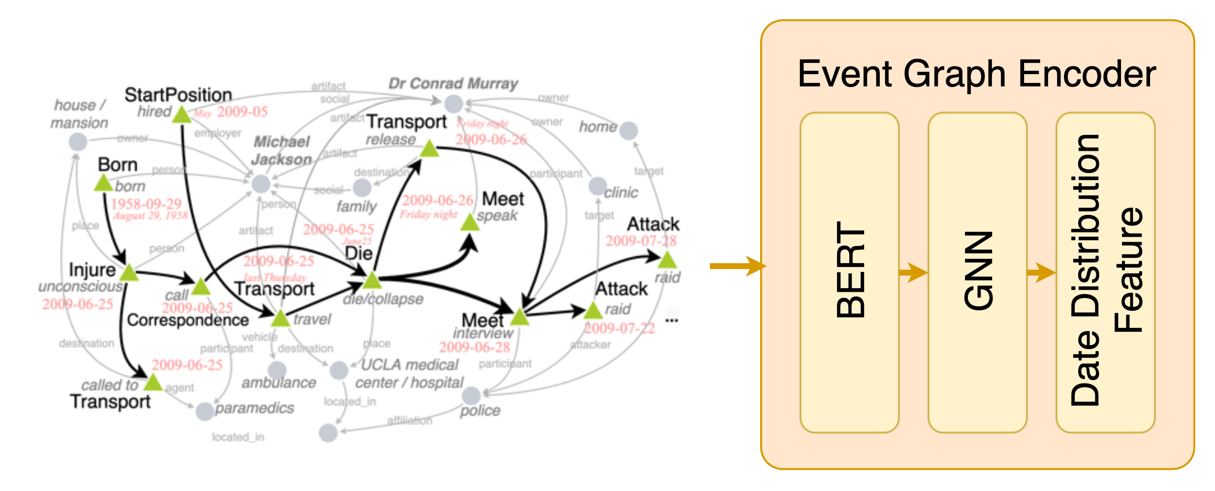
Time-aware Gromov-Wasserstein Distance
How to define the distance between summary and input graph?
Temporal Regularizer
Semantic Relevance
Structural Centrality
Temporal Coherence
the local context encoded via a pre-trained BERT
the global context encoded via Graph Neural Networks
temporal regularizer to enlarge the distance between events that have wide time gap
Notes:
Now we know how to do the transportation, then we want to know how to define the cost matrix. We should consider three criteria.
(click)Semantic relevance: each node first has its initial local context encoded via a pre-trained BERT model and node type embeddings.
Structural centrality: we employ a graph neural network to maintain a global context embedding by encoding the global structure topology, which enables the events of high node centrality to gather comprehensive information from neighbors.
(click)Temporal coherence: we define time-aware Gromov-Wasserstein distance over the temporal edges, and introduce a temporal regularizer to enlarge the distance between events that have wide time gap,
suchas the BORN and INJURE events in Figure 1, so thatthe temporal coherence can be captured. It enablesthe model to select temporally salient events thathave temporal dependencies with multiple eventsin the news collection. Also, timeline summariza-tion is sensitive to temporal ordering, such that theTRANSPORT(travelingin ambulance) beforeDIEin Figure 1 is more important to the story than theTRANSPORT(releasingbody) afterDIE. Hence,we distinguish the before and after events in thedistance computation

Slide 19
Unsupervised Training
Step 1. Differentiable Graph Compression to get summary graph S , following (Ma and Chen, 2021)
Node Weights
Compression Matrix
Adjacency matrix of event nodes in summary graph
Notes:
So now we know how to compute the transport distance between two graphs, the next step is to do the optimization. In our framework, we did not get the summary graph yet, so we follow previous work to learn a weight for each node first using their node features, and then sort the node list and select top ranked nodes into the summary graph and generate the new adjacency matrix.

Slide 20
Unsupervised Training
Step 1. Differentiable Graph Compression to get summary graph S , following (Ma and Chen, 2021)
Node Weights
Compression Matrix
Adjacency matrix of event nodes in summary graph
Step 2. Solving Optimal Transport problem
Objective
T can be approximated by a differentiable Sinkhorn-Knopp algorithm (Sinkhorn, 1964; Cuturi, 2013)
Notes:
After that, we know how to get he summary graph, and how to compute the transport distance, and we can minimize this transport distance, by sinkhorm algorithm.

Slide 21
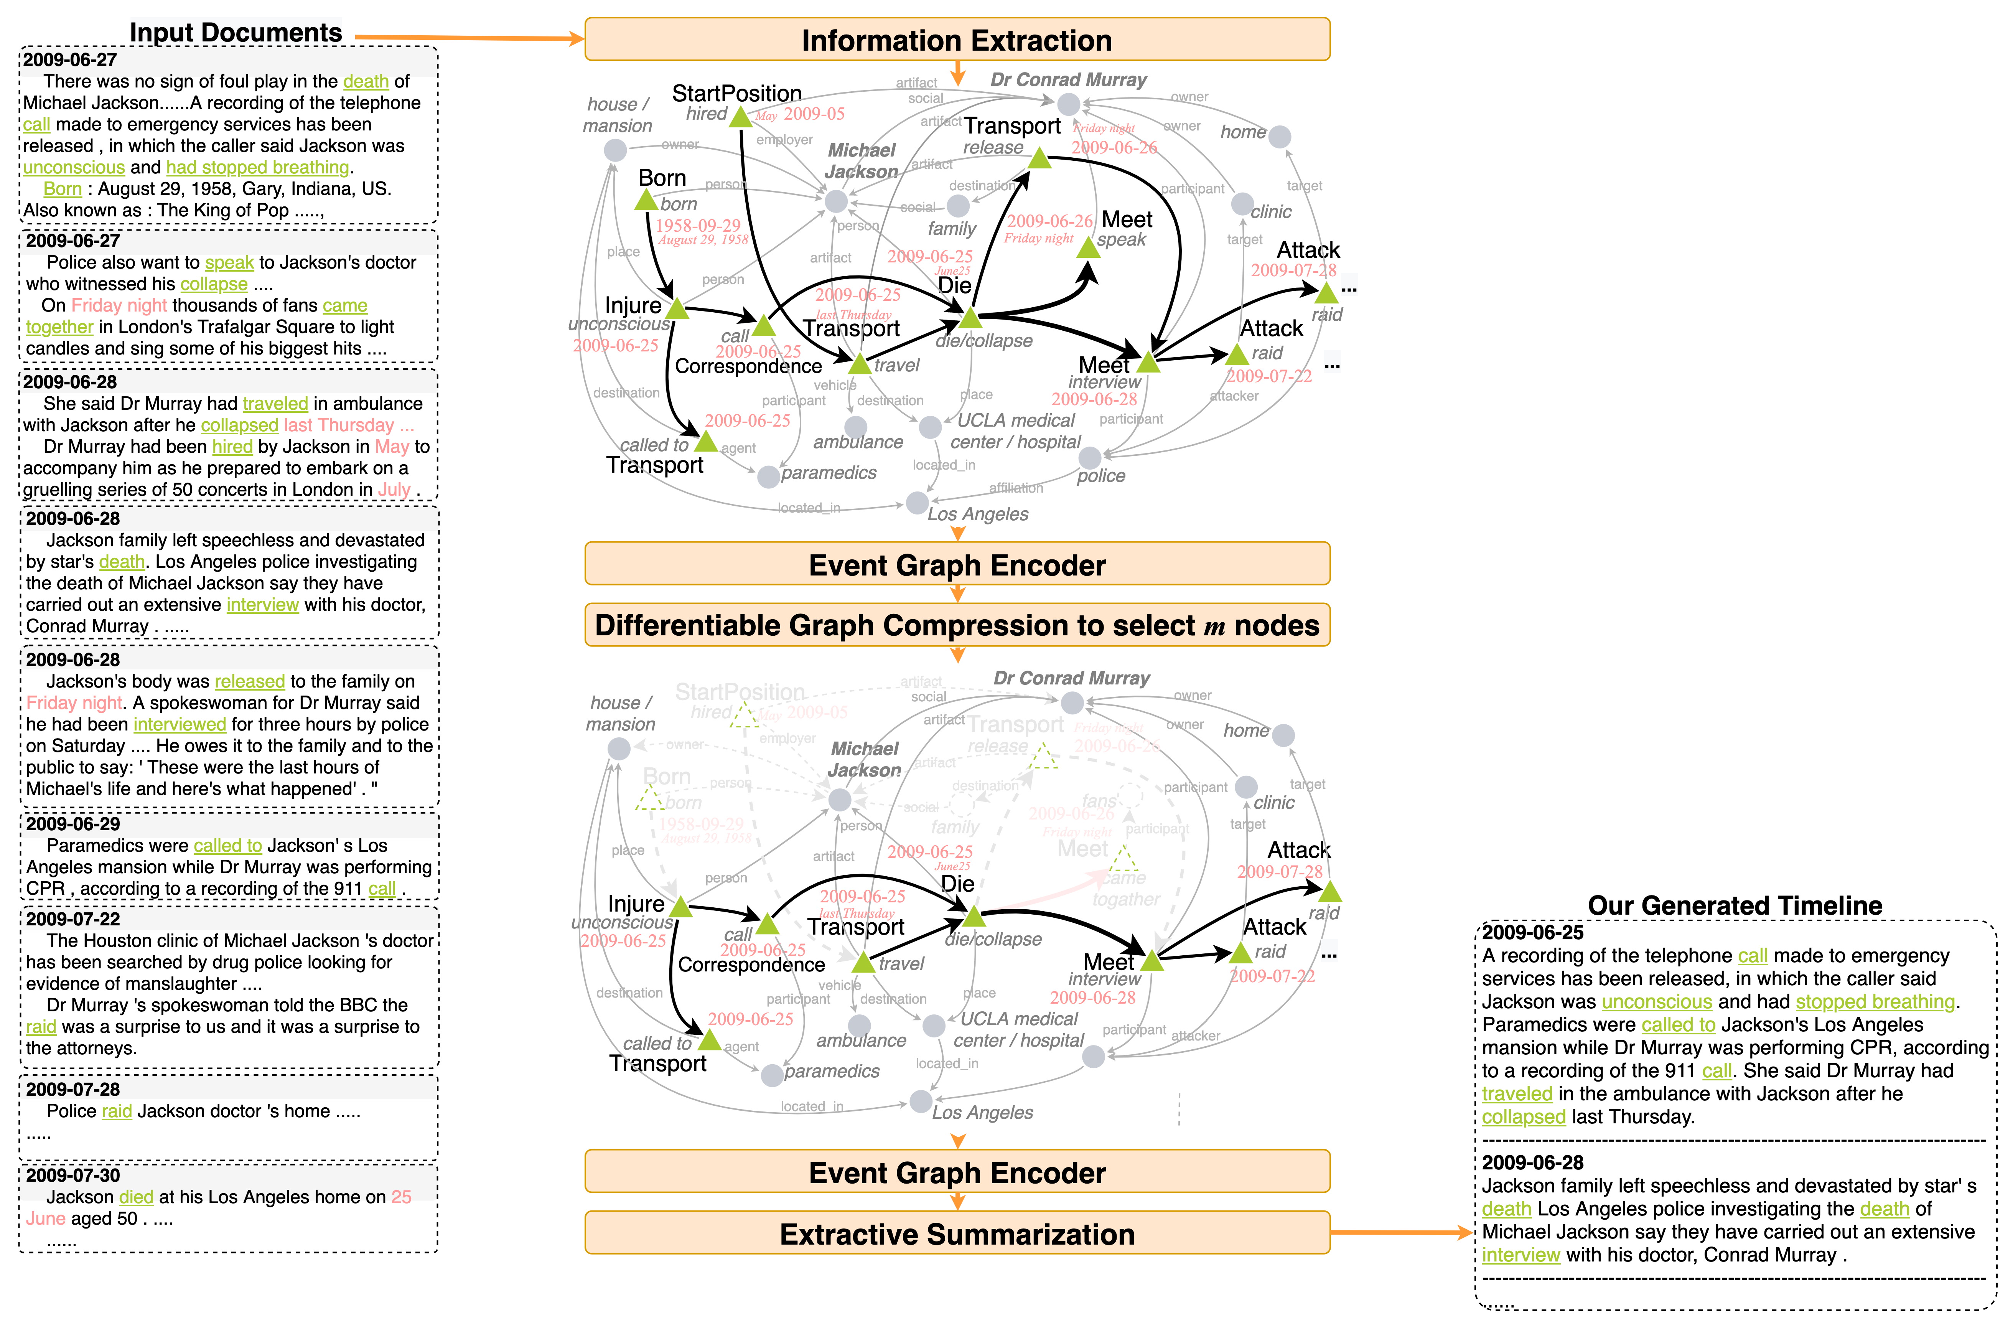
Extractive Summary
We extract the sentences containing event nodes that are kept in the summary graph.
Notes:
The final step is to extract sentences that containing the selected events, and compose them into a timeline according to event time.

Slide 22
Dataset
We contribute a new timeline summarization benchmark with 100 timelines.
The timelines are human written timelines collected from news websites.
The dataset covers various topics related to the economy, military, education, etc.
The input documents for each timeline are selected using BM25 (Robertson et al., 1995)
We extract event graphs for three benchmarks.
Dataset | Split | # Document | # Event | # Entity | # Relation
Timeline17 (Tran et al, 2013) | Input | 4,650 | 74,320 | 115,585 | 136,509
 | Timeline | 19 | 974 | 1,936 | 1,134
Crisis (Tran et al, 2015) | Input | 20,463 | 325,695 | 551,228 | 610,410
 | Timeline | 22 | 736 | 1,184 | 1,309
Timeline100 | Input | 10,379 | 178,581 | 301,132 | 306,975
 | Timeline | 100 | 3,296 | 8,901 | 23,732
Notes:
We conduct experiments on three dataset, two datasets are conventional datasets from previous work, and we also release a new dataset with more timelines provided.

Slide 23
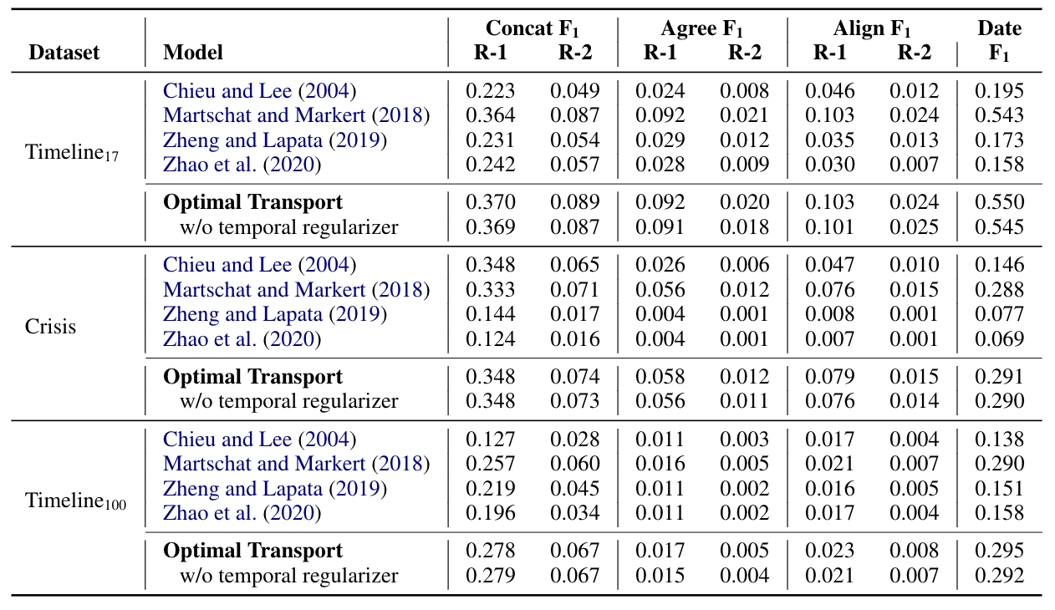
Quantitate Analysis
Our model outperform both timeline summarization baselines and graph-based summarization baselines.
Notes:
There are two kinds of baselines, The first two are timeline summarization baselines, and the second one is the state-of-the-art extractive model. The third and fourth baselines are the state-of-the-art graph-based extractive summarization models. The results show that our model outperform both timeline summarization baseliens and the graph-based summarization baselines.

Slide 24
Quantitate Analysis
Human Evaluation
on a scale of 1-5 (1 is the worst and 5 is the best)
Eval uation Dimensions
General : the general quality of the timeline
Coverage : the events that are covered by the timeline
Coherence : the coherence of the story
Temporal preserving : the selection of key dates.
Notes:
Human evaluation is based on scoring. Since the input document size is too large, we present ground truth timeline to annotators as reference. Then the timelines from different systems are presented to annotator in a random order and ask them to score each timeline. The scoring is based on four demisions, It shows that our model is generating better timelines in coverage, coherence, and also temporal information preserving.
To hold the same scoring standard for each timeline, we only ask one annotator to score a

Slide 25
Qualitative Analysis
Our model performs better on the date selection and event node coverage.
Notes:
We highlight events in the summary and from the visualization, we can see that our model can keep more events.

Slide 26
Outline
Extractive Summarization for News Timeline
Abstractive Summarization for News Timeline
Timeline Summarization with Other Resources
Remaining Challenges

Slide 27
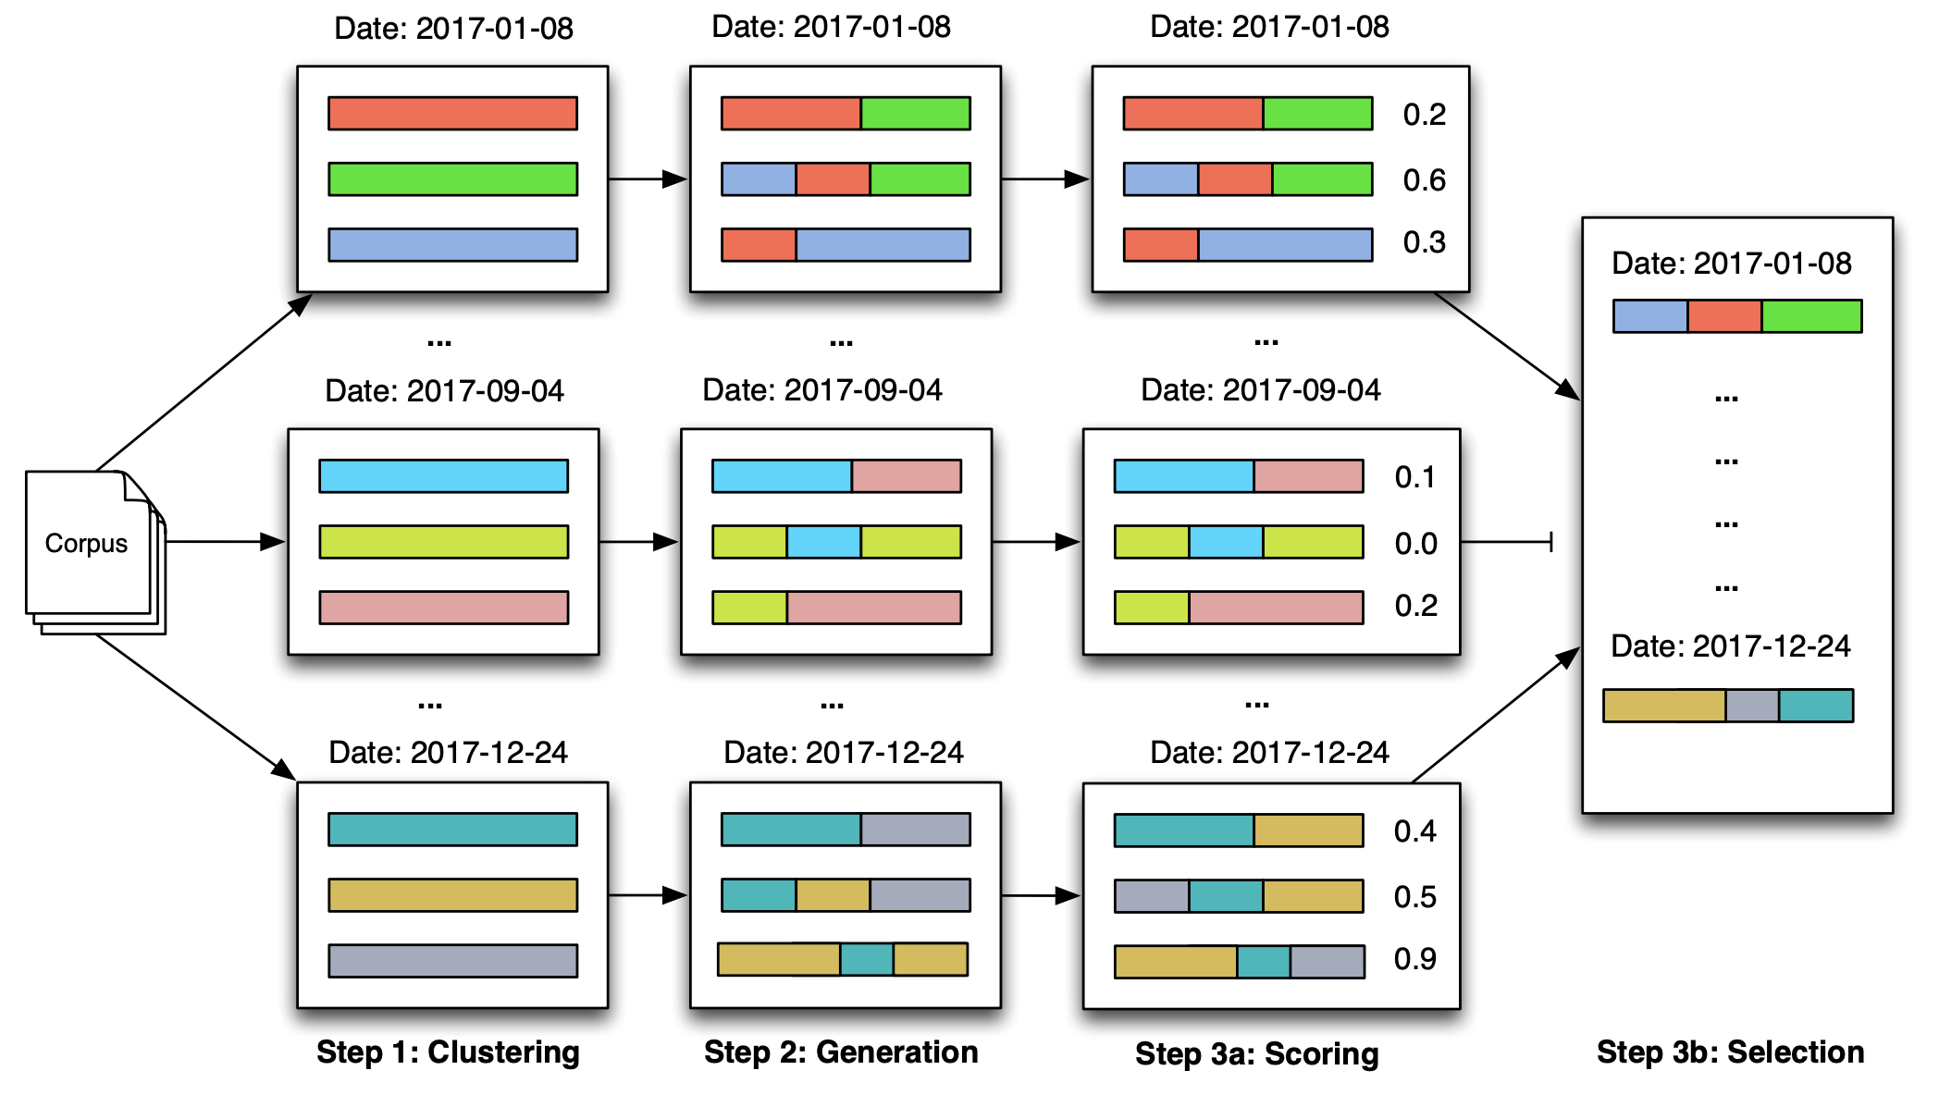
Abstractive Timeline Summarization
Clustering documents based on dates
Not all clusters are included in the timeline
Steen, Julius, and Katja Markert. "Abstractive timeline summarization." Proceedings of the 2nd Workshop on New Frontiers in Summarization. 2019.

Slide 28
Memory-based Timeline Summarization
Three Components:
(1) Event Embedding Module learns event representation;
(2) Time-Event Memory stores highlevel structral event information;
(3) Summary Generator fuses the result from previous stages and generates a summary.
Chen, Xiuying, et al. "Learning towards Abstractive Timeline Summarization." IJCAI. 2019.

Slide 29
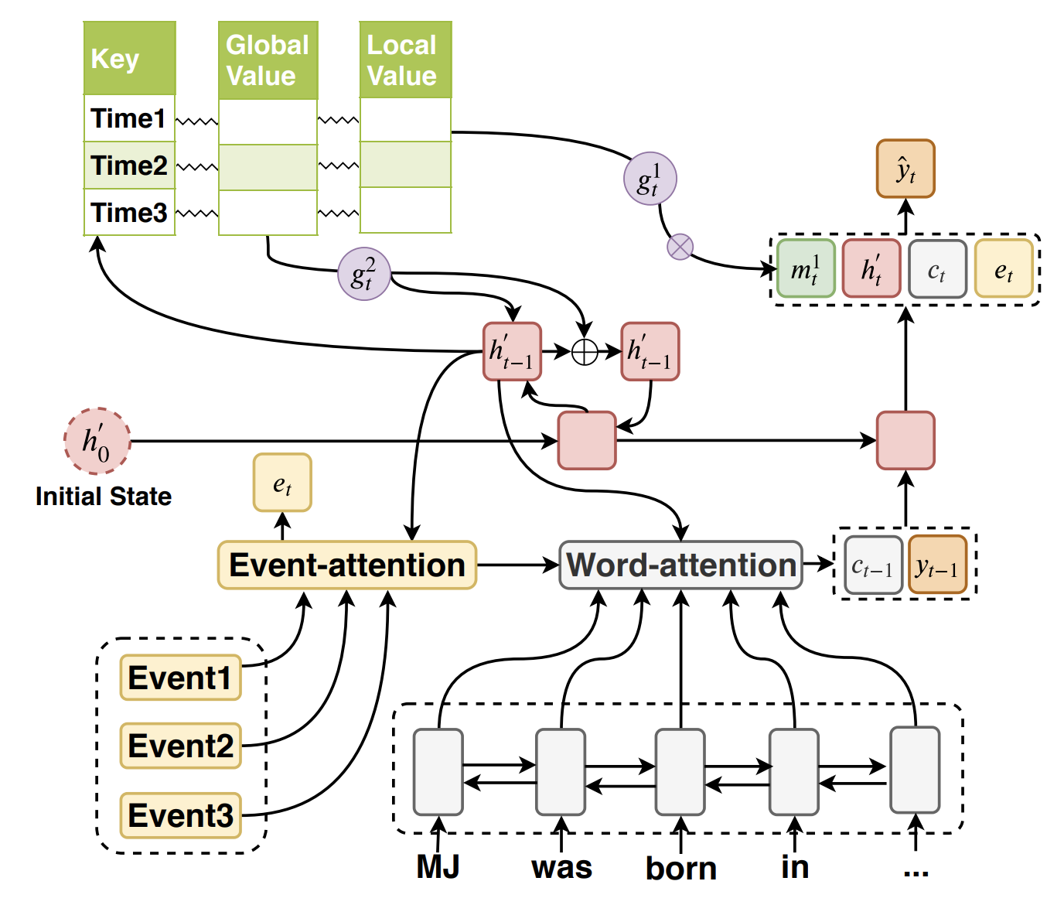
Memory-based Timeline Summarization
Summary Generator:
incorporates outputs of time-event memory module and event representation.
Chen, Xiuying, et al. "Learning towards Abstractive Timeline Summarization." IJCAI. 2019.

Slide 30
Outline
Extractive Summarization for News Timeline
Abstractive Summarization for News Timeline
Timeline Summarization with Other Resources
Remaining Challenges

Slide 31
Timeline Generation with Social Context
Idea: the rich social context provided by user-generated content reveals representative public interests or insightful opinions.
Wang, Lu, Claire Cardie, and Galen Marchetti. "Socially-informed timeline generation for complex events." arXiv preprint arXiv:1606.05699 (2016).

Slide 32
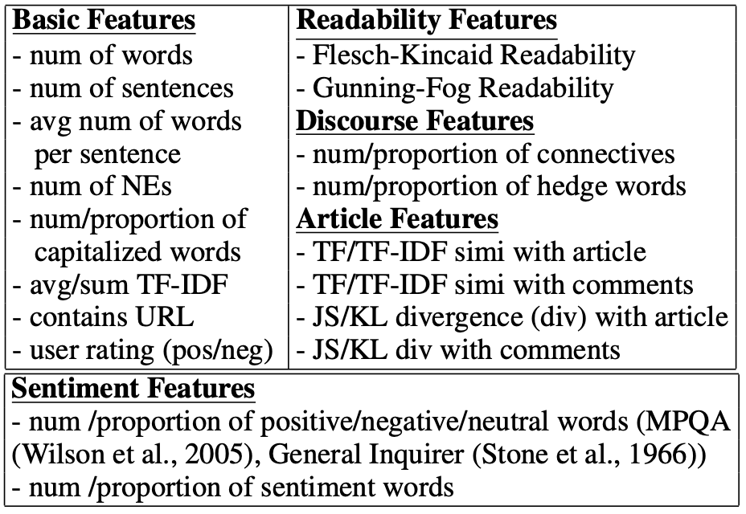
Timeline Generation with Social Context
Idea: the rich social context provided by user-generated content reveals representative public interests or insightful opinions.
Features used for sentence importance scoring
Features used for comment importance scoring
Wang, Lu, Claire Cardie, and Galen Marchetti. "Socially-informed timeline generation for complex events." arXiv preprint arXiv:1606.05699 (2016).

Slide 33
Multi-Document Summarization from the Wikipedia Current Events Portal
Use Wikipedia source as the input of timelines.
Ghalandari, Demian Gholipour, et al. "A Large-Scale Multi-Document Summarization Dataset from the Wikipedia Current Events Portal." arXiv preprint arXiv:2005.10070 (2020).

Slide 34
Outline
Extractive Summarization for News Timeline
Abstractive Summarization for News Timeline
Timeline Summarization with Other Resources
Remaining Challenges

Slide 35
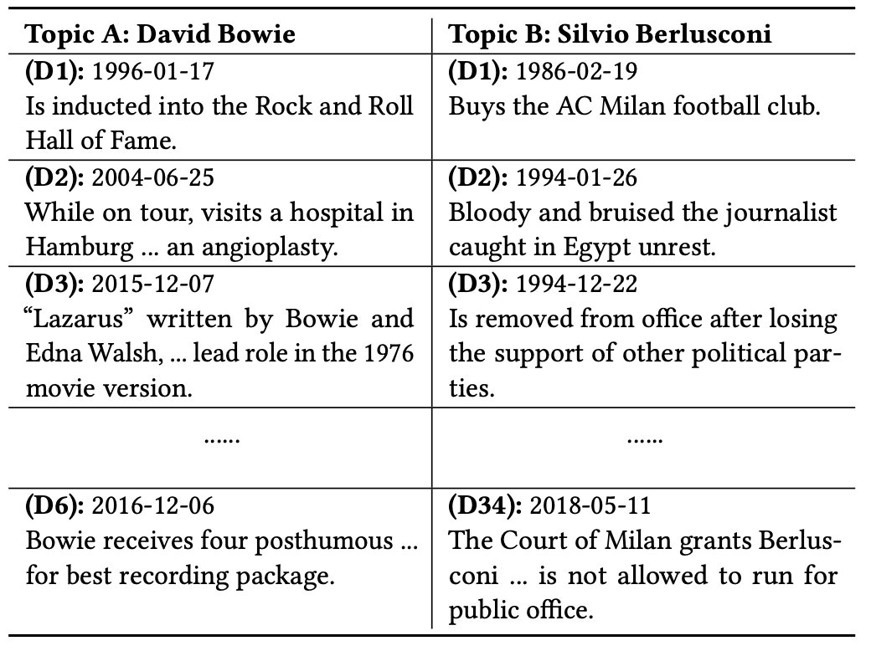
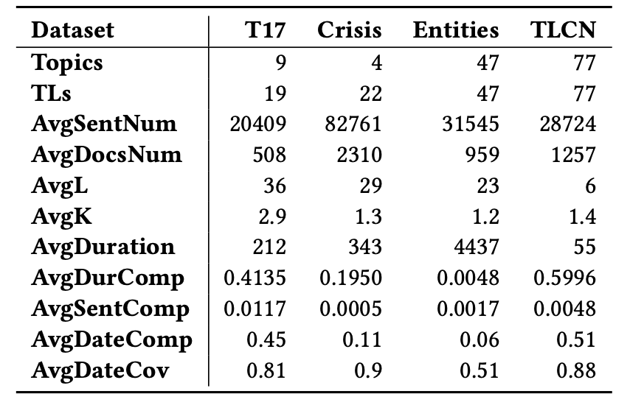
Remaining Challenges
Compression rate: Automated Timeline Length Selection
Notes:
Automated Timeline Length Selection for Flexible Timeline Summarization

Slide 36
Remaining Challenges: Evaluation Metrics
Martschat and Markert (2018) proposes to evaluate timelines with temporal dimension considered:
Date F₁ : to evaluate the key date selection using, and the content generation using ROUGE scores
concat F₁ : to compute ROUGE by concatenating the summaries of all selected dates
agree F₁ : to compute ROUGE only between the summaries which have the same dates
align F₁ : to first align summaries in the output with those in the reference based on similarity and the distance between their dates, then compute the ROUGE score between aligned summaries.

Slide 37
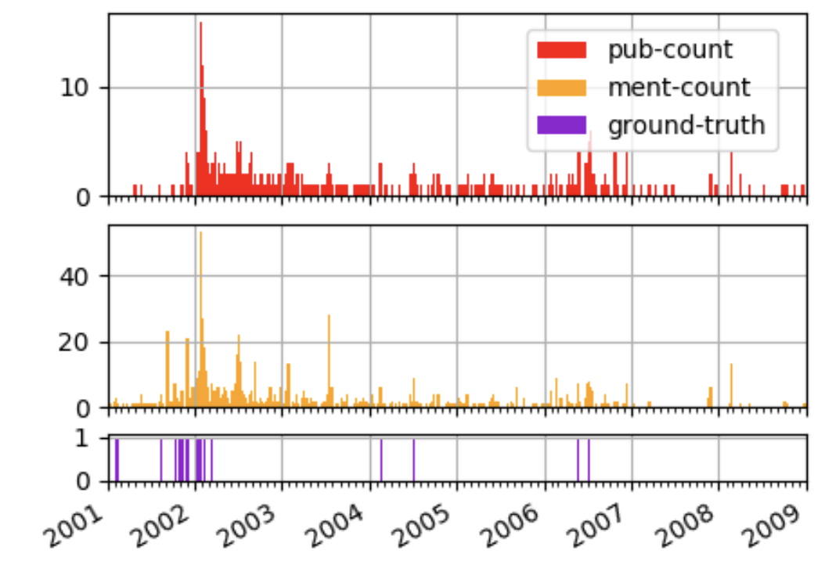
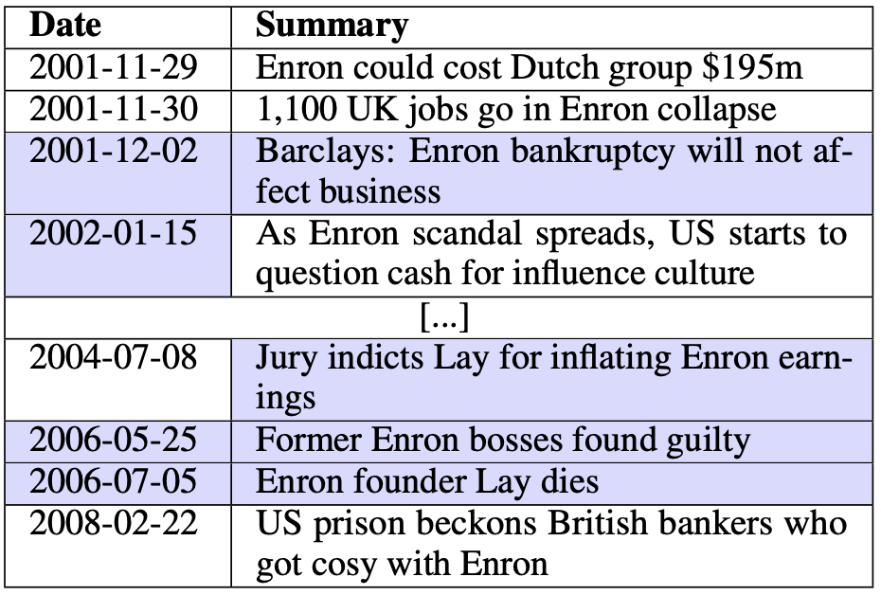
Remaining Challenges: Evaluation Metrics
Examining the State-of-the-Art in News Timeline Summarization
High values often cluster around important dates

Slide 38
THANK YOU

