Slide 1
Misinformation Detection
Heng Ji
hengji@illinois.edu
The second half is based on my amazing PhD student Yi Ren Fung’s ACL2021 Paper

Slide 2
Stance Detection (Hanselowski et al., COLING18)
Notes:
Constructing unified, structured knowledge networks by integrating text, social media and multi-genre networks with low cost, high quality and wide coverage
Combining distributional semantics and symbolic semantics through zero-shot transfer learning to construct multi-genre knowledge networks on the fly

Slide 3
Stance Detection Features
Baseline Features
  The cooccurrence (COOC) of word and character n-grams in the headline and the document as well as two lexicon-based features, which count the number of refuting (REFU) and polarity (POLA) words based on small word lists
Challenge features
  Bag-of-words (BoW) unigram features
  Topic model features based on non-negative matrix factorization (NMF-300, NMF-cos) (Lin, 2007)
  Latent Dirichlet Allocation (LDA-cos) (Blei et al., 2001)
  Latent Semantic Indexing (LSI-300) (Deerwester et al., 1990)
  two lexicon-based features using NRC Hashtag Sentiment (NRC-Lex) and Sentiment140 (Sent140) (Mohammad et al., 2013)
  Word similarity features which measure the cosine similarity of pre-trained word2vec embeddings of nouns and verbs in the headlines and the documents (WSim)
Notes:
Constructing unified, structured knowledge networks by integrating text, social media and multi-genre networks with low cost, high quality and wide coverage
Combining distributional semantics and symbolic semantics through zero-shot transfer learning to construct multi-genre knowledge networks on the fly

Slide 4
Stance Detection Features
Novel Features
  Bag-of-character 3-grams (BoC) represent subword information
  Structural features (STRUC) include the average word lengths of the headline and the document, the number of paragraphs in the document and their average lengths
  Readability features (READ) which estimate the complexity of a text: Less complex texts could be indicative of deficiently written fake news
    Headline and document as a concatenated feature vector: SMOG grade (Mc Laughlin, 1969), Flesch-Kincaid grade level and Flesch reading ease (Kincaid et al., 1975), Gunning fog index (Štajner et al., 2012), Coleman-Liau index (Mari and Ta Lin, 1975), automated readability index (Senter and Smith, 1967), LIX and RIX (Jonathan, 1983), McAlpine EFLAW Readability Score (McAlpine, 1997), and Strain Index (Solomon, 2006)
Notes:
Constructing unified, structured knowledge networks by integrating text, social media and multi-genre networks with low cost, high quality and wide coverage
Combining distributional semantics and symbolic semantics through zero-shot transfer learning to construct multi-genre knowledge networks on the fly

Slide 5
Stance Detection Features
Novel Features
  lexical diversity (LexDiv) metrics, type-token ratio, and the measure of textual diversity (MTLD) (McCarthy, 2005)
  lexicons: MPQA (Wilson et al., 2005), MaxDiff (Kiritchenko et al., 2014), and EmoLex (Mohammad and Turney, 2010).
Notes:
Constructing unified, structured knowledge networks by integrating text, social media and multi-genre networks with low cost, high quality and wide coverage
Combining distributional semantics and symbolic semantics through zero-shot transfer learning to construct multi-genre knowledge networks on the fly

Slide 6
Stance Detection Results
Notes:
Constructing unified, structured knowledge networks by integrating text, social media and multi-genre networks with low cost, high quality and wide coverage
Combining distributional semantics and symbolic semantics through zero-shot transfer learning to construct multi-genre knowledge networks on the fly

Slide 7
Bias Detection (Baly et al., EMNLP18)
Article Features
Structure: POS tags, linguistic features based on the use of specific words (function words, pronouns, etc.), and features for clickbait title classification from (Chakraborty et al., 2016);
Sentiment: sentiment scores using lexicons (Recasens et al., 2013; Mitchell et al., 2013) and full systems (Hutto and Gilbert, 2014);
Engagement: number of shares, reactions, and comments on Facebook;
Topic: lexicon features to differentiate between science topics and personal concerns;
Complexity: type-token ratio, readability, number of cognitive process words (identifying discrepancy, insight, certainty, etc.);
Bias: features modeling bias using lexicons (Recasens et al., 2013; Mukherjee and Weikum, 2015) and subjectivity as calculated using pre-trained classifiers (Horne et al., 2017);
Morality: features based on the Moral Foundation Theory (Graham et al., 2009) and lexicons (Lin et al., 2017)
Notes:
Constructing unified, structured knowledge networks by integrating text, social media and multi-genre networks with low cost, high quality and wide coverage
Combining distributional semantics and symbolic semantics through zero-shot transfer learning to construct multi-genre knowledge networks on the fly

Slide 8
Bias Detection (Baly et al., EMNLP18)
Wikipedia Features
Has Page: indicates whether the target medium has a Wikipedia page;
Vector representation for each of the following segments of the Wikipedia page, whenever applicable: Content, Infobox, Summary, Categories, and Table of Contents. We generate these representations by averaging the word embeddings (pretrained word2vec embeddings) of the corresponding words
Notes:
Constructing unified, structured knowledge networks by integrating text, social media and multi-genre networks with low cost, high quality and wide coverage
Combining distributional semantics and symbolic semantics through zero-shot transfer learning to construct multi-genre knowledge networks on the fly

Slide 9
Bias Detection (Baly et al., EMNLP18)
Twitter Features
Has Account: media that publish unreliable information might have no Twitter accounts
Verified: Whether the account is verified by Twitter
Created: The year the account was created
Has Location
URL Match: Whether the account includes a URL to the medium, and whether it matches the URL we started the search with
Counts: Statistics about the number of friends, statuses, and favorites
Description: A vector representation generated by averaging the Google News embeddings (Mikolov et al., 2013) of all words of the profile description paragraph
URL features
Web Traffic
Notes:
Constructing unified, structured knowledge networks by integrating text, social media and multi-genre networks with low cost, high quality and wide coverage
Combining distributional semantics and symbolic semantics through zero-shot transfer learning to construct multi-genre knowledge networks on the fly

Slide 10
Bias Detection (Baly et al., EMNLP18)
Factuality scores
Notes:
Constructing unified, structured knowledge networks by integrating text, social media and multi-genre networks with low cost, high quality and wide coverage
Combining distributional semantics and symbolic semantics through zero-shot transfer learning to construct multi-genre knowledge networks on the fly

Slide 11
Bias Detection (Baly et al., EMNLP18)
Bias scores
Notes:
Constructing unified, structured knowledge networks by integrating text, social media and multi-genre networks with low cost, high quality and wide coverage
Combining distributional semantics and symbolic semantics through zero-shot transfer learning to construct multi-genre knowledge networks on the fly

Slide 12
Rumor Detection on Twitter (Ma et al., ACL18)
Propagation tree
Notes:
Constructing unified, structured knowledge networks by integrating text, social media and multi-genre networks with low cost, high quality and wide coverage
Combining distributional semantics and symbolic semantics through zero-shot transfer learning to construct multi-genre knowledge networks on the fly

Slide 13
Rumor Detection on Twitter (Ma et al., ACL18)
Syntactic tree based RNN
Notes:
Constructing unified, structured knowledge networks by integrating text, social media and multi-genre networks with low cost, high quality and wide coverage
Combining distributional semantics and symbolic semantics through zero-shot transfer learning to construct multi-genre knowledge networks on the fly

Slide 14
Rumor Detection on Twitter (Ma et al., ACL18)
Notes:
Constructing unified, structured knowledge networks by integrating text, social media and multi-genre networks with low cost, high quality and wide coverage
Combining distributional semantics and symbolic semantics through zero-shot transfer learning to construct multi-genre knowledge networks on the fly

Slide 15
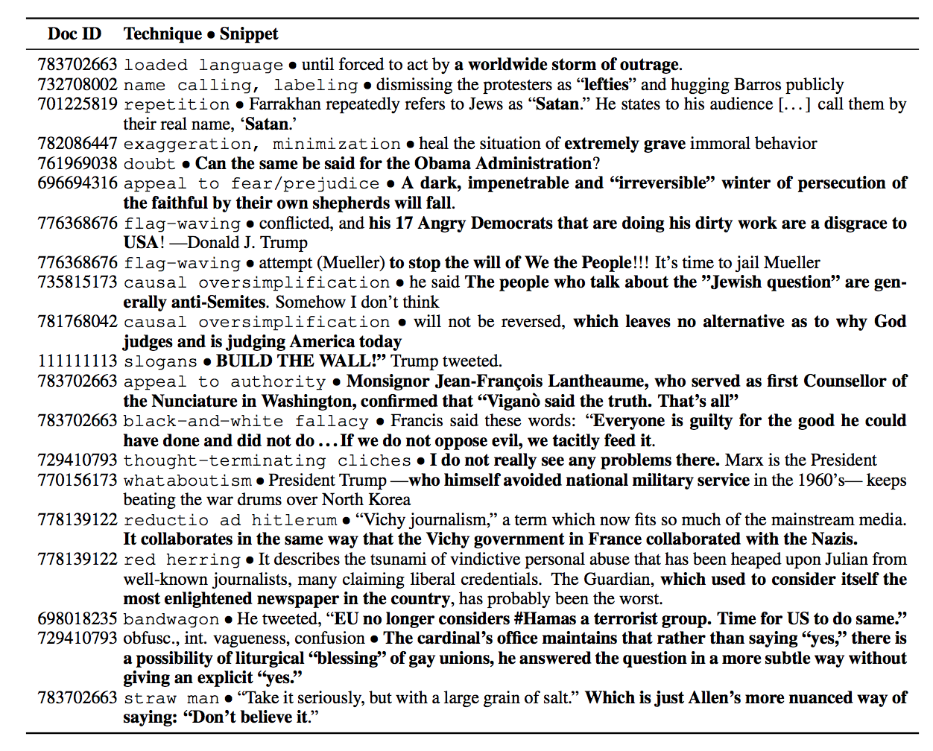
Propaganda Categories (Martino et al., 2019)
Notes:
Constructing unified, structured knowledge networks by integrating text, social media and multi-genre networks with low cost, high quality and wide coverage
Combining distributional semantics and symbolic semantics through zero-shot transfer learning to construct multi-genre knowledge networks on the fly

Slide 16
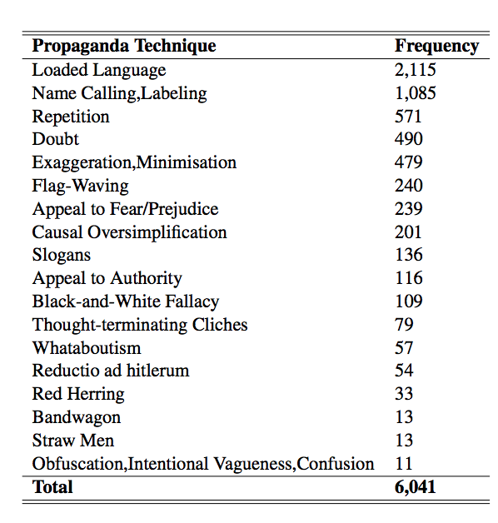
Propaganda Categories (Martino et al., 2019)
Notes:
Constructing unified, structured knowledge networks by integrating text, social media and multi-genre networks with low cost, high quality and wide coverage
Combining distributional semantics and symbolic semantics through zero-shot transfer learning to construct multi-genre knowledge networks on the fly

Slide 17
Propaganda Detection Data set
https://zenodo.org/record/3271522#.Yig-Ju7MJBx
Notes:
Constructing unified, structured knowledge networks by integrating text, social media and multi-genre networks with low cost, high quality and wide coverage
Combining distributional semantics and symbolic semantics through zero-shot transfer learning to construct multi-genre knowledge networks on the fly

Slide 18
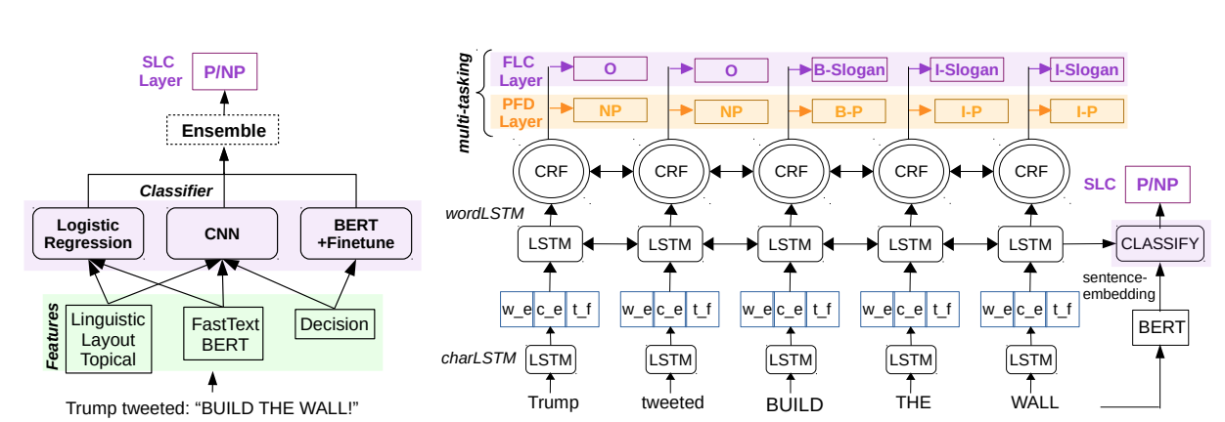
Propaganda Detection (Gupta et al., 2019)
Notes:
Constructing unified, structured knowledge networks by integrating text, social media and multi-genre networks with low cost, high quality and wide coverage
Combining distributional semantics and symbolic semantics through zero-shot transfer learning to construct multi-genre knowledge networks on the fly

Slide 19
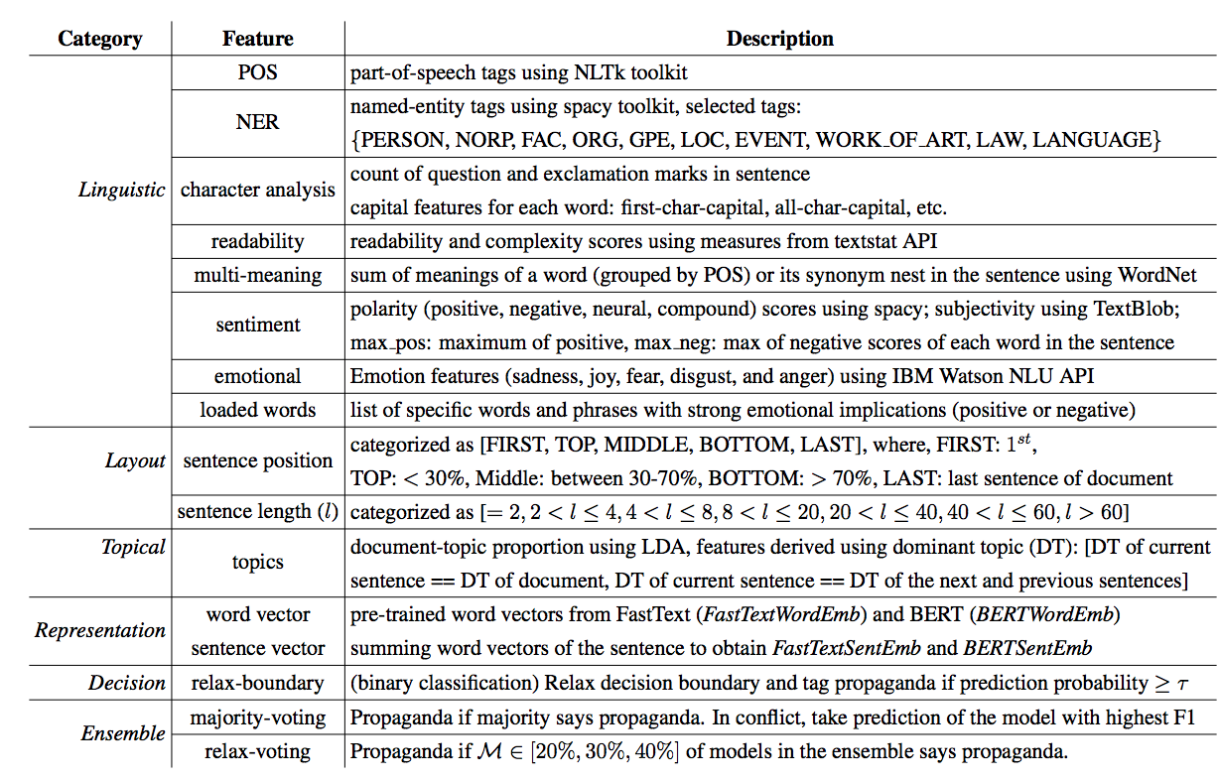
Propaganda Detection (Gupta et al., 2019)
Notes:
Constructing unified, structured knowledge networks by integrating text, social media and multi-genre networks with low cost, high quality and wide coverage
Combining distributional semantics and symbolic semantics through zero-shot transfer learning to construct multi-genre knowledge networks on the fly

Slide 20
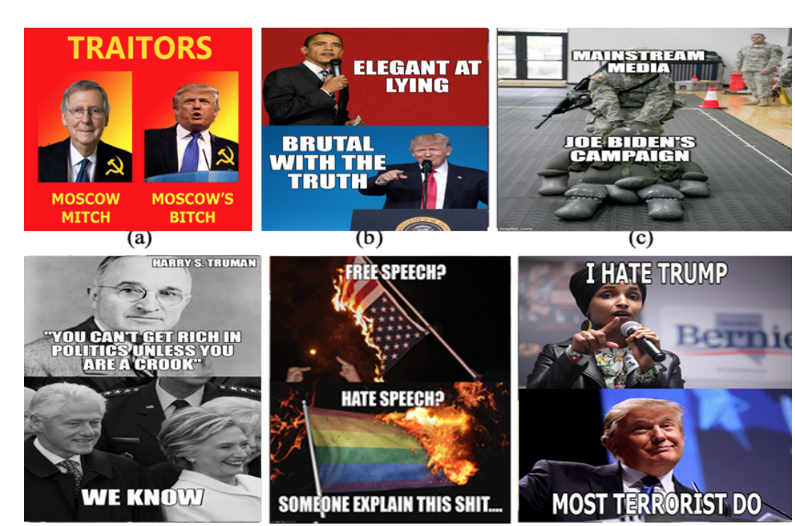
Propaganda Detection from MeMes (Dimitar et al., 2021)
Notes:
Constructing unified, structured knowledge networks by integrating text, social media and multi-genre networks with low cost, high quality and wide coverage
Combining distributional semantics and symbolic semantics through zero-shot transfer learning to construct multi-genre knowledge networks on the fly

Slide 21
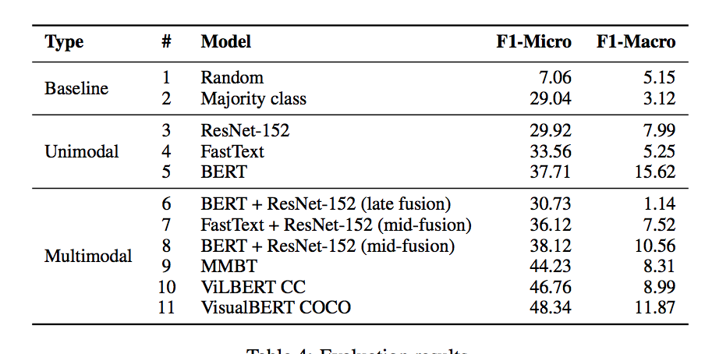
Propaganda Detection from MeMes (Dimitar et al., 2021)
Notes:
Constructing unified, structured knowledge networks by integrating text, social media and multi-genre networks with low cost, high quality and wide coverage
Combining distributional semantics and symbolic semantics through zero-shot transfer learning to construct multi-genre knowledge networks on the fly

Slide 22
Can we generate training data for Propaganda Detection automatically?
Steeve Huang’s short talk
Notes:
Constructing unified, structured knowledge networks by integrating text, social media and multi-genre networks with low cost, high quality and wide coverage
Combining distributional semantics and symbolic semantics through zero-shot transfer learning to construct multi-genre knowledge networks on the fly

Slide 23
Misinformation often occurs at knowledge element level

Slide 24
Limitation of SOTA Fake News Detection
Current fake news detection approaches mostly focus on the document-level detection task, which lacks precision and explainability.
They also tend to lack a unified framework.
 | Text Features | Structured Knowledge | Source Bias | Multimedia Consistency | Fine-Grained Detection
Perez-Rosas et al. (2018) | ✔ | - | - | -
Pan et al. (2017) | - | ✔ | - | -
Baly et al. (2018) | ✔ | - | ✔ | -
Zellers et al. (2019) | ✔ | - | ✔ | -
Tan et al. 2020 | ✔ |  |  | ✔
Notes:
The main motivation that inspired our paper is that .. [read the slide]
The table here shows related works, which separately focus on text features, structured knowledge, source bias, and multimedia consistency when detecting for misinformation in a candidate news article

Slide 25


New Task: Knowledge Element-Level Misinformation Detection [Fung et al., ACL2021]
Combine local and global features
Leverage external knowledge to help pinpoint misinformation
External
Knowledge
Base
bbc.com
Police Brutality in HK at new Extreme Levels
GNN
Aug 11, 2019 Lisa Lu
crowd
Entity Linking
Police brutality has risen to a new, extreme level in HK this past weekend. HK police started shooting
at protestors on the streets, including the unarmed, peaceful protestors. One notable incidence involved a
Head
Nodes
HK
protestors
…
Graph
Classifier
Edge
Classifier
HK police shoot cold bullets at protestors from hidden corners.
police
woman
hidden corner
Real /
Fake
Misinformative
Knowledge
Elements:
woman at the Tsim Sha Tsui bus stop being shot in the eye by a policeman hiding behind corners. No warning was issued beforehand, and the woman was permanently blinded. Local activists are avidly calling for international attention on the HK police brutality.
Tsim Sha Tsui
bus stop
activists
IE / KG Representation
{<police, located in, hidden corner>,
<police, blinded, the woman>}
InfoSurgeon

Slide 26
New Task: Knowledge Element-Level Misinformation Detection
We also propose a new task in addition to document-level fake news detection that is more challenging but interesting.
Label each triplet connecting two entities as True/False

Slide 27
InfoSurgeon extracts both Global and Local Features
External
Knowledge
Base
Global context features
  These are the semantic representations from the images, captions, body text, and news article metadata based on Bert encoder (for textual) or VQA-based attention-guided Faster R-CNN (for visual).
Localized IE features
  These are the structured representations from the entities, relations, and events extracted.
crowd
Entity Linking
Global Context
Nodes [Tan et al.]
HK
protestors
…
police
woman
hidden corner
Tsim Sha Tsui
bus stop
activists
Localized IE / KG Representation
Notes:
Diving into further details here, the InfoSurgeon extracts clues from both Global and Local features in the intermediary network representation.
The global context features are the semantic embeddings from…
The localized IE features are the structured embeddings from the entities, relations, and events extracted. These IE elements make up the KG (on the right side) after entity linking and coreference resolution.

Slide 28
Example Knowledge Graph Construction for InfoSurgeon
[Li et al.]
Image Caption
Hong Kong police shoot cold bullets at protestors from hidden corners.
Notes:
Here, we show an example of knowledge graph construction
Starting from an image caption

Slide 29

Example Knowledge Graph Construction for InfoSurgeon
[Li et al.]
Relation
“Hidden corner”
Image Caption
Physical.
LocatedNear
Hong Kong police shoot cold bullets at protestors from hidden corners.
“Hong Kong Police”
Notes:
So the relation extracted would be ..

Slide 30
Example Knowledge Graph Construction for InfoSurgeon
[Li et al.]
Relation
Events and Arguments
“Hidden corner”
Conflict.
Attack.
Instrument
Image Caption
“cold bullets”
Physical.
LocatedNear
Hong Kong police shoot cold bullets at protestors from hidden corners.
“Hong Kong Police”
“shoot”
Conflict.
Attack.
Attacker
Conflict.
Attack.
Victim
“Hong Kong Police”
“protestors”
= event trigger
Notes:
The event extracted would be ..

Slide 31
Example Knowledge Graph Construction for InfoSurgeon
[Li et al.]
Merged Knowledge Graph
“Hidden corner”
Conflict.
Attack.
Instrument
Image Caption
“cold bullets”
Hong Kong police shoot cold bullets at protestors from hidden corners.
Physical.
LocatedNear
“shoot”
Conflict.
Attack.
Attacker
Conflict.
Attack.
Victim
“Hong Kong Police”
“protestors”
= event trigger
Notes:
The ”HK police” entity from the relation and entity should be merged through coreference resolution

Slide 32
Example Knowledge Graph Construction for InfoSurgeon
[Li et al.]
Merged Knowledge Graph
Conflict.
Attack.
Instrument
“cold bullets”
“shoot”
Conflict.
Attack.
Attacker
Conflict.
Attack.
Victim
Image Caption
Hong Kong police shoot cold bullets at protestors from hidden corners.
“Hidden corner”
Physical.
LocatedNear
“Hong Kong Police”
“protestors”
= event trigger
Notes:
This is just rearranging for space

Slide 33
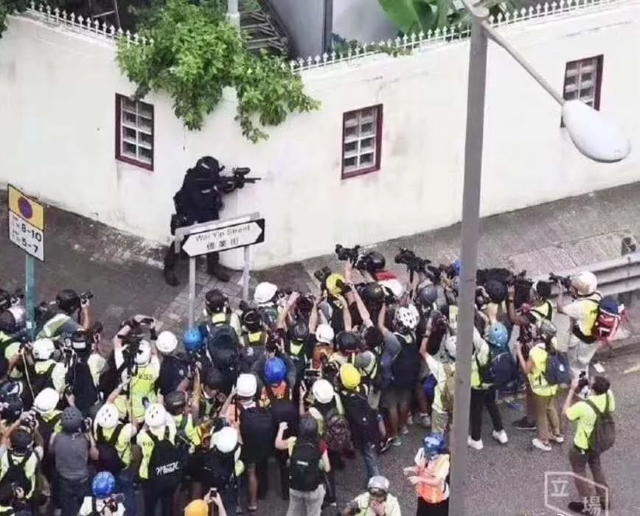
Example Knowledge Graph Construction for InfoSurgeon
[Li et al.]
Merged Knowledge Graph
Conflict.
Attack.
Instrument
“cold bullets”
“shoot”
Conflict.
Attack.
Victim
Conflict.
Attack.
Attacker
Image Caption
Hong Kong police shoot cold bullets at protestors from hidden corners.
“Hidden corner”
Physical.
LocatedNear
“Hong Kong Police”
“protestors”
= event trigger
Notes:
Now at the image side,

Slide 34
Example Knowledge Graph Construction for InfoSurgeon
[Li et al.]
Merged Knowledge Graph
Conflict.
Attack.
Instrument
“cold bullets”
“police”
“shoot”
Conflict.
Attack.
Victim
Conflict.
Attack.
Attacker
Image Caption
Hong Kong police shoot cold bullets at protestors from hidden corners.
“Hidden corner”
Physical.
LocatedNear
“Hong Kong Police”
“protestors”
= event trigger
Notes:
We can detect the person standing there as the police.

Slide 35
Example Knowledge Graph Construction for InfoSurgeon
[Li et al.]
Merged Knowledge Graph
“shoot”
Conflict.
Attack.
Instrument
“cold bullets”
“police”
“shoot”
Conflict.
Attack.
Victim
Conflict.
Attack.
Attacker
Image Caption
Hong Kong police shoot cold bullets at protestors from hidden corners.
“Hidden corner”
Physical.
LocatedNear
“Hong Kong Police”
“protestors”
= event trigger
Notes:
Shooting

Slide 36
Example Knowledge Graph Construction for InfoSurgeon
[Li et al.]
Merged Knowledge Graph
“shoot”
Conflict.
Attack.
Instrument
“cold bullets”
“police”
“shoot”
Cross-media object coreference
Conflict.
Attack.
Victim
Conflict.
Attack.
Attacker
Image Caption
Hong Kong police shoot cold bullets at protestors from hidden corners.
“Hidden corner”
Physical.
LocatedNear
“Hong Kong Police”
“protestors”
= event trigger
Notes:
The police will be merged through cross-media object coreference or visual grounding

Slide 37
Example Knowledge Graph Construction for InfoSurgeon
[Li et al.]
Merged Knowledge Graph
“shoot”
Conflict.
Attack.
Instrument
“cold bullets”
Cross-media event coreference
“police”
“shoot”
Cross-media object coreference
Conflict.
Attack.
Victim
Conflict.
Attack.
Attacker
Image Caption
Hong Kong police shoot cold bullets at protestors from hidden corners.
“Hidden corner”
Physical.
LocatedNear
“Hong Kong Police”
“protestors”
= event trigger
Notes:
The ”shoot” event can also be merged through cross-media event coreference

Slide 38
Example Knowledge Graph Construction for InfoSurgeon
[Li et al.]
Merged Knowledge Graph
“shoot”
Conflict.
Attack.
Instrument
“cold bullets”
Cross-media event coreference
“police”
“shoot”
Cross-media object coreference
Conflict.
Attack.
Victim
Conflict.
Attack.
Attacker
Image Caption
Hong Kong police shoot cold bullets at protestors from hidden corners.
“Hidden corner”
Physical.
LocatedNear
“Hong Kong Police”
“protestors”
External
Knowledge
Base
= event trigger

Slide 39
Graph Propagation
Image
Semantic context node
Caption
Semantic context node
Article
Semantic context node
Coreference
Image Knowledge Graph
Caption Knowledge Graph
Article Knowledge Graph
Coreference

Slide 40

InfoSurgeon checks for Information Inconsistencies
Leverages cross-media signals and background knowledge
through feature propagation.
a.) cross-media signals
b.) background knowledge
police
police
✅
“arrest”
Judicial.
Arrester
Judicial.Arrestee
surface-form mention embeddings
Physical.
LocatedNear
Physical.
LocatedNear
✅
feature propagation
“HK”
background
embeddings
“Police”
“protestors”
“hidden corner”
“crowd of people”
Notes:
InfoSurgeon checks for information inconsistency with this merged KG.
It leverages cross-media signals and background knowledge through feature propagation.
For example, a caption that says <police, located near, hidden corner> would conflict with the police shown in the image. But if the caption says
Similarly, we also check for consistency between the surface-form mention embeddings from the news article input and the background knowledge embeddings from WikiData.

Slide 41
KG-Conditional Fake News Generation
Human generated fake news is usually removed shortly after it’s posted
Annotating specifically which elements in a KG are fake is time-intensive / difficult
We propose a solution to automatically obtain knowledge-element labeled knowledge graphs for free
Given a set of real news articles, we extract KGs from the real articles
Train a text generator model that learns to recreate an article from its KG
To generate fake data, perform manipulation operations on the KG (editing knowledge relations, events, entities, etc.) to produce KG’
Generate a fake article from KG’
Key insight – We now know specifically which elements in KG’ were manipulated!

Slide 42
Manipulated KG-to-Article Synthesis
We perform the following manipulations on KGs:
Entity swapping – Swapping entity that has same type and similar embedding (so they are harder to tell apart)
Addition of new relation or event – Randomly select relation / event argument roles and append a new entity to the relation / event
Subgraph replacement – Select a subgraph of the news article from an entity and replace it with a subgraph from another news article
Generate a fake news article that aligns with manipulated KG's by finetuning a BARTlarge language model (Lewis et al., 2020) on our training set + copy mechanism (Post and Vilar, 2018)

Slide 43
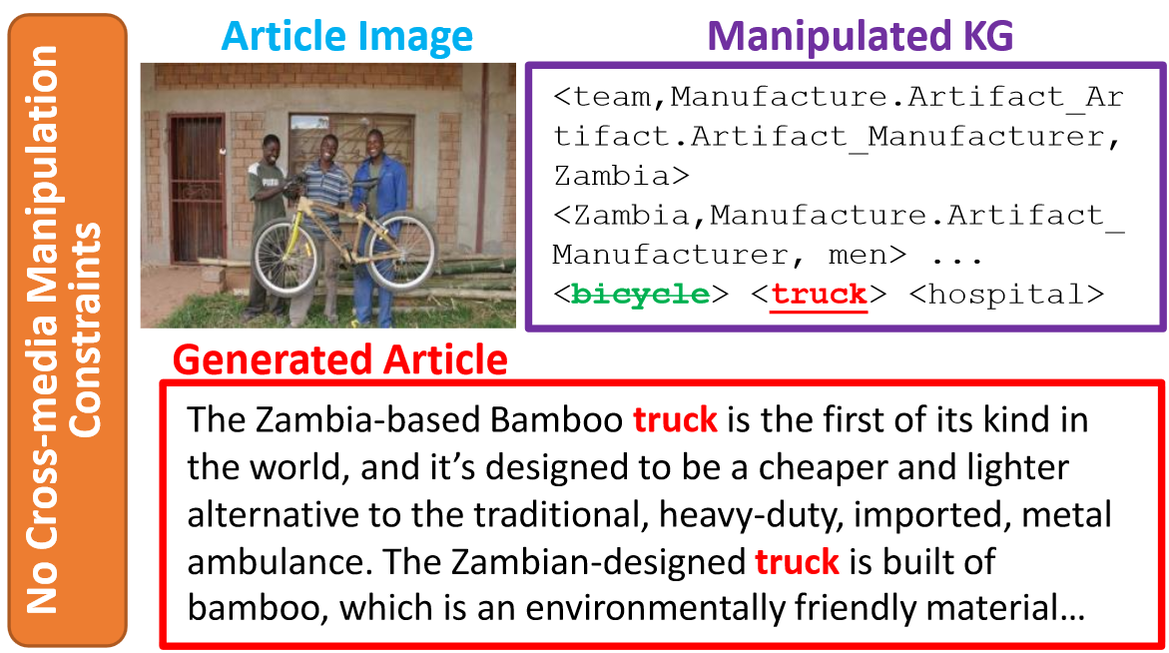
Generating Text from Structured Representations
We manipulate knowledge graphs to synthesize fake news which contain known types of inconsistencies.
This example is trivially detectable due to a inconsistency with the image

Slide 44
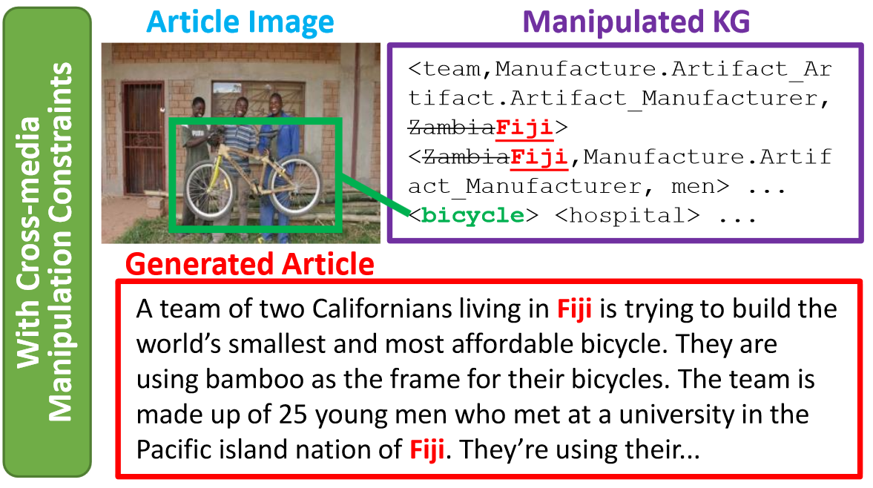
Generating Text from Structured Representations
By imposing cross-media knowledge graph manipulation constraints, we prevent generating text with obvious inconsistencies.
Enables generating more realistic / challenging data for training detector

Slide 45
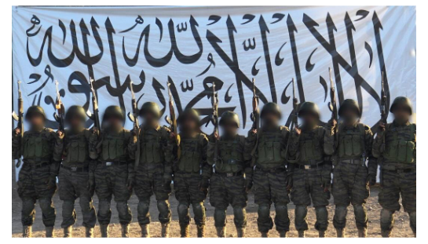
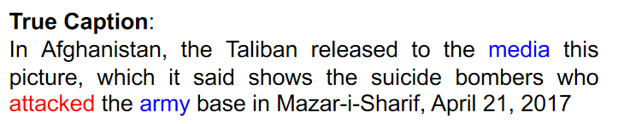
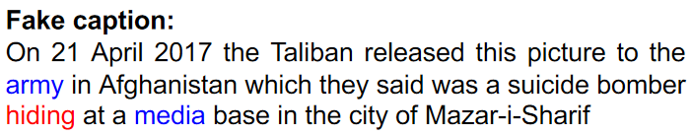
Caption Manipulation – AMR-to-Caption Synthesis
Use text parser to get AMR graphs (Banarescu et al., 2013) from captions
Use AMR since they capture fine-grained relations expressing who does what to whom
Manipulations:
  Role switching – Swapping entity positions in AMR graph
  Predicate negation – Replace triggers / verbs with antonyms from WordNet
Use off-the-shelf model for AMR to text synthesis (Ribeiro et al, 2020)
Convert manipulated AMR graphs them into text using BART-large model fine-tuned to generate the sentence from its corresponding linearized AMR graph (Ribeiro et al., 2020)
Ethical Statement: we are not going to share our generator, but sharing our detector!

Slide 46
Knowledge Element-Level Misinformation Dataset
To address the lack of data for the detection task, we further contribute a KG2txt fake news generation approach, which allows for control over knowledge element manipulation and creating silver standard annotation data.
 | Overall | Real Documents | Fake Documents
Human Detection Accuracy | 61.3% | 80.4% | 42.3%
The Turing Test results above show that our automatically generated fake documents are also very hard for humans to detect.

Slide 47
Knowledge Element-Level Misinformation Detection
Experimental result on traditional document-level detection (Accuracy):
Experimental result on the novel task, knowledge element level misinformation detection (F-score):
 | NYTimes Neural News Dataset | VOA Manipulated KG2Txt Dataset
Grover | 56.0% | 86.4%
DIDAN | 77.6% | 88.3%
InfoSurgeon (Our Model) | 94.5% | 92.1%
 | VOA Manipulated KG2Txt Dataset
Random (baseline) | 27%
InfoSurgeon (Our Model) | 37%

Slide 48
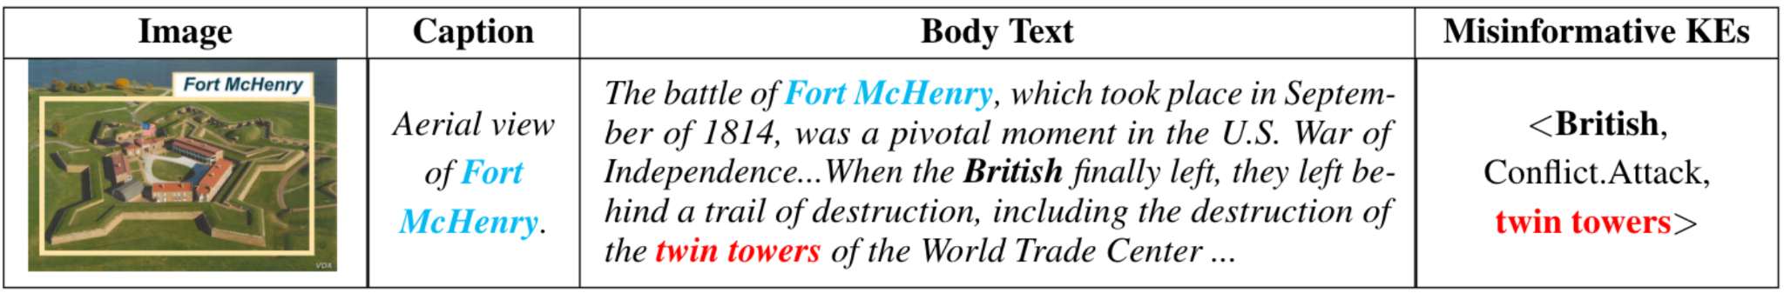
A Successful Example
Example of fake news article in which baseline misses, but InfoSurgeon successfully detects
[accuracy]
[accuracy]

Slide 49
Ongoing Work: Cross-Document Misinformation Detection
Leveraging IE, Argumentation Mining, and Global Context
Also take advantage of argumentation, which is a layer of information granularity
between IE and global context
The arrested protestors should be released.
claim matching
Violent protestors should be arrested.
Claim
Claim
Premises
relation inference
Premises
Probe
Article
Corpus
Extradition law will weaken autonomy and judicial independence.
Protests on the Extradition Law amendment are not necessary.
The ruling government will undermine certain freedom.
Most of the protests are violent.
Misinformation Detection
(& Characterization)

Slide 50
Ongoing Work: Characterizing Intent/Motif behind Misinformation
Notes:
Constructing unified, structured knowledge networks by integrating text, social media and multi-genre networks with low cost, high quality and wide coverage
Combining distributional semantics and symbolic semantics through zero-shot transfer learning to construct multi-genre knowledge networks on the fly

Slide 51

Ongoing Work: InfoSurgeon Extended and More on the Positive Impacts
Information Surgery
Misinformative Text
Bruno Mars’ "Bad Boys" soundtrack will be released on February 5.
On February 4, the Red Hot Chili Peppers will kick off their North American tour with a concert in East Rutherford, New Jersey. The band will be followed by performances in Chicago, Grand Rapids, Michigan, and Las Vegas. R&B singer Carrie Underwood will be inducted into the Rock and Roll Hall of Fame on February 6. The ceremony will be held in New York City. Carrie will be the first female inductee into the Hall. Other inductees include Beyonce, Band Perry, Phillip Phillips, Queen Latifah, Vince Neil, Nikki Sixx, Mick Mars, Alice Cooper and Chantel Jeffries…
Lady Gaga has been released from jail in Miami after posting bail. She was charged with possession of marijuana and possession of drug paraphernalia. She is scheduled to appear on the February 4 episode of "American Idol.” … Susan Ryan and her husband, Jim, will take their fans to the historic Strawberry Fields in Central Park in Orlando, Florida, on February 8. The site was named in honor of …
With InfoSurgeon, we can detect the misinformative claims from fake news (e.g. Lady Gaga arrested), and remove them to regenerate good news articles.
Misinformative KG
<Bruno Mars> <Motley Crue> <NFL> <MetLife Stadium> <Red Hot Chili Peppers> <Beyonce> <Band Perry> <Phillip Phillips> <Jersey Boys> <Renee Fleming> <Lady Gaga,Justice.ArrestJailDetain.ArrestJailDetain _Detainee-ArrestJailDetain_Place, Dade County> ... <Susan Ryan,Movement.TransportArtifact_Transporter-TransportArtifact_Destination, Strawberry Fields>...<John Williams, Personnel.StartPosition_Employee, ...
Regenerated Text from Repaired KG
Bruno Mars’ "Bad Boys" album debuts at Number One on the Billboard 200 chart this week with its first week of sales. The album sold more than 100,000 copies in its first three weeks of release. Other Top 10 debuts this week include: "Lemonade" by Taylor Swift, "Young the Giant" (Number 2) by Toni Braxton (Number 3) by Kenny "Babyface" Edmonds (Number 4) by Candice Glover (Number 5) by Eric Paslay (Number 6) by Les Claypool (Number 7) by Marissa Nadler (Number 9) by Mark McGuire (Number 10).The Rock and Roll Hall of Fame will induct John Lennon, Yoko Ono and Bob Seger … The band will be supported by the Red Hot Chili Peppers, the Dave Matthews Band, Phillip Phillips, the Jersey Boys, Queen Latifah, Vince Neil, Nikki Sixx, Mick Mars, Alice Cooper and Chantel Jeffries…
Susan Ryan and her husband, Jim, will take fans to the historic Strawberry Fields in Central Park on February 2. Susan and Jim are the parents of singer-songwriter Sara Evans, who moved from Missouri to Nashville last year. Susan was diagnosed with lymphoma in January….

Slide 52
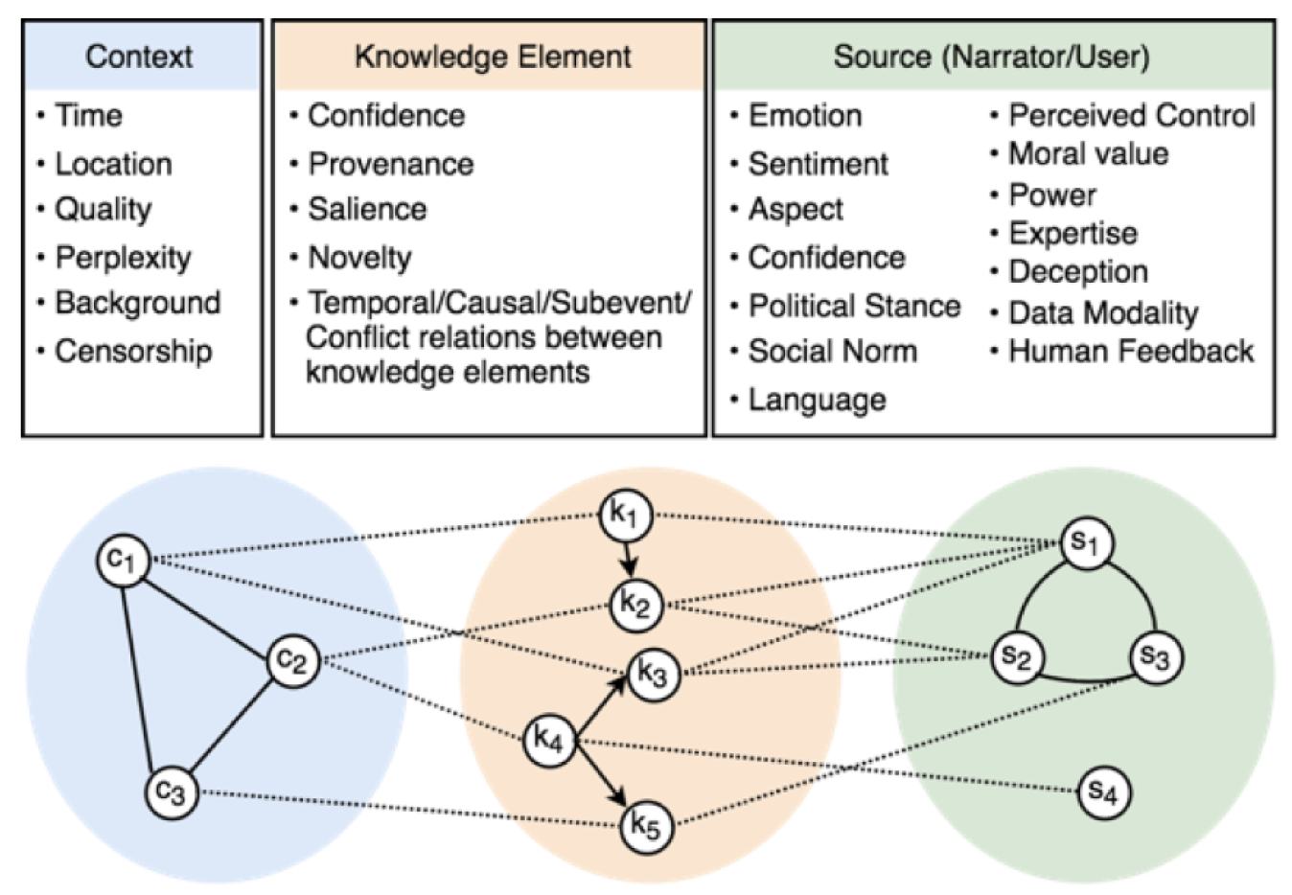
Ongoing Work: Incorporate Source, Context and Target Audience for Authentic Information Delivery
Notes:
Constructing unified, structured knowledge networks by integrating text, social media and multi-genre networks with low cost, high quality and wide coverage
Combining distributional semantics and symbolic semantics through zero-shot transfer learning to construct multi-genre knowledge networks on the fly

