Slide 1
Schema Induction for Event Prediction
Heng Ji (UIUC)

Slide 2
Story Repeats Itself
Chinese/Korean TV shows about “CEO boss guy”
He always has this really slicked back hair-style, always wears a suit
He has this really non.cha.lant look
He speaks at least 5 languages
He spent 5 years somewhere in France just for the sake of learning everything pretentious about the wine
And he spent his recent 5 years somewhere in NYC, of course the upper east side
At age 15 he got into Harvard, accepted by 10 majors
Ever since then he started to run this big multi-billion dollar company
He met this girl who graduated from an unknown college somewhere in the middle of nowhere and applied for internship in the company run by this guy
Love stories by Qiong Yao
Pretty women are good at crying in a pretty way
At least two people get their hearts broken
Main characters are very poetical
The original wife is evil
The main is always a jerk but very popular, jobless, and yells
2
Notes:
Change low resource IL to a language which is not in wikipedia
Word-level: from bi-lingual dicts and alignment; structure-level comes from wals; multi-level alignment

Slide 3
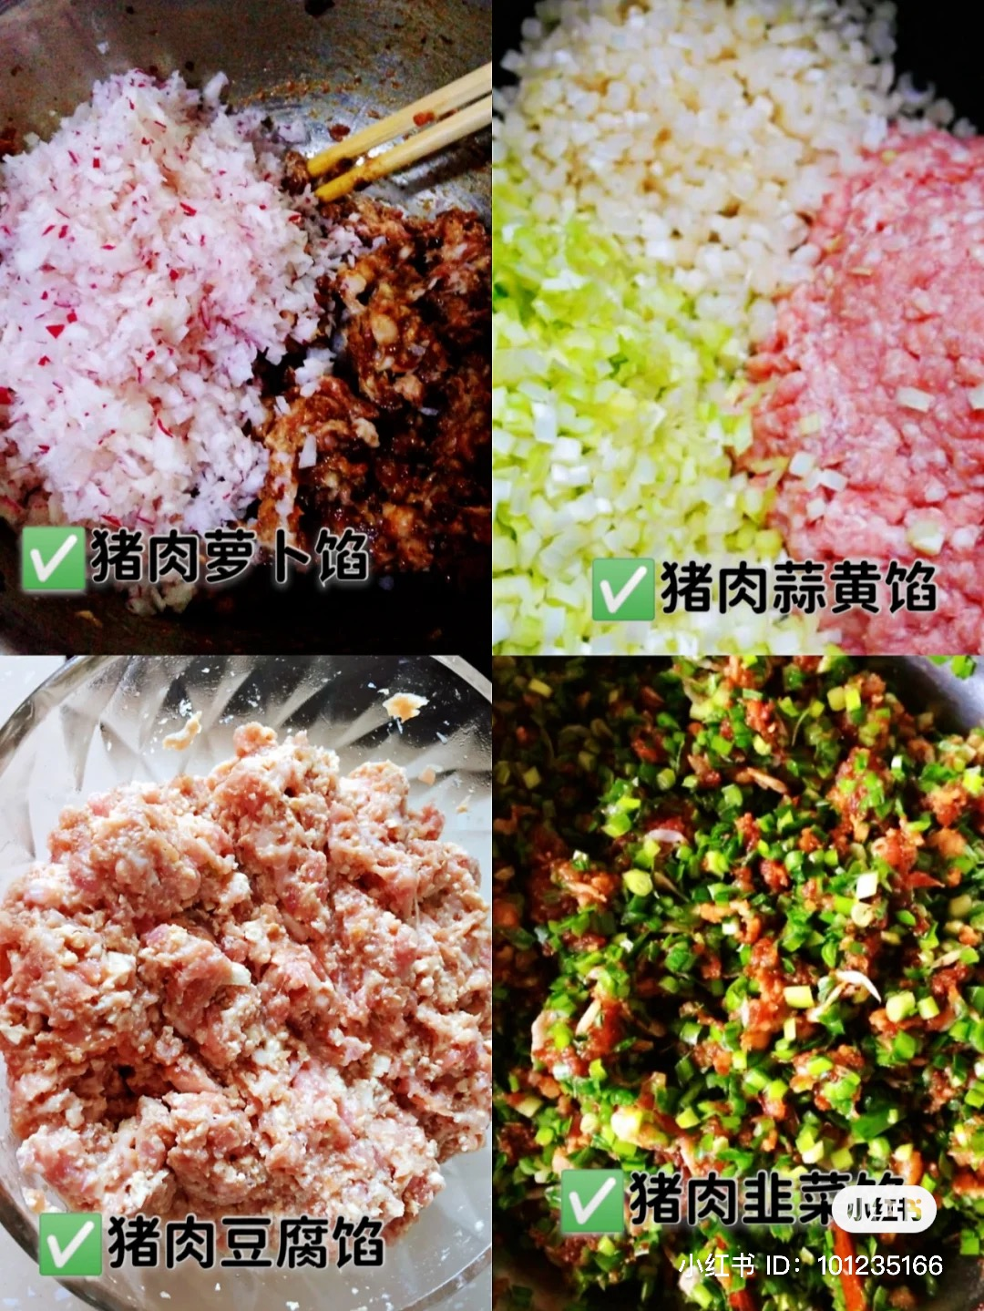
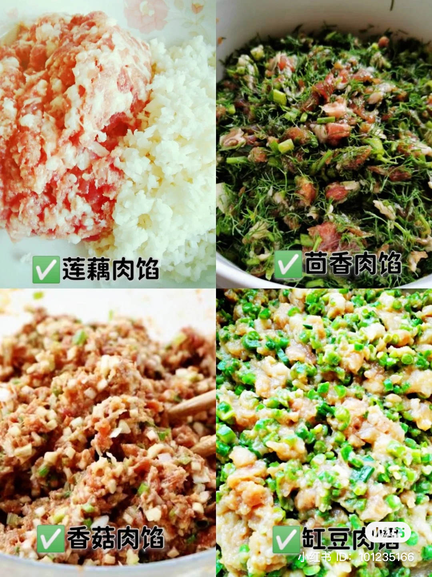
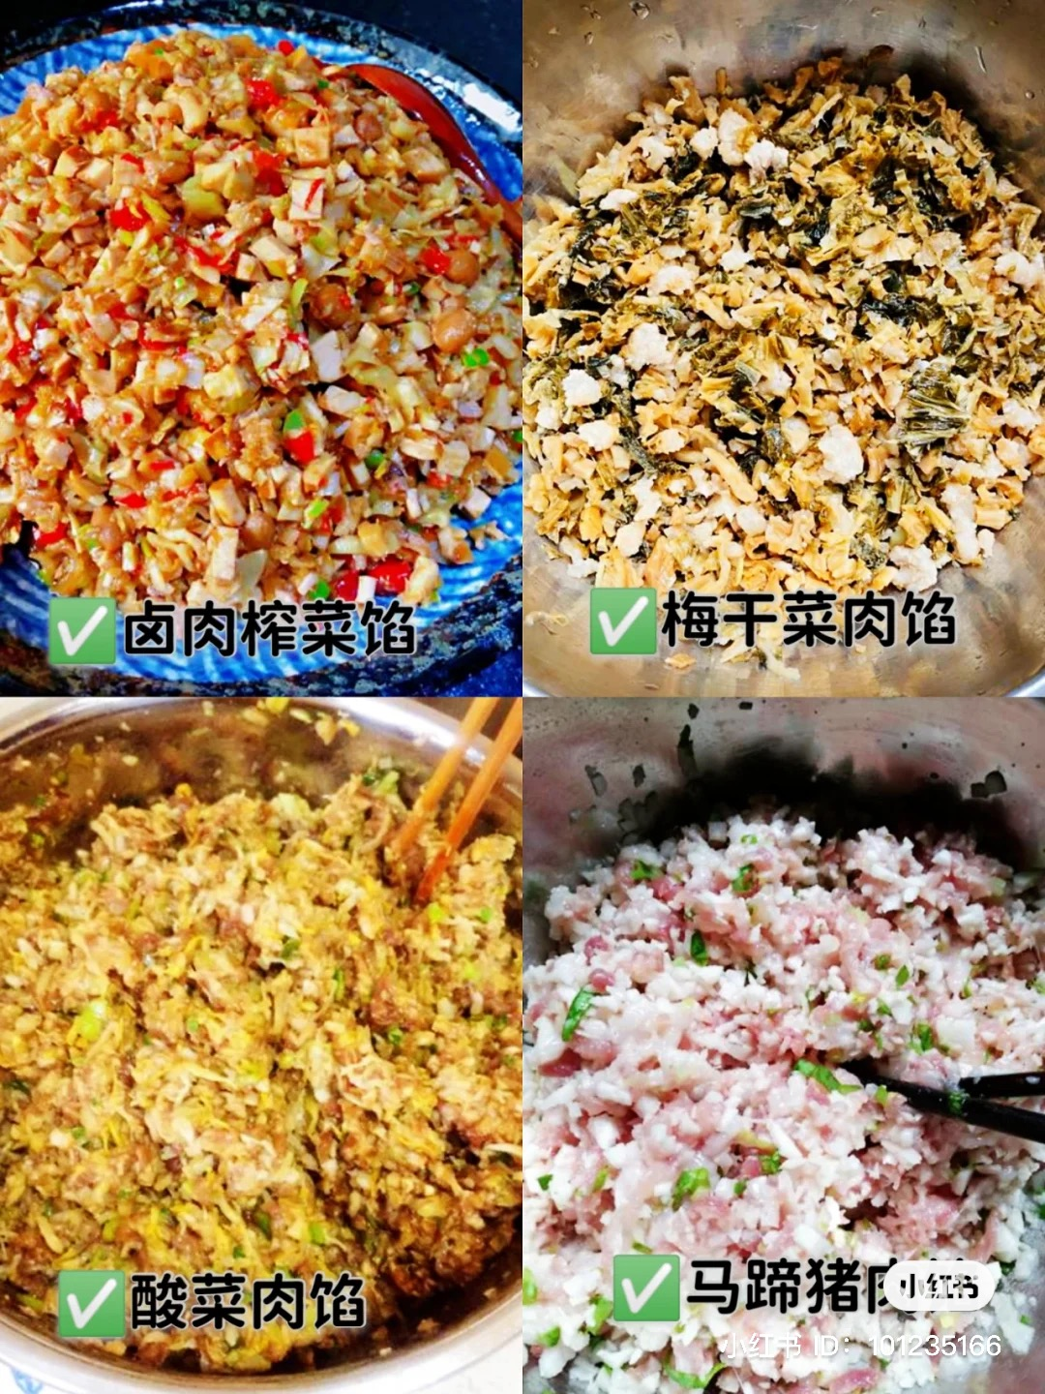
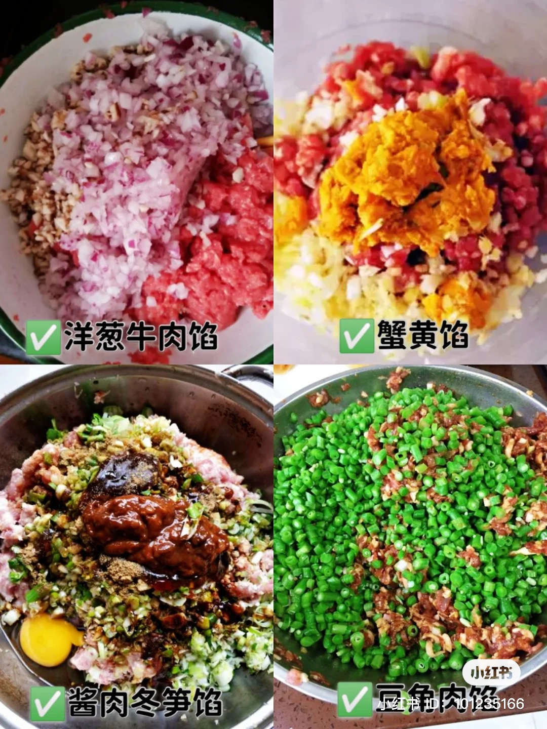
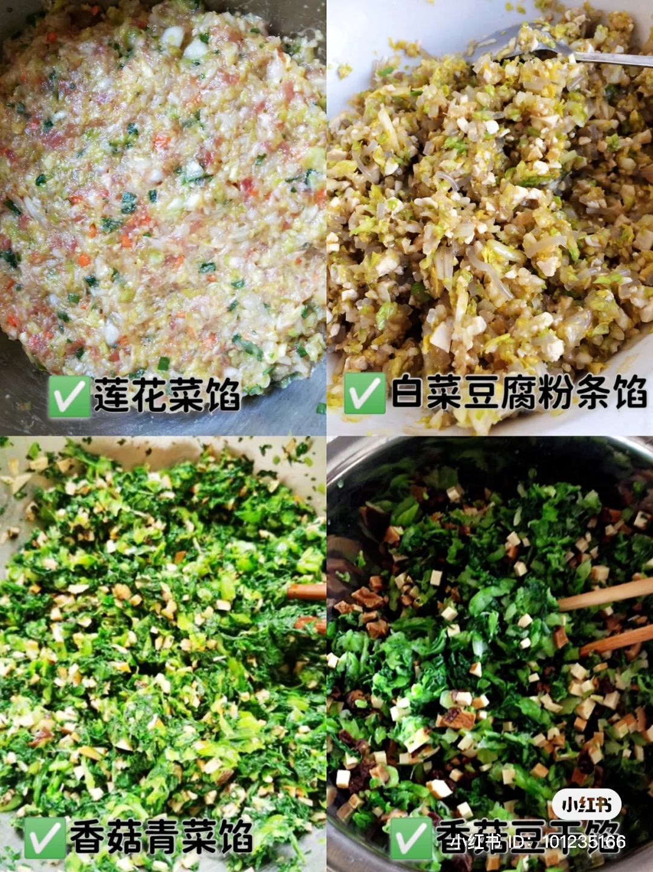
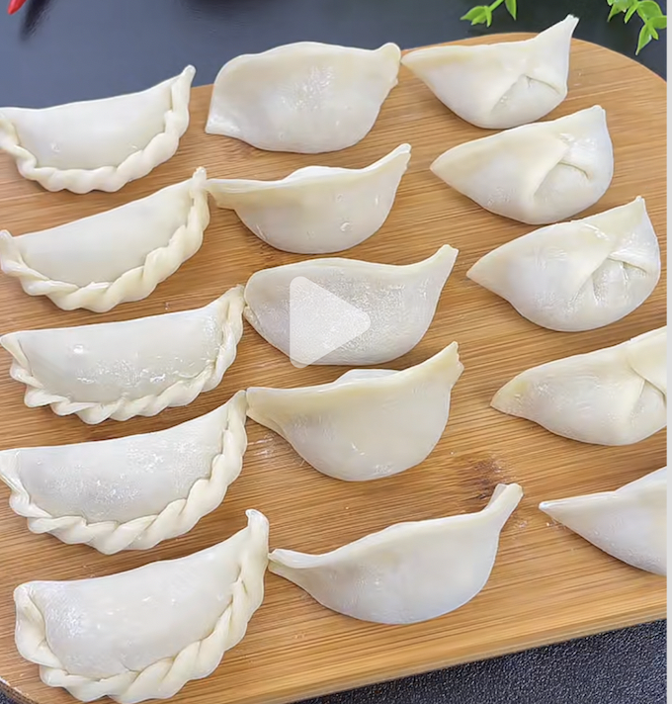
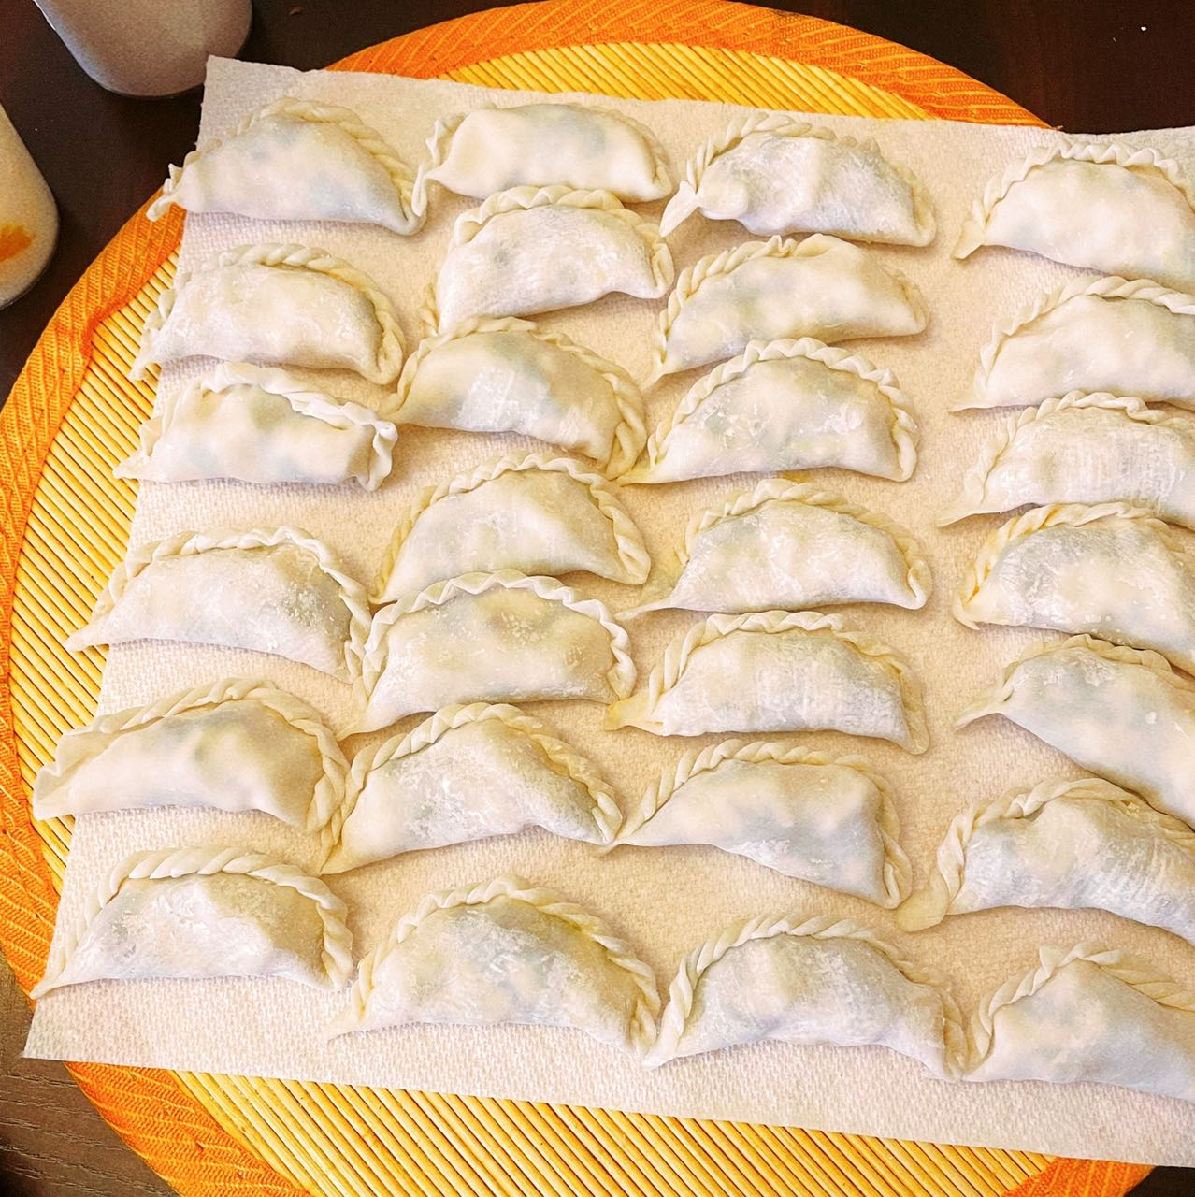
Procedure Repeats Itself
3
Notes:
Change low resource IL to a language which is not in wikipedia
Word-level: from bi-lingual dicts and alignment; structure-level comes from wals; multi-level alignment

Slide 4
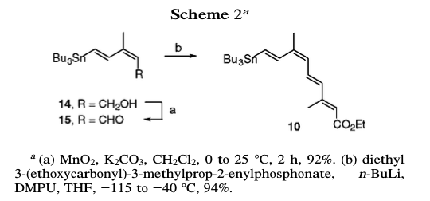
Procedure Repeats Itself
MnO2 (8.31 g, 0.10 mol) and K2CO3 (13.2 g, 0.10 mol) were added to a stirred solution of alcohol (2.06 g, 5.32 mmol) in CH2Cl2 (38 mL).
Stir (the mixture) for 30 min at 25 °C
The suspension was filtered through Celite
The filtrate (things that has passed through the filter) was evaporated
Purify the residue by column chromatography (SiO2, 90:8:2 hexane/EtOAc/Et3N)
Afforded 1.88 g (92%) of 15 (a chemical shown as its structure in the paper)
4
Notes:
Change low resource IL to a language which is not in wikipedia
Word-level: from bi-lingual dicts and alignment; structure-level comes from wals; multi-level alignment

Slide 5
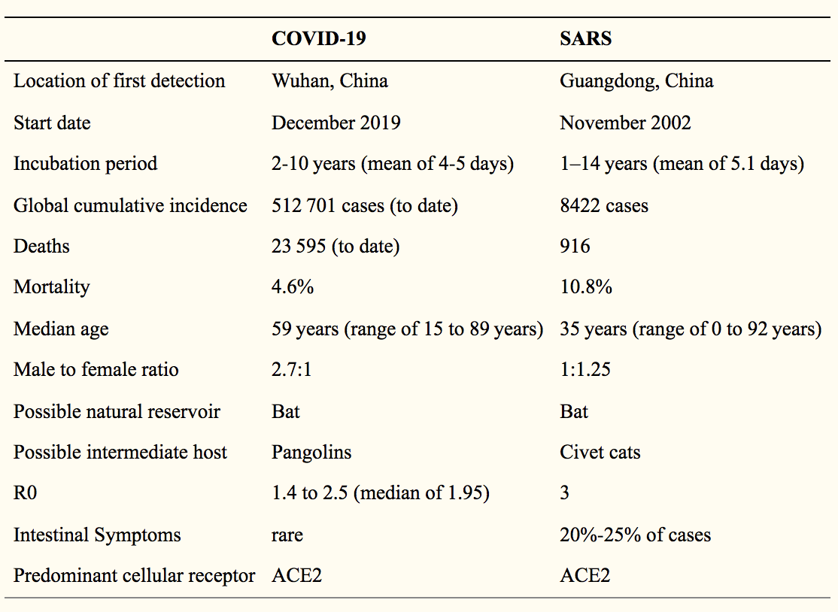
Bad Thing Repeats Itself
5
Notes:
Change low resource IL to a language which is not in wikipedia
Word-level: from bi-lingual dicts and alignment; structure-level comes from wals; multi-level alignment

Slide 6
Quiz Time!
John purchased a high-pressure cooker and materials for bomb making. ________________. _________________. There was an explosion during Boston Marathon. _______________. Police found the bomb was inside a high-pressure cooker. ____________________. ___________________. John was sentenced to death.
6
Notes:
Change low resource IL to a language which is not in wikipedia
Word-level: from bi-lingual dicts and alignment; structure-level comes from wals; multi-level alignment

Slide 7
Schema Definition and Theories
Schemas, or scripts, were originally defined by (Schank and Abelson, 1975) as “ a predetermined, stereotyped sequence of actions that defines a well-known situation”.
Instead of processing complex events as a whole, humans segment events into chunks, or even nested hierarchies (Richmond and Zacks, 2017). Such an organization also appears in human memory and correct segmentation has shown to improve recollection of events (Sargent et al., 2013).
Our Research Question: Are language models good enough for event schema induction already?
7
Notes:
Change low resource IL to a language which is not in wikipedia
Word-level: from bi-lingual dicts and alignment; structure-level comes from wals; multi-level alignment

Slide 8
A Schema Example
8

Slide 9
Our Goals and Innovations
Goal: construct a comprehensive schema library for open-world
Target scenarios: 11 hierarchical scenarios as a starting point
New aspects in our design
Models as schemas: probabilistic schema induction models can be probed on demand for event prediction
Capture uncertainty and recurring events: produce multiple hypotheses with probabilities, confidence values and justifications to enable temporal reasoning and prediction
Learn hierarchical structure of event complexes
Capture temporal dynamics and entity (coreferential or related arguments) connections between events
Measure event and entity salience for entity state tracking
Detect logical relations and goals automatically
9
Notes:
Change low resource IL to a language which is not in wikipedia
Word-level: from bi-lingual dicts and alignment; structure-level comes from wals; multi-level alignment

Slide 10
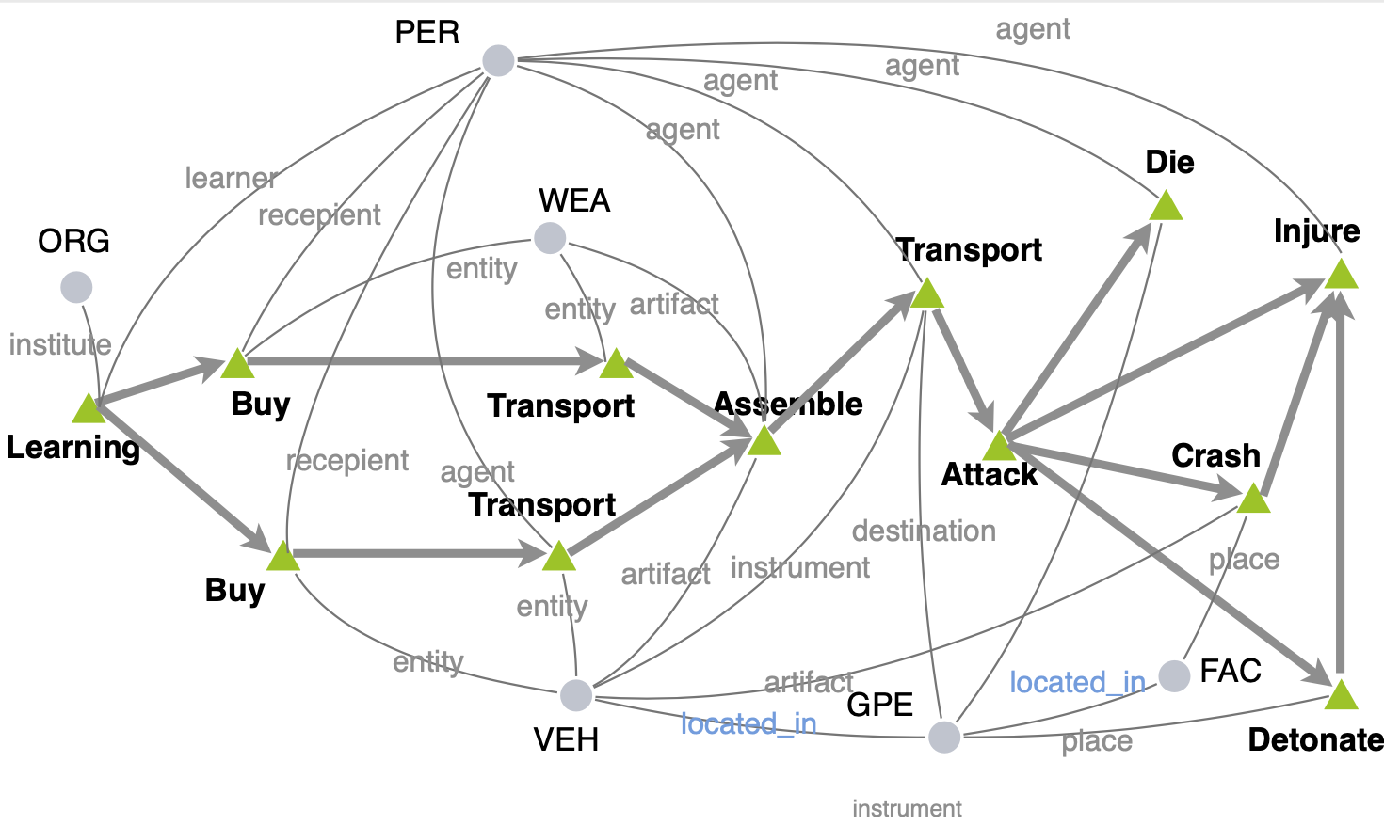
Temporal Complex Event Schema Composition (Li et al., EMNLP2021)
Graph Structure Aware:
Encode entity coreference and entity relation
Capture the interdependency of events and entities (sequences can not)
Scenario guided:
Train one model based on instance graphs of the same scenario
Probabilistic:
Support downstream tasks, such as event prediction

Slide 11
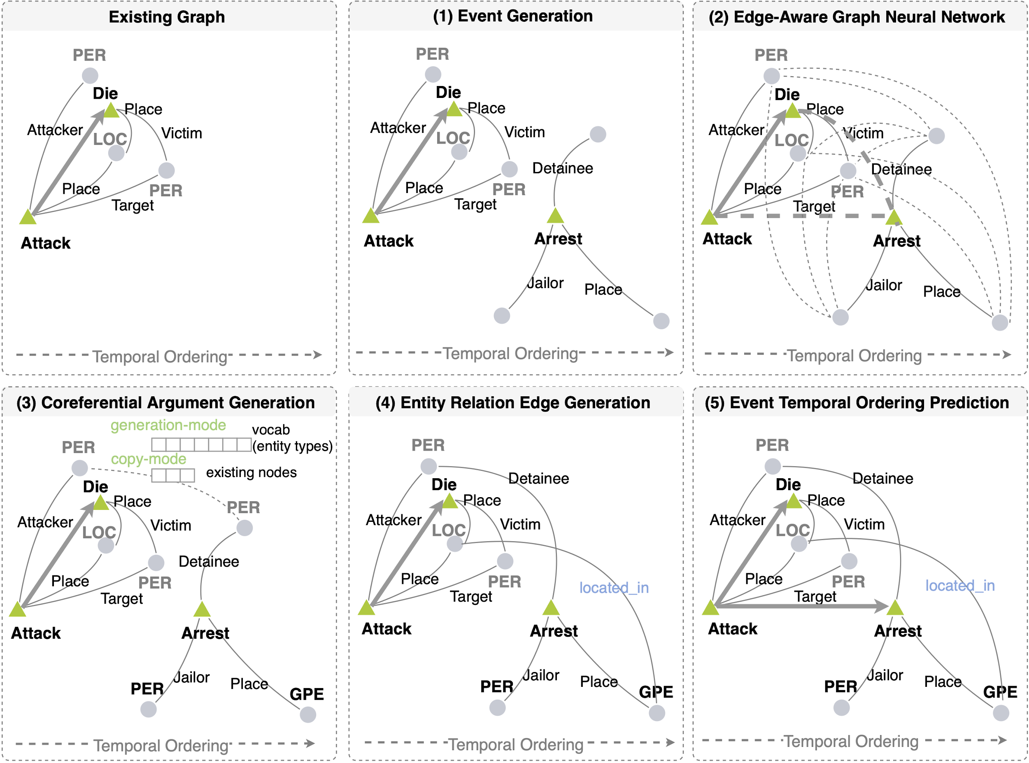
Generative Event Graph Model
Schemas are the hidden knowledge to control instance graph generation
Step 1. Event Node Generation
Step 2. Message Passing
Step 3. Argument Node Generation
Step 4. Relation Edge Generation
Step 5. Temporal Edge Generation

Slide 12
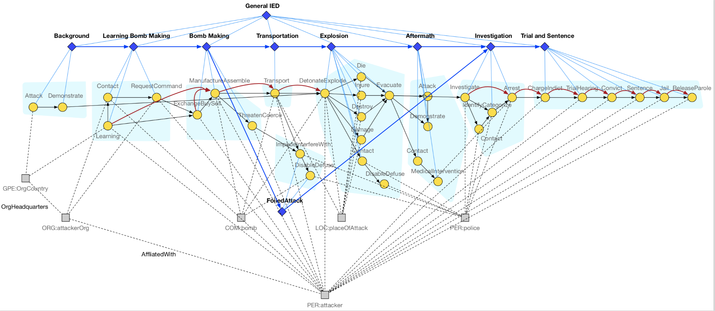
Adding Hierarchy and Multiple Alternative Hypotheses: IED scenario
We add episode nodes (diamond-shaped) to the schema. Each episode node is connected to several event nodes, an event node can only belong to one episode.
Episodes have temporal order
Alternative episodes such as FoiledAttack represent alternative hypotheses for the complex event
Notes:
- how hard is it to do internal schema organization for schema clarity and reasonable compression to remove redundancy? [multiple hypotheses? Make schemas more distinguishable from one another, discriminative factor]

Slide 13
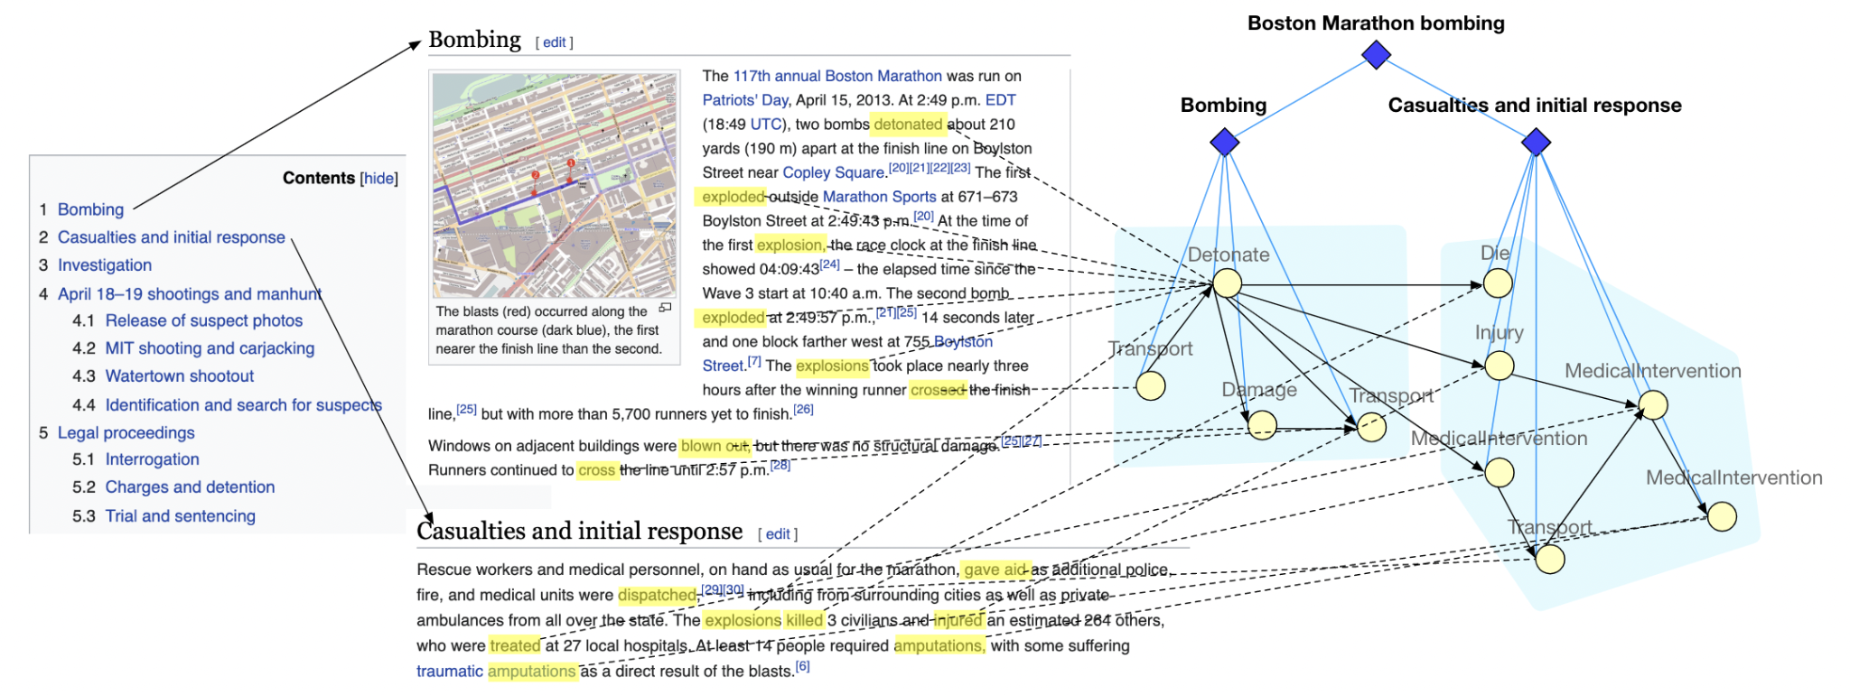
Lack of training data: Training the Graph Encoder with Distant Supervision
We propose to learn how to segment complex event graphs into episodes using distant supervision from Wikipedia
We train a graph generation model from a large number of observed complex event graphs that is capable of predicting future events and episodes

Slide 14
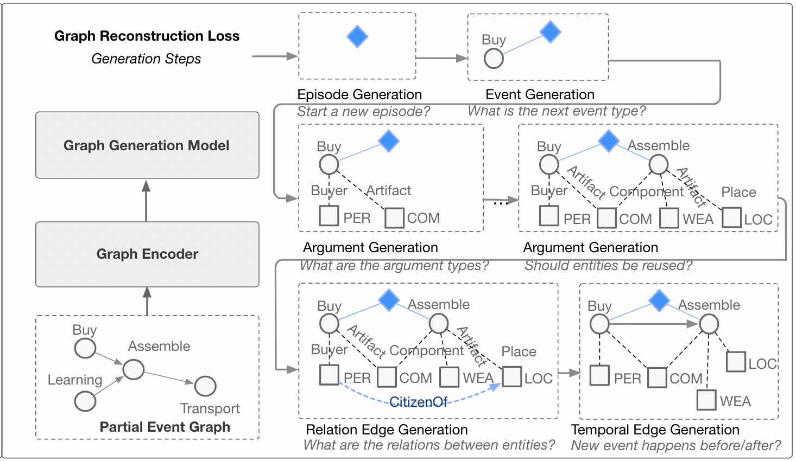
Training the Graph Decoder with Graph Reconstruction
We create the partial event graph by randomly removing one episode from the original graph
The graph is generated episode by episode
Within each episode we follow the steps of (1) event generation, (2) argument generation, (3) relation edge generation and (4) temporal edge generation

Slide 15
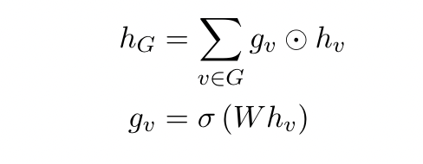
A Graph Encoder-Decoder Model for Hierarchical Complex Event Schema Induction
Embedding Initialization
Event node embeddings are initialized with BERT and corresponding type embeddings
Entity node embeddings are initialized with type embeddings
Heterogeneous Graph Convolution Layers
The graph has 2 types of nodes: event, entity and 5 types of edges: argument(event-entity), relation(entity-entity), temporal(event-event), containment(episode-event), global(episode-episode)
We parameterize the graph convolution function over each type of edge separately
An attention operation is computed over all incoming edges to update the embedding of the target node
Graph Readout Function
Weighted sum over all nodes in the graph
15
Notes:
Change low resource IL to a language which is not in wikipedia
Word-level: from bi-lingual dicts and alignment; structure-level comes from wals; multi-level alignment

Slide 16
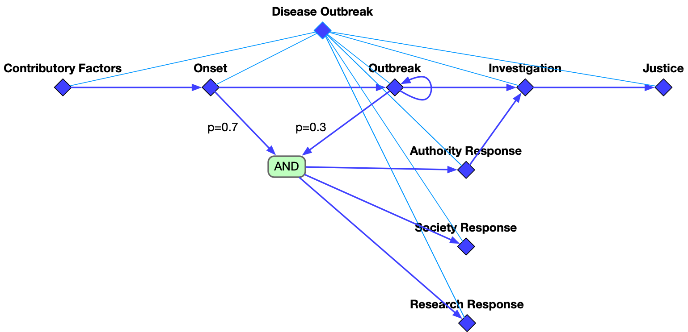
Epidemic Schema Example
Contributory Factors
Onset
Outbreak
Investigation
Justice
Authority Response
Society Response
temporal
hierarchical
Research Response

Slide 17
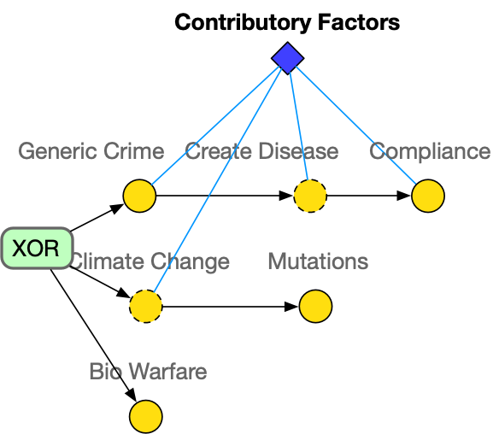
Contributory Factors
Event
Optional Event

Slide 18
Onset
Medical Response

Slide 19
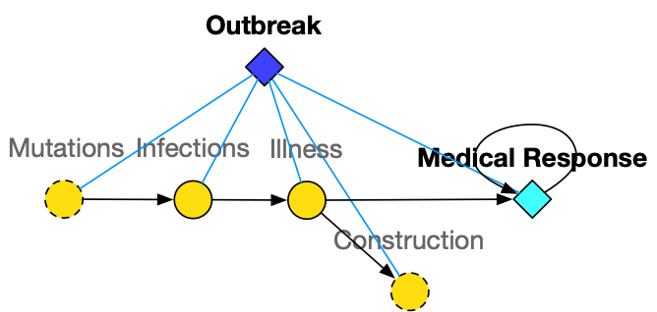
Outbreak
Medical Response

Slide 20
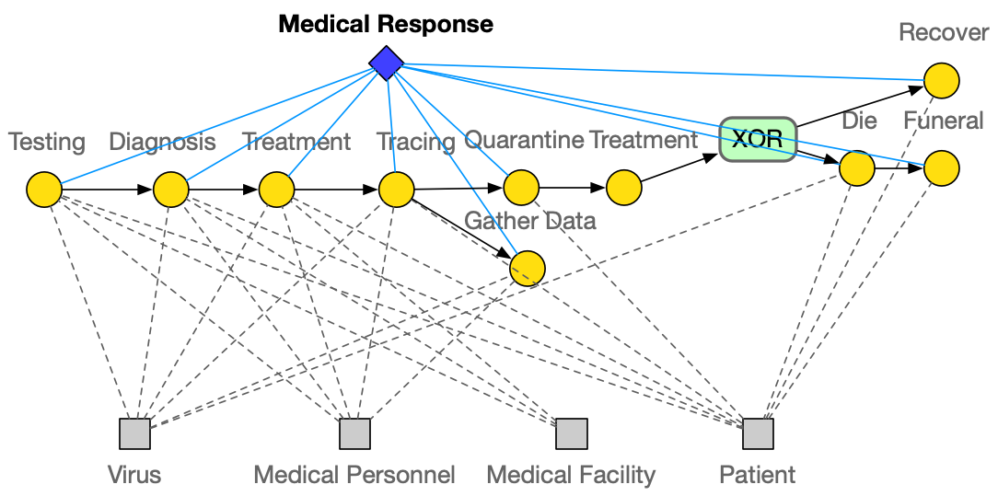
Medical Response

Slide 21
Research Response

Slide 22
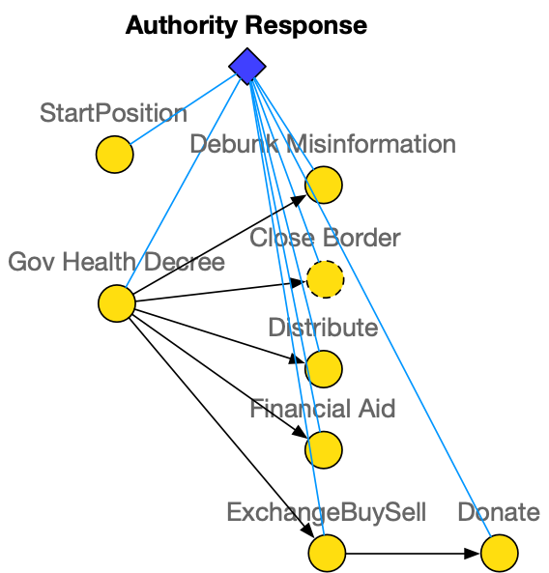
Authority Response

Slide 23
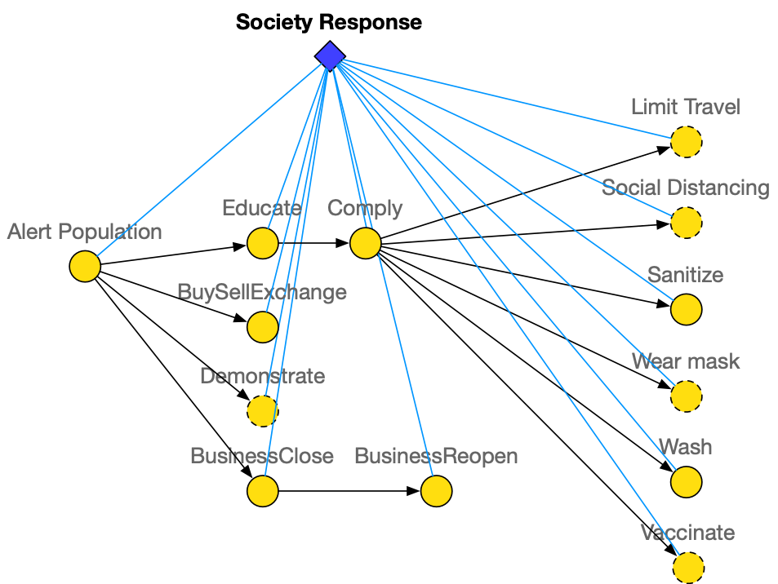
Society Response

Slide 24
Investigation

Slide 25
Justice

Slide 26
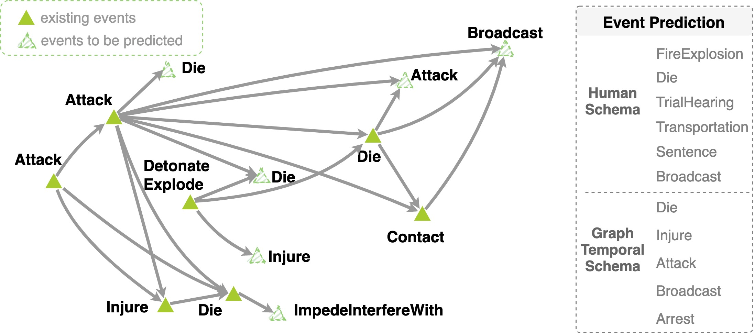
Why is Event Schema Useful? Predicting the Future [Li et al., EMNLP2021]
Schema-guided Event Prediction: The task aims to predict ending events of each graph.
Considering that there can be multiple ending events in one instance graph, we rank event type prediction scores and adopt MRR and HITS@1 as evaluation metrics.
Dataset | Models | MRR | HITS@1
General | Human Schema | 0.173 | 0.205
 | Event Graph Model | 0.457 | 0.591
Dataset | Models | MRR | HITS@1
IED | Human Schema | 0.072 | 0.222
 | Event Graph Model | 0.203 | 0.426
Notes:
Event prediction could be a good evaluation task.

Slide 27
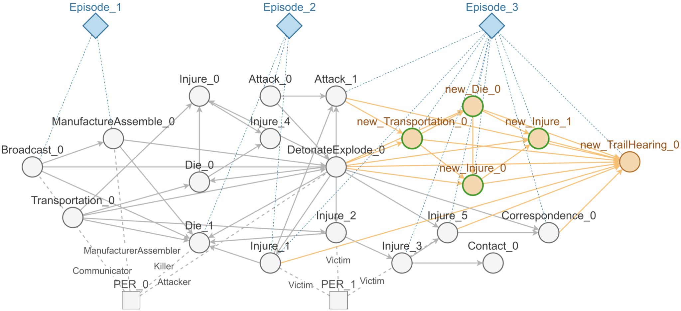
Why is Event Schema Useful? [2] Predicting the Future
Schema-guided Episode Prediction (Li et al., 2021submission)
Yellow nodes are newly predicted, the nodes with green outline are matched in the ground truth graph.

Slide 28
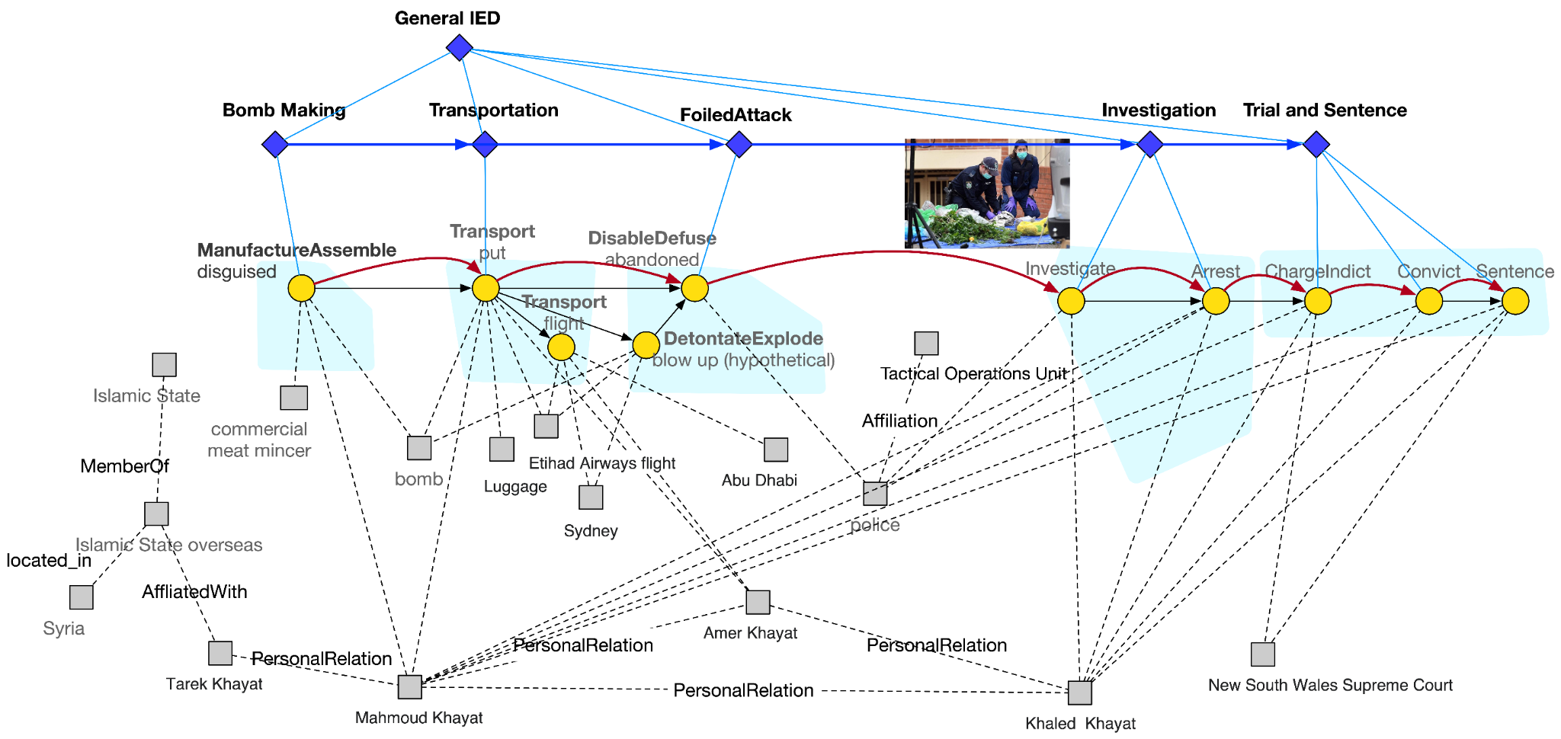
Instance-level Event and Episode Prediction

Slide 29
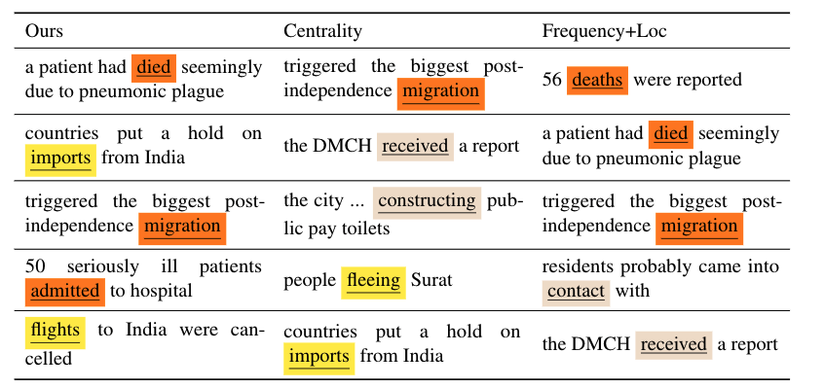
Why is Event Schema Useful? Tracking Entity States
Event salience: checking the drop in coherence after we remove the event
We measure coherence as the generation probability of the entire complex event graph, inspired from [Nan et al., 2021]
Top salient events detected on the 1994 India plague (https://en.wikipedia.org/wiki/1994_plague_in_India) event
Notes:
- if a schema library were encoded as/inside a neural network or a LM like BERT, it could make predictions, but not be understandable to a human. What could one do to make it understandable? [model = schema; automatic naming? Centroid of clusters?]

Slide 30
Tracking Entity States: Protagonist (salient entity) Identification
The saliency of an entity is determined by the events it is involved in and the role it plays in each event.
Thus, we compute the saliency score by aggregating over each edge <e_j, a, ent_i>:
argument role
At any particular timestep t, we should be able to know:
Does entity A exist at timestep t?
Is entity A involved in any event at timestep t?
What is the location of entity A at timestep t?

Slide 31
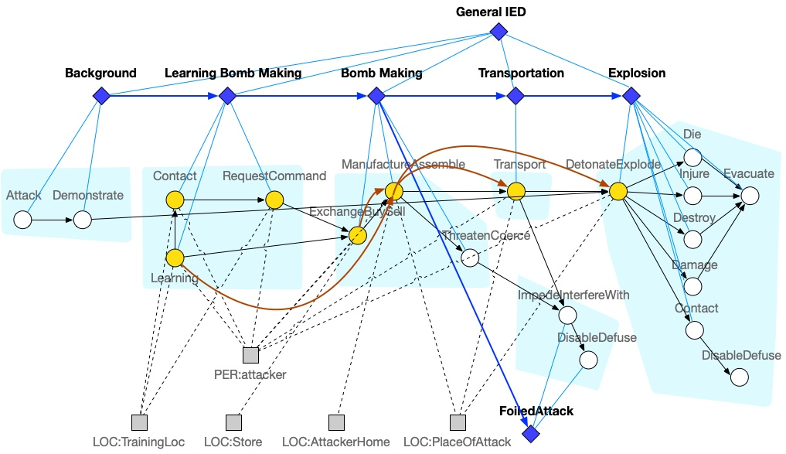
Temporal and Spatial Tracking of Protagonists: Type-level
State of attacker:
Timestep | 1 | 2 | 3 | 4 | 5 | 6 | 7
Event | Learning | Contact | Request | ExchangeBuySell | Manufacture | Transport | DetonateExplode
Location | TrainingLoc | TrainingLoc | TrainingLoc | Store | AttackerHome | AttackerHome->PlaceOfAttack | PlaceOfAttack
Notes:
Maybe add TimeDelta?

Slide 32
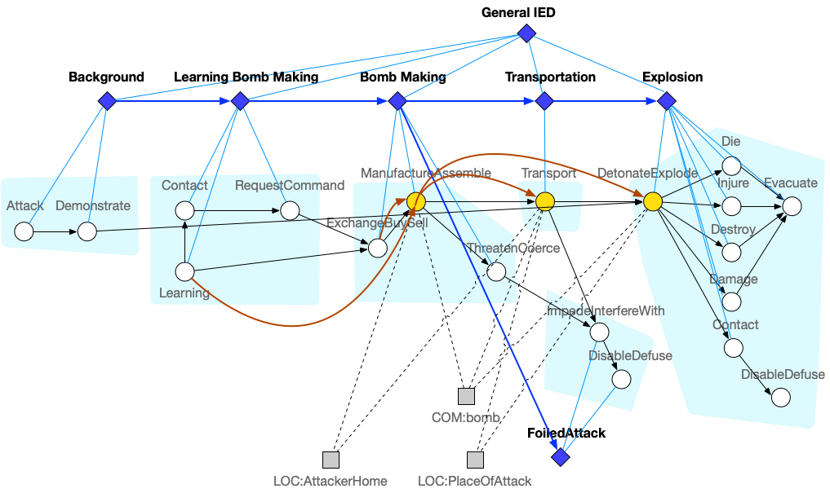
Temporal and Spatial Tracking of Protagonists: Type-level
State of bomb:
Timestep | 1 | 2 | 3 | 4 | 5 | 6 | 7
Existence |  |  |  |  | Created |  | Destroyed
Event |  |  |  |  | Manufacture | Transport | DetonateExplode
Location |  |  |  |  | AttackerHome | AttackerHome->PlaceOfAttack | PlaceOfAttack
Notes:
Maybe add TimeDelta?

Slide 33
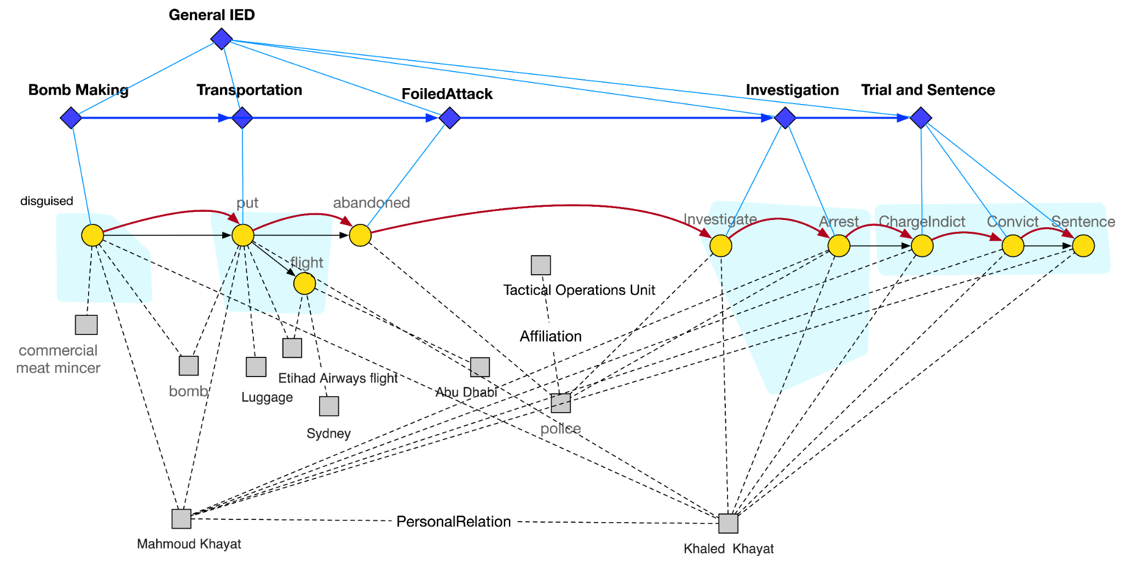
Temporal and Spatial Tracking of Protagonists: Instance-level (attacker Mahmoud Khayat and Khaled Khayat)
Timestep | 1 | 2 | 3 | 4 | 5 | 6 | 7
Event | disguise | put | abandon | investigate | arrest | charge | convict | sentence
Location | Sydney

Slide 34
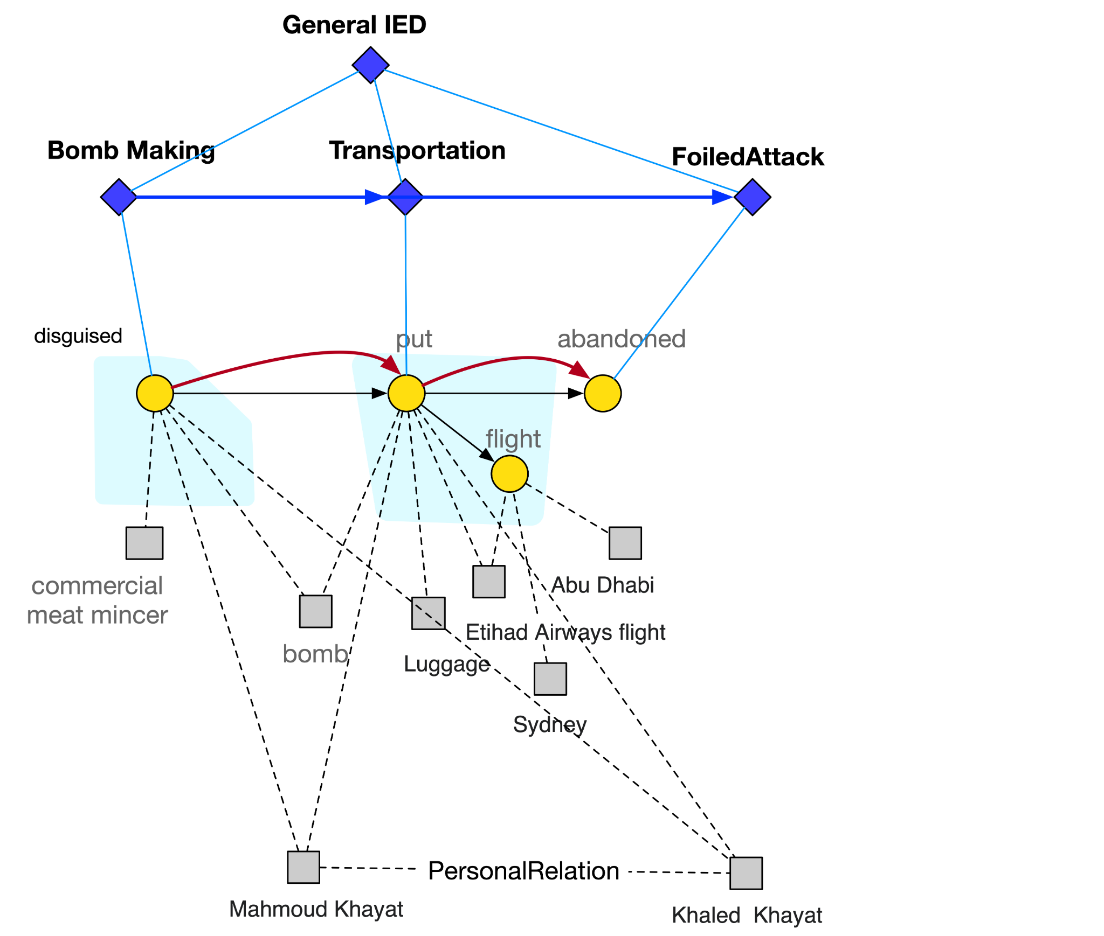
Temporal and Spatial Tracking of Protagonists: Instance-level (bomb)
Timestep | 1 | 2 | 3
Existence | Created |  | Destroyed
Event | Manufacture (disguised) | Transport (put) | DisableDefuse (abandoned)
Location |  | Sydney

Slide 35
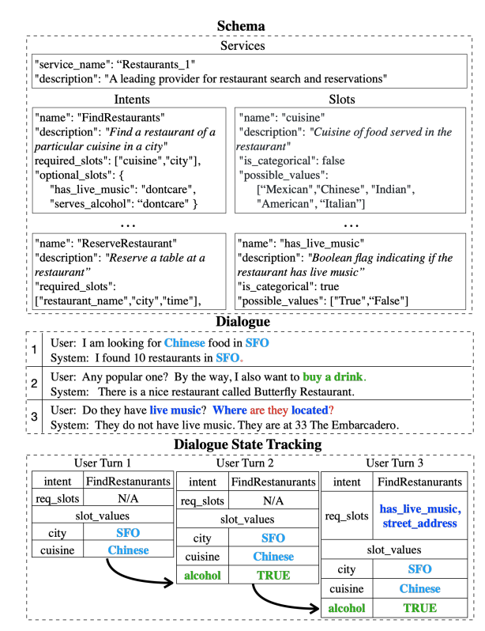
Schema for State Tracking in Dialog [Cao and Zhang, NAACL2021]
35
Notes:
Change low resource IL to a language which is not in wikipedia
Word-level: from bi-lingual dicts and alignment; structure-level comes from wals; multi-level alignment

Slide 36
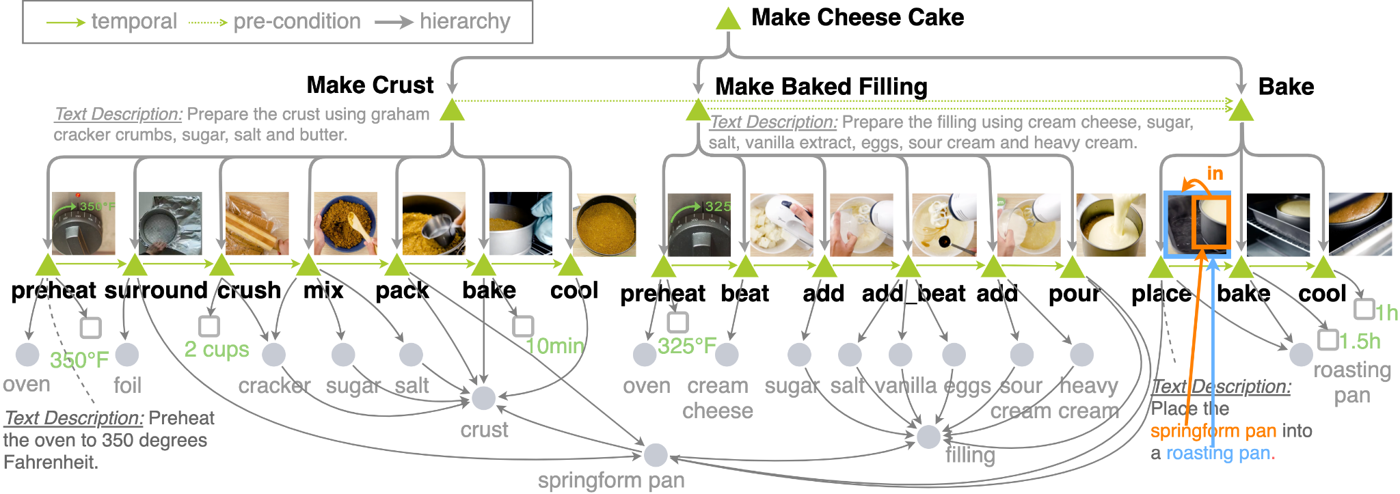
More Fun Applications: Cooking
A end goal is a desired end state
A subgoal is a milestone of each episode
We can represent the planning procedure as the changes of entity states
Goals may not be explicitly mentioned, so they need to be generalized from hierarchical event graphs
Classify each episode as goal-oriented or not, and generalize/generate goal descriptions based on episode name, ending event, and entity state changes

Slide 37
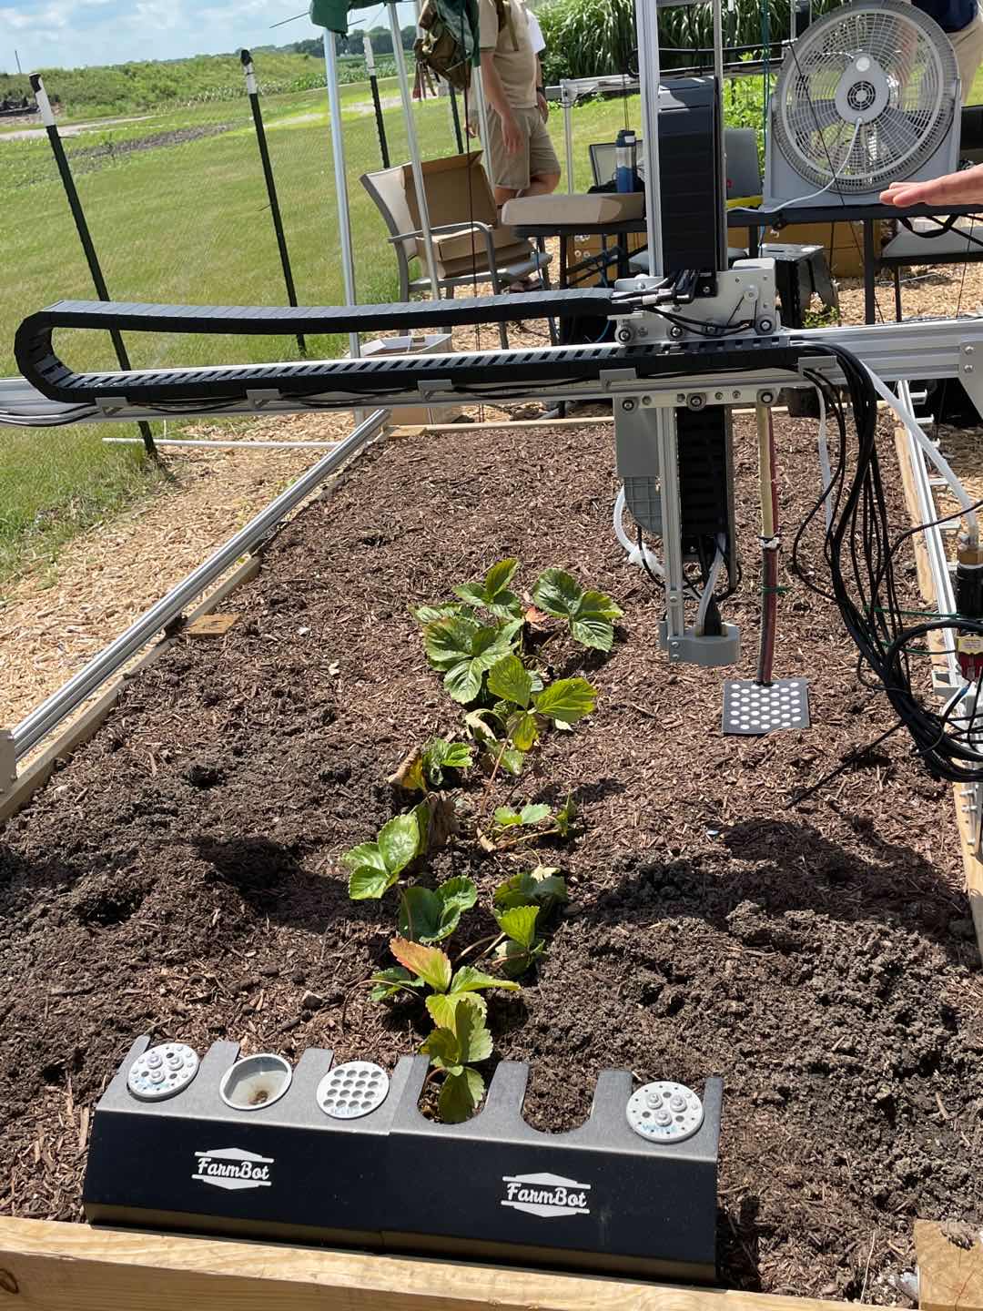
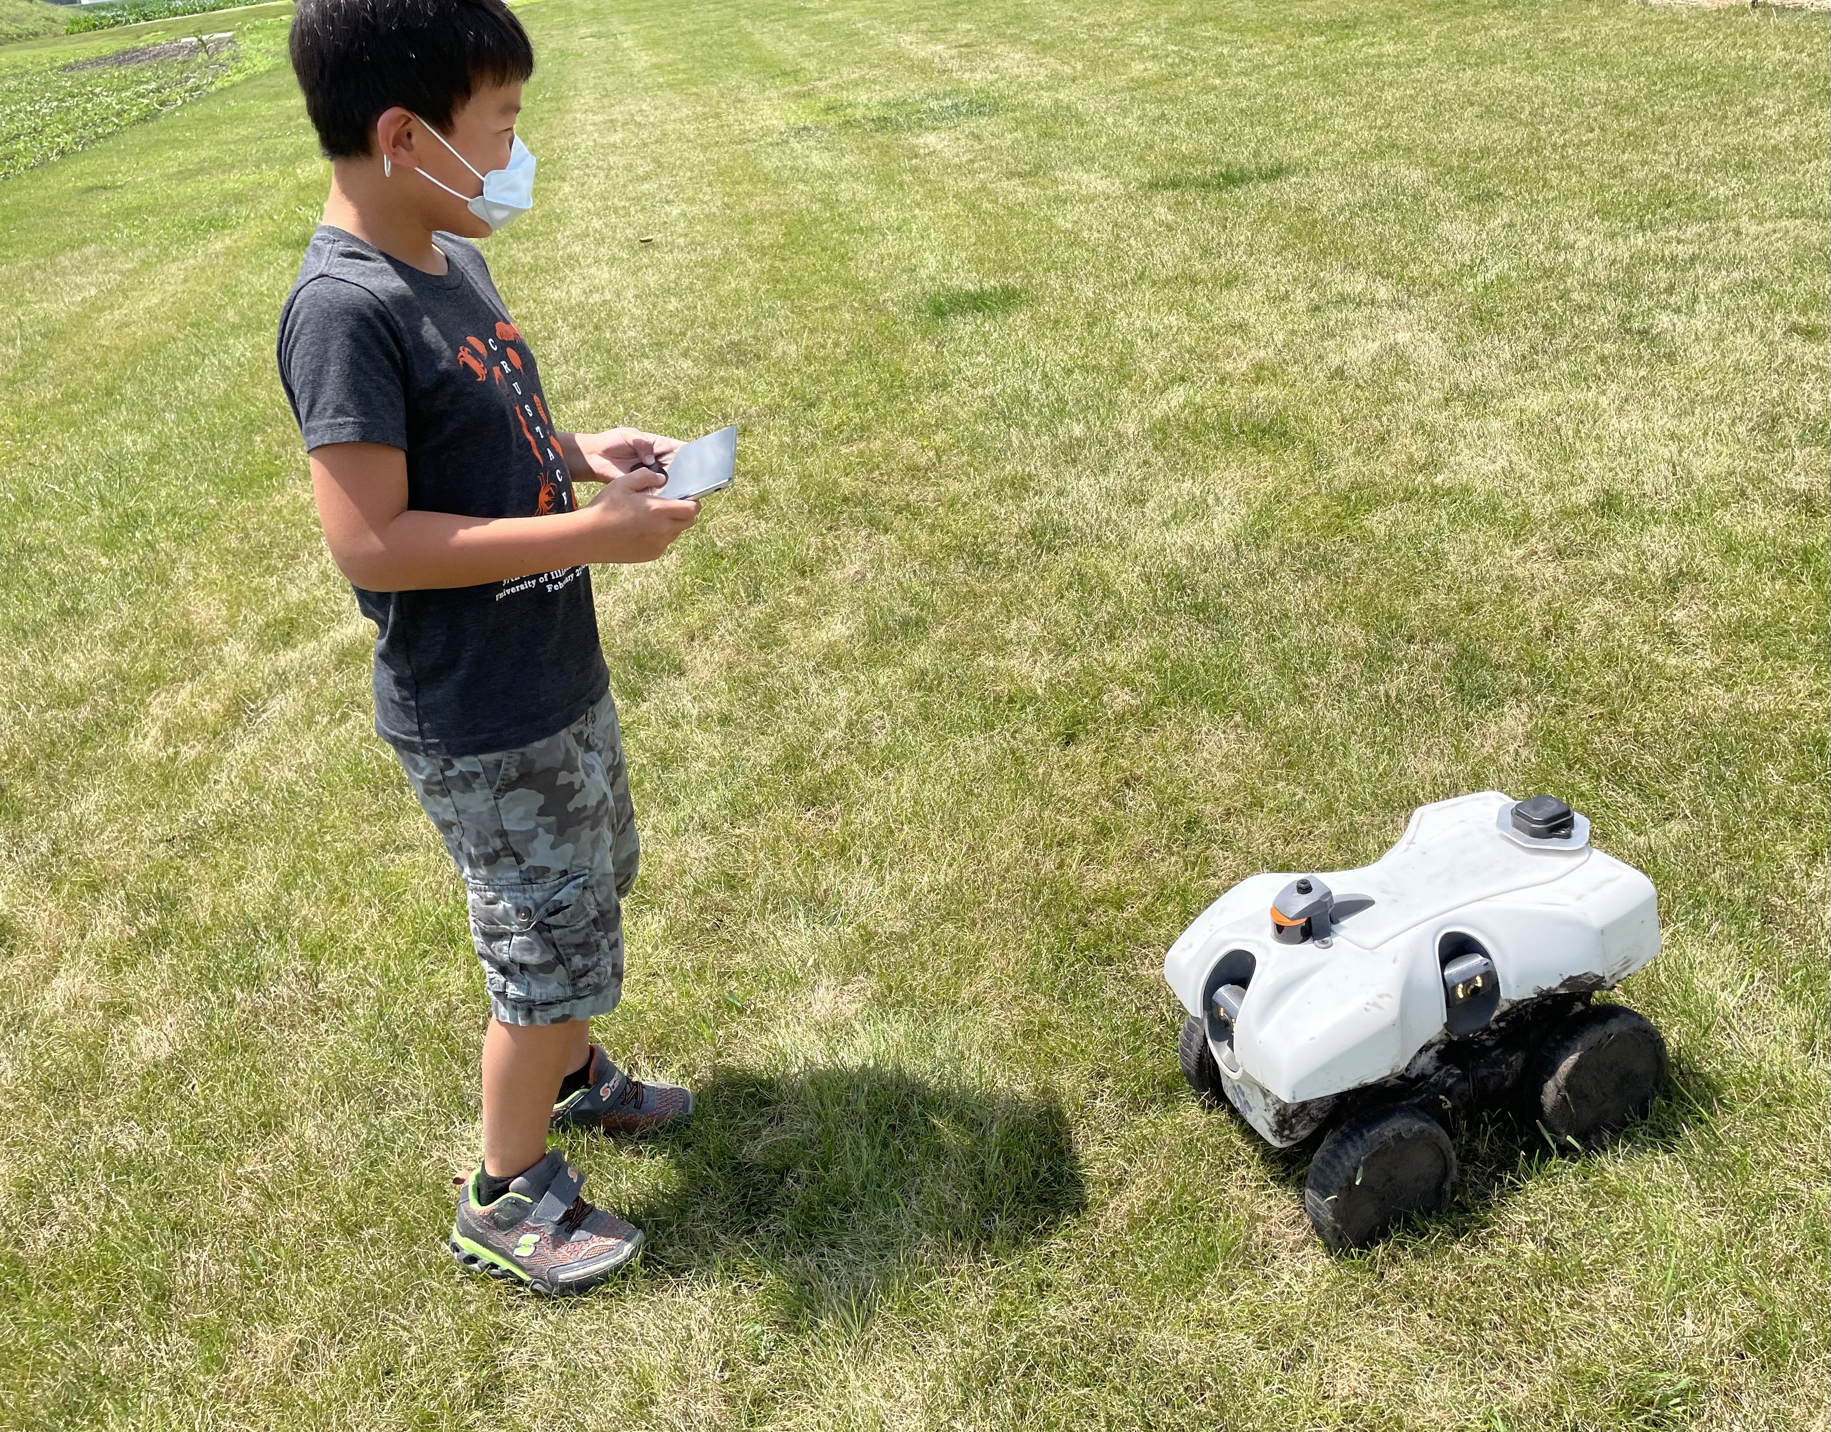
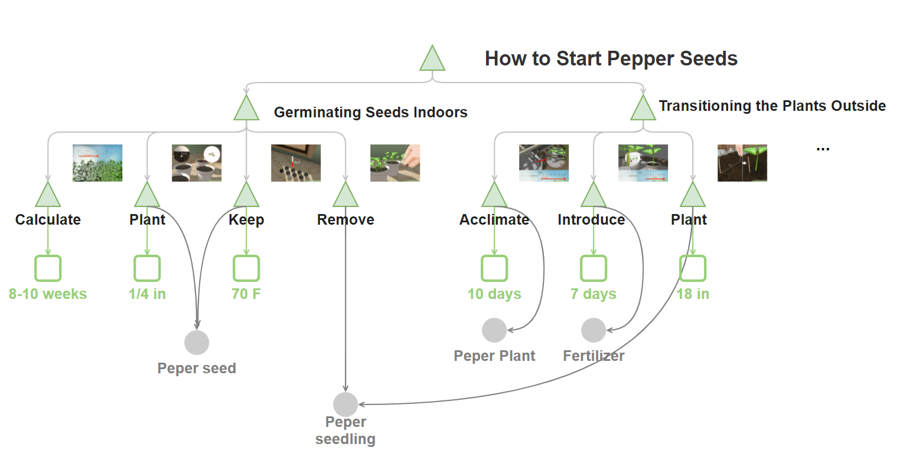
More Fun Applications: AIFarm Bot
Tasks
Step Prediction
Explanation Generation
Goal
Teach robot to grow plants and pick items
Task Title
Subtitle
Step Gist
Step Explanation
Step Gist

Slide 38
Software and Resources
KAIROS RESIN Schema-guided Cross-document Cross-lingual Cross-media Information Extraction system (Wen et al., NAACL2021 demo)
https://github.com/RESIN-KAIROS/RESIN-pipeline-public
Joint Neural Information Extraction system (Lin et al., ACL2020)
http://blender.cs.illinois.edu/software/oneie/
GAIA Multimedia Event Extraction system and new benchmark with annotated data set (Li et al., ACL2020 demo)
GitHub: https://github.com/GAIA-AIDA/uiuc_ie_pipeline_fine_grained
Text IE DockerHub: https://hub.docker.com/orgs/blendernlp/
Visual IE repositories: https://hub.docker.com/u/dannapierskitoptal
38
Notes:
Change low resource IL to a language which is not in wikipedia
Word-level: from bi-lingual dicts and alignment; structure-level comes from wals; multi-level alignment

Slide 39
Conclusions and Future Work
Hierarchical complex event schema induction is a powerful task to enhance information extraction, tracking and prediction
Developed probabilistic hierarchical multimedia schema induction methods based on novel graph generation methods, achieved SOTA results on schema-guided event and episode prediction
Future Work
Add other relation types: containment, enablement, causality
Capture uncertainty at optional and repeated events
Goal and Motif Identification and use it to improve episode segmentation
Rich attributes: Temporal attribute generalization (duration, absolute time points, Periodicity, Frequency, Transient vs. Stationary) and entity profiling
Distinguish actual events from intentions, opinions, hypotheses, future events
Applying to other new and interesting tasks such as social norm discovery

Slide 40
Thank You
Notes:
Sophisticated knowledge graph curation interface provides feedback to schema induction via active reinforcement learning and crowdsourcing
Incorporating schema-guided global constraints into learning deep models for and event prediction

