Slide 1
Remaining Challenges
Challenge 1: LM Hallucination and Bias
Challenge 2: Knowledge Bottleneck
Challenge 3: Capturing Global Consistency across discourse, tables and graphs
Challenge 4: Removing Repetitions
Challenge 5: Urgent Need of Better Evaluation Metrics

Slide 2
Challenge 1: LM Hallucination and Bias
30% of abstractive summaries contain unfaithful information by state-of-the-art models (Cao et al, 2018)
Examples of fabricated answers in movie question answering
Q: What did Susie promise to one of the waiters at the Copacabana Club in return for smuggling her into the club for free? System: Susie promises to buy one of the men a drink after every act. Key: Susie promised him a prime slot for his singing act at the Gaslight Café for 2 weeks. Unfortunately Susie thinks his act is awful but keeps her word even since they had to watch the show from the kitchen.
Q: What do Midge and Susie fight over? System: Their son. Key: With emotions on high, Susie confronts Midge about why she hired Herb. Midge felt Susie does not help and sabotaged her earlier because Susie rushed her on stage. Midge tells her she wants to quit and, after a few insults at each other, walks away.
Q: What do Susie and Midge talk about when Midge visits Susie's home? System: Susie and midge talk about the upcoming moon landing. Key: Susie confronts Midge about her meeting with Randall and his agent. She tells Midge she does not need a man to help with her set and what she is doing is not stand-up, it's being the annoying party guest. Midge breaks down crying and tells Susie her life has been hard and if Susie wants to be her manager, she has to deal with Midge's personal matters and not run away. After this, Susie comforts Midge.
Q: How were some of the Navy Seal members killed back in America? System: In a scuffle in france the four members of the navy were killed. Key: One was run over by a truck while throwing trash in the sideback. One was shot during a car drive.
Bias from LM [Wang et al., INLG2018]
“Silvi Jan (born 27 October 1973) is a former Israel. He played for Israel women‘s national football team,…”
Potential solutions: filter out popularity bias, incorporate more scenario-specific/domain-specific knowledge

Slide 3
Challenge 2: Knowledge Bottleneck
Noise from imperfect automatic information extraction and knowledge acquisition methods
End-to-end information extraction F-score is only around 75%
Lacking of effective domain-specific knowledge mining methods
Paper generation models trained from biomedical domain don’t work for NLP domain
Need to incorporate more commonsense knowledge and dynamic knowledge
Example from KB Description [Wang et al., INLG 2018]:
“Aleksei Gasilin ( born 1 March 1996 ) is a ... He made his professional debut in the Russian Second Division in 1992 for …”
Personification: The attribution of humanlike qualities to something non-human due to lack of common sense knowledge [Modi and Parde, 2019]
Learning external knowledge in a continuous way (Lifelong learning) [Yu et al., 2021; Mazumder et al., 2018]
Embed knowledge into pre-trained language model [Cao et al., 2017; Liu et al., 2019Qin et al., 2021]

Slide 4
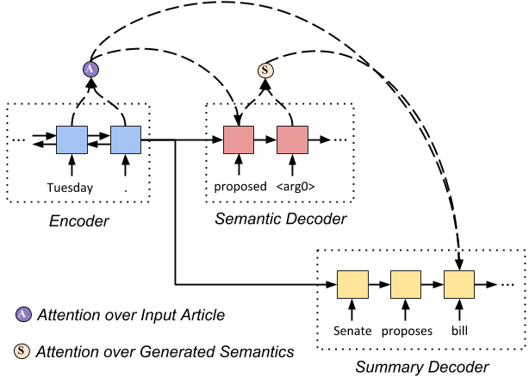
Challenge 3: Capturing Global Consistency
Inconsistency across Discourse
Balanchine's "Mozartiana" (1981) is one of the best ballets in the world, but it is also one of his least interesting. The first movement, a Tchaikovsky Suite, is a bit of a mess, and the second movement is a little too easy. The third movement is too easy; the fourth, a Gigue, is too simple.
Inconsistency Analysis from [Modi and Parde, 2019]
Contradictions in ideas within the same story
Singular/Plural Disagreement
Ghost Entities: Some sub-stories make use of a pronoun that has no antecedent at all
Point-of-View Inconsistency: The narrative point of view randomly changes within the story
Inconsistency across Tables/Graphs
Current methods are limited to encoding position information
Potential solutions
Develop document-level or corpus-level information extraction methods to capture long-term dependencies
Incorporate semantic parsing in encoding and decoding [Huang et al.2020]
Input: the Senate proposed a tax bill on Tuesday
Output:
Semantic structure:
proposed <ARG0> the Senate <ARG1> tax bill
Summary:
Senate proposes bill

Slide 5
Challenge 4: Repetition
It has been a mystery why DNN generates so many repetitions [Modi and Parde, 2019]
Repetitions within Story: Recurrence of the same sentence(s) within a story
Repetitions within Sentence: Recurrence of the same phrase(s) within a substory
Repetitive Subject: The sub-stories have the same subject and differ only in the adjective used to describe it
Repetitive Sentence Structure: Most sentences start with “the [noun] was/were/is [adjective]
Excessive Paraphrasing: Presence of substories that have similar meanings but are expressed using different words or phrases
Most solutions try to add controls (through vocabulary selection or hyperparameter control) in beam search decoding, which might generate less important content

Slide 6
Repetition Removal Example [Wang et al., ACL2019]
Before: Background: The aim of this study was to compare the efficacy and safety of pain relief in patients with knee osteOArthritis (OA). Methods: This was a prospective cohort study of patients with knee osteOArthritis (OA). The primary endpoint was the proportion of patients with knee osteOArthritis (OA).
After: Background: The aim of this study was to compare the efficacy and safety of pain in patients with knee osteOArthritis (OA). Methods: This was a prospective, multicentre, multi-center, non-interventional, observational, randomized, controlled trial. The primary endpoint was the proportion of the knee and joint symptom of the physical functioning, and to evaluate the relationship between the two groups. Patients were randomly assigned to receive either a single dose of 0.5 mg twice daily (n = 30) or placebo (500 mg/day) for 52 weeks.

Slide 7
Repetition Removal Example [Wang et al., ACL2019]
Before: Background: The aim of this study was to compare the clinical outcome of myocardial infarction (MI) in patients with acute ST segment elevation (MI). Methods: We retrospectively reviewed the clinical records of patients with acute ST segment elevation of acute ST elevation myocardial infarction (MI). Patients with acute ST elevation myocardial infarction (MI), and acute ST elevation myocardial infarction (MI), were included in this study. The primary endpoint was the proportion of patients with acute ST elevation myocardial infarction (MI) and coronary artery disease (CAD).
After: Background The aim of this study was to compare the prevalence of myocardial infarction (MI) in patients with acute ST. Methods : The primary endpoint was the first time of the left anterior descending coronary artery , and to evaluate the clinical utility of Protocol . We performed a retrospective analysis of a prospective, randomized controlled trial. Patients were divided into two groups (n=6). The median follow-up period was defined as the presence of the right ventricle, and the level of cardiac catheterization was evaluated .

Slide 8
Challenge 5: Urgent Need of Better Evaluation Metrics
“Bad” examples with 0 BLEU/ROUGE scores
Question: How Midge’s parent react to the news that Joel has left Midge
Key: Midge’s dad starts to play the piano frantically and later blames Midge for marrying a weak man against his advice.
System: Midge’s mother starts crying and whining heavily.
Question: Did the CIA know that Russia was dealing weapons out of Aleppo?
Key: Yes.
System: the intelligence community was aware that the sale of nerve gas was being carried out.
“Bad” examples from Abductive Reasoning
Given beginning: Billy had received good grades on his report card.
TO generate a reason between beginning and ending!
Given ending: He decided as he got home that elephants were his new favorite animal.
Ground truth: He went to the zoo later in the day and saw elephants.
Generated example:
(1) Billy's parents sent him on an African safari for a reward.
(2) His mother stopped by the store and bought him a stuffed elephant.
8
Notes:
Change low resource IL to a language which is not in wikipedia
Word-level: from bi-lingual dicts and alignment; structure-level comes from wals; multi-level alignment

Slide 9
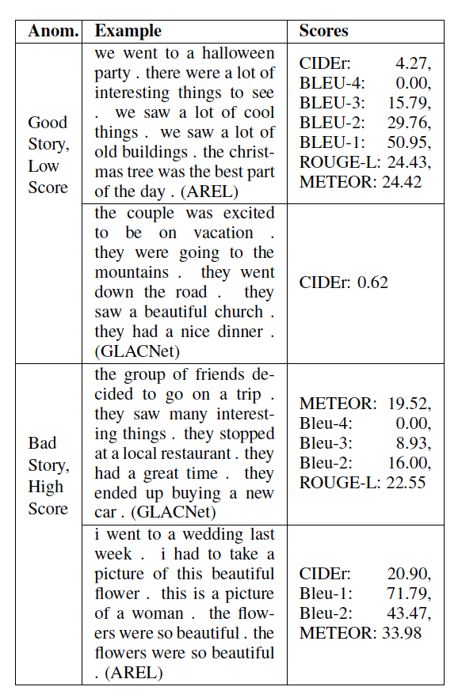
Challenge 5: Urgent Need of Better Evaluation Metrics
(Potash et al., ACL2018 workshop)
Potential solution: adding coherence, fact verification and fluency into metrics, in addition to WordNet/embedding based semantic similarity [Potash et al., 2018]
Knowledge reconstruction metric [Wang et al., 2018]:
9
Notes:
Change low resource IL to a language which is not in wikipedia
Word-level: from bi-lingual dicts and alignment; structure-level comes from wals; multi-level alignment

Slide 10
Future Directions
Direction 1: Background Knowledge Guided NLG
Joint Knowledge and Text Representations
Dynamic knowledge acquisition and encoding
Direction 2: Multimedia Guided NLG
Direction 3: Extract and then Generate
Direction 4: Multi-view Summarization
Direction 5: Using Knowledge-Enhanced NLG for Training Data Generation or Augmentation
Misinformation Detection
Direction 6: Using Knowledge-Enhanced NLG for other NLP tasks
Information Extraction
Taxonomy Completion
Entity Linking

Slide 11
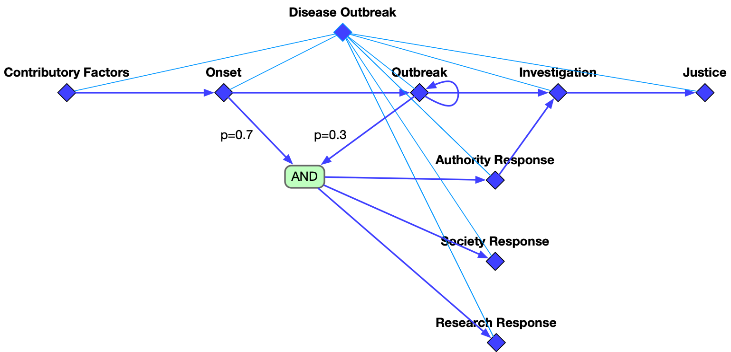
Direction 1: Background Knowledge Guided NLG
Contributory Factors
Onset
Outbreak
Investigation
Justice
Authority Response
Society Response
temporal
hierarchical
Research Response

Slide 12
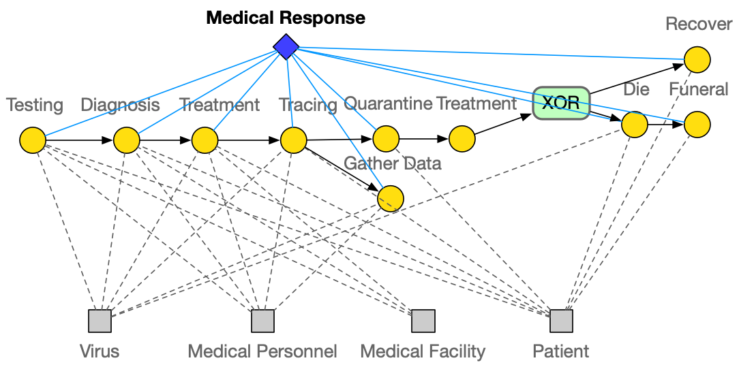
Direction 1: Background Knowledge Guided NLG

Slide 13
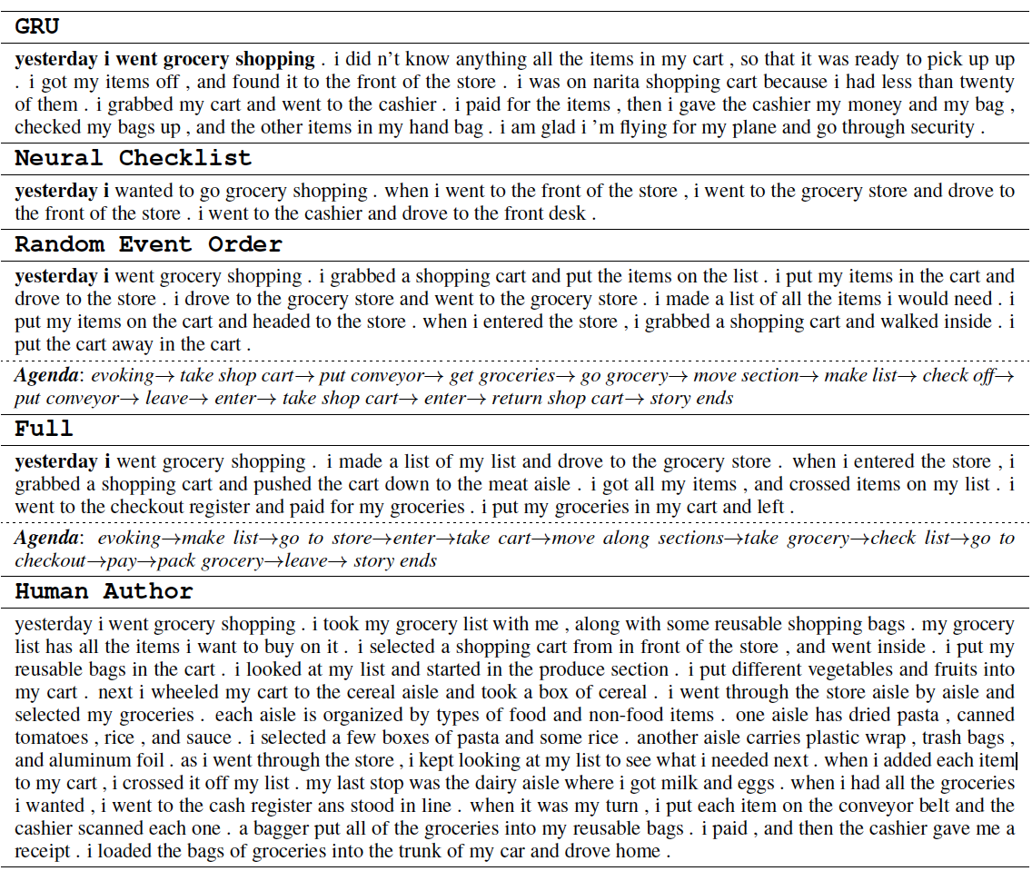
Direction 1: Background Knowledge Guided NLG
Notes:
300 papers… every day… impossible to read… keyword search… abstract doesn’t reflect… results; ignore most of them. Cancer and surgery… 3 days… walk through all posters.. In our field papers that were published twenty years ago are not that important…
including mining PubMed bibliographic data, research papers in PubMed, clinical data sets and numerous bio-medical websites and social media related to medical sciences, where data related to diseases, drugs, treatments, chemical compounds, proteins, genes, biological pathways can be integrated and extracted from text data and their characteristics and relationships can be mined from such datasets as well
. Older literature is often extremely important (and overlooked), and indeed, often provides a rich source of information that can lead to new hypotheses. This makes the information overload problem event more serious, because we need distill and connect knowledge from papers that may cover 70 years.

Slide 14
Direction 2: Multimedia Guided NLG
(Whitehead et al., EMNLP17)
14
Notes:
Change low resource IL to a language which is not in wikipedia
Word-level: from bi-lingual dicts and alignment; structure-level comes from wals; multi-level alignment

Slide 15
Input Article
Direction 3: Extract and then Generate (Sharma et al., 2019)
Prime Minister Bertie Ahern of Ireland called Sunday for a general election on May 24. Mr. Ahern and his centrist party have governed in a coalition government since 1197. . .Under Irish law, which requires legislative elections every five years, Mr. Ahern had to call elections by midsummer. On Sunday, he said he would base his campaign for reelection on his work to strengthen the economy and efforts to revive Northern Ireland’s stalled peace process this year. Political analysts said they expected Mr. Ahern’s work in Northern Ireland to be an asset . . .
Entity-aware Content Selector
Entity Mention Cluster
Extracted Sentences
{Prime Minister Bertie Ahern, Mr. Ahern, he,
he, his, Mr. Ahern’s}
{Ireland, Northern Ireland, Northern Ireland’s}
Political analysis …
Coherent abstract generation
On Sunday, he said …
Mr. Ahern and his …
Output Summary
prime min bertie ahern of ireland calls for general election on may 0. ahern and his centrist party, have governed in coalition government since 0. … ahern says he would base his campaign for re-election on his work to strengthen economy and his efforts to revive northern ireland’s stalled peace process.
Abstract Generator
Notes:
Diagram of the framework
We therefore propose a two-step neural abstractive summarization framework to emulate the way humans construct summaries with the goal of improving both informativeness and coherence of the generated abstracts. As shown in Fig. 2, an entityaware content selection component first selects important sentences from the input that includes references to salient entities. An abstract generation component then produces coherent summaries by conducting cross-sentence information ordering, compression, and revision.

Slide 16
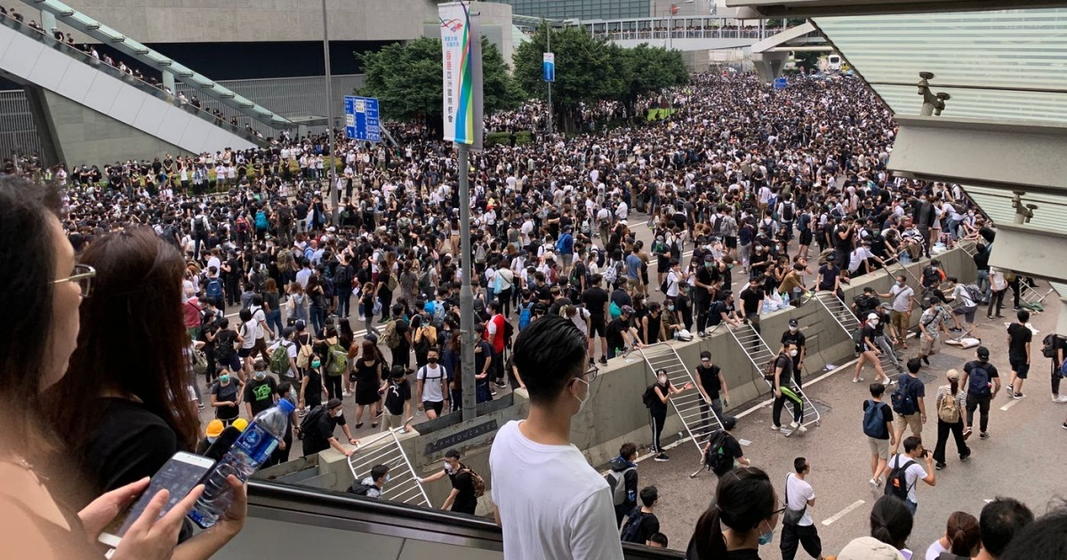
Direction 4: Multi-View Summarization
Claims: | Arrested protesters should be released. |  |  | Claims: | The protests are not necessary.
 | Carrie Lam should resign. |  |  |  | Violent protesters should be arrested.
Profile: | Birth Place: Hong Kong |  | Age: below 30 | Profile: | Birth Place: not Hong Kong |  | Age: Above 50
 | Education: above college |  | Participate in protest? No |  | Education: Below secondary school |  | Participate in protest? No
Premises |  | Evidence |  | Premises |  | Evidence
Extradition Law will weaken autonomy and judicial independence. |  | Police violently attacked protesters. |  | Protests on Extradition Law amendment are not necessary. |  | The target of Extradition Law is only on felon criminals.
 |  | Government ignored requests from protesters about revoking the amendment. |  |  |  | The Law is not proposed by the Beijing government.
Beijing government will undermine certain freedoms. |  | N/A |  | Most of the protests are violent. |  | Protesters blocked traffic.
 |  |  |  |  |  | Protesters attacked the police.

Slide 17
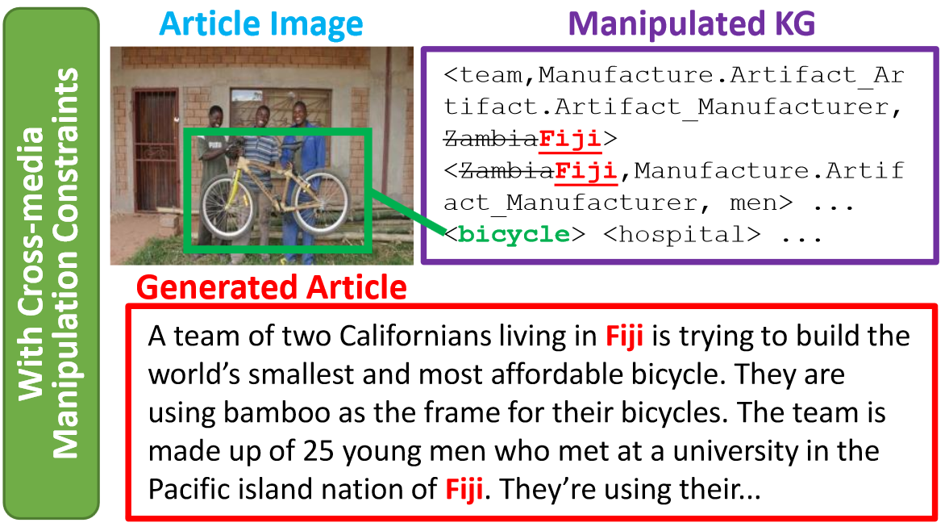
Direction 5: Using Knowledge-Enhanced NLG for Training Data Generation or Augmentation [Fung et al., ACL2021]
Fake News Generation o Train Misinformation Detectors
Knowledge Graph manipulations:
Entity swapping – Swapping entity that has same type and similar embedding (so they are harder to tell apart)
Addition of new relation or event – Randomly select relation / event argument roles and append a new entity to the relation / event
Subgraph replacement – Select a subgraph of the news article from an entity and replace it with a subgraph from another news article
Generate a fake news article that aligns with manipulated KG's by finetuning a BARTlarge language model (Lewis et al., 2020) on our training set + copy mechanism (Post and Vilar, 2018)

Slide 18
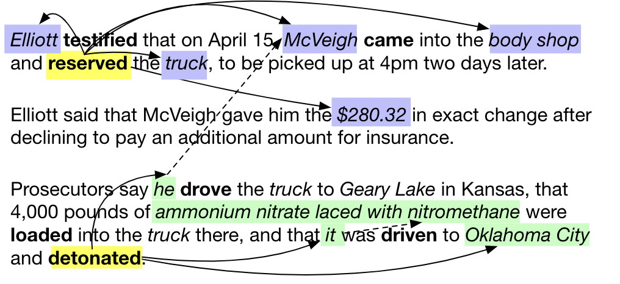
Direction 6: Using Knowledge-Enhanced NLG for other NLP tasks
Use Conditioned NLG for Document-level Event Extraction [Li et al., NAACL2021]
Is there any limitation during inference? Can we extract events from a wider context?
→ document-level IE, corpus-level IE.

Slide 19
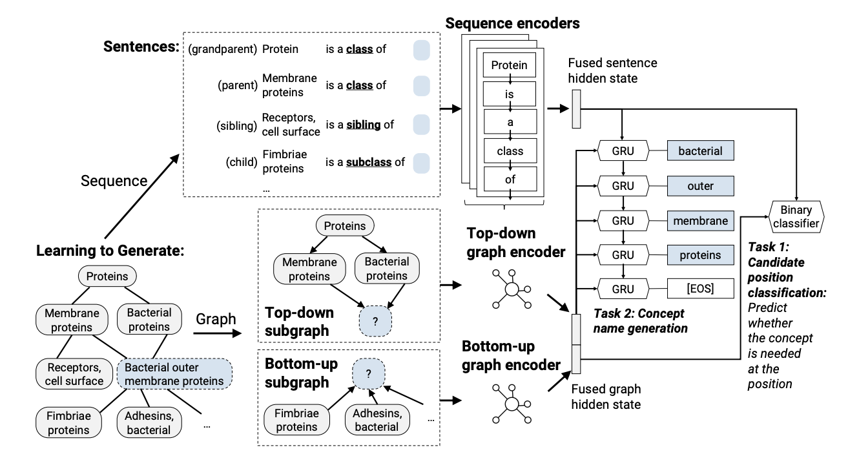
Direction 6: Using Knowledge-Enhanced NLG for other NLP tasks
Use Conditioned NLG for Taxonomy Construction [Zeng et al., 2021]

Slide 20
Direction 6: Using Knowledge-Enhanced NLG for other NLP tasks
Use Conditioned NLG for Entity Linking [Lai et al., submission]

