Slide 1
Neural Natural Language Generation: Encoding, Decoding, Copy Mechamism
Heng Ji
hengji@illinois.edu
Deliberately constructing a natural language text in order to meet specified communicative goals

Slide 2
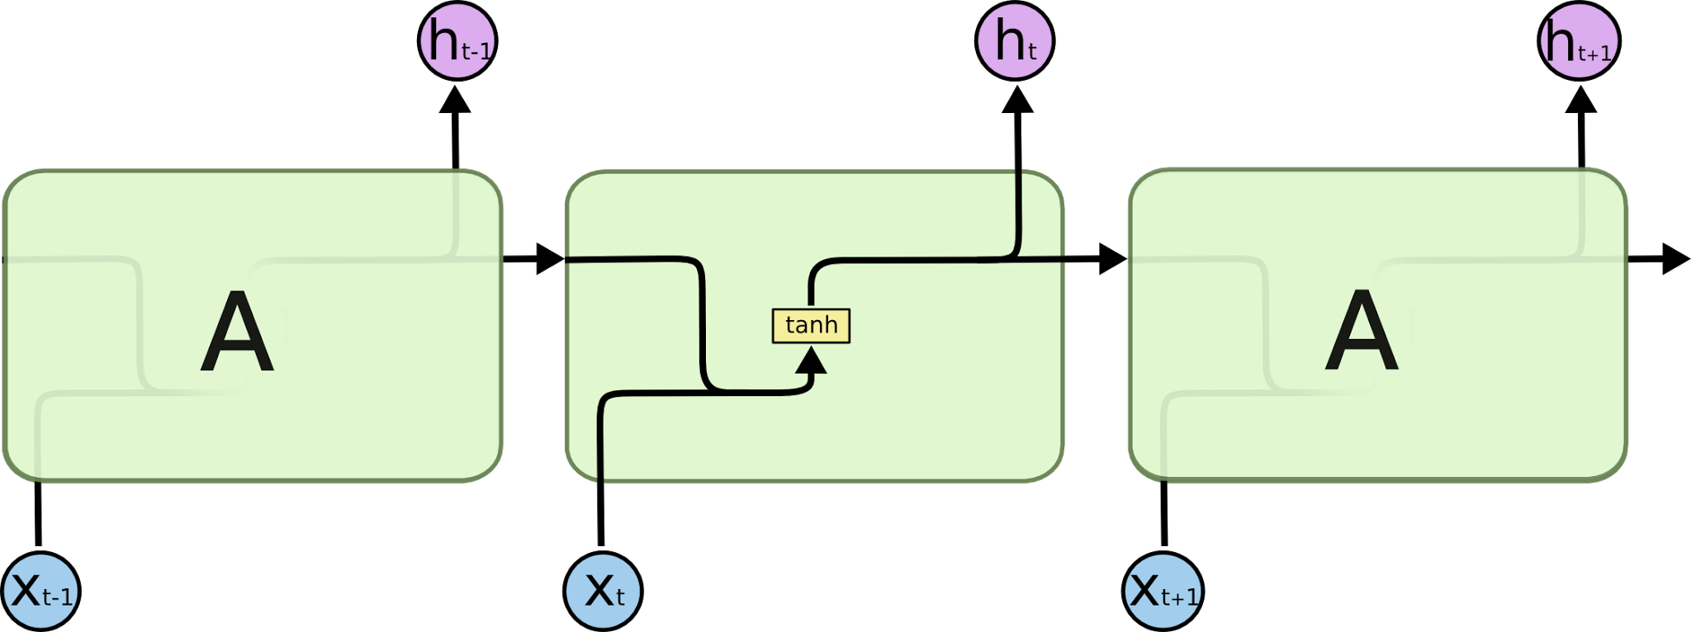
Recap: Recurrent Neural Network
Neural network with loops (output of previous step is input of next)
Maintains hidden state
Tracks previous inputs
Handle variable length input (sentences, video frames,...)
Single differentiable function from input words to output probabilities
h_{t} = f_{W}(h_{t-1}, x_{t})
h_{t} = tanh(W_{h}h_{t-1} + W_{x}x_{t})
y_{t} = W_{y}h_{t}
http://colah.github.io/posts/2015-08-Understanding-LSTMs/
Notes:
So, how does SGNS work?
Let’s say we have this sentence,
(This example was shamelessly taken from Marco Baroni)

Slide 3
They are more exciting than CNN
Allow us to operate over sequences of vectors

Slide 4
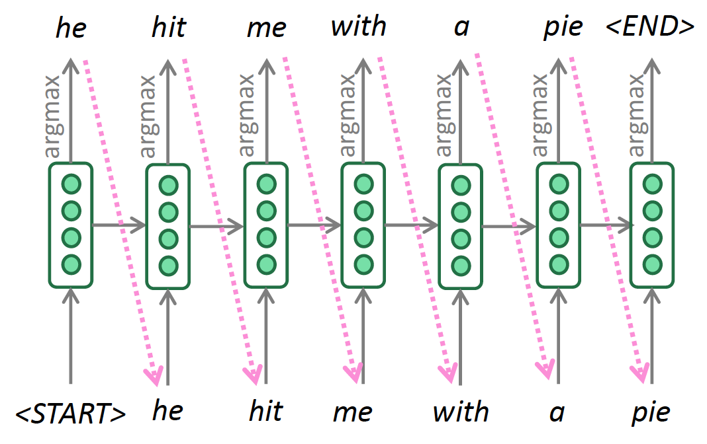
Decoding Algorithm: Greedy Decoding
At each step, take the most probable word (argmax)
Use that as the next word, feed it as input on the next step
Keep going until you produce the end token
Notes:
So, how does SGNS work?
Let’s say we have this sentence,
(This example was shamelessly taken from Marco Baroni)

Slide 5
Parametrization – Transformers
Stack multiple layers of attention to build a transformer
Vaswani et al. [2017] – Attention is all you need
A transformer block consists of
Multi-headed attention
Residual connection
Feedforward layer
Point-wise nonlinearity
Residual connection
(Layer) normalization

Slide 6
Decoding Algorithm: Beam Search
A search algorithm which aims to find a high-probability
sequence (not necessarily the optimal sequence, though) by
tracking multiple possible sequences at once
Core idea: On each step of decoder, keep track of the k most
probable partial sequences (which we call hypotheses)
• k is the beam size
• After you reach some stopping criterion, choose the sequence
with the highest probability (factoring in some adjustment for
Length)
Notes:
So, how does SGNS work?
Let’s say we have this sentence,
(This example was shamelessly taken from Marco Baroni)

Slide 7
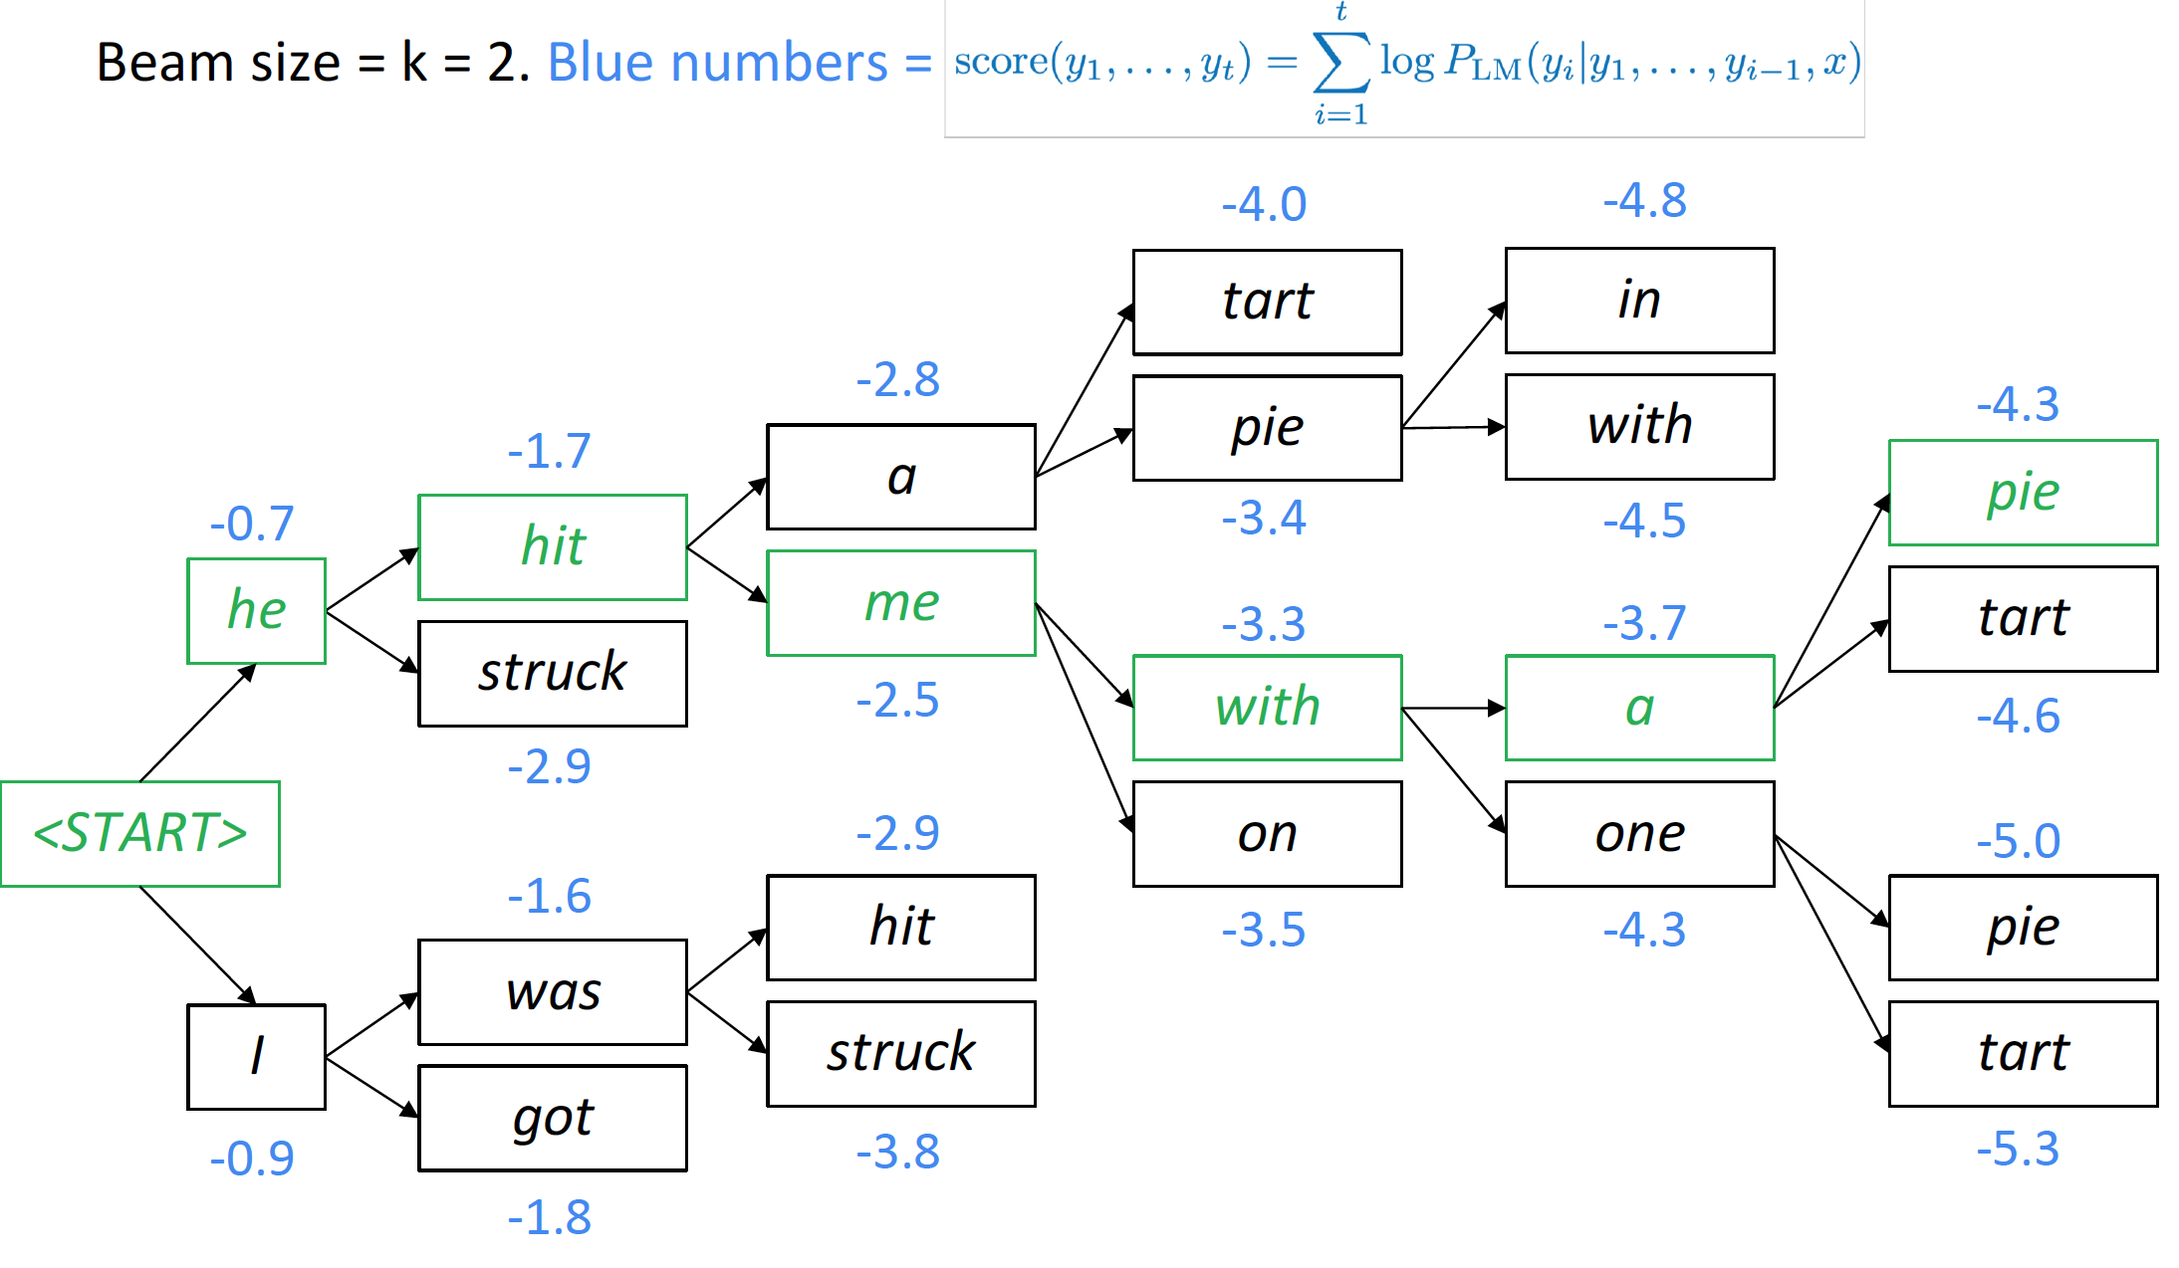
Decoding Algorithm: Beam Search
Notes:
So, how does SGNS work?
Let’s say we have this sentence,
(This example was shamelessly taken from Marco Baroni)

Slide 8
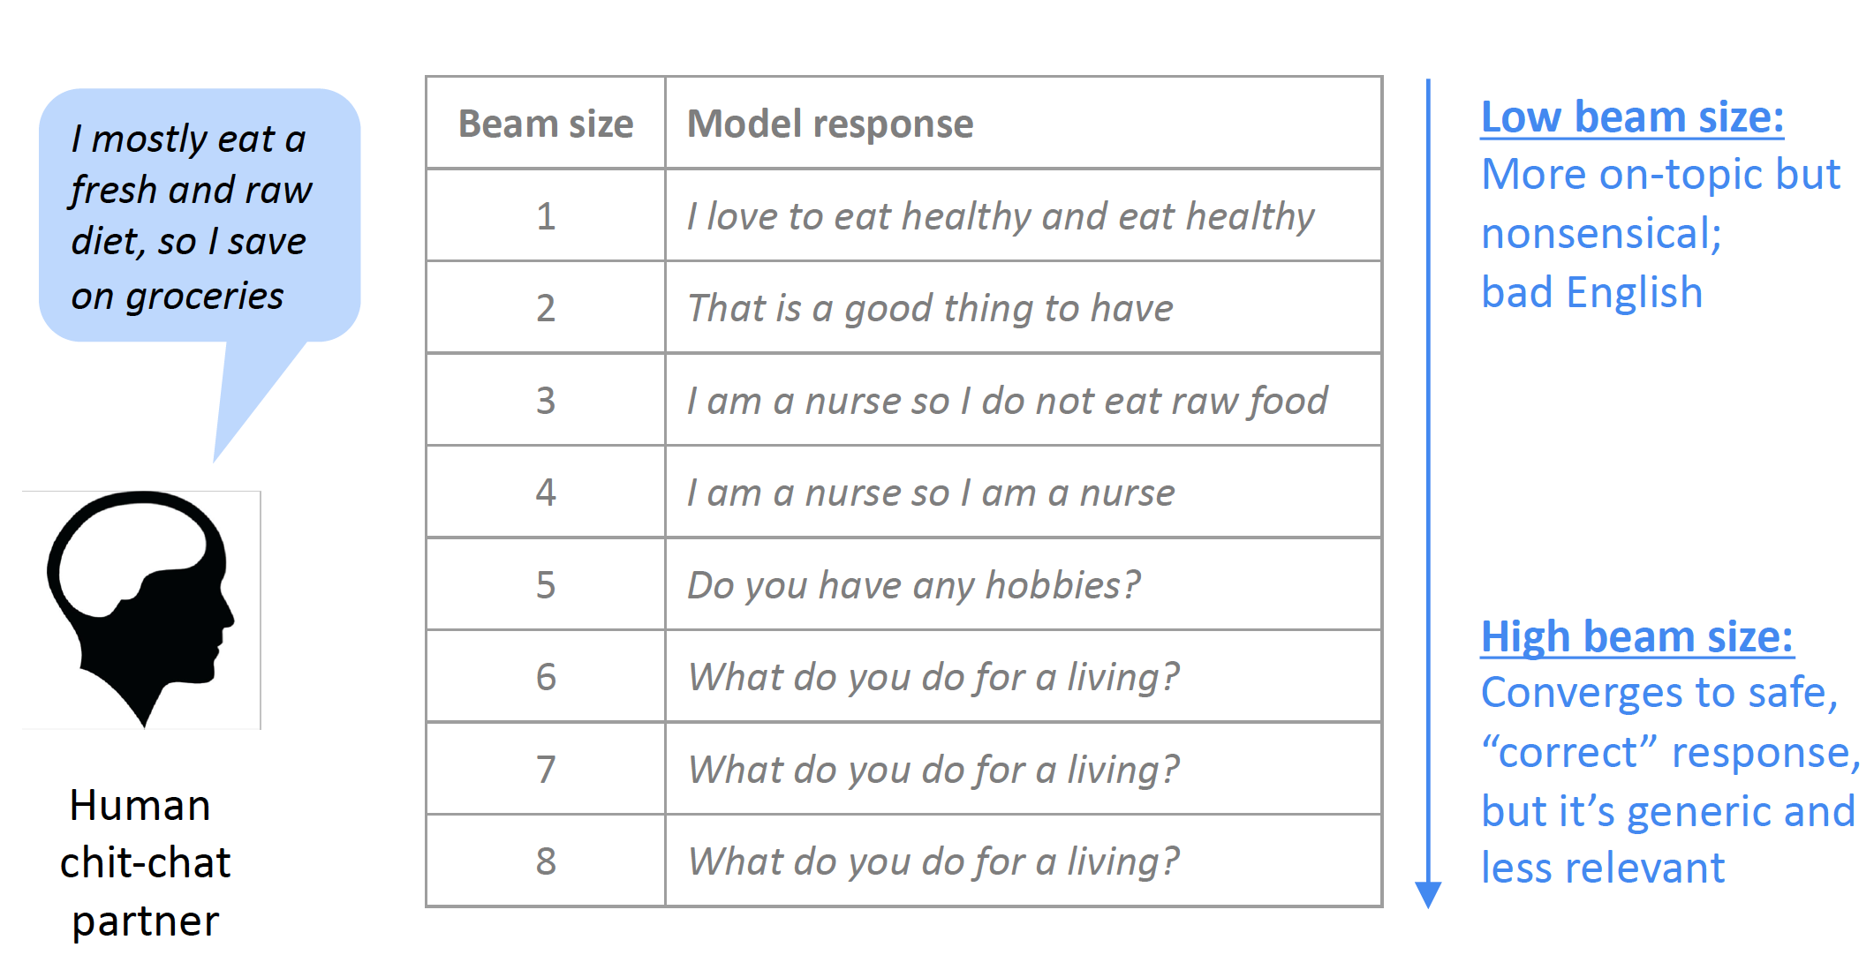
Impact of Beam Size
8
Notes:
Change low resource IL to a language which is not in wikipedia
Word-level: from bi-lingual dicts and alignment; structure-level comes from wals; multi-level alignment

Slide 9
Softmax temperature
It’s not a decoding algorithm – you should apply it in conjunction with a decoding algorithm
Notes:
So, how does SGNS work?
Let’s say we have this sentence,
(This example was shamelessly taken from Marco Baroni)

Slide 10
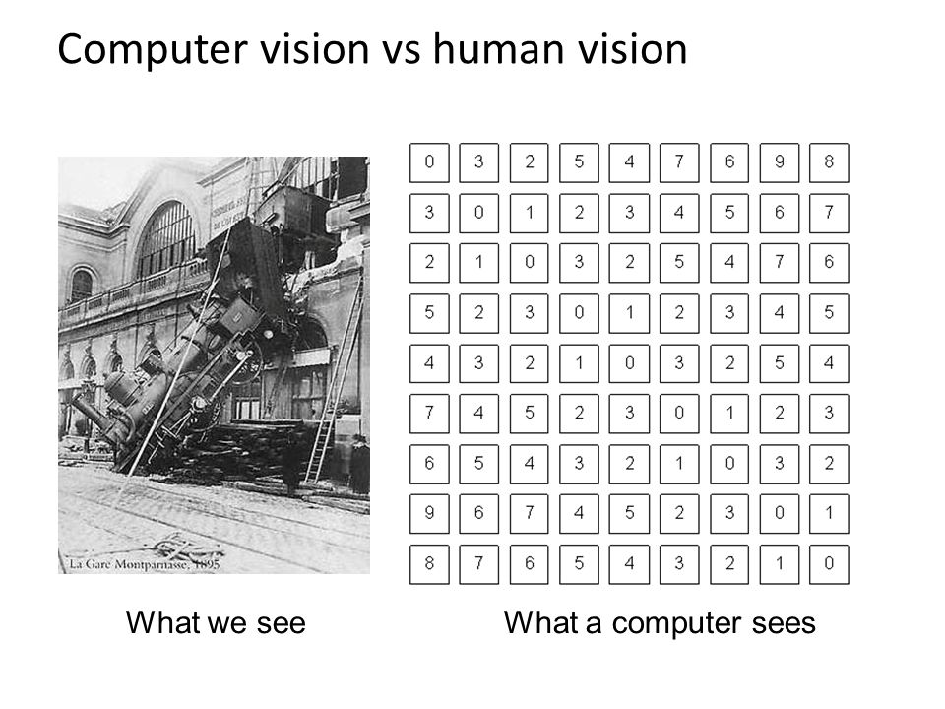
Why is this powerful?
Large number parameters ≈ higher model capacity
Fit complex functions
Representation learning!
No manual features
Operate on raw data
Can compare and refine representations
Similar Words → Similar sentences
The wall is blue → the wall is red
We can change multiple words
The wall is blue → the ceiling is red

Slide 11
Why is this powerful?
Unsupervised machine translation
Machine comprehension
https://demo.allennlp.org/machine-comprehension/NTc4MTY2
Visual grounding
Generative adversarial networks (GAN):
Recycle-GAN: https://www.youtube.com/watch?v=VWXFqDdqLbE
Nvidia’s celebrity face generation: https://www.youtube.com/watch?v=36lE9tV9vm0
Zero-shot learning
Notes:
So, how does SGNS work?
Let’s say we have this sentence,
(This example was shamelessly taken from Marco Baroni)

Slide 12
Why is this powerful?
Shared representations across tasks, languages, and modalities
Notes:
So, how does SGNS work?
Let’s say we have this sentence,
(This example was shamelessly taken from Marco Baroni)

Slide 13
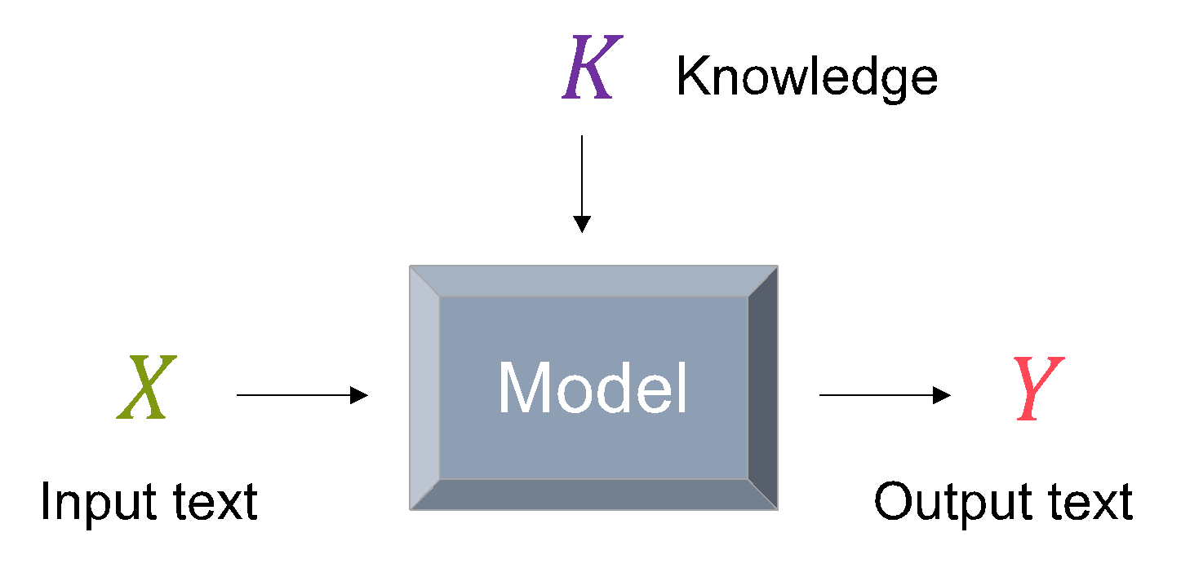
Knowledge-enhanced model architectures
Bake knowledge into the model through specific architectures
Graph NNs for modeling graph-structured knowledge (e.g., knowledge graphs)
Attending to & copying from knowledge

Slide 14
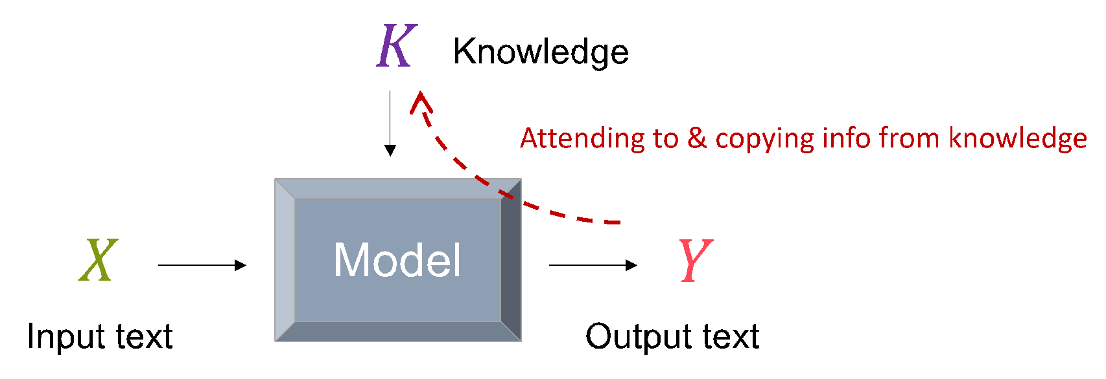
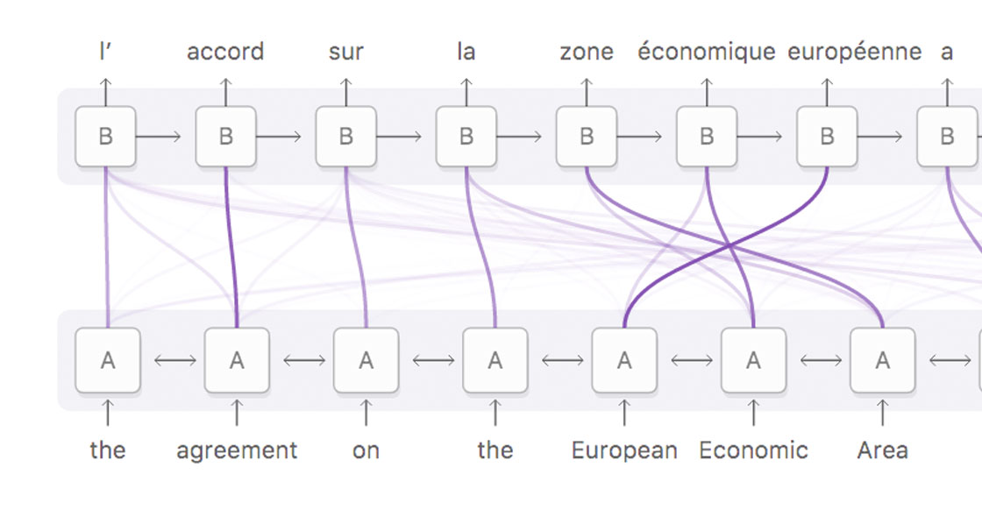
Architectures (I): Attention Mechanisms
Chooses which information to pay attention to
Output text
Decoder hidden states
Encoder hidden states
Knowledge
and/or
Input text
Figure courtesy: Olah & Carter, 2016
Notes:
learn to attend to only the relevant ones as we produce the output.

Slide 15
Architectures (I): Attention Mechanisms
Chooses which information to pay attention to
Output text
Decoder hidden states
Encoder hidden states
Knowledge
and/or
Input text
Figure courtesy: Olah & Carter, 2016
Notes:
learn to attend to only the relevant ones as we produce the output.

Slide 16
Architectures (I): Attention Mechanisms
Chooses which information to pay attention to
Output text
Decoder hidden states
“Values”
“Query”
“Keys”
Encoder hidden states
Knowledge
and/or
Input text
Figure courtesy: Olah & Carter, 2016

Slide 17
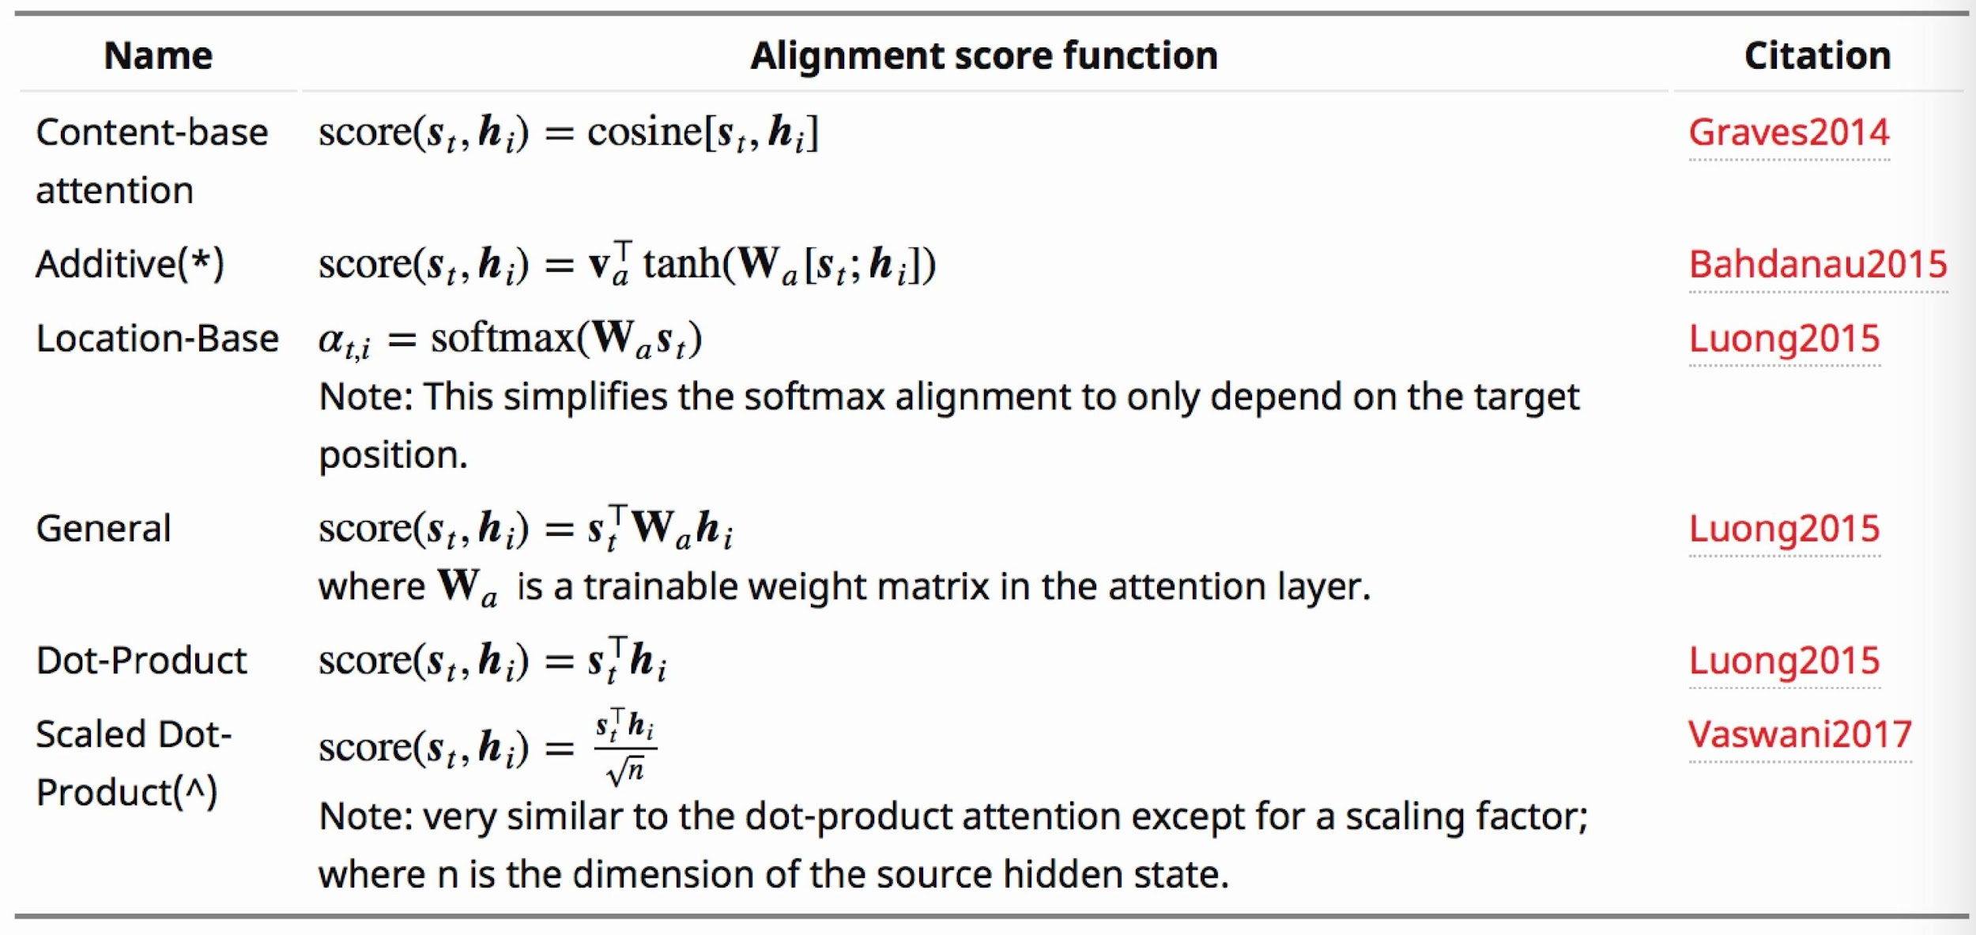
Architectures (I): Attention Mechanisms
“Values”
“Query”
“Keys”
Figure courtesy: Lilian Weng

Slide 18
Architectures (I): Attention Mechanisms
“Values”
“Query”
“Keys”

Slide 19
Let’s apply Seq2Seq+Attention to Abstractive Summarization
Abstract summarization:
Generate a summary to cover the important information in the source document
19
Notes:
Change low resource IL to a language which is not in wikipedia
Word-level: from bi-lingual dicts and alignment; structure-level comes from wals; multi-level alignment

Slide 20
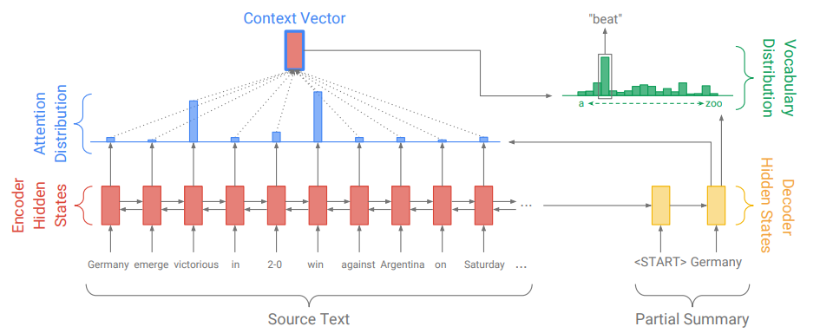
Abstractive Summarization
Problems?
Out Of Vocabulary words

Slide 21
Pointer-Generator Network
(See et al., 2017)
Notes:
החלק הימני בנוסחה מעלה את ההסתברות לגנרט מילים שנמצאות במשפט בתוך הפ_ווקב.
ממש כמו שאני מכיר שעושים

Slide 22
Copy/Pointing Mechanisms
Copy relevant information to the output text
Probability of choosing the generation mode
Probability of choosing the copy mode
Notes:
Not only attending to, but also directly copying the information

Slide 23
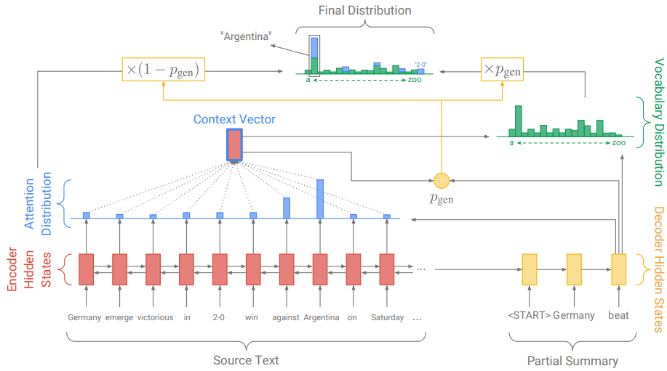
Pointer-Generator Network

Slide 24
Results
ROUGE scores of the trained models on the CNN-Daily Mail dataset, computed on the test set.

Slide 25
Exercise: How to Encode Graphs?
How to distinguish Gary Johnson and Lyndon Johnson?
How to represent the relation between Mitt Romney and Gary Johnson?

Slide 26
Can we flatten graphs to sequence?

Slide 27
What that’s not enough & Why is it hard?
Complex topographical structure (i.e., no spatial locality like grids)
No fixed node ordering or reference point (i.e., the isomorphism problem)
Often dynamic and have multimodal features
More complex for heterogeneous knowledge graphs

Slide 28
Benchmarks
Overview
Evaluation
Datasets
Dialog Systems
Question Answering
Question Generation
Commonsense Reasoning
Summarization

Slide 29
Benchmarks Overview
Tasks | Dataset Name | External Resources | Leaderboard | Benchmark
Dialog Systems | Wizard of Wikipedia | Wikipedia | Yes | Kilt
Question Answering | ELI5 | Common Crawl | Yes | Kilt
Question Generation | SQuAD 1.1 | Wikipedia | No | GLGE
Commonsense Reasoning | CommonGen | N/A | Yes | GEM
 | αNLG-ART | N/A | Yes | GENIE
 | ComVE | N/A | Yes | SemEval
Summarization | CNN/DailyMail | N/A | Yes | GLGE

Slide 30
Automatic Evaluation
Untrained Automatic Metrics
N-Gram Overlap Metrics
ROUGE
METEOR
SacreBLEU
BLEU
GLGE-score
Fact-checking Metrics
PARENT
Trained Automatic Metrics
Pre-trained Language Model-based Evaluation
BERTScore
BARTScore
BLEURT
QuestEval
KPQA

Slide 31
Human Evaluation
Evaluation for Quality of Text
Fluency
Redundancy
Coherence
Commonsense
Grammar
Faithfulness
Inter-Annotator Agreement
Percent agreement, Cohen’s Kappa, Fleiss’s Kappa, Krippendorff’s Alpha
Problems
Expensive
Time-consuming
Quality Control
Challenge Criteria
Inconsistency in Evaluations
Inconsistency in Report

Slide 32
Dialog Systems : Wizard of Wikipedia
An open-domain conversation dataset directly grounded with knowledge retrieved from Wikipedia
Wizard
Inform their conversation partner (Apprentice) about a topic that one of them will choose
Have access to Wikipedia paragraphs that might be related to conversations
Apprentice
Go into depth about a chosen topic that interests themselves or their partner (Wizard), while keeping the conversation engaging and fun
Dataset: https://parl.ai/projects/wizard_of_wikipedia/
Leaderboard: https://eval.ai/web/challenges/challenge-page/689/leaderboard/1909

Slide 33
Dialog Systems: Wizard of Wikipedia
Topic | Lifeguard
Apprentice | So I am a lifeguard. Know anything about saving lives in water?
Wizard | I’m impressed! It’s a big responsibility to supervise other people’s safety in the water! Tell me more.
Apprentice | Well, I help make sure people do not drown or get injured while in or near the water!
Knowledge | A lifeguard is a rescuer who supervises the safety and rescue of swimmers, surfers, . . . Lifeguards are strong swimmers and trained in CPR/AED first aid, certified in water . . . · · · In some areas, the lifeguard service also carries out mountain rescues, or may function as the primary EMS provider
Wizard | I’ve heard that in some places, lifeguards also help with other sorts of emergencies, like mountain rescues! Is that part of your job too?
Apprentice | I have! I feel like you know much about this! What brings you to know so much?
Wizard | Oh, that’s about the extent of my knowledge. I’ve just been around beaches and I’ve always admired lifeguards. I’m not a super strong swimmer myself.

Slide 34
Question Answering: ELI5
A long-form question answering dataset containing complex, diverse questions that require explanatory multi-sentence answers
Use web search results (Common Crawl) as evidence documents to answer each question
Question | How do Jellyfish function without brains or nervous systems?
Supporting Documents | The box jellyfish nervous system is divided into three functional parts namely; rhopalia, conducting nerve ring, and motor nerve net. [...] While they don’t possess brains, the animals still have neurons that send all sorts of signals throughout their body. ``It is not true that jellyfish have no central nervous systems. They have an unusual nervous system,'' [...]
Answer | Jellyfish may not have a brain, but they have a rough nervous system and innate behaviours. However, they are very simple creatures. They're invertebrate: creatures without a backbone. Most jellyfish have really short life spans. [...] As their name implies, they are largely composed of basically jelly inside a thin membrane. They're over 95% water.
Dataset and Leaderboard: https://facebookresearch.github.io/ELI5/

Slide 35
Question Generation: SQuAD 1.1
A reading comprehension dataset consisting of 100,000+ questions posed by crowd workers on a set of Wikipedia articles
The answer to each question is a segment of text from the corresponding reading passage
Passage | Super Bowl 50 was an American football game to determine the champion of the National Football League (NFL) for the 2015 season. The American Football Conference (AFC) champion Denver Broncos defeated the National Football Conference (NFC) champion Carolina Panthers 24–10 to earn their third Super Bowl title. The game was played on February 7, 2016, at Levi’s Stadium in the San Francisco Bay Area at Santa Clara, California. As this was the 50th Super Bowl, [...].
Answer | Santa Clara, California
Target | Where did Super Bowl 50 take place?
Dataset: https://rajpurkar.github.io/SQuAD-explorer/

Slide 36
Commonsense Reasoning: CommonGen
A constrained text generation task, associated with a benchmark dataset
Explicitly test machines for the ability of generative commonsense reasoning
Based on visually-grounded sentences from several existing caption datasets
Dataset and Leaderboard: https://inklab.usc.edu/CommonGen/

Slide 37
Commonsense Reasoning: αNLG-ART
A generative commonsense reasoning dataset consists of over 20k commonsense narrative contexts and 200k explanations
Given the observations at time t1 and t2, the model needs to generate a plausible hypothesis
Observation at t1 | Larry’s yard was covered in dead leaves.
Observation at t2 (t2>t1) | Larry decided to give up for the day and went back inside.
Hypothesis | He spent hours trying to clean the yard.
Dataset and Leaderboard: http://abductivecommonsense.xyz/

Slide 38
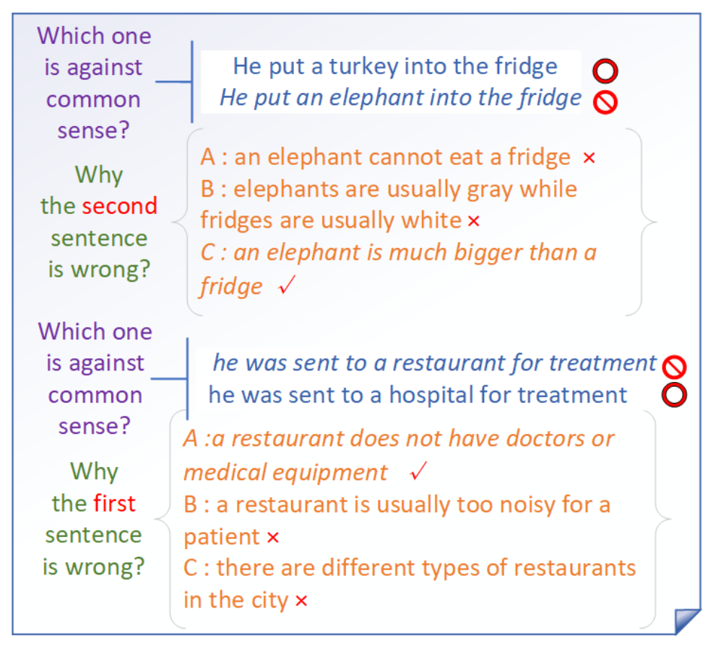
Commonsense Reasoning: ComVE
Generate the reason why a statement is against common sense and use BELU to evaluate it
Consists 2021 against common-sense sentences with true reasons
Dataset and Leaderboard: https://competitions.codalab.org/competitions/21080

Slide 39
Summarization: CNN/DailyMail
A non-anonymized variant of CNN/DailyMail dataset consists of 311,971 <article, summary> pairs
Article | andy murray came close to giving himself some extra preparation time for his wedding next week before ensuring that he still has unfinished tennis business to attend to. the world no 4 is into the semi-finals of the miami open, but not before getting a scare from 21 year-old austrian dominic thiem, who pushed him to 4-4 in the second set before going down 3-6 6-4, 6-1 in an hour and three quarters. murray was awaiting the winner from the last eight match between tomas berdych and argentina’s juan monaco. prior to this tournament thiem lost in the second round of a challenger event to soon-to-be new brit aljaz bedene. andy murray pumps his first after defeating dominic thiem to reach the miami open semi finals. muray throws his sweatband into the crowd after completing a 3-6, 6-4, 6-1 victory in florida. murray shakes hands with thiem who he described as a ‘strong guy’ after the game. (…)
Summary | british no 1 defeated dominic thiem in miami open quarter finals. andy murray celebrated his 500th career win in the previous round. third seed will play the winner of tomas berdych and juan monaco in the semi finals of the atp masters 1000 event in key biscayne
Dataset : https://github.com/becxer/cnn-dailymail/

Slide 40
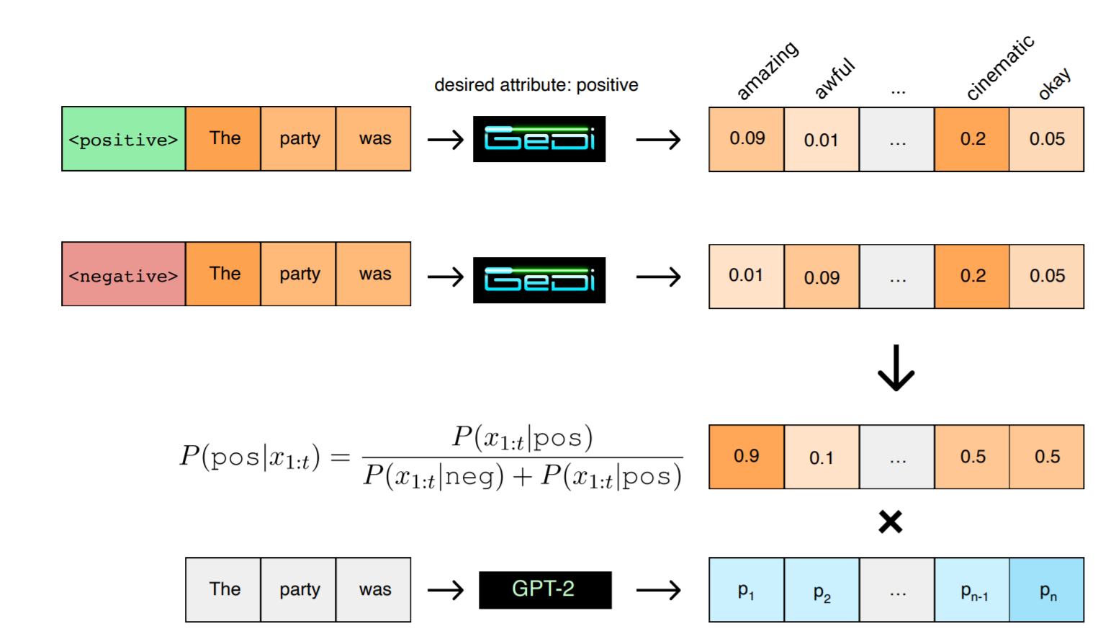
Hands-on for GeDi Generative Discriminator Guided Sequence Generation
We will test the model from GeDi: Generative Discriminator Guided Sequence Generation using Google Colab.
GeDi guides generation at each step by computing classification probabilities for all possible next tokens via Bayes rule by normalizing over two class-conditional distributions
one conditioned on the desired attribute, or control code,
another conditioned on the undesired attribute, or anti control code
Krause, B., Gotmare, A., McCann, B., Keskar, N.S., Joty, S.R., Socher, R., & Rajani, N. (2020). GeDi: Generative Discriminator Guided Sequence Generation. ArXiv, abs/2009.06367.

Slide 41
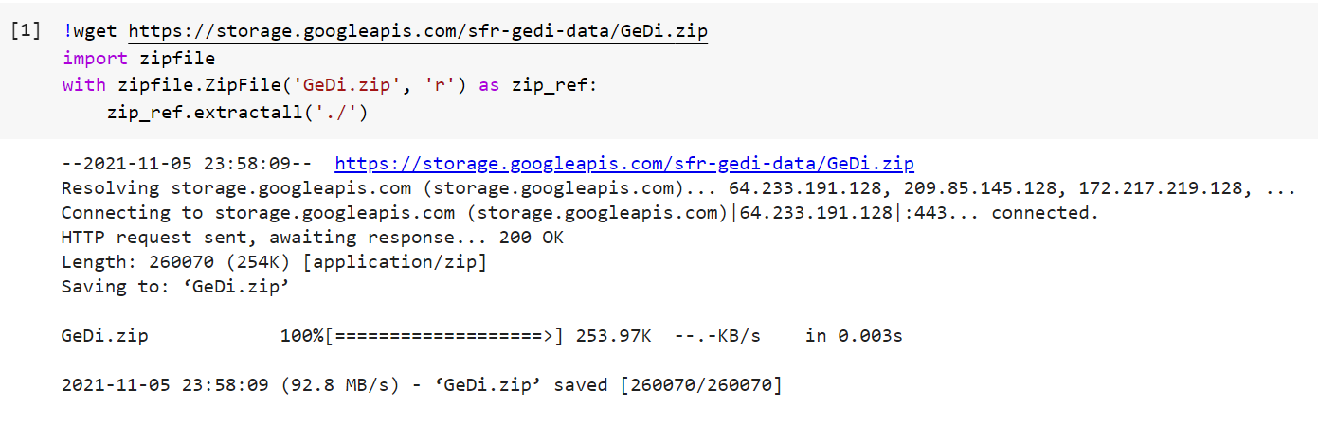
Download Code Repository
Companion Notebook by Salesforce is here: https://colab.research.google.com/github/salesforce/GeDi/blob/master/GeDi_guided_GPT_2_XL.ipynb

Slide 42
Install Dependencies

Slide 43
Download GPT2-XL Tokenizer

Slide 44
Download and Covert GPT2-XL

Slide 45
Set Arguments for Generation

Slide 46
Specify Prompt and Topic to GeDi

Slide 47
Predict Results

Slide 48
Output Results
GeDi estimates the probability that it sample is desired class is: 0.5867899656295776
In a shocking finding that scientists are calling 'extremely worrying', the world's oceans are becoming increasingly acidic.
According to new research published in Nature Climate Change, ocean waters around the world are becoming significantly more acidic due to rising levels of carbon dioxide (CO2) in the atmosphere.
"Our results show that ocean acidification has already begun in many regions, with most regions experiencing acidification rates greater than predicted for preindustrial conditions by 2100," says lead author Thomas Crowley, who conducted this research as part of his doctoral degree thesis at The University of Western Australia. "Ocean acidification has important consequences for organisms living near or below sea surface because low pH environments may be particularly challenging for calcifying organisms; however, our results also show that marine ecosystems will likely experience increasing acidification rates even when they don't experience current ocean acidity trends."
Ocean Acidification is an environmental change caused by increases in atmospheric carbon dioxide (CO2), resulting in increased concentrations of CO2<|endoftext|>

Slide 49
Another Related Project on Colab
Tune GPT2 to generate controlled sentiment reviews
Companion Notebook by Leandro von Werra is here: https://colab.research.google.com/github/lvwerra/trl/blob/master/nbs/05-gpt2-sentiment-control.ipynb
The project optimizes GPT2 to produce IMDB movie reviews with controlled sentiments using a BERT sentiment classifier for rewards
The project website is here

