Slide 1
Graph Controlled NLG
Heng Ji
hengji@illinois.edu
Deliberately constructing a natural language text in order to meet specified communicative goals

Slide 2
Feature Learning in Graphs
Our Goal: Design efficient task-independent/ task-dependent feature learning for machine learning in graphs!
node
v
f:v → ℝ^{d}
vector
_{ℝ}d
Feature representation, embedding

Slide 3
Graph Neural Networks: Foundations
Learning node embeddings:
Learning graph-level embeddings:
A graph filter
adjacency matrix
- Spectral-based
- Spatial-based
- Attention-based
Updated node embeddings
Input node embeddings
- Recurrent-based
Flat Graph Pooling (i.e. Max, Ave, Min)
Hierarchical Graph Pooling (i.e. Diffpool)
A small graph w/
fewer nodes
Input node embeddings
Input graph
New node embeddings
Notes:
The specific models differ only in how 𝑓_filter(·,·) is chosen and parameterized.

Slide 4
Graph Neural Networks: Basic Model
Key idea: Generate node embeddings based on local neighborhoods.
A
TARGET NODE
B
B
C
A
B
A
C
A
C
E
F
D
F
E
D
INPUT GRAPH
A

Slide 5
Neighborhood Aggregation
Intuition: Network neighborhood defines a computation graph
Every node defines a unique
computation graph!

Slide 6
Neighborhood Aggregation
Nodes have embeddings at each layer.
Model can be arbitrary depth.
“layer-0” embedding of node i is its input feature, i.e. x_{i}.
Layer-0
Layer-1
A
X_{A}
TARGET NODE
B
C
X_{C}
B
Layer-2
A
B
X_{A}
A
C
X_{B}
A
C
X_{E}
E
F
X_{F}
D
F
E
D
INPUT GRAPH
A
X_{A}

Slide 7
Overview of GNN Model
1) Define a neighborhood aggregation function
A
TARGET NODE
B
B
C
A
B
A
C
Z_{A}
A
C
E
F
D
F
E
D
INPUT GRAPH
A
2) Define a loss function on the embeddings, L(z_{v})

Slide 8
Overview of GNN Model
3) Train on a set of nodes, i.e., a batch of computation graphs

Slide 9
Overview of GNN Model
4) Generate embeddings for nodes as needed
Even for nodes we
never trained on!
9

Slide 10
GNN Model: A Case Study
Basic approach: Average neighbor information and apply a neural network
1) average messages
from neighbors
A
TARGET NODE
B
B
C
A
B
A
C
A
C
E
F
D
F
E
D
INPUT GRAPH
A
2) apply neural network

Slide 11
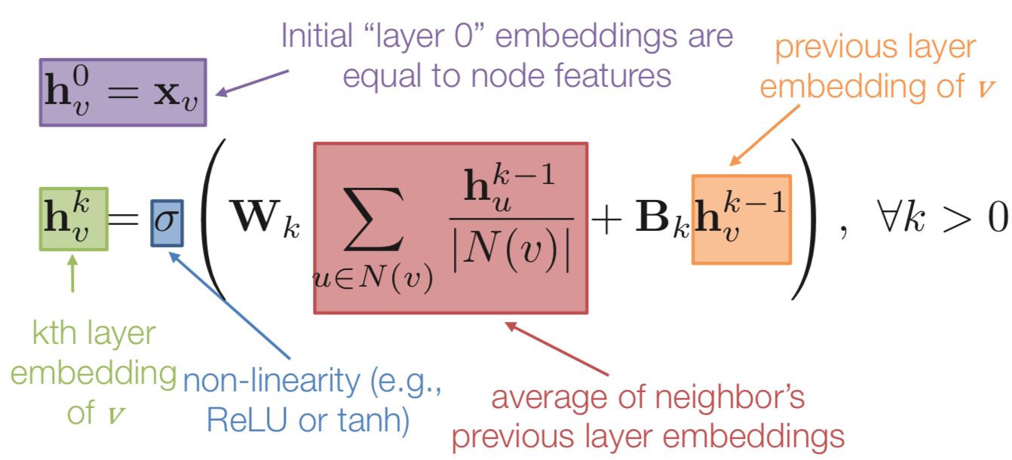
GNN Model: A Case Study
Basic approach: Average neighbor information and apply a neural network.
11

Slide 12
GNN Model: Quick Summary
Key idea: generate node embeddings by aggregating neighborhood information.
Allows for parameter sharing in the encoder
Allows for inductive learning

Slide 13
Graph Neural Networks: Popular Models
Spectral-based Graph Filters
GCN (Kipf & Welling, ICLR 2017), Chebyshev-GNN (Defferrard et al. NIPS 2016)
Spatial-based Graph Filters
MPNN (Gilmer et al. ICML 2017), GraphSage (Hamilton et al. NIPS 2017)
GIN (Xu et al. ICLR 2019)
Attention-based Graph Filters
GAT (Velickovic et al. ICLR 2018)
Recurrent-based Graph Filters
GGNN (Li et al. ICLR 2016)

Slide 14
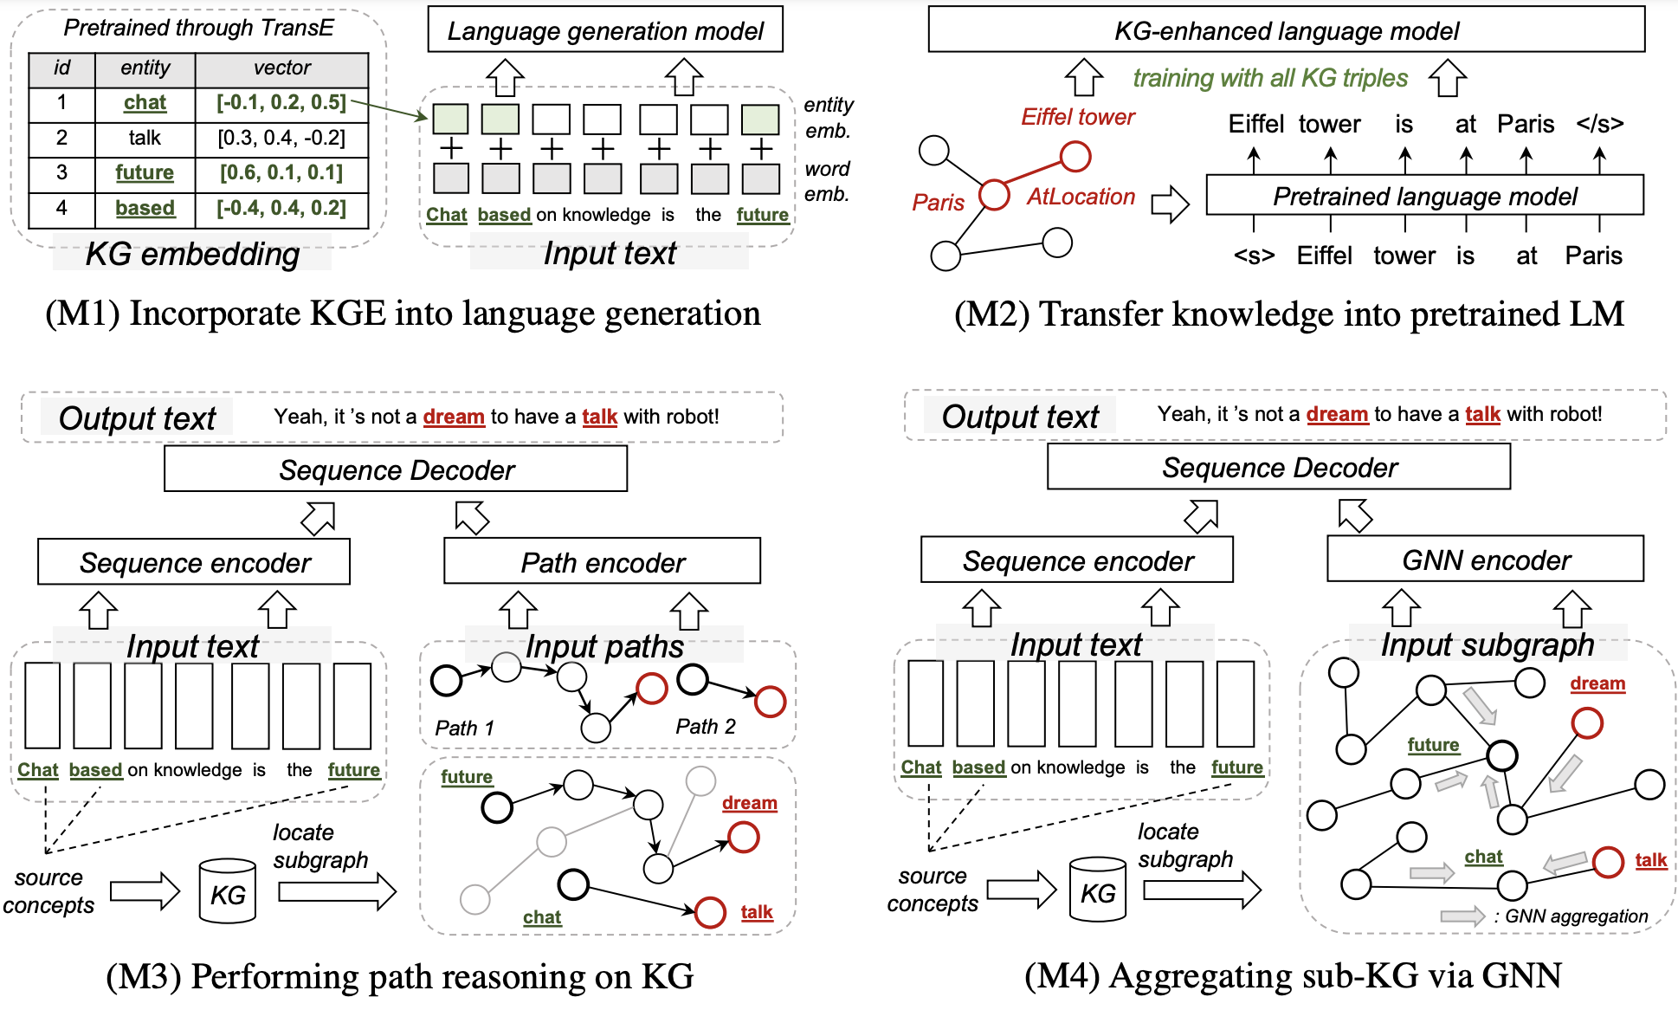
KG-enhanced text generation methods
M1: KGE into NLG
[Zhou 2018 IJCAI]
M2: KG into PLMs
[Guan 2020 TACL]
M3: Path Reasoning
[Liu 2019 EMNLP]
[Ji 2020 EMNLP]
M4: GNN on sub-KG
[Zhou 2018 IJCAI]
[Zhang 2020 ACL]

Slide 15
KG-enhanced text generation methods
M1: Incorporate Knowledge Graph Embeddings into NLG

Slide 16
KG-enhanced text generation methods
M2: Transfer Knowledge into LMs with Knowledge Triplet Information

Slide 17
KG-enhanced text generation methods
M3: Perform Reasoning over KG via Path Finding Strategies
Path routing and ranking (PRA algrithom)
PRA uses random walks to perform multiple bounded depth-first search processes to find relational paths on the KG, then integrate the path into Seq2Seq models
Reinforcement learning based path finding
It takes a sequence as input, retrieve a starting node on the KG, then perform multi-hop graph reasoning, and finally arrive at a target node that incorporates the knowledge for output sequence generation.

Slide 18
KG-enhanced text generation methods
M3: Perform Reasoning over KG via Path Finding Strategies
Path routing and ranking (PRA algrithom)
PRA uses random walks to perform multiple bounded depth-first search processes to find relational paths on the KG, then integrate the path into Seq2Seq models
Reinforcement learning based path finding
It takes a sequence as input, retrieve a starting node on the KG, then perform multi-hop graph reasoning, and finally arrive at a target node that incorporates the knowledge for output sequence generation.

Slide 19
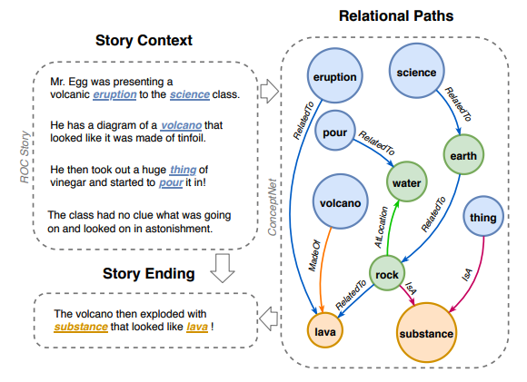
KG-enhanced text generation methods
Language Generation with Multi-Hop Reasoning on Commonsense Knowledge Graph, In EMNLP 2020
Application: Generative commonsense reasoning (e.g., story, alpha-NLG)
Motivation: To reason over multi-hop
relational paths where multiple conec-
ted triples provide chains of evidence
for grounded text generation.

Slide 20
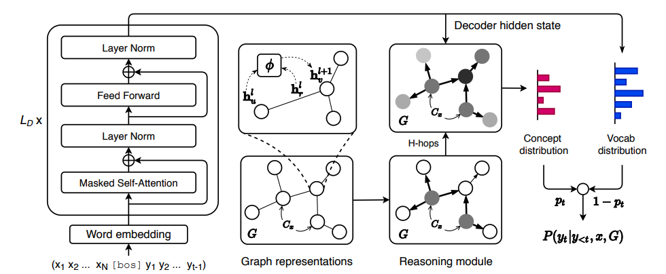
KG-enhanced text generation methods
Language Generation with Multi-Hop Reasoning on Commonsense Knowledge Graph, In EMNLP 2020

Slide 21
KG-enhanced text generation methods
Language Generation with Multi-Hop Reasoning on Commonsense Knowledge Graph, In EMNLP 2020
Encoder: R-GCN to model the
relation type on ConceptNet

Slide 22
KG-enhanced text generation methods
Language Generation with Multi-Hop Reasoning on Commonsense Knowledge Graph, In EMNLP 2020
Decoder: A reasoning module to assign scores for neighboring nodes

Slide 23
KG-enhanced text generation methods
Language Generation with Multi-Hop Reasoning on Commonsense Knowledge Graph, In EMNLP 2020

Slide 24
KG-enhanced text generation methods
Language Generation with Multi-Hop Reasoning on Commonsense Knowledge Graph, In EMNLP 2020
Dataset: ROCStories, alpha-NLG, EG. Metric: BLEU, METEOR, ROUGE

Slide 25
KG-enhanced text generation methods
M4: Improve the Graph Embeddings with Graph Neural Networks.
Notes:
A knowledge graph (KG) is a directed and multi-relational
graph composed of entities and relations which are regarded as nodes and different types of edges.
Formally, a KG is defined as G = (U, E, R), where U is the set of entity nodes and E ⊆ U°øR °øU
is the set of typed edges between nodes in U with a certain relation in the relation schema R.

Slide 26
KG-enhanced text generation methods
Commonsense Knowledge Aware Conversation Generation with Graph Attention, In IJCAI 2018
Application: Dialogue system

Slide 27
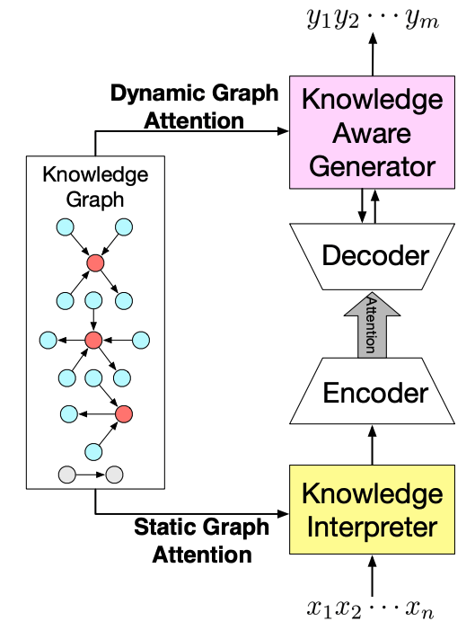
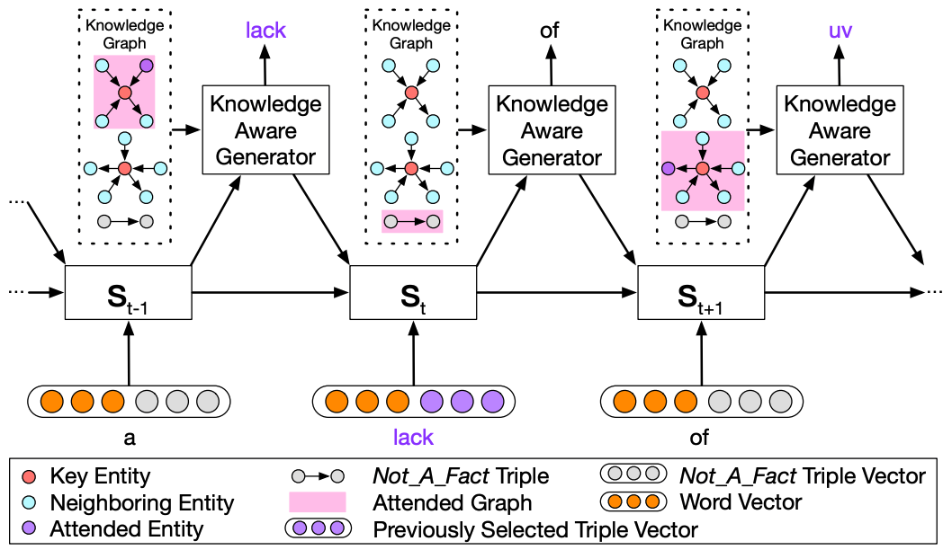
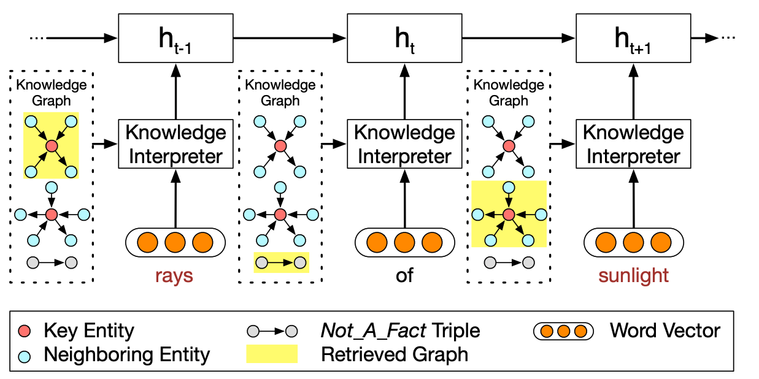
KG-enhanced text generation methods
Commonsense Knowledge Aware Conversation Generation with Graph Attention, In IJCAI 2018

Slide 28
KG-enhanced text generation methods
Commonsense Knowledge Aware Conversation Generation with Graph Attention, In IJCAI 2018
Encoder: word embedding from text + entity embedding from KG
* Only one-hop relation is used in this work

Slide 29
KG-enhanced text generation methods
Commonsense Knowledge Aware Conversation Generation with Graph Attention, In IJCAI 2018
Decoder: encoder-decoder attention + knowledge graph attention

Slide 30
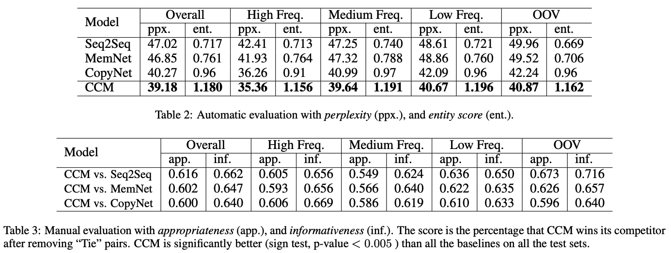
KG-enhanced text generation methods
Commonsense Knowledge Aware Conversation Generation with Graph Attention, In IJCAI 2018
Dataset: Reddit-1M + ConceptNet Metric: Perplexity ↓; Entropy ↑

Slide 31
KG-enhanced text generation methods
Grounded Conversation Generation as Guided Traverses in Commonsense Knowledge Graphs, In ACL 2020.
Application: Dialogue system
Motivation: Concept shift in human conversations has not been modeled.
outer graph

Slide 32
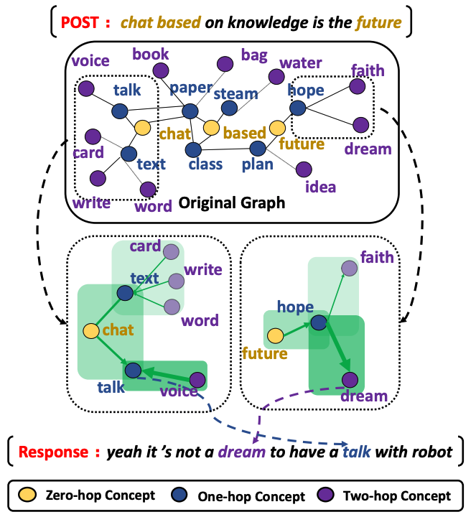
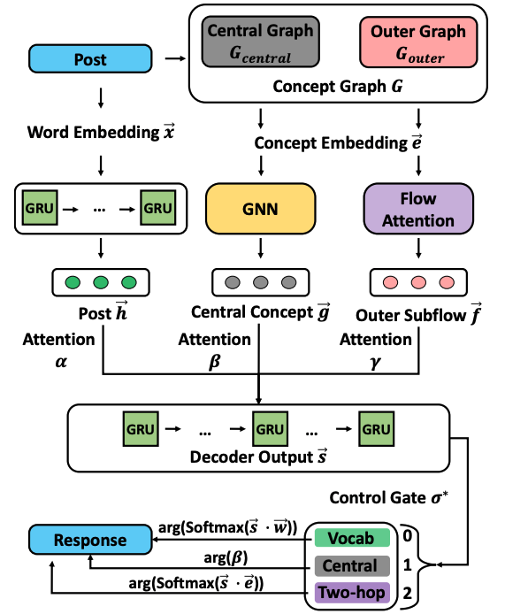
KG-enhanced text generation methods
Grounded Conversation Generation as Guided Traverses in Commonsense Knowledge Graphs, In ACL 2020

Slide 33
KG-enhanced text generation methods
Grounded Conversation Generation as Guided Traverses in Commonsense Knowledge Graphs, In ACL 2020

Slide 34
KG-enhanced text generation methods
Grounded Conversation Generation as Guided Traverses in Commonsense Knowledge Graphs, In ACL 2020
Dataset: Reddit-1M + ConceptNet; Metric: BLEU; Nist; ROUGE
Table: Relevance Between Generated and Golden Responses.

Slide 35
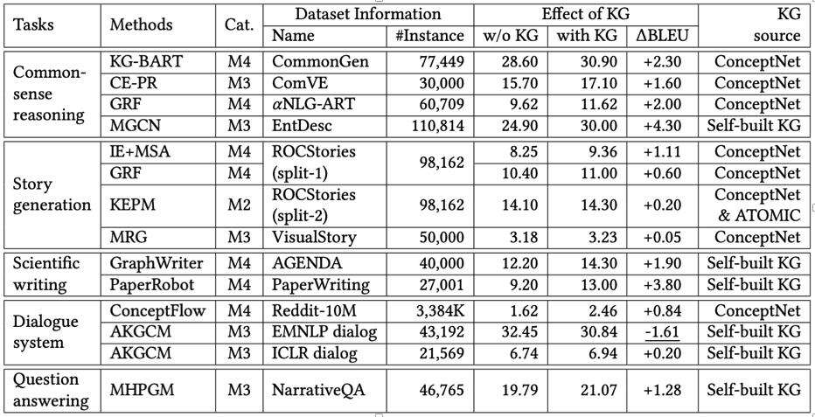
KG-enhanced text generation methods
Observation 1: KG makes largest improvement on commonsense reasoning tasks
Observation 2: ConceptNet is the most popular used KG.
Table: Tasks, datasets and KG sources used in different KG-enhanced papers.

Slide 36
KG-enhanced text generation methods
M1 (Incorporate Knowledge Graph Embeddings into Language Generation):
Pros: (i) Easy to use (by simple vector concatenation)
Cons: (i) Text representation and KG representation are from two vector space
(ii) KGE can only capture one-hop relations
M2 (Transfer Knowledge into Language Model with Knowledge Triplet Information):
Pros: (i) Easy to use (train with any pre-trained LM)
(ii) KG knowledge is embedded into LMs
Cons: (i) Only capture one-hop relations

Slide 37
KG-enhanced text generation methods
M3:
Pros: (i) Multi-hop reasoning
(ii) Better interpretability
Cons: (i) Only one path is considered
(ii) Large complexity and hard to train
M4:
Pros: (i) Multi-hop relations
(ii) Joint optimization of Seq2Seq and GNN
Cons: (i) May incorporate noisy information

Slide 38
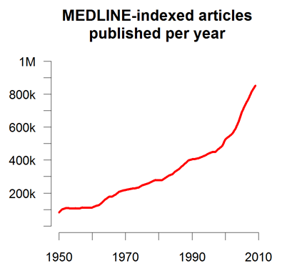
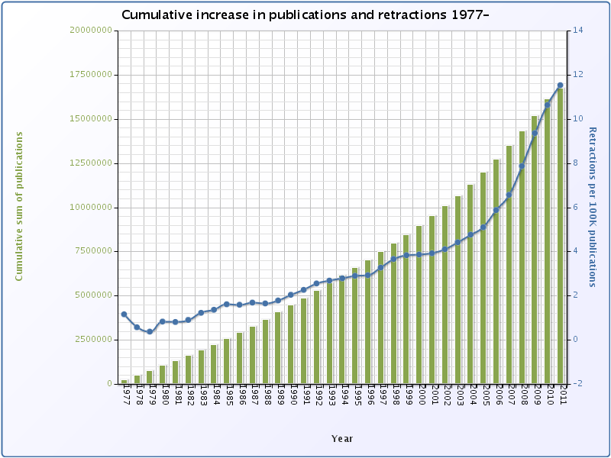
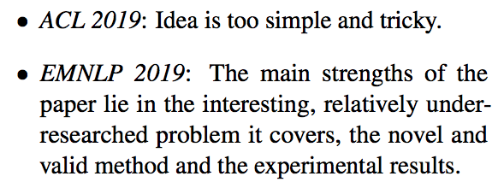
Application on Paper Writing
More than 500K papers are published at PubMed every year, and more than 1.2 million new papers are published in 2016 alone, bringing the total number of papers to over 26 million (Van Noorden, 2014)
The number of papers submitted for ACL 2020 reached a record for 3,429
ICLR 2021 has 3,000+ submitted papers, which is doubled compared to ICLR 2018
Human’s reading ability keeps almost the same across years: US scientists estimated that they read, on average, only 264 papers per year (1 out of 5000 available papers, the same across years)
Reviews for for the same paper rejected by ACL2019 and accepted by EMNLP2019 without any change on content:
Notes:
300 papers… every day… impossible to read… keyword search… abstract doesn’t reflect… results; ignore most of them. Cancer and surgery… 3 days… walk through all posters.. In our field papers that were published twenty years ago are not that important…
including mining PubMed bibliographic data, research papers in PubMed, clinical data sets and numerous bio-medical websites and social media related to medical sciences, where data related to diseases, drugs, treatments, chemical compounds, proteins, genes, biological pathways can be integrated and extracted from text data and their characteristics and relationships can be mined from such datasets as well
. Older literature is often extremely important (and overlooked), and indeed, often provides a rich source of information that can lead to new hypotheses. This makes the information overload problem event more serious, because we need distill and connect knowledge from papers that may cover 70 years.

Slide 39
There are also too many evil Reivewer#2 out there…
Some bad reviewers often ask to add citations to their own papers to inflate their citation record and h-index, and these papers are often irrelevant or published after the submission deadline of the target paper under review
Early study (Anderson, 2009) shows that the acceptance of a computer systems paper is often random and the dominant factor is the variability between reviewers
The inter-annotator agreement between two review scores for the ACL2017 accepted papers (Kang et al., 2018) are only 71.5%, 68.4%, and 73.1% for substance, clarity and overall recommendation respectively
(Pier et al., 2018) found no agreement among reviewers in evaluating the same NIH grant application
The organizers of NIPS2014 assigned 10% submissions to two different sets of reviewers and observed that these two committees disagreed for 25.9% of the papers (Bornmann et al., 2010)
Half of NIPS2016 papers would have been rejected if reviews are done by a different group (Shah et al., 2017)

Slide 40
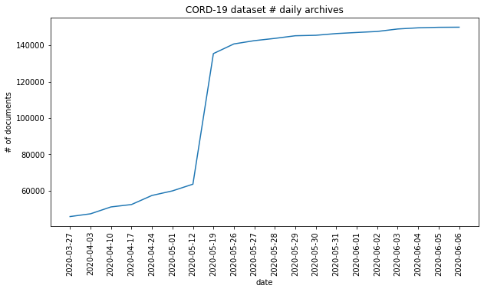
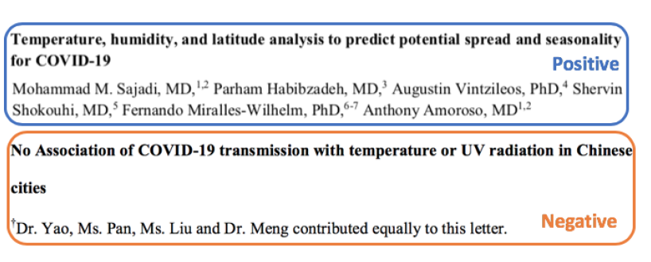
Challenges on Digesting COVID-19 Scientific Literature
Practical progresses at combating COVID-19 highly depend on effective transmission, assessment and extension of research results
Quantity: As of June 13, 2020, there are at least 140K papers about coronavirus
Quality: Given the rapid publications of preprints without peer reviews, many research results are redundant, complementary or even conflicting with each other
Knowledge Bottleneck in Clinical Trials for Drug re-purposing
Mainly rely on symptoms: consider drugs that can treat diseases with similar symptoms
Too many drug candidates
Too much misinformation from multiple countries
Too costly to test all drugs, and difficult to decide threshold to measure success (Is it good enough to if 65% patients have reduced symptoms?)
What doctors need: a reliable ranked list of drugs with detailed knowledge-level (chemicals/genes) evidence

Slide 41
Write about the New Ideas Automatically: PaperRobot [Wang et al., ACL2019]

Slide 42
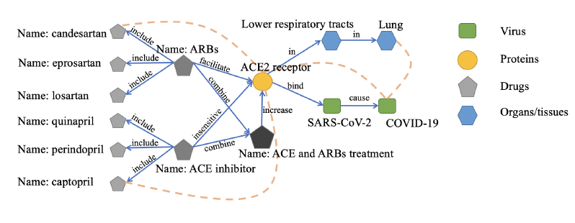
Reading: Create New Knowledge
Foster et al. (2015) shows that more than 60% of 6.4 million papers in biomedicine and chemistry published between 1934 and 2008 report findings that build on existing knowledge and provide additional innovations and improvements
PaperRobot predicts new links (ideas) based on a new representation for each entity by combining knowledge graph structure and unstructured contextual text

Slide 43
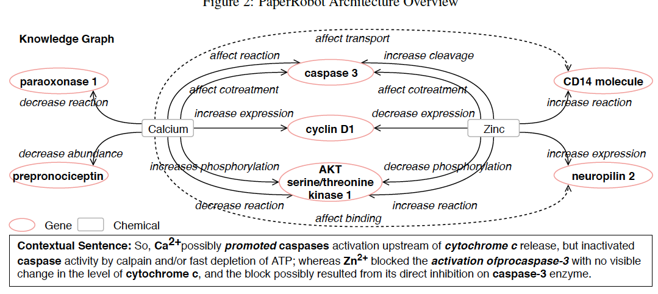
Link Prediction on top of Knowledge Extraction

Slide 44
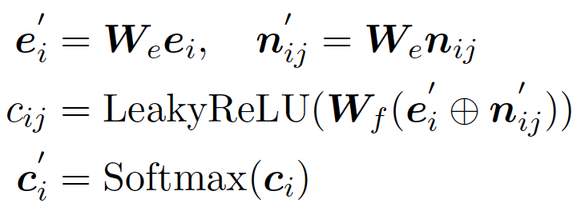
Link Prediction: Graph Structure Encoder
For each entity, perform self-attention (Veliˇckovi´c et al., 2018) and compute a weight distribution over its neighbors:
Knowledge graph structure based context representation:
Perform multi-head attention Ito capture various underlying relationships between each entity and its neighbors:

Slide 45
Link Prediction: Contextual Text Encoder
Each entity e is also associated with a context description sentence
Apply a bi-directional long short-term memory (LSTM) (Graves and Schmidhuber, 2005) network to get the encoder hidden states, then compute a bilinear attention weight for each token of the context sentence:
Gated combination:

Slide 46
Writing Papers for Speeding up Scientific Production
Write a New Paper about New Ideas
Many scientists are, in fact, bad writers (Pinker, 2014):
“I know many scholars who have nothing to hide and no need to impress. They do groundbreaking work on important subjects, reason well about clear ideas, and are honest, down-to-earth people. Still, their writing stinks.”
PaperRobot automatically writes key elements of a new paper

Slide 47
Repetition Removal
Use a coverage loss to avoid any entity in reference input text or related entity receiving attention multiple times
Design a new and simple masking method to remove repetition during the test time
Apply beam search with beam size 4 to generate each output
if a word is not a stop word or punctuation and it is already generated in the previous context, we will not choose it again in the same output

Slide 48
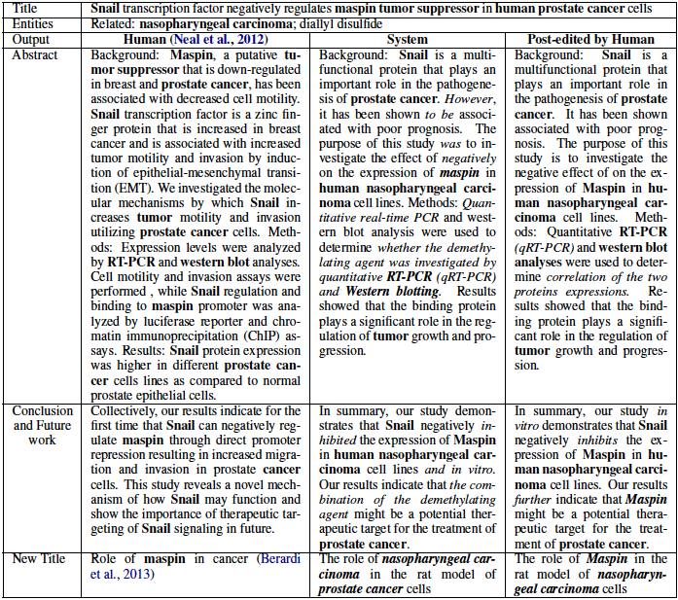
PaperRobot Output Example
It took the domain expert 40 minutes to edit 50 abstracts

Slide 49
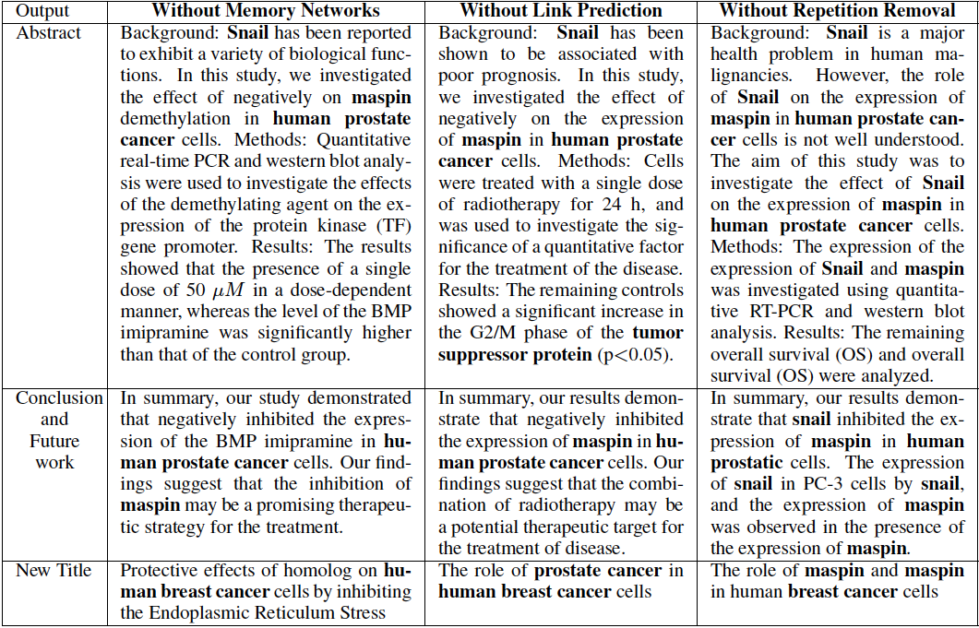
PaperRobot Ablation Test Results

Slide 50
Repetition Removal Example
Before: Background: The aim of this study was to compare the efficacy and safety of pain relief in patients with knee osteOArthritis (OA). Methods: This was a prospective cohort study of patients with knee osteOArthritis (OA). The primary endpoint was the proportion of patients with knee osteOArthritis (OA).
After: Background: The aim of this study was to compare the efficacy and safety of pain in patients with knee osteOArthritis (OA). Methods: This was a prospective, multicentre, multi-center, non-interventional, observational, randomized, controlled trial. The primary endpoint was the proportion of the knee and joint symptom of the physical functioning, and to evaluate the relationship between the two groups. Patients were randomly assigned to receive either a single dose of 0.5 mg twice daily (n = 30) or placebo (500 mg/day) for 52 weeks.

Slide 51
Repetition Removal Example
Before: Background: The aim of this study was to compare the clinical outcome of myocardial infarction (MI) in patients with acute ST segment elevation (MI). Methods: We retrospectively reviewed the clinical records of patients with acute ST segment elevation of acute ST elevation myocardial infarction (MI). Patients with acute ST elevation myocardial infarction (MI), and acute ST elevation myocardial infarction (MI), were included in this study. The primary endpoint was the proportion of patients with acute ST elevation myocardial infarction (MI) and coronary artery disease (CAD).
After: Background The aim of this study was to compare the prevalence of myocardial infarction (MI) in patients with acute ST. Methods : The primary endpoint was the first time of the left anterior descending coronary artery , and to evaluate the clinical utility of Protocol . We performed a retrospective analysis of a prospective, randomized controlled trial. Patients were divided into two groups (n=6). The median follow-up period was defined as the presence of the right ventricle, and the level of cardiac catheterization was evaluated .

Slide 52
Data
Background Knowledge Graph: papers from the PMC Open Access Subset
Paper Writing

Slide 53
Automatic Evaluation Results
Perplexity: How well the language model predicts a word
METEOR: Compute the percentage of overlapped ngrams based on stemming and synonymy matching

Slide 54
Turing Test
Human Subject Passing Rates (%) = Percentages show how often a human judge chooses our system’s output over human’s when it is mixed with a human-authored string
If the output strings (e.g., abstracts) are based on the same input string (e.g., title), the Input condition is marked “Same”, otherwise “Different”

Slide 55
Which Abstract is Written by PaperRobot?
A. Background The aim of the present study was to investigate the effect of Cnidium Lactone on the expression of Mutant and histone deacetylase ( HDAC ) inhibitors in human prostate cancer ( PC ) . Material/Methods We evaluated the effects of Prostate Cancer on cell proliferation and invasion in vitro and in vivo . Cells were incubated with a single dose of 25 ( 50 mg/kg ) , and 10 ( 100 mg/kg/day ) , respectively . The primary endpoint was the ability of the mRNA and protein levels of transcription factor ( VEGF ) .
B. Background Cnidium Lactone is a natural coumarin compound that can inhibit a variety of cancer cell proliferation and induce cancer cell apoptosis . This experiment investigated the effect of cnidium Lactone on molecular marker expression in prostate cancer nude mice to study its effect in inducing apoptosis . Material/Methods We randomly and equally divided 30 male BALB/C nude mice inoculated with human prostate cancer cells PC-3 into a negative control group , a cyclophosphamide group ( 500 mg/Kg ) , and cnidium Lactone groups at 3 doses ( 280 mg/Kg , 140 mg/Kg , and 70 mg/Kg ) . The mice were weighed at 2 weeks after administration .

Slide 56
Which Abstract is Written by PaperRobot?
A. The use of nanoparticles in medicine is an attractive proposition . In the present study , Zinc oxide and silver nanoparticles were evaluated for their antidiabetic activity . Fifty male albino rats with weight 120 ± 20 and age 6 months were used . Animals were grouped as follows : control ; did not receive any type of treatment , diabetic ; received a single intraperitoneal dose of streptozotocin ( 100 mg/kg ) , diabetic + Zinc oxide nanoparticles ( ZnONPs ) , received single daily oral dose of 10 mg/kg ZnONPs in suspension , diabetic + silver nanoparticles ( SNPs ) ; received a single daily oral dose of SNP of 10 mg/kg in suspension and diabetic + insulin ; received a single subcutaneous dose of 0.6 units/50 g body.
B. Rationale : Aliskiren is a rare disease characterized by a variety of hypertensive disorders . The aim of the present study was to evaluate the effectiveness of aliskiren , pharmacodynamics , and clinical outcomes in patients with hypertension . Methods We reviewed the medical records of ambulatory blood pressure ( BP ) , kinetics , and high-sensitivity C-reactive protein ( CRP ) levels in the treatment of corneal tissue . We performed a retrospective review of the English literature search of PubMed , EMBASE , and Cochrane Library databases . The primary outcome was established by using a scoring system.

Slide 57
Which Conclusion is Written by PaperRobot?
A. In summary , the present study demonstrated that BBR could suppress tubulointerstitial fibrosis in NRK 52E cells . In addition , the effects of action on the EMT and HG of DN in the liver cell lines , and the inhibition of renal function may be a potential therapeutic agent for the treatment of diabetic mice . Further studies are needed to elucidate the mechanisms underlying the mechanism of these drugs in the future .
B. We characterised KGN cells as a malignant tumour model of GCTs . Continuously cultivated KGN cells acquire an aggressive phenotype , confirmed by the analysis of cellular activities and the expression of biomarkers . More strikingly , KGN cells injected under the skin were metastatic with nodule formation occurring mostly in the bowel . Thus , this cell line is a good model for analysing GCT progression and the mechanisms of metastasis.

Slide 58
Which Conclusion is Written by PaperRobot?
A. In reproductive-age women with ovarian endometriosis , the transcriptional factor SOX2 and NANOG are over expression . Future studies is need to determine their role in pathogenesis of ovarian endometriosis.
B. In summary , the present study demonstrated that Hydrogen alleviates neuronal apoptosis in SAH rats . These results suggest that the Akt/GSK3β signaling pathway may be a novel therapeutic target for the treatment of EBI .

Slide 59
Which Conclusion is Written by PaperRobot?
A. Our novel data strongly suggest that BMP-2 signaling modulates SOST transcription in OA through changes in Smad 1/5/8 binding affinity to the CpG region located upstream of the TSS in the SOST gene , pointing towards the involvement of DNA methylation in SOST expression in OA.
B. In conclusion , the present study demonstrated that DNA methylation and BMP-2 expression was associated with a higher risk of developing Wnt/β-catenin pathway in OA chondrocytes . These results suggest that the SOST of Wnt signaling pathways may be a potential target for the treatment of disease .

Slide 60
Which Conclusion is Written by PaperRobot?
A. VWF is an autocrine/paracrine effector of signal transduction and gene expression in ECs that regulates EC adhesiveness for MSCs via activation of p38 MAPK in ECs.
B. In conclusion , our study demonstrated that HOTAIR transcript expression in NSCLC cells. These results suggest that the overexpression of metastasis may play a role in regulating tumor progression and invasion. Further studies are needed to elucidate the molecular mechanisms involved in the development of cancer.

Slide 61
Which Title is Written by PaperRobot?
A. The role of cancer stem cells to trastuzumab-based and breast cancer cell proliferation, migration, and invasion
B. Long-term supplementation of decaffeinated green tea extract does not modify body weight or abdominal obesity in a randomized trial of men at high risk for Prostate cancer

Slide 62
Which Title is Written by PaperRobot?
A. Efficacy and Safety of Artesunate in the Treatment of Uncomplicated Malaria: a Systematic Review and Meta-analysis
B. Low RBM3 Protein Expression Correlates with Clinical Stage, PrognOStic Classification and Increased Risk of Treatment Failure in Testicular Non-Seminomatous Germ Cell Cancer

Slide 63
Remaining Challenges: Human output is usually more vivid
Human: “ Does HPV play any role in the initiation or prognosis of endometrial adenocarcinomas ? ”
System: “ The role of HPV in the treatment of endometrial adenocarcinomas”

Slide 64
Remaining Challenges: Human output is usually more concrete
Human written title:
“etumorType , An Algorithm of Discriminating Cancer Types for Circulating Tumor Cells or Cell-free DNAs in Blood” create new entity abbreviations such as etumorType in this example
System written title:
Gastrointestinal Stromal tumor initiation : A Review of the Literature .

Slide 65
Did it Work for NLP?
(Fortunately) we are still not publishing enough…
The language model is not able to effectively copy out-of-vocabulary words and thus the output is often too generic
Title: Statistics based hybrid approach to Chinese base phrase identification
Abstract: This paper describes a novel approach to the task of Chinese-base-phrase identification. We first utilize the solid foundation for the Chinese parser, and we show that our tool can be easily extended to meet the needs of the sentence structure.
The types of entities and relations in the NLP domain are rather coarse-grained, which often leads to inaccurate prediction of related entities
Title: Extracting molecular binding relationships from biomedical text
Abstract: In this paper, we present a novel approach to the problem of extracting relationships among the prolog program. We present a system that uses a macromolecular binding relationships to extract the relationships between the abstracts of the entry. The results show that the system is able to extract the most important concepts in the prolog program.

Slide 66
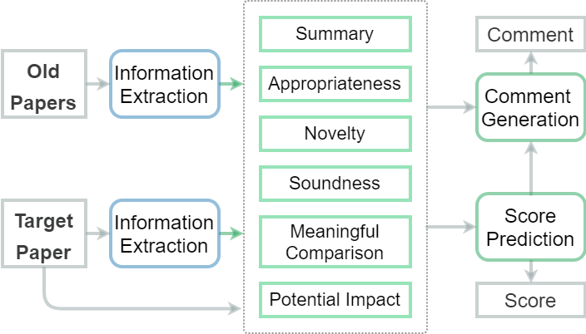
ReviewRobot Overview [Wang et al., INLG2020]
How do humans review a paper?
Have sufficient background knowledge about the topic
Understand knowledge of the current paper
Compare the current paper with previous paper
Give score and review comments for each review category
Can machine repeat such a process?
Build large-scale background KG from previous papers
Construct KG for related work section and other sections
Extract evidence based on the difference of KGs and corresponding paper sentences
Predict category scores and corresponding review comments based on the extracted evidence

Slide 67
Dataset Construction
Based on PeerRead^{[1]}, we further collect additional paper-review pairs from Openreview and NeurIPS
We construct the background KG from 174,165 papers from the open research corpus^{[2]} using Science IE system [Luan et al., EMNLP2018]
Conference | Year
 | 2013 | 2014 | 2015 | 2016 | 2017 | 2018 | 2019 | 2020
ICLR | - | - | - | - | 404 | 874 | 1,342 | 2,067
NeurIPS | 342 | 399 | 389 | 545 | 655 | 963 | - | -
ACL | - | - | - | - | 130 | - | - | -
Years (1965~) | 2011 | 2012 | 2013 | 2014 | 2015 | 2016 | 2017 | 2018 | 2019
# of Entities | 535,075 | 585,321 | 628,713 | 683,686 | 737,878 | 801,740 | 870,992 | 950,457 | 1,008,955
# of Relations | 160,123 | 175,780 | 188,876 | 205,898 | 222,592 | 242,312 | 263,827 | 288,805 | 307,636
[1] Kang, D., Ammar, W., Dalvi, B., van Zuylen, M., Kohlmeier, S., Hovy, E., & Schwartz, R. (2018). A Dataset of Peer Reviews (PeerRead): Collection, Insights and NLP Applications. In Proceedings of the 2018 Conference of the North American Chapter of the Association for Computational Linguistics: Human Language Technologies, Volume 1 (Long Papers) (pp. 1647–1661).
[2] Ammar, W., Groeneveld, D., Bhagavatula, C., Beltagy, I., Crawford, M., Downey, D., … Etzioni, O. (2018). Construction of the Literature Graph in Semantic Scholar. In Proceedings of the 2018 Conference of the North American Chapter of the Association for Computational Linguistics: Human Language Technologies, Volume 3 (Industry Papers) (pp. 84–91).

Slide 68
Review Category
We adopt the following most common categories from NeurIPS2019^{[1]} and PeerRead^{[2]}:
Summary: What is this paper about?
Appropriateness: Does the paper fit in the venue?
Clarity: Is it clear what was done and why? Is the paper well-written and well-structured?
Novelty: Does this paper break new ground in topic, methodology, or content? How exciting and innovative is the research it describes?
Soundness: Can one trust the empirical claims of the paper -- are they supported by proper experiments and are the results of the experiments correctly interpreted?
Meaningful Comparison: Do the authors make clear where the problems and methods sit with respect to existing literature? Are the references adequate?
Potential Impact: How significant is the work described? If the ideas are novel, will they also be useful or inspirational? Does the paper bring any new insights into the nature of the problem?
[1] https://nips.cc/Conferences/2019/PaperInformation/ReviewerGuidelines
[2] Kang, D., Ammar, W., Dalvi, B., van Zuylen, M., Kohlmeier, S., Hovy, E., & Schwartz, R. (2018). A Dataset of Peer Reviews (PeerRead): Collection, Insights and NLP Applications. In Proceedings of the 2018 Conference of the North American Chapter of the Association for Computational Linguistics: Human Language Technologies, Volume 1 (Long Papers) (pp. 1647–1661).

Slide 69
Category Annotation
We manually annotate 200 paper-review pairs from ACL2017 and ICIR2017 datasets to select those constructive and informative human review sentences that are supported by certain evidence in the papers.
Category | # of Pairs | Evidence Sentence in Paper | Corresponding Review Sentence
Summary | 236 | In this paper, we present a simple but novel model called attention-over-attention reader for better solving cloze-style reading comprehension task. | The paper describes a new method called attention-over-attention for reading comprehension.
Novelty | 33 | The paper presents a new framework to solve the SR problem - amortized MAP inference and adopts a pre-learned affine projection layer to ensure the output is consistent with LR. | It introduces a novel neural network architecture that performs a projection to the affine subspace of valid SR solutions ensuring that the high resolution output of the network is always consistent with the low resolution input.
Soundness | 174 | In high dimensions we empirically found that the GAN based approach, AffGAN produced the most visually appealing results. | Combined with GAN, this framework can obtain plausible and good results.
Meaningful Comparison | 16 | As a concrete instantiation, we show in this paper that we can enable recursive neural programs in the NPI model, and thus enable perfectly generalizable neural programs for tasks such as sorting where the original, non-recursive NPI program fails. | This paper improves significantly upon the original NPI work, showing that the model generalizes far better when trained on traces in recursive form.
Potential Impact | 14 | Since there may be several rounds of questioning and reasoning, these requirements bring the problem closer to task-oriented dialog and represent a significant increase in the difficulty of the challenge over the original bAbI (supporting fact) problems. | I am a bit worried that the tasks may be too easy (as the bAbI tasks have been), but still, I think locally these will be useful.

Slide 70
Knowledge Graph Construction
Given the target paper under review , we first construct the following knowledge graphs using a state-of-the-art Information Extraction (IE) system for Natural Language Processing (NLP) and Machine Learning (ML) domains:
: A KG constructed from the abstract and conclusion sections of a target paper , which describes the main techniques
: A KG constructed from the related work section of , which describes related techniques.
: A background KG constructed from all of the old NLP/ML papers published before the publication year of , in order to teach ReviewRobot what’s happening in the field.
[1] Luan, Y., He, L., Ostendorf, M., & Hajishirzi, H. (2018). Multi-Task Identification of Entities, Relations, and Coreference for Scientific Knowledge Graph Construction. In Proceedings the 2018 Conference on Empirical Methods in Natural Language Processing, Volume 1 (Long Papers) (pp. 3219–3232).

Slide 71
Knowledge Graph Construction
[1] Bahdanau, D., Cho, K., & Bengio, Y. (2015). Neural machine translation by jointly learning to align and translate. In Proceedings of the 5th International Conference on Learning Representations.

Slide 72
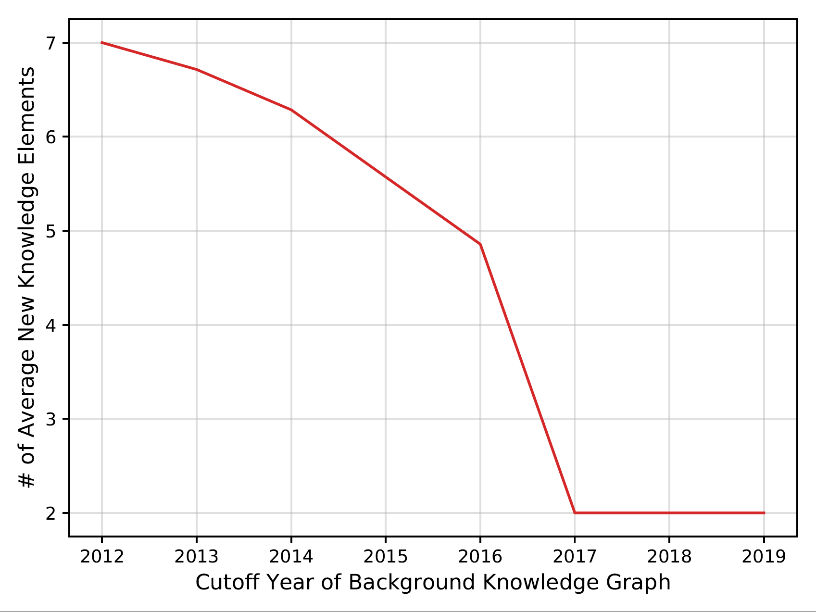
Knowledge Graph Construction
The average number of new knowledge elements in ACL2017 test papers given the background KG constructed from (1965∼cutoff year)

Slide 73
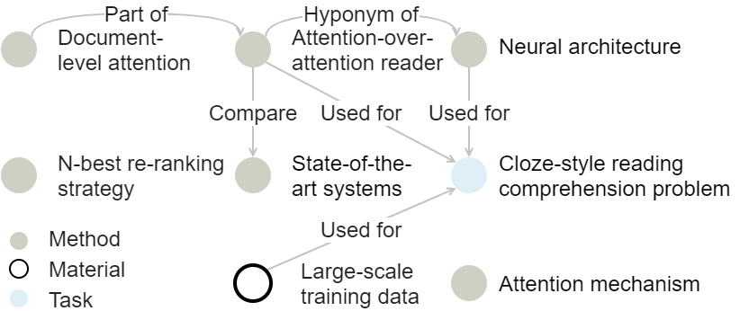
Evidence Extraction for an Example Paper^{[1]}
Category | Evidence | Example
Summary
Appropriateness | The number of entities overlapped between the target paper and the domain’s background KG: Abstract
Novelty | New knowledge elements that appear in the target paper but not in the background KG: Paper sentences that contain new knowledge elements
[1] Cui, Y., Chen, Z., Wei, S., Wang, S., Liu, T., & Hu, G. (2017). Attention-over-Attention Neural Networks for Reading Comprehension. In Proceedings of the 55th Annual Meeting of the Association for Computational Linguistics (Volume 1: Long Papers) (pp. 593–602).

Slide 74
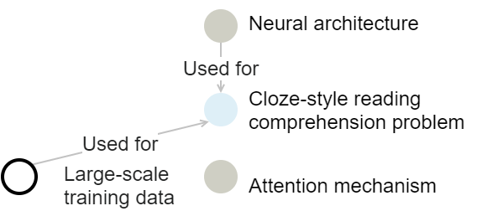
Evidence Extraction for an Example Paper^{[1]}
Category | Evidence | Example
Soundness | The number of knowledge elements that appear in the contribution claims in the introduction section and that are verified in the experiment section Abstract | attention-over-attention reader, n-best re-ranking, strategy is verified in the related work section
Meaningful Comparison | The number of papers about relevant knowledge elements which are missed in the related work section: The number of papers about relevant knowledge elements which are claimed new in the related work section: The description sentences about comparison with related work If the related work section is not available, we use the difference between and instead | [2],[3]
[1] Cui, Y., Chen, Z., Wei, S., Wang, S., Liu, T., & Hu, G. (2017). Attention-over-Attention Neural Networks for Reading Comprehension. In Proceedings of the 55th Annual Meeting of the Association for Computational Linguistics (Volume 1: Long Papers) (pp. 593–602).
[2] Bahdanau, D., Cho, K., & Bengio, Y. (2015). Neural machine translation by jointly learning to align and translate. In Proceedings of the 5th International Conference on Learning Representations.
[3] Hermann, K. M., Kocisky, T., Grefenstette, E., Espeholt, L., Kay, W., Suleyman, M., & Blunsom, P. (2015). Teaching machines to read and comprehend. In Advances in neural information processing systems28 (pp. 1693–1701).

Slide 75
Evidence Extraction for an Example Paper^{[1]}
Category | Evidence | Example
Potential Impact | The number of new knowledge elements in the future work section The number of new software, systems, data sets, and other resources | 5 new knowledge elements 1 new architecture
Overall Recommendations | All features mentioned in the above categories Abstract
[1] Cui, Y., Chen, Z., Wei, S., Wang, S., Liu, T., & Hu, G. (2017). Attention-over-Attention Neural Networks for Reading Comprehension. In Proceedings of the 55th Annual Meeting of the Association for Computational Linguistics (Volume 1: Long Papers) (pp. 593–602).

Slide 76
Score Prediction
We first encode its category related sentences with an attentional Gated Recurrent Unit (GRU)^{[1]} to obtain attentional contextual sentence embedding.
We also encode the extracted evidence for each review category with an embedding layer.
Then we concatenate the context embedding and evidence embedding to predict the quality score r in the range of 1 to 5 with a linear output layer. We use the prediction probability as the confidence score.
[1] Bahdanau, D., Cho, K., & Bengio, Y. (2015). Neural machine translation by jointly learning to align and translate. In Proceedings of the 5th International Conference on Learning Representations.

Slide 77
Comment Generation
For appropriateness, soundness, and potential impact categories, we generate generic positive or negative comments based on the predicted scores.
For summary, novelty, and meaningful comparison categories, we consider review generation as a template-based graph-to-text generation task.
Specifically, for summary and novelty, we generate reviews by describing the Used-for, Feature-of, Compare and Evaluate-for relations in evidence graphs. We choose positive or negative templates depending on whether the predicted scores are above 3. We use the predicted overall recommendation score to control summary generation. For related work, we keep the knowledge elements in the evidence graph with a TF-IDF score ^{[1]} higher than 0.5. For each knowledge element, we recommend the most recent 5 papers that are not cited as related papers.
[1] Jones, K. S. (1972). A statistical interpretation of term specificity and its application in retrieval. Journal of Documentation.

Slide 78
Score Prediction Accuracy

Slide 79
Decision Accuracy

Slide 80
Mean Square Error

Slide 81
Comment Generation Performance
For the system generated review comments for 50 ACL2017 papers, we ask domain experts to check whether each comment is constructive and valid.
Two researchers independently annotate the reviews and reach the inter-annotator agreement of 92%, 92%, and 82% for Novelty, Summary and Related Work, respectively. One expert annotator performs data adjudication.
The percentages of constructive and valid comments are 70.5%, 44.6% and 41.7% for Summary, Novelty and Meaningful Comparison, respectively. Human assessors also find that for 20% of these papers, human reviewers do not suggest missing related work for Meaningful Comparison, while ReviewRobot generates constructive and informative comments. For example, the human reviewer ^{[1]} states “The paper would be stronger with the inclusion of more baselines based on related work”, but fails to provide any useful references.
[1] 7Review for Improved word representation learning with sememes. https://github.com/allenai/PeerRead/blob/master/data/acl_2017/train/reviews/318.json

Slide 82
System Generated Review for an Example Paper ^{[1]}
Summary
[SYSTEM]: The paper proposes novel skip-gram, attention scheme, sememe-encoded models and word representation learning for NLP tasks. The authors uses linguistic common-sense knowledge bases.
[HUMAN] This paper proposes the use of HowNet to enrich embeddings.
Novelty
[SYSTEM] The paper proposes novel attention scheme and sememe-encoded models.
[HUMAN] I see the main contribution of the work to be the results which show that we can learn better word representations (unsure about wsi) by modeling sememe information than other competitive baselines.
[1] Niu, Y., Xie, R., Liu, Z., & Sun, M. (2017). Improved Word Representation Learning with Sememes. In Proceedings of the 55th Annual Meeting of the Association for Computational Linguistics (Volume 1: Long Papers) (pp. 2049–2058).

Slide 83
System Generated Review for an Example Paper ^{[1]}
Meaningful Comparison
[SYSTEM] The following related papers are missing:
About low-dimensional semantic space:
Unsupervised Approximate-semantic Vocabulary Learning for Human Action and Video Classification: Qiong Zhao and Horace HS Ip. 2013. Unsupervised Approximate-semantic Vocabulary Learning for Human Action and Video Classification. Pattern Recognition Letters, 34(15):1870–1878.
About sememes:
Chinese Word Sense Disambiguation with PageRank and HowNet: Jinghua Wang, Jianyi Liu, and Ping Zhang. 2008. Chinese Word Sense Disambiguation with PageRank and HowNet. In Proceedings of the Sixth SIGHAN Workshop on Chinese Language Processing.
A Maximum Entropy Approach to HowNet-based Chinese Word Sense Disambiguation: Ping Wai Wong and Yongsheng Yang. 2002. A Maximum Entropy Approach to HowNet-based Chinese Word Sense Disambiguation. In COLING-02: SEMANET: Building and Using Semantic Networks.
About word similarity and word analogy:
Open IE as an Intermediate Structure for Semantic Tasks: Gabriel Stanovsky, Ido Dagan, et al. 2015. Open IE as an Intermediate Structure for Semantic Tasks. In Proceedings of the 53rd Annual Meeting of the Association for Computational Linguistics and the 7th International Joint Conference on Natural Language Processing (Volume 2: Short Papers), pages 303–308.
[HUMAN] The paper would be stronger with the inclusion of more baselines based on related work.
[1] Niu, Y., Xie, R., Liu, Z., & Sun, M. (2017). Improved Word Representation Learning with Sememes. In Proceedings of the 55th Annual Meeting of the Association for Computational Linguistics (Volume 1: Long Papers) (pp. 2049–2058).

Slide 84
Remaining challenges
The quality of ReviewRobot is mainly limited by state-of-the-art Information Extraction performance for the scientific literature domain.
“Japanese short-answer scoring and support machine” cannot be recognized by the IE system
Paper review generation requires background knowledge acquisition and comparison with the target paper content.
Given the following two sentences in a paper: “Third, at least 93% of time expressions contain at least one time token.”, and “For the relaxed match on all three datasets , SynTime-I and SynTime-E achieve recalls above 92%.”, the ReviewRobot cannot understand “93%” is the upper bound of the model performance.
ReviewRobot cannot generalize knowledge elements into high-level comments such as “deterministic” as in “The tasks 1-5 are also completely deterministic”.
ReviewRobot still lacks of deep knowledge reasoning ability to judge the soundness of algorithm design details, such as whether the split of data set makes sense, whether a model is able to generalize.
ReviewRobot is not able to comment on missing hypotheses, the problems on experimental setting and future work.
ReviewRobot currently focuses on text only and cannot comment on mathematical formulas, tables and figures.
Notes:
Add examples

