Slide 1
Neural Language Modeling
Heng Ji (UIUC)
hengji@illinois.edu

Slide 2
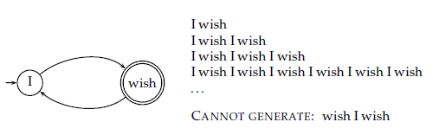
Language Models (LMs)
Generative Model:
  Recognize or generate strings.
  The full set of strings that can be generated is called the language of the automaton.
Language Model:
  A function that puts a probability measure over strings drawn from some vocabulary.

Slide 3
Language Models (LMs)
Example 1:
  Calculate the probability of a word sequence.
    Multiply the probabilities that the model gives to each word in the sequence, together with the probability of continuing or stopping after producing each word.
    P(frog said that toad likes frog)=(0.01*0.03*0.04*0.01*0.02*0.01)
    *(0.8*0.8*0.8*0.8*0.8*0.8*0.2)
    =0.000000000001573
  Most of the time, we will omit to include STOP and (1-STOP) probabilities.

Slide 4


Language Models (LMs)
Basic LM using chain rule:
Unigram language model:
  Throws away all conditioning context.
  Most used in Information Retrieval.
Bigram language model:
  Condition on the previous term or short local history (“Markov Assumption”)

Slide 5
Learning probabilistic language models
Learn joint likelihood of training sentences
under (n-1)^{th} order Markov assumption
using n-grams
Maximize the log-likelihood:
  Assuming a parametric model θ
Could we take advantage of higher-order history?
target word
word history

Slide 6
Evaluating language models: perplexity
How well can we predict next word?
  A random predictor would give each word probability 1/V
  where V is the size of the vocabulary
  A better model of a text should assign a higher probability
  to the word that actually occurs
Perplexity: lower better! Lower means better generalization capability
mushrooms 0.1
pepperoni 0.1
anchovies 0.01
….
fried rice 0.0001
….
and 1e-100
I always order pizza with cheese and ____
The 33rd President of the US was ____
I saw a ____

Slide 7






Limitations of n-grams
Conditional likelihood of seeing a sub-sequence of length n in available training data
Limitation: discrete model (each word is a token)
  Incomplete coverage of the training dataset
  Vocabulary of size V words: V^{n} possible n-grams (exponential in n)
  Semantic similarity between word tokens is not exploited
the
cat
sat
on
the
mat
the
cat
sat
on
the
hat
the
cat
sat
on
the
sat
my
cat
sat
on
the
mat
the
cat
sat
on
the
rug

Slide 8
Workarounds for n-grams
Smoothing
  Adding non-zero offset to probabilities of unseen words
  Example: Kneyser-Ney smoothing
Back-off
  No such trigram? try bigrams…
  No such bigram? try unigrams…
Interpolation
  Mix unigram, bigram, trigram, etc…

Slide 9
Continuous Space Language Models
Word tokens mapped to vectors in a low-dimensional space
Conditional word probabilities replaced by normalized dynamical models
on vectors of word embeddings
Vector-space representation enables semantic/syntactic similarity between words/sentences
  Use cosine similarity as semantic word similarity
  Find nearest neighbours: synonyms, antonyms
  Algebra on words: {king} – {man} + {woman} = {queen}?

Slide 10
Vector-space representation of words
“One-hot” of “one-of-V”
representation
of a word token at position t
in the text corpus,
with vocabulary of size V
1
Vector-space representation
of the prediction
of target word w_{t}
(we predict a vector of size D)
ẑ_{t}
v
V
z_{t-1}
Vector-space representation
of any word v
in the vocabulary
using a vector of dimension D
Also called
distributed representation
z_{v}
1
Vector-space representation
of the t^{th} word history:
e.g., concatenation
of n-1 vectors of size D
z_{t-2}
D
z_{t-1}

Slide 11
Learning continuous space language models
Input:
  word history (one-hot or distributed representation)
Output:
  target word (one-hot or distributed representation)
Function that approximates word likelihood:
  Linear transform
  Feed-forward neural network
  Recurrent neural network
  Continuous bag-of-words
  Skip-gram
  …

Slide 12
Learning neural language models
Maximize the log-likelihood of observed data, w.r.t. parameters θ of the neural language model
Parameters θ (in a neural language model):
  Word embedding matrix R and bias b_{v}
  Neural weights: A, b_{A}, B, b_{B}
Gradient descent with learning rate η:

Slide 13
Learning neural language models
Randomly choose a mini-batch
(e.g., 1000 consecutive words)
Forward-propagate
through word embeddings
and through model
Estimate word likelihood (loss)
Back-propagate loss
Gradient step to update model

Slide 14
Limitations of these neural language models
Computationally expensive to train
  Bottleneck: need to evaluate probability of each word
  over the entire vocabulary
  Very slow training time (days, weeks)
Ignores long-range dependencies
  Fixed time windows
  Continuous version of n-grams

Slide 15
Recurrent Neural Net (RNN) language model
Time-delay
1-layer
neural network
with D output units
word embedding
space ℜ^{D}
in dimension
D=30 to 250
z_{t-1}
z_{t}
W
h
Word embedding matrix
U
V
o
discrete word space {1, ..., M}
M>100k words
Handles longer word history
(~10 words) as well
as 10-gram feed-forward NNLM
Training algorithm: BPTT
Back-Propagation Through Time
wt-5
wt-4
wt-3
wt-2
wt-1
wt
the
cat
sat
on
the
mat
Complexity: D×D + D×D + D×V
[Mikolov et al, 2010, 2011]

Slide 16
Context-dependent RNN language model
Time-delay
1-layer
neural network
with D output units
word embedding
space ℜ^{D}
in dimension D=200
z_{t-1}
h
z_{t}
W
F
sentence or
document
topic
(K=40 topics)
U
V
f
G
o
discrete word space {1, ..., M}
M>100k words
Compute topic
model representation
word-by-word on last 50 words
using approximate LDA
[Blei et al, 2003]
with K topics.
Enables to model long-range
dependencies at sentence level.
wt-5
wt-4
wt-3
wt-2
wt-1
wt
the
cat
sat
on
the
mat
[Mikolov & Zweig, 2012]

Slide 17
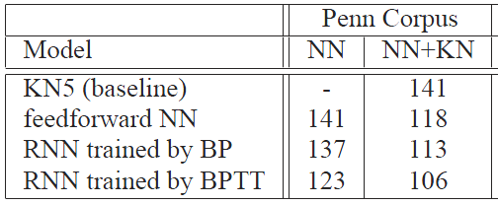
Perplexity of RNN language models
Model | Test ppx
Kneyser-Ney back-off 5-grams | 123.3
Nonlinear LBL (100d) [Mnih & Hinton, 2009, using our implementation] | 104.4
NLBL (100d) + 5 topics LDA [Mirowski, 2010, using our implementation] | 98.5
RNN (200d) + 40 topics LDA [Mikolov & Zweig, 2012, using RNN toolbox] | 86.9
Penn TreeBank
V=10k vocabulary
Train on 900k words
Validate on 80k words
Test on 80k words
AP News
V=17k vocabulary
Train on 14M words
Validate on 1M words
Test on 1M words
[Mirowski, 2010; Mikolov & Zweig, 2012;
RNN toolbox: http://research.microsoft.com/en-us/projects/rnn/default.aspx]

Slide 18
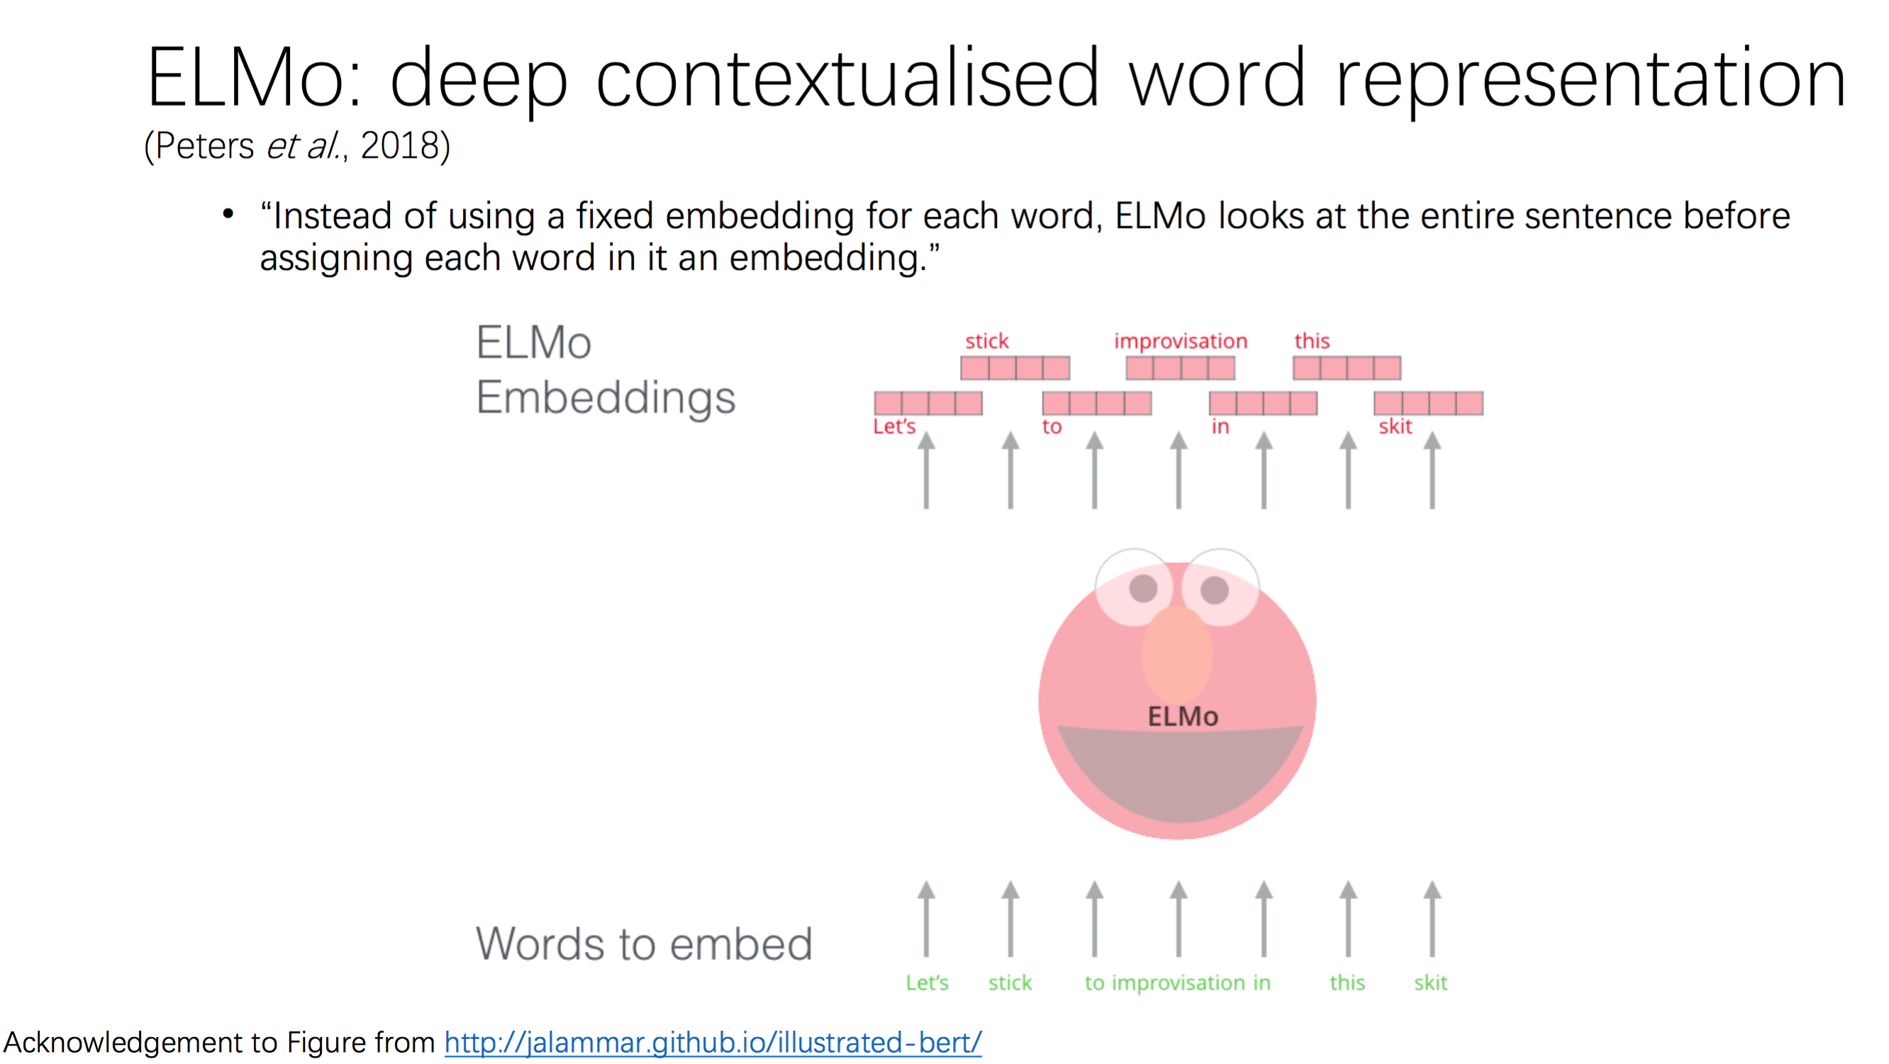

Slide 19
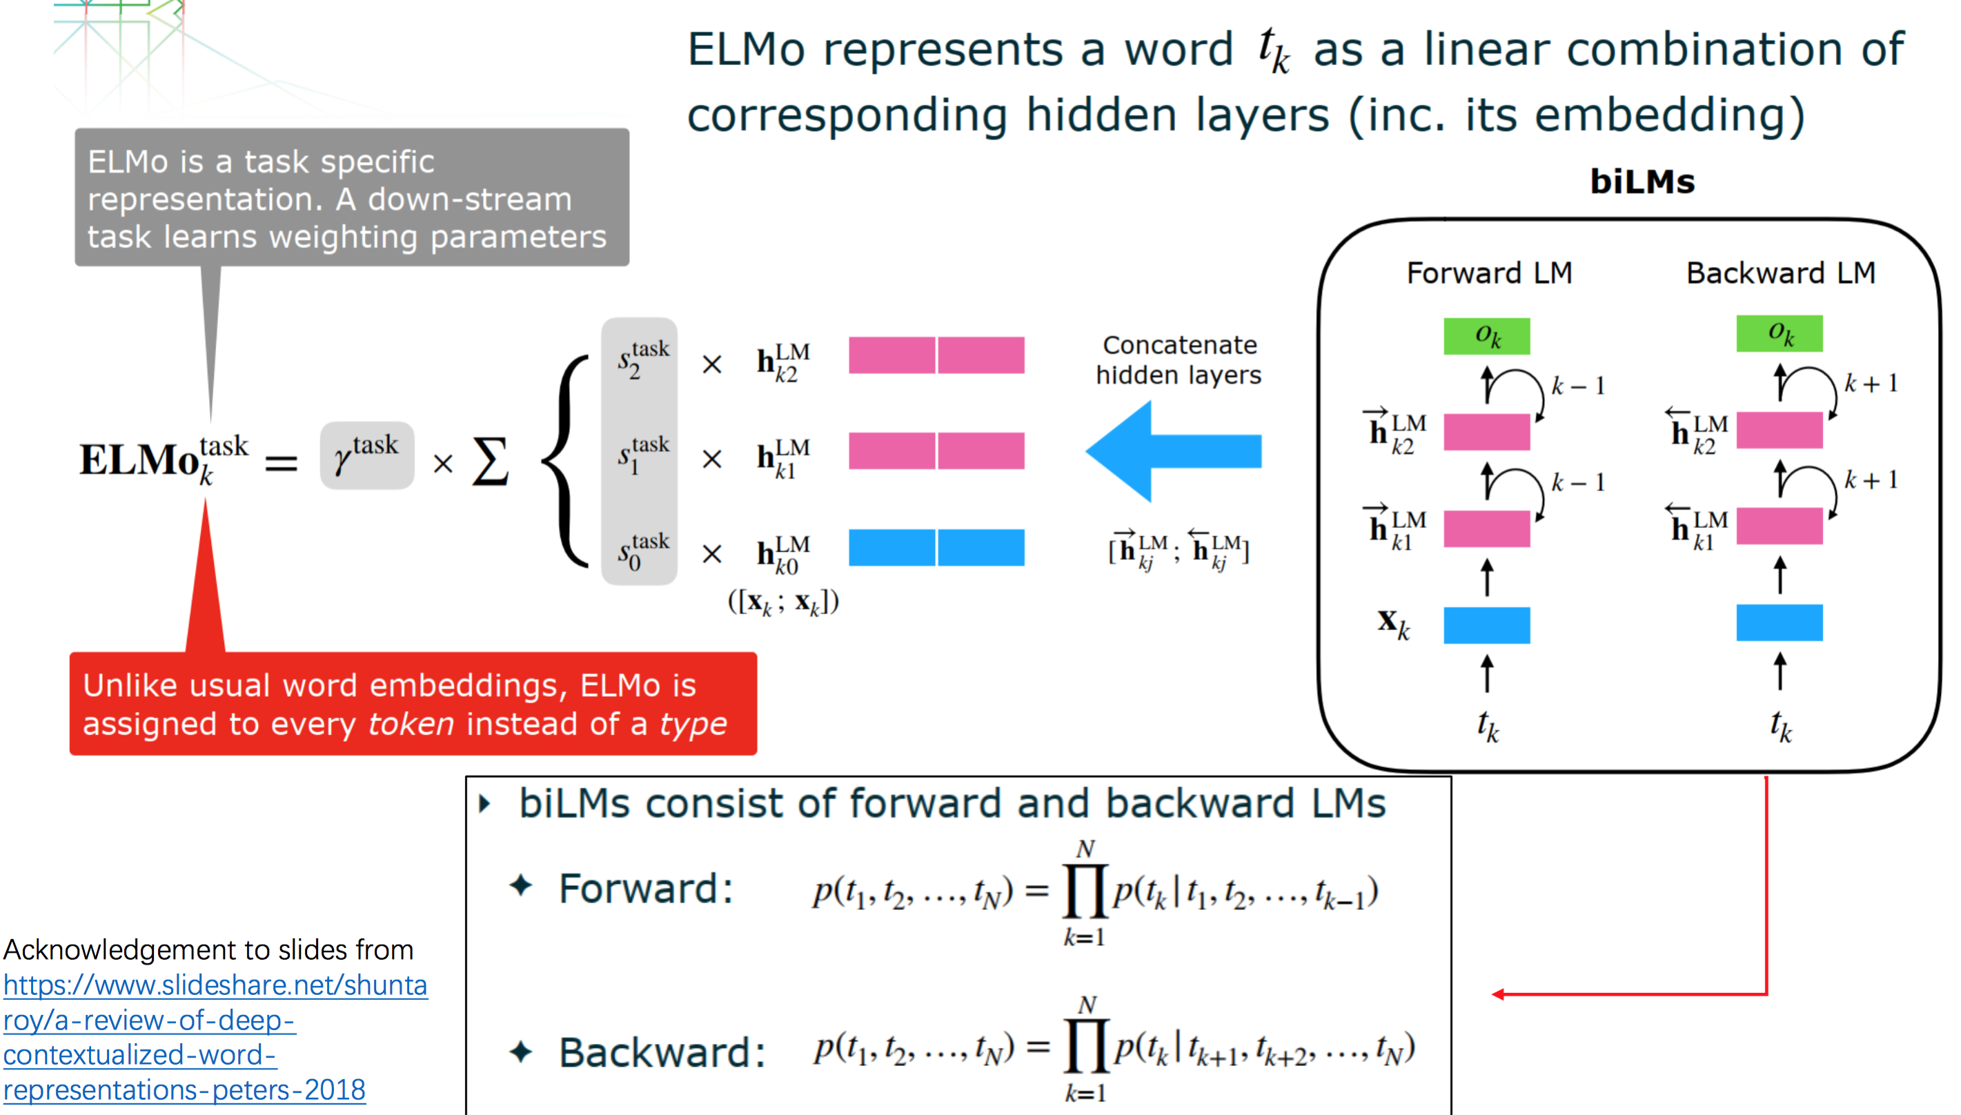

Slide 20
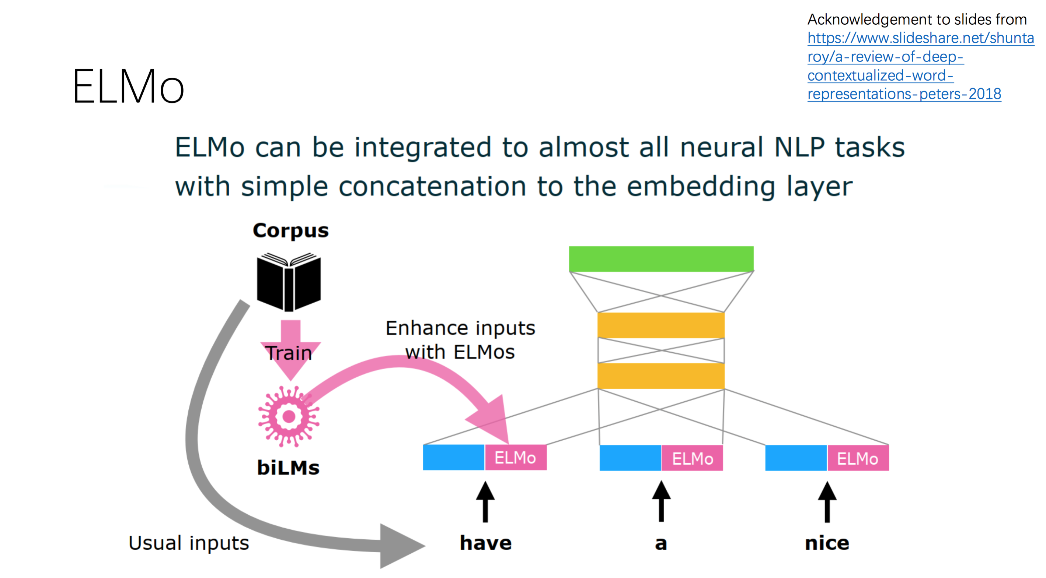

Slide 21
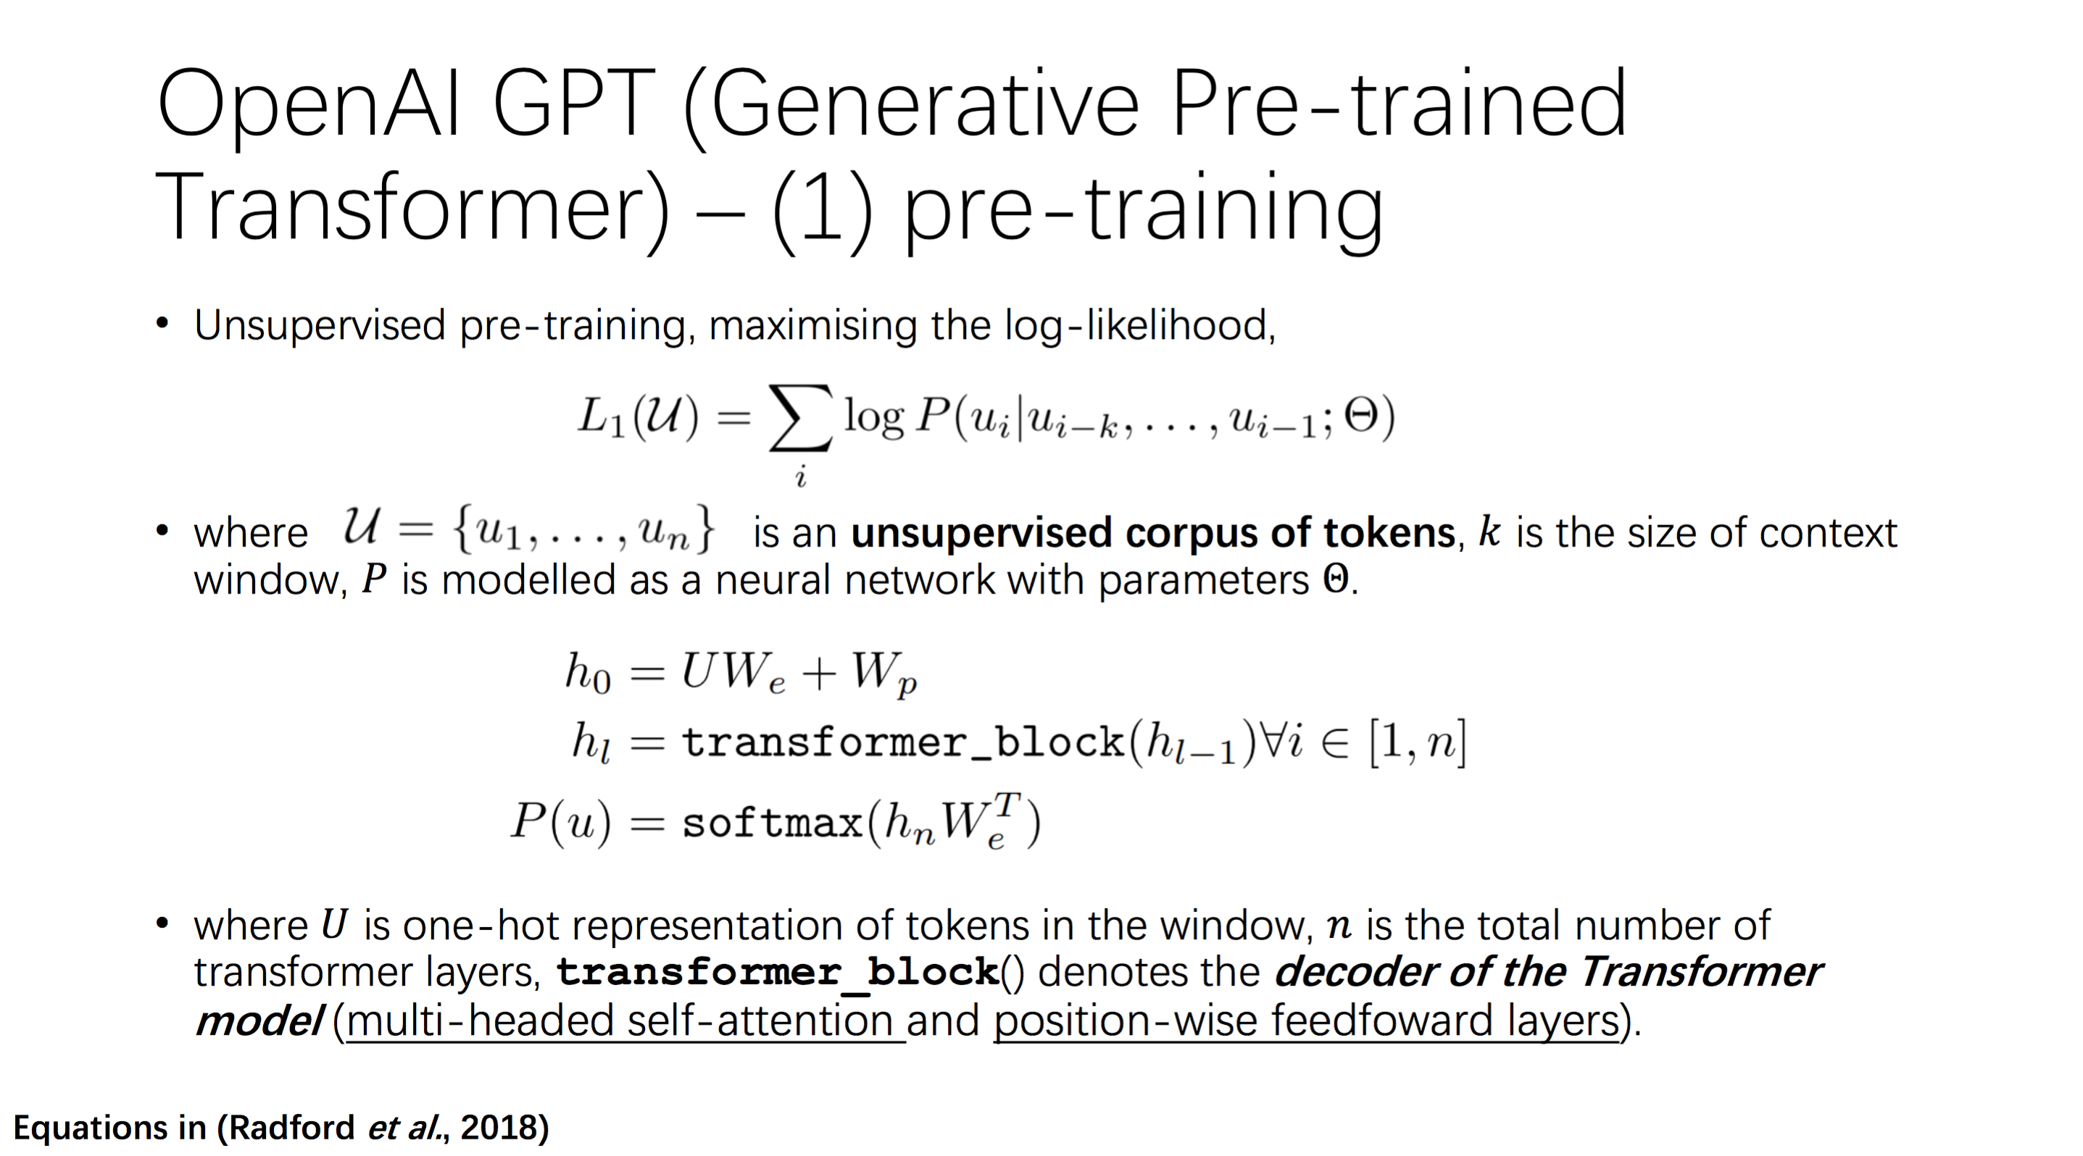

Slide 22
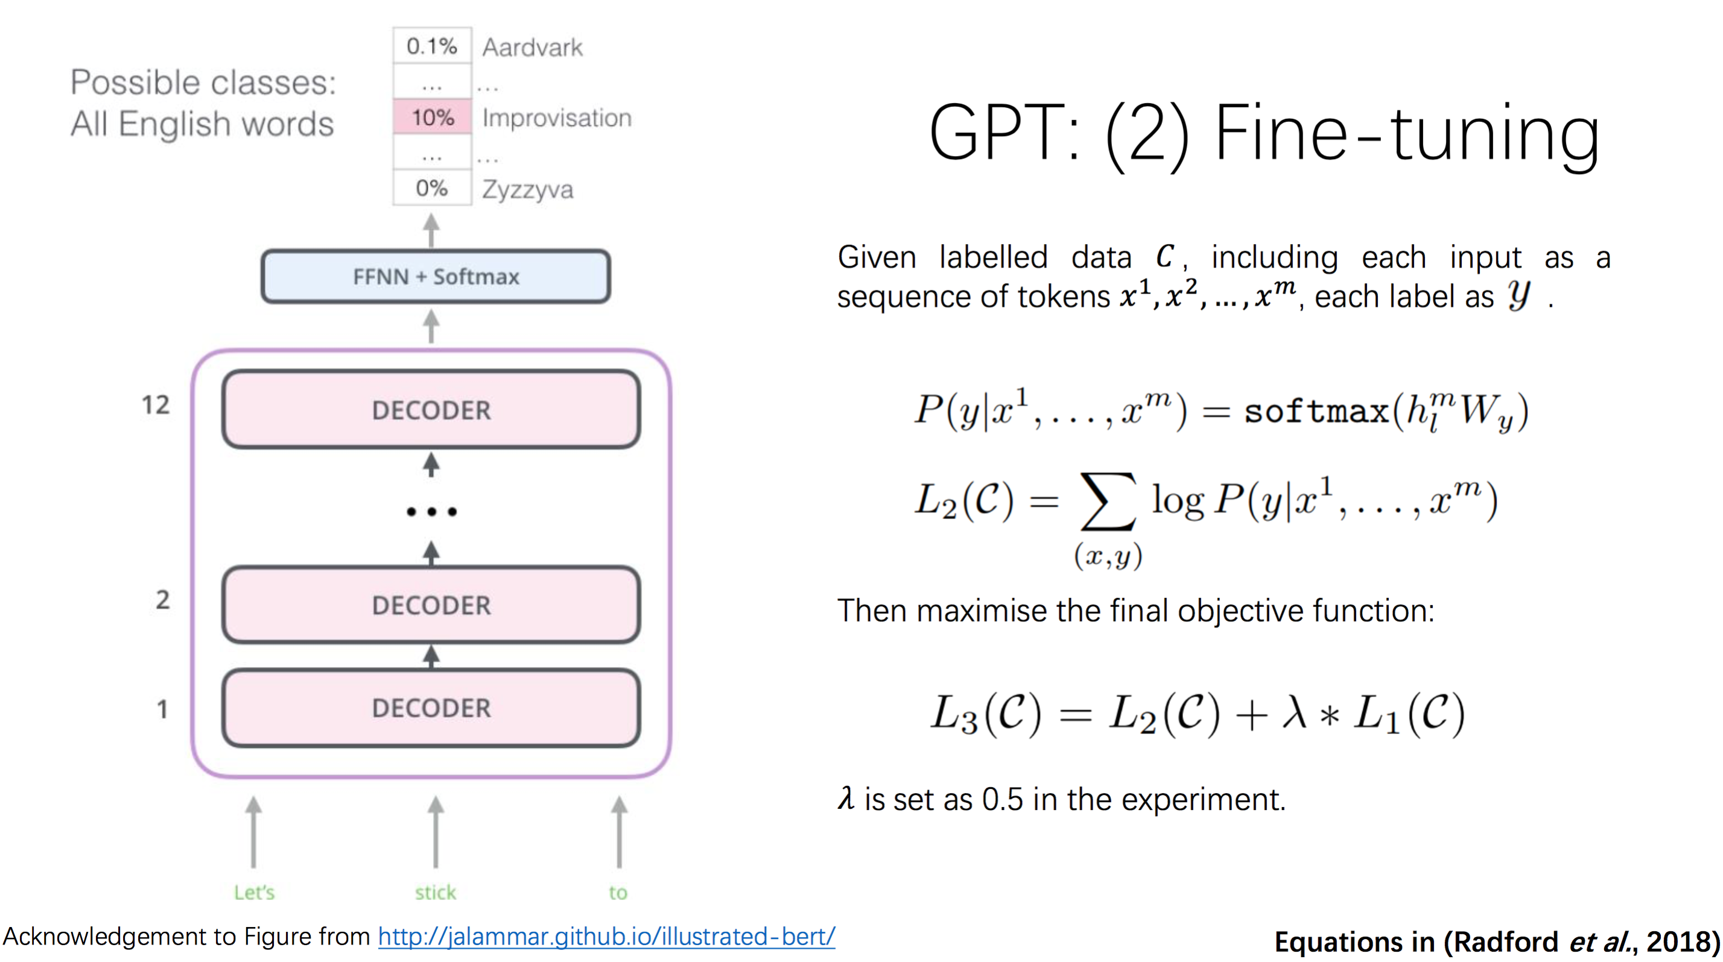

Slide 23
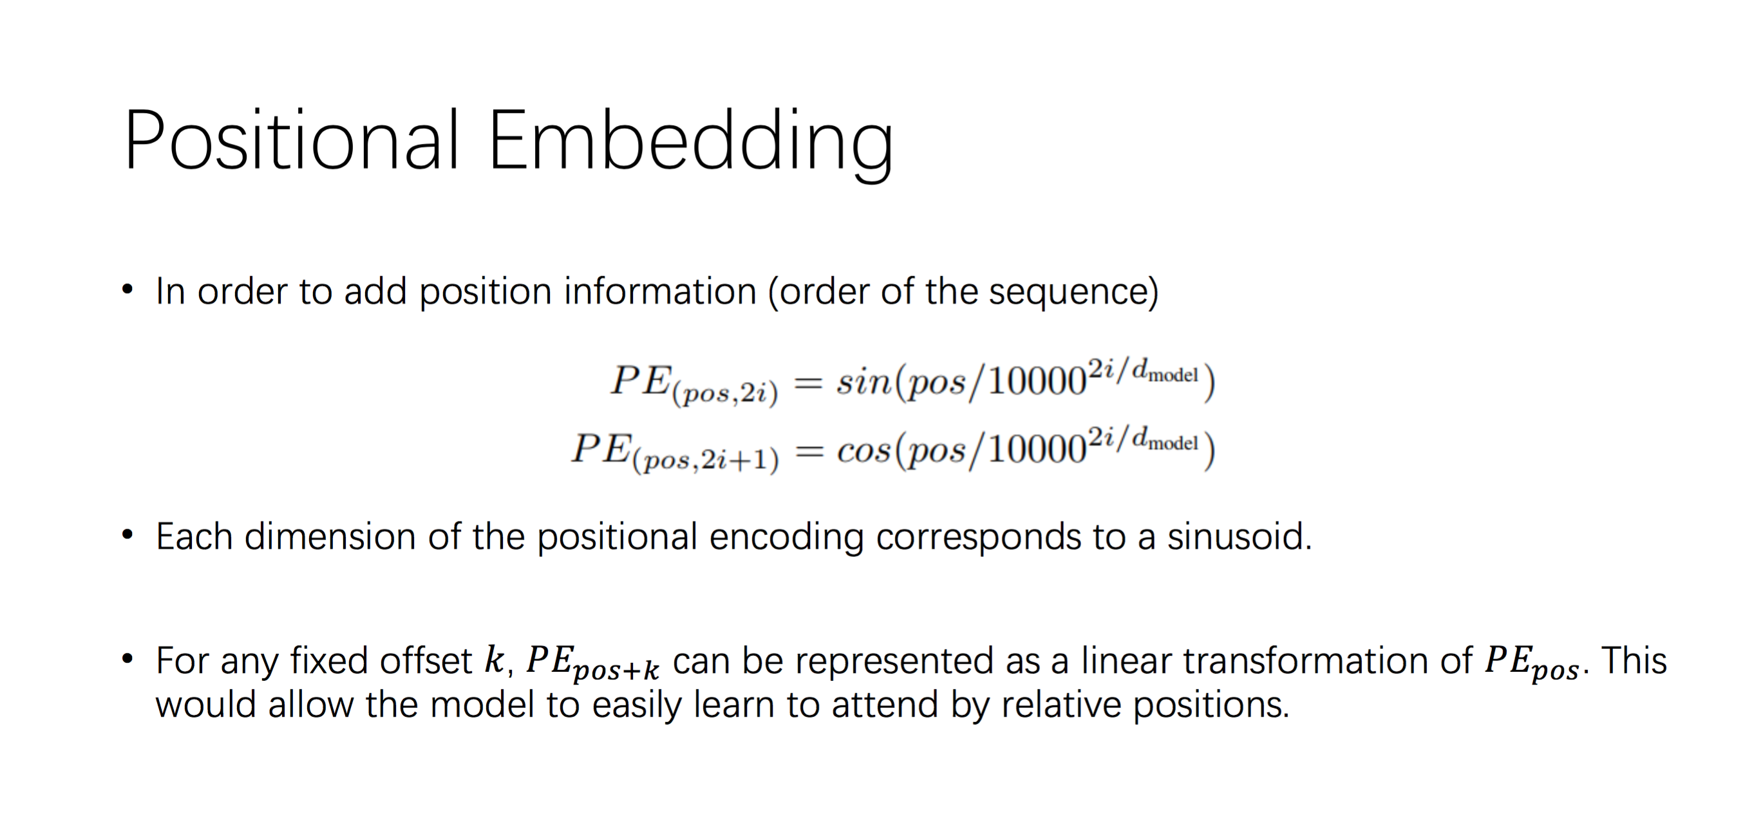

Slide 24
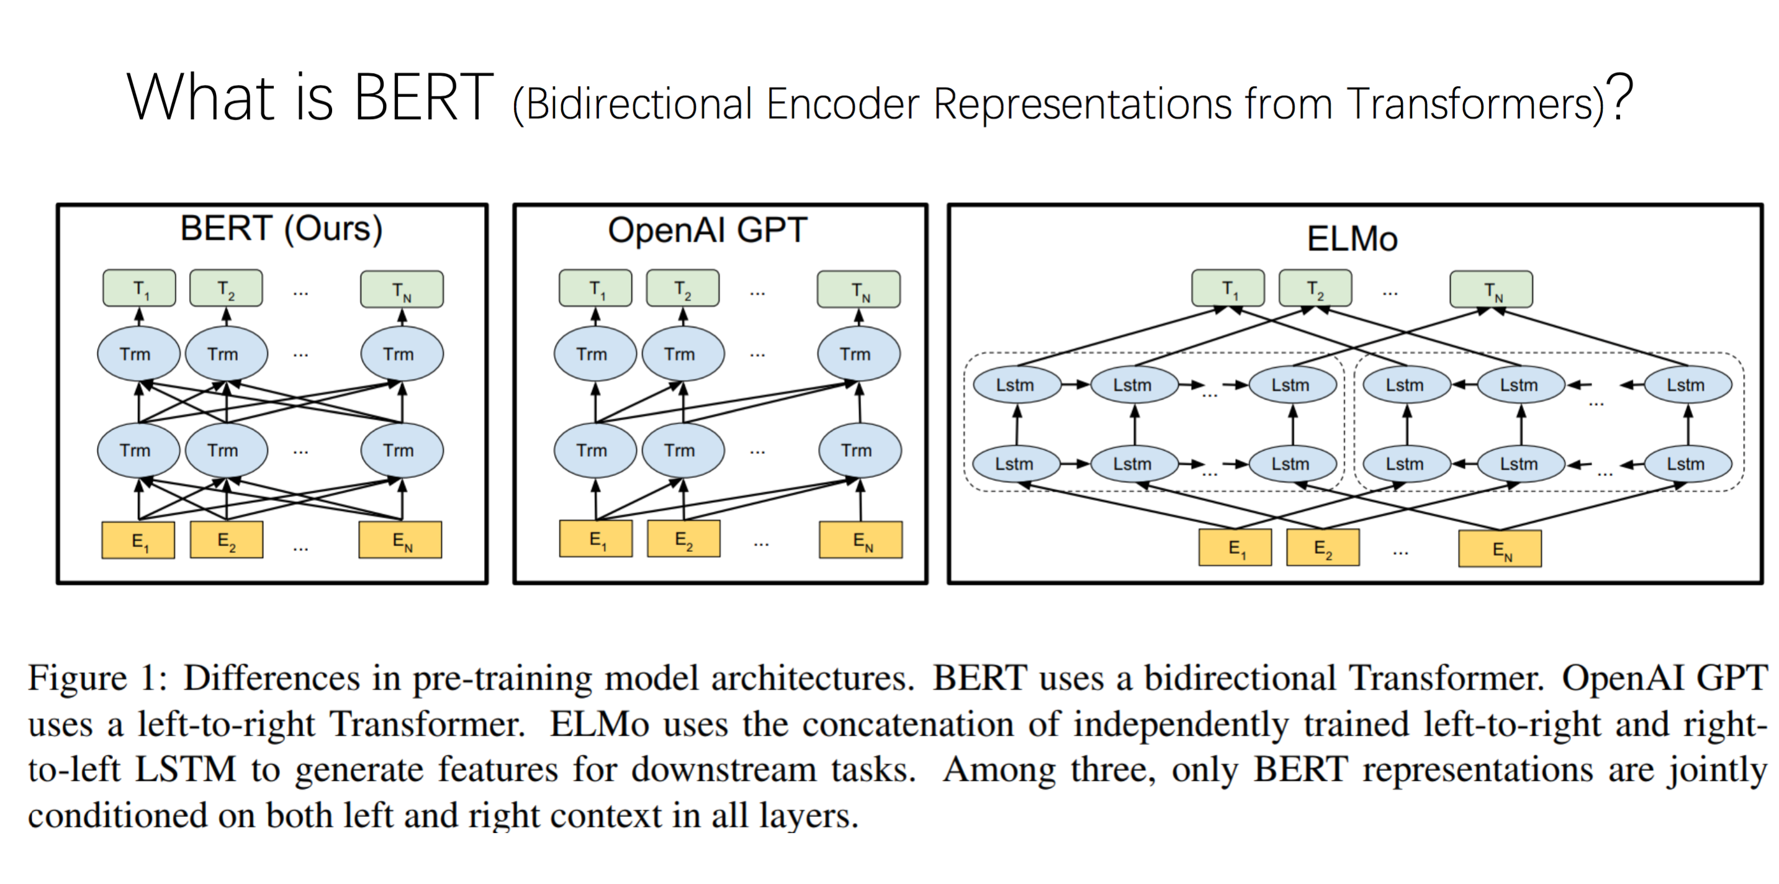

Slide 25
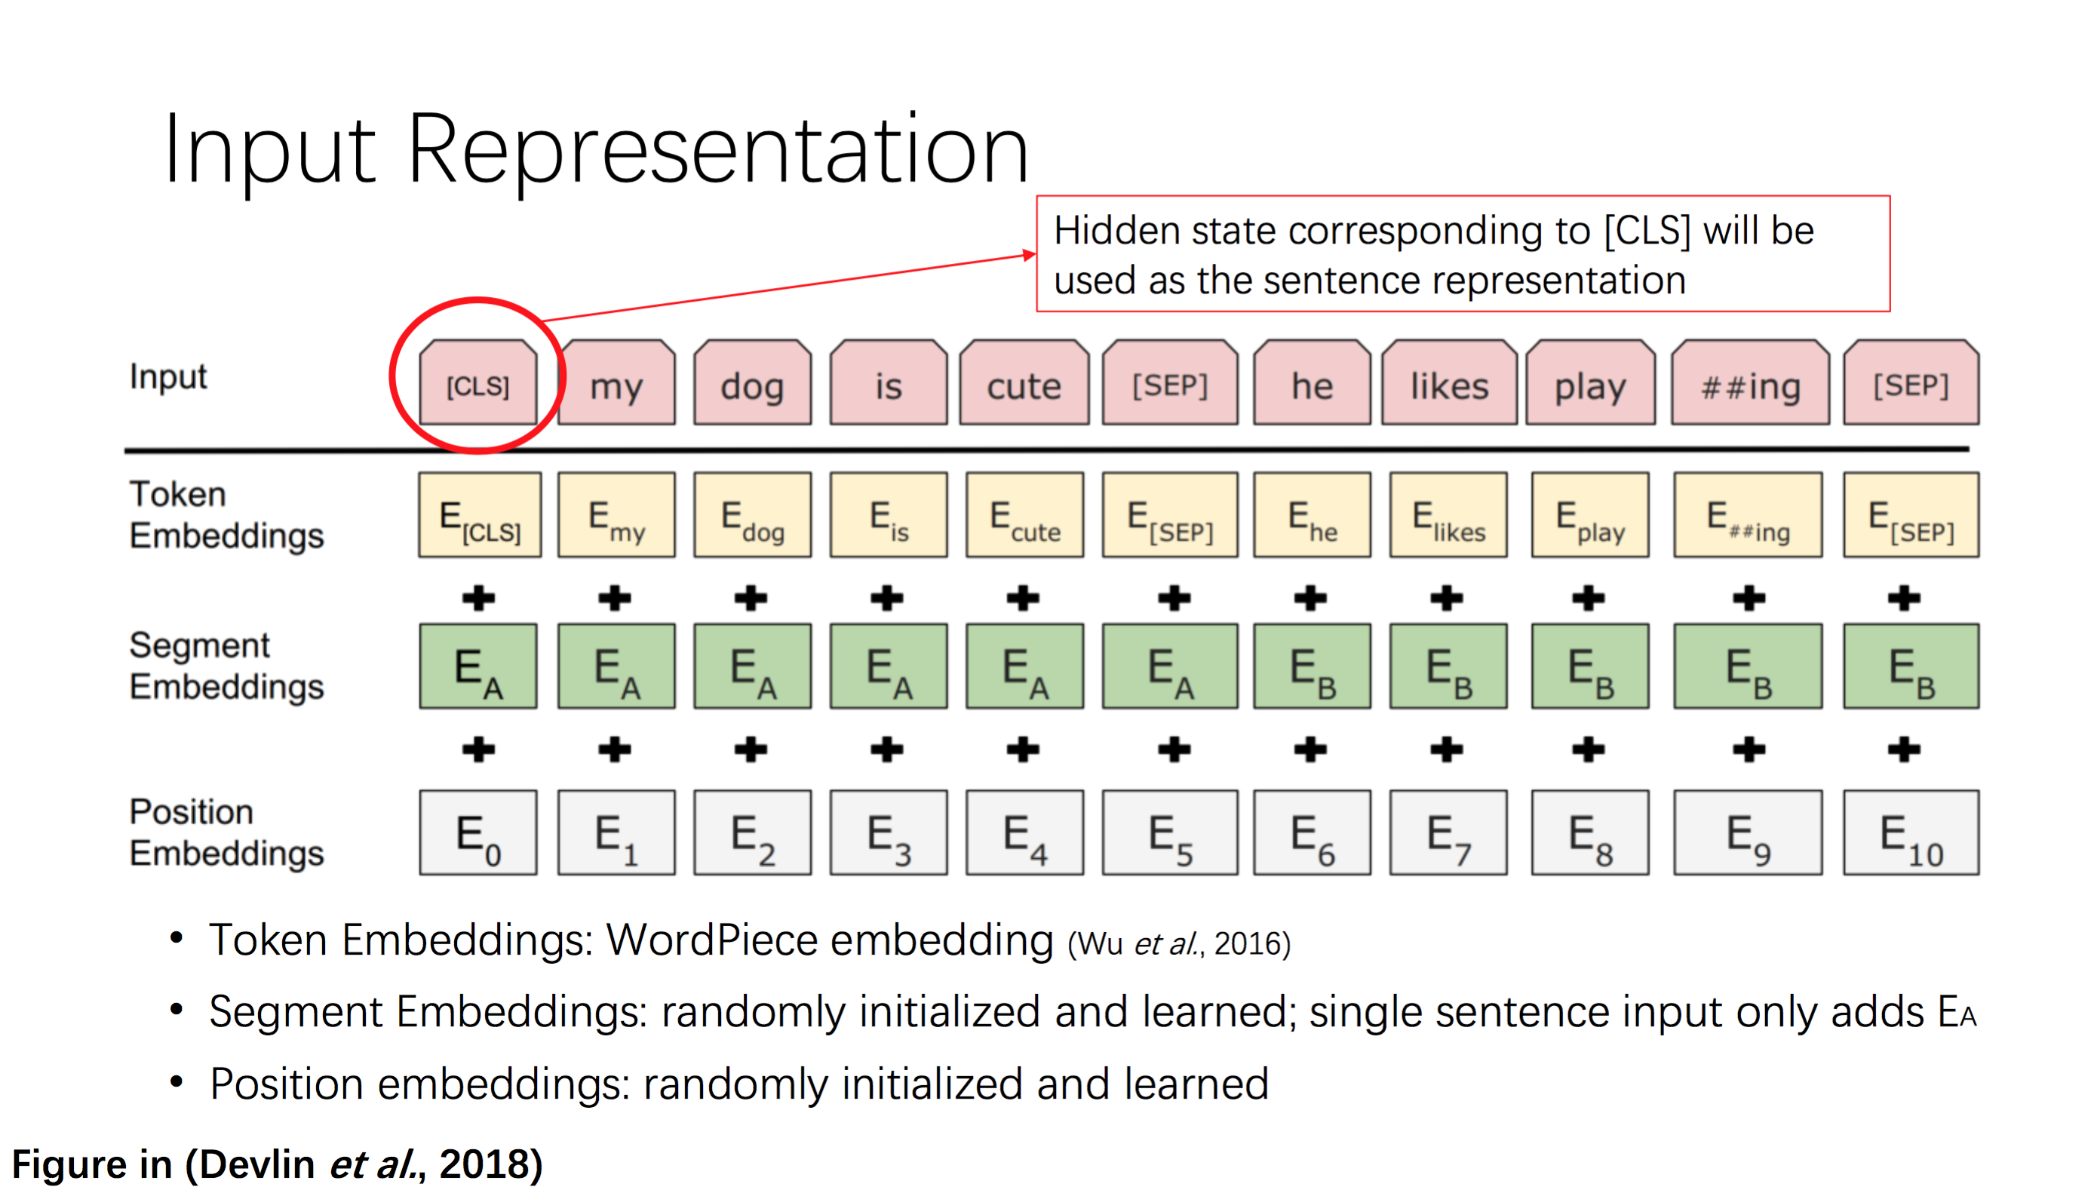

Slide 26
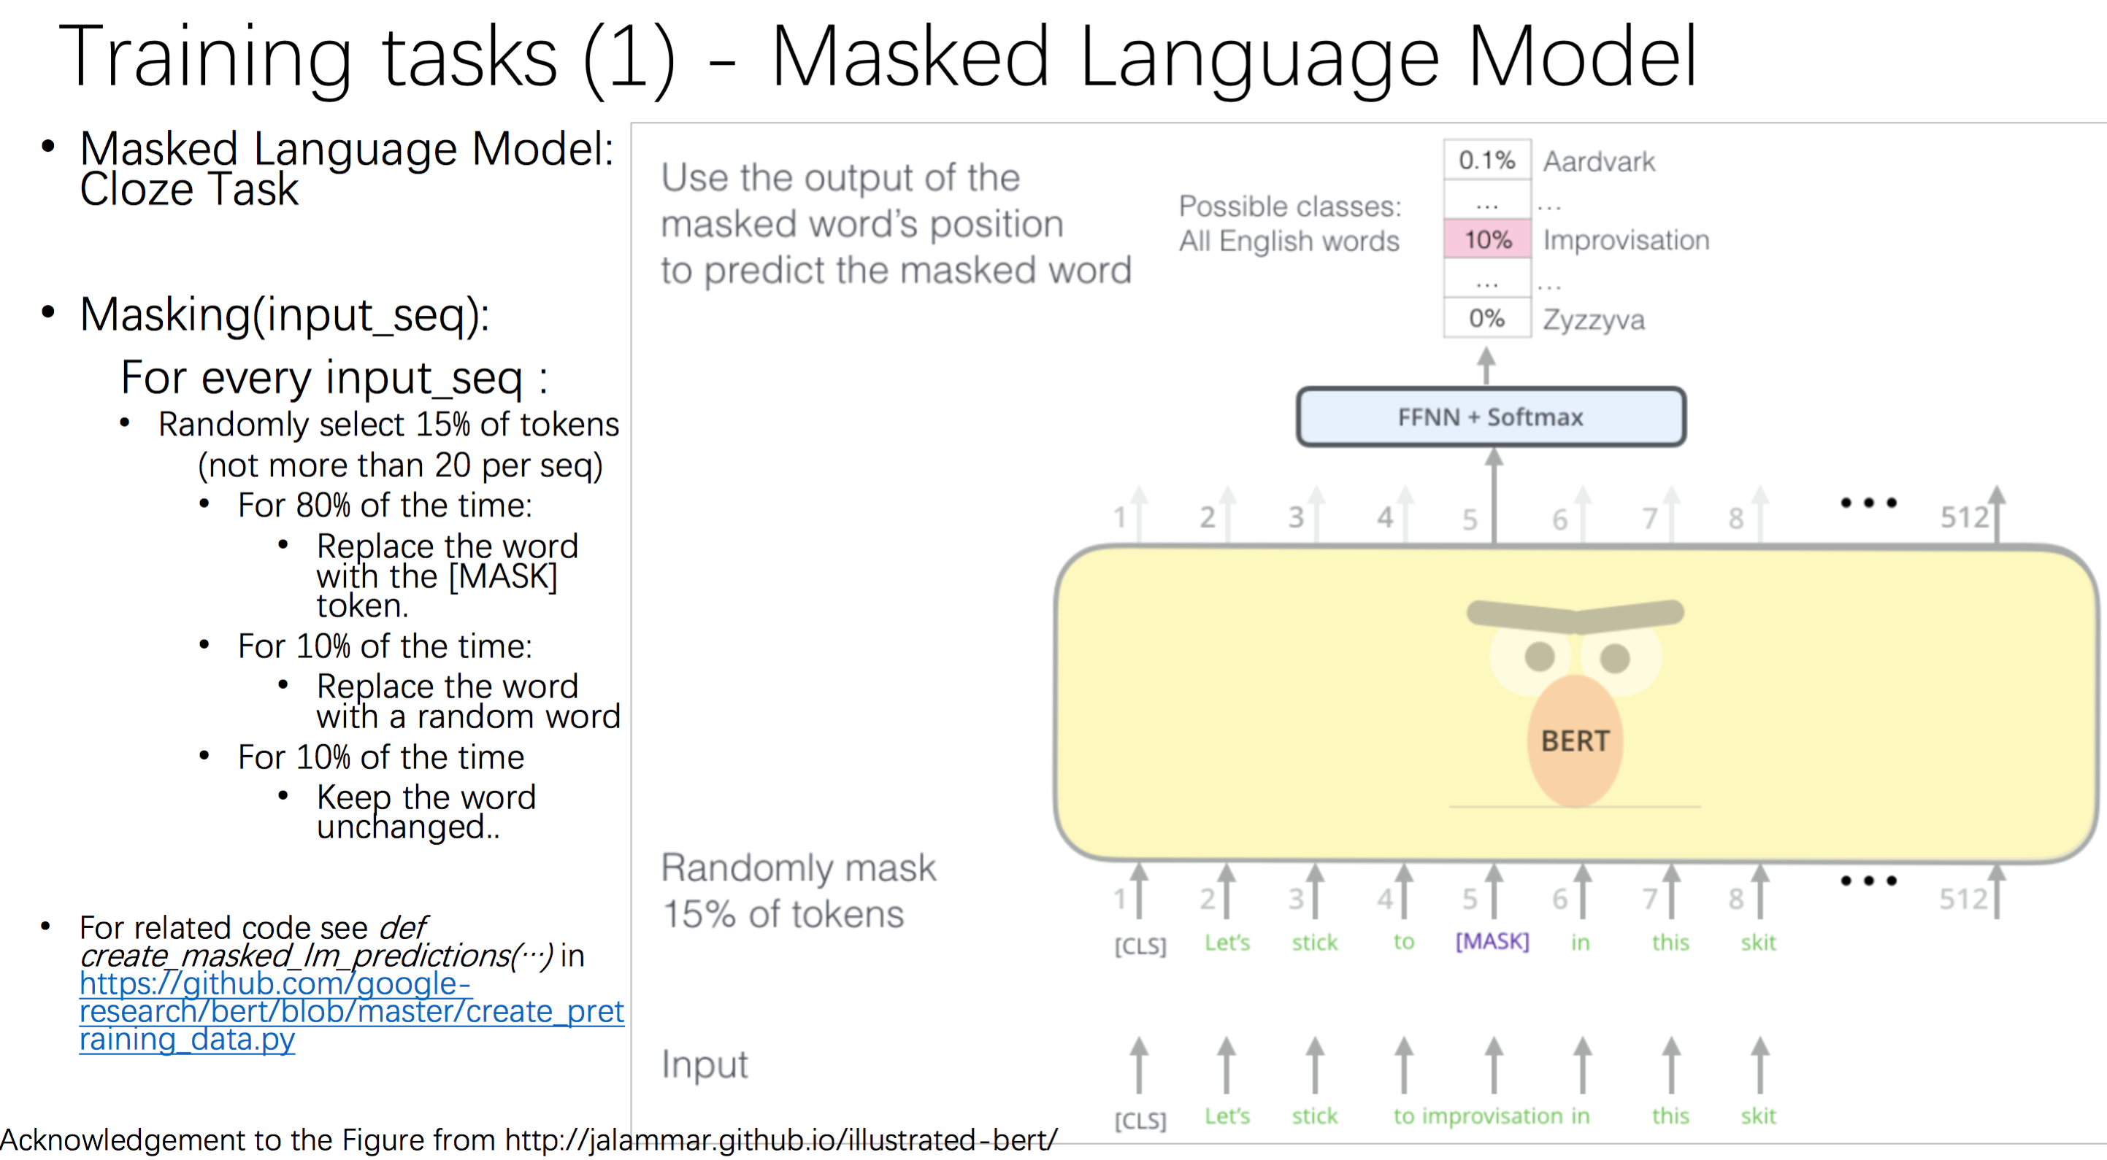

Slide 27
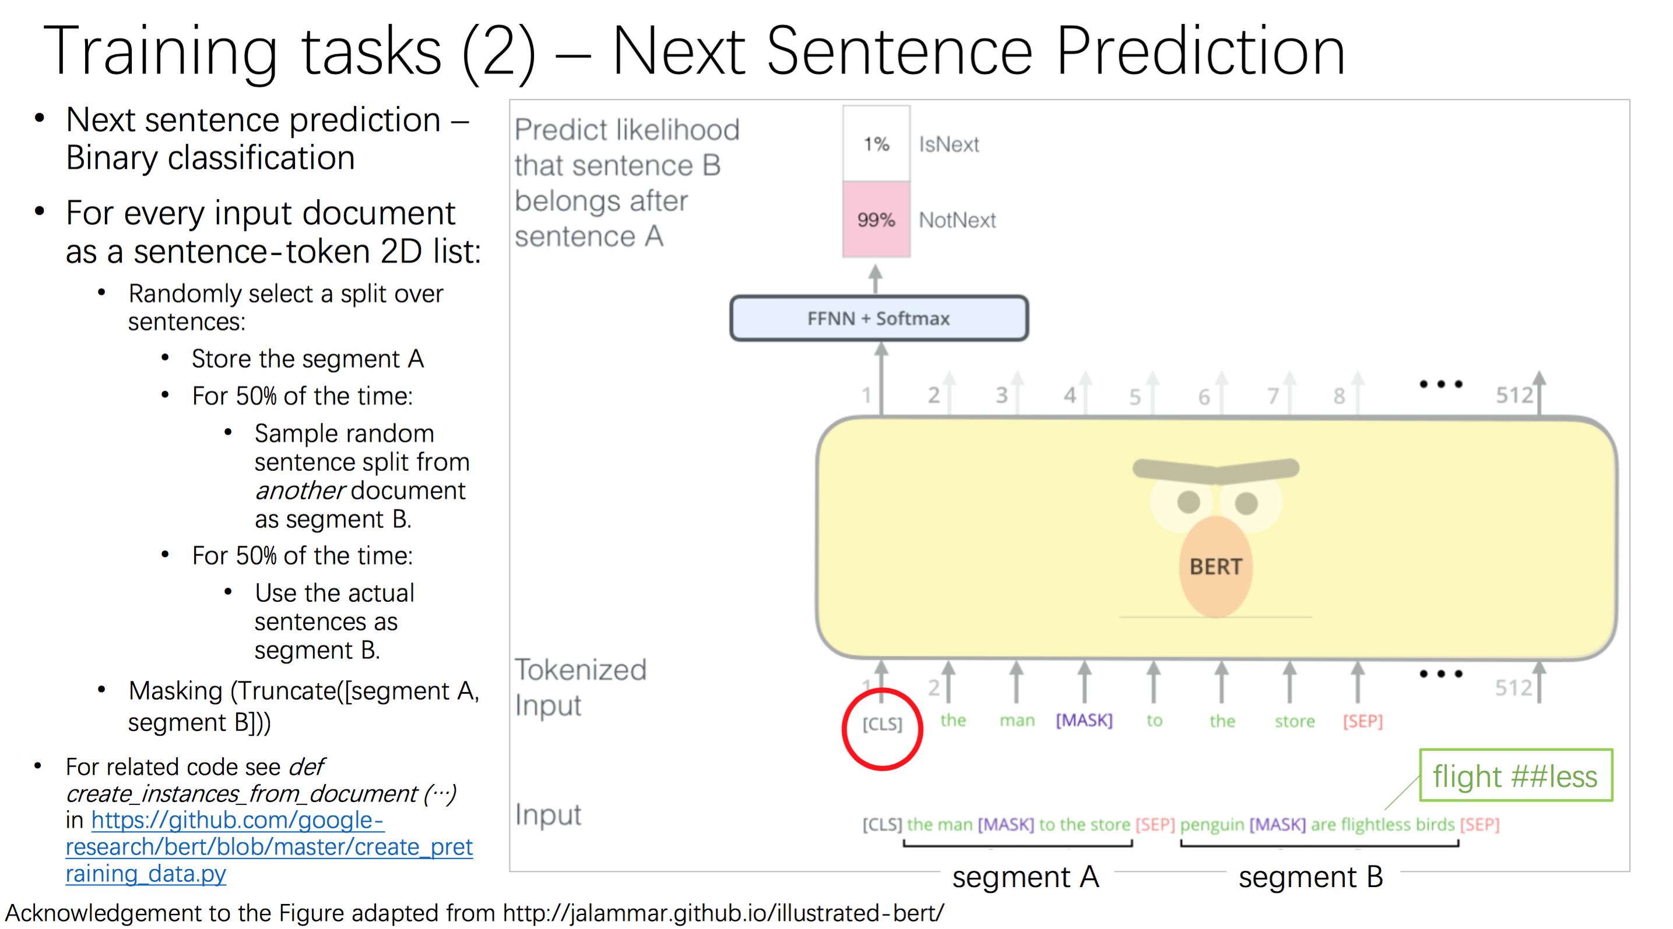

Slide 28
Breakout Room Discussion on Project Topics
Joint Knowledge and Text Embedding Representation
Knowledge-guided Inference and Decoding in Generation (e.g., control hallucination, control repetition, etc.)
Better automatic evaluation metrics for knowledge-guided NLG
Use Prompt Learning for Social Norm Discovery
Knowledge Selection for Dialog
Knowledge-enhanced Abstractive Summarization
Knowledge-guided NLG for Fake News Detection
Conditioned NLG for Information Extraction
Knowledge Guided Generation for Image/Video Caption Generation

