Slide 1
KBP2014 Entity Linking Scorer
Xiaoman Pan, Qi Li, Heng Ji, Xiaoqiang Luo, Ralph Grishman
jih@rpi.edu

Slide 2
Overview
We will apply two steps to evaluate the KBP2014 Entity Discovery and Linking results.
1. Clustering score
2. Entity Linking (Wikification) F-score

Slide 3
Overview
We use a tuple ⟨doc-id, start, end, entity-type, kb-id⟩ to represent each entity mention, where a special type of kb-id is NIL.
Let s be an entity mention in the system output, g be an corresponding gold-standard. An output mention s matches a reference mention g iff:
1. s.doc-id = g.doc-id, 2. s.start = g.start, s.end = g.end, 3. s.entity-type = g.entity-type, 4. and s.kb-id = g.kb-id.

Slide 4
Clustering score
In this step, we only concern clustering performance. Thus, change all mentions’ kb_id to NIL.
We will apply three metrics to evaluate the clustering score
B-Cubed metric
CEAF metric
Graph Edit Distance (G-Edit)

Slide 5
B-Cubed

Slide 6
B-Cubed

Slide 9
CEAF
CEAF (Luo 2005)
Idea: a mention or entity should not be credited more than once
Formulated as a bipartite matching problem
A special ILP problem
efficient algorithm: Kuhn-Munkres
We will use CEAFm as the official scoring metric because it’s more sensitive to cluster size than CEAFe

Slide 10
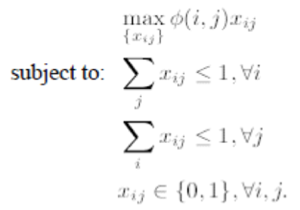
CEAF (Luo, 2005)

Slide 13
G-Edit
The first step, evaluate the name mention tagging F-measure
The second step, evaluate the overlapped mentions by using graph-based edit distance
To do:
Find a theoretical proof that the connected component based method is the unique optimal solution
Try to make the matching more sensitive to cluster size

Slide 18
Wikification F-score
Existing Entity Linking (Wikification) F-score

