Slide 1
From Mono-lingual to Cross-lingual:
State-of-the-art Entity Discovery and Linking
Heng Ji (RPI)
jih@rpi.edu

Slide 2

Goals and The Task

Slide 3
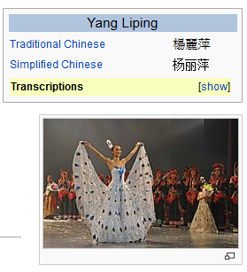

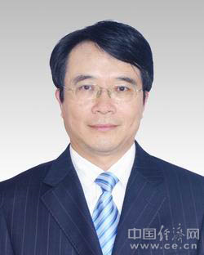
The Task
http://nlp.cs.rpi.edu/kbp/2015/
Source Collection
13岁以前的杨丽萍，是云南一个山村小镇里光着脚丫到处拾麦穗的乡下小姑娘，在洱海之源过着艰苦而又不无乐趣的童年生活。
Now, Ms. Yang, one of China's best-known dancers, is the director, choreographer and star of …
Aunque nacida en Dali, a la edad de nueve años Yang se mudó con su familia a Xishuangbanna. Debido a su extraordinario talento, la eligieron para integrar la Agrupación Artística de Canto …
…
KB
Liping Yang
Liping Yang
Notes:
Find other famous yangliping

Slide 4
The Task
Input
  A set of raw documents in English, Chinese and Spanish
Output
  mention head, offsets
  entity type: GPE, ORG, PER, LOC, FAC
  Mention type: name, nominal
    Nominals are for English individual person in 2015, but maybe for all types in 2016
  reference KB link entity ID, or NIL cluster ID
KB: Freebase dump
Scoring metric: clustering metrics + linking
Diagnostic Tasks
  Mono-lingual and Bi-lingual EDL
  Entity Linking with Perfect Mentions
  Entity Discovery in Cold-Start
Notes:
Some recent in vivo tasks are shown here.
Ratinov and Roth used d2w output to aid coreference resolution.
For example, knowing that kursk can be a vessel helps link kursk to vessel.
WP concepts present in a document help to make document similarity calculation more robust.
Also, WP concepts are rich with information including coarse and fine grained properties that can shed light on,
for example, a users intent during query formulation.

Slide 5
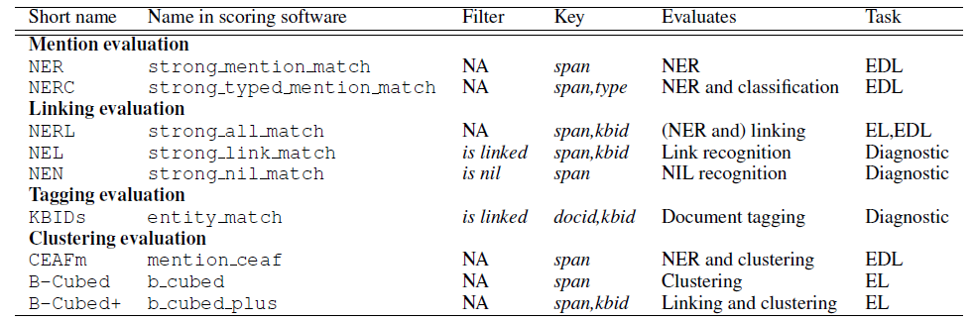
Evaluation Measures
Added type matching variant into each measure
Notes:
Some recent in vivo tasks are shown here.
Ratinov and Roth used d2w output to aid coreference resolution.
For example, knowing that kursk can be a vessel helps link kursk to vessel.
WP concepts present in a document help to make document similarity calculation more robust.
Also, WP concepts are rich with information including coarse and fine grained properties that can shed light on,
for example, a users intent during query formulation.

Slide 8
CEAF (Luo, 2005)
Idea: a mention or entity should not be credited more than once
Formulated as a bipartite matching problem
  A special ILP problem
  Efficient algorithm: Kuhn-Munkres

Slide 10

State-of-the-art Mono-lingual EDL

Slide 11
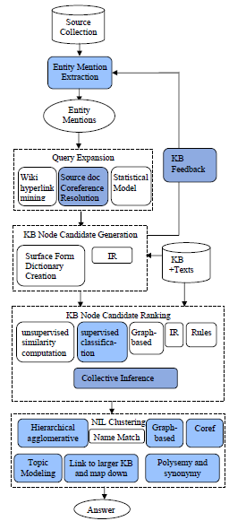
General Architecture
Feedback from linking to improve extraction
New ranking algorithm: Progamming with Personalized PageRank algorithm by CohenCMU (Mazaitis et al., 2014)
A nice summary of the state-of-the-art ranking features by Tohoku NL (Zhou et al., 2014)

Slide 12
Mention Identification
Highest recall: Each n-gram is a potential concept mention
  Intractable for larger documents
Surface form based filtering
  Shallow parsing (especially NP chunks), NP’s augmented with surrounding tokens, capitalized words
  Remove: single characters, “stop words”, punctuation, etc.
Classification and statistics based filtering
  Name tagging (Finkel et al., 2005; Ratinov and Roth, 2009; Li et al., 2012)
  Mention extraction (Florian et al., 2006, Li and Ji, 2014)
  Key phrase extraction, independence tests (Mihalcea and Csomai, 2007), common word removal (Mendes et al., 2012; )
Notes:
We will go over some successful entity mention detection methods (Li and Ji, 2014submission), and highlight some simple yet effective general mention extraction methods based on mining Wikipedia structures and constructing Wikipedia Lexicon (Bunescu, 2006; Cucerzan, 2007; Fernandez et al., 2010; Chang et al., 2010; Chen et al., 2010; Meij et al., 2012; Bysani et al., 2010; Hachey et al., 2013; Huang et al., 2014submission). Due to the noise in informal genres such as web blogs and discussion forums, some systems also performed mis-spelling correction and normalization (Yu et al., 2013; Charton et al., 2013).
XXX to add references
Note that filtering is necessary even if only previous anchor text is used for efficiency! (at least for longer texts or a high-volume data stream)

Slide 13



Need Mention Expansion
“Michael Jordon”
“His Airness”
“Jordanesque”
“Corporate Counsel”
“MJ23”
“Sole practitioner”
“Defense attorney”
“Jordan, Michael”
“Michael J. Jordan”
“Legal counsel”
“Litigator”
Trial lawyer
“Arizona”
“Alitalia”
“Azerbaijan”
“Authority Zero”
“AstraZeneca”
“Assignment Zero”
Notes:
“AZ” may refer to the US state of “Arizona”, the Italian airline “Alitalia”, or the country “Azerbaijan”

Slide 14
Mention Expansion
Co-reference resolution
  Each mention in a co-referential cluster should link to the same concept
  Canonical names are often less ambiguous
  Correct types: “Detroit” = “Red Wings”; “Newport” = “Newport-Gwent Dragons”
Known Aliases
  KB link mining (e.g., Wikipedia “re-direct”) (Nemeskey et al., 2010)
  Patterns for Nicknames/ Acronym mining (Zhang et al., 2011; Tamang et al., 2012)
  “full-name” (acronym) or “acronym (full-name)”, “city, state/country”
Statistical models such as weighted finite state transducer (Friburger and Maurel, 2004)
  CCP = “Communist Party of China”; “MINDEF” = “Ministry of Defence”
Ambiguity drops from 46.3% to 11.2% (Chen and Ji, 2011; Tamang et al., 2012).

Slide 15
Generating Candidate Titles
1. Based on canonical names (e.g. Wikipedia page title)
  Titles that are a super or substring of the mention
    Michael Jordan is a candidate for “Jordan”
  Titles that overlap with the mention
    “William Jefferson Clinton” →Bill Clinton;
    “non-alcoholic drink”→Soft Drink
2. Based on previously attested references
  All Titles ever referred to by a given string in training data
    Using, e.g., Wikipedia-internal hyperlink index
    More Comprehensive Cross-lingual resource (Spitkovsky & Chang, 2012)
Notes:
. We expect this idea to inspire a completely new philosophy for fact
extraction which will be essential for the creation of a high-quality StructNet.
Incorporate arbitrary global features and soft constraints;
Features are automatically learned selectively
Save some human knowledge engineering efforts
Capture inter-dependency knowledge on the entire structure
Efficient linear-time beam search by joint learning and decoding
No need to model joint/conditional distribution with a large number of variables
Extract all facts jointly in a unified framework
Local predictions can be mutually improved
Avoid error compounding problem

Slide 16
  Initial Ranking of Candidate Titles
Initially rank titles according to…
  Wikipedia article length
  Incoming Wikipedia Links (from other titles)
  Number of inhabitants or the largest area (for geo-location titles)
More sophisticated measures of prominance
  Prior link probability
  Graph based methods
Notes:
We intend to use various internal metrics such as Kullback-Leibler divergence, distance, dependency, temporal distribution, Meta-path (common neighbors, normalized path count, pairwise random walk and path sim) (Sun et al., 2011b) and global validation features in order to capture the coherence among all entity mentions in any document.
Collective Inference → next

Slide 17
Similarity Features for Supervised Ranking
Mention/Concept Attribute |  |  | Description
Name | Spelling match |  | Exact string match, acronym match, alias match, string matching…
 | KB link mining |  | Name pairs mined from KB text redirect and disambiguation pages
 | Name Gazetteer |  | Organization and geo-political entity abbreviation gazetteers
Document surface | Lexical |  | Words in KB facts, KB text, mention name, mention text.
 |  |  | Tf.idf of words and ngrams
 | Position |  | Mention name appears early in KB text
 | Genre |  | Genre of the mention text (newswire, blog, …)
 | Local Context |  | Lexical and part-of-speech tags of context words
Entity Context | Type |  | Mention concept type, subtype
 | Relation/Event |  | Concepts co-occurred, attributes/relations/events with mention
 | Coreference |  | Co-reference links between the source document and the KB text
Profiling |  |  | Slot fills of the mention, concept attributes stored in KB infobox
Concept |  |  | Ontology extracted from KB text
Topic |  |  | Topics (identity and lexical similarity) for the mention text and KB text
KB Link Mining |  |  | Attributes extracted from hyperlink graphs of the KB text
Popularity |  | Web | Top KB text ranked by search engine and its length
 |  | Frequency | Frequency in KB texts
(Ji et al., 2011; Zheng et al., 2010; Dredze et al., 2010; Anastacio et al., 2011)
Notes:
Improve font and shade
Response to DR comment: I think this goes here since these are properties of mention, concept candidate, or both, and/or their associated text. But the use of “feature category” is
what is confusing here. Phi is the feature function, but these attributes in the table here could be used as features per se, or could be inputs to a feature function.
So, I changed the column titles to “Mention/Concept Attribute” and “Description” from “feature category” and “feature description”.
I should also make it clear that many systems use features (phi) that are only specified in terms of either the mention or the concept, and not both (e.g. linkability for mentions).
Thus there are cases where the feature function phi is the identity or a simple transformation.
On this note, I renamed the slide to “Typical Attributes for Ranking Features”. Perhaps this is unwieldy.

Slide 18
Ranking Approach Comparison
Unsupervised or weakly-supervised learning (Ferragina and Scaiella, 2010)
  Annotated data is minimally used to tune thresholds and parameters
  The similarity measure is largely based on the unlabeled contexts
Supervised learning (Bunescu and Pasca, 2006; Mihalcea and Csomai, 2007; Milne and Witten, 2008, Lehmann et al., 2010; McNamee, 2010; Chang et al., 2010; Zhang et al., 2010; Pablo-Sanchez et al., 2010, Han and Sun, 2011, Chen and Ji, 2011; Meij et al., 2012)
  Each <mention, title> pair is a classification instance
  Learn from annotated training data based on a variety of features
  ListNet performs the best using the same feature set (Chen and Ji, 2011)
Graph-based ranking (Gonzalez et al., 2012)
  context entities are taken into account in order to reach a global optimized solution together with the query entity
IR approach (Nemeskey et al., 2010)
  the entire source document is considered as a single query to retrieve the most relevant Wikipedia article

Slide 19
Or Try Unsupervised Knowledge Networks Matching:
Knowledge Network for Mentions in Source
E.g., using Abstract Meaning Representation (Pan et al., 2015)
Notes:
30
We first generate the individual knowledge network for each entity mention,
And then merge coherent mentions’ knowledge networks.
The figure shows the merged knowledge network for the previous example.

Slide 20
Construct Knowledge Network for Entities in KB
Notes:
10
This figure shows a part of knowledge network for entities in KB

Slide 21
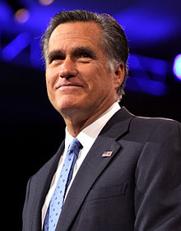




Linking Knowledge Networks: Salience
Commonness(“Romney”, Mitt_Romney)
Notes:
45
We apply three approaches for linking knowledge networks
First is Salience which means entity candidates should be salient and popular in KB
We use commonness measure to generate initial candidates list.
So it is a probability models for mentions and entities
In our experiments, top 10 initial candidates can give us accuracy around 97%.

Slide 22
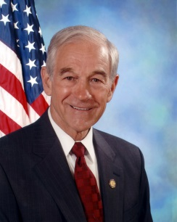
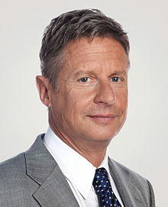
Salience based Ranking
Mitt Romney
Mitt Romney presidential campaign, 2012
George W. Romney
Romney, West Virginia
New Romney
George Romney (painter)
HMS Romney (1708)
New Romney (UK Parliament constituency)
Romney family
Romney Expedition
Paul McCartney
Ron Paul
Paul the Apostle
St Paul's Cathedral
Paul Martin
Paul Klee
Paul Allen
Chris Paul
Pauline epistles
Paul I of Russia
Lyndon B. Johnson
Andrew Johnson
Samuel Johnson
Magic Johnson
Jimmie Johnson
Boris Johnson
Randy Johnson
Johnson & Johnson
Gary Johnson
Robert Johnson
Notes:
25
using this salience approach
“Romney” is successfully linked to Mitt Romney.
For the mention “Paul”, the politician Ron Paul is ranked at top 2, (less popular than the musician Paul McCartney).
For the mention “Johnson”, the correct entity Gary Johnson is ranked at top 9 because Johnson is a very common name and he is not that popular,
We call this as popularity bais

Slide 23
Similarity
: knowledge network for mention
: knowledge network for each entity candidate of
Compute similarity between and based on Jaccard Index
Note that the edge labels are ignored
Two elements are considered equal if and only if they have one or more token in common.
Notes:
20
We use jaccard index to compute similarity between mention and entity candidate knowledge network

Slide 24
Knowledge Network for Entities in KB
Notes:
35
Due to the support from their neighbor “Republican Party” in the KB which matches the neighbor “Republican” of mentions “Paul” and “Johnson”,
Ron Paul and Gary Johnson are promoted to top 1 and top 3 respectively.
Gary Johnson is still behind two former U.S. presidents Andrew Johnson and Lyndon B. Johnson who also shares the neighbor “Republican Party” in the KB.

Slide 25
Similarity based Re-ranking
Mitt Romney
George W. Romney
Mitt Romney presidential campaign, 2012
Ann Romney
Lenore Romney
Ronna Romney
Tagg Romney
G. Scott Romney
Vernon B. Romney
New Romney
Ron Paul
Paul Ryan
Rand Paul
Paul McCartney
Paul Krugman
Paul Wellstone
Paul Broun
Paul Laxalt
Paul Coverdell
Paul Cellucci
Lyndon B. Johnson
Andrew Johnson
Gary Johnson
Hiram Johnson
Sam Johnson
Tim Johnson (U.S. Senator)
Ron Johnson (U.S. politician)
Walter Johnson
Samuel Johnson
Magic Johnson
Notes:
5

Slide 26
Coherence
: a set of coherent entity mentions
  [Romney, Paul, Johnson]
: the set of corresponding entity candidate lists
: all the possible combinations of top candidate lists from
  [Mitt Romney, Ron Paul, Gary Johnson]
  [Mitt Romney, Paul McCartney, Lyndon Johnson]
  etc.
Compute coherence for each combination as Jaccard similarity, taking any number of arguments to the set of knowledge networks for all entities in
Notes:
20

Slide 27
Knowledge Network for Entities in KB
Notes:
20
compared to Andrew Johnson and Lyndon Johnson,
Gary Johnson is more coherently connected with Mitt Romney and Ron Paul in KB,
therefore it is promoted to top 1 with the coherence approach.

Slide 28
Coherence based Re-Ranking
Mitt Romney
George W. Romney
Mitt Romney presidential campaign, 2012
Mitt Romney presidential campaign, 2008
List of Mitt Romney presidential campaign endorsements, 2012
Governorship of Mitt RomneyAnn Romney
Lenore Romney
Ronna Romney
Ron Paul
Paul Ryan
Paul Krassner
Chris Paul
Paul Harvey
Ron Paul presidential campaign, 2008
Paul Samuelson
Rand Paul
Ron Paul presidential campaign, 2012
Paul McCartney
Gary Johnson
Lyndon B. Johnson
Andrew Johnson
Magic Johnson
Woody Johnson
Boris Johnson
Jimmie Johnson
Dwayne Johnson
Donald Johnson
Hiram Johnson
Notes:
5

Slide 29
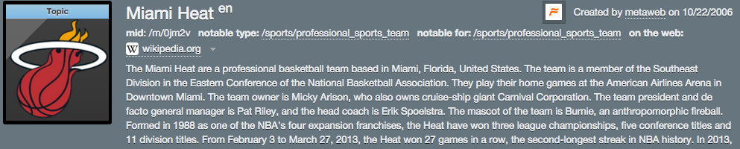
Or Try to Measure Semantic Relatedness using DNN
Semantic relatedness
(cosine similarity)
SR(e_{i} , e_{j})
Semantic Layer
y
300
300
Multi-layer non-
linear projections
300
300
300
300
105k (50k + 50k + 3.2k + 1.6k)
105k (50k + 50k + 3.2k + 1.6k)
Word Hashing Layer
Feature Vector
x
1m
4m
3.2k
1.6k
1m
4m
3.2k
1.6k
D_{i}
E_{i}
R_{i}
ET_{i}
D_{j}
E_{j}
R_{j}
ET_{j}
Miami
Location
Miami Heat
Professional
Sports Team
Titanic
Type
Roster
Member
Dwyane Wade
National Basketball
Association

Slide 30
Comparison of Semantic Relatedness Methods
Method | Simple | DNN
New York City | 0.92 | 0.22
New York Knicks | 0.78 | 0.79
Washington, D.C. | 0.80 | 0.30
Washington Wizards | 0.60 | 0.85
Atlanta | 0.71 | 0.39
Atlanta Hawks | 0.53 | 0.83
Houston | 0.55 | 0.37
Houston Rockets | 0.49 | 0.80
Semantic relatedness scores between a sample of entities
and the entity ”National Basketball Association” in sports domain.
(Huang et al., 2015submission)

Slide 31
Joint Extraction and Linking
Some recent work (Sil and Yates, 2013; Meij et al., 2012; Guo et al., 2013; Huang et al., 2014b) proved extraction and linking can mutually enhance each other
  Bosch will provide the rear axle. → Robert Bosch Tool Corporation → ORG
  Parker was 15 for 21 from the field, putting up a season high while scoring nine of San Antonio’s final 10 points in regulation → San Antonio Spurs → ORG
IBM (Sil and Florian, 2014), MSIIPL THU (Zhao et al., 2014), SemLinker (Meurs et al., 2014), UBC (Barrena et al., 2014) and RPI (Hong et al., 2014) used the properties in external KBs such as DBPedia as feedback to refine the identification and classification of name mentions.
  RPI system successfully corrected 11.26% wrong mentions
HITS team (Judea et al., 2014) proposed a joint approach that simultaneously solves extraction, linking and clustering using Markov Logic Networks
Document Linking → Event Extraction (Ji and Grishman, 2008)
Entity Linking → Relation Extraction (Chan and Roth, 2010)
Joint Linking and Translation

Slide 32
NIL Clustering
… Michael Jordan …
… Michael Jordan …
… Michael Jordan …
“All in one”
Simple string matching
… Michael Jordan …
… Michael Jordan …
… Michael Jordan …
“One in one”
Often difficult to beat!
… Michael Jordan …
… Michael Jordan …
… Michael Jordan …
Collaborative Clustering
Most effective when ambiguity is high

Slide 33
NIL Clustering Methods Comparison
(Chen and Ji, 2011; Tamang et al., 2012)
Algorithms |  | B-cubed+ F-Measure | Complexity
Agglomerative clustering | 3 linkage based algorithms (single linkage, complete linkage, average linkage) (Manning et al., 2008) | 85.4%-85.8% | n: the number of mentions
 | 6 algorithms optimizing internal measures cohesion and separation | 85.6%-86.6%
Partitioning Clustering | 6 repeated bisection algorithms optimizing internal measures | 85.4%-86.1% | NNZ: the number of non-zeroes in the input matrix M: dimension of feature vector for each mention k: the number of clusters
 | 6 direct k-way algorithms optimizing internal measures (Zhao and Karypis, 2002) | 85.5%-86.9%
Co-reference methods were also used to address NIL Clustering (E.g., Cheng et. al 2013): L³M Latent Left Linking jointly learn metric and clusters mentions
Notes:
. We expect this idea to inspire a completely new philosophy for fact
extraction which will be essential for the creation of a high-quality StructNet.
Incorporate arbitrary global features and soft constraints;
Features are automatically learned selectively
Save some human knowledge engineering efforts
Capture inter-dependency knowledge on the entire structure
Efficient linear-time beam search by joint learning and decoding
No need to model joint/conditional distribution with a large number of variables
Extract all facts jointly in a unified framework
Local predictions can be mutually improved
Avoid error compounding problem

Slide 34

Move to Cross-lingual

Slide 35
Tri-lingual EDL Schedule and Pilot Evaluation
June 30: Full Training Data available
September 1: Registration deadline
September 28-October 12: Evaluation (including diagnostic tracks)
November 17-18: TAC KBP 2015 Workshop
Pilot Evaluation:
CMU, IBM, OSU and RPI participated
Two general approaches
  Chinese/Spanish EDL + Name Translation
  Machine Translation + English EDL
Human annotation is not done yet
Notes:
Some recent in vivo tasks are shown here.
Ratinov and Roth used d2w output to aid coreference resolution.
For example, knowing that kursk can be a vessel helps link kursk to vessel.
WP concepts present in a document help to make document similarity calculation more robust.
Also, WP concepts are rich with information including coarse and fine grained properties that can shed light on,
for example, a users intent during query formulation.

Slide 36
Pilot Evaluation: Inter-system Agreement
Overall
English
 | CMU | IBM | OSU | RPI
CMU | 1 | 0.530 | 0.676 | 0.752
IBM | 0.530 | 1 | 0.489 | 0.514
OSU | 0.676 | 0.489 | 1 | 0.668
RPI | 0.752 | 0.514 | 0.668 | 1
 | CMU | IBM | OSU | RPI
CMU | 1 | 0.561 | 0.782 | 0.803
IBM | 0.561 | 1 | 0.507 | 0.522
OSU | 0.782 | 0.507 | 1 | 0.827
RPI | 0.803 | 0.522 | 0.827 | 1
Notes:
- RPI and CMU systems got most agreement from other teams
- RPI and CMU agree each other the most
- Among the three languages, agreement English > Spanish > Chinese

Slide 37
Pilot Evaluation: Inter-system Agreement
Chinese
Spanish
 | CMU | IBM | OSU | RPI
CMU | 1 | 0.404 | 0.643 | 0.739
IBM | 0.404 | 1 | 0.396 | 0.381
OSU | 0.643 | 0.396 | 1 | 0.634
RPI | 0.739 | 0.381 | 0.634 | 1
 | CMU | IBM | OSU | RPI
CMU | 1 | 0.702 | 0.762 | 0.836
IBM | 0.702 | 1 | 0.654 | 0.641
OSU | 0.762 | 0.654 | 1 | 0.741
RPI | 0.836 | 0.641 | 0.741 | 1

Slide 38
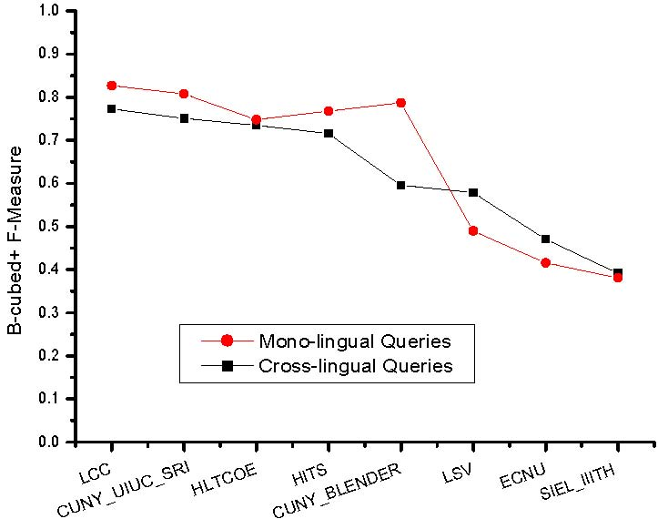
KBP2011 Chinese-English CLEL Results
Difficulty | Task | All | NIL | Non- NIL
Ambiguity | Mono-lingual | 12.9% | 5.7% | 9.3%
 | Cross-lingual | 20.9% | 14.0% | 28.6%
Notes:
add another foreign language; LDC has experience in multiple foreign languages; hltcoe

Slide 39
Name Translation Maze
English Chinese | Phonetic Name | Semantic Name | Semantic+ Phonetic Name
Semantic Name | 基地组织 (Base Organization) → al-Qaeda | 解放之虎 (Liberation Tiger) → Liberation Tiger | 长江 (Long River) → Yangtze River
Phonetic Name | 尤申科 (You shen ke)→ Yushchenko | 可伶可俐 (Ke Ling Ke Li) → Clean Clear | 欧佩尔吧 (Ou Per Er Ba)→ Opal Bar
Semantic+ Phonetic Name | 清华大学学报 (The Journal of Tsinghua University) Tsinghua Da Xue Xue Bao | 华尔街 (Hua Er Street) → Wall Street | 尤干斯克石油天然气 公司 (You Gan Si Ke Oil and Gas Company)→ Yuganskneftegaz Oil and Gas Company
Need advanced transliteration model
But not only these…
Notes:
Why name translation is so difficult for name-unaware mt; brief in word, not go into detail.

Slide 40
Name Translation Maze
English Chinese | Phonetic Name | Semantic Name | Semantic+ Phonetic Name | Context-Dependent Name
Semantic Name |  |  |  | 红军→ Red Army (in China) Liverpool Football Club (England)
Phonetic Name |  |  |  | 亚西尔·阿拉法特→ Yasser Arafat (PLO Chairman) Yasir Arafat (Cricketer)
Semantic+ Phonetic Name |  |  |  | 圣地亚哥市→ Santiago City (in Chile) San Diego City (in CA)
No-Clue Name |  |  |  | 潘基文→ Pan Jiwen (Chinese) Ban Ki-Moon (Korean Foreign Minister) 林一→ Lin Yi (Chinese) Hayashi Hajime (Japanese Writer)
Use Global
English
Context
…
…
…
…
…
…
…
…
…
Notes:
Why name translation is so difficult for name-unaware mt; brief in word, not go into detail.

Slide 41
Cross-lingual IE to Re-rank Name Transliteration
Lawyer
… 据国际文传电讯社和伊塔塔斯社报道，格里戈里 ·帕斯科的 律师詹利·雷兹尼克向俄最高法院提 出上诉。 报道说，他请求法庭宣布有罪判决无 效，并取消对帕斯科的刑事立案。 帕斯科于 2001 年 12 月被判处四年 有期徒刑，罪名是非法参加一个高级军事指挥官 会议，并在会上做笔记。 一个军事法庭说他意 图将笔记提供给他曾供职的日本媒体。 帕斯科的判决包括已服刑的时间。在服满三分之 二刑期后，他于今年一月因表现良好被释放。 他坚持称自己是无辜的，并表示军方因其披露俄 罗斯海军的环境破坏而惩罚他，这包括向海里倾 倒放射性废弃物。 据国际文传电讯社报道，雷兹尼克表示他在帕斯 科获释当日提交的最初一份上诉状从未到达过最 高法院主席团手中。 这名律师说法院的军事委 员会拒绝对上诉进行审理。国际文传电讯社报道，雷兹尼克表示他在新诉状 的抬头上直接写着最高法院院长维亚切斯拉夫· 列别捷夫，并要求此案不由军事法官考虑，“因 为军事司法制度对帕斯科采取了偏见态度”
Grigory Pasko
zhan li lei zi ni ke
24.11 amri 28.31 reznik
23.09 obry 26.40 rezek
22.57 zeri 25.24 linic
20.82 henri 23.95 riziq
20.00 henry 23.25 ryshich
19.82 genri 22.66 lysenko
19.67 djari 22.58 ryzhenko
19.57 jafri 22.19 linnik
zhan li lei zi ni ke
24.11 amri 28.31 reznik
23.09 obry 26.40 rezek
22.57 zeri 25.24 linic
20.82 henri 23.95 riziq
20.00 henry 23.25 ryshich
19.82 genri 22.66 lysenko
19.67 djari 22.58 ryzhenko
19.57 jafri 22.19 linnik
Genri Reznik, Goldovsky's lawyer, asked Russian Supreme Court Chairman Vyacheslav Lebedev….
Henry Reznik
Genri Reznik
>90% accurate!
Vyacheslav Lebedev

Slide 42
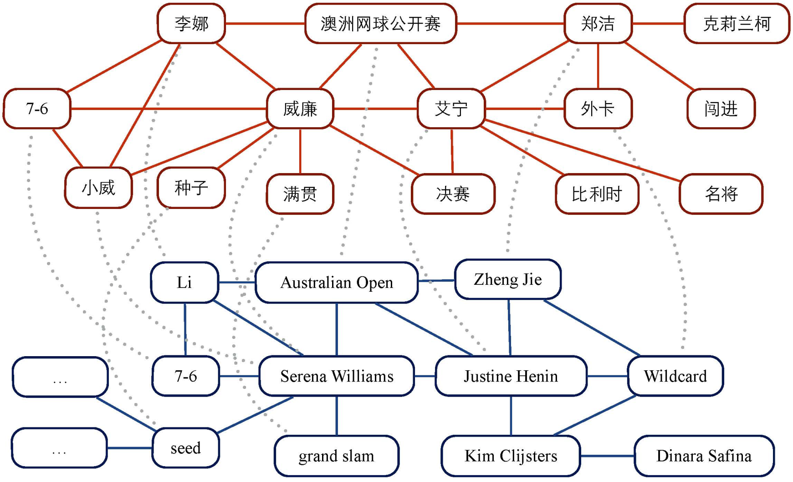
Name Translation Mining
Mine name pairs from non-parallel data using co-burst graph decipherment
Burst entities/events tend to appear across languages; Exploit temporal, graph structure, pronunciation constraints, semantic LMs (Ge et al., 2015submission)
Go beyond transliteration (e.g. 巴本德 (ba ben de) = Papandreou)
Discover new phrases (e.g., 小威 (little Wei) = Serena Williams)

Slide 43

Error Analysis

Slide 44
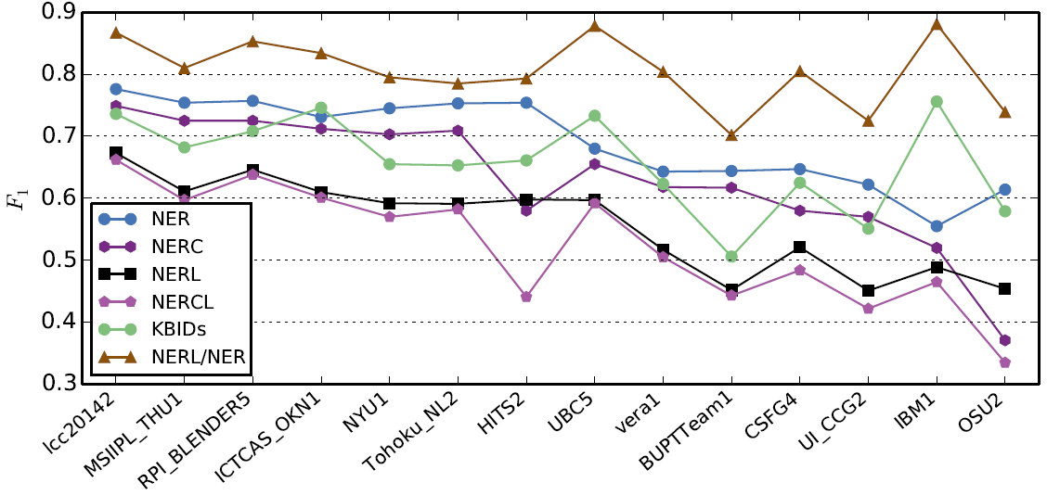
English Entity Mention Extraction
75%, Much lower than state-of-the-art name tagging (89%)
NER: span; NERC: span_type; NERL: span_type_KBID KBIDs: docid_KBID

Slide 45
What’s Wrong?
Name taggers are getting old (trained from 2003 news & test on 2012 news)
Genre adaptation (informal contexts, posters)
Revisit the definition of name mention – extraction for linking
Old unsolved problems
  Identification: “Asian Pulp and Paper Joint Stock Company , Lt. of Singapore”
  Classification: “FAW has also utilized the capital market to directly finance,…” (FAW = First Automotive Works)
  Potential Solutions for Quality
  Word clustering, Lexical Knowledge Discovery (Brown, 1992; Ratinov and Roth, 2009; Ji and Lin, 2010)
  Feedback from Linking, Relation, Event (Sil and Yates, 2013; Li and Ji, 2014)
Chinese Name Tagging
  会议由中国佛教协会副会长[嘉木样・洛桑久美・图丹却吉尼玛仁波切]person活佛主持
  Is [圣辉大 (Shen Huida)]person和尚(monk) or
  [圣辉(Shen Hui)]person大和尚 (major monk)?

Slide 46


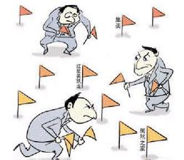
What are We still Missing for Linking?
Knowledge Gap between Source and KB
  Source: breaking events, new information, trending topics, or even mundane details about the entity
  KB: a snapshot summarizing only the entity’s most representative and important facts
  AMR’s synthesis of words and phrases from surface texts into concepts provides the first step
Remaining Challenges
  Explore Even Richer AMR
    Richer Node / Link Types for Context Selection
    Cross-sentence Nominal / Pronoun Coreference Resolution
  Knowledge Synthesis and Reasoning
  Background Knowledge Acquisition
  Commonsense Knowledge Acquisition
  Better Collaborator Selection for Collective Inference
  Morphs: the 98% Accuracy Upper-bound
Notes:
Abstract Meaning Representation (AMR) (Banarescu et al., 2013) 2 is a sembanking language that utilizes multi-layer linguistic analysis such as PropBank frames, non-core semantic roles, coreference, named entity annotation, modality and negation to represent the semantic structure of a sentence.

Slide 47
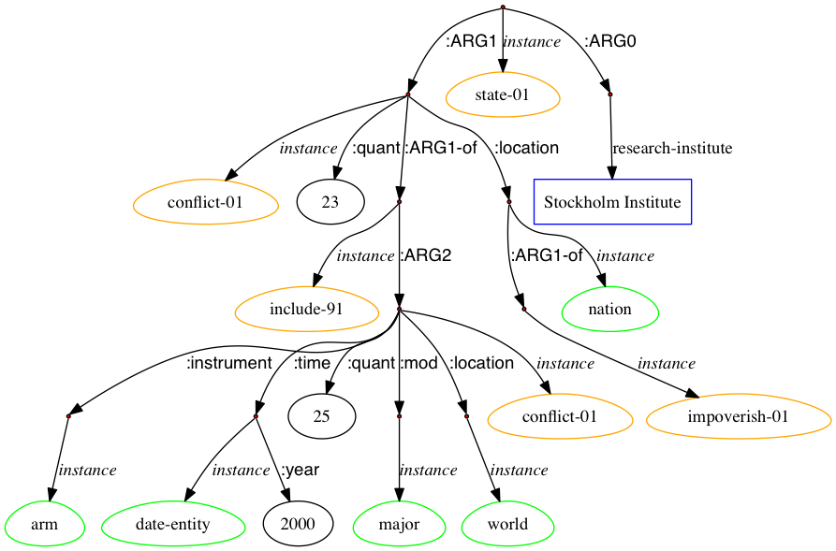
Explore Even Richer AMR
The Stockholm Institute stated that 23 of 25 major armed conflicts in the world in 2000 occurred in impoverished nations.
Stockholm International Peace Research Institute
Stockholm Institute of Education

Slide 48
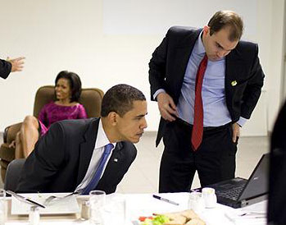
Knowledge Synthesis and Reasoning
Source | KB
Christies denial of marriage priviledges to gays will alienate independents and his “I wanted to have the people vote on it” will ring hollow. | Christie has said that he favoured New Jersey's law allowing same-sex couples to form civil unions, but would veto any bill legalizing same-sex marriage in New Jersey
It was a pool report typo. Here is exact Rhodes quote: ”this is not gonna be a couple of weeks. It will be a period of days.” He singled out a Senate resolution that passed on March 1st . | In 2007, Rhodes began working as a speechwriter for the 2008 Obama presidential campaign.

Slide 49
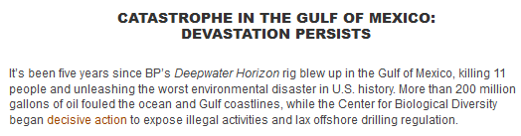

Background Knowledge Acquisition
Source | KB
I went to youtube and checked out the Gulf oil crisis: all of the posts are one month old, or older… | On April 20, 2010, the Deepwarter Horizon oil platform, located in the Mississippi Canyon about 40 miles (64 km) off the Louisiana coast, suffered a catastrophic explosion; it sank a day-and-a-half later
Translation out of hype-speak: some kook made threatening noises at Brownback and go arrested | Samuel Dale "Sam" Brownback (born September 12, 1956) is an American politician, the 46th and current Governor of Kansas.

Slide 50
Commonsense Knowledge
2008-07-26
During talks in Geneva attended by William J. Burns Iran refused to respond to Solana’s offers.
William_Joseph_Burns (1956- )
William_J._Burns (1861-1932)
The petition demanded the introduction of a parliament elected by all adults - men and women in Saudi Arabia.
Consultative Assembly of Saudi_Arabia
Millions of Americans went to war for America, and came back broken or otherwise gave up a lot, and now we look to take a huge chunk of their hide because Washington no longer works.
Federal government of the United States

Slide 51
  Better Collaborator Selection for Collective Inference
Two mentions can be collectively linked because they are often involved in some specific types of relations and events
Not because they are involved in a syntactic structure
  e.g., conjunction, dependency relation, predicate-argument structure
Not because they co-occur
But high-quality relation/event extraction (e.g., ACE) is limited to a fixed set of pre-defined types
Possible solution: never-ending construction of background knowledge of real-time relations and events, then infer collaborators from this background knowledge base
Notes:
Two broad… co-occurrence, and two narrow using amr
How to balance?
Corrobarive filtering build matrix between entity and word, SVD. Yu…
Discourse parsing using embeddings..
Detect threads using topic shifting, focus detection.
Detect the scope of discourse for finding collaborators. For bill…trorpe
Limitation of discourse parsing, no connectives
KB construction : mention elements

Slide 52
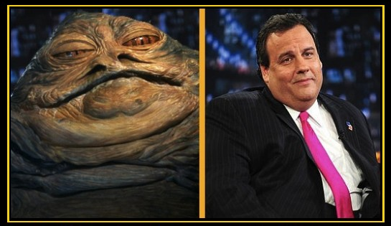
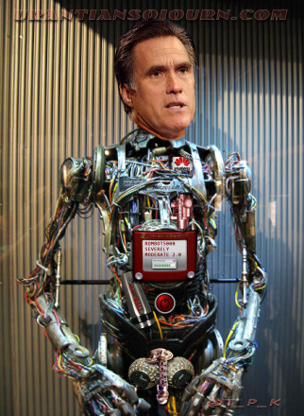
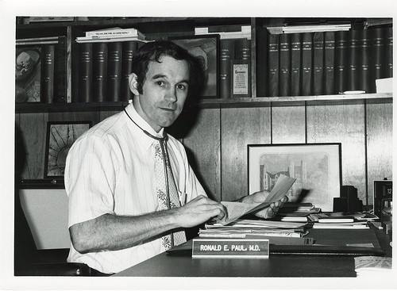
Morphs
They passed a bill, and Christie the Hutt decides he's stull sucking up to be RomBot's running mate.
I think the Good Doctor is too crazy to hang it up.
Chris Christie
Mitt Romney
Ron Paul
Notes:
Morphs
Morph resolution using deep learning
nickname
background knowledge base about good doctor.
Background knowledge KB construction, real time from the web
Search for external docs (web docs) for both candidate retrieval and ranking improvement.
Morph resolution to get new candidates.

Slide 53
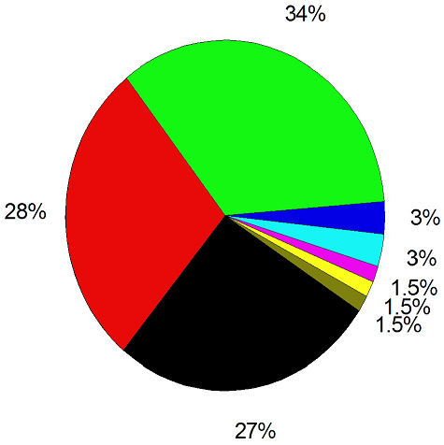
Person Name Translation
Name Transliteration + Global Validation:
克劳斯 (Klaus), 莫科(Moco)
比兹利 (Beazley), 皮耶 (Pierre)…
Name Pair Mining
and Matching
(common foreign
names)
Pronounciation vs.
Meaning confusion
拉索 (Lasso vs. Cable)
何伯 (He Uncle)
伊莎贝拉 (Isabella), 斯诺(Snow),
林肯(Lincoln), 亚当斯(Adams)…
Entity type confusion
魏玛 (Weimar vs. Weima)
Chinese Name vs.
Foreign Name confusion
洪森 (Hun Sen vs. Hussein)
Origin confusion
Mixture of Chinese Name
vs. English Name
Chinese Names (Pinyin)
王其江 (Wang Qijiang), 吴鹏(Wu Peng), …
王菲 (Faye Wong)

Slide 54

Resources

Slide 55
Resources
LDC Data and resources are listed in the evaluation license
  Some overlapped data sets including multi-layer annotations such as ACE/ERE/AMR/EDL, or entity/MT
  Chinese gender and animacy dictionaries (Zhiyi Song)
tools:
  http://nlp.cs.rpi.edu/kbp/2015/tools.html
  Including RPI Multi-lingual EDL system and Stanford Tri-lingual CoreNLP tools
Reading Lists
  http://nlp.cs.rpi.edu/kbp/2015/elreading.html
BBN, IBM, RPI, LCC’s automatic annotations for KBP source collection
Chinese-English Name Translation Pairs
  RPI > 2 million pairs semi-automatically discovered
  LDC has Chinese-English name dict/dicts with frequency information

Slide 56

We can do it!

Slide 57
Mention Identification (Cont’)
Wikipedia Lexicon Construction based on prior link knowledge
  Only n-grams linked in training data (prior anchor text) (Ratinov et al., 2011; Davis et al., 2012; Sil et al., 2012; Demartini et al., 2012; Wang et al., 2012; Han and Sun, 2011; Han et al., 2011; Mihalcea and Csomai, 2007; Cucerzan, 2007; Milne and Witten, 2008; Ferragina and Scaiella, 2010)
    E.g. all n-grams used as anchor text within Wikipedia
  Only terms that exceed link probability threshold (Bunescu, 2006; Cucerzan, 2007; Fernandez et al., 2010; Chang et al., 2010; Chen et al., 2010; Meij et al., 2012; Bysani et al., 2010; Hachey et al., 2013; Huang et al., 2014)
  Dictionary-based chunking
  String matching (n-gram with canonical concept name list)
Mis-spelling correction and normalization (Yu et al., 2013; Charton et al., 2013)
Notes:
.
We will go over some successful entity mention detection methods (Li and Ji, 2014submission), and highlight some simple yet effective general mention extraction methods based on mining Wikipedia structures and constructing Wikipedia Lexicon (Bunescu, 2006; Cucerzan, 2007; Fernandez et al., 2010; Chang et al., 2010; Chen et al., 2010; Meij et al., 2012; Bysani et al., 2010; Hachey et al., 2013; Huang et al., 2014submission). Due to the noise in informal genres such as web blogs and discussion forums, some systems also performed mis-spelling correction and normalization (Yu et al., 2013; Charton et al., 2013).
XXX to add references
Note that filtering is necessary even if only previous anchor text is used for efficiency! (at least for longer texts or a high-volume data stream)

Slide 58
Putting it All Together
Learning to Rank [Ratinov et. al. 2011]
  Consider all pairs of title candidates
    Supervision is provided by Wikipedia
  Train a ranker on the pairs (learn to prefer the correct solution)
  A Collaborative Ranking approach: outperforms many other learning approaches (Chen and Ji, 2011)
 | Score Baseline | Score Context | Score Text
Chicago_city | 0.99 | 0.01 | 0.03
Chicago_font | 0.0001 | 0.2 | 0.01
Chicago_band | 0.001 | 0.001 | 0.02
Notes:
To DR Comment: I do not have the additional data with feature values here, unfortunately.
Double check: “all pairs of title candidates” (is this phrased correctly?)

Slide 59
Goal: Cross-lingual KBP
Source Collection
13岁以前的杨丽萍，是云南一个山村小镇里光着脚丫到处拾麦穗的乡下小姑娘，在洱海之源过着艰苦而又不无乐趣的童年生活。
Now, Ms. Yang, one of China's best-known dancers, is the director, choreographer and star of …
Aunque nacida en Dali, a la edad de nueve años Yang se mudó con su familia a Xishuangbanna. Debido a su extraordinario talento, la eligieron para integrar la Agrupación Artística de Canto …
…
KB
Liping Yang
Liping Yang
Spouse: Liu Chunqing
Employer: University of Maine
Title: Professor
Employer: Ningbo
Title: Mayor
State/Province-of-Residence: Yunnan
Notes:
Find other famous yangliping

Slide 60

Entity Linking to Improve Relation Extraction (Chan and Roth, 2010)
David
Cone
,
a
Kansas
City
native
,
was
originally
signed
by
the
Royals
and
broke
into
the
majors
with
the
team
David Brian Cone (born January 2, 1963) is a former Major League Baseball pitcher. He compiled an 8–3 postseason record over 21 postseason starts and was a part of five World Series championship teams (1992 with the Toronto Blue Jays and 1996, 1998, 1999 & 2000 with the New York Yankees). He had a career postseason ERA of 3.80. He is the subject of the book A Pitcher's Story: Innings With David Cone by Roger Angell. Fans of David are known as "Cone-Heads."
Cone lives in Stamford, Connecticut, and is formerly a color commentator for the Yankees on the YES Network.^{[1]}
Contents
[hide]
1 Early years
2 Kansas City Royals
3 New York Mets
Partly because of the resulting lack of leadership, after the 1994 season the Royals decided to reduce payroll by trading pitcher David Cone and outfielder Brian McRae, then continued their salary dump in the 1995 season. In fact, the team payroll, which was always among the league's highest, was sliced in half from $40.5 million in 1994 (fourth-highest in the major leagues) to $18.5 million in 1996 (second-lowest in the major leagues)
60

Slide 61
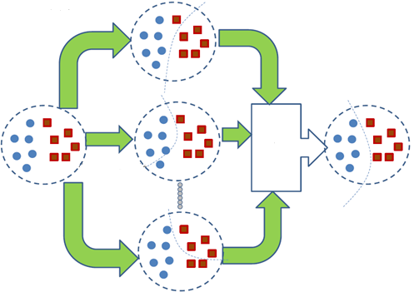
Collaborative Clustering (Chen and Ji, 2011; Tamang et al., 2012)
Consensus functions
  Co-association matrix (Fred and Jain,2002)
  Graph formulations (Strehl and Ghosh, 2002; Fern and Brodley, 2004): instance-based; cluster-based; hybrid bipartite
12% gain over the best individual clustering algorithm
clustering1
final clustering
consensus
function
clusteringN
Notes:
We have applied four similarity functions, including unsupervised learning (cosine and correlation) and supervised learning models (Maximum Entropy and Support Vector Machines). The supervised learning models can be re-trained with any given labeled data and any enriched feature sets. Finally, we developed four consensus functions based on co-association matrix (Fred and Jain, 2002) and graph formulation (Strehl and Ghosh, 2002; Fern and Brodley, 2004). Our preliminary experiments showed that CC can obtain 12% gain over the best individual clustering algorithm (Chen, 2012; Tamang et al., 2012).
. We expect this idea to inspire a completely new philosophy for fact
extraction which will be essential for the creation of a high-quality StructNet.
Incorporate arbitrary global features and soft constraints;
Features are automatically learned selectively
Save some human knowledge engineering efforts
Capture inter-dependency knowledge on the entire structure
Efficient linear-time beam search by joint learning and decoding
No need to model joint/conditional distribution with a large number of variables
Extract all facts jointly in a unified framework
Local predictions can be mutually improved
Avoid error compounding problem

Slide 62
Toward Deep Understanding of Full Documents
Old Query-driven Entity Linking
  Limited exploration of co-occurring entity mentions
  Bag-of-words style
EDL
    Deep representation and understanding the relations among entities in the source documents
    Natural Language Understanding style
    e.g., Use Abstract Meaning Representation (Pan et al., NAACL2015)

Slide 63
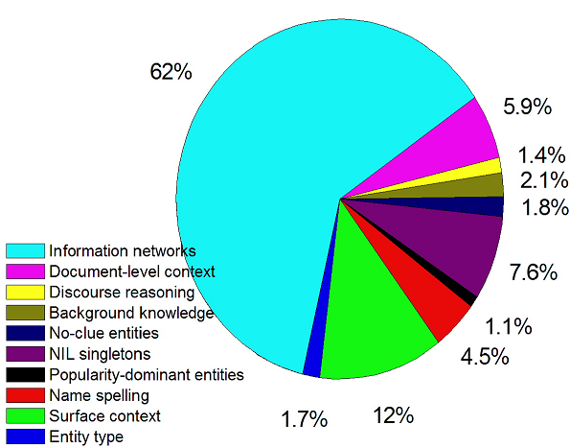
CLEL Knowledge Categorization
  “何伯” (He Uncle) refers to
  “an 81-years old man” or “He Yingjie”
  News reporter
  “Xiaoping Zhang”,
  Ancient people
  “Bao Zheng”
“丰华中文学校
(Fenghua Chinese School)”
  莱赫. 卡钦斯基
  (Lech Aleksander Kaczynsk) vs.
  雅罗斯瓦夫. 卡钦斯基
  (Jaroslaw Aleksander Kaczynski)

