Slide 1
Overview of KBP2015 Tri-lingual Entity Discovery and Linking
Heng Ji
jih@rpi.edu
Thanks to KBP2015 Organizing Committee

Slide 2
Goals and The Task

Slide 3
DEFT Example Chinese
Source Material
DEFT Output
A: 你在哪?我们等了你一整天,你都没来。 B: 我没法过去,没办法。他们…他们无所不在。连一只老鼠都没法穿过去。 A: 你应该想个办法。你知道我们明天的…的派对需要这些东西。我们今晚需要一个新的地点见面。那间…嗯…嗯…房子怎么样?你知道的,我们上次见面的那间。 B: 你是说你叔叔家? A: 对,跟上次一样。不要忘了任何东西。我们需要全部的东西。我已经付了你钱,所以你最好交差。你这次最好别再 搞砸了。
Who
A: 你在哪?我们等了你一整天,你都没来。 B: 我没法过去,没办法。他们…他们无所不在。连一只老鼠都没法穿过去。 A: 你应该想个办法。你知道我们明天的…的派对需要这些东西。我们今晚需要一个新的地点见面。那间…嗯…嗯…房子怎么样?你知道的,我们上次见面的那间。 B: 你是说你叔叔家? A: 对,跟上次一样。不要忘了任何东西。我们需要全部的东西。我已经付了你钱,所以你最好交差。你这次最好别再 搞砸了。
Planner(A), Courier(B)
DEFT Algorithms
What
Meeting(1),Meeting(2)
Superior(A,B)
When Where
TodayPM(2) Location(2,UncleHouse)
How
Via(Transfer(B,A,Stuff), Meeting(2))
Why
Cause(~Passage,Failed(1))
Opinion
Negative(A,FailedMeeting)

Slide 4
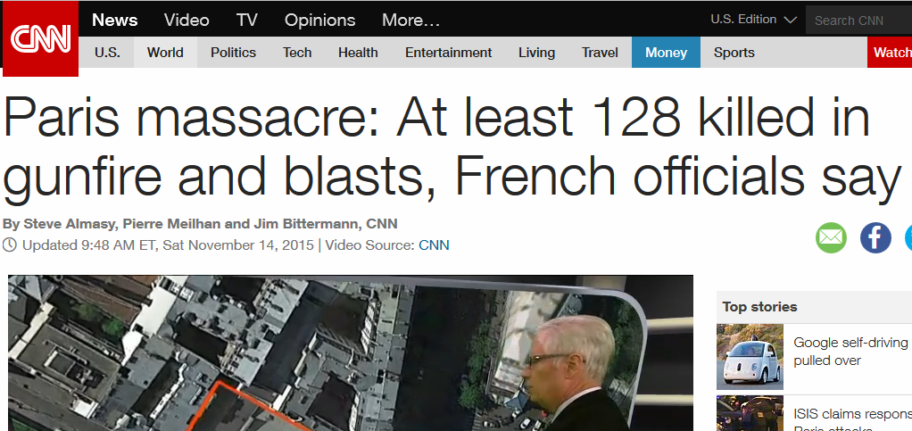
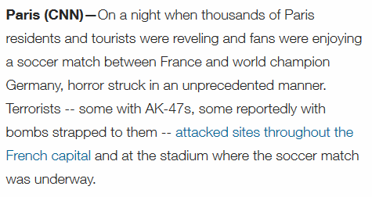
Motivations
Cross-lingual knowledge fusion: For certain entities and events, new and detailed information is only available in low-resource foreign incident languages
Cross-lingual Knowledge transfer: Build cross-lingual links to transfer resources (e.g., annotated data, gazetteers and rich knowledge representations) from English to foreign language EDL

Slide 5
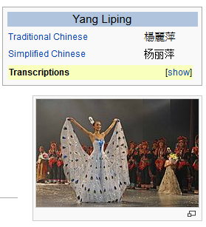
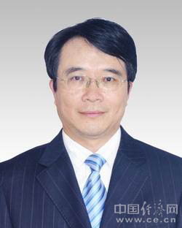
Looking Ahead: Tri-lingual KBP
Source Collection
13岁以前的杨丽萍，是云南一个山村小镇里光着脚丫到处拾麦穗的乡下小姑娘，在洱海之源过着艰苦而又不无乐趣的童年生活。
Now, Ms. Yang, one of China's best-known dancers, is the director, choreographer and star of …
Aunque nacida en Dali, a la edad de nueve años Yang se mudó con su familia a Xishuangbanna. Debido a su extraordinario talento, la eligieron para integrar la Agrupación Artística de Canto …
…
KB
Liping Yang
Liping Yang
Spouse: Liu Chunqing
Employer: University of Maine
Title: Professor
Employer: Ningbo
Title: Mayor
State/Province-of-Residence: Yunnan

Slide 6
What’s New in 2015
Extended English EDL task from mono-lingual to tri-lingual
Added two new entity types - natural locations (LOC) and facilities (FAC), for all three languages
gradually add new entity types into the KBP program
Added person nominal mentions for English
cluster nominal mentions for creating new entries in KB
Prepared and used a new KB based on Freebase snapshot
Defined a new diagnostic task of English Entity Discovery within the Cold-start KBP track

Slide 7
The Task
http://nlp.cs.rpi.edu/kbp/2015/
Source Collection
13岁以前的杨丽萍，是云南一个山村小镇里光着脚丫到处拾麦穗的乡下小姑娘，在洱海之源过着艰苦而又不无乐趣的童年生活。
Now, Ms. Yang, one of China's best-known dancers, is the director, choreographer and star of …
Aunque nacida en Dali, a la edad de nueve años Yang se mudó con su familia a Xishuangbanna. Debido a su extraordinario talento, la eligieron para integrar la Agrupación Artística de Canto …
…
KB
Liping Yang
Liping Yang

Slide 8
The Task
Input
A set of raw documents in English, Chinese and Spanish
Output
Document ID, mention ID, head, offsets
Entity type: GPE, ORG, PER, LOC, FAC
Mention type: name, nominal (person individual specific mentions, for English only in 2015)
Reference KB link entity ID, or NIL cluster ID
Confidence value
Diagnostic Tasks
Mono-lingual and Bi-lingual EDL
Entity Linking with Perfect Mention Identification (Boundaries)
Entity Discovery in Cold-Start

Slide 9
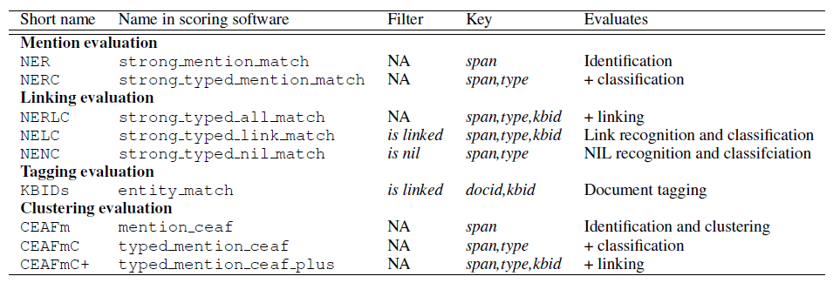
Evaluation Measures
New Enhanced Metrics
CEAFmC: adding type match into CEAFm
CEAFmC+: CEAFmC+ KB ID matching: end to end metric for extraction, linking and clustering
CEAFm-weak: allow weak boundary matching, implemented a new maximal alignment algorithm

Slide 10
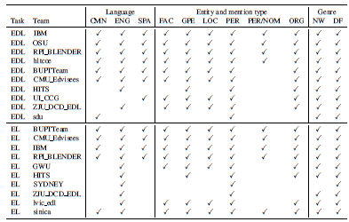
Participants

Slide 11
Data Annotation and Resources
Details in LDC talk and resource overview paper (Ellis et al., 2015)
Training
Evaluation
Tools
http://nlp.cs.rpi.edu/kbp/2015/tools.html
Reading List
http://nlp.cs.rpi.edu/kbp/2015/elreading.html

Slide 12
The Results

Slide 13
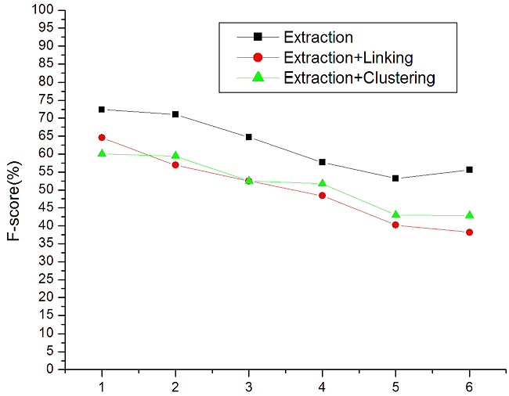
Tri-lingual EDL Performance
Tri-lingual EDL performance (CEAFm) is only 11% lower than KBP2014 mono-lingual English EDL
But the best Tri-lingual mention extraction F-score is not great: 72.4%; the highest mention identification recall is 72.7%

Slide 14
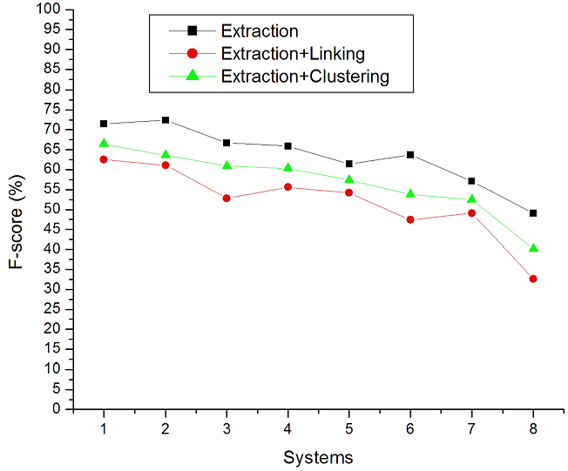
English EDL Performance
The best English mention extraction F-score is not great: 76.1%; looks lower than state-of-the-art English mention extraction performance 80.8% for clean ACE newswire data (Florian et al., 2006; Li et al., 2014; Lu and Roth, 2015)
But Great News (Great thanks Hans!): IBM mention detection system is much better than ACE system from a decade ago
Mention F-score: 62.7% → 71.5%
English Extraction+Linking is much more difficult than KBP2014

Slide 15
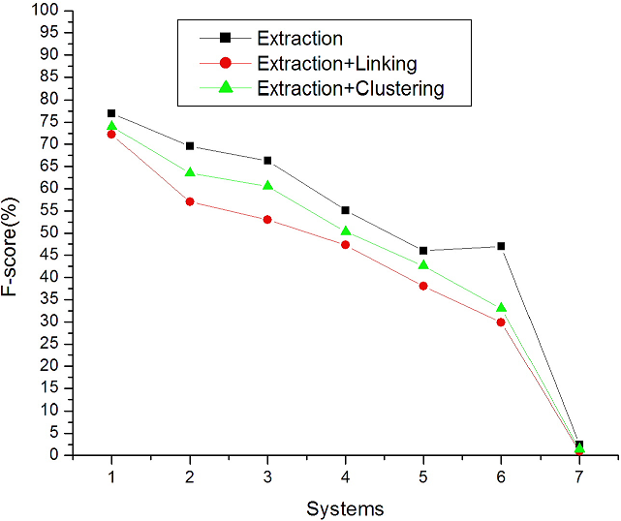
Chinese EDL Performance
Most systems used Chinese EDL + Entity Translation
Name Mention extraction performance is much lower than state-of-the-art English and Chinese name tagging F-scores (around 89%) on news data (Finkel et al., 2005; Li et al., 2012)

Slide 16
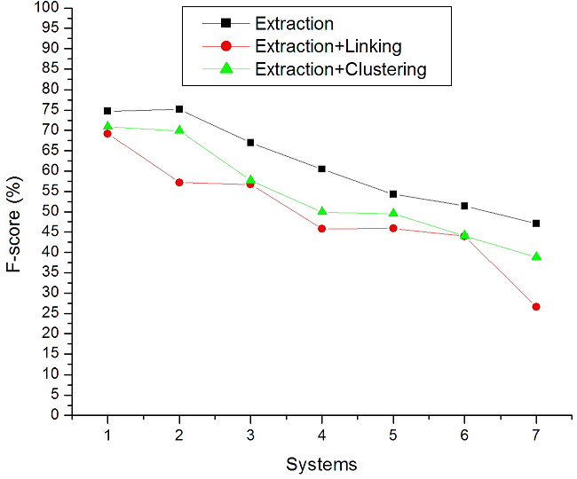
Spanish EDL Performance
Most systems used Spanish-to-English MT + English EDL

Slide 17
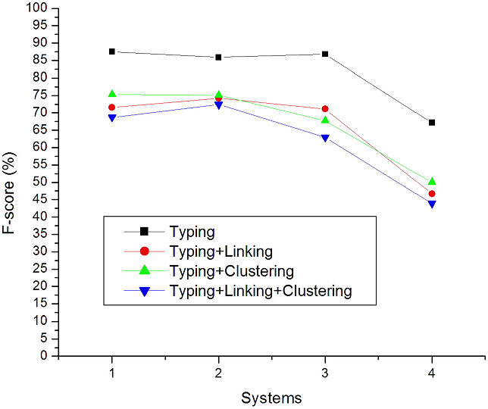
Tri-lingual EL Performance
Best typing+clustering: 75.3% (EL) vs. 55.1% (EDL)
Best typing+clustering+linking: 72.4% (EL) vs. 59.4% (EDL)
Entity mention identification is a major challenge for EDL
Best system used cross-lingual knowledge transfer + unsupervised linking

Slide 18
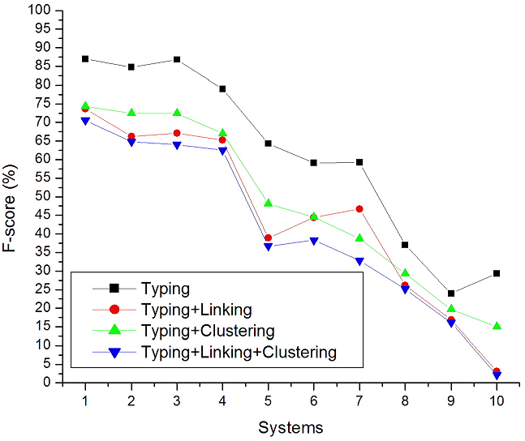
English EL Performance

Slide 19
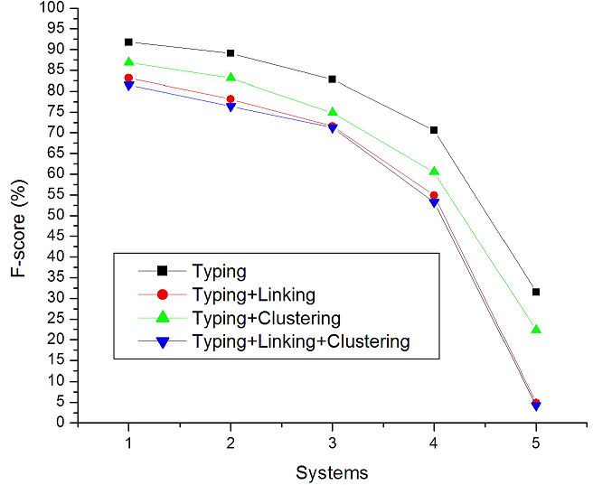
Chinese EL Performance

Slide 20
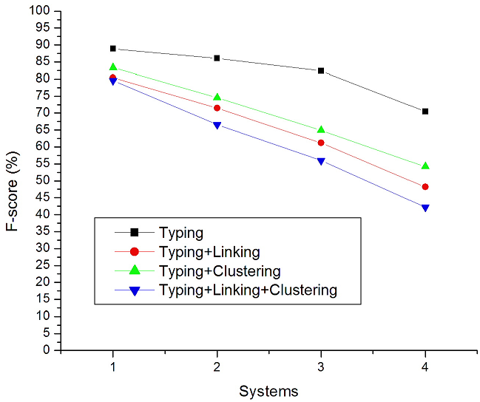
Spanish EL Performance
F-score of English name tagging on Spanish-to-English MT output is 10% higher than Spanish name tagging (Sammons et al., 2015)

Slide 21
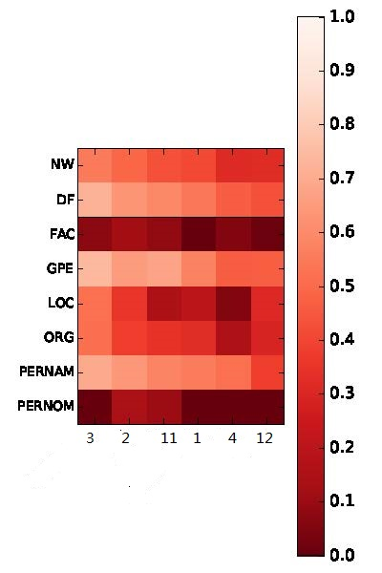
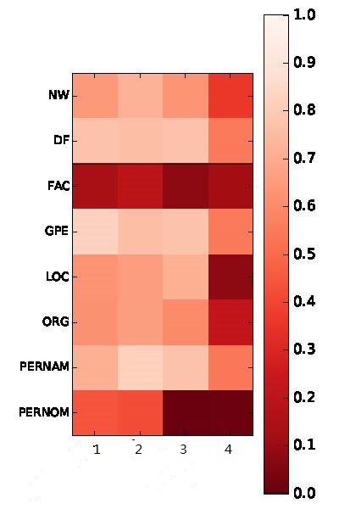
Entity Types and Textual Genres
EDL
EL
Nominal challenge: genericity/specificity
Facility is the most difficult type

Slide 22
Are We Picking the Same Low-Hanging Fruit?
Re: Benjamin’s question – are top systems finding the same easy ones?
Are we facing the same difficulty?
A case study on comparing IBM EL vs. RPI EL (Credit: Xiaoman Pan)

Slide 23
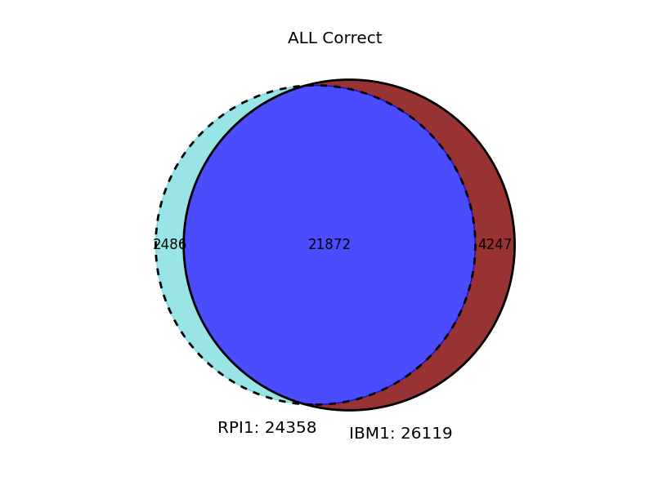
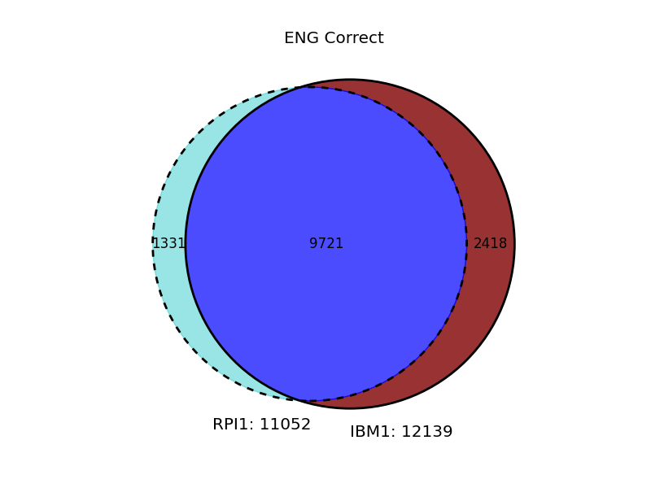
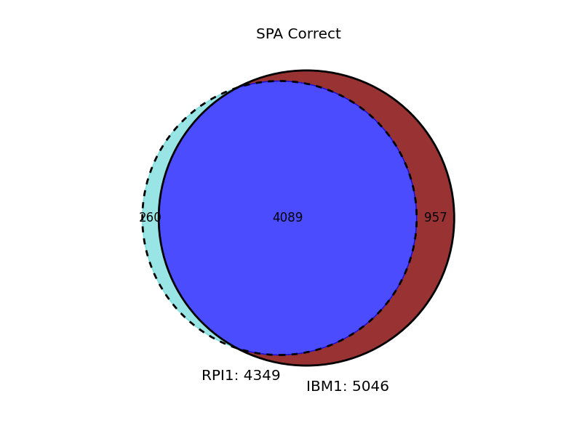
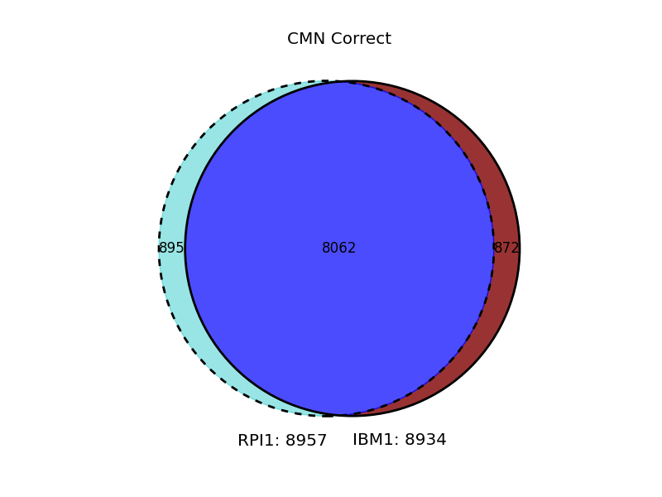

Slide 24
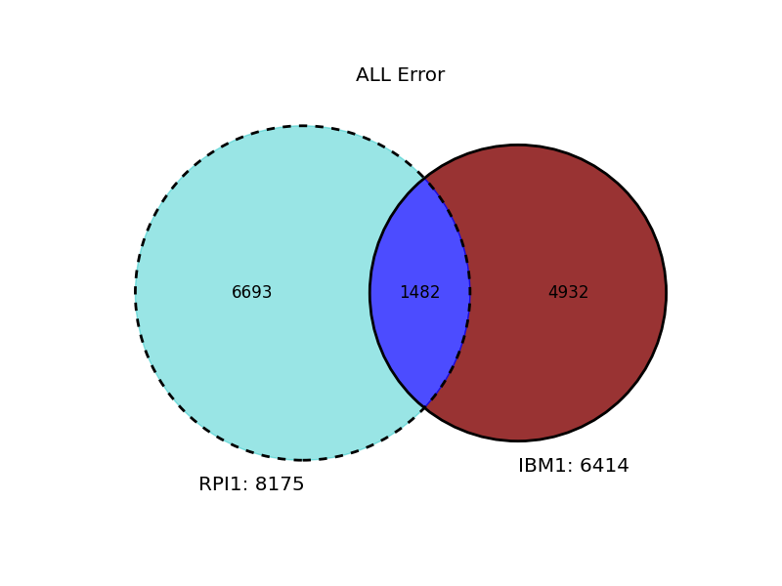
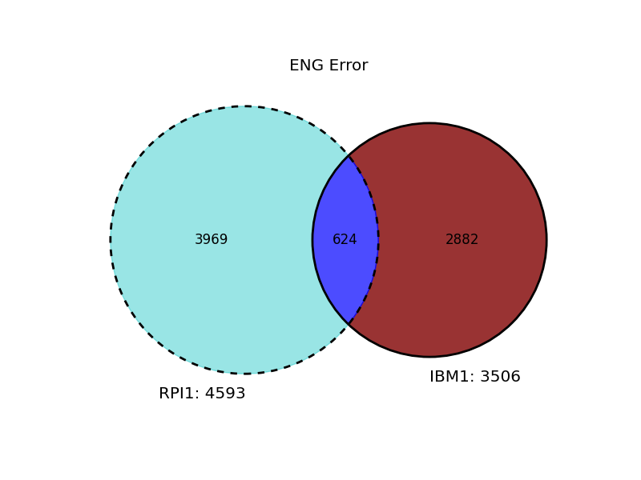
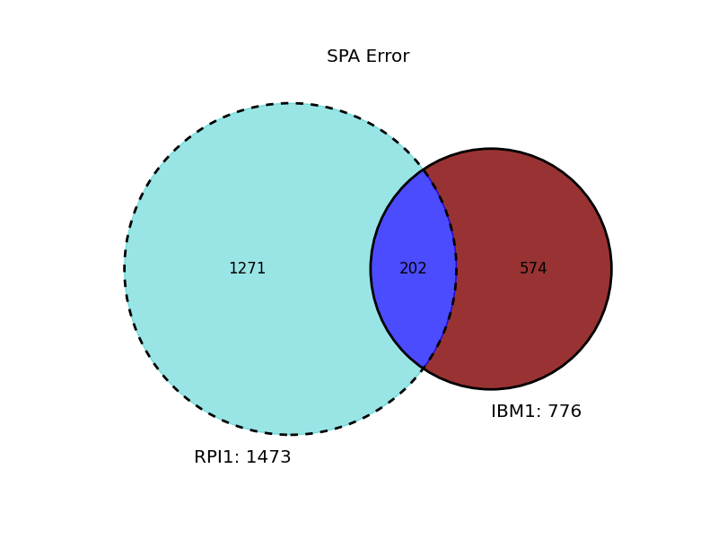
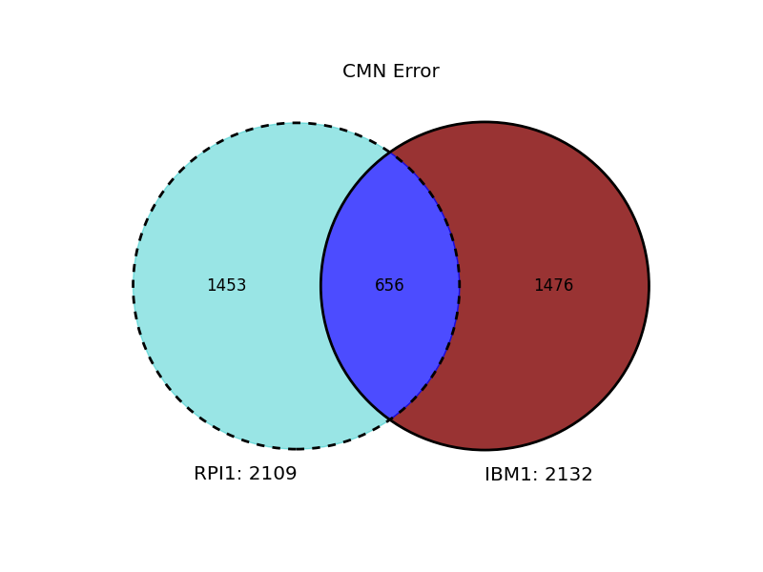

Slide 25
 | Sim(err)
ENG | 8.51%
CMN | 18.24%
SPA | 9.86%
ALL | 11.31%
 | Sim(cor)
ENG | 72.16%
CMN | 82.01%
SPA | 77.06%
ALL | 76.16%

Slide 26
3/4 happy families resemble each other, while unhappy ones are 9/10 different.
https://blender04.cs.rpi.edu/~panx2/tmp/edl15out/ana/err_ana.html
EDL Ensemble?

Slide 27
What’s New and What Works

Slide 28
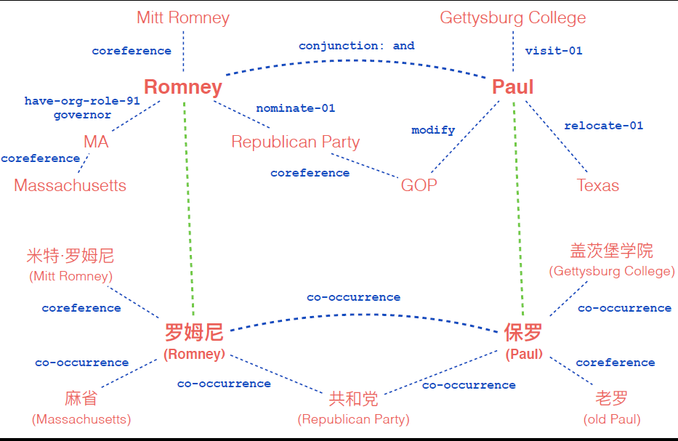
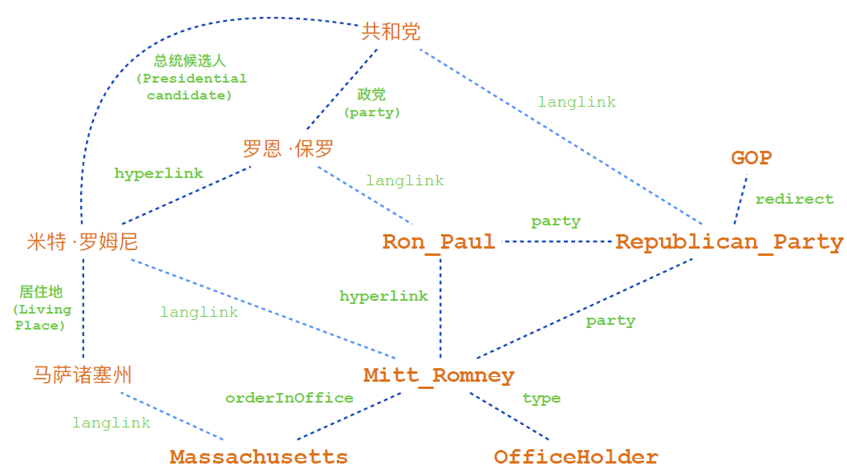
Cross-lingual Knowledge Transfer
RPI system (Hong et al., 2015) developed a joint mention extraction, translation and linking model and enhanced the quality of mention boundary identification, typing, translation and linking simultaneously
HLT-COE system (Finin et al., 2015) found cross-lingual coreference and inference can greatly decrease the number of candidate clusters and thus reduce ambiguity

Slide 29
Tackling Nominal Mentions
Distinguish specific and generic nominal mentions (RPI, Hong et al., 2015): 46% F-score on nominal mention extraction
Hypothetical
Apparently, Bibi assumes that the next GPE US President will see things much more his way than does Barack Obama. If H is the nominee, he may be right.
because it is so widely presumed that H is the inevitable candidate.
And if something happened to Hillary he could become president.
Subjective Mood
while President Hillary Clinton lived in the White House ... Vice President Bill C would reside at N.
Generic Referent
instead it’s the US President who should take the abuse and apologize for having a backbone.
“which lists they shall sign and certify, and transmit sealed to the seat of the government of the United States, directed to the President of the Senate.“
Within-document coreference resolution
Linking each identified person nominal mention to its closest person name mention: 67% accuracy

Slide 30
Global Knowledge Derived from KB
Entropy based measure to quantify the discriminative power of link types in KB (RPI, Hong et al., 2015)
IBM (Sil et al., 2015) proposed a global feature based on PMI for the Wikipedia categories of consecutive pairs of entities
Many systems including HITS (Heinzerling et al., 2015), LVIC (Besancon et al., 2015), IBM (Sil et al., 2015) and RPI (Hong et al., 2015) utilized entity linking results as feedback to map the entity properties in KB to one of the five types defined in KBP
RPI designed a mapping table between Abstract Meaning Representation (AMR) (Banarescu et al., 2013) type and DBPedia rdf:type
e.g., university – TechnicalUniversitiesAndColleges
Typing F1 score is 93.2% for perfect mentions in English training data

Slide 31
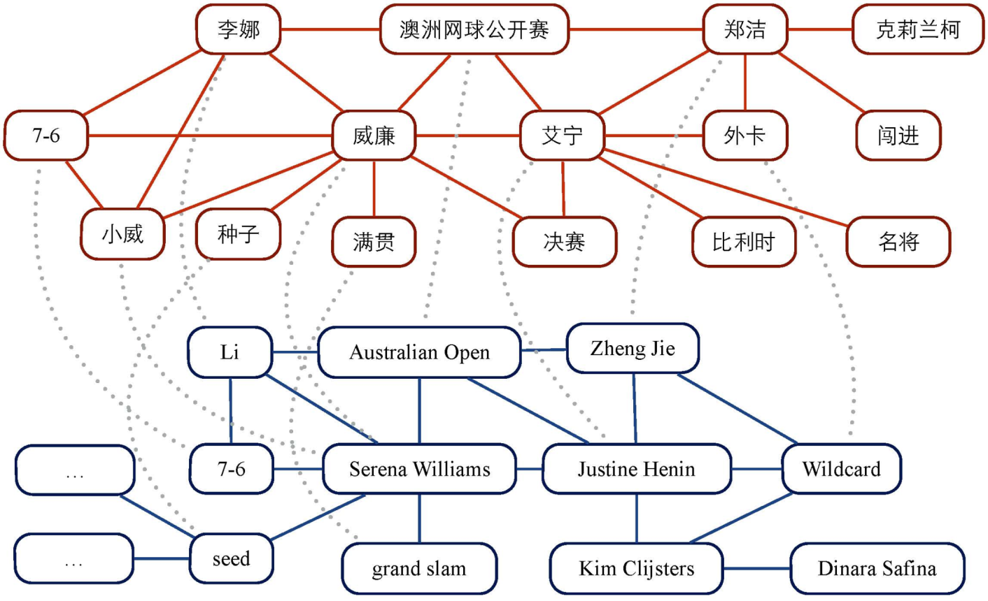
Name Translation Mining
Unsupervised phrase mining based on statistical measures [Liu et al. 15]
Popularity, Informativeness, Completeness, Coherence
Language-independent Burst Detection [Ge et al. 14]
Graph alignment based on minimal resources and decipherment [Ge et al. 15submission]
Pronunciation, Translation, Neighbor, Co-burst

Slide 32
Name Translation Mining
周五深夜，俄罗斯知名反对派领袖鲍里斯·Y·涅姆佐夫(Boris Y. Nemtsov)在莫斯科市中心遭枪击身亡，遇难地距离克里姆林宫的围墙几步之遥。 周六凌晨1点刚过不久，俄罗斯内政部 (Interior Ministry)证实了涅姆佐夫遇刺一事。享年55岁的涅姆佐夫曾是鲍里斯·N·叶利钦(Boris N. Yeltsin)的第一副总理，后参与组织反对弗拉基米尔·V·普京(Vladimir V. Putin)的示威活动。 国际文传电讯社(Interfax)援引一名警方知情人士称，这似乎是一次买凶杀人。 本月早些时候，涅姆佐夫曾告诉《对话》(Sobesednik)杂志，他想过俄罗斯总统弗拉基米尔·V·普京(Vladimir V. Putin)可能会杀掉自己，不过，他似乎并没有把这个想法当回事。他说他的母亲比他忧虑的多。 2004年，《福布斯》(Forbes)杂志的保罗·克列布尼科夫(Paul Khlebnikov)遭枪击身亡；2006年，以反对车臣 战争的激烈论战而闻名的安娜·波利特科夫斯卡娅(Anna Politkovskaya)遭到枪杀。2009年，纳塔利娅·埃斯蒂米洛娃(Natalya Estemirova)在北高加索遭遇绑架，并被枪击身亡。
Parenthesis translation mining (Lin et al., 2008, Ji et al., 2009)

Slide 33
Portability for a New Type or a New Language
Fine-grained Entity Typing and Discovery (RPI, Liberal IE, Hong et al., 2015)
Move to a new incident language
IBM (Sil and Florian, 2015) trained a universal linker from English Wikipedia
RPI Liberal IE (Hong et al., 2015) to build EDL for a surprise language overnight

Slide 34
Remaining Challenges

Slide 35
Mention Extraction: OOV Mention Identification
Informal Nominals
OK, what in cheney's background makes you think he's the puppeteer and bush is the puppet?
Kenyan enyan authorities also put a $220,000 (200,000 euro) bounty on the head of the alleged mastermind of the attack, Mohamed Mohamud, - also known as Dulyadin Gamadhere - who is believed to be in Somilia.
Abbreviations
Even the Bush family knew W needed help moving his lips.
Names embedded in URLs and Posters
http://news.yahoo.com/liberal-israelis-netanyahus-win-reality-check-115401998.html
Remove this requirement in KBP2016?
Clearer definition of nested mentions (IBM’s talk)

Slide 36
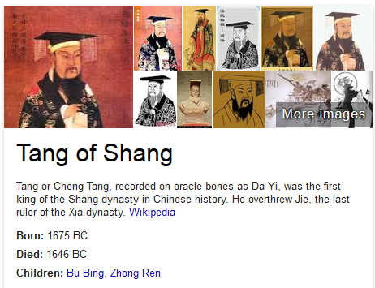
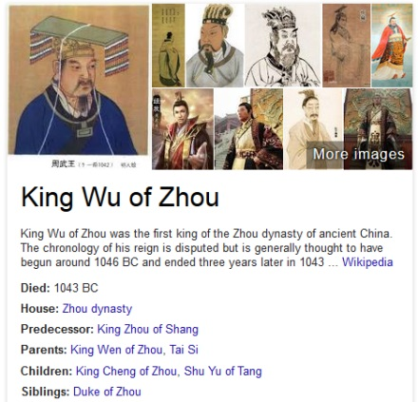
Mention Extraction: OOV Mention Identification
Code-switch
Dahabshiil就是名单上一家汇款公司，它的业务涉及整个非洲之角地区。
Ancient entities
详细解释：出处及演变“革命”一词的古义是变革天命，最早见于《周易·革卦·彖传》：“天地革而四时成，汤武革命，顺乎天而应乎人
Morphs
In KBP2015 EDL training data, about 16% mentions are morphs
所以，我觉得，乡港人还是太没有气魄了，只占领*中*环算什么？

Slide 37
Mention Extraction: Boundary Errors
while Pres [Obama] and Holder are willing to give them a pass.
Let's give Obama a THIRD TERM as President Have [Pelosi] and Reid introduce a Bill to bomb some place that republicans hate.
Some effective text normalization techniques might be worth adding before mention extraction

Slide 38
Joint Linking and Typing: When to trust Whom more?
When to trust typing and when to trust linking?
His stands on fracking, the TPP, indefinite detention, the Patriot Act, torture, war crimes, drone killings, persecution of whistle-blowers and journalists, etc., preclude him from being a "Populist President
TPP: “Trans-Pacific Partnership“ instead of ``Comandante FAP Guillermo del Castillo Paredes Airport (IATA: TPP)“ (facility)
Integrate more reliable confidence estimation.

Slide 39
Machine Translation
Most Spanish-to-English EDL systems used Google/Bing Translation service to translate Spanish documents into English and then apply English EDL to the MT output
Compared to Spanish-to-English MT, state-of-the-art Chinese-to-English MT performance is still not satisfactory
Our previous analysis (Ji et al., 2009) showed that a state-of-the-art Chinese-to-English MT system mis-translated about 40% person names
Most Chinese-to-English EDL systems have chosen an alternative pipeline: Chinese EDL + Entity Translation

Slide 40
Entity Translation
KBP2011 overview paper (Ji et al., 2011) presented the detailed error distributions for Entity Translation
Many of these challenges still remain, especially when the Chinese name is composed based on meanings while the English translation is based on pronunciation
上海国际化自贸区 (Shanghai International Free Trade Zone) →Causeway Bay
State-of-the-art name transliteration models rely on a large amount of name pairs (NEWS workshops)
It would be more promising to focus on automatic name translation mining techniques

Slide 41
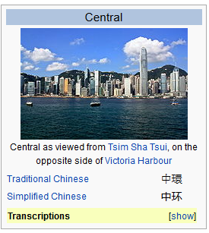
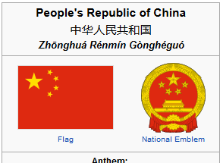
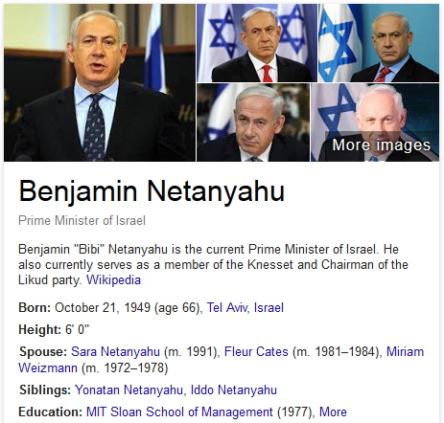
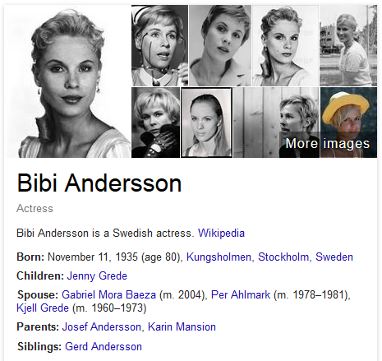
Linking: Abbreviations and Nicknames
Context similarity vs. popularity bias
香港人都支持占中?(Do all of Hong Kong people support Occupy the Central?)
First, as much as Bibi says Israel will go it alone if it has to, I doubt that it would/could.

Slide 42
Linking: Re-visit ``Collaborators" in Collective Inference
Collective Inference: a set of mention collaborators are linked simultaneously by choosing a maximally ``coherent'' set of named entity targets - one target entity for each mention in the coherent set
Many existing methods extract ``collaborators'' based on co-occurrence (Ratinov et al., 2011, Wang et al., 2015), topic relevance (Cassidy et al., 2012), social distance (Cassidy et al., 2012; Huang et al., 2014), dependency relation (Ling et al., 2014), or a combination of these through meta-paths (Huang et al., 2014)
Two mentions can be collectively linked because they are often involved in some specific types of relations and events, not because they are involved in a syntactic structure or they co-occur
Some other work tried to restrict collaborators that bear a specific type of relation (Cheng and Roth, 2013), but high-quality relation/event extraction (e.g., ACE) is limited to a fixed set of pre-defined types
Possible solution: never-ending construction of background knowledge of real-time relations and events, then infer collaborators from this background knowledge base

Slide 43
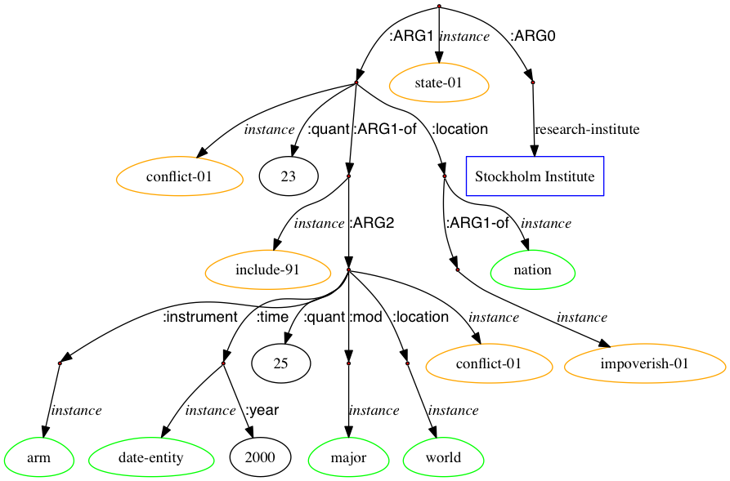
Linking: Knowledge Representation
The Stockholm Institute stated that 23 of 25 major armed conflicts in the world in 2000 occurred in impoverished nations.
Stockholm International Peace Research Institute
Stockholm Institute of Education
Adding even richer types of nodes and edges, and Cross-sentence nominal and pronoun coreference resolution into AMR

Slide 44
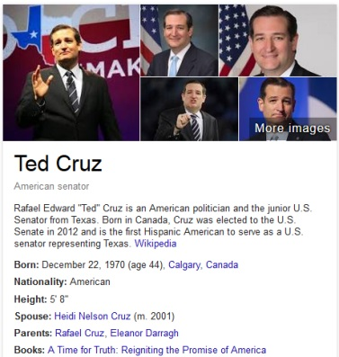
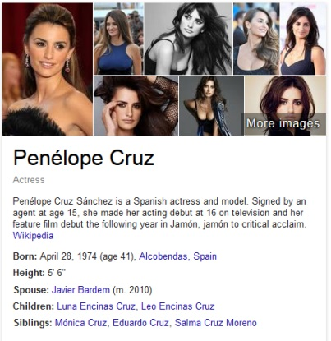
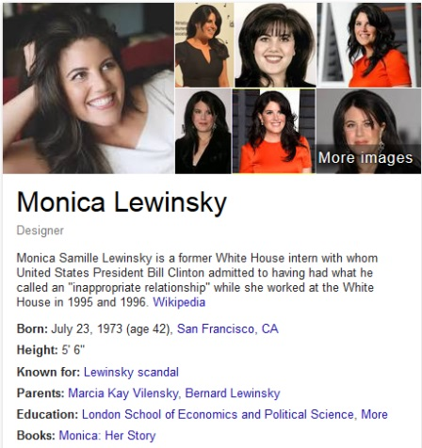
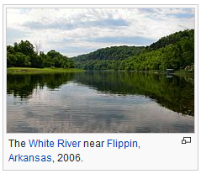
Linking: Background Knowledge
Source | KB
I went to youtube and checked out the Gulf oil crisis: all of the posts are one month old, or older… | On April 20, 2010, the Deepwarter Horizon oil platform, located in the Mississippi Canyon about 40 miles (64 km) off the Louisiana coast, suffered a catastrophic explosion; it sank a day-and-a-half later
What words about Bush, Cruz, Romney, Carson, Walker
Whitewater, Monica, B, infidelity, Foster, health care reform, sniper fire, Sir Edmund Hillary, head trauma, I war vote, support for the Iraq war, email, servers, lesbians........

Slide 45
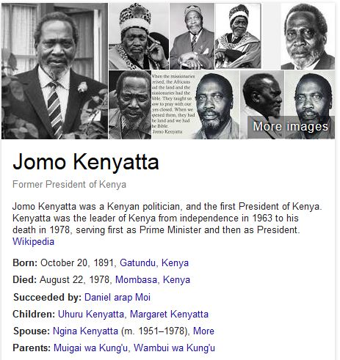
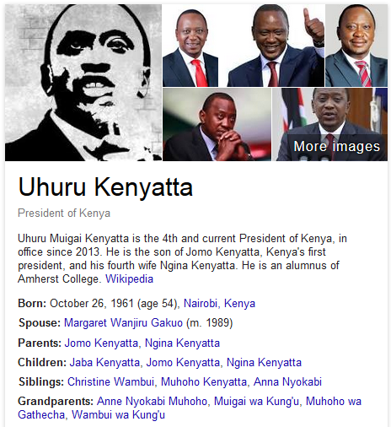
Linking: Commonsense Knowledge
In his first televised address since the attack ended on Thursday, Kenyatta condemned the "barbaric slaughter" and asked help from the Muslim community in rooting out radical elements.
Millions of Americans went to war for America, and came back broken or otherwise gave up a lot, and now we look to take a huge chunk of their hide because Washington no longer works.
Federal government of the United States

Slide 46
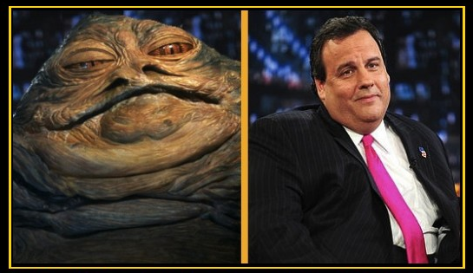
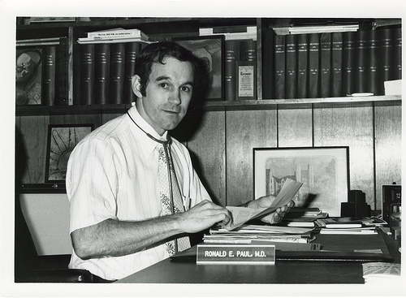
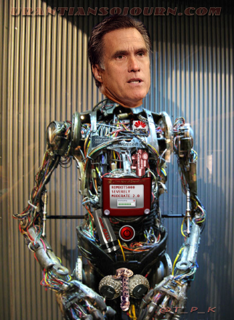
Linking: Morph Decoding
They passed a bill, and Christie the Hutt decides he's stull sucking up to be RomBot's running mate.
I think the Good Doctor is too crazy to hang it up.
Chris Christie
Mitt Romney
Ron Paul

Slide 47
Looking Ahead

Slide 48
Looking Forward to KBP2016 EDL
Combine with tri-lingual slot filling to form up an end-to-end cold-start tri-lingual KBP task
Target at a larger scale data processing, by increasing the size of source collections from 500 documents to >10,000 documents
Add nominal mention EDL into all three languages
Add named class, more fine-grained entity types, or allow EDL systems to automatically discover new entity types
Add streaming data into the source collection
Perhaps replace Spanish with a new low-resource language for which full-document MT techniques are less mature

Slide 49
Looking Ahead: Tri-lingual KBP
Source Collection
13岁以前的杨丽萍，是云南一个山村小镇里光着脚丫到处拾麦穗的乡下小姑娘，在洱海之源过着艰苦而又不无乐趣的童年生活。
Now, Ms. Yang, one of China's best-known dancers, is the director, choreographer and star of …
Aunque nacida en Dali, a la edad de nueve años Yang se mudó con su familia a Xishuangbanna. Debido a su extraordinario talento, la eligieron para integrar la Agrupación Artística de Canto …
…
KB
Liping Yang
Liping Yang
Spouse: Liu Chunqing
Employer: University of Maine
Title: Professor
Employer: Ningbo
Title: Mayor
State/Province-of-Residence: Yunnan

