Slide 1
Overview of KBP2016 Tri-lingual EDL and Its Impact on Cold-Start KBP
Heng Ji, Joel Nothman and Hoa Trang Dang
jih@rpi.edu
Thanks to KBP2016 Organizing Committee

Slide 2
Goals and The Task

Slide 3
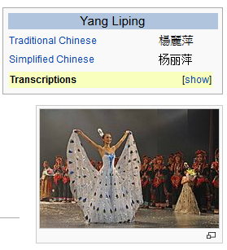
Tri-lingual KBP
Source Collection
13岁以前的杨丽萍，是云南一个山村小镇里光着脚丫到处拾麦穗的乡下小姑娘，在洱海之源过着艰苦而又不无乐趣的童年生活。
Now, Ms. Yang, one of China's best-known dancers, is the director, choreographer and star of …
Aunque nacida en Dali, a la edad de nueve años Yang se mudó con su familia a Xishuangbanna. Debido a su extraordinario talento, la eligieron para integrar la Agrupación Artística de Canto …
…
KB
Liping Yang
Liping Yang
Spouse: Liu Chunqing
Employer: University of Maine
Title: Professor
Employer: Ningbo
Title: Mayor
State/Province-of-Residence: Yunnan

Slide 4
What’s New in 2016
Quality: Combined EDL with Tri-lingual slot filling to form up a new end-to-end tri-lingual KBP task
Scalability: Increased the size of source collections from 500 documents to 90,003 documents
Portability: Extended the task of detecting specific, individual nominal mentions to all five entity types and all three languages
Notes:
Quality
Automatically discovering and clustering nominal mentions, and grounding them to KB or other name mentions is crucial to many real-world applications such as intelligence analysis and product profiling. Therefore we

Slide 5
The Task
http://nlp.cs.rpi.edu/kbp/2016/
Source Collection
13岁以前的杨丽萍，是云南一个山村小镇里光着脚丫到处拾麦穗的乡下小姑娘，在洱海之源过着艰苦而又不无乐趣的童年生活。
Now, Ms. Yang, one of China's best-known dancers, is the director, choreographer and star of …
Aunque nacida en Dali, a la edad de nueve años Yang se mudó con su familia a Xishuangbanna. Debido a su extraordinario talento, la eligieron para integrar la Agrupación Artística de Canto …
…
KB
Liping Yang
Liping Yang

Slide 6
The Task
Input
A large set of raw documents in English, Chinese and Spanish
Output
Document ID, mention ID, head, offsets
Entity type: GPE, ORG, PER, LOC, FAC
Mention type: name, nominal
Reference KB link entity ID, or NIL cluster ID
Confidence value

Slide 7
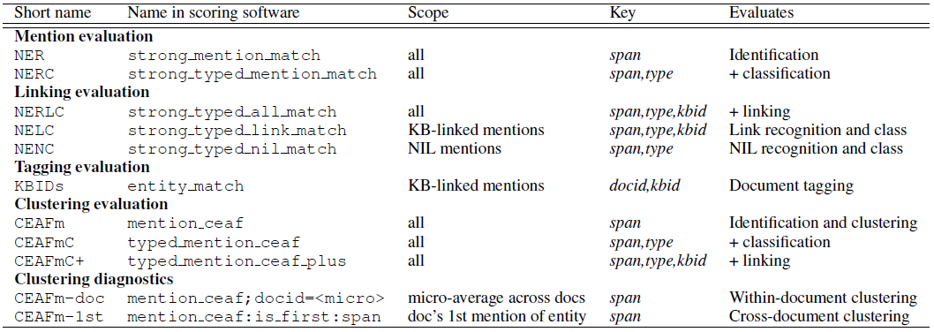
Evaluation Measures
New Diagnostic Metrics
CEAFm-doc: within-document coreference performance, micro-averaging across all documents
CEAFm-1st: approximate cross-document performance by limiting evaluation to the first mention per document of each entity
Confidence intervals: bootstrap resampling documents from the corpus, calculating these pseudo-systems scores, and determining their values at the (100-c)/2 th and (100+c)/2 th percentiles of 2500 bootstrap resamples

Slide 8
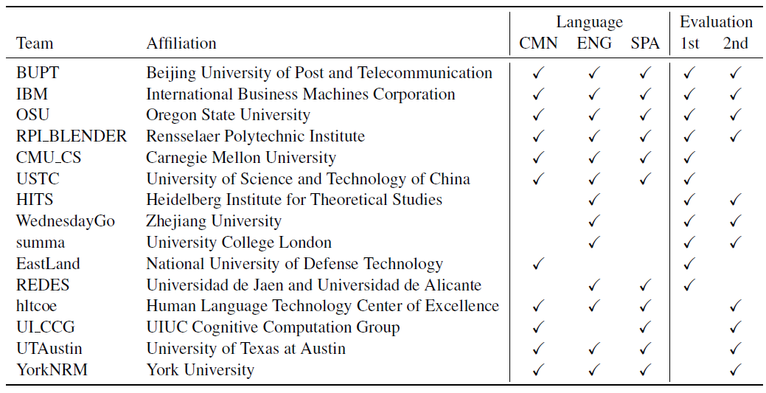
Participants

Slide 9
Data Annotation and Resources
Details in LDC talk and resource overview paper (Ellis et al., 2016)
# Documents in Evaluation Data
# Mentions in Evaluation
# Entities in Evaluation
Tools and Reading List
http://nlp.cs.rpi.edu/kbp/2015/tools.html
http://nlp.cs.rpi.edu/kbp/2015/elreading.html

Slide 10
The Results

Slide 11
Progress from August to September
EDL2015 system
DEFT and LORELEI team
DEFT team

Slide 12
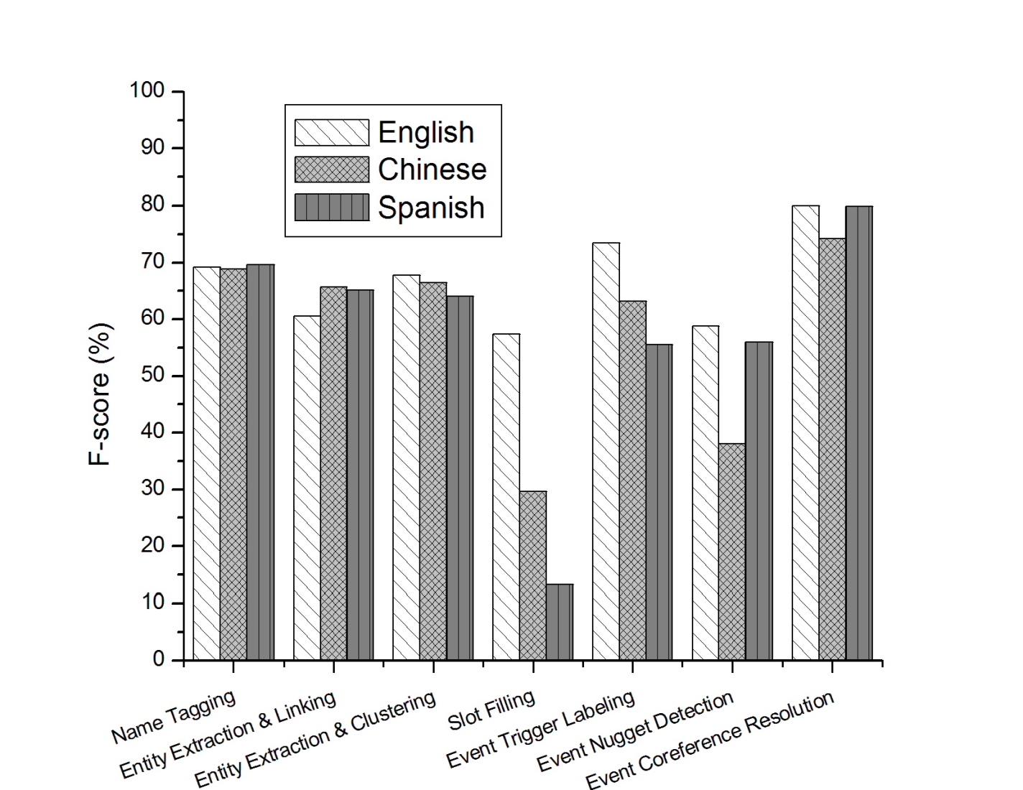
Comparison on Languages

Slide 13
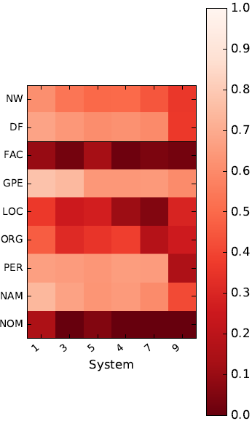
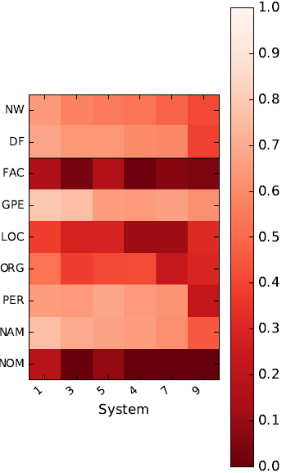
Entity Types and Textual Genres
Bottlenecks on nominals and facilities
No gap between newswire and discussion forum

Slide 14
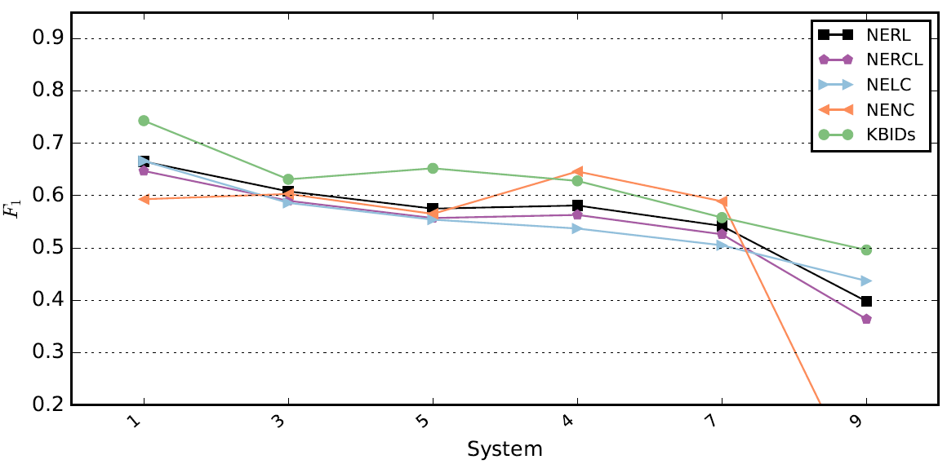
NIL and Non-NIL Comparison: Window 1

Slide 15
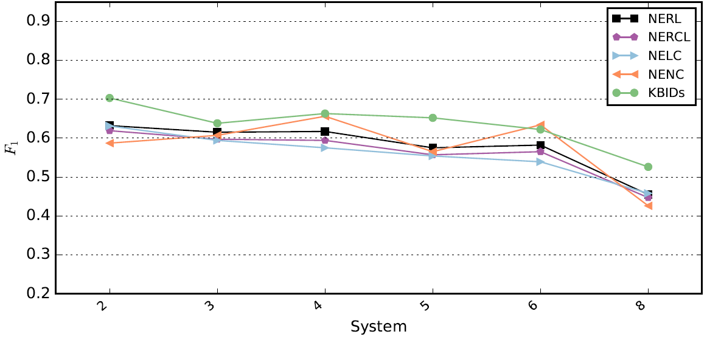
NIL and Non-NIL Comparison: Window 2

Slide 16
EDL Assembling
UTAustin tried assembling EDL results from the first evaluation window by both supervised and unsupervised methods
Assume no prior knowledge about the history performance of any individual system
Did not beat top 1-5 teams, but outperform teams with lower ranks
Notes:
Quality
Automatically discovering and clustering nominal mentions, and grounding them to KB or other name mentions is crucial to many real-world applications such as intelligence analysis and product profiling. Therefore we

Slide 17
Impact on Cold-Start Slot Filling
Many slot filling queries this year are ambiguous, some appear in multiple queries
PER: Bush, Hong Lei, Kerry, Iron Lady, Ma Jun, McCain, Cuomo
ORG: CDU (appears in two queries)
RPI used the DBPedia properties of linkable entities to expand query mentions and enrich slot fillers
e.g., Morsi → Mohamed Morsi; Cuomo → Mario Cuomo
Cold-start slot filling F-score 13.27% → 14.57%
Future work: Use EDL techniques to replace simple document retrieval or document clustering components
Ministry of Environmental Protection → Ministry of Environmental Protection of the People's Republic of China
Distant supervision for slot filling (Stanford)
Notes:
Quality
Automatically discovering and clustering nominal mentions, and grounding them to KB or other name mentions is crucial to many real-world applications such as intelligence analysis and product profiling. Therefore we

Slide 18
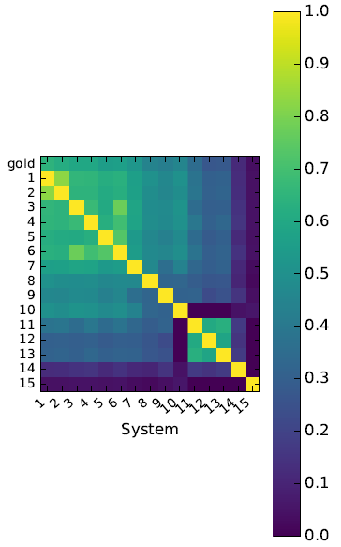
Agreement across Submissions
The outputs of the best systems are much more similar to each other than they are to the gold standard
They are making the same errors and omissions with each other, consistent with the general difficulty of obtaining recall in IE's long tail
Notes:
Quality
Automatically discovering and clustering nominal mentions, and grounding them to KB or other name mentions is crucial to many real-world applications such as intelligence analysis and product profiling. Therefore we

Slide 19
What’s New and What Works

Slide 20
Keep Name Taggers Young
Test on KBP2015 EDL data (news/forum 2014-2015)
Chinese Training data | #docs | Time-stamp | F-score
Ontonotes | 1,911 | 2005-2006 | 56.7%
EDL | 147 | 2014-2015 | 49.9%
Ontonotes+EDL |  |  | 70.2%
Method | Training data | amount | Time-stamp | F-score
Spanish name tagging | CONLL | 273, 037 tokens | 2000 | 54.3%
 | EDL | 129 docs | 2014-2015 | 58.2%
 | CONLL+EDL |  |  | 69.6%

Slide 21
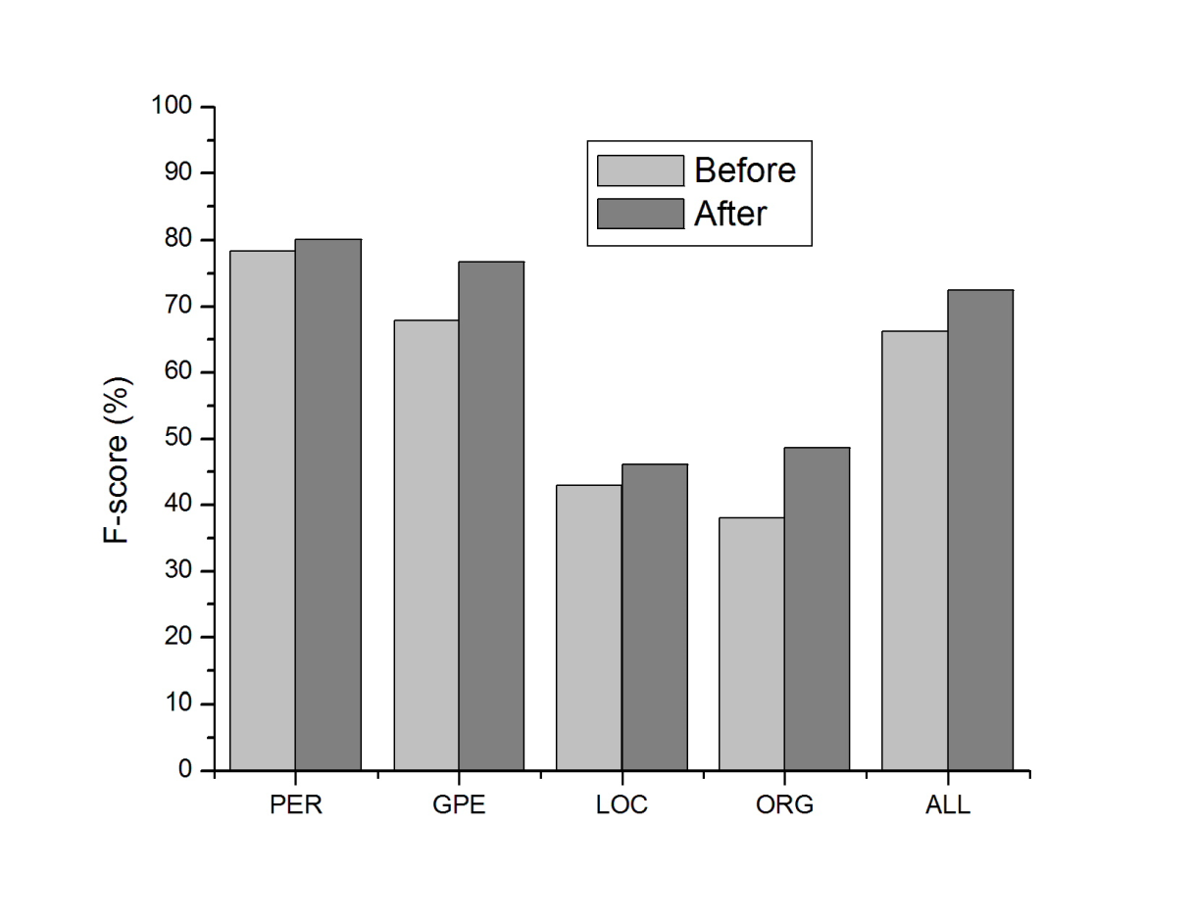
Let System Know the Language
Chinese Language-specific Resources that we developed 15 years ago:
Chinese first name and last name character lists
Foreign transliterated name initial/middle/end character lists
Gazetteeers
Title words
Action verbs that are likely to appear before or after animate entities
Triggers for events involving each type of entity
Nominal lists
Idiom list
Conjunction words
Time expressions
…

Slide 22
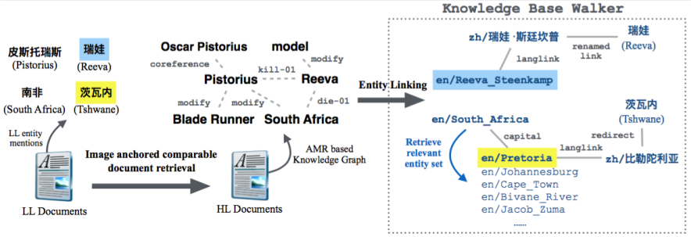
Cross-lingual Knowledge Transfer

Slide 23
Cross-lingual Knowledge Transfer
Using Knowledge Transfer | NERC |  |  | KBIDs |  |  | CEAFm |  |  | CEAFmC
 | P | R | F1 | P | R | F1 | P | R | F1 | P | R | F1
TRILINGUAL
Before | 86.9 | 88.1 | 87.5 | 65.5 | 76.4 | 70.6 | 81.1 | 82.3 | 81.7 | 74.8 | 75.9 | 75.3
After | 91.7 | 90.6 | 91.1 | 72.2 | 83.8 | 77.6 | 85.4 | 84.3 | 84.8 | 81.4 | 80.4 | 80.9
ENGLISH
Before | 85.6 | 88.1 | 86.8 | 62.7 | 79.9 | 70.3 | 79.0 | 81.4 | 80.2 | 71.3 | 73.5 | 72.4
After | 89.9 | 89.3 | 89.6 | 65.7 | 82.7 | 73.2 | 81.4 | 80.9 | 81.1 | 76.2 | 75.7 | 76.0
SPANISH
Before | 86.1 | 86.1 | 86.1 | 63.9 | 74.9 | 69.0 | 80.6 | 80.6 | 80.6 | 74.5 | 74.5 | 74.5
After | 92.6 | 92.2 | 92.4 | 76.2 | 86.1 | 80.9 | 87.4 | 86.9 | 87.1 | 83.3 | 82.9 | 83.1
CHINESE
Before | 89.1 | 89.1 | 89.1 | 72.2 | 72.6 | 72.4 | 89.9 | 89.9 | 89.9 | 83.1 | 83.1 | 83.1
After | 93.9 | 91.5 | 92.7 | 80.2 | 83.8 | 82.0 | 93.0 | 90.7 | 91.8 | 89.7 | 87.4 | 88.5
Notes:
Hltcoe also provies cross-lingual knowledge transfer helped slot filling

Slide 24
Foreign Language EDL or MT+English EDL
Test on KBP2015 EDL data (news/forum 2014-2015)
UIUC: Google translation works for Spanish, but not for Chinese
Method | Training data | F-score
Spanish name tagging | CONLL+EDL | 69.6%
SRI MT + English name tagging + project names back to Spanish | All available resources | 65.7%

Slide 25
Remaining Challenges

Slide 26
Mention Extraction
Remains the bottleneck of EDL
Manual filtering works but a bit tedious and boring
Google translation/search works but not very publishable, and difficult to adapt for constrained low-resource settings
The EDL corpora we have annotated so far are still not sufficient to generalize entity mentions that were created by a variety of categories
Morphs / Coded Entity Mentions
Coded language defeats most contextual features used by state-of-the-art EDL techniques
Less-mature metaphor detection techniques also have trouble with abstract coded language
Word-sense disambiguation techniques deal in sense inventories that are fairly static over time, whereas code language evolves rapidly
Coded language effectively hides in plain sight because anything is a candidate mention; 姐夫 (jie fu) → sister‐in‐law or Medvedev
Notes:
Quality
Automatically discovering and clustering nominal mentions, and grounding them to KB or other name mentions is crucial to many real-world applications such as intelligence analysis and product profiling. Therefore we

Slide 27
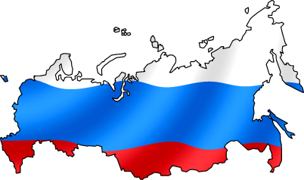
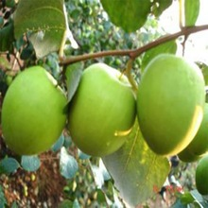
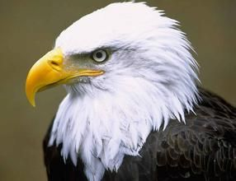
More and More New Morphs Ever Since 2014
北极熊
兔子
白头鹰
大青果
Notes:
北极熊 {'GPE': 11} {'m.06bnz': 11} Russia
兔子 {'GPE': 8} {'m.0d05w3': 8} China
白头鹰 {'GPE': 6} {'m.09c7w0': 6} USA
大青果 {'GPE': 5} {'m.0d05w3': 5} China

Slide 28
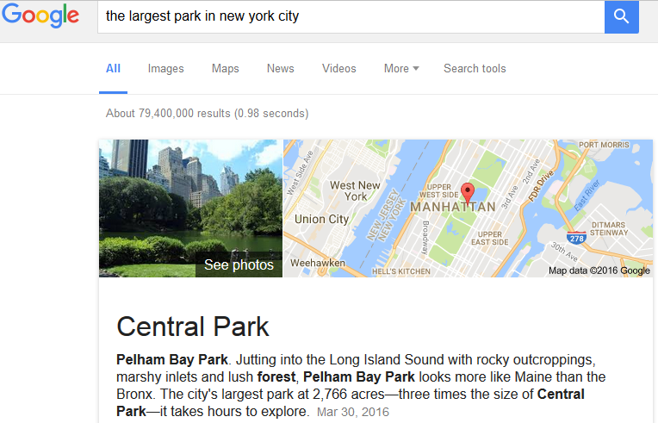
Within-document Coreference Resolution
More efforts should be made on Chinese and Spanish within-document coreference resolution
Error Propagation to Event Coreference Resolution
笔者(writer) 到(went to)阳城县(Yangcheng County)新阳东街(Xinyang East Street)营业厅(business hall)询问 (consulted)，工作人员 (personnel) 称(claimed) 他们(they)会(will)在24小时内(within 24 hours)抢修通(fix the tunnel)
Error Propagation to Slot Filling
Notes:
Quality
Automatically discovering and clustering nominal mentions, and grounding them to KB or other name mentions is crucial to many real-world applications such as intelligence analysis and product profiling. Therefore we

Slide 29
IBM’s Mysterious Coreference Scores
In the second evaluation:
Best English within-document entity coreference resolution
Best at finding the first mention for each entity across documetns for English
But top 4 entity extraction+clustering score (CEAFmC)
Notes:
Quality
Automatically discovering and clustering nominal mentions, and grounding them to KB or other name mentions is crucial to many real-world applications such as intelligence analysis and product profiling. Therefore we

Slide 30
Is DNN Working for EDL, or Worth It?
Controversial Results:
RPI team found that compared to Conditional Random Fields (CRFs), DNN usually provides up to 6% higher F-score for various languages, if a massive amount of clean annotated data is available
IBM team had opposite observations - their DNN model got 2%-3% lower performance than CRFs
DNN = not easily portable w/o massive annotation
For Entity Linking, the systems based on unsupervised learning achieved comparable (only 2% lower) performance to DNN based supervised methods trained from a large amount of labeled data
Notes:
Quality
Automatically discovering and clustering nominal mentions, and grounding them to KB or other name mentions is crucial to many real-world applications such as intelligence analysis and product profiling. Therefore we

Slide 31
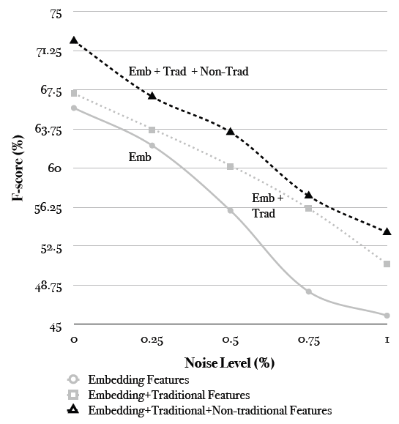
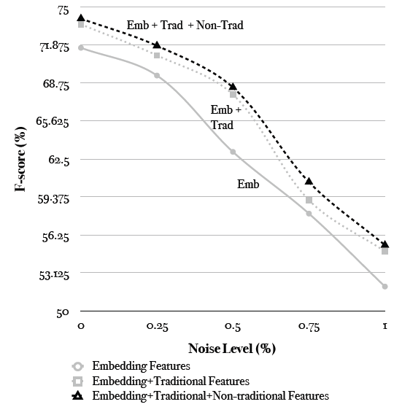
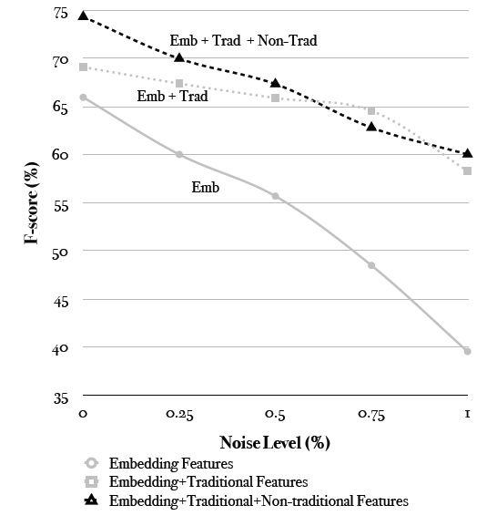
Is DNN Working for EDL, or Worth It?
Sensitive to Noise
Hausa Turkish Uzbek
Notes:
In any case, such data annotations are expensive to prepare. In order to compensate this data requirement, various automatic annotation generation methods have been attempted in previous work, including knowledge base driven distant supervision, cross-lingual projection and naturally existing noisy annotations such as Wikipedia markups. Annotations produced from these methods are usually very noisy, while DNN is sensitive to noise just like many other machine learning methods. For example, RPI found that the F-score of the same DNN model learned from noisy training data is 45\% lower than that trained from clean data for some low-resource languages.
Quality
Automatically discovering and clustering nominal mentions, and grounding them to KB or other name mentions is crucial to many real-world applications such as intelligence analysis and product profiling. Therefore we

Slide 32
Looking Ahead
Cold-Start KBP++
Multiple Hypotheses and Confidence Estimation
EDL for 300+ languages
KB Choice
Multi-media EDL
Fine-grained entity typing
Streaming data
Notes:
Quality
Automatically discovering and clustering nominal mentions, and grounding them to KB or other name mentions is crucial to many real-world applications such as intelligence analysis and product profiling. Therefore we

