Slide 1
KBP2016 Tri-lingual Entity Discovery and Linking Planning
Heng Ji
(on behalf of KBP Organizing Committee)
jih@rpi.edu

Slide 2
Looking Forward to KBP2016 EDL
Combine with tri-lingual slot filling to form up an end-to-end cool-start tri-lingual KBP task
Target at a larger scale data processing, by increasing the size of source collections from 500 documents to >10,000 documents
Add nominal mention EDL into all three languages
Add “named classes”, or more fine-grained entity types, or allow EDL systems to automatically discover new entity types
Add streaming data into the source collection
Perhaps replace Spanish with a new low-resource language for which full-document MT techniques are less mature
Pilot study on Tagalog EDL?

Slide 3
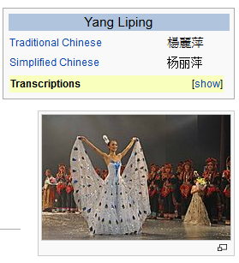
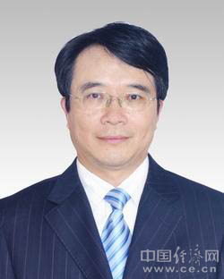
Tri-lingual KBP: EDL+SF+EDL(?)
More to discuss at tomorrow’s evaluation session
Source Collection
13岁以前的杨丽萍，是云南一个山村小镇里光着脚丫到处拾麦穗的乡下小姑娘，在洱海之源过着艰苦而又不无乐趣的童年生活。
Now, Ms. Yang, one of China's best-known dancers, is the director, choreographer and star of …
Aunque nacida en Dali, a la edad de nueve años Yang se mudó con su familia a Xishuangbanna. Debido a su extraordinario talento, la eligieron para integrar la Agrupación Artística de Canto …
…
KB
Liping Yang
Liping Yang
Spouse: Liu Chunqing
Employer: University of Maine
Title: Professor
Employer: Ningbo
Title: Mayor
State/Province-of-Residence: Yunnan
Notes:
Find other famous yangliping

Slide 4
Combine with Tri-lingual Slot Filling
KB
Chinese-to-English SF Pilot done in May
Each query = an entity cluster of
multi-lingual mentions, with type, KB ID,
and each mention’s Document ID, offsets
Source Collection
State/Province-of-Residence: 云南
13岁以前的杨丽萍，是云南一个山村小镇里光着脚丫到处拾麦穗的乡下小姑娘，在洱海之源过着艰苦而又不无乐趣的童年生活。十几年后，她摇身一变，成为舞台 上最绚丽的“孔雀”…而关于杨丽萍的感情问题，曾经有个爆料人称，杨丽萍的前夫是中央民 族歌舞团里的才子，一直帮着杨丽萍策划舞蹈，但后来，一个叫做托尼的美籍台湾人(刘淳晴)出现后，把杨丽萍给撬走了。
Spouse: 刘淳晴
Title: dancer, director, choreographer
Now, Ms. Yang, one of China's best-known dancers, is the director, choreographer and star of a new show that is drawing sellout crowds all over the country.
Notes:
Sfv, already part of cross-lingual knowledge transfer

Slide 5
Scale Up: Source Collection
Target at a larger scale data processing, by increasing the size of source collections from 500 documents to >10,000 documents
Challenge to Entity Clustering?
Challenge to Topic Clustering (KBP2015 data assumes 500 documents are topically related across languages)
How to evaluate?
Sample clusters
Sample documents
Sample mentions
Notes:
). For
example at Time X, my system thinks that "Whitey Bulger" and "James
Bulger" are two different people (and adds two novel NILs into the KB).
At Time Y, my system gets the sentence "James Bulger, who is known as
Whitey Bulger". -- Can my system correct the mistake?
There is a related question of what is required of the streaming
system. On at time period n, can the system re-read the documents it
saw at time period n-1 (and possibly reprocess everything, turning
streaming into a task of working with an ever-growing amount of data).
Or is it required to work with only the documents in time period n-1 and
the KB? If the latter, what is allowed to be stored in the KB? Can my
internal KB record every semantic role that a name string participates
in? Or is it limited to the ~40-slots in the TAC ontology?
yay for MT?

Slide 6
Entity Types and Nominal Types
Add EDL for individual specific nominals for PER, GPE, ORG, LOC and FAC entities into all three languages;
Introduces a new definition of mentions from the end usage of KB construction
May promote within-document coreference resolution research which is currently a bottleneck for all KBP tracks (EDL, Slot Filling, Event KBP);
Add named classes
AK47, iphone6,…
We may start by adding Weapon, Vehicle, Commodity and other Product subtypes as defined in AMR~\cite{Banarescu2013} such as work-of-art, picture, music, show, broadcast-program, publication, book, newspaper, magazine and journal;
Add more fine-grained entity types, or allow EDL systems to automatically discover new entity types?
Check human performance & inter-annotator agreement

Slide 7
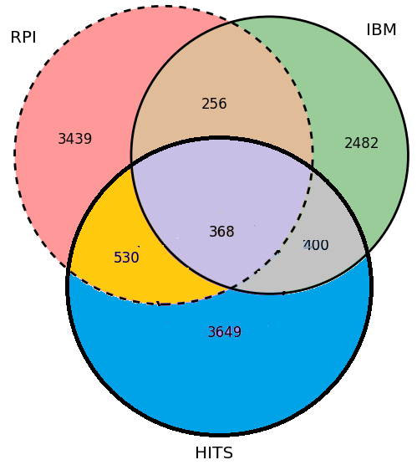
EDL Assembling?
Common Errors

Slide 8
Streaming Data
The reference KB needs to be dynamically updated, when new entries are created from NIL mentions.
Besides the quality measures, we need to check Run time of the algorithm based on different size of data as time goes by
Check the tradeoff between quality decrease vs. making algorithms parallel
Aging-off of low confidence assertions over-time
What criteria should be used to age-off information over time?
Are system allowed to go back and fix errors as they know more?
Update entries but also slot fillers?
KBP slot types or open slot types?
Data
RPI purchased 17 million tweets crawled from major cities influenced by Baltimore Riots during April 12th (the day when Freddie Gray was arrested) ~ May 7th
Cities/districts: Baltimore + D.C., Philadelphia, New York City, Boston, Seattle, Chicago, Minneapolis + St. Paul, San Francisco, Los Angles
Contains text and multimedia data (also links from Youtube and other image/video sharing websites)
Protest tweets (532K ISIS, 29K Hong Kong, 37K New York)
Notes:
). For
example at Time X, my system thinks that "Whitey Bulger" and "James
Bulger" are two different people (and adds two novel NILs into the KB).
At Time Y, my system gets the sentence "James Bulger, who is known as
Whitey Bulger". -- Can my system correct the mistake?
There is a related question of what is required of the streaming
system. On at time period n, can the system re-read the documents it
saw at time period n-1 (and possibly reprocess everything, turning
streaming into a task of working with an ever-growing amount of data).
Or is it required to work with only the documents in time period n-1 and
the KB? If the latter, what is allowed to be stored in the KB? Can my
internal KB record every semantic role that a name string participates
in? Or is it limited to the ~40-slots in the TAC ontology?
yay for MT?

Slide 9
Language Choice?
Consider a new language with less mature MT?
A language that doesn’t have Google/Bing translation service? (e.g., Tagalog)
A language that Google/Bing translation service performs poorly (e.g., Japanese, Korean)
A Pilot Study on Tagalog EDL

Slide 10
Time Table
Evaluation Time: 1-2months after summer would be much better for universities
Is TAC workshop time fixed to the middle of November?

Slide 11
Backup

Slide 12
Pilot Data
103 queries
51 persons, 52 organizations
Most are Chinese-centric, quite a few religious organizations and buddhist monks
Human annotators found 1,516 slot fillers
Three teams submitted results
RPI, UWashington, UWisconsin
Human assessment on pooled human and system results
28% done
Human annotation quality: P=88.57%, R=84.16%, F=86.31%
Notes:
Some recent in vivo tasks are shown here.
Ratinov and Roth used d2w output to aid coreference resolution.
For example, knowing that kursk can be a vessel helps link kursk to vessel.
WP concepts present in a document help to make document similarity calculation more robust.
Also, WP concepts are rich with information including coarse and fine grained properties that can shed light on,
for example, a users intent during query formulation.

Slide 13
Pilot Slot Types
ORG slot | PER slot
top_members, employees | title | date_of_death
alternate names | employee_or_member_of | date_of_birth
subsidiaries | alternate_names | city_of_birth
country of headquarters | countries_of_residence | country_of_birth
org:parents | origin | other_family
member_of | charges | parents
shareholders | children | religion
stateorprovince_of_headquarters | cities_of_residence | siblings
city of headquarters | age | spouse
website | schools_attended
political,religious_affiliation | stateorprovinces_of_ residence
dissolved | stateorprovince_of_birth
members | cause_of_death
number_of_employees,members | stateorprovince_of_death
founded | country_of_death
founded_by | city_of_death

Slide 14
Data
103 queries
51 persons, 52 organizations
Most are Chinese-centric, quite a few religious organizations and buddhist monks
Human annotators found 1,516 slot fillers
Three teams submitted results
RPI, UWashington, UWisconsin
Human assessment on pooled human and system results
28% done
Human annotation quality: P=88.57%, R=84.16%, F=86.31%
Notes:
Some recent in vivo tasks are shown here.
Ratinov and Roth used d2w output to aid coreference resolution.
For example, knowing that kursk can be a vessel helps link kursk to vessel.
WP concepts present in a document help to make document similarity calculation more robust.
Also, WP concepts are rich with information including coarse and fine grained properties that can shed light on,
for example, a users intent during query formulation.

Slide 15
Human Annotation Errors
Implicit slot fillers, in a language with 3000 years history
Reasoning: a 102-year-old person’s birthday party is likely to be held in his residence/employer place?
some vivid description: e.g., “圆寂(complete silence)” indicates the death of a Buddhist monk, did he live there?
经过战争磨炼的卓琳顶着巨大的精神压力,毫不犹豫地陪伴邓小平到了江西 (After the torture of the war, Zhuolin tolerated huge psychological pressure and accompanied Deng Xiaoping to Jiangxi.)
→ did they live in Jiangxi?
Working place = residence?
Misunderstood slot type spec
Label persons for org:members
Political issues
Is Taiwan a province or a country without suffix words?
Missing errors
Is “unprofessional singer” a singer?
Need bi-lingual expert annotators to do quality control
Notes:
Some recent in vivo tasks are shown here.
Ratinov and Roth used d2w output to aid coreference resolution.
For example, knowing that kursk can be a vessel helps link kursk to vessel.
WP concepts present in a document help to make document similarity calculation more robust.
Also, WP concepts are rich with information including coarse and fine grained properties that can shed light on,
for example, a users intent during query formulation.

Slide 16
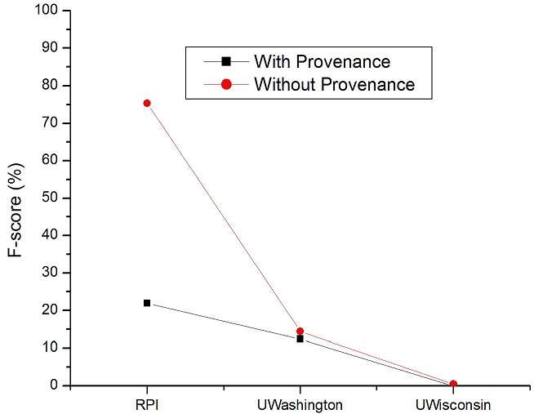
Overall Performance
Query = United Airlines
Slot Type = Country_of_Headquarter
Slot Filler = USA
Incorrect Provenance: (2015/05/27, DC, USA) Based on Jason and Heng’s comments, United is the very best choice for DC people because it only took 17 hours to reach Denver.
Notes:
Xx compare to english; a much larger pool
First, early, work on cross-lingual knowledge base population
Extended monolingual KBP to Chinese
Task is not impossible!
Two Approaches
Translate documents: poor
Translate queries and answers: better
Results dramatically improved with system combination and deep features

Slide 17
RPI Pipeline Comparison
CH Queries
1: 21%
2: 2.26%
1+2: 21.98%
1+2+3: 21.91%
CH Slot Filling
1
CH Documents
Name
Translation
Machine Translation
EN Queries
Translated Documents
EN Documents
3
EN Slot Filling
2
Slot Fillers
Notes:
The results might be a bit biased because most queries don't exist in English source collection. But the good news is we should be able to setup a slot filling system quickly for a low-resource foreign language as long as we have some methods (e.g., dependency paths) to compute semantic distance between a query and a candidate slot filler, and acquire trigger words. And we don't need full-document MT. Chinese dependency parsing and name translation are two major bottlenecks.

Slide 18
CLSF Task Improvement
Redefine/Refine slot type spec to make each definition more precise
Enrich language-specific properties
Require all slot fillers to be translated into English
Save human assessment time at creating cross-lingual equivalence classes
Document/Query Selection
More recent epoch instead of 1993/1994 news
Balance foreign centric vs. English centric
Balance local news vs. international news
Balance subtype distribution
Balance ambiguity/variety vs. informativeness
Balance mono-lingual vs. cross-lingual richness
Notes:
Homework for the organizing committee

Slide 19
Existing Chinese/Spanish/English KBP Resources
Data and resources released by LDC
Some overlapped data sets including multi-layer annotations such as ACE/ERE/AMR/EDL, or entity/MT
Chinese gender and animacy dictionaries (Zhiyi Song)
KBP tools:
http://nlp.cs.rpi.edu/kbp/2015/tools.html
Including RPI Multi-lingual EDL system and links to Stanford Tri-lingual CoreNLP
BBN, IBM, RPI, LCC’s automatic annotations for KBP source collection
UPenn English/Chinese/Spanish Paraphrase Databases
SUNY Albany can create Metaphor Databases for Chinese/Spanish
Chinese-English Name Translation Pairs
RPI > 2 million pairs semi-automatically discovered
LDC has Chinese-English name dicts with frequency information

Slide 20
A Chinese/Spanish Resource Wish List
Very good name taggers
Good dependency parsers
Good coreference resolution
Resources and Methodologies for Trigger Discovery
Resources and Methodologies for Name Translation
Chinese and Spanish paraphrase databases
Large-scale actionable, probabilistic world knowledge base
Not just annotating another 100 queries / 500 documents

