Slide 1
Tri-lingual EDL for 2017 and Beyond
Heng Ji
(on behalf of KBP Organizing Committee)
jih@rpi.edu

Slide 2
Cold-Start KBP++
Combine with tri-lingual slot filling, event extraction and sentiment/belief anaysis
allow more development time to achieve end-to-end KBP performance
DEFT teams: CMU, BBN, and
TinkerBell (Columbia+Cornell+JHU+RPI+Stanford+UIUC+Upenn)
Two weeks between the end of EDL and the start of SF?
EDL teams run on data from previous years in by spring 17, so SF teams have chance to play with the results and try out effective ways of using EDL

Slide 3
Multiple Hypotheses and Confidence Estimation
Only two EDL teams in KBP2016 produced meaningful confidence values, but it will become a requirement in EDL2017
Produce multiple or n-best hypotheses at all levels, from individual assertions to subgraphs
Perhaps produce canonical form for each NIL cluster
All kb assertions to be tagged with meaningful confidence/certainty measures
Important for both downstream applications and real-world users
Improve EDL scorer so multi-layer confidence values can be incorporated

Slide 4
EDL for 300+ languages
EDL for all the languages in the world, at least for those we have Wikipedia entries
Some teams including RPI and Sydney have been cleaning and enriching Wikipedia markups so we can get silver standard annotations for EDL for all the 300+ languages in Wikipedia
Possible collaborations with other tasks by KBC / EU

Slide 5
LoReHLT – Low Resources HLT
Open evaluations of component technologies relevant to LORELEI (Low Resource Languages for Emergent Incidents)
LoReHLT16: NER, MT, and SF (not Slot Filling) in Uyghur
LoReHLT17: EDL, MT and SF
Two surprise incident languages (IL’s) in parallel
Three evaluation checkpoints to gauge performance based on time and resources given
EDL in LoReHLT similar to but more challenging than EDL in KBP
2~3 weeks in late summer
https://www.nist.gov/itl/iad/mig/lorehlt-evaluations

Slide 6
KB Choice
BaseKB is difficult for human annotators to work with, due to the lack of effective search tools
Most EDL systems use Wikipedia or DBPedia and map results back to BaseKB
Any suggestions from the community?
LORELEI EDL will use Geoname for GPE/LOC, an dWorld Leader Book and World Fact Book for PER/ORG
Too specific on Incidents for TAC-KBP?

Slide 7
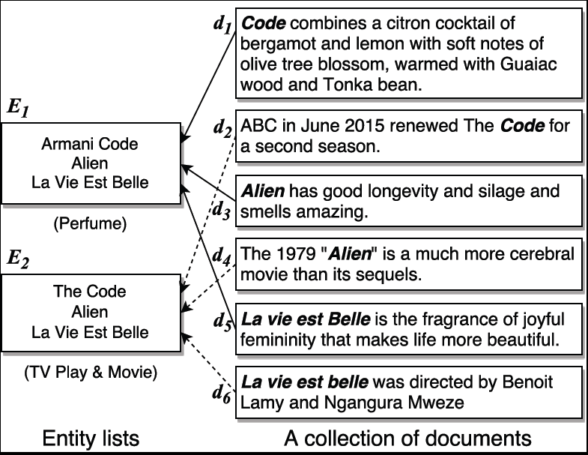
List-only EDL
Link mentions to entities in various automatically or manually constructed lists

Slide 8
Time Table
Evaluation Window 1: before SF/Event/Best Evaluations, August/September?
Set up 2 weeks between the end of EDL and the start of SF
Allow enough time for system development and focused research
Evaluation Window 2: late October
Constrained Resources Setting
Difficult to disallow Google translation / Google search

Slide 9
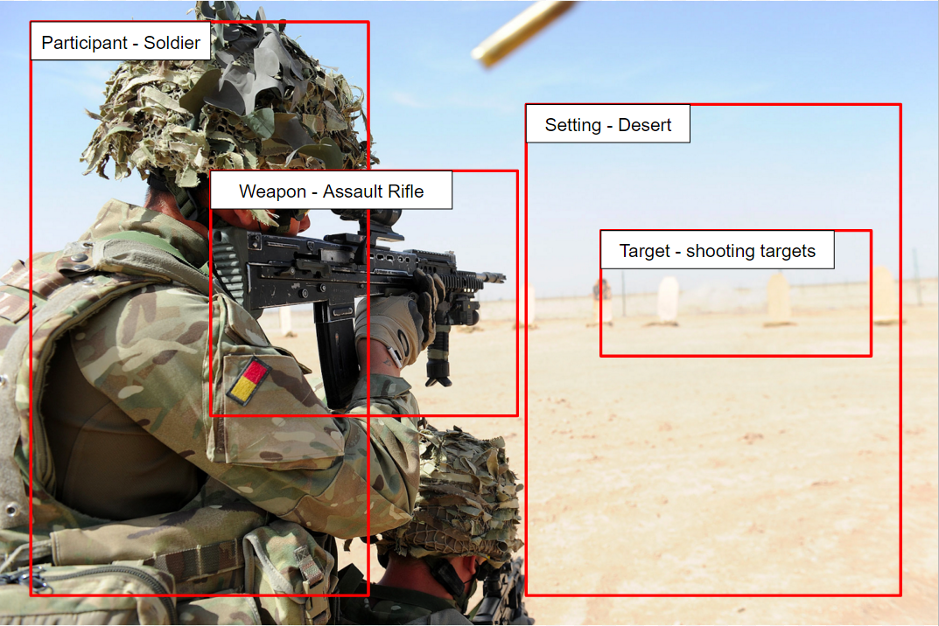
Multi-media EDL and KBP
Arguments | Entity Type | Definition-Text | Definition-Image
Participant | PER ORG | People or organizations who commit the attack | Person/People with weapon(s)
Target | PER ORG GPE objects | People or organization or location which is attacked | object which is aimed or attacked
Place | GPE LOC FAC scene | where the attack happens | Generic description of the attack setting.
Time | TIMEX | when the attack happens | N/A
Instruments | Weapon | N/A | The type of weapon used during the attack.
Notes:
The schema is defined by experts based on their experience.
Red text is the new / modified items from the original ACE.
Multimedia: entity subtypes, speechwriter, attacker, protester, relation, or multimedia event

Slide 10
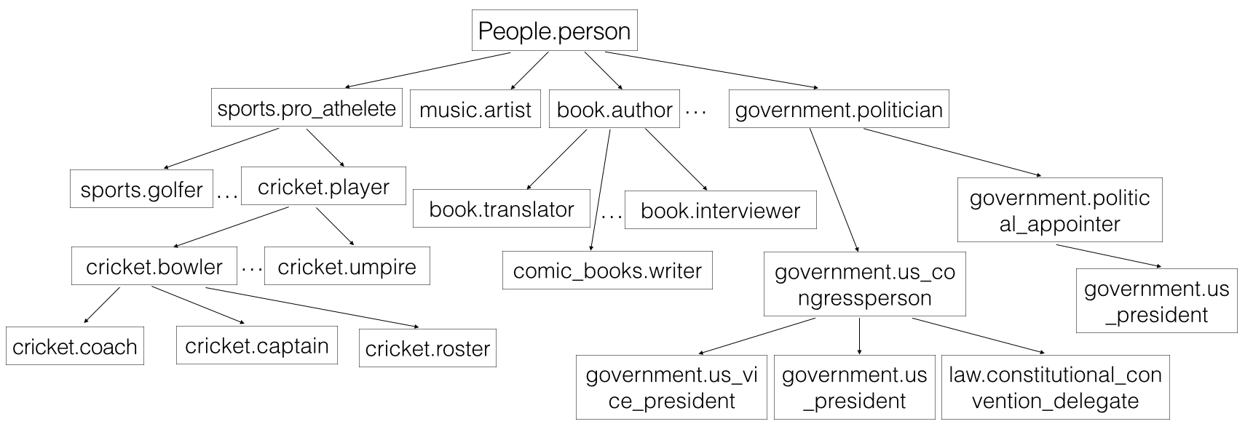
Fine-grained Entity Typing
Type Hierarchy from Freebase
Notes:
Merge this with next page

Slide 11
Streaming Data
The reference KB needs to be dynamically updated, when new entries are created from NIL mentions.
Besides the quality measures, we need to check Run time of the algorithm based on different size of data as time goes by
Check the tradeoff between quality decrease vs. making algorithms parallel
Aging-off of low confidence assertions over-time
What criteria should be used to age-off information over time?
Are system allowed to go back and fix errors as they know more?
Update entries but also slot fillers?
KBP slot types or open slot types?
Data
RPI purchased 17 million tweets crawled from major cities influenced by Baltimore Riots during April 12th (the day when Freddie Gray was arrested) ~ May 7th
Cities/districts: Baltimore + D.C., Philadelphia, New York City, Boston, Seattle, Chicago, Minneapolis + St. Paul, San Francisco, Los Angles
Contains text and multimedia data (also links from Youtube and other image/video sharing websites)
Protest tweets (532K ISIS, 29K Hong Kong, 37K New York)
Notes:
). For
example at Time X, my system thinks that "Whitey Bulger" and "James
Bulger" are two different people (and adds two novel NILs into the KB).
At Time Y, my system gets the sentence "James Bulger, who is known as
Whitey Bulger". -- Can my system correct the mistake?
There is a related question of what is required of the streaming
system. On at time period n, can the system re-read the documents it
saw at time period n-1 (and possibly reprocess everything, turning
streaming into a task of working with an ever-growing amount of data).
Or is it required to work with only the documents in time period n-1 and
the KB? If the latter, what is allowed to be stored in the KB? Can my
internal KB record every semantic role that a name string participates
in? Or is it limited to the ~40-slots in the TAC ontology?
yay for MT?

