Slide 1
Schema Induction
Heng Ji
hengji@illinois.edu

Slide 2
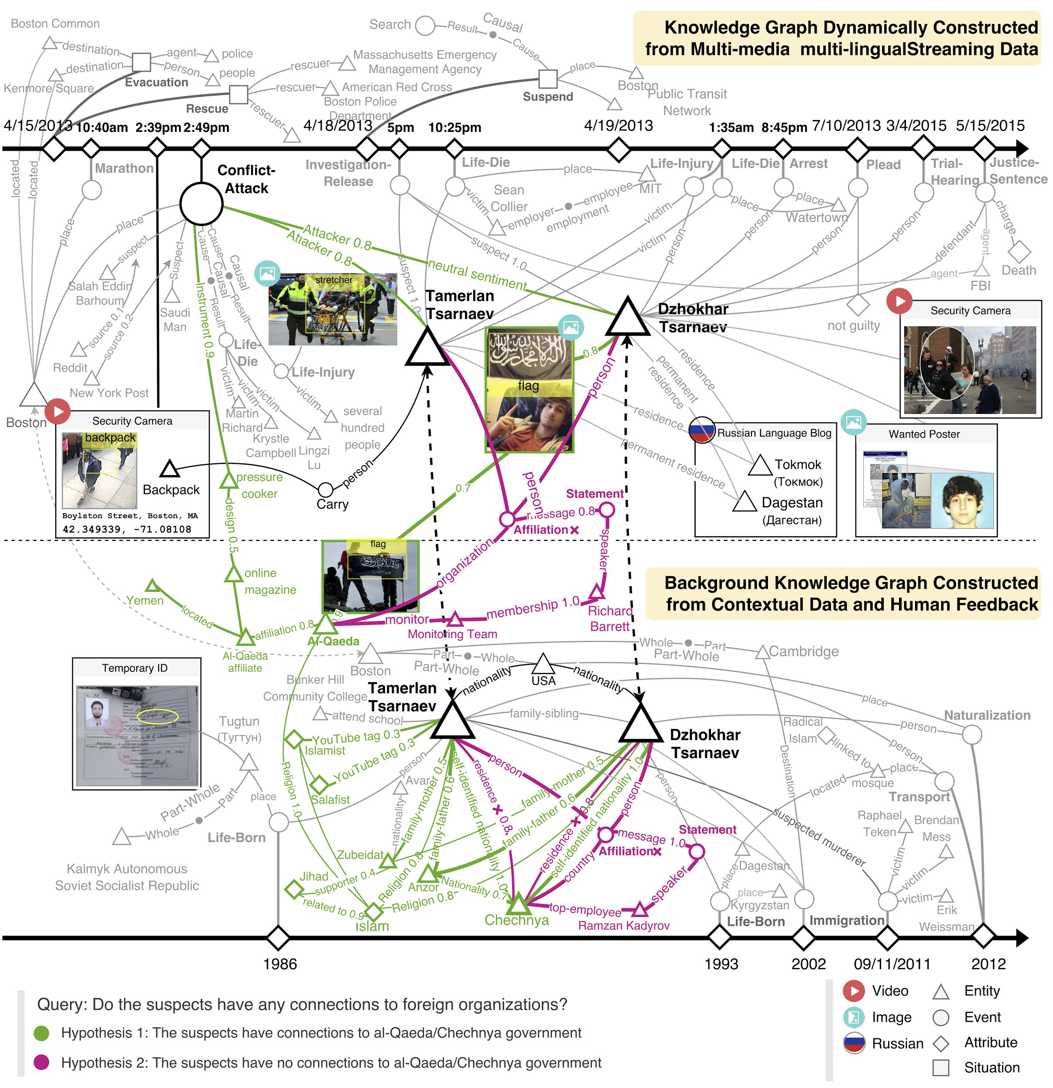
Complex Event Example: 2013 Boston Marathon Bombing
Events don’t happen in isolation
2
Notes:
Change low resource IL to a language which is not in wikipedia
Word-level: from bi-lingual dicts and alignment; structure-level comes from wals; multi-level alignment

Slide 3
Complex Event Example: 2019 Hong Kong Protest

Slide 4
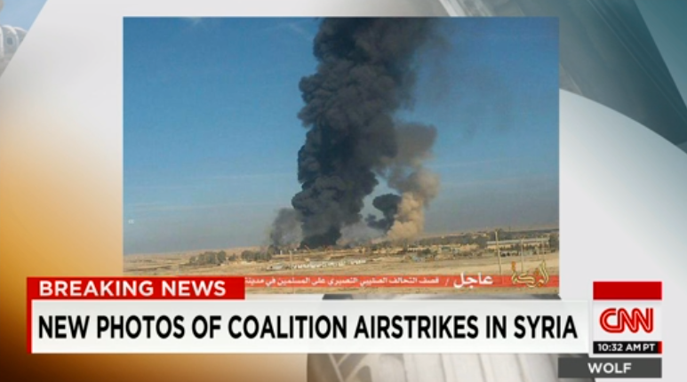
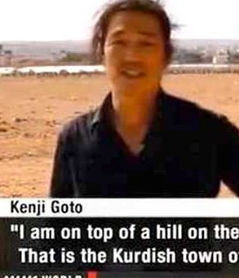
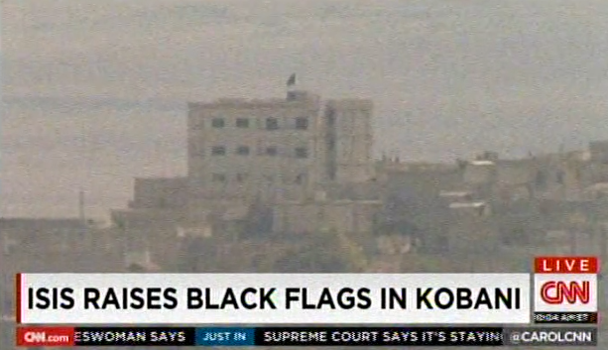
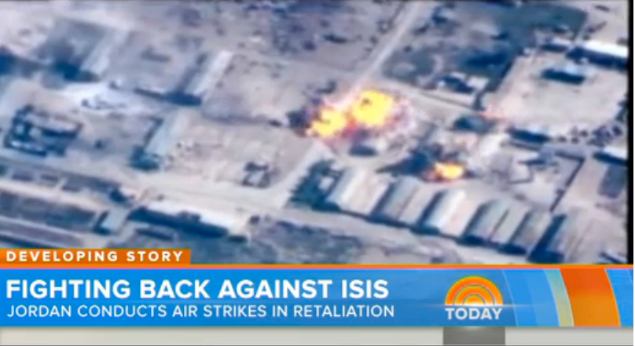
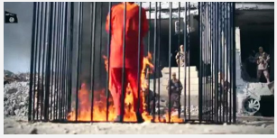
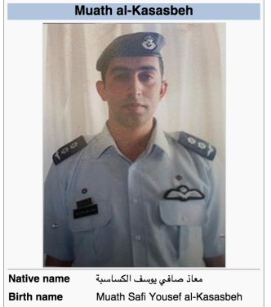
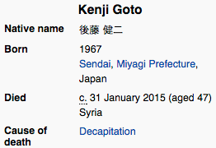
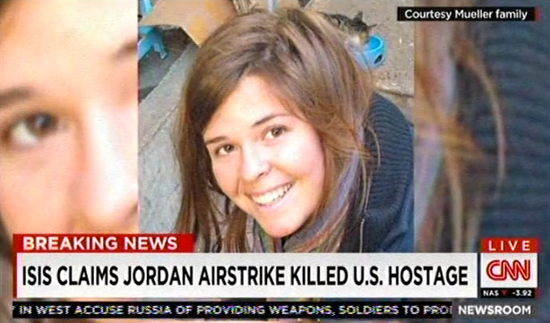
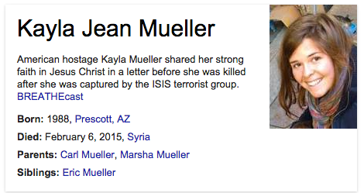
Complex Event Example: ISIS attacks
ISIS Activity
Attack Events Against ISIS
ISIS Hostage Events
Attacker: ISIS Target: Kobani
Instrument: tanks and artillery
Agent: Jordan Target: ISIS
Instrument: bomber
Place: Raqqa
Attacker: ISIS Victim: pilot
Cause: burnt alive
Victim: Goto Place: Syria
?
Legend:
Event
Subevent
Temporal
Causality
Ext. KB
Oct 2014
Feb 2015
U.S. Hostage died in airstrike
Notes:
More ambitious problems: Deep scene
understanding, fine-grained extraction Flick photos+tags → No; News videos → Yes
(RPI + Columbia, in submission)
TEXT
Source: closed captions, ASR, news, Web, and social media
Information:
entities, attributes, relations, events and their arguments, links to KB
VIDEO
Source: channels, youtube, social media
Information:
OCR text showing breaking news event and other captions
Visual recognition and attributes, e.g., scene/object/event
Concept recognition from images (e.g., building, bombing, crowd, tanks, etc)
News reporting time and sources (e.g., CNN 16:00pm EST)
Named speakers, linked to KB
Most people who read the Jan 28th news and watch the Feb 3rd video will think that the pilot died as early as Jan 28th, however, the NYT later release a different message:
"On Tuesday, Jordanian officials said they learned that the pilot had actually been killed on Jan. 3, suggesting that their caution had been justifiable.”
Speech-> asr, closed
entities linked across documents, link to KB
how the information (e.g., temporal) from video can correct / enrich the results from texts
caption, title, keyframes, images.

Slide 5
What is Event Schema?
5

Slide 6
Re-defining Event Schema
Event schemas encode knowledge of stereotypical structures of events and their connections
New aspects in our work
Models as schemas: probabilistic schema induction models can be probed on demand for event prediction
Capture uncertainty and recurring events: produce multiple hypotheses with probabilities, confidence values and justifications to enable temporal reasoning and prediction
Learn hierarchical structure of event complexes: humans segment events into chunks, or even nested hierarchies [Richmond and Zacks, 2017]; such an organization also appears in human memory and correct segmentation has shown to improve recollection of events [Sargent et al., 2013]
Capture temporal dynamics and entity (coreferential or related arguments) connections between events
Measure event and entity salience for entity state tracking
6
Notes:
Change low resource IL to a language which is not in wikipedia
Word-level: from bi-lingual dicts and alignment; structure-level comes from wals; multi-level alignment

Slide 7
Event Graph Schema Induction (Li et al., 2020)
Select salient and coherent paths based on Path Language Model, and merge them into graph schemas
Manling Li, Qi Zeng, Kyunghyun Cho, Heng Ji, Jonathon May, Nathanael Chambers, Clare Voss. Connecting the Dots: Event Graph Schema Induction with Path Language Modeling. ACL 2020.
Notes:
The good thing about schema-level event knowledge is that it can help us to achieve a kind of abstraction to transfer the knowledge from observed event instances to unseen ones. At the same time, it can also help select the salient event knowledge and minimize the influence of noise.
Here is an example, assume that we have two instance-level event graph, even though they are not describing the identical event, some components are shared. For example, how are these transport events are connected with the attack events. To effectively find such schema knowledge, they first generate a set of paths and then learn a path language model. As a result, they will then get the final graph schema.

Slide 8
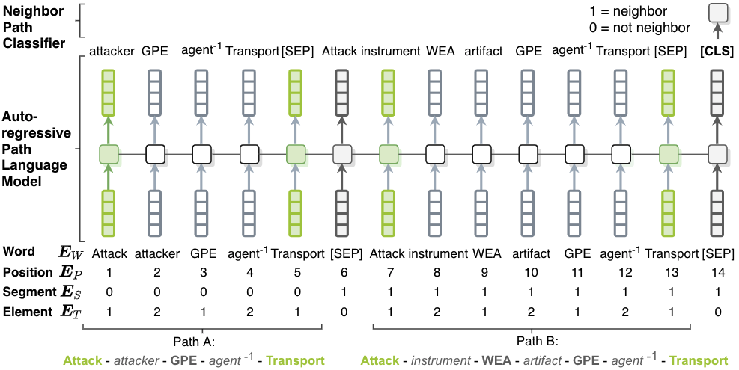
Path Language Model
Path Language Model is trained on two tasks
Autoregressive Language Model Loss: capturing the frequency and coherence of a single path
Neighbor Path Classification Loss: capturing co-occurrence of two paths
Notes:
Here is how they trained the path language model, the approach is actually very straightforward. You can concatenate multiple paths together and treat it as a sentence to model the coherence of those paths. One thing worth mentioning is that, to capture the co-occurrence information of two paths, they also introduce an additional neightbor path classification loss.

Slide 9
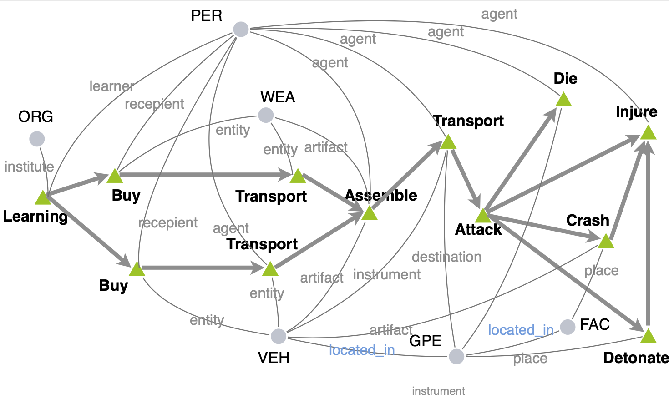
Temporal Complex Event Schema Composition
Graph Structure Aware:
Encode entity coreference and entity relation
Capture the interdependency of events and entities (sequences can not)
Scenario guided:
Train one model based on instance graphs of the same scenario
Probabilistic:
Support downstream tasks, such as event prediction

Slide 10
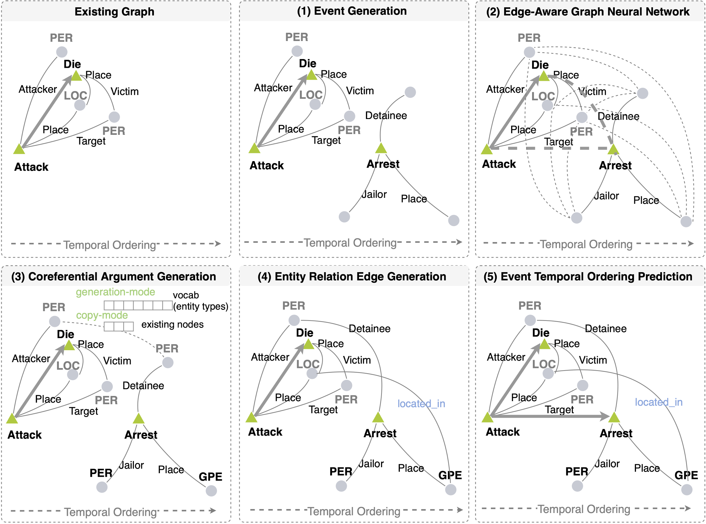
Generative Event Graph Model
Schemas are the hidden knowledge to control instance graph generation
Step 1. Event Node Generation
Step 2. Message Passing
Step 3. Argument Node Generation
Step 4. Relation Edge Generation
Step 5. Temporal Edge Generation

Slide 11
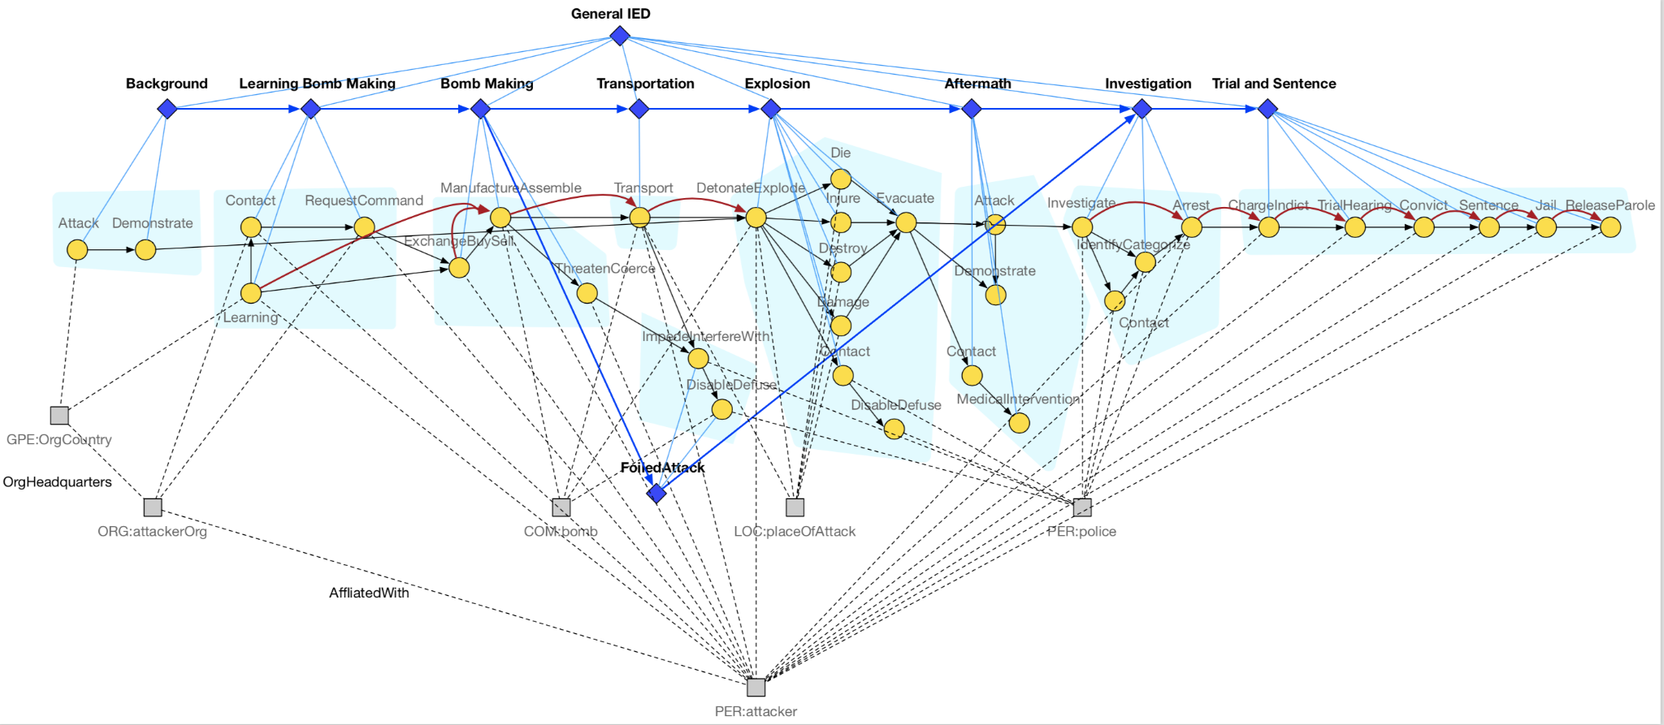
Adding Hierarchy and Multiple Alternative Hypotheses: IED scenario
We add episode nodes (diamond-shaped) to the schema. Each episode node is connected to several event nodes, an event node can only belong to one episode.
Episodes have temporal order
Alternative episodes such as FoiledAttack represent alternative hypotheses for the complex event
Notes:
- how hard is it to do internal schema organization for schema clarity and reasonable compression to remove redundancy? [multiple hypotheses? Make schemas more distinguishable from one another, discriminative factor]

Slide 12
Adding Hierarchy: Pandemic Scenario

Slide 13
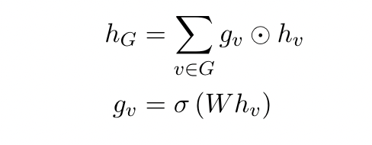
A Graph Encoder-Decoder Model for Hierarchical Complex Event Schema Induction
Embedding Initialization
Event node embeddings are initialized with BERT and corresponding type embeddings
Entity node embeddings are initialized with type embeddings
Heterogeneous Graph Convolution Layers
The graph has 2 types of nodes: event, entity and 5 types of edges: argument(event-entity), relation(entity-entity), temporal(event-event), containment(episode-event), global(episode-episode)
We parameterize the graph convolution function over each type of edge separately
An attention operation is computed over all incoming edges to update the embedding of the target node
Graph Readout Function
Weighted sum over all nodes in the graph
13
Notes:
Change low resource IL to a language which is not in wikipedia
Word-level: from bi-lingual dicts and alignment; structure-level comes from wals; multi-level alignment

Slide 14
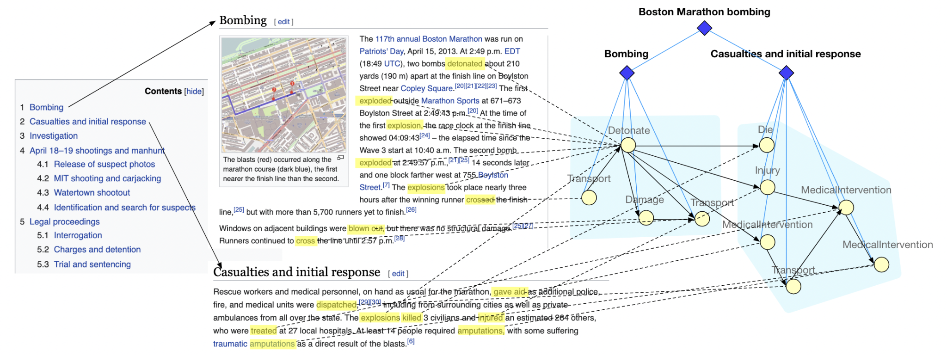
Lack of training data: Training the Graph Encoder with Distant Supervision
We propose to learn how to segment complex event graphs into episodes using distant supervision from Wikipedia
We train a graph generation model from a large number of observed complex event graphs that is capable of predicting future events and episodes

Slide 15
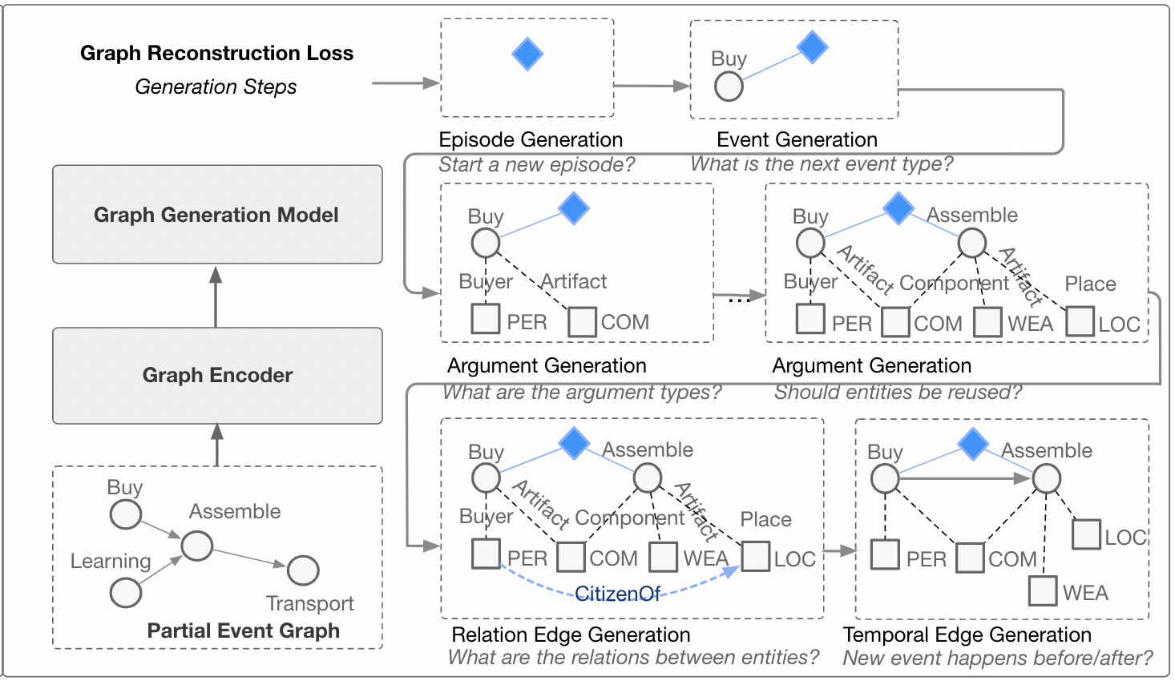
Training the Graph Decoder with Graph Reconstruction
We create the partial event graph by randomly removing one episode from the original graph
The graph is generated episode by episode
Within each episode we follow the steps of (1) event generation, (2) argument generation, (3) relation edge generation and (4) temporal edge generation

Slide 16
Why is Event Schema Useful? [1] Enhance Information Extraction
A typical sequence-to-graph information extraction model [Lin et al., ACL2020]

Slide 17
Schema-Enhanced Information Extraction
We design a set of global feature templates (e.g., event_type₁ – role₁ – role₂ – event_type₂ : an entity acts a role₁ argument for an event_type₁ event and a role₂ argument for an event_type₂ event in the same sentence). A more comprehensive event schema library is inducted following (Li et al, 2020).
The model learns the weight of each feature during training
role₁
role₂
victim
target
victim
attacker
event_type₁
event_type₂
Life.Die
Conflict.Attack
Life.Die
Conflict.Attack
Template
Positive weight
Negative weight
Global score of a graph: local graph score + global feature score
Notes:
To induce this kind of event schema, we use templates to explore the interactions between knowledge elements. For each template we fill in all possible types to generate a set of global features. For example, the victim of die event is always the target of the attacking event, but not the attacker. Our work on schema induction using path language model further extends the schema library to longer paths between events.

Slide 18
Schema-Enhanced Information Extraction
We use beam search to decode the information graph (Lin, et al, 2020)
Example: He also brought a check from Campbell to pay the fines and fees.
Node Step
Node Step
Edge Step
Sort
Prune
E1¹
T1¹
E1¹
R1¹
T1¹
E1¹
R1²
T1¹
entity
E1²
R1¹
T1¹
E1¹
R1²
T1¹
E1¹
Fine
FAC
E1¹
T1²
E1¹
R1¹
T1²
E1¹
R1²
T1²
fines
Campbell
E1¹
R1²
T1²
E1¹
R1¹
T1²
Candidate 1 of node E1
Higher local score
E1²
T1¹
E1²
R1¹
T1¹
E1²
R1²
T1¹
E1¹
R1¹
T1¹
E1²
R1²
T1²
entity
E1²
R1¹
R1²
Fine
PER
R1¹
R1²
Candidate 2 of node E1
E1²
T1²
E1²
T1²
E1²
T1²
fines
Campbell
E1²
T1²
E1²
T1¹
Higher global score
add node 1
add node 2
add the edge between node 1 and 2
Campbell: FAC, ORG
fine: Fine, Sue
null, entity, person, …
Notes:
Then this combined score is used in the beam search to decode the graph. In each decoding step we generate a node and the edges related to that node. The local score helps select the best type prediction for each knowledge elements, and the global score promotes the graph that matches event schema.

Slide 19
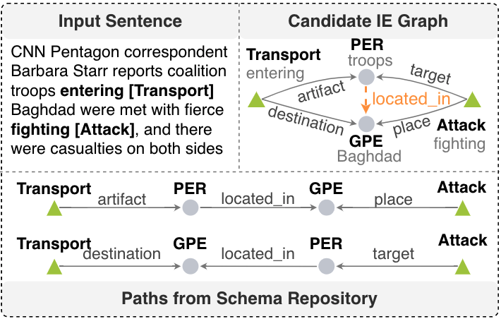
Schema-Enhanced Information Extraction (Li et al., EMNLP2020)
Use the state-of-the-art IE system OneIE (Lin et al, 2020) to decode converts each input document into an IE graph
Each path in the graph schema is encoded as a single global feature for scoring candidate IE graphs
OneIE promotes candidate IE graphs containing paths matching schema graphs
http://blender.cs.illinois.edu/software/oneie
F-scores (%) on ACE2005 data [Lin et al., ACL2020]:
Dataset | Entity | Event Trigger Identification | Event Trigger Classification | Event Argument Identification | Event Argument Classification | Relation
Baseline | 90.3 | 75.8 | 72.7 | 57.8 | 55.5 | 44.7
+PathLM | 90.2 | 76.0 | 73.4 | 59.0 | 56.6 | 60.9
Notes:
We also try to use the discovered schema repository to support downstream tasks, here we use information extraction as an example, we use the paths from
relation, example

Slide 20
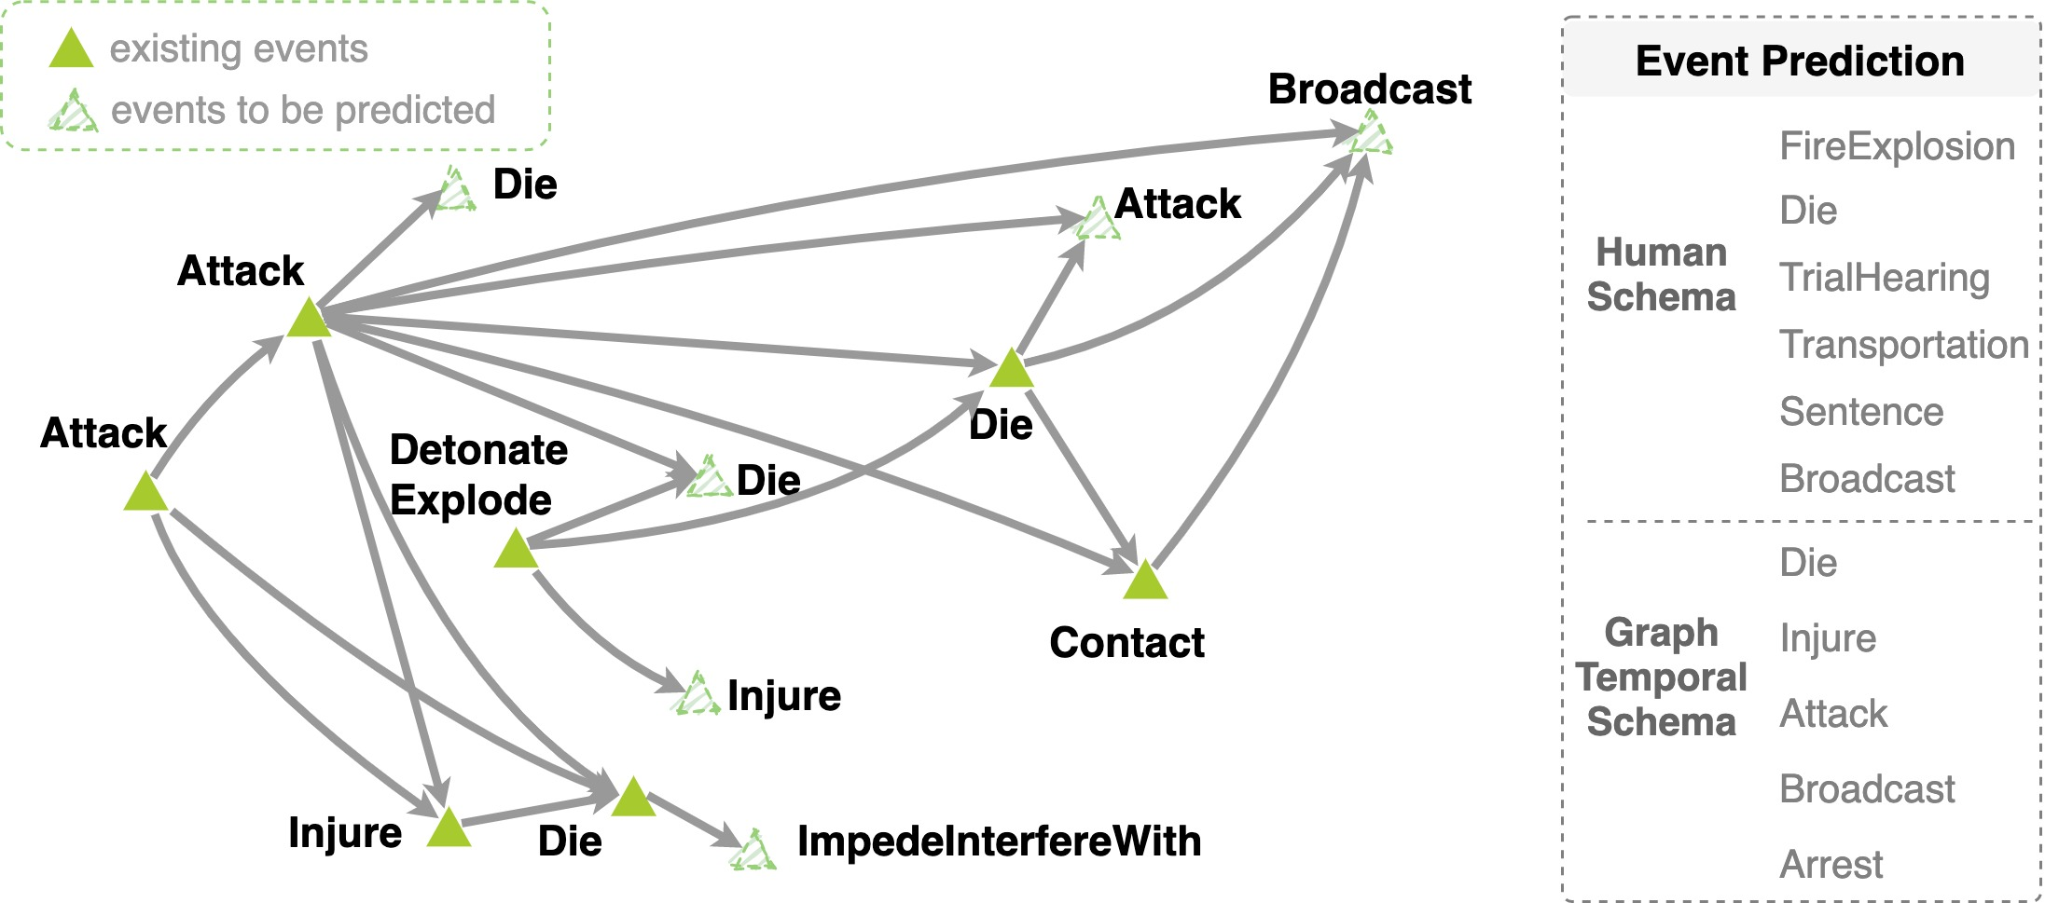
Why is Event Schema Useful? [2] Predicting the Future [Li et al., 2021]
Schema-guided Event Prediction: The task aims to predict ending events of each graph.
Considering that there can be multiple ending events in one instance graph, we rank event type prediction scores and adopt MRR and HITS@1 as evaluation metrics.
Dataset | Models | MRR | HITS@1
General | Human Schema | 0.173 | 0.205
 | Event Graph Model | 0.457 | 0.591
Dataset | Models | MRR | HITS@1
IED | Human Schema | 0.072 | 0.222
 | Event Graph Model | 0.203 | 0.426
Notes:
Event prediction could be a good evaluation task.

Slide 21
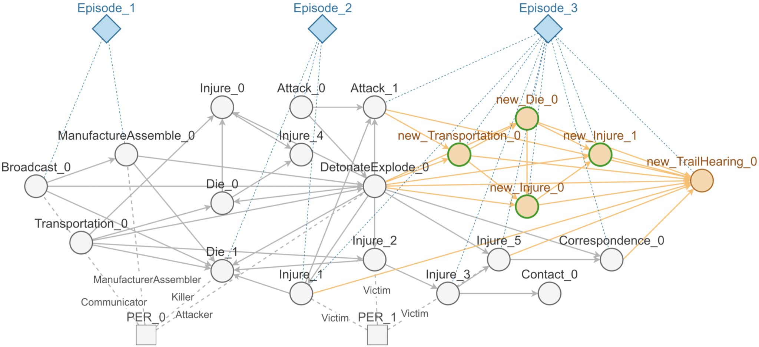
Why is Event Schema Useful? [2] Predicting the Future
Schema-guided Episode Prediction (Li et al., 2021submission)
Yellow nodes are newly predicted, the nodes with green outline are matched in the ground truth graph.

Slide 22
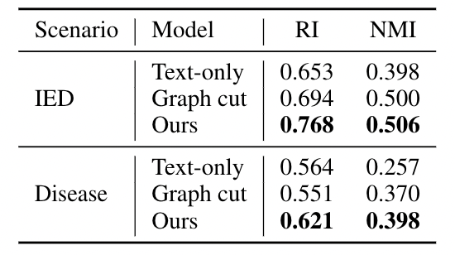
Event Segmentation Results
This is a probing task to check the performance of our graph encoder
By combining both graph structure and text features, we do better than models that rely on text or graph alone

Slide 23
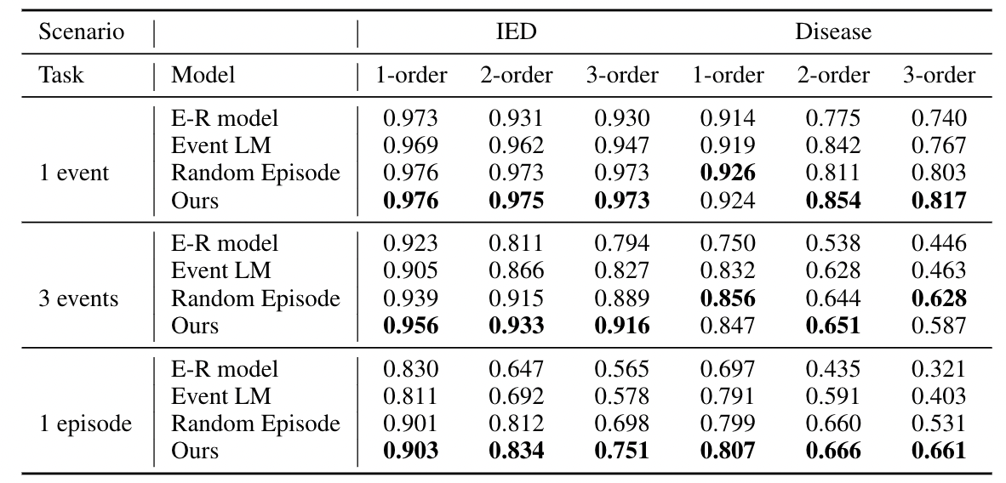
Event and Episode Prediction Results

Slide 24
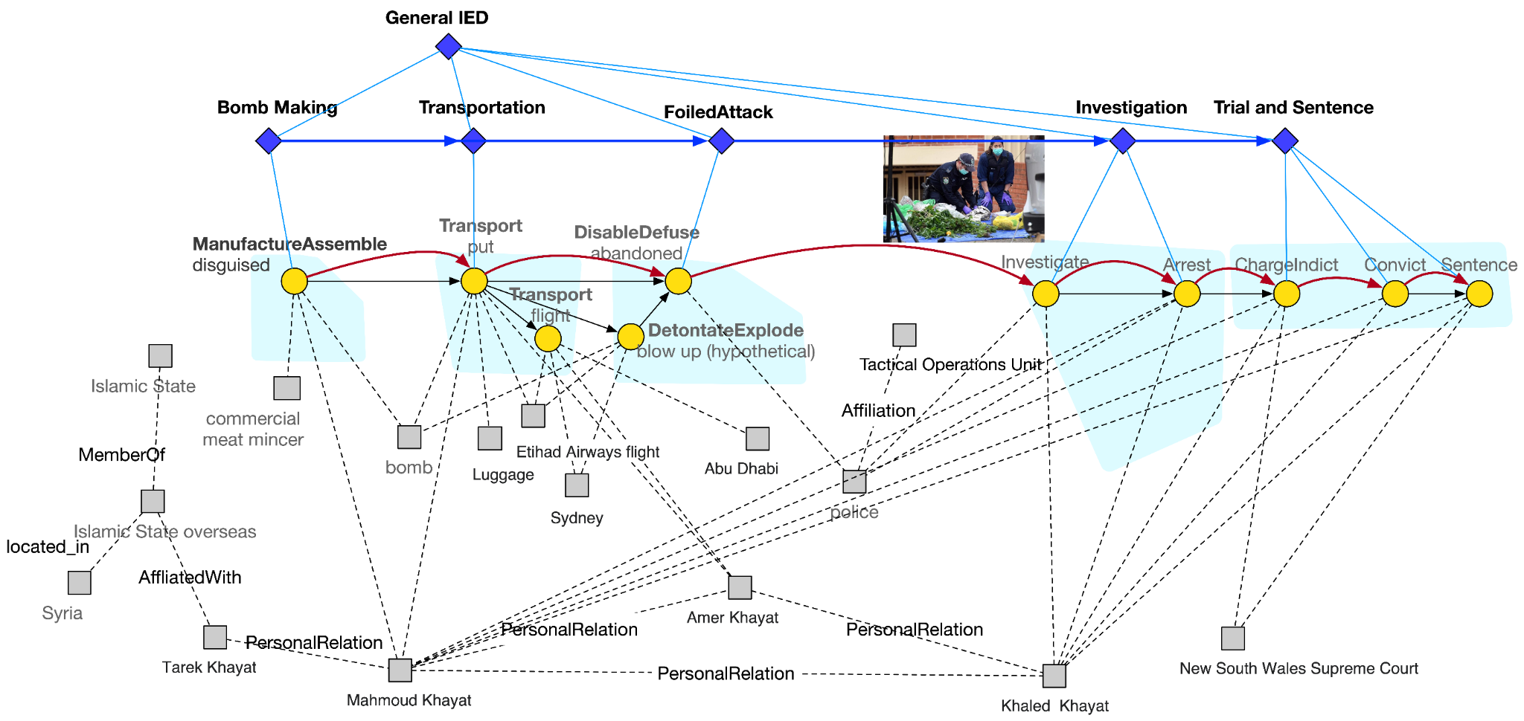
Instance-level Event and Episode Prediction

Slide 25
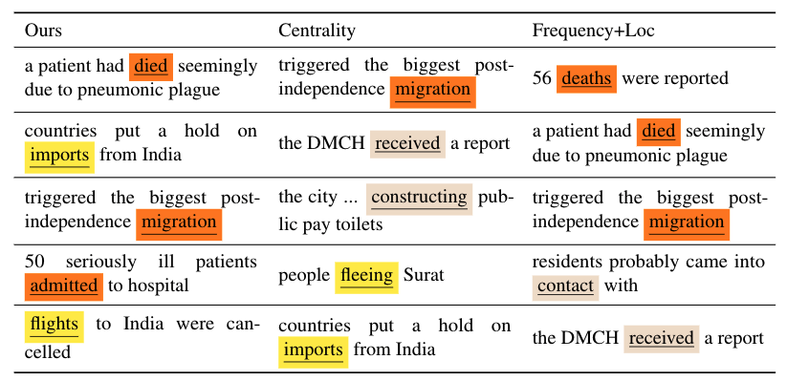
Why is Event Schema Useful? [3] Tracking Entity States
Event salience: checking the drop in coherence after we remove the event
We measure coherence as the generation probability of the entire complex event graph
Top salient events detected on the 1994 India plague (https://en.wikipedia.org/wiki/1994_plague_in_India) event
Notes:
- if a schema library were encoded as/inside a neural network or a LM like BERT, it could make predictions, but not be understandable to a human. What could one do to make it understandable? [model = schema; automatic naming? Centroid of clusters?]

Slide 26
Tracking Entity States: Protagonist (salient entity) Identification
The saliency of an entity is determined by the events it is involved in and the role it plays in each event.
Thus, we compute the saliency score by aggregating over each edge <e_j, a, ent_i>:
argument role
At any particular timestep t, we should be able to know:
Does entity A exist at timestep t?
Is entity A involved in any event at timestep t?
What is the location of entity A at timestep t?

Slide 27
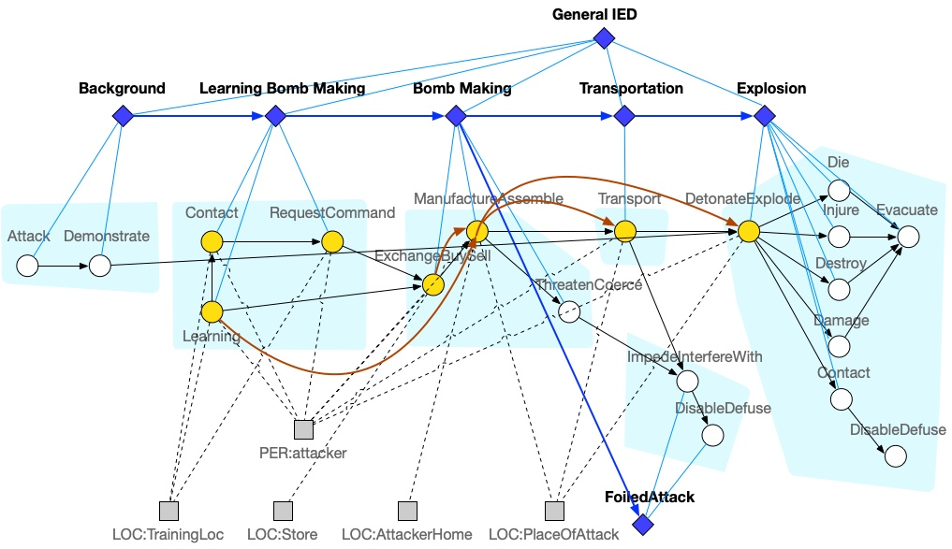
Temporal and Spatial Tracking of Protagonists: Type-level
State of attacker:
Timestep | 1 | 2 | 3 | 4 | 5 | 6 | 7
Event | Learning | Contact | Request | ExchangeBuySell | Manufacture | Transport | DetonateExplode
Location | TrainingLoc | TrainingLoc | TrainingLoc | Store | AttackerHome | AttackerHome->PlaceOfAttack | PlaceOfAttack
Notes:
Maybe add TimeDelta?

Slide 28
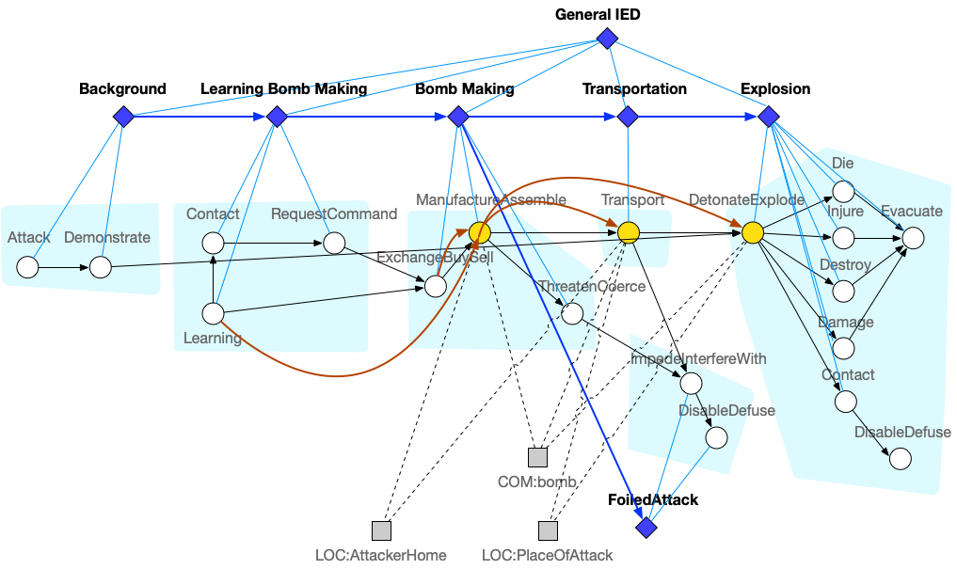
Temporal and Spatial Tracking of Protagonists: Type-level
State of bomb:
Timestep | 1 | 2 | 3 | 4 | 5 | 6 | 7
Existence |  |  |  |  | Created |  | Destroyed
Event |  |  |  |  | Manufacture | Transport | DetonateExplode
Location |  |  |  |  | AttackerHome | AttackerHome->PlaceOfAttack | PlaceOfAttack
Notes:
Maybe add TimeDelta?

Slide 29
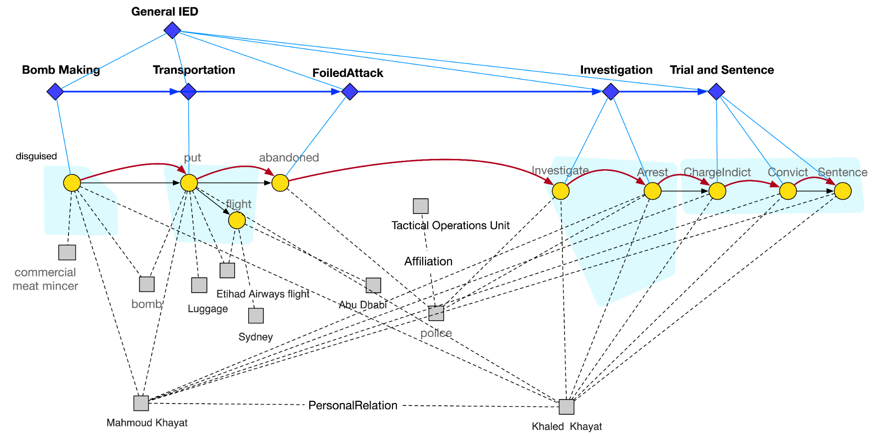
Temporal and Spatial Tracking of Protagonists: Instance-level (attacker Mahmoud Khayat and Khaled Khayat)
Timestep | 1 | 2 | 3 | 4 | 5 | 6 | 7
Event | disguise | put | abandon | investigate | arrest | charge | convict | sentence
Location | Sydney

Slide 30
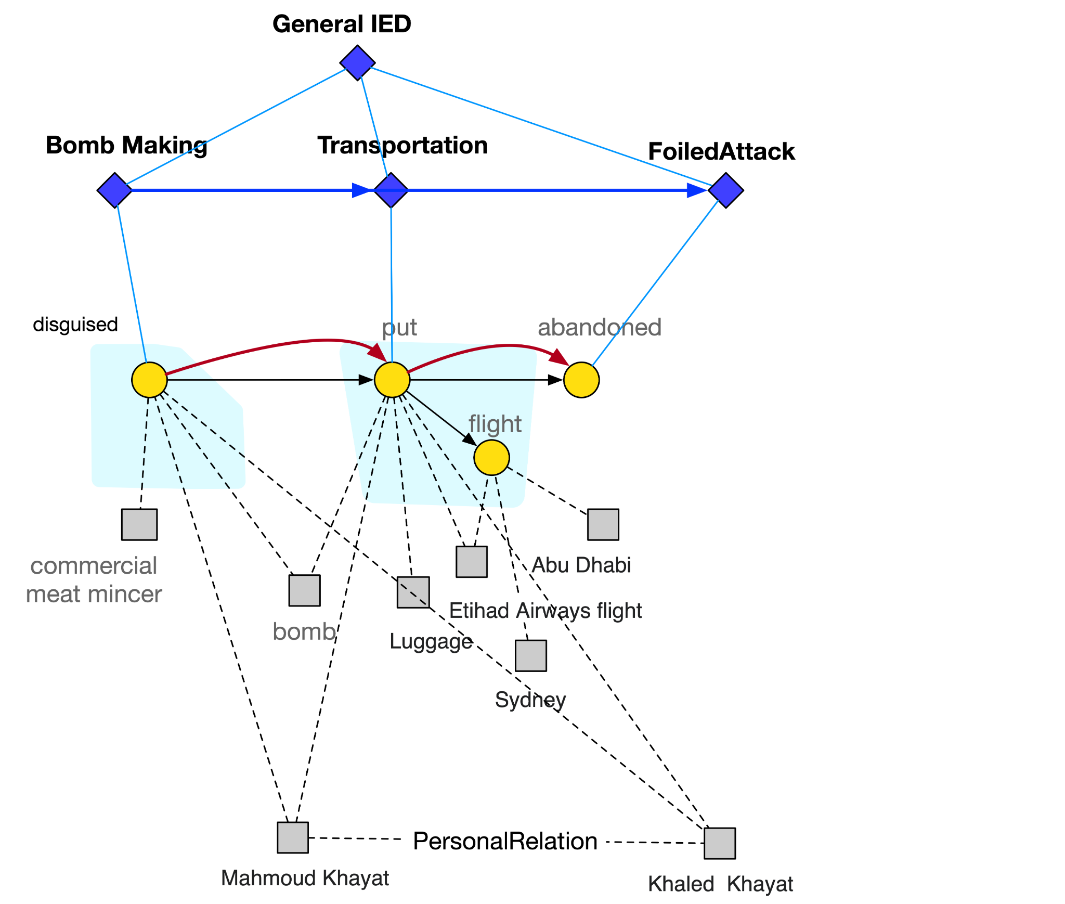
Temporal and Spatial Tracking of Protagonists: Instance-level (bomb)
Timestep | 1 | 2 | 3
Existence | Created |  | Destroyed
Event | Manufacture (disguised) | Transport (put) | DisableDefuse (abandoned)
Location |  | Sydney

Slide 31
Goal Detection
Goal: Put the attacker into jail
Goal: Arrest the attacker
Goal: Place the bomb
Notes:
- how hard is it to do internal schema organization for schema clarity and reasonable compression to remove redundancy? [multiple hypotheses? Make schemas more distinguishable from one another, discriminative factor]

Slide 32
Schema Induction with wikiHow -- Textual (Lyu et al., 2020)
Three goal-step inference tasks in binary classification format:
Input:
Goal: “Prevent Coronavirus”
Question: Is the step “Wash Your Hands” involved in the given goal ?
Answer: Yes.
Input:
Step: “Blink Repeatedly”
Question: Is the given step involved in the goal “Fall Asleep”?
Answer: No.
Input:
Goal: “Act after Getting Arrested” Step A: Get a lawyer. Step B: Request bond from the judge.
Question: Which step comes first?
Answer: A.
Task 1: Step Inference
Task 2: Goal Inference
Task 3: Step Ordering
Notes:
Our textual schema induction algorithm (by Harry & Veronica from UPenn):
For training, we design three subtasks in the binary classification format:
Step Inference: Given a goal (e.g. “Prevent Coronavirus”), decide if an event (e.g. “Wash your hands”) is a step towards it.
Goal Inference: Given a step (e.g. “Blink Repeatedly”), decide if an event (e.g. “Fall asleep”) is its potential goal.
Step Ordering: Given a goal (e.g. “Act after getting arrested”) and two of its steps (e.g. “get a lawyer”, “request bond from the judge”), determine which comes first.
Data source: wikiHow, a large-scale website of instructional articles

Slide 33
Schema Induction with wikiHow -- Textual
We train a model for Step Inference, Goal Inference, Step Ordering on wikiHow respectively.
Schema construction pipeline:
Input: raw docs, intended schema name(≈goal)
steps in the schema
raw docs
IE model
events
Step Inference model
Step Ordering model
The complete schema!
+
+
KAIROS event ontology
intended schema name
Notes:
We train a model for Step Inference, Goal Inference, Step Ordering on wikiHow respectively.
Our schema induction pipeline builds on the Step Inference and Step Ordering models.
Input: a set of raw documents + intended schema name (e.g. “Have an IED attack”, similar to our “goal”)
Pipeline:
IE model extracts events from raw docs using KAIROS ontology.
Each output event is feed into the Step Inference model along with the intended schema name. The Step Inference model outputs the probability score that the event is indeed a step in the schema. We take events with the highest scores (based on some threshold) as the set of steps in the schema.
The set of steps are feed into the Step Ordering model in pairs. We finally get a complete ordering by tournament ranking.
The output is the complete schema.

Slide 34
Schema Induction with wikiHow -- Textual
Conversion of IE events to textual form: Take “templates” from event ontology, and instantiate them using extracted arguments.
e.g. Event type: Disaster.Crash.Unspecified Template: “<arg1> person in <arg2> vehicle crashed into <arg3> at <arg4> place.” IE output: Trigger: crashed Arguments: <arg2>: drone; <arg3>: building Instantiated template: “Some person in drone vehicle crashed into building at some place.”
Notes:
One caveat in our pipeline: wikiHow events are represented as natural language texts, while KAIROS events are represented as trigger+arguments.
Our solution: We convert the extracted KAIROS events to NL form by instantiating the event templates using extracted arguments. Example above.

Slide 35
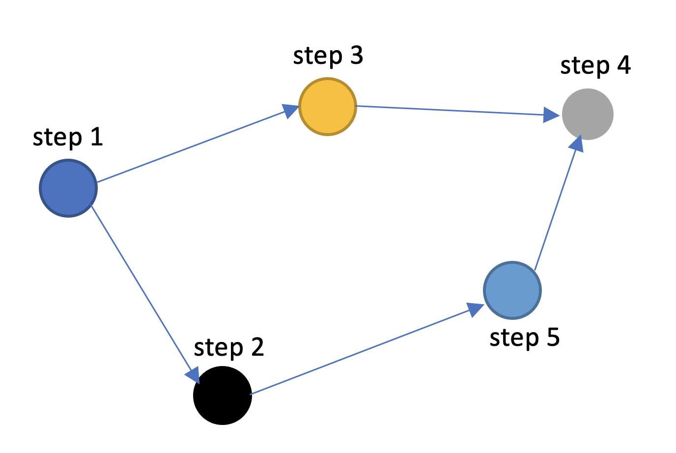
Schema Induction with wikiHow -- Multimodal [Yang et al., 2021]
Schema Induction using Videos
Input: a bag of videos (describing the same task)
Output: schema (ordered set of steps representing the high-level goal)
Format of Schema (Directed Graph with nodes as steps / FST with edges as steps)

Slide 36
Schema Induction with wikiHow -- Multimodal
Task: Blacken Fish
Sprinkle both sides of the meat with blackening spices. | 1.
1
Sprinkle both sides of the meat with blackening spices. | 0.839
Flip the fish and add a bit more butter. | 0.574
Plate the fish and lemon, and wipe the skillet.| 1.
0
Pat the fish dry and season it. | 0.819
4
6
Turn and season the other side of the veal chops. | 0.925
Garnish and serve the lemon butter tilapia. | 0.869
3
2
Garnish and serve the lemon butter tilapia. | 1.
Grill yellowfin tuna steaks. | 0.936
5
Use tongs to take the oysters off the grill. | 1.
Notes:
Here is an example of the output of our model for the task Blacken Fish. We can observe that a lot of the tasks are relevant in terms of the actions required to blacken the fish, but a lot of the nouns are taken from other how to steps. For example, “use tongs to take the oysters off the grill” would be applicable if instead of oysters we had “fish” as the object. We are looking to improve these schemas with entity extraction and templatic matching of them.

Slide 37
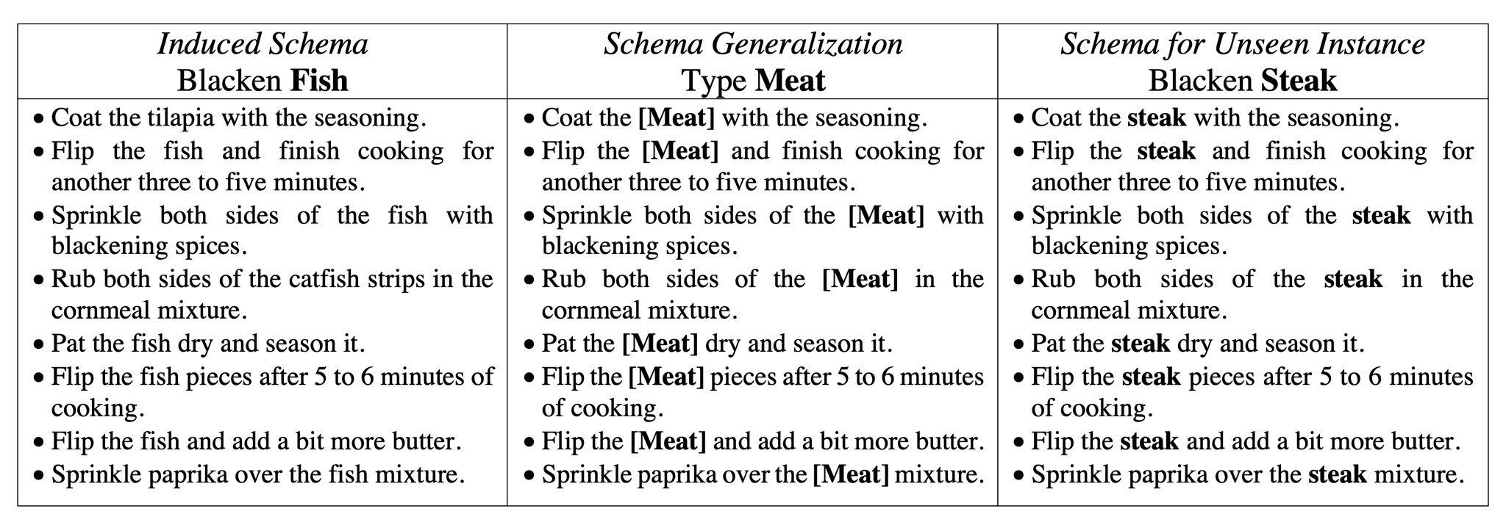
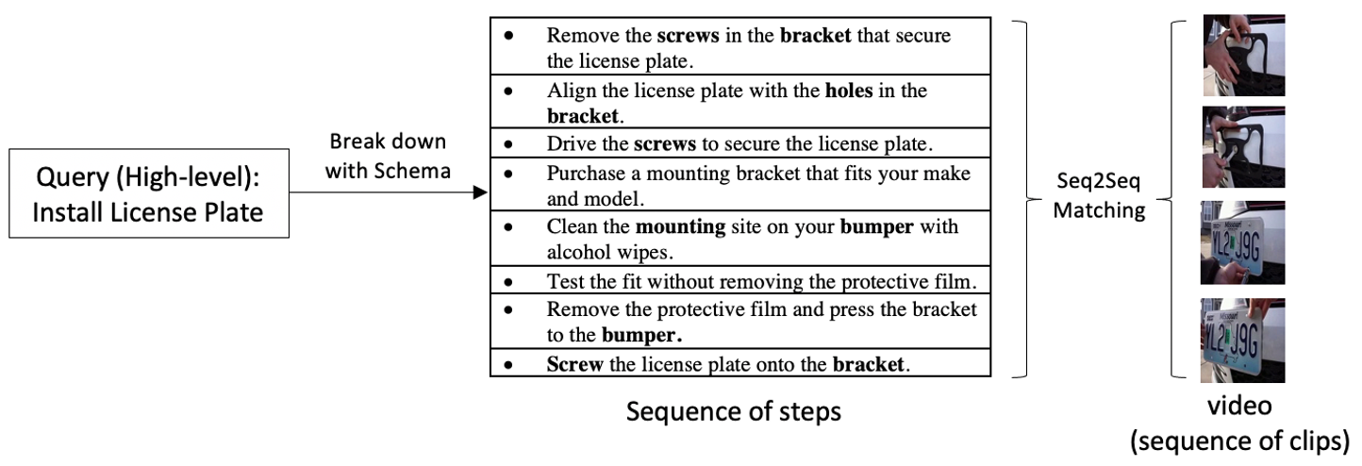
Schema Induction with wikiHow -- Multimodal
Schema Generalization
Transfer existing schemas to unseen tasks
Extrinsic Evaluation (Long Video Retrieval)
Use schema to mitigate the lack of intermediate steps for long video retrieval

Slide 38
Conclusions and Future Work
Hierarchical complex event schema induction is a powerful task to enhance information extraction, tracking and prediction
Future Work
Other relation types: containment, enablement, causality, logical (AND, OR, XOR)
Capture uncertainty at optional and repeated events
Multimodal Schema Learning
Goal and Motif Identification and use it to improve episode segmentation
Rich attributes: Temporal attribute generalization (duration, absolute time points, Periodicity, Frequency, Transient vs. Stationary) and entity profiling
Distinguish actual events from intentions, opinions, hypotheses, future events
38
Notes:
Change low resource IL to a language which is not in wikipedia
Goal identification
A end goal is a desired end state
A subgoal is a milestone of each episode
We can represent the planning procedure as the changes of entity states
Goals may not be explicitly mentioned, so they need to be generalized from hierarchical event graphs
Classify each episode as goal-oriented or not, and generalize/generate goal descriptions based on episode name, ending event, and entity state changes
Word-level: from bi-lingual dicts and alignment; structure-level comes from wals; multi-level alignment

