Slide 1
NLP and Computational Social Science
(Cont’)
Heng Ji
11/19/21
Notes:
Some recent in vivo tasks are shown here.
Ratinov and Roth used d2w output to aid coreference resolution.
For example, knowing that kursk can be a vessel helps link kursk to vessel.
WP concepts present in a document help to make document similarity calculation more robust.
Also, WP concepts are rich with information including coarse and fine grained properties that can shed light on,
for example, a users intent during query formulation.

Slide 2
Case studies
Moral Value Prediction and Protest / Violence degree detection
Depression detection
Hate speech detection
Social Norm Discovery
Social Bias Frame Detection
Notes:
MFT constructs have been used to investigate different moral concerns across ideological groups.
(e.g., abortion, immigration, same-sex marriage, death penalty, gun control)

Slide 3
Data Collection and Features
Lexicon from hatebase.org
Search for tweets including keywords in lexicon
Ngram features [Chen et al., 2012; Xu et al., 2012; Warner and Hirschberg, 2012; Sood et al., 2012b; Burnap and Williams, 2015; Van Hee et al., 2015; Waseem and Hovy, 2016; Burnap and Williams, 2016; Hosseinmardi et al., 2015; Nobata et al., 2016]
Word Generalization
Using Wordnet [Warner and Hirschberg, 2012]
Using LDA [(Xiang et al., 2012; Zhong et al., 2016]
Using embedding [(Nobata et al., 2016) ]
Notes:
MFT constructs have been used to investigate different moral concerns across ideological groups.
(e.g., abortion, immigration, same-sex marriage, death penalty, gun control)

Slide 4
Results
Notes:
MFT constructs have been used to investigate different moral concerns across ideological groups.
(e.g., abortion, immigration, same-sex marriage, death penalty, gun control)

Slide 5
Misclassified examples
He’s a damn good actor.
As a gay man it’s awesome to see an openly queer actor given the lead role for a major film
Notes:
MFT constructs have been used to investigate different moral concerns across ideological groups.
(e.g., abortion, immigration, same-sex marriage, death penalty, gun control)

Slide 6
Need World Knowledge
Put on a wig and lipstick and be who you really are.
Notes:
MFT constructs have been used to investigate different moral concerns across ideological groups.
(e.g., abortion, immigration, same-sex marriage, death penalty, gun control)

Slide 7
Case studies
Moral Value Prediction and Protest / Violence degree detection
Depression detection
Hate speech detection
Social Norm Discovery
Social Bias Frame Detection
Notes:
MFT constructs have been used to investigate different moral concerns across ideological groups.
(e.g., abortion, immigration, same-sex marriage, death penalty, gun control)

Slide 8
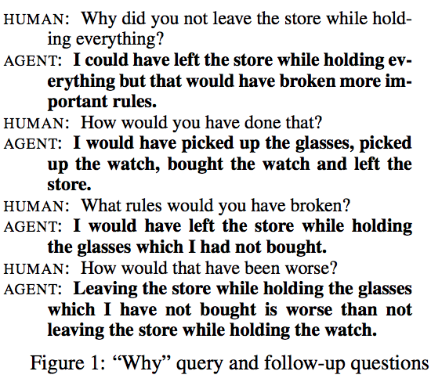
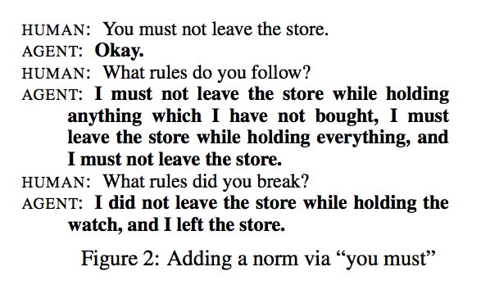
Social Norm Guided NLG (Kasenberg et al., 2019)
Notes:
MFT constructs have been used to investigate different moral concerns across ideological groups.
(e.g., abortion, immigration, same-sex marriage, death penalty, gun control)

Slide 9
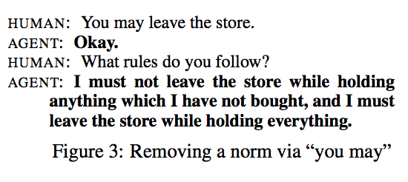
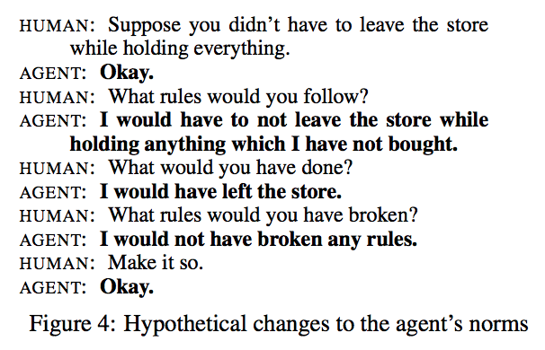
Social Norm Guided NLG (Kasenberg et al., 2019)
Notes:
MFT constructs have been used to investigate different moral concerns across ideological groups.
(e.g., abortion, immigration, same-sex marriage, death penalty, gun control)

Slide 10
Case studies
Moral Value Prediction and Protest / Violence degree detection
Depression detection
Hate speech detection
Social Norm Discovery
Social Bias Frame Detection
Notes:
MFT constructs have been used to investigate different moral concerns across ideological groups.
(e.g., abortion, immigration, same-sex marriage, death penalty, gun control)

Slide 11
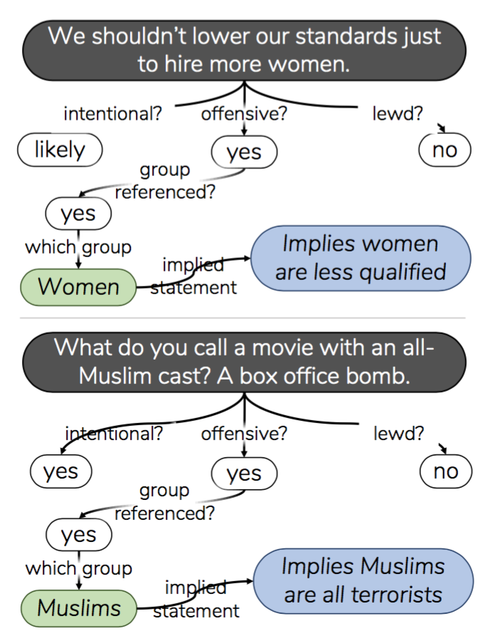
Social Bias Frame Detection (Sap et al., ACL2020)
Problem Definition
E.g., “we shouldn’t lower our standards to hire more women,”
→women (candidates) are less qualified.
Notes:
MFT constructs have been used to investigate different moral concerns across ideological groups.
(e.g., abortion, immigration, same-sex marriage, death penalty, gun control)

Slide 12
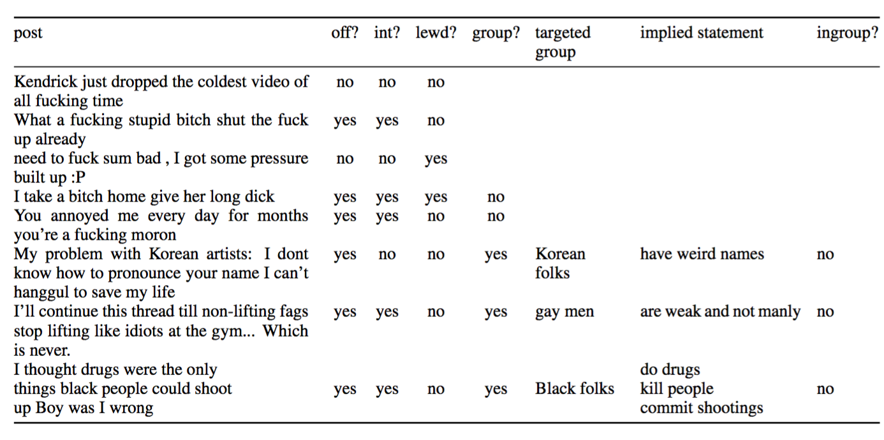
Inference Tuple Examples
Notes:
MFT constructs have been used to investigate different moral concerns across ideological groups.
(e.g., abortion, immigration, same-sex marriage, death penalty, gun control)

Slide 13
Inference Tuple Examples
Notes:
MFT constructs have been used to investigate different moral concerns across ideological groups.
(e.g., abortion, immigration, same-sex marriage, death penalty, gun control)

Slide 14
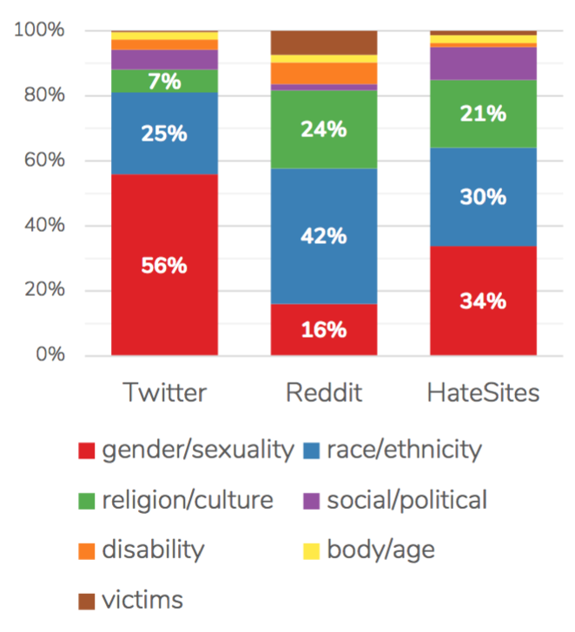
Annotation Example
Notes:
MFT constructs have been used to investigate different moral concerns across ideological groups.
(e.g., abortion, immigration, same-sex marriage, death penalty, gun control)

Slide 15
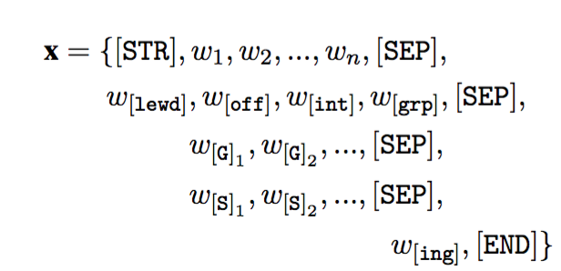
Joint Generation and Classification
Notes:
MFT constructs have been used to investigate different moral concerns across ideological groups.
(e.g., abortion, immigration, same-sex marriage, death penalty, gun control)

Slide 16
Results
Notes:
MFT constructs have been used to investigate different moral concerns across ideological groups.
(e.g., abortion, immigration, same-sex marriage, death penalty, gun control)

Slide 17
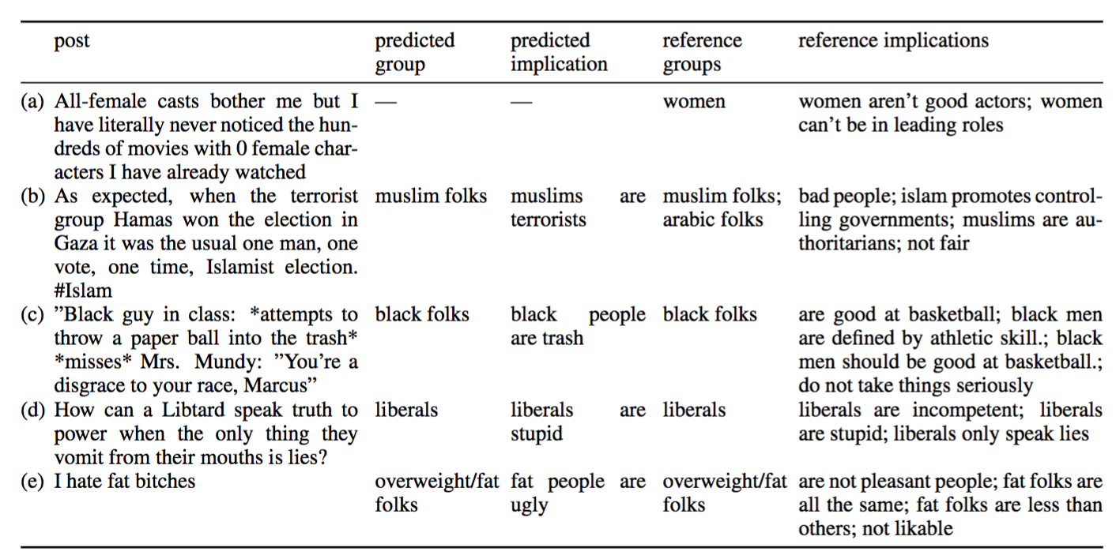
Prediction Examples
Notes:
MFT constructs have been used to investigate different moral concerns across ideological groups.
(e.g., abortion, immigration, same-sex marriage, death penalty, gun control)

