Slide 1
Deep Neural Networks Methods for NLP
Heng Ji
hengji@illinois.edu
(Acknowledgement: some slides from Jianfeng Gao, Avi Sil, Ming Li, Yu Chen)

Slide 2
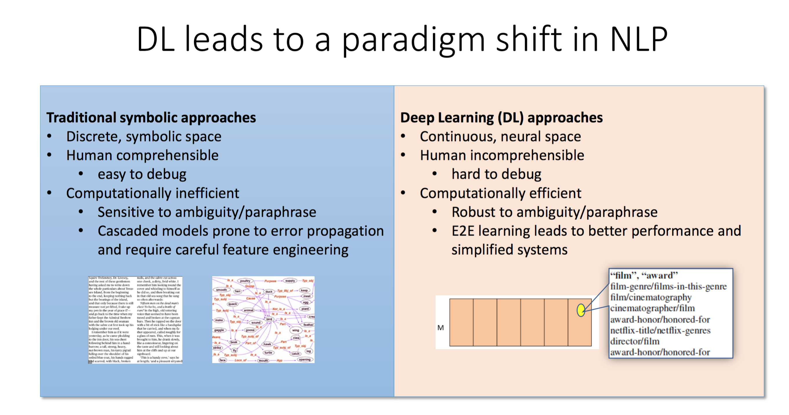
Notes:
An event is NEGATIVE if it is explicitly indicated that the event did not occur, otherwise, the event is POSITIVE ~ Polarity
An event is ASSERTED if it is mentioned as if it were a real occurrence, otherwise it is OTHER. ~ Modality
An event is SPECIFIC if it is a single occurrence at a particular place and time, or a finite set of such occurrences; otherwise, it is GENERIC ~ Genericity.
Tense ~ Unspecified, Past, Present, Future

Slide 3
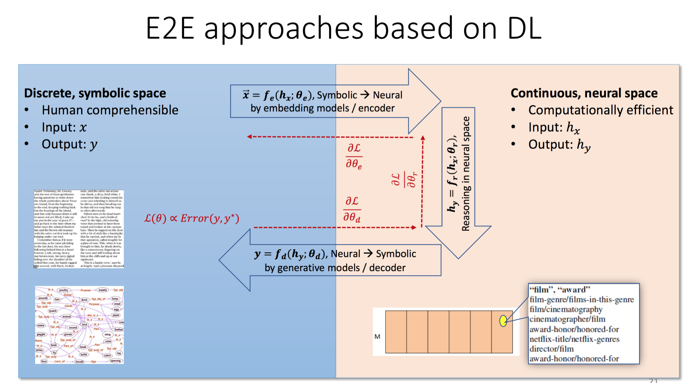
Notes:
An event is NEGATIVE if it is explicitly indicated that the event did not occur, otherwise, the event is POSITIVE ~ Polarity
An event is ASSERTED if it is mentioned as if it were a real occurrence, otherwise it is OTHER. ~ Modality
An event is SPECIFIC if it is a single occurrence at a particular place and time, or a finite set of such occurrences; otherwise, it is GENERIC ~ Genericity.
Tense ~ Unspecified, Past, Present, Future

Slide 4
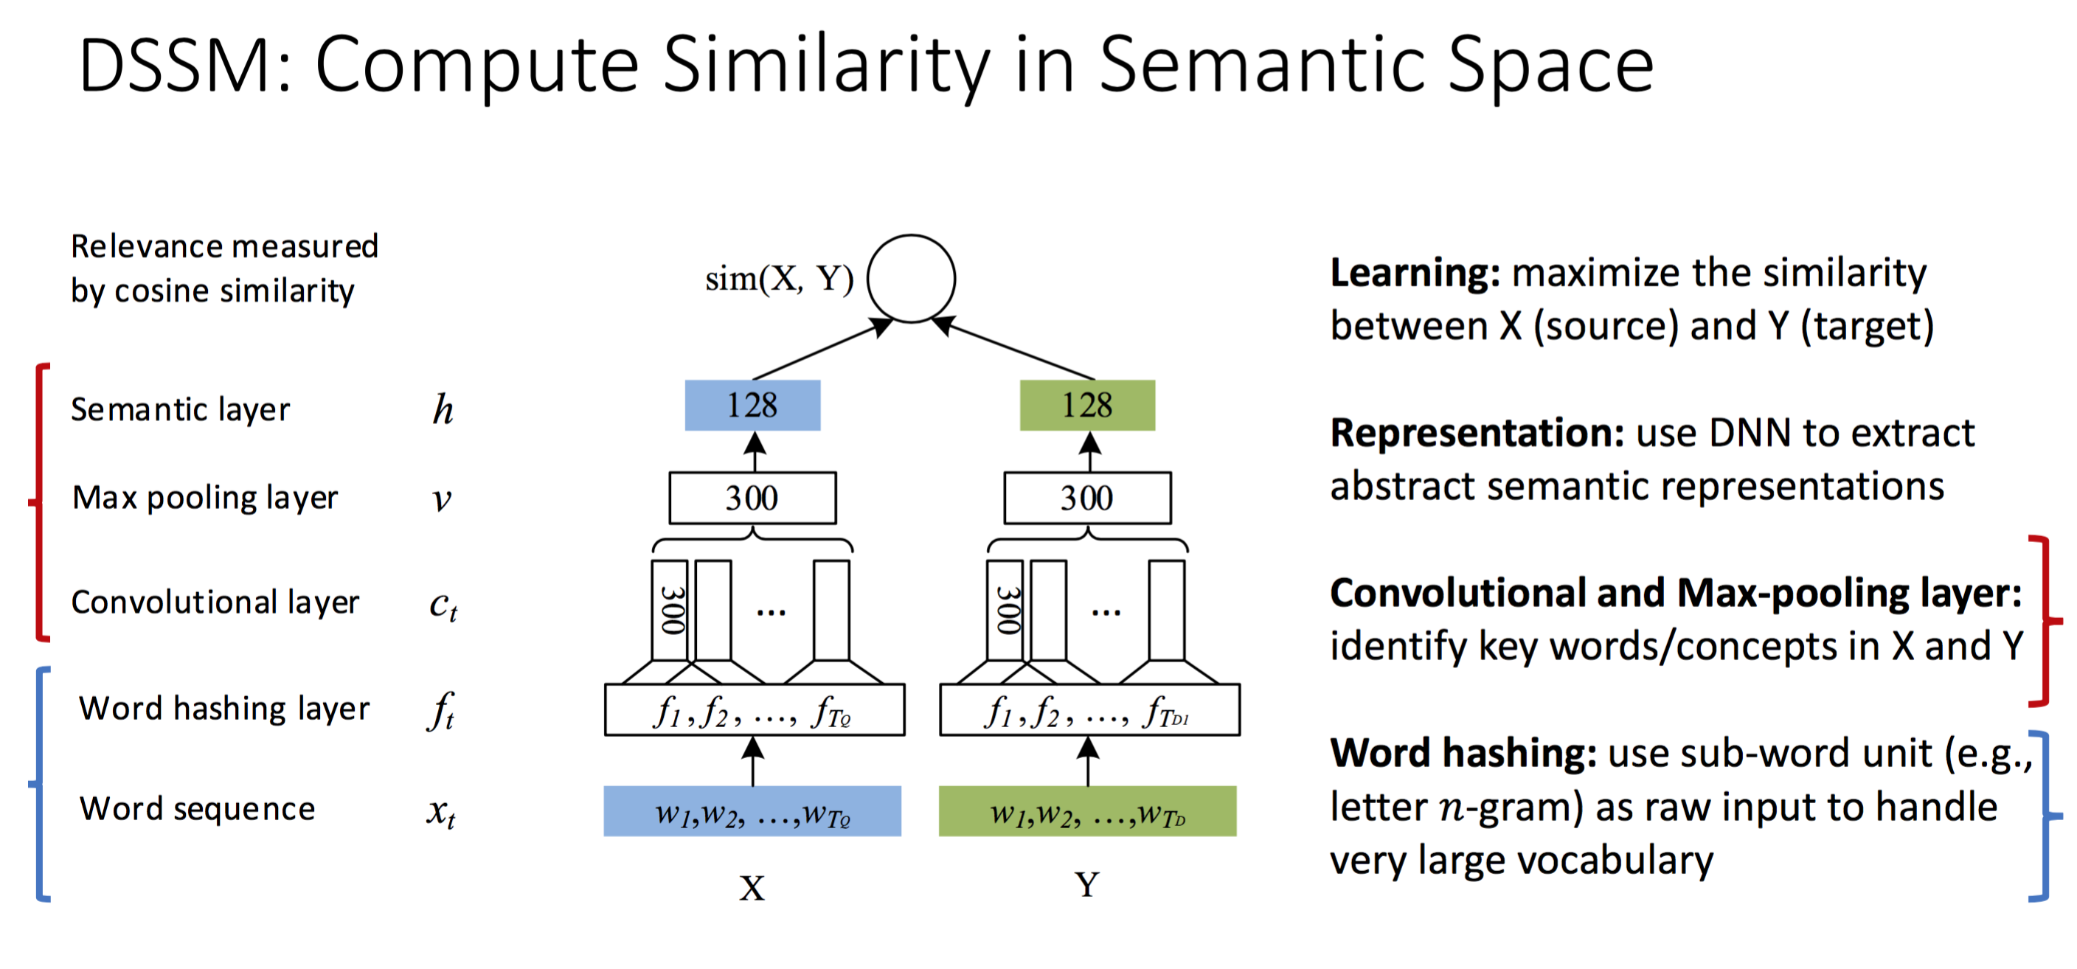
Notes:
An event is NEGATIVE if it is explicitly indicated that the event did not occur, otherwise, the event is POSITIVE ~ Polarity
An event is ASSERTED if it is mentioned as if it were a real occurrence, otherwise it is OTHER. ~ Modality
An event is SPECIFIC if it is a single occurrence at a particular place and time, or a finite set of such occurrences; otherwise, it is GENERIC ~ Genericity.
Tense ~ Unspecified, Past, Present, Future

Slide 5
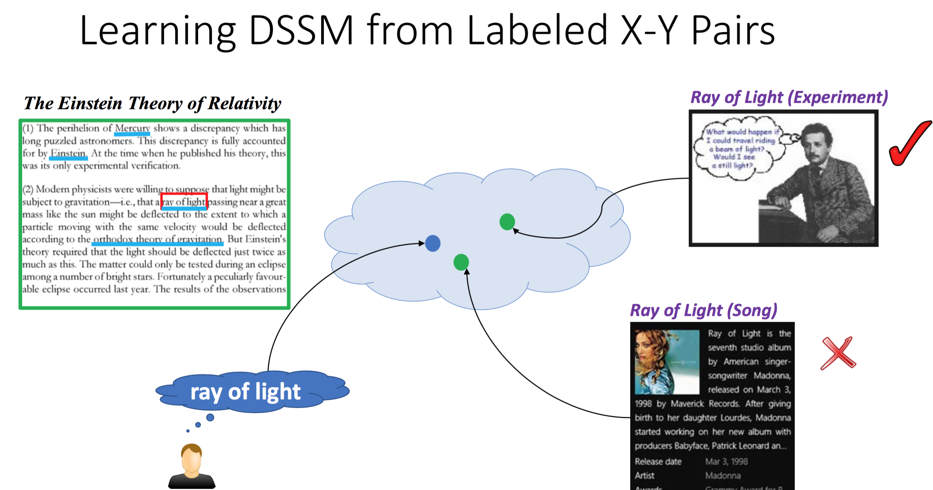
Notes:
An event is NEGATIVE if it is explicitly indicated that the event did not occur, otherwise, the event is POSITIVE ~ Polarity
An event is ASSERTED if it is mentioned as if it were a real occurrence, otherwise it is OTHER. ~ Modality
An event is SPECIFIC if it is a single occurrence at a particular place and time, or a finite set of such occurrences; otherwise, it is GENERIC ~ Genericity.
Tense ~ Unspecified, Past, Present, Future

Slide 6
Measure the Cosine Similarity
sim
tanh
tanh
Mean Pool
Mean Pool
Convolution
Layer
Convolution
Layer
Context from the query Document
Context from the target Wiki Page

Slide 7
Similarities over multiple granularities of context
Cosine Similarity based features:
These values are mapped to a 100-D vector using an RBF node
  Smooth binning process
  More parameters than a single cosine value
sim
sim
Conv(sent)
Conv(WFPara)
Conv(sent)
Wiki Page Emb

Slide 8
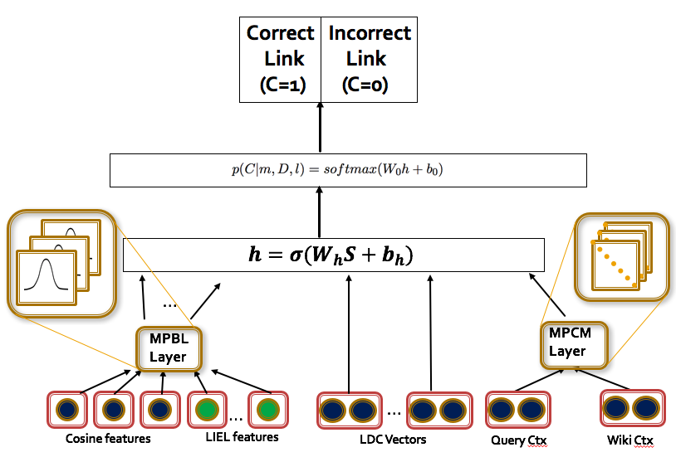
Neural Model Architecture
Features from LIEL (ACL 2016) paper

Slide 9
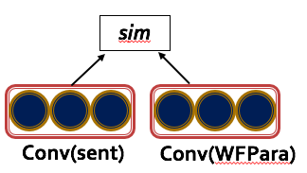
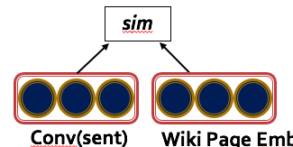
Neural Model Architecture
Cosine similarity based features
We run CNNs on the context of the entity
to create representations of the source and
target document

Slide 10
Neural Model Architecture
Multi-perspective Binning Layer ☺
Project features to higher dimensional space
The layer chooses the bins instead of a human
Details in our paper

Slide 11
Neural Model Architecture
Multi-perspective Similarities (SQuAD QA papers!)
Semantic Similarity and Dis-similarities (LDC)
Multi-perspective Cosine
Notes:
Use models from QA for Entity Linking. EL is also a QA task

Slide 12
Zero-shot Cross-lingual EL
A Generic EL Model
Notes:
Start with an English EL system but take it further

Slide 13


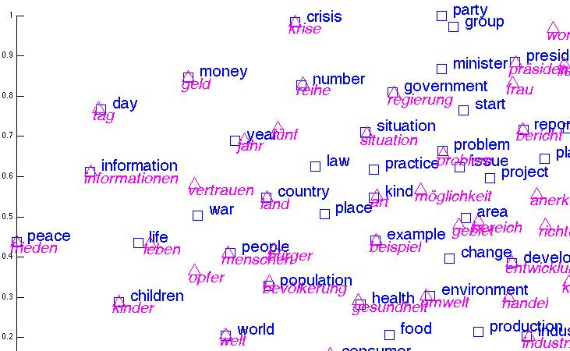
Zero-shot Cross-lingual EL
A Generic EL Model
English
Corpus
English WP
Apply the model to
Any Language for EL
Multi-lingual Word
Embeddings
Inter-language
Wiki links
Multi-lingual Word
Embeddings
English WP
Spanish
Corpus

Slide 14
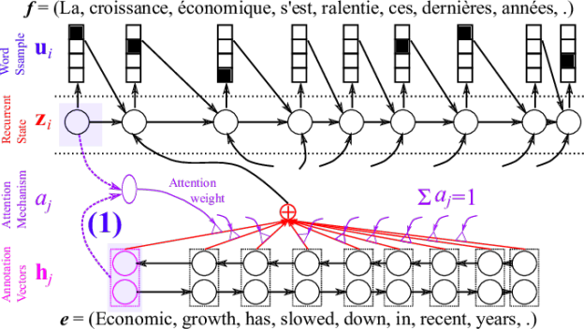
02
Attention and Transformers
Attention

Slide 15

02
Attention and Transformers
Image caption generation using attention
A vector for each region
z⁰ is initial parameter, it is also learned
match
z⁰
0.7
CNN
filter
filter
filter
filter
filter
filter
filter
filter
filter
filter
filter
filter

Slide 16
02
Attention and Transformers
Image caption generation using attention
Word 1
A vector for each region
z⁰
z¹
Attention to
a region
weighted sum
CNN
filter
filter
filter
filter
filter
filter
0.7
0.1
0.1
0.1
0.0
0.0
filter
filter
filter
filter
filter
filter

Slide 17
02
Attention and Transformers
Image caption generation using attention
Word 1
Word 2
A vector for each region
z²
z⁰
z¹
weighted sum
CNN
filter
filter
filter
filter
filter
filter
0.0
0.8
0.2
0.0
0.0
0.0
filter
filter
filter
filter
filter
filter

Slide 18
02
Attention and Transformers
Image caption generation using attention
Kelvin Xu, Jimmy Ba, Ryan Kiros, Kyunghyun Cho, Aaron Courville, Ruslan Salakhutdinov, Richard Zemel, Yoshua Bengio,
“Show, Attend and Tell: Neural Image Caption Generation with Visual Attention”, ICML, 2015

Slide 19
Feature Learning in Graphs
Our Goal: Design efficient task-independent/ task-dependent feature learning for machine learning in graphs!
node
v
f:v → ℝ^{d}
vector
19
_{ℝ}d
Feature representation, embedding

Slide 20




Graph Neural Networks: Foundations
Learning node embeddings:
Learning graph-level embeddings:
A graph filter
adjacency matrix
- Spectral-based
- Spatial-based
- Attention-based
Updated node embeddings
Input node embeddings
- Recurrent-based
Flat Graph Pooling (i.e. Max, Ave, Min)
Hierarchical Graph Pooling (i.e. Diffpool)
A small graph w/
fewer nodes
Input node embeddings
Input graph
New node embeddings
Notes:
The specific models differ only in how 𝑓_filter(·,·) is chosen and parameterized.

Slide 21







Graph Neural Networks: Basic Model
Key idea: Generate node embeddings based on local neighborhoods.
A
TARGET NODE
B
B
C
A
B
A
C
A
C
E
F
D
F
E
D
INPUT GRAPH
A

Slide 22
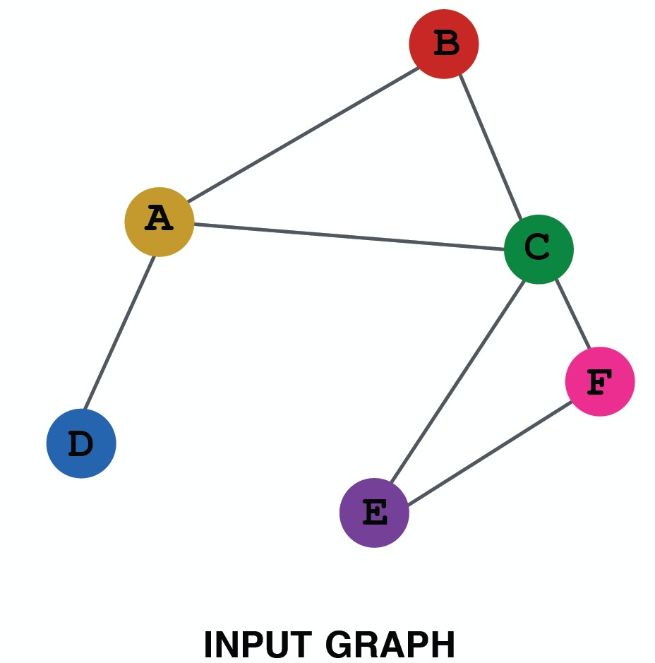
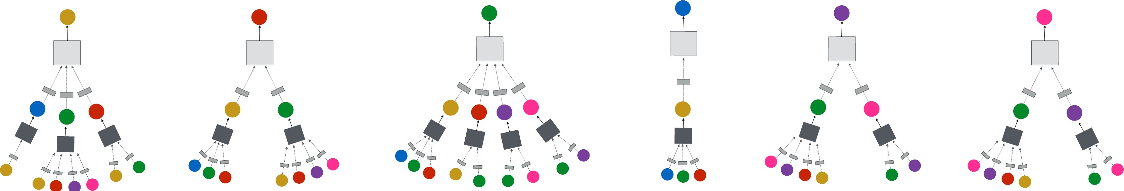
Neighborhood Aggregation
Intuition: Network neighborhood defines a computation graph
Every node defines a unique
computation graph!

Slide 23
Neighborhood Aggregation
Nodes have embeddings at each layer.
Model can be arbitrary depth.
“layer-0” embedding of node i is its input feature, i.e. x_{i}.
Layer-0
Layer-1
A
X_{A}
TARGET NODE
B
C
X_{C}
B
Layer-2
A
B
X_{A}
A
C
X_{B}
A
C
X_{E}
E
F
X_{F}
D
F
E
D
INPUT GRAPH
A
X_{A}

Slide 24
Overview of GNN Model
1) Define a neighborhood aggregation function
A
TARGET NODE
B
B
C
A
B
A
C
Z_{A}
A
C
E
F
D
F
E
D
INPUT GRAPH
A
2) Define a loss function on the embeddings, L(z_{v})

Slide 25
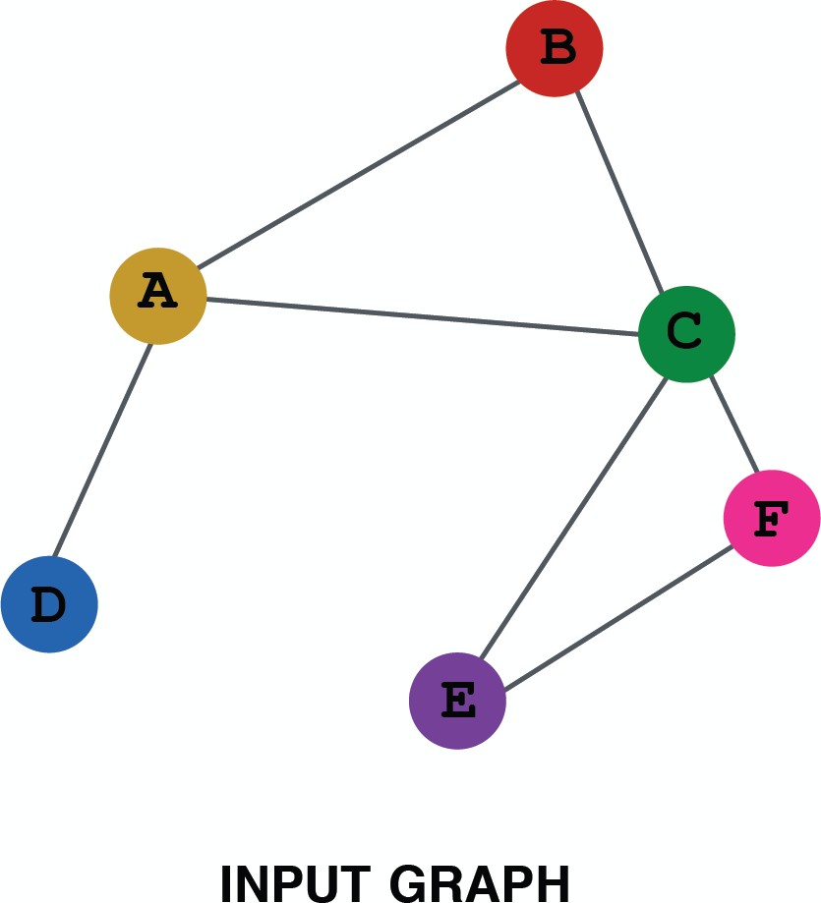
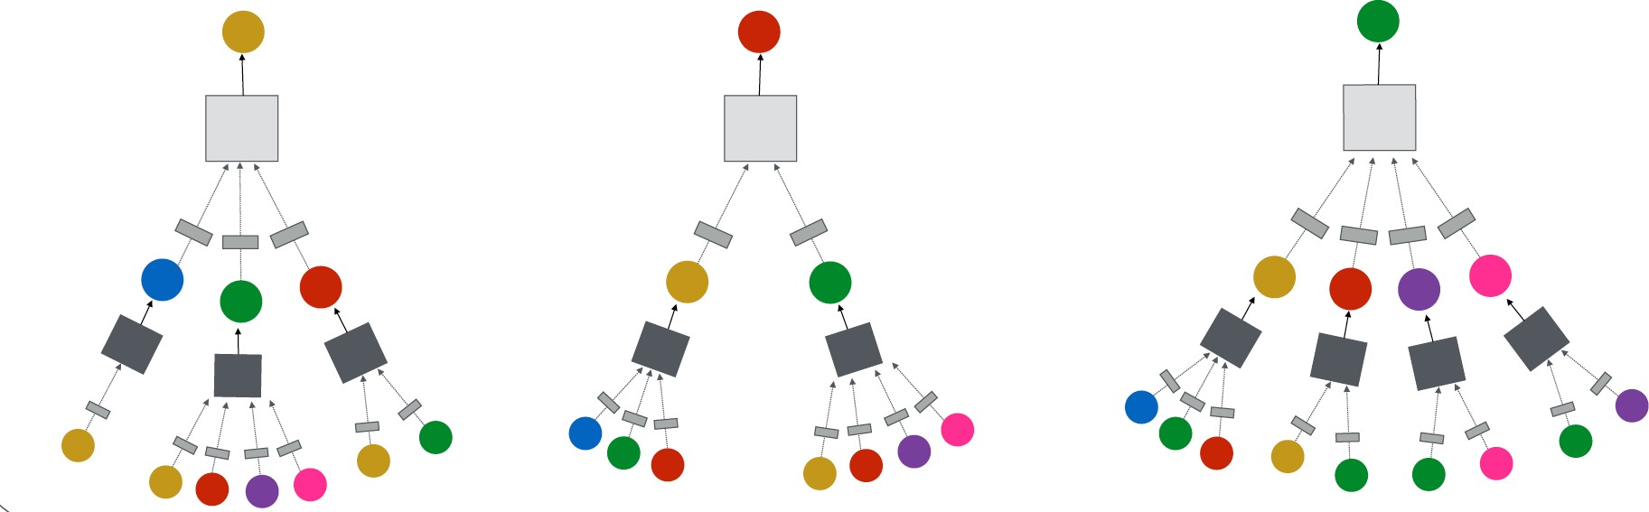
Overview of GNN Model
3) Train on a set of nodes, i.e., a batch of computation graphs

Slide 26
Overview of GNN Model
4) Generate embeddings for nodes as needed
Even for nodes we
never trained on!
26

Slide 27
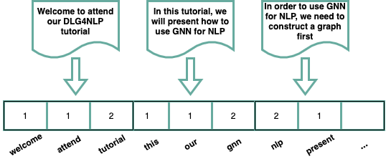
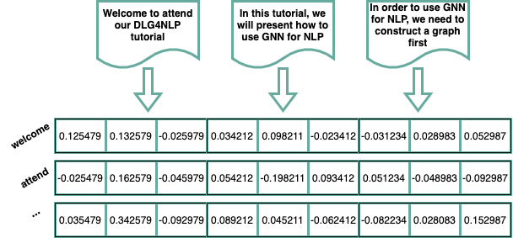
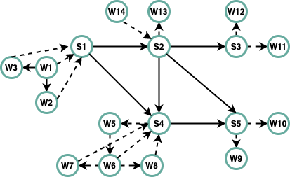
Natural Language Processing: A Graph Perspective
Represent natural language as a bag of tokens
  BOW, TF-IDF
  Topic Modeling: text as a mixture of topics
Represent natural language as a sequence of tokens
  Linear-chain CRF
  Word2vec, Glove
Represent natural language as a graph
  Dependency graphs, constituency graphs, AMR graphs, IE graphs, and knowledge graphs
  Text graph containing multiple hierarchies of elements, i.e. document, sentence and word

Slide 28
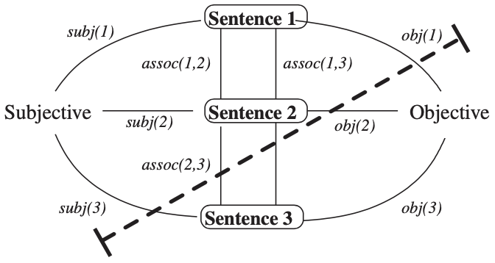
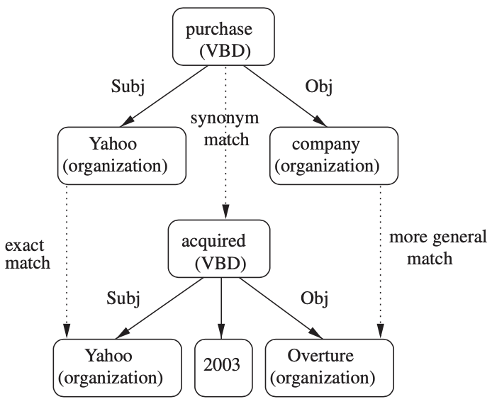
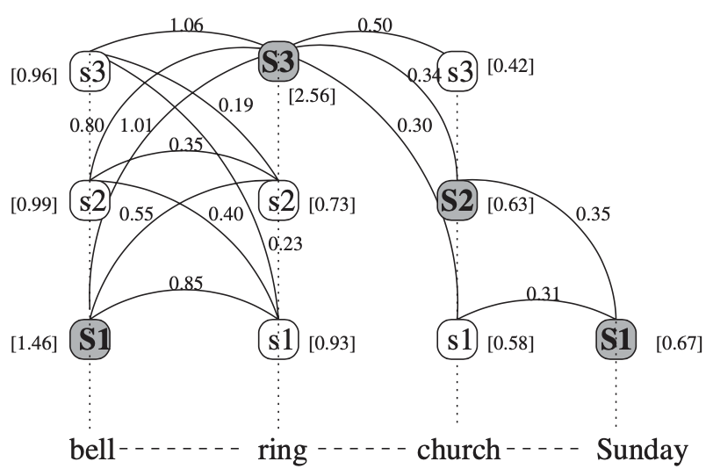
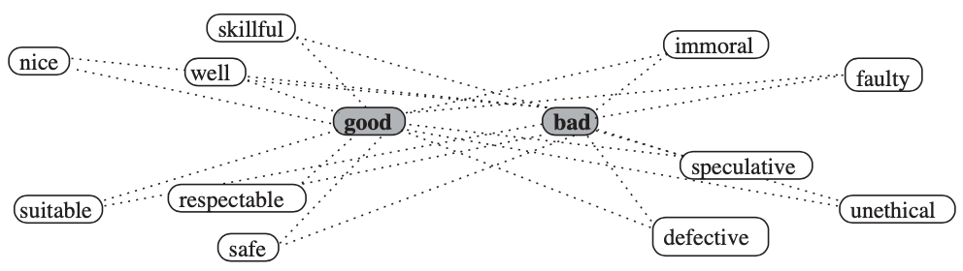
Graph Based Methods for NLP
[Mihalcea and Radev, 2011]
Random Walk Algorithms
  Generate random paths, one can obtain a stationary distribution over all the nodes in a graph
  Applications: semantic similarity of texts, name disambiguation
Graph Clustering Algorithms
  Spectral clustering, random walk clustering and min-cut clustering for text clustering
Graph Matching Algorithms
  Compute the similarity between two graphs for textual entailment task
Label Propagation Algorithms
  Propagate labels from labeled data points to previously unlabeled data points
  Applications: word-sense disambiguation, sentiment analysis

Slide 29
Graph-to-Sequence Model
Graph Convolutional Neural Network
[1] Kun Xu*, Lingfei Wu*, Zhiguo Wang, Yansong Feng, Michael Witbrock, and Vadim Sheinin (Equally Contributed), "Graph2Seq: Graph to Sequence Learning with Attention-based Neural Networks", arXiv 2018.
[2] Yu Chen, Lingfei Wu** and Mohammed J. Zaki (**Corresponding Author), "Reinforcement Learning Based Graph-to-Sequence Model for Natural Question Generation”, ICLR’20.

Slide 30

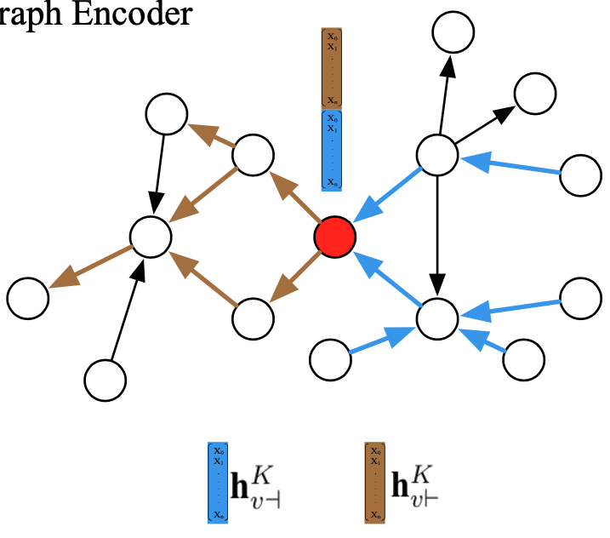
Bidirectional GNNs for Directed Graphs
Bi-Sep GNNs formulation:
Run multi-hop backward/forward GNN on the graph
Concatenate backward/forward node embeddings at last hop
Xu et al. “Graph2Seq: Graph to Sequence Learning with Attention-based Neural Networks”. 2018.
Notes:
\mathbf{h}^{k}_{i, \dashv} &= \textit{GNN}(\mathbf{h}^{k-1}_{i, \dashv}, \{\mathbf{h}^{k-1}_{j, \dashv}: \forall v_j \in \mathcal{N}_{\dashv}(v_i) \})
\mathbf{h}^{k}_{i, \vdash} &= \textit{GNN}(\mathbf{h}^{k-1}_{i, \vdash}, \{\mathbf{h}^{k-1}_{j, \vdash}: \forall v_j \in \mathcal{N}_{\vdash}(v_i) \})
\mathbf{h}^{K}_{i} = \mathbf{h}^{K}_{i, \dashv} || \mathbf{h}^{K}_{i, \vdash}

Slide 31
Bidirectional GNNs for Directed Graphs (cont)
Bi-Fuse GNNs formulation:
Run one-hop backward/forward node aggregation
Fuse backward/forward aggregation vectors at each hop
Update node embeddings with fused aggregation vectors at each hop
Chen et al. “Reinforcement Learning Based Graph-to-Sequence Model for Natural Question Generation”. ICLR 2020.
Notes:
\mathbf{h}^{k}_{\mathcal{N}_{\dashv}(v_i)} &= \textit{AGG}(\mathbf{h}^{k-1}_i, \{\mathbf{h}^{k-1}_j: \forall v_j \in \mathcal{N}_{\dashv}(v_i) \})
\mathbf{h}^{k}_{\mathcal{N}_{\vdash}(v_i)} &= \textit{AGG}(\mathbf{h}^{k-1}_i, \{\mathbf{h}^{k-1}_j: \forall v_j \in \mathcal{N}_{\vdash}(v_i) \})
\mathbf{h}^k_{\mathcal{N}(v_i)} = \textit{Fuse}(\mathbf{h}^{k}_{\mathcal{N}_{\dashv}(v_i)}, bi_fuse)
\mathbf{h}^{k}_i = \sigma(\mathbf{h}^{k-1}_i, \mathbf{h}^k_{\mathcal{N}(v_i)})

Slide 32
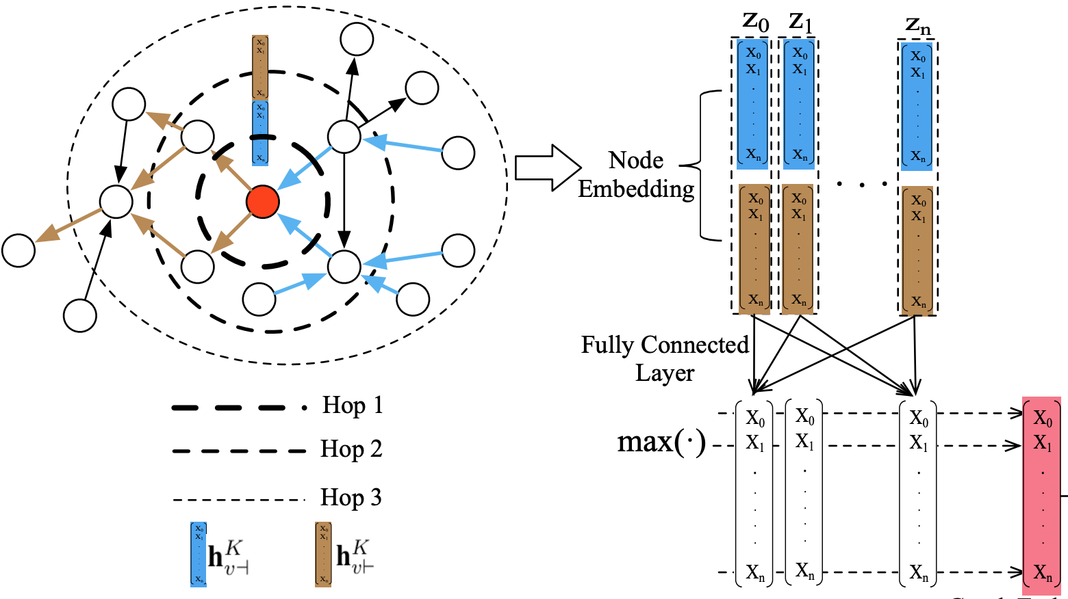
Graph Encoding
Graph embedding
  Pooling based graph embedding (max, min and average pooling)
  Node based graph embedding
    Add one super node which is connected to all other nodes in the graph
    The embedding of this super node is treated as graph embedding

Slide 33
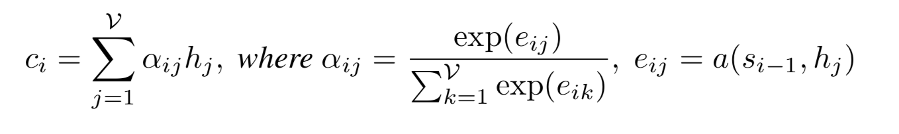
Attention Based Sequence Decoding
context vector
node representation

Slide 34
Attention Based Sequence Decoding
context vector
node representation
attention weights
alignment model

Slide 35
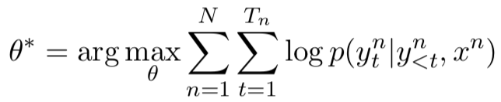
Attention Based Sequence Decoding
context vector
node representation
attention weights
alignment model
Objective Function

Slide 36
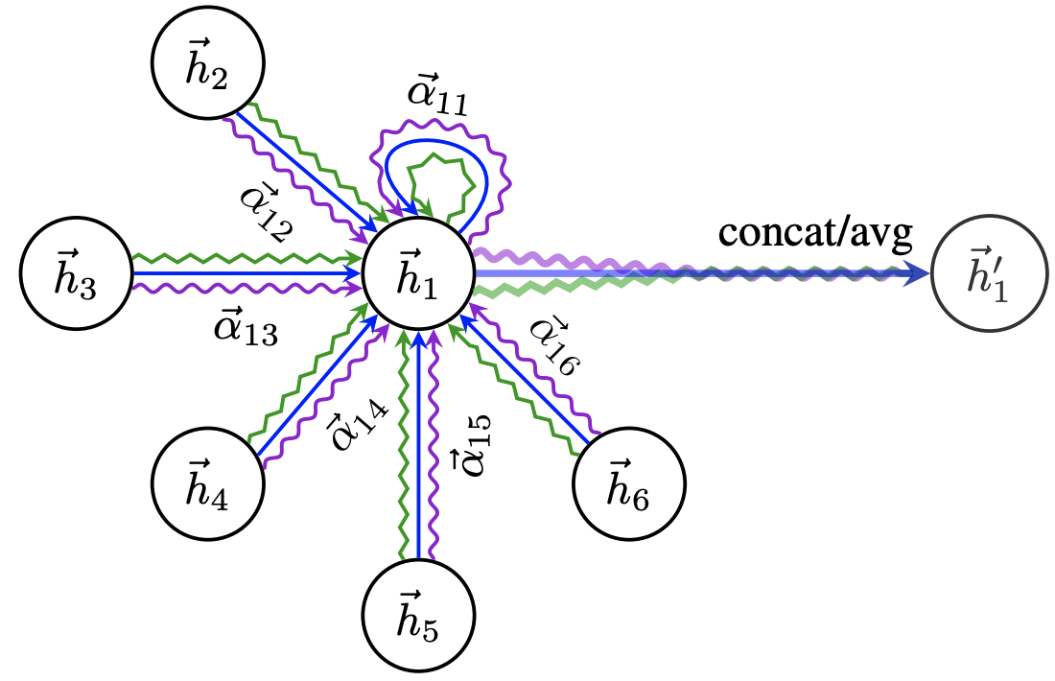
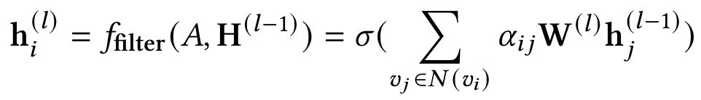
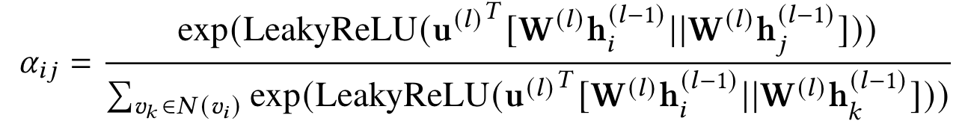
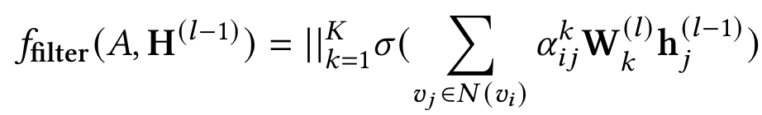
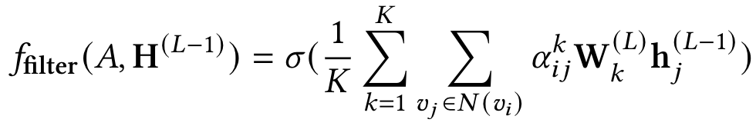
Graph Attention Network (GAT)
Key idea: dynamically learn the weights (attention scores) on the edges when performing message passing
Weighted sum of node embeddings
Learned local weights with self-attention
GAT in NLP Tasks:
Text classification
Question Answering
Knowledge graph
Information extraction
Semantic parsing
Intermediate node embeddings
Final node embeddings

Slide 37
Case Study on Information Extraction (IE)
Extract structured information and knowledge from unstructured data of heterogeneous data types, in various domains, genres, languages, and data modalities
place
place
target
victim
instrument
instrument
target
In Baghdad, a cameraman died when a combat tank fired on the Palestine Hotel.
LOC
PER
VEH
FAC
O
O
O
O
Die
O
O
O
O
Attack
O
O
O
O
It’s naturally a structure prediction task! Convert unstructured sequences to graphs

Slide 38
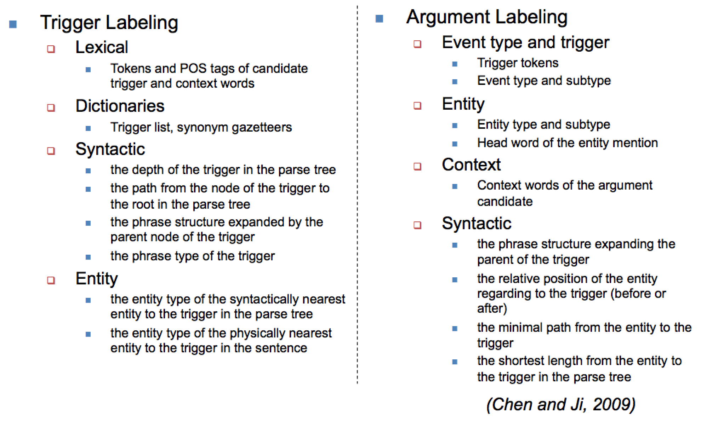
“Old” Days: Supervised Learning with Hand-crafed Features
38

Slide 39
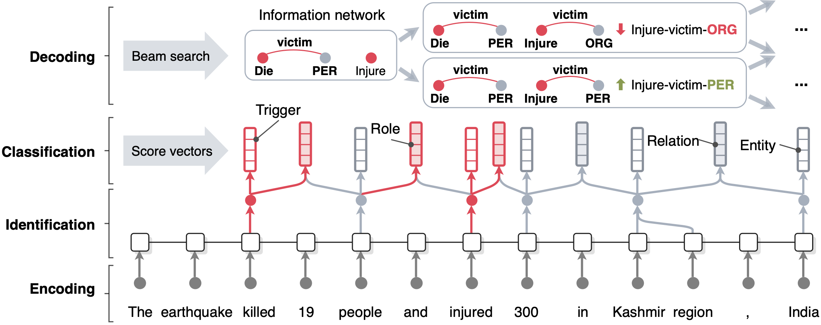
A Modern Approach: Joint Neural Information Extraction
A single joint neural model for information extraction that extracts the information graph from a given sentence in four steps: encoding, identification, classification, and decoding (Lin et al., ACL2020)
Use BERT embedding to encode each sentence, can be extended to any language with multilingual embeding

Slide 40
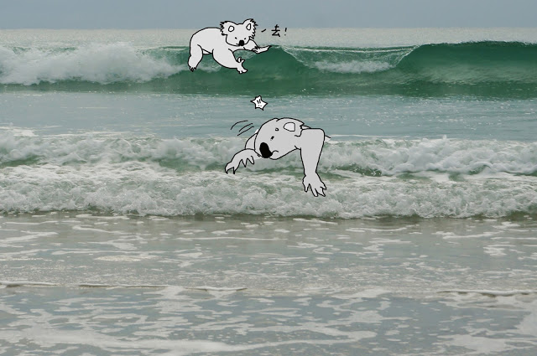
Should the old waves just fade away?
“The back wave pushes the front wave, and the front wave dies on the beach!” But symbolic semantics still matter…

Slide 41
Why? Because they are complementary
Representation | Pros | Cons
Symbolic Semantics | Easy to manipulate | Not trivial to define symbols
 | Effective for ordering and composition | Hard to integrate incompatible representations across multiple data modalities or languages
 | More explainable to users; Easy for users to specify needs / influence results | Has limited coverage; learning not scalable
 |  | Complexity grows very fast with the number of symbols

Slide 42
Why? Because they are complementary
Representation | Pros | Cons
Distributional Semantics | Easy to extend to multi-media and multi-lingual, can serve as a bridge for cross-media cross-lingual common representation | Not explainable
 | provide continuous instead of discrete representation: allow soft decisions and soft matching | Hard to control the output and its properties
 | more generalizable | hard/impossible to verify/validate the correctness of the result

Slide 43
How to Combine?
Use symbolic semantics to represent input structure (e.g., edges in AMR graphs) and distributional semantics to represent nodes (e.g., concept nodes in AMR)
  Use in composition based classifiers such as CNN and GCN
  Use in composition based methods like Tree/Graph NN.
  Match sub-structures using soft-similarity on nodes and hard similarity on edges/structure
2. Combine graph embedding (e.g., knowledge graph embedding, social graph embedding) with text embedding to:
  Extend the coverage (Graph embedding provides additional ‘neighbors’.)
  Validate
  Allow flexible matching

Slide 44
How to Combine?
3. Use symbolic structure to enforce output structure
  inter-dependency between labels and constraints (e.g., we use Bi-LSTM + CRFs for name tagging, where CRFs layer is used to capture the inter-dependency among labels, I-ORG cannot appear after B-PER, Lin et al., ACL2020)
4. Convert distributional semantic representation to symbolic semantic
representation (to show to a user / to edit / to perform symbolic
inference later)
  ground/map the distributions of concepts to taxonomy/ontology/knowledge bases
  perform hierarchical clustering on event trigger words based on their distributional semantic representations, and then select the centroid entity or predicate lexical dictionary in Propbank/Ontonotes/VerbNet to assign a name to the event type (Huang et al., 2016)
5. “reason with symbolic, compute with distributional”
  Use local prediction/scoring based on distributional representation + global inference based on symbolic representation (Li et al., EMNLP2020)

Slide 45
Case Study on IE Tasks
Bring structures and symbols back to Monolingual Information Extraction
Cross-lingual Structure Transfer for Multi-lingual Information Extraction
Cross-media Structured Common Space for Multimedia Information Extraction and Misinformation Detection
45
Notes:
Change low resource IL to a language which is not in wikipedia
Word-level: from bi-lingual dicts and alignment; structure-level comes from wals; multi-level alignment

Slide 46
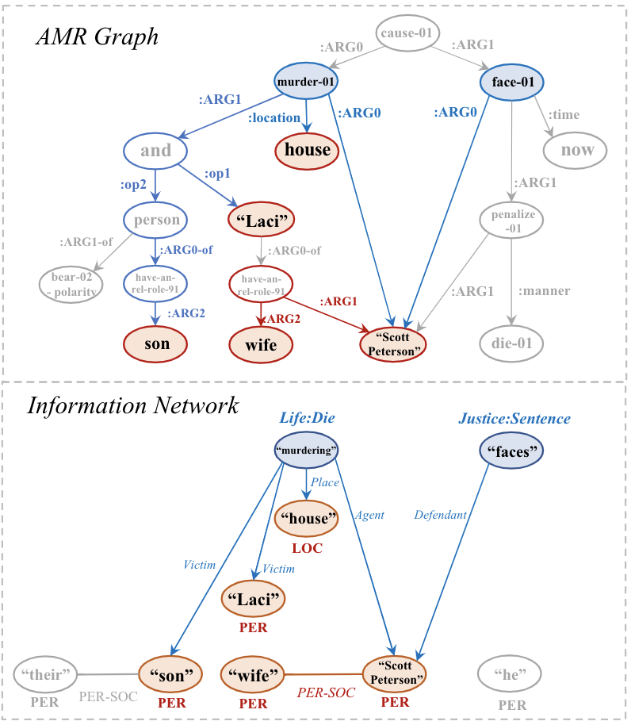
Moving from Seq-to-Graph to Graph-to-Graph
Abstract Meaning Representation (AMR):
  A kind of rich semantic parsing.
  Converts input sentence into a directed and acyclic graph structure with fine-grained node and edge type labels.
AMR parsing shares inherent similarities with information network (IE outputs).
  Similar node and edge semantics.
  Similar graph topology.
Semantic graphs can better capture non-local context in a sentence.
Therefore, we manage to exploit the similarity between AMR and IE to help on joint information extraction.

Slide 47
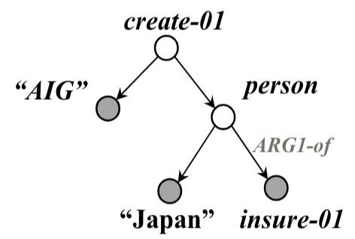
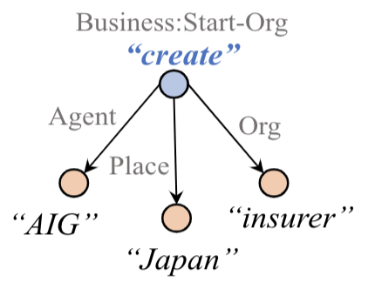


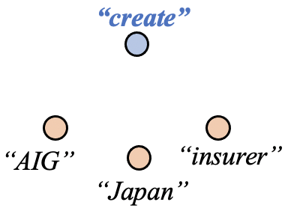
AMR-IE: An AMR-guided encoding and decoding framework for IE
Pretrained
AMR Parser
Roberta
AMR-Guided Graph
Encoding and Decoding
Input
Sentence
Encoded
Sentence
CRF-based
Span Tagger
IE Output

Slide 48
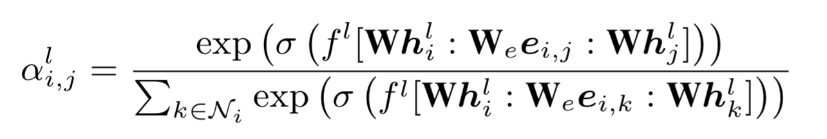
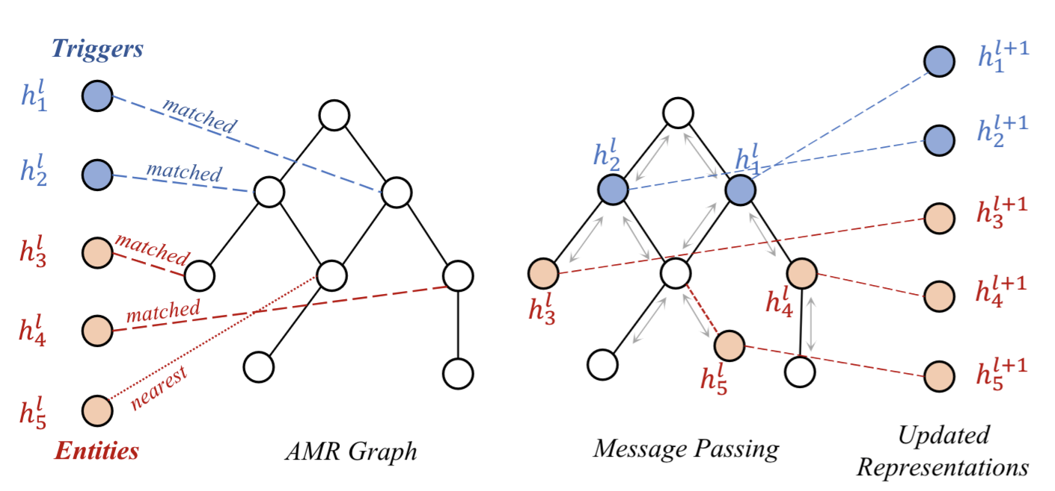
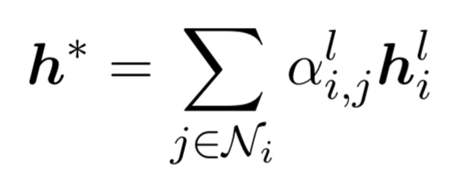

AMR Guided Graph Encoding: Using an Edge-Conditioned GAT
Map each candidate entity and event to AMR nodes.
Update entity and event representations using an edge-conditioned GAT to incorporate information from AMR neighbors.

Slide 49

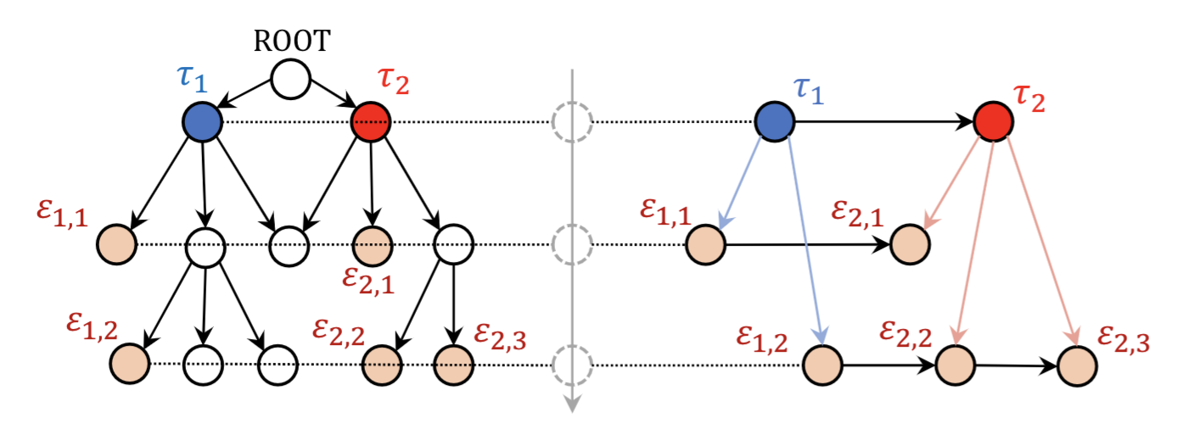
AMR Guided Graph Decoding: Ordered decoding guided by AMR
Beam search based decoding as in OneIE (Lin et al. 2020).
The decoding order of candidate nodes are determined by the hierarchy in AMR in a top-to-down manner.
For example, the correct ordered decoding in the following graph is:

Slide 50
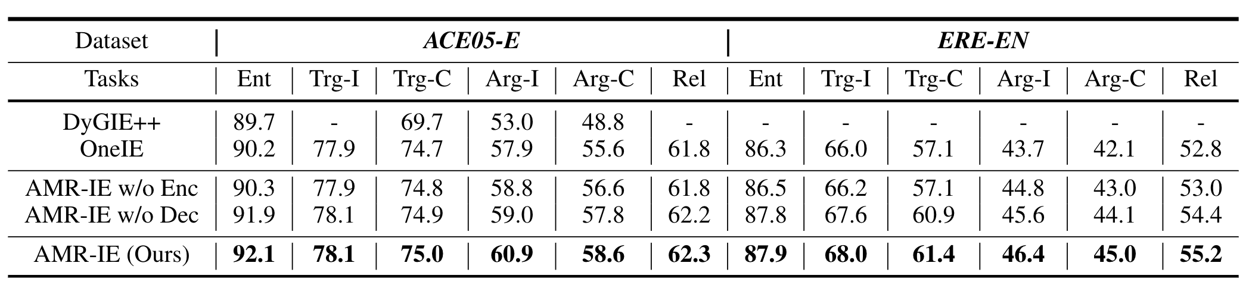
Experiments: Joint IE on ACE-2005 and ERE datasets.
ACE-2005: 7 entity types, 6 relation types, 33 event types, 22 event argument roles.
ERE: 7 entity types, 5 relation types, 38 event types, 20 event argument roles.
State-of-the-art results, especially for event argument role extraction.
Both AMR guided encoding and decoding demonstrate great effectiveness.

Slide 51
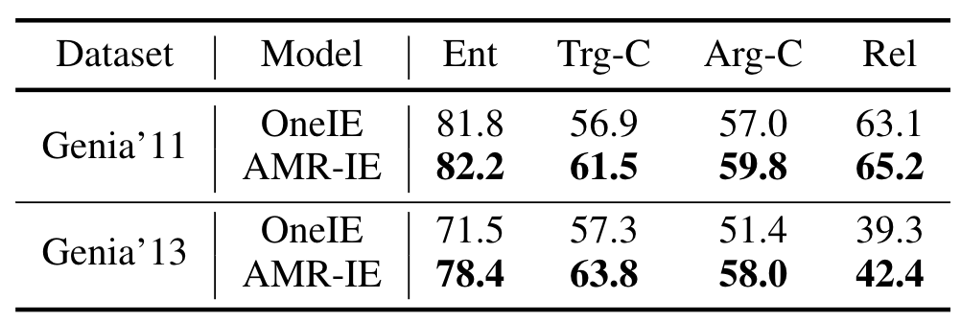
Experiments: Joint IE in biomedical domain.
Dataset: BioNLP Genia 2011 & 2013
Significant improvements.
Excellent model generalization ability to biomedical domains.

Slide 52
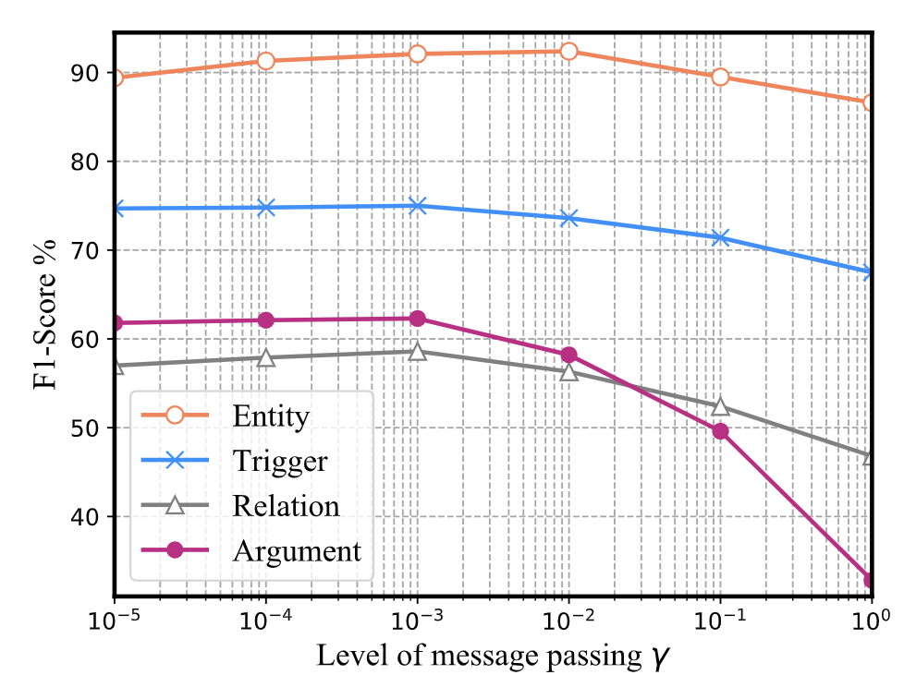
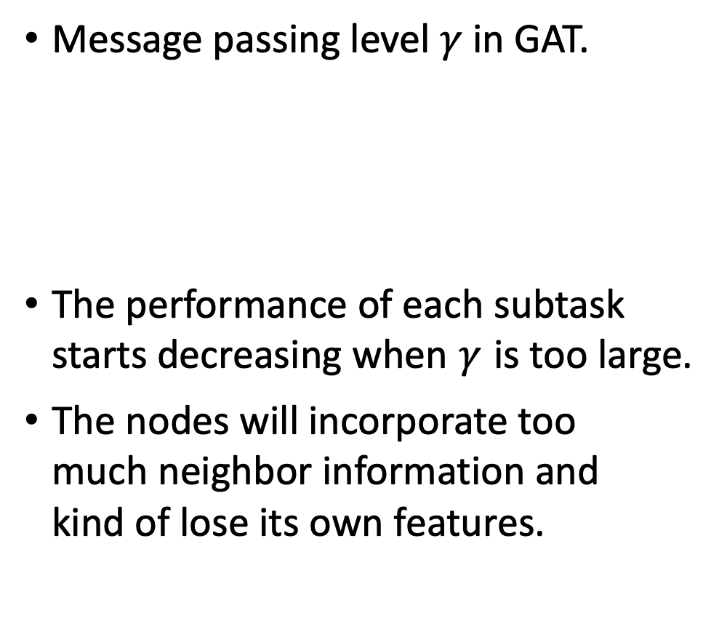
Experiments: Study on message passing level.
Message passing level in GAT.
The performance of each subtask starts decreasing when is too large.
The nodes will incorporate too much neighbor information and kind of lose its own features.
own
feature
neighbor
information

Slide 53
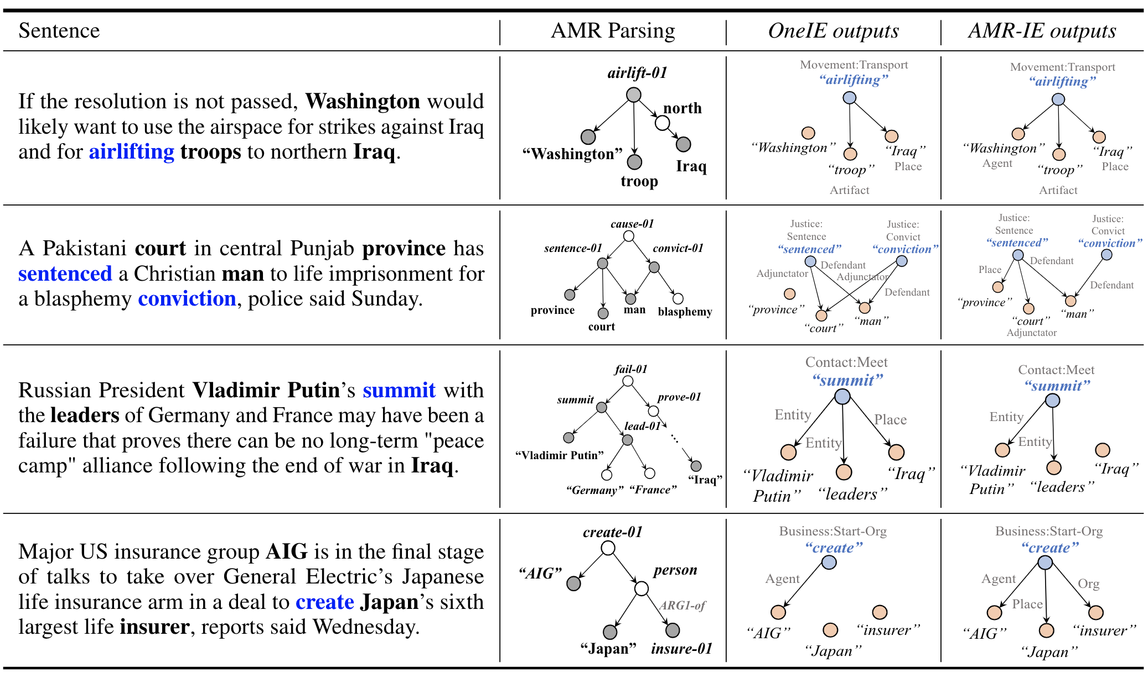
Qualitative Analysis: Examples on how AMR helps.

Slide 54
Incorporating Event Attributes into
Event Coreference Resolution
  If two event mentions have different attributes, it is likely that they are not the same event
    Modality = ASSERTED
Reporter : and this is a military town , judy and little by little we are seeing these soldiers head out . in a strange way and this may sound unusual , there ' s a little sense of relief because these soldiers were set to leave in January and now they got second deployment orders , the delay , of course , the inability to get access to turkey , but along the way , the 4th infantry division is one seeped in tradition and there ' s a real sense of pride among the soldiers , 250 of which left yesterday , over the course of the week 12 , 000 will be leaving from here .
    Modality = OTHER

Slide 55
Incorporating Event Attributes into
Event Coreference Resolution
    Polarity = Negative
… have input into the government but , since you are not directly elected , it would be a nonsense for you to have direct executive power ,' the source said . " The last thing we want is to leave a bunch of self - appointed oligarchs in power ," the source said . The comments came on the same day that a prominent Iraqi called for internationally - supervised elections in Iraq . Adnan Pachachi , a onetime foreign minister who returned to Iraq on May 6 after 33 years in exile , told the independent Az - Zaman daily that elections should be held under international supervision
    Polarity = Positive
Notes:
An event is NEGATIVE if it is explicitly indicated that the event did not occur, otherwise, the event is POSITIVE ~ Polarity
An event is ASSERTED if it is mentioned as if it were a real occurrence, otherwise it is OTHER. ~ Modality
An event is SPECIFIC if it is a single occurrence at a particular place and time, or a finite set of such occurrences; otherwise, it is GENERIC ~ Genericity.
Tense ~ Unspecified, Past, Present, Future

Slide 56
Incorporating Event Attributes into
Event Coreference Resolution
    Genericity = specific
… who says he was framed for political reasons , told reporters after his appeal was rejected : " You must remember its pre - selected judges , most junior of the court of appeal , and its all scripted . " What do you expect ?" Mahathir ' s sacking of the charismatic and popular Anwar in September 1998 rocked Malaysian politics , with thousands of people taking to the streets to demonstrate their support for him . …
    Genericity = generic
Notes:
An event is NEGATIVE if it is explicitly indicated that the event did not occur, otherwise, the event is POSITIVE ~ Polarity
An event is ASSERTED if it is mentioned as if it were a real occurrence, otherwise it is OTHER. ~ Modality
An event is SPECIFIC if it is a single occurrence at a particular place and time, or a finite set of such occurrences; otherwise, it is GENERIC ~ Genericity.
Tense ~ Unspecified, Past, Present, Future

Slide 57
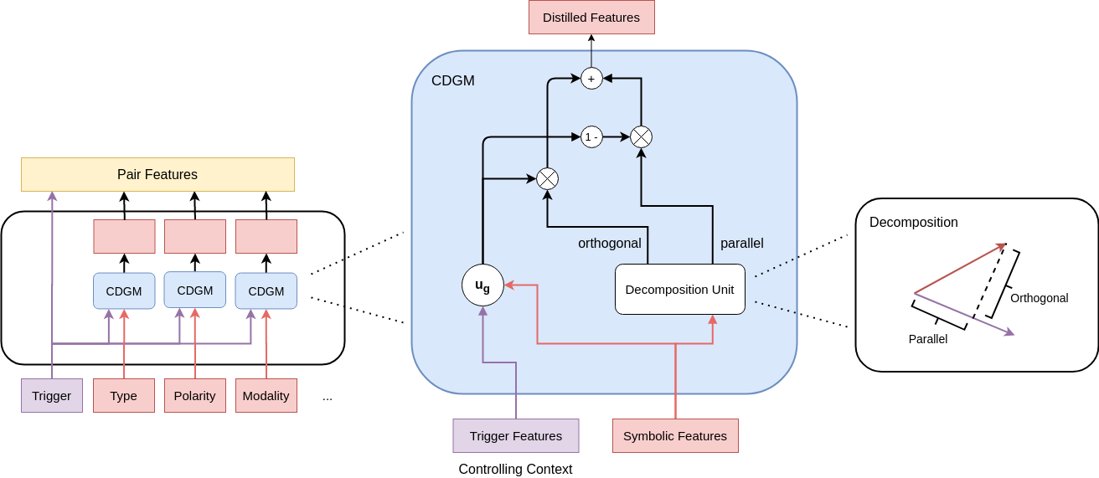
Gated Mechanism with Noisy Data Synthesis
Introduce a context-dependent gated mechanism (CDGM)
Use the trigger features as the controlling context for adaptively control the information flows from the input symbolic features
Intentionally add noise to symbolic features during training to encourage the model to learn to distill reliable signal
Notes:
An event is NEGATIVE if it is explicitly indicated that the event did not occur, otherwise, the event is POSITIVE ~ Polarity
An event is ASSERTED if it is mentioned as if it were a real occurrence, otherwise it is OTHER. ~ Modality
An event is SPECIFIC if it is a single occurrence at a particular place and time, or a finite set of such occurrences; otherwise, it is GENERIC ~ Genericity.
Tense ~ Unspecified, Past, Present, Future

Slide 58
Contributions of Symbolic Features to
Event Coreference Resolution
System | B3 | MUC | CEAFe | BLANC | AVG
SSED + Supervised (Sammons. et al 2015) | 59.90 | 47.10 | 58.70 | 44.40 | 52.53
SSED + MSEP (Peng. et al 2016) | 60.30 | 42.10 | 59.00 | 44.10 | 51.38
Baseline (Ours) | 64.31 | 50.00 | 62.47 | 46.32 | 55.78
Baseline + All Features (Simple) | 65.50 | 43.92 | 63.24 | 46.48 | 54.79
Baseline + All Features (Gated) | 65.94 | 47.22 | 63.80 | 48.32 | 56.32
Baseline + All Features (Simple + Noise) | 66.76 | 51.12 | 63.40 | 50.10 | 57.85
Baseline + All Features (Gated + Noise) | 67.18 | 54.00 | 65.03 | 52.81 | 59.76
Overall F-score (%) on ACE2005 Dataset (Red lines show previous SOTA methods)
Notes:
An event is NEGATIVE if it is explicitly indicated that the event did not occur, otherwise, the event is POSITIVE ~ Polarity
An event is ASSERTED if it is mentioned as if it were a real occurrence, otherwise it is OTHER. ~ Modality
An event is SPECIFIC if it is a single occurrence at a particular place and time, or a finite set of such occurrences; otherwise, it is GENERIC ~ Genericity.
Tense ~ Unspecified, Past, Present, Future

