Slide 1
Meta-learning for NLP:
A Case Study on Event Detection
HHeng Ji
(UIUC & Amazon Scholar)
hengji@illinois.edu
Some introduction slides from Chelsea Finn and Sergey Levine

Slide 3
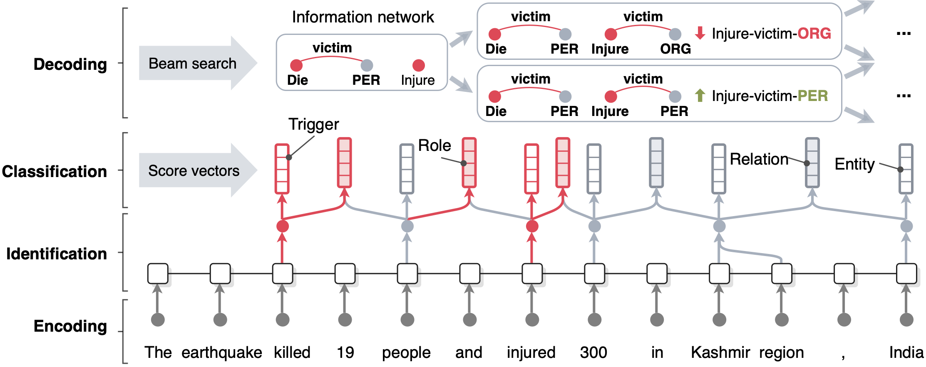
A Typical Supervised Information Extraction Framework
OneIE [Lin et al., ACL2020] extracts the information graph from a given sentence in four steps: encoding, identification, classification, and decoding

Slide 4






How SOTA Event Detectors are Trained
Expert consumers define what to link/extract
High Cost: requires manual clean annotations for 500 documents
Poor Portability: e.g., only covers 41 relation types and 33 event types
Limited to a certain target ontology, genre, language, and data modality
Human Annotators annotate a large amount of documents
Researchers design features/rules, train supervised learning models to identify and classify facts into pre-defined types
4
Notes:
Took experts from multiple institutions about one year for each language, limited number of types
: (1). Some expert linguists define a schema about “what to link/fill in” such as entity and slot types for a specific data collection based on the needs of potential users and stakeholders, and write annotation guidelines for each type in the schema; (2). Human annotators follow the guidelines to annotate a certain amount of documents (a typical size is 500 documents); (3). Researchers write heuristic rules or design features and train supervised learning models from these manually annotated data. This paradigm is not fully automatic because it involves human in the loop for the first two steps. Both of them are very expensive, yet such a predefined schema can only cover a limited number of types. For example, some typical types of emergent events such as “donation” and “evacuation” in response to a natural disaster are missing in the TAC-KBP and ACE programs. In addition, traditional KBP systems are highly dependent on linguistic resources tuned to the pre-defined schema, so they suffer from poor scalability and portability when moving to a new language, domain or genre.

Slide 7
How Human does Event Annotation
Annotation Guideline
Old Types
New Unseen Types

Slide 8
Our “Green” Solutions
For old types: learning from annotation guideline
  Type definition
  Keywords that indicate the type
  0-10 example annotation sentences
For new types:
  Figure out the correlation between new types and old types
  Use lifelong learning to leverage annotations of old types for extracting mentions of new types

Slide 9
Learning from Annotation Guideline
Goal: Acquire training data automatically from event descriptions
  Use keywords + examples to define an event
  Manually selected examples to cover diverse semantics of the event types
Example: Personnel-Nominate
  Keywords: name, nominate
  Examples: … a new chief executive's nominations to fill vacant positions …

Slide 10
Learning from Annotation Guideline

Slide 11
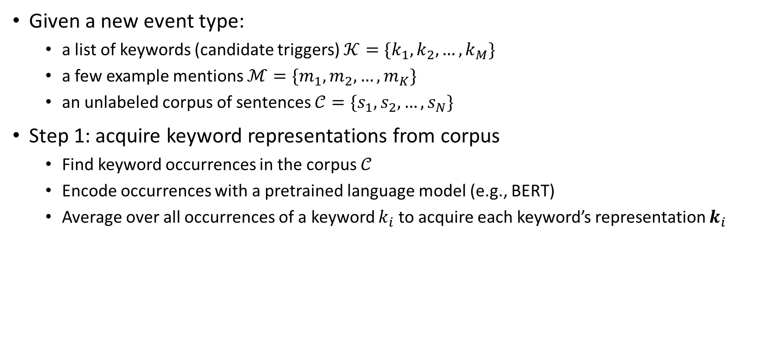
Weakly Supervised Data Acquisition: Keyword Representation
Given a new event type:
  a list of keywords (candidate triggers) $𝒦=\{k_{1},k_{2},…,k_{M}\}$
  a few example mentions $ℳ=\{m_{1},m_{2},…,m_{K}\}$
  an unlabeled corpus of sentences $𝒞=\{s_{1},s_{2},…,s_{N}\}$
Step 1: acquire keyword representations from corpus
  Find keyword occurrences in the corpus $𝒞$
  Encode occurrences with a pretrained language model (e.g., BERT)
  Average over all occurrences of a keyword $k_{i}$ to acquire each keyword’s representation $k_{i}$

Slide 12

Weakly Supervised Data Acquisition: Clustering
Some keywords have similar meanings
  Group similar keywords to find mentions of novel trigger words
Step 2: cluster keyword representations
  cluster ${\left\{k_{i}\right\}}_{i=1}^{M}$ into several clusters ${\left\{c_{j}\right\}}_{j=1}^{T}$

Slide 13
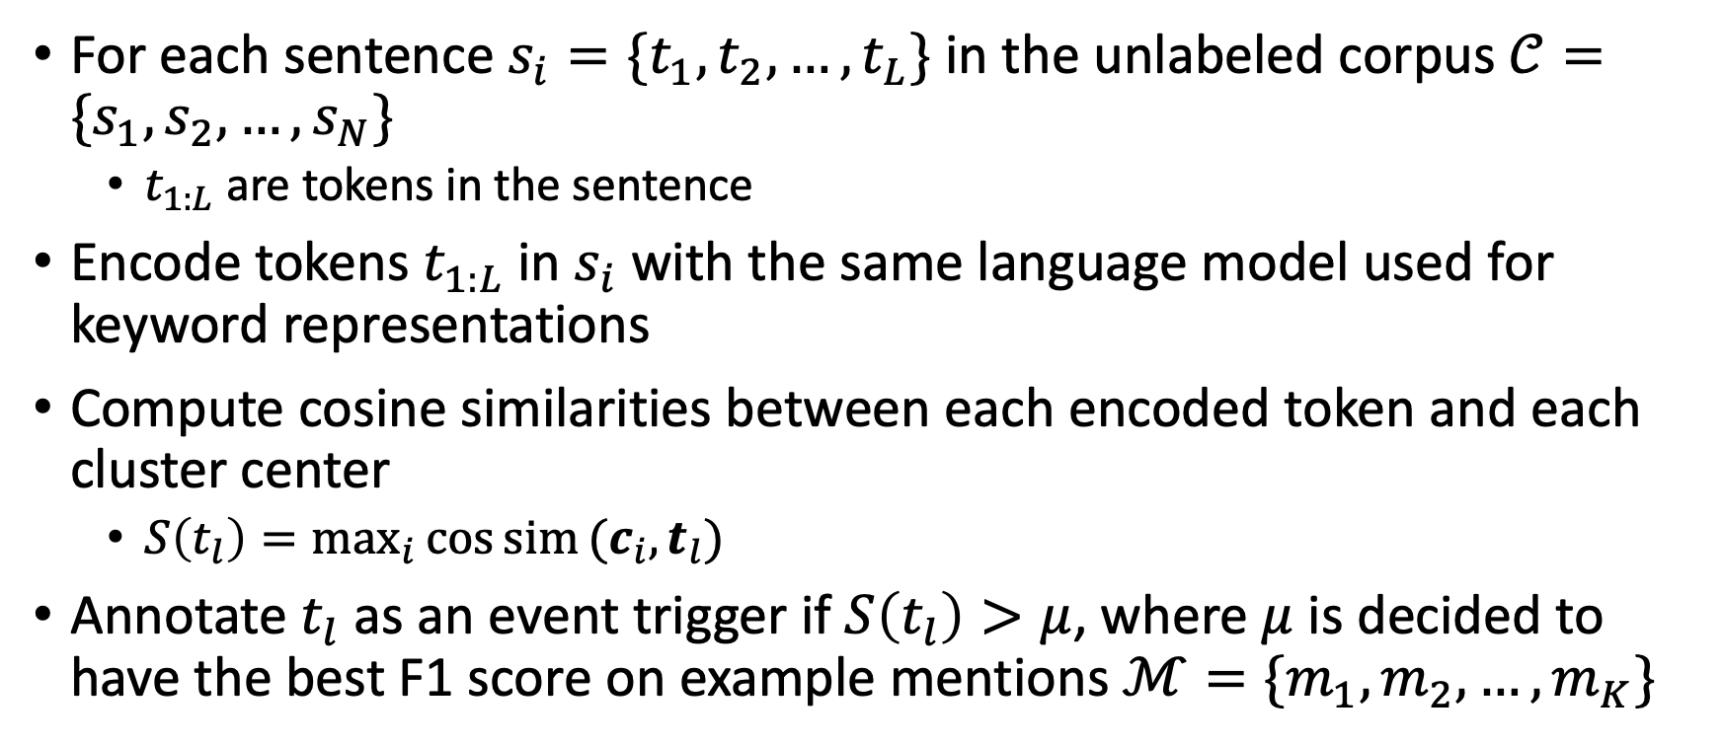
Weakly Supervised Data Acquisition: Annotation
For each sentence $s_{i}=\{t_{1},t_{2},…,t_{L}\}$ in the unlabeled corpus $𝒞=\{s_{1},s_{2},…,s_{N}\}$
  $t_{1:L}$ are tokens in the sentence
Encode tokens $t_{1:L}$in $s_{i}$ with the same language model used for keyword representations
Compute cosine similarities between each encoded token and each cluster center
  $S\left(t_{l}\right)=\max_{i}{\cos{sim}(c_{i},t_{l})}$
Annotate $t_{l}$ as an event trigger if $S\left(t_{l}\right)>μ$, where $μ$ is decided to have the best F1 score on example mentions $ℳ=\{m_{1},m_{2},…,m_{K}\}$

Slide 14



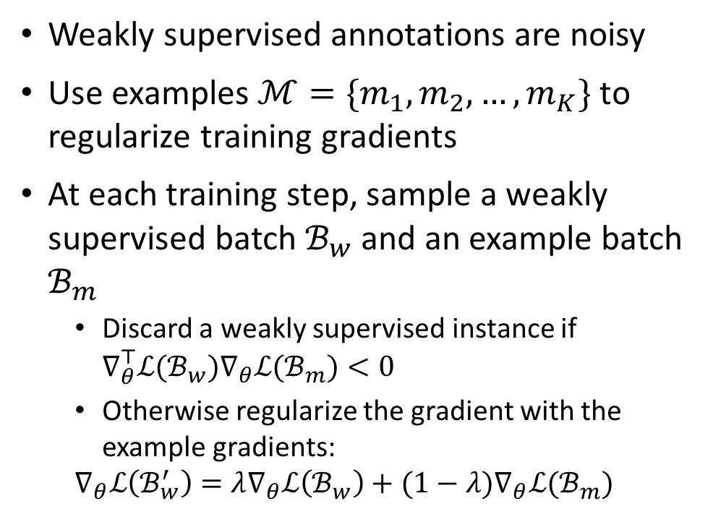
Denoising Training
Weakly supervised annotations are noisy
Use examples $ℳ=\{m_{1},m_{2},…,m_{K}\}$ to regularize training gradients
At each training step, sample a weakly supervised batch $ℬ_{w}$ and an example batch $ℬ_{m}$
  Discard a weakly supervised instance if $∇_{θ}^{⊤}ℒ(ℬ_{w})∇_{θ}ℒ(ℬ_{m})<0$
  Otherwise regularize the gradient with the example gradients:
  $$∇_{θ}ℒ\left(ℬ_{w}^{′}\right)=λ∇_{θ}ℒ\left(ℬ_{w}\right)+(1−λ)∇_{θ}ℒ(ℬ_{m})$$
Example Gradients $∇_{θ}ℒ(ℬ_{m})$
Regularized Gradient $∇_{θ}ℒ\left(ℬ_{w}^{′}\right)$
Weakly Supervised Gradients $ℒ\left(ℬ_{w}\right)$
Weakly Supervised Gradients
(discarded)

Slide 15
Dataset and Evaluation
Dataset: ACE 2005
Example mentions: extracted from ACE annotation guidelines
  7.3 mentions per event type on average
Use traditional training split as the unlabeled corpus for weak supervision
Evaluation:
  trigger labeling precision, recall and f1 score
  sentence-level event detection precision, recall and f1

Slide 16
Experiments: Trigger Labeling
ACE | Precision | Recall | F1
Example data only | 57.2 | 63.0 | 59.8
Ours | 65.6 | 60.8 | 63.1
w/o clustering | 61.3 | 59.7 | 60.4
w/o denoising | 62.2 | 61.1 | 61.6
Subset (23 types) | Precision | Recall | F1
Zero-shot learning (Huang et al., 2018) | 75.5 | 36.3 | 49.1
Ours | 66.3 | 60.5 | 63.3
[1] Lifu Huang, Heng Ji, Kyunghyun Cho, Ido Dagan, Sebastian Riedel, and Clare Voss. 2018. Zero-shot transfer learning for event extraction. In Proceedings of the 56th Annual Meeting of the Association for Computational Linguistics (Volume 1: Long Papers), pages 2160–2170, Melbourne, Australia. Association for Computational Linguistics.

Slide 17
Compared to Supervised Learning
Compare micro and macro F1 with supervised training with different portion of training data
Close to 20% supervised model in micro F1, but the supervised performance benefits little from additional data
Micro F1 score is dominated by frequent event types with many redundant training mentions
Close to 40% training data in macro F1

Slide 18
Experiments: Sentence-level Detection
 | Precision | Recall | F1
9-shot[1] | 54.5 | 57.0 | 61.8
Example Only | 66.4 | 68.0 | 66.9
Ours | 66.2 | 74.2 | 69.9
Our example data contains 7.3 mentions (shots) per event type
[1] Rui Feng, Jie Yuan, and Chao Zhang. 2020. Probing and fine-tuning reading comprehension models for few-shot event extraction. arXiv preprint arXiv:2010.11325.

Slide 19
Example-Gradient-based Denoising
Weak supervision annotations have inconsistent gradients with example mentions
Denoising framework can identify both false positive and false negative errors
Rejected Weakly Supervised Example
This is not even a minute fraction of the sum of money[Transfer-Money] that they ( or Enron ) actually invested in the project (incorrect trigger)
The one that I am most interested in comparing to similar policies at other schools concerns our ability to travel [Transport]. (trigger missed by weak supervision)

Slide 20
However, these methods are still limited to a pre-defiend ontology
More structured output and better performance compared with open-domain IE
Limited to ontology types: frequently need to learn a new model for emergent new types, new fine-grained substypes from scratch
Event
Life
Conflict
Life.Die
Conflict.Attack
In Baghdad, a cameraman died when a combat tank fired on the Palestine Hotel.

Slide 21
Lifelong IE with Expanded Ontology
Continually update trained IE model with new training data for new types
  Only use annotations for new types to update the model
Event
Event
Life
Conflict
Life
Conflict
Life.Die
Life.Die
Life.Born
Conflict.Attack
Event
Life
Conflict
Contact
Life.Die
Life.Born
Conflict.Attack
Contact.Meet

Slide 22
Event
Types in ACE
Life
Conflict
Contact
Die
Born
Attack
Meet
Types in AIDA
Event
Life
Conflict
Contact
Disaster
Die
Born
Attack
Meet
Disease Outbreak
Emerging New Types of Interest
Related Semantics
Invade
New Fine-grained Types
Relatives in Hierarchy

Slide 23
Comparison with Class Incremental Lifelong Learning
Class Incremental Lifelong Learning: learning classification on expanding number of classes
What is special about ontology-based IE compared with classification?
Fundamental Difference: existence of negative instances, Not-Any-type (NA), in extraction task
Additional Challenge: long-tail distribution of knowledge element types

Slide 24

Negative Instance in Lifelong IE
Two kinds of negative mentions:
  Baghdad: contextual text spans that don’t imply any events
  fired: other event types that are not learned yet
If new types are in close domain with old types, negative mentions may also contain old event types. Annotators may only focus on annotating new types and ignore them.
Event
Life
Conflict
Life.Die
Conflict.Attack
Not Learned
In Baghdad, a cameraman died when a combat tank fired on the Palestine Hotel.

Slide 25
Negative Instance in Lifelong IE
Semantics drift of Not-Any-type (NA) over time
  NA contains unlearned types, and shrinks as more types are learned
  NA might also contain old types
Existence of negative instances in any stages (in context)
  in class incremental learning only data for new type exists at each stage
Class Incremental
Lifelong Ontology Expansion for IE
NA
Learned Types
NA
NA
New Types

Slide 26
Additional Challenge: Long-tail Distribution of Knowledge Types
Re-balancing among all types (old and new types) tackles catastrophic forgetting in lifelong learning, under the assumption of balanced priors
Knowledge types in natural language are naturally imbalanced, which breaks the assumption
  EEIL (Castro et al., 2018), BIC (Wu et al., 2019) are state-of-the-art methods with additional re-balancing techniques compared with baseline, which don’t improve performance due to over-balancing
Long-tail Distribution on Event Type
Mentions (MAVEN¹ Dataset)
[1] Xiaozhi Wang, Ziqi Wang, Xu Han, Wangyi Jiang, Rong Han, Zhiyuan Liu, Juanzi Li, Peng Li, Yankai Lin, and Jie Zhou. 2020. MAVEN: A massive general domain event detection dataset. abs/2004.13590.

Slide 27
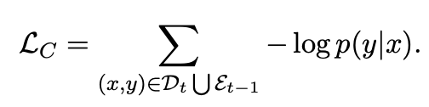
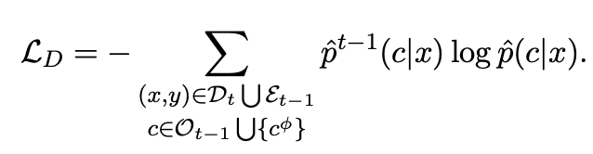
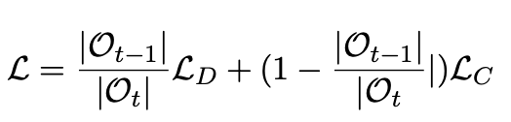
Lifelong Event Detection Architecture
Problem formulation
A stream of datasets $\left\{D_{t}\right\}$ is provided to the model sequentially
Each training instance is labeled with event types from the set$C_{t}=\left\{c_{t}^{1},c_{t}^{2},…, c_{t}^{n_{t}}\right\}$ and NA, denoted as $c_{φ}$.
At stage $t$, the model needs to detect events for the combined ontology
$$O_{t}=C_{1}∪C_{2}…∪C_{t}$$
Training:
Experience Replay: augment $D_{t}$with an exemplar set $ε_{t−1}$
Knowledge Distillation (Retain old knowledge):

Slide 28
Knowledge Transfer for Lifelong Learning
Leverage rich connections between event types in the ontology
Event
Life
Conflict
Contact
Life.Die
Life.Born
Conflict.Attack
Contact.Meet
Relatives in Hierarchy
Related Semantics

Slide 29
Overall Framework
Two-way Knowledge Transfer
New → Old: Use new data to update old knowledge by self-training
Old → New: Use old knowledge to help learning new types by knowledge-aware initialization of new weights

Slide 30
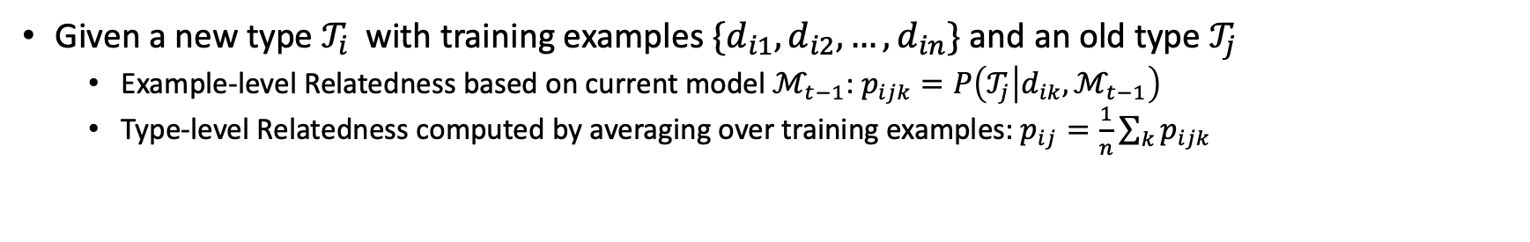
Knowledge Transfer: Type Relatedness
Given a new type $𝒯_{i}$ with training examples $\{d_{i1}, d_{i2}, …, d_{in}\}$ and an old type $𝒯_{j}$
  Example-level Relatedness based on current model $ℳ_{t−1}$: $p_{ijk}=P\left(𝒯_{j} | d_{ik},ℳ_{t−1}\right)$
  Type-level Relatedness computed by averaging over training examples: $p_{ij}=\frac{1}{n}\sum_{k}{p_{ijk}}$

Slide 31
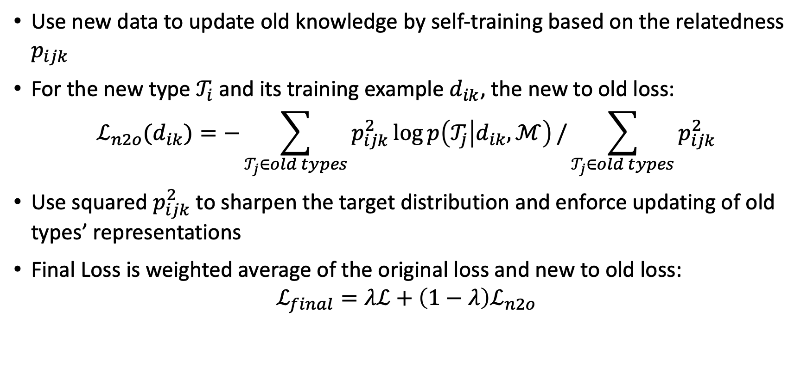
Knowledge Transfer: New to Old
Use new data to update old knowledge by self-training based on the relatedness $p_{ijk}$
For the new type $𝒯_{i}$ and its training example $d_{ik}$, the new to old loss:
$$ℒ_{n2o}(d_{ik})=−\sum_{𝒯_{j}∈old types}{p_{ijk}^{2}\log{p\left(𝒯_{j} | d_{ik},ℳ\right)}}/\sum_{𝒯_{j}∈old types}{p_{ijk}^{2}}$$
Use squared $p_{ijk}^{2}$ to sharpen the target distribution and enforce updating of old types’ representations
Final Loss is weighted average of the original loss and new to old loss:
$$ℒ_{final}=λℒ+\left(1−λ\right)ℒ_{n2o}$$

Slide 32
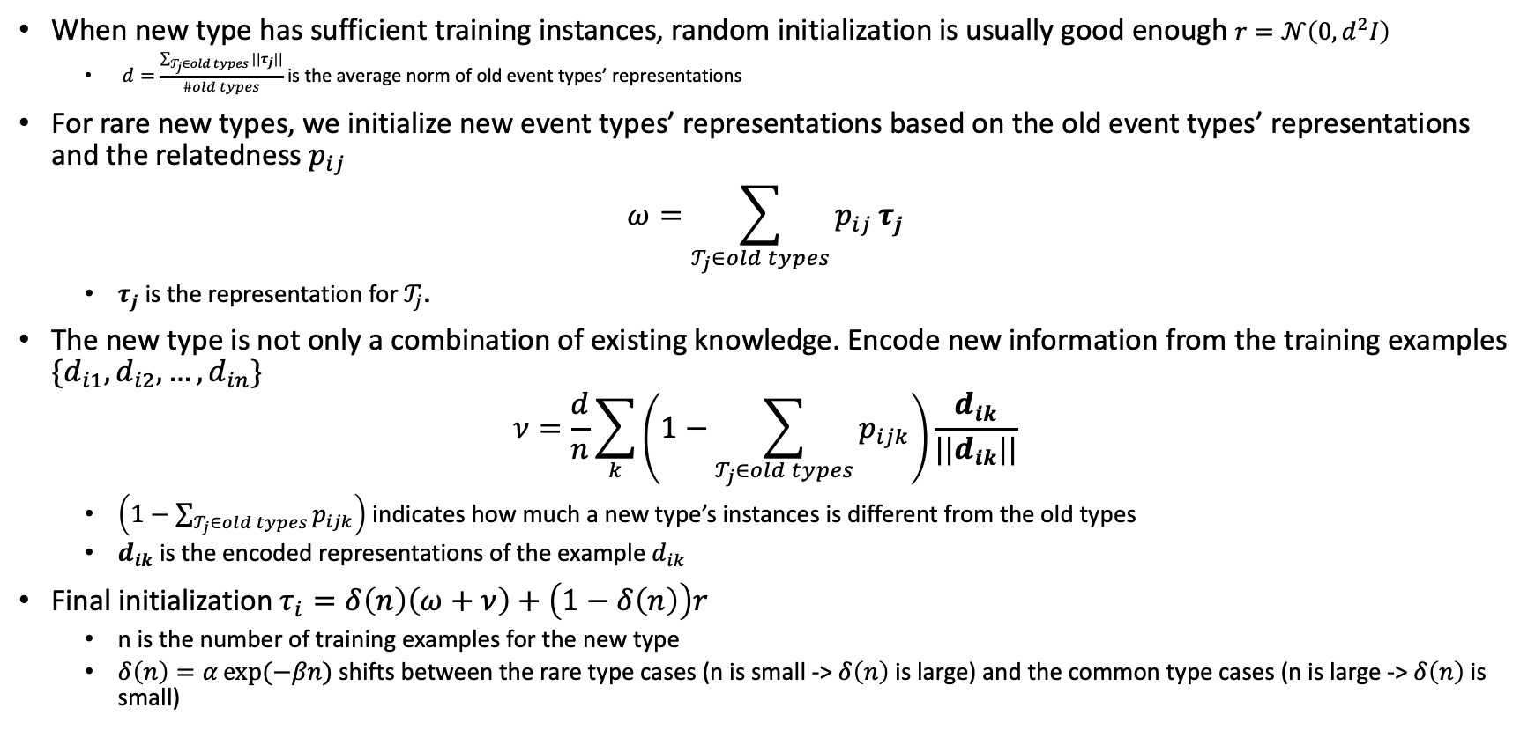
Knowledge Transfer: Old to New
When new type has sufficient training instances, random initialization is usually good enough $r=𝒩\left(0, d^{2}I\right)$
  $d=$ $\frac{\sum_{𝒯_{j}∈old types}{||τ_{j}||}}{\#old types}$ is the average norm of old event types’ representations
For rare new types, we initialize new event types’ representations based on the old event types’ representations and the relatedness $p_{ij}$
$$ω=\sum_{𝒯_{j}∈old types}{p_{ij}}τ_{j}$$
  $τ_{j}$ is the representation for $𝒯_{j}$.
The new type is not only a combination of existing knowledge. Encode new information from the training examples $\{d_{i1}, d_{i2}, …, d_{in}\}$
$$ν=\frac{d}{n}\sum_{k}{\left(1−\sum_{𝒯_{j}∈old types}{p_{ijk}}\right)\frac{d_{ik}}{||d_{ik}||}}$$
  $\left(1−\sum_{𝒯_{j}∈old types}{p_{ijk}}\right)$ indicates how much a new type’s instances is different from the old types
  $d_{ik}$ is the encoded representations of the example $d_{ik}$
Final initialization $τ_{i}=δ\left(n\right)\left(ω+ν\right)+\left(1−δ\left(n\right)\right)r$
  n is the number of training examples for the new type
  $δ\left(n\right)=α\exp{(−βn)}$ shifts between the rare type cases (n is small -> $δ\left(n\right)$ is large) and the common type cases (n is large -> $δ\left(n\right)$ is small)

Slide 33
Experimental Settings to Simulate the Lifelong Learning
Datasets:
  MAVEN^{[1]}
  ACE 2005^{[2]}
Simulation:
  Randomly split all event types into 5 groups
  The model continuously learn events in these groups
  At each training stage, only present the model with labeled data for one group of events
[1] Xiaozhi Wang, Ziqi Wang, Xu Han, Wangyi Jiang, Rong Han, Zhiyuan Liu, Juanzi Li, Peng Li, Yankai Lin, and Jie Zhou. 2020. MAVEN: A massive general domain event detection dataset. CoRR, abs/2004.13590.
[2] Christopher Walker, Stephanie Strassel, Julie Medero, and Kazuaki Maeda. 2006. ACE 2005 multilingual training corpus LDC2006T06. Web Download. Philadelphia: Linguistic Data Consortium.

Slide 34


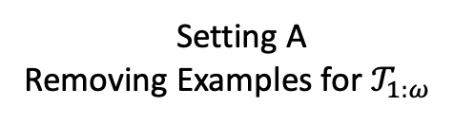
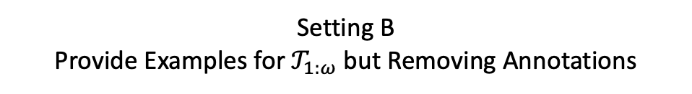

Experimental Setting: Data Construction
At stage t, the model
  has already learned $𝒯_{1:ω}$
  is learning $𝒯_{ω+1:ω+ν}$
  has not seen $𝒯_{ω+ν+1:N}$, N is the total number of event types
To simulate the lifelong learning problem, we only provide labels for $𝒯_{ω+1:ω+ν}$
Consider two ways of removing labels for learned types $𝒯_{1:ω}$
Setting A
Removing Examples for $𝒯_{1:ω}$
Setting B
Provide Examples for $𝒯_{1:ω}$ but Removing Annotations
Event Types | Training Examples Provided | Provided Label
$$𝒯_{1:ω}$$ | No | /
$$𝒯_{ω+1:ω+ν}$$ | Yes | True Label
$$𝒯_{ω+ν+1:N}$$ | Yes | Not-Any (NA)
Event Types | Training Examples Provided | Provided Label
$$𝒯_{1:ω}$$ | Yes | Not-Any (NA)
$$𝒯_{ω+1:ω+ν}$$ | Yes | True Label
$$𝒯_{ω+ν+1:N}$$ | Yes | Not-Any (NA)

Slide 35
Experimental Results: Overall Final Performance (Setting A)
Baselines:
  Finetune: finetune on new data
  KD+R (our baseline): knowledge distillation with replay
  EEIL, BIC, KCN* ^{[1-3]} adapted from state-of-the-art methods
[1] Francisco M. Castro, Manuel J. Marín-Jiménez, Nicolás Guil, Cordelia Schmid, and Karteek Alahari. 2018. End-to-end incremental learning. In Com- puter Vision - ECCV 2018 - 15th European Conference, Munich, Germany, September 8-14, 2018, Pro- ceedings, Part XII, volume 11216 of Lecture Notes in Computer Science, pages 241–257. Springer.
[2] Yue Wu, Yinpeng Chen, Lijuan Wang, Yuancheng Ye, Zicheng Liu, Yandong Guo, and Yun Fu. 2019. Large scale incremental learning. In IEEE Conference on Computer Vision and Pattern Recognition, CVPR 2019, Long Beach, CA, USA, June 16-20, 2019, pages 374–382. Computer Vision Foundation / IEEE.
[3] Pengfei Cao, Yubo Chen, Jun Zhao, and Taifeng Wang. 2020. Incremental event detection via knowledge consolidation networks. In Proceedings of the 2020 Conference on Empirical Methods in Natural Lan- guage Processing (EMNLP), pages 707–717, Online. Association for Computational Linguistics.

Slide 36
Experimental Results: Stage-wise Micro F1
Larger gap in later stages, showing the power of accumulated knowledge and knowledge transfer

Slide 37
Experimental Results: Stage-wise Micro F1 (Setting B)

Slide 38
Improving Learning Old and New Types
After training on each stage, compute Macro F1 to show type-wise performance
  Old: old types learned in previous stages
  New: new types learned in this stage
  New Rare: new types with fewer than 120 training mentions
Compare with baseline (KD+R), knowledge transfer improves both acquisition of new types and consolidation of old types
  More improvements on rare new types, showing that sharing knowledge can help learning long-tail events

Slide 39
Examples of Identified Related Old Types Helping New Types
New Instance | New Type | Related Old Type
In 1378 Manuel II Palaiologos promised to hand over the city of Philadelphia to the Turks in re- turn for the Ottoman sultan’s aid in a disastrous Byzantine civil war. | Commitment | Statement
Graham’s family filed a lawsuit against the city of New York, and the lawsuit was settled for $ 3. 9 million in 2015. | Legality | Judgment
The French and British commanders in the pocket decided to make for Le Havre and Fortune detached Arkforce, the equivalent of two brigades, to guard the routes back to the port. | Patrolling | Perception_active (observation)

Slide 40
Case Study on Rare New Types
By transferring knowledge from related old types to rare new types, recall is significantly improved, while precision slightly drops due to potential noise in the transfer process.
Type | Model | Precision | Recall | F1
Commitment | KD+R (baseline) | 100.00 | 3.45 | 6.67
 | KD+R+K (knowledge transfer) | 66.67 | 34.48 | 45.45
Cost | KD+R (baseline) | 100.00 | 5.26 | 10.00
 | KD+R+K (knowledge transfer) | 81.82 | 47.37 | 60.00

Slide 41
Take-away Messages
It’s not feasible to develop supervised models for fast-expanding event ontology
  Beneficial to mimic human annotation process by leveraging event type definition
Take advantage of semantic relatedness between old types and new types, and update the model in lifelong learning fashion
  Particularly effective at handling long-tail distributions
Future work: extend to other IE tasks that involve more structures

Slide 42
Thank you

Slide 43
Related Work for Weakly Supervised Event Extraction
Current Weak Supervision mainly focusing on augmenting existing data, which usually requires a large dataset to start with,
  [1] propose a semi-supervised method
    requires a strong supervised event extractor for data collection.
  [2] propose a distance-supervision-based framework using FreeBase Compound Value Types (CVTs
    established ontology is limited to only 21 types
    cannot generalize to arbitrary new event types
    In order to apply their data for ACE, training data for the missing event types is required
[3] introduce a novel adversarial training method to denoise the noisy training data for event extraction
  mainly focuses on false positive errors
  our example-based denoising considers both false positive and false negative errors.
[1] James Ferguson, Colin Lockard, Daniel Weld, and Hannaneh Hajishirzi. 2018. Semi-supervised event extraction with paraphrase clusters. In Proceedings of the 2018 Conference of the North American Chapter of the Association for Computational Linguistics: Human Language Technologies, Volume 2 (Short Papers), pages 359–364, New Orleans, Louisiana. Association for Computational Linguistics.
[2] Yubo Chen, Liheng Xu, Kang Liu, Daojian Zeng, and Jun Zhao. 2015. Event extraction via dynamic multi-pooling convolutional neural networks. In Proceedings of the 53rd Annual Meeting of the Association for Computational Linguistics and the 7th International Joint Conference on Natural Language Processing (Volume 1: Long Papers), pages 167–176, Beijing, China. Association for Computational Linguistics.
[3] Xiaozhi Wang, Xu Han, Zhiyuan Liu, Maosong Sun, and Peng Li. 2019. Adversarial training for weakly supervised event detection. In Proceedings of the 2019 Conference of the North American Chapter of the Association for Computational Linguistics: Hu- man Language Technologies, Volume 1 (Long and Short Papers), pages 998–1008, Minneapolis, Min- nesota. Association for Computational Linguistics.

Slide 44
Data Acquisition
Use keywords to search corpus for event occurrences
Improve recall by cluster-based pseudo-labeling
  Diverse semantic meanings of event types such as Movement:Transport
    the Iraq is retreated from this area …
    … in order to ship her from one state to another (cosine sim 0.32)
  Use keyword cluster to collect examples

Slide 45
Data Acquisition Pipeline
Step 1: Acquire a list of keywords: {attack, battle, invade, …}
Step 2: Search the corpus for all occurrences of words in K
  …one determined to undermine peace talks by supporting militant groups that attack Israelis.
Step 3: For each occurrence, keep if top 50 mask predictions contain words in K
  …one determined to undermine peace talks by supporting militant groups that [mask] Israelis. -> attack, invade, …

Slide 46
Data Acquisition Pipeline
Step 4: Compute a vector for each keyword as averaged contextual representations of filtered occurrences
the test designed to measure the responsiveness of emergency workers to a terrorist attack.
…one determined to undermine peace talks by supporting militant groups that attack Israelis.
attack
…

Slide 47
Data Acquisition Pipeline
Step 5: Cluster keywords into a set of clusters with KMeans
war
attack
violence
battle
invade
terrorism

Slide 48
Data Acquisition Pipeline
Step 6: Search the corpus by computing cosine similarities between each token and cluster centers. Accept a token if > threshold
Decide the threshold by best F1 on example data
attack
invade
EU would help in the humanitarian crisis expected to follow an attack on Iraq.

Slide 49
Evaluation of Data Quality
F1 of weakly supervised annotation on ace training data
  1, Clustering keywords, and match clusters: 0.46
  2. Averaging representations of all keywords 0.44
  3. Matching using individual keywords: 0.42
Notes:
F1 of weakly supervised annotation on example data
1, Clustering keywords, and match clusters: 0.63
2. Matching using individual keywords: 0.60
3. Averaging representations of all keywords 0.57

Slide 50
Related Work on Class Incremental Learning
There has been many work on lifelong learning for classification tasks
  The Learning without Forgetting method ^{[1]} uses knowledge distillation to avoid catastrophic forgetting.
  ICaRL ^{[2]} combines knowledge distillation with experience replay to learn feature representation for each class.
  EEIL ^{[3]} adopts an end-to-end training method by adding another finetuning stage on the balanced exemplar set.
  BIC ^{[4]} prevents overfitting during balanced finetuning by training only two additional parameters on a small balanced validation exemplar set to correct the bias towards new classes.
As shown in our experiments, we cannot get good performance if directly transferring these methods to the event detection task
[1] Zhizhong Li and Derek Hoiem. 2018. Learning without forgetting. IEEE Trans. Pattern Anal. Mach. Intell., 40(12):2935–2947.
[2] Sylvestre-Alvise Rebuffi, Alexander Kolesnikov, Georg Sperl, and Christoph H. Lampert. 2017. iCaRL: Incremental classifier and representation learning. In 2017 IEEE Conference on Computer Vision and Pattern Recognition, CVPR 2017, Honolulu, HI, USA, July 21-26, 2017, pages 5533–5542. IEEE Computer Society.
[3] Francisco M. Castro, Manuel J. Marín-Jiménez, Nicolás Guil, Cordelia Schmid, and Karteek Alahari. 2018. End-to-end incremental learning. In Com- puter Vision - ECCV 2018 - 15th European Confer- ence, Munich, Germany, September 8-14, 2018, Pro- ceedings, Part XII, volume 11216 of Lecture Notes in Computer Science, pages 241–257. Springer.
[4] Yue Wu, Yinpeng Chen, Lijuan Wang, Yuancheng Ye, Zicheng Liu, Yandong Guo, and Yun Fu. 2019. Large scale incremental learning. In IEEE Conference on Computer Vision and Pattern Recognition, CVPR 2019, Long Beach, CA, USA, June 16-20, 2019, pages 374–382. Computer Vision Foundation / IEEE.

Slide 51
Related Work on Lifelong Information Extraction
[1] studies the problem of adding one new event type to the existing model
  only focus on frequent types
  single-stage incremental learning
[2] studies lifelong relation classification
  still a classification task
[3] work on lifelong event detection.
  focusing on frequent event types,
  single token trigger
  learning one type at a time
[1] Thien Huu Nguyen, Lisheng Fu, Kyunghyun Cho, and Ralph Grishman. 2016. A two-stage approach for extending event detection to new types via neural networks. In Proceedings of the 1st Workshop on Representation Learning for NLP, pages 158–165, Berlin, Germany. Association for Computational Linguistics.
[2] Hong Wang, Wenhan Xiong, Mo Yu, Xiaoxiao Guo, 778 Shiyu Chang, and William Yang Wang. 2019. Sen- 779 tence embedding alignment for lifelong relation ex- 780 traction. In Proceedings of the 2019 Conference of 781 the North American Chapter of the Association for 782 Computational Linguistics: Human Language Tech- 783 nologies, Volume 1 (Long and Short Papers), pages 784 796–806, Minneapolis, Minnesota. Association for 785 Computational Linguistics.
[3] Pengfei Cao, Yubo Chen, Jun Zhao, and Taifeng Wang. 2020. Incremental event detection via knowledge consolidation networks. In Proceedings of the 2020 Conference on Empirical Methods in Natural Lan- guage Processing (EMNLP), pages 707–717, Online. Association for Computational Linguistics.

