Slide 1
Knowledge Acquisition for Information Extraction
Heng Ji
Some slides from ACL2021 tutorial on event-centric NLP, part by Hongming Zhang
Notes:
Hello everyone, This is Hongming. I am currently a last-year Ph.D. student at HKUST, working with Prof. Yangqiu Song, and a visiting Ph.D. student at the CogComp group, working with Prof. Dan Roth. In the fourth section, I will introduce how to understand commonsense from the angle of events and how to collect those event knowledge.

Slide 2
Some Old Work
Knowledge Harvesting:
YAGO (Hoffart et al. 2011), OpenIE (Banko et al. 2007)
cover only a small amount of relations
Need for more domain specific knowledge:
Temporal (Kozareva et al. 2011), Psychology (Rashkin et al. 2018), Spatial (Collell et al. 2018)
Comparative Knowledge:
Until this paper, large scale data had not been used.
Jindal and Liu (2006) identified potential comparative sentences and their elements using sequence mining techniques.
Cao et al. (2010) extracted comparative observations using manually defined patterns.
Notes:
We have already seen Quite a few state of the art models in the field of knowledge harvesting such as YAGO And TextRunner.
A big shortcoming was that they covered a small amount of relations only which calls for more domain specific knowledge. We’ve seen extraction of psychology and temporal knowledge already and will see a paper on Spatial knowledge next week.
In the field of comparative knowledge up until this paper, large scale data had not been used to mine knowledge.
Other works used sequence mining techniques and manually defined patterns.

Slide 3
Learning Temporal Information for States and Events Kozareva and Hovy, 2011
Acquiring temporal knowledge about events
Not a lot of work had been done about this particular problem before
Work done on defining order of events with respect to each other
Most previous work done in this field discusses the duration of events and ignores other temporal aspects
Defines six temporal aspects frequently associated with events

Slide 4
Problem & Motivation
Examples:
“The concert lasted for two hours.”
“The concert started at 11 pm.”
“The concert had been sold out for months.”
Proposes an automated procedure to learn, for a set of events, different associated times

Slide 5
Previous approaches
TimeML
J. Pustejovsky, J. Castao, R. Ingria, R. Saur, R. Gaizauskas, A. Setzer, and G. Katz, Fifth International Workshop on Computational Semantics (IWCS-5, 2003
Rich specification language for event and temporal expressions in natural language text
Time stamping of events
Ordering events with respect to each other
Reasoning with contextually underspecified temporal expressions
Reasoning about the persistence of events
“John left two days before the attack.”
Event: left
Duration: two days
Link: before
Event: the attack
TimeBank corpus

Slide 6
Previous approaches
Learning Event Durations from Event Descriptions
F. Pan, R. Mulkar, J. R. Hobbs, G. W. Bush, and V. Putin, Proceedings of the 44th Conference of the Association for Computational Linguistics (COLINGACL, 2006, pp. 393–400
Corpus of news articles in which events are annotated with estimated bounds for their durations
Typical durations for a small set of verbs denoting events
Using query patterns to learn the duration of events
A. Gusev, N. Chambers, D. R. Khilnani, P. Khaitan, S. Bethard, and D. Jurafsky, International Conference on Computational Semantics, 2011
Learn durations of events without annotated training data
Query web with patterns

Slide 7
Contributions of this work
Identified 6 different temporal aspects
Automated learning of temporal information
Learning states and events from the web
Learning patterns between events and temporal units
Mapping between patterns and typical temporal characteristics of an event

Slide 8
Identified Temporal Aspects
Duration (D): Specifies length of time t that event e occurs
“e for t”
Example: “She ran for three hours.”
Time-at (T): Timepoint or frequency t at which event e occurs, or starts occurring.
“e at t”
Example: “The dinner is at 9 pm.”
“e is every t”
Example: “The dance is every two months.”

Slide 9
Identified Temporal Aspects
Interval before or after (BA): t specifies the duration of the preparatory stage leading up to event e or of the subsequent stage following it
“e starts in t”
Example: “The concert starts in two hours.”
“it is t until e”
Example: “It is two days until the eclipse.”
“t since e”.
Example: “It’s been 5 years since the last festival.”

Slide 10
Identified Temporal Aspects
Inclusion during (I): e occurs during the period defined by t.
Intermittent occurrence included (II): e occurs repeatedly during t.
Continuous occurrence included (CI): e occurs without interruption during t.
Negated occurred included (NI): event e does not occur at or during the time t specified.

Slide 11
Identified Temporal Aspects
Speed (S): t expresses the speed or rate at which the event e, or a part of it, occurs.
Example: “The shutter clicked at 30 frames a second”.
Age (A): t specifies length of time since event e first occurred; that is, it provides the age of event e (if e is an often-repeated event), or the starting point of the appearance of e.
“e is t old”
“the first e was t ago”

Slide 12
Learning states and events from the web
Semi-supervised procedure for automatically harvesting states and events from the internet
Use of lexico-syntactic patterns based on the approach of Kozareva et al.
Minimally supervised learning
Requires only one seed example and pattern as input
Built in bootstrapping procedure that retrieves larger quantities of terms
Higher accuracy than other methods

Slide 13
Learning states and events from the web
Doubly anchored lexico-syntactic pattern (DAP)
“semantic-class such as seed and *”
Has a bootstrapping mechanism that takes terms on * and uses them as seed for a new round of learning
New lexico-syntactic patterns automatically created
Implemented as a breadth-first-search
Output is set of terms related to semantic-class
“Events such as earthquakes and *”
Extract the word “hurricanes”
Generate new query:
“Events such as hurricanes and *”
Position on which new input terms are extracted
Class we want to learn
Input Example

Slide 14
Learning states and events from the web
Assign confidence to each extracted term
u – current term being ranked
– sum of all outgoing edges from u
|V| – number of unique terms extracted during bootstrapping process
Captures how often a term is seen as seed
More often = More likely to belong to same semantic-class

Slide 15
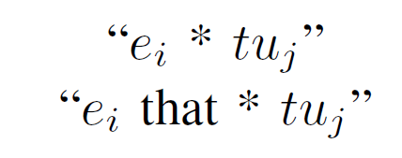
Patterns between e and t
Ten temporal units used
Seconds, minutes, hours, days, weeks, months, years, decades (Pan and Jurafsky)
Centuries and eras
Automated pattern harvesting procedure
Use top 1000 events from previous step to build web queries
Quadruples of the form event, temporal unit, pattern and frequency of the extraction
.
Concert * hours
Concert that * hours
“We only want to participate in a concert that takes two hours.”

Slide 16
Patterns between e and t
TextRunner Corpus
Noun-Verb-Noun
Loosely defined patterns
Output same as querying the web
Example:
“storm” –verb– “hours”
“lasted”, “lasted about”, “raged for”, “continued for” etc.

Slide 17
Results and Analysis
Social Events:
Birthdays
Anniversaries
Concerts
Event Data Collection
16,347 unique event terms
12,135 events seen more than once
Selected top 1000 for manual annotation
Pattern Harvesting
1,187,683 patterns learned
220,315 unique patterns
Disaster Events:
Hurricanes
Tornadoes
Floods
Health Events:
Heart attacks
Strokes

Slide 18
Results and Analysis
It is not just duration that matters.
Preparation time, age of the event etc. clearly occur more times in relation with the event.

Slide 19
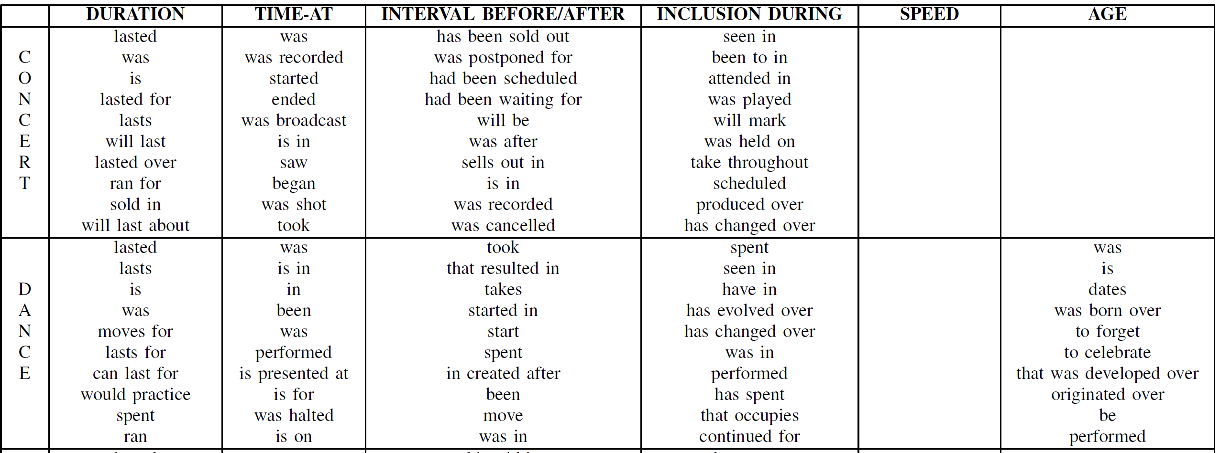
Results and Analysis

Slide 20
Results and Analysis
Manually assigned a small subset of patterns harvested for four events to the different temporal aspects
When unsure, used class “Other”
Concert:
Duration – “lasted”, “lasted for”, “was”, “will last” etc.
Time-at – “was”, “started”, “ended”, “is in” etc.
Interval Before/After – “will be”, “had been scheduled”, “sells out in” etc.
Inclusion During – “seen in”, “attended in”, “has changed over” etc.

Slide 21
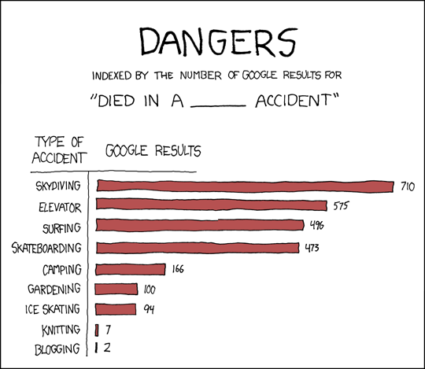
Counts on the Web

Slide 22
died in (a|an) _ accident
car 13966, automobile 2954, road 1892, auto 1650, traffic 1549, tragic 1480, motorcycle 1399, boating 823, freak 733, drowning 438, vehicle 417, hunting 304, helicopter 289, skiing 281, mining 254, train 250, airplane 236, plane 234, climbing 231, bus 208, motor 198, industrial 187, swimming 180, training 170, motorbike 155, aircraft 152, terrible 137, riding 136, bicycle 132, diving 127, tractor 115, construction 111, farming 107, horrible 105, one-car 104, flying 103, hit-and-run 99, similar 89, racing 89, hiking 89, truck 86, farm 81, bike 78, mine 75, carriage 73, logging 72, unfortunate 71, railroad 71, work-related 70, snowmobile 70, mysterious 68, fishing 67, shooting 66, mountaineering 66, highway 66, single-car 63, cycling 62, air 59, boat 59, horrific 56, sailing 55, fatal 55, workplace 50, skydiving 50, rollover 50, one-vehicle 48, <UNK> 48, work 47, single-vehicle 47, vehicular 45, kayaking 43, surfing 42, automobile 41, car 40, electrical 39, ATV 39, railway 38, Humvee 38, skating 35, hang-gliding 35, canoeing 35, 0000 35, shuttle 34, parachuting 34, jeep 34, ski 33, bulldozer 31, aviation 30, van 30, bizarre 30, wagon 27, two-vehicle 27, street 27, glider 26, " 25, sawmill 25, horse 25, bomb-making 25, bicycling 25, auto 25, alcohol-related 24, snowboarding 24, motoring 24, early-morning 24, trucking 23, elevator 22, horse-riding 22, fire 22, two-car 21, strange 20, mountain-climbing 20, drunk-driving 20, gun 19, rail 18, snowmobiling 17, mill 17, forklift 17, biking 17, river 16, motorcyle 16, lab 16, gliding 16, bonfire 16, apparent 15, aeroplane 15, testing 15, sledding 15, scuba-diving 15, rock-climbing 15, rafting 15, fiery 15, scooter 14, parachute 14, four-wheeler 14, suspicious 13, rodeo 13, mountain 13, laboratory 13, flight 13, domestic 13, buggy 13, horrific 12, violent 12, trolley 12, three-vehicle 12, tank 12, sudden 12, stupid 12, speedboat 12, single 12, jousting 12, ferry 12, airplane 12, unrelated 11, transporter 11, tram 11, scuba 11, common 11, canoe 11, skateboarding 10, ship 10, paragliding 10, paddock 10, moped 10, factory 10

Slide 23
Patterns for Gender and Animacy Discovery
(Ji and Lin, 2009)
Property | Name | target [#] | context | Pronoun | Example
Gender | Conjunction-Possessive | noun[292,212] |capitalized [162,426] | conjunction | his|her|its|their | John and his
 | Nominative-Predicate | noun [53,587] | am|is|are| was|were|be | he|she|it|they | he is John
 | Verb-Nominative | noun [116,607] | verb | he|she|it|they | John thought he
 | Verb-Possessive | noun [88,577]| capitalized [52,036] | verb | his|her|its|their | John bought his
 | Verb-Reflexive | noun [18,725] | verb | himself|herself| itself|themselves | John explained himself
Animacy | Relative-Pronoun | (noun|adjective) & not after (preposition| noun|adjective) [664,673] | comma| empty | who|which| where|when | John, who
Notes:
Don’t have to be smart people.

Slide 24
Lexical Property Mapping
Property | Pronoun | Value
Gender | his|he|himself | masculine
 | her|she|herself | feminine
 | its|it|itself | neutral
 | their|they|themselves | plural
Animacy | who | animate
 | which|where|when | non-animate
Notes:
Don’t have to be smart people.

Slide 25
Gender Discovery Examples
If a mention indicates male and female with high confidence, it’s likely to be a person mention
Patterns for candidate mentions | male | female | neutral | plural
John Joseph bought/… his/… | 32 | 0 | 0 | 0
Haifa and its/… | 21 | 19 | 92 | 15
screenwriter published/… his/… | 144 | 27 | 0 | 0
it/… is/… fish | 22 | 41 | 1741 | 1186
Notes:
Don’t have to be smart people.

Slide 26
Animacy Discovery Examples
If a mention indicates animacy with high confidence, it’s likely to be a person mention
Patterns for candidate mentions | Animate | Non-Animate
 | who | when | where | which
supremo | 24 | 0 | 0 | 0
shepherd | 807 | 24 | 0 | 56
prophet | 7372 | 1066 | 63 | 1141
imam | 910 | 76 | 0 | 57
oligarchs | 299 | 13 | 0 | 28
sheikh | 338 | 11 | 0 | 0
Notes:
Give pattern, along with examples.

Slide 27
Unsupervised Mention Detection Using
Gender and Animacy Statistics
Candidate mention detection
Name: capitalized sequence of <=3 words; filter stop words, nationality words, dates, numbers and title words
Nominal: un-capitalized sequence of <=3 words without stop words
Margin Confidence Estimation
freq (best property) – freq (second best property)
freq (second best property)
Confidence (candidate, Male/Female/Animate) >
Full matching: candidate = full string
Composite matching: candidate = each token in the string
Relaxed matching: Candidate = any two tokens in the string
Notes:
Give pattern, along with examples.

Slide 28
Property Matching Examples
Mention candidate | Matching Method | String for matching | Property Frequency
 |  |  | masculine | feminine | neutral | plural
John Joseph | Full Matching | John Joseph | 32 | 0 | 0 | 0
Ayub Masih | Composite Matching | Ayub | 87 | 0 | 0 | 0
 |  | Masih | 117 | 0 | 0 | 0
Mahmoud Salim Qawasmi | Relaxed Matching | Mahmoud | 159 | 13 | 0 | 0
 |  | Salim | 188 | 13 | 0 | 0
 |  | Qawasmi | 0 | 0 | 0 | 0
Notes:
Give pattern, along with examples.

Slide 29
Separate Wheat from Chaff:
Confidence Estimation
Rank the properties for each noun according to their frequencies: f₁ > f₂ > … > f_{k}
Notes:
Link to sushant.

Slide 30
Experiments: Data
Candidate mention detection
Name: capitalized sequence of <=3 words; filter stop words, nationality words, dates, numbers and title words
Nominal: un-capitalized sequence of <=3 words without stop words
Margin Confidence Estimation
freq (best property) – freq (second best property)
freq (second best property)
Confidence (candidate, Male/Female/Animate) >
Full matching: candidate = full string
Composite matching: candidate = each token in the string
Relaxed matching: Candidate = any two tokens in the string
Notes:
Give pattern, along with examples.

Slide 31
Impact of Knowledge Sources on
Mention Detection for Dev Set
Patterns applied to ngrams for Name Mentions |  | P(%) | R(%) | F(%)
Conjunction-Possessive | John and his | 68.57 | 64.86 | 66.67
+Verb-Nominate | John thought he | 69.23 | 72.97 | 71.05
+Animacy | John, who | 85.48 | 81.96 | 83.68
Patterns applied to ngrams for Nominal Mentions |  | P(%) | R(%) | F(%)
Conjunction-Possessive | writer and his | 78.57 | 10.28 | 18.18
+Predicate | He is a writer | 78.57 | 20.56 | 32.59
+Verb-Nominate | writer thought he | 65.85 | 25.23 | 36.49
+Verb-Possessive | writer bought his | 55.71 | 36.45 | 44.07
+Verb-Reflexive | writer explained himself | 64.41 | 35.51 | 45.78
+Animacy | writer, who | 63.33 | 71.03 | 66.96
Notes:
Give numbers, and the examples of errors.

Slide 32
Event Association Mining (Ge et al., 2017)
32
Notes:
Change low resource IL to a language which is not in wikipedia
Word-level: from bi-lingual dicts and alignment; structure-level comes from wals; multi-level alignment

Slide 33
Event Association Mining (Ge et al., 2017)
33
Notes:
Change low resource IL to a language which is not in wikipedia
Word-level: from bi-lingual dicts and alignment; structure-level comes from wals; multi-level alignment

Slide 34
Event Association Mining (Ge et al., 2017)
34
Notes:
Change low resource IL to a language which is not in wikipedia
Word-level: from bi-lingual dicts and alignment; structure-level comes from wals; multi-level alignment

Slide 35
Commonsense is crucial for NLU
Example: John stepped in a puddle and had to go home to change.
Step in a puddle
Causes
Shoes get wet
Causes
Feel uncomfortable
Motivates
Change
Notes:
OK, so let’s get started. Commonsense is crucial for understanding human language. For example, when we see a sentence that “John stepped in a puddle and had to go home to change”, humans should be able to answer why is this happening. For example, to understand this sentence, we need to know the knowledge that step in a puddle can cause shoes get wet, and then if our shoes get wet, we will feel uncomfortable, which can motivate us to change.
From these examples, we can actually see that the commonsense is deeply connected with events.

Slide 36
Commonsense Knowledge
Modern Definition of Commonsense Knowledge (Liu & Singh, 2004)
“While to the average person the term ‘commonsense’ is regarded as synonymous with ‘good judgement’”
“the AI community it is used in a technical sense to refer to the millions of basic facts and understandings possessed by most people.”
“Commonsense is about preference and not always true”
If you forget someone’s birthday, they may be unhappy with you.
But if your friends understand that you are busy, he will not by angry.
Unlike factual knowledge, they are not inevitably true.
Commonsense is about preference.
Hugo Liu and Push Singh, ConceptNet - a practical commonsense reasoning tool-kit, BTTJ, 2004
Notes:
OK, so, let’s start with the commonsense.
For ordinary people, commonsense basically means the the good judgement about the world around us. In the AI community, it is used as a technical term referring to millions of basic facts and understandings possessed by most people. One unique property of commonsense is that , commonsense is about preference over ordinary objects, and they are not inevitably true
So, basically, different from factual knowledge like Obama was the president of united states, which is always correct, the commonsense knowledge are not. For example, if you forget someone’s birthday, they may be unhappy with you. But, if this person is your friend and he really understands that you are very busy these days, he won’t get angry.
From these examples we can see that the commonsense is about preference.

Slide 37
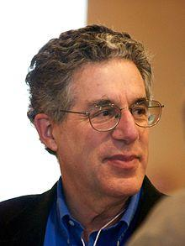
What kinds of preference?
Semantic meaning in our language can be described as “a finite set of mental primitives and a finite set of mental combination.” (Jackendoff, 1990)
The primitive units of semantic meanings include
Thing (or entity)
cat
State
The cat is cute.
The cat is smiling.
Event
The cat is running.
We want to understand humans’ preferences about things, states, and events.
eventuality
States describe things.
Events describe the changing of states.
Ray Jackendoff Semantic Structures. Cambridge, Massachusetts: MIT Press. 1990
Notes:
OK, so, let’s go a little bit deeper and try to think about where could such preference happen. So based on Jackendoff’s semantic theory, the semantic meaning in our language can be described as a finite set of mental primitives and a finite set of mental combinations.
And actually the primitive units could include many things. So, the first kind of primitive units are things or entities. For example, cat. We all know what cat is about. It is a kind of animal that are typically very cute and have four legs, two eyes, two ears, one tail, etc.. Besides that, another important primitive unit is the state, such as the cat is cute or the cat is smiling. Actually I think it is fair to say that our understanding about things can be reflected via states. Because the semantics about things is really just the union of all possible states that it could appear in.
So basically, the states are describing certain properties of things. OK, every thing we have so far are static, however, the world is dynamic and everything is changing. That is why we also need to understand events. So, basically, events are describing the changing of states, I think it is fine to view it a kind of derivative of states? Such as the cat is running. It changes from one state to another one. Actually, there are many interesting things we know or we have preference about this event. For example, the cat is running is such a hurry might because it sees some delicious food or it suddenly wakes and sees somebody is trying to make a video of it and it just got scared.
Considering that knowledge about things can be effectively expressed by states and event, whose overall term is called the eventuality, we can say that the commonsense can be reflected with the preference over eventualities.

Slide 38
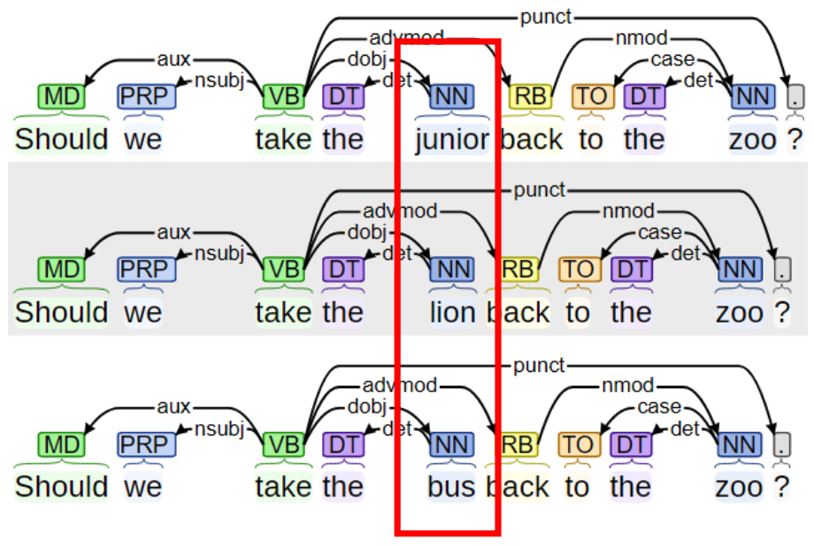
How to represent the preference?
The lower bound of a semantic theory (Katz and Fodor, 1963)
Linguistic description – grammar = semantics
Understanding language needs both “the speaker‘s knowledge of his language and his knowledge about world” (Katz and Fodor, 1963)
When the grammar is controlled, the selection we made can reflect our understanding about the world.
It is so dangerous!!!
Katz, J. J., & Fodor, J. A. (1963). The structure of a semantic theory. Language, 39(2), 170–210.
Notes:
OK, so naturally, the next question would be how to represent such preference so that the machines can understand the commonsense. To answer this question, we need to think about how are this kind of preference is expressed in human language. So based on the lower bound of the semantic theory, if we remove the grammar from the linguistic description, we will get the semantics. So basically, understanding language requires both the knowledge about the language, which is the grammer basically, and the knowledge about the world, which contains both the factual knowledge and commonsense knowledge
Ok, so here are some examples. There are three sentences, Should we take the junior back to the zoo? Should we take the lion back to the zoo? Should we take the bus back to the zoo? Even though these sentences share the same grammar structure, they are describing totally different events, which may have totally different reasons, effect, or like sub-events.So, if we provide a little context, like It is so dangerous. Then which of these these three sentences should be the most appropriate one? Well, I would like to vote for the second one because lions are often very dangerous.
So basically, this example perfectly shows that when the grammar is controlled, our selection can be used to reflect our understandings about junior, lion, and the bus, which is exactly the commonsense knowledge we are trying to capture here.

Slide 39
Selectional Preference
Selectional Preference (Resnik, 1993)
A relaxation of selectional restrictions (Katz and Fodor, 1963) and is often used as syntactic features (Chomsky, 1965).
Applied to IsA hierarchy in WordNet and verb-object relations.
With this formulation, we can easily use the frequency/plausibility scores of different combinations to reflect humans’ preference.
Examples:
(“Cat” -IsA- “Animal”) > (“Cat” -IsA- “Plant”)
(“eat” -dobj- “food”) > (“eat” -dobj- “rock”)
Katz, J. J., & Fodor, J. A. (1963). The structure of a semantic theory. Language, 39(2), 170–210.
Noam Chomsky. 1965. Aspects of the Theory of Syntax. MIT Press, Cambridge, MA.
Philip Resnik. 1993. Selection and information: A class-based approach to lexical relationships. Ph.D. thesis, University of Pennsylvania.
Notes:
Historically, people used to call such grammar based semantics or preference with the term selectional preference or semantic fit in some other literatures. So, basically, selectional preference is a kind of relaxation of selectional restrictions and is often used as syntactic features. Originally, it was only applied to the IsA hierarchy in WordNet and verb-object relations. Actually, the idea of selectional preference is very simple. We controlled the grammar, like the direct object dependency connection and its head, basically the verbs, humans should have preference about the arguments it can be connected to. With this formulation, we can easily use the frequency or some plasusibiity scores given by different models to reflect humans preference.
Here are two examples. Cat is more likely to be a kind of animal rather than plant. So, if one model or knowledge graph can manage to assign higher score to the first combination rather than the second, we can claim that this model or knowledge graph understands humans’ preference about this piece of commonsense knowledge. Similarly, if a model manages to assign higher weight or score to the first tuple “eat dobj food”, rather than the second one, we can say that it understand the commonsense knowledge that we are more likely to eat food rather than rock.

Slide 40
Higher-order Selectional Preference
First-order
dobj: (“eat”–>dobj->“food”) > (“eat”->dobj->“house”)
Nsubj: (“sing”->nsubj->“singer”) > (“sing”->nsubj->“house”)
…
Second-order (Zhang et al., 2019)
Nsubj-amod / dobj-amod
(“eat”->nsubj->“[SUB]”->amod->“hungry”) > (“eat”->dobj>“[OBJ]”->amod->“hungry”)
Higher-order
(“I eat dinner”->Causes->“I am full”) > (“I eat dinner”->Causes->“I am hungry”)
Commonsense can be represented by the higher-order selectional preference over eventualities.
Hongming Zhang, Hantian Ding, and Yangqiu Song. SP-10K: A Large-Scale Evaluation Set for Selectional Preference Acquisition. ACL 2019.
Notes:
Of course, these two kinds of relations are not enough to cover all the commonsense knowledge, people start to extend the definition of selectional preference to other dependency relations like the subject. So for example, it is more likely for a signer or person to sing rather than the house.
And, then we can further extend the idea of selectional preference to second-order. The motivation is that sometimes humans do not have preference for the subject or object of specific event, but they do have the preference about the property of the subject or object.
If we further extend, we fill get the higher-order selectional preference, which describes the commonsense knowledge about complex relations between events or states. Like eating dinner may cause the person to be full rather than hungry. We call it higher order because really the semantic unit is the eventualities rather than the words. You need to view each eventuality as a whole.
To summarize what we have discussed so far, the commonsense can be represented by the higher-order selectional preference over eventualities.

Slide 41
Transferability from event knowledge to Commonsense
customer
he
nsubj
nsubj
Result
eats
is
dobj
acomp
food
full
customer
he
customer
he
customer
he
nsubj
nsubj
nsubj
nsubj
nsubj
nsubj
Result
Result
Result
eats
is
eats
is
eats
is
dobj
acomp
dobj
acomp
dobj
acomp
food
full
food
full
food
full
(‘customer’-CapableOf-‘eat food’)
(‘food’-ReceivesAction-‘eat’)
(‘eat’-Causes-‘be full’)
Hongming Zhang, Daniel Khashabi, Yangqiu Song, and Dan Roth. TransOMCS: From Linguistic Graphs to Commonsense Knowledge. IJCAI 2020.
Notes:
To demonstrate that the preference knowledge about eventualities are indeed the commonsense, this TransOMCS paper tried to convert a linguistic based eventuality knowledge graph into human-defined commonsense knowledge graphs like ConceptNet. And it turns out there are many interesting patterns between those linguistic relations and the human-defined commonsense relations.
OK, so assume that we have linguistic graph, which contains an event “customer eats food” and a state “he is full”. There is a discourse relation “Result” connecting these two eventualities. And inside these events and states, the words are connected with dependency relations like “subject” or “object”. We can find many interesting overlaps between this graph and the commonsense assertions in ConceptNet. For example, we can find out that the customer actually appears as the subject, and the tail “eat food” appears as the verb and object, we can then conclude a pattern that for the capableOf relations, we can extract the subject as the head, and the combinational of verb and object as the tail.
Similarly, for the receiveaction relations, we can see that the object usually can be used as the head with the verb as the tail.
Last but not least, we can also see some interesting patterns cross different events, like this one for the causes relation.

Slide 42
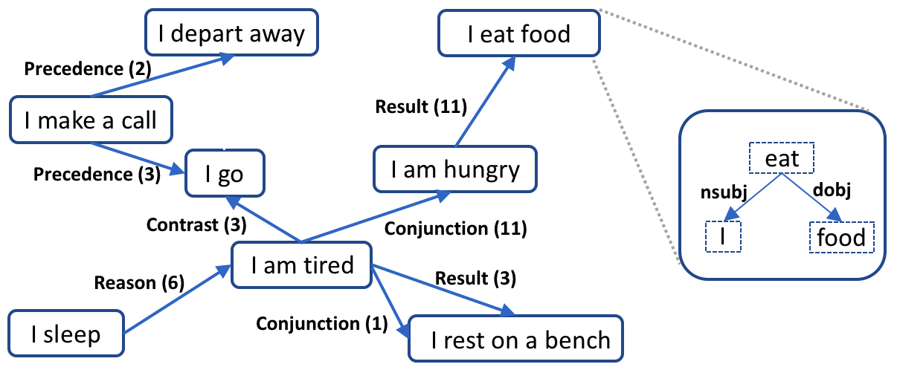
Transferability from event knowledge to Commonsense
“human” CapableOf
“love” Causes
stand
think
die
learn
make mistake
lie
typically have
create society
have cell
create life
be friendly
be happy
pain
marriage
be quaint
be unhappy
be allergic
be desperate
be apart
be silly
Event-centric KG
Human-defined commonsense
Notes:
OK, so after we collect those patterns, we can apply those patterns back to the original event KG to acquire large-scale of commonsense knowledge. We borrowed some examples and show them here, the confusing face means that human think the extracted knowledge might be problematic, but I think the overall quality is quite good. For example, we can actually observe some interesting commonsense such as human is capable of having cells and love can cause both being happy and pain.

Slide 43
Event-centric KBs
 | # Events | # Event relation | # Relation Types
FrameNet (Baker et al., 1998) | 27,691 | 1,709 | 7
ACE (Aguilar et al., 2014) | 3,290 | 0 | 0
PropBank (Palmer et al., 2005) | 112,917 | 0 | 0
NomBank (Meyers et al., 2004) | 114,576 | 0 | 0
TimeBank (Pustejovsky et al., 2003) | 7,571 | 8,242 | 1
ConceptNet (Liu and Singh, 2004) | 74,989 | 116,097 | 4
Event2Mind (Smith et al., 2018) | 24,716 | 57,097 | 3
ProPora (Dalvi et al., 2018) | 2,406 | 16,269 | 1
ATOMIC (Sap et al., 2019) | 309,515 | 877,108 | 9
ATOMIC 2020* (Hwang et al., 2020) | - | 165,164 | 4
Pro: High quality
Con: Expensive; Small Scale; Limited relation types
*For ATOMIC 2020, we only count the unique edges and ignore the edges it inherits from other KBs.
Notes:
As an important semantic unit, the study on event semantics has long be the focus on the NLP community. Throughout the years, many event-centric resource are developed, even they may have very different purpose and scale.
For example, FrameNet is considered to be one of the earliest knowledge base defining events and their relations. It provides annotations about relations among about 1,000 human defined eventuality frames, which contain 27,691 eventualities. However, given the fine-grained definition of frames, the scale of the annotations is limited.
After that, ACE reduces the number of event types and annotates more examples in each of event types.
Different from them, PropBank and NomBank build frames over syntactic parse trees, and only focus on annotating popular verbs and nouns. OK, so all aforementioned resources are mostly focusing on the event themselves and do not care too much about the relations between them. But there are some resources do care about the relations.
For example, TimeBank focuses only on temporal relations between verbs.
While all previous knowledge bases are annotated by domain experts, they often have very good quality, but also suffer from the scale issue.
Recently, with the development of those crowdsourcing platforms, crowdsourcing becomes a more popular way to construct event KBs. A popular example is the ConceptNet, even though its original design purpose is the commonsense rather than just events, it does contain four event relevant relations HasPrerequisite, HasFirstSubevent, HasSubEvent, HasLastSubEvent.
Besides the conceptnet, several other popular crowd-sourcing event bases are event2mind, propora, and ATOMIC. They often focus on specific relations between events. For example, Propora focuses on the scientific process, while atomic focus on nine human-defined relations between daily events.
As a quick conclusion, the most significant advantage of those event-centric knowledge bases is that they are often of high quality. But at the same time, it may suffer from the the expensive cost, and small scale. Also, the limited relation types, because we always need to first define the relation we care about and then we can annotate them.

Slide 44
Knowlywood (Tandon et al., 2015)
KG Format
Node: Verb + Object
Edge: Temporal Relation
Resource
560 movie scripts
Extraction Methodology
Niket Tandon, Gerard de Melo, Abir De, and Gerhard Weikum. 2015. Knowlywood: Mining Activity Knowledge From Hollywood Narratives. CIKM 2015.
Notes:
OK, the first work I want to introduce is the knowlywood. As one of the earliest large event knowledge graphs, it extracts event knowledge from movie scripts. Specifically, it defines each event to be the combination of a verb and its object. And it only focuses on the temporal relation between events. It uses 560 movie scripts as the corpus.
Here is the overall pipeline, it first leverage existing tools like clause parsing and word sense disambiguation to parse the raw corpus. After that, based on the parsing result, they build a graph inference model to align all the extracted event knowledge. The main purpose of this step is to minimize the influence of the conflict. In the last step, it build the event taxonomy based on the cleaned knowledge and generate the final KB.

Slide 45
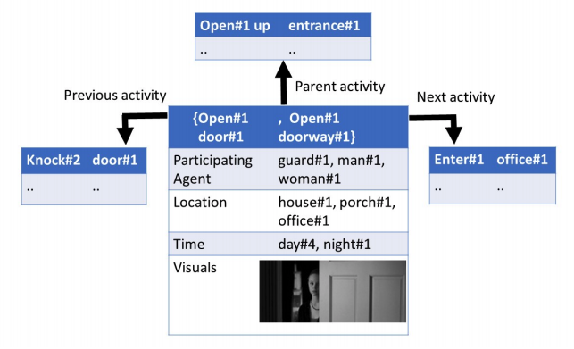
Knowlywood
Example
Quantity
“Knock door”->“open up entrance”->“enter office”
Notes:
Here is an case study showing the extraction results. From this scene, we can actually extract some interesting event knowledge that we first knock the door and then open up the entrance, and then we can enter the office.
An big advantage of this approach is the quantity, as this approach is automatic, it is much cheaper than the crowd-sourcing, it can effectively extract knowledge about 964 thousand events, which is much larger than the ConceptNet.

Slide 46
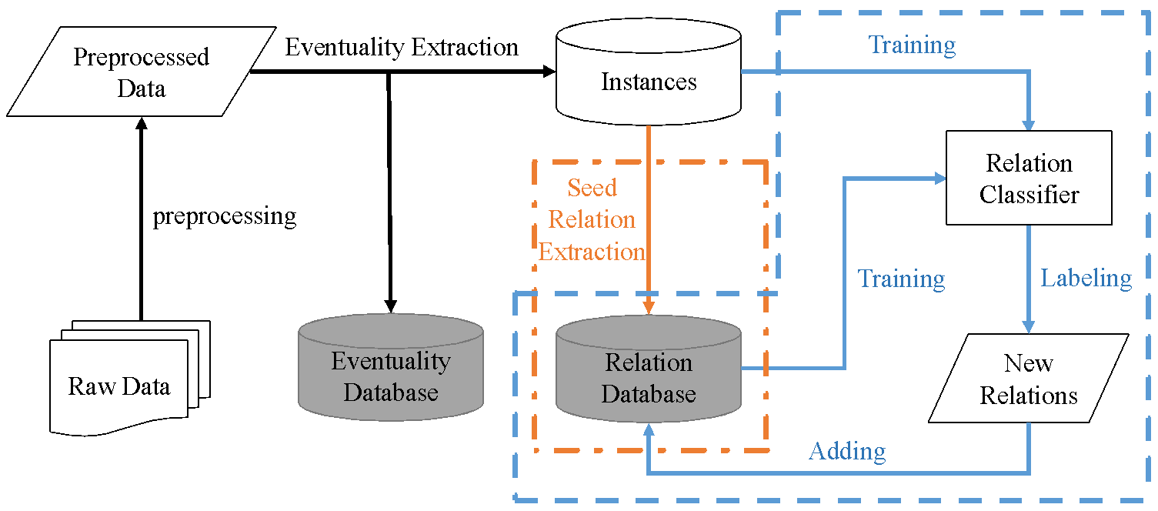
ASER (Zhang et al., 2020)
KG Format
A Hybrid graph
Node: Eventualities in the format of dependency graphs
Edge: All discourse relations
Resource
11B token textual corpora (i.e., Yelp, NYT, Wikipedia, Reddit, Subtitles, E-books)
Extraction
Hongming Zhang, Xin Liu, Haojie Pan, Yangqiu Song, and Cane Wing-Ki Leung. ASER: A Large-scale Eventuality Knowledge Graph. WWW 2020.
Notes:
Besides Knowlywood, another large-scale event-centric knowledge graph is ASER. Compared with Knowlywood, the overall sctructure of ASER is more complex. As a result, it has the potential to cover richer event knowledge, but also faces larger extraction difficulty. Specifically, ASER is a Hybrid graph, and each node in ASER represents an eventuality, which is in the format of dependency graphs. Currently, ASER uses all the discourse relations between eventualities as the edges.
As for the resources, ASER use a 11 billion token corpus as the raw data. It includes textual data from YELP, NYT, Wikipedia, reddit, movie subtitles, and electronic books.
OK, so here is the overall extraction pipeline. After collecting the raw corpora, ASER first preprocess the texts with the dependency parser, and then performs the eventuality extraction algorithm with the pattern matching approach. After that, ASER will extract discourse relations from these candidate instances with the help of an explicit discourse parser. Considering that compared with the eventualities, the discourse markers are often much more sparse, then introduce an additional bootstrapping framework to increase the edges iteratively.

Slide 47
ASER Example
A hybrid graph of
Each eventuality is a hyper-edge of words
Heterogeneous edges among eventualities
I sleep
I sleep
I depart away
I eat food
Precedence (2)
I sleep
Result (11)
I make a call
I sleep
eat
I sleep
I am hungry
Precedence (3)
I go
nsubj
dobj
(~3000)
> [I eat rock (0)]
Contrast (3)
Conjunction (11)
I
food
I sleep
I am tired
Reason (6)
Result (3)
I sleep
Conjunction (1)
I sleep
I sleep
I rest on a bench
194 million eventualities, 64 million edges
Notes:
As for the result, they created ASER. As you can see from this example, ASER is essentially a hybrid graph, like each node in ASER is a hyper-edge of words, that describes an eventuality and there exist heterogeneous edges among eventualities. The current ASER contains 194 million eventualities and 64 million edges.
Actually, lots of interesting commonsense knowledge can be found in this example. For example, the eventuality “I eat food” appears about 3000 times in the whole KG, but the eventuality “I eat rock” has never appear in ASER. By comparing these two can see that the statistics about eventualities actually reflects lower-order selectional preference like we are more likely to eat food rather than rock. Besides that, we can also observe some interesting higher-order preference like we often make a call before we depart away, and being tired and hungry often happen together.

Slide 48
ASER Quantity and Quality (Eventuality)
Notes:
As for the quantity and quality of eventuality extraction, the overall precision is above 80%, which is pretty good, especially considering that we do not use any annotations. One important reason for this is that the eventuality extraction algorithm of ASER is actually quite strict.
As for the scale, of course, scale is also an important issue here, but since the approach is unsupervised and they can easily increase it by scanning over more data. For example, as you can see here, ASER got about 1 million to 100 million unique eventualities for each selected pattern.

Slide 49
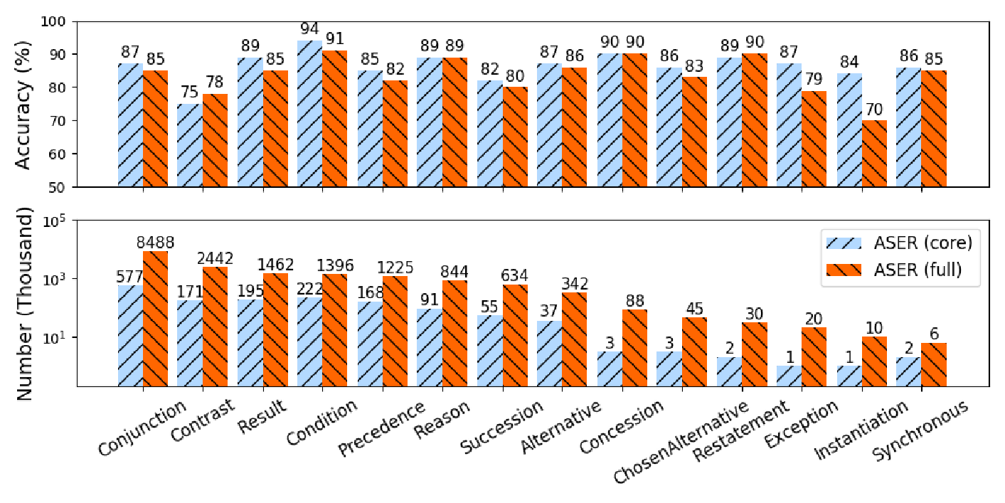
ASER Quantity and Quality (Edge)
Notes:
As for the edges, ASER got 64 million edges in total and here are the distributions and the qualities. As you can see from this result, in general, the distribution of relation types are not balanced. Some of relations appear over 8 million times, while some others only appear less than 6 thousand times.
As for the quality, it is a little bit worse than the eventualities because the higher-order selectional preference knowledge is more complex.

Slide 50
Comparison with Other event KGs
100X larger !!!
1,000X larger !!!
PS: In ConceptNet 5.0, more edges are added, but only the core part, which is inherited from ConceptNet 1.0 (Liu & Singh, 2004), is related to commonsense knowledge.
Notes:
OK, so here is the size comparison of all the other verb-based knowledge resources. Currently, ASER is the largest one, As ASER is automatically extracted from unlabeled textual data, by scanning a large-scale corpus, it is 100 times larger than all the other resources and 1000 times larger than ConceptNet.

Slide 51
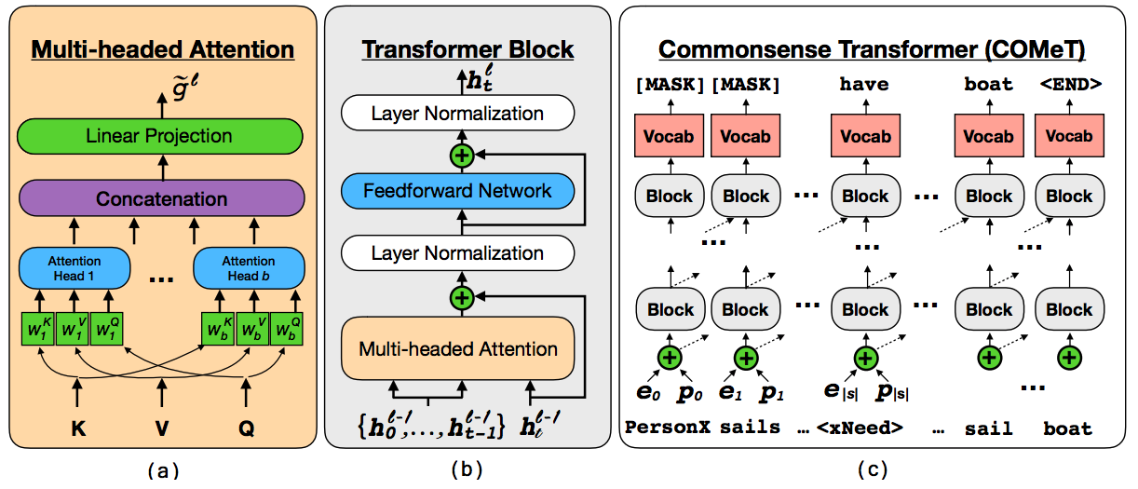
Knowledge Discovery from Pre-trained LMs
Language Model
Examples: GPT-1/2/3
COMET (Bosselut et al., 2019):
Commonsense Transformers for Automatic Knowledge Graph Construction
Event 1
Event 2
Antoine Bosselut, Hannah Rashkin, Maarten Sap, Chaitanya Malaviya, Asli Celikyilmaz, and Yejin Choi. COMET: Commonsense Transformers for Automatic Knowledge Graph Construction. ACL 2019.
Notes:
Recently, the most important breakthrough in the NLP community is the pre-trained language models. With the help of deep models and the large-scale pretraining corpus, the language model manages to memorize rich knowledge and commonsense knowledge is not an exception. So, basically, one natural question is that how can we mine such knowledge out of the language models.
And to answer this question, COMET proposed a supervised solution, By learning with a seed commonsense knowledge graph, it manages to produce interesting commonsense with the help of those pre-trained models. Here is the overall framework, even though the approach is pretty straightforward, it first encode the head and relation with an encoder, and try to predict the tail event with a standard decoder, the overall result is quite impressive.

Slide 52
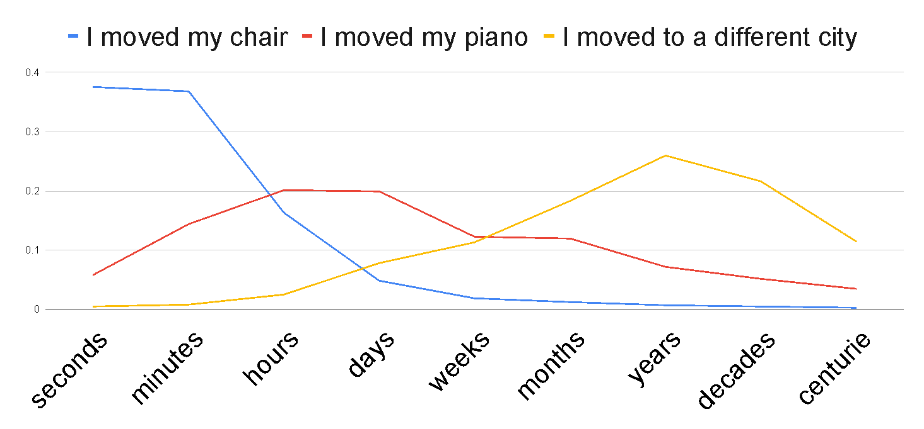
Event Temporal Commonsense
TacoLM (Zhou et al., 2020)
a general time-aware language model that distincts temporal properties in fine grained contexts.
Ben Zhou, Qiang Ning, Daniel Khashabi,, and Dan Roth. Temporal Common Sense Acquisition with Minimal Supervision. ACL 2020.
Notes:
Besides extracting event knowledge from the language models, as those language models may also not be perfect, people also care about how can we help them to better extract and memorize event knowledge from raw corpus. And TacoLM is a good example. Specifically, it aims at helping language models to understand how long does an event typically last for.
Some examples are like moving chairs will typically last for seconds, but moving piano will last for hours because the piano is much heavier. And similarly, moving to a different city may take years.

Slide 53
Event Temporal Commonsense
Goal: build a general time-aware LM with minimal supervision
Use high-precision patterns to acquire temporal information
Unsupervised automatic extraction
Overcomes reporting biases with a large amount of natural text
Multiple temporal dimensions
Duration ~ 1 / Frequency
Further generalization to combat reporting biases
Step 1: Information Extraction
Step 2: Joint Language Model Pre-training
“I brush my teeth every morning”
Duration of “brushing teeth” < morning
Output: TacoLM- a time-aware general BERT
Notes:
With the goal of building a general time-aware LM with minimal supervision, CocoLM starts with a focused, unsupervised information extraction step, in which they use a set of high-precision patterns to acquire temporal information. ♦This helps the model to overcome reporting biases as we can automatically extract over a large amount of natural text.
♦After that, they use the temporal information acquired in step 1 to jointly train the the language model. ♦Specifcially, they pre-train the language model jointly over multiple temporal dimensions, such that it is able to utilize the natural relations such as duration being inversely related to frequency. ♦This is beneficial. For example, we may not see direct mentions of the duration of brushing teeth, however, we know that it is shorter than a morning as the frequency is likely to be every morning. ♦This provides further generalization to combat reporting biases.
♦Finally, they can obtain the final model TacoLM, a BERT transformer that is more aware of time.

Slide 54
Event Temporal Commonsense
I played basketball for 2 hours.
Original sentence
I [M] played basketball [SEP] [M] [DUR] [HRS]
Baseline Model: Pre-trained BERT-base
Main objective: mask some tokens and recover them
How we mask:
With some probability, mask temporal value while keeping others
Otherwise, mask a certain portion of E1...En while keeping temporal value unchanged
Max (P(Event|Dim,Val) + P(Val|Event,Dim)); Preserving original LM capability
SRL Parse
Arg-0
Arg-1
I played basketball for 2 hours.
Verb
Arg-Tmp
I [M] played basketball [SEP] [M] [DUR] [MASK]
Pattern Matching
for 2 hours: matches Duration pattern
I [M] [MASK] [MASK] [SEP] [M] [DUR] [HRS]
Event
Value
I played basketball, Duration, Hours
Formatted Output Instance
Dimension
Information Extraction
Joint training with language model
Notes:
OK, so here are some details. In the information extraction step, a set of high-precision patterns based on SRL parsing to mine temporal information in ♦ duration, frequency and typical time.
♦Consider a raw sentence I played basketball for two hours as an example. ♦they first apply a SRL model and get the verb and arguments. In this case, there is a temporal argument for 2 hours, ♦which can match the duration pattern. That is, we know that for 2 hours is describing the duration of the verb played. ♦Following this, they can transform the original sentence into a training instance of a event, dimension and value tuple. In total, they got 4.3 million such tuples for pre-training.
For the model part, they employ a simple objective of masking some tokens in the formatted sequence and then recover them such that the model can know more about time. With the higher probability, they will mask the temporal value while keeping the others.
Otherwise, We will instead mask some event tokens and keep the temporal value token unchanged. In this case, they can then maximize the conditional probability of the events and the value at the same time to preserve the original capability of a language model.

Slide 55
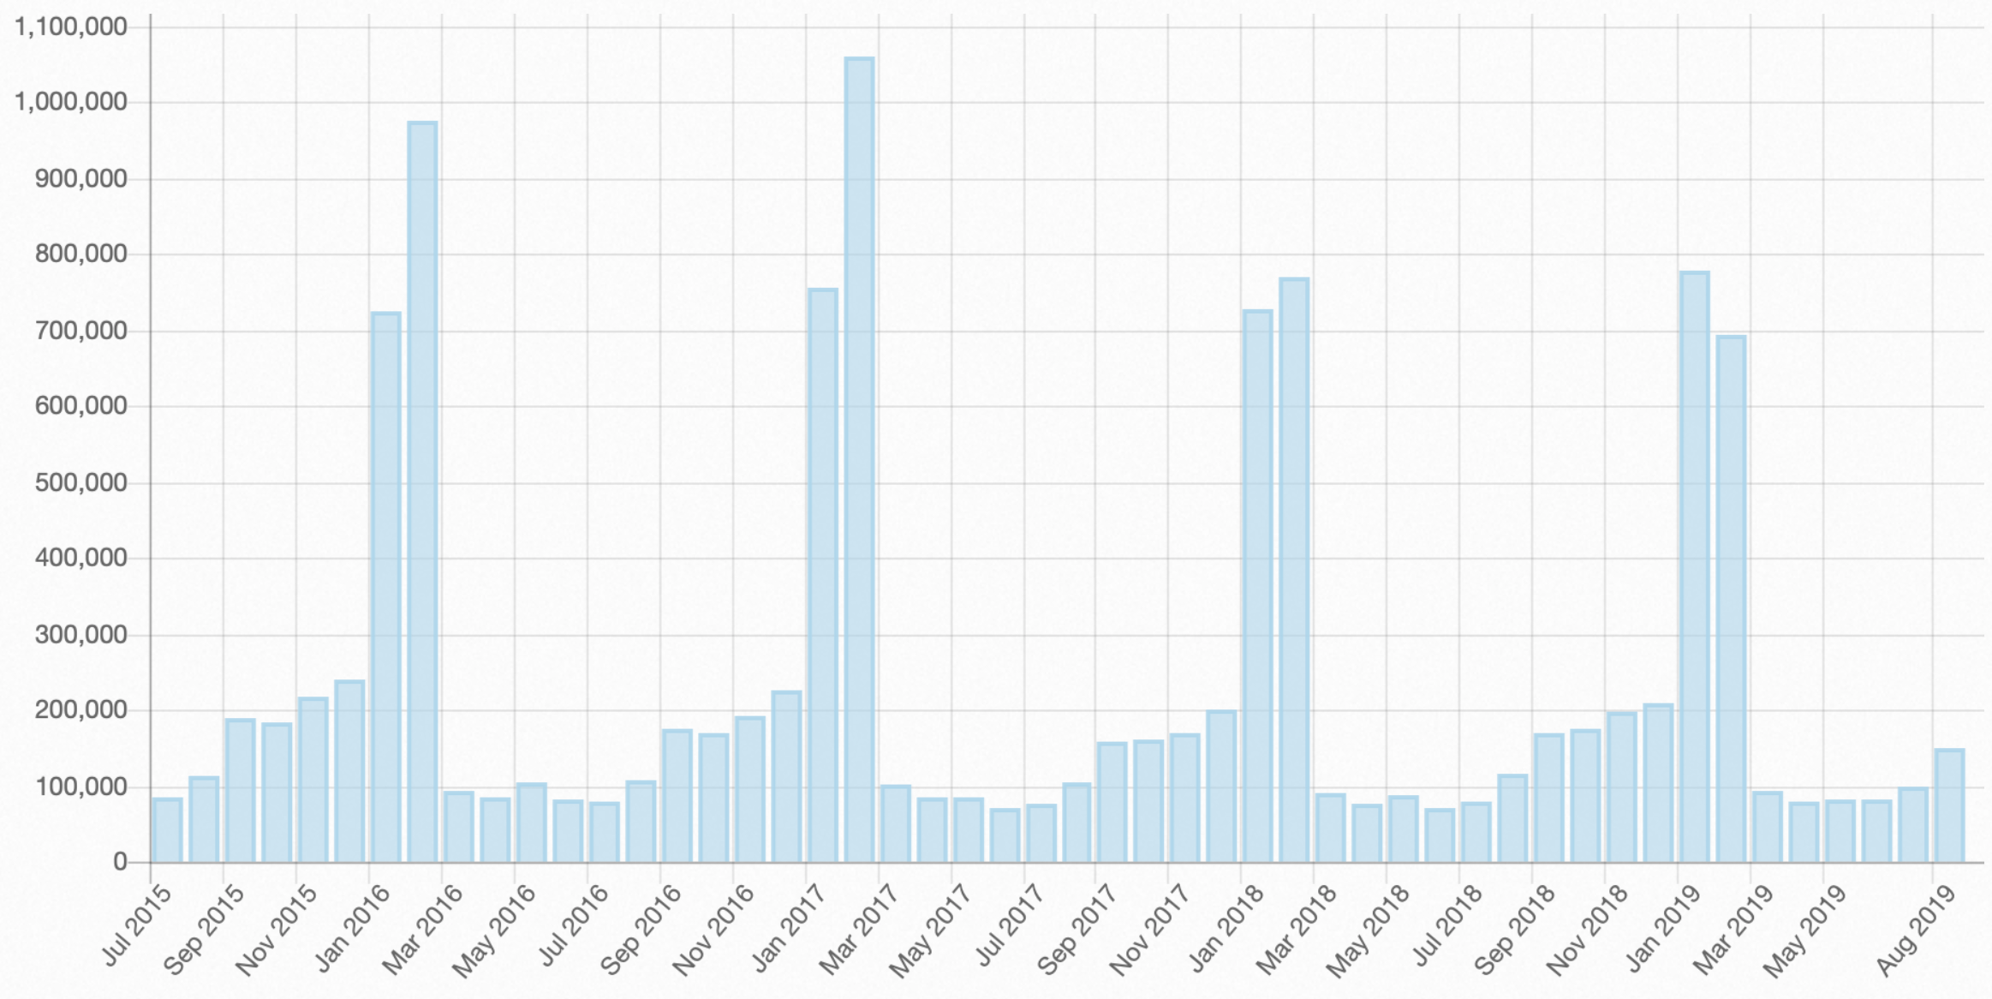
Temporal Knowledge Acquisition
Temporal and Schema Composition
Distinguish actual events from intentions, opinions, hypotheses, future events, etc.
Temporal relation discovery from videos and common sequential event relations in text. Use page view info from Wikipedia to discover periodicity.
The Super Bowl happens once every year in February
Page views
Time
Notes:
. Starting at each single frequent event (e.g., e1: SocialGathering in Figure 2), we will check all subsequent events following e1, finding among them the first frequently occurring event e2 (e.g., e2: Attack); then continue searching after e1e2 to find subsequent event e3 (e.g., e3 ArrestJailDetain). This method efficiently discovers frequent and/or ordered events of both long and short durations [131].
. It is possible to identify pageview spikes that occur after a newsworthy event by measuring trends in page views over a period of time across
300 languages. We define the monthly trend value tk of an article k as: tk = ∑15 dk − ∑30 dk t=1 i t=16 i
where dki is the daily page views i − 1 days ago for an article k.
We propose to utilize our large-scale dataset of visual atomic actions 1 to extract visual attributes and ground them into text event types to enrich reliable temporal and causal links in the complex schema. We aim to capitalize on ∼108 videos we crawled to extensively cover the space of unconstrained events.
Extract additional multimodal (e.g., video/audio) attributes based on our well developed powerful visual recognition for discovery of temporal and causal relations
The natural coherency of video enables us to objectively establish the temporal ordering of events
E.g., in videos the concept sound of explosion usually occurs before building on fire; the action police knock on door usually occurs before person arrested.
Temporal and Causal Schema Composition
Distinguish actual events from intentions, opinions, hypotheses, future events, etc.
Unsupervised temporal relation discovery that incorporates multimodal attributes
Mine frequent and discriminative sequential entity/event relations
Discover temporal/burst information from Wikipedia hourly page view statistics; use autocorrelation from signal processing to analyze page views as time series, and detect events which have an annual/multi-year cycle (e.g., Super Bowl championships, Olympics, and US presidential elections).
Extract additional multimodal (e.g., video/audio) attributes based on our well developed powerful visual recognition for discovery of temporal and causal relations
The natural coherency of video enables us to objectively establish the temporal ordering of events
E.g., in videos the concept sound of explosion usually occurs before building on fire; the action police knock on door usually occurs before person arrested.

Slide 56
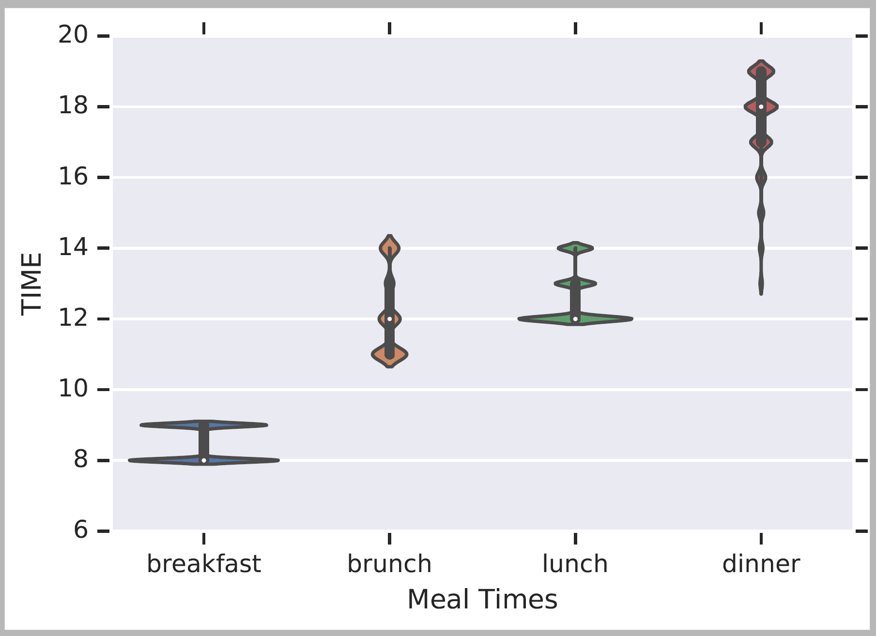
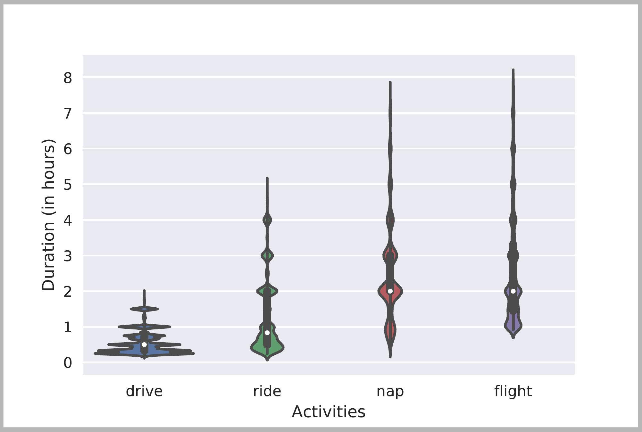
Many Forms of Common Sense [ACL’19, EMNLP’19]
Typical Time
Duration

Slide 57
Event distributions from TemProb
Notes:
We also plotted the distribution of events that usually precede or follow specific events, of course, in terms of time. Although we only have the verbs here, we can still get some intuitive answers.

Slide 58
Key takeaways
There is a transferability from event knowledge to commonsense knowledge
Compared with commonsense, acquiring event knowledge is cheaper and more scalable.
All existing acquisition systems have advantages and limitations.
 | Quality | Scale | Relation Coverage | Explainability | Robustness | Downstream Task
Human Annotation | High | Small | Middle | High | High | Difficult
Automatic Event Knowledge Extraction | Middle | Large | High | High | Middle | Difficult
Language Model | Middle | Large | High | Low | Low | Easy
Notes:
In the first part of this talk, I demonstrated that there is a transferability from event knowledge to commonsense knowledge. After that, I introduce those popular existing event knowledge acquisition approaches to show that compared with the commonsense, acquiring event knowledge is often cheaper and more scalable. Last but not least, there is no perfect acquisition system and we need to select the most suitable one based on our need.
That is all for the fourth section, thank you so much for the time.

Slide 59
Key References
WSC: Hector Levesque, Ernest Davis, and Leora Morgenstern. The winograd schema challenge. KRR 2012.
ConceptNet: Hugo Liu and Push Singh, ConceptNet - a practical commonsense reasoning tool-kit, BTTJ, 2004
ATOMIC: Maarten Sap, Ronan LeBras, Emily Allaway, Chandra Bhagavatula, Nicholas Lourie, Hannah Rashkin, Brendan Roof, Noah A. Smith, Yejin Choi, ATOMIC: An Atlas of Machine Commonsense for If-Then Reasoning. AAAI 2019
COMET: Antoine Bosselut, Hannah Rashkin, Maarten Sap, Chaitanya Malaviya, Asli Celikyilmaz, and Yejin Choi. COMET: commonsense transformers for automatic knowledge graph construction. ACL 2019.
LAMA: Fabio Petroni, Tim Rocktaschel, Se- ¨ bastian Riedel, Patrick Lewis, Anton Bakhtin, Yuxiang Wu, and Alexander H. Miller. Language models as knowledge bases? EMNLP 2019.
ASER: Hongming Zhang, Xin Liu, Haojie Pan, Yangqiu Song, and Cane Wing-Ki Leung. ASER: A Large-scale Eventuality Knowledge Graph. WWW 2020.
TransOMCS: Hongming Zhang, Daniel Khashabi, Yangqiu Song, and Dan Roth. TransOMCS: From Linguistic Graphs to Commonsense Knowledge. International Joint Conference on Artificial Intelligence (IJCAI). 2020.
KnowlyWood: Niket Tandon, Gerard de Melo, Abir De, and Gerhard Weikum. 2015. Knowlywood: Mining Activity Knowledge From Hollywood Narratives. CIKM 2015.
Manling Li, Qi Zeng, Kyunghyun Cho, Heng Ji, Jonathon May, Nathanael Chambers, Clare Voss. Connecting the Dots: Event Graph Schema Induction with Path Language Modeling. ACL 2020.
TacoLM: Ben Zhou, Qiang Ning, Daniel Khashabi, Dan Roth. Temporal Common Sense Acquisition with Minimal Supervision. ACL 2020
Notes:
Here are the key references.

Slide 60
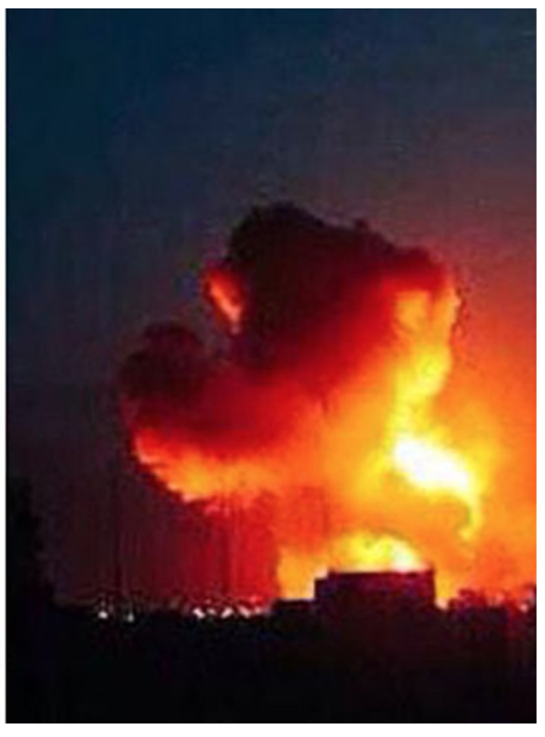
Event Extraction Challenges: Scene Understanding
Three Young Boys,ages 2, 5 and 10 survived and are in critical [injure] condition after spending in 18 hours in the cold.
This was the Italian ship that was taken -- that was captured [transfer-ownership] by Palestinian terrorists back in 1985 [die_time] and some may remember the story of Leon clinghover, he was in a cheal chair and the terrorists shot him and pushed him over the side of the ship into the Mediterranean [die_place] where he [die_victim] obviously, died.
Then police say the baby's mother pulled out a kitchen knife [die_instrument] opinion on the 911 tape you can hear Williams tape say "go ahead kill me."
Scenario = ISIS attack → Event = bombing instead of concert
60
Notes:
Two most popular previous event representations
Inheritance is a way to describe the roadmap of event hierarchy; the property of the child is inherited from its parent
60

Slide 61
Long-Tail Triggers and Arguments
Rare Triggers
his men back to their compound
A suicide bomber detonated explosives at the entrance to a crowded
medical teams carting away dozens of wounded victims
Today I was let go from my job after working there for 4 1/2 years.
This morning in Michigan, a second straight night and into this morning, hundreds of people have been rioting in Benton harbor.
Rare Arguments
We've seen in the past in Bosnia for example, you held elections and all of the old ethnic thugs [election_person] get into power because they have organization and they have money and they stop the process of genuine building of democracy.
He called the case and I'm quoting now, a judge's worst nightmare, but he noted that Maryland Parole Boards and the facility where Michael Serious was held, the institution made what the judge called the final decision on whether to release serious [release-parole_person].
Last week Williamson, a mother of four, was found stabbed to death at a condominium [die_place] in Greenbelt, Maryland.
A source tell US Enron is considering suing its own investment bankers for giving it bad financial advice [Sue_crime].

Slide 62
Highly Ambiguous Triggers
Ellison to spend $10.3 billion to get [org-acquisition] his company.
I want to take [transport] this opportunity to stand behind the Mimi and proclaim my solidarity.
He's left [transport] a lot on the table.
Stewart has found the road to fortune wherever she has traveled [transport].
And it's hard to win back that sort of brand equity that she's lost [end-position].
Still hurts [attack] me to read this.
We happen to be at a very nice spot by the beach where this is a chance for people to get [transport] away from CNN coverage, everything, and kind of relax.
He bought the machinery, moved [transport] to a new factory, rehired some of the old workers and started heritage programs.

Slide 63
Event Coreference Resolution Challenges
Super-event and subevent are often mistakenly identified as coreferential
These same imposters were later filmed shooting handguns and automatic weapons in the direction of the building just minutes after they had switched sides .
Right sector goons started the fire by throwing Molotov cocktails through the windows
A sequence of subevents are often mistakenly considered as coreferential
Nor does the author speculate on why the police stood by while people hurled themselves from windows to escape the fire or were savagely beaten by right wing extremists on the pavement in front of the building .
Its true that Washington supports Neo-Nazi extremists who burned down the Odessa Trade Unions House .
Notes:
Sophisticated knowledge graph curation interface provides feedback to schema induction via active reinforcement learning and crowdsourcing
Incorporating schema-guided global constraints into learning deep models for and event prediction

Slide 64
Remaining Challenges for Multimedia Extraction: wrong localization

Slide 65
Remaining Challenges for Multimedia Extraction: too many instances

Slide 66
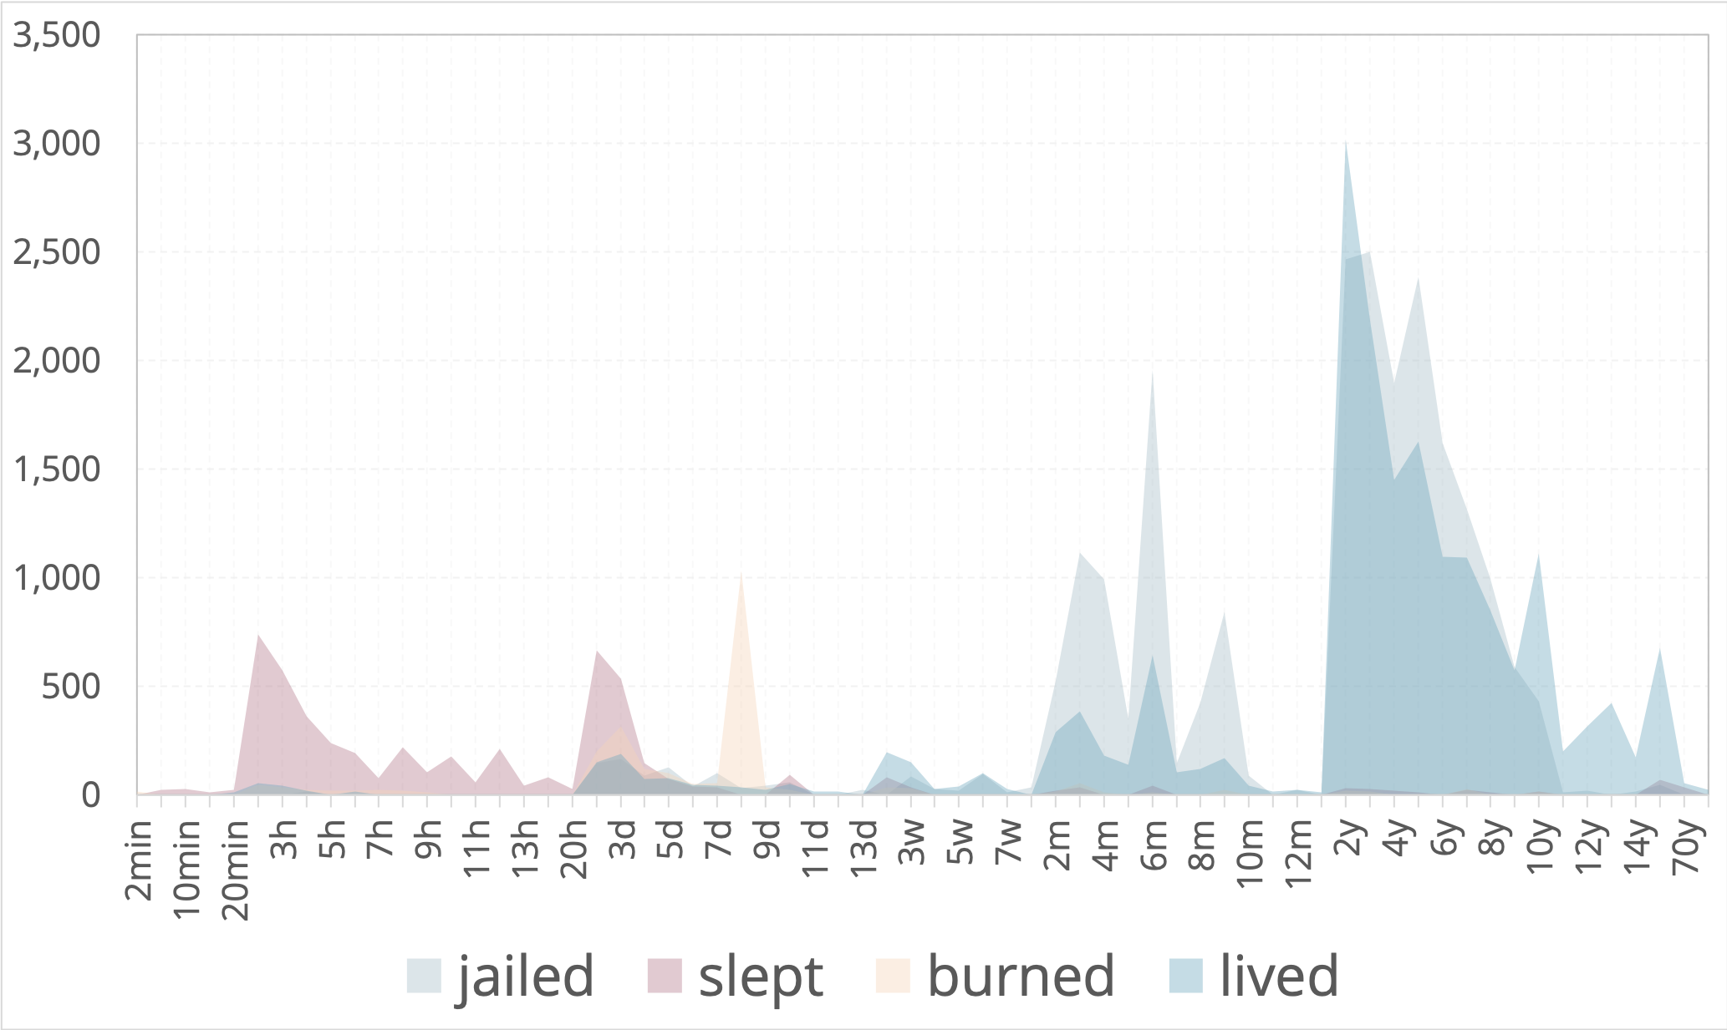
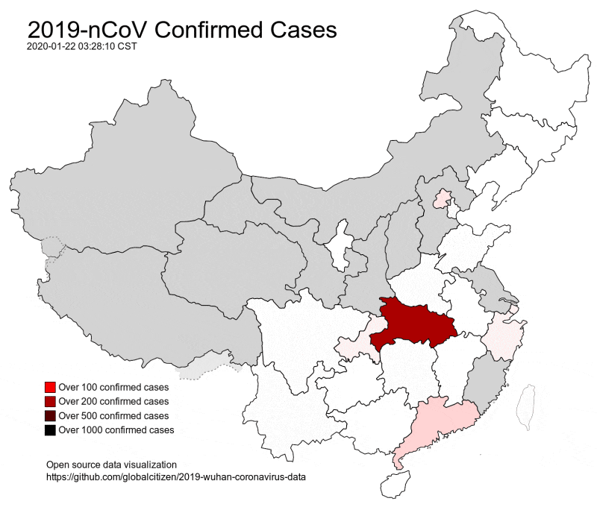
Future Direction 1: Knowledge Acquisition and Reasoning
Discover from Google N-grams using lexical patterns
Verb + for + Time / Spent + Time + Verb-ing
Discover from Wikipedia event infoboxes and categories
Event Spatial Evolution Pattern
lived
jailed
slept
burned
2017
2019
2020
2014
2016
2015
2018

Slide 67
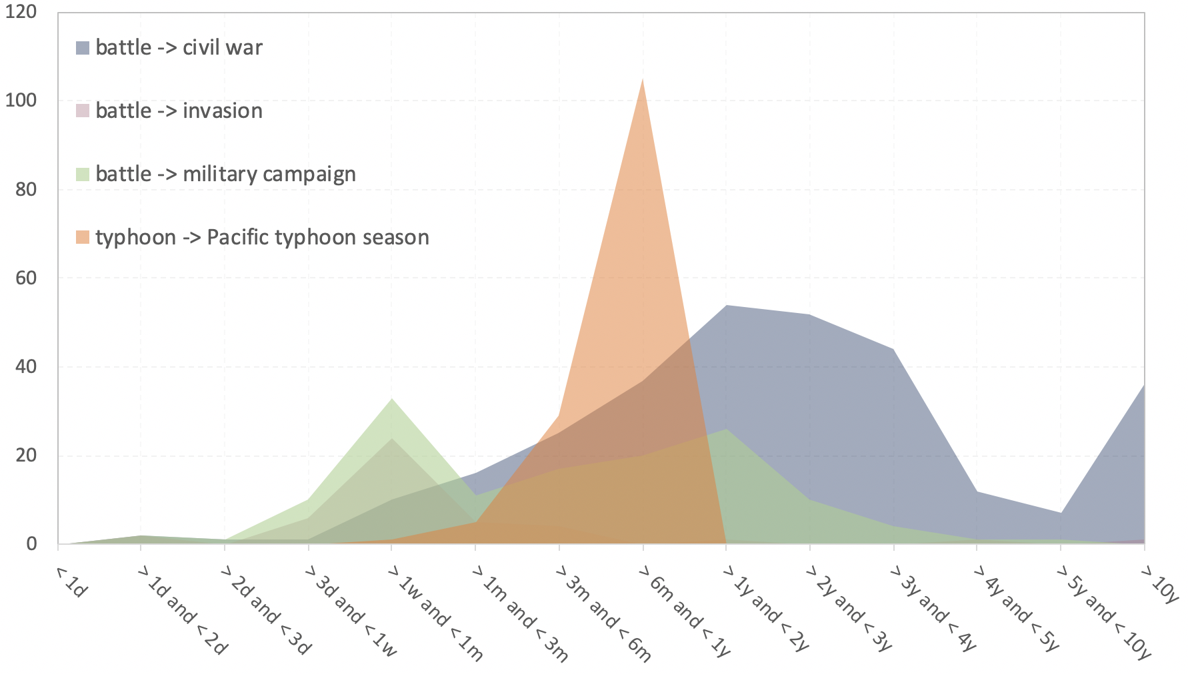
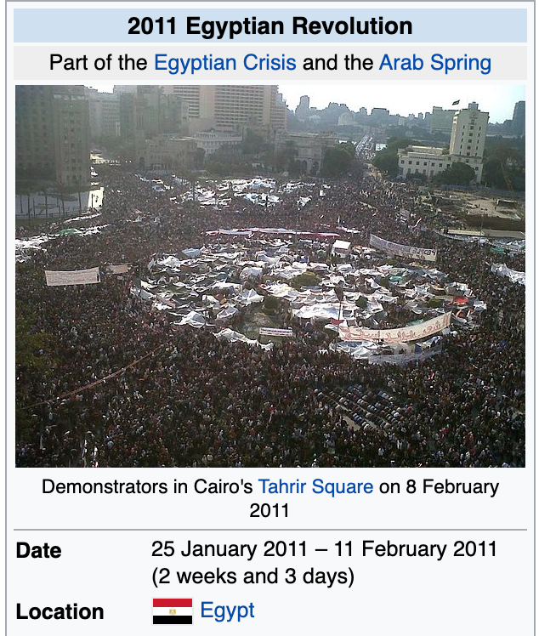
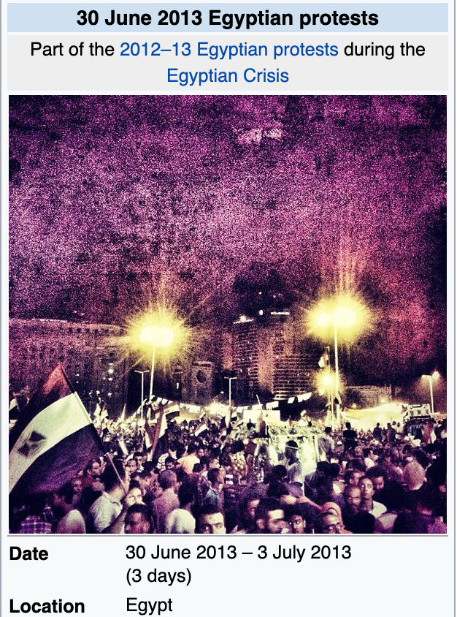
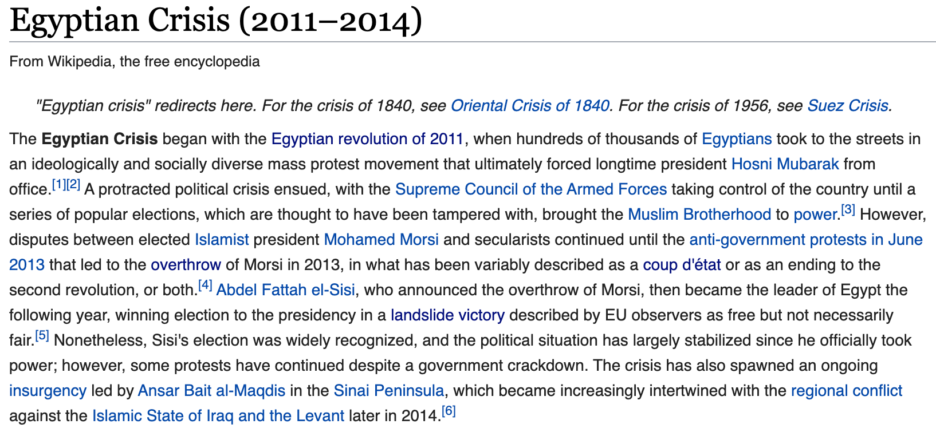
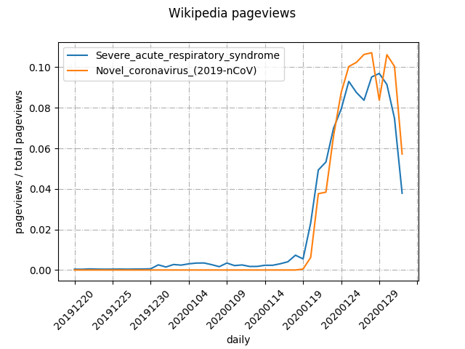
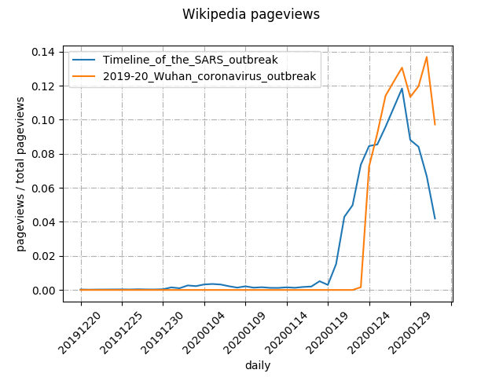
Future Direction 1: Knowledge Acquisition and Reasoning
Exploit Wikipedia/Wikidata
layout, category (event type), part of relation, has cause, has immediate cause, has contributing factor, has effect, immediate cause of, start/end time
Cross-event Time Gap Pattern Discovery
battle → civil war
Mining external links in Wikipedia articles and edit history; measuring the similarity of two temporal histograms
battle → invasion
battle → military campaign
typhoon → Pacific typhoon season
Hierarchical/Causal Composition
Wikipedia Pageview Co-burst

