Slide 1
Overview & Intro
Heng Ji
(UIUC CS Professor & Amazon Scholar)
hengji@illinois.edu

Slide 2
About me and my lab
  http://blender.cs.illinois.edu/hengji.html
  http://blender.cs.illinois.edu/
  We are a bunch of passionate and fun people working on challenging NLP problems, including information extraction and natural language generation
  In my 20% extra time, I’m an Amazon Scholar to make Alexa smarter
  I’m a feminist.
  I'm hiring! UIUC side: research faculty members, research scientists, post-docs, PhD/master/undergraduate RAs, summer interns, visitors, program managers and software engineers. Amazon side: research scientists, software engineers and interns.
Notes:
Nowadays, the practice of journalism often distributes news content via multimedia.

Slide 3
About you
  Quiz time! Your research background
  Please speak up, show up, and meet me during office hours
  Write your fun facts in chat
Notes:
Nowadays, the practice of journalism often distributes news content via multimedia.

Slide 4
About this course
  https://blender.cs.illinois.edu/course/fall21/anlp.html
  Google drive folder
Notes:
Nowadays, the practice of journalism often distributes news content via multimedia.

Slide 5
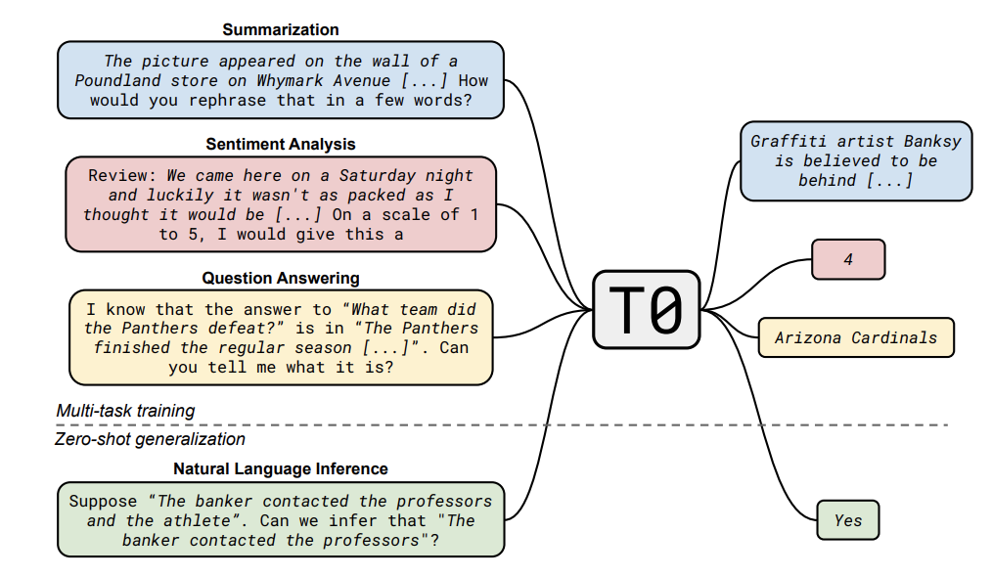
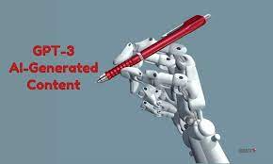
A Boast of Today’s Flat NLP World
The unified text generation paradigm is taking over the NLP world, with flat sequences and implicit representations
Huge successes on zero-shot sequence prediction tasks (e.g., multitask prompted training on 12 tasks and 60 datasets [Sanh et al., ICLR2022])
Some successes on structured prediction tasks too, such as information extraction →
Key to success: do smart prompt engineering to elicit knowledge from LMs
5

Slide 6
A Successful History and Promising Future of Information Extraction
 |  | 2012 | 2022 | 2042 (Projected Goal)
Portability | # Languages | 1-3 | 300 for entity and event detection | 6000 for entity and event detection
 | # Entity types | 5 | 16,000 | 16,000 for 6000 languages
 | # Relation types | 41 | 2,000 for English | 2,000 for 300 languages
 | # Event types | 33 | 1,000 for English | 1,000 for 300 languages
Quality F-score (no manual annotations) |  | 0% | Up to 76% F-score for low-resource name tagging | 100% for English, 90+% for other languages
Development Time |  | Half a year for anyone with a laptop | A few months for a handful of groups with computing resources | A few hours for anyone with a smart phone
Cost |  | Supervised models based on 500 fully annotated documents | No annotation for new language/domain | No or few annotations for any language, domain or modality

Slide 7
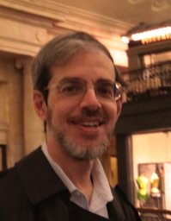

We are Getting Lazier
It’s not the first time that we are modifying our task (nail) for
the method (hammer), shouldn’t it be the other way around?
1996: Pattern based Corpus-level IE [Grishman and Sundheim, 1996]
2004: Maximum Entropy based Sentence-level IE [Florian et al., 2004]
2016: Bi-LSTM based Sentence-level IE [Lample et al., 2016]
2020: BERT based Sentence-level IE [Lin et al., 2020]
2021: Text generation based Document-level IE [Li et al., 2021]
2022 and Beyond: Text generation based Corpus-level IE?
Key to success: describe the task in natural language, ask LM to generate the information we are looking for
7

Slide 8
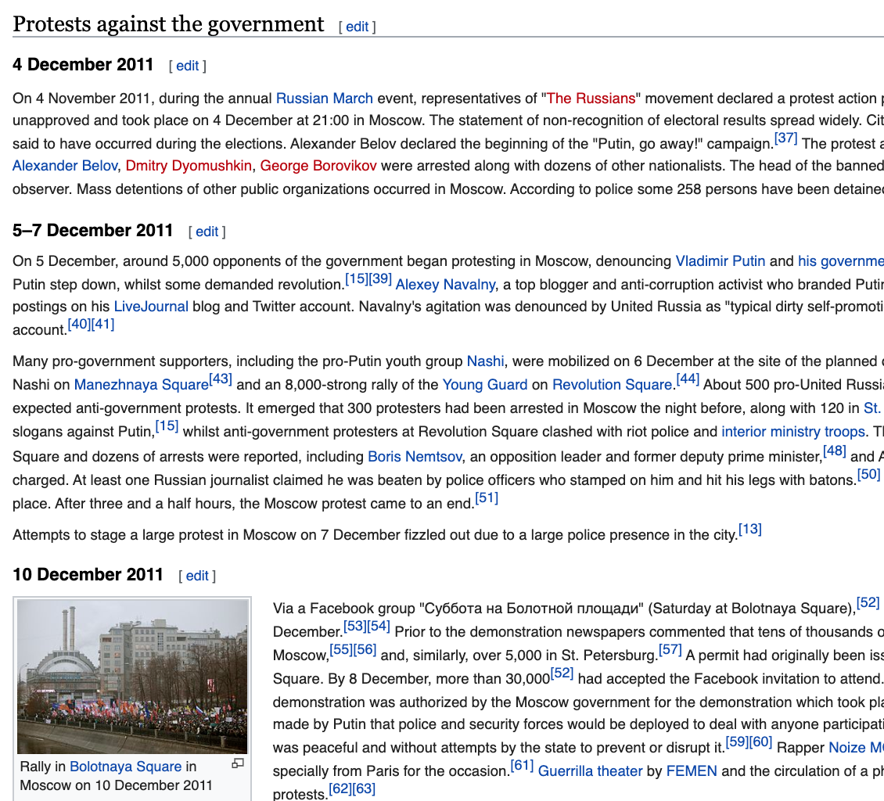
NLP Application 1: Writing a History Book
Organize chapters by major events clusters
and order them on a timeline
Each chapter looks like a Wikipedia page
  The description is organized by multimedia timeline
  with detailed source and evidence information,
  links to original news articles
  Detailed participants (arguments) and their roles, and their connections and relations
  Infobox shows event-event relations: temporal,
  causal and hierarchical
Never-ending updating over time; put up to the wild for human editing and curation
8
Notes:
Change low resource IL to a language which is not in wikipedia
Word-level: from bi-lingual dicts and alignment; structure-level comes from wals; multi-level alignment

Slide 9
Example Chapter: 2019 Hong Kong Protests

Slide 10
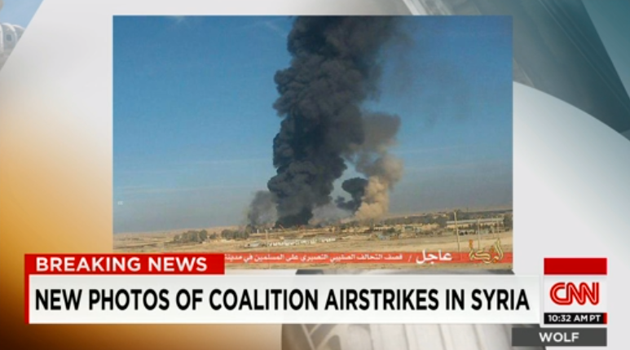


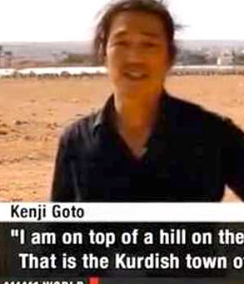
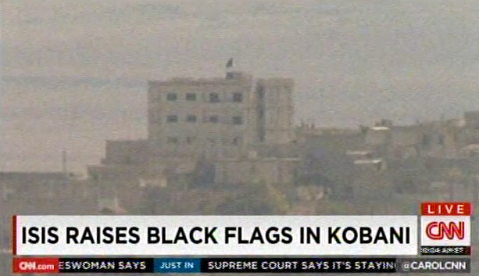
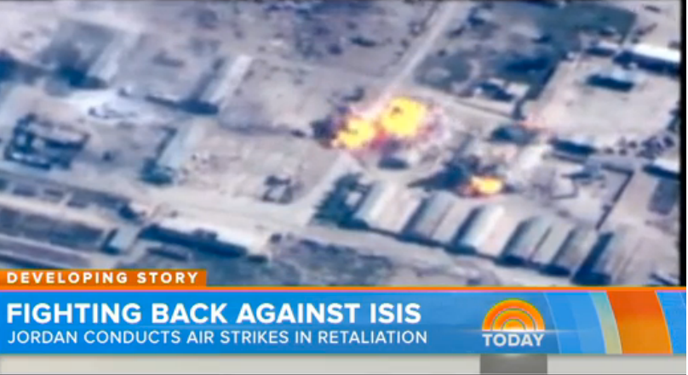
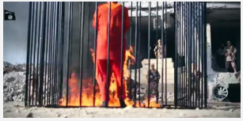
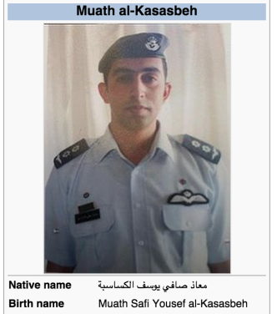
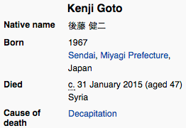
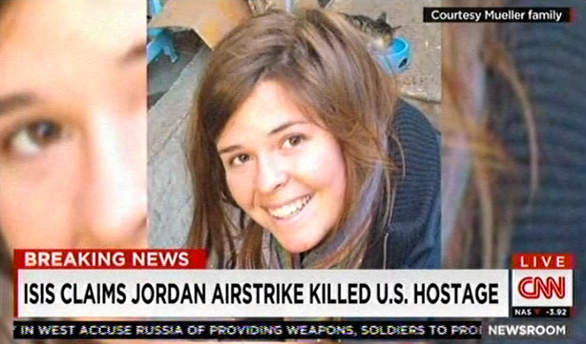
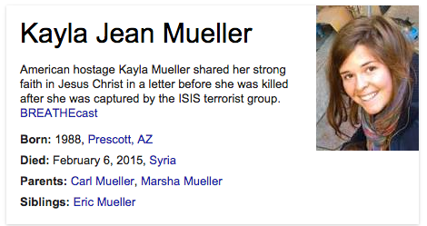
Example Chapter: ISIS attacks
ISIS Activity
Attack Events Against ISIS
ISIS Hostage Events
Attacker: ISIS Target: Kobani
Instrument: tanks and artillery
Agent: Jordan Target: ISIS
Instrument: bomber
Place: Raqqa
Attacker: ISIS Victim: pilot
Cause: burnt alive
Victim: Goto Place: Syria
?
Legend:
Event
Subevent
Temporal
Causality
Ext. KB
Oct 2014
Feb 2015
U.S. Hostage died in airstrike
Notes:
More ambitious problems: Deep scene
understanding, fine-grained extraction
Flick photos+tags → No; News videos → Yes
(RPI + Columbia, in submission)
TEXT
Source: closed captions, ASR, news, Web, and social media
Information:
entities, attributes, relations, events and their arguments, links to KB
VIDEO
Source: channels, youtube, social media
Information:
OCR text showing breaking news event and other captions
Visual recognition and attributes, e.g., scene/object/event
Concept recognition from images (e.g., building, bombing, crowd, tanks, etc)
News reporting time and sources (e.g., CNN 16:00pm EST)
Named speakers, linked to KB
Most people who read the Jan 28th news and watch the Feb 3rd video will think that the pilot died as early as Jan 28th, however, the NYT later release a different message:
"On Tuesday, Jordanian officials said they learned that the pilot had actually been killed on Jan. 3, suggesting that their caution had been justifiable.”
Speech-> asr, closed
entities linked across documents, link to KB
how the information (e.g., temporal) from video can correct / enrich the results from texts
caption, title, keyframes, images.

Slide 11
Example Chapter: COVID19 Pandemic

Slide 12
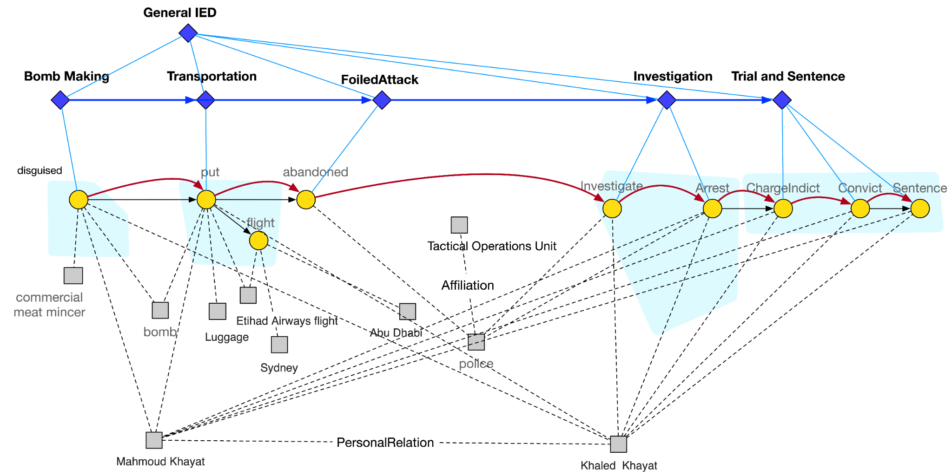
Tracking attackers Mahmoud Khayat and Khaled Khayat:
Example Chapter: Entity State Tracking
Timestep | 1 | 2 | 3 | 4 | 5 | 6 | 7
Event | disguise | put | abandon | investigate | arrest | charge | convict | sentence
Location | Sydney

Slide 13
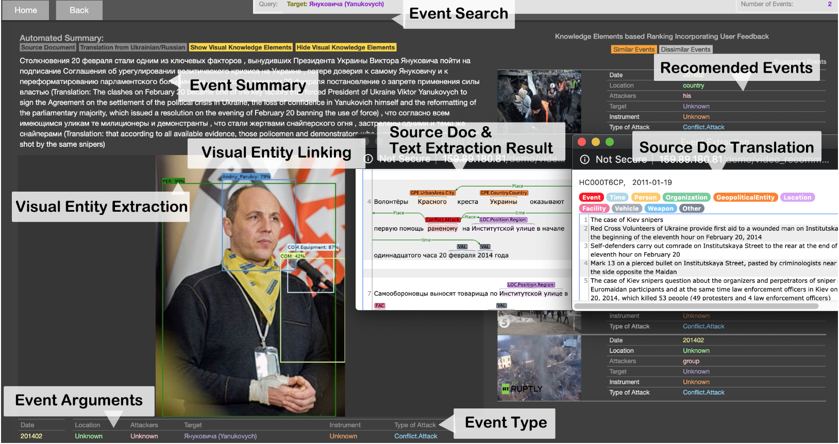
Application 2: News Understanding and Recommendation
(Li et al., ACL2020Demo)
(Li et al., ACL2020 Best Demo Paper Award)
GitHub: https://github.com/GAIA-IE/gaia
DockerHub: https://hub.docker.com/orgs/blendernlp/repositories
Demo: http://159.89.180.81/demo/video_recommendation/index_attack_dark.html

Slide 14
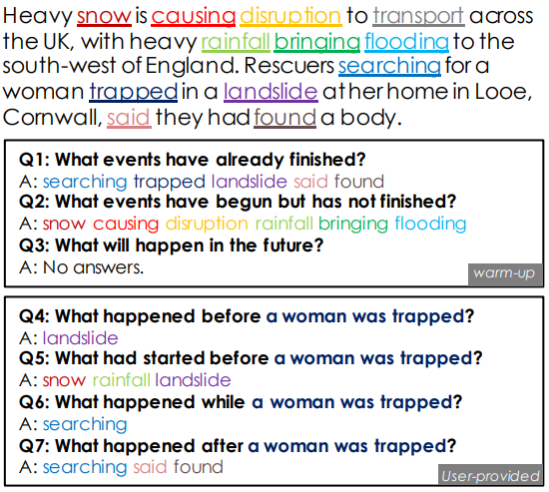
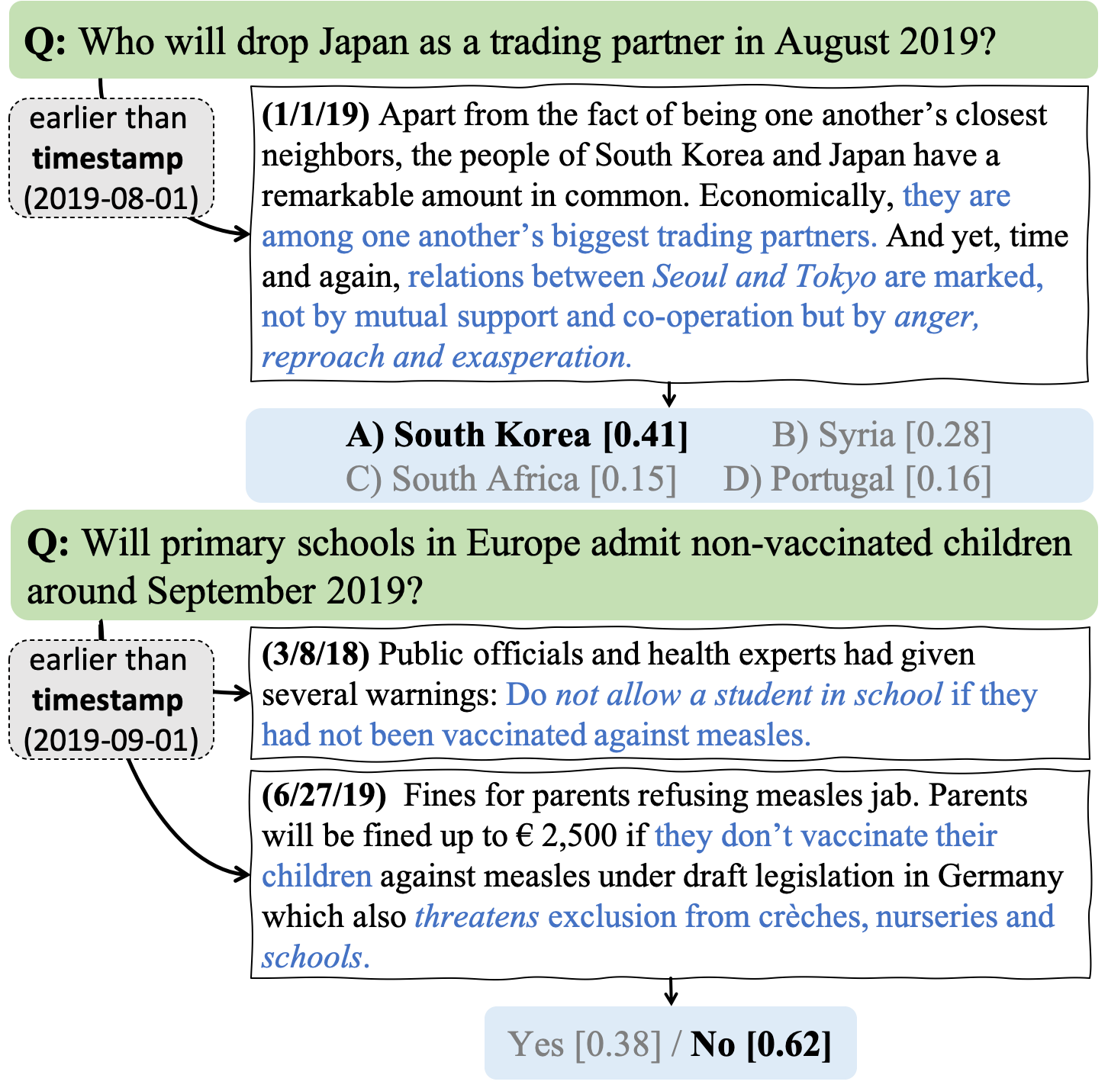
Event-centric Question Answering
Identifying event orders and predicting future events
Ning, et al. TORQUE: A Reading Comprehension Dataset of Temporal Ordering Questions. EMNLP, 2020
3.2k news snippets with 21k human-generated questions querying temporal relationships
ForecastQA: A Question Answering Challenge for Event Forecasting
Notes:
Constructing unified, structured knowledge networks by integrating text, social media and multi-genre networks with low cost, high quality and wide coverage
Combining distributional semantics and symbolic semantics through zero-shot transfer learning to construct multi-genre knowledge networks on the fly

Slide 15
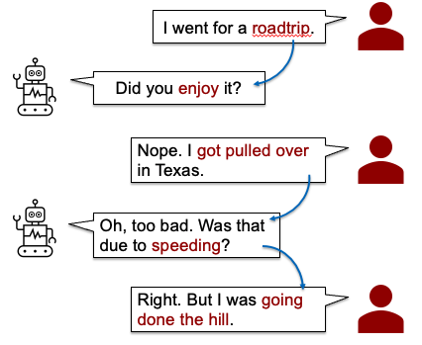
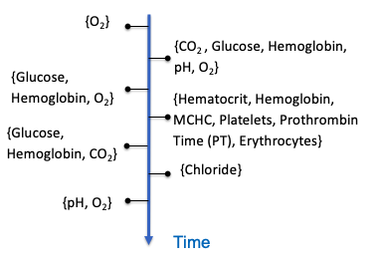
Event-centric Dialogue Systems
Chatbots
Clinical event processes
Diagnostic prediction, phenotype prediction, …
Transfer learning can important (naturally lack of data)
Structured prediction can be important (dependency of phenotypes, disease labels)
Can event processes improve the consistency of utterance generation/retrieval?
Notes:
Constructing unified, structured knowledge networks by integrating text, social media and multi-genre networks with low cost, high quality and wide coverage
Combining distributional semantics and symbolic semantics through zero-shot transfer learning to construct multi-genre knowledge networks on the fly

Slide 16
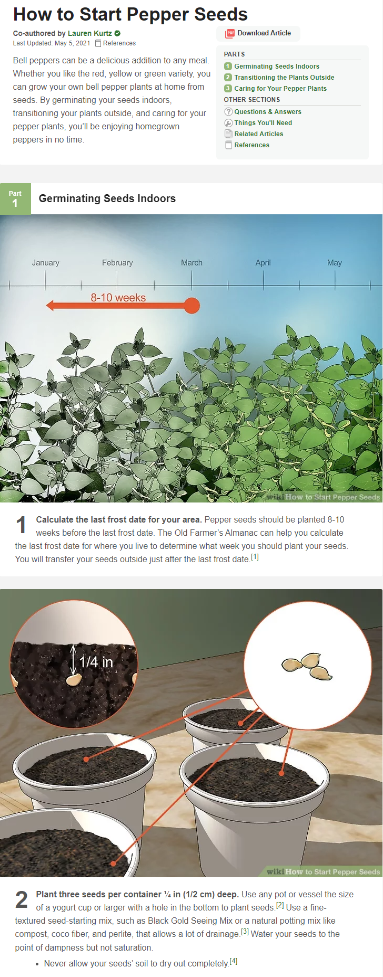
Event-centric Dialogue Systems: Gardening Alexa
Step Prediction
Given a task title and the previous step gist, automatically generate the next step gist
Explanation Generation
  Given a task title and the previous step gist, automatically generate the next step gist (detailed instructions in natural language and illustrative images)
Our approach is highly generalizable and capable of predicting procedures for unseen tasks or concepts
Subtitle
Step Gist
Step Explanation
Step Gist
Notes:
Each WikiHow article describes a particular task, which is composed of a number of steps.
Each step is represented by a gist and an explanation.
Tnhe gist is a brief and concise summary of the step, such as “purchase packing supplies”. The corresponding explanation gives additional contexts and details to the gist.
We propose 2 tasks: step Prediction and Explanation generation. When predicting the next step, the system is given a task title and the previous step. We also want to generate detailed instructions in natural language and illustrative images for each step given a task title and the previous step. Our approach is highly generalizable and capable of predicting procedures for unseen tasks or concepts

Slide 17
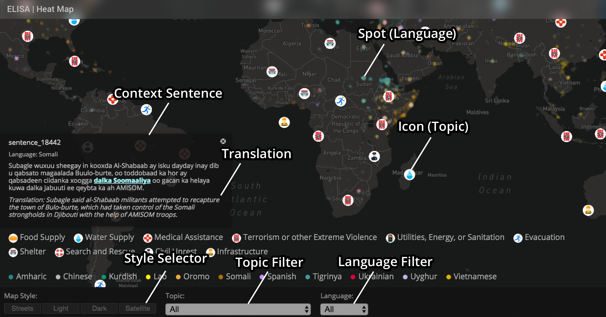
Applications 3: Disaster Relief (Zhang et al., NAACL18Demo)
Re-trainable Systems: http://159.89.180.81:3300/elisa_ie/api
Demos: http://159.89.180.81:3300/elisa_ie
Heat map: http://159.89.180.81:8080/
Notes:
deployed

Slide 18
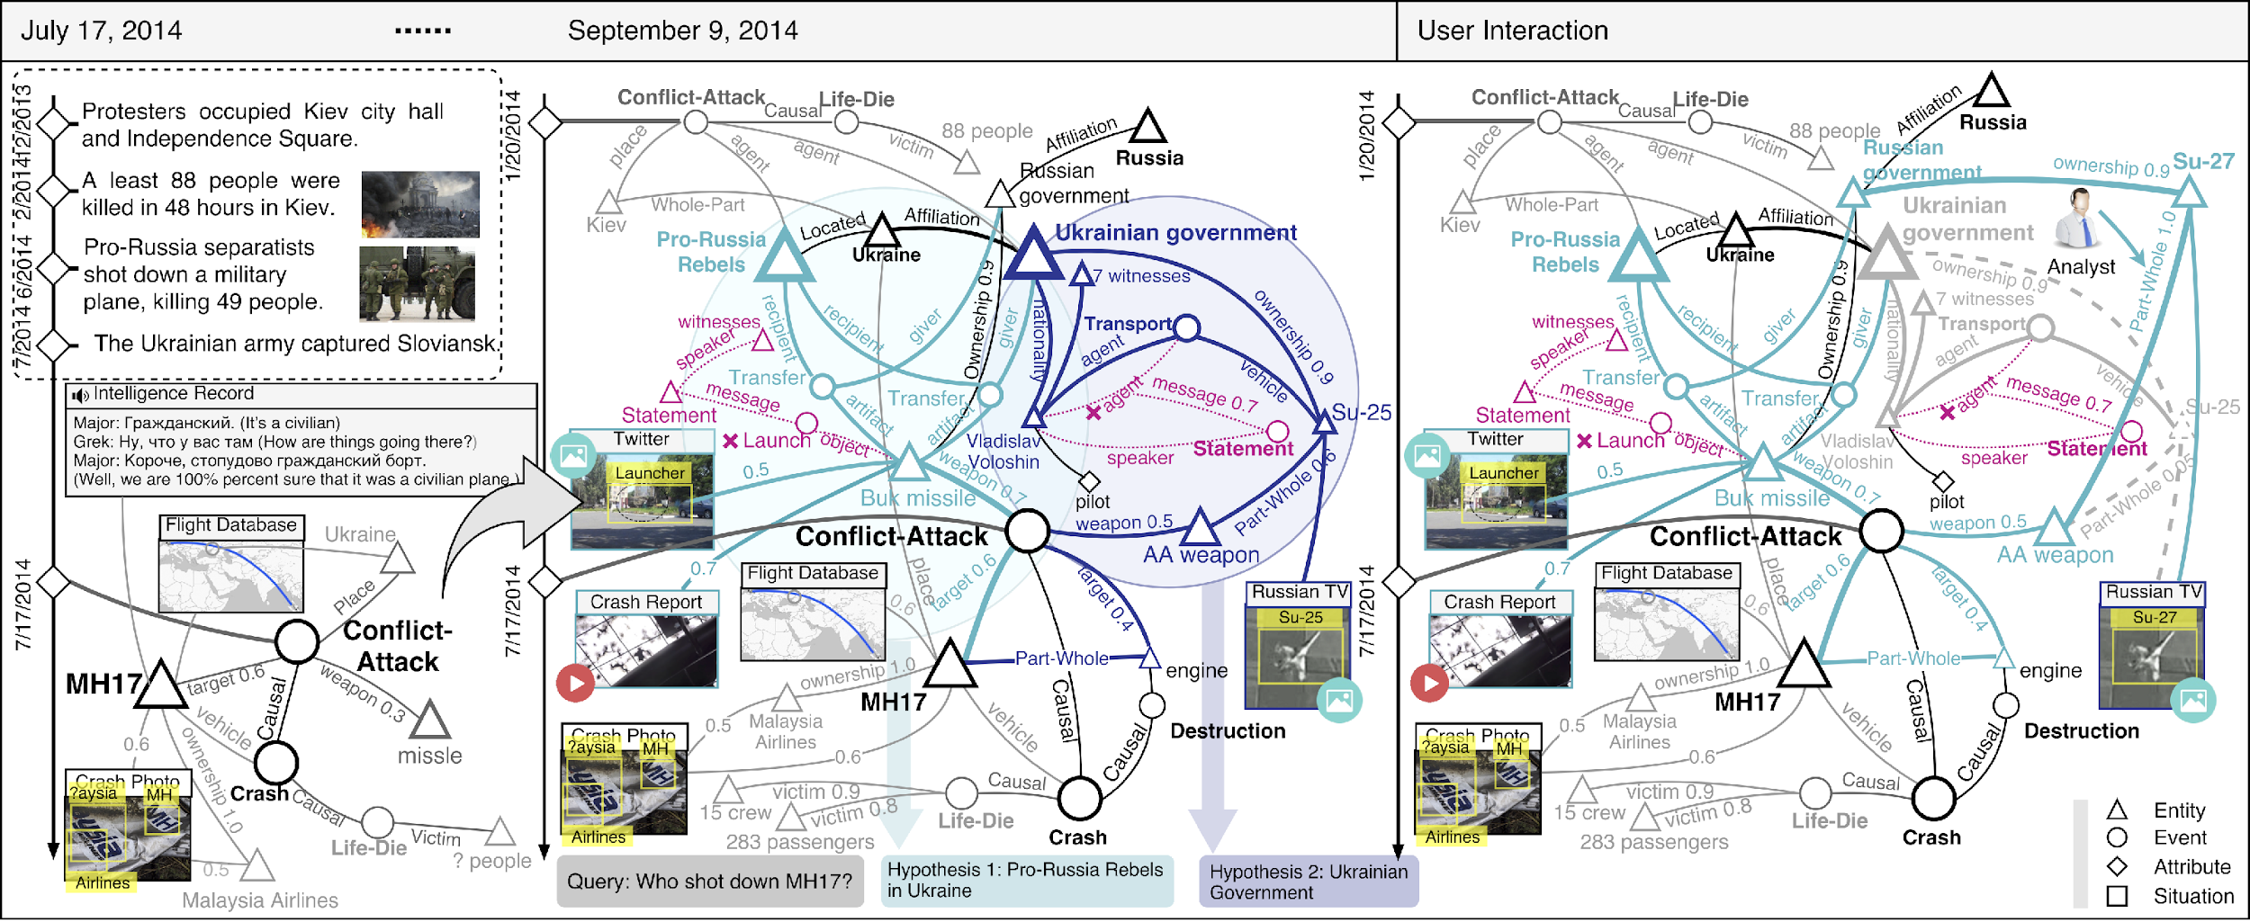
Applications 4: Intelligence Analysis

Slide 19
Applications 4: Intelligence Analysis
http://162.243.120.148:8080/
Achievement, Benevolence, Conformity, Hedonism, Power, Security, Self-direction, Simulation, Tradition and Universalism (Schwartz, 2012)

Slide 20
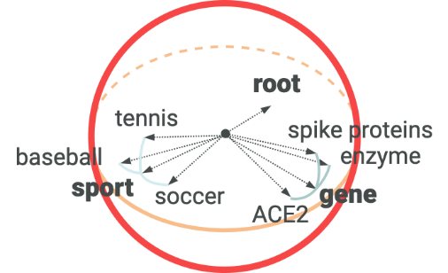
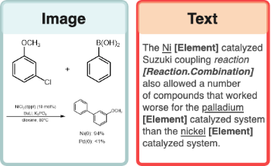
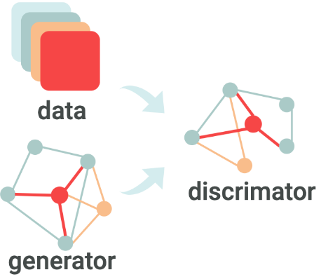
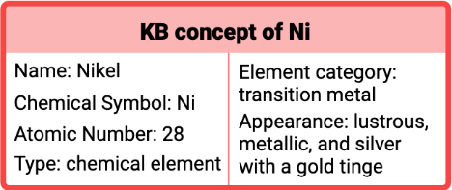

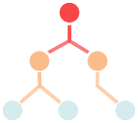
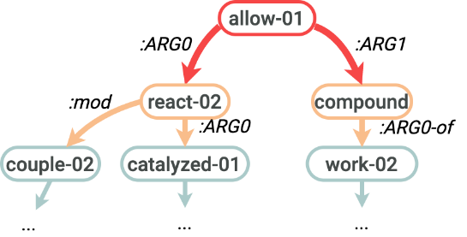

Application 5: Accelerating Scientific Discovery
DATA
SEMANTICS
KNOWLEDGE BASE
NeurIPS’19, WWW’20, KDD’20, ACL’20
NAACL’19, EMNLP’19, ACL’19, ACL’20
AAAI’19, ACL’20
Graph neural networks
Joint entity/relation/event extraction and ontology construction
Hierarchical Spherical Embedding
Scientific Literature
Multimedia Knowledge Base
Ontology Enriched Text Embedding
Generative Adversarial Networks for Data Augmentation and Distant Supervision
Chemical Ontology & Existing Databases
Cross-media Structured Semantic Representation
Multimedia Search and Summarization
Extending to other scientific domains including Molecular Synthesis and Agriculture under two new NSF institutes
Notes:
Distant supervision to acquire annotations by multi-instance multi-label learning
Apply Generative Adversarial Networks for data augmentation: regard positive samples generated by the generator as negative samples to train the discriminator
General framework: Transform massive chemistry literature into a structured knowledge base (KB) for link prediction, hypothesis ranking, search, summarization on any theme/term, enable accelerating knowledge-based scientific discovery
Technical innovation 1. New distantly supervised, refined fine-grained extraction and typing to help KB construction
Technical innovation 2: Chemical graph parsing and image analysis to enable multi-media common semantic space construction and new hierarchical embedding for graph neural networks based knowledge extraction and entity resolution [NAACL’19, EMNLP’19; ACL’19; ACL’20]
Technical innovation 3: Domain-specific ontology and database guided knowledge enrichment for joint neural end-to-end entity/relation/event extraction (Lin et al., ACL’20; success in COVID’19 KB construction, 500+ downloads: http://blender.cs.illinois.edu/covid19/)
Technical innovation 4: Weakly-supervised automated taxonomy construction, and taxonomy-guided, theme-based multidimensional document classification and text summarization
(WeSHClass [AAAI’19] and EvidenceMiner [ACL’20]
(success in COVID’19 analysis)

Slide 21
Fine-grained COVID-19 Event Extraction
Joint neural Information Extraction model is proven successful for news domain (Lin et al., ACL2020)

Slide 22
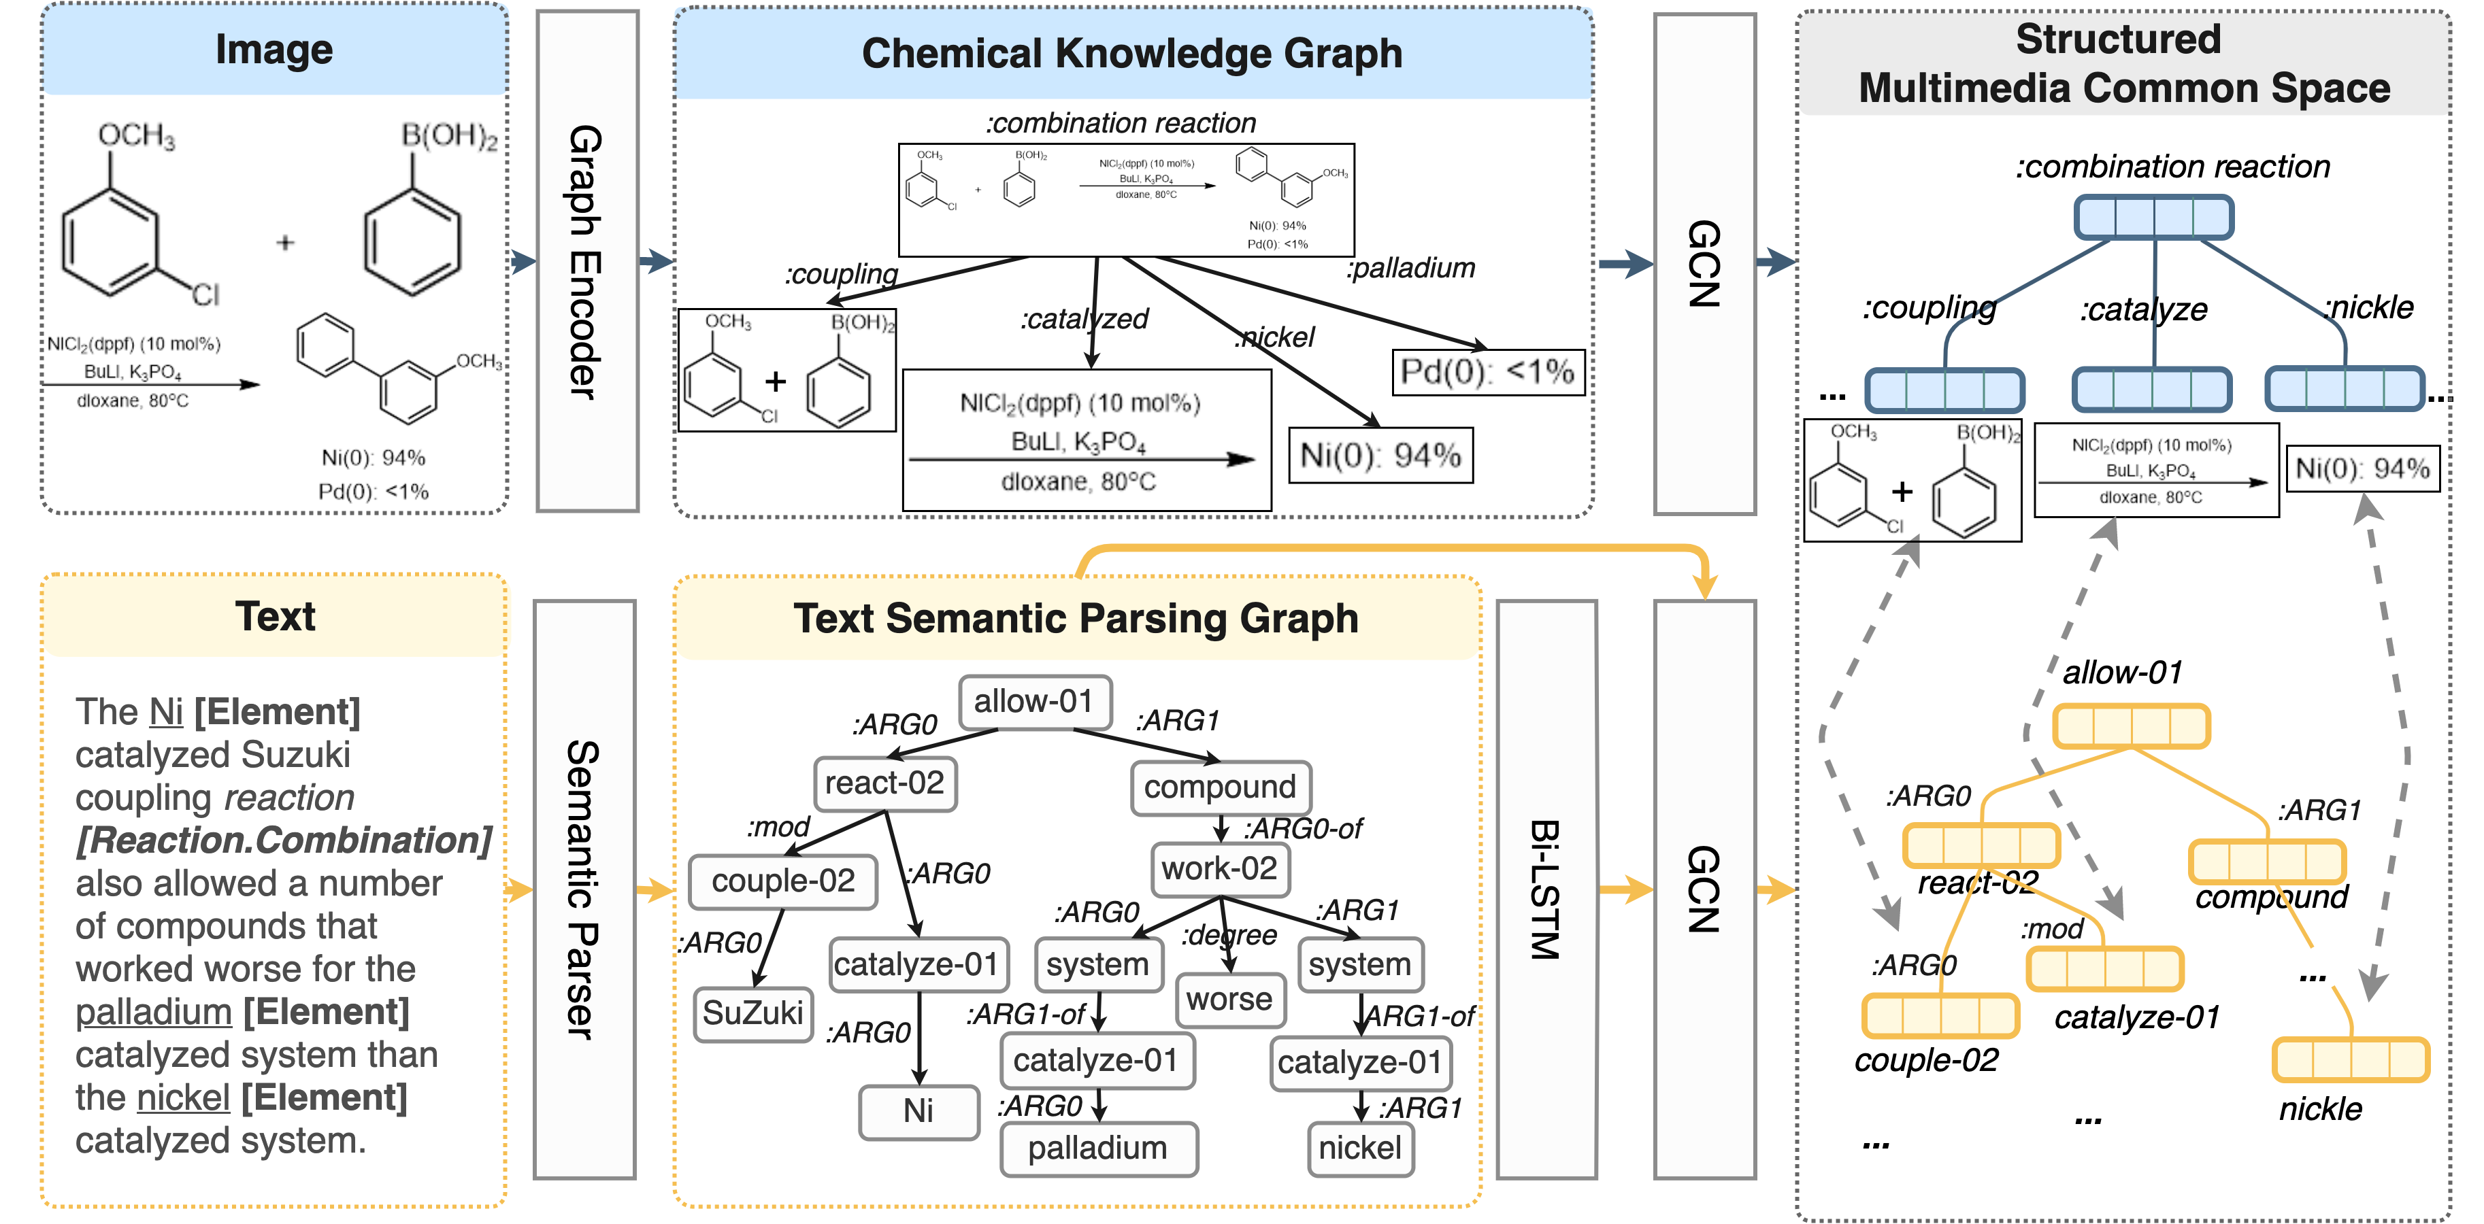
Fine-grained COVID-19 Event Extraction
Multimedia Common Semantic Space Construction is proven successful for news domain (Li et al., ACL2020)

Slide 23
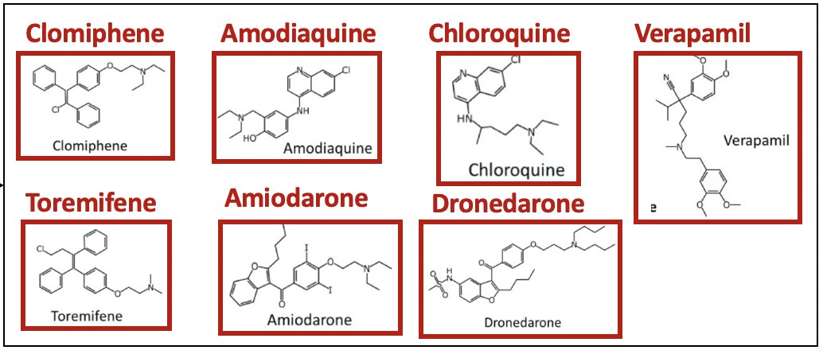
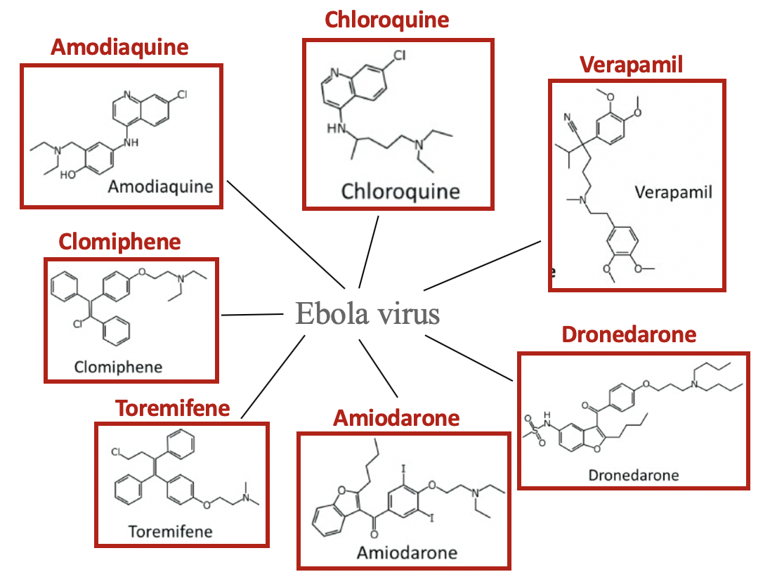
Multimedia Knowledge Graph Construction for Drug Repurposing
Entity Grounding for Drug Molecular Structure Image
Figure 1.
FDA approved drugs of most interest for repurposing as potential Ebola virus treatments.
KG from caption text
FDA
approve
Multimedia Knowledge Graph Expansion
repurpose
Drugs
Ebola

Slide 24
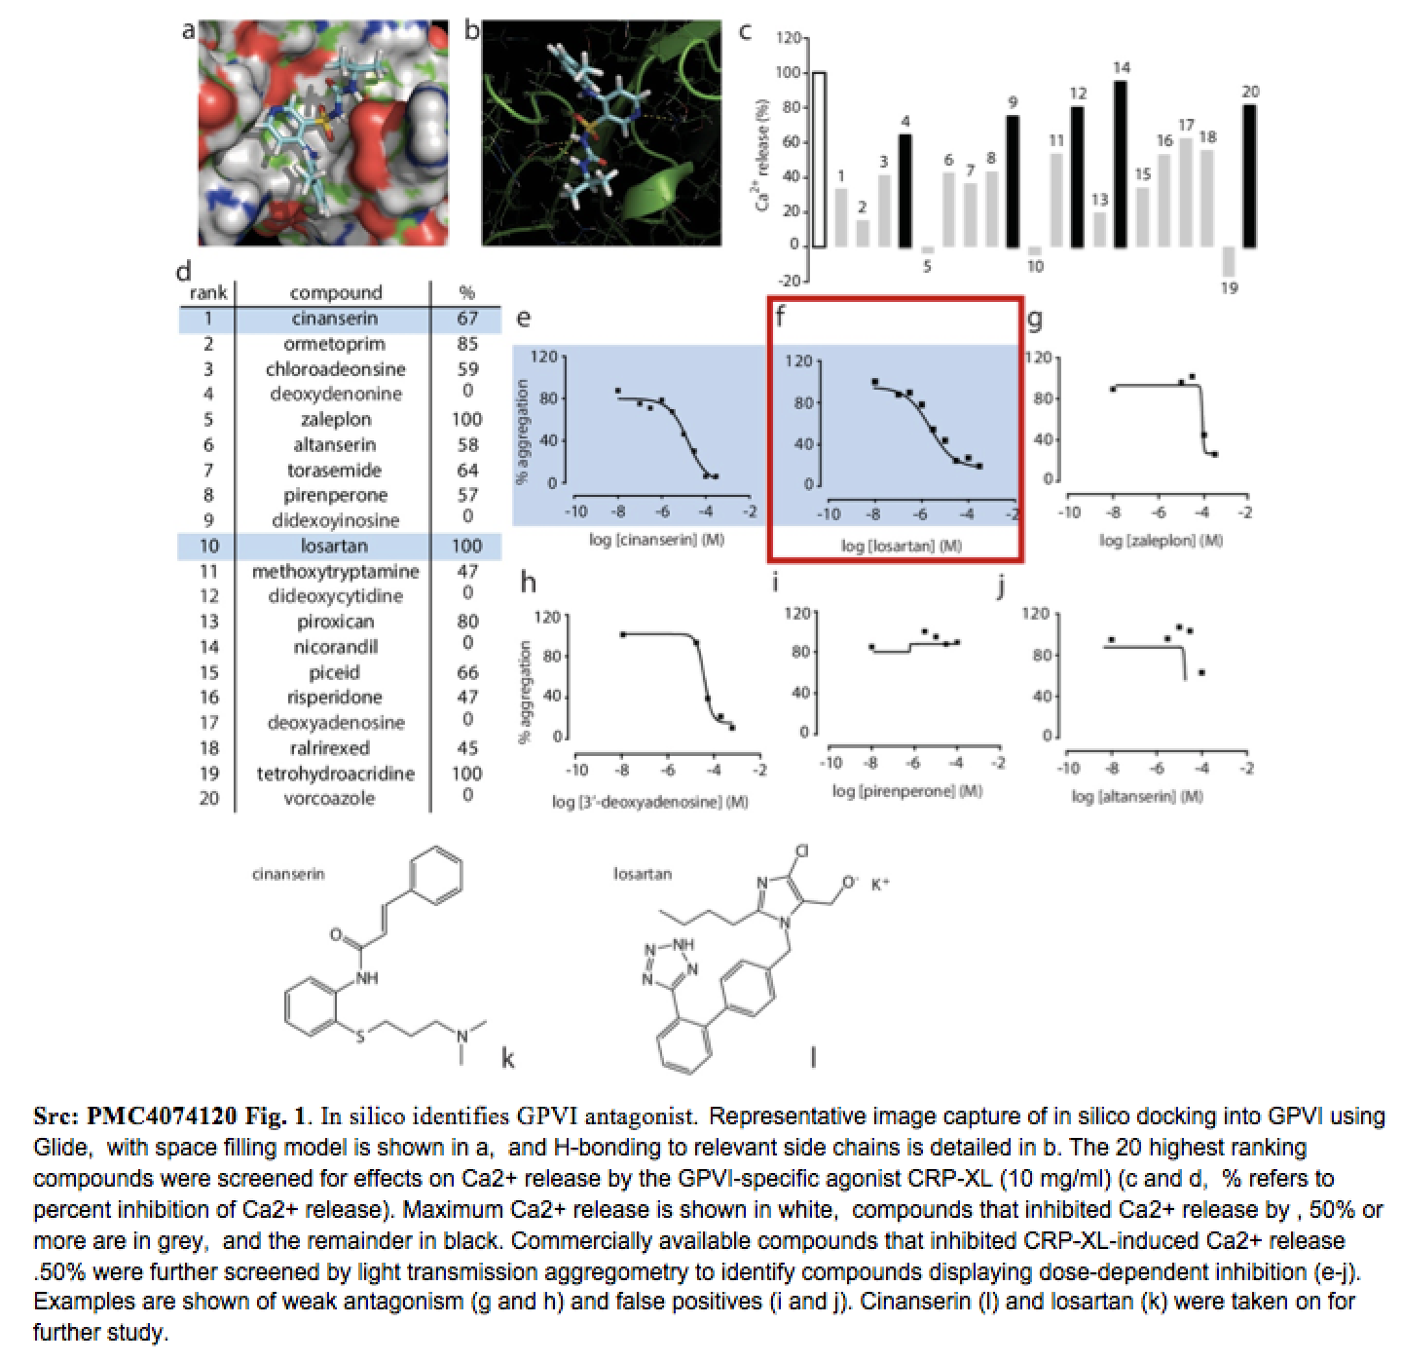
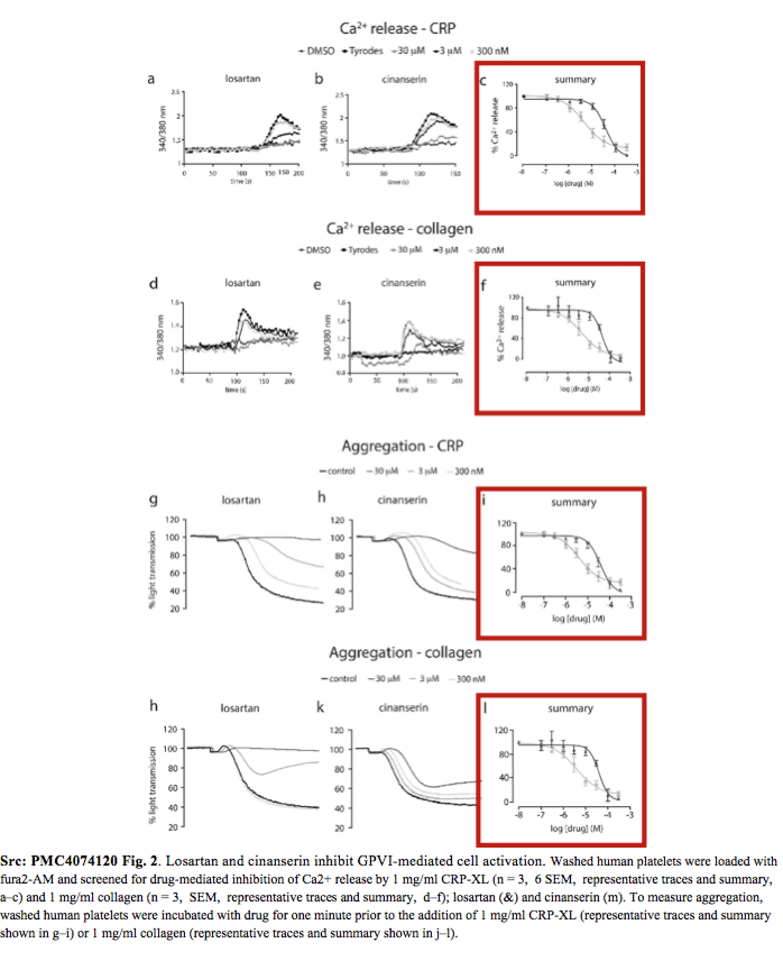
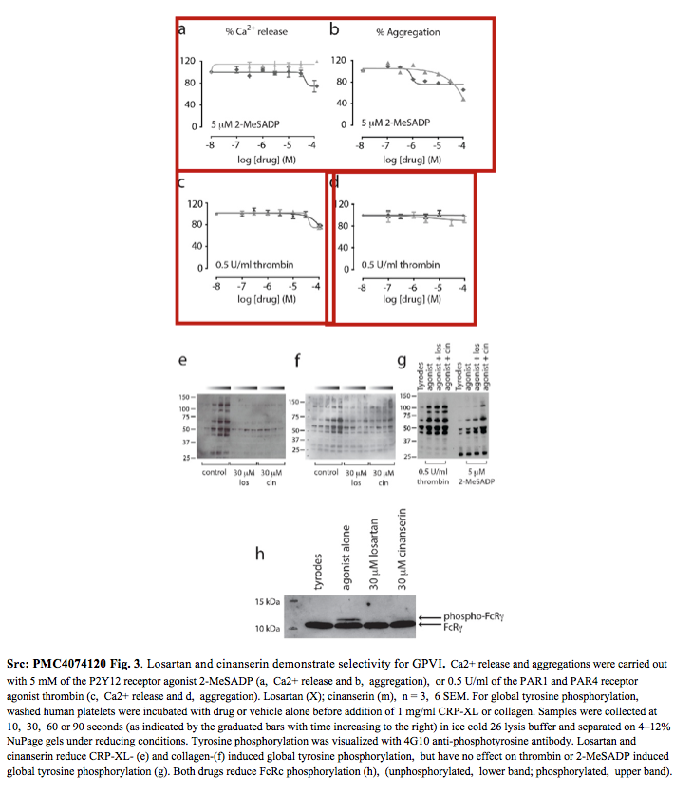
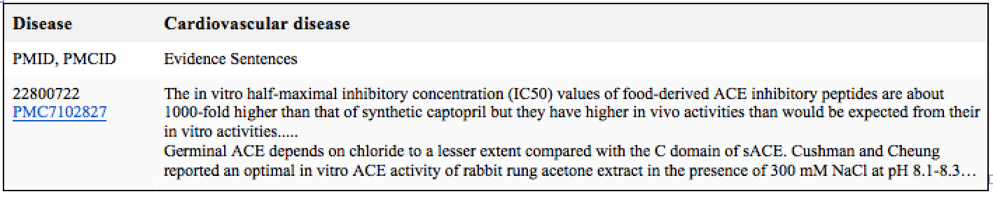
Drug Repurposing Report Generation
(In vitro Data available?)

Slide 25
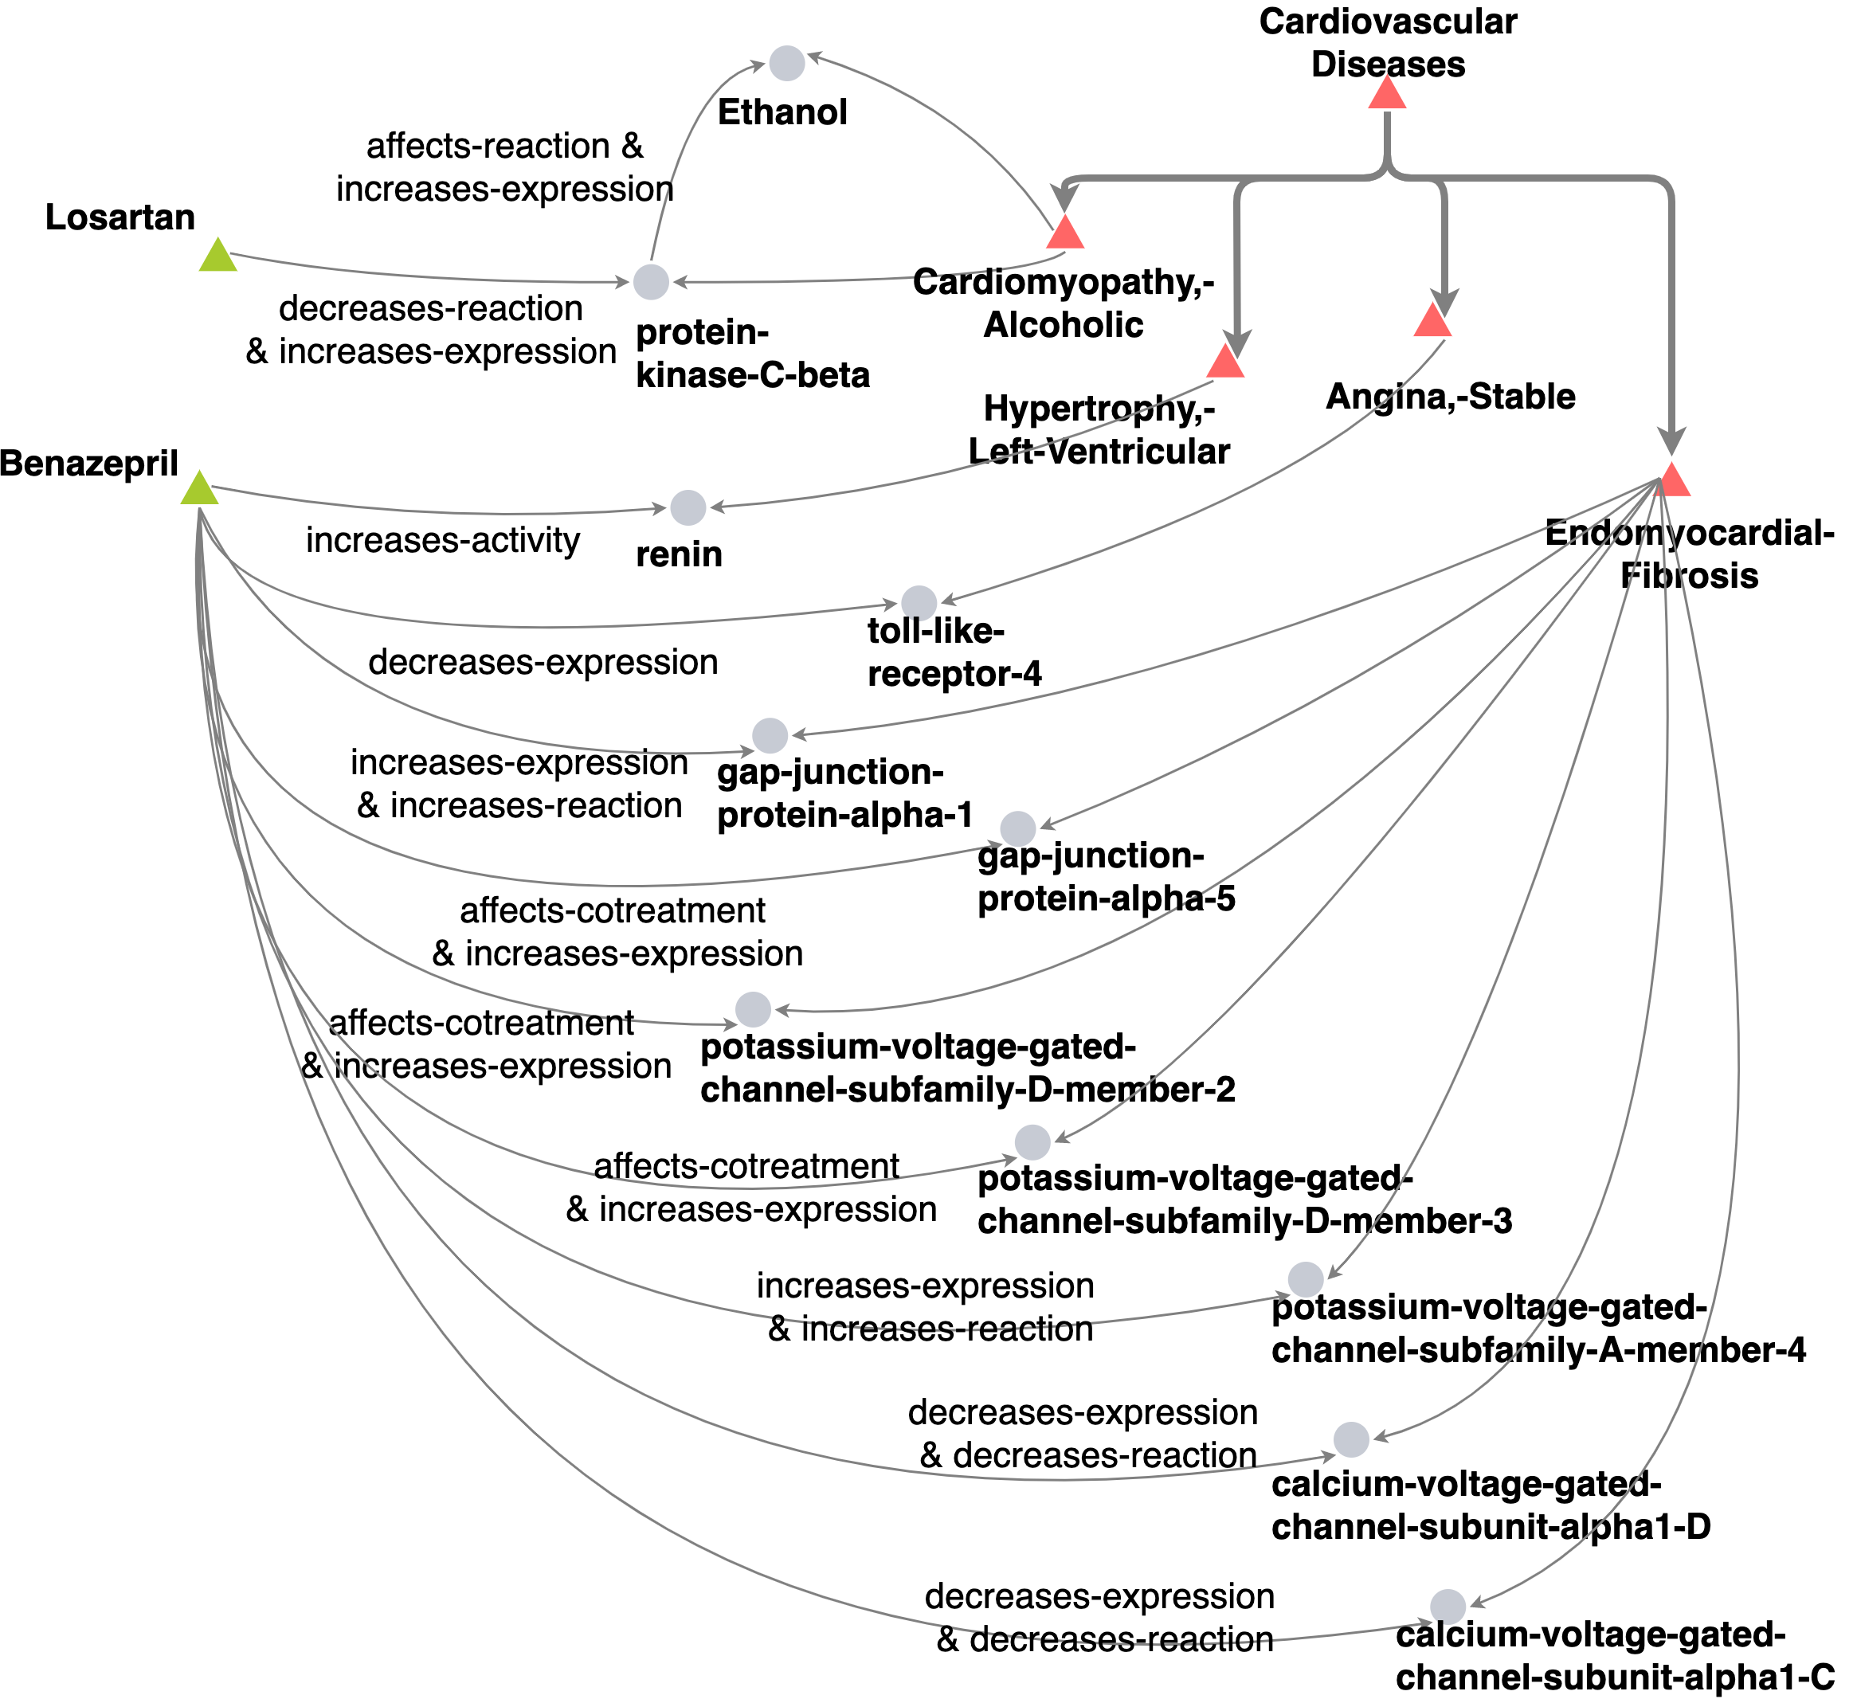
Has the drug shown evidence of systemic toxicity?

Slide 26
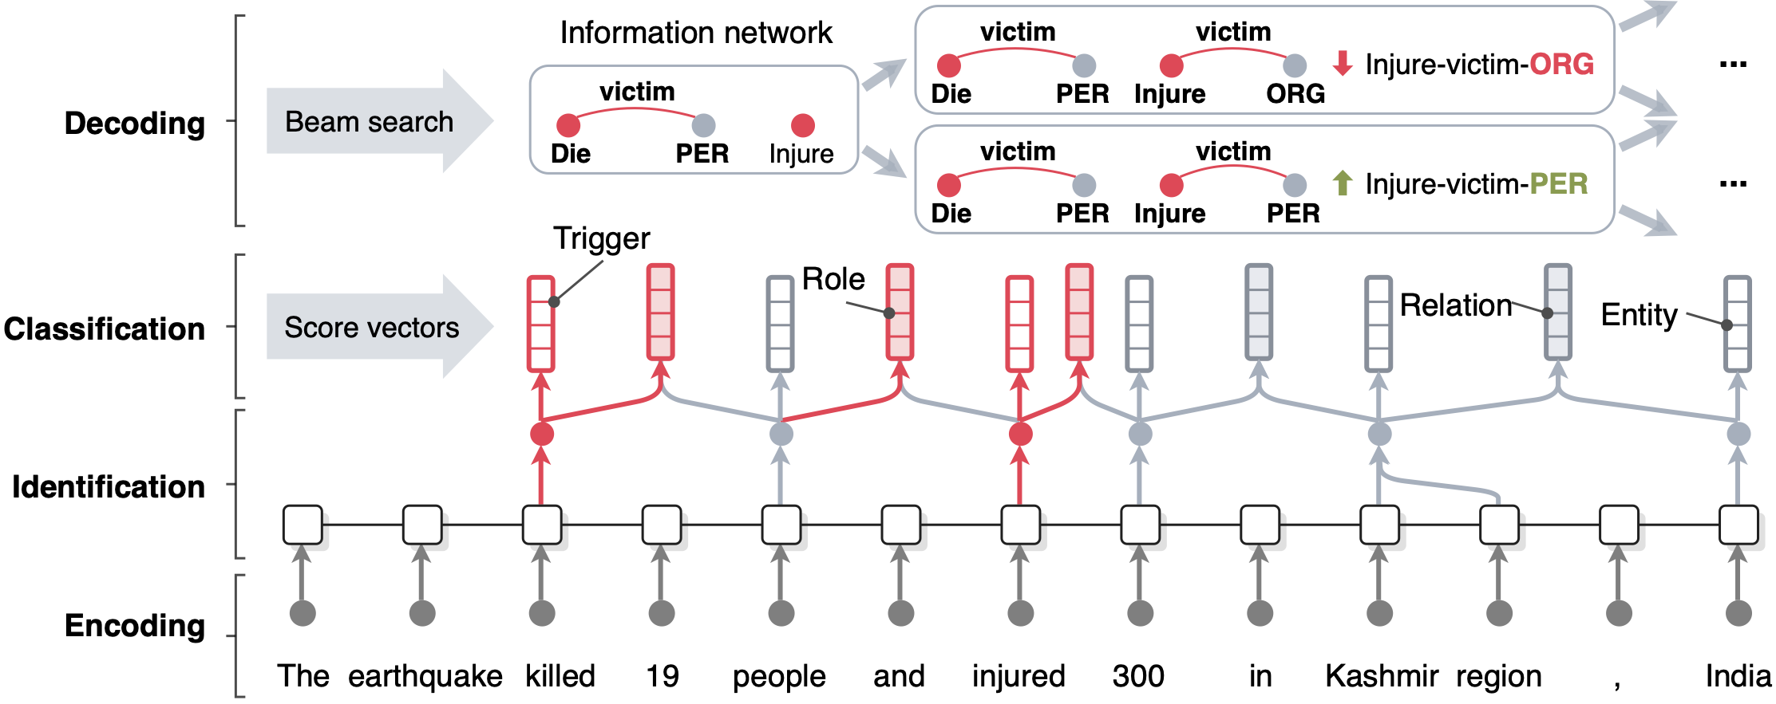
A Typical NLP system: language representation + deep neural networks
OneIE [Lin et al., ACL2020] framework extracts the information graph from a given sentence in four steps: encoding, identification, classification, and decoding

Slide 27
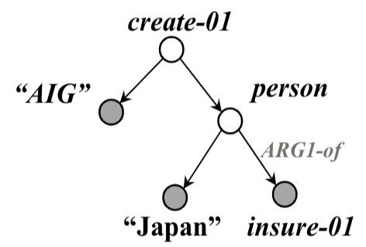
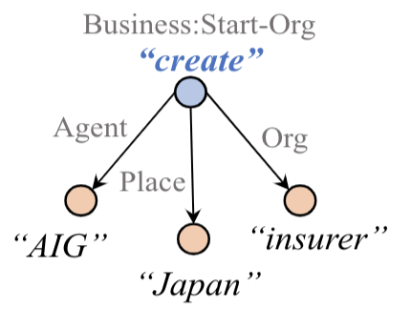


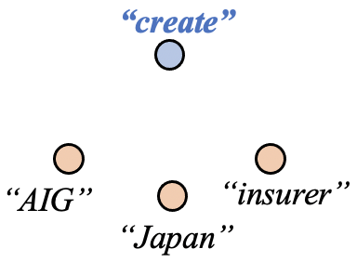
A Typical NLP system: language representation + deep neural networks [Zhang et al., NAACL2021]
Pretrained
AMR Parser
Roberta
AMR-Guided Graph
Encoding and Decoding
Input
Sentence
Encoded
Sentence
CRF-based
Span Tagger
IE Output

Slide 28
Language Modeling Based Representation Learning
[slide from Liyuan Liu]
Granularity: from word-level to char-level, and eventually subword-level
Architecture: from RNNs to Transformers
Task: from “direction-specific ” to “direction-unified ”
word-level RNN-based direction-specific LM
subword-level Transformer-based direction-unified LM
Dai
& Le (2015)
Peters et al. (2017)
ELMo (Peters et al., 2018)
ULMFiT (Howard & Ruder, 2018)
BERT (Devlin et al., 2018)
Rei (2017)
Liu et al. (2017)
Flair (Akbik et al., 2018)
GPT (Radford & Narasimhan, 2018)
  — BERT is the first model sharing all parameters among both directions (forward & backward)
Notes:
Specifically, from 2015 to 2018, the algorithm mostly evolves in three dimension
The first dimension is granularity.
In 2015, only word-level language models were used, and later some study starts to use char-level language model, and eventually subword-level language model becomes the standard.
I think it might be worth mentioning that our 2017 paper is the first to go beyond word level language model and leverage LM of other guanularity to learn representations.
The second dimension is architecture, RNNs is the default choice in the beginning, and starting 2018, Transformer becomes the new standard.
The third dimension is task. For this dimension, many people, including in the original BERT model, describes the difference as one-dimensional language model vs. two-dimensional language model.
But I feel the key difference is direction-specific vs. direction-unified.
Like ELMo, there are many attempts to train two-directional language model by parameter sharing, but most of their parameters are still direction-specific.
BERT is the first model sharing all parameters among both directions.
So, in other words, from 2015 to 2018, it changes from word-level RNN-based direction-specific language model pre-training to subword-level Transformer-based direction-unified language model.

Slide 29
Embedding Learning
(Pan et al., DeepLo2019)
Code-switch cross-lingual entity/word data generation
Use English entities as anchor points to learn a mapping (rotation matrix) W which aligns distributions in IL and English
Notes:
Code-switch, english anchor link, learn rotation matrix to align two spaces. So now we get xiaomi is aligned to apple_inc, so we at least know it’s tech company

Slide 30




Graph Neural Networks: Foundations
Learning node embeddings:
Learning graph-level embeddings:
A graph filter
adjacency matrix
- Spectral-based
- Spatial-based
- Attention-based
Updated node embeddings
Input node embeddings
- Recurrent-based
Flat Graph Pooling (i.e. Max, Ave, Min)
Hierarchical Graph Pooling (i.e. Diffpool)
A small graph w/
fewer nodes
Input node embeddings
Input graph
New node embeddings
Notes:
The specific models differ only in how 𝑓_filter(·,·) is chosen and parameterized.

Slide 31
Meta-Learning

Slide 32
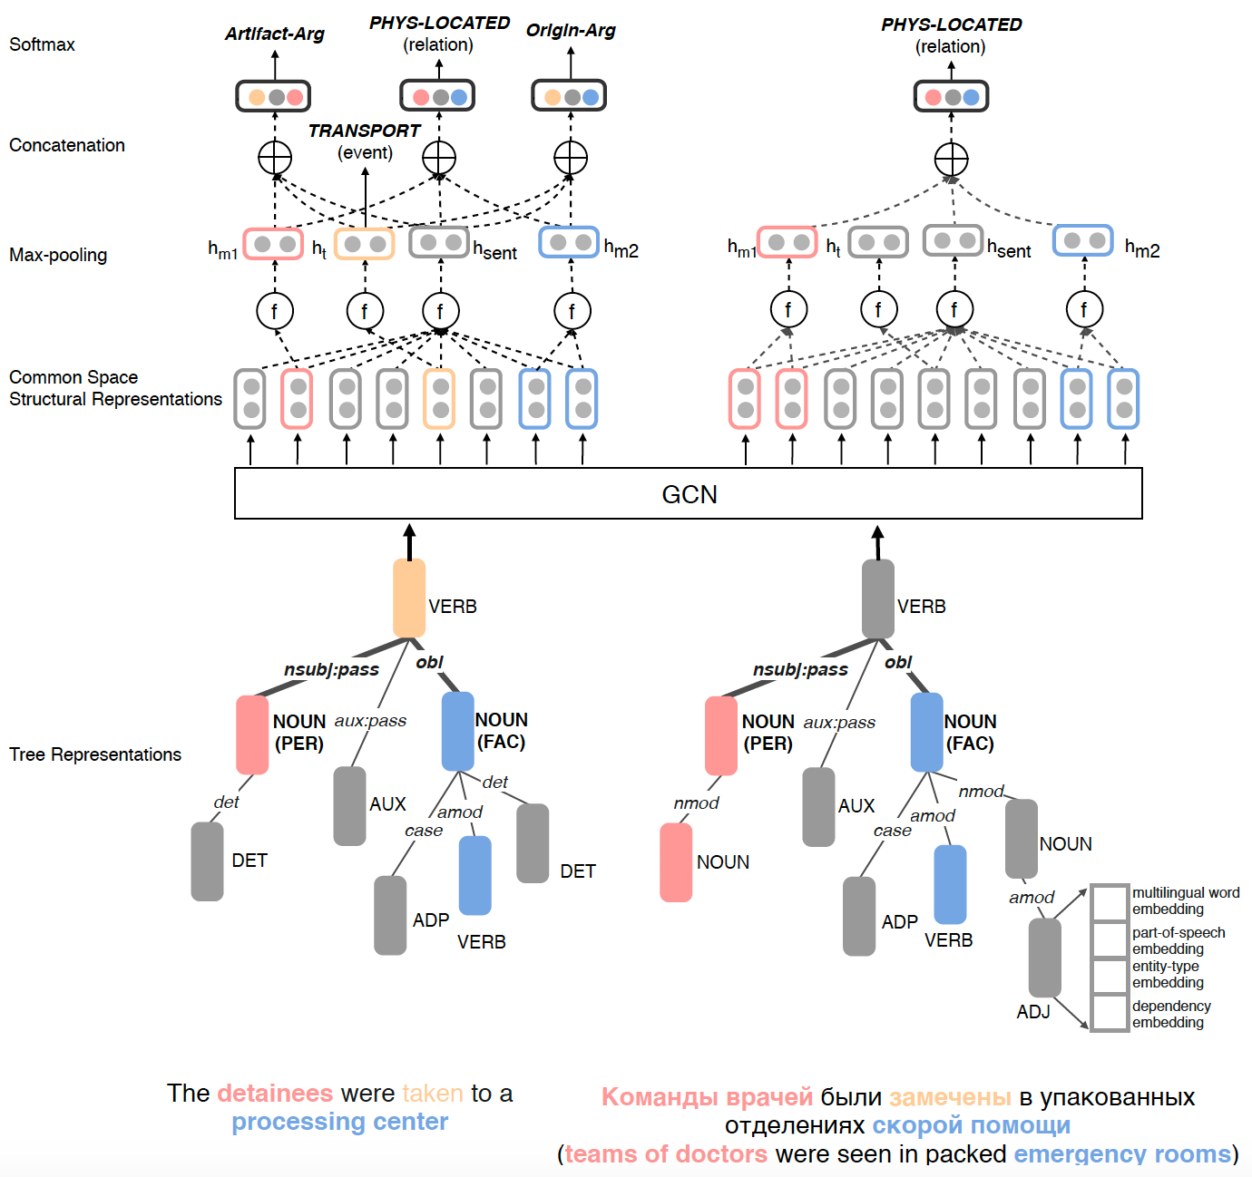
Multilingual Information Extraction
[Lu et al., ACL2020]

Slide 33
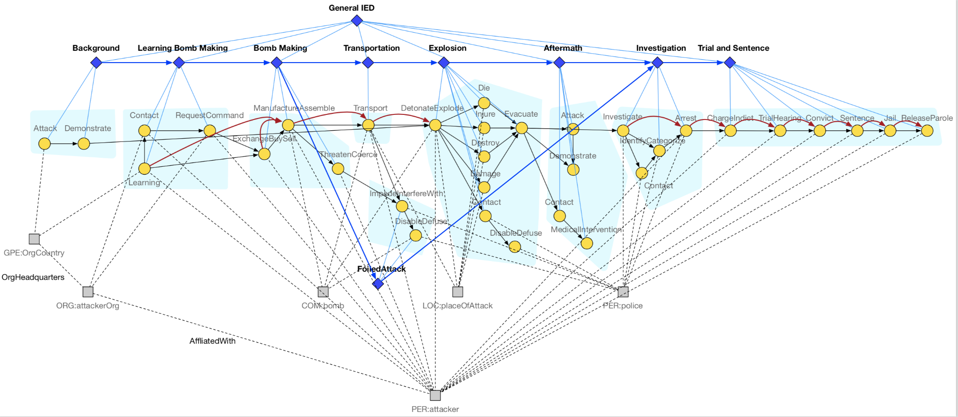
Schema Induction
[Li et al., 2021submission]
Notes:
- how hard is it to do internal schema organization for schema clarity and reasonable compression to remove redundancy? [multiple hypotheses? Make schemas more distinguishable from one another, discriminative factor]

Slide 34
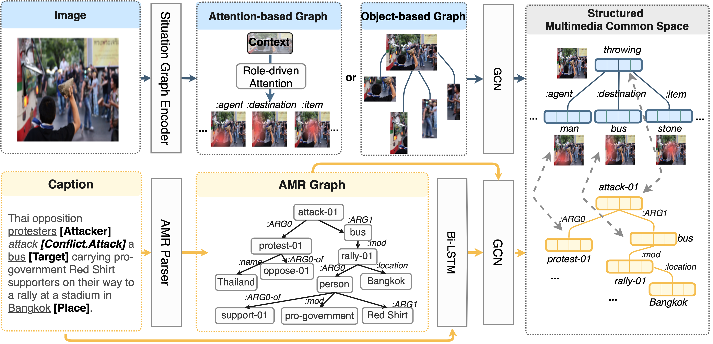
Multimedia Information Extraction
[Li et al., ACL2020]

Slide 35


Misinformation Detection
[Fung et al., ACL2021]
External
Knowledge
Base
bbc.com
Police Brutality in HK at new Extreme Levels
GNN
Aug 11, 2019 Lisa Lu
crowd
Entity Linking
Police brutality has risen to a new, extreme level in HK this past weekend. HK police started shooting
at protestors on the streets, including the unarmed, peaceful protestors. One notable incidence involved a
Head
Nodes
HK
protestors
…
Graph
Classifier
Edge
Classifier
HK police shoot cold bullets at protestors from hidden corners.
police
woman
hidden corner
Real /
Fake
Misinformative
Knowledge
Elements:
woman at the Tsim Sha Tsui bus stop being shot in the eye by a policeman hiding behind corners. No warning was issued beforehand, and the woman was permanently blinded. Local activists are avidly calling for international attention on the HK police brutality.
Tsim Sha Tsui
bus stop
activists
IE / KG Representation
{<police, located in, hidden corner>,
<police, blinded, the woman>}
InfoSurgeon

Slide 36
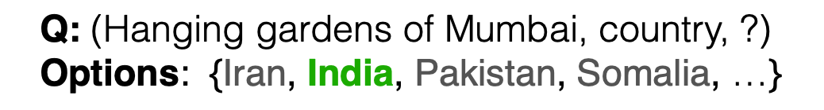
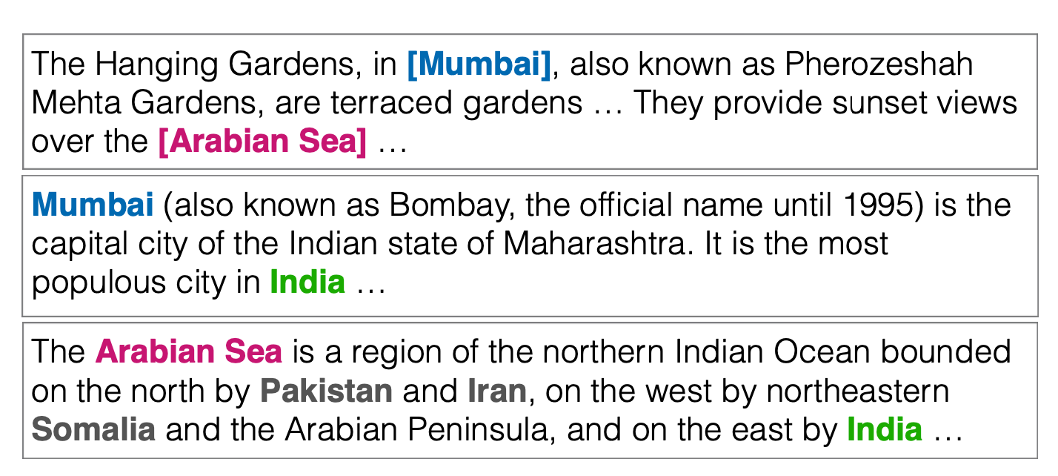
Reading Comprehension
MRC System
Question
Answer
Q: ⟨source entity, relation, answer entity?⟩
Options: ⟨candidate entity₁ , candidate entity₂, … ⟩
⟨answer entity⟩
Wikipedia
Wikidata
A WikiHop Example
Welbl et al. Constructing Datasets for Multi-hop Reading Comprehension Across Documents. TACL’18
Notes:
One particularly challenging type of task is Multi-hope Reading Comprehension, where the answer can only be obtained based on reasoning across multiple documents.
WikiHop is one dataset for this task.
For this dataset, the input is a question in the form of ⟨source entity, relation, unknown answer entity⟩ along with a short list of candidate entitles.
Then based on Wikipedia and Wikidata, a MRC system then selects the correct candidate entity from the given list.

Slide 37
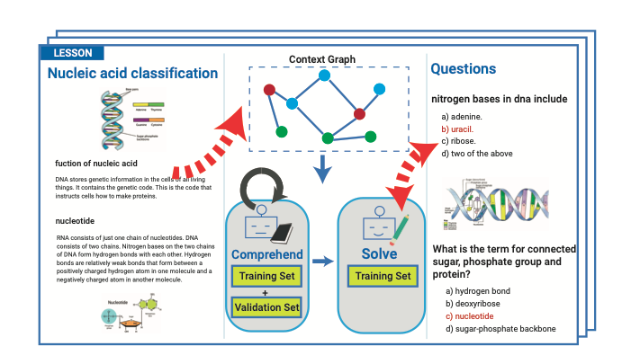
Question Answering
[Kim et al., ACL’19]
Kim et al. Textbook Question Answering with Multi-modal Context Graph Understanding and Self-supervised Open-set Comprehension ACL’19
Notes:
1. The TQA contains visual contents as well as textual contents, it re- quires to solve multi-modal QA
2. Format of the questions contains both text-related and diagram-related questions

Slide 38
Which Abstract is Written by PaperRobot?
Natural Language Generation
A. The use of nanoparticles in medicine is an attractive proposition . In the present study , Zinc oxide and silver nanoparticles were evaluated for their antidiabetic activity . Fifty male albino rats with weight 120 ± 20 and age 6 months were used . Animals were grouped as follows : control ; did not receive any type of treatment , diabetic ; received a single intraperitoneal dose of streptozotocin ( 100 mg/kg ) , diabetic + Zinc oxide nanoparticles ( ZnONPs ) , received single daily oral dose of 10 mg/kg ZnONPs in suspension , diabetic + silver nanoparticles ( SNPs ) ; received a single daily oral dose of SNP of 10 mg/kg in suspension and diabetic + insulin ; received a single subcutaneous dose of 0.6 units/50 g body.
B. Rationale : Aliskiren is a rare disease characterized by a variety of hypertensive disorders . The aim of the present study was to evaluate the effectiveness of aliskiren , pharmacodynamics , and clinical outcomes in patients with hypertension . Methods We reviewed the medical records of ambulatory blood pressure ( BP ) , kinetics , and high-sensitivity C-reactive protein ( CRP ) levels in the treatment of corneal tissue . We performed a retrospective review of the English literature search of PubMed , EMBASE , and Cochrane Library databases . The primary outcome was established by using a scoring system.

Slide 39
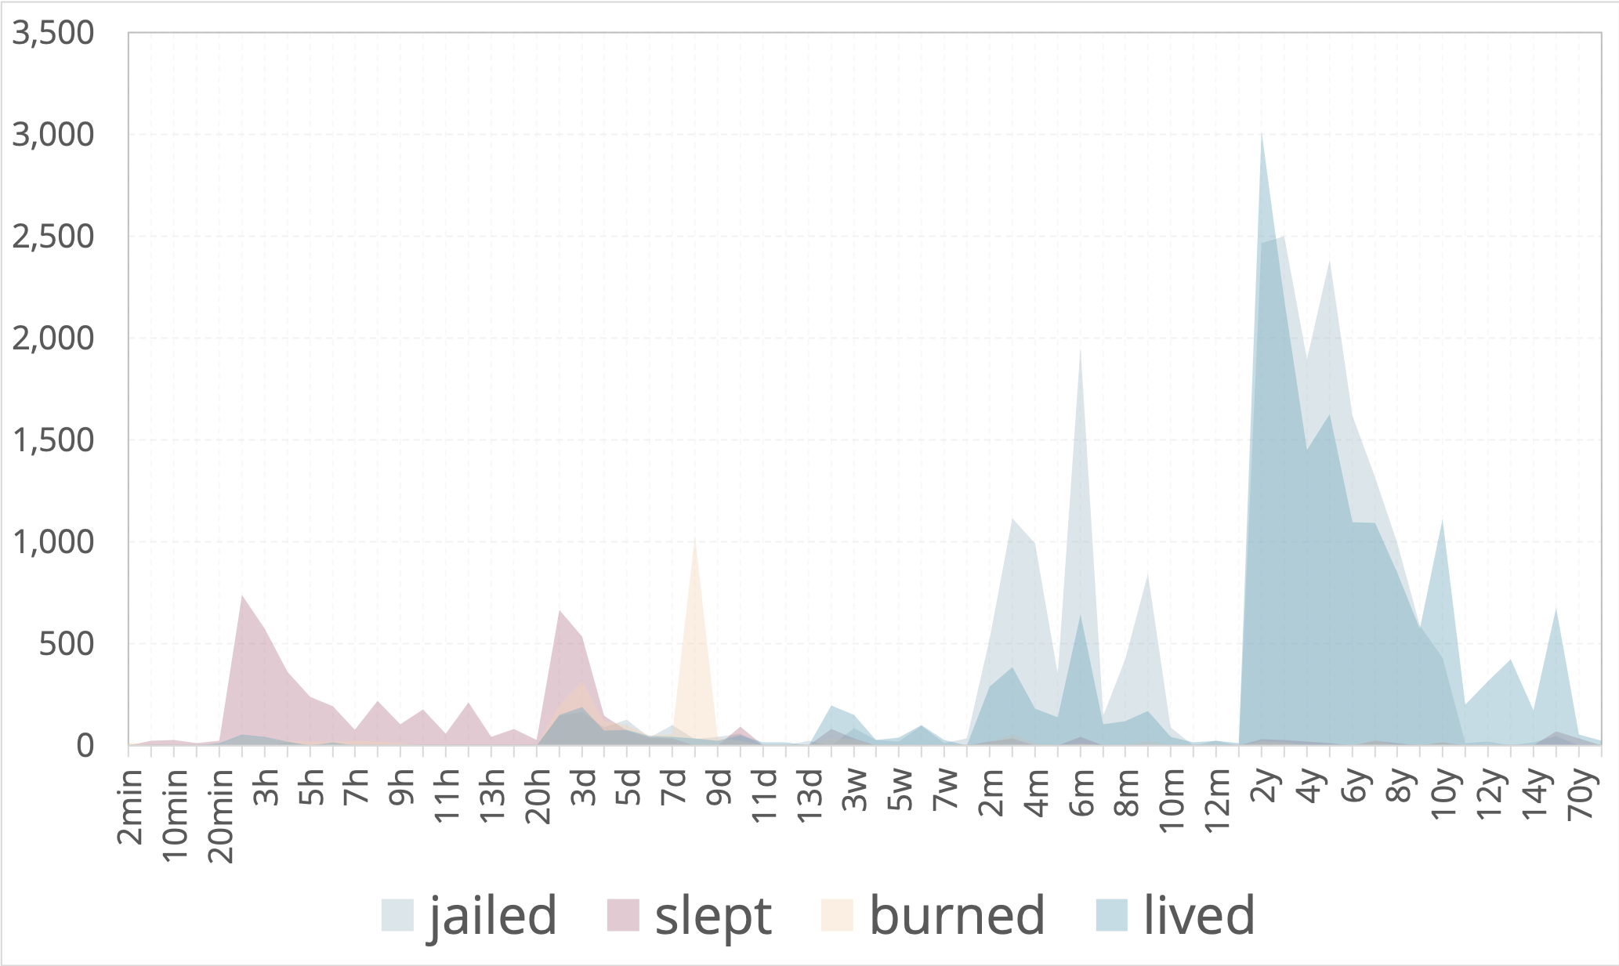
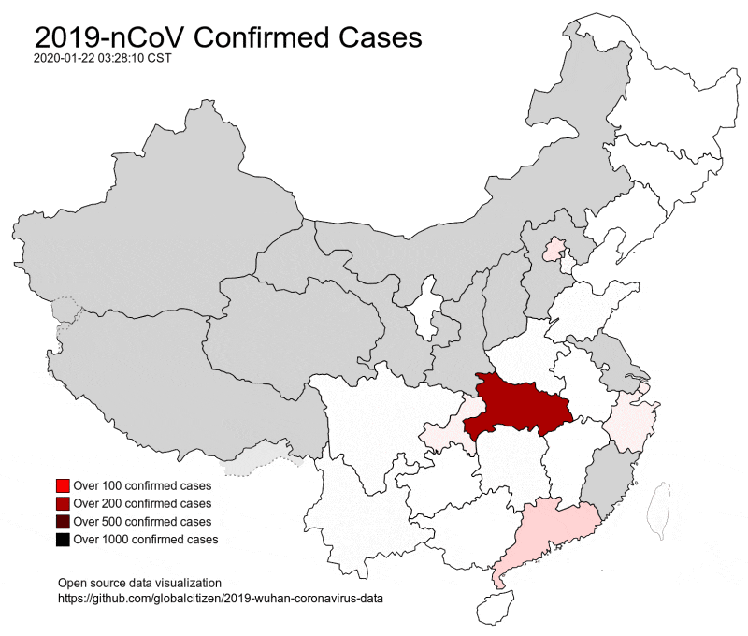
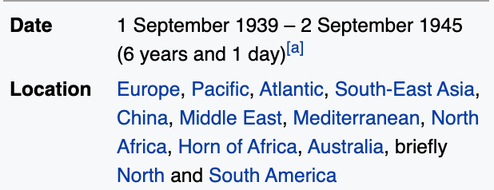
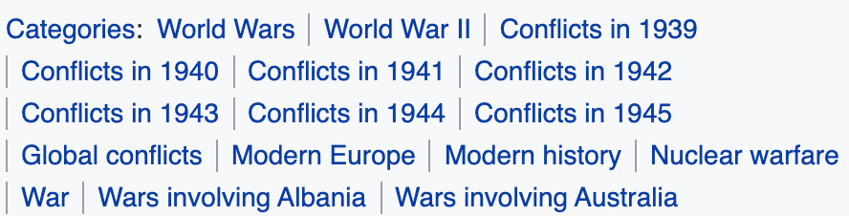
Future Direction 1: Knowledge Acquisition and Reasoning
Discover from Google N-grams using lexical patterns
  Verb + for + Time / Spent + Time + Verb-ing
Discover from Wikipedia event infoboxes and categories
Event Spatial Evolution Pattern
lived
jailed
slept
burned
2017
2019
2020
2014
2016
2015
2018

Slide 40







Future Direction 1: Knowledge Acquisition and Reasoning
Exploit Wikipedia/Wikidata
  layout, category (event type), part of relation, has cause, has immediate cause, has contributing factor, has effect, immediate
  cause of, start/end time
Cross-event Time Gap Pattern Discovery
battle → civil war
  Mining external links in Wikipedia articles and edit history; measuring the similarity of two temporal histograms
battle → invasion
battle → military campaign
typhoon → Pacific typhoon season
Hierarchical/Causal Composition
Wikipedia Pageview Co-burst

Slide 41
But How to Encode such Symbolic Knowledge?
1. Use symbolic semantics to represent input structure (e.g., edges in AMR graphs) and distributional semantics to represent nodes (e.g., concept nodes in AMR)
  Use in composition based classifiers such as CNN and GCN
  Use in composition based methods like Tree/Graph NN.
  Match sub-structures using soft-similarity on nodes and hard similarity on edges/structure
2. Combine graph embedding (e.g., knowledge graph embedding, social graph embedding) with text embedding to:
  Extend the coverage (Graph embedding provides additional ‘neighbors’.)
  Validate
  Allow flexible matching

Slide 42
How to Combine?
3. Use symbolic structure to enforce output structure
  inter-dependency between labels and constraints (e.g., we use Bi-LSTM + CRFs for name tagging, where CRFs layer is used to capture the inter-dependency among labels, I-ORG cannot appear after B-PER, Lin et al., ACL2020)
4. Convert distributional semantic representation to symbolic semantic
representation (to show to a user / to edit / to perform symbolic
inference later)
  ground/map the distributions of concepts to taxonomy/ontology/knowledge bases
  perform hierarchical clustering on event trigger words based on their distributional semantic representations, and then select the centroid entity or predicate lexical dictionary in Propbank/Ontonotes/VerbNet to assign a name to the event type (Huang et al., 2016)
5. “reason with symbolic, compute with distributional”
  Use local prediction/scoring based on distributional representation + global inference based on symbolic representation (Li et al., EMNLP2020)

Slide 43
Future Direction 2: Document-Level/Corpus-Level Event Extraction
  So we can answer questions like “Why did Rachel break up with Ross?”
Seven people convicted last week in Vietnam‘s biggest-ever criminal trial, including two former senior government officials, have requested an appeal of the verdicts, a court official said Tuesday.
The trial by a Ho Chi Minh City court was seen as a litmus test of the communist government's resolve to fight widespread corruption.
The ``godfather‘’ of organized crime, Truong Van Cam, better known as Nam Cam, was convicted of seven crimes, including murder. He was sentenced to face a firing squad, and his lawyer has said he also plans to appeal.
Hanh, also a former member of the powerful Communist Party Central Committee, was convicted of receiving US$8,500 in bribes from Nam Cam‘s family to secure the crime boss’ early release from labor camp in 1990s. Hanh was sentenced to 10 years in jail.
Chien was convicted of receiving a stereo set worth 27 million dong (US$1,750) from Nam Cam's family and sentenced to six years in jail.
—> Where was Hanh / Chien sentenced?

Slide 44


Future Direction 3: Multi-view Event Summarization
Claims: | Arrested protesters should be released. |  |  | Claims: | The protests are not necessary.
 | Carrie Lam should resign. |  |  |  | Violent protesters should be arrested.
Profile: | Birth Place: Hong Kong |  | Age: below 30 | Profile: | Birth Place: not Hong Kong |  | Age: Above 50
 | Education: above college |  | Participate in protest? No |  | Education: Below secondary school |  | Participate in protest? No
Premises |  | Evidence |  | Premises |  | Evidence
Extradition Law will weaken autonomy and judicial independence. |  | Police violently attacked protesters. |  | Protests on Extradition Law amendment are not necessary. |  | The target of Extradition Law is only on felon criminals.
 |  | Government ignored requests from protesters about revoking the amendment. |  |  |  | The Law is not proposed by the Beijing government.
Beijing government will undermine certain freedom. |  | N/A |  | Most of the protests are violent. |  | Protesters blocked traffic.
 |  |  |  |  |  | Protesters attacked the police.

Slide 45

Future Direction 4: Knowledge-element Level Information
Consistency Checking
Notes:
Constructing unified, structured knowledge networks by integrating text, social media and multi-genre networks with low cost, high quality and wide coverage
Combining distributional semantics and symbolic semantics through zero-shot transfer learning to construct multi-genre knowledge networks on the fly

Slide 46

Future Direction 5: Incorporating More Structures into
Joint Multimedia Understanding
In the past decade we have been mainly borrowing ideas from CV, now it’s the other way around
Translate all images and videos into visual tokens, organize them into structures, describe the task in structured templates, then everything becomes an NLP task [Li et al., CVPR2022]
Applications: Intel Analyst Assistant through Knowledge-guided Dialog Systems; Travel assistant with real-time event and situation understanding
46

Slide 47

Future Direction 6: Precision Information Surgery [Fung et al., 2021]
Advancing sciences by long-distance knowledge aggregation and reasoning, and lifelong learning
Information Surgery
Misinformative Text
Bruno Mars’ "Bad Boys" soundtrack will be released on February 5.
On February 4, the Red Hot Chili Peppers will kick off their North American tour with a concert in East Rutherford, New Jersey. The band will be followed by performances in Chicago, Grand Rapids, Michigan, and Las Vegas. R&B singer Carrie Underwood will be inducted into the Rock and Roll Hall of Fame on February 6. The ceremony will be held in New York City. Carrie will be the first female inductee into the Hall. Other inductees include Beyonce, Band Perry, Phillip Phillips, Queen Latifah, Vince Neil, Nikki Sixx, Mick Mars, Alice Cooper and Chantel Jeffries…
Lady Gaga has been released from jail in Miami after posting bail. She was charged with possession of marijuana and possession of drug paraphernalia. She is scheduled to appear on the February 4 episode of "American Idol.” … Susan Ryan and her husband, Jim, will take their fans to the historic Strawberry Fields in Central Park in Orlando, Florida, on February 8. The site was named in honor of …
With InfoSurgeon, we can detect the misinformative claims from fake news (e.g. Lady Gaga arrested), and remove them to regenerate good news articles.
Misinformative KG
<Bruno Mars> <Motley Crue> <NFL> <MetLife Stadium> <Red Hot Chili Peppers> <Beyonce> <Band Perry> <Phillip Phillips> <Jersey Boys> <Renee Fleming> <Lady Gaga,Justice.ArrestJailDetain.ArrestJailDetain _Detainee-ArrestJailDetain_Place, Dade County> ... <Susan Ryan,Movement.TransportArtifact_Transporter-TransportArtifact_Destination, Strawberry Fields>...<John Williams, Personnel.StartPosition_Employee, ...
Regenerated Text from Repaired KG
Bruno Mars’ "Bad Boys" album debuts at Number One on the Billboard 200 chart this week with its first week of sales. The album sold more than 100,000 copies in its first three weeks of release. Other Top 10 debuts this week include: "Lemonade" by Taylor Swift, "Young the Giant" (Number 2) by Toni Braxton (Number 3) by Kenny "Babyface" Edmonds (Number 4) by Candice Glover (Number 5) by Eric Paslay (Number 6) by Les Claypool (Number 7) by Marissa Nadler (Number 9) by Mark McGuire (Number 10).The Rock and Roll Hall of Fame will induct John Lennon, Yoko Ono and Bob Seger … The band will be supported by the Red Hot Chili Peppers, the Dave Matthews Band, Phillip Phillips, the Jersey Boys, Queen Latifah, Vince Neil, Nikki Sixx, Mick Mars, Alice Cooper and Chantel Jeffries…
Susan Ryan and her husband, Jim, will take fans to the historic Strawberry Fields in Central Park on February 2. Susan and Jim are the parents of singer-songwriter Sara Evans, who moved from Missouri to Nashville last year. Susan was diagnosed with lymphoma in January….

Slide 48

How Doctors Predict Cancer Today
The classification features are extremely coarse-grained, generic and fragile
  Changing the number of biopsies from 1 to 2 will change the cancer risk level from 17% to 37%, despite of the positive/negative results of biopsies
Precision Medicine is only affordable for a tiny population
Development cost is about $2.6 billion

Slide 49


Future Direction 7: Democratizing Drug Discovery
Generate a new skincare product or a specialized drug by describing it [Edwards et al.,2022arxiv]; We need a national computing cloud to stay relevant!
Zeatin is a cytokinin derived from adenine, which occurs in the form of a cis- and a trans-isomer and conjugates. Zeatin was discovered in immature corn kernels from the genus Zea
49

Slide 50
About you
  Quiz time! Choose topics
  Group discussions
    Room1: Language Representation
    Room2: DNN Architectures for NLP
    Room3: Information Extraction and Knowledge Acquisition
    Room4: Misinfomation Detection
    Room5: Question Answering and Reading Comprehension
    Room6: Natural Language Generation and Summarization
    Room7: Dialogue Systems
    Room8: NLP and Computational Social Science
Notes:
Nowadays, the practice of journalism often distributes news content via multimedia.

