Slide 1
Knowledge-Guided Natural Language Generation
Heng Ji
hengji@illinois.edu
Deliberately constructing a natural language text in order to meet specified communicative goals

Slide 2
Let’s apply Seq2Seq+Attention to Abstractive Summarization
Abstract summarization:
Generate a summary to cover the important information in the source document
2
Notes:
Change low resource IL to a language which is not in wikipedia
Word-level: from bi-lingual dicts and alignment; structure-level comes from wals; multi-level alignment

Slide 3
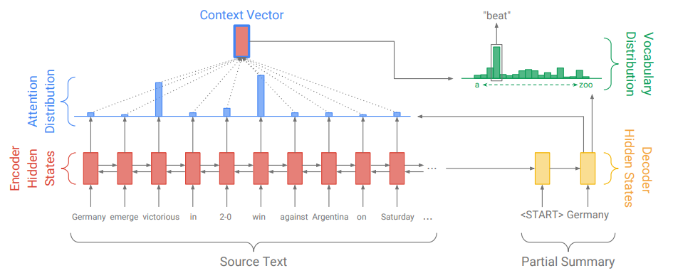
Abstractive Summarization
Problems?
Out Of Vocabulary words

Slide 4
Pointer-Generator Network
(See et al., 2017)
Notes:
החלק הימני בנוסחה מעלה את ההסתברות לגנרט מילים שנמצאות במשפט בתוך הפ_ווקב.
ממש כמו שאני מכיר שעושים

Slide 5
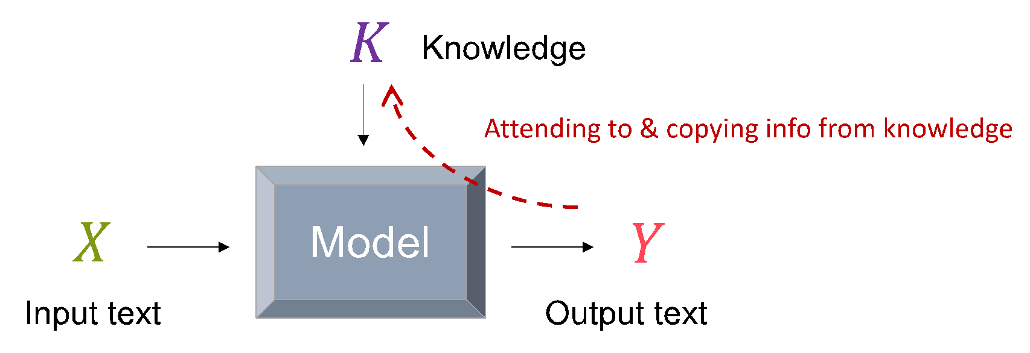
Copy/Pointing Mechanisms
Copy relevant information to the output text
Probability of choosing the generation mode
Probability of choosing the copy mode
Notes:
Not only attending to, but also directly copying the information

Slide 6
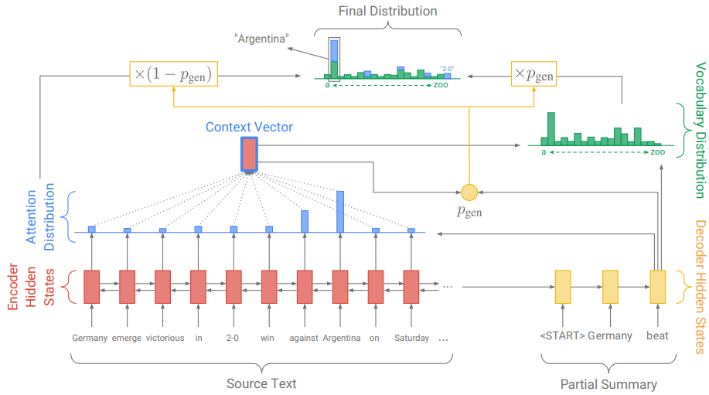
Pointer-Generator Network

Slide 7
Results
ROUGE scores of the trained models on the CNN-Daily Mail dataset, computed on the test set.

Slide 8
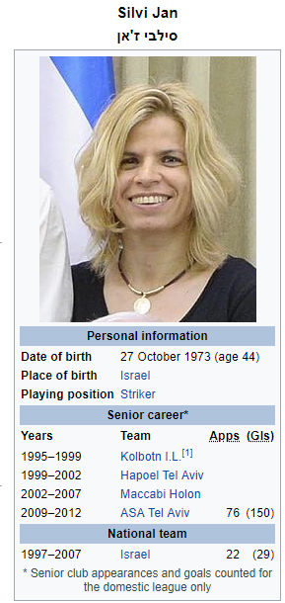
Encoding Tables (Wang et al., 2018)
Slot Type (s) | Row (r) | Slot Value (v)
Name | 1 | Silvi Jan
Member of Sports Team | 2 | ASA Tel Aviv University
 | 3 | Hapoel Tel F.C. (women)
 | 4 | Maccabi Holon F.C. (women)
 | 5 | Israel women's national football team | Match | 22
 |  |  | Goal | 29
Date of birth | 6 | 27 October 1973
Country of Citizenship | 7 | Israel
Position | 8 | Forward (association football)
Notes:
Here we use an example to show the creation of this dataset. We name each attribute as slot type, and the value of each attribute as slot value. For each inforbox extracted from Wikidata, for example, the inforbox for Silvi Jan shown in left figure, since the goals of ASA Tel Aviv is not mentioned in the description, we removed it.

Slide 9
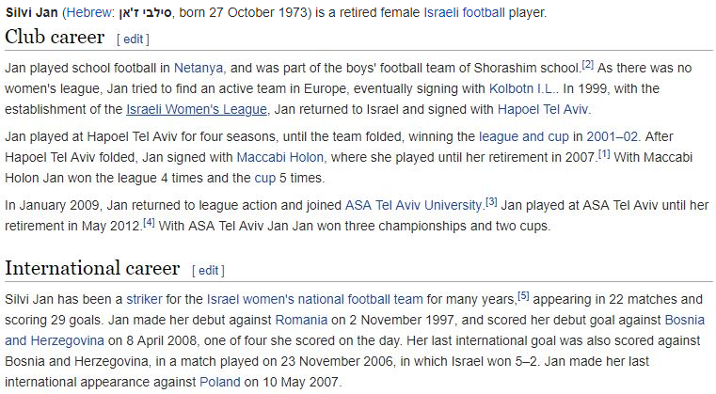
Reference
Silvi Jan (born 27 October 1973 ) is a retired female Israeli football player. Silvi Jan has been a Forward (association football for the Israel women's national football team for many years appearing in 22 matches and scoring 29 goals. After Hapoel Tel F.C. (women) folded, Jan signed with Maccabi Holon F.C. (women) where she played until her retirement in 2007. In January 2009, Jan returned to league action and joined ASA Tel Aviv University. In 1999, with the establishment of the Israeli Women’s League, Jan returned to Israel and signed with Hapoel Tel F.C. (women).
Notes:
Similarly, for each description extracted from Wikidata, we removed unrelated sentence such as “Jan played at ASA Tel Aviv until her retirement”. We also viewed each highlight information as a whole phrase.

Slide 10
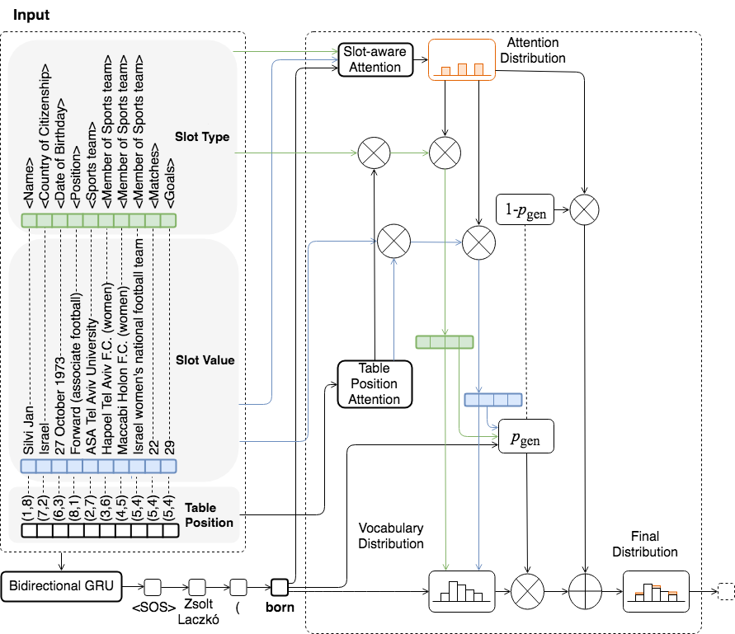
Model
Notes:
Here is the overall architecture of the model. Since the seq2seq is unable to capture the correct entities, we develop our framework based on the pointer network. We use two type of attention to capture the relationship: slot aware attention to relate the slot type and its value, table position attention to get the interdependency in the table. The table position attention is inspired by the assumption in the structured text representation paper that each word in a sentence can be a child or parent node.

Slide 11
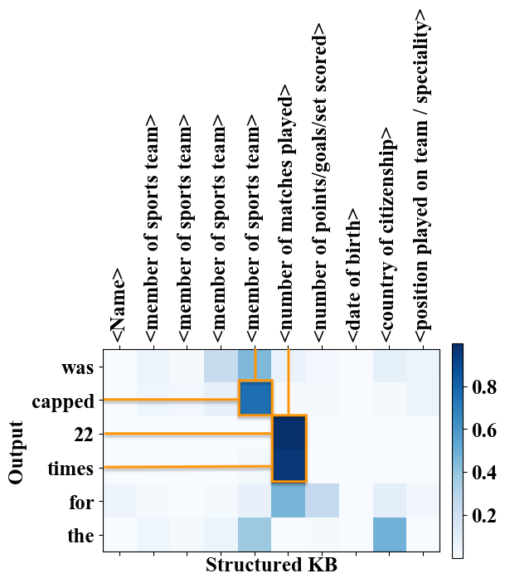
Capture slot-aware information
At each step , for each triple :
Compute Slot-aware attention from decoder hidden , embedding of slot type , embedding of slot value , the coverage vector
Notes:
For slot-aware information, we capture it used the slot aware attention which computes the from the slot type, slot value, coverage, and the context. The coverage vector is the sum of attention distributions over all previous decoder time steps and can be used to reduce repetition. As in the attention visualization, we can see that the verb “cap” most relied on the number of sports team. And ’22 times’ depends most on the number of matches plays the most important role.

Slide 12
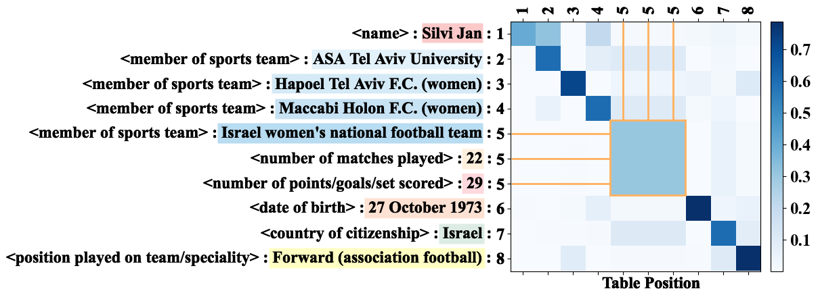
Capture slot dependency
Given a structured KB, obtain a sequence of row index embedding $R=\left[r_{1}^{′},r_{2}^{′},…,r_{n}^{′},\right]$ where $r_{i}^{′}=\left[r_{i};\hat{r_{i}}\right]$
For each pair of slots $i$ and $j$, compute table attention score $f_{ij}$
$g_{in}=\tanh\left(W_{in}r_{i}^{′}\right)$
$g_{out}=\tanh\left(W_{out}r_{i}^{′}\right)$
$f_{ij}=\operatorname{Softmax}\left(g_{in}^{T}W_{g}g_{out}\right)$
Notes:
For the slot dependency, we used similar structure as self-attention on the row index embeddings. The self-attention models inter-dependencies between each slot. Because when computing the context vectors, the information in the same row should receive the same weight as shown in the visualization.

Slide 13
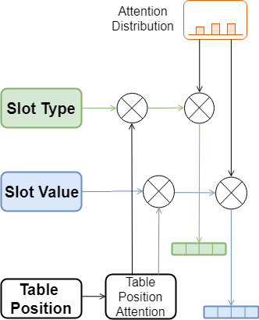
Capture slot dependency
Update each embedding of slot type $s_{i}$ and slot value $v_{i}$
$s_{i}^{∗}=\sum_{k=1}^{n}{f_{ik}s_{k}}$
$v_{i}^{∗}=\sum_{k=1}^{n}{f_{ik}v_{k}}$
Update their context vectors $L_{t}^{∗}$ and $L_{v}^{∗}$ with attention score
$L_{t}^{∗}=\sum_{k=1}^{n}{α^{t}s_{i}^{∗}}$
$L_{v}^{∗}=\sum_{k=1}^{n}{α^{t}v_{i}^{∗}}$
Notes:
We then updated context vector with previous generated attention. We first compute the updated embeddings for each slot by multiplying the table-position attention. We then compute the context vector based on the slot-aware attention.

Slide 14
Structure Generator
Obtain vocabulary distribution from decoder and attention, and combine them with structure-aware gate $p_{gen}$
$p_{gen}=σ\left(W_{s}^{T}L_{s}^{∗}+W_{v}^{T}L_{v}^{∗}+W_{h}^{T}{\tilde{h}}^{t}+W_{y}^{T}y^{t−1}+b_{gen}\right)$
$P_{vocab}=\operatorname{Softmax}\left(V\left[{\tilde{h}}^{t};L_{s}^{∗};L_{v}^{∗}\right]+b_{vocab}\right)$
$P_{source}^{j}=\sum_{m|v_{m}=v_{j}}{α_{m}^{t}}$
$P\left(y_{t}\right)=p_{gen}P_{vocab}+\left(1−p_{gen}\right)P_{source}$
Notes:
Finally, we used a structure aware gate to combine the copied information with the language model generated words. The language model probability depends on decoder hidden and previous computed two context vectors. The copied probability is computed by aggregating the attention weights of each unique slot value. The gate is a soft switch between generating a word from the fixed vocabulary and copying a slot value from the structured input.

Slide 15
Standard Metrics (%)
Notes:
We apply the standard BLEU, METEOR, and ROUGE metrics to evaluate the generation performance, because they can measure the content overlap between system output and ground-truth and also check whether the system output is written in sufficiently good English. As we can see, the overall trends are increasing for each metrics.

Slide 16
KB reconstruction metric
KB Reconstruction based Evaluation (Scores for the example: Overall Slot Filling P=6/7=85.7%, R=6/11=54.5%, F1=66.7%; Inter-dependent Slot Filling P=5/7=71.4%, R=5/9=55.6%, F1=62.5%
Notes:
To evaluate the quality of the generation output, we also propose KB reconstruction-based metric to evaluate how many facts are correctly expressed in the generation output. We compare them with two metrics (1). Overall Slot Filling: If a pair of slot type and its slot value exists in both of the reconstructed KB and the input KB, it’s considered as a correct slot. (2). Inter-dependent Slot Filling: If a row that consists one or multiple slot types and their slot values exist in both of the reconstructed KB and the input KB, it’s considered as a correct row. For example, here the number of correct slots has 6. But the number of correct row only has 5 (start active year is not correct).

Slide 17
Overall Slot Filling Precision(P), Recall(R), F1 %
Notes:
Here is the result of Overall Slot Filling Precision, Recall and F-score. The overall rising trends prove the efficacy of our model. The abnormal high in the precision of seq2seq might result from the redundant information the model generated.

Slide 18
Result of Seq2Seq
(born 23 April 1981) is a retired Israeli footballer. He played for the Thailand 's (scoring one goal) and was a member of the team that won the first ever player in the history of the National Basketball League. She played for the team from 1997 to 2001 scoring 29 goals. She played for the team from 1997 to 2001 scoring 29 goals. She played for the team from 1999 to 2001 and played for the team in the 1997 and 2003 seasons.
Problem: Lack of important entity (e.g. football team)
Solution: Pointer Network
Notes:
Now let’s first take a look at the results of some preliminary baselines. First is the attention based Seq-to-Seq model. We used LSTM to encode the whole table. We can see that, a lot of important entities are missing since the model cannot effectively copy the keywords.

Slide 19
Result of Pointer Network
Silvi Jan the fourth past the Maccabi Holon F.C. (women). On 27 October 1973 in 29 2014) (born 22) is a former Israel. She was a Forward (association football) and currently plays for Hapoel Tel Aviv F.C.(women) in the Swedish league. She played for the ASA Tel Aviv University in the Swedish league. She was a member of the Israel women's national football team at the beginning of the 2008 season.
Problem: Incorrect slot type (e.g. Israel)
Solution: Slot type attention
Notes:
Then, to make sure that the important entities can be generated, we tried the pointer network. Here is the result of the pointer network. It successfully copies most of the facts. However, some facts are not in correct position. For example, here, Israel should be Forward (association football).

Slide 20
Result of Pointer + Type
Silvi Jan (born 27 October 1973) is a former Israeli footballer. He played for Hapoel Tel Aviv F.C.(women) and ASA Tel Aviv University.
Problem: Missing alignment slot (e.g. No. of goals )
Solution: Table position attention
Notes:
In order to further capture the connection of each slot type and its corresponding slot value, we tried the table type attention. Here is the result of pointer network with table type attention. However, the goal of the football team is still missing.

Slide 21
Result of Pointer + Type & Position
Silvi Jan (born 27 October 1973) is a former Israel. He played for Israel women‘s national football team, Hapoel Tel Aviv F.C.(women), ASA Tel Aviv University and Maccabi Holon F.C. (women). He was capped 22 times for the Israel women's national football team.
Result: Capture most of slots as well as their dependencies
Notes:
Here is our final result. As we can see it correctly aligned the number of matches with corresponding football team.

Slide 22
Impact of Slot-aware Attention
Fill the value into correct slot types
Pointer result: “24 September 1979 was born 3 October 1903 in 17 on 33 October 1906” where 33 should be the number and 17 should be the number of goals
Our final result: “he made 33 appearances and scored 17 goals”.
Notes:
Next, we use more examples to show the impact of each component in our architecture. Here is an extra example of the impact of slot aware attention. Without the type information, the same string can be filled into various slots of multiple types. For example, 17 can be the goals or the ages. Here, the final result aligned with the reference used 17 as the goals.

Slide 23
Impact of Table Position Attention
Capture interdependent slots
“Bill Sampy ... who played for Sheffield United F.C. 41 times.”
“Giancarlo Antognoni ... he was also a member of the Italy national football team at the 1982 FIFA World Cup.”
“Ernő Solymosi … played 38 games and scored 7 goals for the Hungary national football team.”
Notes:
Here are some extra examples of the impact table position attention. As we can see, the table position attention successfully captures interdependent slots

Slide 24
Remaining challenges
Noun to the adjective form when it appears right before a position slot
“Italy professional Association football player”
Low KB Reconstruction recall
Unmatched temporal expressions
“Aleksei Gasilin ( born 1 March 1996 ) is a ... He made his professional debut in the Russian Second Division in 1992 for …”
Person genders
“Silvi Jan (born 27 October 1973) is a former Israel. He played for Israel women‘s national football team,…”
More details about the entity
Notes:
However, many challenges still remain. Firstly, the model needs to change the noun to the adjective form when it appears right before a position slot. For example, Italy to Italian. Secondly, the KB Reconstruction recall is low. Third, some unmatched temporal expressions exists because of language model makes up facts. Fourth, the model needs to consider the person genders. Finally, the wikidata still does not provide enough information. More details about the entity are needed.

Slide 25
Coherent Story Generation
(Zhai et al., ACL2019)
Notes:
300 papers… every day… impossible to read… keyword search… abstract doesn’t reflect… results; ignore most of them. Cancer and surgery… 3 days… walk through all posters.. In our field papers that were published twenty years ago are not that important…
including mining PubMed bibliographic data, research papers in PubMed, clinical data sets and numerous bio-medical websites and social media related to medical sciences, where data related to diseases, drugs, treatments, chemical compounds, proteins, genes, biological pathways can be integrated and extracted from text data and their characteristics and relationships can be mined from such datasets as well
. Older literature is often extremely important (and overlooked), and indeed, often provides a rich source of information that can lead to new hypotheses. This makes the information overload problem event more serious, because we need distill and connect knowledge from papers that may cover 70 years.

Slide 26
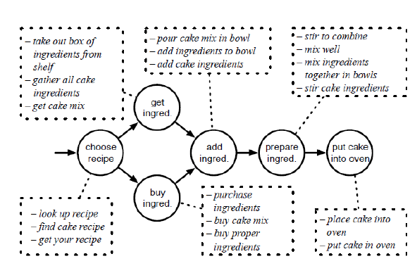
Temporal Script Graphs
Notes:
300 papers… every day… impossible to read… keyword search… abstract doesn’t reflect… results; ignore most of them. Cancer and surgery… 3 days… walk through all posters.. In our field papers that were published twenty years ago are not that important…
including mining PubMed bibliographic data, research papers in PubMed, clinical data sets and numerous bio-medical websites and social media related to medical sciences, where data related to diseases, drugs, treatments, chemical compounds, proteins, genes, biological pathways can be integrated and extracted from text data and their characteristics and relationships can be mined from such datasets as well
. Older literature is often extremely important (and overlooked), and indeed, often provides a rich source of information that can lead to new hypotheses. This makes the information overload problem event more serious, because we need distill and connect knowledge from papers that may cover 70 years.

Slide 27
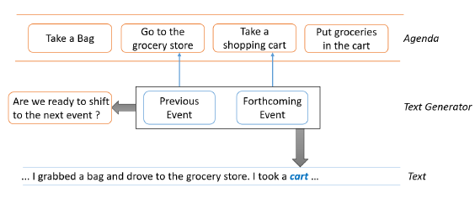
Surface Realization Model
Produces two outputs: a distribution over the vocabulary that predicts the successive word, and a boolean-valued variable that indicates whether the generation should move to the next event
Notes:
300 papers… every day… impossible to read… keyword search… abstract doesn’t reflect… results; ignore most of them. Cancer and surgery… 3 days… walk through all posters.. In our field papers that were published twenty years ago are not that important…
including mining PubMed bibliographic data, research papers in PubMed, clinical data sets and numerous bio-medical websites and social media related to medical sciences, where data related to diseases, drugs, treatments, chemical compounds, proteins, genes, biological pathways can be integrated and extracted from text data and their characteristics and relationships can be mined from such datasets as well
. Older literature is often extremely important (and overlooked), and indeed, often provides a rich source of information that can lead to new hypotheses. This makes the information overload problem event more serious, because we need distill and connect knowledge from papers that may cover 70 years.

Slide 28
Surface Realization Model
Exploits a multi-task learning framework: it outputs the distribution over the next token d_{t} , as well as a_{t} , which determines whether to shift to the next event
Notes:
300 papers… every day… impossible to read… keyword search… abstract doesn’t reflect… results; ignore most of them. Cancer and surgery… 3 days… walk through all posters.. In our field papers that were published twenty years ago are not that important…
including mining PubMed bibliographic data, research papers in PubMed, clinical data sets and numerous bio-medical websites and social media related to medical sciences, where data related to diseases, drugs, treatments, chemical compounds, proteins, genes, biological pathways can be integrated and extracted from text data and their characteristics and relationships can be mined from such datasets as well
. Older literature is often extremely important (and overlooked), and indeed, often provides a rich source of information that can lead to new hypotheses. This makes the information overload problem event more serious, because we need distill and connect knowledge from papers that may cover 70 years.

Slide 29
Results
Notes:
300 papers… every day… impossible to read… keyword search… abstract doesn’t reflect… results; ignore most of them. Cancer and surgery… 3 days… walk through all posters.. In our field papers that were published twenty years ago are not that important…
including mining PubMed bibliographic data, research papers in PubMed, clinical data sets and numerous bio-medical websites and social media related to medical sciences, where data related to diseases, drugs, treatments, chemical compounds, proteins, genes, biological pathways can be integrated and extracted from text data and their characteristics and relationships can be mined from such datasets as well
. Older literature is often extremely important (and overlooked), and indeed, often provides a rich source of information that can lead to new hypotheses. This makes the information overload problem event more serious, because we need distill and connect knowledge from papers that may cover 70 years.

Slide 30
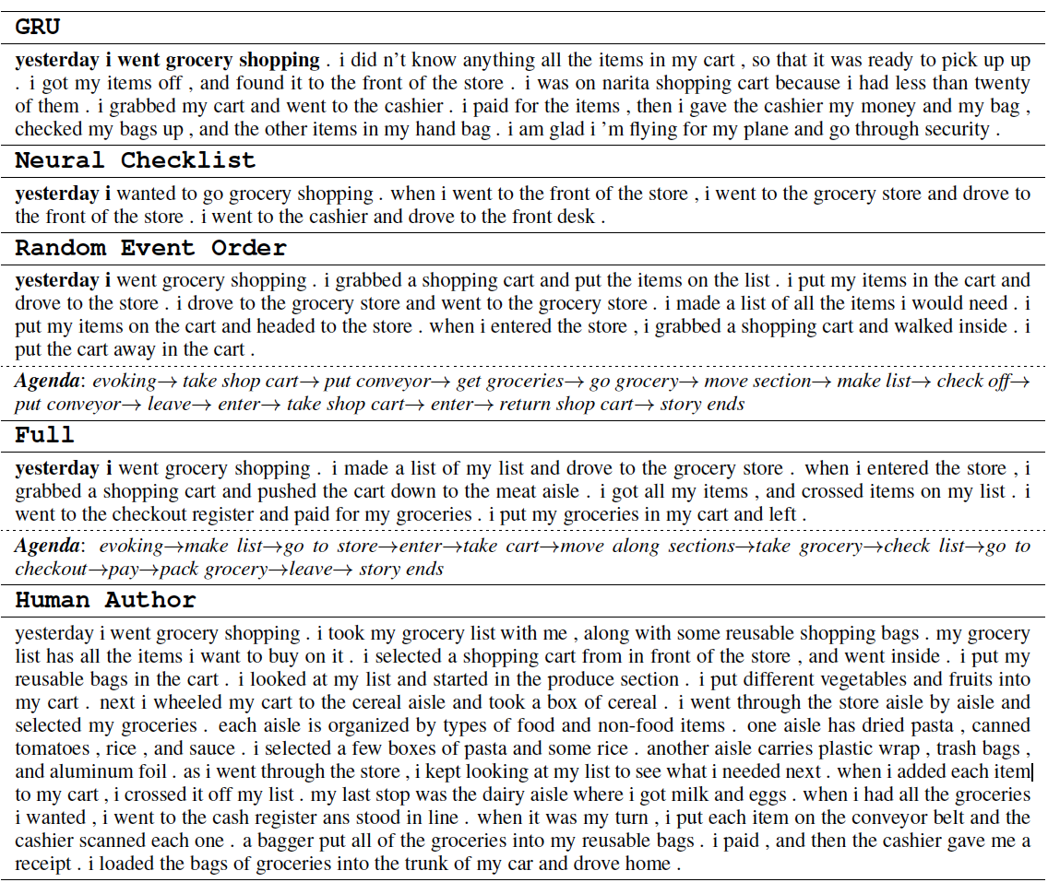
Sample Generation Output
Notes:
300 papers… every day… impossible to read… keyword search… abstract doesn’t reflect… results; ignore most of them. Cancer and surgery… 3 days… walk through all posters.. In our field papers that were published twenty years ago are not that important…
including mining PubMed bibliographic data, research papers in PubMed, clinical data sets and numerous bio-medical websites and social media related to medical sciences, where data related to diseases, drugs, treatments, chemical compounds, proteins, genes, biological pathways can be integrated and extracted from text data and their characteristics and relationships can be mined from such datasets as well
. Older literature is often extremely important (and overlooked), and indeed, often provides a rich source of information that can lead to new hypotheses. This makes the information overload problem event more serious, because we need distill and connect knowledge from papers that may cover 70 years.

Slide 31
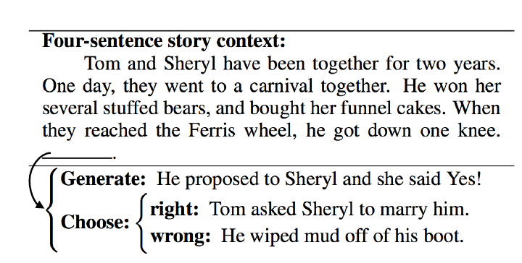
Story Ending Generation
(Li et al., COLING2018)
Notes:
300 papers… every day… impossible to read… keyword search… abstract doesn’t reflect… results; ignore most of them. Cancer and surgery… 3 days… walk through all posters.. In our field papers that were published twenty years ago are not that important…
including mining PubMed bibliographic data, research papers in PubMed, clinical data sets and numerous bio-medical websites and social media related to medical sciences, where data related to diseases, drugs, treatments, chemical compounds, proteins, genes, biological pathways can be integrated and extracted from text data and their characteristics and relationships can be mined from such datasets as well
. Older literature is often extremely important (and overlooked), and indeed, often provides a rich source of information that can lead to new hypotheses. This makes the information overload problem event more serious, because we need distill and connect knowledge from papers that may cover 70 years.

Slide 32
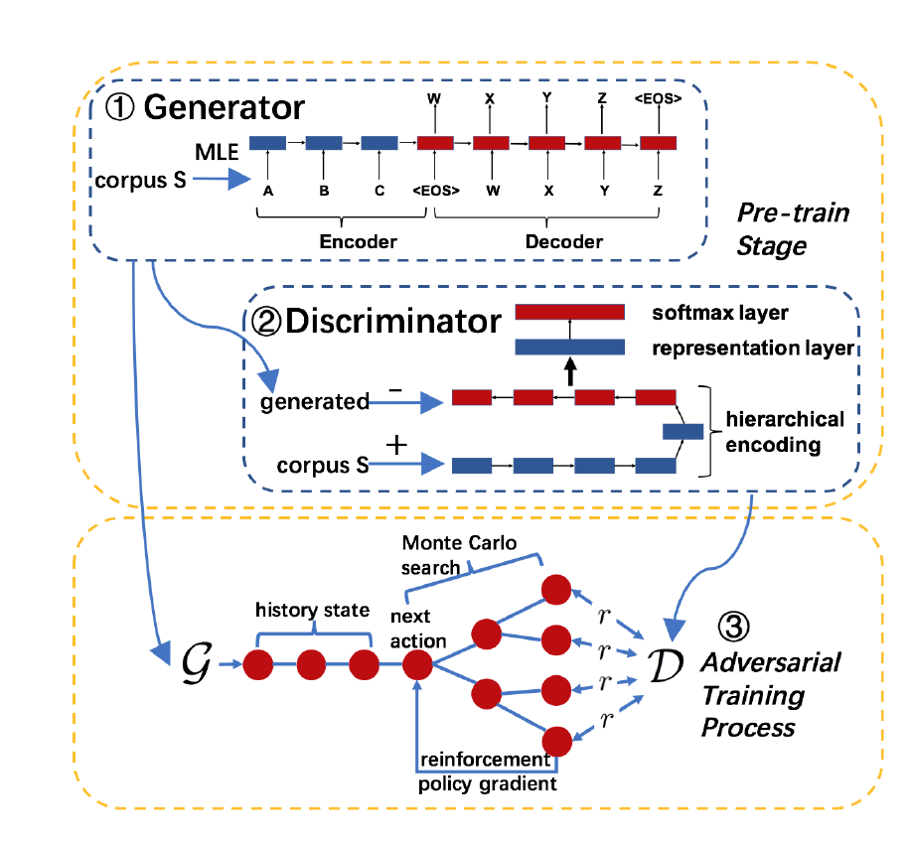
Method
Notes:
300 papers… every day… impossible to read… keyword search… abstract doesn’t reflect… results; ignore most of them. Cancer and surgery… 3 days… walk through all posters.. In our field papers that were published twenty years ago are not that important…
including mining PubMed bibliographic data, research papers in PubMed, clinical data sets and numerous bio-medical websites and social media related to medical sciences, where data related to diseases, drugs, treatments, chemical compounds, proteins, genes, biological pathways can be integrated and extracted from text data and their characteristics and relationships can be mined from such datasets as well
. Older literature is often extremely important (and overlooked), and indeed, often provides a rich source of information that can lead to new hypotheses. This makes the information overload problem event more serious, because we need distill and connect knowledge from papers that may cover 70 years.

Slide 33
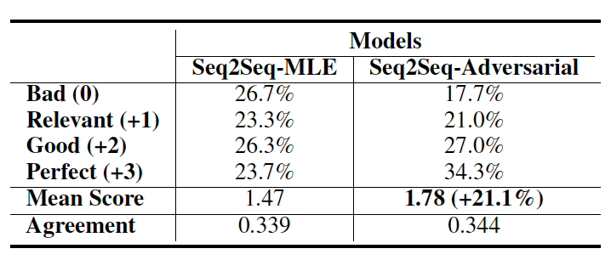
Results
(Li et al., COLING2018)
Notes:
300 papers… every day… impossible to read… keyword search… abstract doesn’t reflect… results; ignore most of them. Cancer and surgery… 3 days… walk through all posters.. In our field papers that were published twenty years ago are not that important…
including mining PubMed bibliographic data, research papers in PubMed, clinical data sets and numerous bio-medical websites and social media related to medical sciences, where data related to diseases, drugs, treatments, chemical compounds, proteins, genes, biological pathways can be integrated and extracted from text data and their characteristics and relationships can be mined from such datasets as well
. Older literature is often extremely important (and overlooked), and indeed, often provides a rich source of information that can lead to new hypotheses. This makes the information overload problem event more serious, because we need distill and connect knowledge from papers that may cover 70 years.

Slide 34
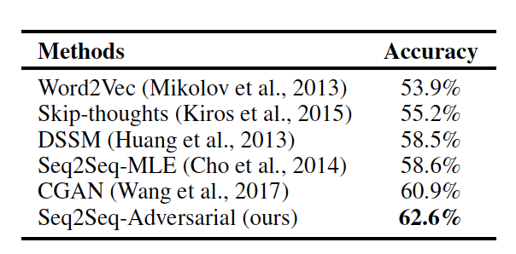
Results
Story Cloze Prediction
Notes:
300 papers… every day… impossible to read… keyword search… abstract doesn’t reflect… results; ignore most of them. Cancer and surgery… 3 days… walk through all posters.. In our field papers that were published twenty years ago are not that important…
including mining PubMed bibliographic data, research papers in PubMed, clinical data sets and numerous bio-medical websites and social media related to medical sciences, where data related to diseases, drugs, treatments, chemical compounds, proteins, genes, biological pathways can be integrated and extracted from text data and their characteristics and relationships can be mined from such datasets as well
. Older literature is often extremely important (and overlooked), and indeed, often provides a rich source of information that can lead to new hypotheses. This makes the information overload problem event more serious, because we need distill and connect knowledge from papers that may cover 70 years.

Slide 35
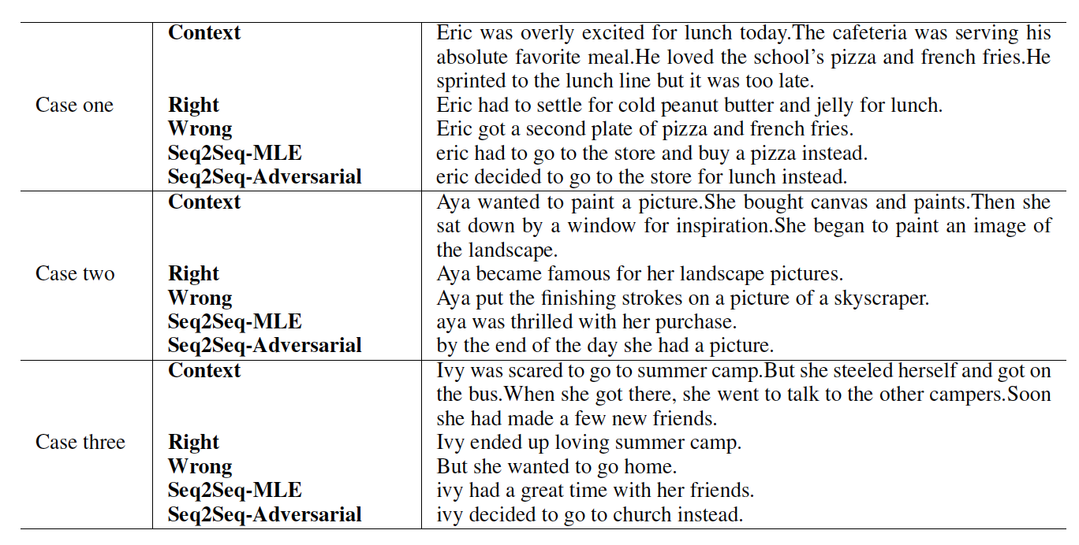
Example Output
Notes:
300 papers… every day… impossible to read… keyword search… abstract doesn’t reflect… results; ignore most of them. Cancer and surgery… 3 days… walk through all posters.. In our field papers that were published twenty years ago are not that important…
including mining PubMed bibliographic data, research papers in PubMed, clinical data sets and numerous bio-medical websites and social media related to medical sciences, where data related to diseases, drugs, treatments, chemical compounds, proteins, genes, biological pathways can be integrated and extracted from text data and their characteristics and relationships can be mined from such datasets as well
. Older literature is often extremely important (and overlooked), and indeed, often provides a rich source of information that can lead to new hypotheses. This makes the information overload problem event more serious, because we need distill and connect knowledge from papers that may cover 70 years.

Slide 36
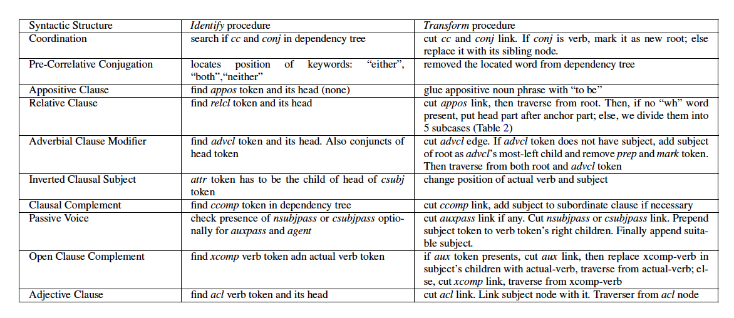
Text Simplification
Notes:
300 papers… every day… impossible to read… keyword search… abstract doesn’t reflect… results; ignore most of them. Cancer and surgery… 3 days… walk through all posters.. In our field papers that were published twenty years ago are not that important…
including mining PubMed bibliographic data, research papers in PubMed, clinical data sets and numerous bio-medical websites and social media related to medical sciences, where data related to diseases, drugs, treatments, chemical compounds, proteins, genes, biological pathways can be integrated and extracted from text data and their characteristics and relationships can be mined from such datasets as well
. Older literature is often extremely important (and overlooked), and indeed, often provides a rich source of information that can lead to new hypotheses. This makes the information overload problem event more serious, because we need distill and connect knowledge from papers that may cover 70 years.

Slide 37
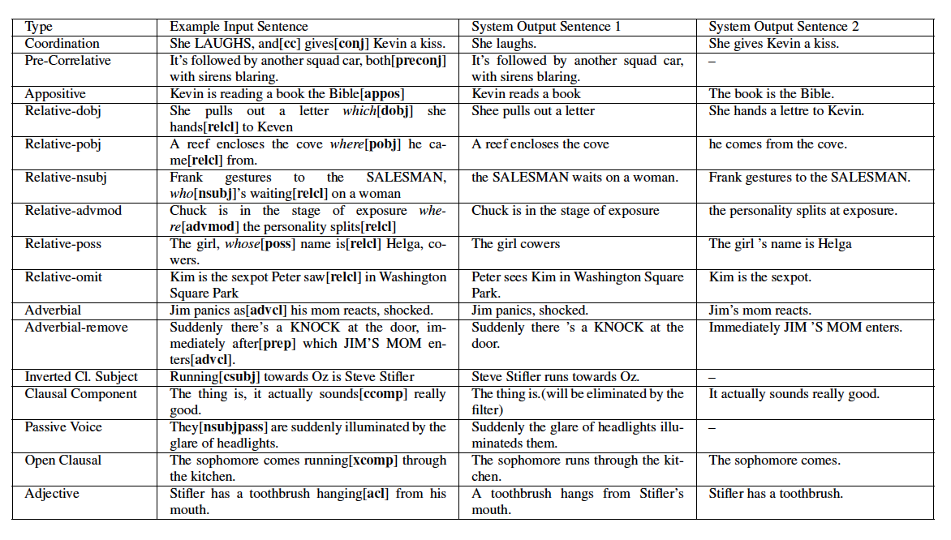
Text Simplification
Notes:
300 papers… every day… impossible to read… keyword search… abstract doesn’t reflect… results; ignore most of them. Cancer and surgery… 3 days… walk through all posters.. In our field papers that were published twenty years ago are not that important…
including mining PubMed bibliographic data, research papers in PubMed, clinical data sets and numerous bio-medical websites and social media related to medical sciences, where data related to diseases, drugs, treatments, chemical compounds, proteins, genes, biological pathways can be integrated and extracted from text data and their characteristics and relationships can be mined from such datasets as well
. Older literature is often extremely important (and overlooked), and indeed, often provides a rich source of information that can lead to new hypotheses. This makes the information overload problem event more serious, because we need distill and connect knowledge from papers that may cover 70 years.

Slide 38
Text Simplification
Firstly the dependency links of cc and conj are cut
Then we look for a noun in the left direct children of the original root LAUGHS and link the new root gives with it
In-order traverse from the original root and the new root will result in simplified sentences
Notes:
300 papers… every day… impossible to read… keyword search… abstract doesn’t reflect… results; ignore most of them. Cancer and surgery… 3 days… walk through all posters.. In our field papers that were published twenty years ago are not that important…
including mining PubMed bibliographic data, research papers in PubMed, clinical data sets and numerous bio-medical websites and social media related to medical sciences, where data related to diseases, drugs, treatments, chemical compounds, proteins, genes, biological pathways can be integrated and extracted from text data and their characteristics and relationships can be mined from such datasets as well
. Older literature is often extremely important (and overlooked), and indeed, often provides a rich source of information that can lead to new hypotheses. This makes the information overload problem event more serious, because we need distill and connect knowledge from papers that may cover 70 years.

Slide 39
User Study Results
Notes:
300 papers… every day… impossible to read… keyword search… abstract doesn’t reflect… results; ignore most of them. Cancer and surgery… 3 days… walk through all posters.. In our field papers that were published twenty years ago are not that important…
including mining PubMed bibliographic data, research papers in PubMed, clinical data sets and numerous bio-medical websites and social media related to medical sciences, where data related to diseases, drugs, treatments, chemical compounds, proteins, genes, biological pathways can be integrated and extracted from text data and their characteristics and relationships can be mined from such datasets as well
. Older literature is often extremely important (and overlooked), and indeed, often provides a rich source of information that can lead to new hypotheses. This makes the information overload problem event more serious, because we need distill and connect knowledge from papers that may cover 70 years.

Slide 40
Interactive Creative Story Generation
Can you tell a story about an athlete ran a race?
Sam was a star athlete.
He ran track at college.
There was a big race coming up.
Everyone was sure he would win.
Sam got first place.
Sam was a star athlete.
He ran track at college.
There was a big race coming up.
Everyone was sure he would win.
Sam got very nervous and lost the game.
Nice story! But can you make the ending sad?
Notes:
More concretely, I made some cartoon about what we want for controllable and creative generation

Slide 41
Rap Lyric Generation
(Manjavacas et al., ACL2019 workshop)
Character-level, syllable-level and a hierarchical LM (HLM) that integrates both levels
Consider syllable-level instead of word-level based on two-fold reasoning:
(i) similar to sub-word models — such as those induced through Byte-Pair-Encoding (Sennrich et al., 2016) or SentencePiece (Kudo and Richardson, 2018) —, syllable-level segmented input helps limiting the exploding vocabulary size of noisy corpora.
(ii) Syllables play a more central role than words in a particularly rhythmic genre like Hip-Hop in which, moreover, a tendency towards monosyllabic words reduces the vocabulary differences for word-level modeling.

Slide 42
Conditional Templates
Rhythm
Condition LMs on a a measure of verse length
count the number of syllables of each line in the erse and bucket them according to the following ranges: < 10, (10 -15), (15 - 20) and > 20
Rhyme
the rhyme-based condition corresponding to the line ‘unite around the corner’ is AO1-ERO — i.e. the ARPABET representations corresponding to the stressed syllabic nuclei of ‘cor-’ and ‘-ner’

Slide 43
Example Output

Slide 44
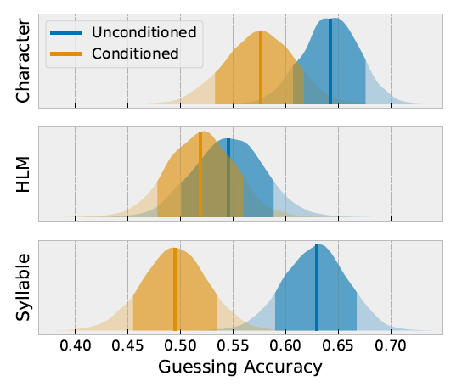
Results
Participants were shown Hip-Hop samples of lengths of 3
to 4 lines and were tasked to guess whether the dis306
played text was generated or real in 15 seconds.

Slide 45
How to evaluate creative generation?
(Potash et al., ACL2018 workshop)
Fluency/Coherence Evaluation: Given a generated verse, we ask annotators to determine the fluency and coherence of the lyrics.
The goal of the style matching annotation is to determine how well a given verse captures the style of the target artist.

Slide 46
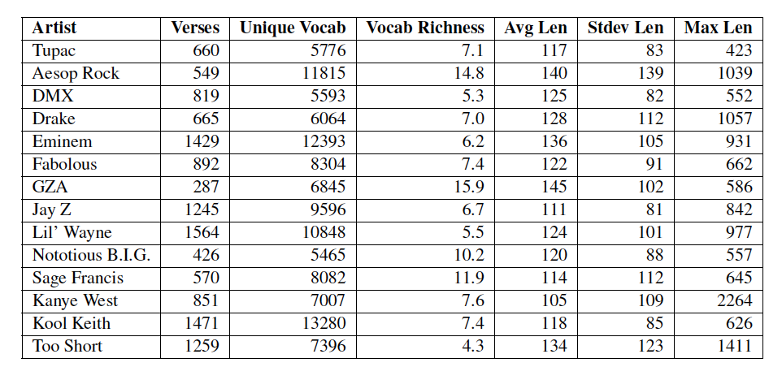
Rap Lyrics dataset statistics

Slide 47
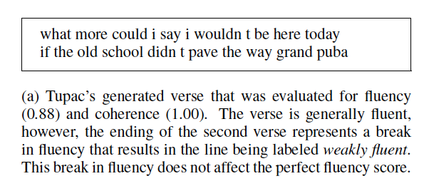
Results

Slide 48
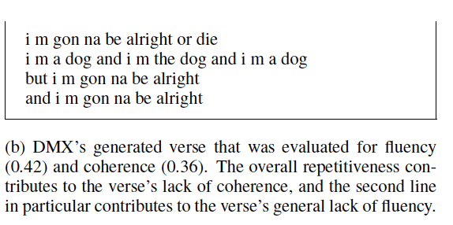
Results

Slide 49
Benchmarks
Overview
Evaluation
Datasets
Dialog Systems
Question Answering
Question Generation
Commonsense Reasoning
Summarization

Slide 50
Benchmarks Overview
Tasks | Dataset Name | External Resources | Leaderboard | Benchmark
Dialog Systems | Wizard of Wikipedia | Wikipedia | Yes | Kilt
Question Answering | ELI5 | Common Crawl | Yes | Kilt
Question Generation | SQuAD 1.1 | Wikipedia | No | GLGE
Commonsense Reasoning | CommonGen | N/A | Yes | GEM
 | αNLG-ART | N/A | Yes | GENIE
 | ComVE | N/A | Yes | SemEval
Summarization | CNN/DailyMail | N/A | Yes | GLGE

Slide 51
Automatic Evaluation
Untrained Automatic Metrics
N-Gram Overlap Metrics
ROUGE
METEOR
SacreBLEU
BLEU
GLGE-score
Fact-checking Metrics
PARENT
Trained Automatic Metrics
Pre-trained Language Model-based Evaluation
BERTScore
BARTScore
BLEURT
QuestEval
KPQA

Slide 52
Human Evaluation
Evaluation for Quality of Text
Fluency
Redundancy
Coherence
Commonsense
Grammar
Faithfulness
Inter-Annotator Agreement
Percent agreement, Cohen’s Kappa, Fleiss’s Kappa, Krippendorff’s Alpha
Problems
Expensive
Time-consuming
Quality Control
Challenge Criteria
Inconsistency in Evaluations
Inconsistency in Report

Slide 53
Dialog Systems : Wizard of Wikipedia
An open-domain conversation dataset directly grounded with knowledge retrieved from Wikipedia
Wizard
Inform their conversation partner (Apprentice) about a topic that one of them will choose
Have access to Wikipedia paragraphs that might be related to conversations
Apprentice
Go into depth about a chosen topic that interests themselves or their partner (Wizard), while keeping the conversation engaging and fun
Dataset: https://parl.ai/projects/wizard_of_wikipedia/
Leaderboard: https://eval.ai/web/challenges/challenge-page/689/leaderboard/1909

Slide 54
Dialog Systems: Wizard of Wikipedia
Topic | Lifeguard
Apprentice | So I am a lifeguard. Know anything about saving lives in water?
Wizard | I’m impressed! It’s a big responsibility to supervise other people’s safety in the water! Tell me more.
Apprentice | Well, I help make sure people do not drown or get injured while in or near the water!
Knowledge | A lifeguard is a rescuer who supervises the safety and rescue of swimmers, surfers, . . . Lifeguards are strong swimmers and trained in CPR/AED first aid, certified in water . . . · · · In some areas, the lifeguard service also carries out mountain rescues, or may function as the primary EMS provider
Wizard | I’ve heard that in some places, lifeguards also help with other sorts of emergencies, like mountain rescues! Is that part of your job too?
Apprentice | I have! I feel like you know much about this! What brings you to know so much?
Wizard | Oh, that’s about the extent of my knowledge. I’ve just been around beaches and I’ve always admired lifeguards. I’m not a super strong swimmer myself.

Slide 55
Question Answering: ELI5
A long-form question answering dataset containing complex, diverse questions that require explanatory multi-sentence answers
Use web search results (Common Crawl) as evidence documents to answer each question
Question | How do Jellyfish function without brains or nervous systems?
Supporting Documents | The box jellyfish nervous system is divided into three functional parts namely; rhopalia, conducting nerve ring, and motor nerve net. [...] While they don’t possess brains, the animals still have neurons that send all sorts of signals throughout their body. ``It is not true that jellyfish have no central nervous systems. They have an unusual nervous system,'' [...]
Answer | Jellyfish may not have a brain, but they have a rough nervous system and innate behaviours. However, they are very simple creatures. They're invertebrate: creatures without a backbone. Most jellyfish have really short life spans. [...] As their name implies, they are largely composed of basically jelly inside a thin membrane. They're over 95% water.
Dataset and Leaderboard: https://facebookresearch.github.io/ELI5/

Slide 56
Question Generation: SQuAD 1.1
A reading comprehension dataset consisting of 100,000+ questions posed by crowd workers on a set of Wikipedia articles
The answer to each question is a segment of text from the corresponding reading passage
Passage | Super Bowl 50 was an American football game to determine the champion of the National Football League (NFL) for the 2015 season. The American Football Conference (AFC) champion Denver Broncos defeated the National Football Conference (NFC) champion Carolina Panthers 24–10 to earn their third Super Bowl title. The game was played on February 7, 2016, at Levi’s Stadium in the San Francisco Bay Area at Santa Clara, California. As this was the 50th Super Bowl, [...].
Answer | Santa Clara, California
Target | Where did Super Bowl 50 take place?
Dataset: https://rajpurkar.github.io/SQuAD-explorer/

Slide 57
Commonsense Reasoning: CommonGen
A constrained text generation task, associated with a benchmark dataset
Explicitly test machines for the ability of generative commonsense reasoning
Based on visually-grounded sentences from several existing caption datasets
Dataset and Leaderboard: https://inklab.usc.edu/CommonGen/

Slide 58
Commonsense Reasoning: αNLG-ART
A generative commonsense reasoning dataset consists of over 20k commonsense narrative contexts and 200k explanations
Given the observations at time t1 and t2, the model needs to generate a plausible hypothesis
Observation at t1 | Larry’s yard was covered in dead leaves.
Observation at t2 (t2>t1) | Larry decided to give up for the day and went back inside.
Hypothesis | He spent hours trying to clean the yard.
Dataset and Leaderboard: http://abductivecommonsense.xyz/

Slide 59
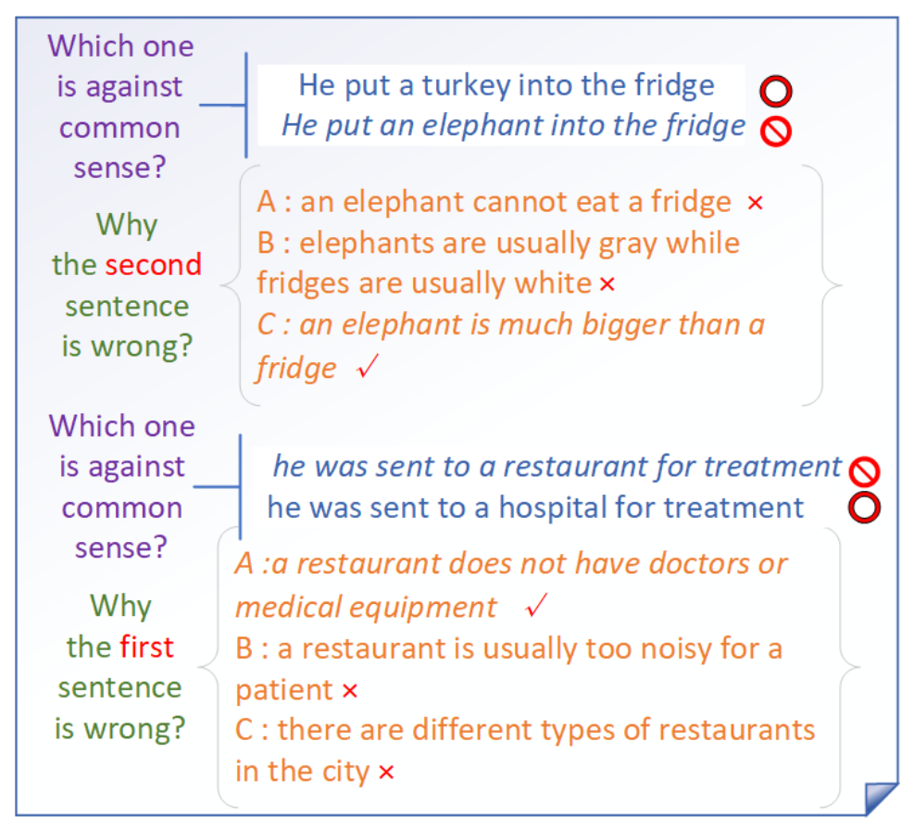
Commonsense Reasoning: ComVE
Generate the reason why a statement is against common sense and use BELU to evaluate it
Consists 2021 against common-sense sentences with true reasons
Dataset and Leaderboard: https://competitions.codalab.org/competitions/21080

Slide 60
Summarization: CNN/DailyMail
A non-anonymized variant of CNN/DailyMail dataset consists of 311,971 <article, summary> pairs
Article | andy murray came close to giving himself some extra preparation time for his wedding next week before ensuring that he still has unfinished tennis business to attend to. the world no 4 is into the semi-finals of the miami open, but not before getting a scare from 21 year-old austrian dominic thiem, who pushed him to 4-4 in the second set before going down 3-6 6-4, 6-1 in an hour and three quarters. murray was awaiting the winner from the last eight match between tomas berdych and argentina’s juan monaco. prior to this tournament thiem lost in the second round of a challenger event to soon-to-be new brit aljaz bedene. andy murray pumps his first after defeating dominic thiem to reach the miami open semi finals. muray throws his sweatband into the crowd after completing a 3-6, 6-4, 6-1 victory in florida. murray shakes hands with thiem who he described as a ‘strong guy’ after the game. (…)
Summary | british no 1 defeated dominic thiem in miami open quarter finals. andy murray celebrated his 500th career win in the previous round. third seed will play the winner of tomas berdych and juan monaco in the semi finals of the atp masters 1000 event in key biscayne
Dataset : https://github.com/becxer/cnn-dailymail/

Slide 61
Remaining Challenges
Challenge 1: LM Hallucination and Bias
Challenge 2: Knowledge Bottleneck
Challenge 3: Capturing Global Consistency across discourse, tables and graphs
Challenge 4: Removing Repetitions
Challenge 5: Urgent Need of Better Evaluation Metrics

Slide 62
Challenge 1: LM Hallucination and Bias
30% of abstractive summaries contain unfaithful information by state-of-the-art models (Cao et al, 2018)
Examples of fabricated answers in movie question answering
Q: What did Susie promise to one of the waiters at the Copacabana Club in return for smuggling her into the club for free? System: Susie promises to buy one of the men a drink after every act. Key: Susie promised him a prime slot for his singing act at the Gaslight Café for 2 weeks. Unfortunately Susie thinks his act is awful but keeps her word even since they had to watch the show from the kitchen.
Q: What do Midge and Susie fight over? System: Their son. Key: With emotions on high, Susie confronts Midge about why she hired Herb. Midge felt Susie does not help and sabotaged her earlier because Susie rushed her on stage. Midge tells her she wants to quit and, after a few insults at each other, walks away.
Q: What do Susie and Midge talk about when Midge visits Susie's home? System: Susie and midge talk about the upcoming moon landing. Key: Susie confronts Midge about her meeting with Randall and his agent. She tells Midge she does not need a man to help with her set and what she is doing is not stand-up, it's being the annoying party guest. Midge breaks down crying and tells Susie her life has been hard and if Susie wants to be her manager, she has to deal with Midge's personal matters and not run away. After this, Susie comforts Midge.
Q: How were some of the Navy Seal members killed back in America? System: In a scuffle in france the four members of the navy were killed. Key: One was run over by a truck while throwing trash in the sideback. One was shot during a car drive.
Bias from LM [Wang et al., INLG2018]
“Silvi Jan (born 27 October 1973) is a former Israel. He played for Israel women‘s national football team,…”
Potential solutions: filter out popularity bias, incorporate more scenario-specific/domain-specific knowledge

Slide 63
Challenge 2: Knowledge Bottleneck
Noise from imperfect automatic information extraction and knowledge acquisition methods
End-to-end information extraction F-score is only around 75%
Lacking of effective domain-specific knowledge mining methods
Paper generation models trained from biomedical domain don’t work for NLP domain
Need to incorporate more commonsense knowledge and dynamic knowledge
Example from KB Description [Wang et al., INLG 2018]:
“Aleksei Gasilin ( born 1 March 1996 ) is a ... He made his professional debut in the Russian Second Division in 1992 for …”
Personification: The attribution of humanlike qualities to something non-human due to lack of common sense knowledge [Modi and Parde, 2019]
Learning external knowledge in a continuous way (Lifelong learning) [Yu et al., 2021; Mazumder et al., 2018]
Embed knowledge into pre-trained language model [Cao et al., 2017; Liu et al., 2019Qin et al., 2021]

Slide 64
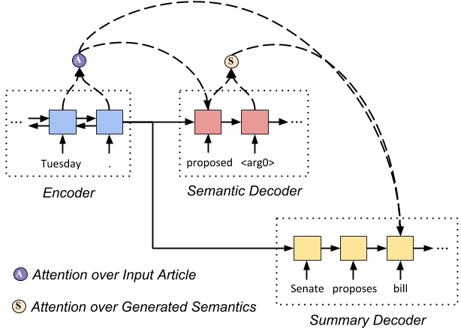
Challenge 3: Capturing Global Consistency
Inconsistency across Discourse
Balanchine's "Mozartiana" (1981) is one of the best ballets in the world, but it is also one of his least interesting. The first movement, a Tchaikovsky Suite, is a bit of a mess, and the second movement is a little too easy. The third movement is too easy; the fourth, a Gigue, is too simple.
Inconsistency Analysis from [Modi and Parde, 2019]
Contradictions in ideas within the same story
Singular/Plural Disagreement
Ghost Entities: Some sub-stories make use of a pronoun that has no antecedent at all
Point-of-View Inconsistency: The narrative point of view randomly changes within the story
Inconsistency across Tables/Graphs
Current methods are limited to encoding position information
Potential solutions
Develop document-level or corpus-level information extraction methods to capture long-term dependencies
Incorporate semantic parsing in encoding and decoding [Huang et al.2020]
Input: the Senate proposed a tax bill on Tuesday
Output:
Semantic structure:
proposed <ARG0> the Senate <ARG1> tax bill
Summary:
Senate proposes bill

Slide 65
Challenge 4: Repetition
It has been a mystery why DNN generates so many repetitions [Modi and Parde, 2019]
Repetitions within Story: Recurrence of the same sentence(s) within a story
Repetitions within Sentence: Recurrence of the same phrase(s) within a substory
Repetitive Subject: The sub-stories have the same subject and differ only in the adjective used to describe it
Repetitive Sentence Structure: Most sentences start with “the [noun] was/were/is [adjective]
Excessive Paraphrasing: Presence of substories that have similar meanings but are expressed using different words or phrases
Most solutions try to add controls (through vocabulary selection or hyperparameter control) in beam search decoding, which might generate less important content

Slide 66
Repetition Removal Example [Wang et al., ACL2019]
Before: Background: The aim of this study was to compare the efficacy and safety of pain relief in patients with knee osteOArthritis (OA). Methods: This was a prospective cohort study of patients with knee osteOArthritis (OA). The primary endpoint was the proportion of patients with knee osteOArthritis (OA).
After: Background: The aim of this study was to compare the efficacy and safety of pain in patients with knee osteOArthritis (OA). Methods: This was a prospective, multicentre, multi-center, non-interventional, observational, randomized, controlled trial. The primary endpoint was the proportion of the knee and joint symptom of the physical functioning, and to evaluate the relationship between the two groups. Patients were randomly assigned to receive either a single dose of 0.5 mg twice daily (n = 30) or placebo (500 mg/day) for 52 weeks.

Slide 67
Repetition Removal Example [Wang et al., ACL2019]
Before: Background: The aim of this study was to compare the clinical outcome of myocardial infarction (MI) in patients with acute ST segment elevation (MI). Methods: We retrospectively reviewed the clinical records of patients with acute ST segment elevation of acute ST elevation myocardial infarction (MI). Patients with acute ST elevation myocardial infarction (MI), and acute ST elevation myocardial infarction (MI), were included in this study. The primary endpoint was the proportion of patients with acute ST elevation myocardial infarction (MI) and coronary artery disease (CAD).
After: Background The aim of this study was to compare the prevalence of myocardial infarction (MI) in patients with acute ST. Methods : The primary endpoint was the first time of the left anterior descending coronary artery , and to evaluate the clinical utility of Protocol . We performed a retrospective analysis of a prospective, randomized controlled trial. Patients were divided into two groups (n=6). The median follow-up period was defined as the presence of the right ventricle, and the level of cardiac catheterization was evaluated .

Slide 68
Challenge 5: Urgent Need of Better Evaluation Metrics
“Bad” examples with 0 BLEU/ROUGE scores
Question: How Midge’s parent react to the news that Joel has left Midge
Key: Midge’s dad starts to play the piano frantically and later blames Midge for marrying a weak man against his advice.
System: Midge’s mother starts crying and whining heavily.
Question: Did the CIA know that Russia was dealing weapons out of Aleppo?
Key: Yes.
System: the intelligence community was aware that the sale of nerve gas was being carried out.
“Bad” examples from Abductive Reasoning
Given beginning: Billy had received good grades on his report card.
TO generate a reason between beginning and ending!
Given ending: He decided as he got home that elephants were his new favorite animal.
Ground truth: He went to the zoo later in the day and saw elephants.
Generated example:
(1) Billy's parents sent him on an African safari for a reward.
(2) His mother stopped by the store and bought him a stuffed elephant.
68
Notes:
Change low resource IL to a language which is not in wikipedia
Word-level: from bi-lingual dicts and alignment; structure-level comes from wals; multi-level alignment

Slide 69
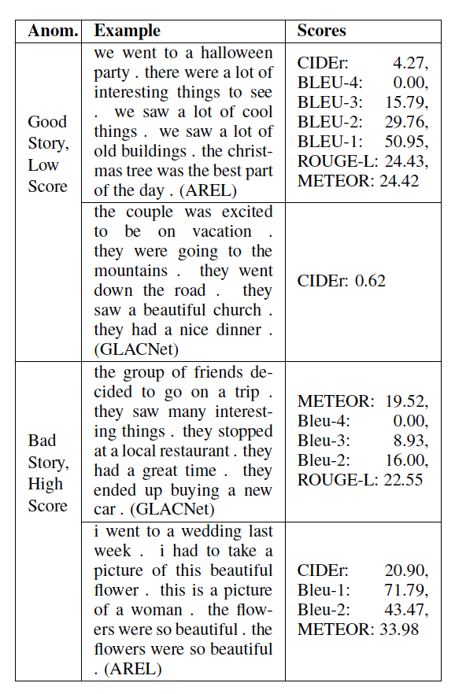
Challenge 5: Urgent Need of Better Evaluation Metrics
(Potash et al., ACL2018 workshop)
Potential solution: adding coherence, fact verification and fluency into metrics, in addition to WordNet/embedding based semantic similarity [Potash et al., 2018]
Knowledge reconstruction metric [Wang et al., 2018]:
69
Notes:
Change low resource IL to a language which is not in wikipedia
Word-level: from bi-lingual dicts and alignment; structure-level comes from wals; multi-level alignment

Slide 70
Future Directions
Direction 1: Background Knowledge Guided NLG
Joint Knowledge and Text Representations
Dynamic knowledge acquisition and encoding
Direction 2: Multimedia Guided NLG
Direction 3: Extract and then Generate
Direction 4: Multi-view Summarization
Direction 5: Using Knowledge-Enhanced NLG for Training Data Generation or Augmentation
Misinformation Detection
Direction 6: Using Knowledge-Enhanced NLG for other NLP tasks
Information Extraction
Taxonomy Completion
Entity Linking

Slide 71
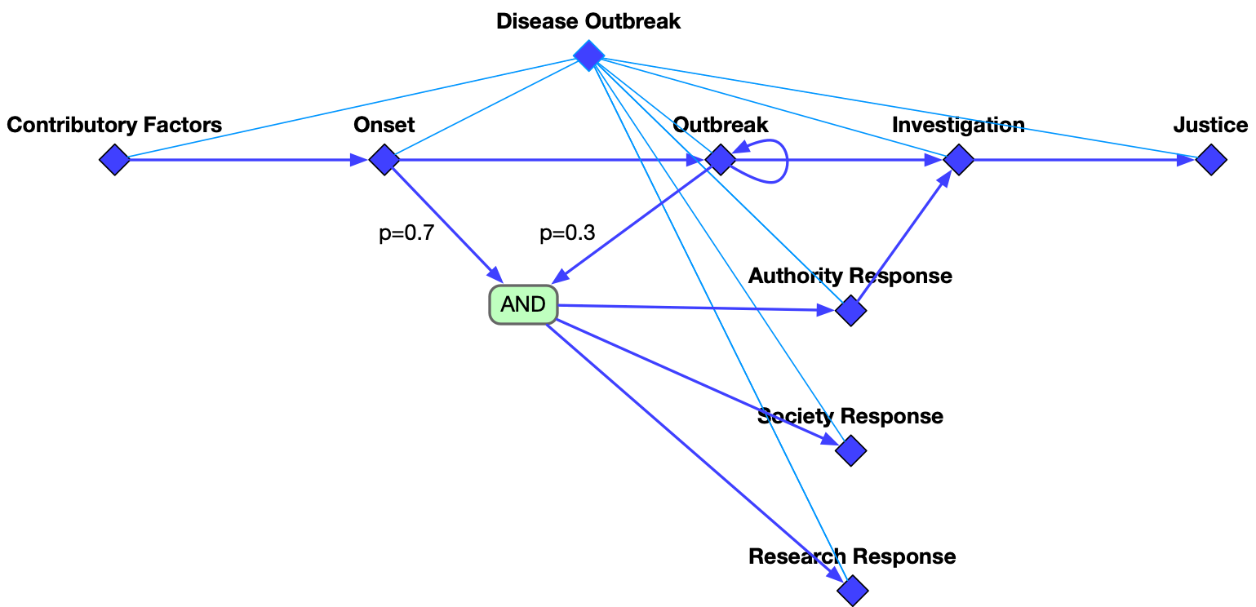
Direction 1: Background Knowledge Guided NLG
Contributory Factors
Onset
Outbreak
Investigation
Justice
Authority Response
Society Response
temporal
hierarchical
Research Response

Slide 72
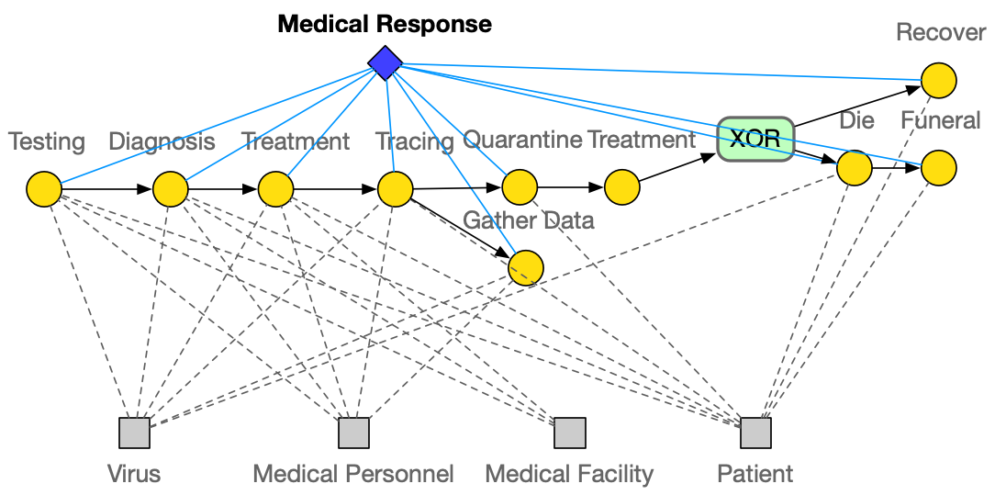
Direction 1: Background Knowledge Guided NLG

Slide 73
Direction 1: Background Knowledge Guided NLG
Notes:
300 papers… every day… impossible to read… keyword search… abstract doesn’t reflect… results; ignore most of them. Cancer and surgery… 3 days… walk through all posters.. In our field papers that were published twenty years ago are not that important…
including mining PubMed bibliographic data, research papers in PubMed, clinical data sets and numerous bio-medical websites and social media related to medical sciences, where data related to diseases, drugs, treatments, chemical compounds, proteins, genes, biological pathways can be integrated and extracted from text data and their characteristics and relationships can be mined from such datasets as well
. Older literature is often extremely important (and overlooked), and indeed, often provides a rich source of information that can lead to new hypotheses. This makes the information overload problem event more serious, because we need distill and connect knowledge from papers that may cover 70 years.

Slide 74
Direction 2: Multimedia Guided NLG
(Whitehead et al., EMNLP17)
74
Notes:
Change low resource IL to a language which is not in wikipedia
Word-level: from bi-lingual dicts and alignment; structure-level comes from wals; multi-level alignment

Slide 75
Input Article
Direction 3: Extract and then Generate (Sharma et al., 2019)
Prime Minister Bertie Ahern of Ireland called Sunday for a general election on May 24. Mr. Ahern and his centrist party have governed in a coalition government since 1197. . .Under Irish law, which requires legislative elections every five years, Mr. Ahern had to call elections by midsummer. On Sunday, he said he would base his campaign for reelection on his work to strengthen the economy and efforts to revive Northern Ireland’s stalled peace process this year. Political analysts said they expected Mr. Ahern’s work in Northern Ireland to be an asset . . .
Entity-aware Content Selector
Entity Mention Cluster
Extracted Sentences
{Prime Minister Bertie Ahern, Mr. Ahern, he,
he, his, Mr. Ahern’s}
{Ireland, Northern Ireland, Northern Ireland’s}
Political analysis …
Coherent abstract generation
On Sunday, he said …
Mr. Ahern and his …
Output Summary
prime min bertie ahern of ireland calls for general election on may 0. ahern and his centrist party, have governed in coalition government since 0. … ahern says he would base his campaign for re-election on his work to strengthen economy and his efforts to revive northern ireland’s stalled peace process.
Abstract Generator
Notes:
Diagram of the framework
We therefore propose a two-step neural abstractive summarization framework to emulate the way humans construct summaries with the goal of improving both informativeness and coherence of the generated abstracts. As shown in Fig. 2, an entityaware content selection component first selects important sentences from the input that includes references to salient entities. An abstract generation component then produces coherent summaries by conducting cross-sentence information ordering, compression, and revision.

Slide 76
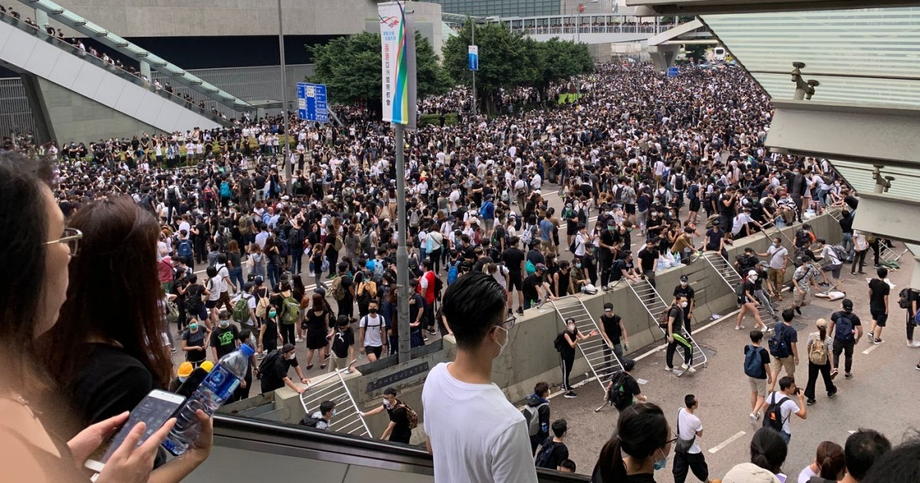
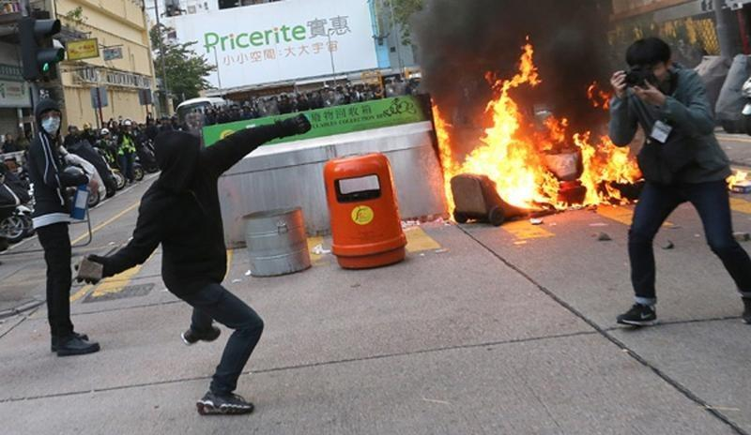
Direction 4: Multi-View Summarization
Claims: | Arrested protesters should be released. |  |  | Claims: | The protests are not necessary.
 | Carrie Lam should resign. |  |  |  | Violent protesters should be arrested.
Profile: | Birth Place: Hong Kong |  | Age: below 30 | Profile: | Birth Place: not Hong Kong |  | Age: Above 50
 | Education: above college |  | Participate in protest? No |  | Education: Below secondary school |  | Participate in protest? No
Premises |  | Evidence |  | Premises |  | Evidence
Extradition Law will weaken autonomy and judicial independence. |  | Police violently attacked protesters. |  | Protests on Extradition Law amendment are not necessary. |  | The target of Extradition Law is only on felon criminals.
 |  | Government ignored requests from protesters about revoking the amendment. |  |  |  | The Law is not proposed by the Beijing government.
Beijing government will undermine certain freedoms. |  | N/A |  | Most of the protests are violent. |  | Protesters blocked traffic.
 |  |  |  |  |  | Protesters attacked the police.

Slide 77
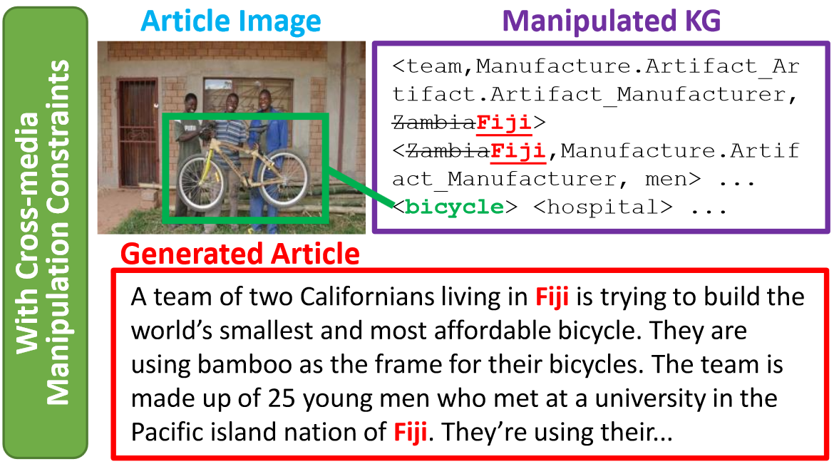
Direction 5: Using Knowledge-Enhanced NLG for Training Data Generation or Augmentation [Fung et al., ACL2021]
Fake News Generation o Train Misinformation Detectors
Knowledge Graph manipulations:
Entity swapping – Swapping entity that has same type and similar embedding (so they are harder to tell apart)
Addition of new relation or event – Randomly select relation / event argument roles and append a new entity to the relation / event
Subgraph replacement – Select a subgraph of the news article from an entity and replace it with a subgraph from another news article
Generate a fake news article that aligns with manipulated KG's by finetuning a BARTlarge language model (Lewis et al., 2020) on our training set + copy mechanism (Post and Vilar, 2018)

Slide 78
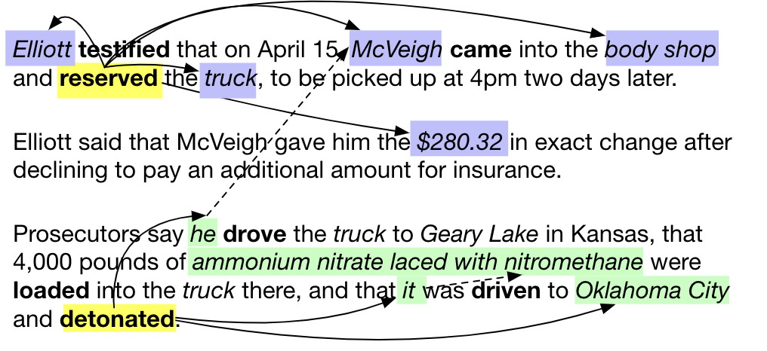
Direction 6: Using Knowledge-Enhanced NLG for other NLP tasks
Use Conditioned NLG for Document-level Event Extraction [Li et al., NAACL2021]
Is there any limitation during inference? Can we extract events from a wider context?
→ document-level IE, corpus-level IE.

Slide 79
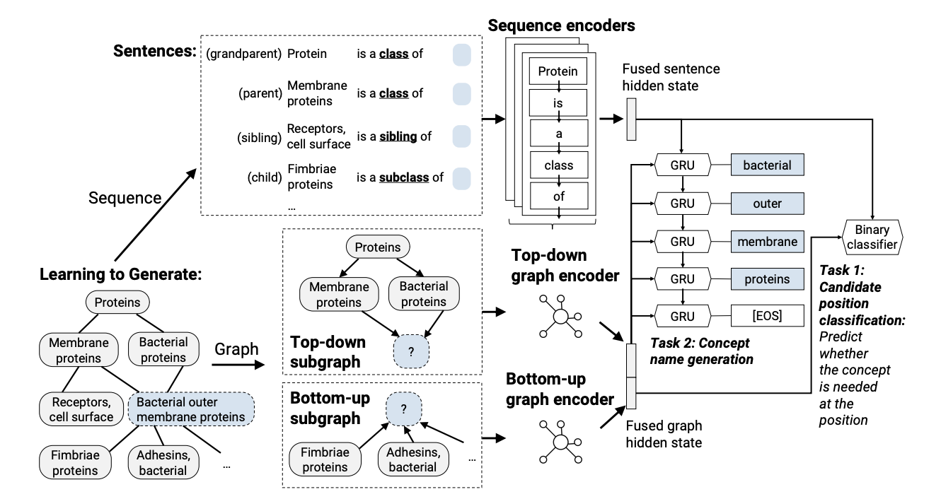
Direction 6: Using Knowledge-Enhanced NLG for other NLP tasks
Use Conditioned NLG for Taxonomy Construction [Zeng et al., 2021]

Slide 80
Direction 6: Using Knowledge-Enhanced NLG for other NLP tasks
Use Conditioned NLG for Entity Linking [Lai et al., submission]

