Slide 1
Fine-grained Entity Extraction
Heng Ji (UIUC)

Slide 2
What are “entities”?
[Main meaning]
- unique world bodies with (non-unique) names, such as
people, organizations, locations
e.g. Washington County
[Extended meaning – information extraction]
- unique identifiers, such as URLs, email addresses, tracking numbers, hashtags
- expressions of time, quantities, monetary values
Concepts (e.g. county)
But, everything is ambiguous

Slide 3
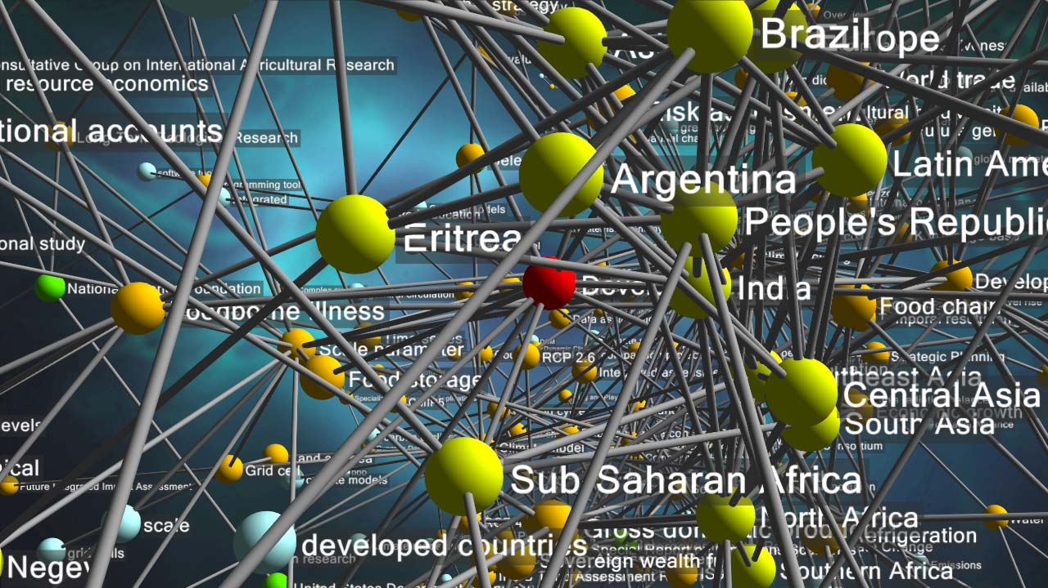

Why Are Entities Important?

Slide 4
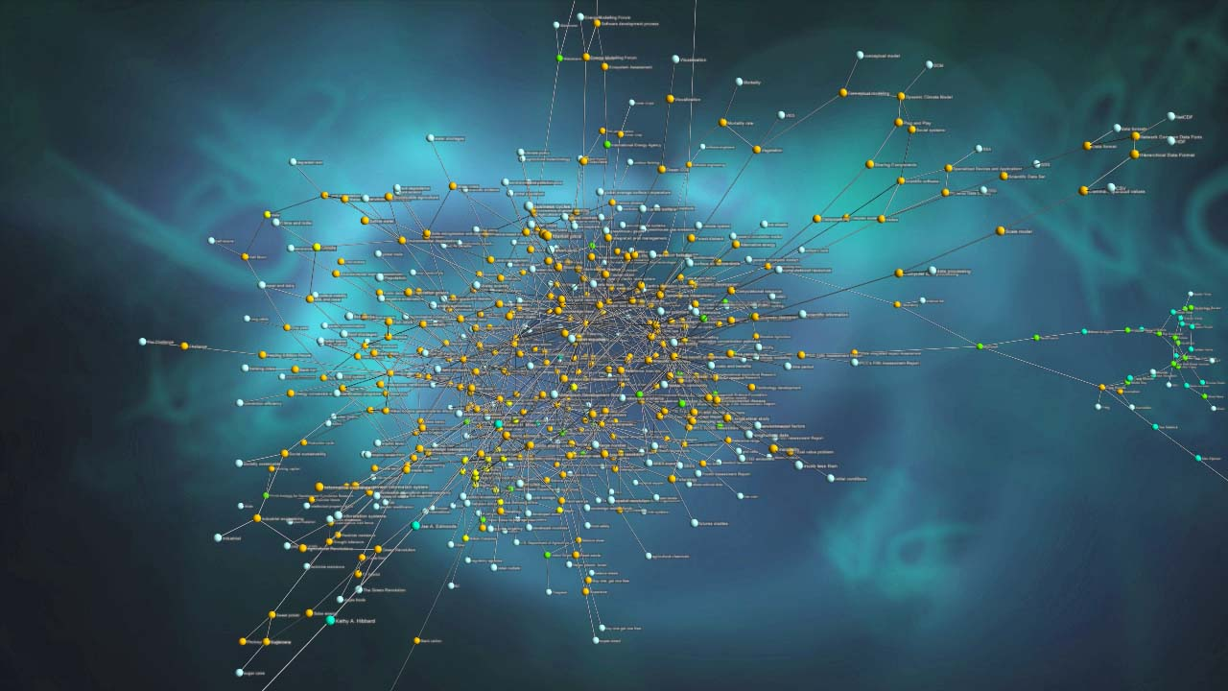
How Many Entities Are There?
Named places on Earth:
  ~ 10 million
Books written:
  ~ 130 million
People:
  ~ 8 billion
Species on Earth:
  ~ 1 trillion (of which ~10 million catalogued)
Stars in the Universe:
  ~ 1 billion trillion (1,000,000,000,000,000,000,000)
How Many Attributes?
How Many Relationships?
How Many Mentions?

Slide 5
Toward Fine-grained Entity Extraction
Real-world applications in scenarios such as disaster relief and technical support require us to significantly extend EDL capabilities to a wider variety of fine-grained entity types (e.g., technical terms, lawsuits, disease, crisis, vehicles, food, biomedical entities)
  e.g., the most frequent questions people ask Amazon's Alexa often involve new products, movies and actors
What’s New
  Low-resource setting: some silver-standard annotation but limited gold-standard annotation for training
  Human-in-the-loop: provide limited “feedback” on system output, which should be used to improve each system. The feedback will be provided based on a user model of how analysts might interact with the system while giving feedback on system output
  A new benchmark for both identification and classification of fine-grained entity types
5
Notes:
Change low resource IL to a language which is not in wikipedia
Word-level: from bi-lingual dicts and alignment; structure-level comes from wals; multi-level alignment

Slide 6
Task

Slide 7
Data Annotation and Resources
The Source collection for the evaluation includes 300K documents; only a core subset of 300 documents is evaluated
Jeremy will present details about the evaluation set and AIDA related annotations
UIUC has annotated 144 additional documents following the AIDA ontology and shared the annotations along with the annotation interface with the community
Because ultra-fine-grained entity types bring significant challenges to both of the annotation interface and human annotation, UIUC team has created silver-standard annotation derived from Wikipedia markups (Pan et al., 2017) for 16K+ YAGO entity types (571GB)
7
Notes:
Change low resource IL to a language which is not in wikipedia
Word-level: from bi-lingual dicts and alignment; structure-level comes from wals; multi-level alignment

Slide 8
Successful Methods: Incorporating Contextual Embedding Representations
Most teams have incorporated deep contextual embedding representations in deep neural networks models
  UIUC team (Lin and Ji, EMNLP2019) has used ELMO embeddings for both coarse-grained and fine-grained extraction
  IBM team uses regular BERT model for coarse-grained extraction, based name tagger, and a mention-centric classifier using RoBERTa and has features that comprise each mention and its context separately to specialize the mention into a fine-grained type
8
Notes:
Change low resource IL to a language which is not in wikipedia
Word-level: from bi-lingual dicts and alignment; structure-level comes from wals; multi-level alignment

Slide 9
Successful Methods: Joint Fine-grained Entity Identification, Classification and Linking
Ousia Team performs joint entity identification along with type classification
  pre-training phase: encode the given context with BERT along with BiLSTM; then they compute two layers: one performing a CRF to get standard BIO tags and the other computes YAGO tags
  fine-tuning phase: these two layers are combined to learn a mapping to output AIDA tags.
UIUC team and Diffbot team use Entity Linking (EL) to link mentions to the KB and then infer the types from the KB
  The types from the KB are restricted to the AIDA types: in particular they use the parent types of the linked entity in the type ontolog
  Diffbot system further uses 10 representative entities for each type using a popularity metric
9
Notes:
Change low resource IL to a language which is not in wikipedia
Word-level: from bi-lingual dicts and alignment; structure-level comes from wals; multi-level alignment

Slide 10
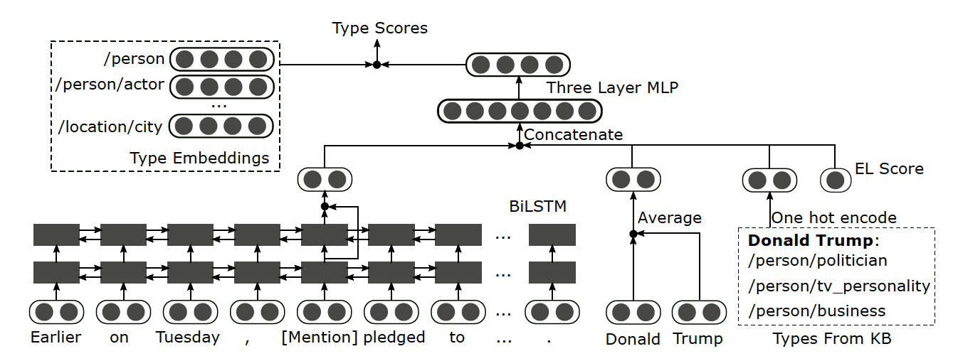
Use Entity Linking to Improve Fine-grained Entity Extraction
(Dai et al., EMNLP2019)

Slide 11
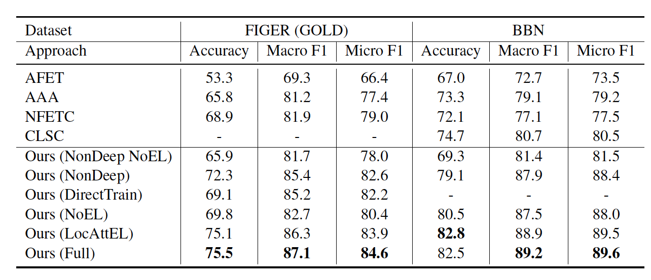
Use Entity Linking to Improve Fine-grained Entity Extraction
(Dai et al., EMNLP2019)

Slide 12
Successful Methods: Capturing Type Interdependency and Differentiating Similar Types
(Lin and Ji, EMNLP2019)
12
Notes:
\subsection{Capturing Type Inter-dependency}Fine-grained entity typing is usually formulated as a multi-label classification problem.Previous approaches~\cite{ling2012fine,choi2018ultra,xin2018improving} typically address it with binary relevancethat decomposes the problem into isolated binary classification subproblems and independently predicts each type.However, this method is commonly criticized for its label independence assumption, which is not valid for %does not hold true in fine-grained entity typing. For example, if the model is confident at predicting the type \texttt{artist}, it should promote its parent type \texttt{person} but discourage \texttt{organization} and its descendant types.In order to capture inter-dependencies between types, UIUC team~\cite{LinACL2019,LinTAC2019} has developed a hybrid model that incorporates latent type representation in addition to binary relevance.Specifically, the model learns to predict a low-dimensional vector that encodes latent type features obtained through Principle Label Space Transformation~\cite{tai2012multilabel} and reconstruct the sparse and high-dimensional type vector from this latent representation.\subsection{Differentiating Similar Types}Another major challenge in fine-grained entity typing is to differentiate similar types, such as \texttt{director} and \texttt{actor}, which requires the model to capture slightly different nuances in texts.Previous neural models~\cite{shimaoka2016attentive,xin2018improving,choi2018ultra,xu2018neural} generally extract features from pre-trained word embeddings.Instead, UIUC team~\cite{LinACL2019,LinTAC2019} adopts contextualized word representations~\cite{peters2018elmo}, which can capture context-aware word semantics and better represent out-of-vocabulary words.They further propose a two-step attention mechanism to actively extract the most relevant information from the sentence.Particularly, they calculate the attention for context words in a mention-aware manner, allowing the model to focus on different parts of the sentence for different mentions.For example, in the following sentence, ``\textit{In 2005 two {federal agencies}, the \textbf{US Geological Survey} and the \textbf{Fish and Wildlife Service}, began to identify {fish} in the \textbf{Potomac} and {tributaries}} ...'', the model should use ``federal agencies'' to help classify ``US Geological Survey'' and ``Fish and Wildlife Service'' as \texttt{government\_agency},but focus on ``fish'' and ``tributaries'' to determine that ``Potomac'' should be a %river \texttt{body\_of\_water} (river) instead of a %city \texttt{city}.

Slide 13
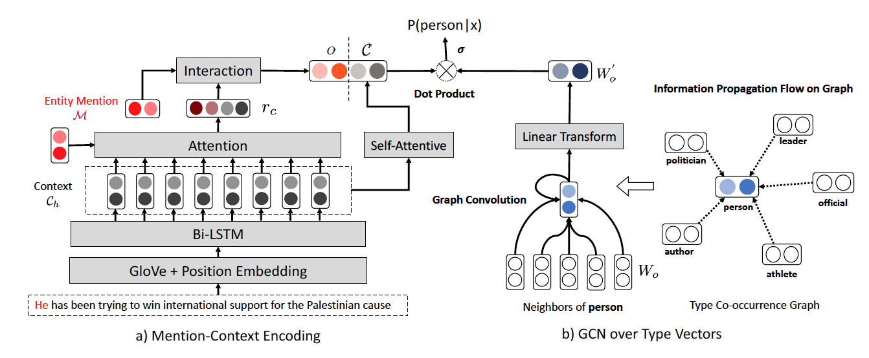
Successful Methods: Capturing Type Interdependency and Differentiating Similar Types
(Xiong et al., NAACL2019)
13
Notes:
\subsection{Capturing Type Inter-dependency}Fine-grained entity typing is usually formulated as a multi-label classification problem.Previous approaches~\cite{ling2012fine,choi2018ultra,xin2018improving} typically address it with binary relevancethat decomposes the problem into isolated binary classification subproblems and independently predicts each type.However, this method is commonly criticized for its label independence assumption, which is not valid for %does not hold true in fine-grained entity typing. For example, if the model is confident at predicting the type \texttt{artist}, it should promote its parent type \texttt{person} but discourage \texttt{organization} and its descendant types.In order to capture inter-dependencies between types, UIUC team~\cite{LinACL2019,LinTAC2019} has developed a hybrid model that incorporates latent type representation in addition to binary relevance.Specifically, the model learns to predict a low-dimensional vector that encodes latent type features obtained through Principle Label Space Transformation~\cite{tai2012multilabel} and reconstruct the sparse and high-dimensional type vector from this latent representation.\subsection{Differentiating Similar Types}Another major challenge in fine-grained entity typing is to differentiate similar types, such as \texttt{director} and \texttt{actor}, which requires the model to capture slightly different nuances in texts.Previous neural models~\cite{shimaoka2016attentive,xin2018improving,choi2018ultra,xu2018neural} generally extract features from pre-trained word embeddings.Instead, UIUC team~\cite{LinACL2019,LinTAC2019} adopts contextualized word representations~\cite{peters2018elmo}, which can capture context-aware word semantics and better represent out-of-vocabulary words.They further propose a two-step attention mechanism to actively extract the most relevant information from the sentence.Particularly, they calculate the attention for context words in a mention-aware manner, allowing the model to focus on different parts of the sentence for different mentions.For example, in the following sentence, ``\textit{In 2005 two {federal agencies}, the \textbf{US Geological Survey} and the \textbf{Fish and Wildlife Service}, began to identify {fish} in the \textbf{Potomac} and {tributaries}} ...'', the model should use ``federal agencies'' to help classify ``US Geological Survey'' and ``Fish and Wildlife Service'' as \texttt{government\_agency},but focus on ``fish'' and ``tributaries'' to determine that ``Potomac'' should be a %river \texttt{body\_of\_water} (river) instead of a %city \texttt{city}.

Slide 14
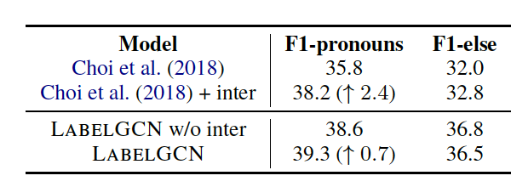
Successful Methods: Capturing Type Interdependency and Differentiating Similar Types
(Xiong et al., NAACL2019)
14
Notes:
\subsection{Capturing Type Inter-dependency}Fine-grained entity typing is usually formulated as a multi-label classification problem.Previous approaches~\cite{ling2012fine,choi2018ultra,xin2018improving} typically address it with binary relevancethat decomposes the problem into isolated binary classification subproblems and independently predicts each type.However, this method is commonly criticized for its label independence assumption, which is not valid for %does not hold true in fine-grained entity typing. For example, if the model is confident at predicting the type \texttt{artist}, it should promote its parent type \texttt{person} but discourage \texttt{organization} and its descendant types.In order to capture inter-dependencies between types, UIUC team~\cite{LinACL2019,LinTAC2019} has developed a hybrid model that incorporates latent type representation in addition to binary relevance.Specifically, the model learns to predict a low-dimensional vector that encodes latent type features obtained through Principle Label Space Transformation~\cite{tai2012multilabel} and reconstruct the sparse and high-dimensional type vector from this latent representation.\subsection{Differentiating Similar Types}Another major challenge in fine-grained entity typing is to differentiate similar types, such as \texttt{director} and \texttt{actor}, which requires the model to capture slightly different nuances in texts.Previous neural models~\cite{shimaoka2016attentive,xin2018improving,choi2018ultra,xu2018neural} generally extract features from pre-trained word embeddings.Instead, UIUC team~\cite{LinACL2019,LinTAC2019} adopts contextualized word representations~\cite{peters2018elmo}, which can capture context-aware word semantics and better represent out-of-vocabulary words.They further propose a two-step attention mechanism to actively extract the most relevant information from the sentence.Particularly, they calculate the attention for context words in a mention-aware manner, allowing the model to focus on different parts of the sentence for different mentions.For example, in the following sentence, ``\textit{In 2005 two {federal agencies}, the \textbf{US Geological Survey} and the \textbf{Fish and Wildlife Service}, began to identify {fish} in the \textbf{Potomac} and {tributaries}} ...'', the model should use ``federal agencies'' to help classify ``US Geological Survey'' and ``Fish and Wildlife Service'' as \texttt{government\_agency},but focus on ``fish'' and ``tributaries'' to determine that ``Potomac'' should be a %river \texttt{body\_of\_water} (river) instead of a %city \texttt{city}.

Slide 15
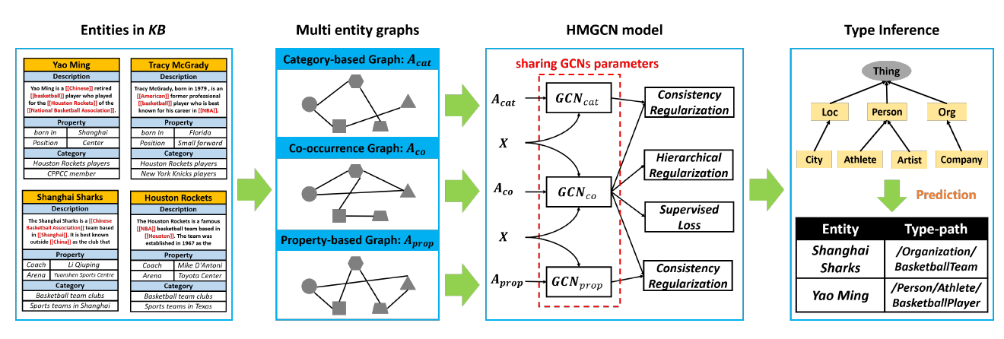
Capturing Hierarchy in Hierarchical GCN
(Jin et al., EMNLP2019)

Slide 16
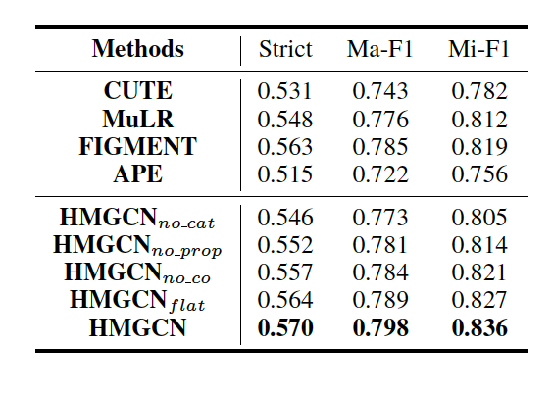
Capturing Hierarchy in Hierarchical GCN
(Jin et al., EMNLP2019)

Slide 17
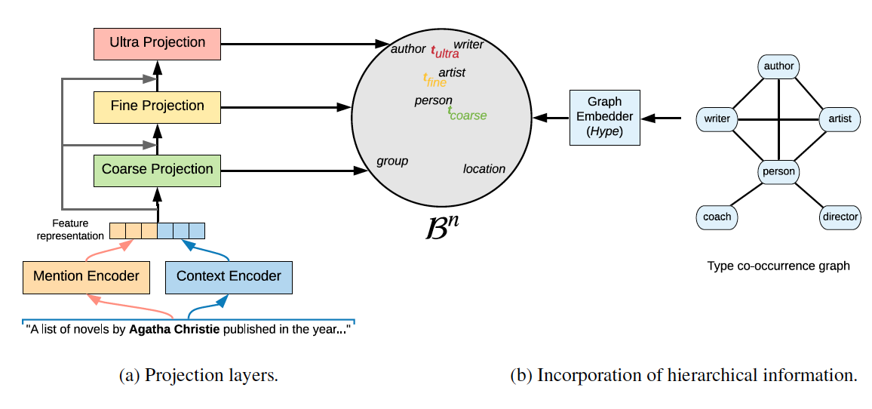
Capturing Hierarchy in Hierarchical GCN
(Lopez et al., RepL4NLP2019)

Slide 18
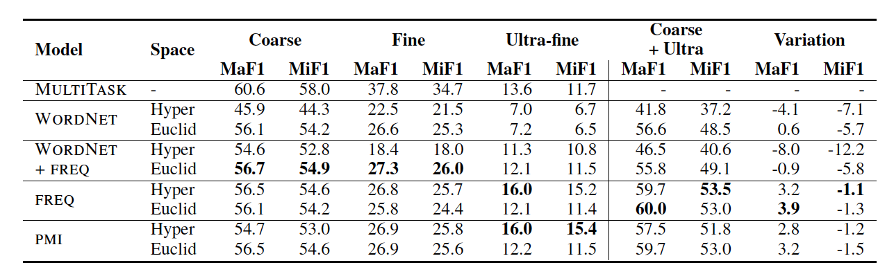
Capturing Hierarchy in Hierarchical GCN
(Lopez et al., RepL4NLP2019)

Slide 19
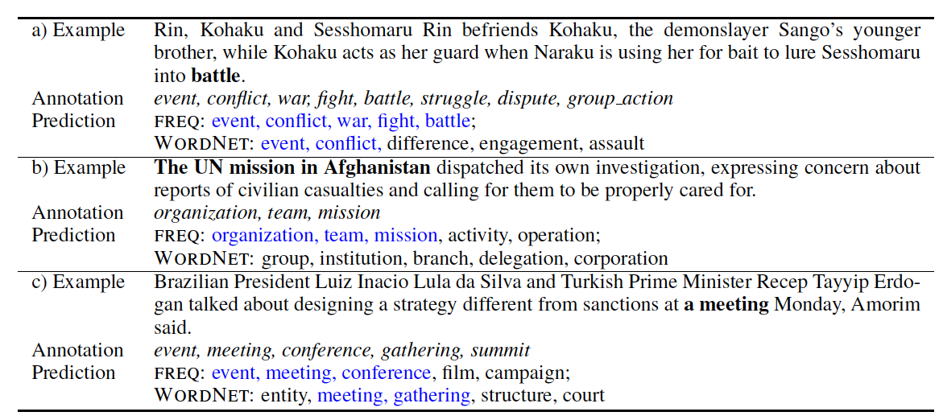
Capturing Hierarchy in Hierarchical GCN
(Lopez et al., RepL4NLP2019)

Slide 20
Extend to Thousands of Entity Types
7,297 hierarchical entity types defined in YAGO, derived from WordNet synsets
  Top level: thing
  Second level: person, organization, building, artifact, abstraction, physical entity, geographical entity
  Each type has at least 10 Wikipedia entries

Slide 21
Ultra-fine-grained Entity Extraction Examples
Hormone
  Briain-derived neuotrophic factor (“BDNF”), another important gene in neural plasticity, has also been shown to have reduced methylation and increased transcription in animals that have undergone learning.
Infectious Disease
  Notable exceptions include the Large Pine Weevil (“Hylobius abietis”), which can kill young conifers.
Dumpling
  Shengjian mantou is a type of small , pan - fried " baozi " ( steamed buns ) which is a specialty of Shanghai .
Fairy
  The background story of the game starts somewhere in the desert where Anwar , a pure hearted young man finds a rusty oil lamp from what he releases a very powerful and evil djinn the Nadir .

Slide 22
Ultra-fine-grained Entity Extraction Examples
Lawsuit
  The landmark Brown v. Board of Education decision paved they way for PARC v. Commonwealth of Pennsylvania and Mills vs. Board of Education of District of Columbia, which challenged the segregation of students with special needs.
Mental Disorder
  Many of these veterans suffer from post traumatic stress disorder, an anxiety disorder that often occurs after extreme emotional trauma involving threat or injury.
Military Academy
  The year after, the prince went back to France,[2] where he eventually entered the prestigious academy of École spéciale militaire de Saint-Cyr-Coëtquidan.
Military Uniform
  The following below depicted gallery of mounting loops are practically in use in conjunction with the 5- or 3 color flectarn fighting suit.

Slide 23
Ultra-fine-grained Entity Extraction Examples
Fundraiser
  The U.S. Fund administers the long-running Trick-or-Treat for UNICEF compaign which began as a local fundraising event in Pennsylvania in 1950 and has since raised more than US $170 million to support UNICEF’s work.
Investigator
  Samuel Hume was born in San Francisco, California in 1885, the son of James B. Hume, a famous Wells Fargo detective.
Lobbyist
  Represented by Lanny Davis, the CES lobbied for changes to the “gainful employment rule”.
Medical Scientist
  Pillemer was born on October 15, 1954, to Jean Burrell Pillemer and Louis Pillemer, and early pioneer in the filed of immunology at Case Western Reserve University.

Slide 24
Ultra-fine-grained Entity Extraction Examples
Molecular Biologist
  Meanwhile an overlapping class of transposable element was described under the name " polintons", derived from the key proteins polymerase and integrase, by Vladimir Kapitonov and Jerzy Jurka.
Natural Language
  The Vai language , also called Vy or Gallinas , is a Mande language spoken by the Vai people , roughly 104,000 in Liberia , and by smaller populations , some 15,500 , in Sierra Leone
Naval Commander
  His ship drifting dangerously inshore , at 14:30 Captain Thomas Frederick gave control to a sailor on board who claimed to have navigated the region and knew a safe anchorage .
Naval Gun
  She carried one15 cm SK L/45 gun, four 10.5 cm SK L/45 guns, four SK L/45 gun, four 8.8 cm SK L/35 guns, five 8.8 cm SK L/30 guns, and one 8.8 cm SK L/30 gun in a U- boat mounting.

Slide 25
Ultra-fine-grained Entity Extraction Examples
Poisoner
  It began to be used for murderers who used poisons after the Bishop of Rochester 's cook , Richard Rice , gave a number of people poisoned porridge , resulting in two deaths in February 1532 .
President
  Founder 's Day is national public holiday observed in Ghana to mark the birthday of Ghana 's first president , Dr. Kwame Nkrumah the key founding father of Ghana .
Queen
  He later became the King of Spain and married twice to Marie Louise of Savoy and then Elisabeth Farnese .
Religion
  The Mu'tazila tradition of tafsir has received little attention in modern scholarship , owing to several reasons .
Salad
  Texas caviar is a salad of black - eyed peas lightly pickled in a vinaigrette - style dressing , often eaten as a dip accompaniment to tortilla chips .

Slide 26
Ultra-fine-grained Entity Extraction Examples
Seafood
  Lauriea siagiani, is a species of squat lobster in the family Galatheidae, genus " Lauriea" .
Sign Language
  Following this , he has been at many festivals , including Ferstival Clin d’Œil throughout Europe as an actor , performer in various sign languages like DGS , BSL , LIS and LSF .
Appetizer
  This invention of a faux Polynesian experience is heavily influenced by Don the Beachcomber , who is credited for the creation of the "pūpū" platter and the drink named the " Zombie " for his Hollywood restaurant .
Bomber
  The carburetor intake was much larger , a long duct like that on the Nakajima B6N Tenzan was added , and a large spinner — like that on the Yokosuka D4Y Suisei with the Kinsei 62—was mounted .

Slide 27
Chinese Ultra-fine-grained Entity Extraction Examples
Vector
  一般 的 ， 令 D 是 作用 于 黎曼流 形 M 上 的 向量丛 V 的 一阶 微分 算子 。
  (In general, let D be the first-order differential operator of the vector bundle V acting on the Riemannian manifold M.)
  柯西 - 施瓦茨 不等式 叙述 ， 对于 一个 内积空间 所有 向量 " x " 和 " y "
  (Cauchy - Schwarz inequality description, for an inner product space of all vectors "x" and "y”)
Footbridge
  而 较 高 的 一座 哥特式 塔楼 于 1357 年 与 查理大桥 一起 由 彼得 帕尔 莱勒 兴建 ， 直到 1464 年 才 完成 。
  (The taller Gothic tower was built in 1357 by Peter Parleler with the Charles Bridge until 1464.)
  而 中国 最着 名 的 铁索 吊桥 是 四川省 甘孜 的 泸定桥 。
  (The most famous iron suspension bridge in China is Luding Bridge in Garze, Sichuan Province.)

Slide 28
Chinese Ultra-fine-grained Entity Extraction Examples
AutomotiveTechnology
  同时， 奥迪 也 在 这 一代 A4 中 引入 了 当时 全新 开发 的 Tiptronic 手自一体变速箱
  (At the same time, Audi also introduced a newly developed Tiptronic tiptronic transmission to this generation of A4 )
  电子稳定程序 ， 亦 称 车身动态稳定系统 （ 常 缩写 为 ESP® ） ， 又称 电子稳定控制系统 （ 缩写 ： ESC ） ， 是 对 旨在 提升 车辆 的 操控 表现 的 同时 、 有效 地 防止 汽车 达到 其 动态 极限 时 失控 的 系统 或 程序 的 通称。
  (Electronic stability program, also known as dynamic body stability system (often abbreviated as ESP®), also known as electronic stability control system (abbreviation: ESC), is designed to improve vehicle handling performance, while effectively preventing the car to reach The generic term for a system or program out of control at its dynamic limits.)
DataInputDevice
  多数 键盘布局 及 输入法 皆 可 用于 输入 拉丁文 字 或 汉字 。
  (Most keyboard layouts and input methods are available for entering Latin text or Chinese characters.)

Slide 29
KBP2020 Task on Fine-grained EDL
http://blender.cs.illinois.edu/kbp/2020/
29
Notes:
Change low resource IL to a language which is not in wikipedia
Word-level: from bi-lingual dicts and alignment; structure-level comes from wals; multi-level alignment

Slide 30
Annotation Exercise
http://159.89.180.81:12182/?dataset=Seedling_EN_2018e01
username: admin
password: lyiso8855631

Slide 31
Possible Term Projects
Hierarchical Type Embedding
Zero-shot fine-grained entity extraction
Incorporate Entity Linking to improve fine-grained entity typing

Slide 32
Overview of TAC-KBP2020 Recognizing Ultra Fine-grained EntitieS Task (RUFES):
Motivations and Goals
Questions for a knowledge base often involve fine-grained knowledge elements, e.g.,
  “Which epidemiologists have attended the meeting?”
  “Which animo acids in glycoprotein are most related to Glycan?”
Our goals
  significantly extend entity extraction capabilities to a wider variety of fine-grained entity types (e.g., technical terms, lawsuits, disease, crisis, vehicles, food, biomedical entities)
  perform document-level knowledge aggregation
Limitations of Existing fine-grained entity extraction benchmarks
  The amount of gold-standard annotation is very small while most annotations are ‘silver-standard’, derived from automatic mapping from KBs onto unstructured texts
  Most data sets are Wikipedia articles instead of other documents in the real-world that may contain unknown entities
  Only assign one type per entity mention given a certain context
  The existing ontologies are not designed based on the distributions of entities in data from a wide range of topics
  Existing methods have focused on name mentions only.
  There are very few shared open-source systems
32
Notes:
Change low resource IL to a language which is not in wikipedia
Word-level: from bi-lingual dicts and alignment; structure-level comes from wals; multi-level alignment

Slide 33
What’s New in RUFES
New source data: Washington Post collection (2012-2019)
Reorganized and expanded ontology
Added nominal and pronominal mentions
Paragraph as context for entity types
Allow multiple entity types
Document-level coreference resolution
33
Notes:
Change low resource IL to a language which is not in wikipedia
Word-level: from bi-lingual dicts and alignment; structure-level comes from wals; multi-level alignment

Slide 34
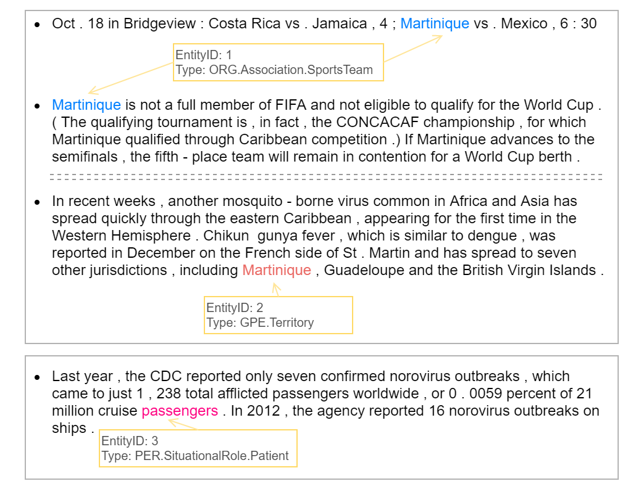
Task Overview

Slide 35
Datasets
Long articles are truncated so that the average length (based on the annotated data) is 500 words
139 first-passed from the evaluation set
106 completed second pass when the second evaluation window closed
33 remaining articles reserved for 2021
 | Development | Sample Annotation | Evaluation | Evaluation Annotation
Planned | 100,000 | 50 | 100,000 | 250
Delivered | 100,000 | 50 | 100,000 | 106

Slide 36
Ontology Development
Goal: over 250 entity types (coarse, fine and ultra-fine combined)
AIDA ontology as base (179)
  Some dropped; some reorganized
  SituationalRole*
Expansion with input from YAGO and Wikidata
  Scan news articles for potential entity types salient to the topic
  New top-level class: APP, Pathogen, Publication

Slide 37
Entities: AIDA vs RUFES vs Annotated
 | Level 1 | Level 2 | Level 3 | Total | Level 1|2 Terminal
AIDA | 17 | 61 | 101 | 179 | 24
RUFES | 14 | 80 | 172 | 266 | 37
Annotated | 14 | 79 | 146 | 239

Slide 38
Mention Types and Reference
Added nominals and pronominals
Removed specific reference limitation
Mentions are taggable if they are referential
  Singular specific reference
  Plural specific (group) reference
  Generic
  Indefinite
Limitations of tagging named mentions only:
  Named mentions usually refer to specific individual entities
  Many entities do not usually have names at the individual level, although named mentions may make “class/type/kind” reference to those entities

Slide 39
Annotated Mention Types
Mention Level
Entity Level
 | NAM | NOM | PRO | Total
Mention | 5869 | 6270 | 2621 | 14760
 | Total | NAM | NOM | PRO | NOM w/o NAM | PRO Only
Entity | 6299 | 2732 | 4145 | 1257 | 3333 | 234

Slide 40
Participants (alphabetical order)
24 teams registered; 5 teams participated
Team | Affliation
ibm_mnlp_ie | IBM Research (US)
L3i | La Rochelle Université (France)
RelMatter | Northwestern Polytechnical University (China)
sinai | Universidad de Jaén (Spain)
UIUC | University of Illinois at Urbana-Champaign (US)
40
Notes:
Change low resource IL to a language which is not in wikipedia
Word-level: from bi-lingual dicts and alignment; structure-level comes from wals; multi-level alignment

Slide 41
Performance – Mention Detection
*top-level entity type
Team | strong_mention_match |  |  | strong_typed_mention_match*
 | P | R | F | P | R | F
L3i | 0.869 | 0.867 | 0.868 | 0.743 | 0.740 | 0.741
ibm_mnlp_ie | 0.829 | 0.848 | 0.839 | 0.715 | 0.729 | 0.722
UIUC | 0.774 | 0.803 | 0.789 | 0.679 | 0.695 | 0.687
RelMatter | 0.825 | 0.786 | 0.805 | 0.345 | 0.335 | 0.340
sinai | 0.388 | 0.477 | 0.428 | 0.172 | 0.210 | 0.189

Slide 42
Performance – Coreference
*Top-level entity types
**New fine-grained entity type metric
Team | mention_ceaf |  |  | typed_mention_ceaf* |  |  | type metric**
 | P | R | F | P | R | F | F
UIUC | 0.677 | 0.702 | 0.689 | 0.614 | 0.631 | 0.622 | 0.383
ibm_mnlp_ie | 0.584 | 0.598 | 0.591 | 0.536 | 0.548 | 0.542 | 0.417
L3i | 0.579 | 0.577 | 0.578 | 0.504 | 0.503 | 0.504 | 0.323
RelMatter | 0.522 | 0.497 | 0.509 | 0.226 | 0.215 | 0.221 | 0.234
sinai | 0.238 | 0.292 | 0.262 | 0.133 | 0.164 | 0.147 | 0.061

Slide 43
Performance – Coreference
*Top-level entity types
**New fine-grained entity type metric
Team | mention_ceaf |  |  | typed_mention_ceaf* |  |  | type metric**
 | P | R | F | P | R | F | F
UIUC | 0.677 | 0.702 | 0.689 | 0.614 | 0.631 | 0.622 | 0.383
ibm_mnlp_ie | 0.584 | 0.598 | 0.591 | 0.536 | 0.548 | 0.542 | 0.417
L3i | 0.579 | 0.577 | 0.578 | 0.504 | 0.503 | 0.504 | 0.323
RelMatter | 0.522 | 0.497 | 0.509 | 0.226 | 0.215 | 0.221 | 0.234
sinai | 0.238 | 0.292 | 0.262 | 0.133 | 0.164 | 0.147 | 0.061

Slide 44
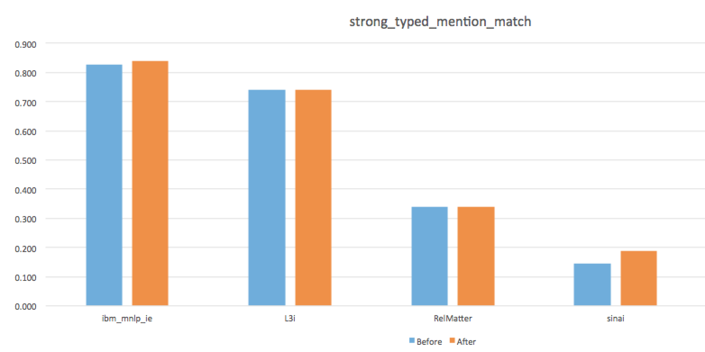
Impact of Human Feedback (Mention)

Slide 45
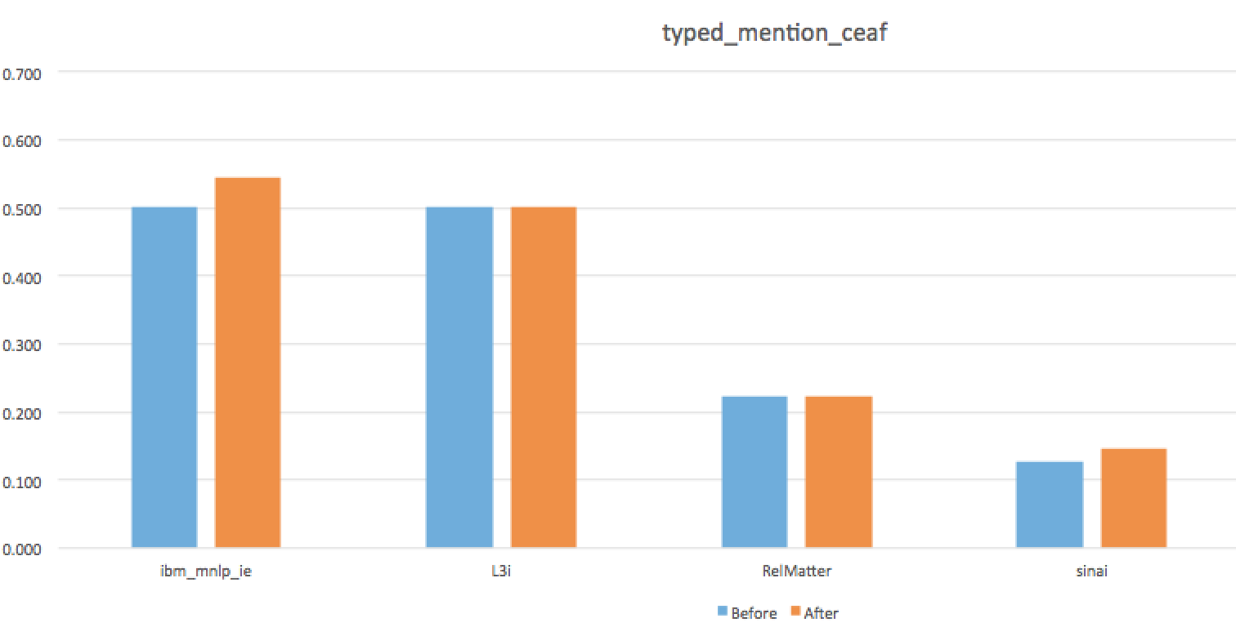
Impact of Human Feedback (Coreference)

Slide 46
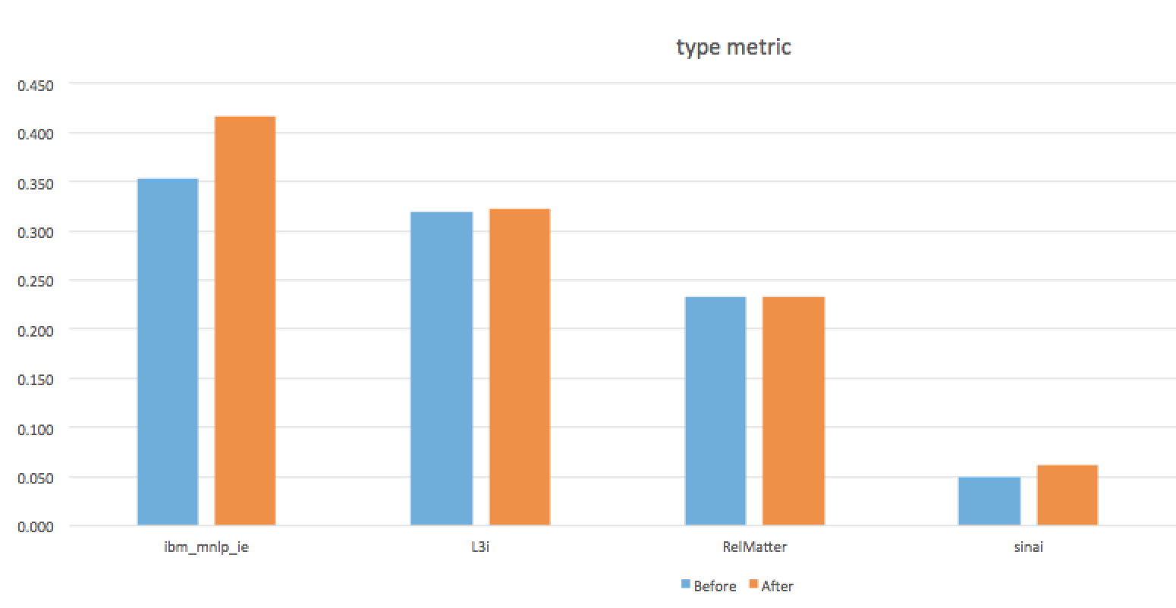
Impact of Human Feedback (Fine-Grain Typing)

Slide 47
Mention Types

Slide 48
Mention Types and Coreference
Team | FULL | NAM | NOM | PRO | NAM+NOM | NAM+PRO | NOM+PRO
UIUC | 0.687 | 0.807 | 0.556 | 0.736 | 0.669 | 0.777 | 0.612
ibm_mnlp_ie | 0.591 | 0.712 | 0.603 | 0.526 | 0.632 | 0.630 | 0.550
L3i | 0.578 | 0.740 | 0.606 | 0.565 | 0.630 | 0.640 | 0.546
RelMatter | 0.509 | 0.000 | 0.343 | 0.000 | 0.527 | 0.000 | 0.370
sinai | 0.262 | 0.283 | 0.263 | 0.403 | 0.260 | 0.289 | 0.275

Slide 49
Mention Types and Coreference

Slide 50
Mention Types, Entity Types and Coreference
Team | FULL | NAM | NOM | PRO | NAM+NOM | NAM+PRO | NOM+PRO
UIUC | 0.622 | 0.727 | 0.492 | 0.669 | 0.603 | 0.709 | 0.550
ibm_mnlp_ie | 0.542 | 0.644 | 0.550 | 0.421 | 0.578 | 0.568 | 0.496
L3i | 0.504 | 0.614 | 0.541 | 0.502 | 0.546 | 0.542 | 0.490
RelMatter | 0.221 | 0.000 | 0.177 | 0.000 | 0.216 | 0.000 | 0.201
sinai | 0.147 | 0.163 | 0.095 | 0.270 | 0.131 | 0.183 | 0.134

Slide 51
Mention Types, Entity Types and Coreference

Slide 52
Mention Types and Fine Typing
Team | FULL | NAM | NOM | PRO | NAM+NOM | NAM+PRO | NOM+PRO
ibm_mnlp_ie | 0.416 | 0.424 | 0.404 | 0.249 | 0.419 | 0.382 | 0.388
UIUC | 0.382 | 0.479 | 0.309 | 0.364 | 0.382 | 0.440 | 0.324
L3i | 0.324 | 0.367 | 0.347 | 0.283 | 0.340 | 0.324 | 0.330
RelMatter | 0.231 | 0.000 | 0.139 | 0.000 | 0.223 | 0.000 | 0.153
sinai | 0.061 | 0.061 | 0.044 | 0.095 | 0.056 | 0.069 | 0.058

Slide 53
Mention Types and Fine Typing

Slide 54
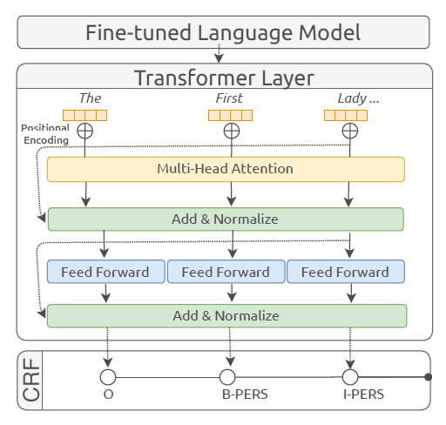
Successful Methods: L3i Hierarchical Multitask Learning for Entity Extraction
54
Notes:
Change low resource IL to a language which is not in wikipedia
Word-level: from bi-lingual dicts and alignment; structure-level comes from wals; multi-level alignment

Slide 55
Successful Methods: IBM Synthetic Data Augmentation
Use IBM in-house KLUE dataset (Florian et al., 2004) and DBPedia Abstract Corpus to train the seed supervised model
Generate synthetic data from the unannotated development corpus to augment the available data with k-Nearest Neighbor Graph
Query the K-NNG with each extracted mention representation and retrieve the k nearest mentions and labels associated with them, then select the fine-grained type using a threshold to vote between the first supervised model and the second model with data augmentation
55
Notes:
Change low resource IL to a language which is not in wikipedia
Word-level: from bi-lingual dicts and alignment; structure-level comes from wals; multi-level alignment

Slide 56
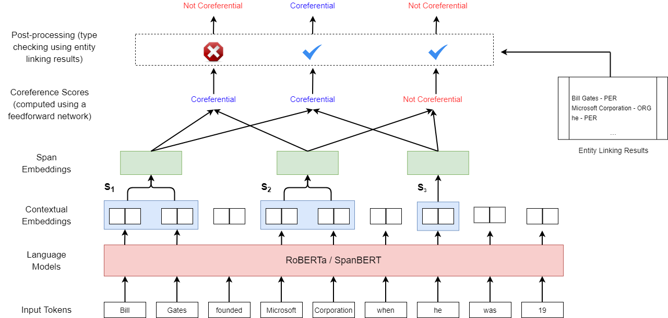
Successful Methods: UIUC Joint Entity and Event Coreference Resolution
Adopt a span-based architecture similar to previous work (Lee at al., 2017)
  Contextual Embeddings ~ Using a Transformer encoder
  Span Representations ~ Using an attention mechanism
  Pairwise Scores ~ Using a 2-layer multilayer feedforward network
Refine prediction decisions by using entity linking results
 | Ontonotes (CoNLL)
Previous SOTA (Lu and Ng, 2020) | 91.9
Ours | 92.4
 | SemEval 2010
TANL-1 (Attardi et al., 2010) | 56.1
Ours | 67.6
Performance of English systems (on gold mentions)
Performance of Spanish systems (on gold mentions)

Slide 57
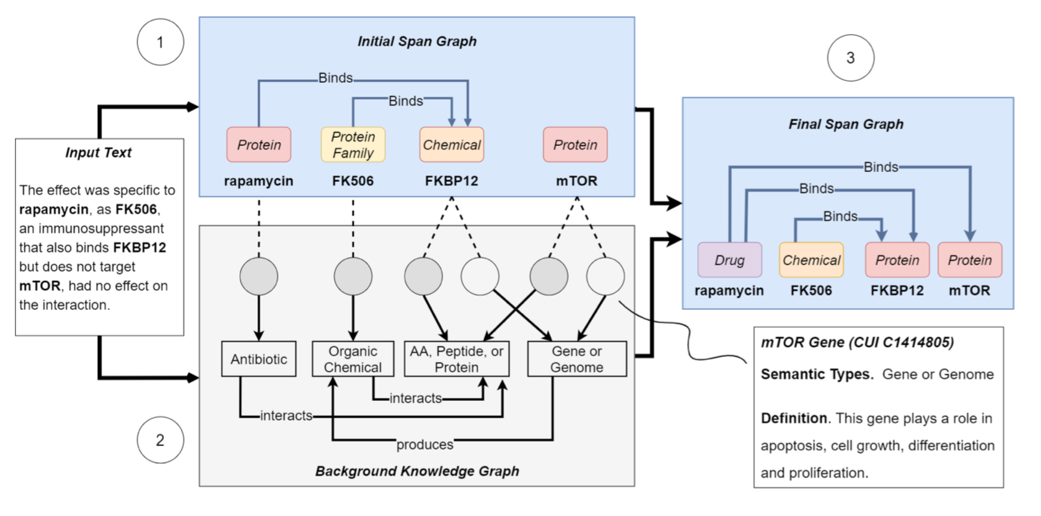
Successful Methods: UIUC External Knowledge Acquisition for Entity Extraction by Entity Linking
Method | Entity (Micro-F1 %) | Relation (Micro-F1%)
Full Model (KECI) | 87.42 | 66.09
• w/o external knowledge | 83.98 | 63.90
• w/o collective inference | 84.32 | 64.23

Slide 58
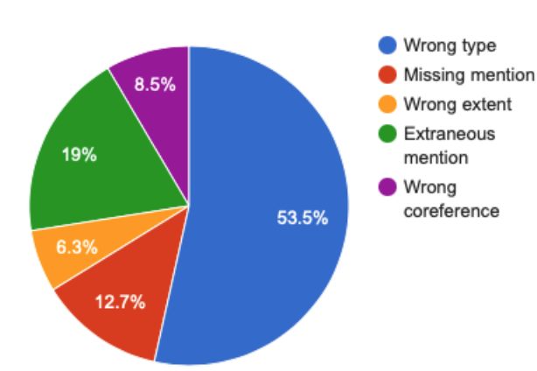
Remaining Errors: UIUC System Error Distribution
58
Notes:
Change low resource IL to a language which is not in wikipedia
Word-level: from bi-lingual dicts and alignment; structure-level comes from wals; multi-level alignment

Slide 59
Remaining Challenges: External Knowledge
Requires coreference resolution before typing
  ORG.WorldOrganization instead of ORG.Government.Agency:
  The WHO , the U. N. Food and Agriculture Organization, and the World Organization for Animal Health are also participating in the effort .
Requires entity linking before typing
  GPE.Territory instead of GPE.country
  In recent weeks , another mosquito - borne virus common in Africa and Asia has spread quickly through the eastern Caribbean , appearing for the first time in the Western Hemisphere . Chikun ­ gunya fever , which is similar to dengue , was reported in December on the French side of St . Martin and has spread to seven other jurisdictions , including Martinique , Guadeloupe and the British Virgin Islands .
59
Notes:
Change low resource IL to a language which is not in wikipedia
Word-level: from bi-lingual dicts and alignment; structure-level comes from wals; multi-level alignment

Slide 60
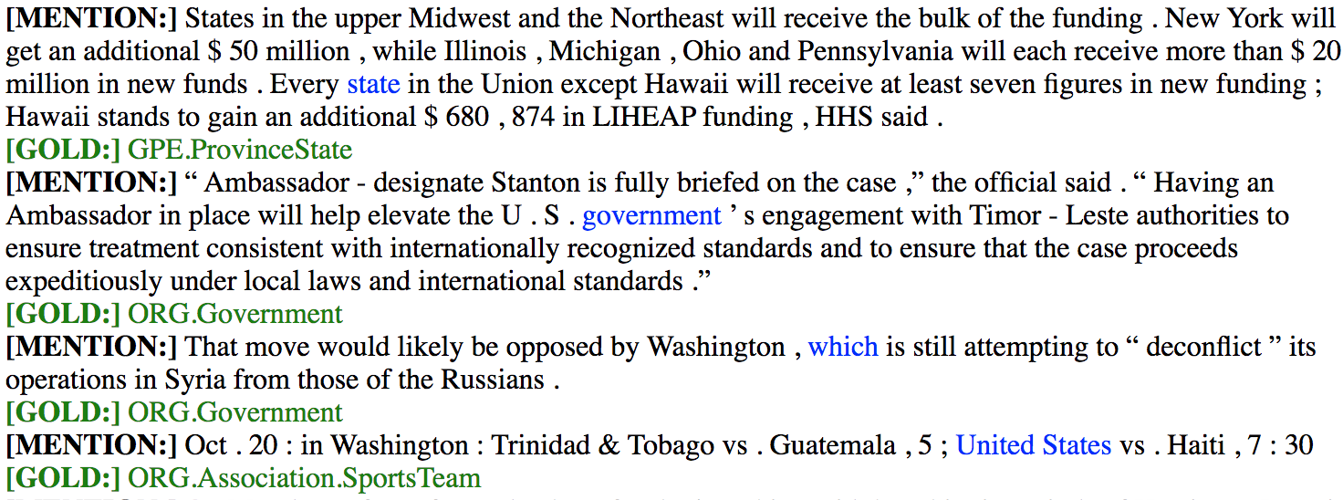
Remaining Challenges: Better Coreference Resolution
60
Notes:
Change low resource IL to a language which is not in wikipedia
Word-level: from bi-lingual dicts and alignment; structure-level comes from wals; multi-level alignment

Slide 61
Remaining Challenges: Incorporating Relation Extraction
PER.Serviceman.MilitaryOfficer
  According to Lt . Col . Peter Lerner , senior spokesman for the Israeli Defense Forces , a Palestinian man in his 20s approached a checkpoint at Tapuah Junction south of Nablus in the West Bank about 10 : 30 a . m . Friday .
PER.Politician.Legislator
  D . C . Council member Tommy Wells ( D - Ward 6 ), who introduced the resolution to request a congressional hearing on the project , said the reconstruction of the tunnel raises concerns about rail safety and the passage of hazardous materials through the city . He said it provides an opportunity to reexamine alternatives for rerouting cargo trains from he city .
61
Notes:
Change low resource IL to a language which is not in wikipedia
Word-level: from bi-lingual dicts and alignment; structure-level comes from wals; multi-level alignment

Slide 62
Remaining Challenges: Incorporating Event Argument Role Labeling
PER.SituationalRole.Victim
  There was an uptick last year in attacks against Israelis by Palestinians , who acted on their own out of personal vendettas or frustrations.
PER.SituationalRole.Survivor
  The last suicide bombings in Israel that led to deaths or injuries occurred in 2008 . Since then there have been numerous uses of improvised explosive devices , left along the Israeli fence that surrounds the Gaza Strip and other locales , designed to kill or maim Israeli military patrols . In 2012 , a bomb left on a Tel Aviv bus that was remotely detonated injured two dozen people.
ORG.AdvocacyGroup
  National Train Day activities will keep Union Station hopping , with model - train displays and the Chuggington Kids Depot , where kids can do train - related crafts and play with toy locomotives . Dovetail Games will offer free downloads of the Amtrak Pacific Surfliner version of the video game “ Train Simulator 2014 ,” and people from Operation Lifesaver will be on hand to talk about how to stay safe around railroad tracks .
62
Notes:
Change low resource IL to a language which is not in wikipedia
Word-level: from bi-lingual dicts and alignment; structure-level comes from wals; multi-level alignment

Slide 63
Remaining Challenges: Require Situation Understanding beyond sentence-level
PER.Terrorist
  The border guards ordered the man to stop , open his jacket and lift up his shirt .
  He revealed “ 12 steel pipes connected with wires ” around his waist , Lerner said .
  Later , a bomb disposal team detonated one of the metal tubes and confirmed that it contained explosive material .
WEA.ExplosiveDevice.Bomb
  Israeli media quoted unnamed military sources as saying that it was unclear whether the man with the explosives was planning to detonate the device at the checkpoint or travel to another location .
  The last suicide bombings in Israel that led to deaths or injuries occurred in 2008 . Since then there have been numerous uses of improvised explosive devices , left along the Israeli fence that surrounds the Gaza Strip and other locales , designed to kill or maim Israeli military patrols . In 2012 , a bomb left on a Tel Aviv bus that was remotely detonated injured two dozen people .
VEH.WheeledVehicle.RailedVehicle
  From the Hogwarts Express to “ The Polar Express ,” trains transport us to magical places in books and movies . But real - life trains can be pretty magical , too . And this Saturday is all about trains . National Train Day , celebrated at hundreds of locations across the United States — including Washington ’ s Union Station — has tons of fun stuff for train fanatics and choo - choo newbies alike .
63
Notes:
Change low resource IL to a language which is not in wikipedia
Word-level: from bi-lingual dicts and alignment; structure-level comes from wals; multi-level alignment

Slide 64
Remaining Challenges: Confusion between types
LOC.GeographicPoint.Address instead of FAC.Way
According to Lt . Col . Peter Lerner , senior spokesman for the Israeli Defense Forces , a Palestinian man in his 20s approached a checkpoint at Tapuah Junction south of Nablus in the West Bank about 10 : 30 a . m . Friday .
WEA.ExplosiveDevice instead of WEA.ExplosiveDevice.Bomb
JERUSALEM — Israeli security officials said their border police at a military checkpoint in the West Bank detained a young Palestinian man wearing a “ suicide belt ” packed with explosives . The man was arrested and did not activate the device , they said .
64
Notes:
Change low resource IL to a language which is not in wikipedia
Word-level: from bi-lingual dicts and alignment; structure-level comes from wals; multi-level alignment

