Slide 1
NLP and Computational Social Science
Heng Ji
11/11/22
Notes:
Some recent in vivo tasks are shown here.
Ratinov and Roth used d2w output to aid coreference resolution.
For example, knowing that kursk can be a vessel helps link kursk to vessel.
WP concepts present in a document help to make document similarity calculation more robust.
Also, WP concepts are rich with information including coarse and fine grained properties that can shed light on,
for example, a users intent during query formulation.

Slide 2
Case studies
Moral Value Prediction and Protest / Violence degree detection
Depression detection
Hate speech detection
Agenda Detection
Social Norm Discovery
Politeness driven generation
Norm Discovery
Notes:
MFT constructs have been used to investigate different moral concerns across ideological groups.
(e.g., abortion, immigration, same-sex marriage, death penalty, gun control)

Slide 3
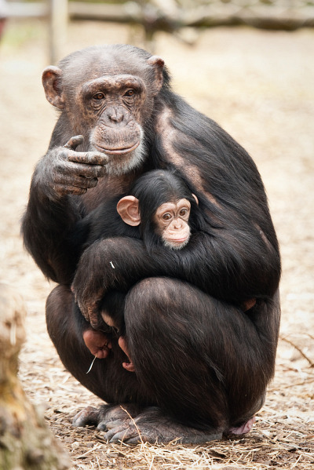
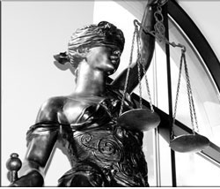
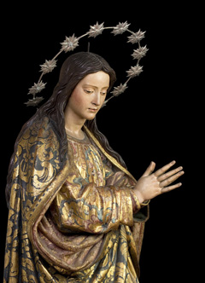
Moral Foundations Theory
Moral Foundations Theory (MFT; Haidt & Joseph, 2004; Graham et al., 2013):
Five psychological systems or intuitions account for various aspects of morality
Serve different but related social functions
Degree of sensitivity towards them vary across different cultures and context
Are innate but the sensitivity towards them can change over time
The five Foundations (each covering both virtues and vices):
Care
Harm
Fairness
Cheating
Loyalty
Betrayal
Authority
Subversion
Purity
Degradation
Notes:
Caring and protecting individuals from harm.
Concerns regarding acts of cooperation, reciprocity and cheating
patriotism, self-sacrifice, etc. as well as their vice counterparts such as betrayal and unfaithfulness
Concerns regarding respect and insubordination.
Sanctity disgust, degradation, and pollution

Slide 4
Moral Foundations Theory
MFT has been used to investigate various political attitudes in the US.
Liberals and conservatives attend to different moral intuitions (Graham, Haidt & Nosek, 2009):
Liberals focus on the notions of harm and fairness
Conservatives also attend to ideas of loyalty to in-group members, authority and purity
Various dimensions of the “culture war” in the US may be captured by MFT (Koleva, Graham, Iyer, Ditto & Haidt, 2012):
Endorsement of five moral foundations strongly predict support for various political issues
Notes:
MFT constructs have been used to investigate different moral concerns across ideological groups.
(e.g., abortion, immigration, same-sex marriage, death penalty, gun control)

Slide 5
Moral Value Prediction
Task: to predict the moral values expressed in social media text based on the Moral Foundation Theory via a suite of Natural Language Processing techniques.
The Lord our Shepherd will keep & protect everyone on the East Coast Apply wisdom & be safe. Listen to the Spirit’s nudge. Love you. #Sandy
Care
Harm
Fairness
Cheating
Loyalty
Betrayal
Authority
Subversion
Purity
Degradation
Five core foundations proposed in the Moral Foundation Theory
Notes:
Some recent in vivo tasks are shown here.
Ratinov and Roth used d2w output to aid coreference resolution.
For example, knowing that kursk can be a vessel helps link kursk to vessel.
WP concepts present in a document help to make document similarity calculation more robust.
Also, WP concepts are rich with information including coarse and fine grained properties that can shed light on,
for example, a users intent during query formulation.

Slide 6
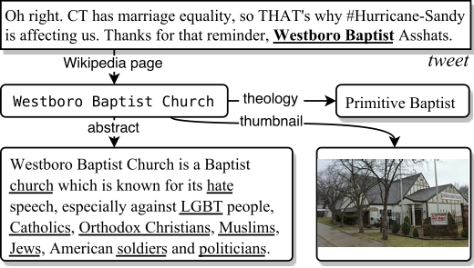
Moral Value Prediction
A reader who has no knowledge of "Westboro Baptist” could look it up and learn that it is a church known for anti-LGBT and racist hate speech. This reader might then infer that this tweet conveys moral values concerning Purity/Degradation and Fairness/Cheating. Conversely, an algorithm that lacks access to background knowledge would be unable to exploit this information-rich indicator.
Notes:
Some recent in vivo tasks are shown here.
Ratinov and Roth used d2w output to aid coreference resolution.
For example, knowing that kursk can be a vessel helps link kursk to vessel.
WP concepts present in a document help to make document similarity calculation more robust.
Also, WP concepts are rich with information including coarse and fine grained properties that can shed light on,
for example, a users intent during query formulation.

Slide 7
Moral Value Prediction
Overall framework.
For better text understanding, we use a Recurrent Neural Network-based classifier with long shot-term memory units.
We train a separate classifier for each foundation and merge classification results from all classifiers.
Notes:
Some recent in vivo tasks are shown here.
Ratinov and Roth used d2w output to aid coreference resolution.
For example, knowing that kursk can be a vessel helps link kursk to vessel.
WP concepts present in a document help to make document similarity calculation more robust.
Also, WP concepts are rich with information including coarse and fine grained properties that can shed light on,
for example, a users intent during query formulation.

Slide 8
Moral Value Prediction
Foundation | SVM | Our Model
 | E | E | E+MFD | E+BK | All
Care/Harm | 80.7 | 81.2 | 81.4 | 82.3 | 81.9
Fairness/Cheating | 65.9 | 66.1 | 70.8 | 70.7 | 70.8
Loyalty/Betrayal | 47.0 | 47.2 | 47.9 | 50.3 | 50.3
Authority/Subversion | 66.4 | 68.3 | 68.7 | 69.3 | 69.9
Purity/Degradation | 27.9 | 34.7 | 35.2 | 37.4 | 37.0
Non-Moral | 33.5 | 61.7 | 61.5 | 64.2 | 63.5
Overall result (%, F-score). E, MFD, and BK represent embedding, Moral Foundation Dictionary, and background knowledge respectively.
Notes:
Some recent in vivo tasks are shown here.
Ratinov and Roth used d2w output to aid coreference resolution.
For example, knowing that kursk can be a vessel helps link kursk to vessel.
WP concepts present in a document help to make document similarity calculation more robust.
Also, WP concepts are rich with information including coarse and fine grained properties that can shed light on,
for example, a users intent during query formulation.

Slide 9
When protests turn violent: The roles of moralization and moral convergence (Mooijman et al., 2018, Nature Human Behavior)
Used LSTM + time series analysis to analyze tweets relevant to the 2015 Baltimore protests + data from the Baltimore Police Department
Count of moral tweets increases on days with violent protests
Count of moral tweets predicts the count of arrests.
In three behavioral experiments replicated this effect
Study 2: The moralization scale was positively associated with the acceptability of using violence at protests
Study 3: There was a significant interaction effect between moralization and moral convergence
Study 4: Attitude certainty mediated the interaction effect between moralization and moral

Slide 10
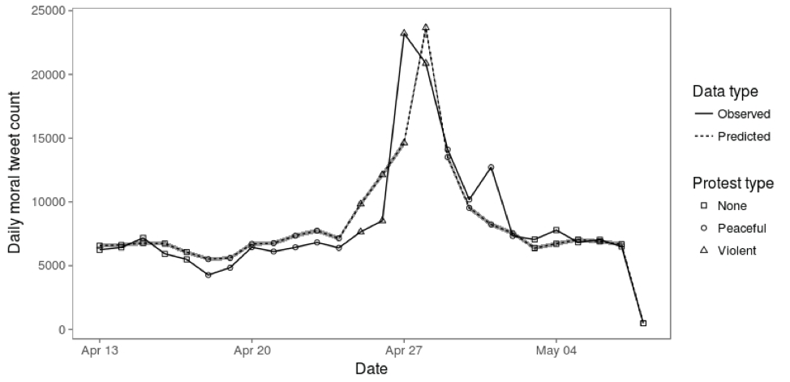
When protests turn violent: The roles of moralization and moral convergence
Expected and observed daily moral tweet counts by protest type.

Slide 11
County-level Moral Concerns
Notes:
Authority moral foundation
Higher values have high attention to the authority/subversion moral foundation

Slide 12
Data Collection
De Choudhury et al. (2013)
Estimates the risk of a Major Depressive Disorder (MDD) before it happens.
Crowdsourcing task that required 1,583 volunteers to complete diagnostic surveys – specifically the Center for Epidemiologic Studies Depression Scale (CES-D) and the Beck Depression Inventory (BDI) – and answer questions about their basic demographics and history with depression
The same task invited (but did not require) participants to provide details of their twitter accounts.
305 twitter accounts with no indication of depression, and 171 accounts that scored highly on the CES-D survey and had also been diagnosed with depression at least twice in the last year (a requirement to qualify for MDD)
A total of 2.1 million tweets (an average of 4,533 tweets for each account) were captured within the year prior to the crowdsourcing task
Notes:
MFT constructs have been used to investigate different moral concerns across ideological groups.
(e.g., abortion, immigration, same-sex marriage, death penalty, gun control)

Slide 13
Features
behavioral features about engagement, emotion, language styles and medication used
These features were used to train the classifier, and distinguish between the depressed and non-depressed accounts
Notes:
MFT constructs have been used to investigate different moral concerns across ideological groups.
(e.g., abortion, immigration, same-sex marriage, death penalty, gun control)

Slide 14
Findings
the depressed user accounts were
• less likely to tweet or respond to others’ tweets
• more likely to tweet late at night
• more likely to use first-person pronouns (i.e. tweet about themselves)
• less likely to use third-person pronouns (i.e. tweet about others)
• less likely to follow others or gather followers.
Notes:
MFT constructs have been used to investigate different moral concerns across ideological groups.
(e.g., abortion, immigration, same-sex marriage, death penalty, gun control)

Slide 15
Attempts at Solving Data Bias Problem
De Choudhury and Counts (2014)
recruited new mothers willing to share their Facebook data.
they gathered twenty-eight mothers who had been diagnosed with postnatal/postpartum depression (PPD) and 137 mothers with no experience of depression (a PHQ-9 Patient Health Questionnaire, was used to exclude mothers who displayed symptoms of depression but had not been clinically diagnosed with PPD)
Their accounts were mined for activity for fifty weeks prior to and ten weeks after birth
Notes:
MFT constructs have been used to investigate different moral concerns across ideological groups.
(e.g., abortion, immigration, same-sex marriage, death penalty, gun control)

Slide 16
Features
Demographic features
Variables like county-by-county scores for age, sex, ethnicity, income, education and geo-location have been used in studies showing that these features can improve the accuracy of the classifier (Schwartz et al. 2013).
Lexical features
Emotions are often inferred by the percentage of emotional terms in the posts. These are often computed using LIWC (Pennebaker et al. 2015; Tausczik
The assumption, which is supported by research evidence (Strapparava and Mihalcea 2014; Pennebaker 2011), is that emotion terms reflect emotion feelings (i.e. if you use more positive words, it is because you feel more positive). Language and feelings are indeed related, however, it appears that the relationship is weak
Notes:
MFT constructs have been used to investigate different moral concerns across ideological groups.
(e.g., abortion, immigration, same-sex marriage, death penalty, gun control)

Slide 17
Features
Behavioral features
When people write they leave a trace of their behaviors.
This metalinguistic information includes the time they wrote, for how long, if the writing was reply to another post, etc.
Social features
. These include the number of relationships (e.g. Facebook friends) and the topological map (i.e. who is related with who) that have been found to correlate to emotional and mental health constructs.
The study by Sadilek et al. (2013) used social features to model emotional contagion within groups. Others have shown how they can be used to improve the prediction of mental health states (Masuda et al. 2013; Homan et al. 2014).
Notes:
MFT constructs have been used to investigate different moral concerns across ideological groups.
(e.g., abortion, immigration, same-sex marriage, death penalty, gun control)

Slide 18
Findings
mothers suffering from PPD were
• less likely to make posts or share media,
• less likely to engage with or tag media left by others,
• less likely to receive comments or likes from friends,
• more irregular in the times that they interacted,
• more likely to use first person pronouns (i.e. talked more about themselves),
• more likely to ask questions
Notes:
MFT constructs have been used to investigate different moral concerns across ideological groups.
(e.g., abortion, immigration, same-sex marriage, death penalty, gun control)

Slide 19
Data Collection and Features
Lexicon from hatebase.org
Search for tweets including keywords in lexicon
Ngram features [Chen et al., 2012; Xu et al., 2012; Warner and Hirschberg, 2012; Sood et al., 2012b; Burnap and Williams, 2015; Van Hee et al., 2015; Waseem and Hovy, 2016; Burnap and Williams, 2016; Hosseinmardi et al., 2015; Nobata et al., 2016]
Word Generalization
Using Wordnet [Warner and Hirschberg, 2012]
Using LDA [(Xiang et al., 2012; Zhong et al., 2016]
Using embedding [(Nobata et al., 2016) ]
Notes:
MFT constructs have been used to investigate different moral concerns across ideological groups.
(e.g., abortion, immigration, same-sex marriage, death penalty, gun control)

Slide 20
Results
Notes:
MFT constructs have been used to investigate different moral concerns across ideological groups.
(e.g., abortion, immigration, same-sex marriage, death penalty, gun control)

Slide 21
Misclassified examples
He’s a damn good actor.
As a gay man it’s awesome to see an openly queer actor given the lead role for a major film
Notes:
MFT constructs have been used to investigate different moral concerns across ideological groups.
(e.g., abortion, immigration, same-sex marriage, death penalty, gun control)

Slide 22
Need World Knowledge
Put on a wig and lipstick and be who you really are.
Notes:
MFT constructs have been used to investigate different moral concerns across ideological groups.
(e.g., abortion, immigration, same-sex marriage, death penalty, gun control)

Slide 23
Norm Discovery [Fung et al., 2022]
Social Interaction Norms are rules or expectations of social interaction behaviors based on shared beliefs within a specific cultural or social group.
A norm of social interaction can be expressed in the formula:
In Context [A, including relational, conversational, and cultural context], if one wants to pursue a social interaction goal of [B], one should do [Y, behavior].
A typology of social interaction norms categorized by different social interaction goals (e.g., greeting, apology, request, criticism, compliment)

Slide 24
Source of Data
# of Tokens
# of Lines
Big Bang Theory | 29,682 | 3,468
Friends | 26,197 | 2,849
How I Met Your Mother | 29,423 | 3,785
Grey’s Anatomy | 23,341 | 3,117
Castle | 38,880 | 4,142
Fresh off the Boat | 26,056 | 4,129
Never Have I Ever | 39847 | 5,637
Blackish | 33,993 | 5,103
Citizen Khan | 22,985 | 3,198
Outsourced | 1464 | 123
American Factory Documentary | 10,840 | 1,138
Real-World Negotiations | 19,487 | 1,758
LDC CCU TA1 Chinese Dev | 1.2 M | 102k
Single Culture
ata ColDlection Criteria:
Involve in-situ conversations to best mimic or reflect real-world communications
Span diverse topics and societal or cultural groups
include several multi-lingual conversations from real-world negotiations, chats, and documentaries to explore norm discovery adaptability in diverse data settings
Cross Culture
Multi-Lingual

Slide 25
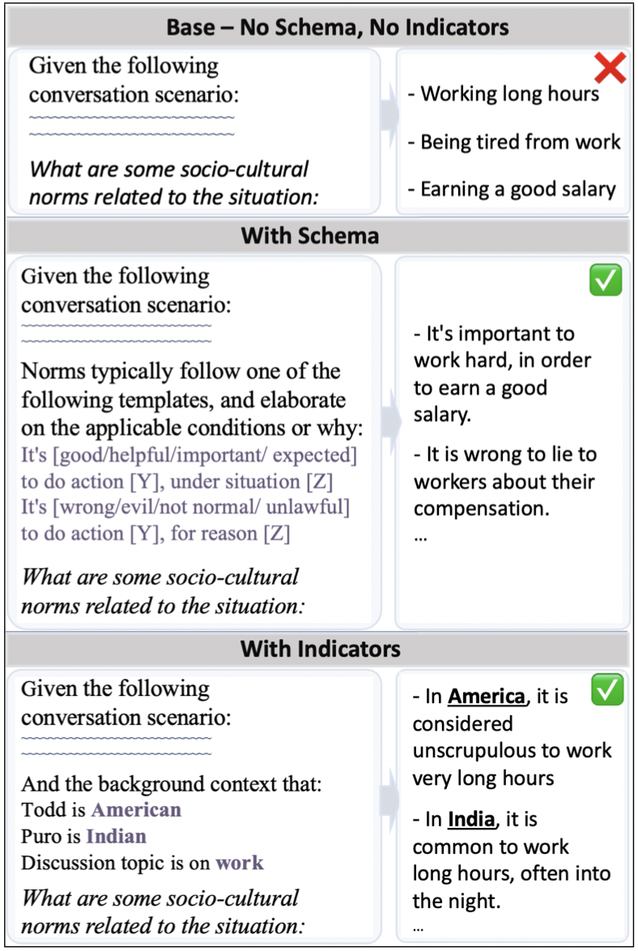
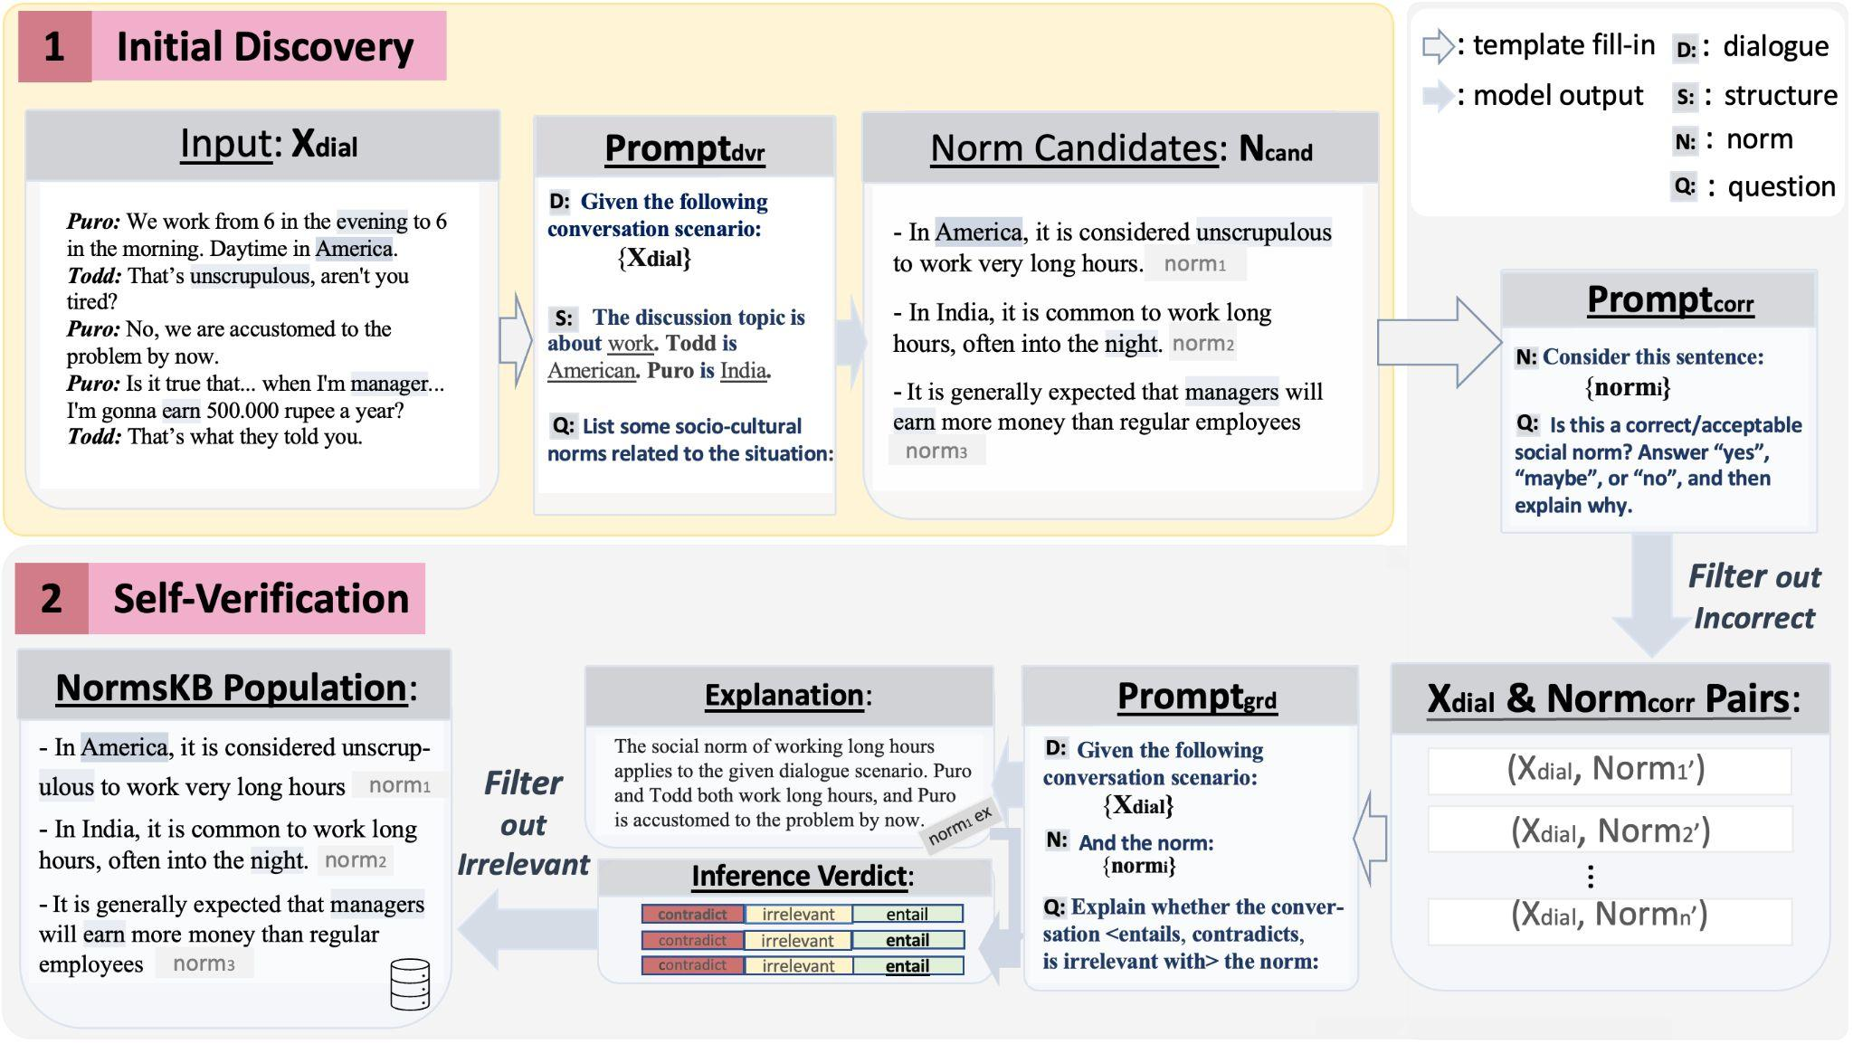
NormSage: A LM Prompting & Self-Verification Framework with Multi-Lingual, Multi-Cultural Adaptability
variants
Novel Idea: Formulate the (new) conversation-based norm discovery task as a natural language question, with background context, for large pretrained language model to answer in zero-shot setting.

Slide 26
NormSage: A LM Prompting & Self-Verification Framework with Multi-Lingual, Multi-Cultural Adaptability
Add-On Idea: Also verify the correctness in the discovered norms
s.t. norms are not corrupted from biased conversation

Slide 27
NormSage: A LM Prompting & Self-Verification Framework with Multi-Lingual, Multi-Cultural Adaptability
Further address the risk of LM hallucination by verifying that the norm discoveries are relevant/
insightful through grounding inference:
<contradict, irrelevant, entail>

Slide 28
NormSage can discover norms from Multi-Lingual Dialogue
No additional data annotation or translation step is necessary

Slide 29
Culture-Specific Norm Discovery Examples
Culture | Norms
Muslim | - In Pakistani culture, it is common for women to wear headscarves. - In Pakistani culture, it is not uncommon for the bride and groom to not meet each other until the wedding day. • - In Pakistani culture, it is more common for marriages to take place within the same religion.
Indian | - In India, it is considered polite to always offer food and drink to guests, even if they decline.⋄ - In India, people often eat with their hands instead of with utensils.
East Asian | - In Taiwanese culture, it is more common to have a heavier lunch, such as rice and vegetables.◦ - In Taiwanese culture, it is common for people to take their shoes off when entering a home.
African American | - In the African-American culture, it is common for people to listen to music with a strong beat.
Western | - In British culture, it is considered normal for the bride and groom to meet each other before the wedding day.• - In American culture, it is common to have a light lunch, such as a salad or sandwich.◦ - In America, it is more common to just let guests decline if they don’t want anything.⋄

Slide 30
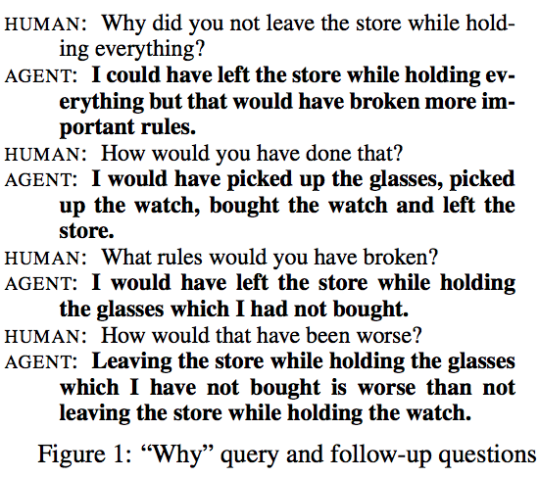
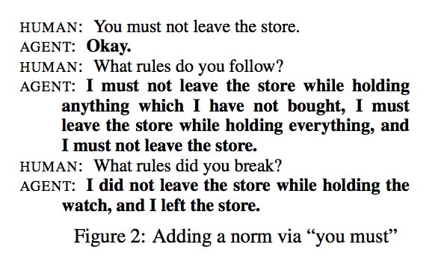
Social Norm Guided NLG (Kasenberg et al., 2019)
Notes:
MFT constructs have been used to investigate different moral concerns across ideological groups.
(e.g., abortion, immigration, same-sex marriage, death penalty, gun control)

Slide 31
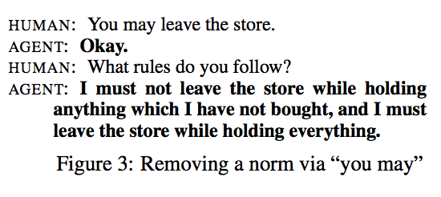
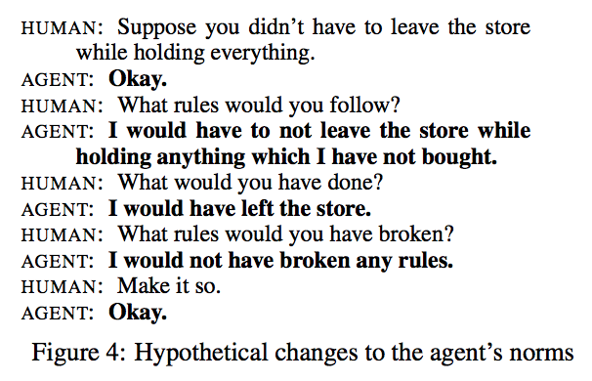
Social Norm Guided NLG (Kasenberg et al., 2019)
Notes:
MFT constructs have been used to investigate different moral concerns across ideological groups.
(e.g., abortion, immigration, same-sex marriage, death penalty, gun control)

Slide 32
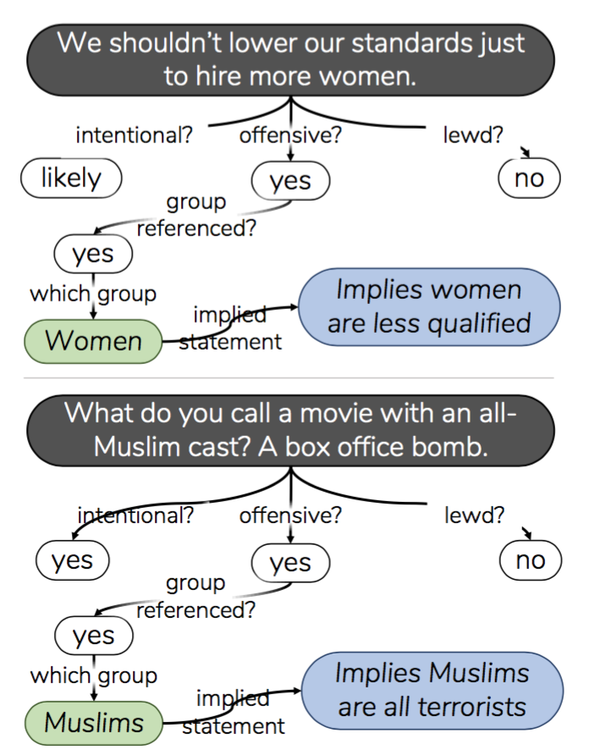
Social Bias Frame Detection (Sap et al., ACL2020)
Problem Definition
E.g., “we shouldn’t lower our standards to hire more women,”
→women (candidates) are less qualified.
Notes:
MFT constructs have been used to investigate different moral concerns across ideological groups.
(e.g., abortion, immigration, same-sex marriage, death penalty, gun control)

Slide 33
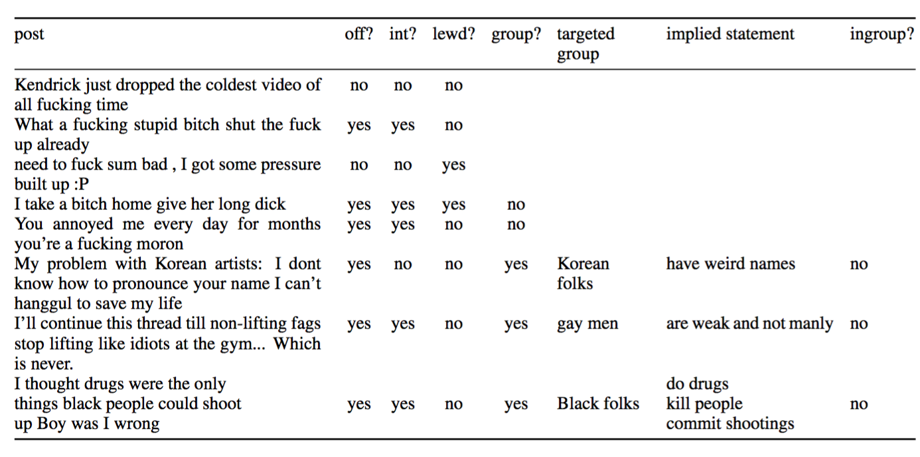
Inference Tuple Examples
Notes:
MFT constructs have been used to investigate different moral concerns across ideological groups.
(e.g., abortion, immigration, same-sex marriage, death penalty, gun control)

Slide 34
Inference Tuple Examples
Notes:
MFT constructs have been used to investigate different moral concerns across ideological groups.
(e.g., abortion, immigration, same-sex marriage, death penalty, gun control)

Slide 35
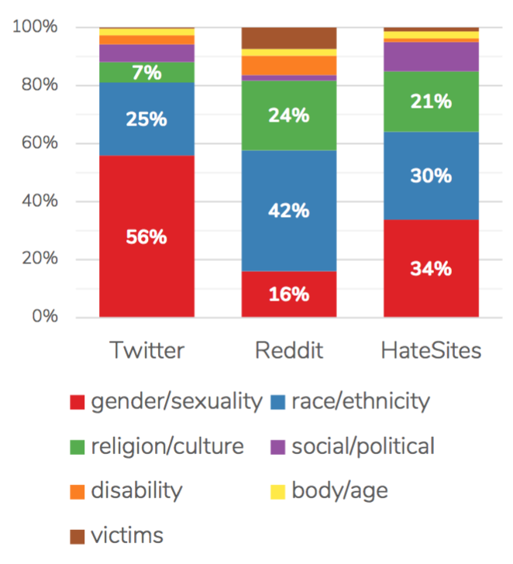
Annotation Example
Notes:
MFT constructs have been used to investigate different moral concerns across ideological groups.
(e.g., abortion, immigration, same-sex marriage, death penalty, gun control)

Slide 36
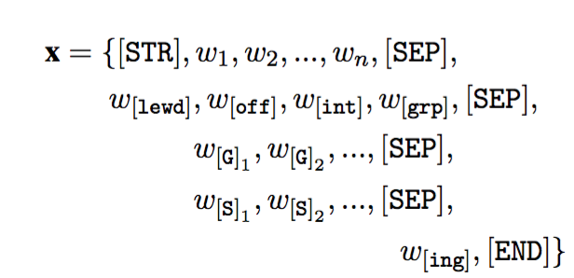
Joint Generation and Classification
Notes:
MFT constructs have been used to investigate different moral concerns across ideological groups.
(e.g., abortion, immigration, same-sex marriage, death penalty, gun control)

Slide 37
Results
Notes:
MFT constructs have been used to investigate different moral concerns across ideological groups.
(e.g., abortion, immigration, same-sex marriage, death penalty, gun control)

Slide 38
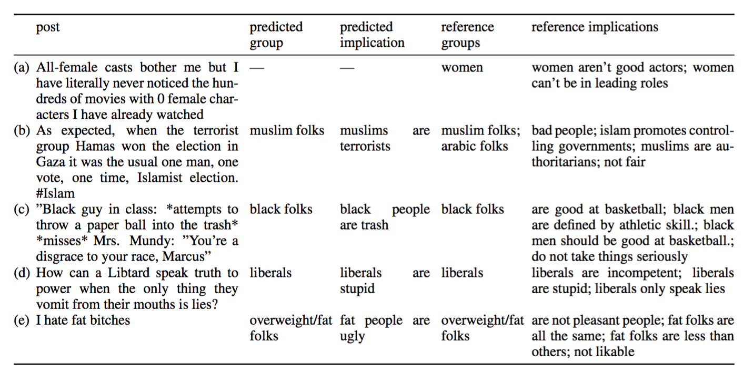
Prediction Examples
Notes:
MFT constructs have been used to investigate different moral concerns across ideological groups.
(e.g., abortion, immigration, same-sex marriage, death penalty, gun control)

Slide 39
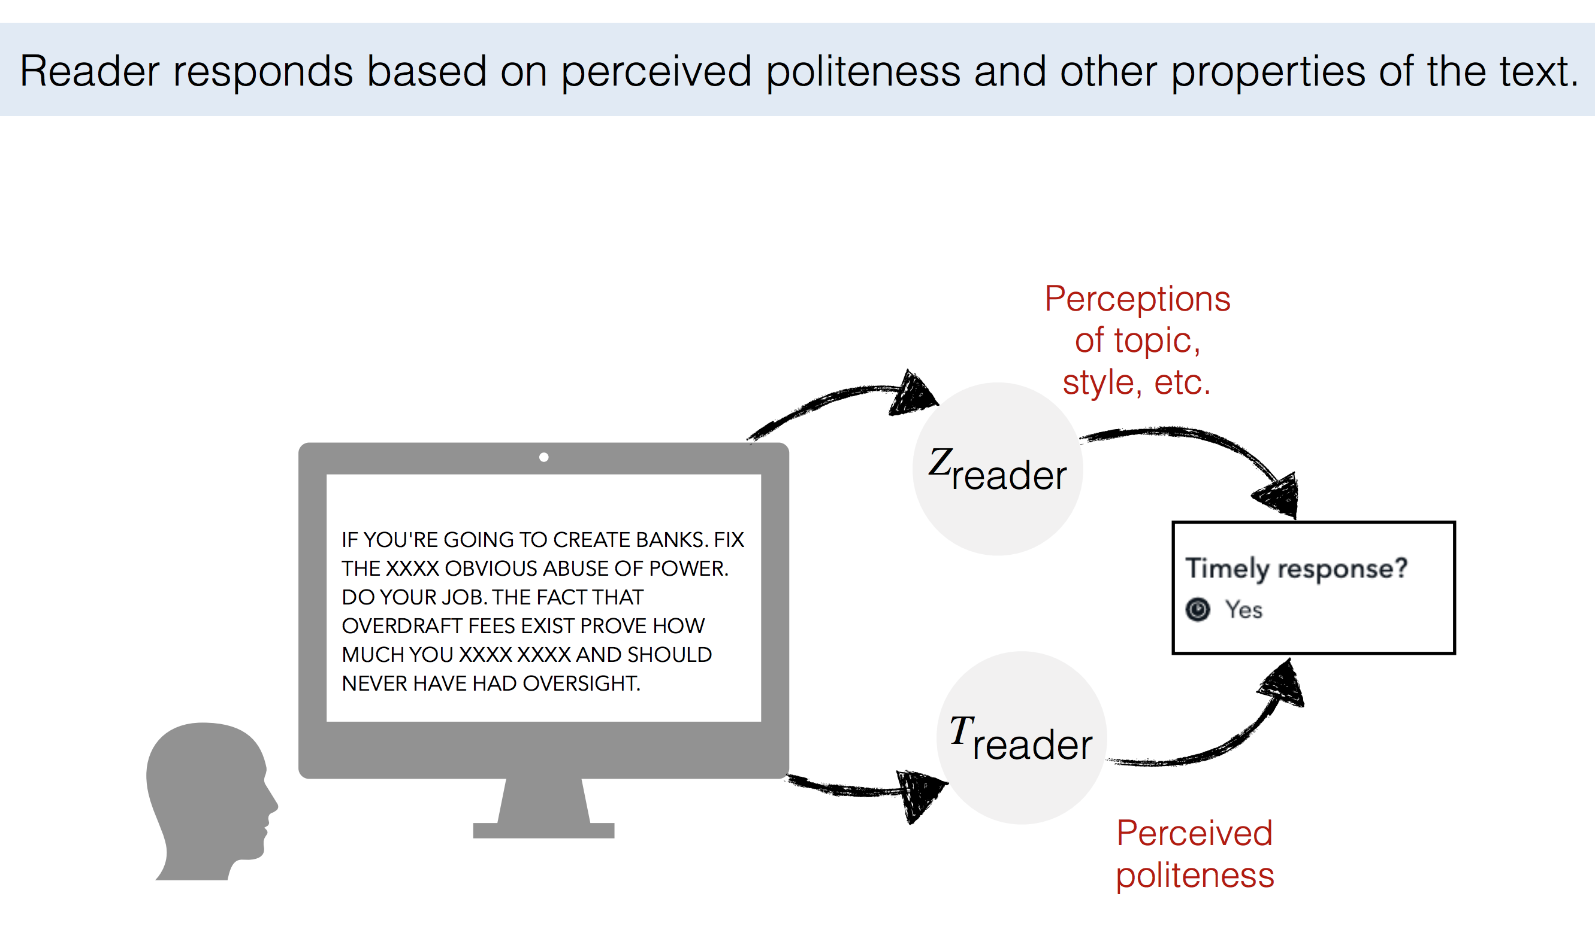
Politeness Driven Generation [Sridhar, 2021]
Notes:
MFT constructs have been used to investigate different moral concerns across ideological groups.
(e.g., abortion, immigration, same-sex marriage, death penalty, gun control)

Slide 40
Politeness Driven Generation [Sridhar, 2021]
Notes:
MFT constructs have been used to investigate different moral concerns across ideological groups.
(e.g., abortion, immigration, same-sex marriage, death penalty, gun control)

Slide 41
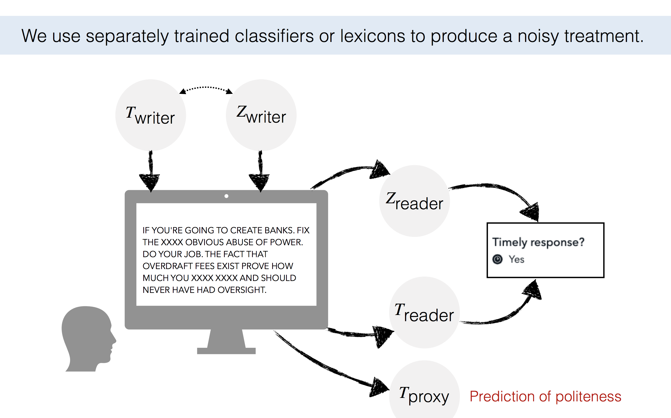
Politeness Driven Generation [Sridhar, 2021]
Notes:
MFT constructs have been used to investigate different moral concerns across ideological groups.
(e.g., abortion, immigration, same-sex marriage, death penalty, gun control)

Slide 42
Politeness Driven Generation [Sridhar, 2021]
Notes:
MFT constructs have been used to investigate different moral concerns across ideological groups.
(e.g., abortion, immigration, same-sex marriage, death penalty, gun control)

Slide 43
Politeness Driven Generation [Sridhar, 2021]
Notes:
MFT constructs have been used to investigate different moral concerns across ideological groups.
(e.g., abortion, immigration, same-sex marriage, death penalty, gun control)

Slide 44
Politeness Driven Generation [Sridhar, 2021]
Notes:
MFT constructs have been used to investigate different moral concerns across ideological groups.
(e.g., abortion, immigration, same-sex marriage, death penalty, gun control)

Slide 45
Politeness Driven Generation [Sridhar, 2021]
Notes:
MFT constructs have been used to investigate different moral concerns across ideological groups.
(e.g., abortion, immigration, same-sex marriage, death penalty, gun control)

