Slide 1
Multilingual Multimedia Encoding
Heng Ji (UIUC)
hengji@illinois.edu
Acknowledgement: some slides are from Sebastian Ruder and Manling Li

Slide 2
English doesn’t deserve to be the center of language universe
  6000+¹ living languages, 300+ languages have digital news data
  Certain information is often reported predominantly in local news in low-resource languages
  e.g., the vast majority of Physical-Located relations and Meeting events involving Aung San Suu Kyi are only reported locally in Burmese news
  e.g., language barrier was one of the main difficulties faced by humanitarian workers responding to the Ebola crisis in 2014
Publicly available gold-standard annotations for IE exist for
only a few languages
Annotations for edge (relation and event) extraction are more
expensive than node (entity) extraction because relations/
events are structured and require a rich label space – not
suitable for crowd-sourcing
¹ https://www.linguisticsociety.org/content/how-many-languages-are-there-world?fbclid=IwAR2_j34iZAqWf8nkBLriYTvEabm-_KnVFkiZosZ8lou_J1g4kzOoRV8wvJU
Notes:
All of these cool things are about english. But foreign languages are very important. E.g.. Burmese.

Slide 3
Why embed words?
Embeddings are themselves parameters—can be learned
Sharing representations across tasks
Lower dimensional space
  Better for computation—difficult to handle sparse vectors.

Slide 4
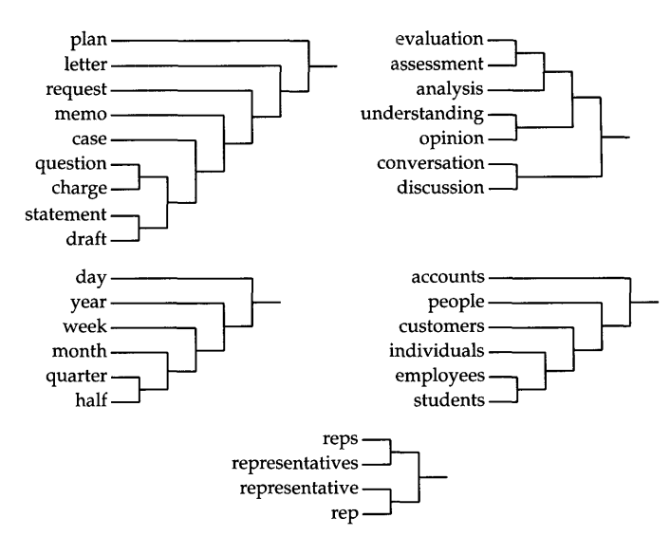
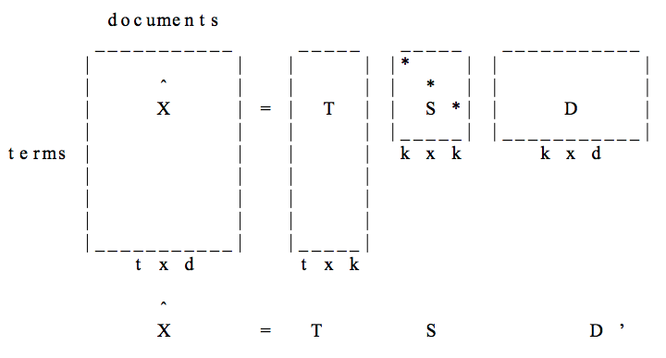
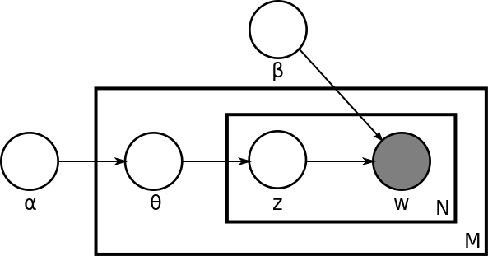
Word Type Representation
Unsupervised pretraining : Pre-Neural
Latent Semantic Analysis (LSA)—SVD of term-document matrix, (Deerwester et al., 1990)
Brown clusters, hard hierarchical clustering based on n-gram LMs, (Brown et al. 1992)
Latent Dirichlet Allocation (LDA)—Documents are mixtures of topics and topics are mixtures of words (Blei et al., 2003)

Slide 5
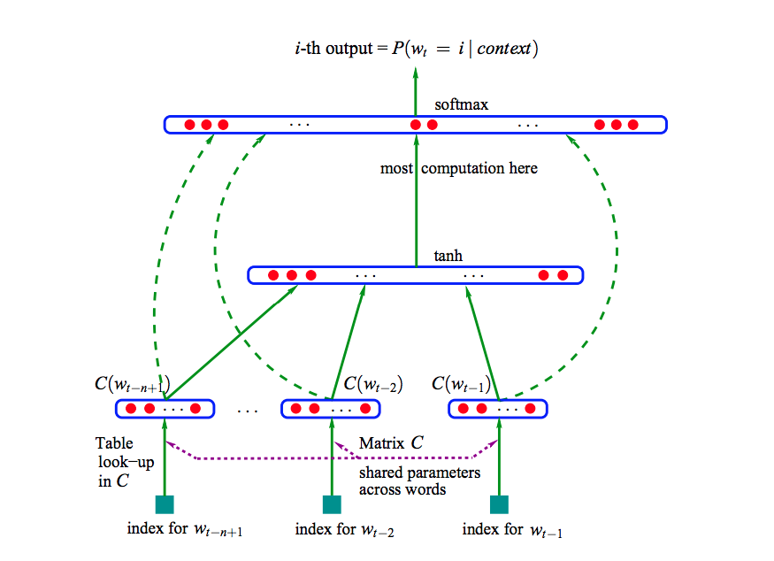
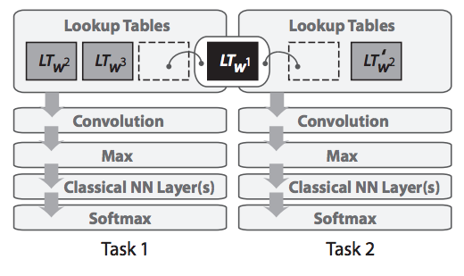
Word Type Representation
n-gram neural language model (Bengio et al. 2003)
Supervised multitask word embeddings (Collobert and Weston, 2008)
Word vector pretraining

Slide 6
Autoencoder pretraining
Supervised sentence embeddings
Also possible to train sentence embeddings with supervised objective
Paragram-phrase: uses paraphrase database for supervision, best for paraphrase and semantic similarity (Wieting et al. 2016)
InferSent: bi-LSTM trained on SNLI + MNLI (Conneau et al. 2017)
GenSen: multitask training (skip-thought, machine translation, NLI, parsing) (Subramanian et al. 2018)

Slide 7
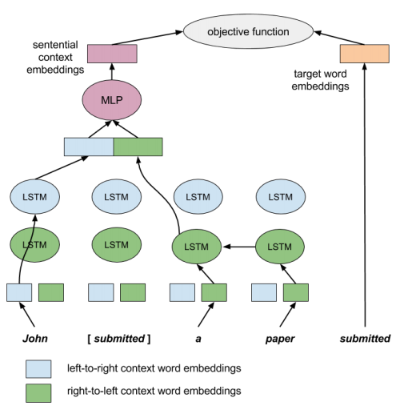
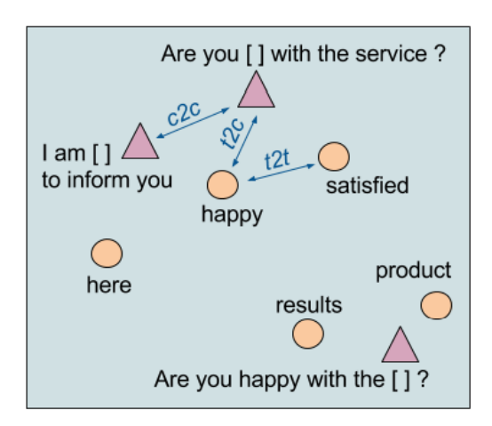
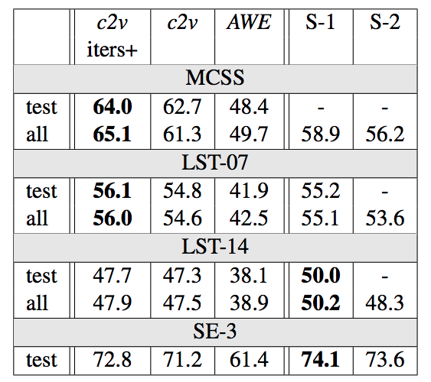
Use bidirectional LSTM and cloze prediction objective (a 1 layer masked LM)
Learn representations for both words and contexts (minus word)
Sentence completion
Lexical substitution
WSD
(Melamud et al., CoNLL 2016)
context2vec

Slide 8
Other pretraining objectives
Contextual string representations (Akbik et al., COLING 2018)—SOTA NER results
Cross-view training (Clark et al. EMNLP 2018)—improve supervised tasks with unlabeled data
Cloze-driven pretraining (Baevski et al. (2019)—SOTA NER and constituency parsing

Slide 9
Why does language modeling work so well?
Language modeling is a very difficult task, even for humans.
Language models are expected to compress any possible context into a vector that generalizes over possible completions.
  “They walked down the street to ???”
To have any chance at solving this task, a model is forced to learn syntax, semantics, encode facts about the world, etc.
Given enough data, a huge model, and enough compute, can do a reasonable job!
Empirically works better than translation, autoencoding: “Language Modeling Teaches You More Syntax than Translation Does” (Zhang et al. 2018)

Slide 10
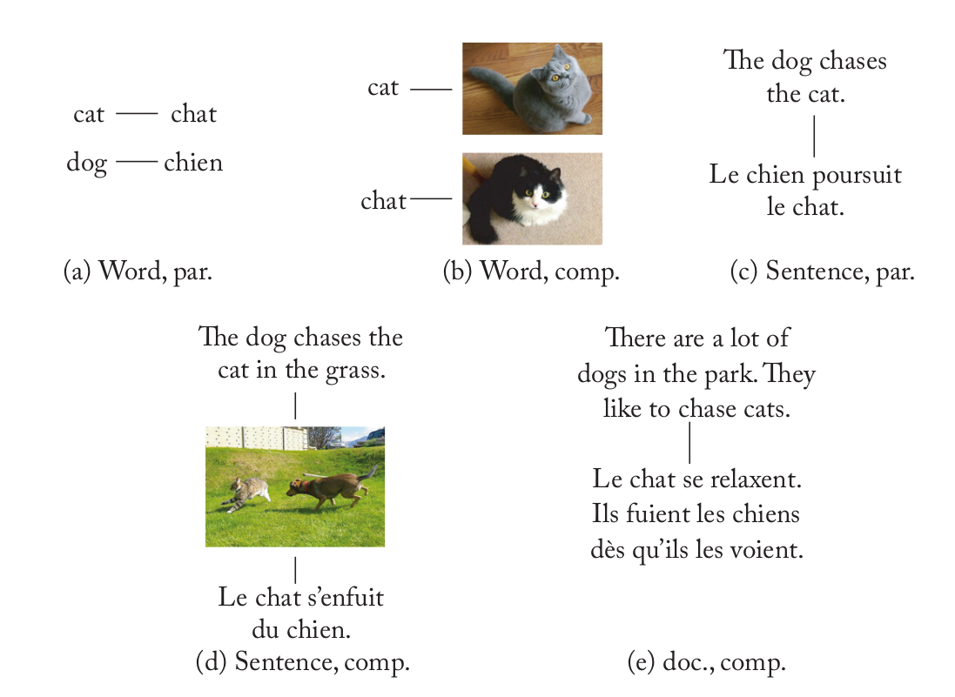
Cross-Lingual Word Embeddings
A large number of different methods, but the same end goal:
Induce a shared semantic vector space in which words with similar meaning end up with similar vectors, regardless of their actual language.
We need some bilingual supervision to
learn CLWE-s.
Fully unsupervised CLWE-s: they rely only on monolingual data

Slide 11
Cross-Lingual Word Embeddings
A large number of different methods, but the same end goal:
Induce a shared semantic vector space in which words with similar meaning end up with similar vectors, regardless of their actual language.
Typology of methods for inducing CLWE-s [Ruder et al., JAIR-19; Søgaard et al., M&C Book]
Type of bilingual signal
Document-level, sentence-level, word-level, no signal (i.e., unsupervised)
Comparability
Parallel texts, comparable texts, non-comparable
Point/Time of alignment
Joint embedding models vs. Post-hoc alignment vs. post-specialisation/retrofitting
Modality
Text only vs. using images for alignment, e.g., [Kiela et al., EMNLP-15; Vulić et al., ACL-16; Gella et al., EMNLP-17]

Slide 12
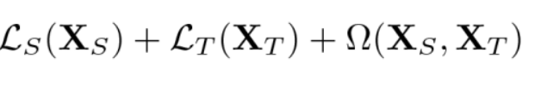
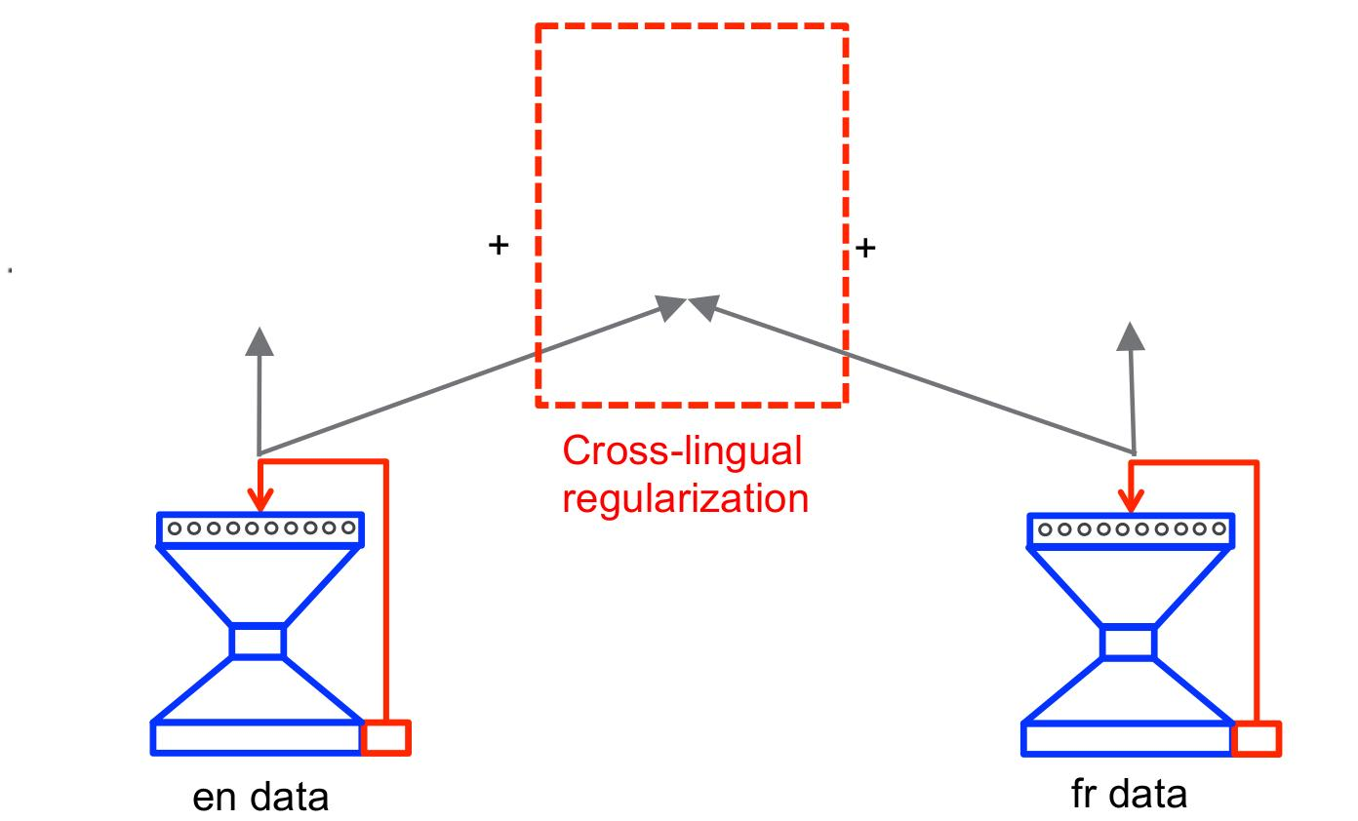
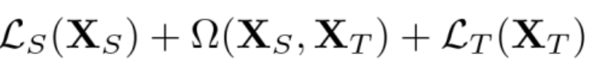
General (Simplified) CLWE Methodology
Previously: (bilingual) data sources seem more important than the chosen algorithm [Levy et al, EACL-17]
Most CLWE algorithms are formulated as:
Image adapted from [Gouws et al., ICML-15]

Slide 13
What is Hubness?
Hubness: the tendency of some vectors (i.e., “hubs”) to appear in the ranked lists of nearest neighbours of many other vectors in high-dimensional spaces
[Radovanović et al., JMLR-10; Dinu et al., ICLR-15]
Solutions:
Globally-corrected retrieval: : instead of returning the nearest neighbour of the query, it returns the target element which has the query ranked highest
[Dinu et al., ICLR-15; Smith et al., ICLR-17]
A margin-based ranking loss instead of mean-squared error
[Lazaridou et al., ACL-15]
Scaled similarity measures instead of cosine: discounting similarity in dense areas: CSLS
[Conneau et al., ICLR-18]

Slide 14
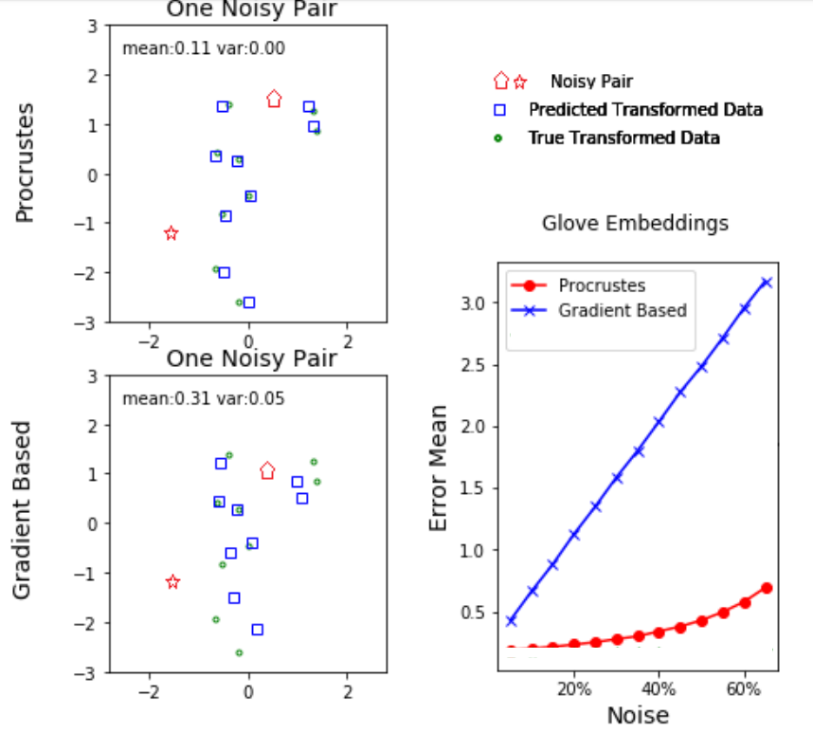
How Important is (the Noise in the) the Seed Lexicon?
Orthogonal Procrustes is less affected by noise (i.e., incorrect translation pairs in the training set)
Open question: how to reduce the noise in seed lexicons?
Are larger seed lexicons necessarily better seed lexicons?
Image adapted from [Lubin et al., NAACL-19]

Slide 15
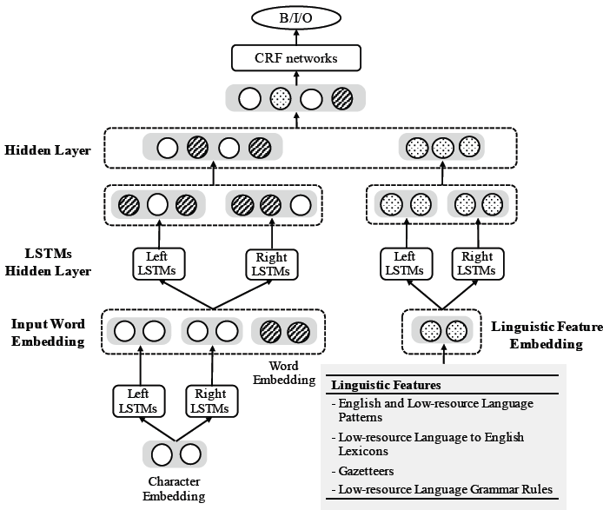
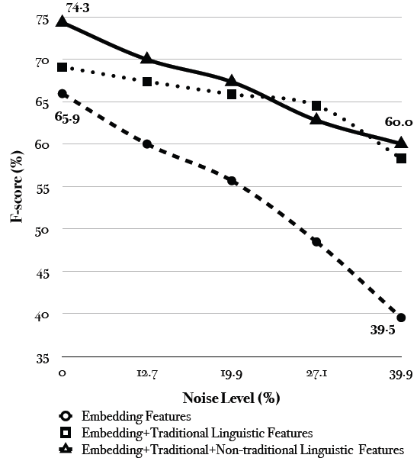
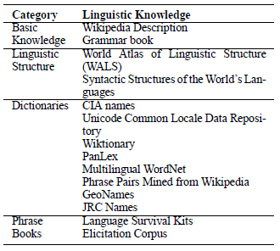
Case Study on Name Tagging
  (Zhang et al., 2017)

Slide 16
The Solution: Share and Transfer
Cross-lingual Embedding Representations
  Cluster-consistent embedding: avoid using bi-lingual dictionaries or parallel corpora
  Joint Entity and Word embedding
  Cross-lingual language modeling for contextualized embedding
Cross-lingual Transfer Learning
  Multi-task Multi-lingual transfer learning
  Adversarial learning to select language-universal resources and features
16
Notes:
Change low resource IL to a language which is not in wikipedia
Word-level: from bi-lingual dicts and alignment; structure-level comes from wals; multi-level alignment

Slide 17
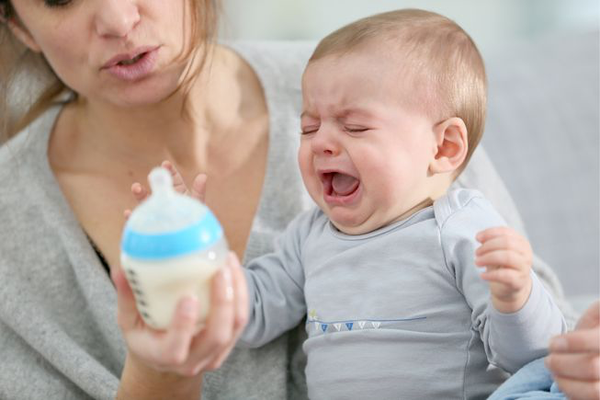


The Solution: Share and Transfer
Enhance Quality with deep knowledge acquisition and reasoning
Transfer knowledge across domain/genre/language/data modality
Notes:
Enhance english capability. then help others. Milk training data. Grow then help other kids.

Slide 18
Cross-lingual Node (Entity) Transfer
First Step
  Build a common semantic space across thousands of languages for resource sharing and richer semantic continuous representation for words, concepts and entities
Limitations of Previous Attempts (e.g., Upadhyay et al., 2016, Cho et al., 2017)
  Mostly English-anchored, cannot capture all linguistic phenomena
  Heavily relied on bilingual dictionaries and parallel data which are not always available
  Only limited to dozens of languages
18
Notes:
Change low resource IL to a language which is not in wikipedia
Word-level: from bi-lingual dicts and alignment; structure-level comes from wals; multi-level alignment

Slide 19
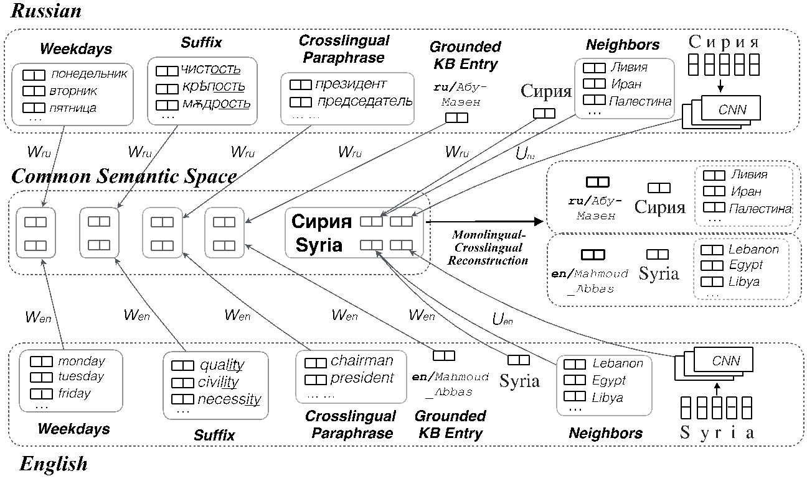
Share: Multi-lingual Cluster-consistent Common Space Construction
Our new hypothesis: Cluster distribution tends to be consistent across languages (Huang et al., EMNLP2018)

Slide 20
Share: Cross-lingual Joint Entity and Word Embedding Learning
(Pan et al., DeepLo2019)
Code-switch cross-lingual entity/word data generation
Use English entities as anchor points to learn a mapping (rotation matrix) W which aligns distributions in IL and English
Notes:
Code-switch, english anchor link, learn rotation matrix to align two spaces. So now we get xiaomi is aligned to apple_inc, so we at least know it’s tech company

Slide 21
Embedding with cross-lingual language model
Cross-lingual Contextualized Joint Entity and Word Embedding

Slide 22
Transfer: Unsupervised Adversarial Training
Solution: apply unsupervised adversarial training to extract language-agnostic features
Word-level adversarial transfer
Sequence-level adversarial transfer
Bi-LSTM-CRF Name Tagger
(Huang et al., NAACL2019)

Slide 23
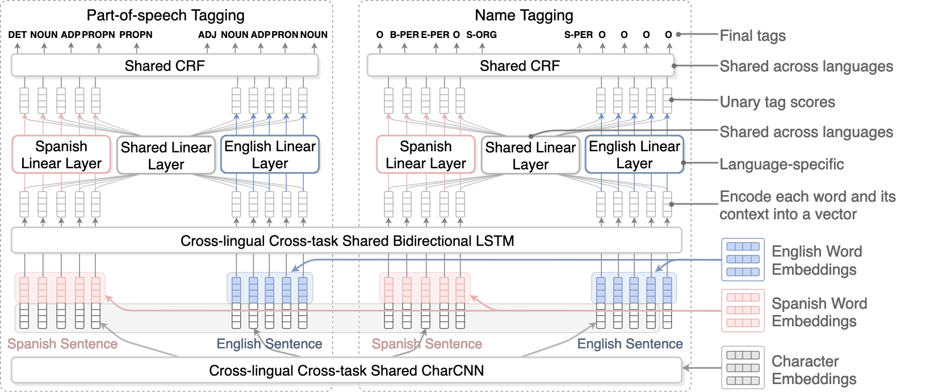
Multi-lingual Multi-task Architecture for Sequence Labeling
A unified architecture that performs multiple types of knowledge transfer simultaneously (Lin et al., ACL2018)

Slide 24
Cross-lingual direct transfer: trained on a related language
and tested on a target language

Slide 25
Mutual enhancement: training set expanded by
annotated instances in related languages

Slide 26
Cross-lingual Transfer: Name Tagging Performance
Russian name tagging F-score; English to help Russian
Cross-lingual Embedding
Monolingual Embedding
Notes:
Cross-lingual word embeddings are appealing due to two main factors: First, they enable cross-lingual and multilingual semantics, that is, reasoning about word meaning in multilingual contexts. An intriguing goal per se, this furthermore enables computation of cross-lingual word similarities, which is relevant for many tasks, and many other applications such as bilingual lexicon induction or cross-lingual information retrieval. Second, cross-lingual word embeddings enable knowledge transfer between languages, most importantly between resource-rich and resource-lean languages. This duality is illustrated by common evaluation tasks for cross-lingual embeddings, which either evaluate their capacity to capture similarity or their ability to serve as features for cross-lingual transfer

Slide 27
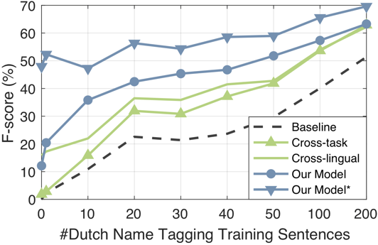
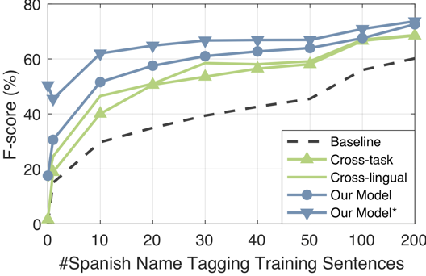
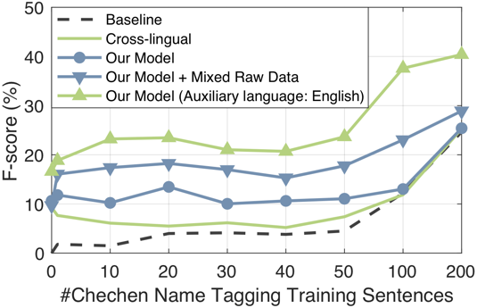
Cross-lingual Cross-task Transfer: Name Tagging Performance
We compare the performance of the following models under low-resource settings:
  Baseline: mono-lingual single-task LSTM-CNNs
  Cross-lingual transfer model
  Cross-task transfer model
  Our model: cross-lingual cross-task transfer model
Dutch
Spanish
Chechen

Slide 28
What is being Transferred?
  Chechen Name Tagging, common space constructed from Russian and Chechen non-parallel documents, bridged by PanLex (4K word entries) and 26K overlapped/reused words
  Common space learned better quality embeddings from related languages and identified many OOV new names in low-resource languages
Models | P (%) | R (%) | F (%)
Randomly initialized monolingual embedding | 46.3 | 45.3 | 45.8
Pre-trained monolingual embedding | 67.5 | 55.6 | 60.9
+ Common semantic space word embedding | 76.6 | 62.4 | 68.8
Type | Chechen Names found by common space & missed by monolingual baseline | English Translation | Frequency in Chechen | Frequency in Russian
GPE | Ши шо даьлча, тхо Кыргызстане, тхайн да волчу дIадахара | Kyrgyzstan | 2 | 420
PER | дIa ца. . .ма гIолахь . . . со . . . яда, Марина , вайша . . . хьо чу а йигна | Marina | 25 | 20,735
ORG | А |. Халикова |, ЧГУ |- н студентка |. ДАЙМОХК № 54, 2005 | CSU (Chuvash State University) | 1 | 183
Notes:
Low-resource language Name Tagging
Universal Name Tagging
Incorporate non-traditional linguistic resources
Cross-lingual Transfer Learning
Fine-grained name tagging for 7000+ types
Word coverage numbers need to be updated; org mention coverage, put in new org example
;
Кыргызстане (Kyrgyzstan, country in Central Asia) 2 420
PER Марина (Marina) 25 20735
ORG ЧГУ (CSU: Chuvash State University) 1 183

Slide 29
Cross-lingual Entity Linking Accuracy
Language | Supervised Approach trained from 3000 mentions (Mayfield et al., 2011) | Our Unsupervised Approach
Arabic | 70.6% | 80.2%
Bulgarian | 82.1% | 84.1%
Croatian | 88.9% | 90.8%
Czech | 77.2% | 85.9%
French | 90.4% | 92.1%
German | 85.7% | 89.7%
Greek | 71.4% | 79.8%
Urdu | 70.7% | 73.2%
Macedonian | 70.6% | 71.6%
Serbian | 65.3% | 81.2%

Slide 30
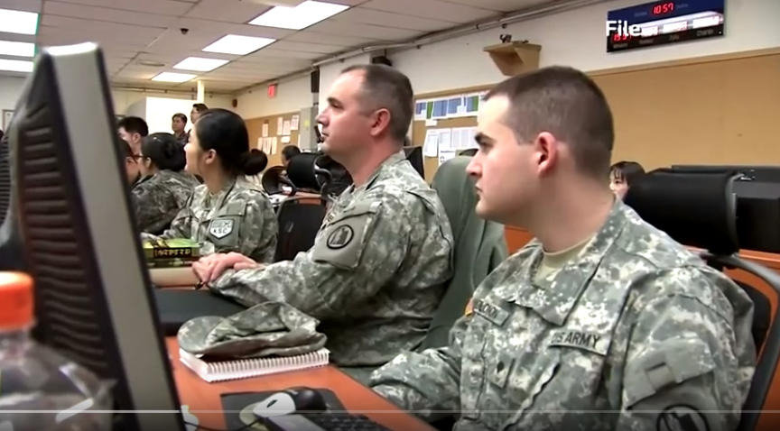
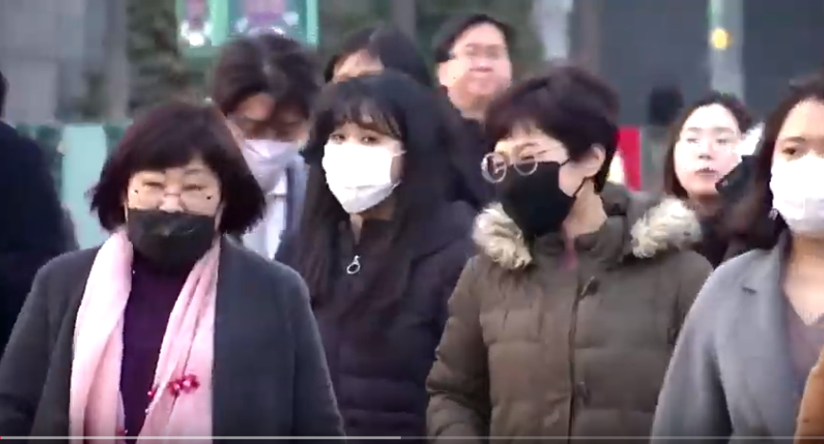
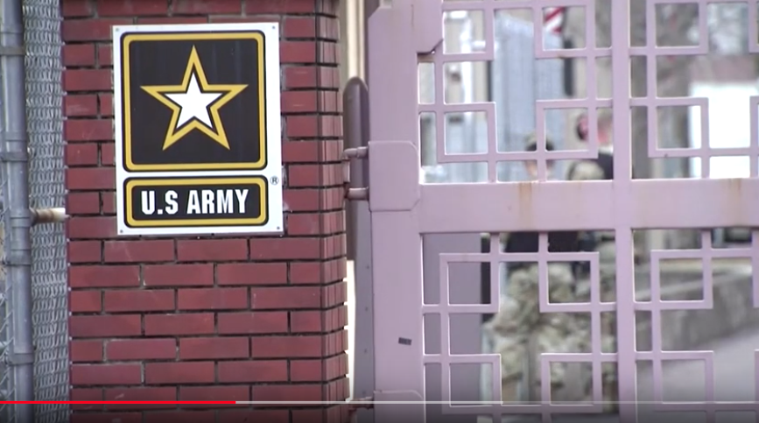
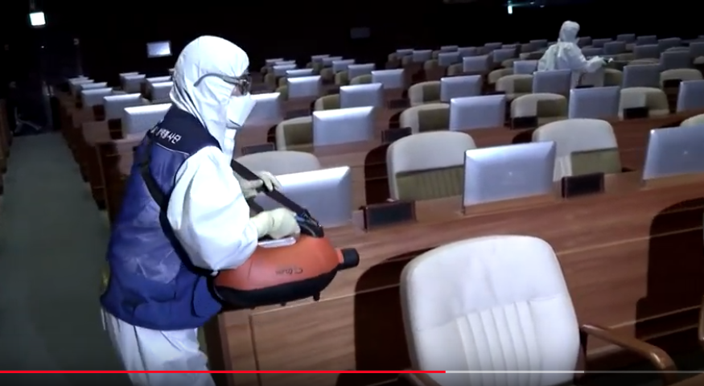
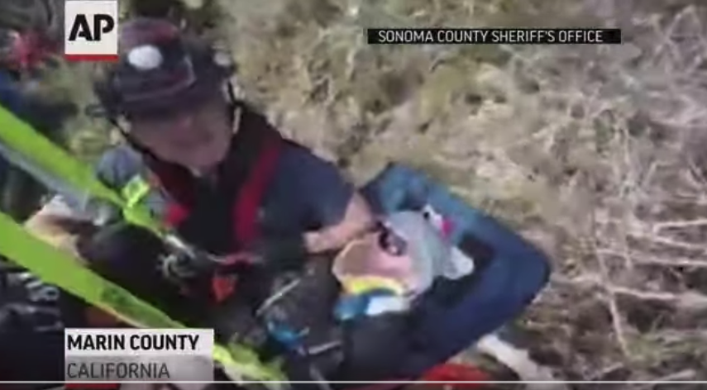
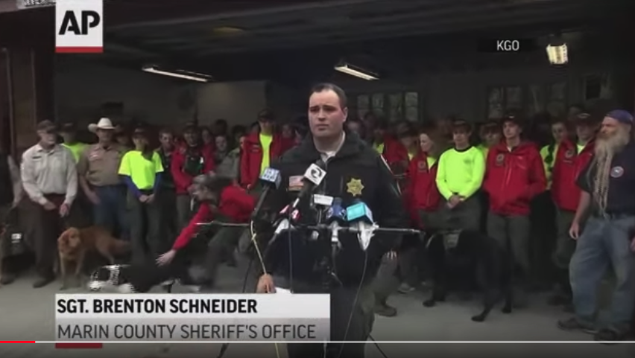
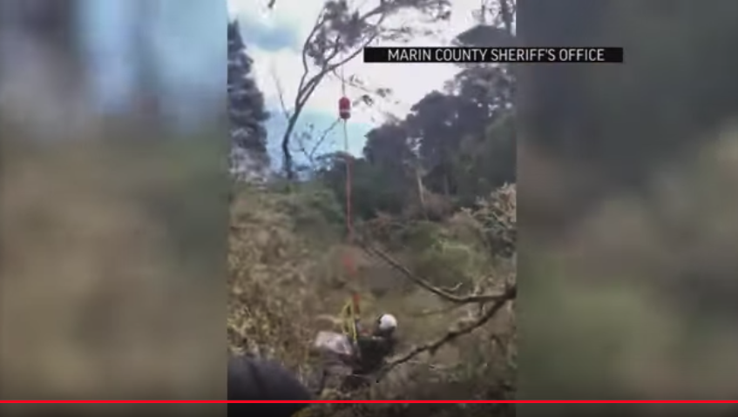
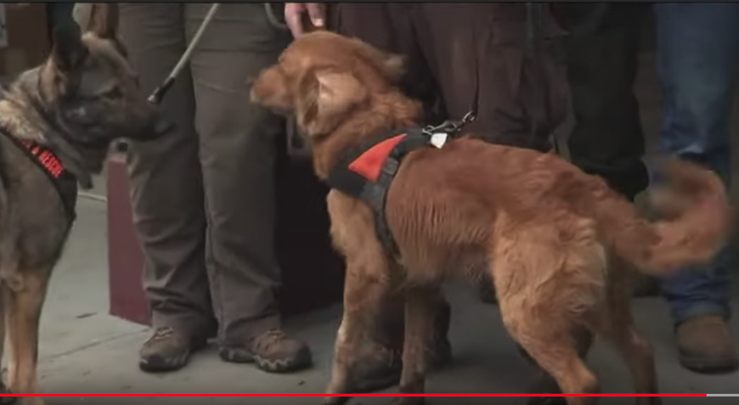
Real-world Multimedia Applications
Real-world multimedia applications requires image-language models to understand multiple levels of alignments such as verbs, objects, as well as semantic structures.
The U.S. and S. Korea consider scaling back military exercises because of coronavirus outbreak https://www.youtube.com/watch?v=AUlkKgJHWgU
Couple lost on Valentines Day hike is rescued
https://www.youtube.com/watch?v=nkP4yVwOhCI
Notes:
Multimodal pretraining has achieved impressive results on a lot of tasks like VQA. However, real world applications requires the model to understand different aspects, not only objects, but also events. the things we human talk about everday are the events happening around us, like in news website, due to the covid pandemic, we have training event, wearing mask event, lock down event, and cleaning event. Event understanding not only needs the model to understand verbs, but also its participants. For example, for this training event, it is for military people, and it will be very different when the participants are students, or doctors.

Slide 31
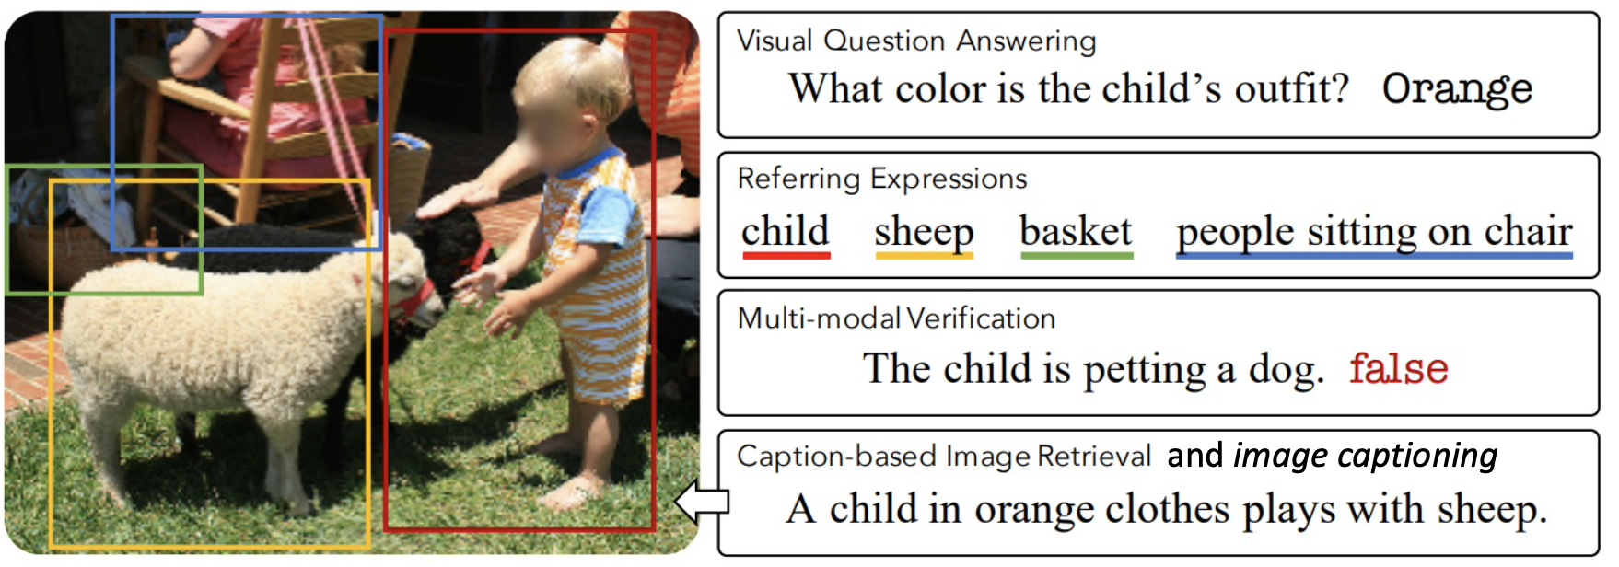
Real-world Multimedia Applications
Multimedia downstream tasks
Image from: https://arxiv.org/pdf/1912.02315.pdf

Slide 32
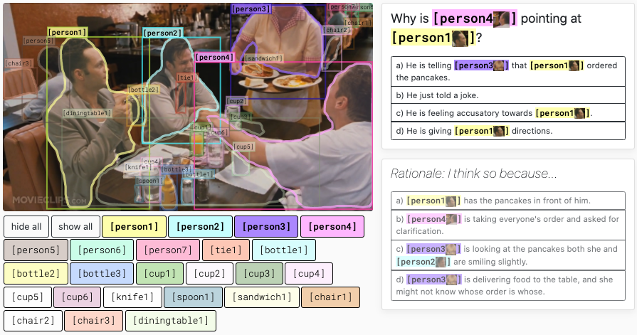
Real-world Multimedia Applications
VCR: Visual Commonsense Reasoning
Zellers, Rowan, et al. "From recognition to cognition: Visual commonsense reasoning." CVPR. 2019.
Notes:
Driven by real world applications, there are some tasks being proposed, such as the visual commonsense reasoning task. Different from VQA’s naïve questions, it mimics the real questions people will have when seeing the image, such as why person 4 is pointing to person 1, and its all about event understanding.

Slide 33
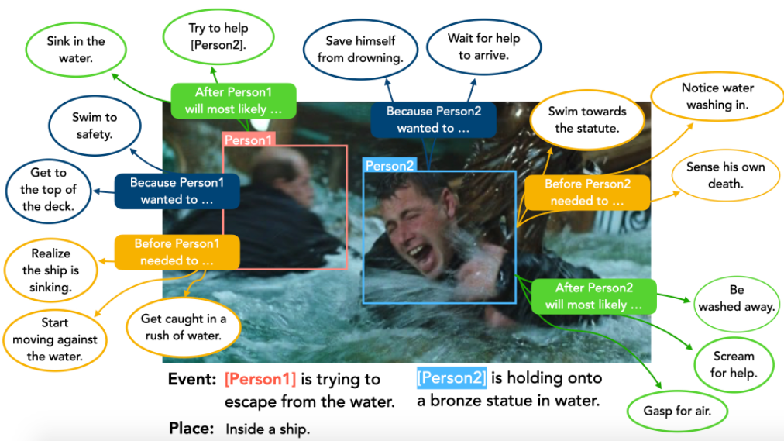
Real-world Multimedia Applications
VisualCOMET: Visual Commonsense Reasoning in Time
Park, Jae Sung, et al. "Visualcomet: Reasoning about the dynamic context of a still image.” ECCV. Springer, Cham, 2020.
Notes:
Going beyond that, VisualCOMET is proposed to predict the events happening now, before and after. For example, the blue boxes indicate now, yellow boxes for before, and green boxes for after. Given the image and the event, it aims to predict these boxes. Similar to previous tasks, it needs to not only knowing the event that happening, but also the argument role that person 1 or person2 is palying.

Slide 34
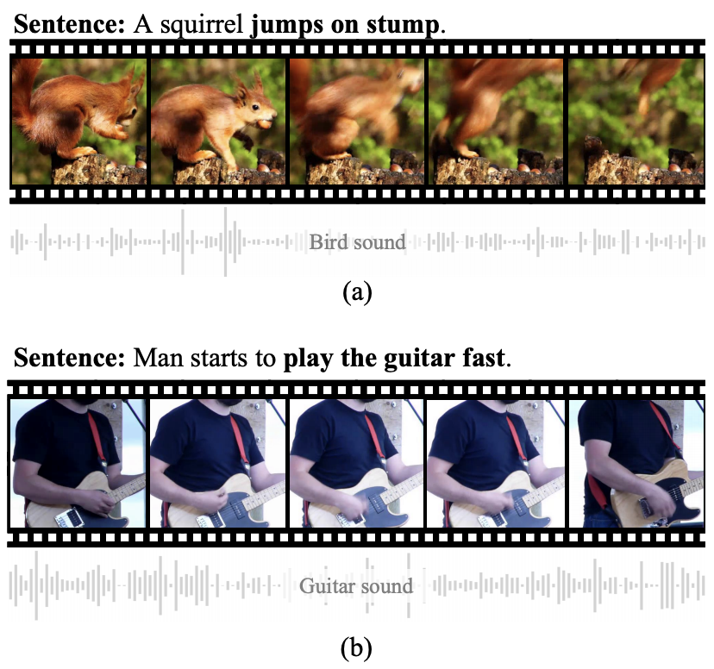
Why multimedia embedding?
It has been proven that multimedia information can benefit multiple tasks:
  NAACL 2021 Best Long Paper: Video-aided Unsupervised Grammar Induction

Slide 35
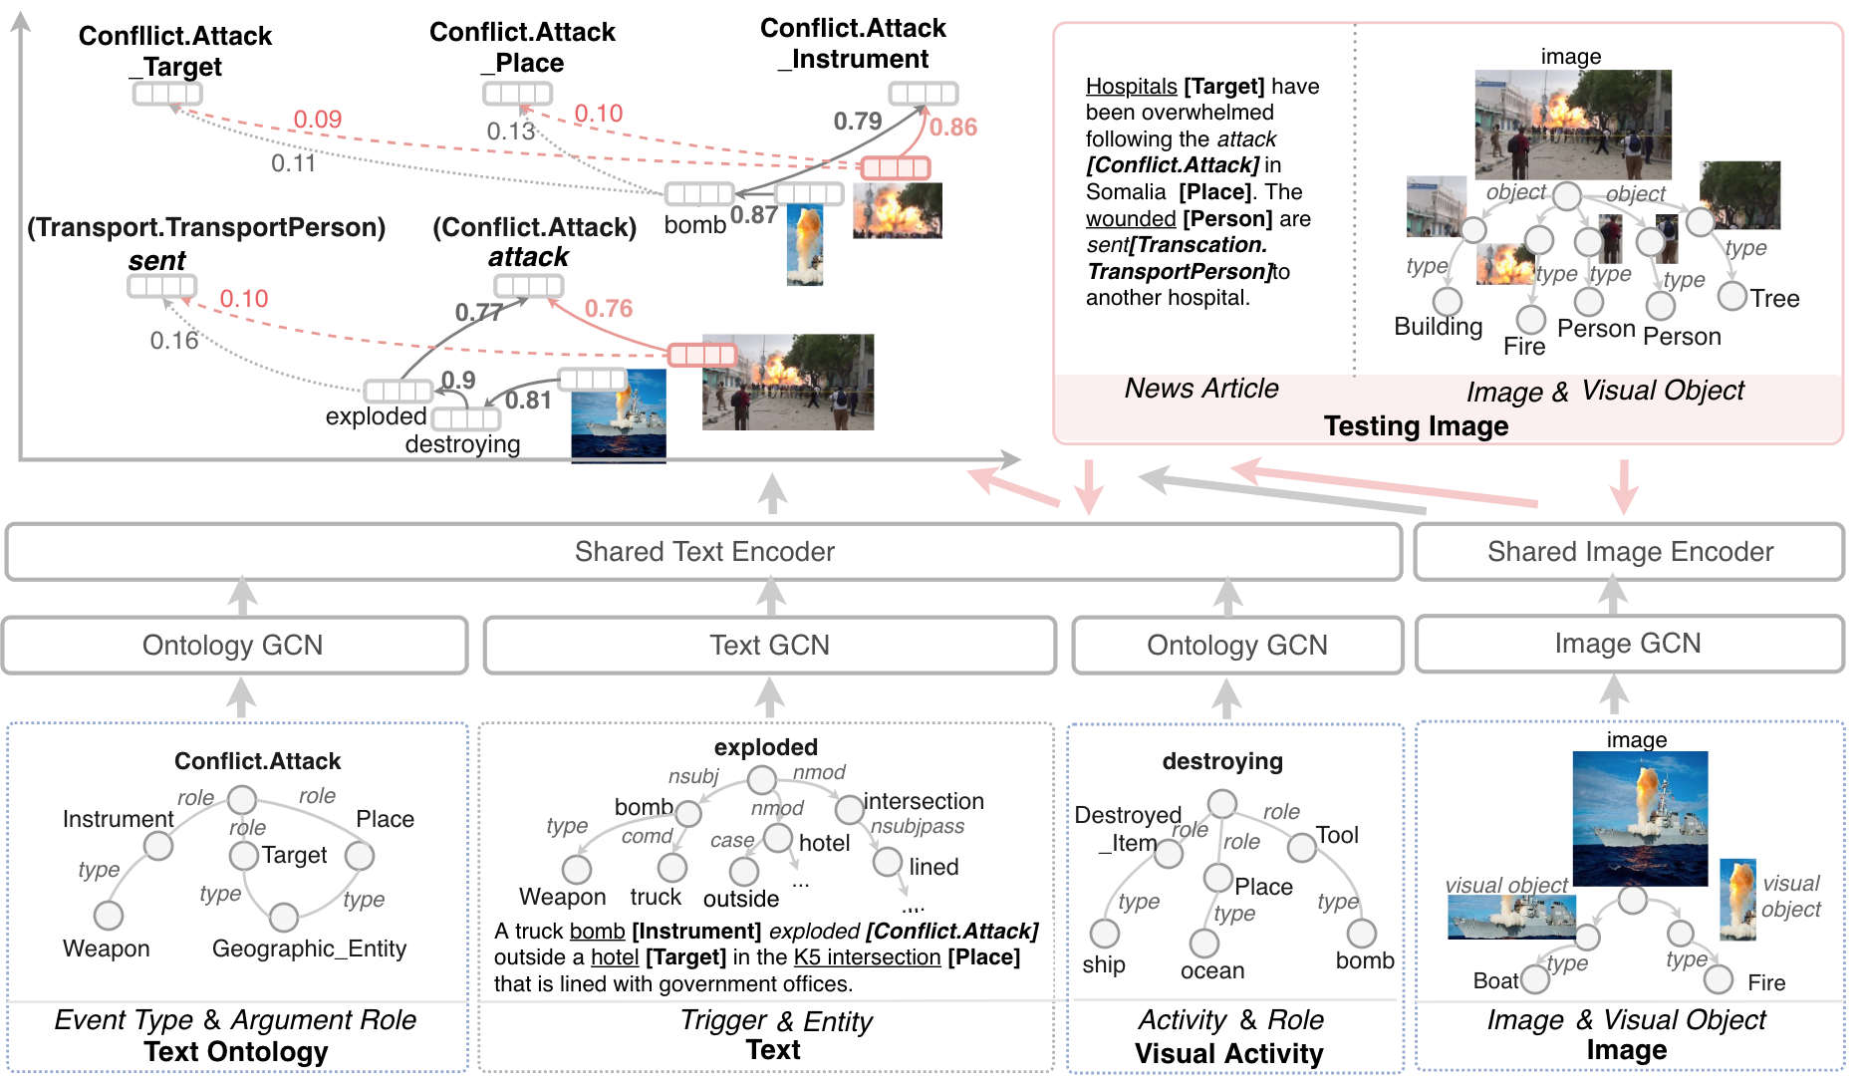
Goal: A joint representation of text and vision modalities

Slide 36
How to learn multimedia embedding?
Model
Data
Multimedia Pretraining

Slide 37
On the model side…
Before 2019
After 2019
Neural models based on pooling, attention mechanisms, etc.
Large-scale Transformer based pretraining models
Notes:
Transformer:firstproposedforNLP,popularizedbyBERTandGPT-2/3,extended to image generation, vision-language pre-training, and now image classification

Slide 38
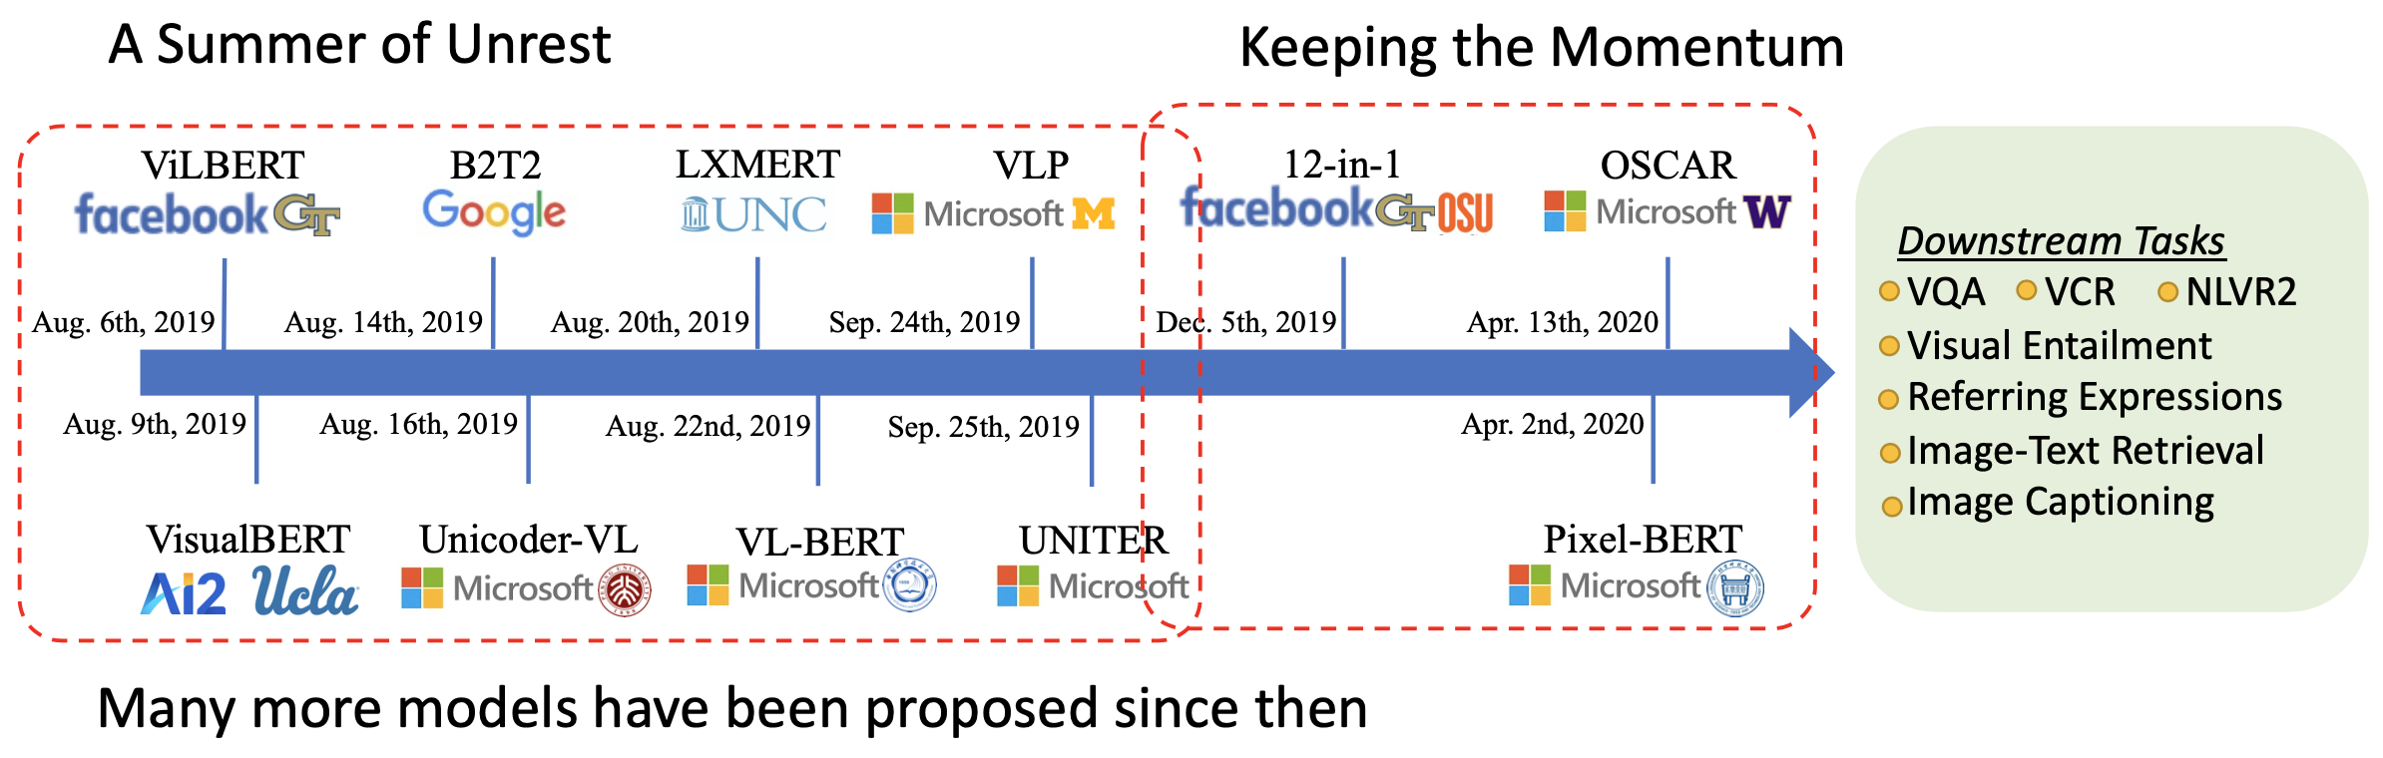
Great success of V+L Pretraining
From VQA to VLN: Recent Advances in Vision-and-Language Research. CVPR 2021. https://vqa2vln-tutorial.github.io/

Slide 39
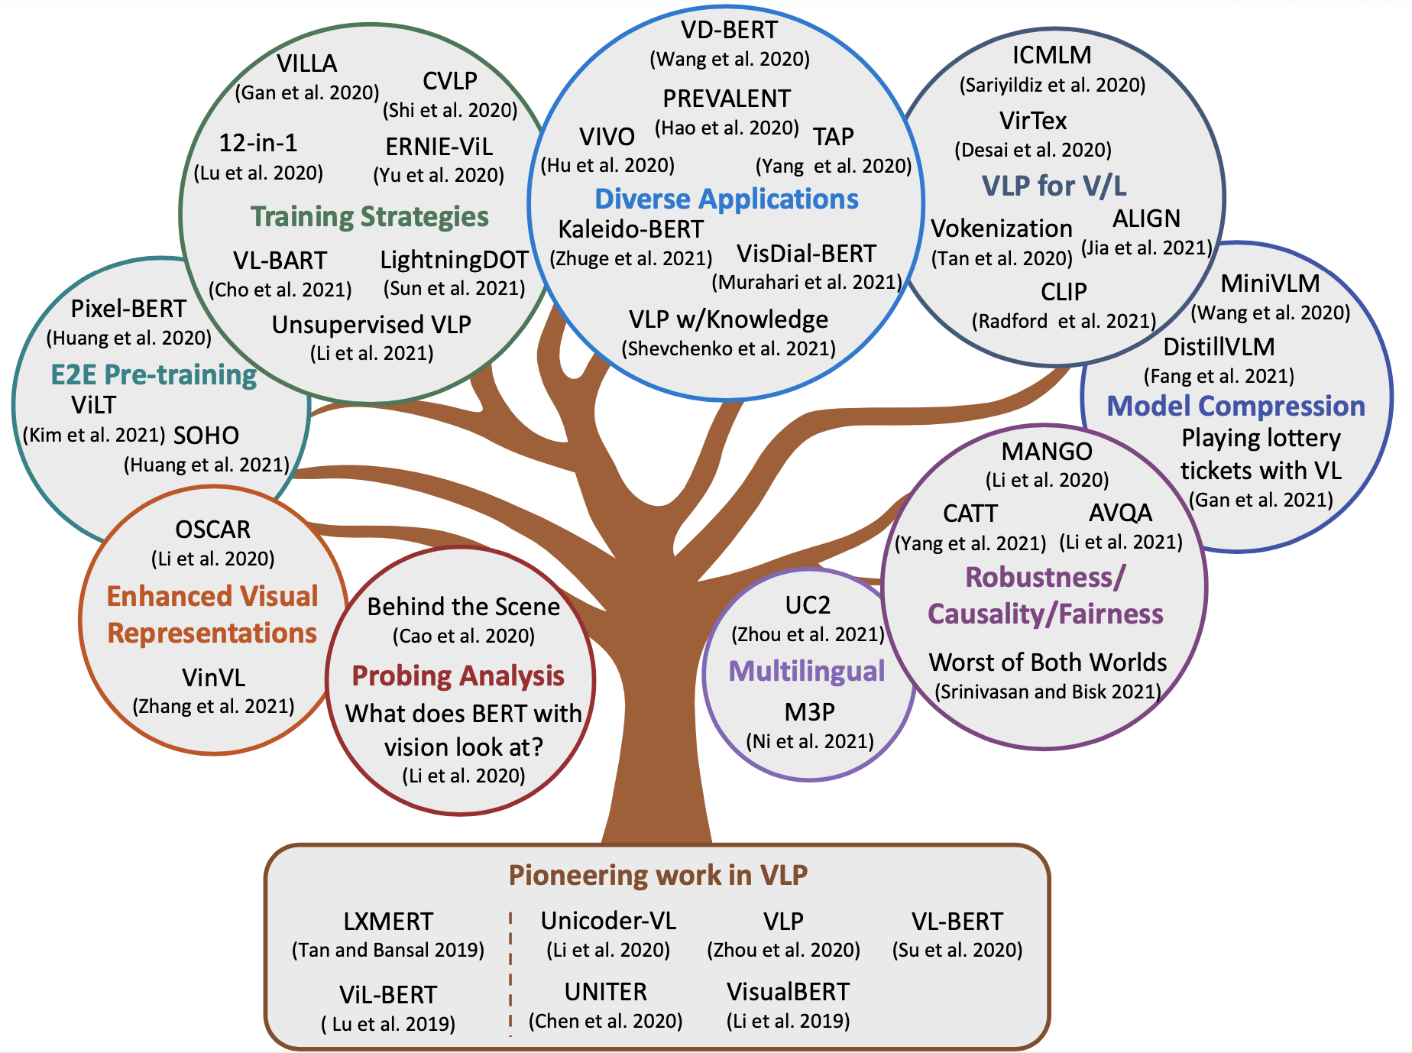
Great success of V+L Pretraining
From VQA to VLN: Recent Advances in Vision-and-Language Research. CVPR 2021. https://vqa2vln-tutorial.github.io/

Slide 40
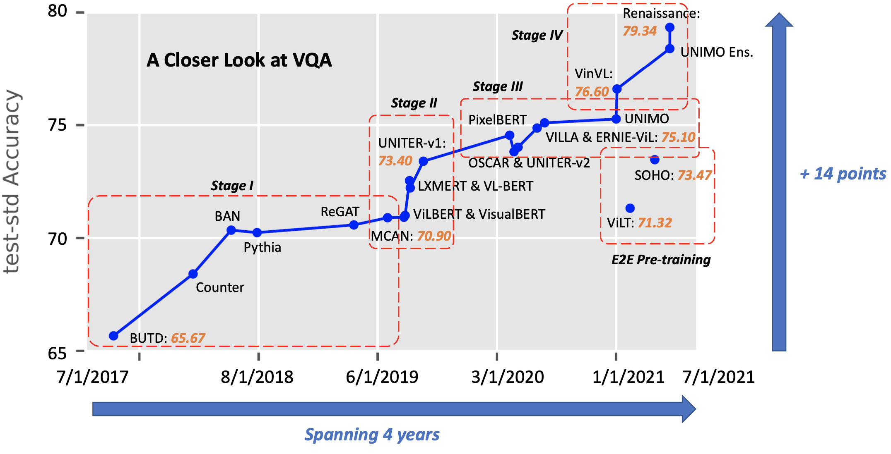
Great success of V+L Pretraining
From VQA to VLN: Recent Advances in Vision-and-Language Research. CVPR 2021. https://vqa2vln-tutorial.github.io/

Slide 41
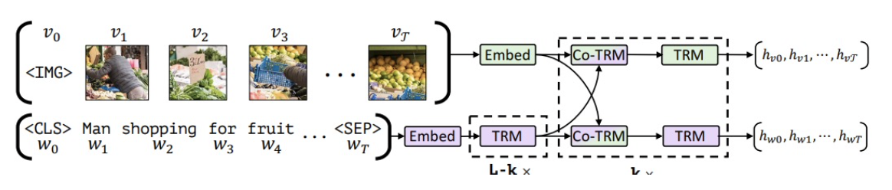
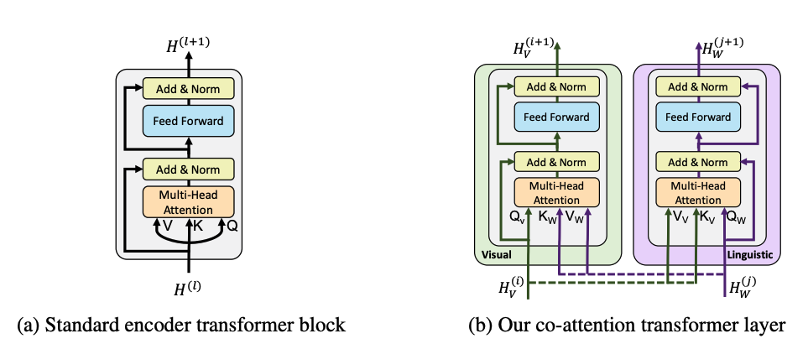
ViLBERT [NeurlPS 2019]
The first work on Transformer-based multimedia pretraining
  Co-attentional transformer to capture relatedness of two modalities

Slide 42
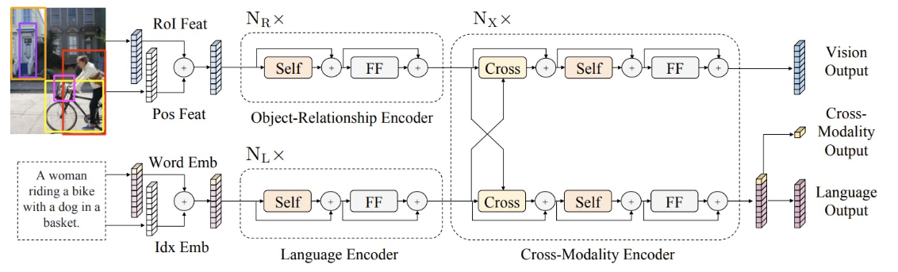
LXMERT [EMNLP 2019]
Can we learn the fine-grained alignments of two modalities?
  Add object detection results
  Use cross-attention between two modalities

Slide 43
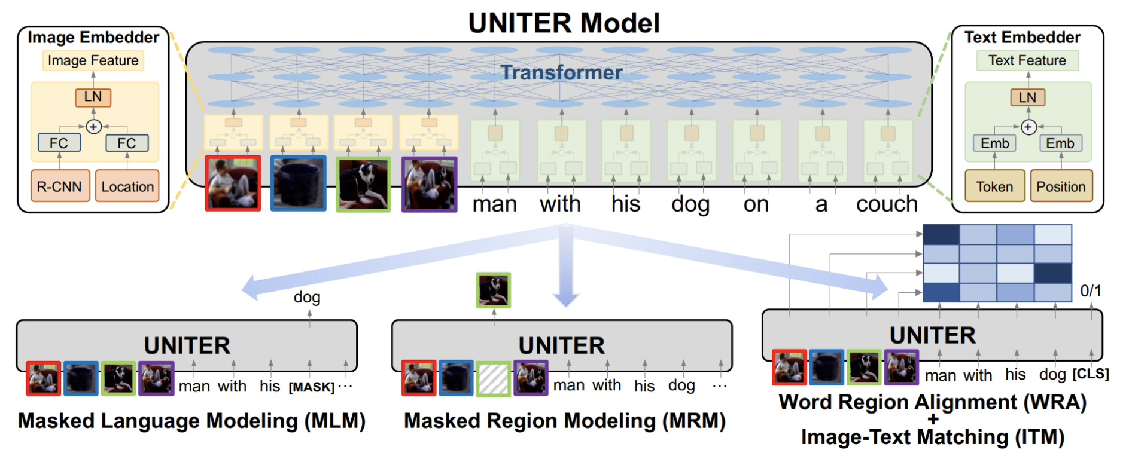
UNITER [ECCV 2020]
Better fine-grained alignments:
  Using Optimal Transport to align objects and words
UNITER: UNiversal Image-TExt Representation Learning, ECCV 2020

Slide 44
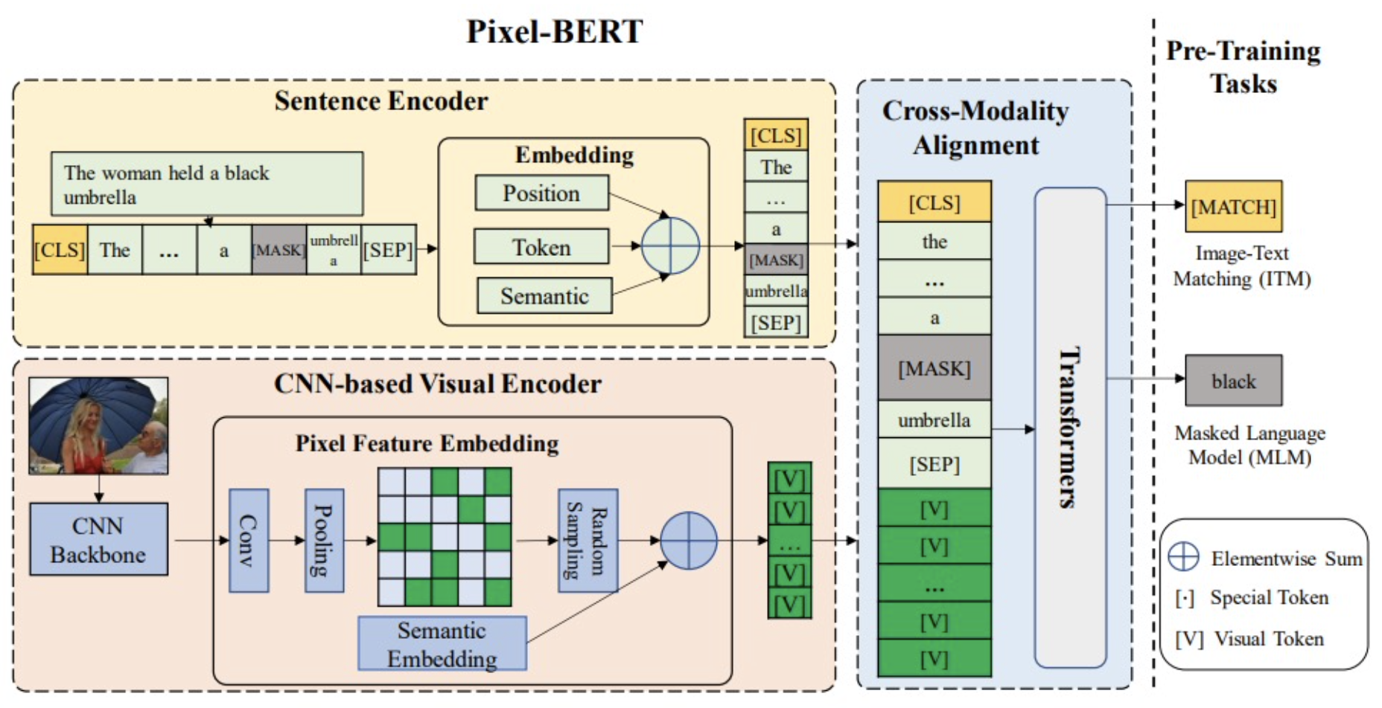
Pixel-BERT [2020]
At the same time, another line of work is using grid features instead of objects.
  Using grid features is fast.
  It is E2E training.
Pixel-BERT: Aligning Image Pixels with Text by Deep Multi-Modal Transformers, 2020
Notes:
Another Line of Work: Grid features instead of objects

Slide 45
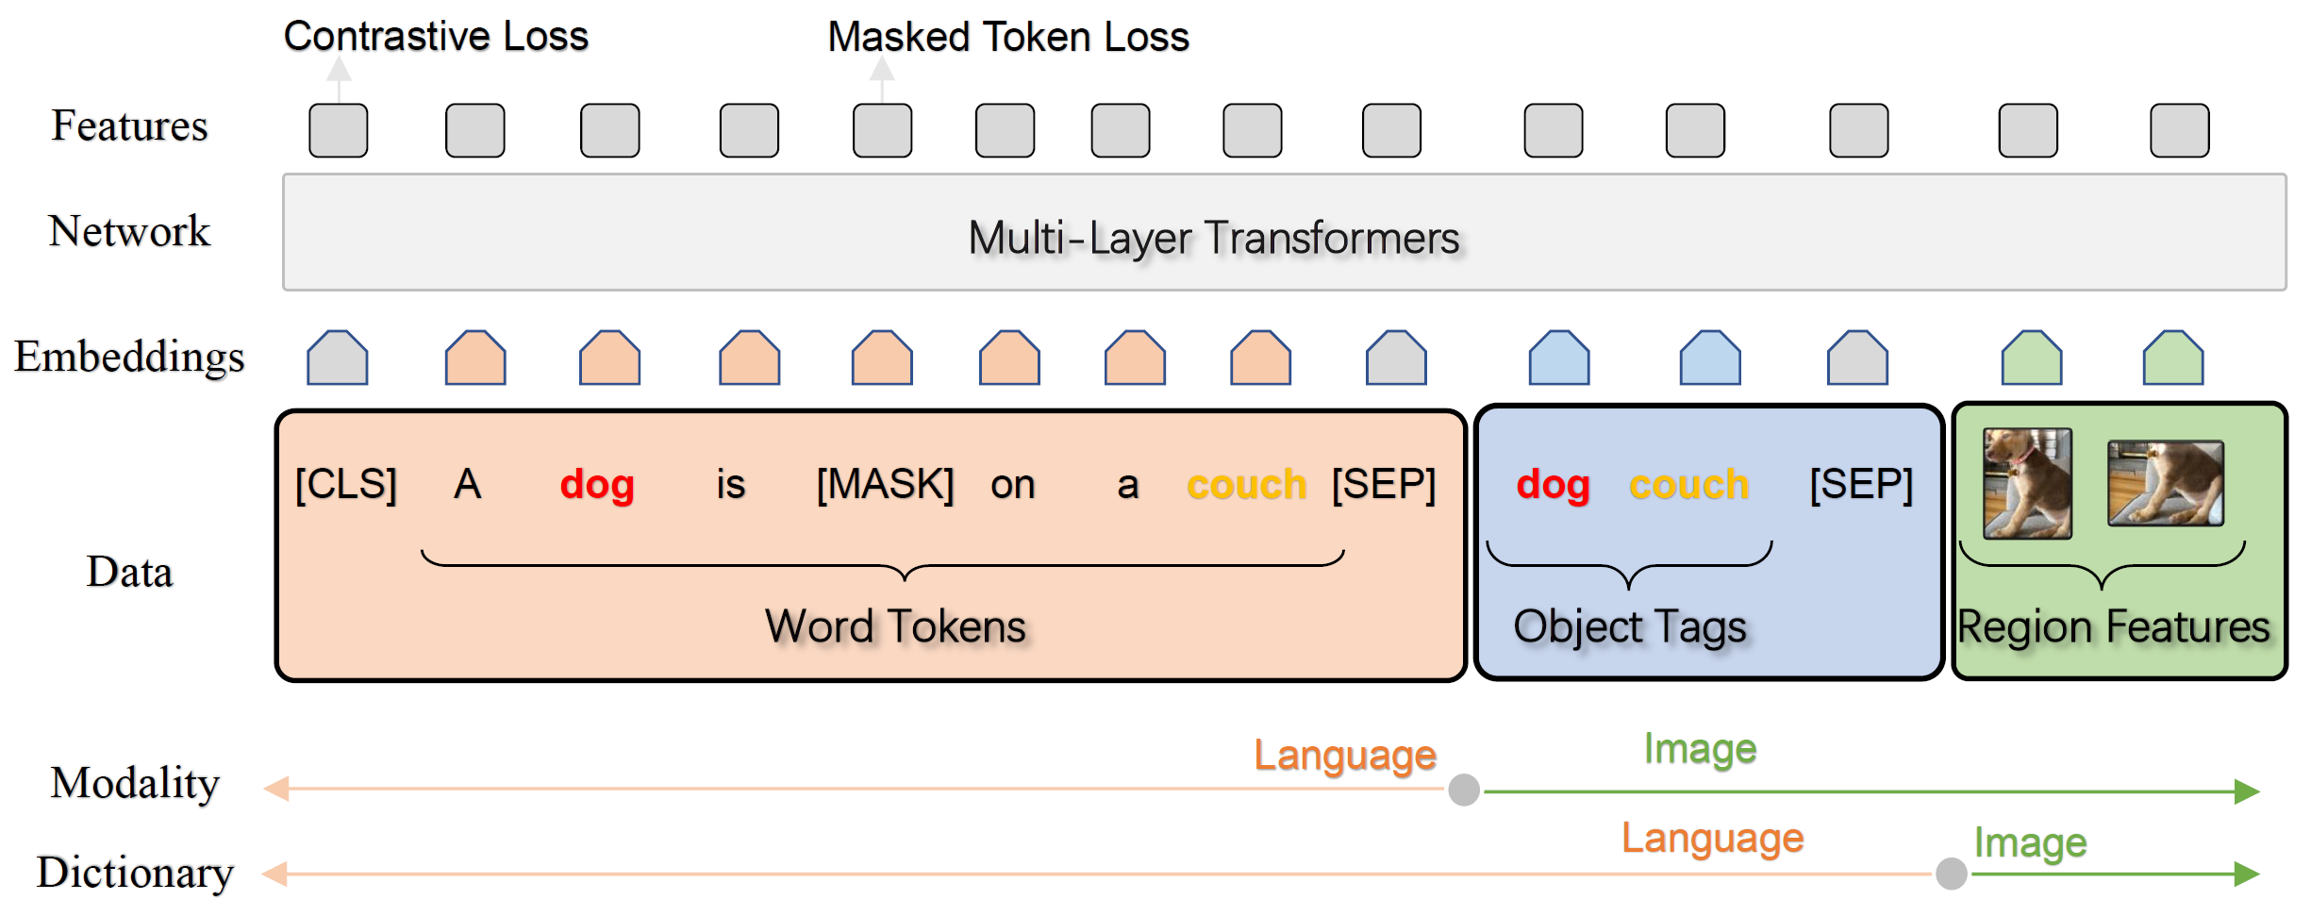
Oscar [ECCV 2020] and VinVL [CVPR 2021]
Object knowledge is richer.
  Add object label knowledge as anchor points
Oscar: Object-Semantics Aligned Pre-training for Vision-Language Tasks, ECCV 2020
VinVL: Making Visual Representations Matter in Vision-Language Models. CVPR 2021
Notes:
Object knowledge is actually much richer than we thought.
Object Tags as Anchor Points
The image-text pair is represented as a triplet

Slide 46
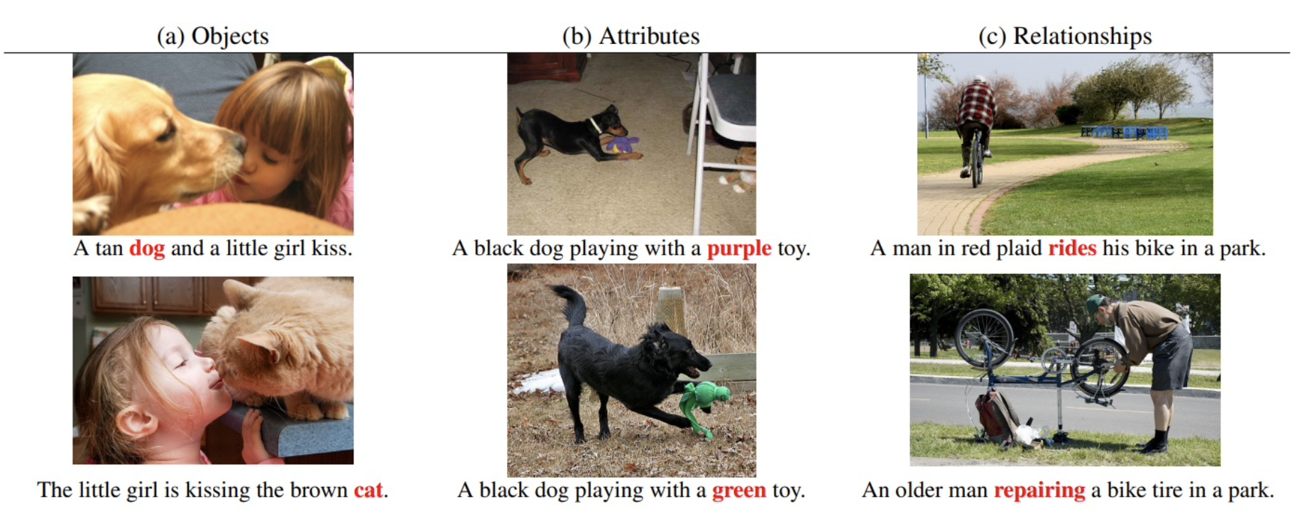
ERINE-ViL [AAAI2021]
Add scene graph knowledge as downstream tasks
  Object prediction
  Attribute prediction
  Relationship prediction
ERNIE-ViL: Knowledge Enhanced Vision-Language Representations Through Scene Graph, AAAI 2021

Slide 47
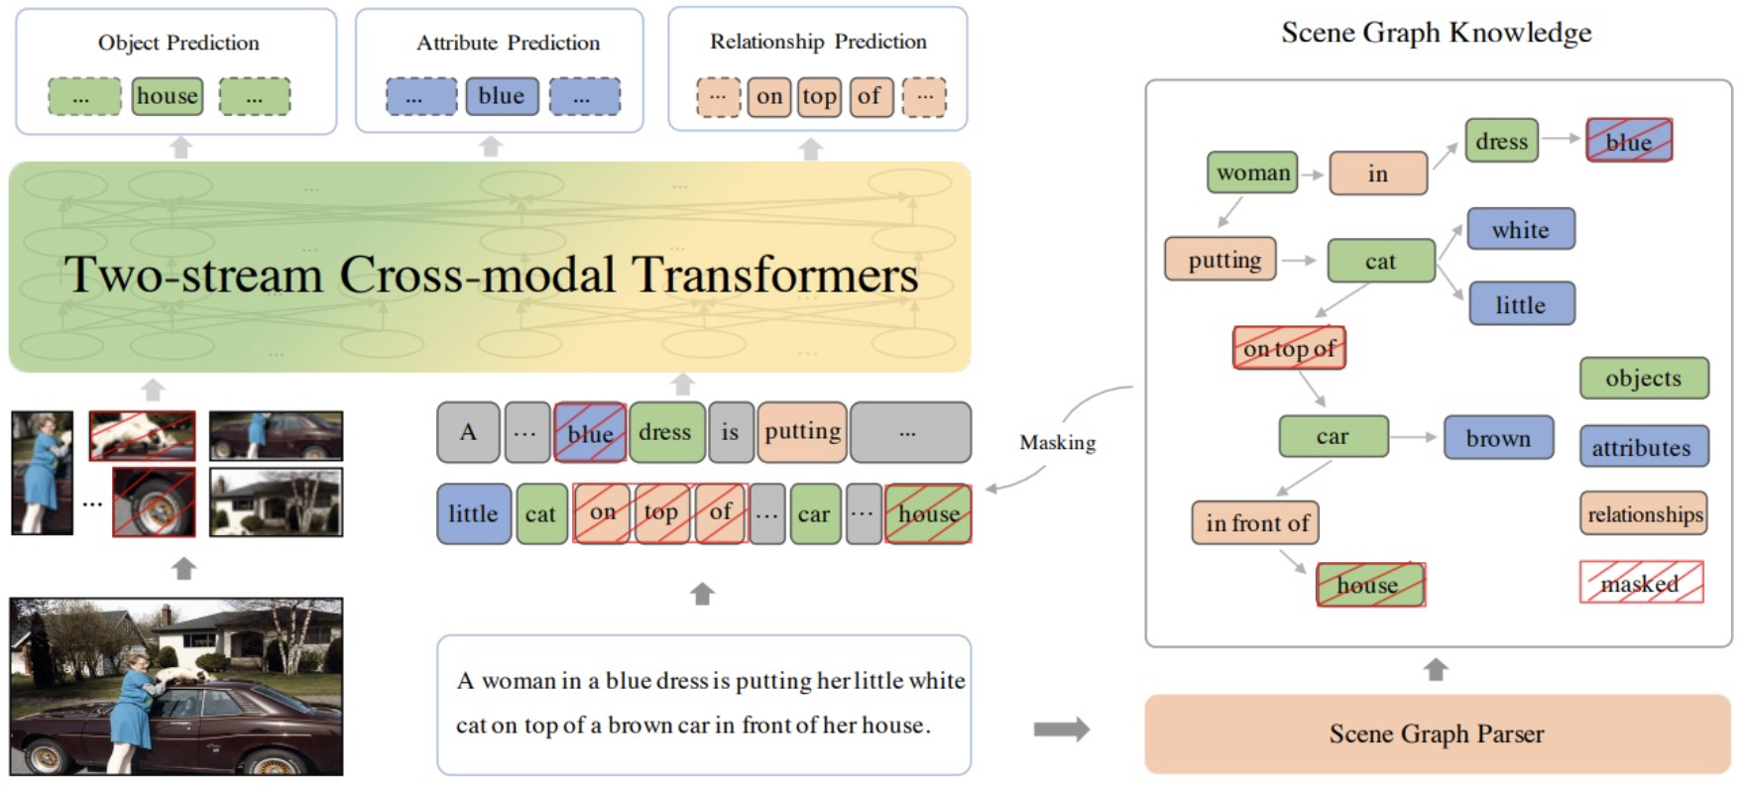
ERINE-ViL [AAAI2021]
Add scene graph knowledge as downstream tasks
  Object prediction
  Attribute prediction
  Relationship prediction
ERNIE-ViL: Knowledge Enhanced Vision-Language Representations Through Scene Graph, AAAI 2021

Slide 48
Summary
Add object Labels
Add objects
Image-caption pairs
Add scene graphs
Use pixels
More knowledge

Slide 49
Training Data
Image-caption pairs
  Free of cost
  The state-of-the-art model CLIP (from OpenAI) uses ~400M pairs for model training
Popular datasets
  Flicker 30K (~30K images)
  MS COCO (~330K images)
  Visual Genome (~108K images)
  Conceptual Captions (~3.3M images)
  SBU Captions (~1M images)
  …
Learning Transferable Visual Models From Natural Language Supervision, OpenAI. 2021

Slide 50
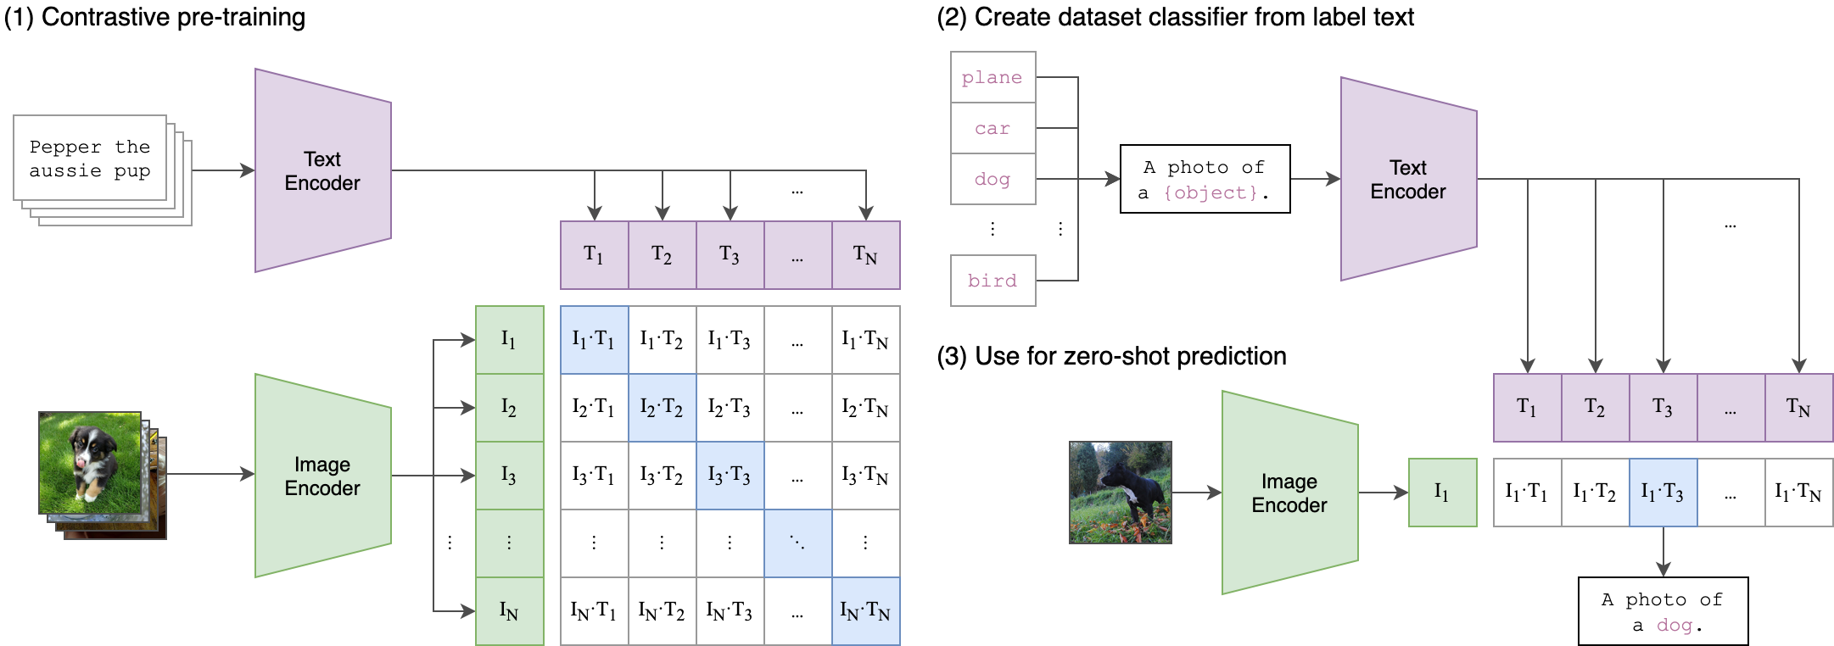
CLIP [2021, released by OpenAI]
State-of-the-art on object detection, etc. Especially good on zero-shot setting.
Very simple method, but performance is good due to the large data size (~400M images).

Slide 51
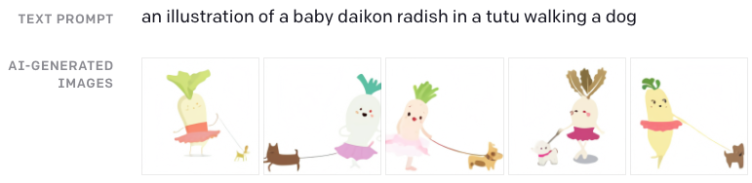
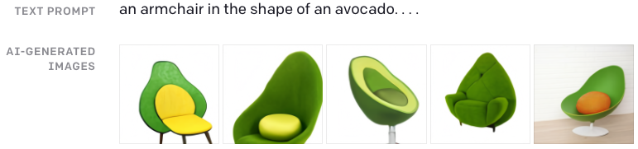
DALL·E [2021]
https://openai.com/blog/dall-e/
An image generation model with fairly good performance
It is just interesting!

Slide 52
Summary
Add object Labels
Add objects
Add scene graphs
Use pixels
?
More data
More knowledge

Slide 53
Understanding Multiple-level Alignments
Current multimedia pretrained embeddings focus on image-caption level, or object- entity level.
However, there are multiple levels of alignments between text and image
Text | Image
Word | Image Region
Entity | Visual Object
Relation | Visual Relation
Entity-Relation Graph | Visual Scene Graph
Event Trigger | Visual Activity
Linguistic Structure (semantic parsing tree, etc) | Visual Semantic Structure (Situation Recognition, etc)
Notes:
However, current .. Ignores the visual event knowledge. Actually, there are multiple level alignments between text and image, but the current models only focus on image-caption or entity-object level. Higher level alignments like event structures and linguistic structures, they are rich in semantics and is critical to understand complicated scenarios and support downstream tasks like QA.

Slide 54
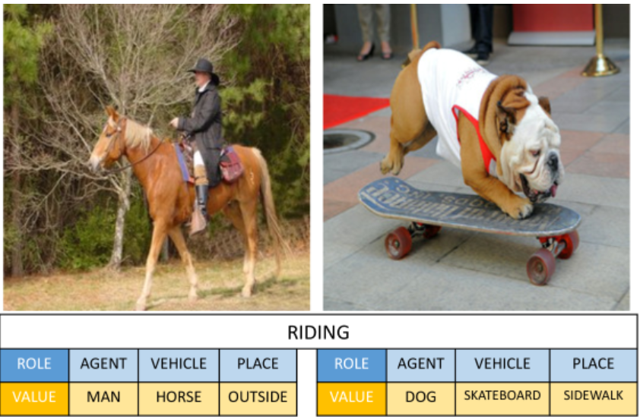

Situation Recognition
Detecting the visual semantics roles has been paid attention to in CV community.
Situation Recognition [Yatskar et al. 2016]
Grounded Situation Recognition [Pratt et al, 2020]
Yatskar, Mark, Luke Zettlemoyer, and Ali Farhadi. "Situation recognition: Visual semantic role labeling for image understanding." CVPR. 2016.
Li, Ruiyu, et al. "Situation recognition with graph neural networks." ICCV. 2017.
Sarah Pratt, Mark Yatskar, Luca Weihs, Ali Farhadi, and Aniruddha Kembhavi. Grounded situation recognition. In ECCV, 2020
Sadhu, A., Gupta, T., Yatskar, M., Nevatia, R., & Kembhavi, A. (2021). Visual Semantic Role Labeling for Video Understanding. ArXiv, abs/2104.00990.
Notes:
This problem also has been paid much attention in computer vision community. Most work are based on situation recognition. Given an image, the goal is to detect the verb and semantic roles. For example, these two images are about riding, and the agent of the first image is man while for the second image, the agent is a dog. Recent work extends the output to include the bounding boxes of each role, so the model needs to localize the argument role in the image.

Slide 55

Visual Event and Argument
Understand the verbs and argument role semantics of the image

Slide 56

How to encode event knowledge?
The key of event knowledge is event structures
Structured Multimedia Common Space using GNN

Slide 57

Event-Driven Vision-Language Pretraining [Li et al., CVPR22]
Transfer text event knowledge to images: Using text event structures as a distant supervision
Construct hard negatives by manipulating event structures.
[Li, et al, CVPR2022]

Slide 58

Learning To Recognize Procedural Activities with
Distant Supervision [Lin et al., CVPR22]

Slide 59
Take Away
On the model side, Transformer based models using self supervision has achieved great success in multiple downstream tasks.
  Adding knowledge can boost the performance of pretrained embedding.
  Structured knowledge (such as event graph structure) and abstract word understanding (such as verb, adjectives, etc) are still lack of exploration.
On the data side, increasing data size will largely boost the performance

