Slide 1
Multimedia Encoding
Manling Li, Heng Ji
manling2@illinois.edu

Slide 2
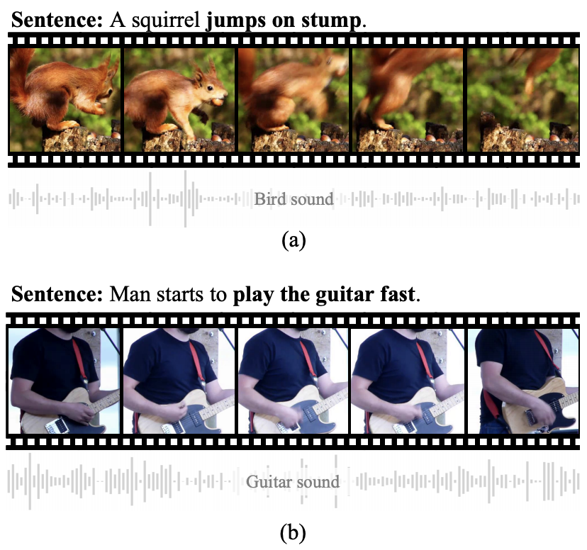
Why multimedia?
It has been proven that multimedia information can benefit multiple tasks:
NAACL 2021 Best Long Paper: Video-aided Unsupervised Grammar Induction
Notes:
Encode information of two modalities into a common representation, PCFG

Slide 3
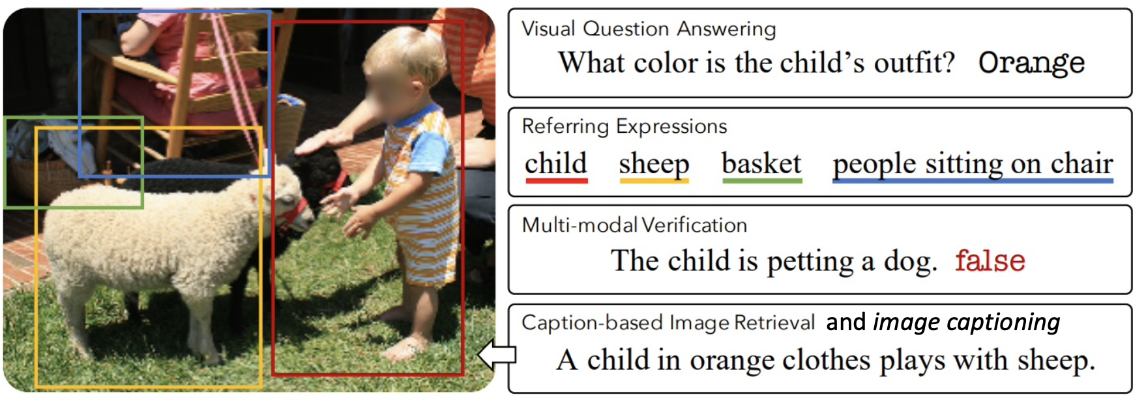
How to use Multimedia Embeddings?
Multimedia downstream tasks
Image from: https://arxiv.org/pdf/1912.02315.pdf

Slide 4
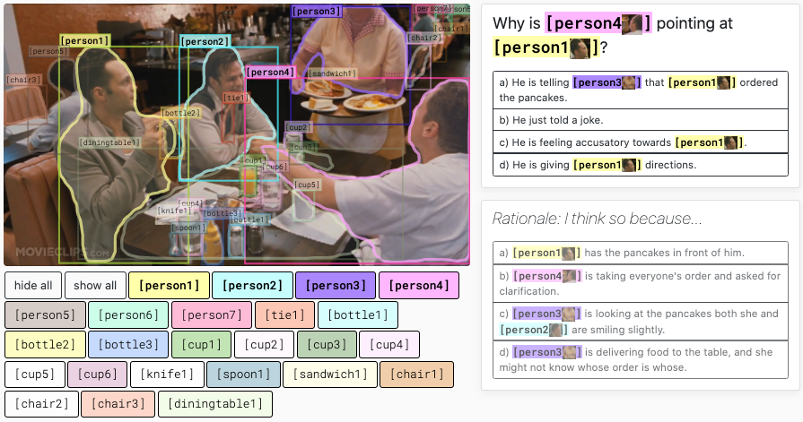
Real-world Multimedia Applications
VCR: Visual Commonsense Reasoning
Zellers, Rowan, et al. "From recognition to cognition: Visual commonsense reasoning." CVPR. 2019.

Slide 5
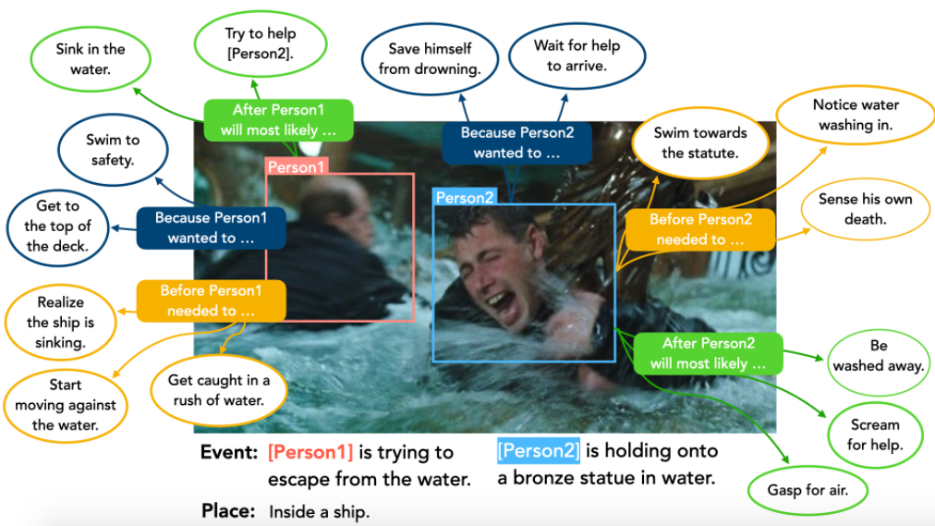
Real-world Multimedia Applications
VisualCOMET: Visual Commonsense Reasoning in Time
Park, Jae Sung, et al. "Visualcomet: Reasoning about the dynamic context of a still image.” ECCV. Springer, Cham, 2020.

Slide 6
The Goal of Multimedia Embedding Space
How? Image-text pre-training by image-text pairs
cross-media alignment
vision
text

Slide 7
The Goal of Multimedia Embedding Space
How? Image-text pre-training by image-text pairs
cross-media alignment
vision
text
Sparse features (token, entity, parsing,..)
Continuous features (Transformer, ..)

Slide 8
The Goal of Multimedia Embedding Space
How? Image-text pre-training by image-text pairs
cross-media alignment
vision
text
Sparse features (token, entity, parsing,..)
Continuous features (Transformer, ..)
Sparse features (object, scene graphs,..)
Continuous features (CNN, ViT, ..)

Slide 9
The Goal of Multimedia Embedding Space
How? Image-text pre-training by image-text pairs
cross-media alignment
vision
text
ITC
ITM
MLM
LM
Sparse features (token, entity, parsing,..)
Continuous features (Transformer, ..)
Sparse features (object, scene graphs,..)
Continuous features (CNN, ViT, ..)

Slide 10
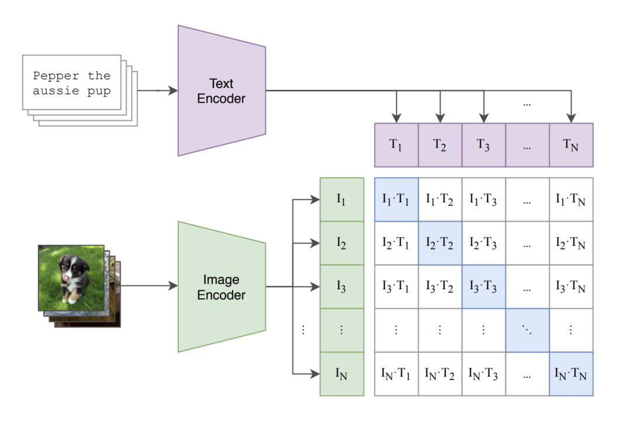
Image-text contrastive (ITC) loss
https://datarelease.blob.core.windows.net/tutorial/VLP-Tutorial_2022/image_text_part1.pdf

Slide 11
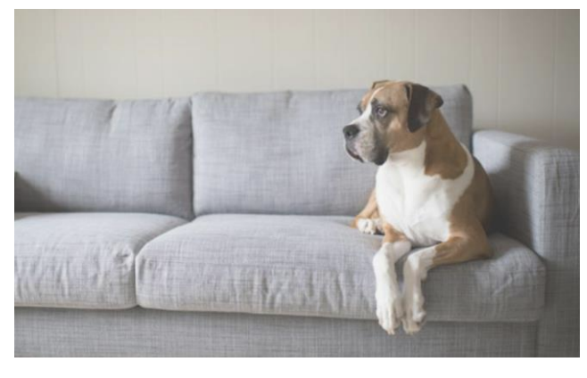
Image-text matching (ITM) loss
https://datarelease.blob.core.windows.net/tutorial/VLP-Tutorial_2022/image_text_part1.pdf

Slide 12
Masked language modeling (MLM) loss
https://datarelease.blob.core.windows.net/tutorial/VLP-Tutorial_2022/image_text_part1.pdf

Slide 13
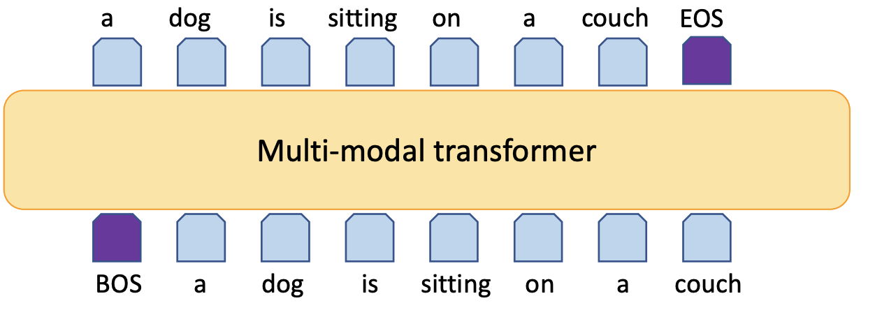
Language modeling (LM) loss
https://datarelease.blob.core.windows.net/tutorial/VLP-Tutorial_2022/image_text_part1.pdf

Slide 14
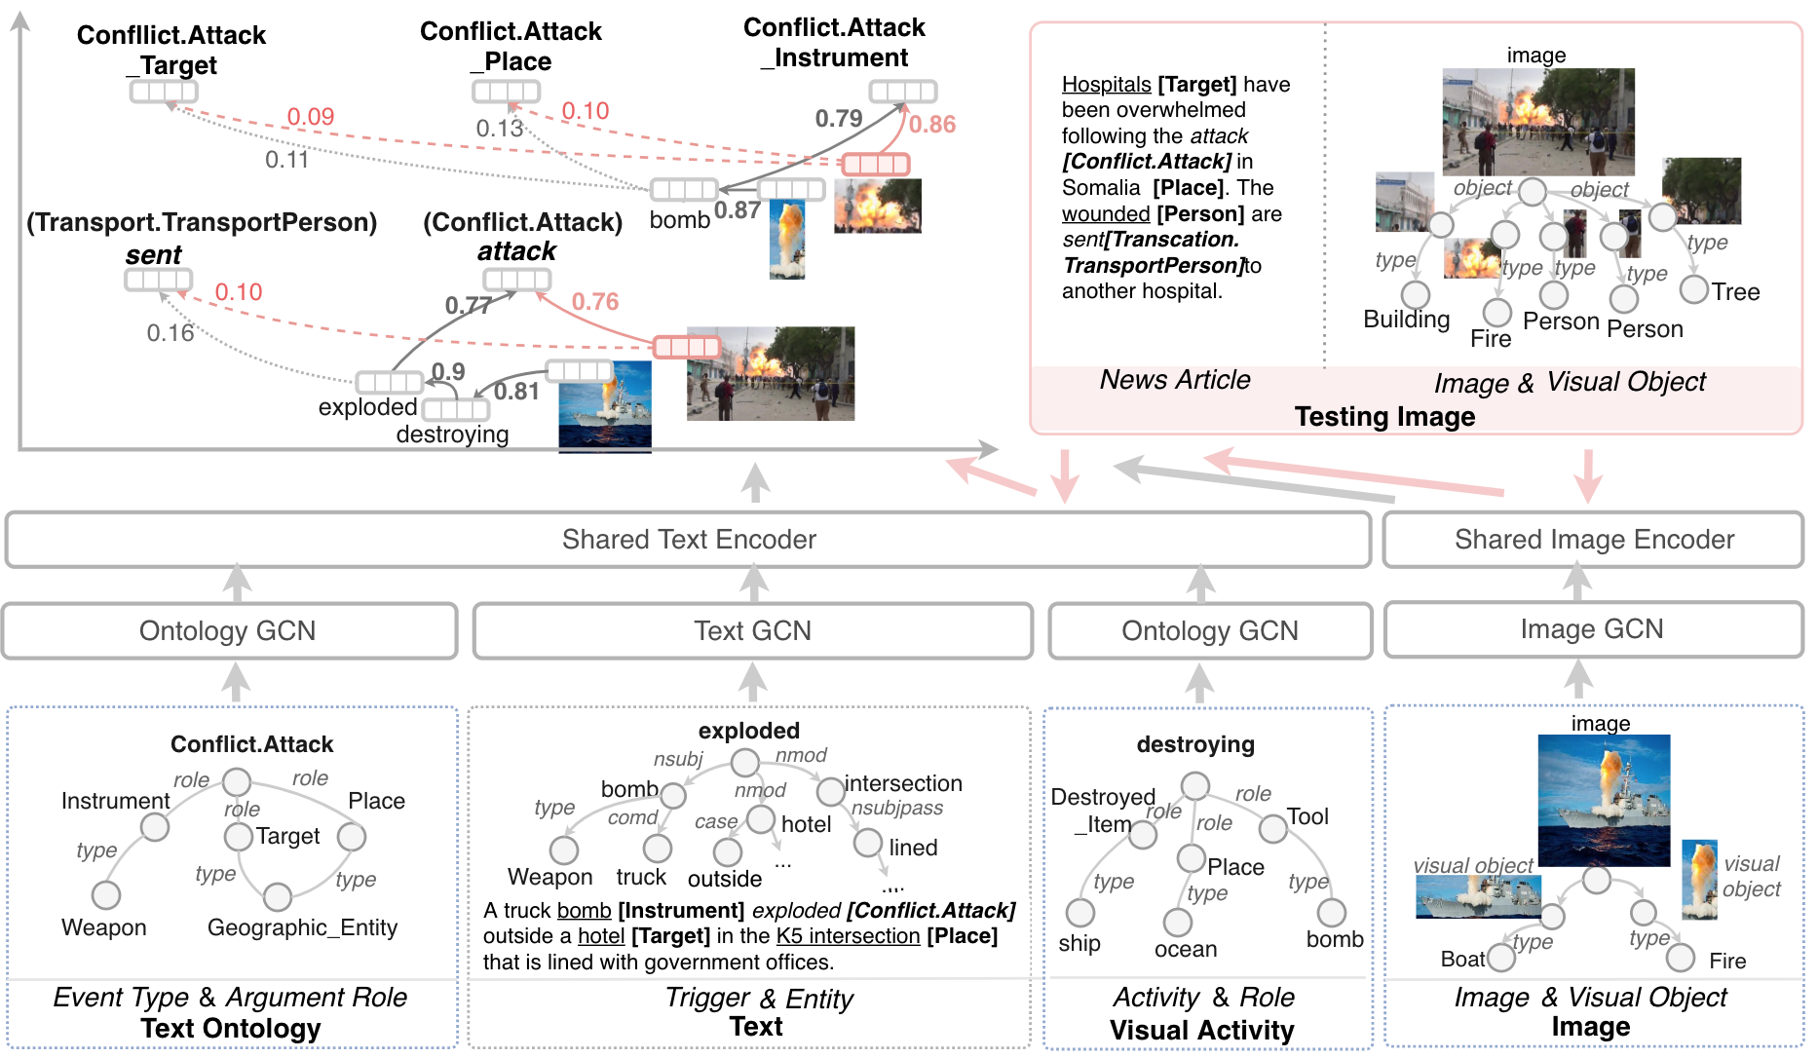
Goal: A joint representation of text and vision modalities
Notes:
To support this kind of tasks

Slide 15
How to learn multimedia embedding?
Model
Data
Multimedia Pretraining

Slide 16
On the model side…
Before 2019
After 2019
Neural models based on pooling, attention mechanisms, etc.
Large-scale Transformer based pretraining models
Notes:
Transformer:firstproposedforNLP,popularizedbyBERTandGPT-2/3,extended to image generation, vision-language pre-training, and now image classification

Slide 17
Transformer is taking over
From VQA to VLN: Recent Advances in Vision-and-Language Research. CVPR 2021. https://vqa2vln-tutorial.github.io/

Slide 18
Transformer is taking over
From VQA to VLN: Recent Advances in Vision-and-Language Research. CVPR 2021. https://vqa2vln-tutorial.github.io/

Slide 19
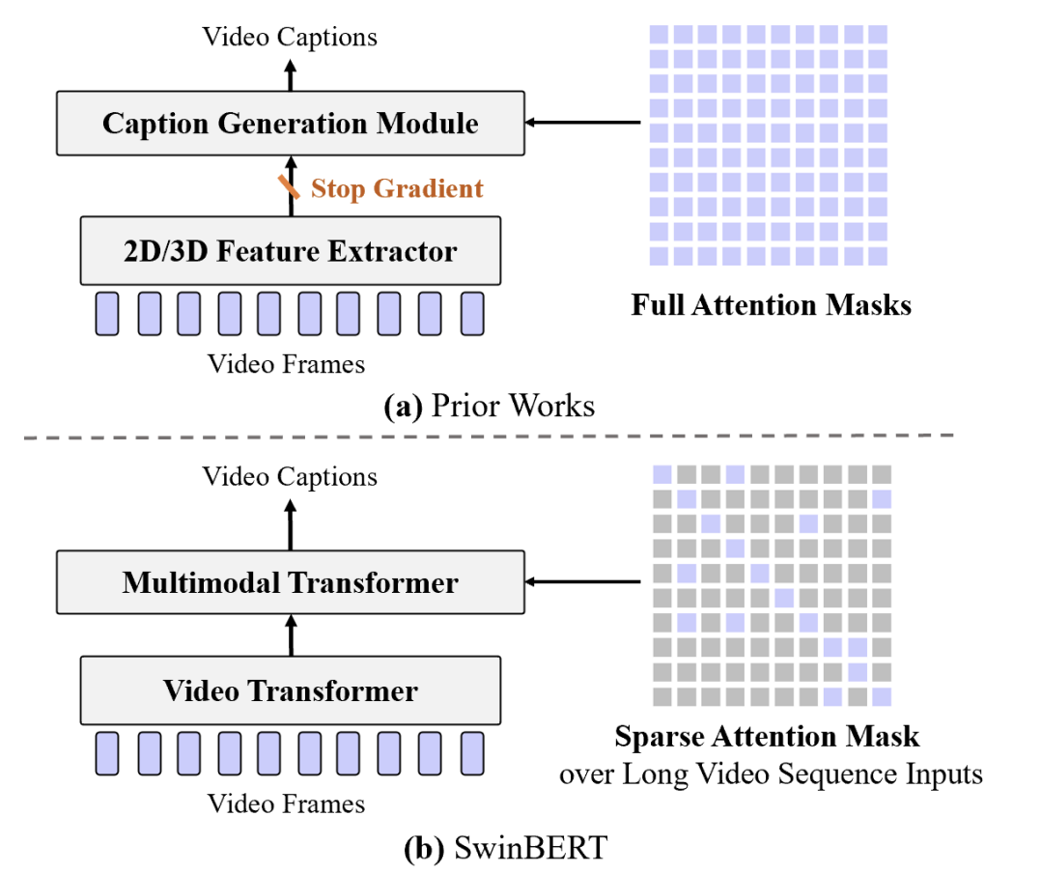
State-of-the-art model: SwinBERT
adaptively learn a sparse attention mask to improve long-range video sequence modeling

Slide 20
Training Data
Image-caption pairs
Free of cost
The state-of-the-art model CLIP (from OpenAI) uses ~400M pairs for model training
Popular datasets
Flicker 30K (~30K images)
MS COCO (~330K images)
Visual Genome (~108K images)
Conceptual Captions (~3.3M images)
SBU Captions (~1M images)
…
Learning Transferable Visual Models From Natural Language Supervision, OpenAI. 2021

Slide 21
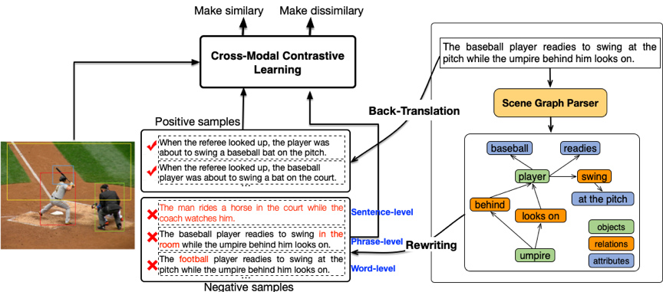
UNIMO [ACL 2021]
Data augmentation using back-translation

Slide 22
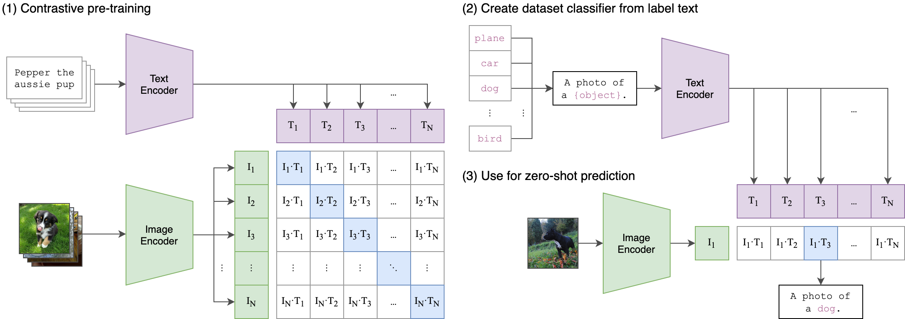
CLIP [2021, released by OpenAI]
State-of-the-art on object detection, etc. Especially good on zero-shot setting.
Very simple method, but performance is good due to the large data size (~400M images).

Slide 23
DALL·E [2021]
An image generation model with fairly good performance
It is just interesting!

Slide 24
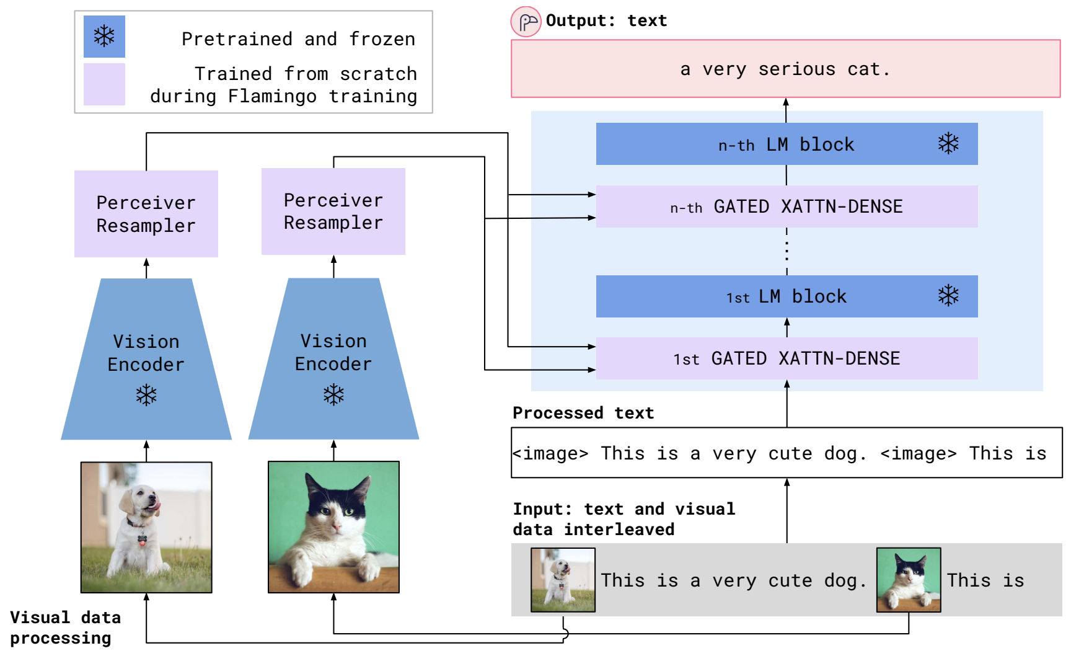
Flamingo [2022]
The Flamingo models are a family of visual language model (VLM) that can take as input visual data interleaved with text and can produce free-form text as output.

Slide 25
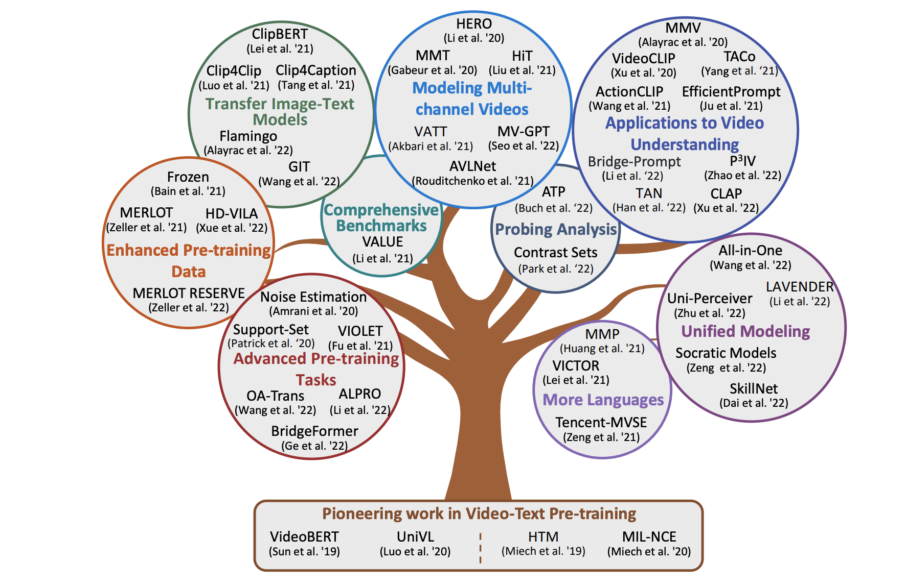
How about videos?
https://datarelease.blob.core.windows.net/tutorial/VLP-Tutorial_2022/video_text_part1.pdf

Slide 26
Evolution of Video-Text Pre-training
https://datarelease.blob.core.windows.net/tutorial/VLP-Tutorial_2022/video_text_part1.pdf

Slide 27
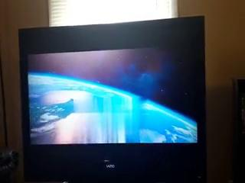
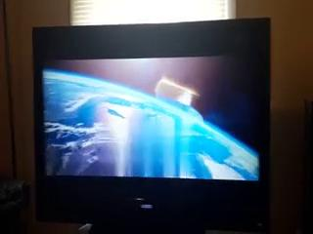
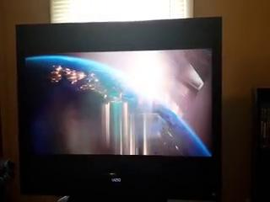
Video pretraining is lagging behind
Observation:
rich knowledge/alignments in image-language pretrained models
video-language pretraining is lagging behind in visual concept understanding
(A) a man giving a presentation and showing the planet earth
ALPRO (video-language model)
(B) a movie is starting with a logo of Universal Pictures
CLIP (image-language model)

Slide 29
Video-and-Language Datasets
https://datarelease.blob.core.windows.net/tutorial/VLP-Tutorial_2022/video_text_part1.pdf

Slide 30
Why video pretraining is lagging behind?
Source: Disentangled Representation Learning for Text-Video Retrieval

Slide 31
ClipBERT: Less is more
Idea: uses sparsely sampled clips and raw text tokens for end-to-end modeling.

Slide 32
Take Away
On the model side, Transformer based models using self supervision has achieved great success in multiple downstream tasks.
Adding knowledge can boost the performance of pretrained embedding.
Structured knowledge (such as event graph structure) and abstract word understanding (such as verb, adjectives, etc) are still lack of exploration.
On the data side, the following directions can be explored more:
In-context prompt
data augmentation
data selection

Slide 33
Next Part: Knowledge-enhanced V+L Encoding

Slide 34
Multimedia Encoding (09/02)
Manling Li, Heng Ji
manling2@illinois.edu

Slide 35
Recap: The Goal of Multimedia Embedding Space
How? Image-text pre-training by image-text pairs
cross-media alignment
vision
text
ITC
ITM
MLM
LM
Sparse features (token, entity, parsing,..)
Continuous features (Transformer, ..)
Sparse features (object, scene graphs,..)
Continuous features (CNN, ViT, ..)

Slide 36
Adding knowledge to pretraining models
object labels
objects
scene graphs
pixels
More knowledge?
More data
More knowledge

Slide 37
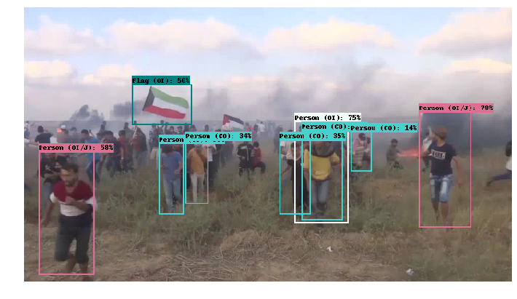
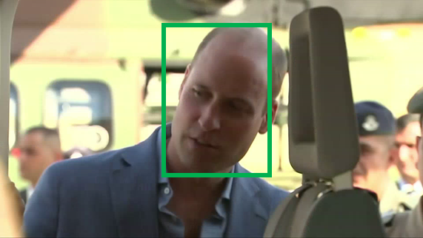
What is multimedia knowledge?
Multimedia Knowledge Base with entities, relations and events.
event
entity
Prince William
Flag
KB
Israel
Prince William
visit
The first-ever official visit by a British royal to Israel is underway. Prince William the 36 year-old Duke of Cambridge and second in line to the throne will meet with both Israeli and Palestinian leaders over the next three days.
Contact.Meet_Participant
entity: GPE
entity: PER
event

Slide 38
Knowledge-enhanced V+L Encoding

Slide 39
Knowledge-enhanced V+L Encoding

Slide 40
Visual Entity Extraction
Object Detection: Object instances at the bounding box level
Semantic Segmentation: Object class at the pixel level
Instance Segmentation: Object instances at the pixel level
https://www.v7labs.com/blog/object-detection-guide
Notes:
There are also pixel level detection tasks, called semgntation, including the semantic segmentation and instance segmentation. Semantic segmentation covers pixels of general object class, and instance segmentation higlights pixels of each individual object.
Image segmentation is the process of defining which pixels of an object class are found in an image.
Semantic image segmentation will mark all pixels belonging to that tag, but won’t define the boundaries of each object.
Object detection instead will not segment the object, but will clearly define the location of each individual object instance with a box.
Combining semantic segmentation with object detection leads to instance segmentation, which first detects the object instances, and then segments each within the detected boxes (known in this case as regions of interest).

Slide 41
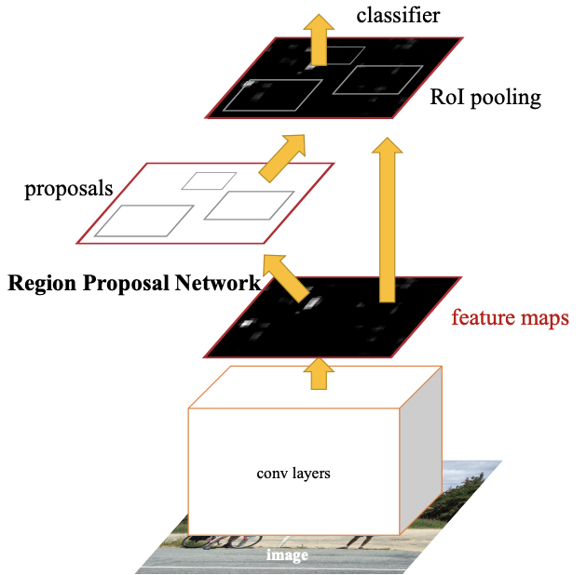
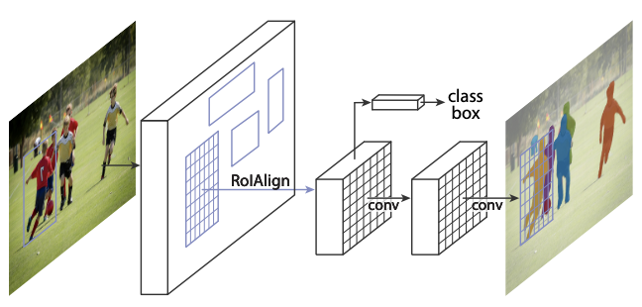
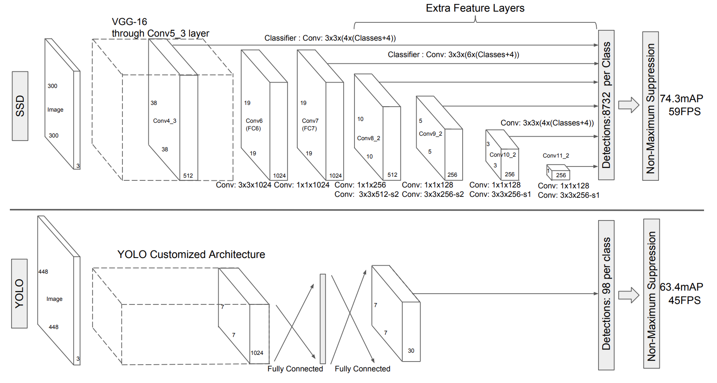
Visual Object Extraction
Two-Stage (With Proposal)
One-Stage (Without Proposal)
YOLO
Faster RCNN
Mask RCNN
SSD
Ren, S., He, K., Girshick, R., & Sun, J. Faster r-cnn: Towards real-time object detection with region proposal networks. NeurIPS 2015.
He, Kaiming, et al. "Mask r-cnn." CVPR 2017.
Redmon, Joseph, et al. "You only look once: Unified, real-time object detection." CVPR 2016.
Liu, Wei, et al. "Ssd: Single shot multibox detector." ECCV 2016.
Notes:
Popolar models can be dived into two categories, two-stage models will first detect the region proposals such as Fater RCNN and MASk RCNN, but one-stage model skips the proposal, and represntative models are YOLO and SSD.

Slide 42
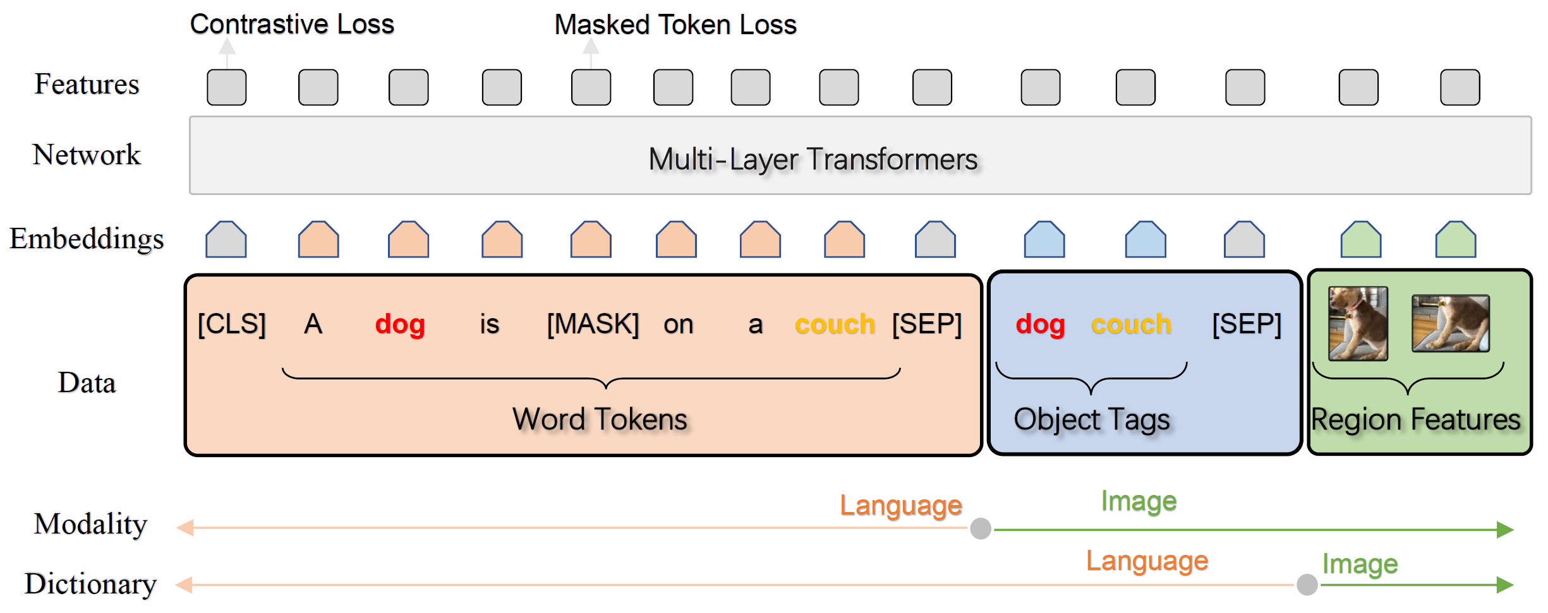
Oscar [ECCV 2020] and VinVL [CVPR 2021]
Object knowledge is richer.
Add object label knowledge as anchor points
Oscar: Object-Semantics Aligned Pre-training for Vision-Language Tasks, ECCV 2020
VinVL: Making Visual Representations Matter in Vision-Language Models. CVPR 2021
Notes:
Object knowledge is actually much richer than we thought.
Object Tags as Anchor Points
The image-text pair is represented as a triplet

Slide 43
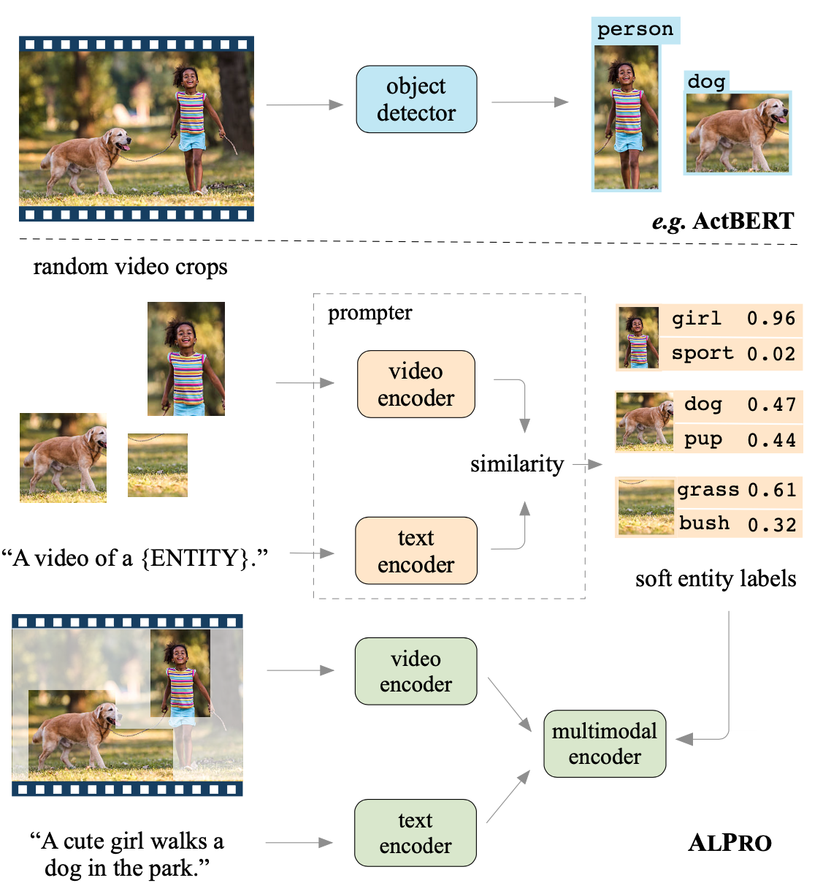
Adding soft/open-world object knowledge
[Align and Prompt 2021] Align and Prompt: Video-and-Language Pre-training with Entity Prompts
Adding regional entity prediction task
Individually pre-trained with Video-Text Contrastive loss
previous work rely on object detectors with expensive computation and limited object categories
image source: Align and Prompt: Video-and-Language Pre-training with Entity Prompts
Notes:
VTC, VTM, MLM + PEM

Slide 44
ERINE-ViL [AAAI2021]
Add scene graph knowledge as downstream tasks
Object prediction
Attribute prediction
Relationship prediction
ERNIE-ViL: Knowledge Enhanced Vision-Language Representations Through Scene Graph, AAAI 2021

Slide 45
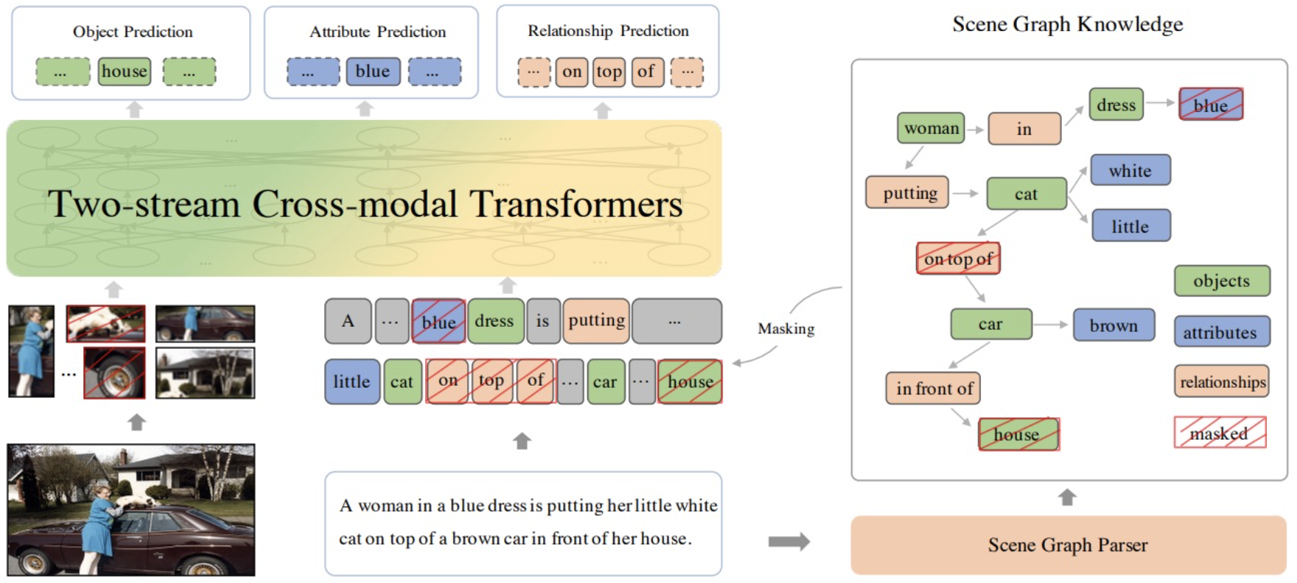
ERINE-ViL [AAAI2021]
Add scene graph knowledge as downstream tasks
Object prediction
Attribute prediction
Relationship prediction
ERNIE-ViL: Knowledge Enhanced Vision-Language Representations Through Scene Graph, AAAI 2021

Slide 46
Adding knowledge to pretraining models
object Labels
objects
scene graphs
pixels
?
More knowledge

Slide 47
Vision vs. NLP for Event Extraction
Vision does not study newsworthy, complex events
Focusing on daily life and sports (Perera et al., 2012; Chang et al., 2016; Zhang et al., 2007; Ma et al., 2017)
Without localizing a complete set of arguments for each event (Gu et al., 2018; Li et al., 2018; Duarte et al., 2018; Sigurdsson et al., 2016; Kato et al., 2018; Wu et al., 2019a)
Most related: Situation Recognition (Yatskar et al., 2016)
Classify an image as one of 500+ FrameNet verbs
Identify 192 generic semantic roles via a 1-word description
Notes:
There are some work in computer vision to extract events, but with a different focus on physical events in daily life scenario, like clipping and jumping. So it has a gap with complex events in traditional text event extraction, such as transport and protest event.
But the good news is that some work offers resources similar to event argument extraction. For example, in situation recognition, one image is classified to a verb, and it populates a table with nouns as arguments. But different from our task, it does not localize arguments in images,

Slide 48
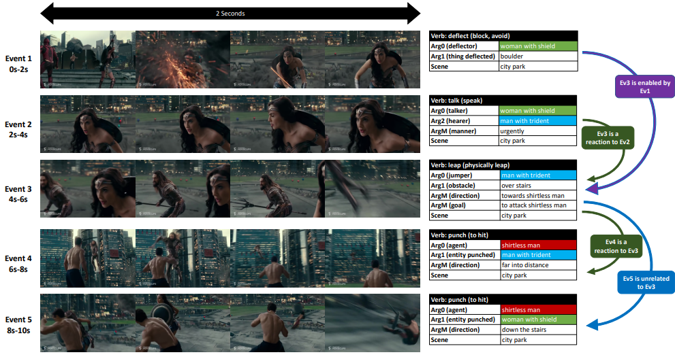
Vision-only Event and Argument Extraction
Grounded Situation Recognition adds visual argument localization [Pratt et al, 2020]
Video Situation Recognition extends the work to videos [Sadhu et al, 2021]
Sarah Pratt, Mark Yatskar, Luca Weihs, Ali Farhadi, and Aniruddha Kembhavi. Grounded situation recognition. In ECCV, 2020
Sadhu, A., Gupta, T., Yatskar, M., Nevatia, R., & Kembhavi, A. (2021). Visual Semantic Role Labeling for Video Understanding. ArXiv, abs/2104.00990.

Slide 49
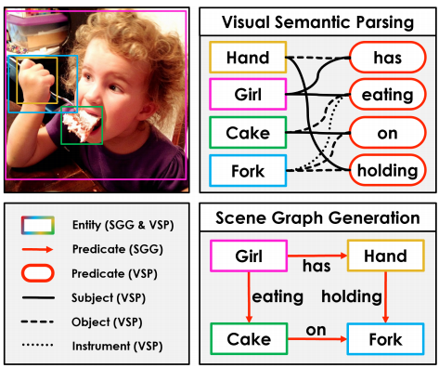
Vision-only Event and Argument Extraction
Another line of work is based on scene graphs [Xu et al, 2017; Li et al, 2017; Yang et al, 2018; Zellers et al, 2018].
extracting <subject, predicate, object>
structure is simpler than the aforementioned multi-argument event
Visual Semantic Parsing is using predicate as event, and subject, object, instrument as argument [Zareian el al, 2020]
Added bounding box grounding
Notes:
Zareian, Alireza, Svebor Karaman, and Shih-Fu Chang. "Weakly supervised visual semantic parsing." CVPR. 2020.
Yang, Jianwei, et al. "Graph r-cnn for scene graph generation." Proceedings of the European conference on computer vision (ECCV). 2018.
Xu, Danfei, et al. "Scene graph generation by iterative message passing." Proceedings of the IEEE conference on computer vision and pattern recognition. 2017.
Li, Yikang, et al. "Scene graph generation from objects, phrases and region captions." Proceedings of the IEEE International Conference on Computer Vision. 2017.
Zellers, Rowan, et al. "Neural motifs: Scene graph parsing with global context." Proceedings of the IEEE Conference on Computer Vision and Pattern Recognition. 2018.

Slide 50
Entity-centric Event-centric
Understanding semantics structures

Slide 51
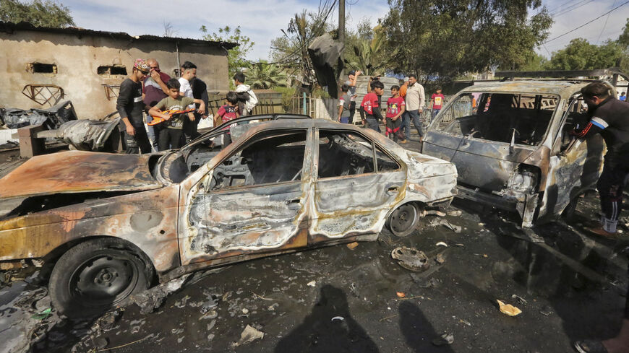
Object
Car
Notes:
Traditional vision-language understanding are mainly about image-level and object-level information. However, it only knows about the car information,

Slide 52
Event | Bombing
Item | Car
Witness | People
Event
Car
Notes:
Ignore the rich semantics related to event-level information, such as the bombing event

Slide 53
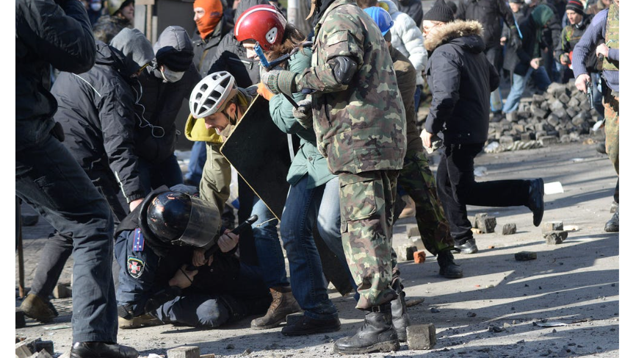
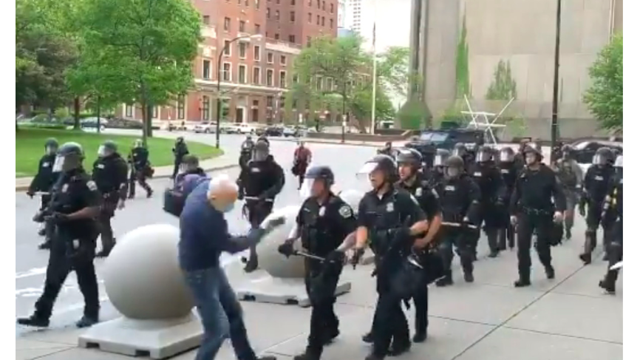
Event | Attacking
Attacker | protesters
Target | police
Argument
Event | Attacking
Attacker | police
Target | protester
Notes:
Also, event understanding also contains the argument structure, to show the role that each object is playing in the event. For example, in the first image, the protesters are attacking police, while in the bottom image, the protesters are being attacked. The same object can play very different roles in different events.

Slide 54
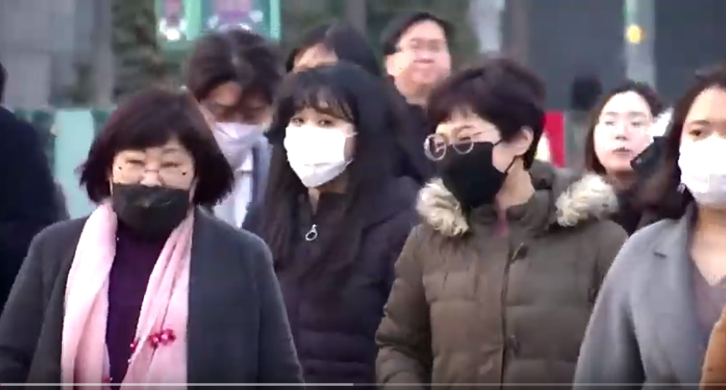
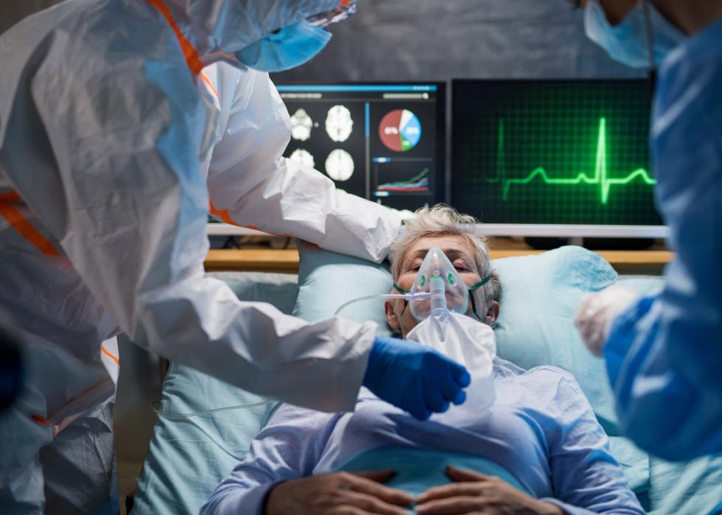
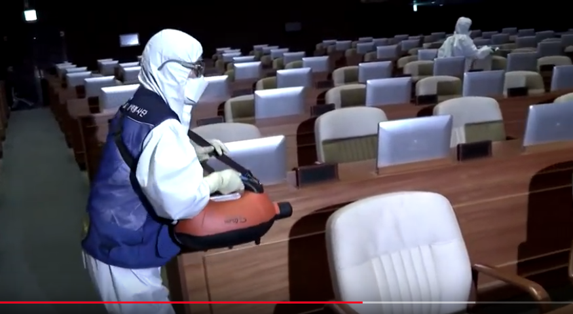
Event | Wearing
Item | mask
Agent | person
Event | Treatment
Agent | doctor
Target | patient
Event | Researching
Agent | researcher
Target | dropper
Event | Sanitizing
Agent | person
Tool | sprayer
Event | Testing
Agent | woman
place | car
Event | Vaccination
Agent | woman
Target | girl
Notes:
Actually, compared to object-level information, event-level information are what we concerned more in real life.
We are exposed to all kinds of events in daily news, These events are not low-level actions, but are about real events showing the status changes, and we human will distinguish the argument role of different persons and objects.

Slide 55
Problem Formulation of Event Extraction
Input …
A piece of text, or images, or videos
Aims to extract …
Events
Trigger identification
Trigger classification
Arguments
Argument identification
Argument classification
Evaluated on …
precision and recall on each task
Input Data
Ontology
Description
Entity Type Constraint
Example Sentences
text
images
videos
Tasks
Entity Extraction
Event Extraction
Trigger Identification
Argument Identification
Relation Extraction
Trigger Classification
Argument Classification
Evaluation
precision, recall, F-score on each task
Notes:
(click) Now we know what is event, here's how we define this problem. (click) So the input can be from multiple modalities, it can be a piece of text, an image, and a video, or all of them.
(click) Another part of input is the ontology. It contains the target event types and argument roles. This ontology is actually rich. it also has descriptions, constrains, examples sentences, and so on. This part is very useful for zero-shot event extraction.
(click) Our goal is to extract a structure, (click) including event traiggers and (click) event arguments. For each task, we have two subtasks, the identification task is predicting the boundry, so for text, we are extracting offsets, and for images, we are extracting bounding boxes. Classification task is predicting the type labels and argument labels.
(click)After that, the evaluation calculates precision, recall and F-score for each task.
Event extraction
Trigger identification: whether the trigger offset is detected correctly
Trigger classification: whether the event type is classified correctly
Argument extraction
Argument identification: whether the argument offset has been identified for correct triggers
Argument classification: whether the argument role has been predicted for correct triggers

Slide 56
Traditional Event Extraction
A structure prediction task:
Trigger Identification and Classification
Argument Identification and Classification
In Baghdad, a cameraman died when a combat tank fired on the Palestine Hotel.
O
O
O
O
O
Attack
Die
O
O
O
O
O
O
O
Notes:
(click)However, traditional event extraction, is text-only and only focus on local structures. It is a structure prediction task, including trigger extraction, and argument extraction. For example, die and fire are trigger words of two events, For each event, there are multiple arguments being extraction, and event argument has an argument role. For example, Baghdad is the place, and cameraman is the victim for the die event.
It focus on this kind of local structure of each event, so each event is understood individually, and there is no reasoning on how die event and fire event are connected via arguments, for example, victim of the die event is the target of the fire event. This kind of global knowledge about event connections is ignored in previous work.

Slide 57
Traditional Event Extraction
A structure prediction task:
Trigger Identification and Classification
Argument Identification and Classification
In Baghdad, a cameraman died when a combat tank fired on the Palestine Hotel.
LOC
PER
VEH
FAC
O
O
O
O
O
Attack
Die
O
O
O
O
O
O
O
Notes:
(click)However, traditional event extraction, is text-only and only focus on local structures. It is a structure prediction task, including trigger extraction, and argument extraction. For example, die and fire are trigger words of two events, For each event, there are multiple arguments being extraction, and event argument has an argument role. For example, Baghdad is the place, and cameraman is the victim for the die event.
It focus on this kind of local structure of each event, so each event is understood individually, and there is no reasoning on how die event and fire event are connected via arguments, for example, victim of the die event is the target of the fire event. This kind of global knowledge about event connections is ignored in previous work.

Slide 58
Traditional Event Extraction
A structure prediction task:
Trigger Identification and Classification
Argument Identification and Classification
place
victim
instrument
In Baghdad, a cameraman died when a combat tank fired on the Palestine Hotel.
LOC
PER
VEH
FAC
O
O
O
O
O
Attack
Die
O
O
O
O
O
O
O
Notes:
(click)However, traditional event extraction, is text-only and only focus on local structures. It is a structure prediction task, including trigger extraction, and argument extraction. For example, die and fire are trigger words of two events, For each event, there are multiple arguments being extraction, and event argument has an argument role. For example, Baghdad is the place, and cameraman is the victim for the die event.
It focus on this kind of local structure of each event, so each event is understood individually, and there is no reasoning on how die event and fire event are connected via arguments, for example, victim of the die event is the target of the fire event. This kind of global knowledge about event connections is ignored in previous work.

Slide 59
Traditional Event Extraction
A structure prediction task:
Trigger Identification and Classification
Argument Identification and Classification
place
place
target
victim
instrument
instrument
target
In Baghdad, a cameraman died when a combat tank fired on the Palestine Hotel.
LOC
PER
VEH
FAC
O
O
O
O
O
Attack
Die
O
O
O
O
O
O
O
Notes:
(click)However, traditional event extraction, is text-only and only focus on local structures. It is a structure prediction task, including trigger extraction, and argument extraction. For example, die and fire are trigger words of two events, For each event, there are multiple arguments being extraction, and event argument has an argument role. For example, Baghdad is the place, and cameraman is the victim for the die event.
It focus on this kind of local structure of each event, so each event is understood individually, and there is no reasoning on how die event and fire event are connected via arguments, for example, victim of the die event is the target of the fire event. This kind of global knowledge about event connections is ignored in previous work.

Slide 60
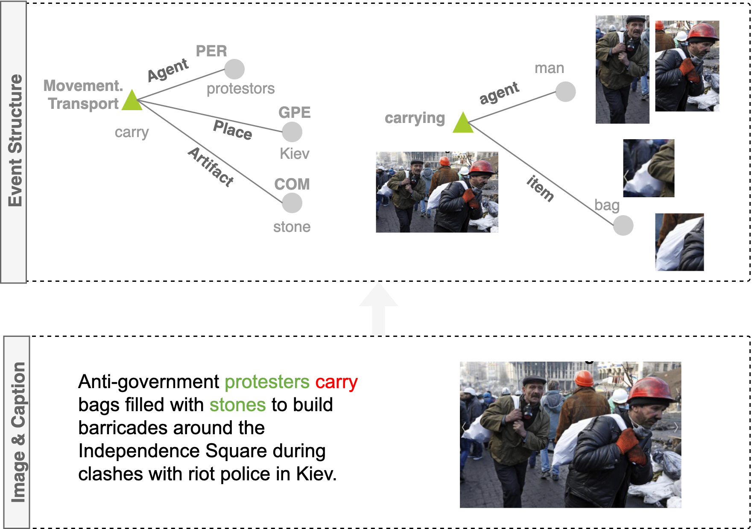
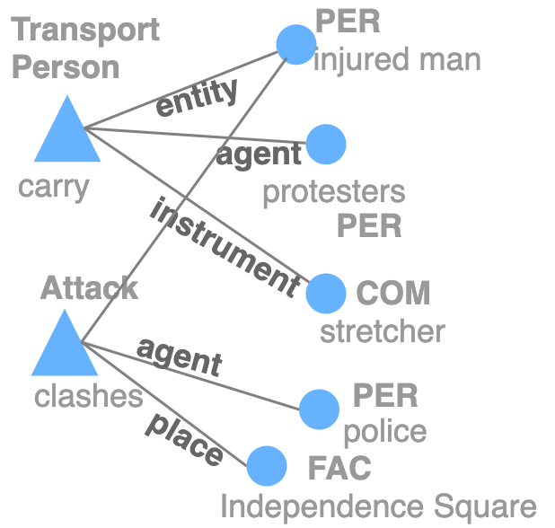
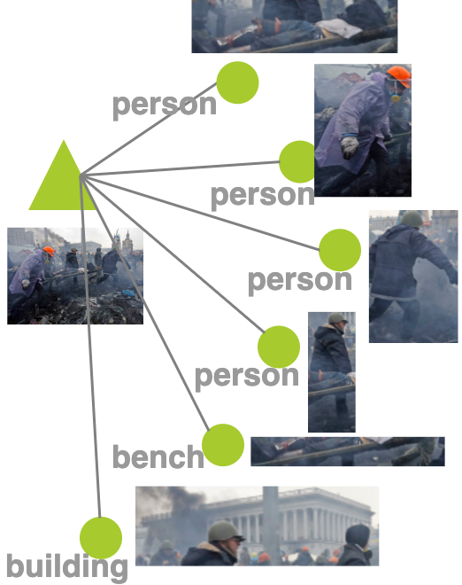
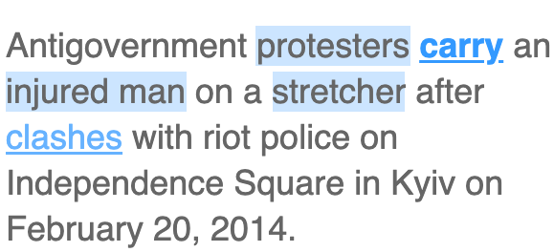
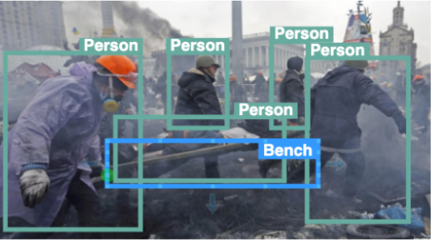
Event Enhanced Vision-Language Pretraining
Why adding event structured knowledge into Vision-Language Pretraining?
Existing vision-language models mainly focus on image-level or object-level information.
Text | Image / Video Frame
Sentence | Image
Word | Region
Entity | Object
Relation | Relation
Entity-Relation Graph | Scene Graph
Event Trigger | Activity
Event Structure | Image Event Graph
object-centric
event-centric
Notes:
However, traditional multimed pretraining models focus more on the object level information, and we focus on the event level, by imposing event structured knowledge into the multimedia pretraining models to enable them to understand events.
The main question is how to get the structured events, and how to teach model to learn their semantics structures.
Since the research of text event structure is much more advanced, we can take advantage of text IE tools to extract the event knowledge, For example, we can get this event star graph from the sentence. For image, we treat each image as a center node, and connect it to objects that related to this image event.
The second question is how to encode this both the semantics and structures of events. Semantics means that the model needs to understand the meaning of events and argument roles, and the structures shows how they are connected.

Slide 61
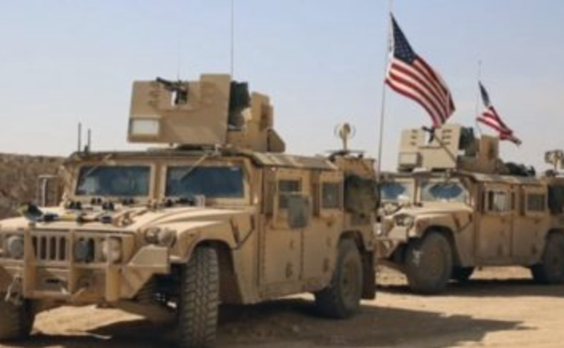
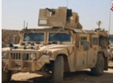
A New Task: Multimedia Event Extraction (M²E²)
Input: News Article Text and Image (The first task to take both modalities as input)
Last week , U.S . Secretary of State Rex Tillerson visited Ankara, the first senior administration official to visit Turkey, to try to seal a deal about the battle for Raqqa and to overcome President Recep Tayyip Erdogan's strong objections to Washington's backing of the Kurdish Democratic Union Party (PYD) militias. Turkish forces have attacked SDF forces in the past around Manbij, west of Raqqa, forcing the United States to deploy dozens of soldiers on the outskirts of the town in a mission to prevent a repeat of clashes, which risk derailing an assault on Raqqa.
land vehicle
land vehicle
Output: Events & Argument Roles
Event Type | Movement.Transport
Event | Text Trigger | deploy
 | Image
Arguments | Agent | United States
 | Destination | outskirts
 | Artifact | soldiers
 | Vehicle
 | Vehicle
Notes:
As a result, we propose a new task called multimedia event extraction, to extract events and their arguments from multimedia documents. The input contains a text article and the images associated. Each output events and arguments can come from either text, or image, or both of them.

Slide 62
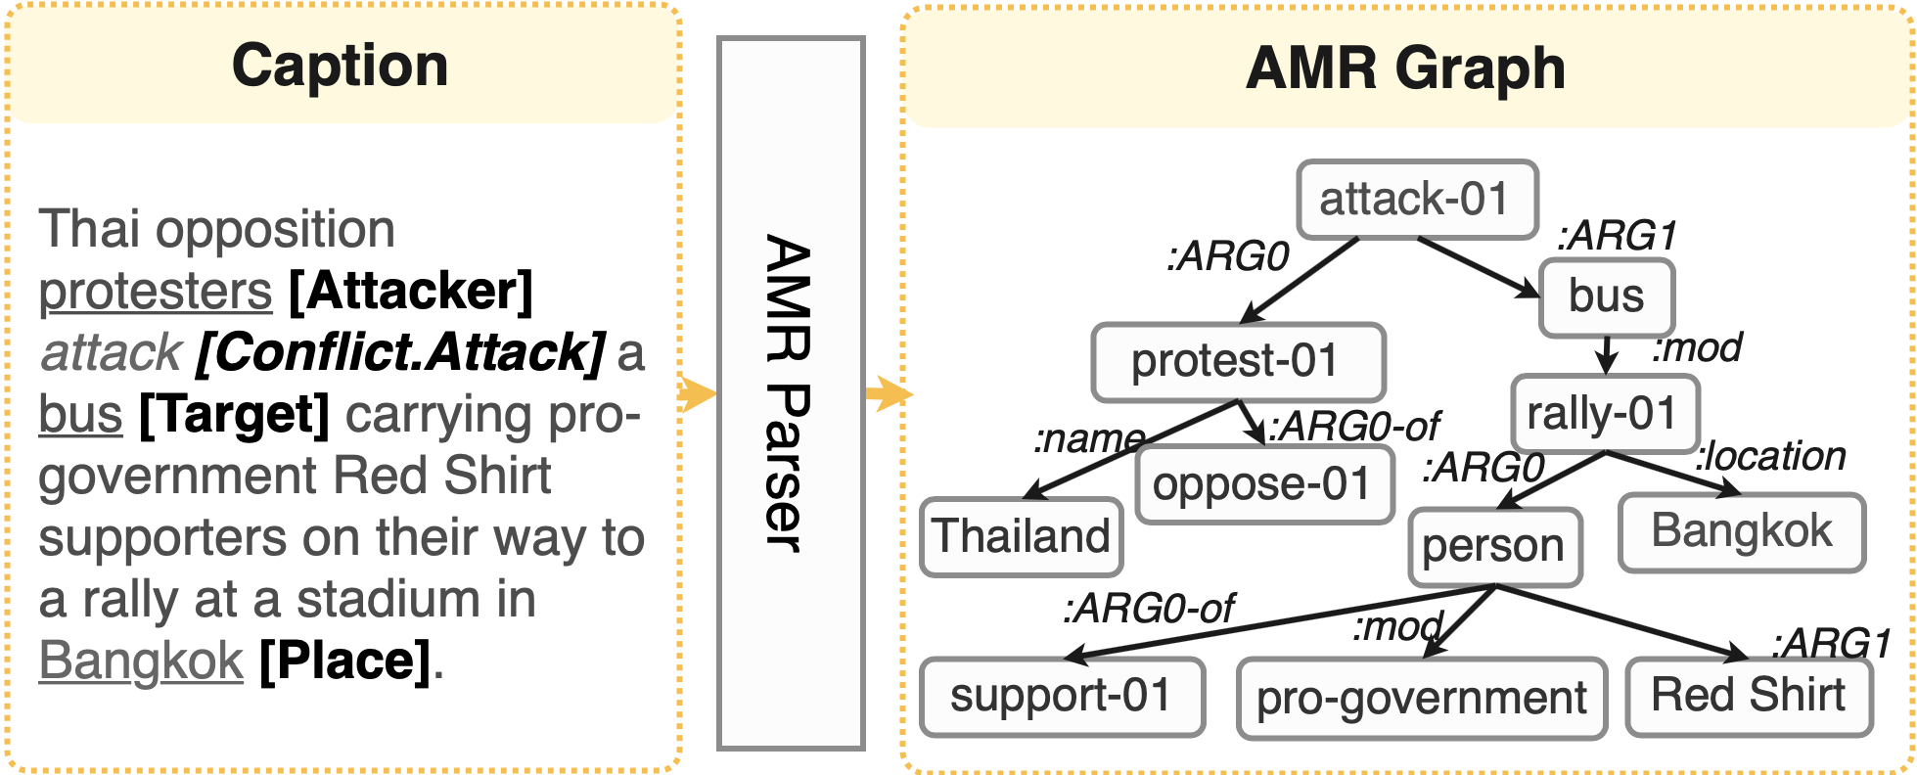
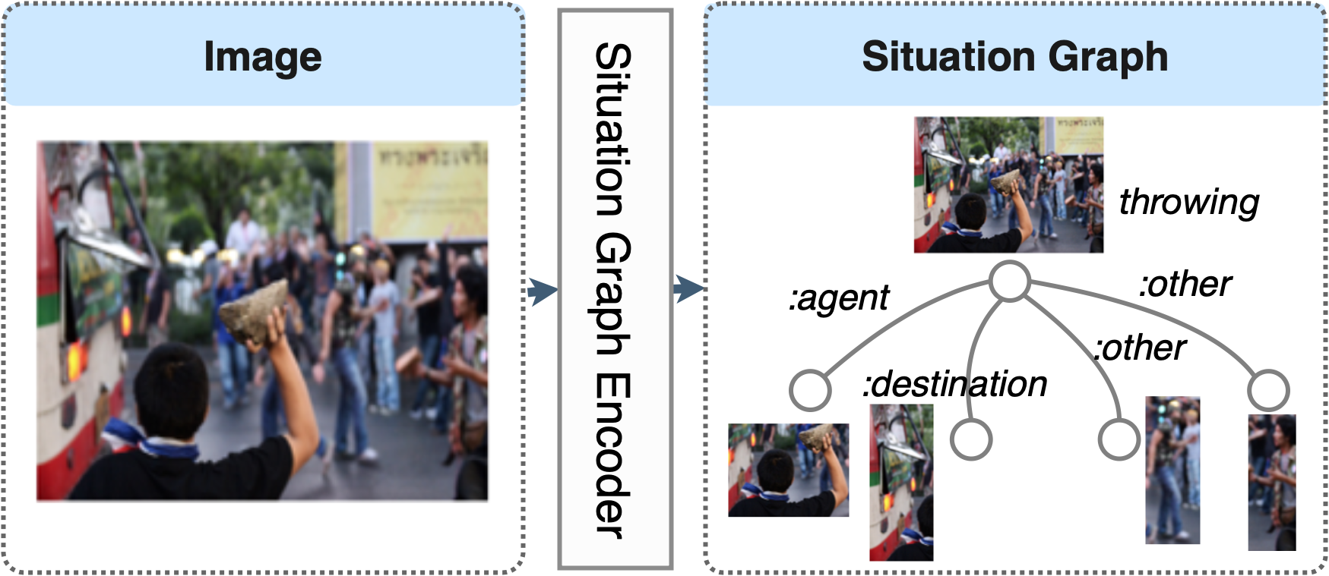
Cross-media Structured Common Space
Treat Image/Video as a foreign language
Represent it with a structure that is similar to AMR graph in text
Linguistic Structure, e.g., Dependency Tree Abstract Meaning Representation (AMR) | Situation Graph
Notes:
On the text side, we extract AMR graph, which is a graph constructed by predicates and their arguments. On the vision side, we mimic it by representing an image as a predicate node, it shows the situation, that is going on in the image, And connect it to objects in the image, which are the potential arguments of the predicate. We call it situation graph since it shows the situation of the image

Slide 63
Related Work on Visual Event Extraction
Vision does not study newsworthy, complex events
Focusing on daily life and sports (Perera et al., 2012; Chang et al., 2016; Zhang et al., 2007; Ma et al., 2017)
Without localizing a complete set of arguments for each event (Gu et al., 2018; Li et al., 2018; Duarte et al., 2018; Sigurdsson et al., 2016; Kato et al., 2018; Wu et al., 2019a)
Most related: Situation Recognition (Yatskar et al., 2016) is vision-only
Classify an image as one of 500+ FrameNet verbs
Identify 192 generic semantic roles via a 1-word description
Notes:
there are some work. but large gap, physical events instead of newsworthy. There is no work to take two modaltities together for a joint extraction

Slide 64
A New Task: Multimedia Event Extraction (M²E²)
Input: News Article Text and Image
Last week , U.S . Secretary of State Rex Tillerson visited Ankara, the first senior administration official to visit Turkey, to try to seal a deal about the battle for Raqqa and to overcome President Recep Tayyip Erdogan's strong objections to Washington's backing of the Kurdish Democratic Union Party (PYD) militias. Turkish forces have attacked SDF forces in the past around Manbij, west of Raqqa, forcing the United States to deploy dozens of soldiers on the outskirts of the town in a mission to prevent a repeat of clashes, which risk derailing an assault on Raqqa.
land vehicle
land vehicle
Output: Events & Argument Roles
Event Type | Movement.Transport
Event | Text Trigger | deploy
 | Image
Arguments | Agent | United States
 | Destination | outskirts
 | Artifact | soldiers
 | Vehicle
 | Vehicle
[Li, et al, ACL 2020]
Notes:
As a result, new task.
input
event merge

Slide 65
CLIP-Event: Event-Driven Vision-Language Pretraining
carry
Event Extraction
Trigger Word
Natural Language Processing
Notes:
Since text event understanding has been researched for a long time, we can take advantage of text IE tools to extract the event knowledge, For example, we can get this carry event from the sentence.

Slide 66
CLIP-Event: Event-Driven Vision-Language Pretraining
Event Extraction
Trigger Word
Natural Language Processing
Argument (Participant)
Notes:
And detect the arguments participating in this event

Slide 67
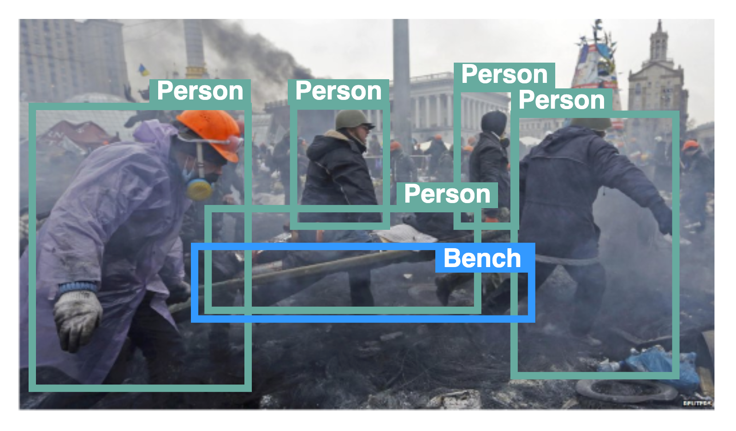
Transfer text event knowledge to images: Using text event structures as a distant supervision
Weakly Supervision
Notes:
In this way, we can use the text event as a distance supervision, and transfer event knowledge from text modality to vision modality, For example, we can treat this transporting event as pseudo labels for the image.
A good thing is that we have assumptions that for news data, the image and its caption should convey similar information about the event. For example, given the caption, we can extract this transport event with its arguments, and we treat the event labels as pseudo labels for the image.

Slide 68
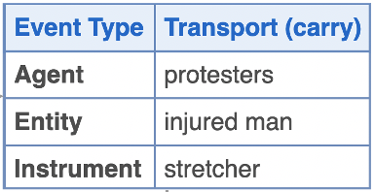
Construct hard negatives by manipulating event structures.
Positive
Labels
Negative
Labels
(events)
Negative
Labels
(arguments)
Notes:
(click)To force the model understand event and argument, so we manipulate the event structures from both event level and argument level, based on the confusion matrix.
We sample ambiguous negative event types based on confusion matrix
(click)For the argument negative sampling, since each event may have multiple arguments, we switch the orders of the arguments using a right-shift.

Slide 69
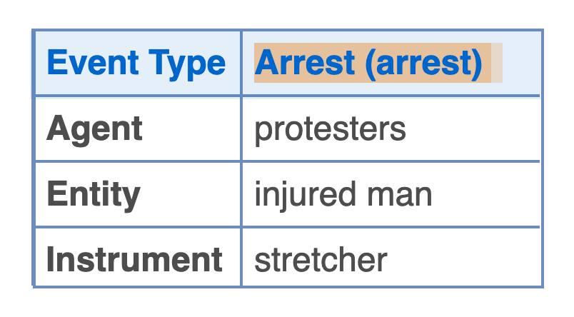
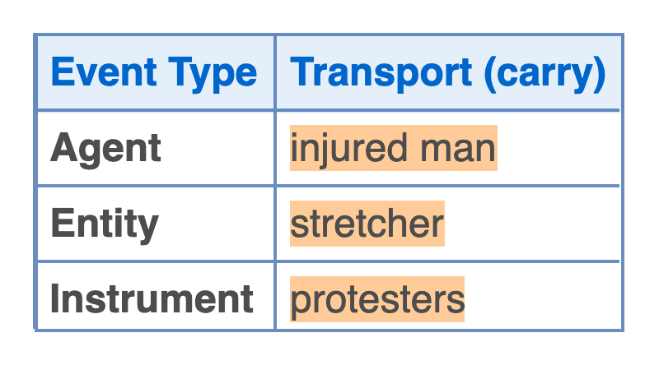
Construct hard negatives by manipulating event structures.
Protesters transported injured man using a stretcher.
Positive
Labels
prompt
Protesters arrested injured man using a stretcher.
Negative
Labels
(events)
prompt
Negative
Labels
(arguments)
Injured man transported a stretcher with protesters.
prompt
Notes:
Then we use some predefined prompt functions to translate the event structures to natural language descriptions,

Slide 70
Construct hard negatives by manipulating event structures.
Protesters transported injured man using a stretcher.
Positive
Labels
prompt
Protesters arrested injured man using a stretcher.
Negative
Labels
(events)
prompt
Negative
Labels
(arguments)
Injured man transported a stretcher with protesters.
prompt
Notes:
so that we can feed this description to CLIP text encoder.

Slide 71
Protesters transported injured man using a stretcher.
Positive
Labels
t₀
Contrastive Learning
s(t₀,v)
Protesters arrested injured man using a stretcher.
Negative
Labels
(events)
Text Encoder
t₁
s(t₁,v)
Injured man transported a stretcher with protesters.
t₂
s(t₂,v)
Negative
Labels
(arguments)
v
Image Encoder
Notes:
The text and vision encoder will be optimized using a contrastive learning loss to distinguish negative events and arguments from positive ones.

Slide 72
GPT-3 Based Prompt
From Event Structure to Natural Language Description:
We use five manual event description examples as few-shot prompts to control the generation.
Notes:
We tried GPT-3 as one of the prompt function to convert event to natural language description by providing five in-context examples.

Slide 73
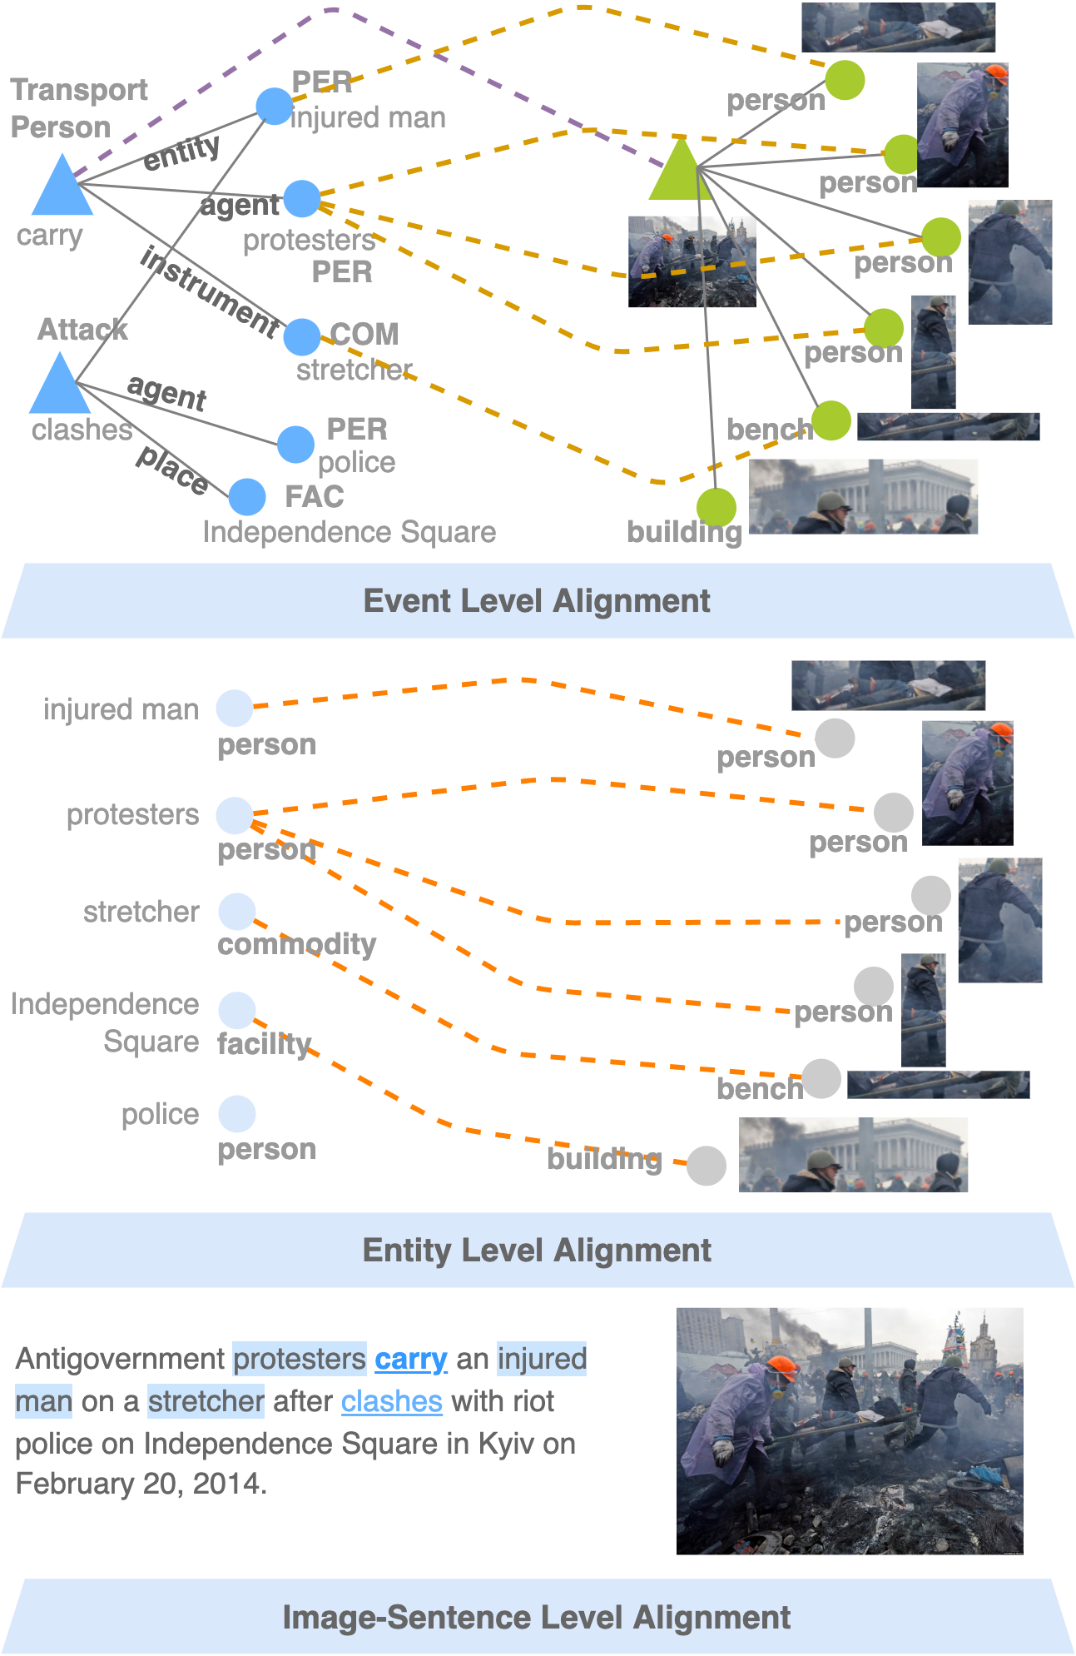
CLIP-Event: Event-Driven Vision-Language Pretraining
Structured Alignment via Optimal Transport
To encode the event structure, we calculate a global graph alignment score based on Optimal Transport
Step1. obtain cost matrix C (embedding similarity)
Step2. optimize the transport plan T within k iterations
Step3. calculate the transport distance
Notes:
However, this is only about semantic encoding, to better encode the structures, we extract the objects in images using Faster RCNN, and construct a vision graph using these objects. After that, we learn the soft alignment between these objects and text event arguments to learn their roles. The soft alignment is optimized using optimal transport.
We use the cosine similarity as cost matrix, The optimal transport plan is solved using Sinkhorn algorithm within k iterations, and the final distance is based on the transport plan and the cost matrix

Slide 74
A New Event-rich Image-Caption Dataset
We collect 106,875 image-captions that are rich in events from VOA news website.
It is a challenging image-retrieval benchmark, aiming to understand long sentences with complex structures.
Split | # image | # event | # arg | # ent
Train | 76,256 | 84,120 | 148,262 | 573,016
^{Test} | 18,310 | 21,211 | 39,375 | 87,671
^{No-event} | 12,309 | - | - | -
 | Flickr30k | MS COCO | VOANews
Average sentence length | 13.4 | 11.3 | 28.2
Notes:
This entire model do not need any annotations, but only image-caption pairs. Since our work focus more on real-world events, we want the pretraining dataset to be more rich in events. As a result, we collect the 100k image-captions from VOA news website as pretraining data. This VOANews is also a more challenging image caption retrieval benchmark compared to Flickr30k and MSCOCO, with longer sentences and complex semantic structures.

Slide 75
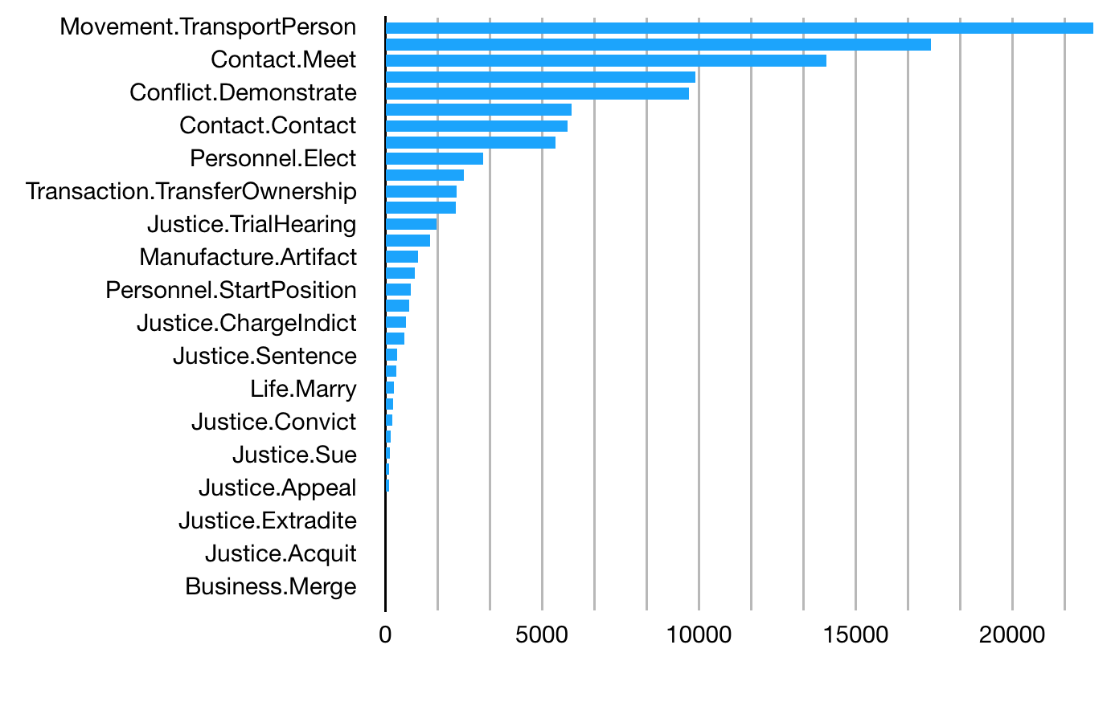
Text Event Extraction Results
State-of-the-art IE (149 event types, Lin et al, 2020)
108,693 captions
84,120 events
0.8 events in average (we filter the captions without events during training)
Notes:
Supervised IE can extract around 1 event for each caption in average, We can see that most events extracted are vision related, like transport, meet, demonstrate, etc.
It matches our assumption that captions are mainly describing the event in the image.

Slide 76
Experiments
Real-world visual events are open-vocabulary
To show the ability of pretraining models, in this work, we focus on zero-shot settings.
Event Structure Extraction (zero-shot)
Grounded Situation Recognition
Multimedia Event Extraction
Our Goal:
Downstream Tasks (without finetune)
VCR: Visual Commonsense Reasoning
VisualCOMET: Visual Commonsense Reasoning in Time
Image Retrievel
Notes:
Since real-world events are open-vocabulary, our goal is to perform well on direct event structure extraction in a zero-shot settings, and also be able to support downstream tasks even without finetuning, such as question answering tasks.

Slide 77
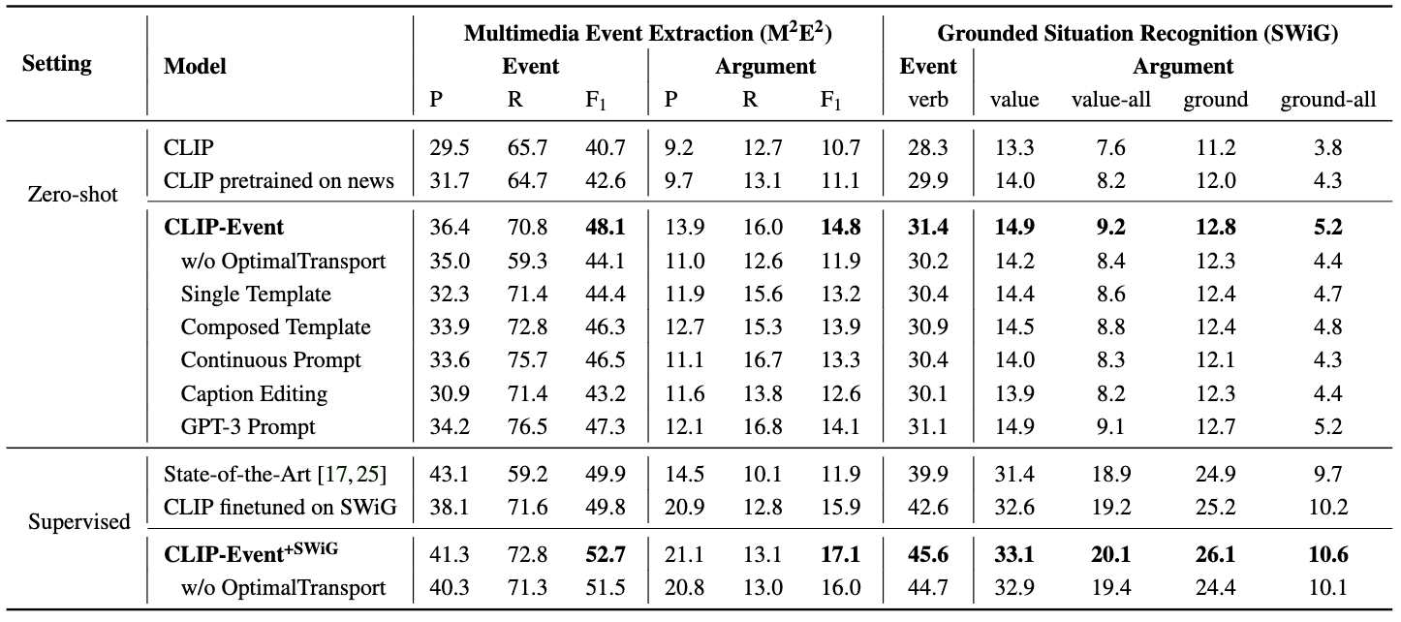
Experiment Results
Zero-shot Argument Extraction outperforms the state-of-the-art supervised model.
Notes:
One exciting thing is that, outperform, unseen
Good performance on argument extraction shows that the model can understand who is participating the events and what is the arguments role its playing.

Slide 78
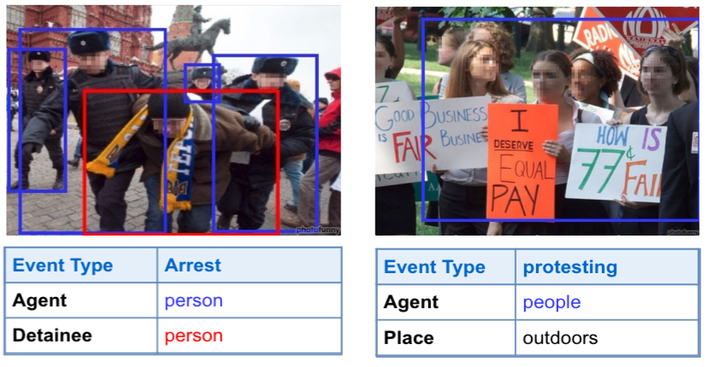
Experiments: Visual Event Extraction
Zero-shot Image Event Extraction successfully identifying unseen events.
Argument extraction demonstrates the support for image structure understanding.
Notes:
Here is an example, that the model can understand the person in the middle are the detainee and people surrounding him are agents.

Slide 79
Experiments: Downstream Tasks
Downstream tasks benefit from event knowledge encoding.
Visual Commonsense Reasoning (VCR)
Visual Commonsense Reasoning in Time (VisualCOMET)
VCR (Visual Commonsense Reasoning)
VisualCOMET (Visual Commonsense Reasoning in Time)
Zellers, Rowan, et al. "From recognition to cognition: Visual commonsense reasoning." CVPR. 2019.
Park, Jae Sung, et al. "Visualcomet: Reasoning about the dynamic context of a still image.” ECCV. Springer, Cham, 2020.
Notes:
Then, we test the model on question answering tasks. We select tasks whose settings are close to real-world applications. such as the visual commonsense reasoning task. Different from VQA’s naïve questions, it mimics the real questions people will have when seeing the image, which are mostly about event understanding.
Going beyond that, VisualCOMET is proposed to predict the events happening now, before and after. Similar to previous tasks, it needs to not only knowing the events, but also the argument roles that different persons are playing.
For example, the blue boxes indicate now, yellow boxes for before, and green boxes for after. Given the image and the event, it aims to predict these boxes.

Slide 80
Experiments: Downstream Tasks
Downstream tasks benefit from event knowledge encoding.
For example, in Visual Commonsense Reasoning, event-level matching can help answer questions about the scene.
Notes:
Our zero-shot model ranks answers based on the similarity scores with images. For example, given the image, only the last answer is about beating event, so the model can easily select the correct answer.

Slide 81
Knowledge-enhanced V+L Encoding

Slide 82
Multimedia Schema Induction
Representative Resource: wikiHow
Current online instructional video/text describe a task as completing a sequential set of steps, assuming that all tasks follow a linear schema

Slide 83
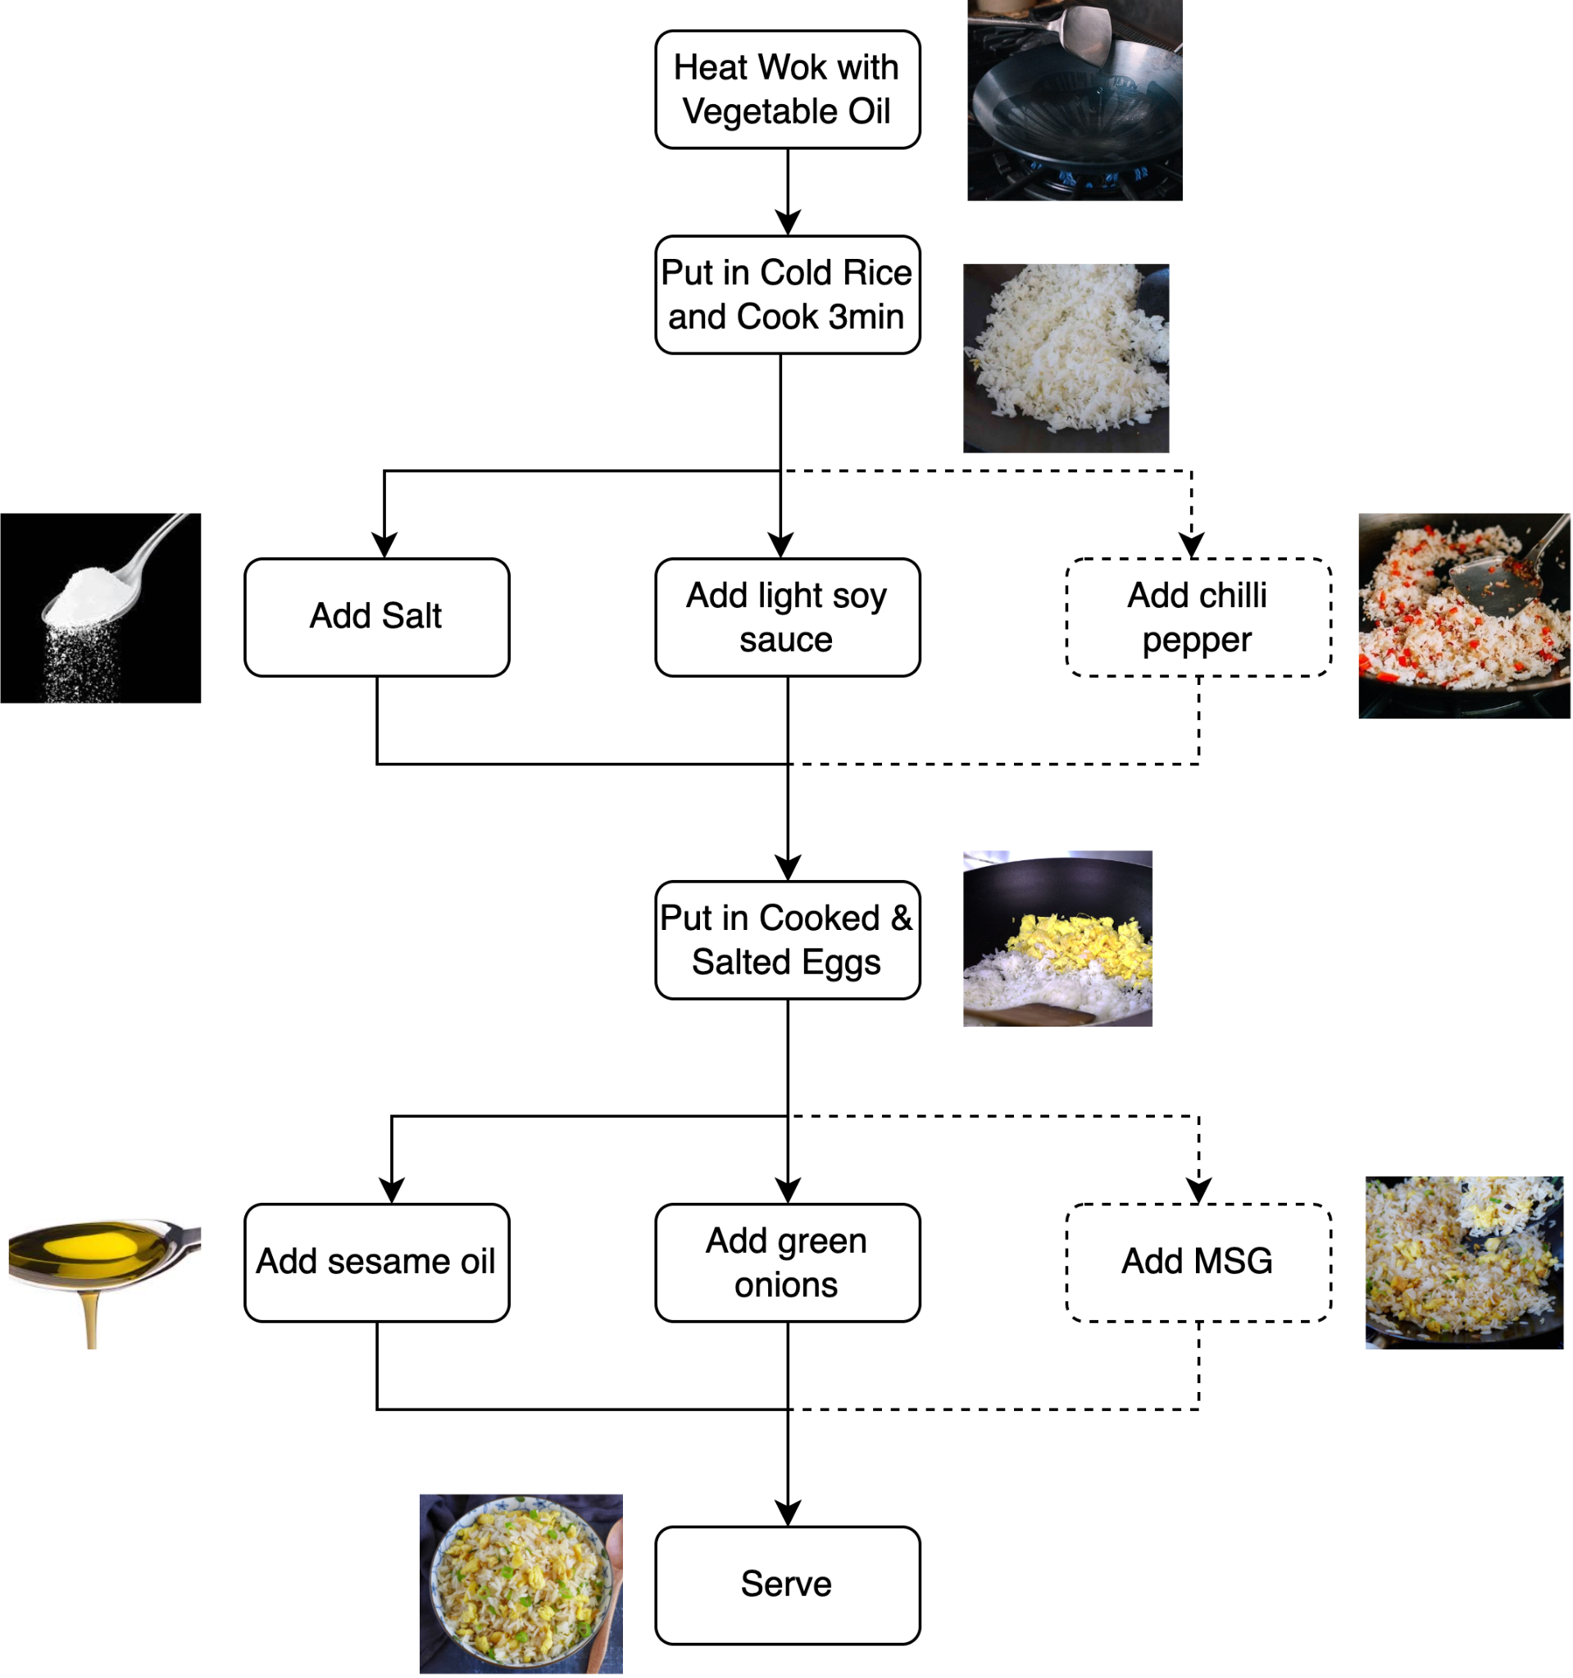
Multimedia Schema Induction
However in reality, this assumption rarely holds true as the text schema can be more complex:
Some of the events are interchangeable, such as “add salt” and “add light soy sauce”
Other events can be optional, such as “add chilli pepper”

Slide 84
Script Knowledge enhanced Pretraining
Two ways to learn script knowledge
Classification Tasks:
Event Understanding
Event Temporal Ordering …
Encoder- Only
Script Knowledge
Pretraining
Encoder- Decoder
Generation Tasks:
Future Event Prediction …

Slide 85
Script Knowledge enhanced Pretraining
MERLOT: Multimodal Neural Script Knowledge Models (2021)

Slide 86
Script Knowledge enhanced Pretraining
MERLOT: Multimodal Neural Script Knowledge Models (2021)

Slide 87
Script Knowledge enhanced Pretraining
MERLOT Reserve: Neural Script Knowledge through Vision and Language and Sound

Slide 88
Script Knowledge enhanced Pretraining
MERLOT Reserve: Neural Script Knowledge through Vision and Language and Sound

Slide 89
Script Knowledge enhanced Pretraining
End-to-end Generative Pretraining for Multimodal Video Captioning (2022)
optimize future generation

Slide 90
Script Knowledge enhanced Pretraining
End-to-end Generative Pretraining for Multimodal Video Captioning (2022)
Forward generation (FG)
Backward generation (BG)

Slide 91
External Script Knowledge: wikiHow
Visual Goal-Step Inference using wikiHow (2021)

Slide 92
External Script Knowledge: wikiHow
Learning To Recognize Procedural Activities with Distant Supervision (2022)
Lin, Xudong, etc. Learning To Recognize Procedural Activities with Distant Supervision. CVPR 2022

Slide 93
Knowledge-enhanced V+L Encoding

Slide 94
Language Models with Image Descriptors are Strong Few-Shot Video-Language Learners
[arXiv] Zhenhailong Wang*, Manling Li*, Ruochen Xu, Luowei Zhou, Jie Lei, Xudong Lin, Shuohang Wang, Ziyi Yang, Chenguang Zhu, Derek Hoiem, Shih-Fu Chang, Mohit Bansal, Heng Ji
[1]
Few-shot Language Learner (e.g., GPT-3)
[1] Brown, Tom, et al. "Language models are few-shot learners." Advances in neural information processing systems 33 (2020)

Slide 95
Language Models with Image Descriptors are Strong Few-Shot Video-Language Learners
[arXiv] Zhenhailong Wang*, Manling Li*, Ruochen Xu, Luowei Zhou, Jie Lei, Xudong Lin, Shuohang Wang, Ziyi Yang, Chenguang Zhu, Derek Hoiem, Shih-Fu Chang, Mohit Bansal, Heng Ji
[1]
Few-shot Language Learner (e.g., GPT-3)
Few-shot Video-Language Learner?
[1] Brown, Tom, et al. "Language models are few-shot learners." Advances in neural information processing systems 33 (2020)

Slide 96
Language Models with Image Descriptors are Strong Few-Shot Video-Language Learners
[arXiv] Zhenhailong Wang*, Manling Li*, Ruochen Xu, Luowei Zhou, Jie Lei, Xudong Lin, Shuohang Wang, Ziyi Yang, Chenguang Zhu, Derek Hoiem, Shih-Fu Chang, Mohit Bansal, Heng Ji
Unique challenges for video-language tasks
How to make GPT-3 understand videos?
Multiple levels of semantics: a video may contain visual features with different granularity
Solution: Hierarchical textual representation of videos by leveraging image-language foundation models and semantic role labeling guidance
The temporal dimension: objects and events in videos are dynamically related
Solution: Temporal-aware few-shot prompt

Slide 97
Language Models with Image Descriptors are Strong Few-Shot Video-Language Learners
[arXiv] Zhenhailong Wang*, Manling Li*, Ruochen Xu, Luowei Zhou, Jie Lei, Xudong Lin, Shuohang Wang, Ziyi Yang, Chenguang Zhu, Derek Hoiem, Shih-Fu Chang, Mohit Bansal, Heng Ji
VidIL (Ours) Framework

Slide 98
Language Models with Image Descriptors are Strong Few-Shot Video-Language Learners
[arXiv] Zhenhailong Wang*, Manling Li*, Ruochen Xu, Luowei Zhou, Jie Lei, Xudong Lin, Shuohang Wang, Ziyi Yang, Chenguang Zhu, Derek Hoiem, Shih-Fu Chang, Mohit Bansal, Heng Ji
VidIL (Ours) Framework

Slide 99
Language Models with Image Descriptors are Strong Few-Shot Video-Language Learners
[arXiv] Zhenhailong Wang*, Manling Li*, Ruochen Xu, Luowei Zhou, Jie Lei, Xudong Lin, Shuohang Wang, Ziyi Yang, Chenguang Zhu, Derek Hoiem, Shih-Fu Chang, Mohit Bansal, Heng Ji
Does NOT require ANY video data for pretraining
Flexibility in adding additional modalities, e.g., ASR

Slide 100
Language Models with Image Descriptors are Strong Few-Shot Video-Language Learners
[arXiv] Zhenhailong Wang*, Manling Li*, Ruochen Xu, Luowei Zhou, Jie Lei, Xudong Lin, Shuohang Wang, Ziyi Yang, Chenguang Zhu, Derek Hoiem, Shih-Fu Chang, Mohit Bansal, Heng Ji
Video Captioning
supervised
Video Question Answering
Video-Language Future Event Prediction (VLEP)

Slide 101
Language Models with Image Descriptors are Strong Few-Shot Video-Language Learners
[arXiv] Zhenhailong Wang*, Manling Li*, Ruochen Xu, Luowei Zhou, Jie Lei, Xudong Lin, Shuohang Wang, Ziyi Yang, Chenguang Zhu, Derek Hoiem, Shih-Fu Chang, Mohit Bansal, Heng Ji
Video Captioning
Video-language Future Event Prediction

Slide 102
Language Models with Image Descriptors are Strong Few-Shot Video-Language Learners
[arXiv] Zhenhailong Wang*, Manling Li*, Ruochen Xu, Luowei Zhou, Jie Lei, Xudong Lin, Shuohang Wang, Ziyi Yang, Chenguang Zhu, Derek Hoiem, Shih-Fu Chang, Mohit Bansal, Heng Ji
Impact of temporal-aware prompt

Slide 103
Unified Model: Pix2Seq

Slide 104
Future Challenges
Local: Capturing semantic structure
Global: Understanding a more global context of multiple entities and events
Local (Single Event)
Structure Alignment
Global (Multiple Event)
Temporal Tracking

Slide 105
Future Direction: Event Tracking
[Ji el al, 2019]

Slide 106
Future Direction: Text and Vison are Complementary
Text
Vision
Better in capturing details with visual features

Slide 107
Future Direction: Text and Vison are Complementary
Text
Vision
Strong ability in reasoning and semantic structure understanding
Better in capturing details with visual features
P3IV: Probabilistic Procedure Planning from Instructional Videoswith Weak Supervision

Slide 108
Resources on Vision-Language Pretraining
Code bases:
CLIP https://github.com/openai/CLIP
BLIP https://github.com/salesforce/BLIP
ALBEF https://github.com/salesforce/ALBEF
ALPRO https://github.com/salesforce/ALPRO
Huggingface https://huggingface.co/docs/transformers/model_doc/vit
Datasets:
Image datasets: page 20
video datasets: page 29
Tutorial:
https://vlp-tutorial.github.io/

