Slide 1

Frontiers of Information Extraction (I)
Heng Ji
(Acknowledgement: Some Slides from our NAACL2022 Tutorial

Slide 2




A Quick Overview of Information Extraction
Artificial Intelligence
Structured Information
Inference
Extraction
With the exponential growth of data from various sources especially the Internet, there is an increasing need for Information Extraction technology that extracts machine-readable structured information to support downstream applications.

Slide 3
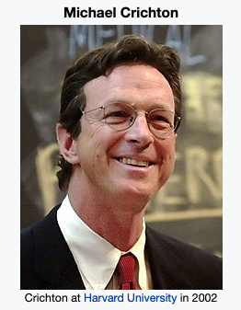
A Quick Overview of Information Extraction
Anne-Marie sued Crichton, best known as the author of Jurassic Park, for divorce in September.
Justice:Sue
Event
defendant
sued
plaintiff
Entity
Linking
PER
PER
spouse
Crichton
Anne-Marie
Relation
September
Entity
PER
coref
author
time
person
person
Coreference Resolution
divorce
Life:Divorce

Slide 4
A Brief Introduction to Information Extraction Subtasks
Entity Extraction aims to identify entity mentions in text and classify them into pre-defined entity types.
Relation Extraction is the task of assigning a relation type to an ordered pair of entity mentions.
Event Extraction entails identifying and classifying event triggers and their arguments
  Event triggers: the words or phrase that most clearly express event occurrences
  Arguments: the words or phrases for participants in those events
Entity Coreference Resolution is the task of resolving all entity mentions that refer to the same entity.
Event Coreference Resolution is the task of resolving all event mentions that refer to the same event.
Life:Be-Born
person
place
person
place
Shenson, who was born in San Francisco, was working in London at the time.
time

Slide 5
Motivation
Pipeline models suffer from the error propagation problem and disallow interactions among components.
Existing neural models do not explicitly model cross-subtask and cross-instance interactions among knowledge elements.
➔ A single joint neural model for Information Extraction.
Russia
minister
GPE
PER
ORG-AFF
ORG-AFF
ORG-AFF
ORG-AFF
PER
GPE
official
Washington
Russia's foreign minister expressed outrage at suggestions from a top Washington official last week...

Slide 6
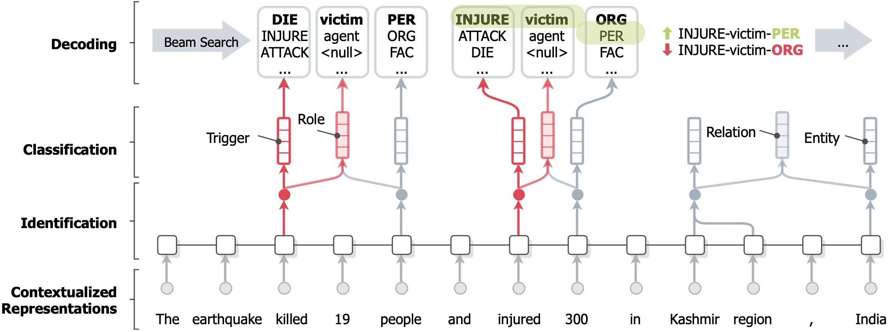
OneIE: An End-to-end Neural Model for IE
Our OneIE framework extracts the information graph from a given sentence in four steps: encoding, identification, classification, and decoding

Slide 7
OneIE: An End-to-end Neural Model for IE
Encoding: We use a BERT encoder to obtain the contextualized embedding of each token

Slide 8

OneIE: An End-to-end Neural Model for IE
Identification: We use CRF taggers to identify entity mentions and event triggers
We define the identification loss as

Slide 9

OneIE: An End-to-end Neural Model for IE
Classification: We use task-specific feed-forward networks to calculate label scores for each node or edge
We define the classification loss as

Slide 10
OneIE: An End-to-end Neural Model for IE
Decoding: In the test phase, we use a beam search decoder to find the information graph with the highest global score

Slide 11
Incorporating Global Features
We design a set of global feature templates (e.g., event_type₁ – role₁ – role₂ – event_type₂ : an entity acts a role₁ argument for an event_type₁ event and a role₂ argument for an event_type₂ event in the same sentence)
The model learns the weight of each feature during training
man
man
PER
PER
victim
target
victim
attacker
Life:Die
Conflict:Attack
Life:Die
Conflict:Attack
dies
shot
dies
shot
Life:Die – victim – target – Conflict:Attack
Life:Die – victim – attacker – Conflict:Attack
Positive weight
Negative weight

Slide 12
Decoding
We use beam search to decode the information graph
Example: He also brought a check from Campbell to pay the fines and fees.
Node Step
Node Step
Edge Step
Sort
Prune
E1¹
E2¹
E1¹
R1¹
E2¹
E1¹
R1²
E2¹
entity
E1²
R1¹
E2¹
E1¹
R1²
E2¹
E1¹
Fine
FAC
E1¹
E2²
E1¹
R1¹
E2²
E1¹
R1²
E2²
fines
Campbell
E1¹
R1²
E2²
E1¹
R1¹
E2²
Candidate 1 of node E1
Higher local score
E1²
E2¹
E1²
R1¹
E2¹
E1²
R1²
E2¹
E1¹
R1¹
E2¹
E1²
R1²
E2²
entity
E1²
R1¹
R1²
Fine
PER
R1¹
R1²
Candidate 2 of node E1
E1²
E2²
E1²
E2²
E1²
E2²
fines
Campbell
E1²
E2²
E1²
E2¹
Higher global score
add node 1
add node 2
add the edge between node 1 and 2
Campbell: FAC, ORG
fine: Fine, Sue
null, entity, person, …

Slide 13
Experiment Results
We conduct our experiments on ACE2005 (F-score, %)
Model | ACE05-R |  | ACE05-E
 | Entity | Relation | Entity | Trigger Identification | Trigger Classification | Argument Identification | Argument Classification
DyGIE++ | 88.6 | 63.4 | 89.7 | - | 69.7 | 53.0 | 48.8
DyGIE++* | - | - | 90.7 | 76.5 | 73.6 | 55.4 | 52.5
OneIE | 88.8 | 67.5 | 90.2 | 78.2 | 74.7 | 59.2 | 56.8
Example: Prime Minister Abdullah Gul resigned earlier Tuesday to make way for Erdogan, who won a parliamentary seat in by-elections Sunday.
Erdogan
Abdullah Gul
Erdogan
Abdullah Gul
PER
PER
1. An Elect event usually has only one Person argument
2. An entity is unlike to act as a Person argument for End-Position and Elect events at the same time
PER
PER
person
person
person
person
person
Elect
End-Position
Elect
End-Position
won
resigned
won
resigned
Baseline Result
OneIE Result

Slide 14
Salient Global Features
Salient positive and negative global features learned by the model
Our global features are explainable
 | Features | Weight
1 | A Transport event has only one Destination argument | 2.61
2 | An Attack event has only one Place argument | 2.31
3 | A PER-SOC relation exists between two PER entities | 1.51
4 | A Beneficiary argument is a PER entity | 0.93
5 | An entity has an ORG-AFF relation with multiple entities | -3.21
6 | An event has two Place arguments | -2.47
7 | A Transport event has multiple Destination argument | -2.25
8 | An entity has a GEN-AFF relation with multiple entities | -2.02

Slide 15
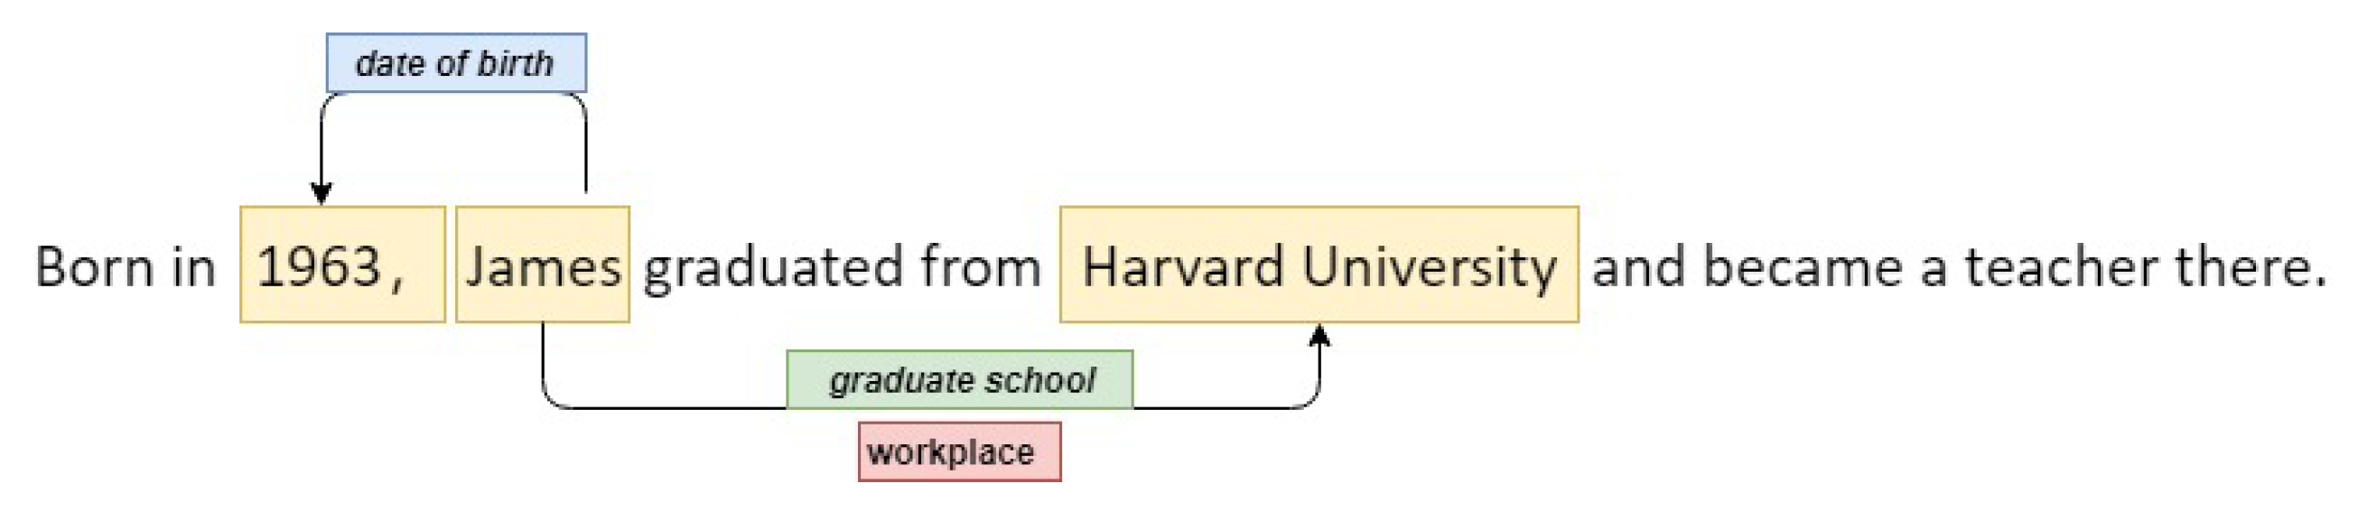
Information Extraction
From the texts:
1 . Identify the concepts
  Entities, events, terms, etc.
2. Identify the relations and other properties
  Entity-entity / event-event
  Temporal properties
  etc.
Lexical IE:
Named entity recognition
Entity/event typing
Entity/event linking
Relational IE:
Relation extraction
  Entity / events
  Sentence/Document
  Temporal
Coreference Resolution

Slide 16
How IE is mostly done?
Direct supervision
  CoNLL 2003: 20K+ entity mention annotations for NER
  Ontonotes5.0: exhaustive NER annotation on 2.9M tokens
But
  Closed label set
  Poor transferability
  Annotation artifacts
  “Worse” on “rare” items
  High cost for new tasks
A multi-head classification model drops from 96 to 74 (F1) on CoNLL, when it’s trained on Ontonotes on the same types.
Zhou et al. (2021) reports $1.0 per instance to annotate clean temporal relations on obscure texts.

Slide 17
In this part of the tutorial:
We explore the the central question
            Cheaper to generalize to new / rare / hard tasks
            Alleviate in-distribution artifacts
How do we find alternative supervision sources for IE tasks?

Slide 18
Alternative Supervision Sources
Weak supervision: from task-related distant signals
  Easy to acquire
  Task-specific
  May be noisy
Indirect supervision: from other tasks
  Human annotations from other popular tasks such as NLI and QA
  Non-task-specific
  Needs clever ways to be applied

Slide 19
Weak Supervision
Mark joined Amazon a month ago.
  What is the entity type?
Weak Supervision:
  From knowledge bases
    Amazon.com, Inc is an American multinational technology company.

Slide 20
Supervision Sources for IE
Mark joined Amazon a month ago.
Direct Supervision: seen similar examples
Weak Supervision:
  From knowledge bases: Amazon.com, Inc is an American multinational technology company.
  From linguistic patterns: PER join company
  From pre-trained LMs: Amazon is a [MASK] <- [MASK] = company.
  From task and label definitions: company is an organization that…
  From global statistics and biases
Indirect Supervision:
  Entailment model: Amazon is a company. <- entailment
  QA model: Q: What is Amazon? A: a company (that Mark joined).
  Summarization model: Mark joined a new company.

Slide 21
Weak Supervision for IE
Weak Supervision (aka. Distant Supervision)
  Directly related to the task
  Do not cost additional annotation
  Often noisy (i.e., are not completely accurate, or do not cover all aspects)
Common Sources
  Existing “free-to-use” knowledge bases, databases, dictionaries
  Unannotated free-form texts (LM pre-training)
  Linguistic patterns and templates (open IE)
  General rules and minimum human inputs (label definitions)

Slide 22
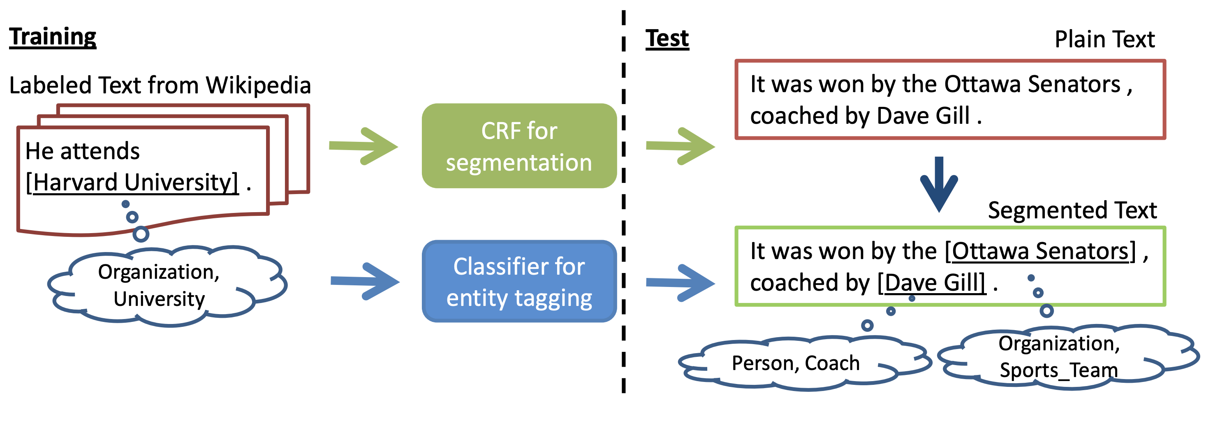
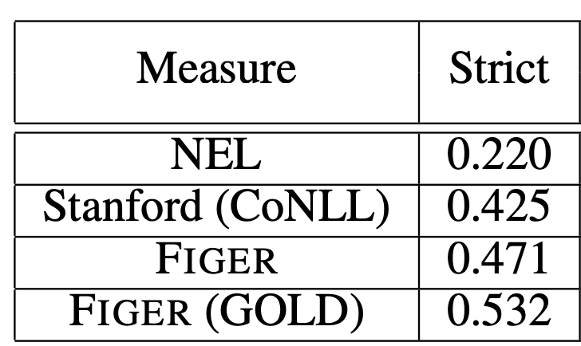
Weak Supervision – Knowledge Bases
One of the earliest attempts: entity and entity relations
Ling and Weld (2012): NER from KB supervision
Note: StanfordNER only predicts a subset of the taxonomy
Ling and Weld. Fine-Grained Entity Recognition. AAAI 2012.

Slide 23
Weak Supervision – Knowledge Bases
One of the earliest attempts: entity and entity relations
Mintz et al. (2009)
  Assumes Freebase relations exist sentences that contain the same entity pairs.
  Learns a large set of relations (102), but noisy
Freebase Relation | Entity Pairs | Sentence with same EPs
/location/location/contains | Paris, Montmartre | Montmartre is a large hill in Paris's 18th arrondissement.
/film/director/film | Michael Mann, Collateral | Collateral is a 2004 American neo-noir action thriller film directed and produced by Michael Mann.
/people/person/profession | Barak Obama, President | Obama announced his run for the president.
Mintz et al. Distant supervision for relation extraction without labeled data. ACL 2009.

Slide 24
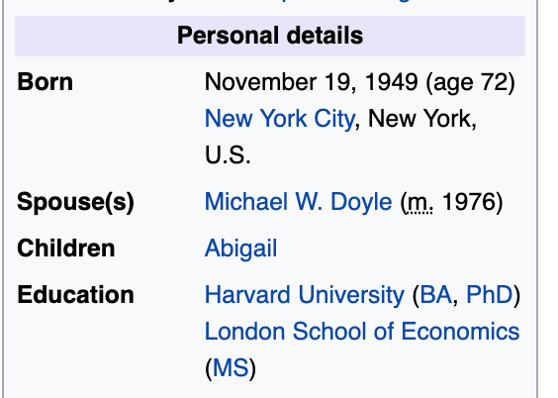
Weak Supervision – Knowledge Bases
One of the earliest attempts: entity and entity relations
Hoffmann et al. (2010): Learn from Wikipedia infoboxes
  Matching info box entities with context, to learn context-dependent relation extraction.
    5000+ relations
  Many follow-up work on de-noising, but with similar weak signals
Amy Gutmann was born on November 19, 1949,^{[2]} in Brooklyn, New York,^{[2]} the only child of Kurt and Beatrice Gutmann. … She then entered Radcliffe College of Harvard University in 1967 on a scholarship as a math major with sophomore standing. … She and her husband Michael Doyle have also funded an endowed undergraduate scholarship and an undergraduate research fund at Penn.
Hoffmann et al. Learning 5000 Relational Extractors. ACL 2010

Slide 25
Weak Supervision
Mark joined Amazon a month ago.
  What is the entity type?
Weak Supervision:
  From knowledge bases
    Amazon.com, Inc is an American multinational technology company.
  From weak but richer label representations
    Word-embedding(company) is close to Word-embedding(Amazon)

Slide 26
Weak Supervision from Label Representations
Chen et al. (2020): Event Process Typing
Action: plant
Object: plant
Dig a hole
Put seeds in
Fill with soil
Water soil
Action: cook
Object: pizza
Make a dough
Add toppings
Preheat the oven
Bake the dough
Action: book
Object: flight
Set locations and dates
Compare airfares
Purchase the ticket
Chen et al. “What Are You Trying to Do?” Semantic Typing of Event Processes. CoNLL 2020

Slide 27

Weak Supervision from Label Representations
Chen et al. (2020): Event Process Typing
Direct label understanding is difficult
  Add glossary definition as a “weak” label defintion
Make
Make | create or manufacture a man-made product
Cocktail
Cocktail | a short, mixed drink
Why using label glosses?
Semantically richer than labels themselves
Capturing the association of a process-gloss pair (two sequences) is much easier
Jump-starting few-shot label representations (and benefiting with fairer prediction)
Chen et al. “What Are You Trying to Do?” Semantic Typing of Event Processes. CoNLL 2020

Slide 28
Weak Supervision from Label Representations
Chen et al. (2020)
Gloss knowledge brings the most improvement
w/ glosses: 2.88× MRR
Chen et al. “What Are You Trying to Do?” Semantic Typing of Event Processes. CoNLL 2020

Slide 29
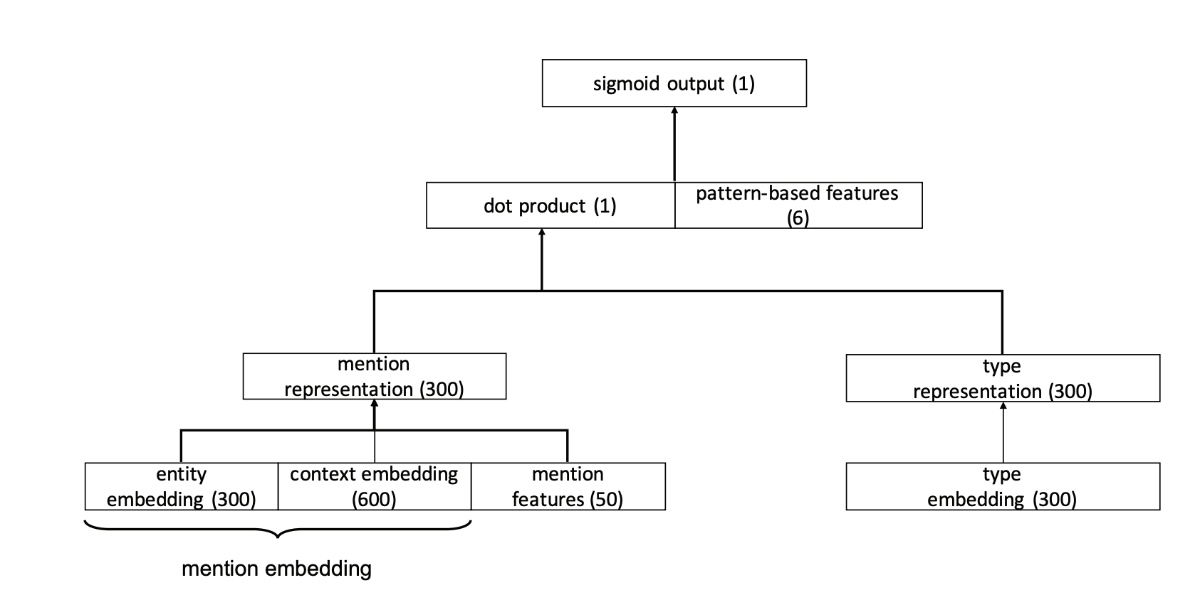
Weak Supervision from Label Representations
Yuan and Downey (2018): Open entity typing from label embeddings
  Labels as meaningless indices -> labels as word embeddings (carries information)
  Optimizes gold “label embedding” to be closer to the mention embedding.
Type embedding: GloVe
Yuan and Downey. OTyper: A Neural Architecture for Open Named Entity Typing. AAAI 2018

Slide 30
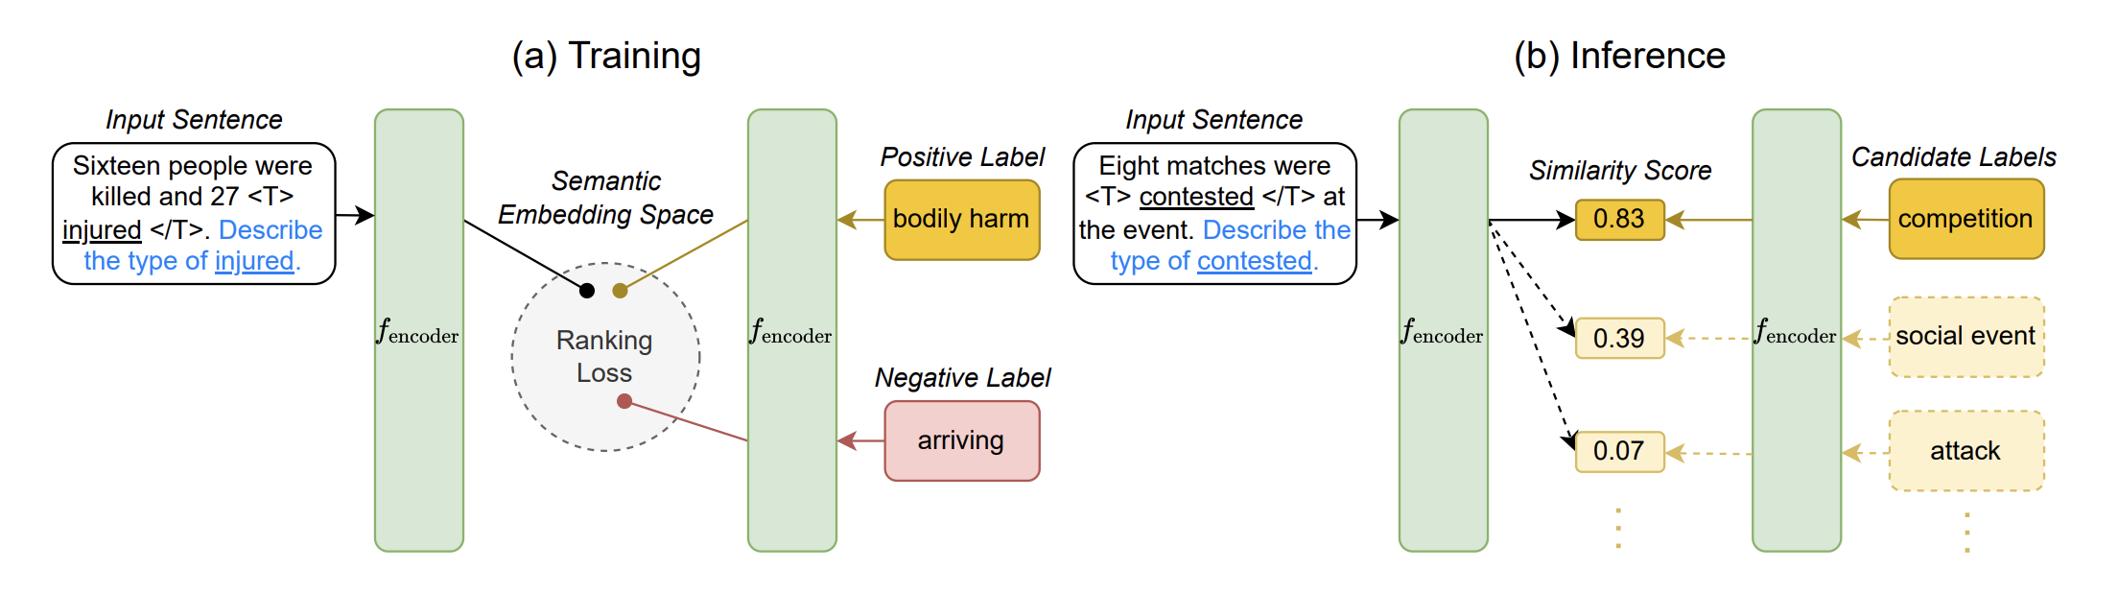
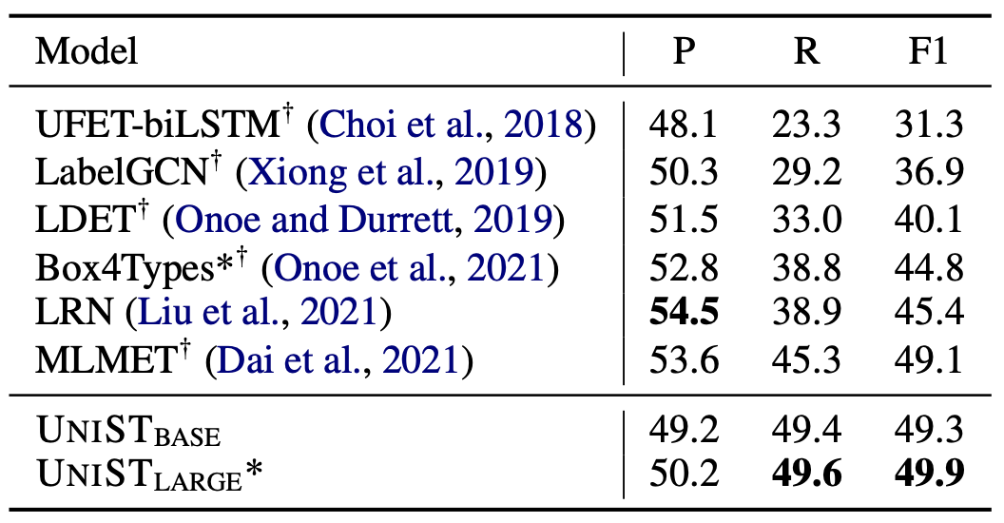
Weak Supervision from Label Representations
Huang et al. (2022): Similar idea but with modern LMs
Experiments on ultrafine dataset (Choi et al. 2018)
Huang et al.: Unified Semantic Typing with Meaningful Label Inference. NAACL 2022

Slide 31
Weak Supervision
Mark joined Amazon a month ago.
  What is the entity type?
Weak Supervision:
  From knowledge bases
    Amazon.com, Inc is an American multinational technology company.
  From weak but richer label representations
    Word-embedding(company) is close to Word-embedding(Amazon)
  From pre-trained LMs
    Amazon is a [MASK] <- [MASK] = company

Slide 32
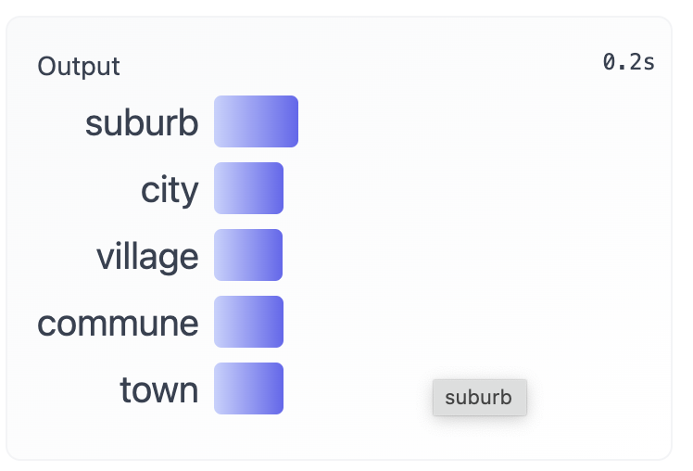
Weak Supervision from PLMs
Pre-trained language models can also be used as weak supervision
  It did not use additional annotations
  It is not task-specific
  It contains inductive biases (weak signals)
PLMs are applied for IE in many creative ways
  Contextual embeddings to replace word embeddings
  Direct probing
  Direct probing + task-specific finetuning
  Task-specific finetuning (not covered)
Paris is a [MASK].

Slide 33
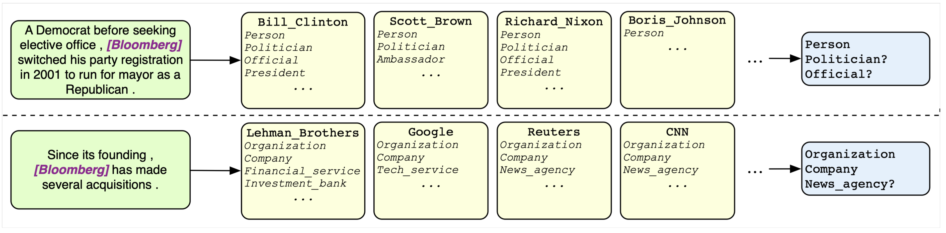
Using pre-trained LM Representations
Zhou et al. (2018): One of the earliest attempts
  Entity typing with pre-trained contextualized LM representations
WikiLinks (free-to-use public resource):
Bill Clinton is the Democratic nominee for president in the 2016 presidential election
…Scott Brown, a little-known Republican Massachusetts state senator…
Mentions with high contextual similarities (ELMo embeddings)
Zhou et al. Zero-Shot Open Entity Typing as Type-Compatible Grounding. EMNLP 2018

Slide 34
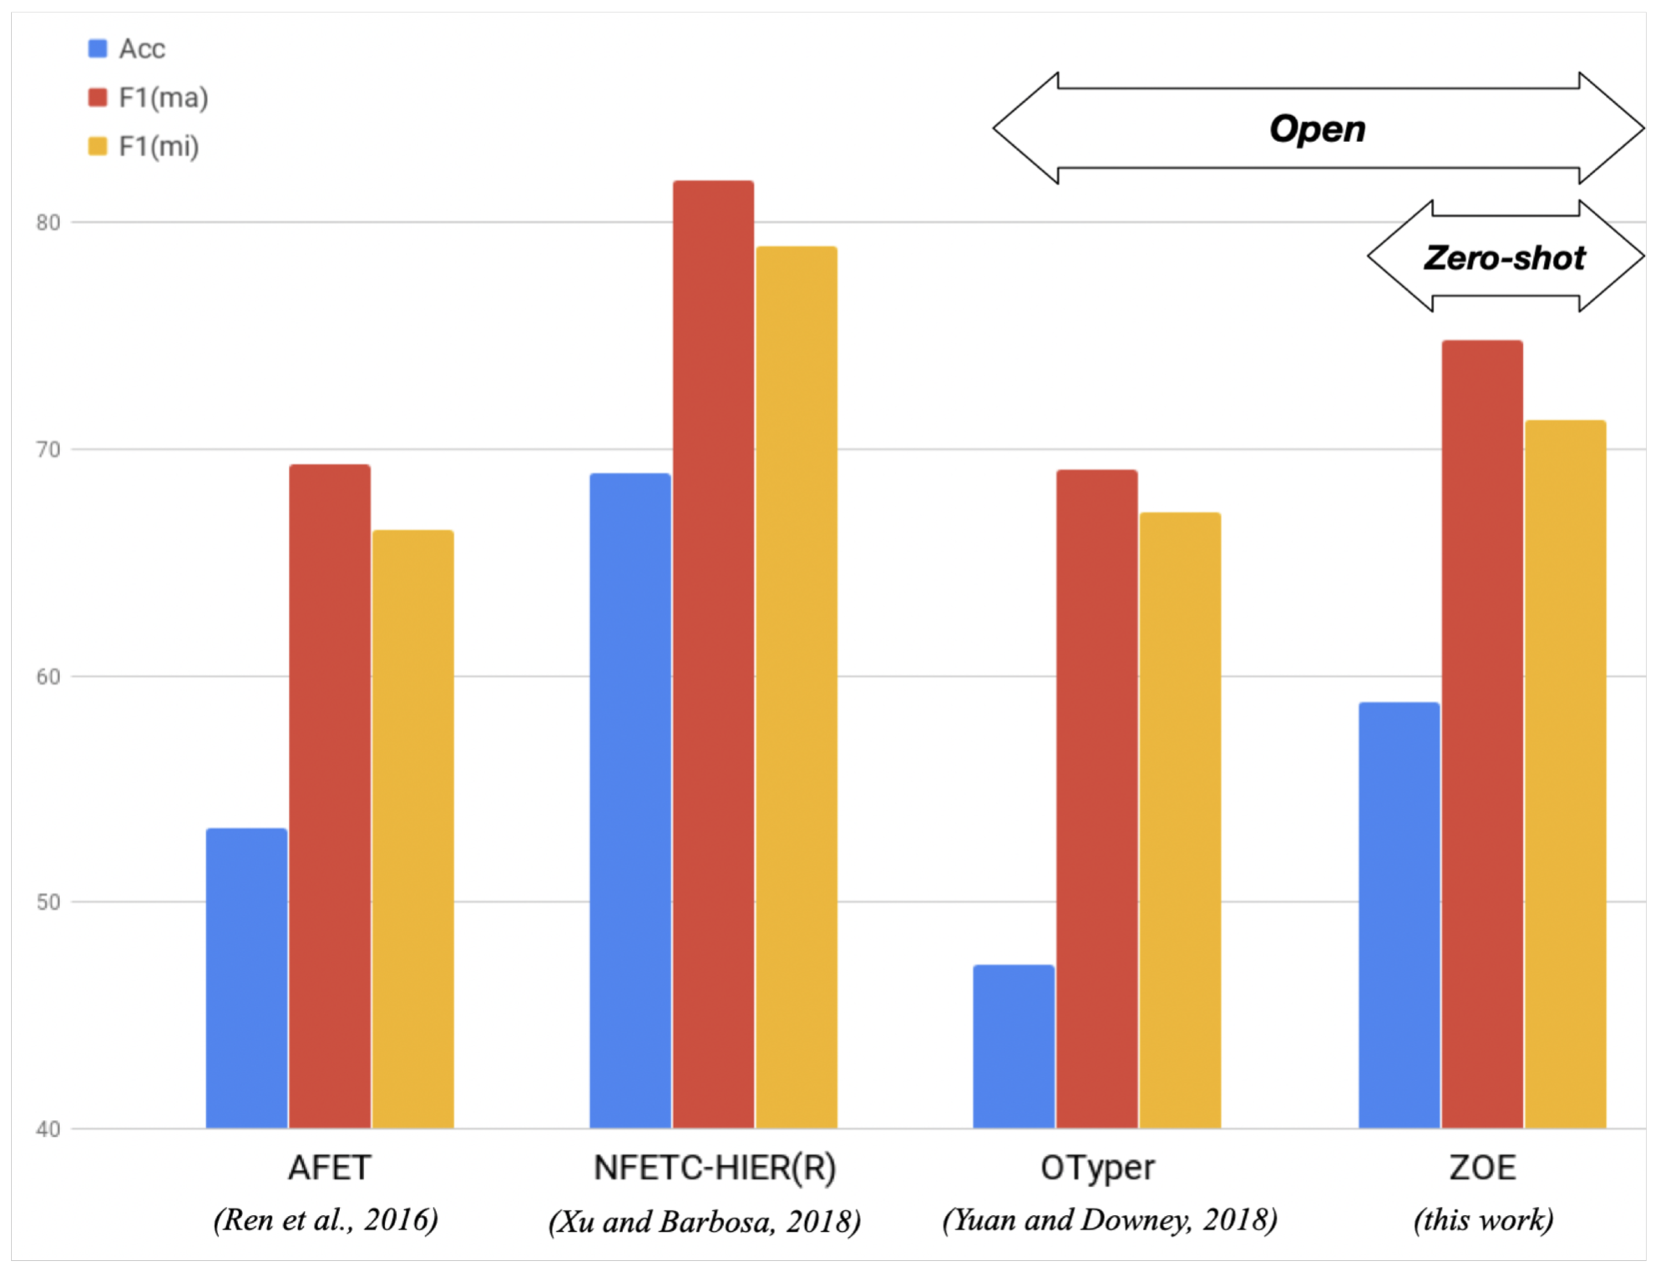
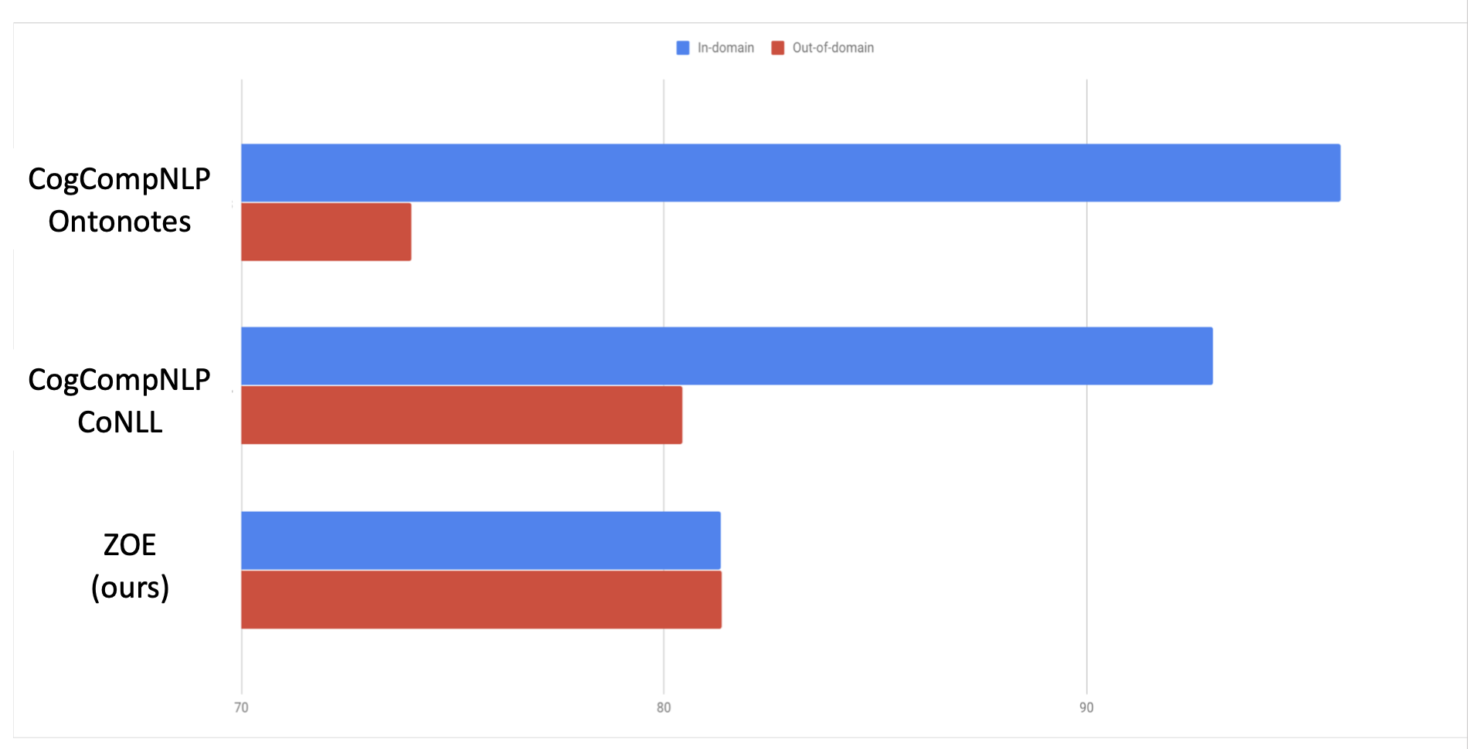
Using pre-trained LM Representations
Zhou et al. (2018): entity typing with LM representation + Wikipedia
Zhou et al. Zero-Shot Open Entity Typing as Type-Compatible Grounding. EMNLP 2018

Slide 35
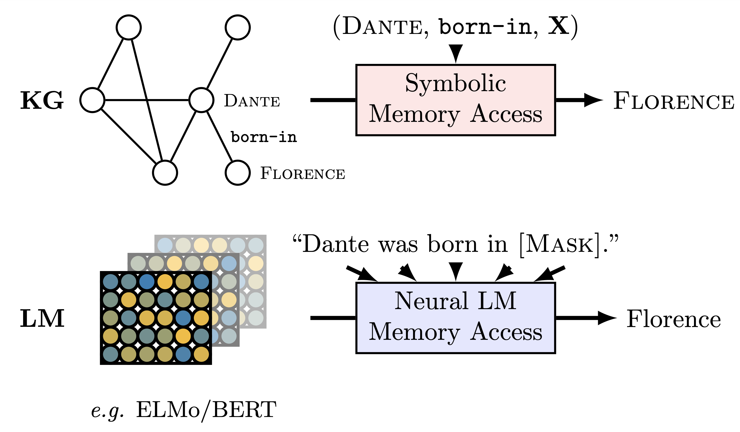
Probing pre-trained LMs
Comparing to ELMo, BERT made direct probing easier
Petroni et al. (2019): Language models as knowledge bases
  Google-RE
  16.1% birth-place
  1.4% birth-date
Petroni et al. Language Models as Knowledge Bases?. EMNLP 2019

Slide 36
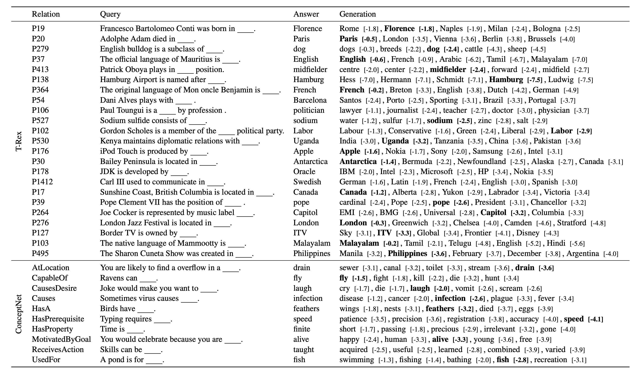
Probing pre-trained LMs
Petroni et al. (2019): Language models as knowledge bases
These predictions are highly relevant to typing and relation extraction
Petroni et al. Language Models as Knowledge Bases?. EMNLP 2019

Slide 37
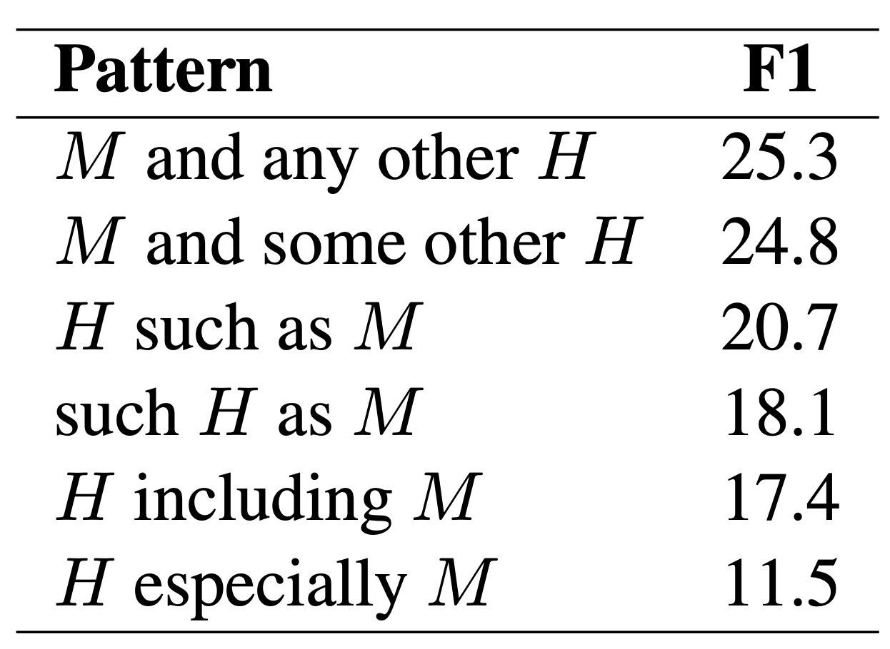
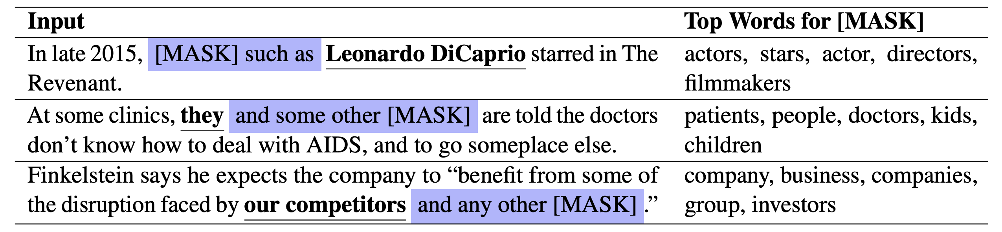
Probing pre-trained LMs for IE
Dai et al. (2021)
Use templates + [MASK] to retrieve entity types
Dai et al. Ultra-Fine Entity Typing with Weak Supervision from a Masked Language Model. ACL 2021

Slide 38
Probing pre-trained LMs for IE
Dai et al. (2021)
Use templates + [MASK] to retrieve entity types
Further self-training based on weakly labeled (by LM) instances
Dai et al. Ultra-Fine Entity Typing with Weak Supervision from a Masked Language Model. ACL 2021

Slide 39
Probing pre-trained LMs for IE
Zhang et al. (2020)
Entity Set Expansion: expand a small set of entities with new ones belonging to the same semantic class.
  {“United States”, “China”, “Canada} –>{“Japan”, “Mexico”}
  A “entity set” fine-grained typing
Zhang et al. Empower Entity Set Expansion via Language Model Probing. ACL 2020

Slide 40
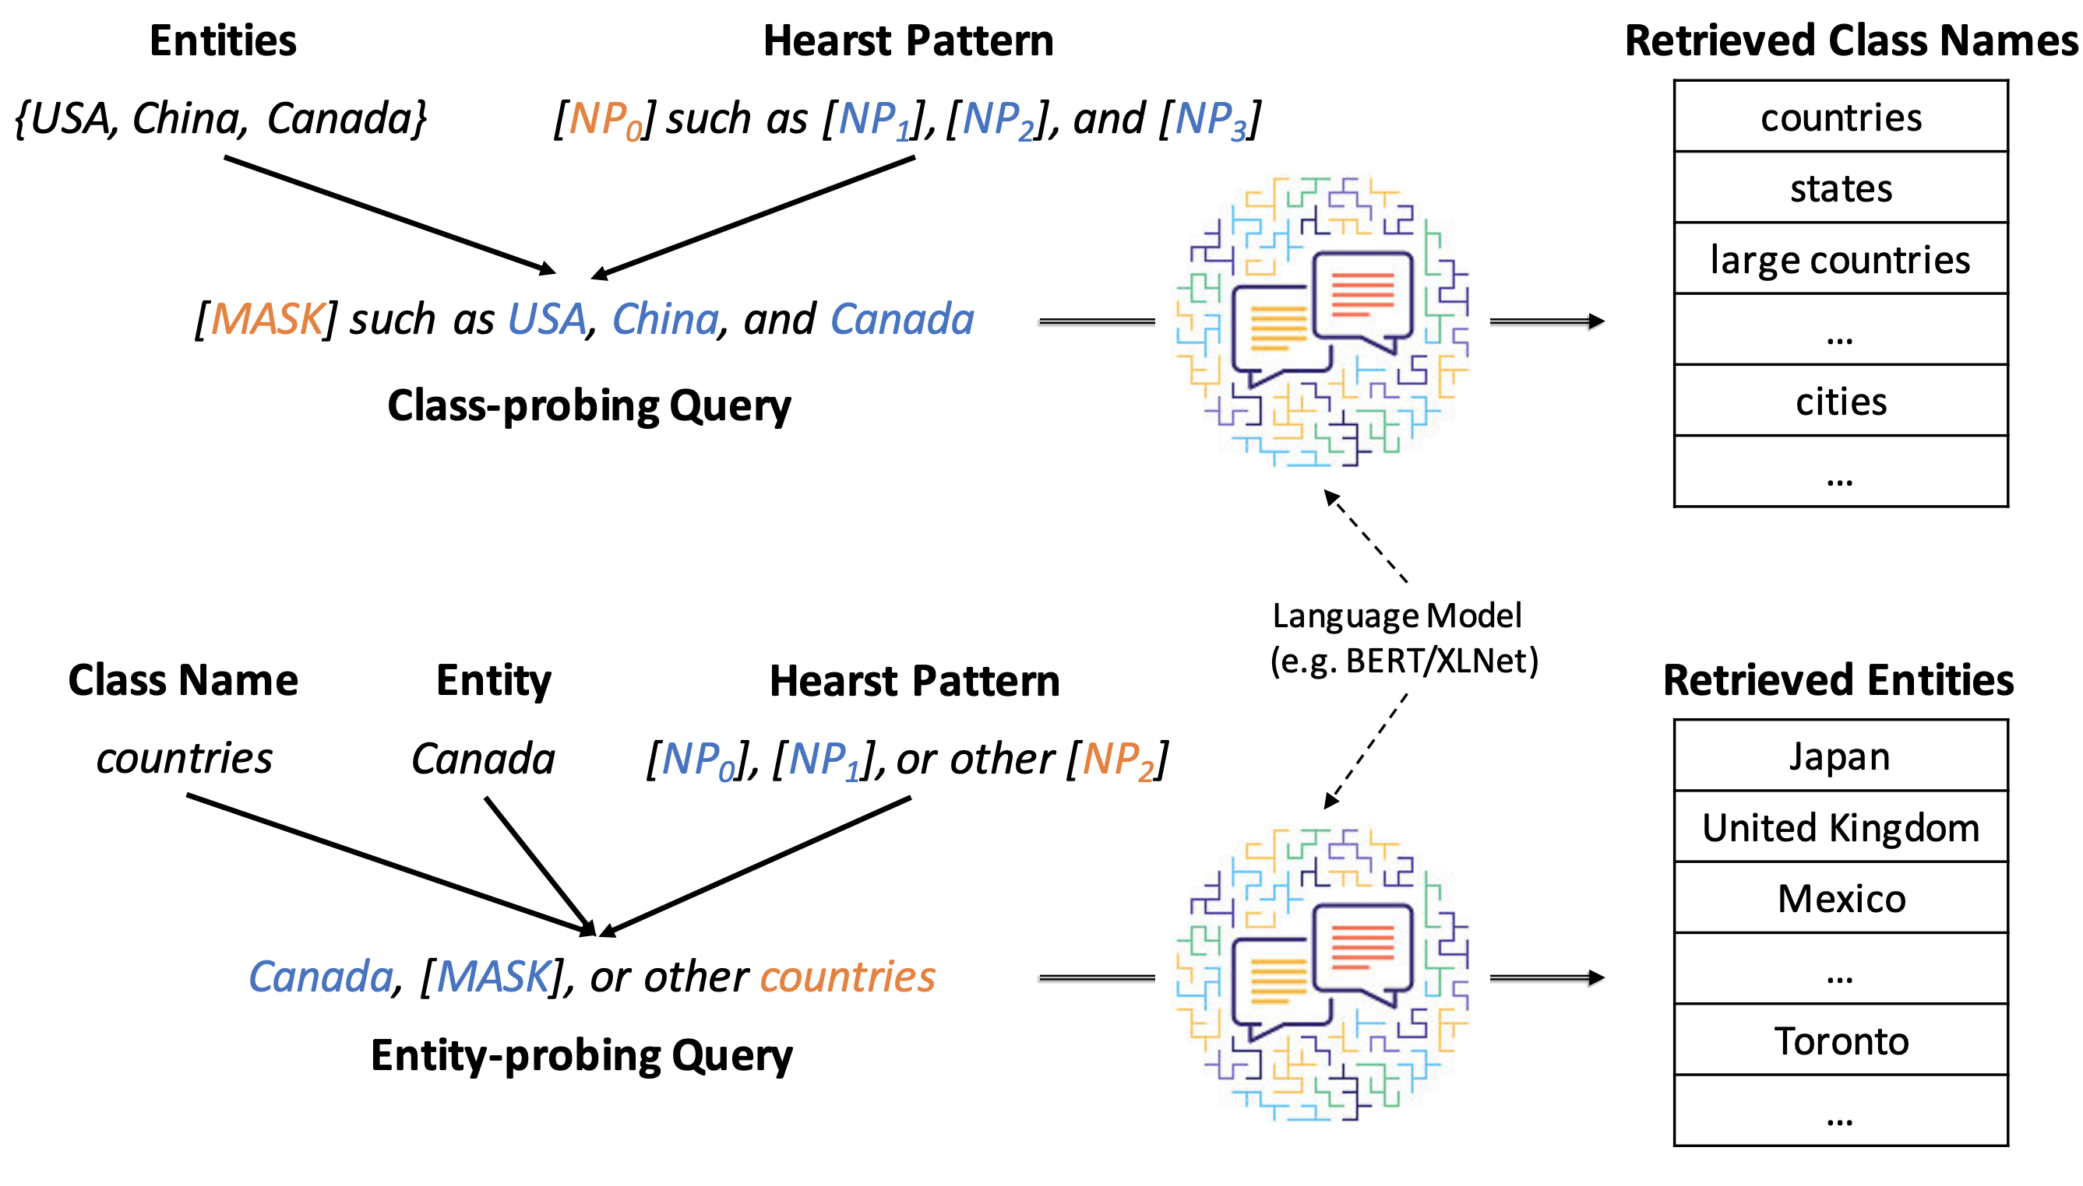
Probing pre-trained LMs for IE
Zhang et al. (2020)
Entity set expansion by probing pre-trained LMs
Generate “class label” via LM probing
Zhang et al. Empower Entity Set Expansion via Language Model Probing. ACL 2020

Slide 41
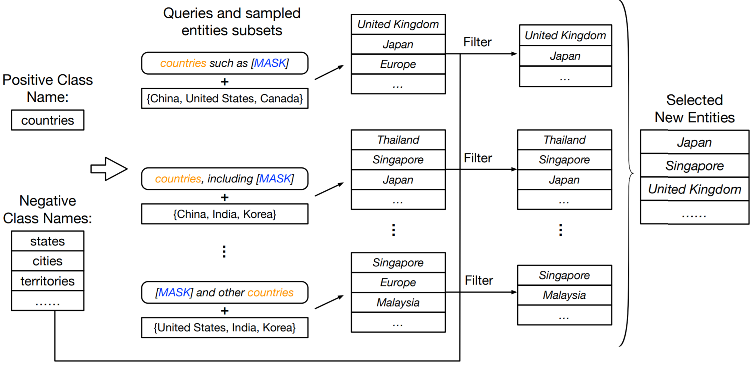
Probing pre-trained LMs for IE
Zhang et al. (2020)
Entity set expansion by probing pre-trained LMs
Zhang et al. Empower Entity Set Expansion via Language Model Probing. ACL 2020

Slide 42
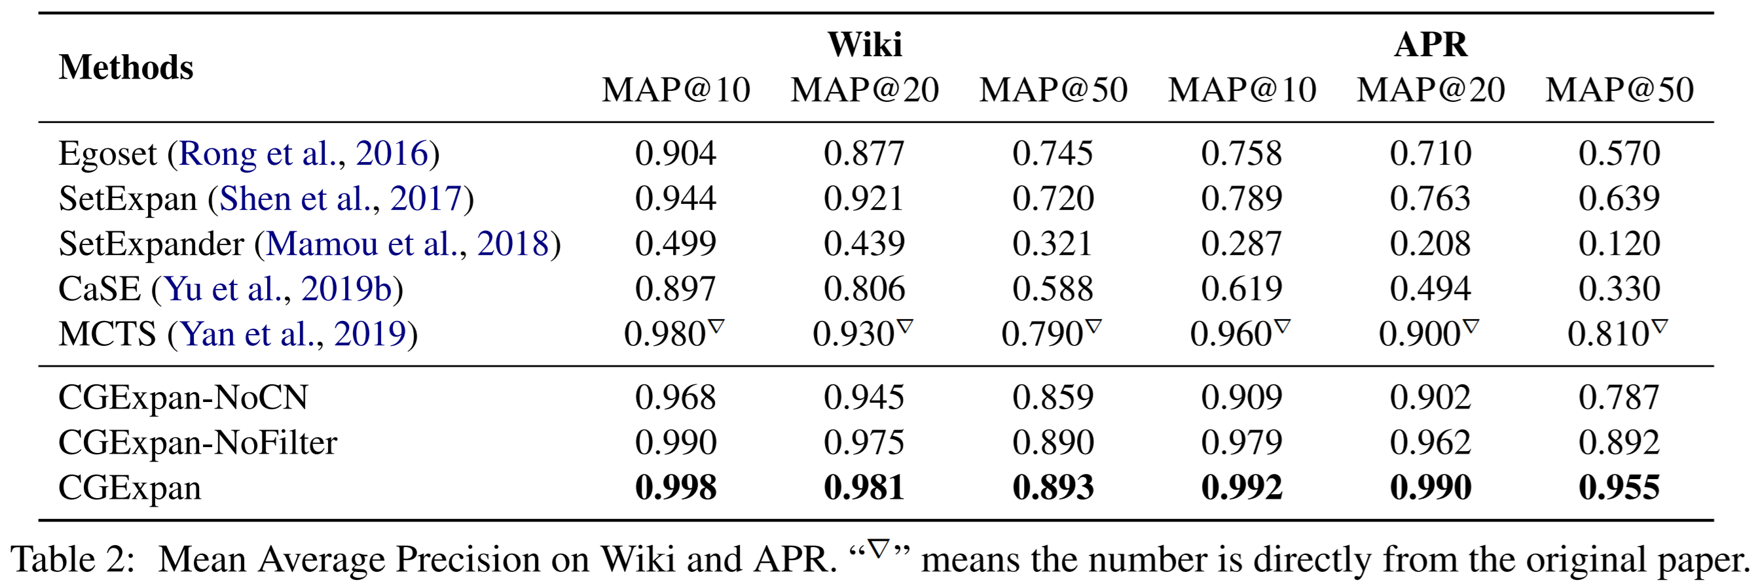
Probing pre-trained LMs for IE
Zhang et al. (2020)
Entity set expansion by probing pre-trained LMs
Zhang et al. Empower Entity Set Expansion via Language Model Probing. ACL 2020

Slide 43
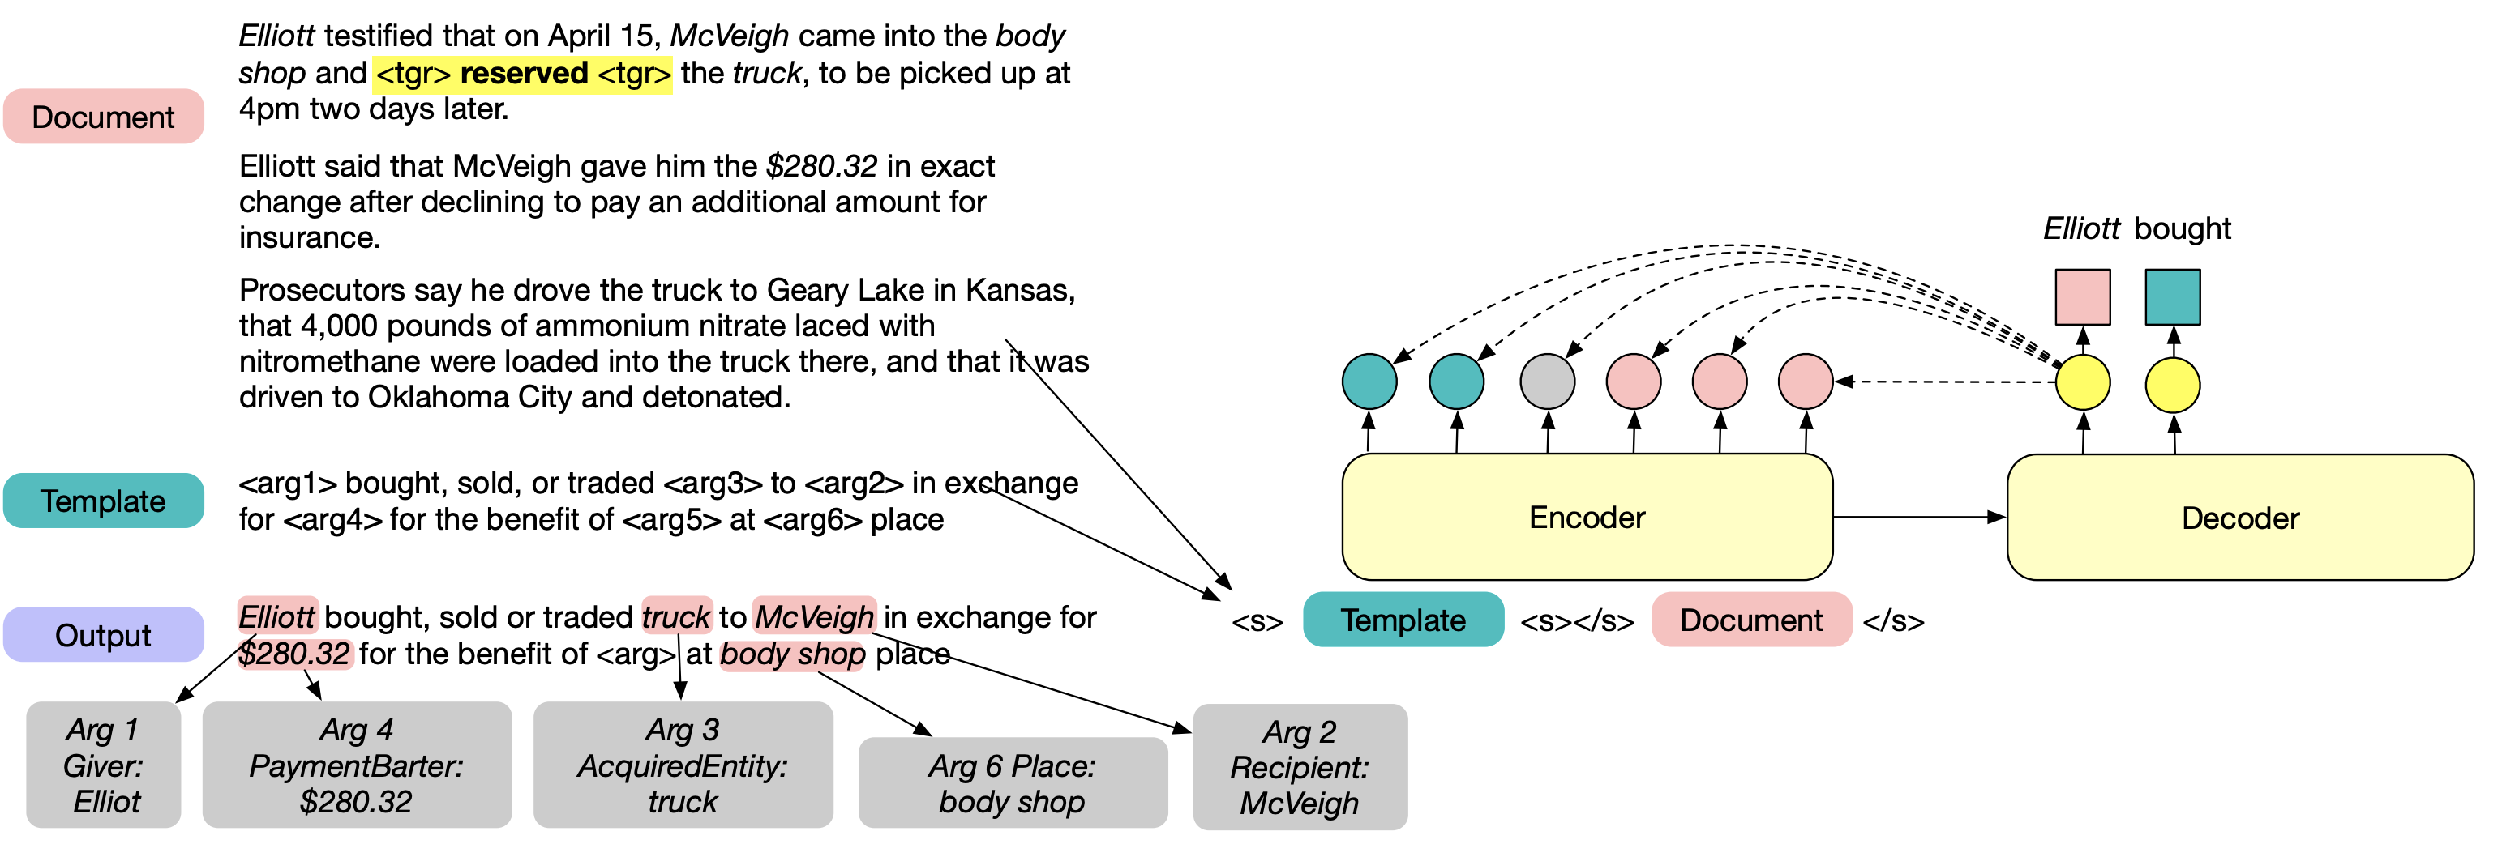
Probing pre-trained LMs through Generation
LMs that are trained with autoregressive structures can be probed through conditional generation (with some supervision)
Li et al. (2021): Event argument extraction via BART + conditional generation
Li et al. Document-Level Event Argument Extraction by Conditional Generation. NAACL 2021

Slide 44
Weak Supervision
Mark joined Amazon a month ago.
  What is the entity type?
Weak Supervision:
  From knowledge bases
    Amazon.com, Inc is an American multinational technology company.
  From weak but richer label representations
    Word-embedding(company) is close to Word-embedding(Amazon)
  From pre-trained LMs
    Amazon is a [MASK] <- [MASK] = company.
  From linguistic patterns
    PER join company

Slide 45
Weak Supervision – Linguistic Patterns
We can use simple linguistic patterns to mine many relations from text
[event] at [time]
Works better with events, as entities would lose contextual information.
[event] because [event]
[entity] is [entity]

Slide 46
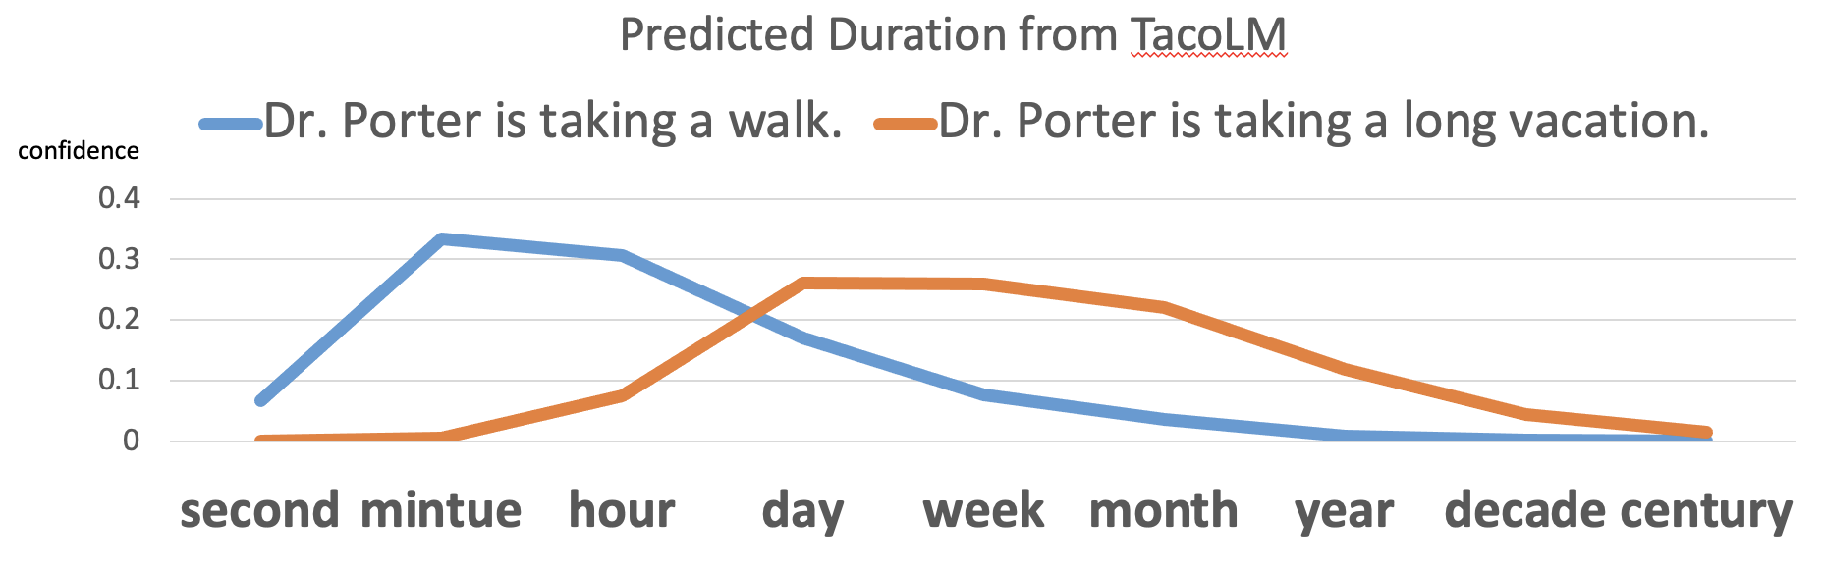
Weak Supervision – Linguistic Patterns
Zhou et al. (2020): Temporal Information Extraction from Patterns
Goal: model events’ temporal property distributions
  Duration, Frequency, Typical Time
Zhou et al. Temporal Common Sense Acquisition with Minimal Supervision. ACL 2020

Slide 47
Weak Supervision – Linguistic Patterns
Zhou et al. (2020): Temporal Information Extraction from Patterns
  Step 1: Extract distant signals of contextualized events and their duration, frequency etc. via linguistic patterns
I played basketball for 2 hours.
Original sentence
SRL Parse
Arg-0
Arg-1
I played basketball for 2 hours.
Verb
Arg-Tmp
Pattern Matching
for 2 hours: matches Duration pattern
Event
Value
Formatted Output Instance
I played basketball, Duration, Hours
Dimension
Zhou et al. Temporal Common Sense Acquisition with Minimal Supervision. ACL 2020

Slide 48
Weak Supervision – Linguistic Patterns
Zhou et al. (2020): Temporal Information Extraction from Patterns
  Step 1: Extract distant signals of contextualized events and their duration, frequency etc. via linguistic patterns
  Step 2: further pre-train a language model with extracted instances
Zhou et al. Temporal Common Sense Acquisition with Minimal Supervision. ACL 2020

Slide 49
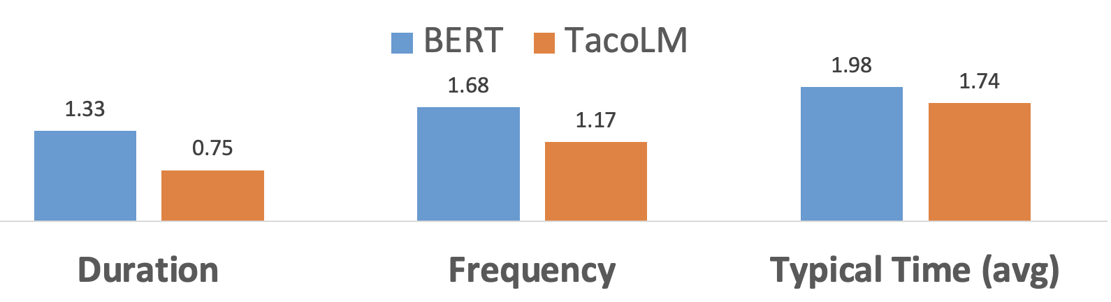
Weak Supervision – Linguistic Patterns
Zhou et al. (2020): Temporal Information Extraction from Patterns
BERT
TacoLM
Distance to gold value (lower the better)
Zhou et al. Temporal Common Sense Acquisition with Minimal Supervision. ACL 2020

Slide 50
Weak Supervision – Linguistic Patterns
Zhou et al. (2021): Temporal relation extraction from patterns
  event-event before/after relation
Within-sentence extraction
  Not enough:
    LMs may know this already
    Does not tell how far the two start times are
Zhou et al. Temporal Common Sense Acquisition with Minimal Supervision. ACL 2020

Slide 51
Weak Supervision – Linguistic Patterns
Zhou et al. (2021): Temporal relation extraction from patterns
  Automatically extracts weak supervision instances from unannotated texts
Cross-sentence extraction
  Based on explicit temporal expressions
  Independent of event locations
  Produces relative distance between start times
Zhou et al. Temporal Common Sense Acquisition with Minimal Supervision. ACL 2020

Slide 52
Weak Supervision – Linguistic Patterns
Zhou et al. (2021): Temporal relation extraction from patterns
  Automatically extracts weak supervision instances from unannotated texts
A sequence-to-sequence model (PatternTime)
  Train on 1.5M distant supervision instances
Input: two event phrases
Output:
  A binary label indicating which event starts earlier
  Probabilities over duration units indicating the interval between two start times
Event 1 starts
before
Event 2
I went to the park
PatternTime
Interval between start times is most likely:
I write a park review
0.0
0.1
0.2
0.3
…
seconds
minutes
hours
days
…
Zhou et al. Temporal Common Sense Acquisition with Minimal Supervision. ACL 2020

Slide 53
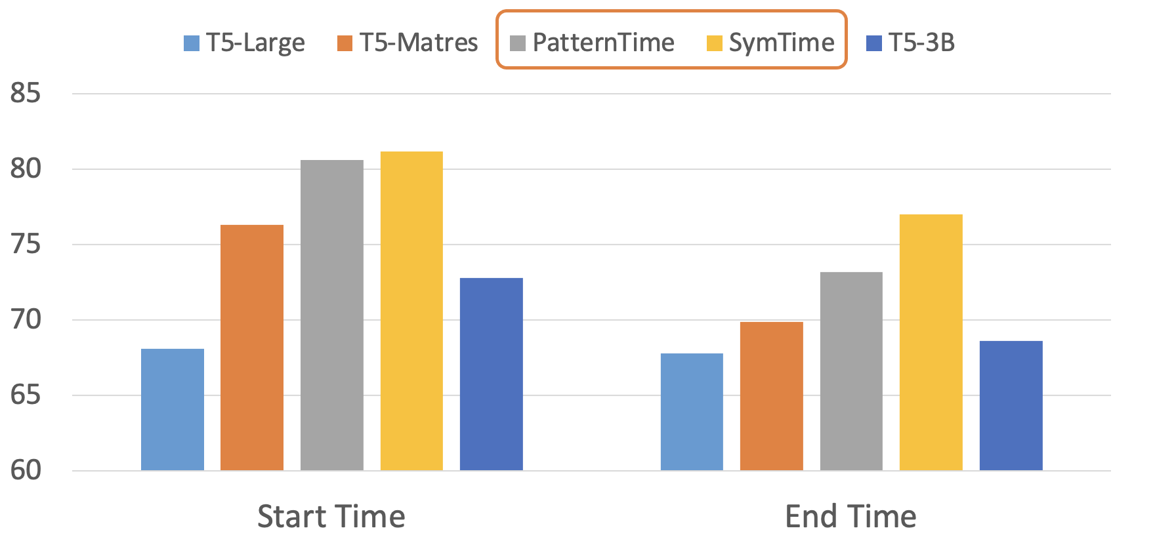
Weak Supervision – Linguistic Patterns
Zhou et al. (2021): Temporal relation extraction from patterns
  Automatically extracts weak supervision instances from unannotated texts
Evaluation done on TRACIE (from the same paper)
  Evaluates temporal relation of both start and end time
SymTime: explicitly computes end time with the start time and duration estimations from PatternTime (detail omitted)
Zhou et al. Temporal Common Sense Acquisition with Minimal Supervision. ACL 2020

Slide 54
Weak Supervision – Linguistic Patterns
Zhou et al. (2020, 2021)
Linguistic patterns can be efficiently applied to acquire weak IE signals
  Patterns are manually designed (human knowledge)
  Provide new information to pre-trained language models

Slide 55
Weak Supervision
Similarity: None of them directly reveals the type in the given context, but they all hint/suggest it.
Mark joined Amazon a month ago.
  What is the entity type?
Weak Supervision:
  From knowledge bases
    Amazon.com, Inc is an American multinational technology company.
  From weak but richer label representations
    Word-embedding(company) is close to Word-embedding(Amazon)
  From pre-trained LMs
    Amazon is a [MASK] <- [MASK] = company.
  From linguistic patterns
    PER join company

Slide 56
Alternative Supervision Sources
Weak supervision: from task-related distant signals
  Easy to acquire
  Task-specific
  May be noisy
Indirect supervision: from other tasks
  Human annotations from other popular tasks such as NLI and QA
  Non-task-specific
  Needs clever ways to be applied

Slide 57
Indirect Supervision for IE
Intuition: Information extraction tasks can benefit from other tasks’
  Formulation
  Supervision
Comparing to weak supervision:
  clean human annotations
  good baselines
Direct IE:
(James, Harvard), relation, graduate_from
LMs use natural languages better..
Indirect IE from QA:
Q: Where did James graduate from?
A: Harvard University
we may train on Squad first…

Slide 58
Indirect Supervision for IE
Part 1: Indirect Supervision from task formulation
  Transform an IE task to another task
  Not use additional supervision (even though indirect) to make fair comparisons
  Question answering
    Relation extraction
    Named entity recognition

Slide 59
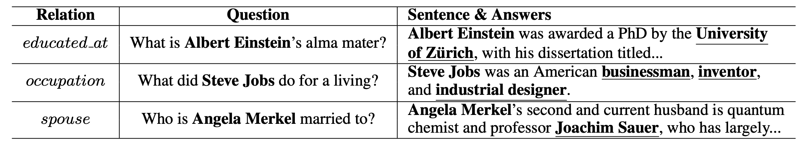
Indirect Supervision from QA
Levy et al. (2017): Relation extraction formulated as QA
  Why would it work?
    Question provides “indirect” information
    on relation labels
Schema Querification (crowdsourced)
Levy et al. Zero-Shot Relation Extraction via Reading Comprehension. CoNLL 2017

Slide 60
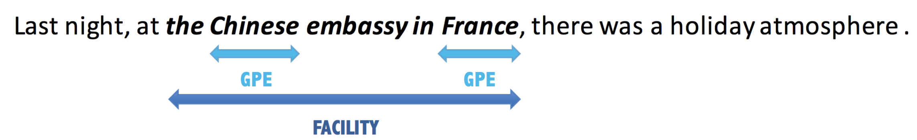
Indirect Supervision from QA
Li et al. (2020): NER formulated as QA
  Sequential labeling is difficult for nested named entities
  Formulate as span-selection QA task will help
Find facilities in the text, including buildings, airports, highways and bridges.
Li et al. A Unified MRC Framework for Named Entity Recognition. ACL 2020

Slide 61
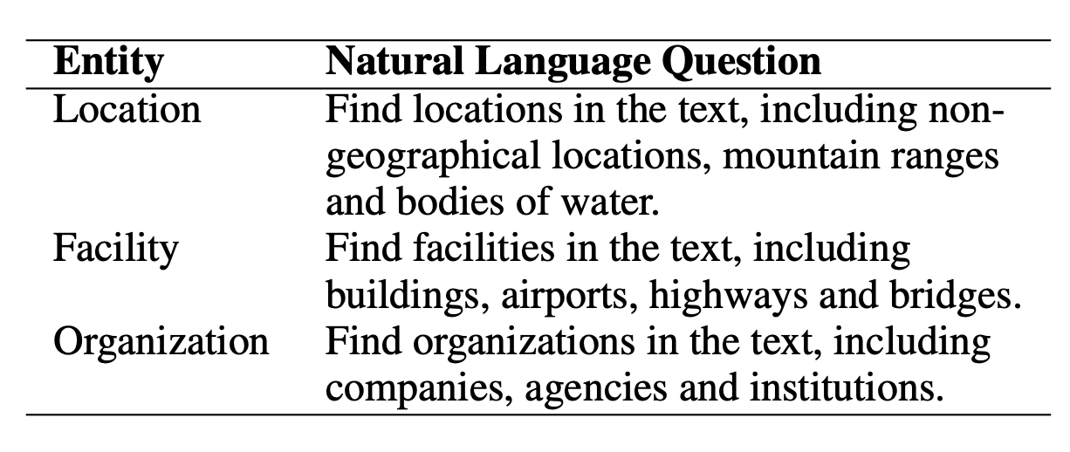
Indirect Supervision from QA
Li et al. (2020): NER as QA, where does the improvement come from?
  Questions serve as “label definitions”, provides additional indirect supervision
Li et al. A Unified MRC Framework for Named Entity Recognition. ACL 2020

Slide 62
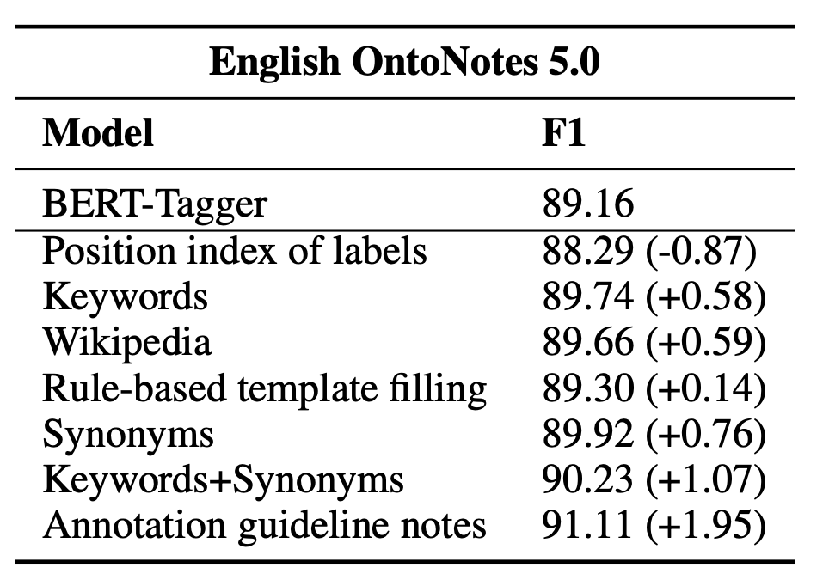
Indirect Supervision from QA
Li et al. (2020): NER as QA, where does the improvement come from?
  Pre-trained language models understand “natural language” better than “labels”
Li et al. A Unified MRC Framework for Named Entity Recognition. ACL 2020

Slide 63
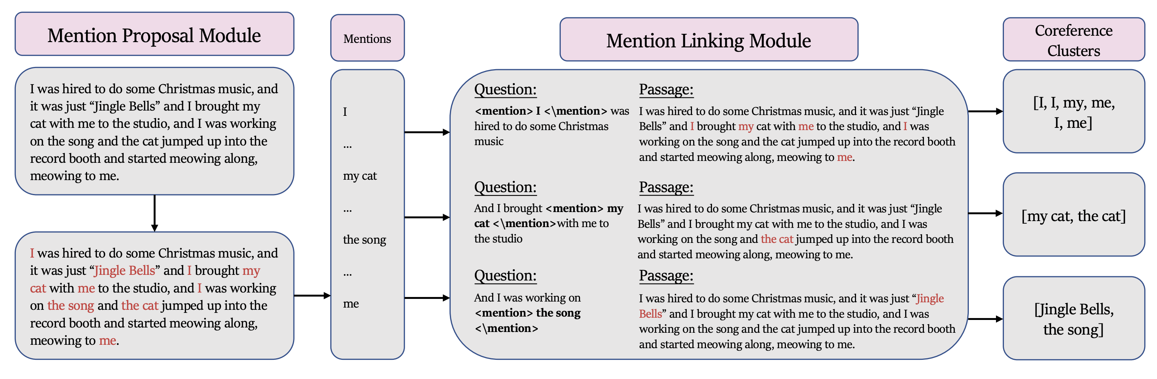
Indirect Supervision from QA
Wu et al. (2020): Coreference as QA
Use the sentence that each mention is in as the “question”, all other spans belonging to the same cluster as “answers”
Wu et al. CorefQA: Coreference Resolution as Query-based Span Prediction. ACL 2020

Slide 64
Indirect Supervision for IE
Part 2: Indirect Supervision from task formulation + supervision
  Transform an IE task to another task, which has a representation that’s easier for models
  Use additional supervision from the original task format (e.g., QA, NLI)
Indirect IE from QA:
Q: Where did James graduate from?
A: Harvard University
we may train on Squad first…

Slide 65
Indirect Supervision from QA
Wu et al. (2020): Coreference as QA
Pre-train on Quoref + SQuAD improves ~1%, while the overall system improves 3.5%
Wu et al. CorefQA: Coreference Resolution as Query-based Span Prediction. ACL 2020

Slide 66
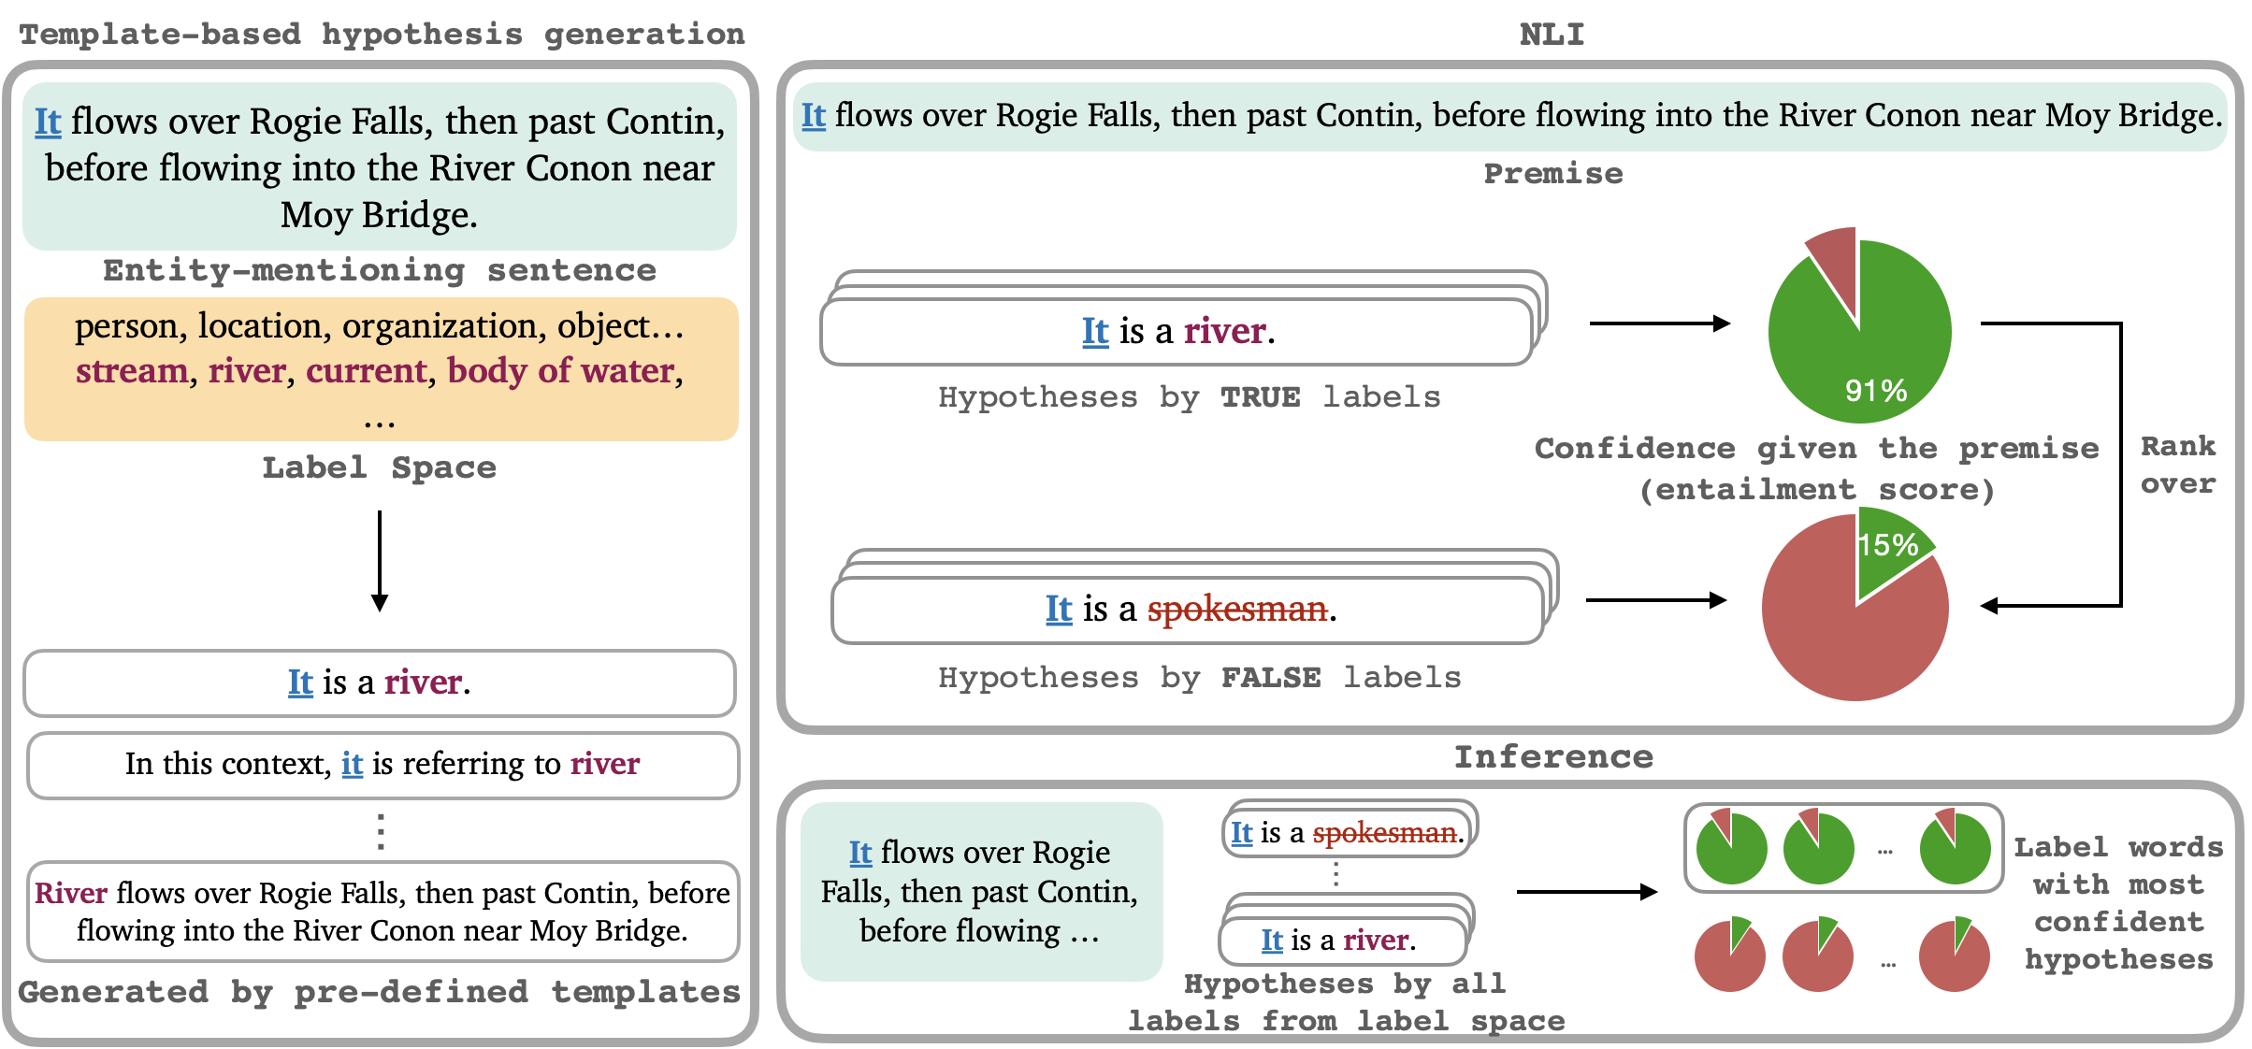
Indirect Supervision from NLI
Li et al. (2022): Entity typing formulated as textual entailment (NLI)
Li et al. Ultra-fine Entity Typing with Indirect Supervision from Natural Language Inference. TACL 2022

Slide 67
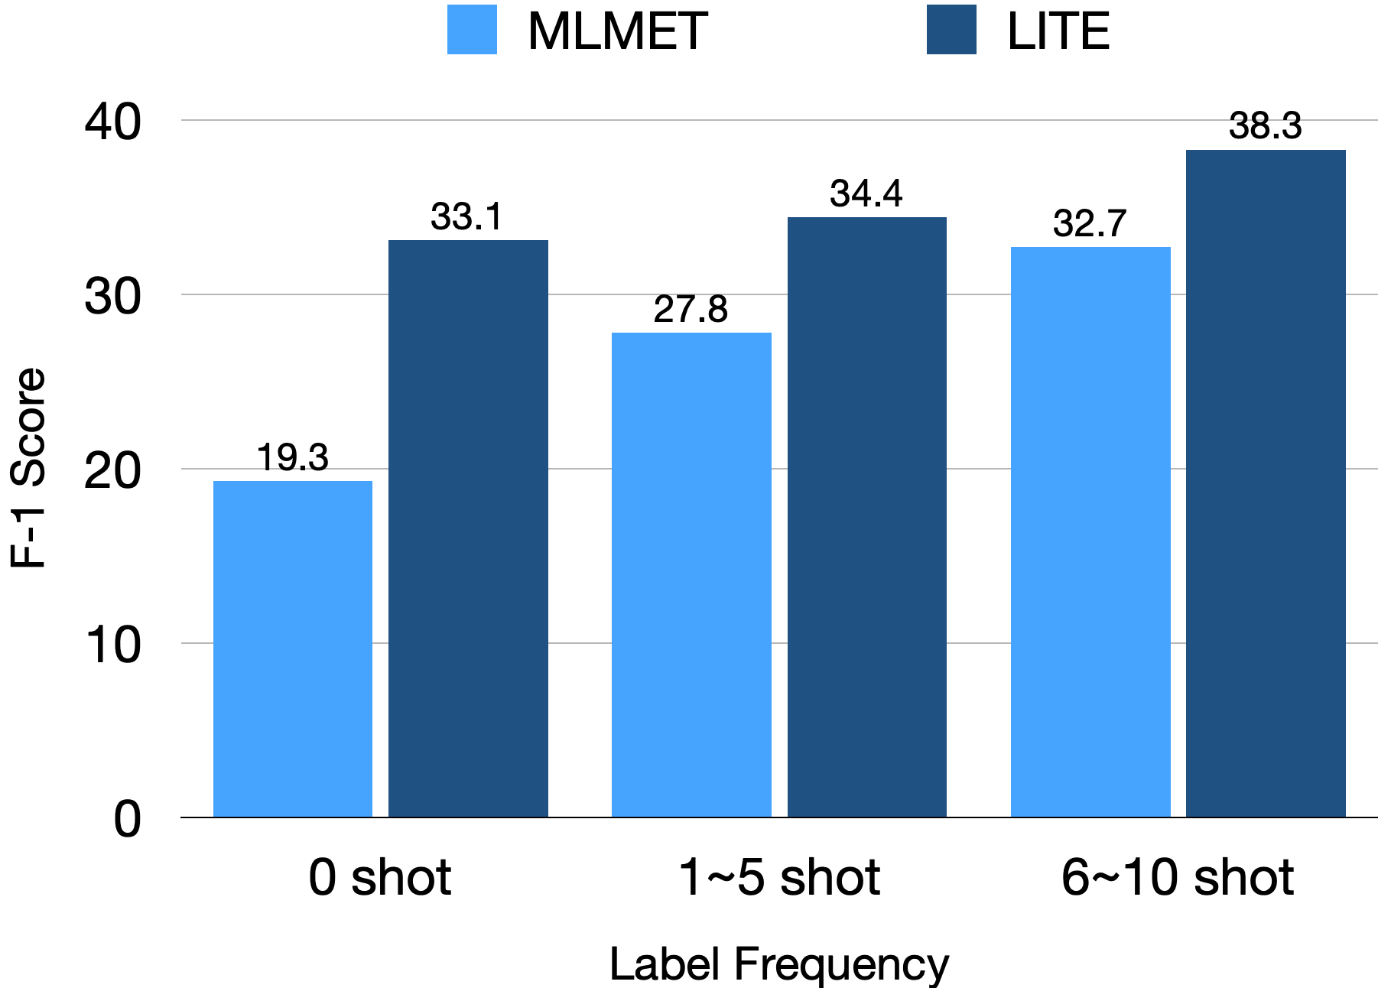
Indirect Supervision from NLI
Li et al. (2021): Entity typing formulated as textual entailment (NLI)
  “[Entity] is [Label]”
  “In this context, [Entity] is referring to [Label]”
  Replace [Entity] with [Label] in original context
Advantages
  “Natural language” representation
  Existing entailment dataset transfers well
  Open label space
Zero/few-shot transferability
Li et al. Ultra-fine Entity Typing with Indirect Supervision from Natural Language Inference. TACL 2022

Slide 68
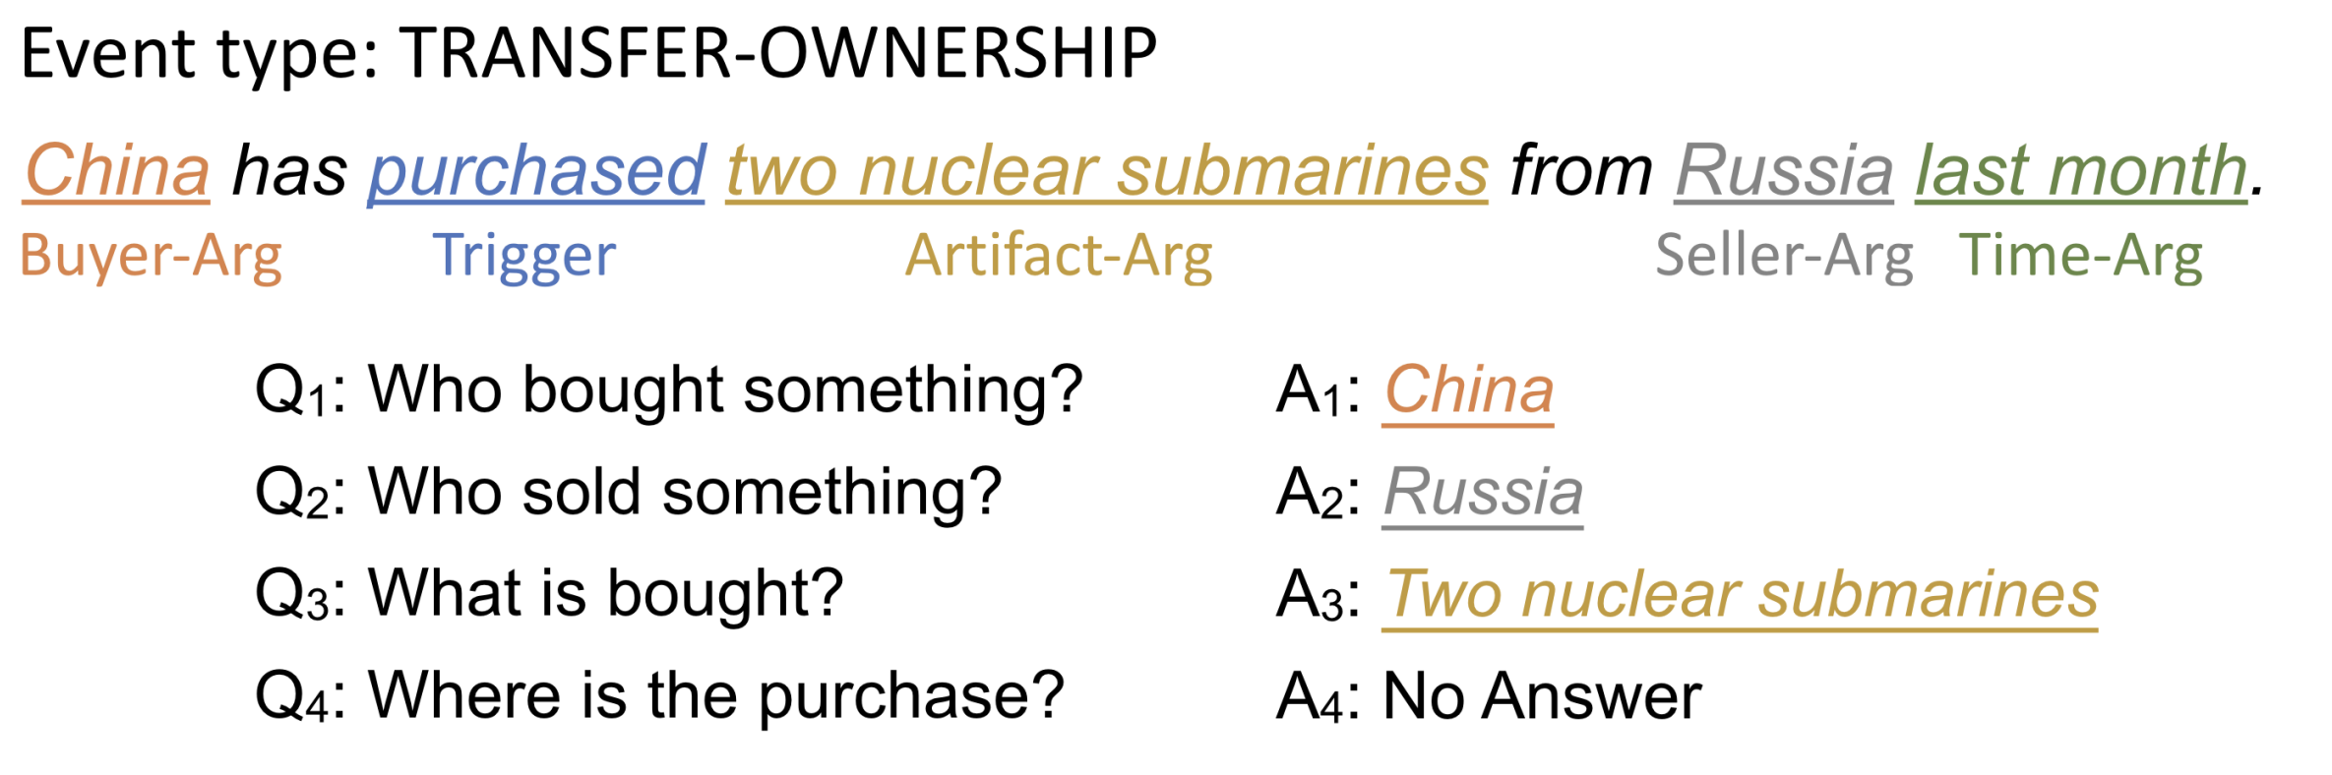
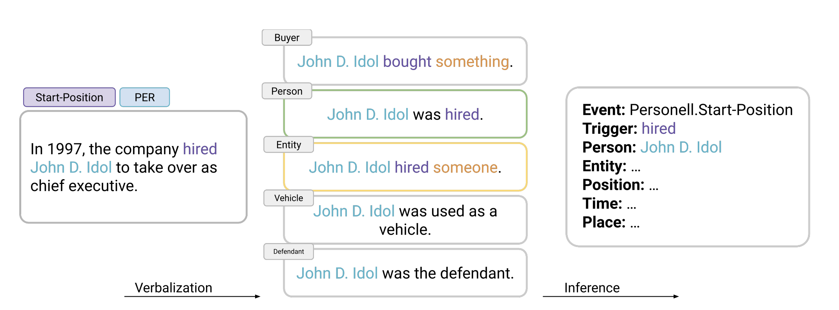
Indirect Supervision from NLI
Lyu et al. (2021), Sainz (2022)
  Event trigger / argument extraction via QA and NLI
  Better zero/few-shot performances
Trigger: this text is about a purchase (NLI)
Lyu et al. Zero-shot Event Extraction via Transfer Learning: Challenges and Insights. IJCNLP 2021
Sainz et al. Textual Entailment for Event Argument Extraction: Zero- and Few-Shot with Multi-Source Learning. NAACL 2022

Slide 69
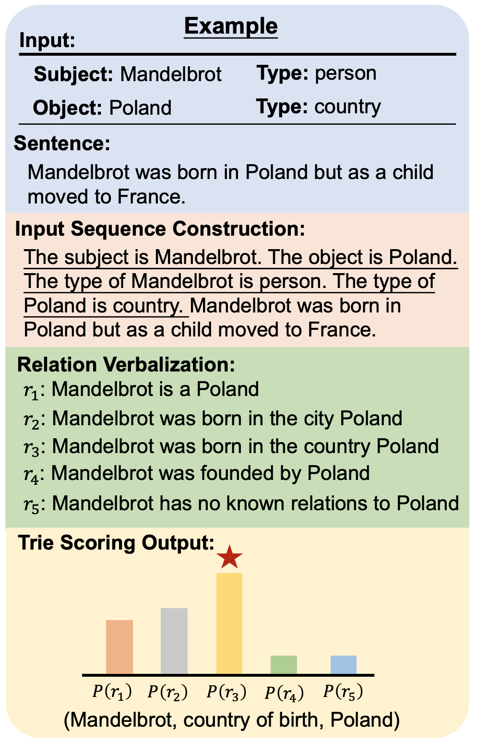
Indirect Supervision with Summarization
Summarization requires advanced reading comprehension
  Can also be tailored to specific tasks
Lu et al. (2022): Relation extraction as summarization
  Format input subject/object types as natural language
  Ask a summarization model to generate verbalized relations
Pre-trained on CNN/Dailymail (Hermann et al., 2015) and XSum (Narayan et al., 2021)
Lu et al. Summarization as Indirect Supervision for Relation Extraction. Arxiv 2022

Slide 70
Conclusion and Future Directions
Direct supervision is not the answer to all problems
Weak supervision
  Knowledge bases and dictionaries
  Label definitions
  Pre-trained language models
  Linguistic patterns
Indirect supervision
  From other task formulation
  From other task formulation and supervision
Future directions:
  Quantify task-task relations
  Unified framework

