Slide 1
Transfer Learning for IE
New Frontiers of Information Extraction (Part IV)
Heng Ji
Some slides from NAACL2022 Tutorial
July 2022
NAACL Tutorials
New Frontiers of Information Extraction

Slide 2

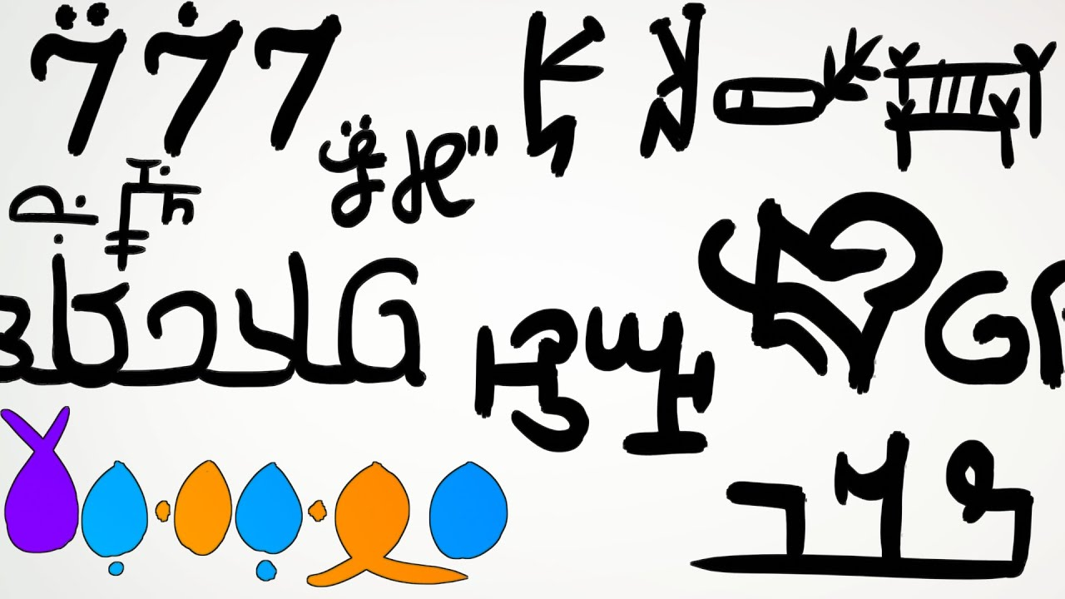

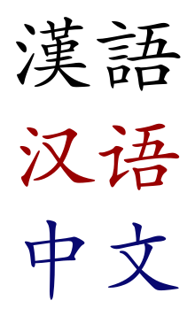



Why Transferability is Important
Current status of information extraction
  Domains: news, biomedical, clinical, legal, agriculture
  Languages: English, Chinese, Spanish, Arabic
  Number of Target Types: 3-100+ for entity recognition, ~100 for relation extraction, 33/38 for event extraction
However, for other languages and domains, learning resources are insufficient.
Transfer
High-resource domains
Low-resource domains

Slide 3
Challenge 1: Cross-type Transfer
How to transfer the knowledge and resources from old types to new types with little to no annotations?
  Type-agnostic semantic mapping between mentions and types – (common semantic space for both mentions and types)
  Type-agnostic inference from unstructured text to (structured) mentions
mentions
mentions
input text
input text
Question Answering
Semantic mapping
Semantic mapping
Textual Entailment
Inference
Inference
Generation
… ….
old types
new types
old typed mentions
new typed mentions

Slide 4
Challenge 2: Continual Learning
How to continually update the model on new annotations or tasks while retaining the capability learned from old tasks?
  Catastrophic Forgetting: the model’s performance on previously learned tasks significantly drops after it is trained on new data
    Solutions: experience replay, knowledge distillation, regularization, task-specific adapter
  Knowledge Transfer: transfer the knowledge from old tasks to new tasks
(Cao et al., 2020)
(Wiewel et al., 2019)

Slide 5
Cross-type Transfer: Type-agnostic Semantic Mapping
Learning label representations based on a few seed examples, e.g., triggers for event extraction, entity-relation instances for relation extraction
(Bronstein et al., 2015)
(Han et al., 2021)
semantic popularity
How to select the best seed examples?
TF-IDF
…

Slide 6
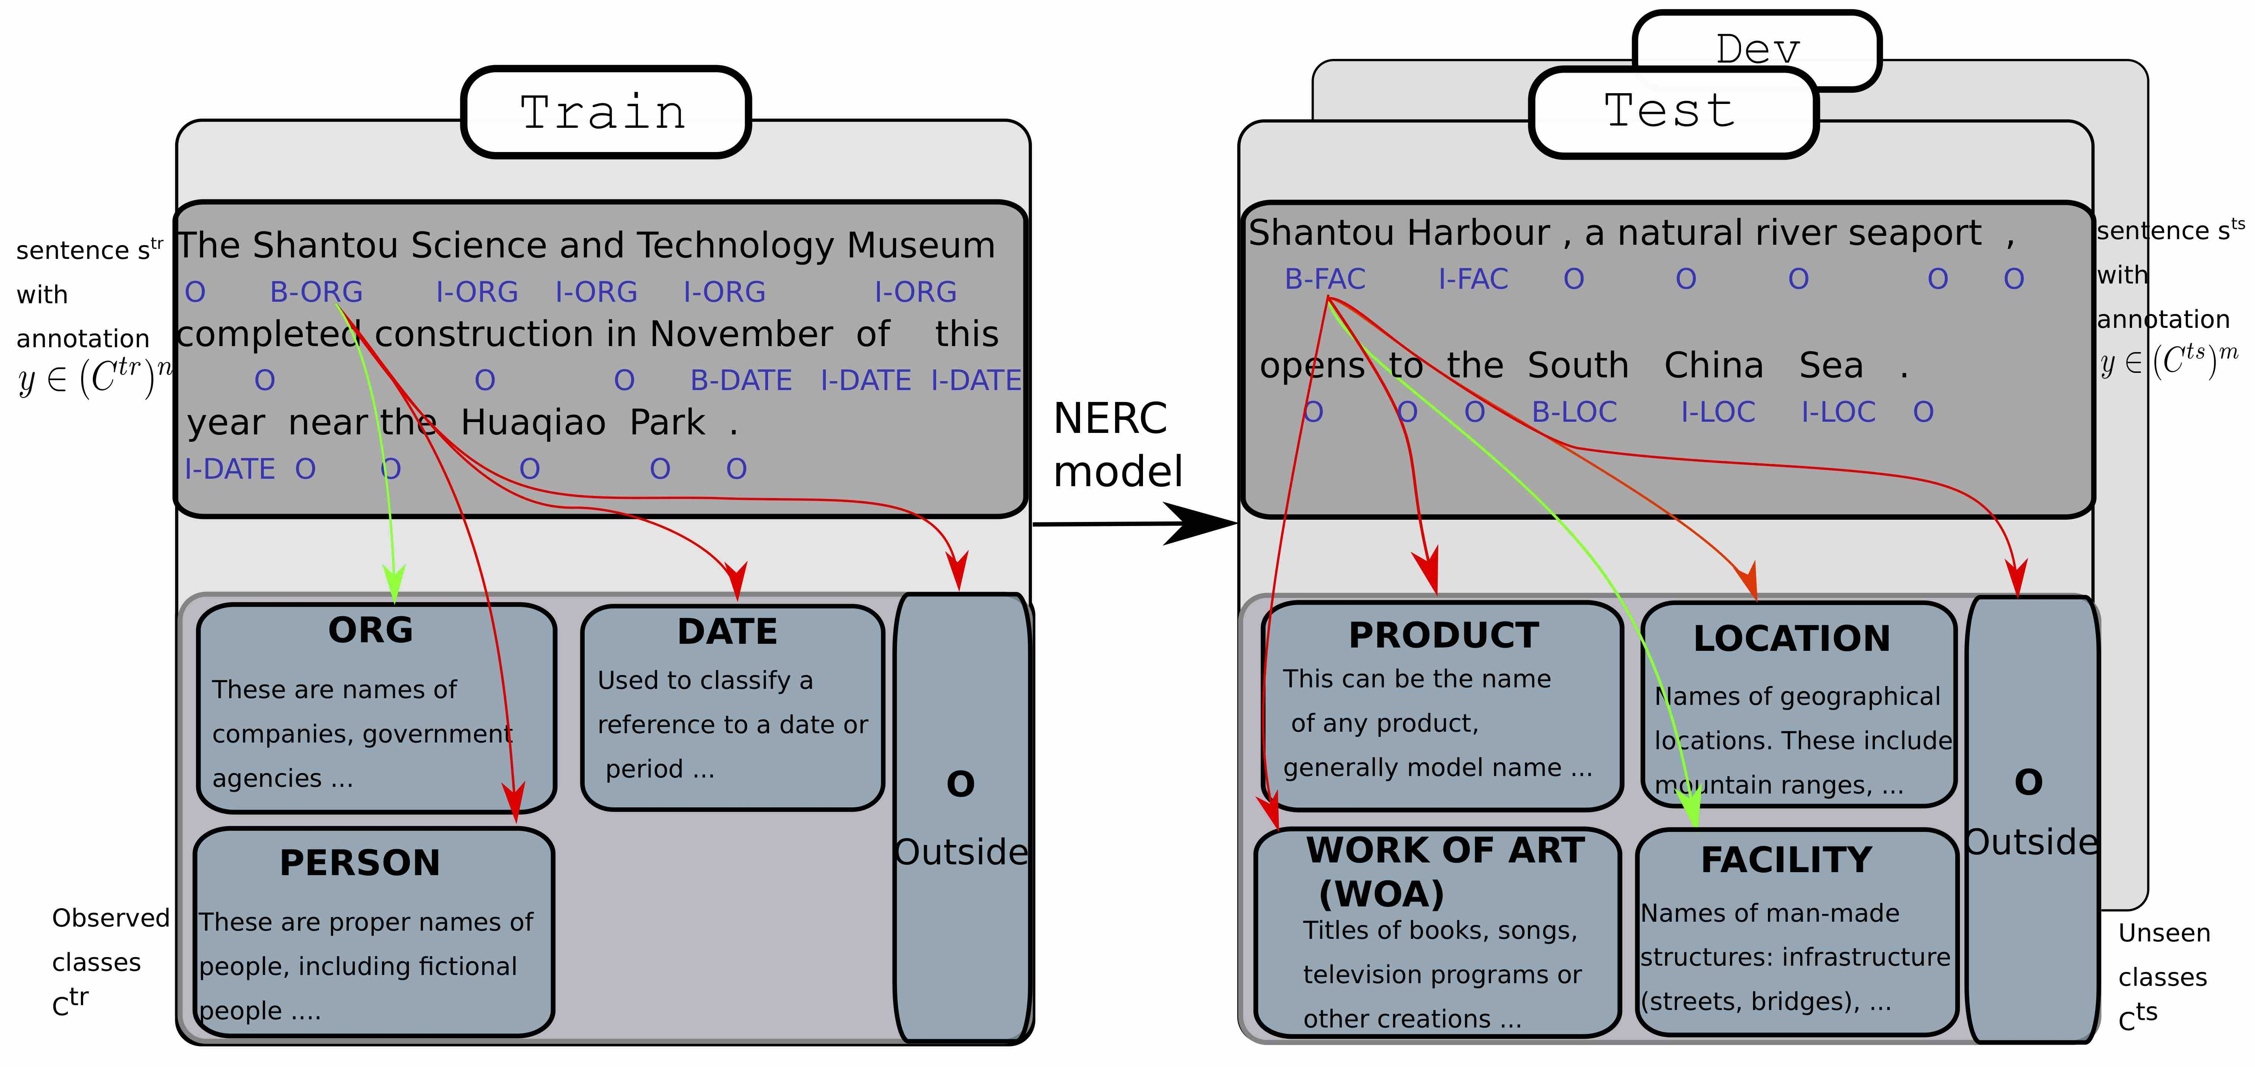
Cross-type Transfer: Type-agnostic Semantic Mapping
Learning label representations based on type descriptions
  Cross-attention Encoding: for each token in an input sentence, learn a type-specific representation by concatenating the sentence with the type description
  Modeling the negative class (other): for each token, learn a negative class specific representation based on the max-pooling of all type-specific representations
How to best describe the types?
(Aly et al., 2021)

Slide 7
Cross-type Transfer: Type-agnostic Semantic Mapping
Learning label and mention representations based on structures
New Event Mention
Available Annotations
Corporate sponsors contributed cash, mattresses, rice to reach remote Orang Asli villages.
\
Seen Types
Unseen Types
(Huang et al., 2018)
Large-Scale Target Event Ontology

Slide 8
Cross-type Transfer: Type-agnostic Semantic Mapping
Which form provides the best label representations?
  Detect mentions for each type by taking a type specific representation as a prompt (Wang et al., 2022)
(a) Type Name
(b) Seed Examples
(c) Definition
(d) Type Structure
(e) Soft Prompt
(f) APEX Prompt (
combination of a-d)
e.g., “Attack”

Slide 9
Cross-type Transfer: Type-agnostic Semantic Mapping
Which form provides the best label representations?
Seeds Triggers are not always selected as the best
  e.g., extermination for Life:Die
  e.g., paralyzed, dismember for Life:Injure
It’s hard to determine if the definition is appropriate
  e.g., “a person entity begins working or change office” for Personnel:Start-Position.
APEX Prompt generally performs well
Performance on all novel event types of ACE under Zero-shot transfer
(Wang et al., 2022)

Slide 10
Cross-type Transfer: QA-based Event Extraction
Questions are constructed based on templates for each role and the predicted answer serves as the extracted argument (Du and Cardie, 2020)
  The input sequences for the two QA models share a standard BERT-style format: [CLS] <question> [SEP] <sentence> [SEP]
Questions for events
Questions for arguments

Slide 11
Cross-type Transfer: QA-based Event Extraction
Questions can also be automatically generated in an unsupervised way (Liu et al., 2020)
Template-based query topic
Context-dependent expression

Slide 12
Cross-type Transfer: QA-based Event Extraction
Query and Extract: directly take event type and argument roles as query to extract event triggers and arguments (Wang et al., 2022).
1. Encode a sentence and a type-specific query together
2. Learn a type-specific contextual rep. for each token based on attention mechanisms
3. Predict a binary label for each token

Slide 13
Cross-type Transfer: QA-based Event Extraction
Query-and-Extract: rely more on semantic mapping between mentions and types rather than machine reading comprehension (Wang et al., 2022)
Pros
  Does not require any questions created for event types or argument roles
  Can extract arguments for all possible argument roles at one time
Cons
  Cannot leverage available annotations for question answering
Model | Trigger Extraction | Argument Extraction
BERT_QA (Du and Cardie, 2020) | 31.6 | 17.0
Query_and_Extract (Wang et al., 2022) | 47.8 | 43.0
Performance on all novel event types of ACE under Zero-shot transfer (Wang et al., 2022)

Slide 14
Summary – Cross-type Transfer
 | Pros | Cons
Semantic Mapping | Easy to setup; Require minimal resource; | Difficult to find the globally optimal form to represent the target types;
Question Answering
Generation

Slide 15
Summary – Cross-type Transfer
 | Pros | Cons
Semantic Mapping | Easy to setup; Require minimal resource; | Difficult to find the globally optimal form to represent the target types;
Question Answering | Can leverage large-scale QA datasets; Leverage the inference capability of pre-trained language models; Does not require entity extraction for event extraction task; | Require template or auto-generated questions as input, however it’s hard to determine the optimal questions; High computational cost as it can only extract for one event type or argument role at each time;
Generation

Slide 16
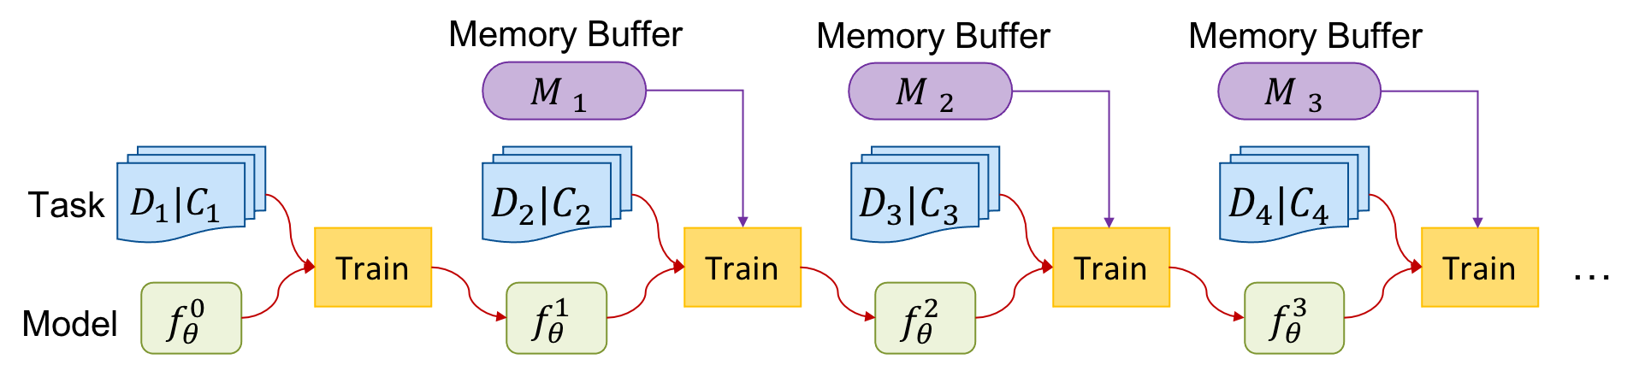
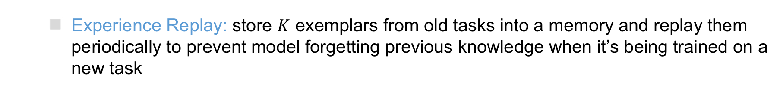
Continual Learning for IE
How to mitigate the catastrophic forgetting?
  Experience Replay: store $K$ exemplars from old tasks into a memory and replay them periodically to prevent model forgetting previous knowledge when it’s being trained on a new task
  Knowledge Distillation: if a model extracts similar features or makes similar predictions for the same input as the old model, we can assume it preserves the knowledge
  Task-specific Adapter: incrementally adding task-specific tunable parameters for each new task while fixing other parameters

Slide 17
Continual Learning for IE
How to select examples?
Selecting the examples that are closer to the prototype of each old type
Removing the examples that are far from the prototype of each old type
Eval Types
Attack
Attack, Meet
(Cao et al., 2020)
Attack, Meet,
Die
Knowledge
distillation
Feature-level Distillation: encourage the new model to extract similar features for the same input as the original model
Prediction-level Distillation: encourage the new model to make similar predictions for the same input as the original model

Slide 18
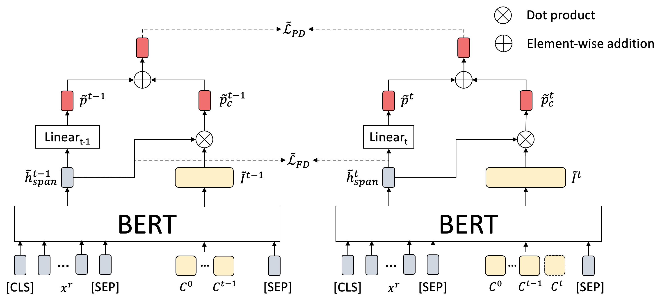
Continual Learning for IE
Episodic Memory Prompting (EMP): incrementally integrating the representations of new labels for each new task
prediction-level distillation
feature-level
distillation
  type representations, which are initialized by the event type names
(Liu et al., 2022)

Slide 19


Continuous Learning for IE
Knowledge Transfer (Yu et al., 2021)
  Event detection: inner product between a token embedding and type embeddings
  New → Old: Use new data to update the knowledge of old model by self-training
  Old → New: Transfer old knowledge to new types by initializing the type embeddings for new types based on learned types
Self-training: encouraging the probability of each instance from the new task over old types to be consistent between the old and new models
Pseudo label dist. from old model
Label dist. from new model
Inst. from new task
Old label embeddings
1. learn new type embeddings based on old types
$x_{i}$: an inst. from new type
$c$: the embedding of an old type
2. learn new type embeddings from new instances
$x_{i}$: embedding of $x_{i}$ from BERT
$p(c^{∅}|x_{i})$: how much $x_{i}$ is different from old types

Slide 20
Lifelong IE with Expanded Ontology
Continually update trained IE model with new training data for new types
  Only use annotations for new types to update the model
Event
Event
Life
Conflict
Life
Conflict
Life.Die
Life.Die
Life.Born
Conflict.Attack
Event
Life
Conflict
Contact
Life.Die
Life.Born
Conflict.Attack
Contact.Meet

Slide 21
Event
Types in ACE
Life
Conflict
Contact
Die
Born
Attack
Meet
Types in AIDA
Event
Life
Conflict
Contact
Disaster
Die
Born
Attack
Meet
Disease Outbreak
Emerging New Types of Interest
Related Semantics
Invade
New Fine-grained Types
Relatives in Hierarchy

Slide 22
Comparison with Class Incremental Lifelong Learning
Class Incremental Lifelong Learning: learning classification on expanding number of classes
What is special about ontology-based IE compared with classification?
Fundamental Difference: existence of negative instances, Not-Any-type (NA), in extraction task
Additional Challenge: long-tail distribution of knowledge element types

Slide 23

Negative Instance in Lifelong IE
Two kinds of negative mentions:
  Baghdad: contextual text spans that don’t imply any events
  fired: other event types that are not learned yet
If new types are in close domain with old types, negative mentions may also contain old event types. Annotators may only focus on annotating new types and ignore them.
Event
Life
Conflict
Life.Die
Conflict.Attack
Not Learned
In Baghdad, a cameraman died when a combat tank fired on the Palestine Hotel.

Slide 24
Additional Challenge: Long-tail Distribution of Knowledge Types
Re-balancing among all types (old and new types) tackles catastrophic forgetting in lifelong learning, under the assumption of balanced priors
Knowledge types in natural language are naturally imbalanced, which breaks the assumption
  EEIL (Castro et al., 2018), BIC (Wu et al., 2019) are state-of-the-art methods with additional re-balancing techniques compared with baseline, which don’t improve performance due to over-balancing
Long-tail Distribution on Event Type
Mentions (MAVEN¹ Dataset)
[1] Xiaozhi Wang, Ziqi Wang, Xu Han, Wangyi Jiang, Rong Han, Zhiyuan Liu, Juanzi Li, Peng Li, Yankai Lin, and Jie Zhou. 2020. MAVEN: A massive general domain event detection dataset. abs/2004.13590.

Slide 25
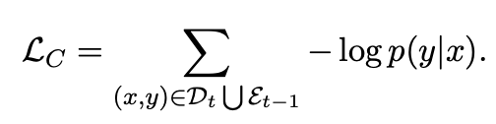
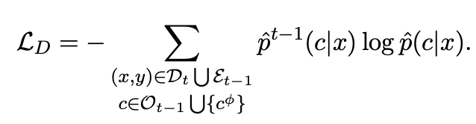
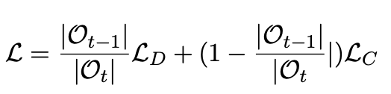

Lifelong Event Detection Architecture
Problem formulation
A stream of datasets $\left\{D_{t}\right\}$ is provided to the model sequentially
Each training instance is labeled with event types from the set$C_{t}=\left\{c_{t}^{1},c_{t}^{2},…, c_{t}^{n_{t}}\right\}$ and NA, denoted as $c_{φ}$.
At stage $t$, the model needs to detect events for the combined ontology
$$O_{t}=C_{1}∪C_{2}…∪C_{t}$$
Training:
Experience Replay: augment $D_{t}$with an exemplar set $ε_{t−1}$
Knowledge Distillation (Retain old knowledge):

Slide 26
Knowledge Transfer for Lifelong Learning
Leverage rich connections between event types in the ontology
Event
Life
Conflict
Contact
Life.Die
Life.Born
Conflict.Attack
Contact.Meet
Relatives in Hierarchy
Related Semantics

Slide 27
Overall Framework
Two-way Knowledge Transfer
New → Old: Use new data to update old knowledge by self-training
Old → New: Use old knowledge to help learning new types by knowledge-aware initialization of new weights

Slide 28
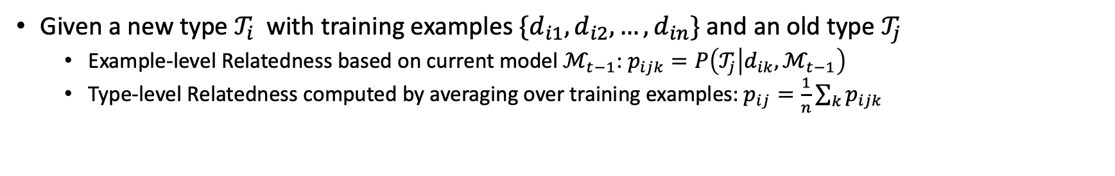
Knowledge Transfer: Type Relatedness
Given a new type $𝒯_{i}$ with training examples $\{d_{i1}, d_{i2}, …, d_{in}\}$ and an old type $𝒯_{j}$
  Example-level Relatedness based on current model $ℳ_{t−1}$: $p_{ijk}=P\left(𝒯_{j} | d_{ik},ℳ_{t−1}\right)$
  Type-level Relatedness computed by averaging over training examples: $p_{ij}=\frac{1}{n}\sum_{k}{p_{ijk}}$

Slide 29
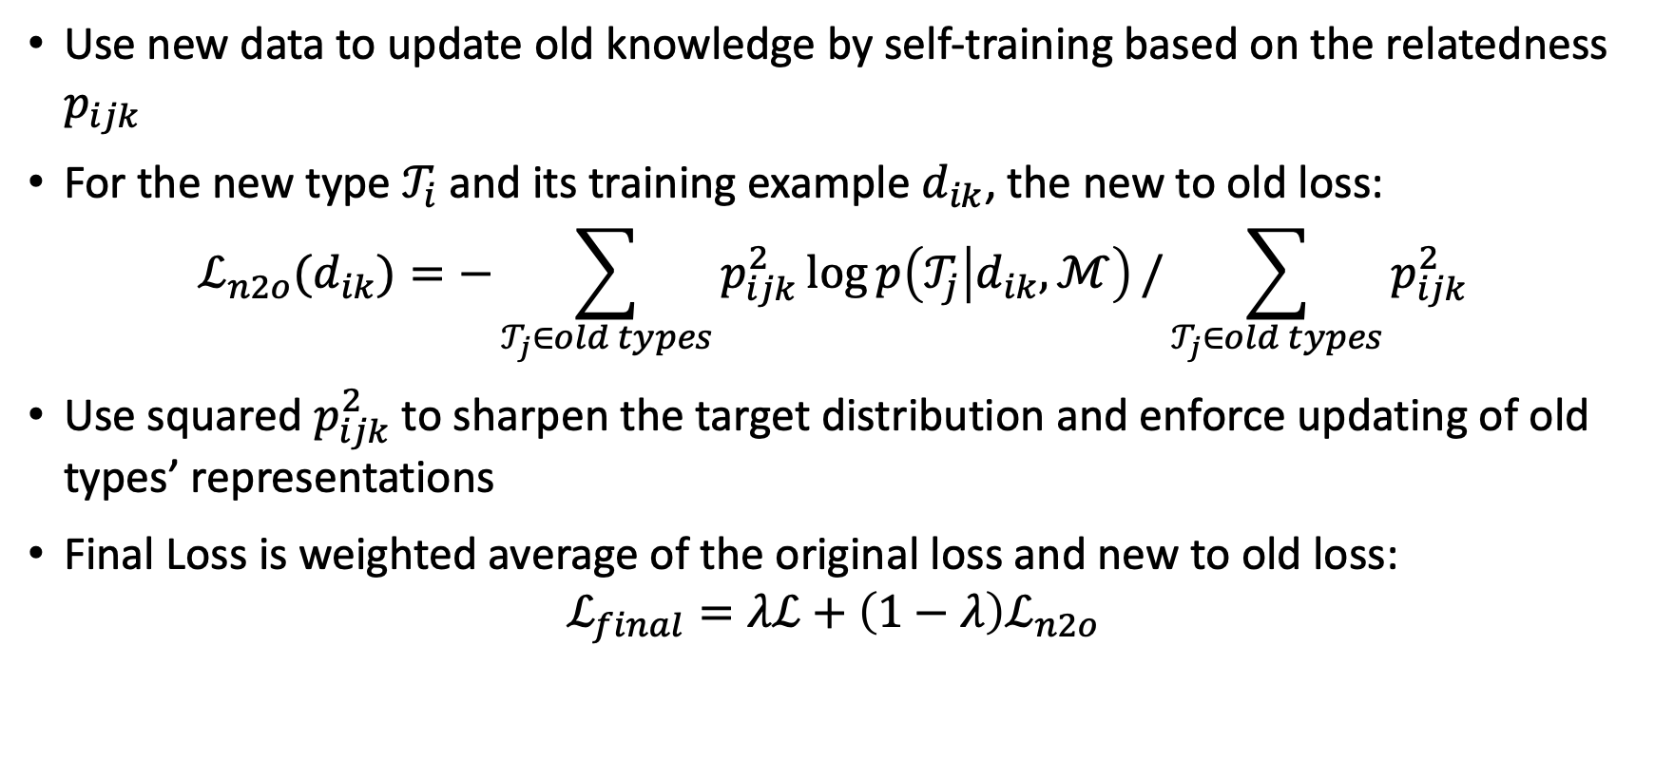
Knowledge Transfer: New to Old
Use new data to update old knowledge by self-training based on the relatedness $p_{ijk}$
For the new type $𝒯_{i}$ and its training example $d_{ik}$, the new to old loss:
$$ℒ_{n2o}(d_{ik})=−\sum_{𝒯_{j}∈old types}{p_{ijk}^{2}\log{p\left(𝒯_{j} | d_{ik},ℳ\right)}}/\sum_{𝒯_{j}∈old types}{p_{ijk}^{2}}$$
Use squared $p_{ijk}^{2}$ to sharpen the target distribution and enforce updating of old types’ representations
Final Loss is weighted average of the original loss and new to old loss:
$$ℒ_{final}=λℒ+\left(1−λ\right)ℒ_{n2o}$$

Slide 30
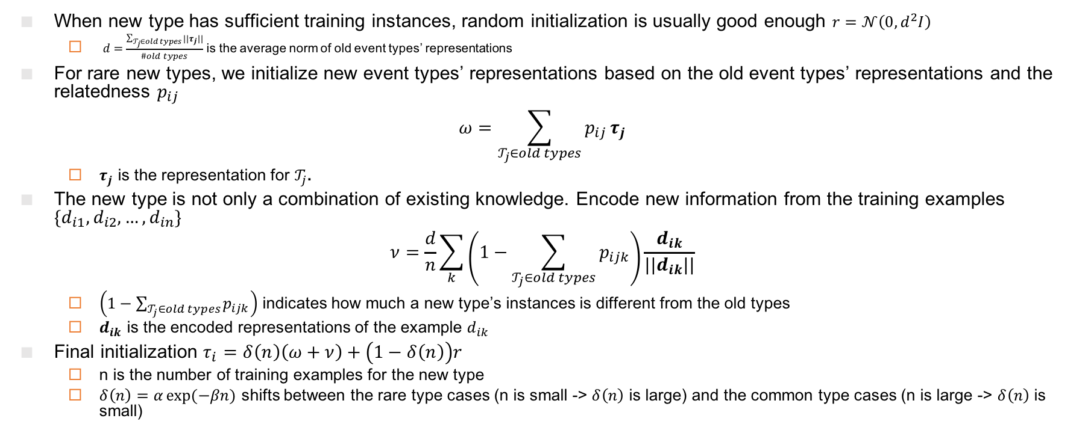
Knowledge Transfer: Old to New
When new type has sufficient training instances, random initialization is usually good enough $r=𝒩\left(0, d^{2}I\right)$
  $d=$ $\frac{\sum_{𝒯_{j}∈old types}{||τ_{j}||}}{\#old types}$ is the average norm of old event types’ representations
For rare new types, we initialize new event types’ representations based on the old event types’ representations and the relatedness $p_{ij}$
$$ω=\sum_{𝒯_{j}∈old types}{p_{ij}}τ_{j}$$
  $τ_{j}$ is the representation for $𝒯_{j}$.
The new type is not only a combination of existing knowledge. Encode new information from the training examples $\{d_{i1}, d_{i2}, …, d_{in}\}$
$$ν=\frac{d}{n}\sum_{k}{\left(1−\sum_{𝒯_{j}∈old types}{p_{ijk}}\right)\frac{d_{ik}}{||d_{ik}||}}$$
  $\left(1−\sum_{𝒯_{j}∈old types}{p_{ijk}}\right)$ indicates how much a new type’s instances is different from the old types
  $d_{ik}$ is the encoded representations of the example $d_{ik}$
Final initialization $τ_{i}=δ\left(n\right)\left(ω+ν\right)+\left(1−δ\left(n\right)\right)r$
  n is the number of training examples for the new type
  $δ\left(n\right)=α\exp{(−βn)}$ shifts between the rare type cases (n is small -> $δ\left(n\right)$ is large) and the common type cases (n is large -> $δ\left(n\right)$ is small)

Slide 31
Continuous Learning for IE
Knowledge Transfer Improves Learning on Old and New Types (Yu et al., 2021)
Comparing with baseline (KD+R), Knowledge transfer improve performance on both new and old types
Old
  More improvements on rare new types, showing that sharing knowledge can help learning long-tail events
New
New Rare
  Old: old types learned in previous stages
  New: new types learned in this stage
  New Rare: new types with fewer than 120 training mentions
  Downside: all these approaches require to store exemplars from old tasks, which is not realistic

Slide 32
Where Are We Today
 |  | 2012 | 2022 | 2042 (Projected Goal)
Portability | # Languages | 1-3 | 300 for entity and event detection | 6000 for entity and event detection
 | # Entity types | 5 | 16,000 | 16,000 for 6000 languages
 | # Relation types | 41 | 2,000 for English | 2,000 for 300 languages
 | # Event types | 33 | 1,000 for English | 1,000 for 300 languages
Quality F-score (no manual annotations) |  | 0% | Up to 76% F-score for low-resource name tagging | 100% for English, 90+% for other languages
Development Time |  | Half a year for anyone with a laptop | A few months for a handful of groups with computing resources | A few hours for anyone with a smart phone
Cost |  | Supervised models based on 500 fully annotated documents | No annotation for new language/domain | No or few annotations for any language, domain or modality

Slide 33
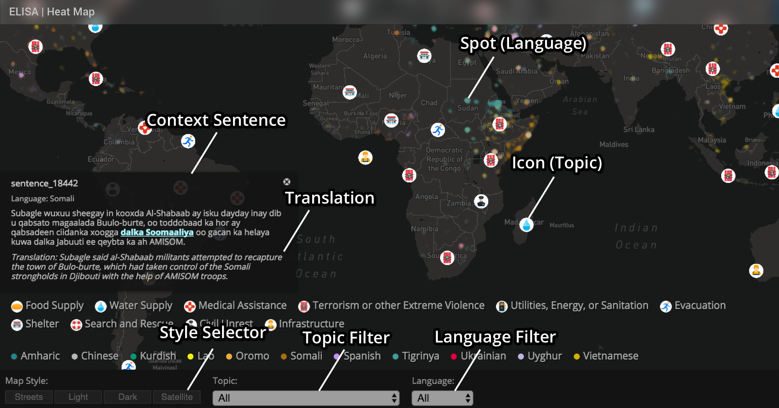
Application 1: Monitoring Disasters Reported in 287 Languages
Re-trainable Systems: http://159.89.180.81:3300/elisa_ie/api
Demos: http://159.89.180.81:3300/elisa_ie
Heat map: http://159.89.180.81:8080/
Notes:
deployed

Slide 34
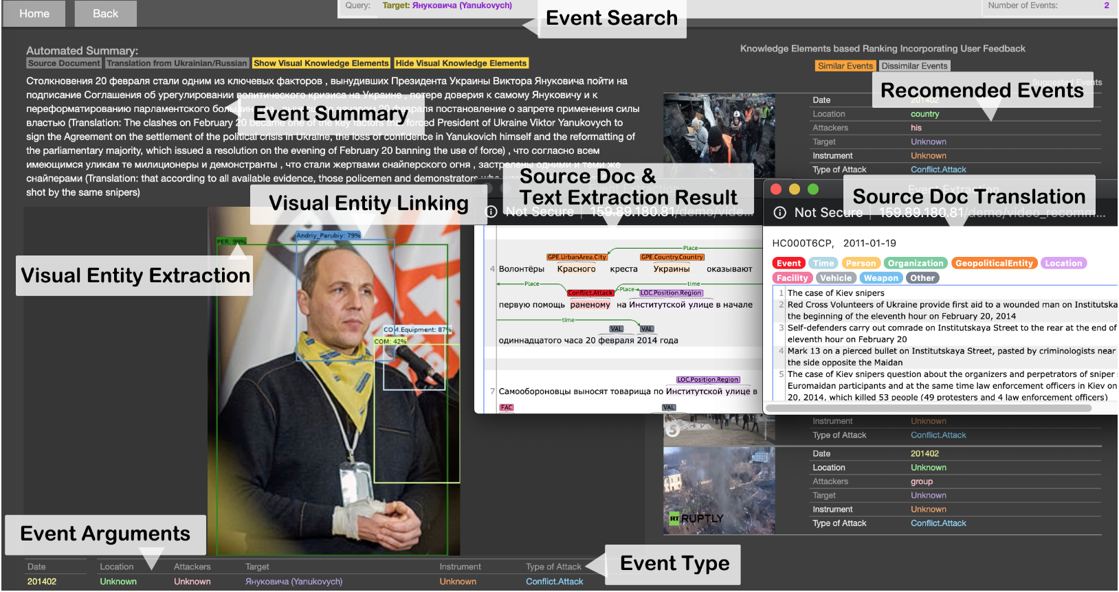
Application 2: Analyzing International Conflicts
(Li et al., ACL2020 Best Demo Paper Award)
GitHub: https://github.com/GAIA-IE/gaia
DockerHub: https://hub.docker.com/orgs/blendernlp/repositories
Demo: http://159.89.180.81/demo/video_recommendation/index_attack_dark.html

Slide 35
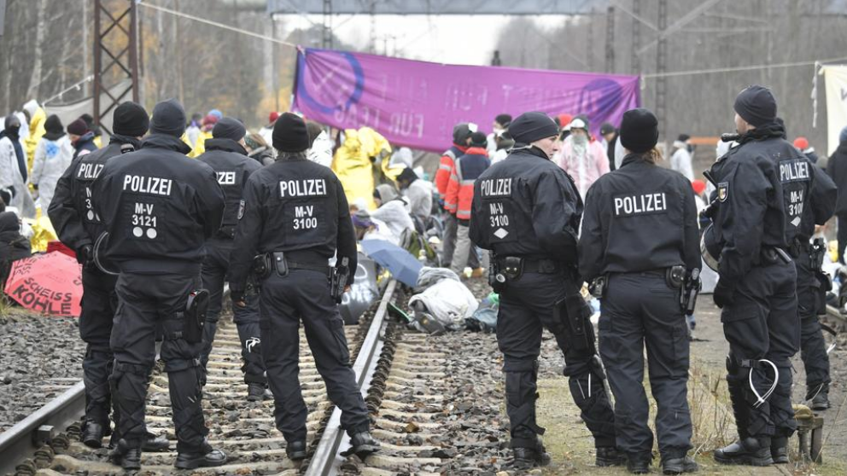
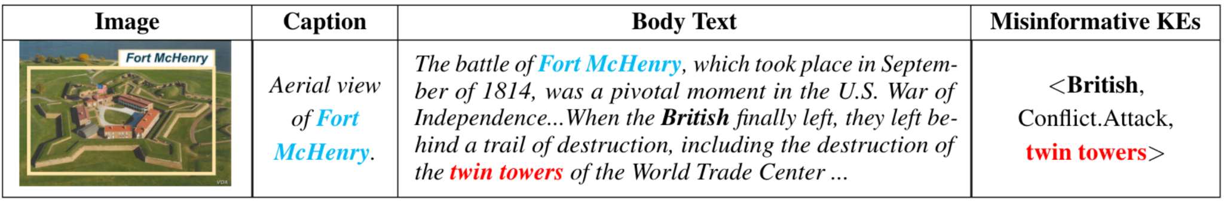
Application 3: Fine-grained Misinformation Detection
Detect fake news by checking cross-media knowledge element inconsistency [Fung et al., 2021]
Police officers watch over climate activists from Ende Gelaende as they block train tracks next to Jaenschwalde power plant in eastern Germany on November 30, 2019
In coal we trust: Australia’s voters back PM Scott Morrison’s faith in fossil fuel

Slide 36
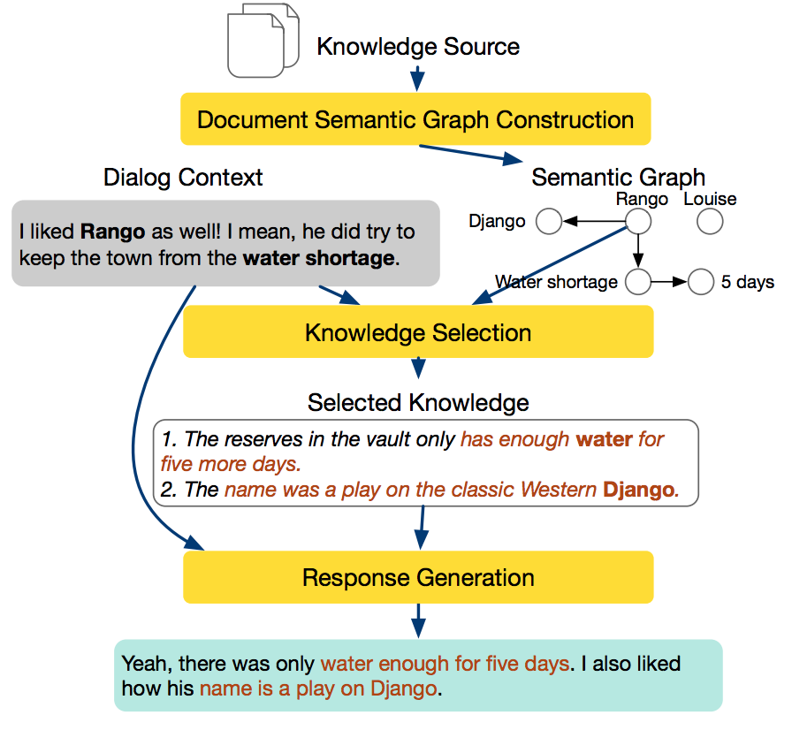
Application 4: Knowledge-guided Dialog Systems
Make the dialog system as knowledgeable as your best friend in the book club [Li et al., NAACL2022]

Slide 37
Remaining Challenge 1: Lack of Knowledge Reasoning
Requires global knowledge aggregation and reasoning
  Contaminated food from Haiti could enter the Dominican Republic
  The contaminated lobster and other food, drinks, and ice served at the wedding were provided by the catering company at Casa de Campo
  More than 300 wedding guests, including a 30-year-old Massachusetts man and others, ate lobster contaminated with cholera at Casa de Campo
  A 30-year-old man went to the emergency room of Massachusetts General Hospital
  A Massachusetts 30-year-old man was diagnosed with cholera in Massachusetts and at Massachusetts General Hospital
  Purchase.agent = the catering company instead of the 30-year-old man
  The 30-year-old man = Sue.plaintiff instead of Sue.defendant

Slide 38
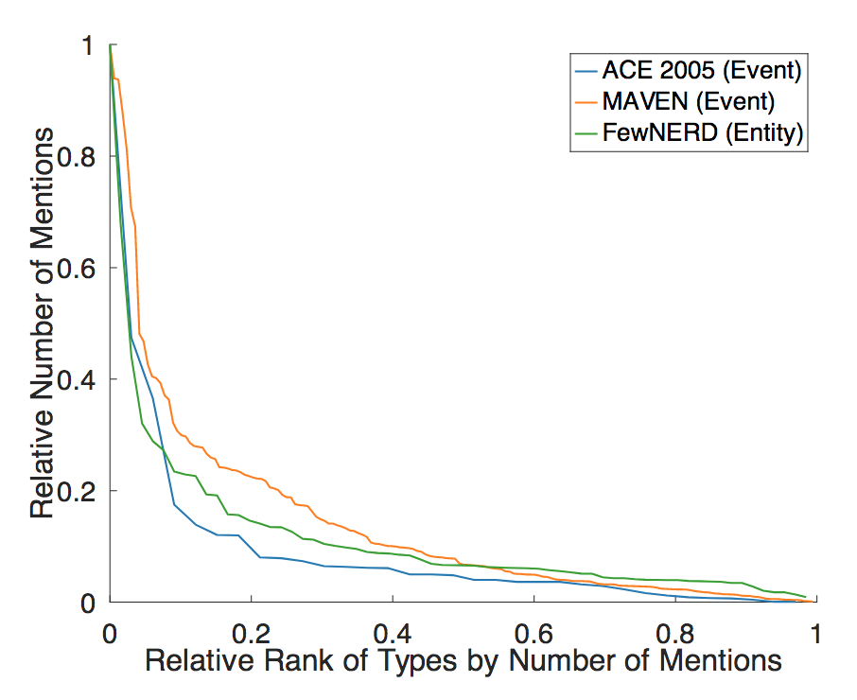
Remaining Challenge 2: The Unsolved “Long-Tail” Problem
Rare Triggers
  his men back to their compound
  A suicide bomber detonated explosives at the entrance to a crowded
  medical teams carting away dozens of wounded victims
  Today I was let go from my job after working there for 4 1/2 years.
  This morning in Michigan, a second straight night and into this morning,
  hundreds of people have been rioting in Benton harbor.
Rare Arguments
  He called the case and I'm quoting now, a judge's worst nightmare, but he noted that Maryland Parole Boards and the facility where Michael Serious was held, the institution made what the judge called the final decision on whether to release serious [release-parole_person].
  A source tell US Enron is considering suing its own investment bankers for giving it bad financial advice [Sue_crime].

Slide 39
Future Direction 1: Corpus-Level IE
1996: Pattern based Corpus-level IE [Grishman and Sundheim, 1996]
2004: Maximum Entropy based Sentence-level IE [Florian et al., 2004]
2016: Bi-LSTM based Sentence-level IE [Lample et al., 2016]
2020: BERT based Sentence-level IE [Lin et al., 2020]
2021: Text generation based Document-level IE [Li et al., 2021]
2022 and Beyond: Text generation based Corpus-level IE?
39

Slide 40
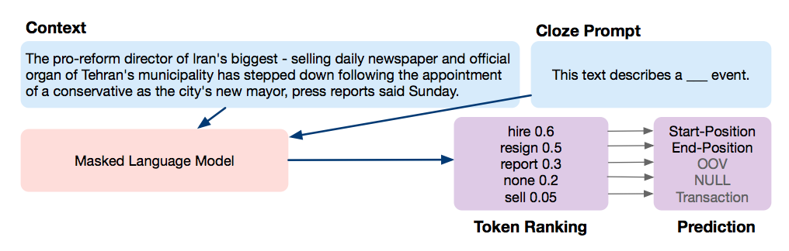
Future Direction 2: Revisit Open-World IE
In the village of Vorzel, 31 miles northwest of Kyiv, Russian soldiers threw a smoke grenade into a basement, then ______ a woman and a 14-year-old child as they emerged from the basement, where they had been _______.
Attack event
Shelter event
Toward bottom-up event discovery by clustering and LM based generalization
[Li et al., arxiv2022]

Slide 41
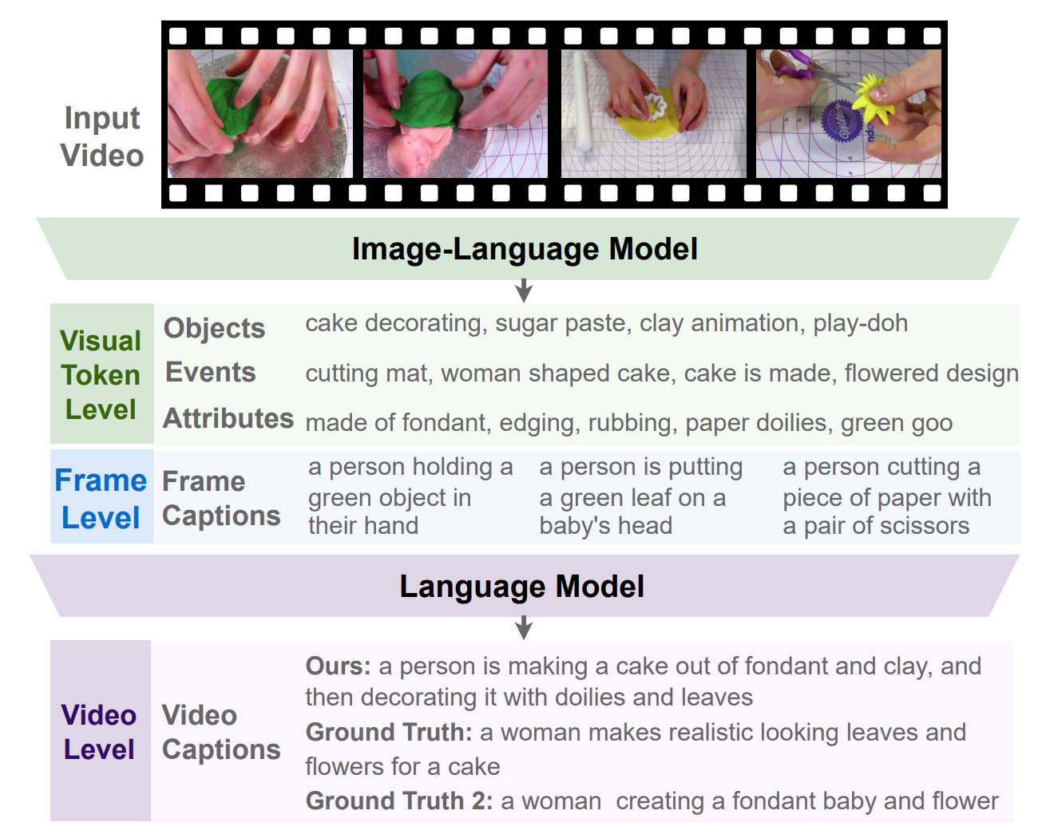
Future Direction 3: Multimedia Information Extraction and Grounding
Pay more attention to videos which include richer dynamic information [Wang et al., arxiv2022]

Slide 42
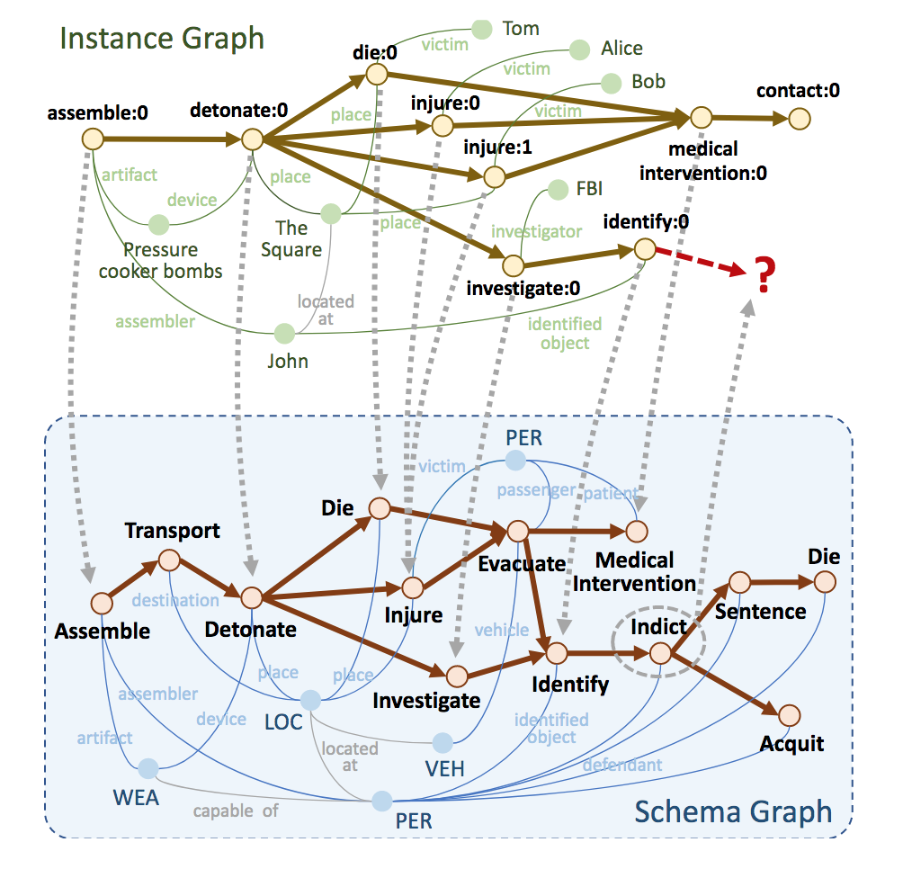
Future Direction 4: Predicting the Future
Our brain organizes events into structures [Richmond and Zacks, 2017], and generalize them into schema knowledge for recollection of events [Sargent et al., 2013]
Schemas can guide us to write a history book and forecast the future [Li et al., 2021]
42

Slide 43
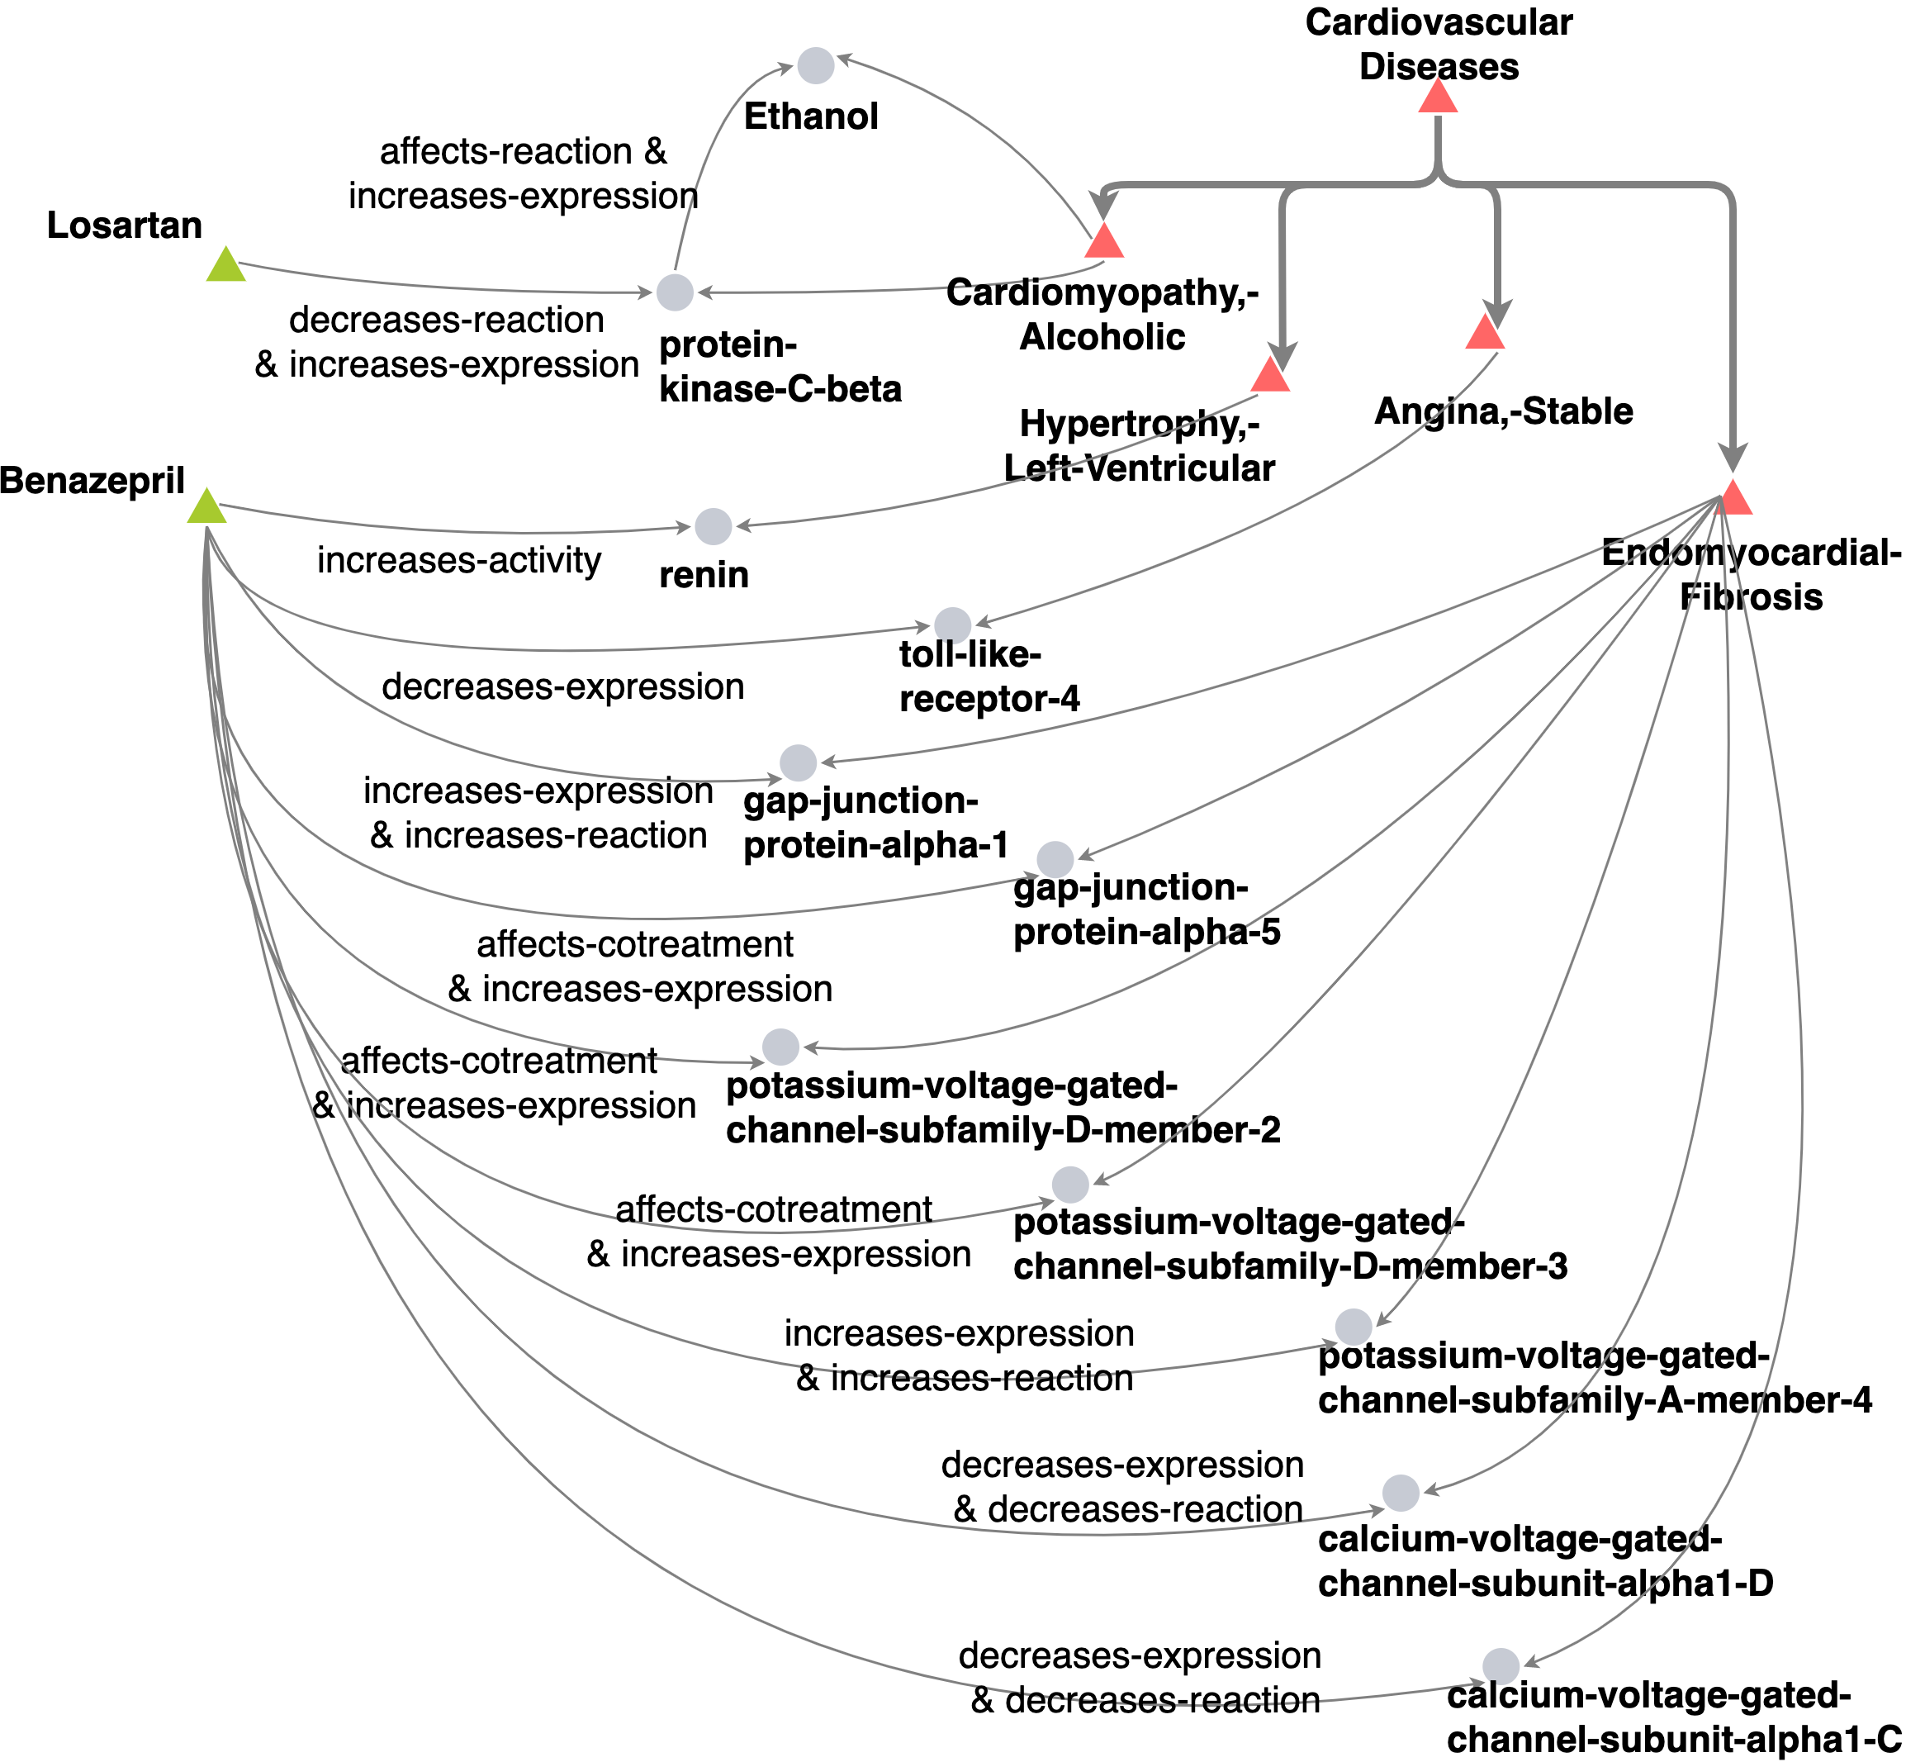
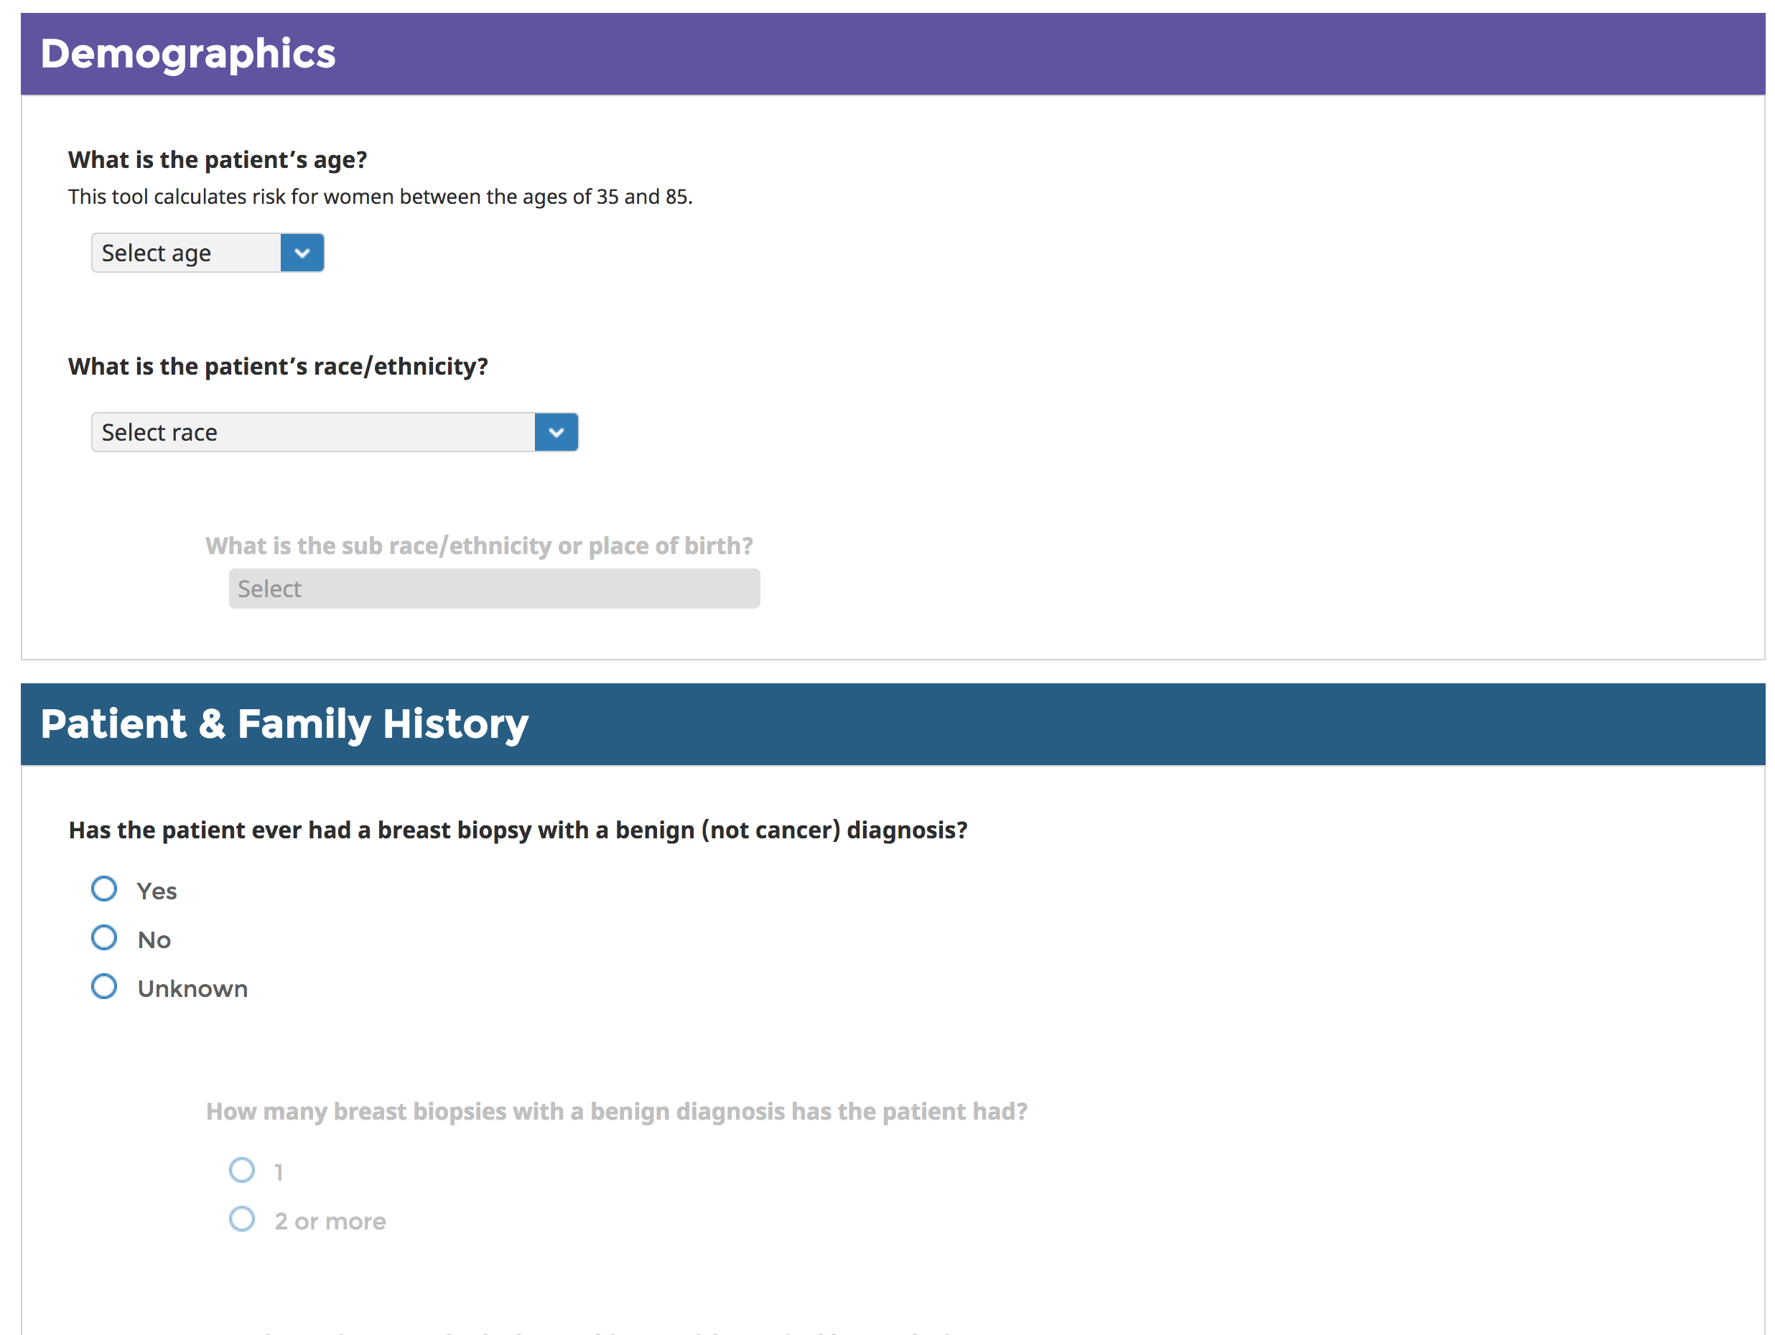
Future Direction 5: Apply Our Success to Social Good
Cancer Predictor Today
What we should/could do

Slide 44

Thank You
44

