Slide 1
Scientific Information Extraction
Heng Ji
Some slides are from our KDD2022 Tutorial

Slide 2
Scientific Information Extraction and Analysis
Unique Challenges for Scientific Information Extraction
Leverage existing knowledge bases for weak supervision
Developed multimodal definition powered entity representation
Incorporate external knowledge via entity linking
Capture complex sentence structures

Slide 3
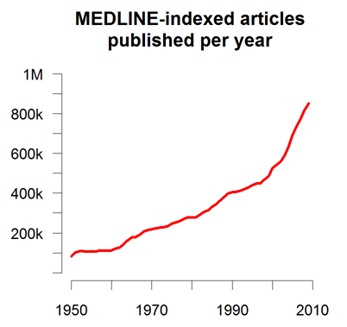
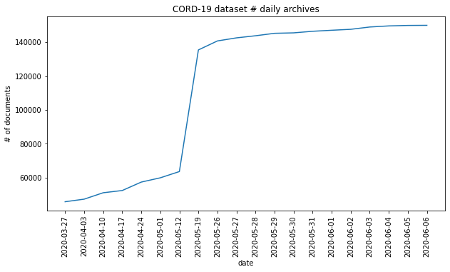
Problem: Too Many papers
Quantity: More than 500K papers are published at PubMed every year
Quality: Given the rapid publications of preprints without peer reviews, many research results are redundant, complementary or even conflicting with each other
Human’s reading ability keeps almost the same across years
Notes:
More than 500K papers are published at PubMed every year, and more than 1.2 million new papers are published in 2016 alone, bringing the total number of papers to over 26 million (Van Noorden, 2014)
As of June 13, 2020, there are at least 140K papers about coronavirus
Quality: Given the rapid publications of preprints without peer reviews, many research results are redundant, complementary or even conflicting with each other
Human’s reading ability keeps almost the same across years: US scientists estimated that they read, on average, only 264 papers per year (1 out of 5000 available papers, the same across years)
300 papers… every day… impossible to read… keyword search… abstract doesn’t reflect… results; ignore most of them. Cancer and surgery… 3 days… walk through all posters.. In our field papers that were published twenty years ago are not that important…
including mining PubMed bibliographic data, research papers in PubMed, clinical data sets and numerous bio-medical websites and social media related to medical sciences, where data related to diseases, drugs, treatments, chemical compounds, proteins, genes, biological pathways can be integrated and extracted from text data and their characteristics and relationships can be mined from such datasets as well
. Older literature is often extremely important (and overlooked), and indeed, often provides a rich source of information that can lead to new hypotheses. This makes the information overload problem event more serious, because we need distill and connect knowledge from papers that may cover 70 years.

Slide 4
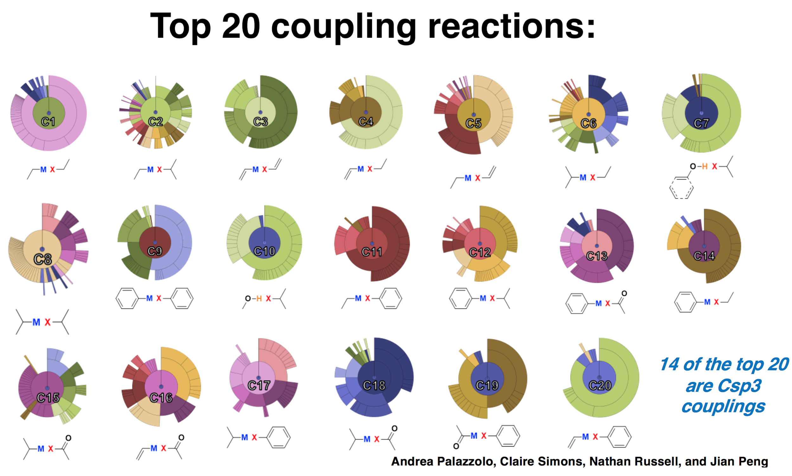
How Modern Scientists Design Their Experiments
Most of the current scientific experiments are still based on manual design
No literature search engines support complex cross-media retrieval
BioNLP shared tasks mainly cover biomedical papers, but very limited papers are about chemistry or other science domains
Notes:
To tackle these two challenges, we propose a new framework COVID-KG to accelerate scientific discovery and build a bridge between clinicians and biology scientists.
COVID-KG starts by reading existing papers to build multimedia knowledge graphs (KGs), in which nodes are entities/concepts and edges represent relations and events involving these entities, extracted from both text and images.
Given the knowledge graphs enriched with path ranking and evidence mining, COVID-KG answers natural language questions effectively.
Our system has several contributions.
Firstly, we use new distantly supervised, refined fine-grained extraction and typing to help Knowledge Graph construction.
Secondly, we use chemical graph parsing and image analysis to enable multi-media common semantic space construction and new hierarchical embedding for graph neural networks-based knowledge extraction and entity resolution.
The third innovation is that we adopt Domain-specific ontology and database guided knowledge enrichment for joint neural end-to-end entity/relation/event extraction; Our COVID’19 Knowledge graph receives more than 500downloads
We also apply Generative Adversarial Networks for data augmentation by regarding samples generated by the generator as negative samples to train the discriminator
Finally, we adopt Weakly-supervised automated taxonomy construction, and taxonomy-guided, theme-based multidimensional document classification and text summarization

Slide 5
BioNLP Community Efforts
BioNLP Workshops (https://aclweb.org/aclwiki/BioNLP_Workshop)
  Entity identification and normalization (linking) for a broad range of semantic categories; Extraction of complex relations and events; Discourse analysis; Anaphora/coreference resolution; Text mining / Literature based discovery; Summarization; Τext simplification; etc.
BioCreative (https://biocreative.bioinformatics.udel.edu/)
  Named entity recognition, relation extraction, text classification, etc.
BioASQ (http://bioasq.org/)
  Biomedical semantic indexing and question answering
Lack of community efforts in other science domains (chemistry, physics, geoscience, etc.)

Slide 6
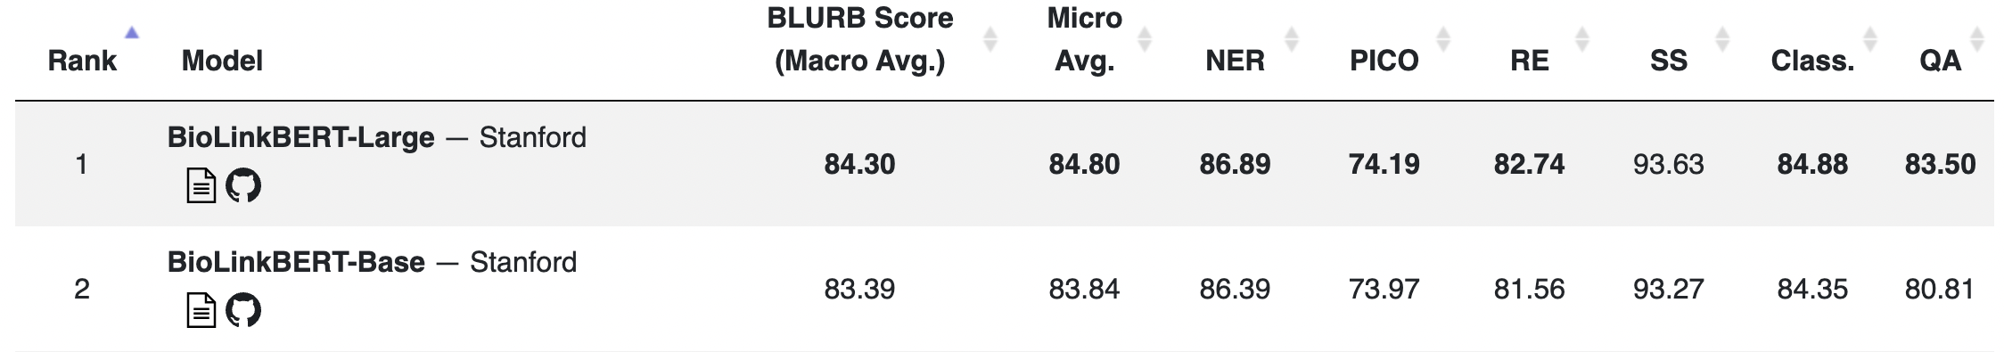
Pre-Trained Scientific Language Models
Biomedicine Domain:
  BioBERT, SciBERT, ClinicalBERT, PubMedBERT, BioELECTRA, BioLinkBERT
  BLURB: Biomedical Language Understanding and Reasoning Benchmark (https://microsoft.github.io/BLURB/)
Chemistry Domain:
  ChemBERT: chemistry literature
  ChemBERTa: SMILE strings of molecule structures

Slide 7
Unique Challenges of Scientific Information Extraction
Lack of human annotations for various science domains
  Not feasible to ask scientists provide annotation in every domain
  Leverage existing knowledge bases for weak supervision
Multi-modal representations of scientific knowledge
  Developed multimodal definition powered entity representation
Lack of specialized domain knowledge in natural language context
  Incorporate external knowledge via entity linking
Complex sentence structures in scientific writing
  Capture complex sentence structures with AMR parsing
Notes:
Add roadmap, major challenges in scientific literature mining, highlight novel techniques in this tutorial

Slide 8
Scientific Information Extraction and Analysis
Unique Challenges for Scientific Information Extraction
Leverage existing knowledge bases for weak supervision
Developed multimodal definition powered entity representation
Incorporate external knowledge via entity linking
Capture complex sentence structures

Slide 9


Challenge 1: Lack of Human Annotations
Text Corpus
Knowledge Bases
Entity Dictionary
ID | Sentence
S1 | There are many similarities of SARS-CoV-2 with the original SARS-CoV.
S2 | SARS-CoV spike protein has a strong binding affinity to human ACE2.
S3 | A phylogenetic analysis [3, 4] found a bat origin for the SARS-CoV-2.
… | …
Distant Supervision
Coronavirus
SARS-CoV
MERS-CoV
……
Candidate Type
Target Type Hierarchy
Root
…
ID | Sentence
S1 | There are many similarities of SARS-CoV-2 CORONAVIRUS with the original SARS-CoV CORONAVIRUS.
S2 | SARS-CoV spike protein GENE_OR_GENOME has a strong binding affinity to human ACE2 GENE_OR_GENOME.
S3 | A phylogenetic analysis [3, 4] found a bat WILDLIFE origin for the SARS-CoV-2 CORONAVIRUS.
… | …
Gene
Organism
Chemical
Disease
…
…
…
Bacterium
Virus
Eukaryote
…
…
Arterivirus
Coronavirus
Torovirus
…

Slide 10
Named Entity Recognition with Distant Supervision
Three challenges for distant supervision:
  Missing Annotation: entities are completely missed in the KBs
    There are many similarities of [SARS-CoV-2]_{CORONAVIRUS} with the original SARS-CoV.
  Partial Annotation: entities are partially matched in the KBs
    Although each of the agents alone caused only slight increase in [[alanine]_{CHEMICAL} aminotransferase]_{PROTEIN} …
  Multi-Type Annotation: entities matched to multiple types in the KBs
    Although it was necessary to employ a stoichiometric quantity of [palladium]_{CATALYST, TRANSITION METAL}, it is …

Slide 11
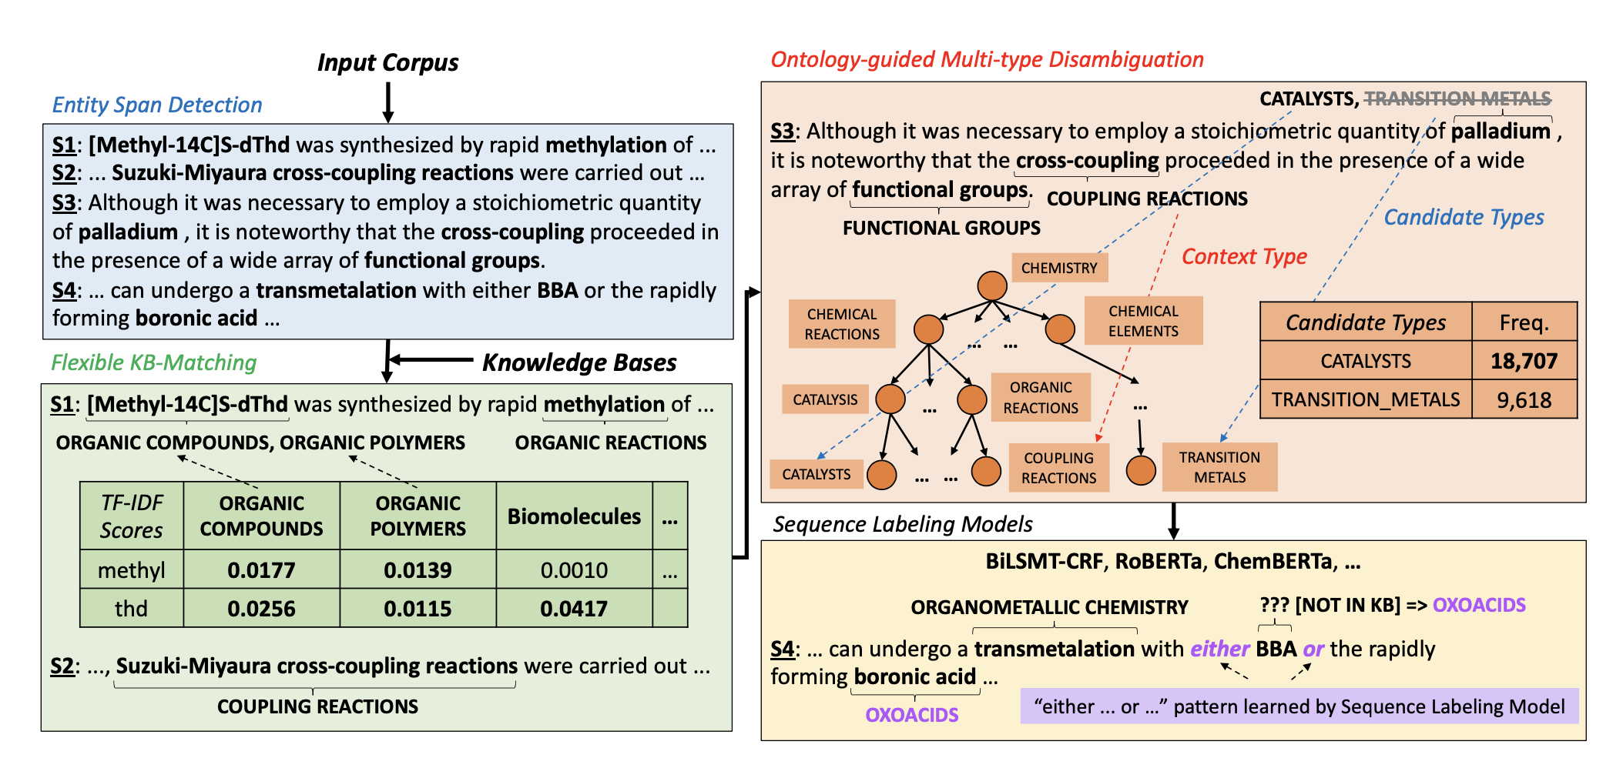
ChemNER: Fine-Grained Chemistry Named Entity Recognition with Ontology-Guided Distant Supervision [Wang et al, EMNLP’21]

Slide 12

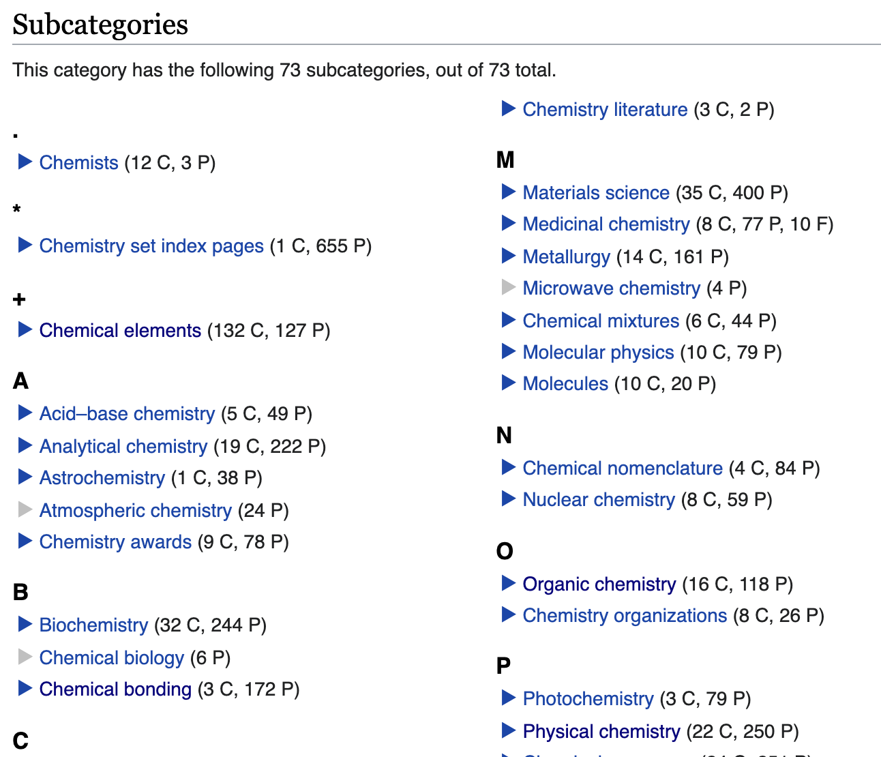
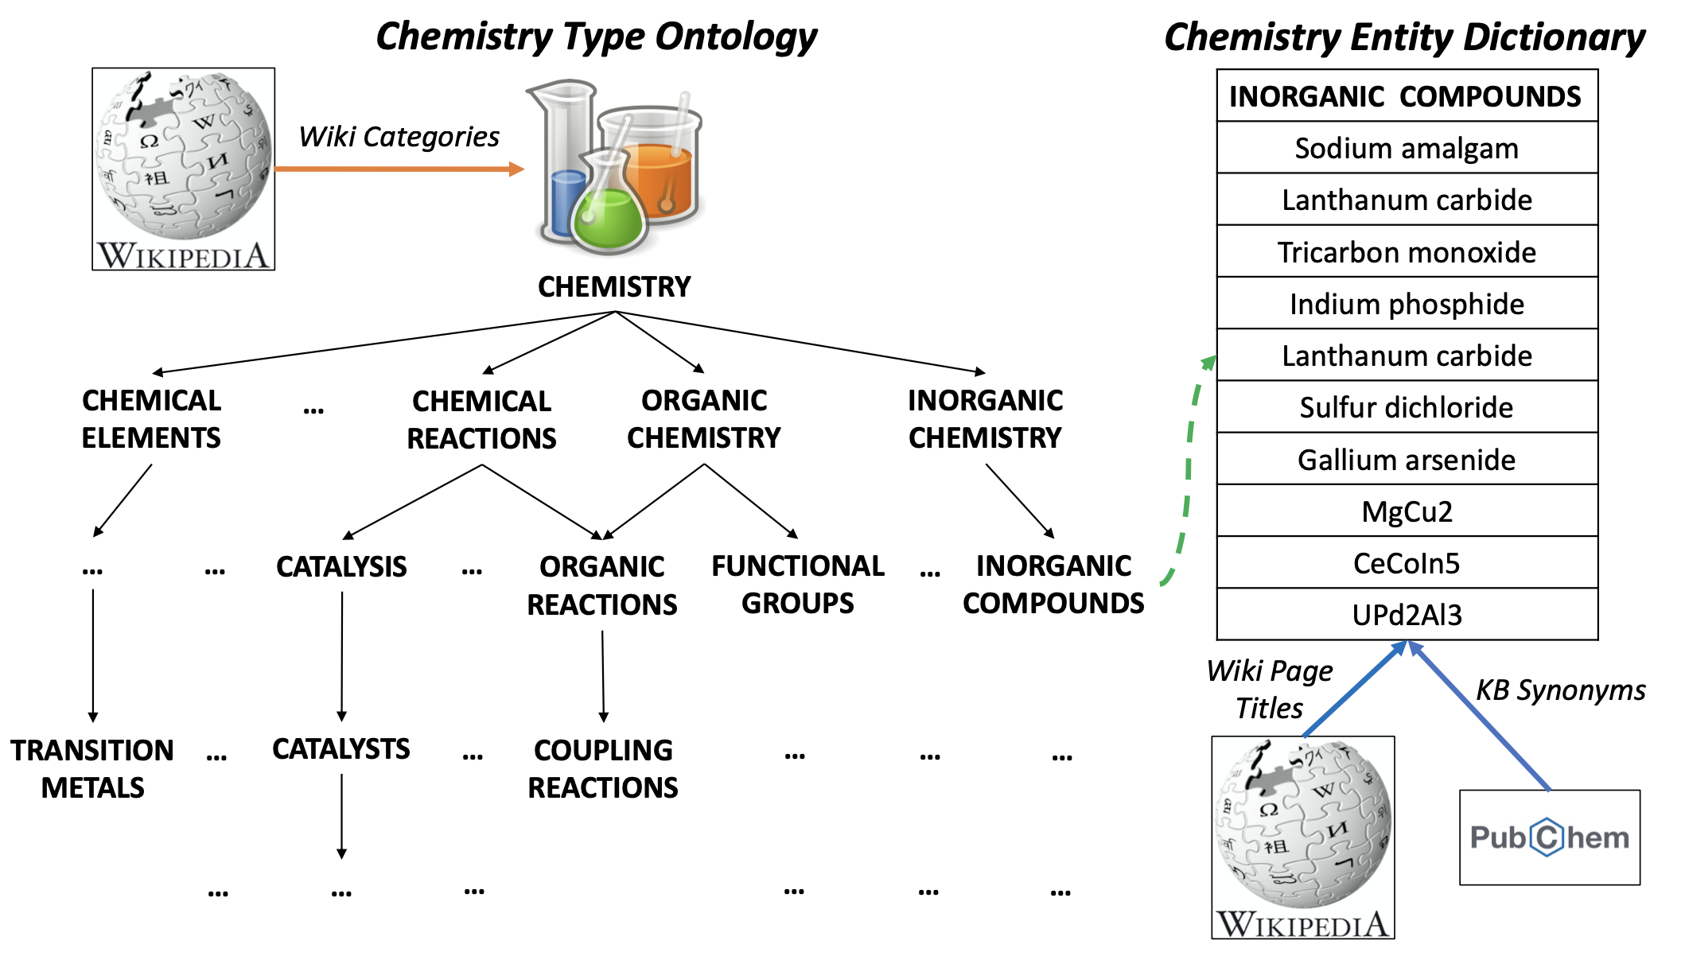
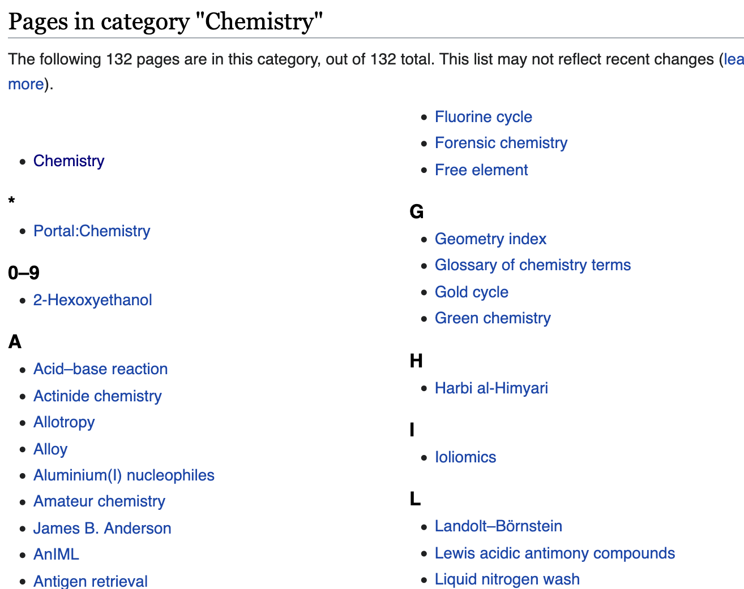
Chemistry Ontology
Fine-grained chemistry type ontology:
  Wikipedia categories rooted under Chemistry
  Categories => Entity Types
  Associated Page Titles => Entity Dictionaries
  Expert proved 62 fine-grained types

Slide 13
Ontology-Guided Multi-Type Disambiguation
Key idea: the entities in the same sentence, paragraph or document usually follow a focused topic
CATALYST, TRANSITION METAL
Although it was necessary to employ a stoichiometric quantity of palladium , it is noteworthy that the cross-coupling proceeded in the presence of a wide array of functional groups.
COUPLING REACTION
FUNCTIONAL GROUP
Context Type
Chemistry
Candidate Types
Chemical Reaction
Chemical Element
…
…
CATALYSIS
…
ORGANIC
REACTION
…
Catalyst
…
…
COUPLING
REACTION
TRANSITION METAL
Notes:
Change type names to singular form

Slide 14
Ontology-Guided Multi-Type Disambiguation
Key idea: the entities in the same sentence, paragraph or document usually follow a focused topic.
CATALYST, TRANSITION METAL
Although it was necessary to employ a stoichiometric quantity of palladium , it is noteworthy that the cross-coupling proceeded in the presence of a wide array of functional groups.
COUPLING REACTIONS
FUNCTIONAL GROUPS
Context Type
Chemistry
Candidate Types
Chemical Reaction
Chemical Element
…
…
CATALYSIS
…
ORGANIC
REACTION
…
Catalyst
…
…
COUPLING
REACTION
TRANSITION METAL

Slide 15

Ontology-Guided Multi-Type Disambiguation
Key idea: the entities in the same sentence, paragraph or document usually follow a focused topic.
CATALYST, TRANSITION METAL
Although it was necessary to employ a stoichiometric quantity of palladium , it is noteworthy that the cross-coupling proceeded in the presence of a wide array of functional groups.
COUPLING REACTIONS
FUNCTIONAL GROUPS
Context Type
Chemistry
Candidate Types
Chemical Reaction
Chemical Element
…
…
CATALYSIS
…
ORGANIC
REACTION
…
Catalyst
…
…
COUPLING
REACTION
TRANSITION METAL

Slide 16
Sequence Labeling Model
The flexible KB-matching and multi-type disambiguation cannot cover all the new entities in the corpus
Train a sequence labeling model to further improve the recall
  RoBERTa (Liu et al., 2019), ChemBERTa (Chithrananda et al., 2020)

Slide 17
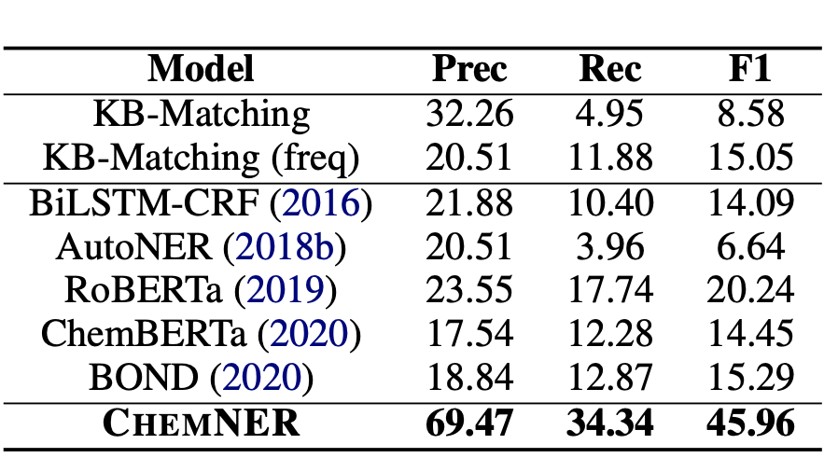
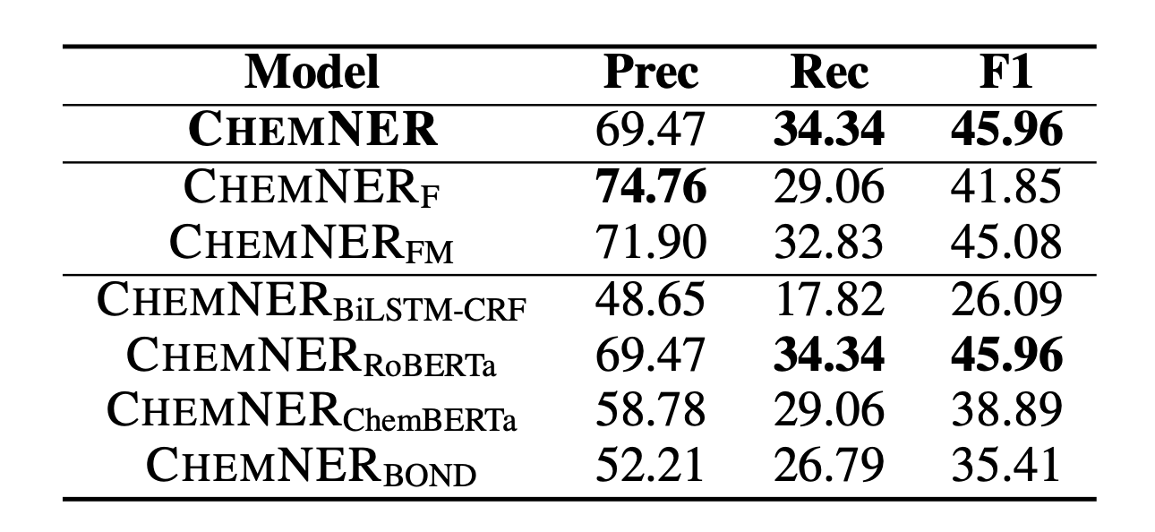
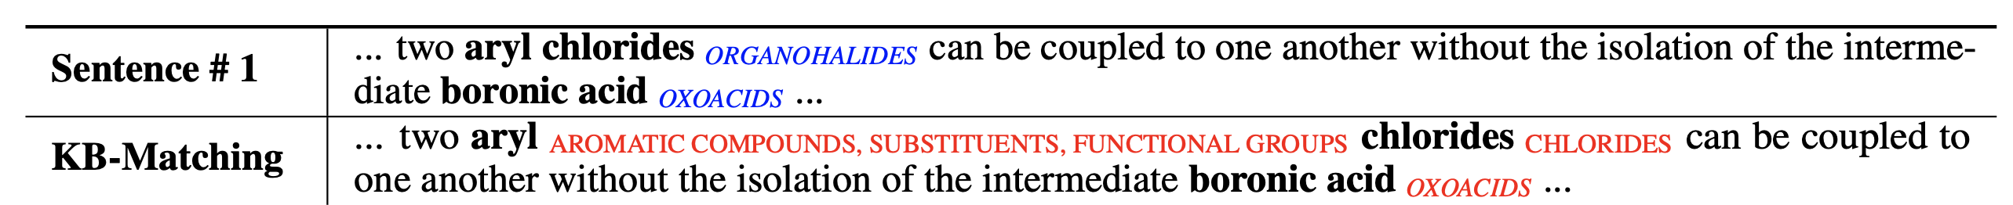
Experiment Results
ChemNER achieves .25 absolute F1 score improvement over the best performing baseline model RoBERTa
+25%↑

Slide 18
Scientific Information Extraction and Analysis
Unique Challenges for Scientific Information Extraction
Leverage existing knowledge bases for weak supervision
Developed multimodal definition powered entity representation
Incorporate external knowledge via entity linking
Capture complex sentence structures

Slide 19
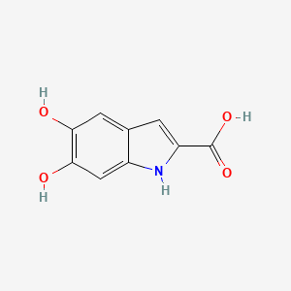
5,6-DIHYDROXY-1H-INDOLE-2-CARBOXYLIC ACID
Challenge 2: What’s in a chemical entity?
Natural Language Definition: 5,6-dihydroxyindole-2-carboxylic acid is a dihydroxyindole that is indole-2-carboxylic acid substituted by hydroxy groups at positions 5 and 6. It has a role as a mouse metabolite. It is a conjugate acid of a 5,6-dihydroxyindole-2-carboxylate. It is a tautomer of a dopachrome.
Natural Language Context: Tautomerization of dopachrome to 5,6-dihydroxyindole-2-carboxylic acid (DHICA) is a biologically crucial reaction relevant to melanin synthesis, cellular antioxidation, and cross-talk among epidermal cells.
Chemical entity mentions are essentially rare terms that cannot be learned well by only language model
  Chemical entities are often complex formula-like names
  Many chemicals simply have never been coined with any nomenclature in natural language

Slide 20
5,6-Dihydroxy-1H-indole-2-carboxylic acid
Property Name | Property Value
Molecular Weight | 193.16
XLogP3-AA | 1.2
Hydrogen Bond Donor Count | 4
Hydrogen Bond Acceptor Count | 4
Rotatable Bond Count | 1
Exact Mass | 193.03750770
Monoisotopic Mass | 193.03750770
Topological Polar Surface Area | 93.6 Å²
Heavy Atom Count | 14
Formal Charge | 0
Complexity | 245

Slide 21



Chemical Reactant Entity Classification
Reaction Groups
C1 Reaction
sp³-sp³ Suzuki cross-coupling
Chemistry
Knowledge
M: Primary Boronate
X: Primary Alkyl Halide
Time and Labor Consuming
Human Supervision
Chemical Names
A palladium-catalyzed Suzuki coupling of the 3-diethylboranylpyridine and a Stille cross-coupling of the corresponding ……
The reactions of 1-iodoadamantane and neopentyl iodide with carbanion ……
Scientific Literature

Slide 22
ReactClass: Cross-Modal Supervision for Subword-Guided Reactant Entity Classification
Automatic Training Data Creation:
  Observation: Each chemical molecule can be represented in two modalities: a chemical name in text and a molecular structure in graph
  Solution: Cross-Modal Supervision of Molecular Structure Matching
Knowledge-Aware Model Design:
  Observation: There is a strong subword correlation between the chemical names to be classified and the reactant group names as labels
  Solution: Subword Cross-Attention-Guided Entity Classification

Slide 23
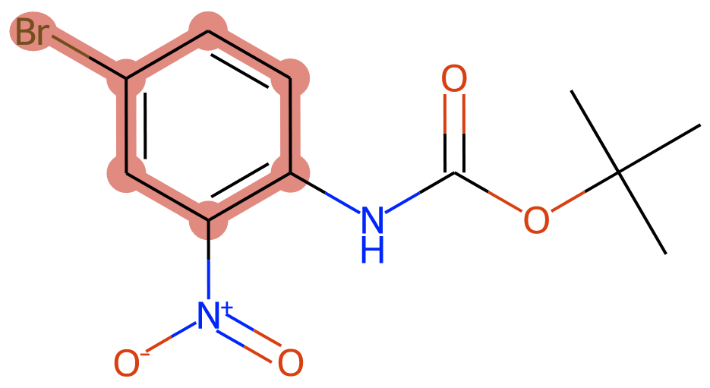
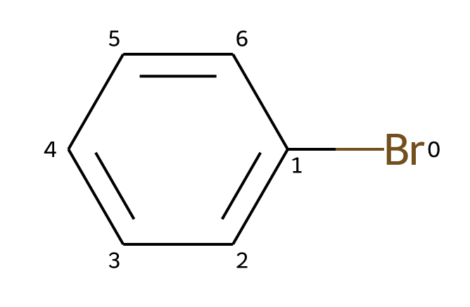
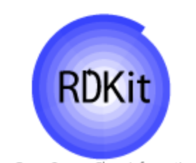

Cross-Modal Supervision of Molecular Structure Matching
Aryl Halide
Reactant Group
Subgraph Matching
X = Br, I, Cl
SMILES String
CC(C)(C)OC(=O)NC1=C(C=C(Br)C=C1)N(=O)=O
Chemical Name
tert-butyl (4-bromo-2-nitrophenyl) carbamate

Slide 24
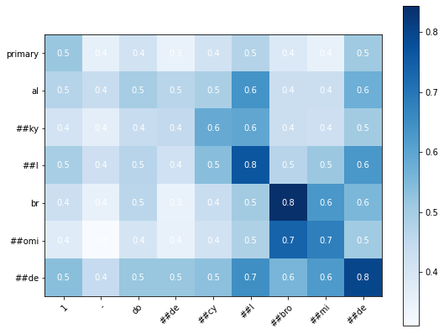
Subword Correlation Between Label and Entity Names
Reactant Group: Primary Alkyl Bromide
Chemical Name: 1-dodecylbromide
dodecyl
Alkyl: C_{n}H_{2n+1}
# of Carbons | 1 | 2 | 3 | 4 | 5 | 6 | 7 | 8 | 9 | 10 | 11 | 12
Group Name | Methyl | Ethyl | Propyl | Butyl | Pentyl | Hexyl | Heptyl | Octyl | Nonyl | Decyl | Undecyl | Dodecyl
alkyl
bromide
bromide

Slide 25
Subword Cross-Attention-Guided Entity Classification
Reactant Group: Primary Alkyl Bromide
Chemical Name: 1-dodecylbromide
Baseline Method
ChemBERT
Linear Layer
Prediction
ReactClass
Subword Cross-Attention
CNN

Slide 26
Experiment Results
ReactClass achieves 98.56% micro-F1 and 90.76% macro-F1 scores with significant improvements over all the baseline methods.

Slide 27
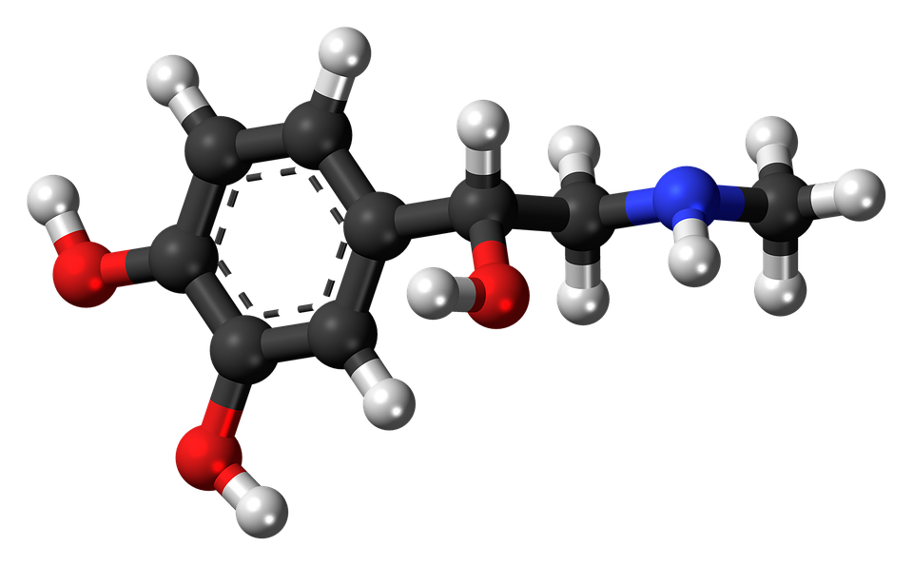
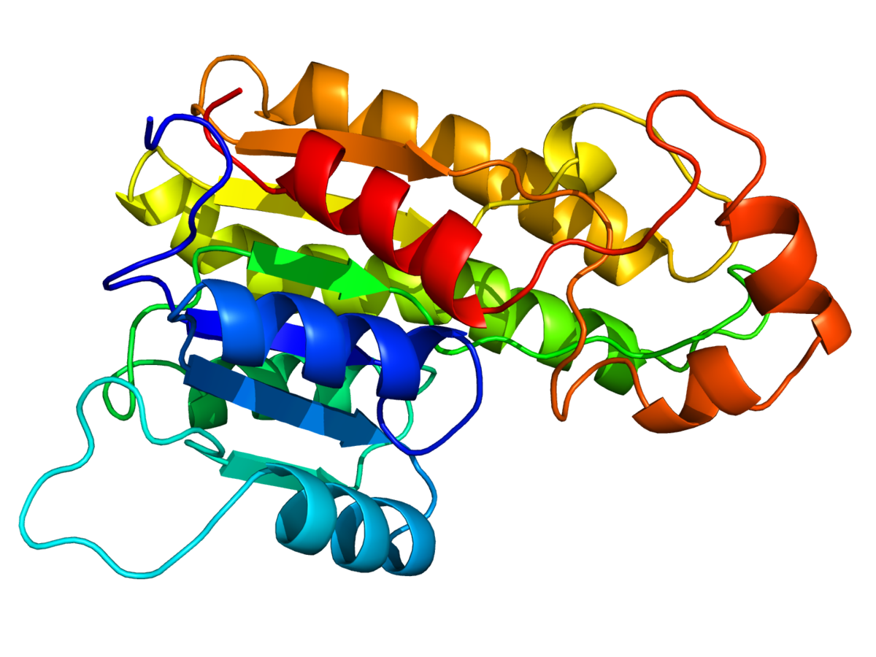
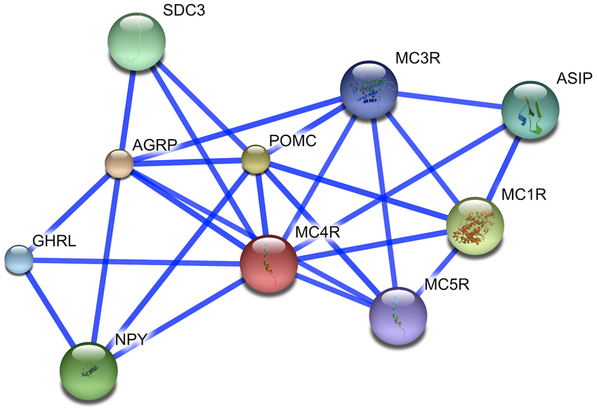
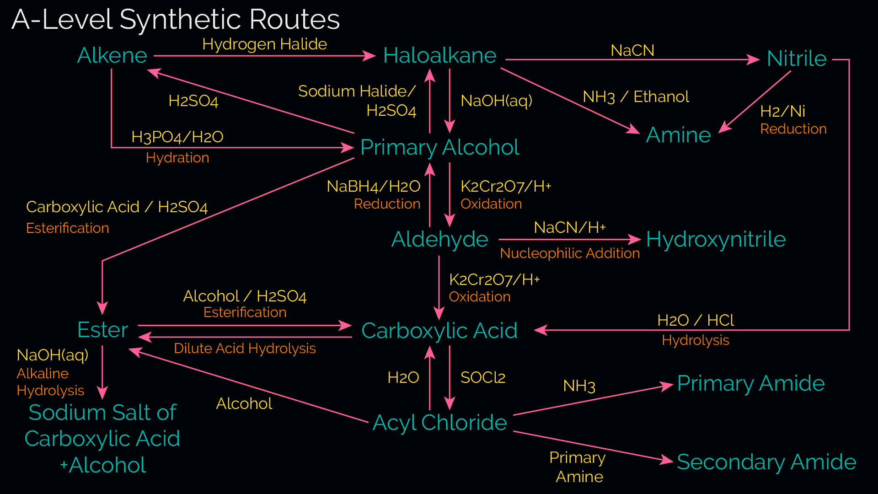
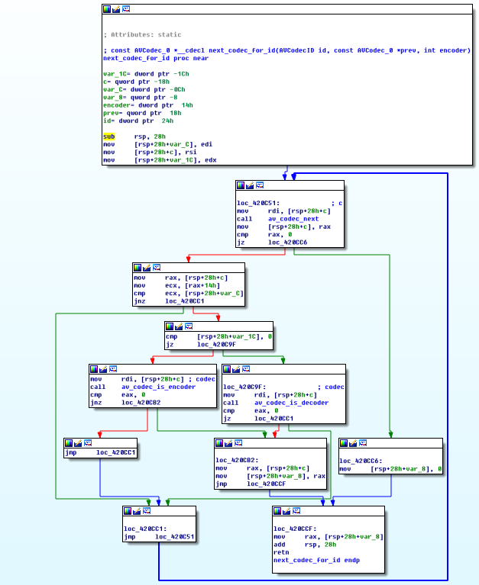
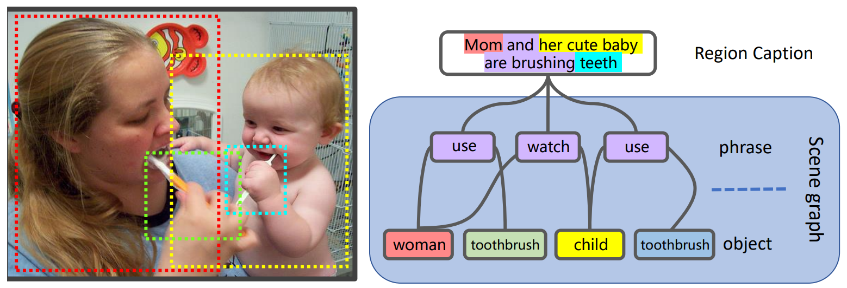
Chemical-Reaction-Aware Molecule Representation Learning [Wang et al, ICLR’21]
Going Beyond Text: Graph-structured data are ubiquitous in scientific domains
Molecules
Proteins
Protein-Protein Interactions
Synthetic routes
Program graphs
Scene graphs

Slide 28
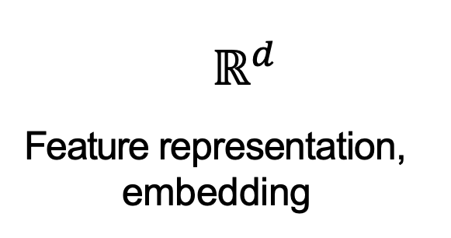

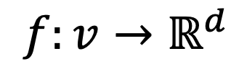
Feature Learning in Graphs
Our Goal: Design efficient task-independent / task-dependent feature learning for machine learning in graphs!
node
vector
$$f:v→ℝ^{d}$$
$$v$$
$$ℝ^{d}$$
Feature representation, embedding

Slide 29







Graph Neural Networks: Basic Model
Key idea: Generate node embeddings based on local neighborhoods.
A
TARGET NODE
B
B
C
A
B
A
C
A
C
E
F
D
F
E
D
INPUT GRAPH
A
Notes:
How to represent molecules is a fundamental and crucial problem in chemistry.
Let’s take lactic acid as an example, chemists usually use IUPAC nomenclature, molecular formula, and structural formula to represent molecules in chemistry literature. Space filling model and ball-and-stick model are also two common ways to represent molecules to show their 3D structure.

Slide 30
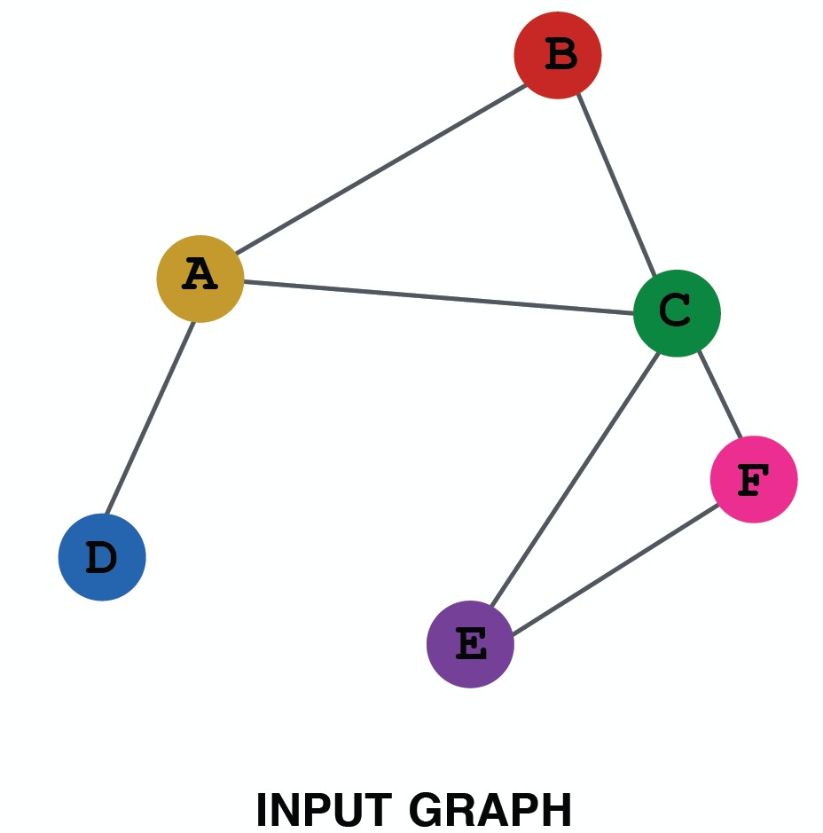
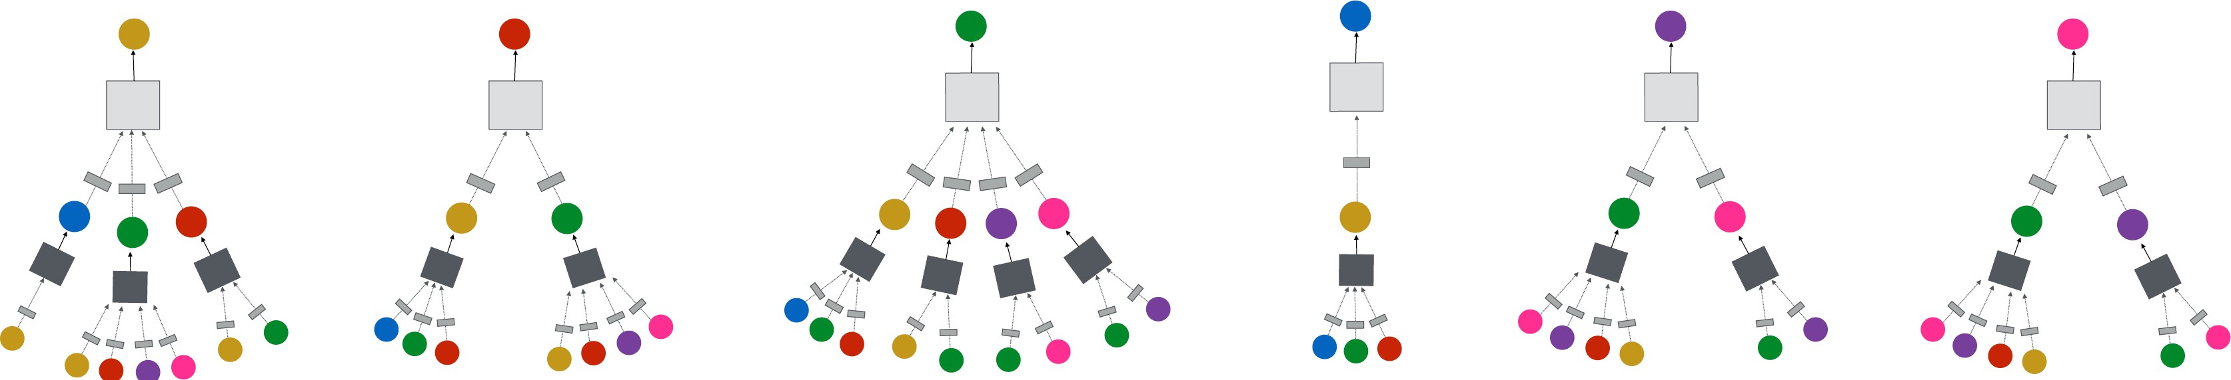
GNN Model: Neighborhood Aggregation
Intuition: Network neighborhood defines a computation graph
Every node defines a unique
computation graph!
Notes:
How to represent molecules is a fundamental and crucial problem in chemistry.
Let’s take lactic acid as an example, chemists usually use IUPAC nomenclature, molecular formula, and structural formula to represent molecules in chemistry literature. Space filling model and ball-and-stick model are also two common ways to represent molecules to show their 3D structure.

Slide 31
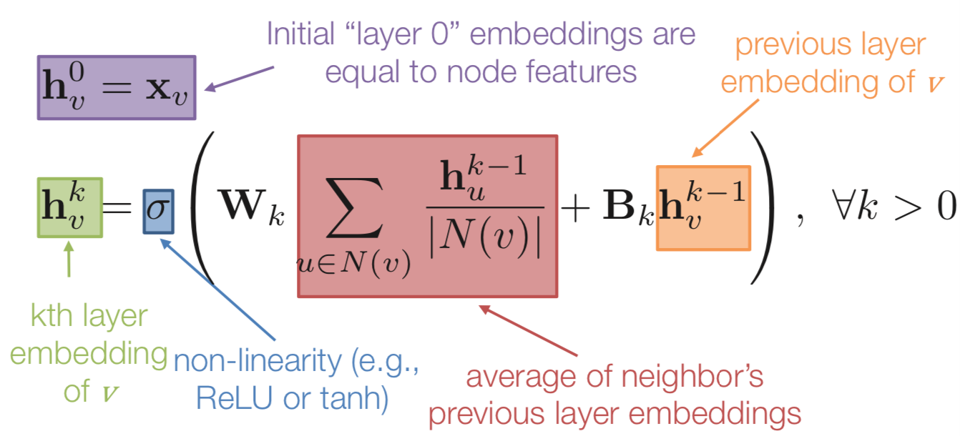
GNN Model: Basic Approach
Basic approach: Average neighbor information and apply a neural network.
31
Notes:
How to represent molecules is a fundamental and crucial problem in chemistry.
Let’s take lactic acid as an example, chemists usually use IUPAC nomenclature, molecular formula, and structural formula to represent molecules in chemistry literature. Space filling model and ball-and-stick model are also two common ways to represent molecules to show their 3D structure.

Slide 32
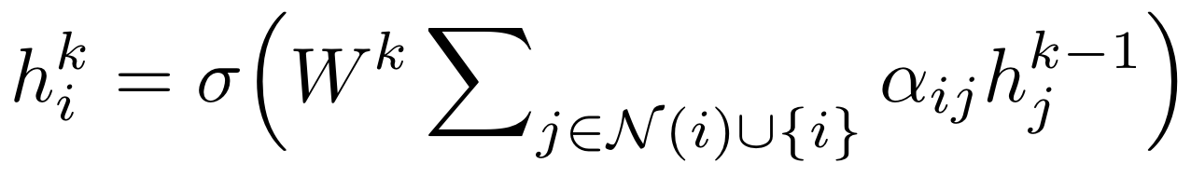


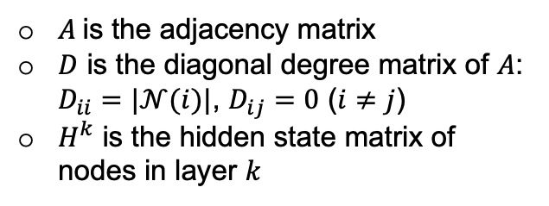
GNN Model: Graph Convolutional Networks (GCN)
Aggregation function in GCN:
$W^{k}$ is a learnable transformation matrix in layer $k$
$α_{ij}=1/\sqrt{|𝒩(i)|∙|𝒩(j)|}$ is a normalization factor
$σ$ is a activation function such as $ReLU\left(x\right)=\max{(x,0)}$
GCN in the matrix form:
$A$ is the adjacency matrix
$D$ is the diagonal degree matrix of $A$: $D_{ii}=|𝒩(i)|$, $D_{ij}=0$ ($i≠j$)
$H^{k}$ is the hidden state matrix of nodes in layer $k$
$$H^{k}=σ\left(W^{k}D^{−1/2}AD^{−1/2}H^{k−1}\right)$$
Notes:
How to represent molecules is a fundamental and crucial problem in chemistry.
Let’s take lactic acid as an example, chemists usually use IUPAC nomenclature, molecular formula, and structural formula to represent molecules in chemistry literature. Space filling model and ball-and-stick model are also two common ways to represent molecules to show their 3D structure.

Slide 33
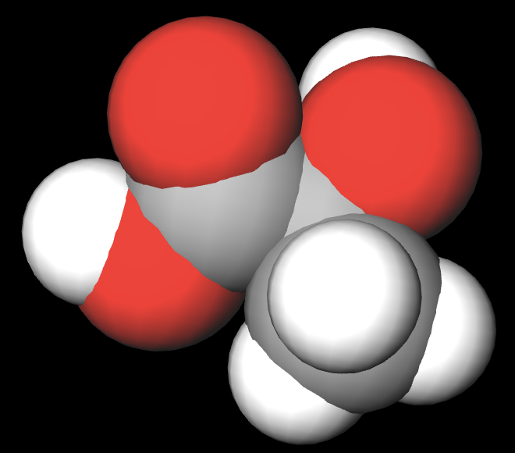
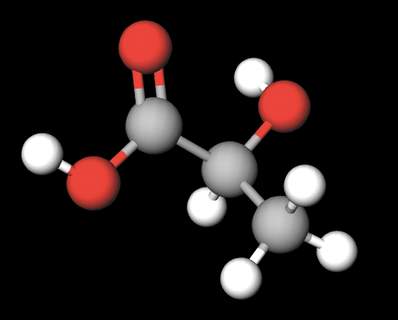


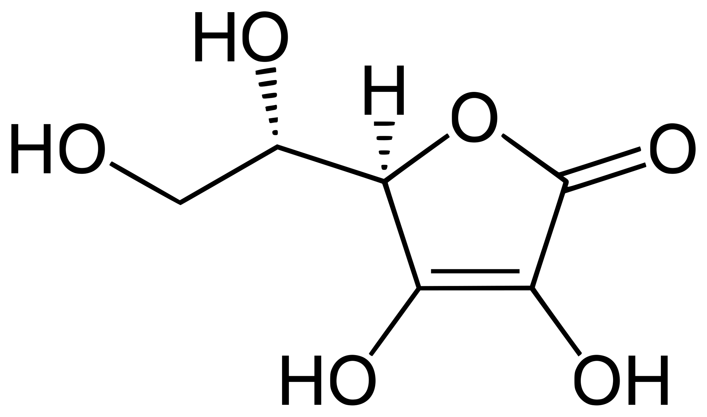
Molecule Representation Learning
OH
O
2-hydroxypropanoic acid
C₃H₆O₃
CH₃-CH-C-OH
IUPAC nomenclature
Molecular formula
Structural formula
Space filling model
Ball-and-stick model
Chemical reaction prediction
Molecule property prediction
Molecule generation
Drug discovery
Retrosynthesis planning
Chemical text mining
Chemical knowledge graph modeling
……
Graph encoder
Downstream tasks
molecule
embedding
Notes:
However, such representations are initially designed for human readers rather than computers.
To facilitate machine learning algorithms understanding and making use of molecules, molecule representation learning (MRL) is proposed to map molecules into a low-dimensional real space and represent them as dense vectors.
The learned vectors of molecules, also known as embeddings, can benefit a wide range of downstream tasks, such as…

Slide 34
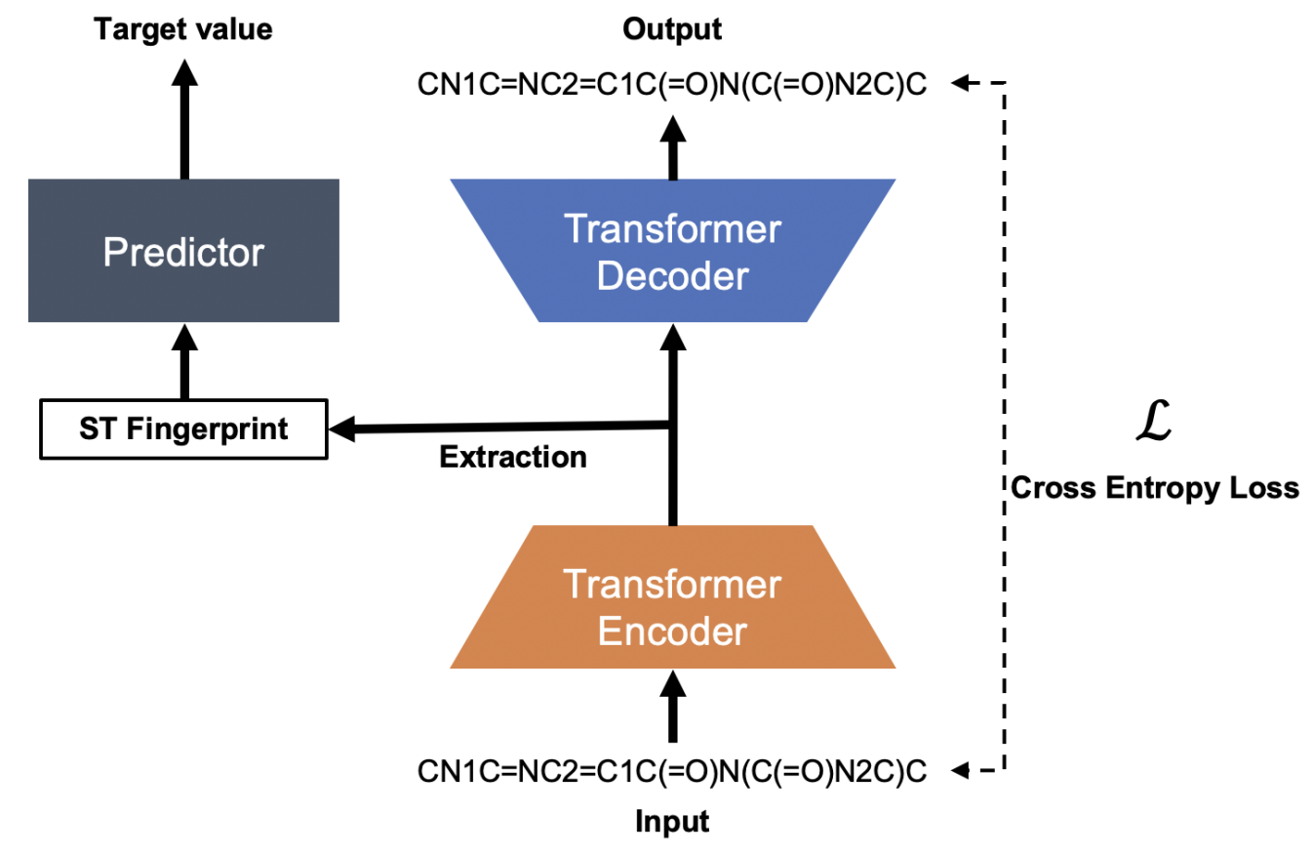
SMILES-Based Methods
SMILES-based MRL methods…
  take SMILES strings as input
  use language models (BERT, Transformer) as their base models
  output hidden layers as molecule embeddings
Examples:
  MolBERT (Fabian et al., 2020)
  ChemBERTa (Chithrananda et al., 2020)
  SMILES-Transformer (Honda et al., 2019)
  SMILES-BERT (Wang et al., 2019)
  Molecule-Transformer (Shin et al., 2019)
Illustration of SMILES-Transformer (Honda et al., 2019)
Notes:
Going back from smiles, let’s see how smiles-based mrl methods work.

Slide 35


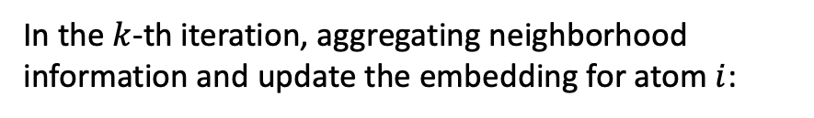
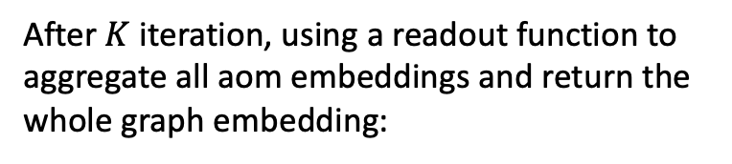


GNN-Based Methods
1. Propagating messages over the graph
2. Read out the molecule graph embedding
Notes:
To use GNN to learn molecule representation, we first repeat the aggregate operation in GNN for K iterations, which means that we propagate messages over the graph for K times.

Slide 36
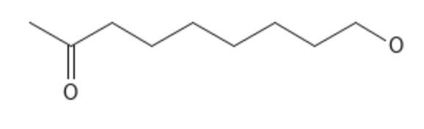
Limitation of SMILES-Based and GNN-Based Methods
Smiles are 1D linearization of molecule structures, which makes them hard to learn the original structural information of molecules
CC(CCCCCCCO)=O
These two O’s are close in SMILES string…
…but actually they are far from each other
GNN-based methods focus on designing fresh and delicate GNN architectures, while ignoring the essence of MRL, which is generalization ability
There is no specific GNN that performs universally best in all downstream tasks of MRL
Notes:
Although these language models have great power of learning representation of texts, they have difficulty dealing with SMILES input, because SMILES is 1D linearization of molecular structure, which makes it hard for language models to learn the original structural information of molecules, simply based on strings.
For example, suppose we have a molecule whose structure and smiles string are shown here.
We can see that these two oxygen atoms…
This will mislead language models, which rely heavily on the relative position of tokens to provide self-supervision signal.

Slide 37
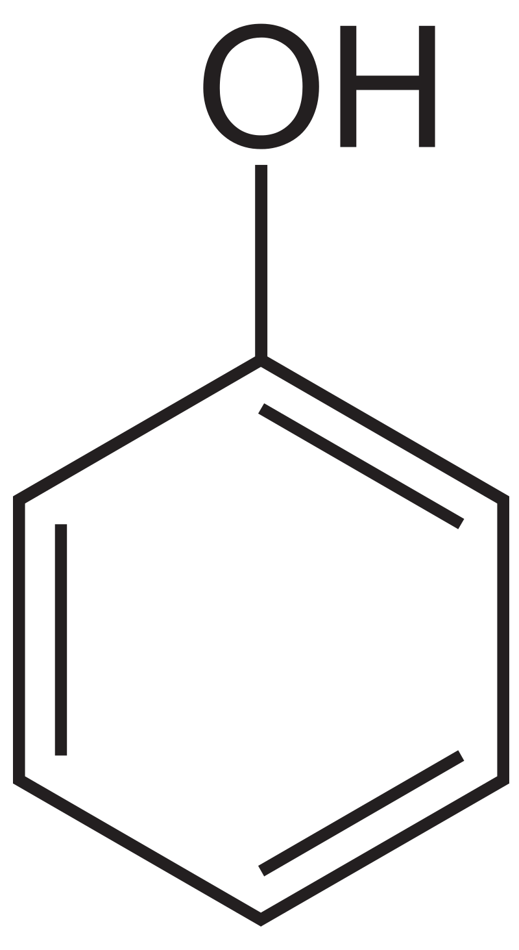

Structural Molecule Encoder
We use GNNs as the molecule encoder
Each atom has an initial feature vector consisting of four parts:
  Element type
  Charge
  Whether the atom is in an aromatic ring
  The count of attached hydrogen atom(s)
No edge feature (i.e., bond type) is considered
  Bond type can be inferred by the features of its two associated atoms
Element type: C
Charge: 0
Whether this atom is in an aromatic ring: True
The count of attached hydrogen atom(s): 1
One-hot encoding
Element type
Charge
Aromatic
# H atom(s)
Notes:
Now I’ll introduce the design of our model.

Slide 38
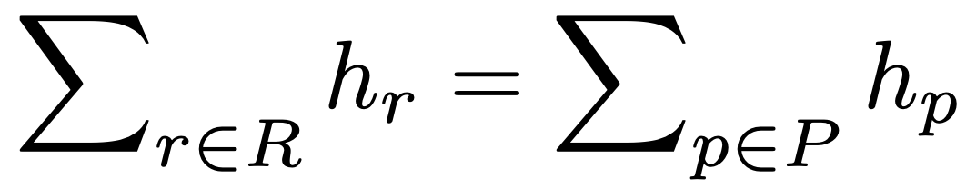




Preserving Chemical Reaction Equivalence
Several physical quantities retain constant before and after the reaction
  Mass, energy, charge, etc.
We aim to preserve such equivalence in the molecule embedding space:
CH₃CHO
C₂H₅OH+ O₂ → CH₃CHO
Chemical reaction space
O₂
Molecule embedding space
C₂H₅OH
Notes:
As we mentioned before, existing GNNs mainly focus on designing new and complicated GNN architectures, but ignore the essence of representation learning, which is the generalization ability. In this work, we propose using chemical reaction to assist learning molecule representations and improve their generalization ability.
A chemical reaction usually represents a closed system where several physical quantities of the system retain constant before and after the reaction, such as mass, energy, charge, etc.
Therefore, it describes a certain kind of equivalence between its reactants and products in the chemical reaction space.
Our key idea is to preserve such equivalence in the molecule embedding space, that is, we hope the sum of reactant embeddings to be equal to the sum of produce embeddings for a chemical reaction.

Slide 39
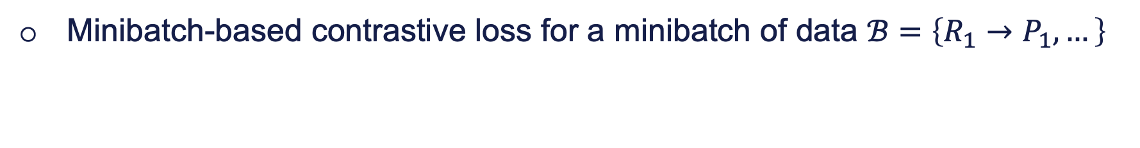
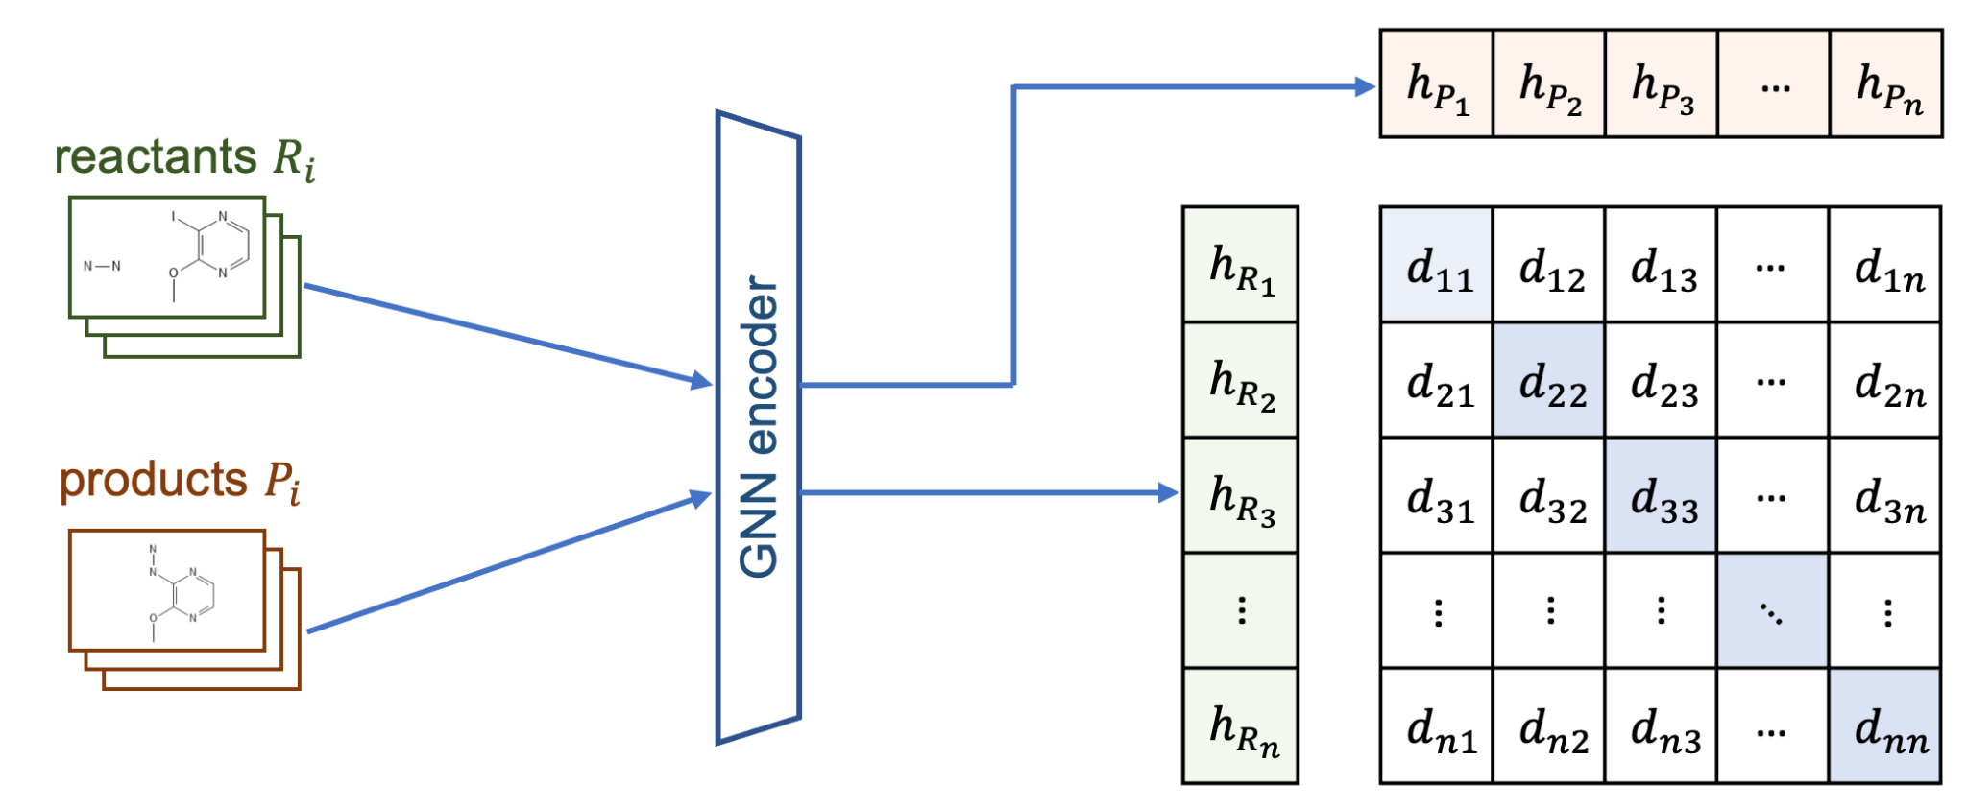
Training the Model
Notes:
a straightforward loss function for the proposed method is to minimizing the difference between the sum of product embeddings and the sum of reactant embeddings for all reactions. However, it doesn’t work because the model will learn to output all-zero embeddings for all molecules. Common solutions to this problem are introducing negative sampling strategy or contrastive learning. Here we use a minibatch-based contrastive learning framework since it is more time- and memory-efficient.
For a minibatch of data B, we first use the GNN encoder to process all reactants Ri and products Pi in this minibatch and get their embeddings. The matched pairs( Ri, Pi) are treated as positive pairs, whose embedding difference will be minimized, while the unmatched pairs are treated as negative pairs, whose embedding difference will be maximized. To avoid the total loss being dominant by negative pairs, we use a margin-based loss here, and gamma is a positive hyperparameter.

Slide 40
Experiments: Chemical Reaction Prediction
Dataset
USPTO
Training set: 409k, validation set: 30k, test set: 40k
Each reaction contains SMILES strings of up to five reactant(s) and exactly one product
Format:
reactant_smiles product_smiles
0 CC(C)C[Mg+].CON(C)C(=O)c1ccc(O)nc1 CC(C)CC(=O)c1ccc(O)nc1
1 CN.O=C(O)c1ccc(Cl)c([N+](=O)[O-])c1 CNc1ccc(C(=O)O)cc1[N+](=O)[O-]
CCn1cc(C(=O)O)c(=O)c2cc(F)c(-c3ccc(N)cc3)cc21.O=CO CCn1cc(C(=O)O)c(=O)c2cc(F)c(-c3ccc(NC=O)cc3)cc21
……

Slide 41


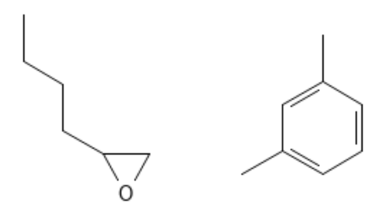
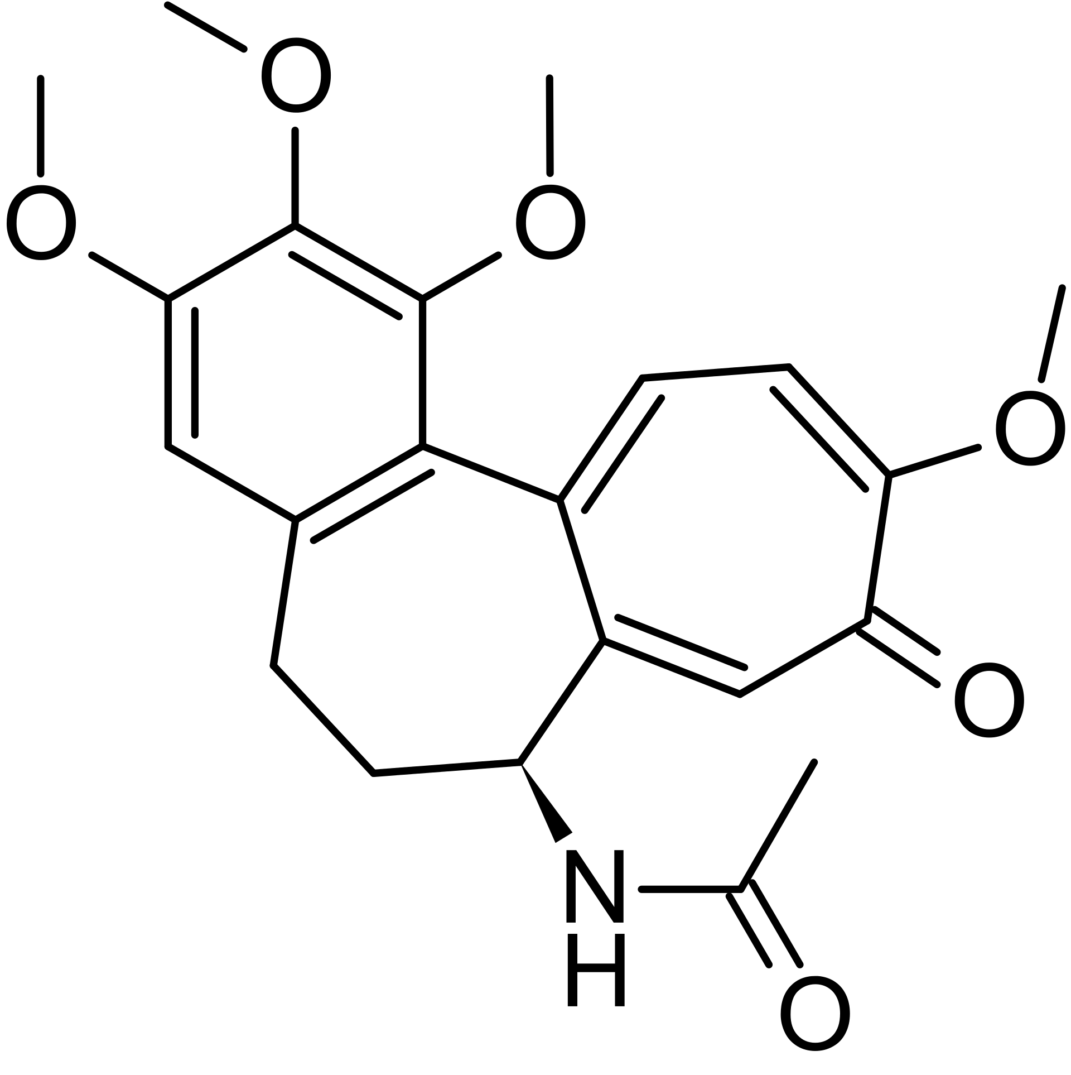
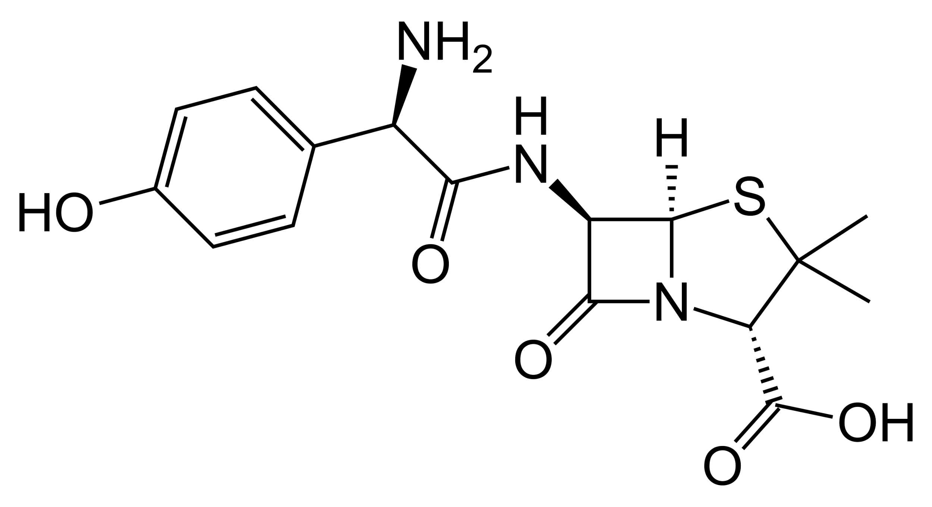
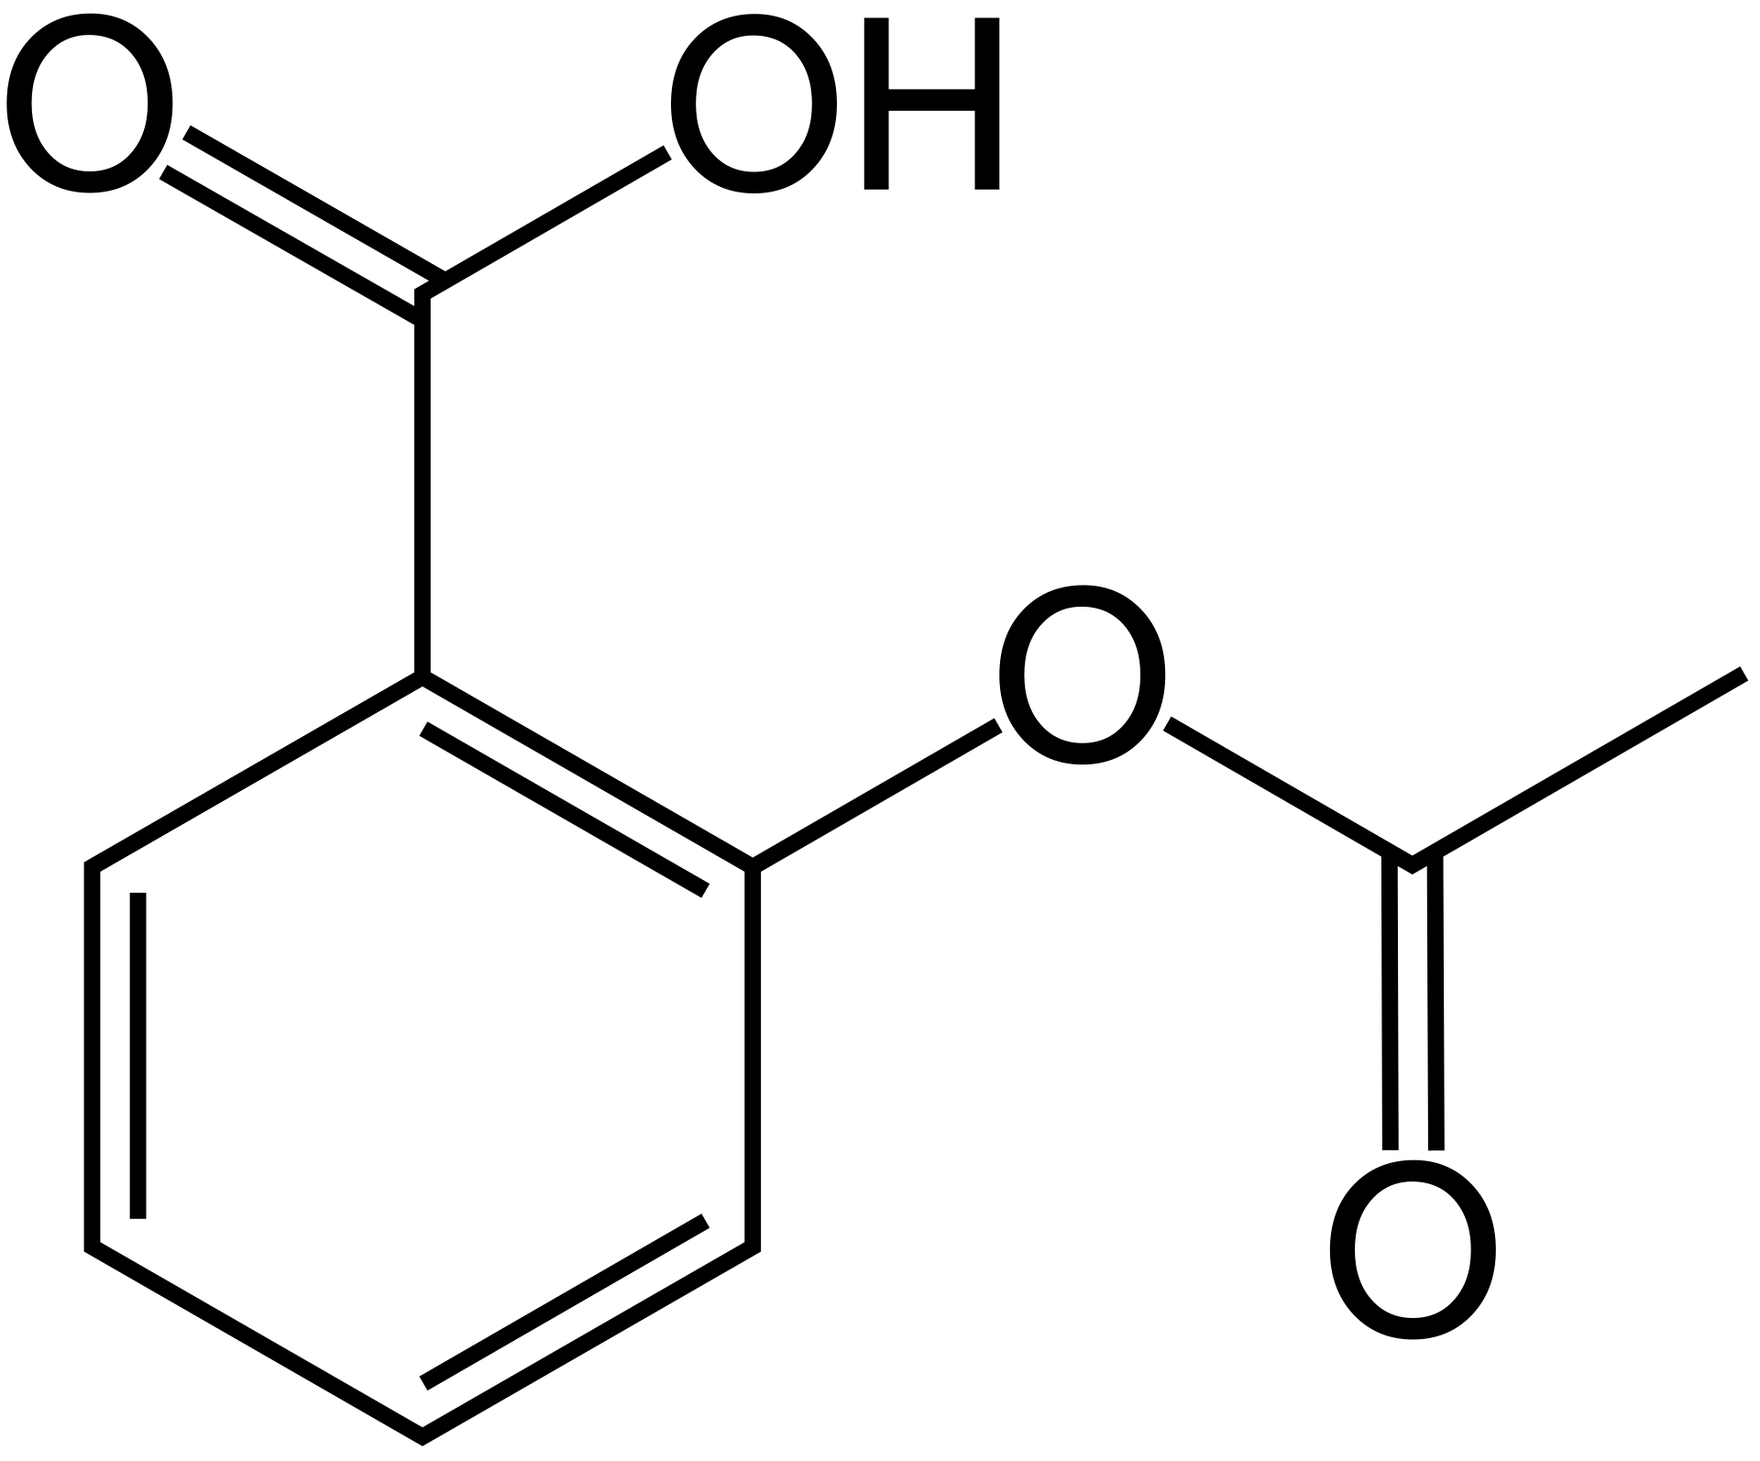
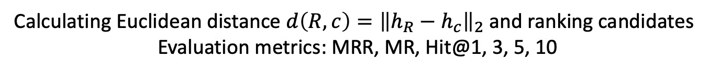
Experiments: Chemical Reaction Prediction
Evaluation Protocol
Trained model
Trained model
Query embedding
[candidate embedding_1, candidate embedding_2, …]
Notes:
We formulate the task of chemical reaction prediction as a ranking problem. In the inference stage, given the query reactant set R of a chemical reaction, we treat all products in the test set as a candidate pool C, and rank all candidates based on the L2 distance between reactant embeddings h_R and candidate product embedding h_c
Then the ranking of the ground-truth product can be used to calculate ( mean reciprocal rank), (mean rank), and Hit@1, 3, 5, 10

Slide 42
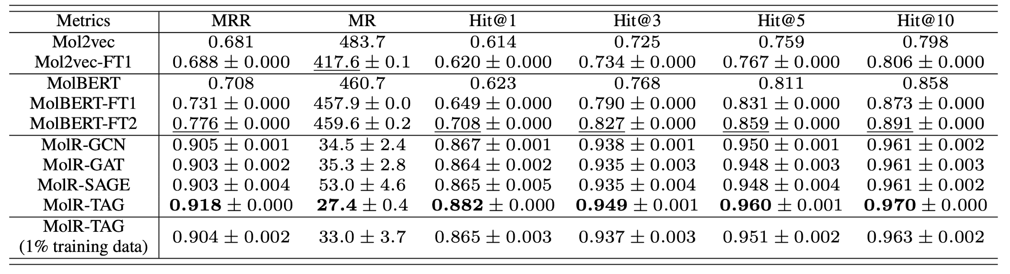
Experiments: Chemical Reaction Prediction
Using products in the test set as candidates
Improvement of MolR-TAG over the best baseline
14.2% 390.2 17.4% 12.2% 10.1% 7.9%
Notes:
Here is the result of our proposed model molr, and we use different GNNs as the molecule encoder.
It is clear that all the four variants of MolR significantly outperform baseline methods.
For example, the MRR improvement of MolR-TAG over the best baseline, MolBERT-FT2, is 14.2 percent.

Slide 43
Scientific Information Extraction and Analysis
Unique Challenges for Scientific Information Extraction
Leverage existing knowledge bases for weak supervision
Developed multimodal definition powered entity representation
Incorporate external knowledge via entity linking
Capture complex sentence structures

Slide 44
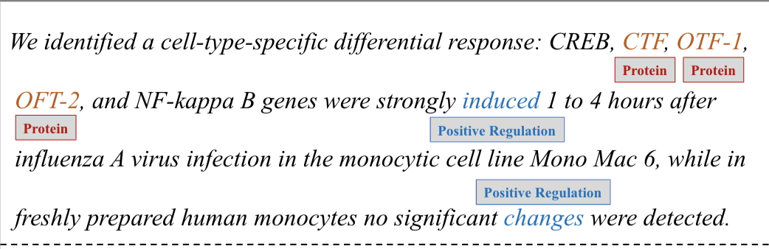
Challenge 3: Sentence-level Context is Insufficient
Most of the scientific concepts are abbreviated without explicit explanations of their meanings.
The complex biomedical and chemical interactions between multifarious chemicals, genes, and proteins are even harder to understand.

Slide 45
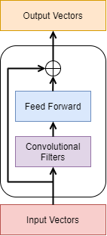
Efficient Entity Linking based on CNN
A simple model that mainly focuses on capturing local interactions may perform as well as SOTA BERT-based models
  A natural candidate that exhibits the desired properties is the convolutional neural network (CNN) architecture
Our encoding layer consists of several encoding blocks
Each encoding block has multiple convolutional filters of varying window sizes.
We also employ a position-wise fully connected feed-forward network after the convolutional filters.
There is a residual connection between the input and output of each encoding block
An illustration of an encoding block

Slide 46
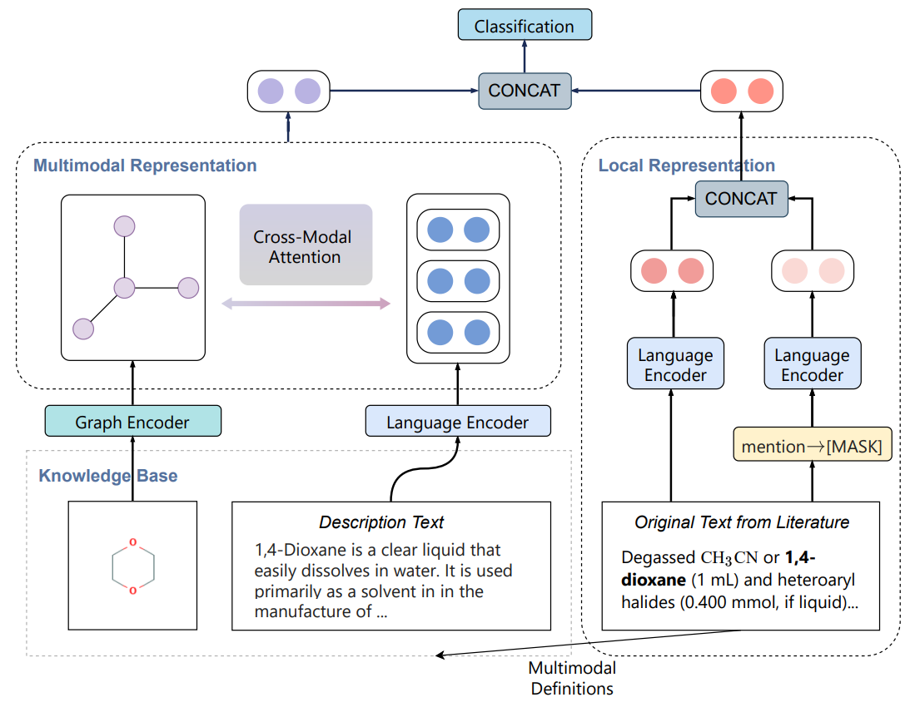
Multimodal Definition Powered Entity Representation
Utilize multimodal definition of chemicals (chemical structure, natural language description)
Incorporate cross-modal attention to align substructures to concepts in natural language description for interactions across different modalities

Slide 47

Constructing an Extra Brain: Encoding External
Knowledge via Entity Linking [Lai et al., ACL’21]
Notes:
KECI operates in three main steps:
Build an initial span graph representing KECI’s initial understanding of the text.
Use an entity linker to build a background knowledge graph containing all potentially relevant biomedical entities from an external KB.
Align the node of the two graphs to make final predictions of entities and relations.

Slide 48


Initial Span Graph Construction
Enumerate all the spans up to a certain length and computes a representation for each span.
Predict the type of each span and the relation between each span pair jointly.
The predictions are then used to construct an initial span graph
Use a bidirectional graph convolutional network (GCN) to integrate initial relational information into each span representation

Slide 49



Final Span Graph Prediction
After building the two graphs, we soft-align the mentions and the candidate entities using an attention mechanism.
With the extracted knowledge-aware span representations, we predict the final span gr

Slide 50
Scientific Information Extraction and Analysis
Unique Challenges for Scientific Information Extraction
Leverage existing knowledge bases for weak supervision
Developed multimodal definition powered entity representation
Incorporate external knowledge via entity linking
Capture complex sentence structures

Slide 51
Challenge 4: Wide Context due to Complex Sentence Structures
  Paper authors tend to write long sentences with clauses and appositions for better presentations.
  Example: Foxp3[Argument] contains a proline-rich amino-terminal domain reported to function as a nuclear factor of activated T cells (NF-AT) and nuclear factor-kappaB (NF-kappaB) binding domain, a central region containing a zinc finger and leucine zipper potentially important for protein-protein interactions, and a carboxyl-terminal forkhead (FKH) domain required for nuclear localization[Trigger] and DNA-binding activity [14-16] .
  Distance between event trigger and argument:
Dataset | Average Distance | Maximal Distance
ACE05-E (News) | 0.212 sentence | 56 words
GENIA-2011 (Papers) | 0.330 sentence | 77 words

Slide 52

Compressing Long Context with Abstract Meaning Representation
Use BioBERT as the sentence encoder, and adopt span enumeration and classification for identifying event triggers and entities
Message passing using an edge-conditioned graph attention network
Jointly training and inference (trigger and arguments) for biomedical event extraction

Slide 53

Knowledge-enriched Abstract Meaning Representation [Zhang et al., ACL’21]

Slide 54
Entity and Relation Extraction Results
BioRelEx dataset – detecting binding interactions between proteins and/or biomolecules
ADE dataset – extracting drug-related adverse effects
 | Entity (Macro-F1) | Relation (Macro-F1)
Relation-Metric (Tran et al. 2019) | 87.11 | 77.29
SpBERT (Eberts et al. 2020) | 89.28 | 78.84
Span_{Multi-Head} (Ji et al. 2020) | 90.59 | 80.73
KnowBertAttention (Baseline) | 90.08 | 79.95
KECI (Ours) | 90.67 | 81.74
 | Entity (Micro-F1) | Relation (Micro-F1)
SciIE (Luan et al. 2018) | 73.56 | 50.15
Second Best Model | 82.76 | 62.18
KECI (Ours) | 87.35 | 67.09
Overall results (%) on the BioRelEx leaderboard
Overall results (%) on the ADE dataset

Slide 55
Event Extraction Results
GENIA2011 (interaction between proteins and biomolecules)
Extracting biomedical events (9 types) and proteins
Data Split | Train Set | Dev Set | Test Set
# Documents | 908 | 259 | 231
# Sentences | 8,620 | 2,846 | 3,348
# Proteins | 11,625 | 4,690 | 5,301
# Events | 10,310 | 3,250 | 4,487
Model | Prec | Rec | F1
String Matching | 43.92 | 21.82 | 29.16
Tree LSTM | 67.01 | 52.14 | 58.65
GEANet | 64.61 | 56.11 | 60.06
BEESL | 69.72 | 53.00 | 60.22
DeepEM | 71.71 | 56.20 | 63.02
Bert-Flat | 64.68 | 52.98 | 58.25
BERT-AMR | 68.39 | 53.58 | 60.09
BERT-AMR-KG | 72.74 | 55.62 | 63.04

Slide 56

Qualitative Analysis
Explanation #1: AMR helps to link the trigger “bind” to entity “CAII” although they are located far away from each other in the sentence.
Explanation #2: External KG helps to recognize “CAII” as the theme of “transcription” based on the additional KG link in the enriched AMR graph.

Slide 57

Qualitative Analysis
Explanation #1: AMR helps to guide the model to find the correct arguments for the two binding events in the sentence.
Explanation #2: External KG helps to identify the positive regulation effect on the generation of heterodimers.

Slide 58




A New Chemistry IE Benchmark
  A new benchmark ChemET: includes 81 million molecules and 100 chemistry papers fully annotated with a new fine-grained Chemistry ontology
Data comes from PubChem open access literature
Developed a new entity ontology that includes 62 entity types (e.g., Chemistry→Organic Chemistry→OrganicCom-197pounds→Hydrocarbons→Other Hydrocarbons)
  Developed a new Chemistry Event Ontology with 59 types about results, methods and procedures
Training set constructed by distant supervision (using Wikipedia page and PubChem synonyms)
Evaluation set annotated by chemistry students
Dataset Stats

Slide 59


A New COVID-19 Benchmark
http://blender.cs.illinois.edu/covid19/
Manually annotated 122 documents with 6,789 sentences in total
Data Sources:
  AI2 CORD-19 archive: index for COVID-19 related papers from PubMed, PubMed Central, Arxiv, and Bio-Arxiv
  NCBI PMC API: retrieve PubMed (PM) or PubMed Central (PMC) articles
  NCBI Pubtator API: retrieve pre-annotated PubMed or Pubmed Central articles

Slide 60



Application in COVID-19 Drug Repurposing Report Generation [Wang et al., NAACL2021 Best Demo Paper Award]
Entity Grounding for Drug Molecular Structure Image
Figure 1.
FDA approved drugs of most interest for repurposing as potential Ebola virus treatments.
KG from caption text
FDA
approve
Multimedia Knowledge Graph Expansion
repurpose
Drugs
Ebola

Slide 61

Application in COVID-19 Drug Repurposing Report Generation [Wang et al., NAACL2021 Best Demo Paper Award]

Slide 62
Scientific Information Extraction and Analysis
Summary
  Lack of human annotations for various science domains
    Leverage existing knowledge bases for weak supervision
  Multi-modal representations of scientific knowledge
    Developed multimodal definition powered entity representation
  Lack of specialized domain knowledge in natural language context
    Incorporate external knowledge via entity linking
  Complex sentence structures in scientific writing
    Capture complex sentence structures with AMR parsing

Slide 63
References
Xuan Wang, Vivian Hu, Xiangchen Song, Shweta Garg, Jinfeng Xiao, and Jiawei Han. "CHEMNER: Fine-Grained Chemistry Named Entity Recognition with Ontology-Guided Distant Supervision." EMNLP’21
Hongwei Wang, Weijiang Li, Xiaomeng Jin, Kyunghyun Cho, Heng Ji, Jiawei Han, and Martin Burke. "Chemical-Reaction-Aware Molecule Representation Learning." ICLR’21
Tuan Lai, Heng Ji, ChengXiang Zhai, and Quan Hung Tran. "Joint Biomedical Entity and Relation Extraction with Knowledge-Enhanced Collective Inference." ACL’21
Zixuan Zhang, Nikolaus Parulian, Heng Ji, Ahmed S. Elsayed, Skatje Myers, and Martha Palmer. "Fine-grained information extraction from biomedical literature based on knowledge-enriched abstract meaning representation." ACL’21
Chenkai Sun, Weijiang Li, Jinfeng Xiao, Nikolaus Nova Parulian, ChengXiang Zhai, and Heng Ji. "Fine-Grained Chemical Entity Typing with Multimodal Knowledge Representation." BIBM’21
Qingyun Wang, Manling Li, Xuan Wang, Nikolaus Parulian, Guangxing Han, Jiawei Ma, Jingxuan Tu et al. "COVID-19 Literature Knowledge Graph Construction and Drug Repurposing Report Generation." NAACL’21: Demonstrations

