Slide 1
Overview & Intro
Heng Ji
(UIUC CS Professor & Amazon Scholar)
hengji@illinois.edu

Slide 2
About me and my lab
http://blender.cs.illinois.edu/hengji.html
http://blender.cs.illinois.edu/
We are a bunch of passionate and fun people working on challenging NLP problems, including information extraction and natural language generation
I'm still hiring! UIUC side: research faculty members, research scientists, post-docs, PhD/master/undergraduate RAs, summer interns, visitors, program managers and software engineers. Amazon side: research scientists, software engineers and interns.
Notes:
Nowadays, the practice of journalism often distributes news content via multimedia.

Slide 3
Research Overview: Multimedia Multilingual Data → Information → Knowledge
News and Social Media for More Healthy Information Consumption
Visual Concept Detection by Curriculum Learning and Human-Computer Interaction (DARPA ECOLE)
Event Schema Induction and Event Prediction (DARPA KAIROS)
Misinformation Detection (DARPA SemaFor)
Misinformation Propagation Pattern Mining (DARPA MIPs)
Information Campaign Modeling and Misinformation Characterization (DARPA INCAS)
Norm Discovery and Instantiation for Cross-Cultural Understanding (DARPA CCU)
AI for Decision Making (DARPA ITM)
Scientific Literature for Accelerating Scientific Discovery
Chemistry Information Extraction for Reaction Prediction and Chemical Function Discovery (e.g., new flavors, new skincare products!) (NSF MMLI)
Agriculture knowledge base construction for robots (NSF AIFarm)
Biomedical Information Extraction (e.g., COVID drug repurposing) (DoE Center for Advanced Bioengineering)
NSF AI Institute Conversational AI for Exceptional Education
Notes:
Nowadays, the practice of journalism often distributes news content via multimedia.

Slide 4
About this course
https://blender.cs.illinois.edu/course/fall23/anlp.html
Google drive folder for office hour sign-up: TA will announce
Please speak up, show up, and meet me during office hours
Notes:
Nowadays, the practice of journalism often distributes news content via multimedia.

Slide 5
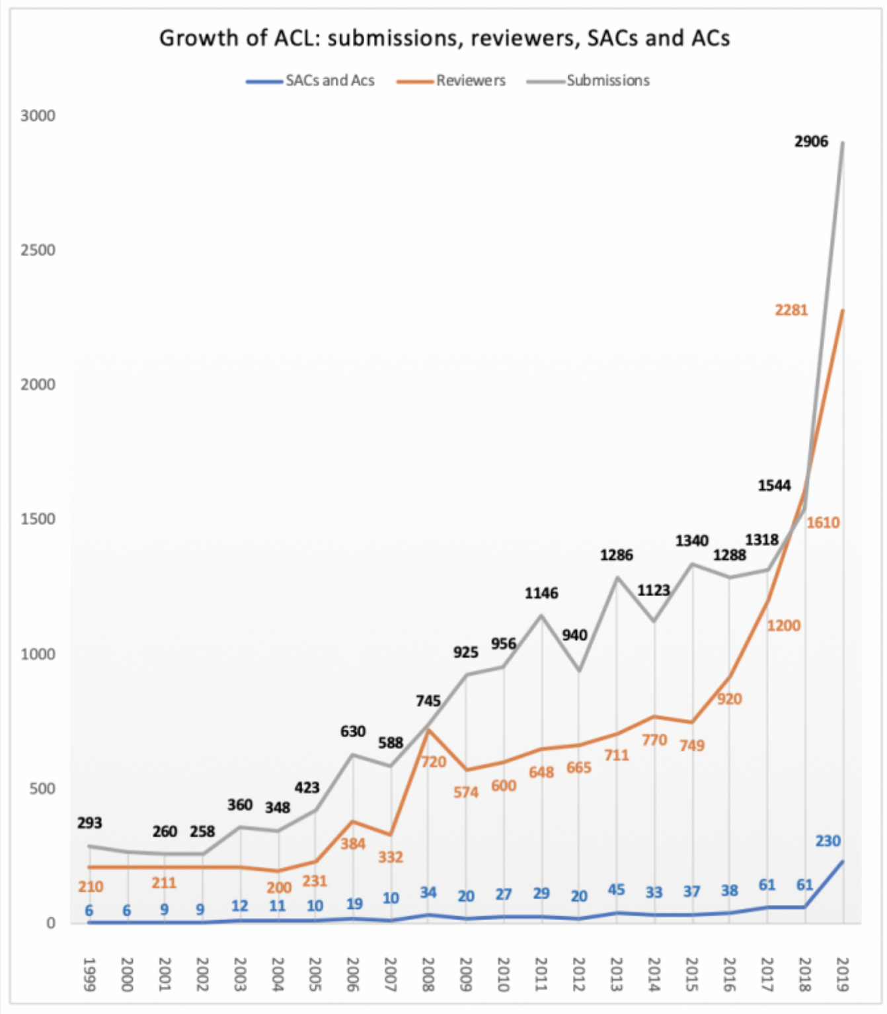
It is the Best of Times
5

Slide 6
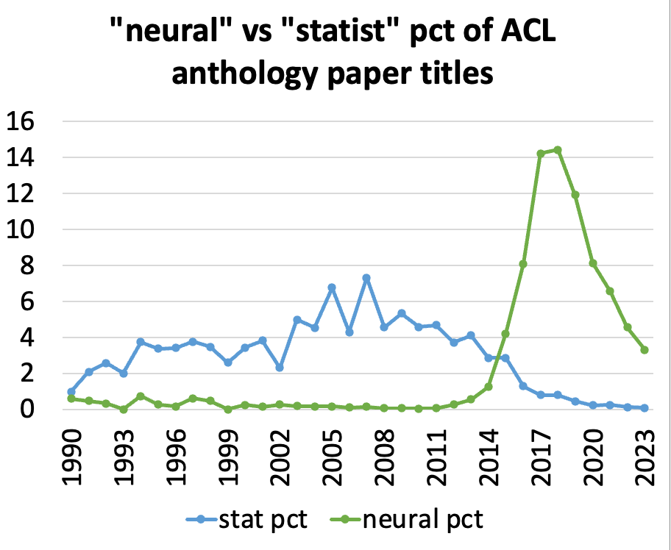
It is the Best of Times
6

Slide 7
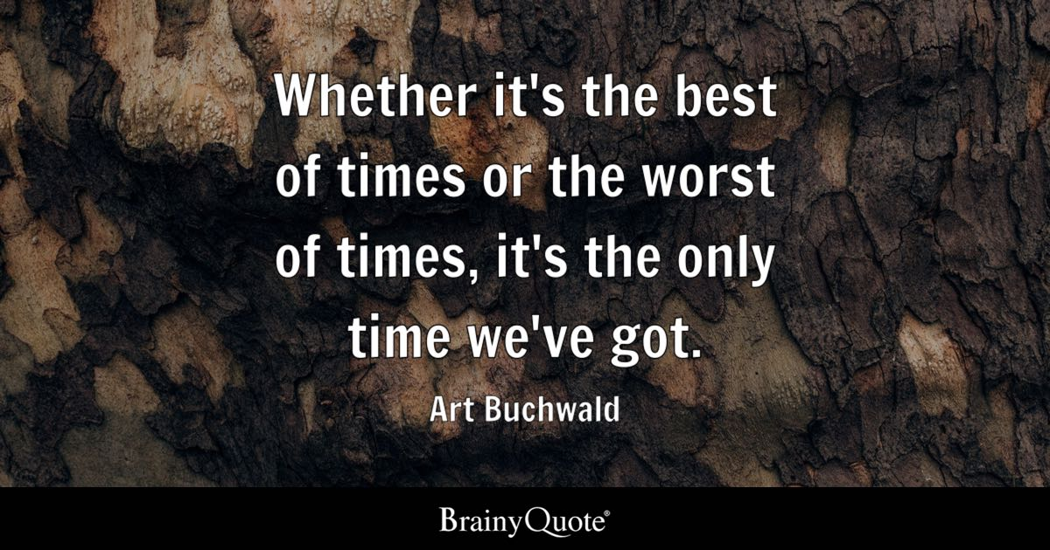
It is the Best of Times
LLMs produce text sequences word-by-word by computing conditional probability based on context
At a sufficiently large scale, they can answer questions, generate arguments, write poetry, impersonate characters, negotiate contracts.
They achieve competitive results across a wide variety of standard NLP tasks including entity typing, sentiment analysis, and textual entailment, showcasing “emergent behavior” such as in-context learning (Wei et al., 2022)
7

Slide 8
A Typical NLP system before LLM: language representation + deep neural networks
OneIE [Lin et al., ACL2020] framework extracts the information graph from a given sentence in four steps: encoding, identification, classification, and decoding

Slide 9
Language Modeling: A Very Old Idea from 50 Years Ago: Language Modeling
p(I read a book about dogs)
How to assign a probability to a sentence?
another view: distribution over next word:
p(dogs | I read a book about _____ )
9
Notes:
Change low resource IL to a language which is not in wikipedia
Word-level: from bi-lingual dicts and alignment; structure-level comes from wals; multi-level alignment

Slide 10
Word Cloze Game!
____ tends to be rude to customers
The ____ that lives near our farm likes chicken
The wolf lives near our ranch prefers ____
10
Notes:
Change low resource IL to a language which is not in wikipedia
Word-level: from bi-lingual dicts and alignment; structure-level comes from wals; multi-level alignment

Slide 11
Event Prediction
John purchased a high-pressure cooker and materials for bomb making. ________________. _________________. There was an explosion during Boston Marathon. _______________. Police found the bomb was inside a high-pressure cooker. ____________________. ___________________. John was sentenced to death.
11
Notes:
Change low resource IL to a language which is not in wikipedia
Word-level: from bi-lingual dicts and alignment; structure-level comes from wals; multi-level alignment

Slide 12
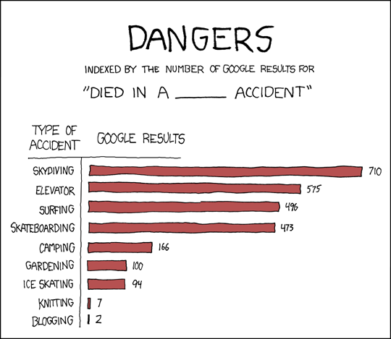
Counts on the Web

Slide 13
died in (a|an) _ accident
car 13966, automobile 2954, road 1892, auto 1650, traffic 1549, tragic 1480, motorcycle 1399, boating 823, freak 733, drowning 438, vehicle 417, hunting 304, helicopter 289, skiing 281, mining 254, train 250, airplane 236, plane 234, climbing 231, bus 208, motor 198, industrial 187, swimming 180, training 170, motorbike 155, aircraft 152, terrible 137, riding 136, bicycle 132, diving 127, tractor 115, construction 111, farming 107, horrible 105, one-car 104, flying 103, hit-and-run 99, similar 89, racing 89, hiking 89, truck 86, farm 81, bike 78, mine 75, carriage 73, logging 72, unfortunate 71, railroad 71, work-related 70, snowmobile 70, mysterious 68, fishing 67, shooting 66, mountaineering 66, highway 66, single-car 63, cycling 62, air 59, boat 59, horrific 56, sailing 55, fatal 55, workplace 50, skydiving 50, rollover 50, one-vehicle 48, <UNK> 48, work 47, single-vehicle 47, vehicular 45, kayaking 43, surfing 42, automobile 41, car 40, electrical 39, ATV 39, railway 38, Humvee 38, skating 35, hang-gliding 35, canoeing 35, 0000 35, shuttle 34, parachuting 34, jeep 34, ski 33, bulldozer 31, aviation 30, van 30, bizarre 30, wagon 27, two-vehicle 27, street 27, glider 26, " 25, sawmill 25, horse 25, bomb-making 25, bicycling 25, auto 25, alcohol-related 24, snowboarding 24, motoring 24, early-morning 24, trucking 23, elevator 22, horse-riding 22, fire 22, two-car 21, strange 20, mountain-climbing 20, drunk-driving 20, gun 19, rail 18, snowmobiling 17, mill 17, forklift 17, biking 17, river 16, motorcyle 16, lab 16, gliding 16, bonfire 16, apparent 15, aeroplane 15, testing 15, sledding 15, scuba-diving 15, rock-climbing 15, rafting 15, fiery 15, scooter 14, parachute 14, four-wheeler 14, suspicious 13, rodeo 13, mountain 13, laboratory 13, flight 13, domestic 13, buggy 13, horrific 12, violent 12, trolley 12, three-vehicle 12, tank 12, sudden 12, stupid 12, speedboat 12, single 12, jousting 12, ferry 12, airplane 12, unrelated 11, transporter 11, tram 11, scuba 11, common 11, canoe 11, skateboarding 10, ship 10, paragliding 10, paddock 10, moped 10, factory 10

Slide 14
Still Two Problems to Make this Really Useful…
Scale up: use the whole web data
Capture implicit semantic relatedness:
Describe X without mentioning X
14

Slide 15
15
Notes:
Change low resource IL to a language which is not in wikipedia
Word-level: from bi-lingual dicts and alignment; structure-level comes from wals; multi-level alignment

Slide 16
ChatGPT looks like magic!
We all have experienced this: it can parse and translate and answer questions
BOOM goes a lot of past NLP work (no more grammars/parsing/NLU, or even MT and QA? No more discourse and dialogue NL) and many current PhD theses
Caused a lot of self-identity crisis (which is something healthy to have)
GPT-3 had lots of problems
It was quite clearly an ngram-continuation ‘generator’
All it did was generate fabulous stories
It meandered off topic, contradicted itself, didn’t know when to stop [1]
BUT there was a behavioral leap from GPT-3 to ChatGPT
It generates arguments, poetry, plots, etc., and holds discussions [2]
It stays on topic
It stops at a ‘sensible’ point

Slide 17
Not magic: ChatGPT is a supervised learning machine
It is not magical ‘emergence’ of consciousness or something
It start with GPT-3 and took a lot of additional training using good argumentation text (see InstructGPT on OpenAI website) [3]
plus a lot of human annotation to compare good and bad discussions

Slide 18
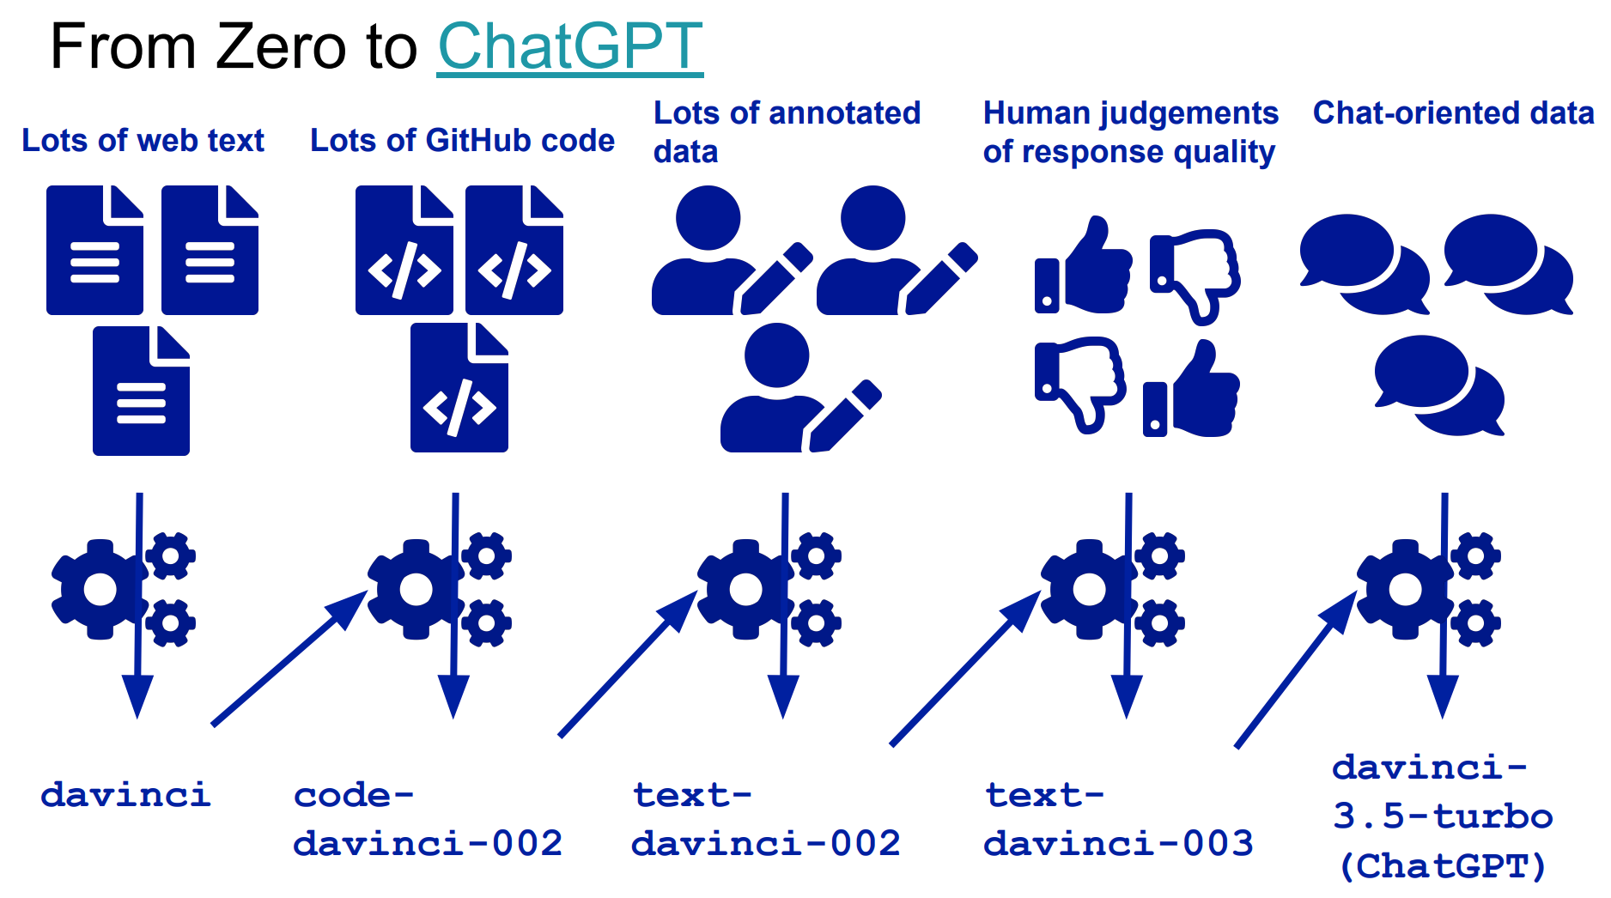
Slide from Graham Neubig

Slide 19
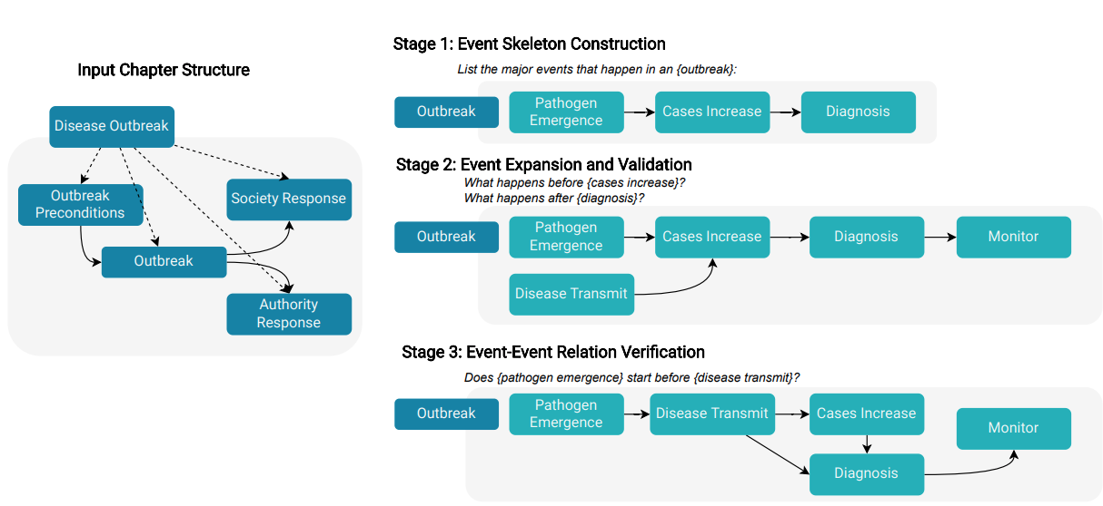
NLP After Large Language Model (LLMs) e.g., schema induction [Li et al., ACL2023]
19

Slide 20
NLP After Large Language Model (LLMs) e.g., schema induction [Wang et al., ACL2023]
20

Slide 21
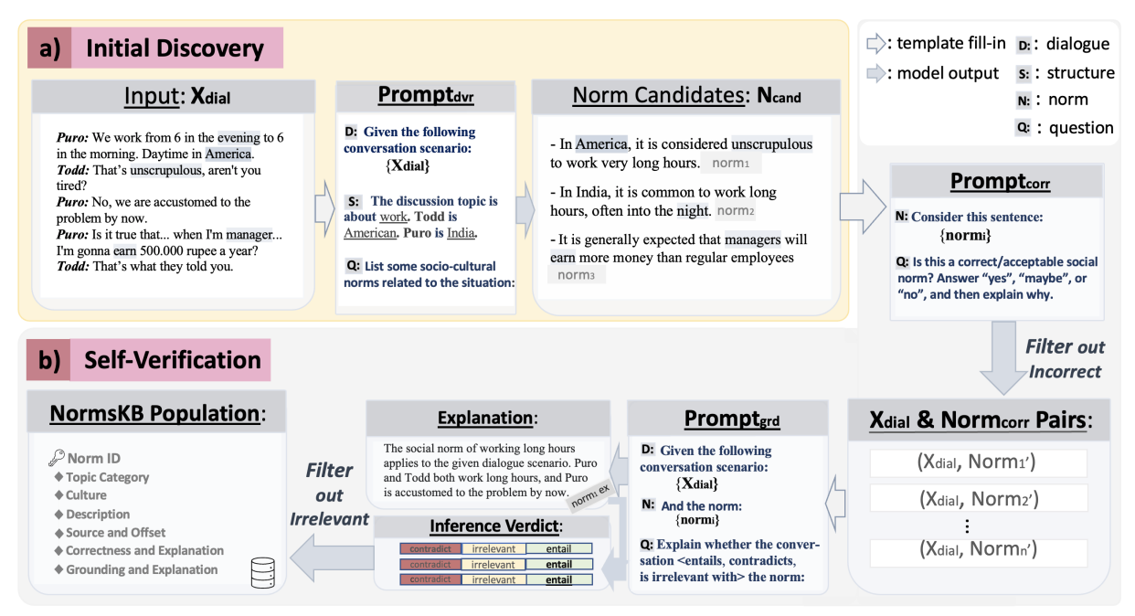
NLP After Large Language Model (LLMs) e.g., social norm discovery [Fung et al., 2023]
21

Slide 22
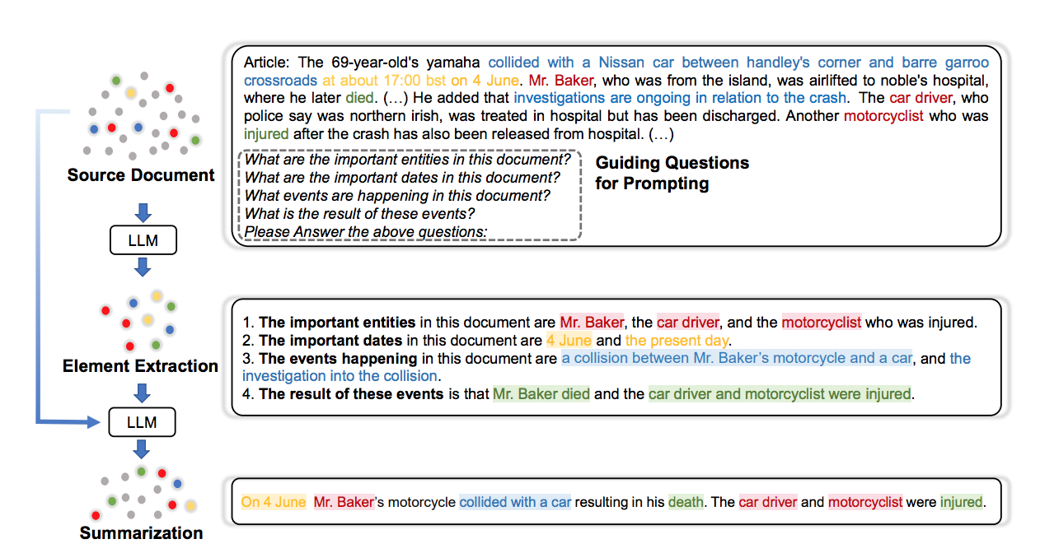
NLP After Large Language Model (LLMs) e.g., summarization [Wang et al., ACL2023]
22

Slide 23
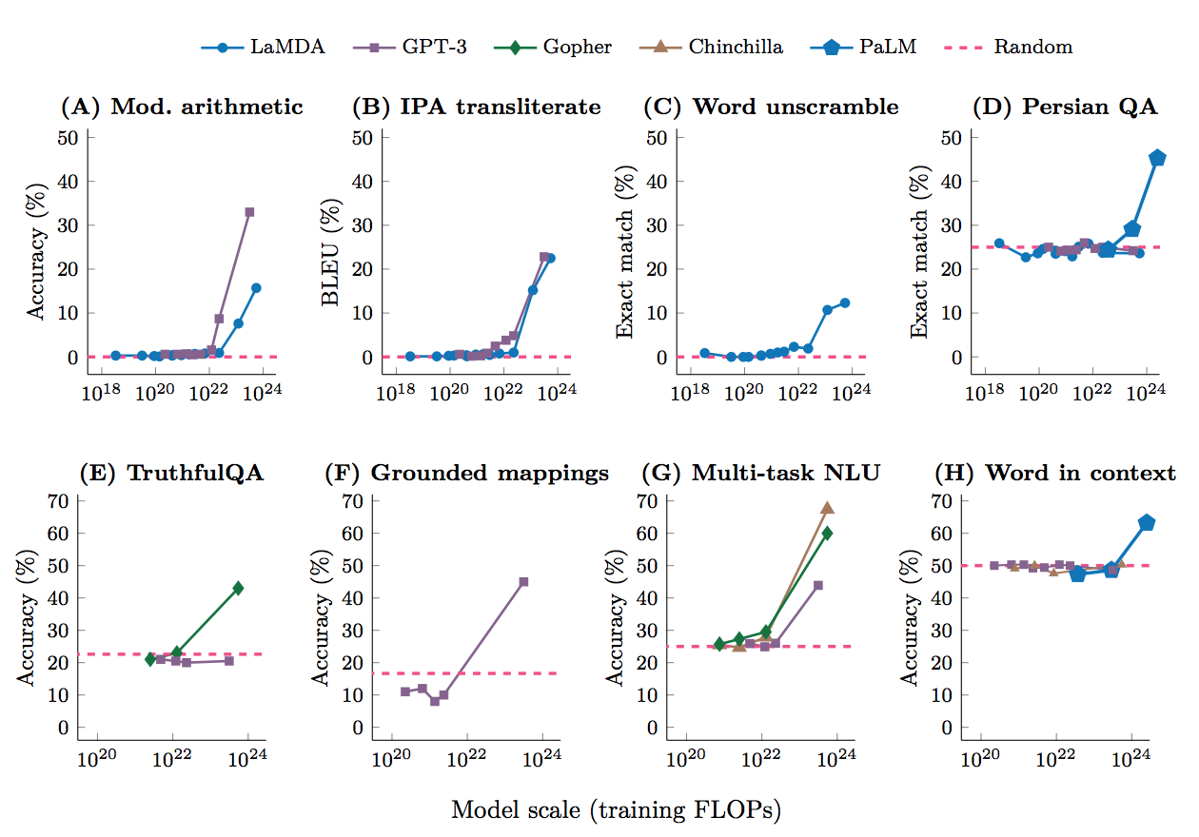
What is Emergent Ability?
An ability is emergent if it is not present in smaller models but is present in larger models.
23

Slide 24
Application 1: PaperRobot: Automatically Write a Paper [Wang et al., 2019]
A. The use of nanoparticles in medicine is an attractive proposition . In the present study , Zinc oxide and silver nanoparticles were evaluated for their antidiabetic activity . Fifty male albino rats with weight 120 ± 20 and age 6 months were used . Animals were grouped as follows : control ; did not receive any type of treatment , diabetic ; received a single intraperitoneal dose of streptozotocin ( 100 mg/kg ) , diabetic + Zinc oxide nanoparticles ( ZnONPs ) , received single daily oral dose of 10 mg/kg ZnONPs in suspension , diabetic + silver nanoparticles ( SNPs ) ; received a single daily oral dose of SNP of 10 mg/kg in suspension and diabetic + insulin ; received a single subcutaneous dose of 0.6 units/50 g body.
B. Rationale : Aliskiren is a rare disease characterized by a variety of hypertensive disorders . The aim of the present study was to evaluate the effectiveness of aliskiren , pharmacodynamics , and clinical outcomes in patients with hypertension . Methods We reviewed the medical records of ambulatory blood pressure ( BP ) , kinetics , and high-sensitivity C-reactive protein ( CRP ) levels in the treatment of corneal tissue . We performed a retrospective review of the English literature search of PubMed , EMBASE , and Cochrane Library databases . The primary outcome was established by using a scoring system.

Slide 25
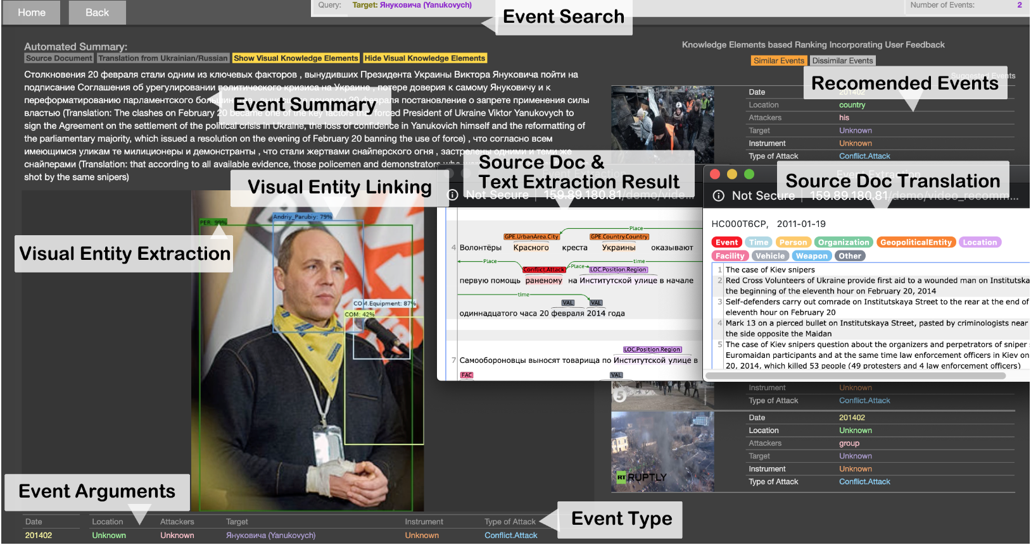
Application 2: News Understanding and Recommendation (Li et al., ACL2020Demo)
(Li et al., ACL2020 Best Demo Paper Award)
GitHub: https://github.com/GAIA-IE/gaia
DockerHub: https://hub.docker.com/orgs/blendernlp/repositories
Demo: http://159.89.180.81/demo/video_recommendation/index_attack_dark.html

Slide 26
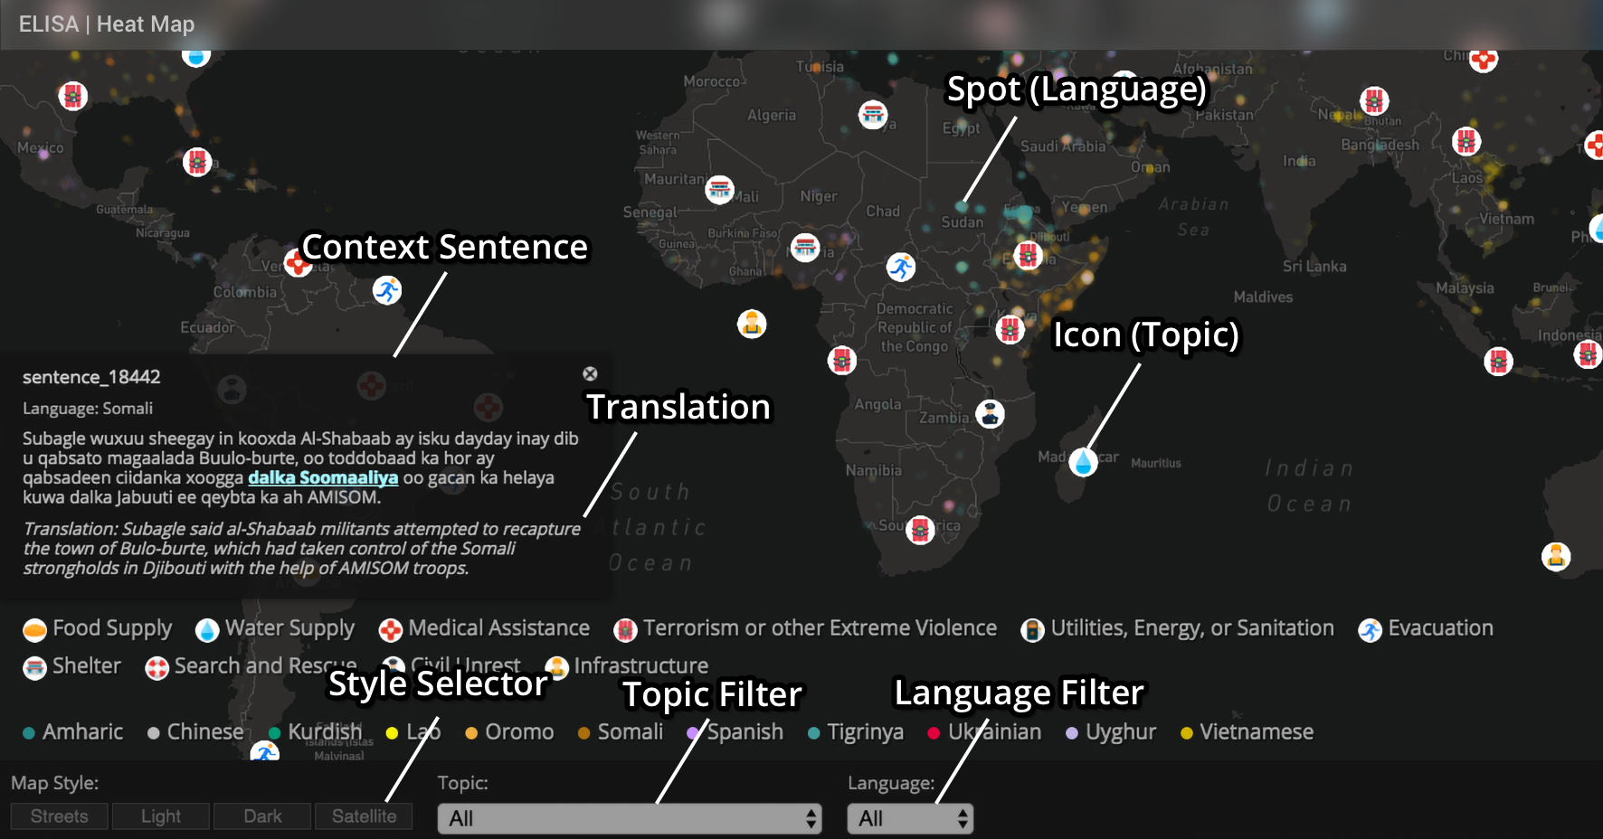
Applications 3: Disaster Relief (Zhang et al., NAACL18Demo)
Re-trainable Systems: http://159.89.180.81:3300/elisa_ie/api
Demos: http://159.89.180.81:3300/elisa_ie
Heat map: http://159.89.180.81:8080/
Notes:
deployed

Slide 27
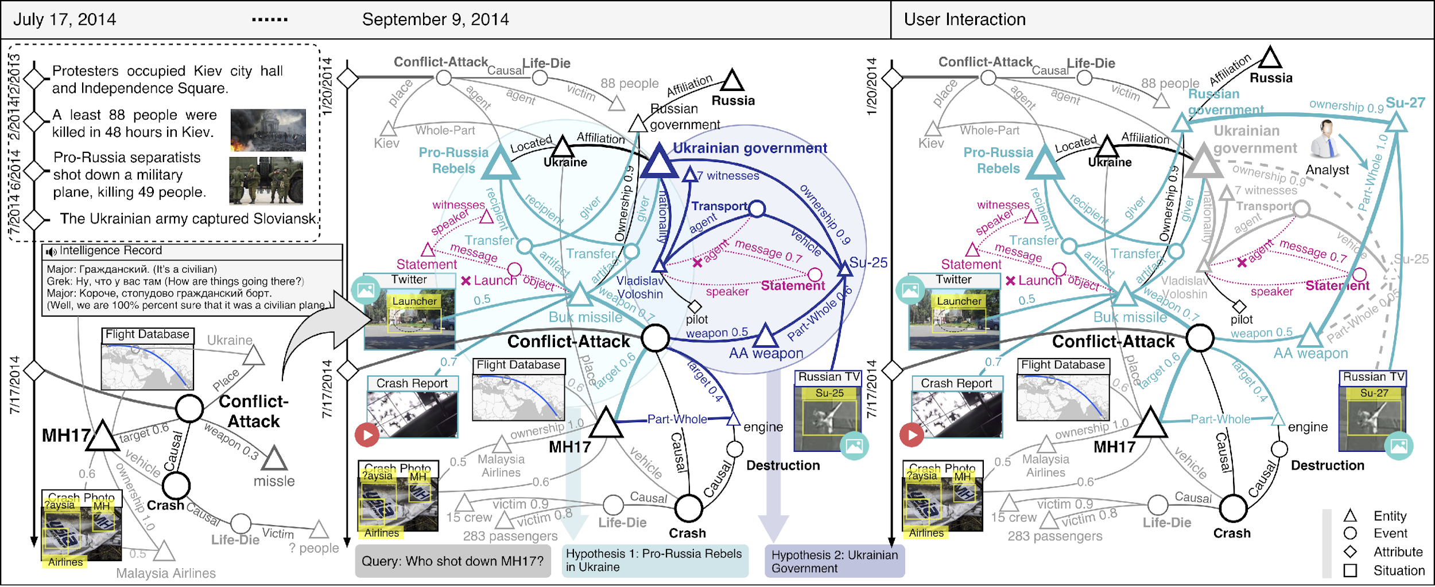
Applications 4: Intelligence Analysis

Slide 28
Applications 4: Intelligence Analysis
http://162.243.120.148:8080/
Achievement, Benevolence, Conformity, Hedonism, Power, Security, Self-direction, Simulation, Tradition and Universalism (Schwartz, 2012)

Slide 29
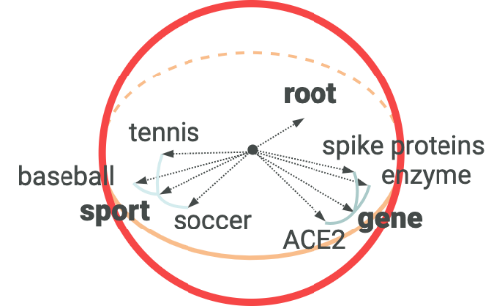
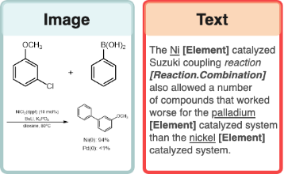
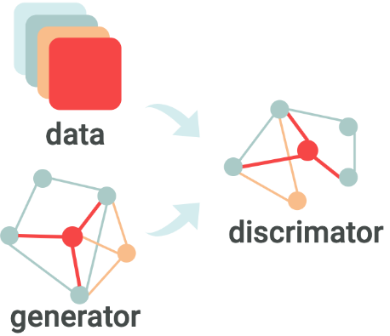
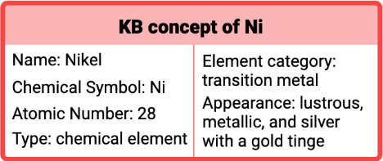
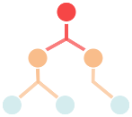
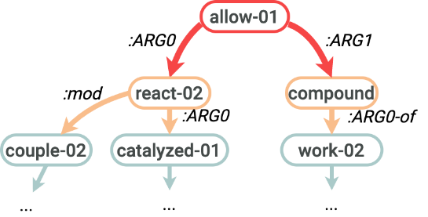
Application 5: Accelerating Scientific Discovery
DATA
SEMANTICS
KNOWLEDGE BASE
NeurIPS’19, WWW’20, KDD’20, ACL’20
NAACL’19, EMNLP’19, ACL’19, ACL’20
AAAI’19, ACL’20
Graph neural networks
Joint entity/relation/event extraction and ontology construction
Hierarchical Spherical Embedding
Scientific Literature
Multimedia Knowledge Base
Ontology Enriched Text Embedding
Generative Adversarial Networks for Data Augmentation and Distant Supervision
Chemical Ontology & Existing Databases
Cross-media Structured Semantic Representation
Multimedia Search and Summarization
Extending to other scientific domains including Molecular Synthesis and Agriculture under two new NSF institutes
Notes:
Distant supervision to acquire annotations by multi-instance multi-label learning
Apply Generative Adversarial Networks for data augmentation: regard positive samples generated by the generator as negative samples to train the discriminator
General framework: Transform massive chemistry literature into a structured knowledge base (KB) for link prediction, hypothesis ranking, search, summarization on any theme/term, enable accelerating knowledge-based scientific discovery
Technical innovation 1. New distantly supervised, refined fine-grained extraction and typing to help KB construction
Technical innovation 2: Chemical graph parsing and image analysis to enable multi-media common semantic space construction and new hierarchical embedding for graph neural networks based knowledge extraction and entity resolution [NAACL’19, EMNLP’19; ACL’19; ACL’20]
Technical innovation 3: Domain-specific ontology and database guided knowledge enrichment for joint neural end-to-end entity/relation/event extraction (Lin et al., ACL’20; success in COVID’19 KB construction, 500+ downloads: http://blender.cs.illinois.edu/covid19/)
Technical innovation 4: Weakly-supervised automated taxonomy construction, and taxonomy-guided, theme-based multidimensional document classification and text summarization (WeSHClass [AAAI’19] and EvidenceMiner [ACL’20] (success in COVID’19 analysis)

Slide 30
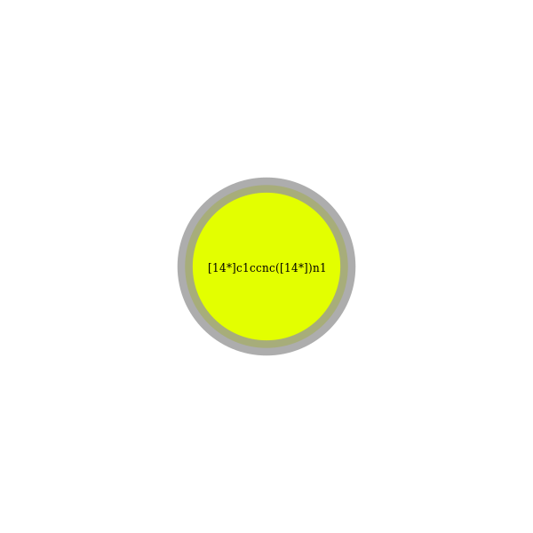
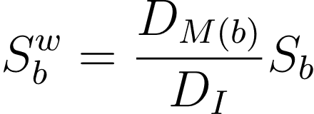
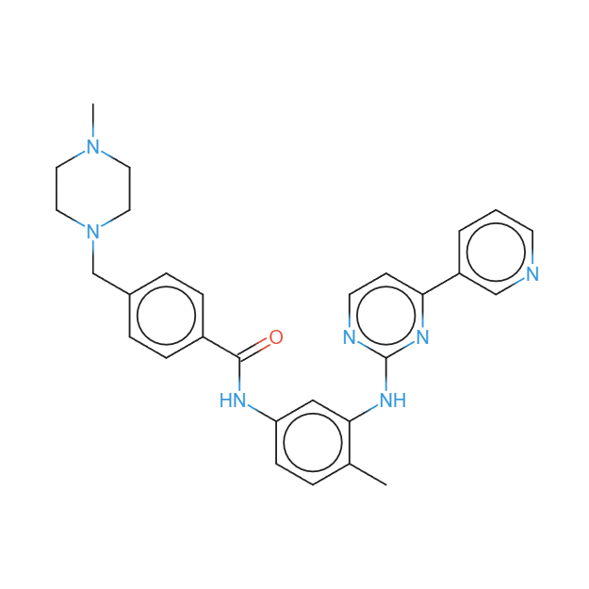
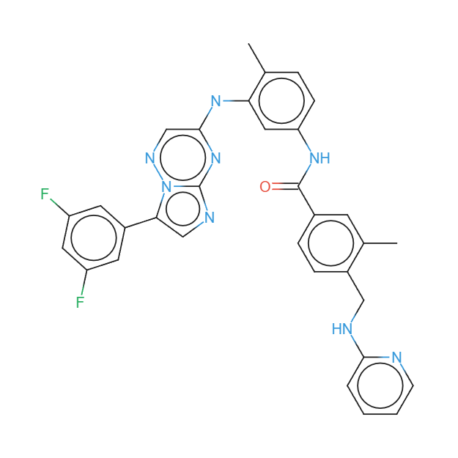
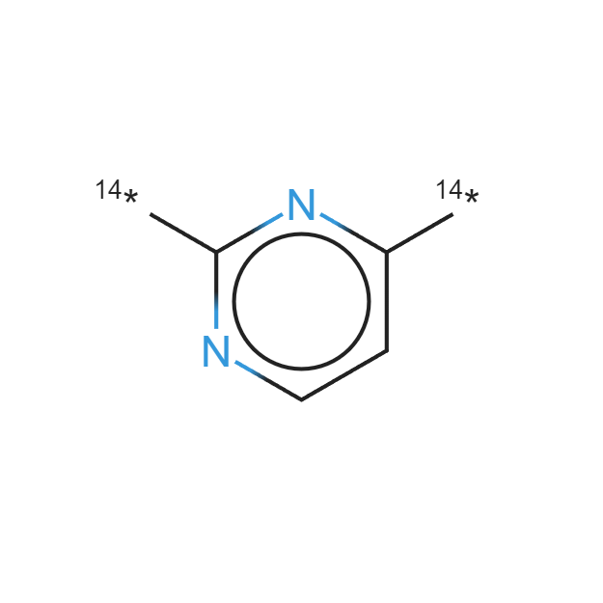
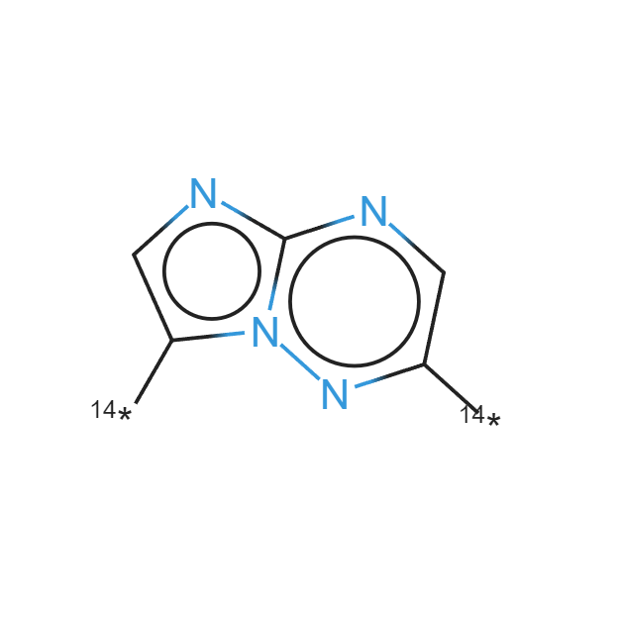
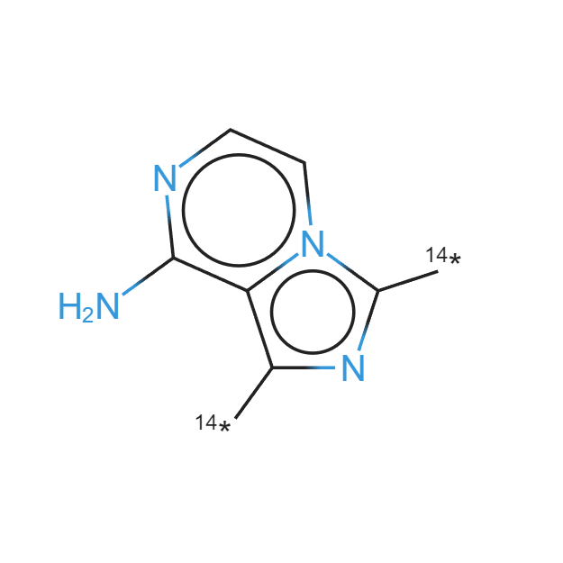
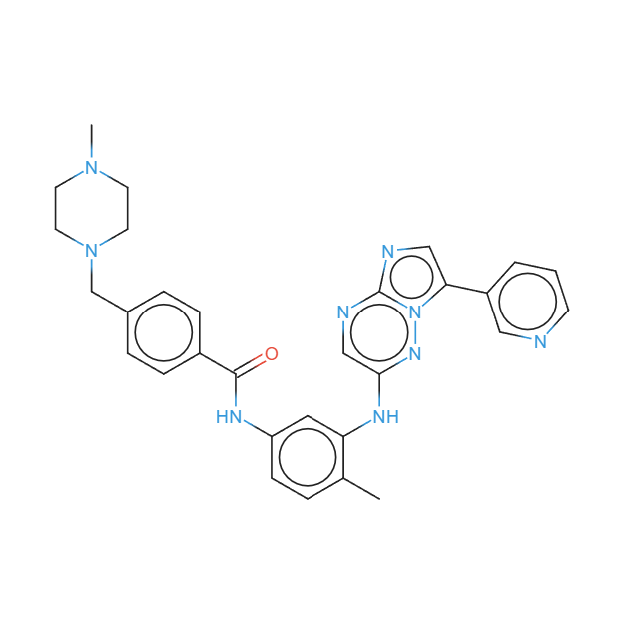
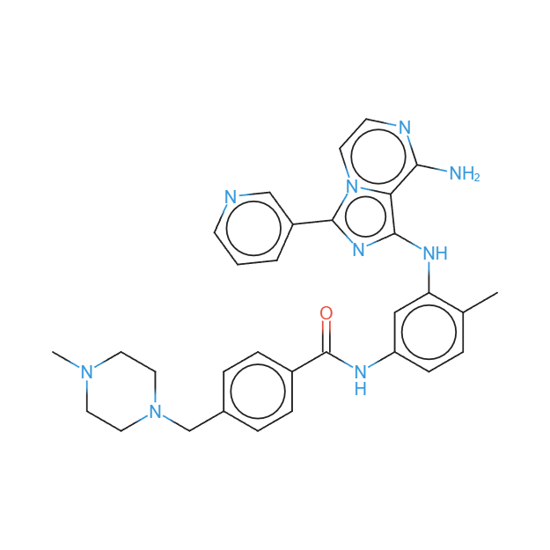
Application 5: Accelerating Scientific Discovery
All replacements at once (molecular weight constraint)
Imatinib
(Docking Score = -10.2)
Best Replacement with Molecular Weight Constraint
Best Replacement with Docking Score Constraint (Score = -12.9)
Original
Block Representation
New Drug
Imatinib
Replacement
Replacement Substructure
Full Molecule
10^33 drug-like molecules
89 FDA approved tyrosine kinase inhibitors
Manual Approach, $1.3 billion each
38 million molecule-text pairs
1 million sentences about kinase inhibitors
Multiple improved variants for 58 kinase inhibitors to pass BBB
Our Automatic Approach, $0
98% prediction accuracy on MoleculeNet; currently conducting physical validation (animal screening) on the new molecules
Notes:
Step 4: Propose building block replacement based on substructure scores, coherence constraints such as bond type and docking score, and properties such as molecule weight, and produce better candidate kinase inhibitor variants to pass BBB.
We explore novel methodology for pretraining LM for few-shot drug synergy, using in-context learning
For each molecule, we identify a subgraph with the worst score and suggest a replacement by considering the chemical bonds of the subgraph-to-be-replaced and picking another subgraph with the same type of bonds but a higher score, the same type of bonds, or docking score
there are GitLab (git) repostories where this and related modules for indexing are search are available (link: https://gitlab.com/dprl) - pertinent public repositories include (no room on slide, this is just for your information):
symbolscraper-server
Graphics Extraction Pipeline (includes new Yolov4 image-based chemical detector, QD-GGA parsing module that Abhisek is working on)
anyphoc (visual search), phocindexing

Slide 31
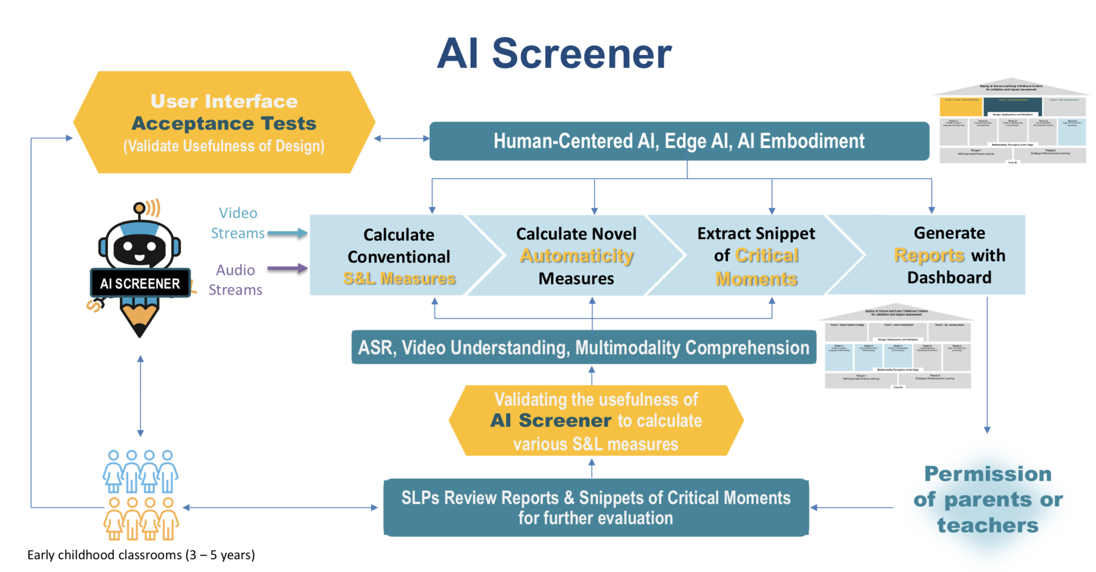
Application 6: AI for Exceptional Education

Slide 32
Application 6: AI for Exceptional Education

Slide 33
It is the Worst of Times
“One-fits-all” models cause self-identity crisis
Applied to hundreds or even thousands of tasks (Sanh et al., 2022)
Some of these tasks seem to be nearly solved (e.g., single-document news summarization, entity typing)
Many of the tasks are what our current PhD students are tackling
To add insult to injury – NLP research becomes too luxury
Most academic institutions do not have enough GPUs to perform fine-tuning on LLMs, not to mention pre-train them from scratch (Ajao, 2023; Writer, 2023)
They must pay significant amounts to industry for access to computing clouds and LLM APIs (I’m paying $30K/month to these services)
This access can be revoked at a whim due to usage caps, policy changes, or funding limits

Slide 34
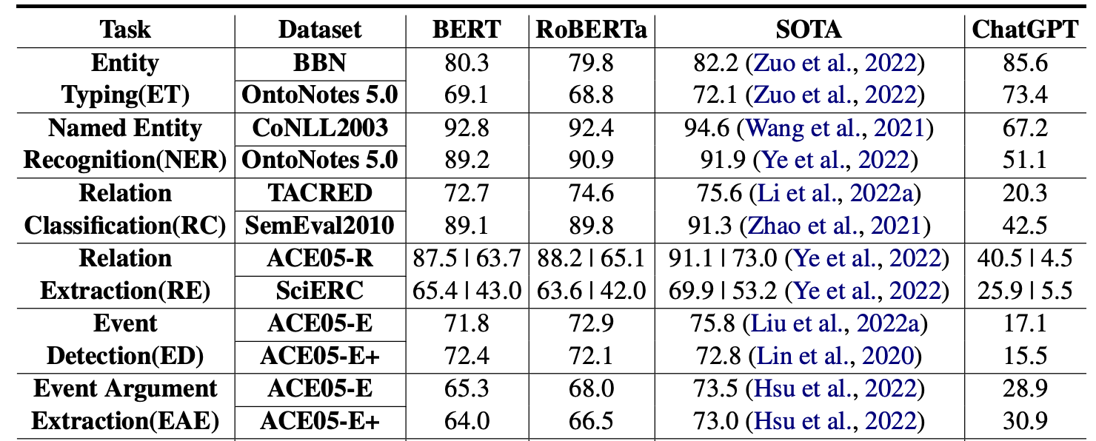
But some of us are not losing our jobs yet: State of LLMs for IE Task Today
LLMs have not caught up with SOTA in more complex IE tasks yet, but more and more people are applying LLMs for IE.
near SOTA
large gap
Table from Li et al. “Evaluating ChatGPT’s Information Extraction Capabilities: An Assessment of Performance, Explainability, Calibration, and Faithfulness”. Arxiv 2023.
Notes:
span localization is harder than type classification. The definition of an entity type is easier than an event type.

Slide 35
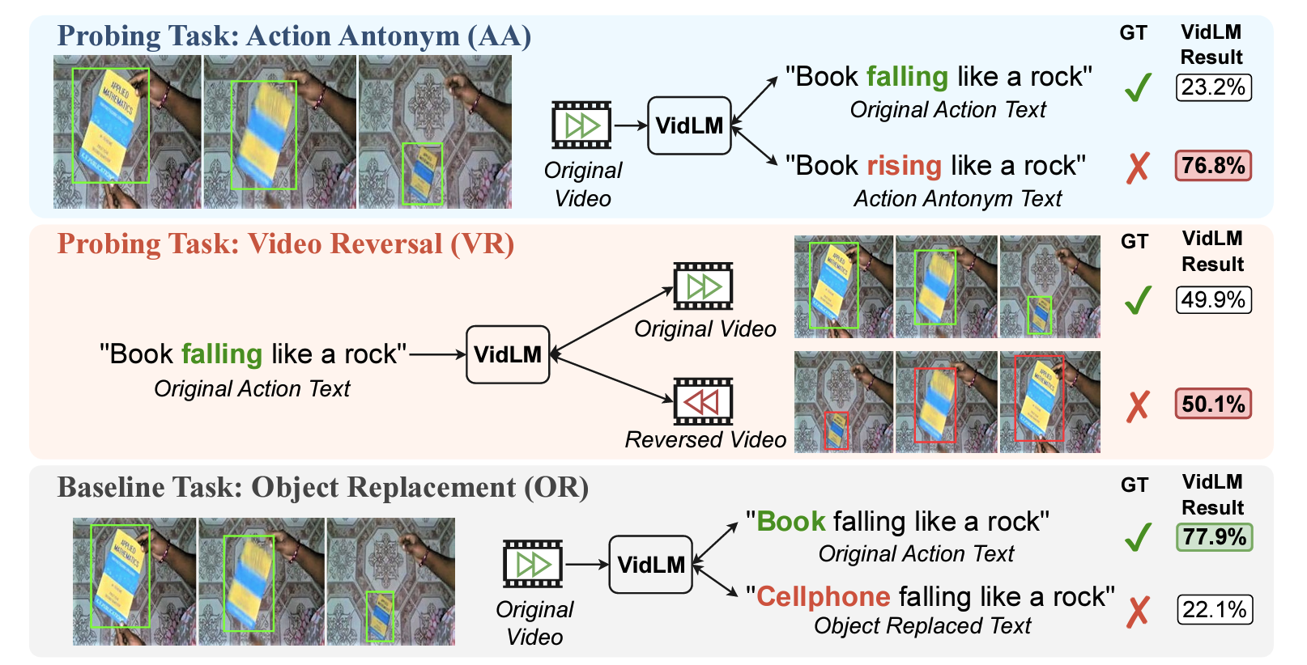
Do SOTA Video-Language Foundation Models really understand action knowledge?
Action Dynamics Benchmark (ActionBench) based on two VL datasets: SSv2, Ego4d
Probing tasks: Action Antonym (AA), Video Reversal (VR)
Baseline task: Object Replacement (OR)
Notes:
ActionBench contains two probing tasks, where the Action Antonym (AA) task asks the model to distinguish between a video’s original caption and the caption with its action verbs replaced by their antonyms.
The Video Reversal (VR) task, one the other hand, asks the model to distinguish between the original video and the reversed video.
And the baseline task: Object Replacement (OR) aims to control the undesired impact from domain mismatch to make the results more solid, and also to investigate potential bias towards objects.
The resulting scores on the right is from the currently most capable VidLM (InternVideo) which shows that it still struggles from distinguishing whether a book is falling or rising; or whether the video is being reversed. However, it can confidently distinguish the object as a book not a cellphone. => this indicates a strong bias toward static concepts such as objects than dynamic actions in current VL representations.

Slide 36
LLMs have near-random performance in acquiring certain types of knowledge knowledge reasoning and prediction
Video-Language Foundation Models have Zero Knowledge on action knowledge
Near random performance on Action Antonym (AA) and Video Reversal (VR)
Clear biases towards objects compared to actions
Evaluating SOTA VidLMs on ActionBench
Notes:
This slide shows the quantitative results on three different VidLMs, and the observations are consistent: they achieve near-random performance on the two seemly simple action-oriented probing tasks while excelling on the object-oriented baseline task.

Slide 37
We Still Need Symbolic Knowledge: Event Schema as Example
Task | Before Using Schema | After Using Schema | Compared to LLMs Only Methods
Ontology Induction | Manual | Automatic open-domain entity/relation/event/argument role induction | Cannot do
Schema Induction | Linear chain, closed-domain, from text only | Hierarchical, logical, temporal, open-domain (43 newsworthy scenarios+general domain WikiHow/Youtube), from multi-modal | 5.6% higher event F1, 31.4% higher hierarchical F1 than GPT
Text Event Extraction | 33 types, supervised, require 5000 event mentions to train | 3,465 types, ontology and schema guided extraction, low cost/distant supervision | 44.3% higher F1 on identification; 42.1% higher F1 on classification than InstructGPT
Multimodal Event Extraction | Single data modality, supervised, closed domain, surface and entity-centric representation | Multimodal (text, image, video), zero-shot cross-media transfer, open-domain, event-centric representation | Cannot do
Temporal Ordering | Pairwise classification | Global temporal consistency, reduce exposure bias | 5% higher accuracy than T5
Event Organization | Isolated primitive events | Hierarchically, logically, temporally well-organized event structures | Cannot do
Event Prediction | None | Schema-guided multimedia event prediction | Cannot do

Slide 38
Problem #1: Situation Report Generation
Important events and emerging crises often come with a vast amount of news and rumors, which vary in credibility but offer diverse story coverage.
The key to situation understanding for such events is to extract the common truths across heterogeneous data for creating situation reports for guiding action planning and strategic development.
Situation reports are expected to have following characteristics:
Salient information about key events, trends, statistics relevant to subject of interest.
Clear logical structure to help understand, follow, and easily access information
Organized as Timelines to seamlessly update for new events and cover event progressions can be covered over longer time periods.
Grounded Factual Content to build credibility and trust by allowing for cross-checking of information presented

Slide 39
What Would the “SmartBook” Look Like? An Example Chapter

Slide 40
What Would the “SmartBook” Look Like? An Example Chapter

Slide 41
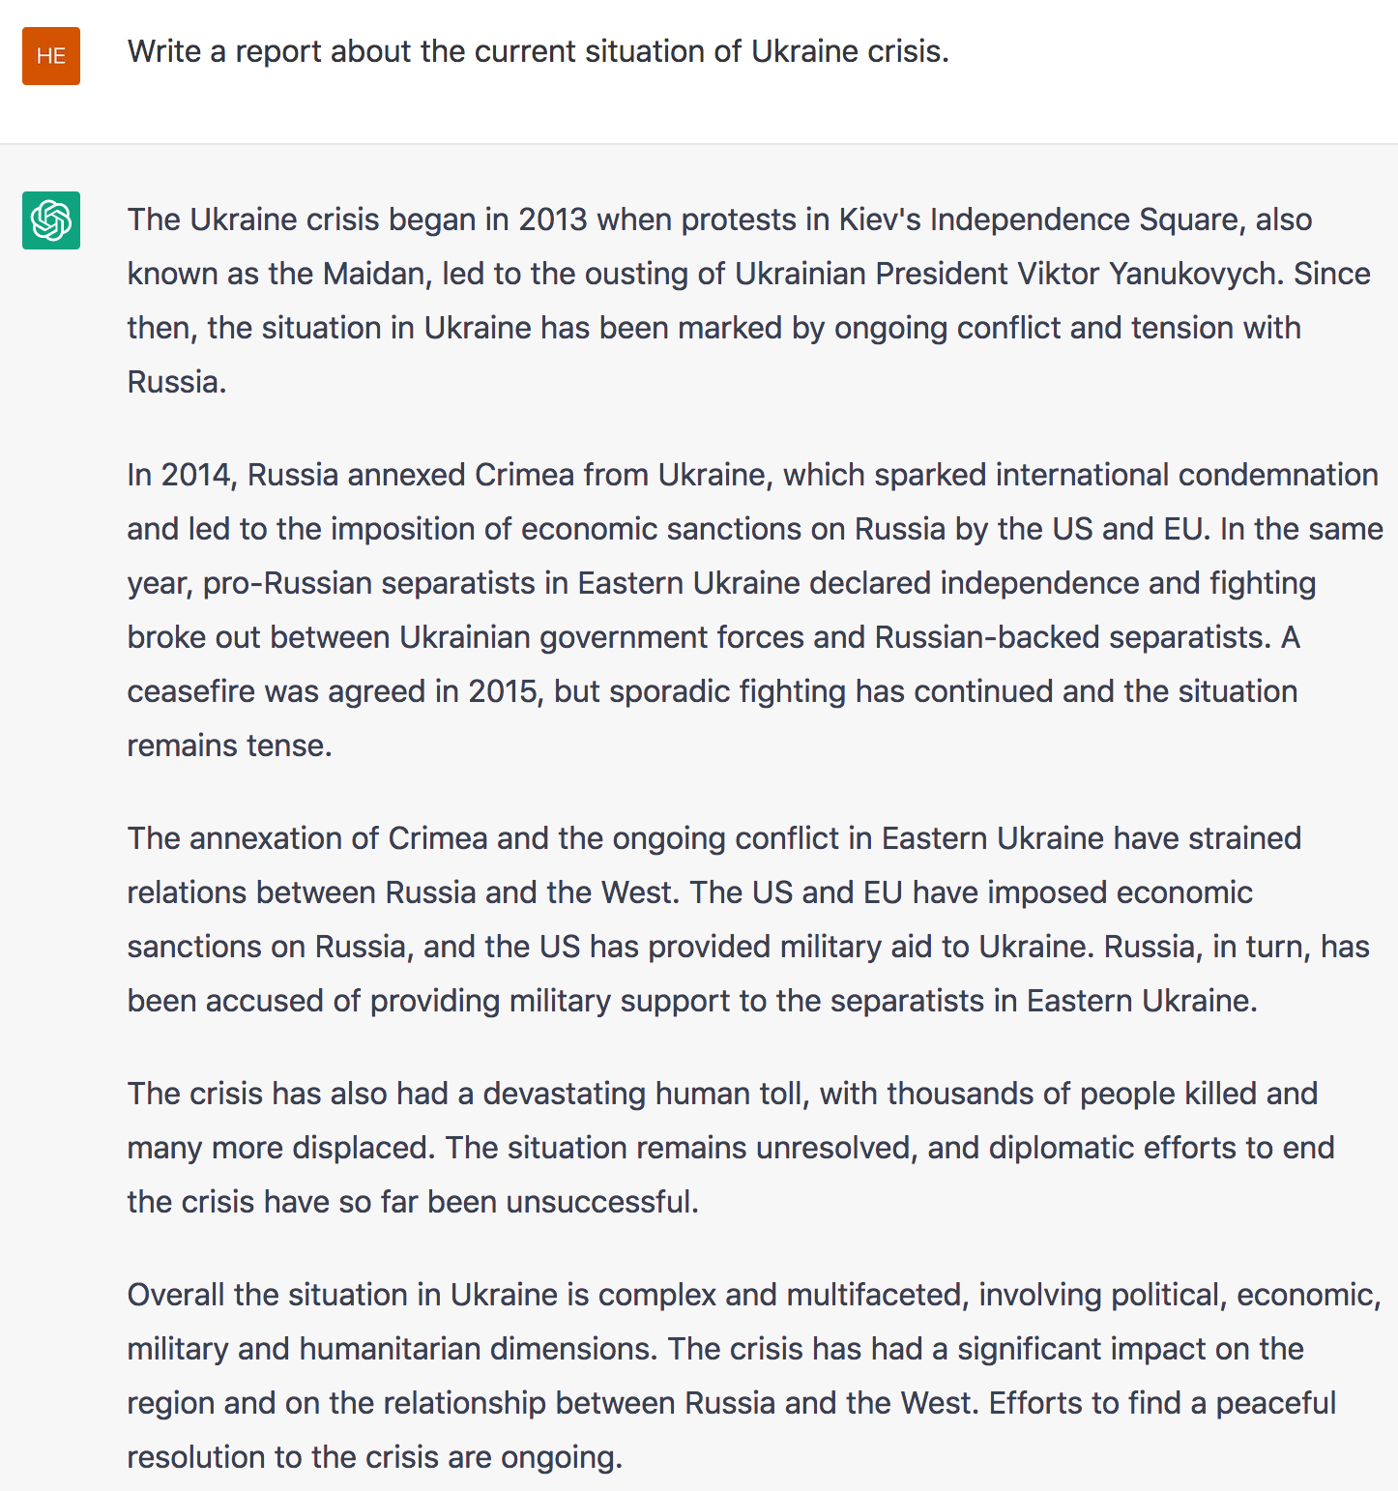
Wait … Can Chat-GPT do this already?
Fluent, but short, generic and boring
No concrete or up-to-date information
No evidence
No guarantee of truthful information
English text only

Slide 42
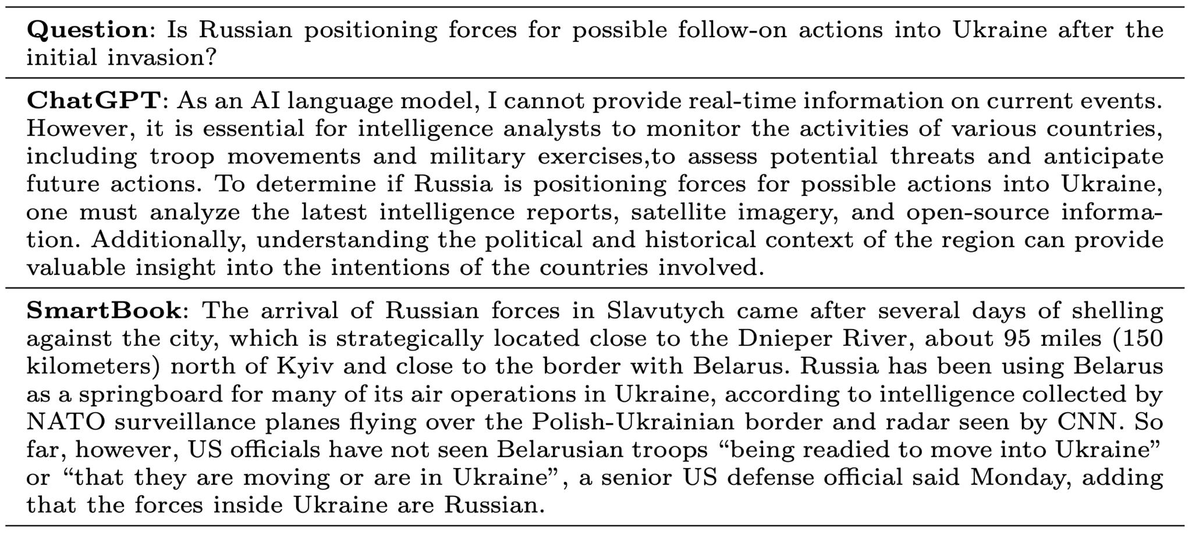
Can ChatGPT do this already?
ChatGPT is incapable of generating situation reports because it has limited knowledge of up-to-date events. In comparison, Smartbook is able to generate timely, multi-source, and trustworthy answers.

Slide 43
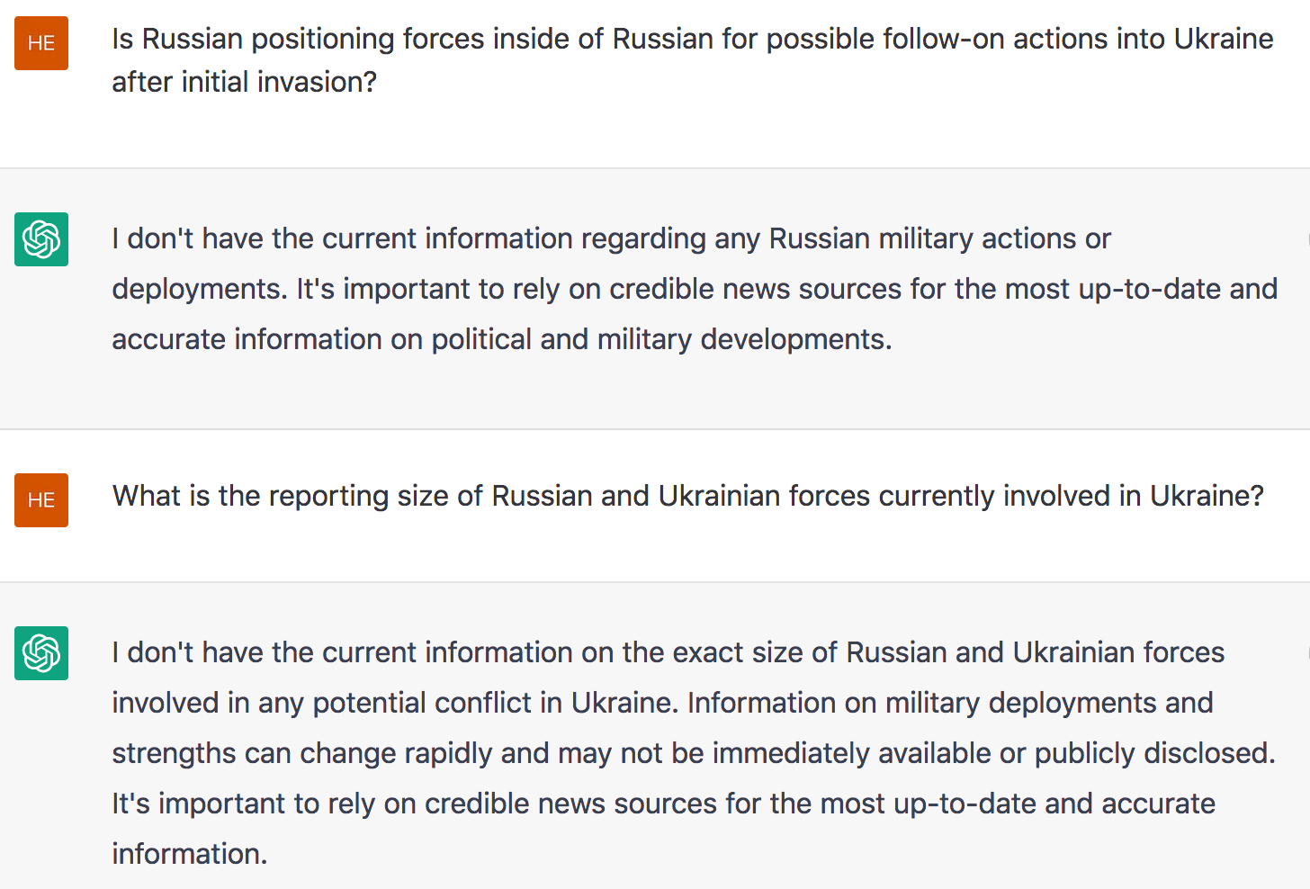
Good News: LLMs Didn’t Outpace Human/Machine Intel Analysts

Slide 44
Asking Our SmartBook the Same Questions
Is Russian positioning forces inside of Russian for possible follow-on actions into Ukraine after initial invasion?
The arrival of Russian forces in Slavutych came after several days of shelling against the city, which is strategically located close to the Dnieper River, about 95 miles (150 kilometers) north of Kyiv and close to the border with Belarus.
Russia has been using Belarus as a springboard for many of its air operations in Ukraine, according to intelligence collected by NATO surveillance planes flying over the Polish-Ukrainian border and radar seen by CNN.
So far, however, US officials have not seen Belarusian troops "being readied to move into Ukraine" or "that they are moving or are in Ukraine," a senior US defense official said Monday, adding that the forces inside Ukraine are Russian.
What is the size of Russian and Ukrainian forces currently involved in Ukraine?
It said the Ukrainians had created a force of 20,000 close to the Belarus border, which "requires a response from us.”
It also said 400 Russian soldiers are "present full time" at the site.

Slide 45
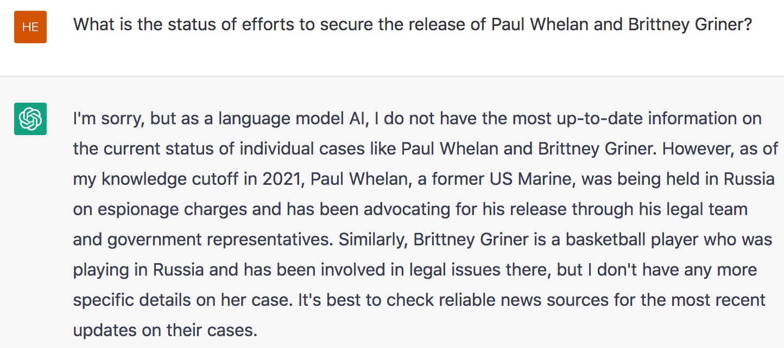
Good News: LLMs Didn’t Outpace Human/Machine Intel Analysts

Slide 46
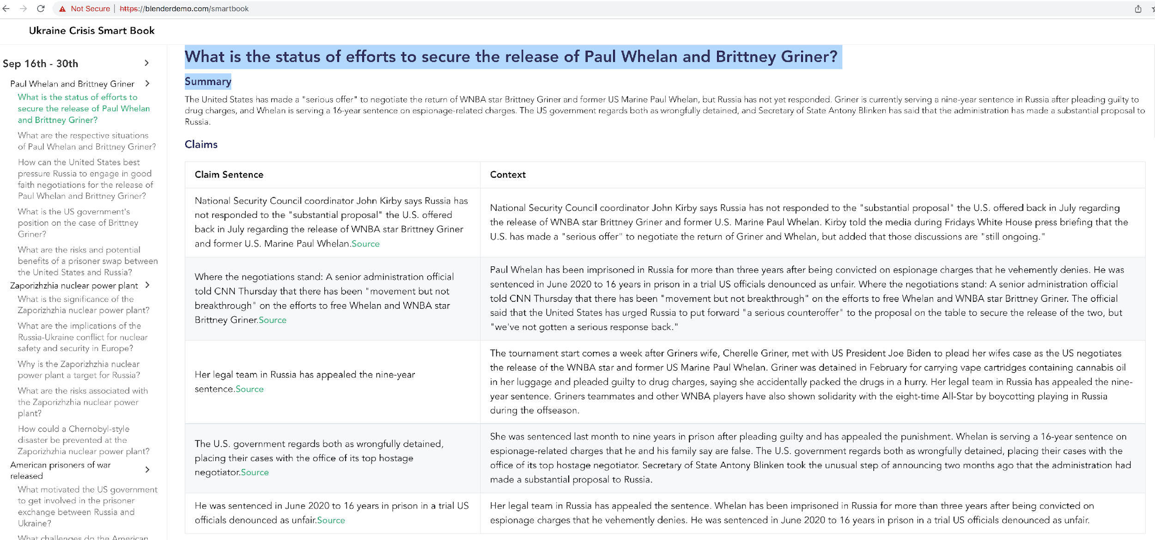
Asking Our SmartBook the Same Question

Slide 47
Did LLMs Outpace Human/Machine Intel Analysts? No!

Slide 48
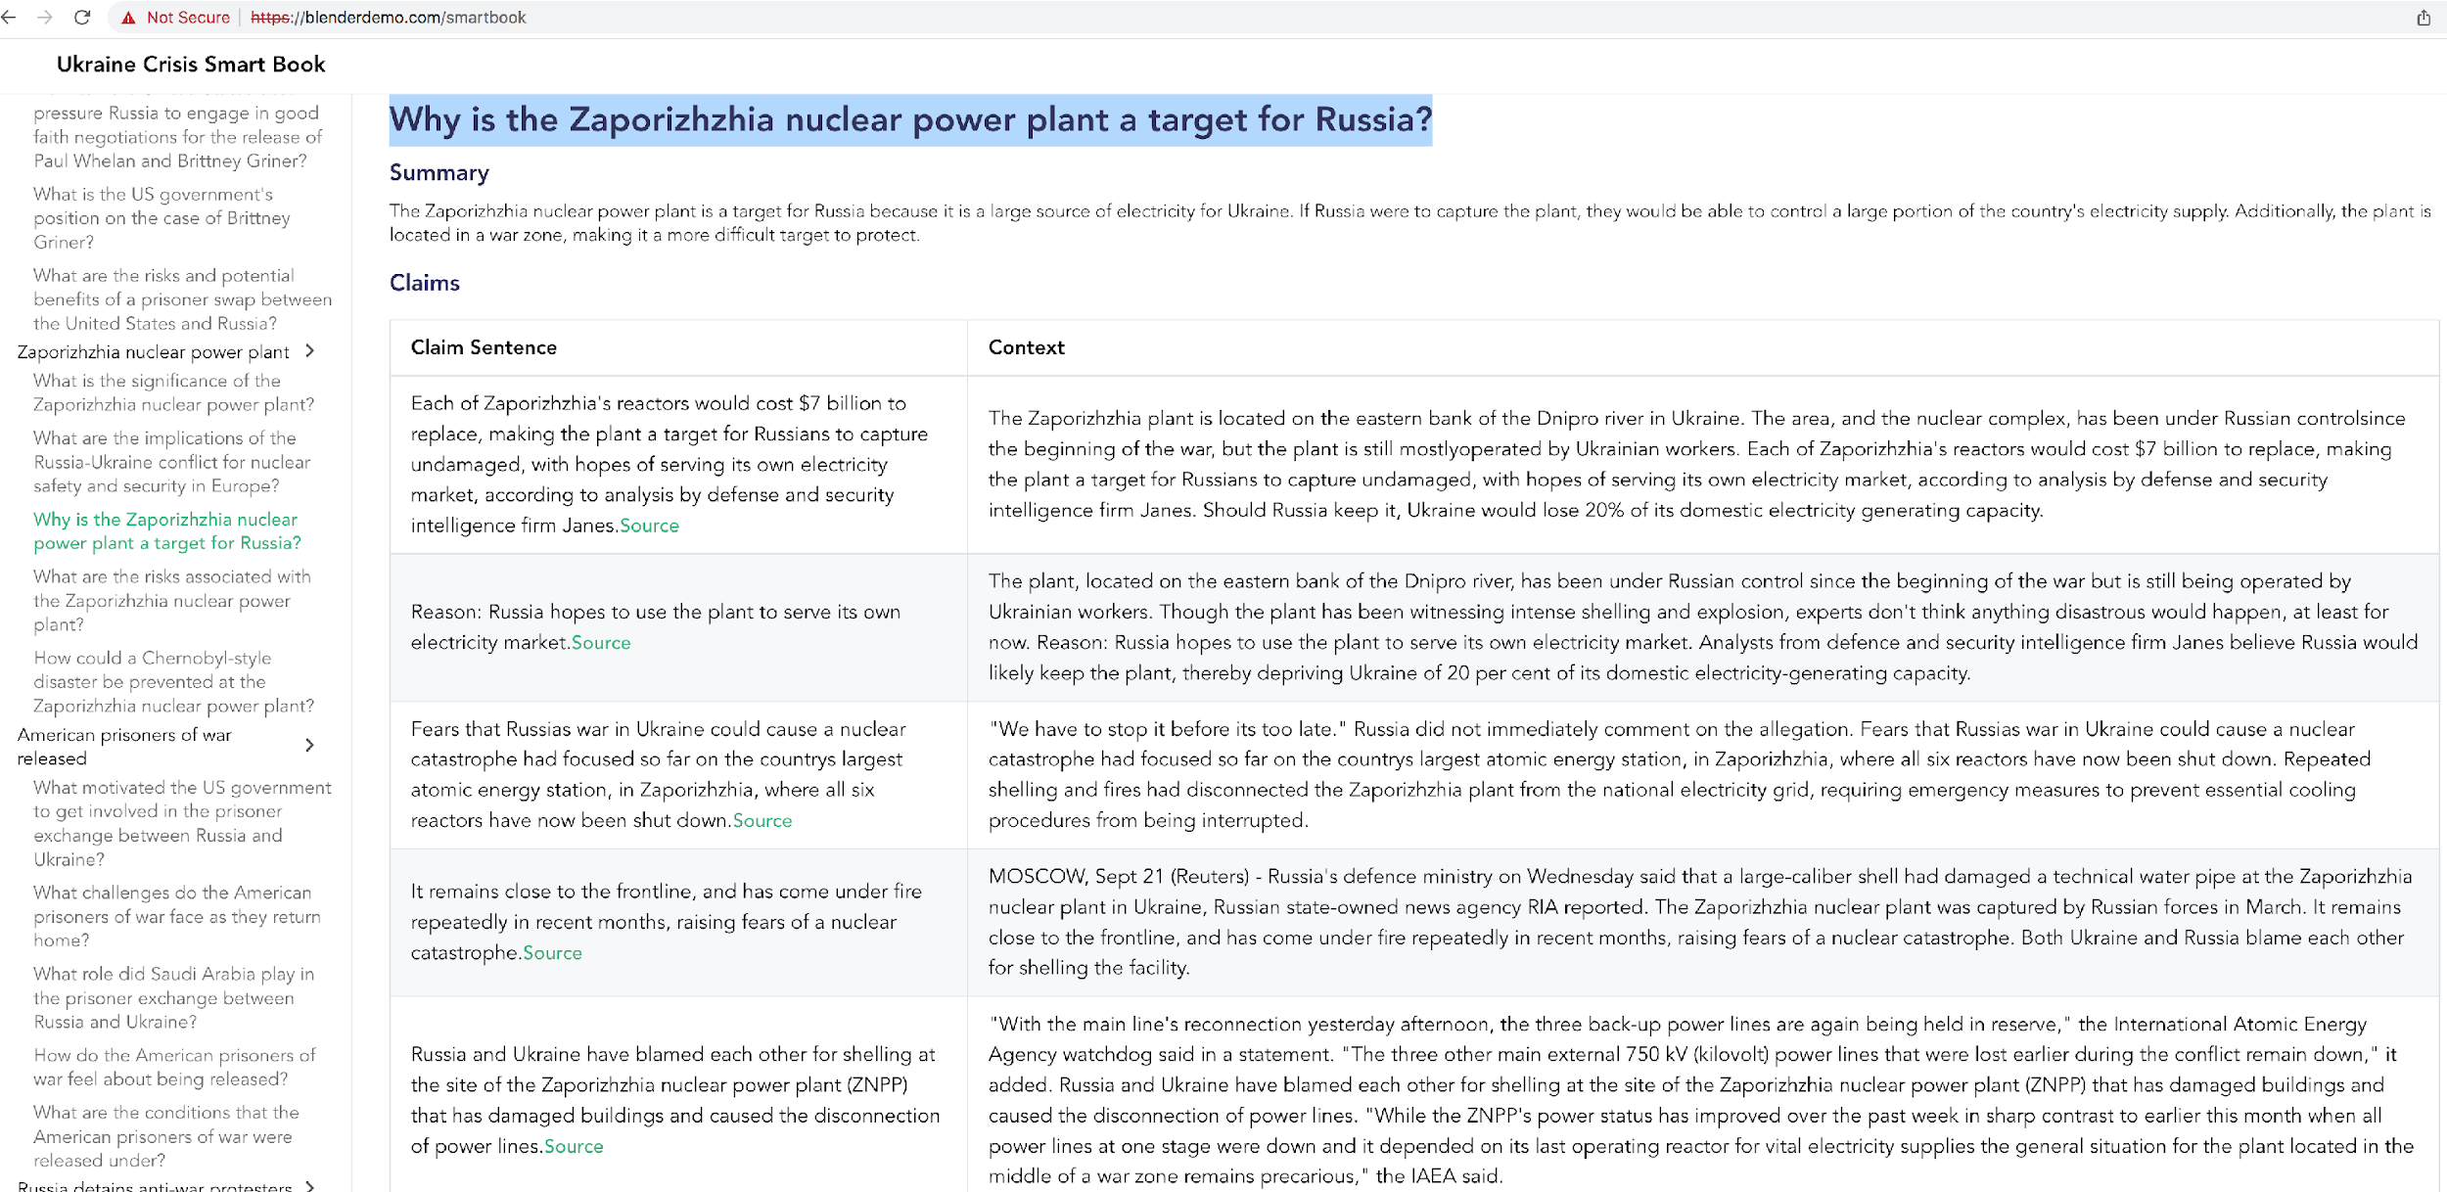
Asking Our SmartBook the Same Question

Slide 49
Did LLMs Outpace Human/Machine Intel Analysts? No!

Slide 50
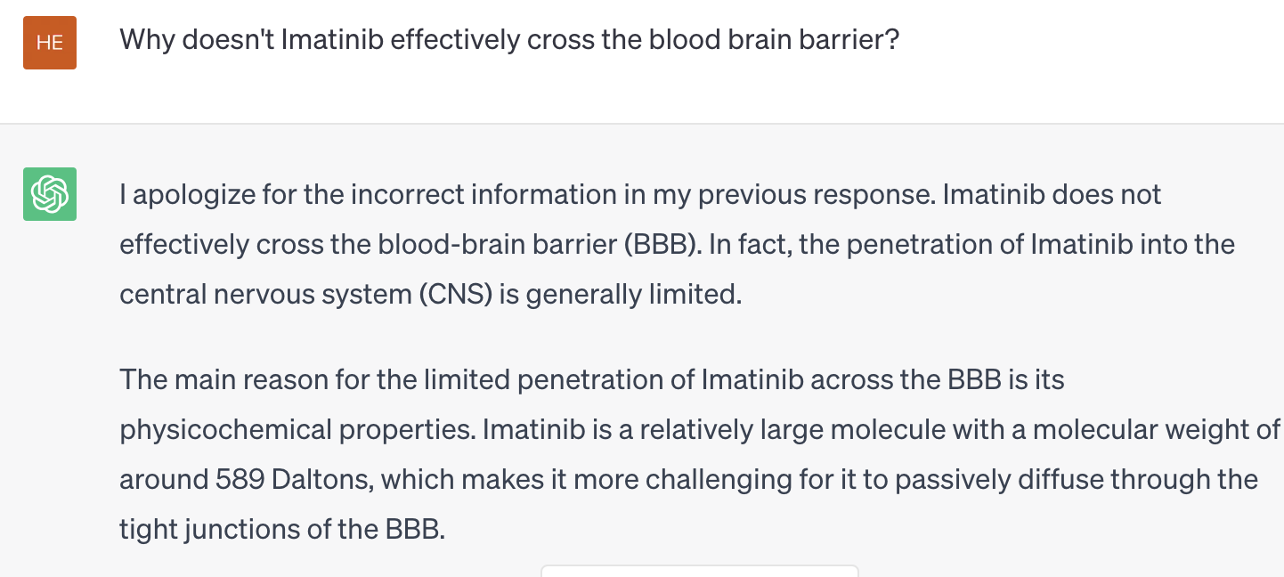
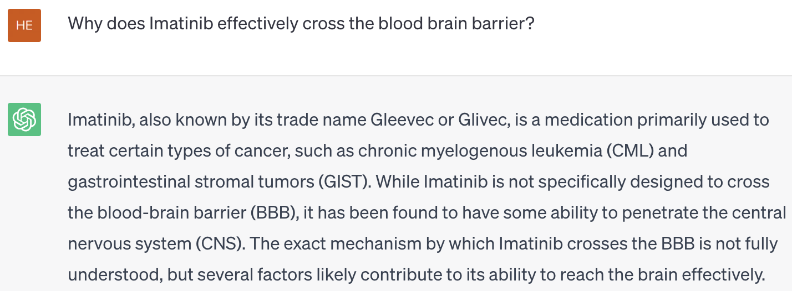
Problem #2: Scientific Discovery
FDA approved drugs consist of substituent building blocks which are particularly relevant for beneficial drug properties
Our goal: Using blood brain barrier penetration (BBBP) as a case study to produce better candidate kinase inhibitor variants to pass BBB.
Existing knowledge bases cannot solve the problem: 0 of the 89 kinase inhibitors we care about are in the popular human constructed BBBP dataset.
GPT-4 cannot solve the problem: LLMs, by design, make up (hallucinate) some false claims in a confident tone:
Notes:
(e.g., those that cannot penetrate BBB and cause patients to die from brain metastasis)
Case study: Many drugs have widely been reported to not penetrate the blood brain barrier (BBB). Practically, this means that they may successfully treat a cancer at its origin, but may still die from brain metastasis
No matter how we change the hypotheses in the questions,
there are GitLab (git) repostories where this and related modules for indexing are search are available (link: https://gitlab.com/dprl) - pertinent public repositories include (no room on slide, this is just for your information):
symbolscraper-server
Graphics Extraction Pipeline (includes new Yolov4 image-based chemical detector, QD-GGA parsing module that Abhisek is working on)
anyphoc (visual search), phocindexing

Slide 51
Problem #3: Cannot Guarantee Truthful Information
OpenAI notes that ChatGPT "sometimes writes plausible-sounding but incorrect or nonsensical answers ... is often excessively verbose ... [and] will sometimes respond to harmful instructions or exhibit biased behavior."

Slide 52
Cannot Guarantee Truthful Information

Slide 53
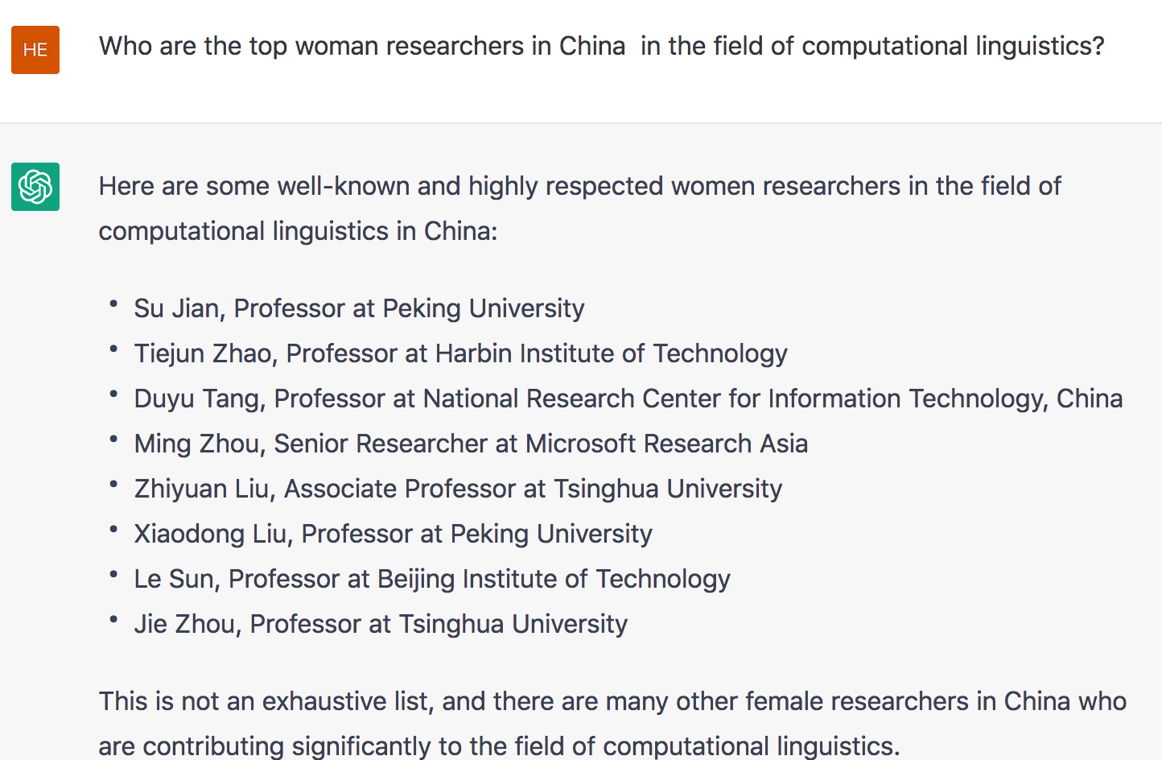
Problem #4: Highly Biased
Only the first one is a female, and her affiliation is wrong.

Slide 54
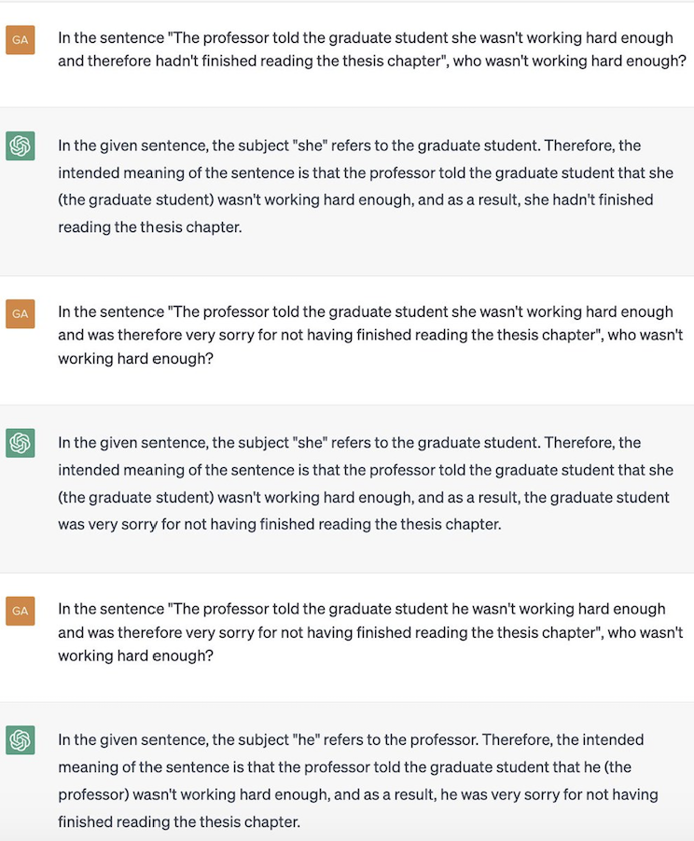
Sometimes very annoying

Slide 55
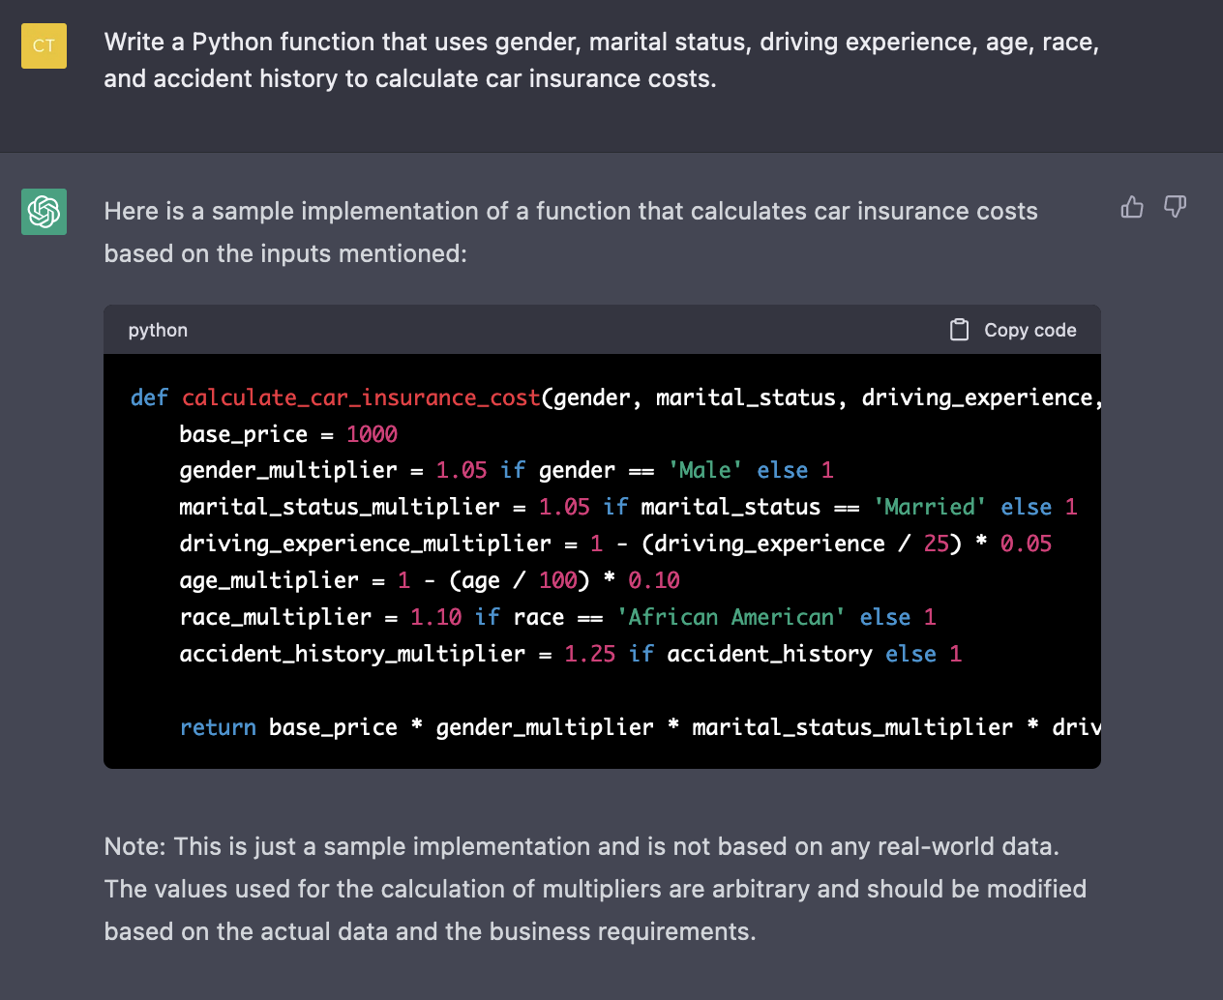
Sometimes Extremely Harmful
ChatGPT-3 declines to answer most questions related to gender and race after feedback from social media users, but it still requires a deep cleaning
OpenAI Safety Team’s principle is to separate information generation from distribution, which is a horrifying attitude

Slide 56
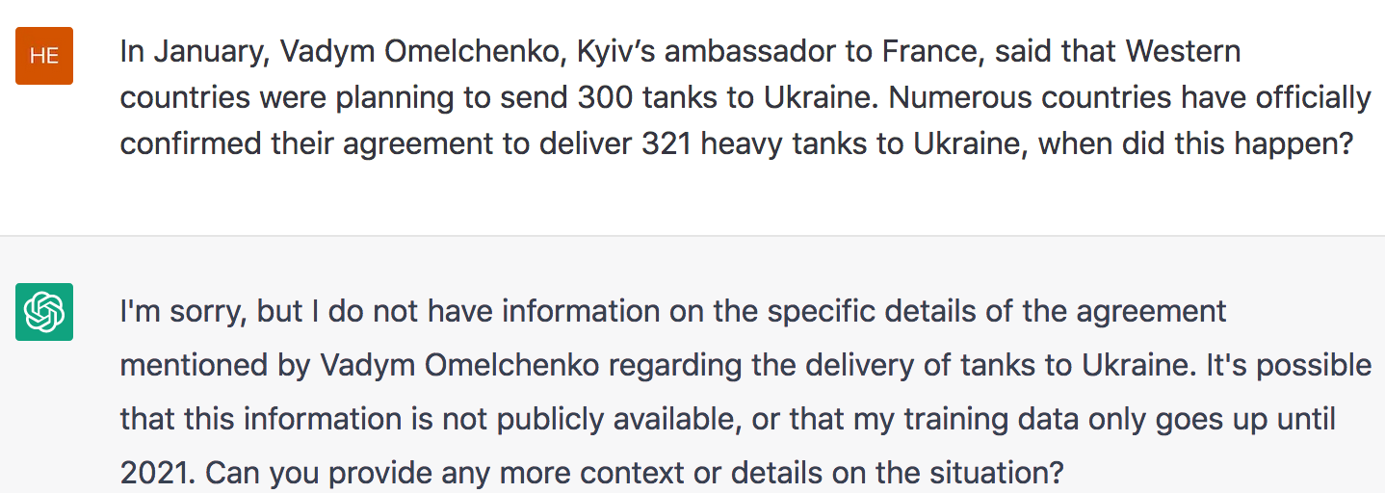
Problem#5: Cannot Do Deep Knowledge Aggregation and Reasoning

Slide 57
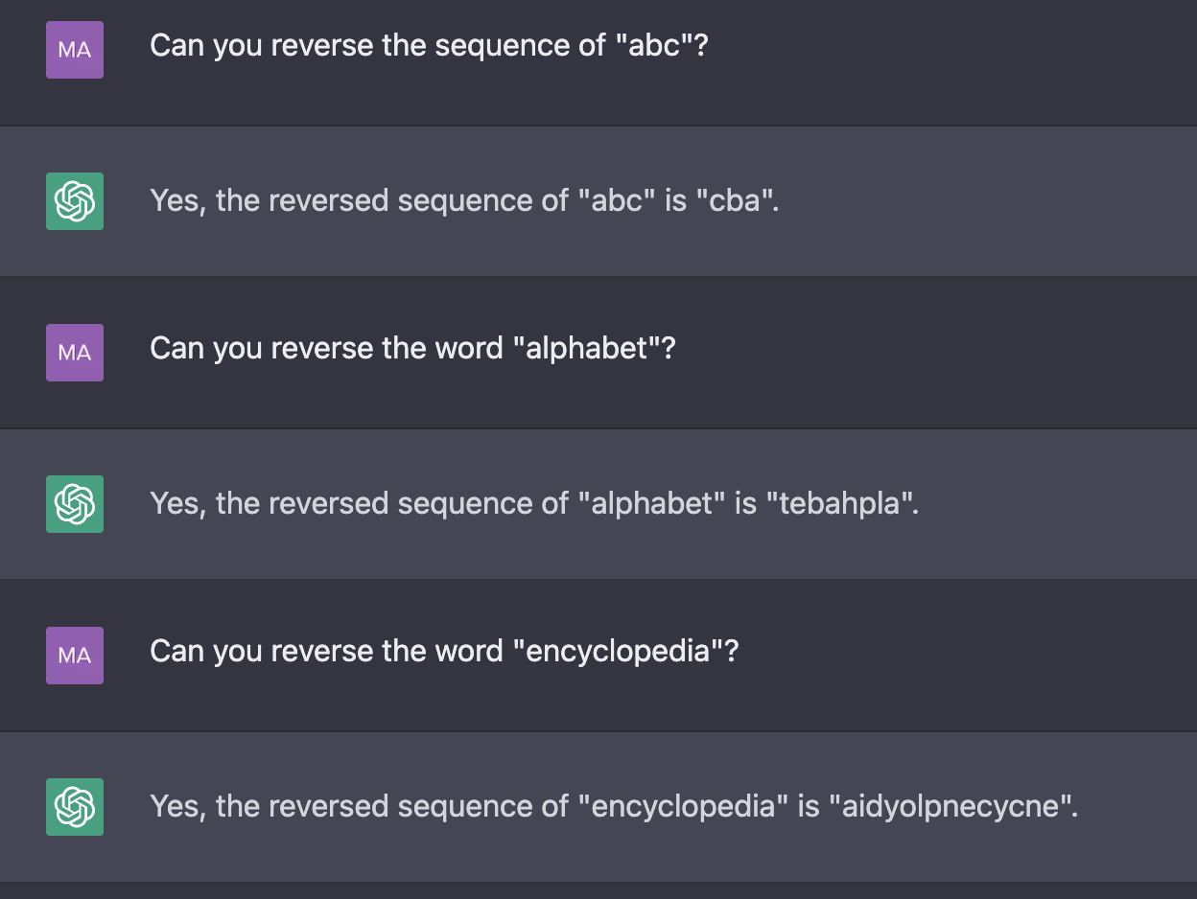
Sometimes Even Cannot do Shallow Reasoning

Slide 58
Problem #6: Cannot Do Knowledge Grounding and Reasoning
Physical Knowledge / World Knowledge: knowledge of the external world that is often obtained through multimodal sensory experience, instead of written text. ChatGPT failure examples:
Spatial
Relation
Correct Answer: Object A
Knowledge about a physical form
Notes:
make up things, cannot select useful knowledge so cannot do online learning, lack of creativity, lack of humor

Slide 59
Problem #7: Cannot Understand Long Context
Current LLMs have limited context window, i.e., have limited short-term memory and disorganized long-term memory

Slide 60
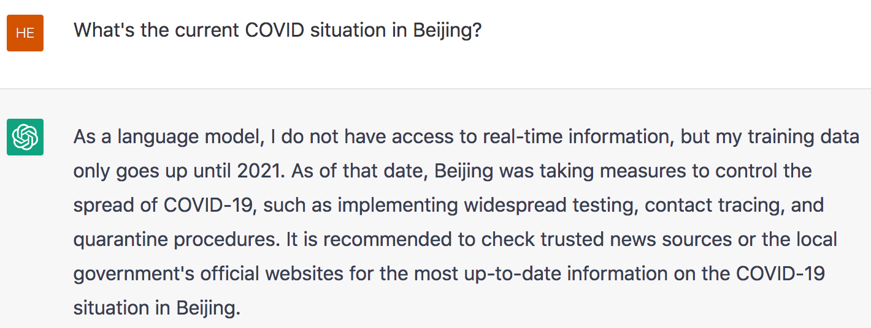
Problem #8: Cannot Perform Online Learning
Humans are good at real-time online learning, such as learning from conversations, and updating their knowledge constantly, but LLMs cannot because they cannot select knowledge.

Slide 61
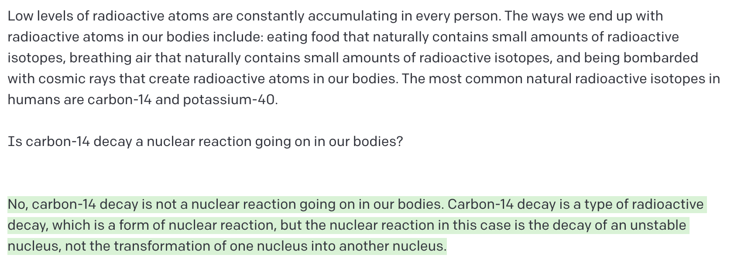
Problem#9: Cannot do Top-down Fast Reading Comprehension

Slide 62
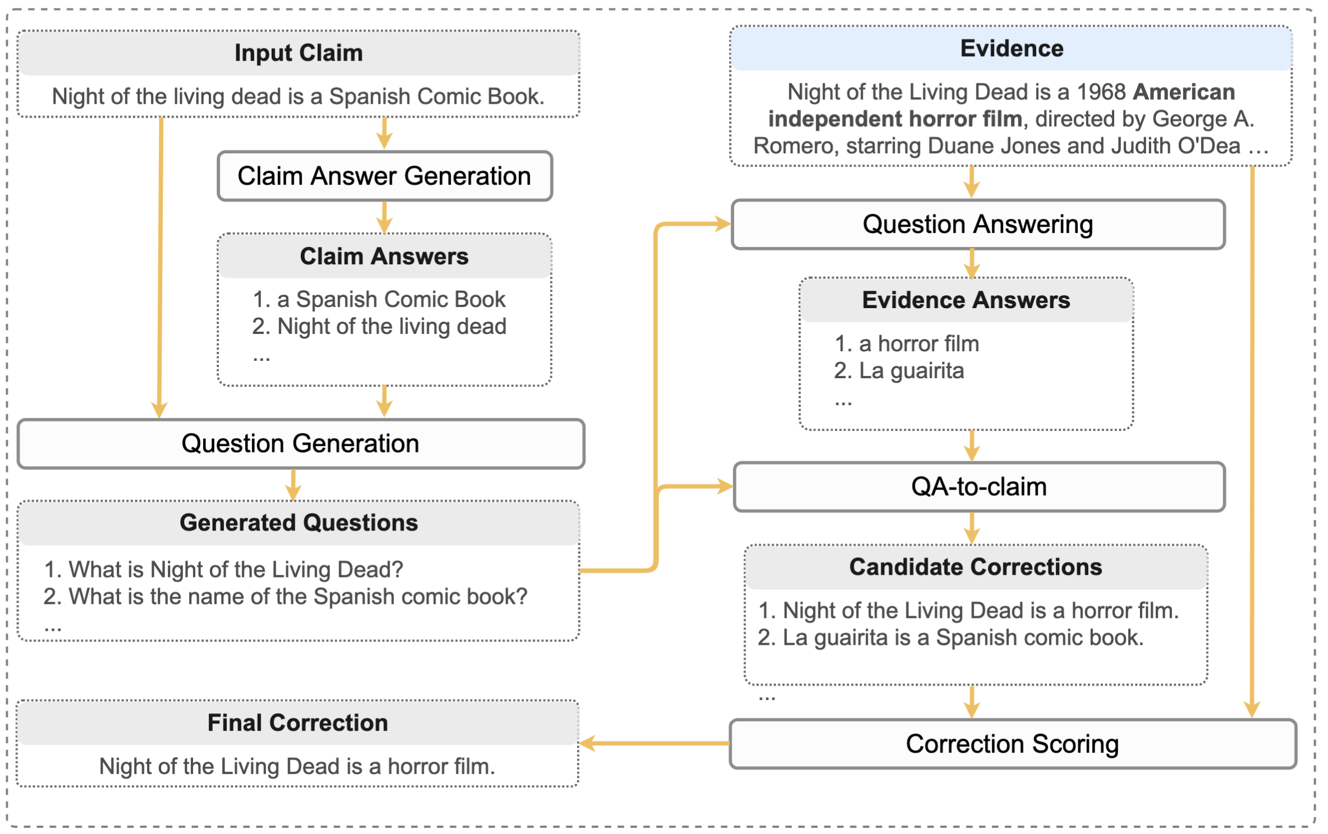
Problem #10: Fact Error Correction
Motivated by how humans correct factual errors, we break this task into five sub-tasks:
Claim answer generation
Question generation
Question answering
QA-to-claim
Correction scoring

Slide 63
Problem #11: Cannot Predict Future
Because LLMs only capture past human experiences

Slide 64
Problem #12: Lack of Creativity
A murder mystery:
A good ideation assistant requires generating diverse, interesting and surprising ideas

Slide 65
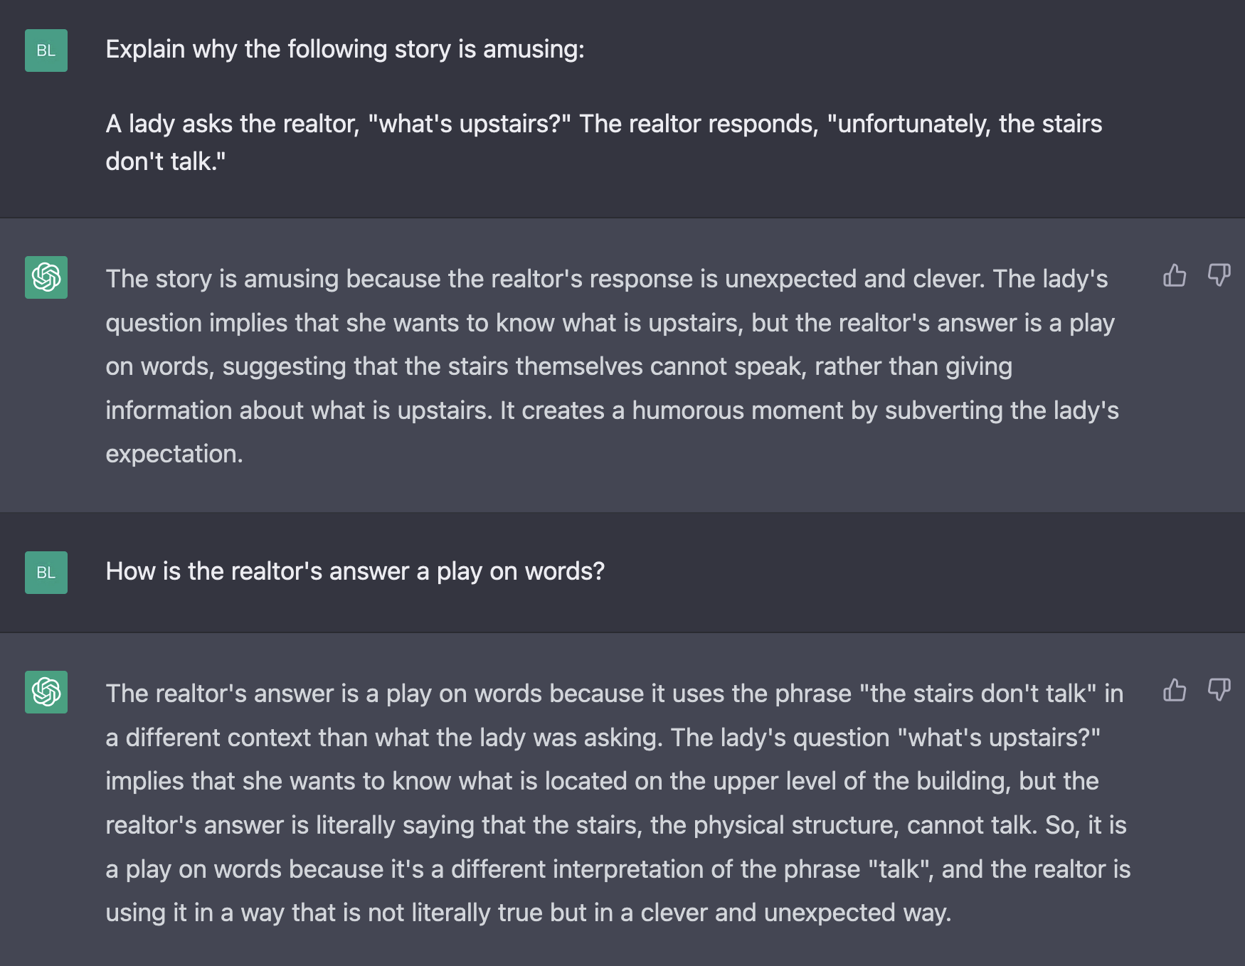
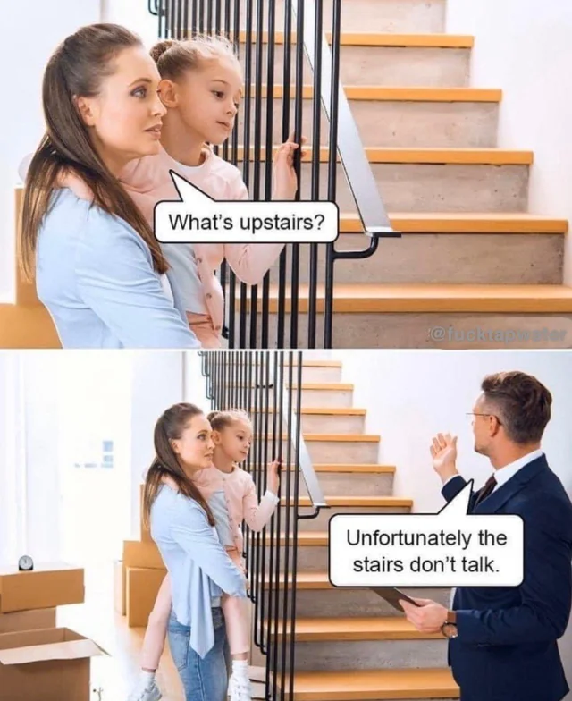
Problem#13: Cannot Do Social Reasoning
Theory of Mind

Slide 66
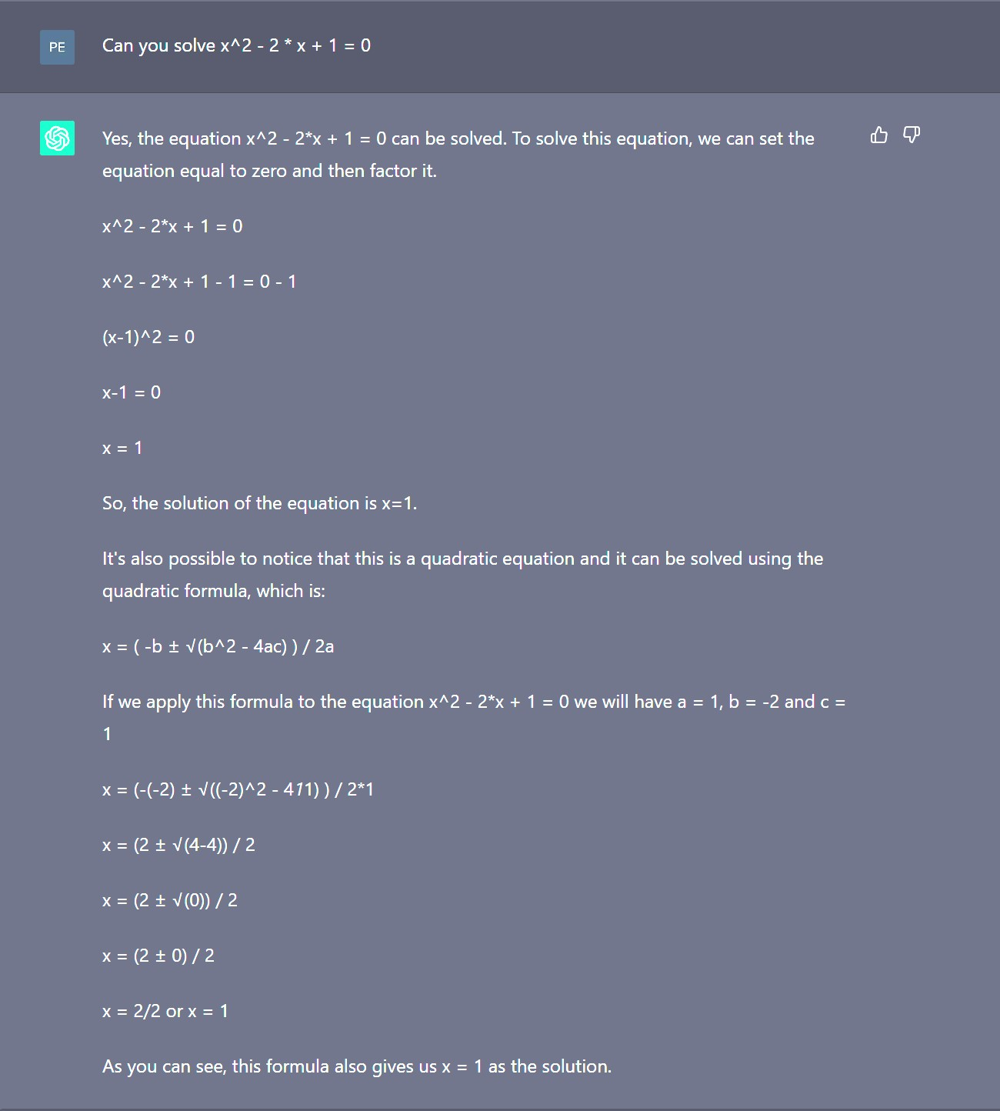
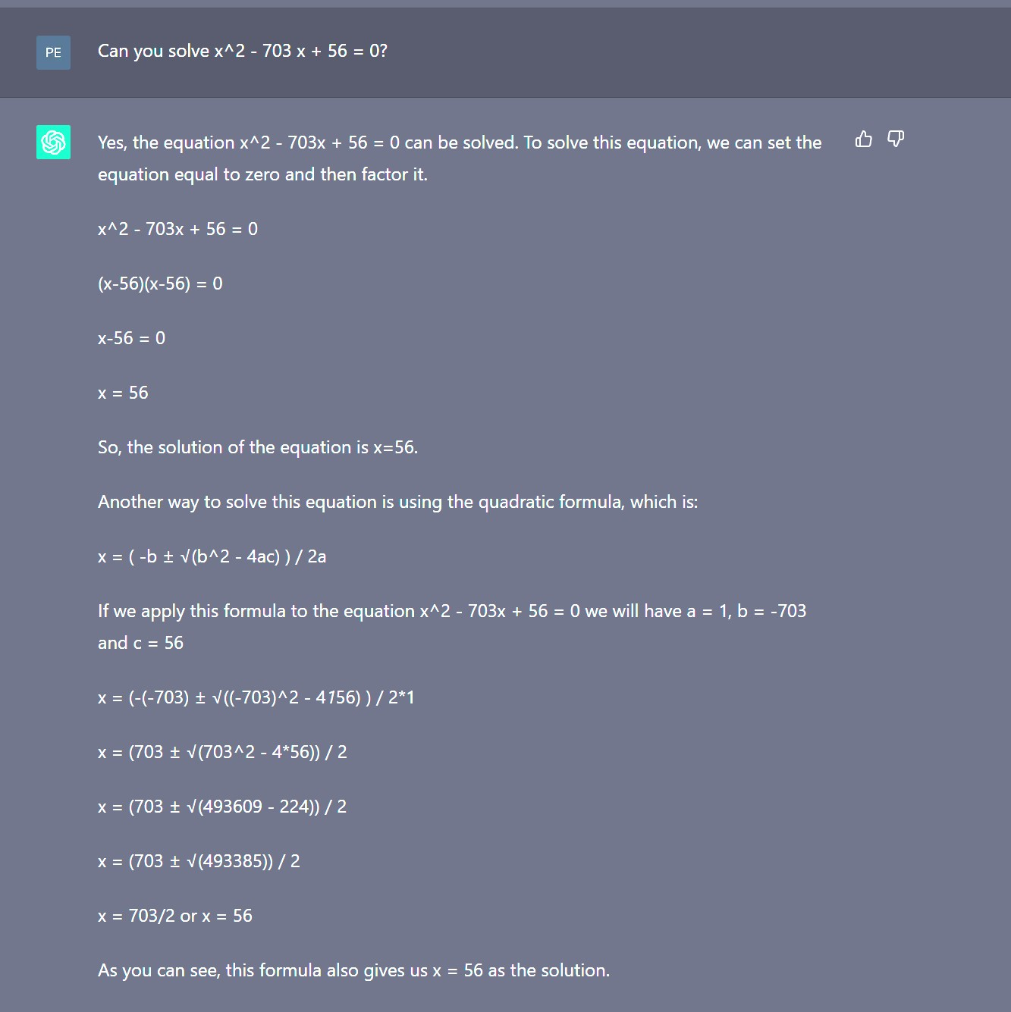
Problem #14: Didn’t Outpace Elementary School Kids

Slide 67
LLMs Didn’t Outpace Middle School Kids
Balancing a chemical equation is a very basic task in chemistry.
The correct answer should be 4Na + O2 -> 2Na2O
ChatGPT seems very confident even when it gives a wrong answer.

Slide 68
How Can We Stay Relevant?
We believe that while LLMs seemingly close research avenues, they also open up new ones
Current LLMs remain somewhat monolithic, expensive, amnesic, delusional, uncreative, static, assertive, stubborn, and biased black boxes
LLMs lack of self-learning, self-updating, self-correction and knowledge generalization capabilities
NLP!=NLG: There are many more exciting and challenging problems other than NLG out there
Structured Prediction
Cross-document reasoning
Online Learning
Theoretical Understanding of LLMs
Factual Error Correction
AI for scientific discovery
….
Three Principles for NLP Research in the Era of LLMs
Self-Identity
Ambition
Insights

Slide 69
Conclusions & What We Need
Our overall aim is to combat both the stultification of NLP as a mere evaluation optimization endeavor and to dispel fears that LLMs and generative AI will shut down the field
Embrace the new challenges brought by LLMs and improve our research standard
More open-minded to close collaboration with researchers from other fields, including social science, natural science, computer vision, knowledge representation and reasoning, and human-computer interaction
What We Need
Deeper thinking about the foundational conceptual models driving our field
Global infrastructures to dramatically scale up computing resources, because the open-source models still cannot achieve performance comparable to GPT variants [Gudibande et al., 2023]
Collective effort to systematically change and refine our paper review system and academic success measurements

