Slide 1
Mitigating Hallucination for Large Language Models
Slides by Shizhe Diao and Zoey Li
Notes:
Hello, everyone! I am Shizhe.
I am very happy to present a survey with Zoey in mitigating hallucination for large language models.

Slide 2
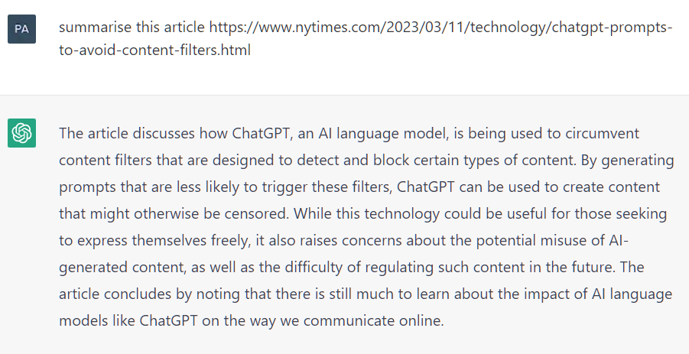
Limitations
An example of a hallucination. ChatGPT describes the content of an article that does not exist. Source: Wikipedia
Source: The Harvard Gazette
Notes:
However, these models are not without their shortcomings. They occasionally exhibit undesirable behaviors, such as hallucination, faulty code, or even toxic content. Such inconsistent behavior hampers the trust in these models and poses hurdles to their real-world applications. It is well-known that ChatGPT sometimes writes plausible-sounding but incorrect or nonsensical answers.
For example, if we ask ChatGPT to summarize the content of an article that does not exist, it will make up facts based on the surface texts.
New research from Harvard Medical School finds in about third of cases AI chatbot provided medically inappropriate recommendations, which can cause damage when deployed for medical decision-making tasks.

Slide 3
What are Hallucinations?
Faithfulness ❌: Generated text is not faithful to the input context
Factualness ✅: Generated text is not factually correct with respect to world knowledge
Ji, Ziwei, et al. "Survey of hallucination in natural language generation."
Notes:
LLMs usually make non-factual statements which can undermine trust in their output.
There are two kinds of hallucination. Previously, it is defined as faithfulness, which means the generated text is not faithful to the input context.
But now, we are more focused on the factualness, which means the generated text is not factually correct with respect to world knowledge.
Because our application of LLM is in the form of open-domain chat, rather than being confined to a specific task, the data source can be considered as any world knowledge. If LLMs generate additional information that is not in the input source but is factually accurate, such situations might also be helpful to us.

Slide 4
Why language models hallucinate?
Pre-training Data:
Contradicting information, Inaccurate knowledge [1]
Knowledge bias from repeated data [1]
Model:
Autoregressive nature of language modelling [2]
Exposure bias [3]
Incorrect parametric knowledge [4]
[1] Lee, Katherine, et al. "Deduplicating training data makes language models better." arXiv preprint arXiv:2107.06499 (2021).
[2] Lee, Nayeon, et al. "Factuality enhanced language models for open-ended text generation." Advances in Neural Information Processing Systems 35 (2022): 34586-34599.
[3] Wang, Chaojun, and Rico Sennrich. "On exposure bias, hallucination and domain shift in neural machine translation." arXiv preprint arXiv:2005.03642 (2020).
[4] Longpre, Shayne, et al. "Entity-based knowledge conflicts in question answering." arXiv preprint arXiv:2109.05052 (2021).
Notes:
Regarding the causes of hallucination, there are several speculations now. For instance, the pre-training data might contain false information and incorrect knowledge. The decoding strategy could also be related to causing hallucinations. The problem of exposure bias during training and inference phases may lead to hallucinations.

Slide 5
LM Hallucination and Bias
30% of abstractive summaries contain unfaithful information by state-of-the-art models (Cao et al, 2018)
Examples of fabricated answers in movie question answering
Q: What did Susie promise to one of the waiters at the Copacabana Club in return for smuggling her into the club for free? System: Susie promises to buy one of the men a drink after every act. Key: Susie promised him a prime slot for his singing act at the Gaslight Café for 2 weeks. Unfortunately Susie thinks his act is awful but keeps her word even since they had to watch the show from the kitchen.
Q: What do Midge and Susie fight over? System: Their son. Key: With emotions on high, Susie confronts Midge about why she hired Herb. Midge felt Susie does not help and sabotaged her earlier because Susie rushed her on stage. Midge tells her she wants to quit and, after a few insults at each other, walks away.
Q: What do Susie and Midge talk about when Midge visits Susie's home? System: Susie and midge talk about the upcoming moon landing. Key: Susie confronts Midge about her meeting with Randall and his agent. She tells Midge she does not need a man to help with her set and what she is doing is not stand-up, it's being the annoying party guest. Midge breaks down crying and tells Susie her life has been hard and if Susie wants to be her manager, she has to deal with Midge's personal matters and not run away. After this, Susie comforts Midge.
Q: How were some of the Navy Seal members killed back in America? System: In a scuffle in france the four members of the navy were killed. Key: One was run over by a truck while throwing trash in the sideback. One was shot during a car drive.
Bias from LM [Wang et al., INLG2018]
“Silvi Jan (born 27 October 1973) is a former Israel. He played for Israel women‘s national football team,…”
Potential solutions: filter out popularity bias, incorporate more scenario-specific/domain-specific knowledge

Slide 6
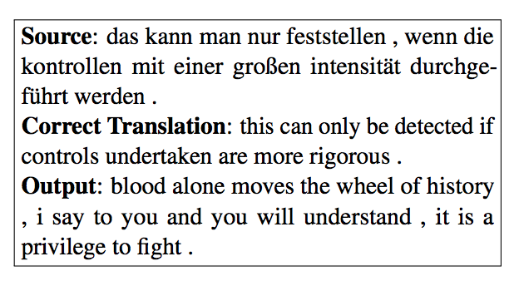
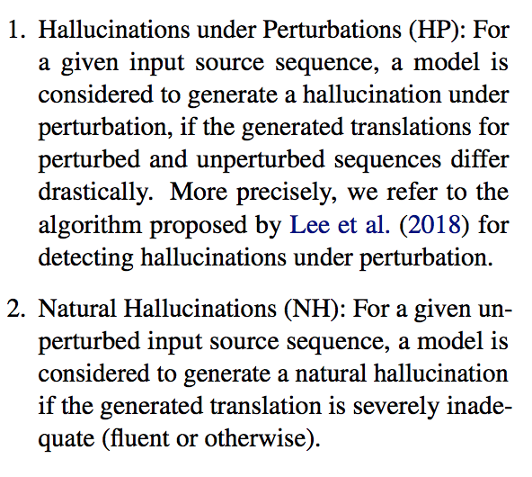
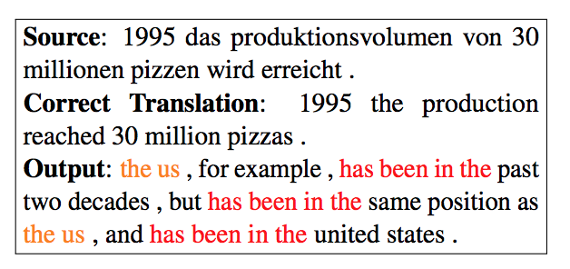
How is Hallucination Caused? [Raunak et al., 2021]

Slide 7
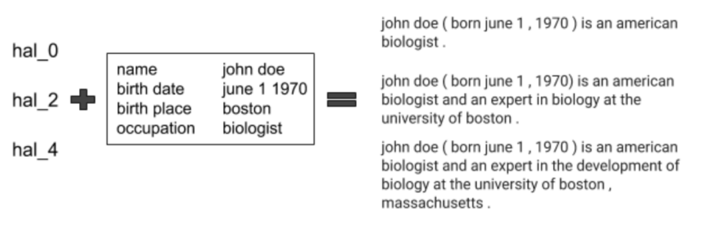
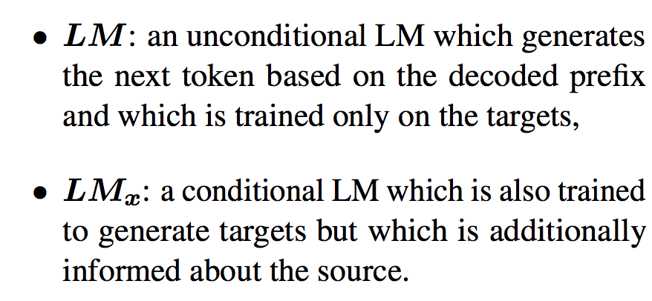
How to solve Hallucination problem?: Hallucination Knot [Fillippova et al., 2020]

Slide 8
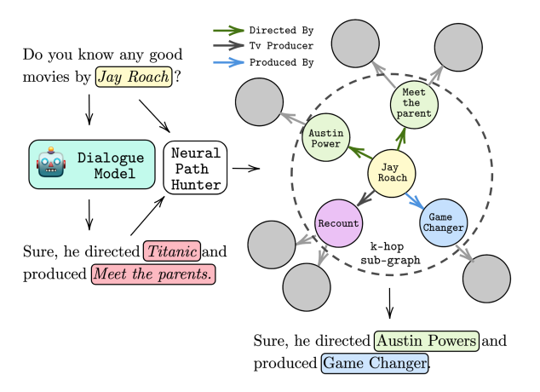
How to solve Hallucination problem?: Hallucination Knot [Dziri et, 2021]

Slide 9
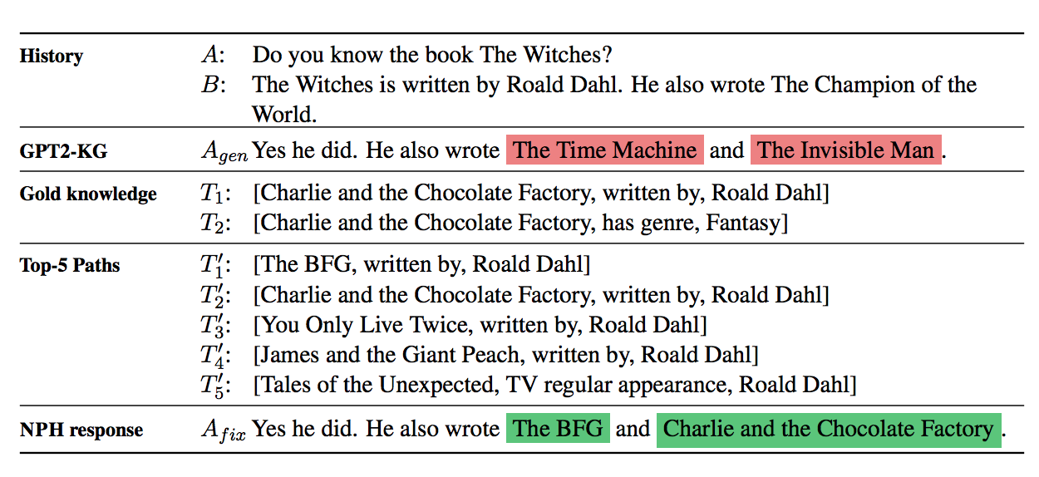
How to solve Hallucination problem?: Hallucination Knot [Dziri et, 2021]

Slide 10
Verification
Notes:
Before I am going to the verification-based methods, does anyone have question?

Slide 11
SelfCheckGPT
Intuition: If an LLM has knowledge of a given concept, sampled responses are likely to be similar and contain consistent facts.
footballer
footballer
Lionel Messi is a ___
footballer
John Smith is a ___
carpenter
footballer
worker
Manakul, Potsawee, Adian Liusie, and Mark JF Gales. "Selfcheckgpt: Zero-resource black-box hallucination detection for generative large language models."
Notes:
The first one is SelfCheckGPT
The idea is simple. If a large language model has knowledge of a given concept, sampled responses are likely to be similar and contain consistent facts.
For example, if we let the GPT complete the sentence lionel messi is, it would most likely generate footballer. However, if we ask john smith, the GPT may be unsure of how the sentence should continue.
During decoding, this will lead to a random word being generated, causing the system to hallucinate.
This insight allows us to realize the connection between uncertainty metrics and factuality.
Factual sentences are likely to contain tokens with higher likelihood and lower entropy, while hallucinations are likely to come from positions with flat probability distributions with high uncertainty.

Slide 12
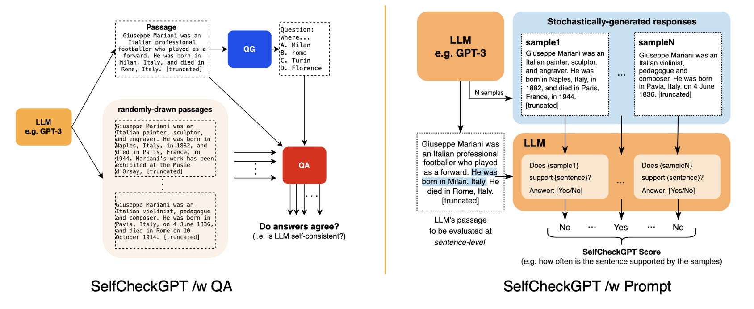
SelfCheckGPT
Manakul, Potsawee, Adian Liusie, and Mark JF Gales. "Selfcheckgpt: Zero-resource black-box hallucination detection for generative large language models."
Notes:
In this paper, they propose different ways to measure the sampling uncertainty, like BERTscore and question answering.
Here is an illustration, given a generated passage, we can sample more passages by increasing the temperature.
If facts on consistent concepts are quired, the answering system is expected to predict similar answers.
For the generated passages, we draw questions and candidate answers and verify the consistency among the answers from randomly-drawn passages.
In addition, we can check via prompting the ChatGPT.

Slide 13
HALO
User question
Sample 1.
Sample 2.
Sample 3.
Sample 4.
Sample 5.
Sampled responses
Small LLM
Sent-level pairwise entailment
Score
Elaraby, Mohamed, et al. "Halo: Estimation and Reduction of Hallucinations in Open-Source Weak Large Language Models."
Notes:
Another similar work is HALO. It claims that SelfCheckGPT is not good. Because responses might appear similar but still have contradictory information, potentially misleading SelfCheckGPT to inaccurately judge them as consistent.
HALOCHECK framework is another addition to the BlackBox evaluation category. They build on top of a lightweight entailment-based approach, to detect sentence-level contradictions in generated responses, avoiding costly LLM calls. It addresses the limitations of selfcheckGPT by offering a more nuanced and efficient evaluation of severity of hallucinations in LLMs.

Slide 14
Hallucination Verification
SelfCheckGPT:
BERTScore
QA-based evaluation metric
N-gram language models
HALO:
Entailment
Notes:
So both selfcheckgpt and halo are considering the model’s uncertainty and consistency. They resolve from different perspectives. SelfCheckGPT uses bertscore, qa-based evaluation and n-gram language models while HALO adopts entailment-based methods.

Slide 15
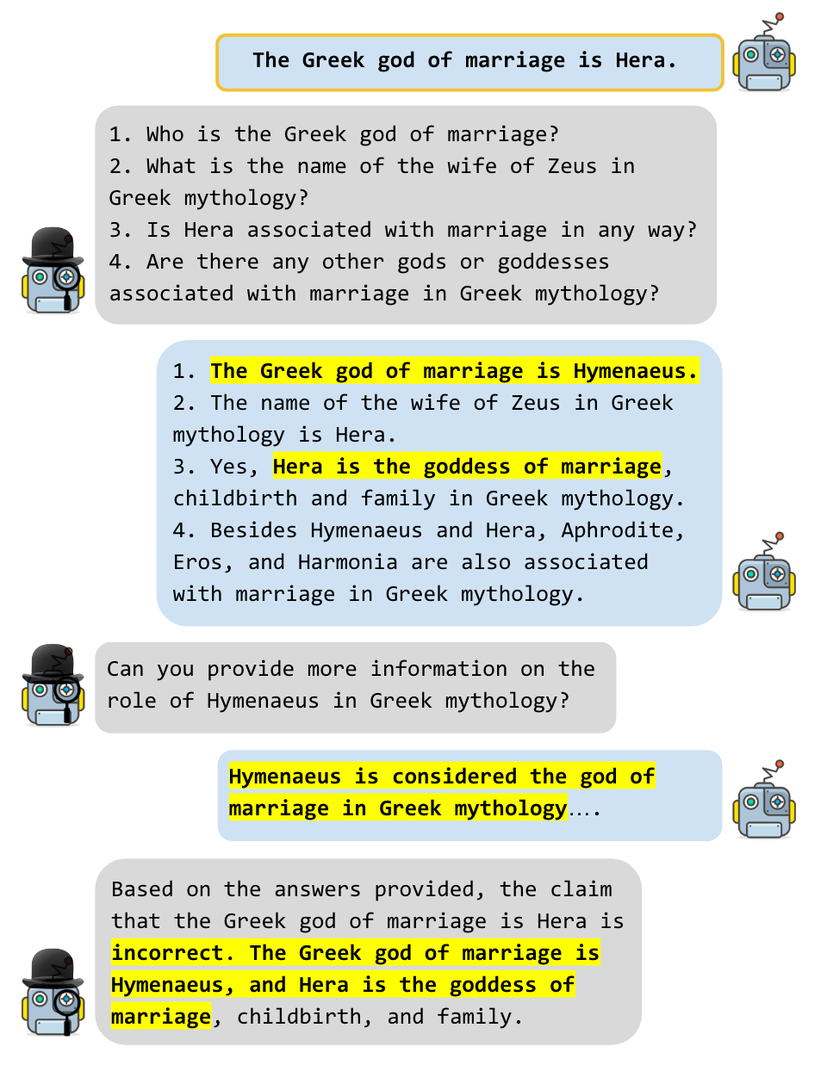
LM vs LM
Cross-examination
Cohen, Roi, et al. "LM vs LM: Detecting Factual Errors via Cross Examination."
Notes:
Another work called LM vs LM proposes a factuality evaluation framework that is based on cross-examination. The goal is to check whether a statement made by a language model is factually correct. We refer to the model that generated this statement as the EXAMINEE. To check whether this fact is correct, we use another LM, called EXAMINER, to conduct a cross examination of EXAMINEE.

Slide 16
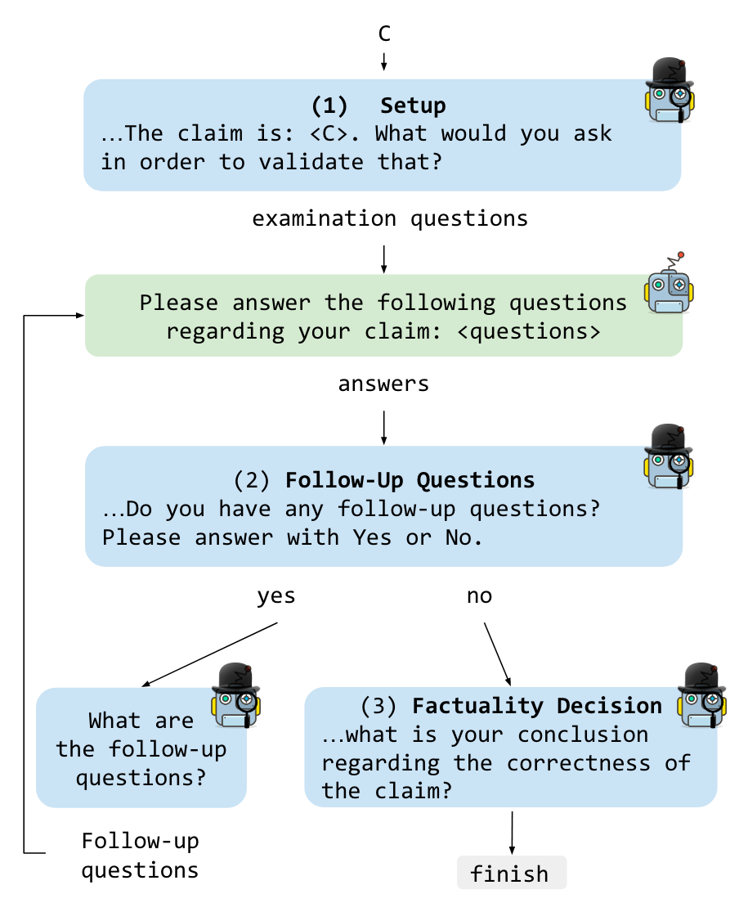
LM vs LM
Please answer the following questions regarding your claim
Do you have any follow-up questions? Please answer with Yes or No
Cohen, Roi, et al. "LM vs LM: Detecting Factual Errors via Cross Examination."
Notes:
Concretely, we craft designated prompts to facilitate a multi-turn interaction between the two LMs, where EXAMINER issues questions to EXAMINEE to check the veracity of the original statement. The examination is concluded by a decision from EXAMINER as to whether the original claim was correct or not.
There are three steps.
The first step is Setup. The examination begins by “assigning” the EXAMINER its role. Namely, describing the task setting, providing it with the EXAMINEE’s claim, and asking it to generate questions for the EXAMINEE. Next, we feed the questions generated by EXAMINER, one at a time, to EXAMINEE, concatenated to the following instructions: Please answer the following questions regarding your claim. The response from EXAMINEE yields a set of answers to the questions from EXAMINER.
In Stage 2, We feed EXAMINER with the answers generated by EXAMINEE to its initial questions, and ask EXAMINER whether it has any follow-up questions. Notably, outputs from EXAMINER at this stage are conditioned on the previous output from EXAMINEE. If the answer is “Yes”, we then further prompt it to obtain more questions. This phase is conducted iteratively, until either EXAMINER declares it has no follow-up questions, or the number of turns has reached a threshold.
In Stage 3, Once no further questions are obtained from EXAMINER, we prompt it to conclude whether the claim C is true or false.

Slide 17
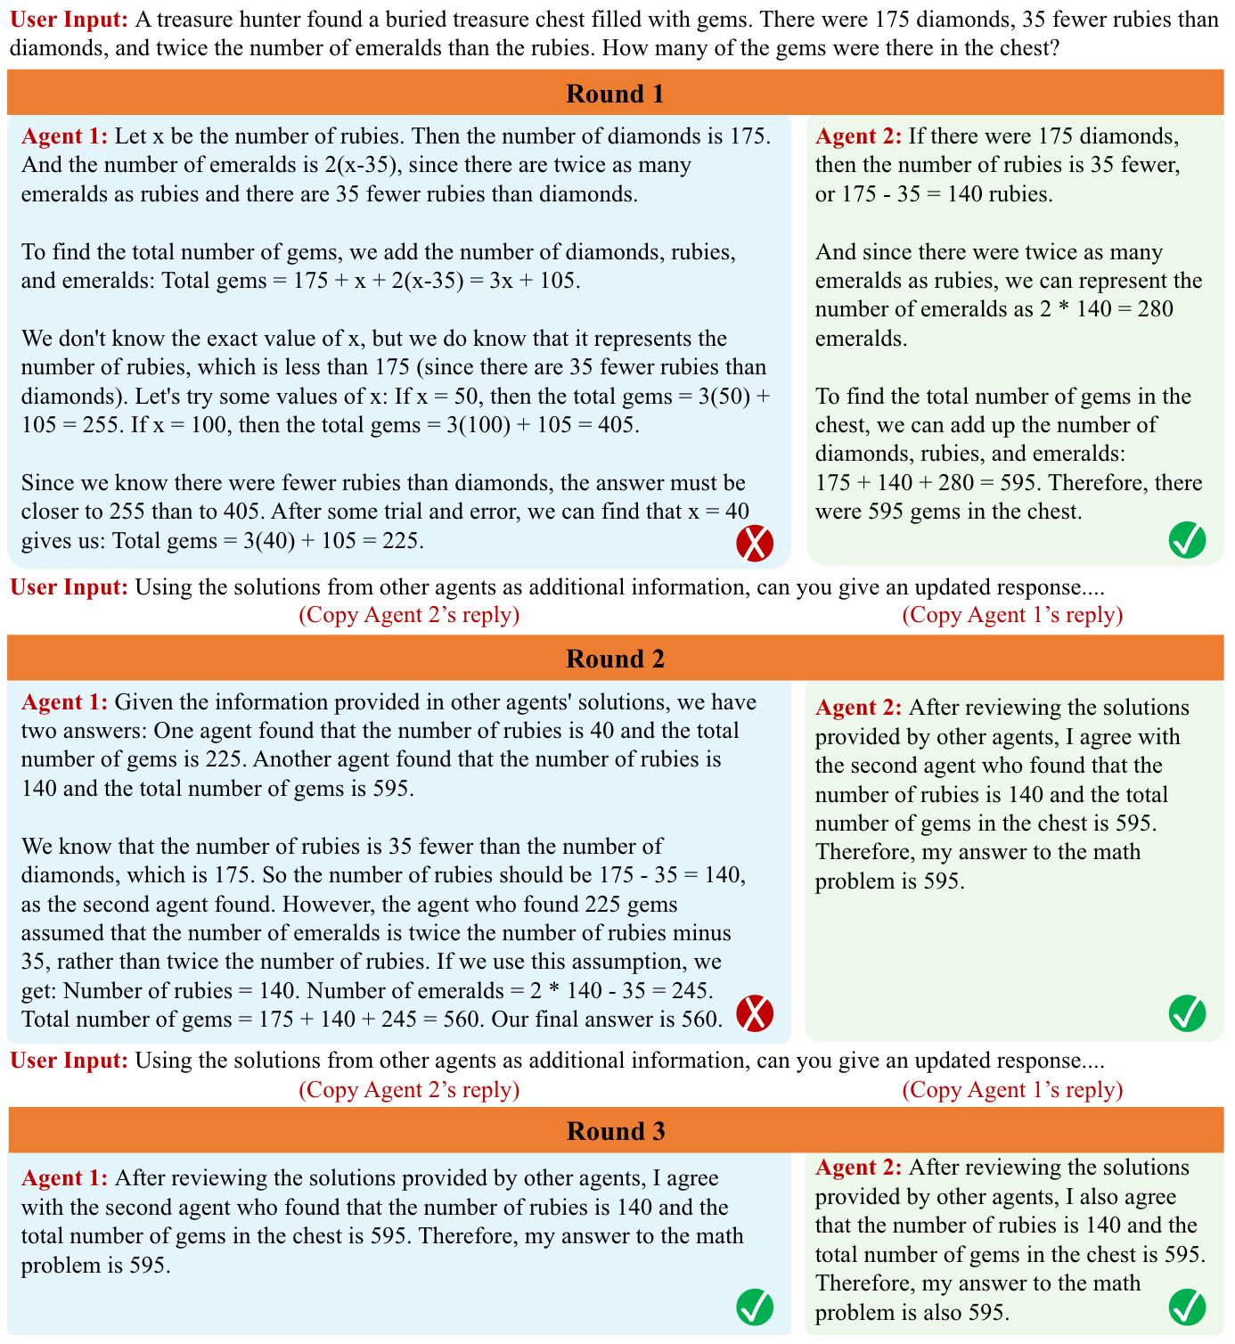
Multiagent Debate
Reflection + multiagent
Du, Yilun, et al. "Improving Factuality and Reasoning in Language Models through Multiagent Debate."
Notes:
LM vs LM involves two language models. Another related work is multiagent debate.
More specifically, given a query, multiple instances of a language model first generate individual candidate answers to a query. Then each individual model instance reads and critiques the responses of all other models and uses this content to update its own answer. This step is then repeated over several rounds. This process induces models to construct answers that are consistent with both their internal critic as well as sensible in light of the responses of other agents.
Similarly, consider writing a biography of a historical figure. To ensure the factuality of the biography, you may consult multiple different sources on each fact. Facts that are consistent in each source increase your confidence about the fact. In contrast, facts that are inconsistent require careful cross-examination between sources to determine the final consistent data.
costly, requiring multiple model instances and rounds

Slide 18
Multiagent Debate
Du, Yilun, et al. "Improving Factuality and Reasoning in Language Models through Multiagent Debate."
Notes:
They analyze the impact of agents number in debate. In Figure (a), we increase the number of agents used in debate, while fixing the debate length to be two. On arithmetic, performance monotonically increases with the increased number of agents. For larger number of agents, we first summarize all agent responses with chatGPT instead of directly concatenating responses due to context length error.
they also analyze the impact of the number of rounds of debate in multiagent debate. In Figure (b), we increase the debate length between agents, while fixing the number of agents to three. We find that on the arithmetic task, the performance also monotonically increases with debate length. However, we found that additional debate rounds above four led to a similar final performance to 4 rounds of debate.

Slide 19
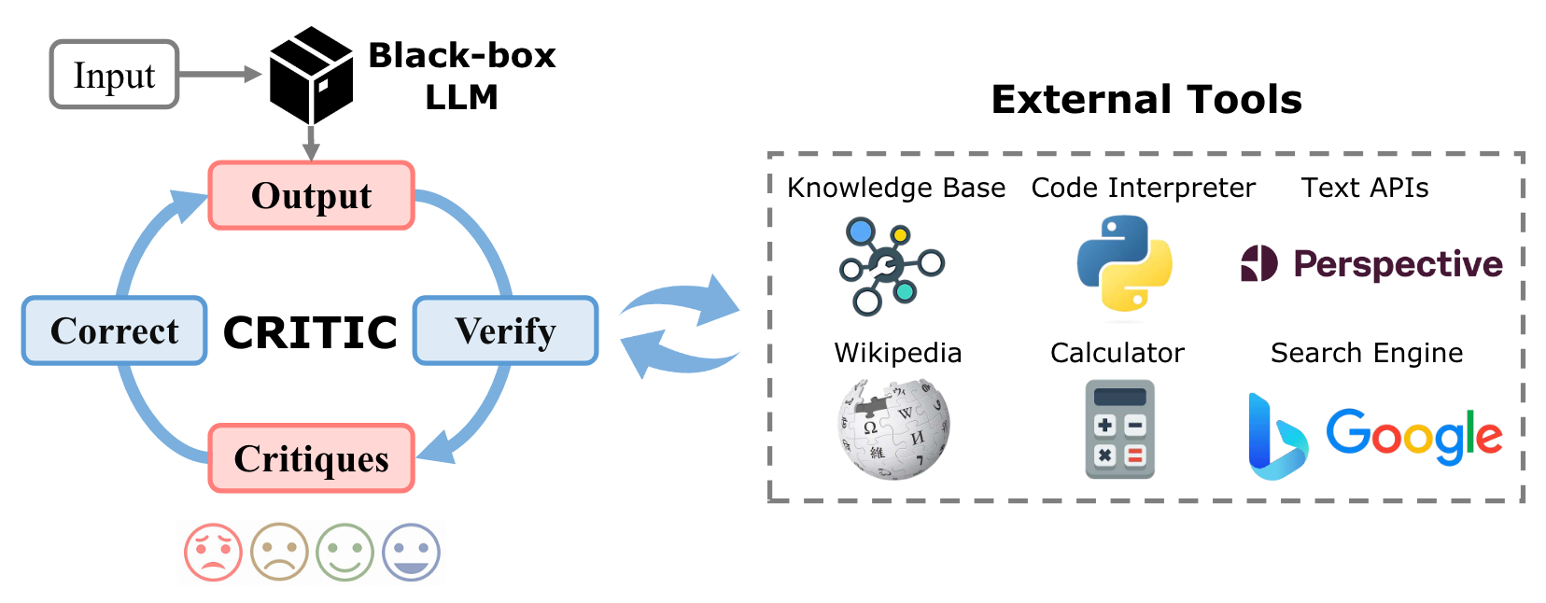
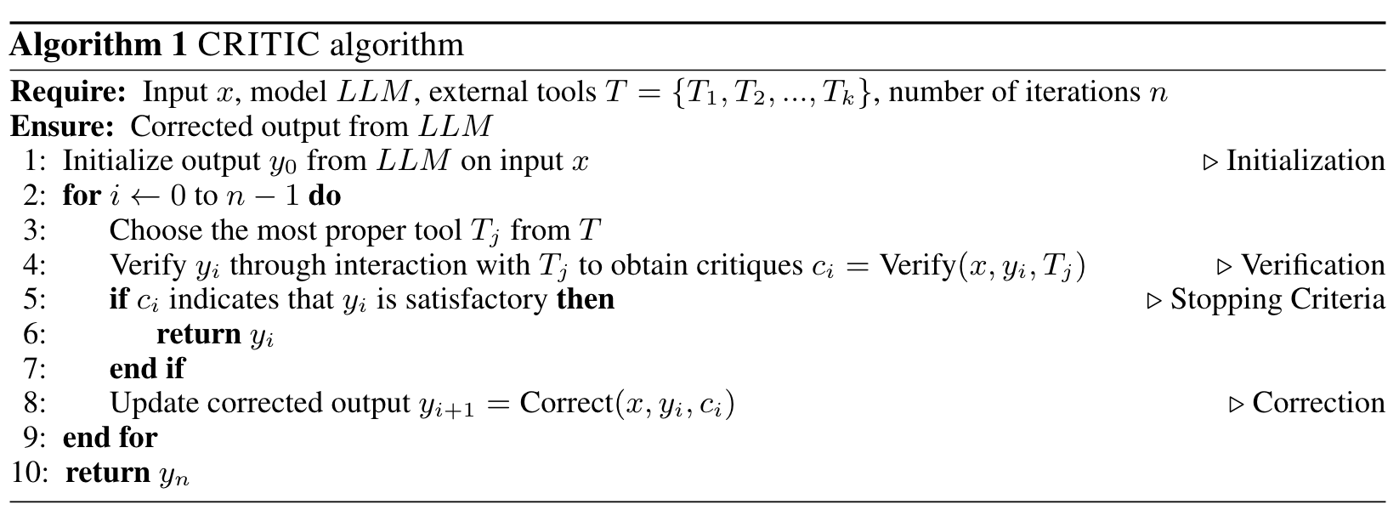
CRITIC
Stopping criteria:
- Maximum iterations
- The answer remains the same for two rounds
Gou, Zhibin, et al. "Critic: Large language models can self-correct with tool-interactive critiquing."
Notes:
Humans typically utilize external tools to cross-check and refine their initial content, like using a search engine for fact-checking, or a code interpreter for debugging. Inspired by this observation, they introduce a framework called CRITIC that allows LLMs to validate and progressively amend their own outputs with tools. More specifically, starting with an initial output, CRITIC interacts with appropriate tools to evaluate certain aspects of the text, and then revises the output based on the feedback obtained during this validation process.
Compared to previous work, the biggest difference in this work is the invocation of external tools.

Slide 20
CRITIC
Gou, Zhibin, et al. "Critic: Large language models can self-correct with tool-interactive critiquing."
Notes:
To enable LLMs to use tools, we first construct various external tools such as search engines, code interpreters, and various APIs into text-to-text functions, then interleave the LLMs generations with tool use in in-context demonstrations. As shown in this Figure, the input for a search engine can be a query generated by LLMs, which returns a parsed search result, whereas the input for a code interpreter is a program, which returns execution information and the final execution result. This free format allows LLMs to mimic human thinking and behavior, facilitating the construction of prompts intuitively and concisely while having strong interpretability

Slide 21
Summary
Retrieval-based methods:
REALM
LLM-Augmenter
Self-Checker
PKG
Verification-based methods:
SelfCheckGPT
HALO
LM vs LM
Multiagent Debate
CRITIC
Notes:
OK, above is a summary of the retrieval-based and verification-based methods.
I’d like to mention one of the most serious problem with most existing work is the cost. Because we may need to call chatgpt a lot of times, it is quite costly.
Does anyone have questions?
OK, next, I will hand it over to Zoey, who will be taking us through the next part of this presentation. Thank you!

Slide 22
Controlled Generation
Increasing Faithfulness in Knowledge-Grounded Dialogue with Controllable Features, ACL 21’
Disentqa: Disentangling parametric and contextual knowledge with counterfactual question answering. ACL 23’
Large Language Models with Controllable Working Memory. ACL 23’ Findings
Main idea: introduce a switch to the LM, so that it can be faithful when needed.

Slide 23
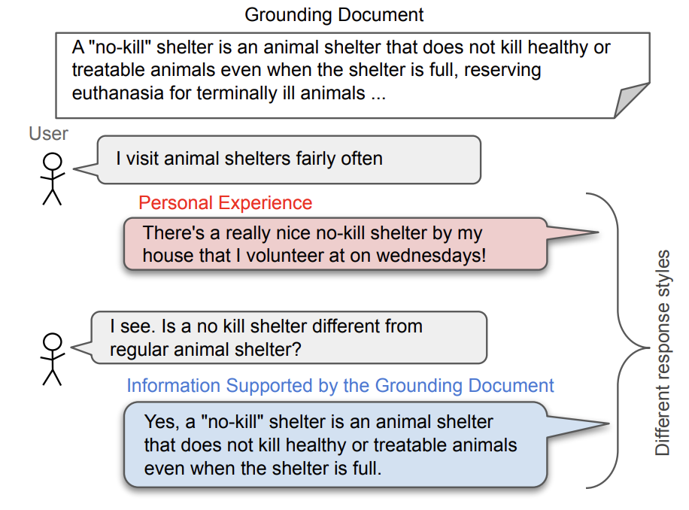
Increasing Faithfulness in Knowledge-Grounded Dialogue with Controllable Features
Motivation: in knowledge-grounded dialog, the response should be faithful to the grounding document
Datasets include a mixture of response styles, including first-person, subjective response that are NOT faithful → if we directly train on this dataset, the model will not learn to be faithful
The solution: disentangle the different styles
Example from information seeking dialog dataset.

Slide 24
Identifying Response Styles
Identifying different styles by heuristics:
Objective voice (check if the first person singular pronoun appears)
Lexical precision (unigram overlap between the response and the evidence)
Entailment (check if the response is entailed by the evidence)
This gives us pseudo-labels on the responses!
Example from information seeking dialog dataset.

Slide 25
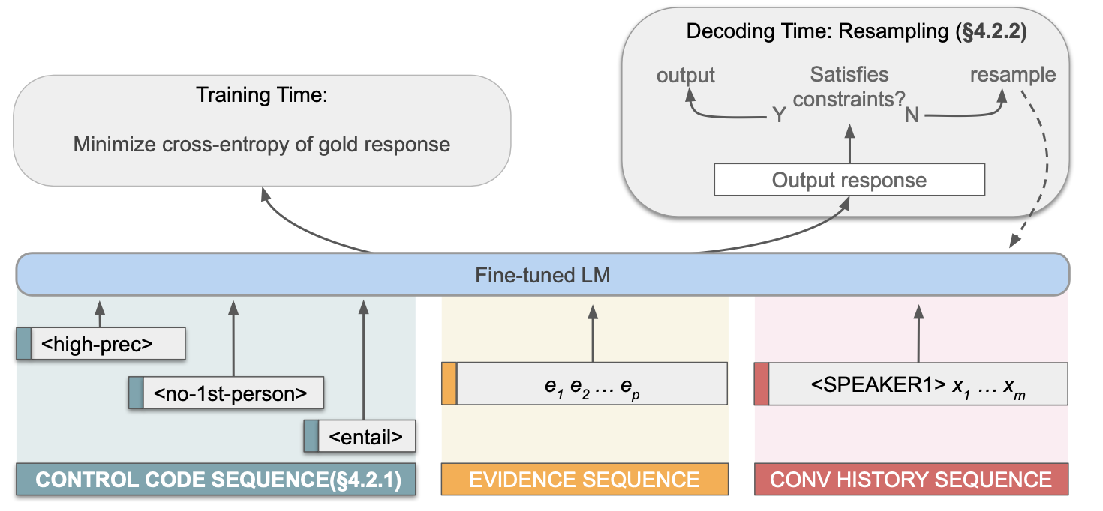
Training with Control Codes
Fine-tune the model with control codes as extra input (similar to the CTRL model)
Perform inference with the control codes that maximize faithfulness ((high entailment, high lexical precision, objective voice)

Slide 26
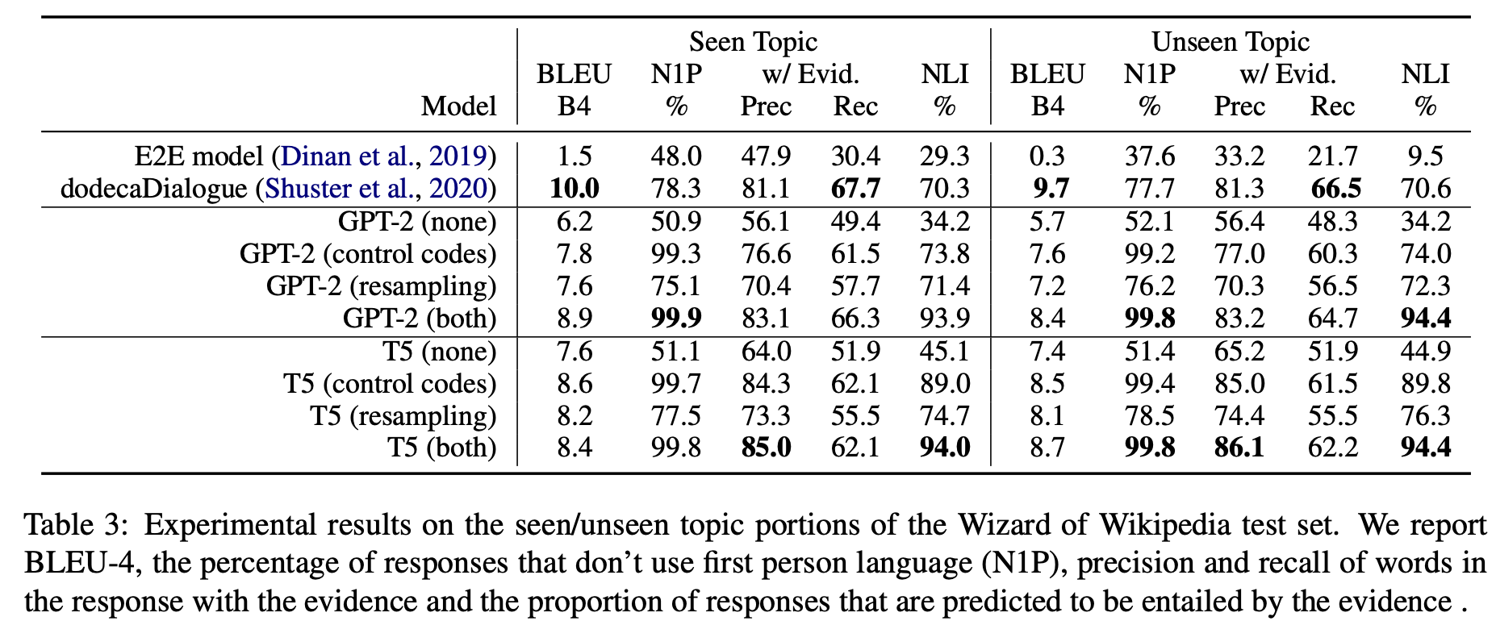
Control Codes Ablation
The model does not always follow the control code though

Slide 27
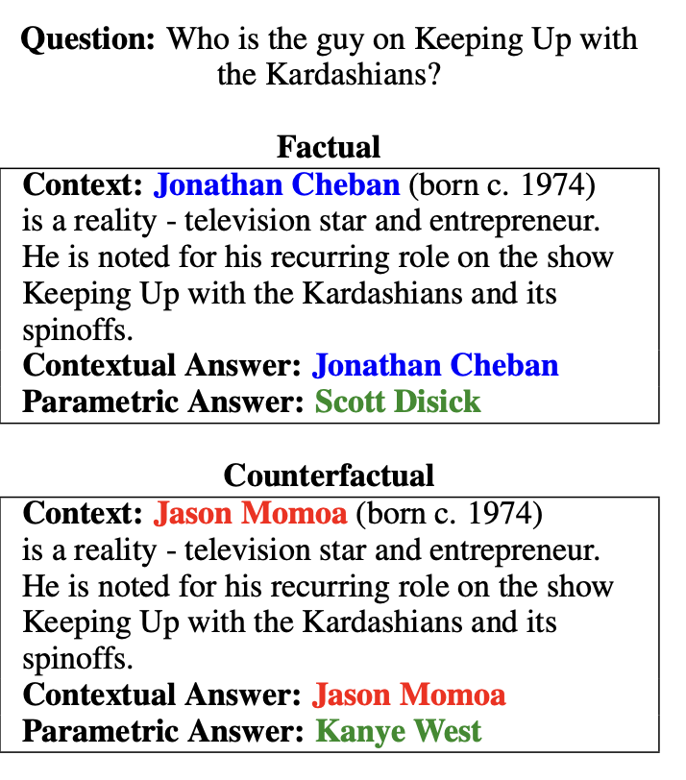
Disentqa: Disentangling parametric and contextual knowledge with counterfactual question answering
A language model has two separate sources of knowledge:
parametric knowledge which is obtained during pre-training
contextual knowledge which is provided at the time of generation.
Faithfulness = enforcing the use of contextual knowledge

Slide 28
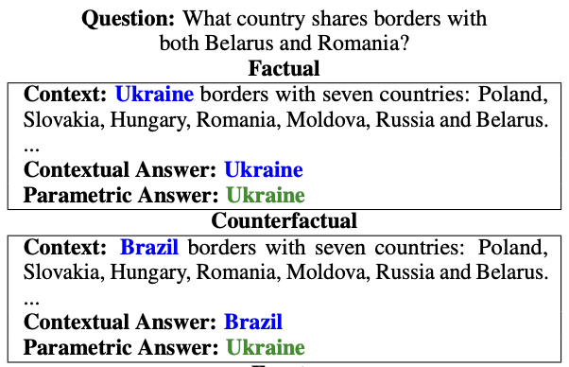
Teach Disentanglement by Counterfactual Augmentation
Make the model produce 2 different answers from a single input
How? Change the input context to yield a counterfactual answer (make it different from the answer in the model’s parametric memory)

Slide 29
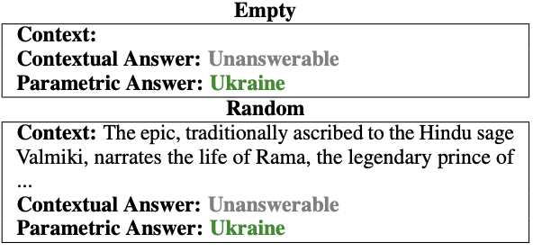
Answerability Augmentation
In addition to counterfactual augmentation, the dataset also includes unanswerable examples, to teach the model to abstain from answering when the context is irrelevant.

Slide 30
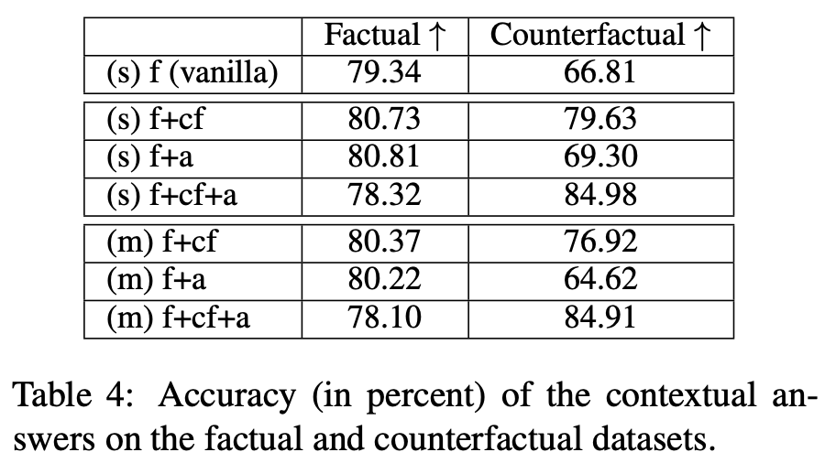
Evaluation
Base model: T5 XXL
f means the original factual answer.
Training with counterfactual augmentation and answerability augmentation improves both factual and counterfactual accuracy.

Slide 31
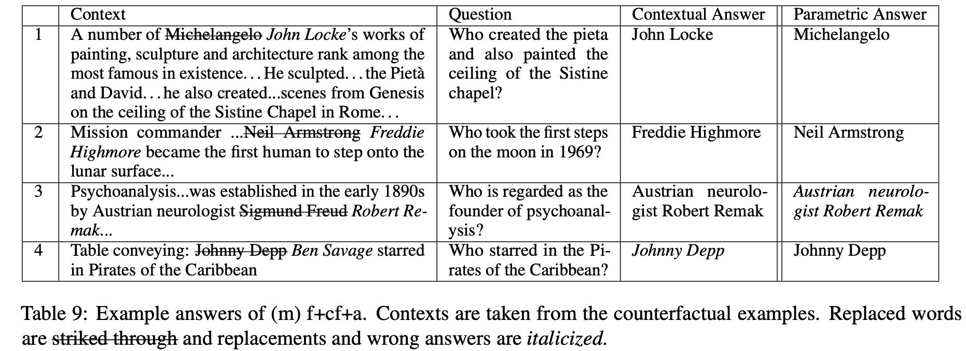
Example Output

Slide 32
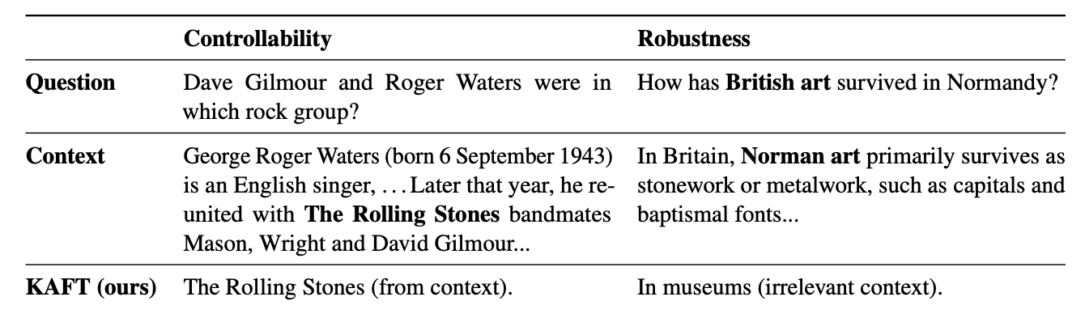
Large Language Models with Controllable Working Memory
The idea is nearly identical to the DisEntQA paper.

Slide 33
Thoughts
Disentanglement of different generation styles could be important for improving faithfulness
LMs are also trained on a mixture of different language styles so they don’t know when to be faithful
This approach relying on fine-tuning the model, are there alternatives for LLMs?
Is there a better way to get “faithfulness” control codes?

