Slide 1
Frontiers of Information Extraction (I)
Heng Ji
(Acknowledgement: Some Slides from our NAACL2022 Tutorial

Slide 2
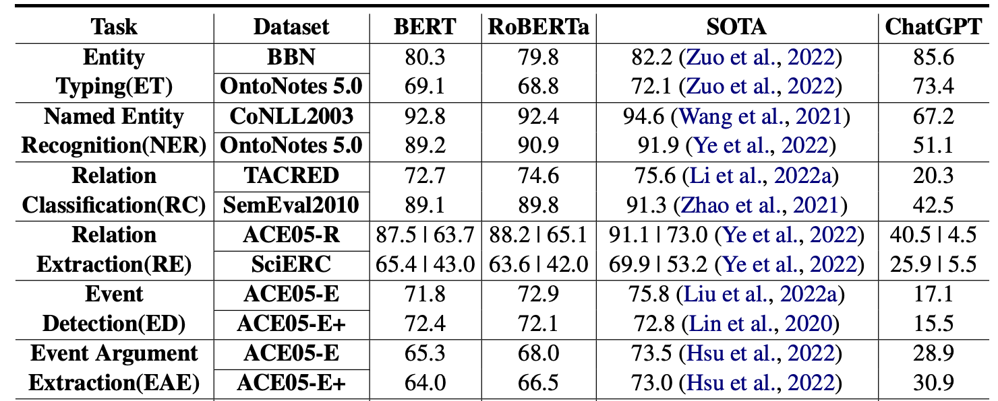
We are not outpaced: State of LLMs for IE Task Today (~2023)
LLMs have not caught up with SOTA in more complex IE tasks yet, but more and more people are applying LLMs for IE.
near SOTA
large gap
Table from Li et al. “Evaluating ChatGPT’s Information Extraction Capabilities: An Assessment of Performance, Explainability, Calibration, and Faithfulness”. Arxiv 2023.
Notes:
span localization is harder than type classification. The definition of an entity type is easier than an event type.

Slide 3
A Quick Overview of Information Extraction
Artificial Intelligence
Structured Information
Inference
Extraction
With the exponential growth of data from various sources especially the Internet, there is an increasing need for Information Extraction technology that extracts machine-readable structured information to support downstream applications.

Slide 4
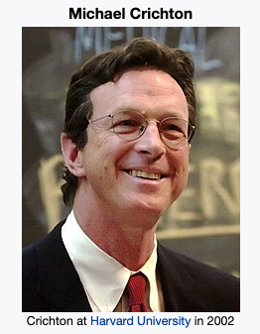
A Quick Overview of Information Extraction
Anne-Marie sued Crichton, best known as the author of Jurassic Park, for divorce in September.
Justice:Sue
Event
defendant
sued
plaintiff
Entity
Linking
PER
PER
spouse
Crichton
Anne-Marie
Relation
September
Entity
PER
coref
author
time
person
person
Coreference Resolution
divorce
Life:Divorce

Slide 5
A Brief Introduction to Information Extraction Subtasks
Entity Extraction aims to identify entity mentions in text and classify them into pre-defined entity types.
Relation Extraction is the task of assigning a relation type to an ordered pair of entity mentions.
Event Extraction entails identifying and classifying event triggers and their arguments
Event triggers: the words or phrase that most clearly express event occurrences
Arguments: the words or phrases for participants in those events
Entity Coreference Resolution is the task of resolving all entity mentions that refer to the same entity.
Event Coreference Resolution is the task of resolving all event mentions that refer to the same event.
Life:Be-Born
person
place
person
place
Shenson, who was born in San Francisco, was working in London at the time.
time

Slide 6
Motivation
Pipeline models suffer from the error propagation problem and disallow interactions among components.
Existing neural models do not explicitly model cross-subtask and cross-instance interactions among knowledge elements.
➔ A single joint neural model for Information Extraction.
Russia
minister
GPE
PER
ORG-AFF
ORG-AFF
ORG-AFF
ORG-AFF
PER
GPE
official
Washington
Russia's foreign minister expressed outrage at suggestions from a top Washington official last week...

Slide 7
OneIE: An End-to-end Neural Model for IE
Our OneIE framework extracts the information graph from a given sentence in four steps: encoding, identification, classification, and decoding

Slide 8
OneIE: An End-to-end Neural Model for IE
Encoding: We use a BERT encoder to obtain the contextualized embedding of each token

Slide 9
OneIE: An End-to-end Neural Model for IE
Identification: We use CRF taggers to identify entity mentions and event triggers
We define the identification loss as

Slide 10
OneIE: An End-to-end Neural Model for IE
Classification: We use task-specific feed-forward networks to calculate label scores for each node or edge
We define the classification loss as

Slide 11
OneIE: An End-to-end Neural Model for IE
Decoding: In the test phase, we use a beam search decoder to find the information graph with the highest global score

Slide 12
Incorporating Global Features
We design a set of global feature templates (e.g., event_type₁ – role₁ – role₂ – event_type₂ : an entity acts a role₁ argument for an event_type₁ event and a role₂ argument for an event_type₂ event in the same sentence)
The model learns the weight of each feature during training
man
man
PER
PER
victim
target
victim
attacker
Life:Die
Conflict:Attack
Life:Die
Conflict:Attack
dies
shot
dies
shot
Life:Die – victim – target – Conflict:Attack
Life:Die – victim – attacker – Conflict:Attack
Positive weight
Negative weight

Slide 13
Decoding
We use beam search to decode the information graph
Example: He also brought a check from Campbell to pay the fines and fees.
Node Step
Node Step
Edge Step
Sort
Prune
E1¹
E2¹
E1¹
R1¹
E2¹
E1¹
R1²
E2¹
entity
E1²
R1¹
E2¹
E1¹
R1²
E2¹
E1¹
Fine
FAC
E1¹
E2²
E1¹
R1¹
E2²
E1¹
R1²
E2²
fines
Campbell
E1¹
R1²
E2²
E1¹
R1¹
E2²
Candidate 1 of node E1
Higher local score
E1²
E2¹
E1²
R1¹
E2¹
E1²
R1²
E2¹
E1¹
R1¹
E2¹
E1²
R1²
E2²
entity
E1²
R1¹
R1²
Fine
PER
R1¹
R1²
Candidate 2 of node E1
E1²
E2²
E1²
E2²
E1²
E2²
fines
Campbell
E1²
E2²
E1²
E2¹
Higher global score
add node 1
add node 2
add the edge between node 1 and 2
Campbell: FAC, ORG
fine: Fine, Sue
null, entity, person, …

Slide 14
Experiment Results
We conduct our experiments on ACE2005 (F-score, %)
Model | ACE05-R |  | ACE05-E
 | Entity | Relation | Entity | Trigger Identification | Trigger Classification | Argument Identification | Argument Classification
DyGIE++ | 88.6 | 63.4 | 89.7 | - | 69.7 | 53.0 | 48.8
DyGIE++* | - | - | 90.7 | 76.5 | 73.6 | 55.4 | 52.5
OneIE | 88.8 | 67.5 | 90.2 | 78.2 | 74.7 | 59.2 | 56.8
Example: Prime Minister Abdullah Gul resigned earlier Tuesday to make way for Erdogan, who won a parliamentary seat in by-elections Sunday.
Erdogan
Abdullah Gul
Erdogan
Abdullah Gul
PER
PER
1. An Elect event usually has only one Person argument
2. An entity is unlike to act as a Person argument for End-Position and Elect events at the same time
PER
PER
person
person
person
person
person
Elect
End-Position
Elect
End-Position
won
resigned
won
resigned
Baseline Result
OneIE Result

Slide 15
Salient Global Features
Salient positive and negative global features learned by the model
Our global features are explainable
 | Features | Weight
1 | A Transport event has only one Destination argument | 2.61
2 | An Attack event has only one Place argument | 2.31
3 | A PER-SOC relation exists between two PER entities | 1.51
4 | A Beneficiary argument is a PER entity | 0.93
5 | An entity has an ORG-AFF relation with multiple entities | -3.21
6 | An event has two Place arguments | -2.47
7 | A Transport event has multiple Destination argument | -2.25
8 | An entity has a GEN-AFF relation with multiple entities | -2.02

Slide 16
Information Extraction
From the texts:
1 . Identify the concepts
Entities, events, terms, etc.
2. Identify the relations and other properties
Entity-entity / event-event
Temporal properties
etc.
Lexical IE:
Named entity recognition
Entity/event typing
Entity/event linking
Relational IE:
Relation extraction
Entity / events
Sentence/Document
Temporal
Coreference Resolution

Slide 17
How IE is mostly done?
Direct supervision
CoNLL 2003: 20K+ entity mention annotations for NER
Ontonotes5.0: exhaustive NER annotation on 2.9M tokens
But
Closed label set
Poor transferability
Annotation artifacts
“Worse” on “rare” items
High cost for new tasks
A multi-head classification model drops from 96 to 74 (F1) on CoNLL, when it’s trained on Ontonotes on the same types.
Zhou et al. (2021) reports $1.0 per instance to annotate clean temporal relations on obscure texts.

Slide 18
We are Getting Lazier
It’s not the first time that we are modifying our task (nail) for the method (hammer), shouldn’t it be the other way around?
1996: Pattern based Corpus-level IE [Grishman and Sundheim, 1996]
2004: Maximum Entropy based Sentence-level IE [Florian et al., 2004]
2016: Bi-LSTM based Sentence-level IE [Lample et al., 2016]
2020: BERT based Sentence-level IE [Lin et al., 2020]
2021: Text generation based document-level IE [Li et al., 2021]
2022: Text generation based corpus-level IE?
A supervised IE system typically requires around 4,000 fully annotated sentences for training
18
Notes:
IE was defined as a corpus-level IE task, compromise it to sentence-level IE… and only recently resume document-level IE
MUC paper… cite task
XXX zoey’s work, from cmu slides
XXX cite MUC, corpus level -> KB, cite ed and ralph’s paper
XXX sentence level maximum entropy, svm, sequence labeling, leverage token-level word embedding and sentence embedding
XXX move a bit back to the document level? Zoey’s paper, prompt
XXX could be really hard to go back
Why do we have to fit our nails to the hammer? Not the other way around?
XXX lazy attitude
Are we changing nails to fit into the hammer?
XXX before and after, low-cost….

Slide 19
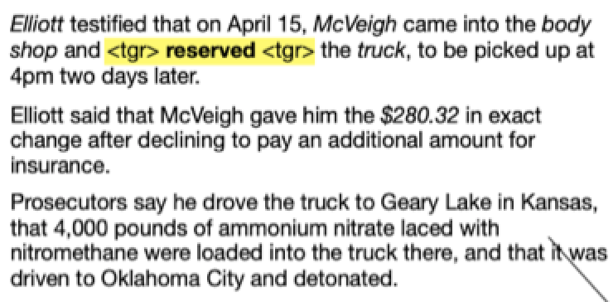
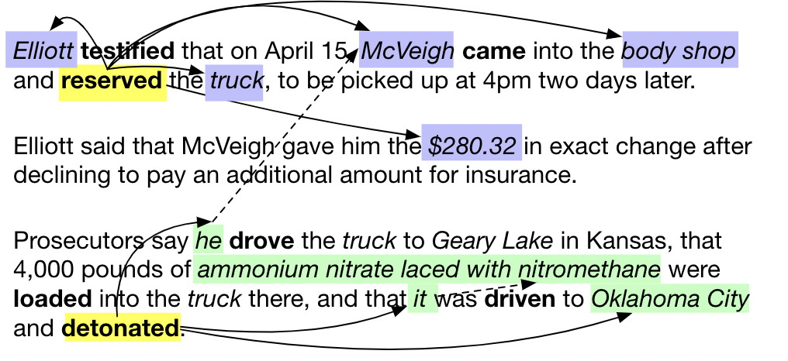
Quiz Time! Human Information Seeking
Read the following document:
Fill in the blank: [A] bought, sold or traded [B] to [C] in exchange for [D] at [E] place.
Insight: describe the task in templates, given the input document as context, ask LM to generate the information we are looking for
Notes:
Examples from the AIDA evaluation

Slide 20
Argument Extraction as NLG [Li et al., 2022]
We formulate argument extraction as a conditional generation problem with a blank event template as part of the input and a filled template as the desired output.
For some datasets, this template is readily available as part of the ontology; for others we only need to design 1 per event type.
All arguments for one event can be extracted in a single pass

Slide 21
Handling Missing Arguments and Multiple Arguments
Unlike the standard Question Answering setting, for the argument extraction task, we often face missing arguments and multiple arguments for the same role
Missing arguments: output the placeholder token <arg>
Multiple arguments: use “and” to connect the arguments
Model output: Trump and Japanese bankers communicated remotely about <arg> topic at <arg> place
Notes:
Add example here

Slide 22
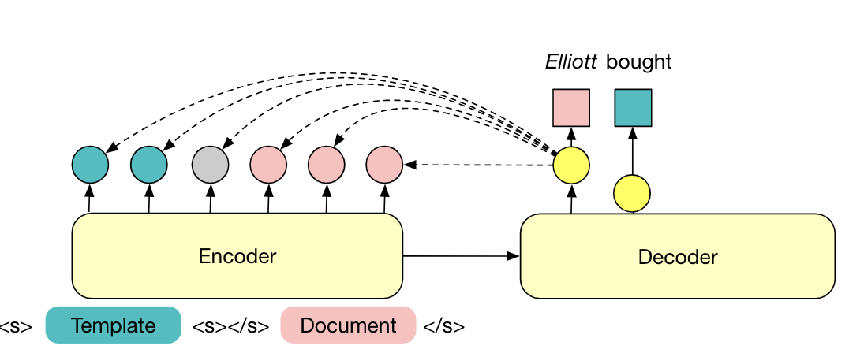
Model Details
Base model: Pretrained encoder-decoder language model BART[Lewis et al. ACL 2020]
Trigger information: The trigger is marked using the [TGR] special token
Tackling hallucination: At the time of inference, we restrict the generation output to select tokens that have been seen in the input

Slide 23
Soft Entity Type Constraints
We append “entity type statements” to the end of the generation output and measure the language model probability
Post-processing to rerank the generated candidates
Set of valid entity types (according to ontology)
Entity type statement:
“<entity> is a <type name>”

Slide 24
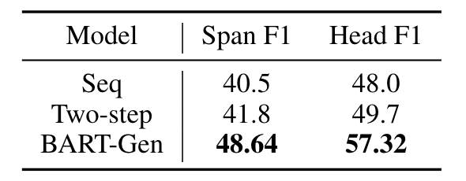
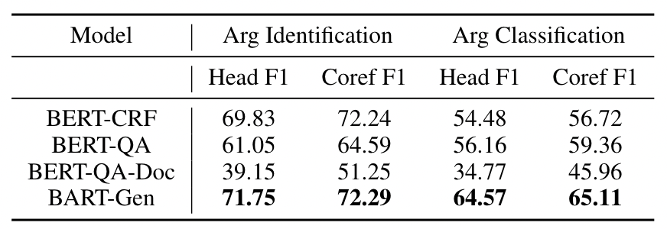
Evaluation
We evaluate our model on three datasets:
ACE05 (sentence-level)
RAMS [Ebner et al. ACL 2020] (document-level)
WikiEvents (document-level)
Argument extraction results on RAMS.
 | Arg Identification Head F1 | Arg Classification Head F1
BERT-QA | 65.74 | 63.34
BART-Gen | 69.92 | 66.67
Argument extraction results on WikiEvents.
Argument extraction results on ACE05 with gold triggers.
Notes:
Clean up ACE table

Slide 25
Case Study
For the Contact event E1, BERT-QA over-generates answers for the participant span.
QA models produce a ranking over possible answers, producing the optimal threshold is hard
For the IdentifyCategorize event, only our model can successfully extract all arguments.
Sequence labeling model struggle with types with few training examples

Slide 26
GLEN - General-Purpose Event Extraction [Zhan et al., 2023arxiv]
Current event extraction benchmarks only focus on a few event types and limited domains
ACE05 has 33 event types, heavily focused on attack-related news
MAVEN is currently the largest event extraction dataset, has 168 types, most are military attack or natural disaster
As a result, none of the current event extraction systems can be used as off-the-shelf tools
Users have to define their own ontology and collect their own data before being able to adopt any of the published models
For the KAIROS evaluation, every time we add a new scenario, we need to collect data and do annotation

Slide 27
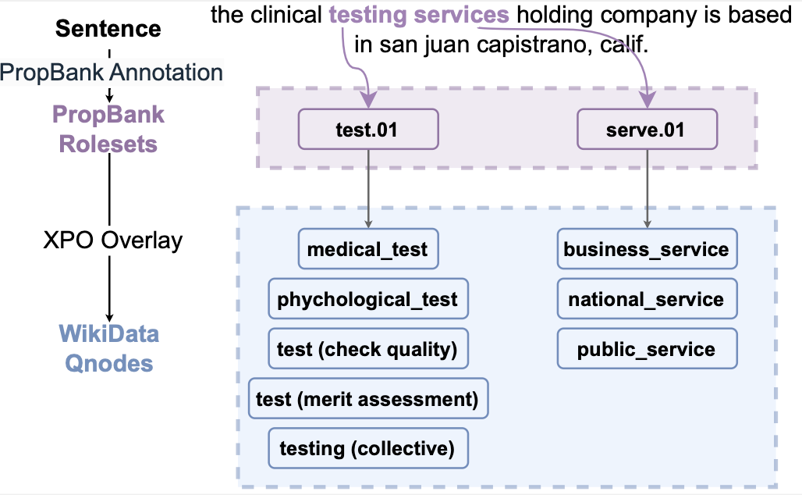
Dataset Construction
We utilize PropBank annotation from multiple sources: PropBank frame files, OntoNotes, AMR, QuestionBank, ANC
We use the XPO Overlay to perform automatic mapping of PropBank labels to WikiData Qnode labels, so each event mention will be associated with one or more Qnodes
Our final dataset is 20x larger in ontology size and 4x larger in corpus size compared to MAVEN
Before KAIROS
After KAIROS

Slide 28
Model Design
Our model has 3 components:
Trigger Identification: finding the trigger word from the sentence
Event Type Ranking: finding the top-K candidate event types for the sentence
Event Type Classification: link each trigger word with one event type

Slide 29
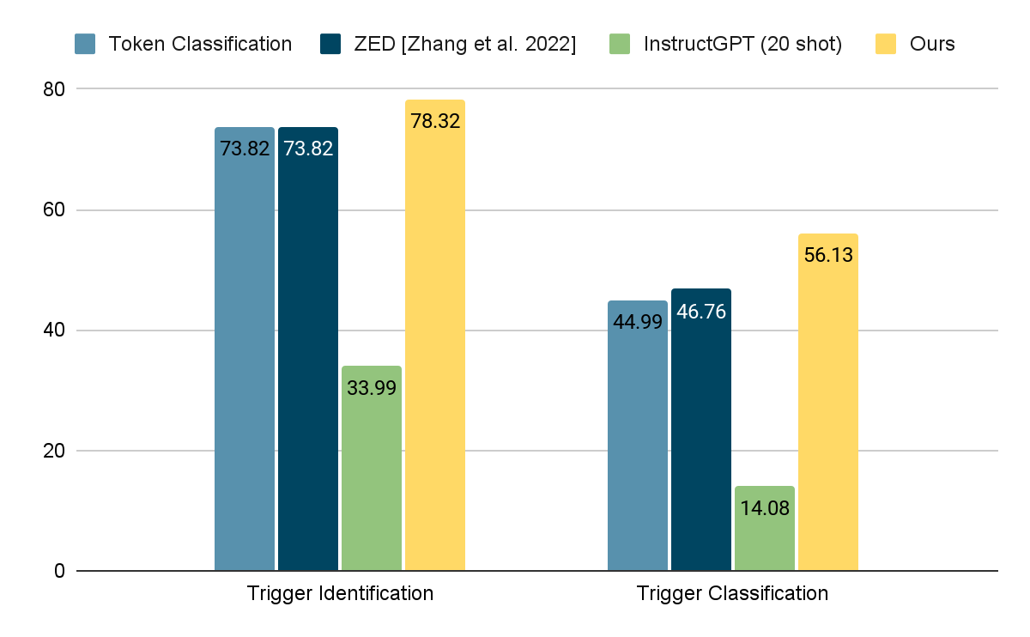
Experiment Results

Slide 30
Where Are We Today
 |  | 2012 | 2023 | 2042 (Projected Goal)
Portability | # Languages | 1-3 | 300 for entity and event detection | 6000 for entity and event detection
 | # Entity types | 5 | 16,000 | 16,000 for 6000 languages
 | # Relation types | 41 | 2,000 for English | 2,000 for 300 languages
 | # Event types | 33 | 1,000 for English | 1,000 for 300 languages
Quality F-score (no manual annotations) |  | 0% | Up to 76% F-score for low-resource name tagging | 100% for English, 90+% for other languages
Development Time |  | Half a year for anyone with a laptop | A few months for a handful of groups with computing resources | A few hours for anyone with a smart phone
Cost |  | Supervised models based on 500 fully annotated documents | No annotation for new language/domain | No or few annotations for any language, domain or modality

Slide 31
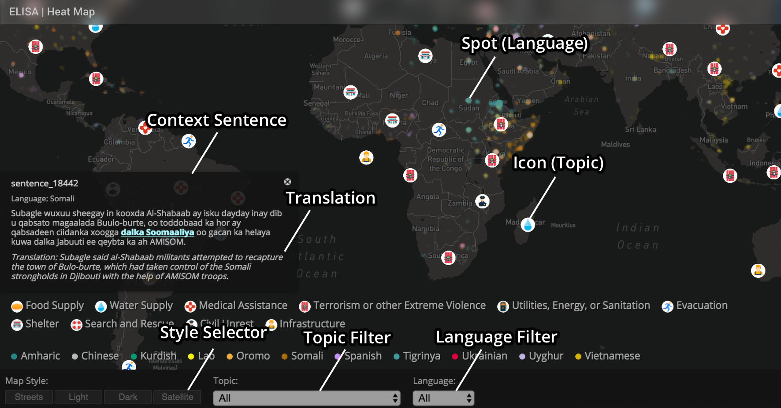
Application 1: Monitoring Disasters Reported in 287 Languages
Re-trainable Systems: http://159.89.180.81:3300/elisa_ie/api
Demos: http://159.89.180.81:3300/elisa_ie
Heat map: http://159.89.180.81:8080/
Notes:
deployed

Slide 32
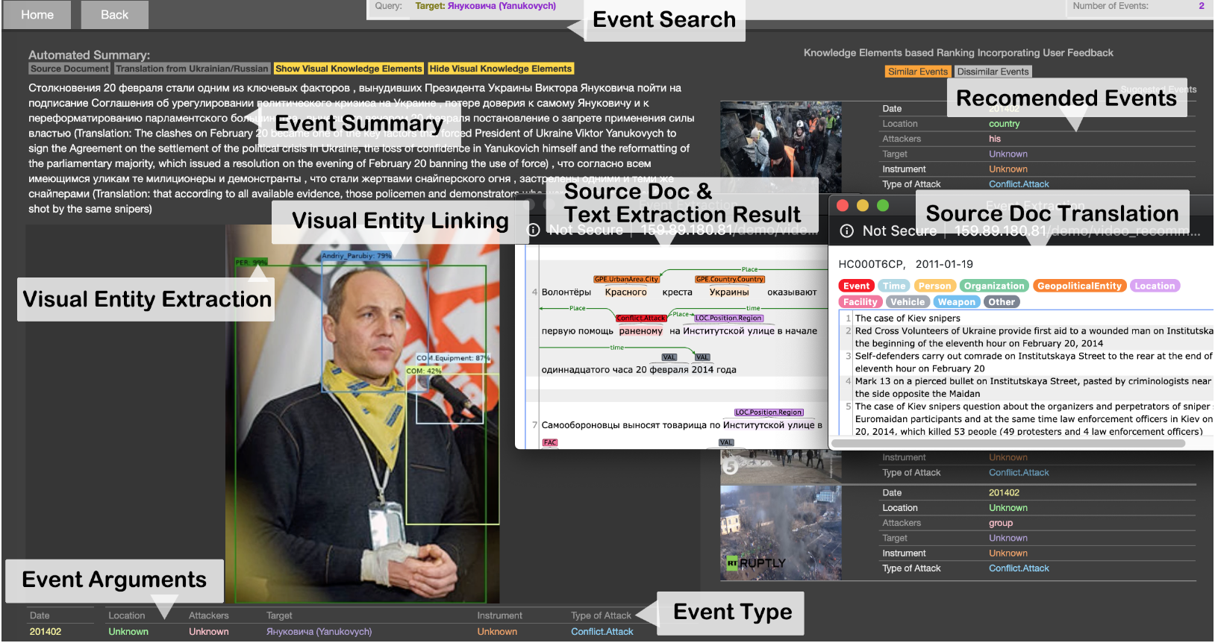
Application 2: Analyzing International Conflicts
(Li et al., ACL2020 Best Demo Paper Award)
GitHub: https://github.com/GAIA-IE/gaia
DockerHub: https://hub.docker.com/orgs/blendernlp/repositories
Demo: http://159.89.180.81/demo/video_recommendation/index_attack_dark.html

Slide 33
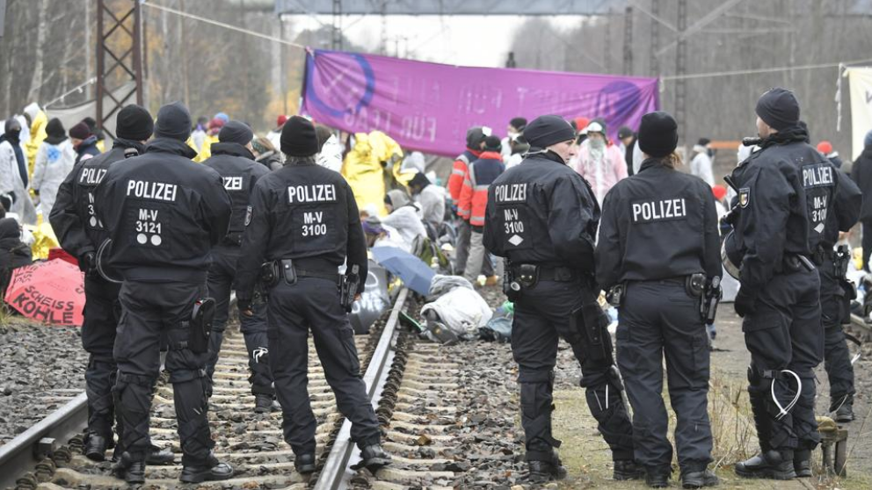
Application 3: Fine-grained Misinformation Detection
Detect fake news by checking cross-media knowledge element inconsistency [Fung et al., 2021]
Police officers watch over climate activists from Ende Gelaende as they block train tracks next to Jaenschwalde power plant in eastern Germany on November 30, 2019
In coal we trust: Australia’s voters back PM Scott Morrison’s faith in fossil fuel

Slide 34
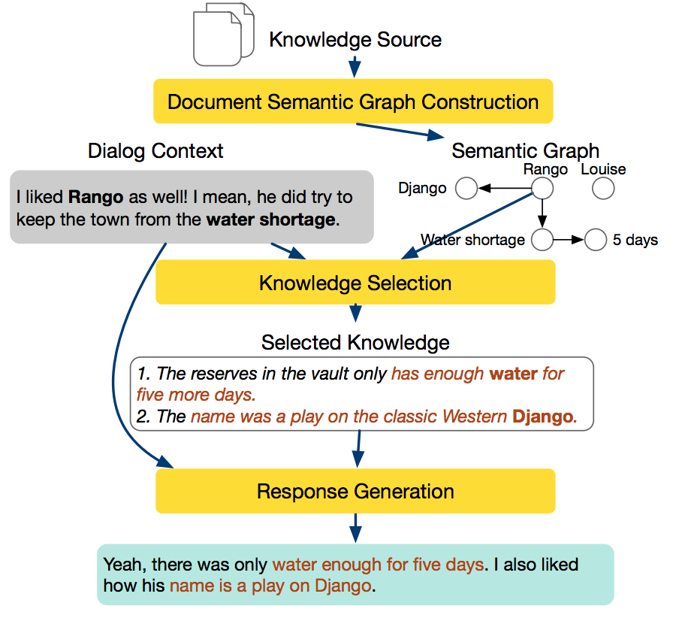
Application 4: Knowledge-guided Dialog Systems
Make the dialog system as knowledgeable as your best friend in the book club [Li et al., NAACL2022]

Slide 35
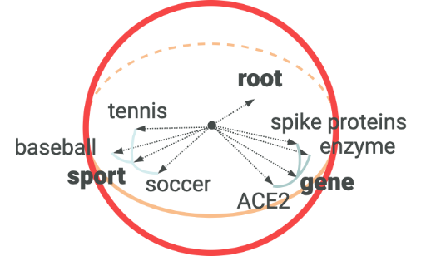
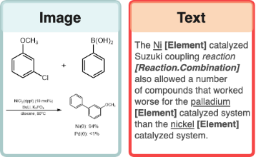
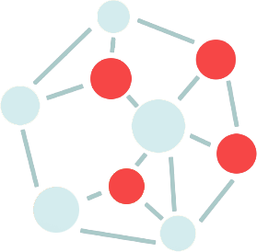
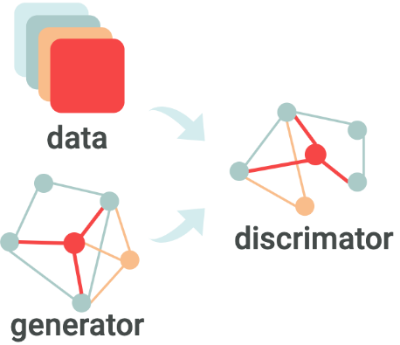
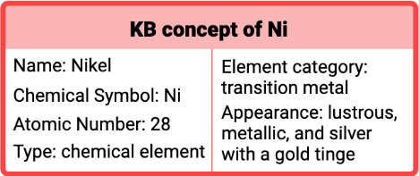
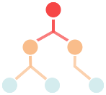
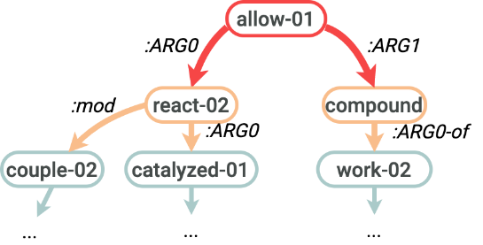
Application 4: Converting Unstructured Scientific Data to Structured Knowledge: Our Road Map
DATA
SEMANTICS
KNOWLEDGE BASE
Graph neural networks
Joint entity/relation/event extraction and ontology construction
Hierarchical Spherical Embedding
Scientific Literature
Multimedia Knowledge Base
Ontology Enriched Text Embedding
Generative Adversarial Networks for Data Augmentation and Distant Supervision
Chemical Ontology & Existing Databases
Cross-media Structured Semantic Representation
Multimedia Search and Summarization
Notes:
To tackle these two challenges, we propose a new framework COVID-KG to accelerate scientific discovery and build a bridge between clinicians and biology scientists.
COVID-KG starts by reading existing papers to build multimedia knowledge graphs (KGs), in which nodes are entities/concepts and edges represent relations and events involving these entities, extracted from both text and images.
Given the knowledge graphs enriched with path ranking and evidence mining, COVID-KG answers natural language questions effectively.
Our system has several contributions.
Firstly, we use new distantly supervised, refined fine-grained extraction and typing to help Knowledge Graph construction.
Secondly, we use chemical graph parsing and image analysis to enable multi-media common semantic space construction and new hierarchical embedding for graph neural networks-based knowledge extraction and entity resolution.
The third innovation is that we adopt Domain-specific ontology and database guided knowledge enrichment for joint neural end-to-end entity/relation/event extraction; Our COVID’19 Knowledge graph receives more than 500downloads
We also apply Generative Adversarial Networks for data augmentation by regarding samples generated by the generator as negative samples to train the discriminator
Finally, we adopt Weakly-supervised automated taxonomy construction, and taxonomy-guided, theme-based multidimensional document classification and text summarization

Slide 36
Unique Challenges and Solutions
Construct Knowledge-Empowered Large Language Models
Develop multimodal reaction-aware molecule representation
2-D images of molecules, representing the underlying molecules or reactions
text-based molecule descriptors
chemical graph structure from 480K reactions
natural language definition and description
structured properties in external databases
Capture complex sentence structures
AMR parsing and graph neural networks

Slide 37
Challenge 1: Sentence-level Context is Insufficient
Most of the scientific concepts are abbreviated without explicit explanations of their meanings.
The complex biomedical and chemical interactions between multifarious chemicals, genes, and proteins are even harder to understand.

Slide 38
Proposed Framework: Domain-Specific Knowledge Enhanced Large Language Models
Unstructured Multimodal Multilingual Data
Large Neural Models
Elicit Explicit Symbolic Knowledge
Knowledge Localization and Generalization
Knowledge Augmentation and Distillation
Knowledge Patching and Fusion
Knowledge Extraction
External Symbolic Knowledge
Background Knowledge
Domain-Specific Knowledge
World Knowledge
Structured Knowledge
Task-Specific Knowledge
Notes:
XXX check ideas in the knowledge section in position paper
XXX
Zi xue cheng cai
Self updating
Self correction
Knowledge generalization

Slide 39
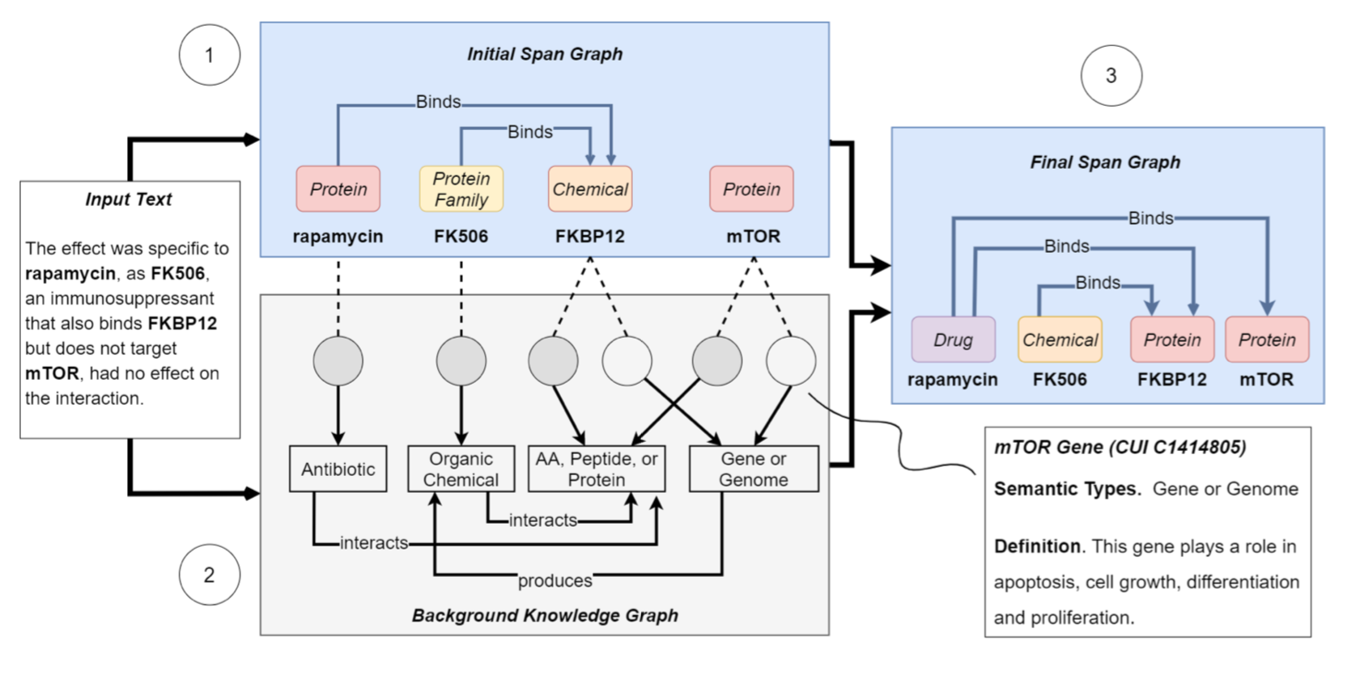
Constructing an Extra Brain: Encoding External Knowledge via Entity Linking
(Lai et al., ACL2021)
Notes:
KECI operates in three main steps:
Build an initial span graph representing KECI’s initial understanding of the text.
Use an entity linker to build a background knowledge graph containing all potentially relevant biomedical entities from an external KB.
Align the node of the two graphs to make final predictions of entities and relations.

Slide 40
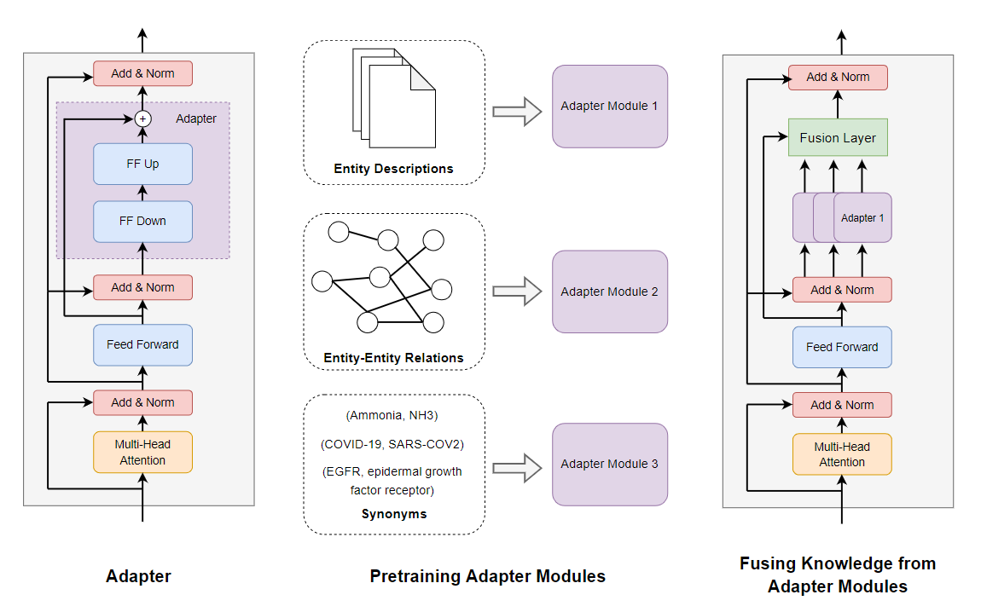
Knowledge-Enhanced Scientific Language Model [Lai et al., Journal of Biomedical Informatics 2023]

Slide 41
Overall Results
 | MedNLI (Accuracy) | PubMedQA (Accuracy)
SciBERT – Ours | 80.59 | 55.2
SciBERT + MoP | 81.43 | 54.78
KEBLM (SciBERT) – Ours | 82.14 | 59.0
BioBERT – Ours | 82.21 | 62.2
BioBERT + MoP | 83.44 | 61.82
BioBERT + DAKI | 83.41
KEBLM (BioBERT) – Ours | 84.24 | 68.0
SciBERT-related Models
BioBERT-related Models
Overall test results on NLI and QA.
MoP and DAKI are prior studies that also aim to incorporate external knowledge into language models.

Slide 42
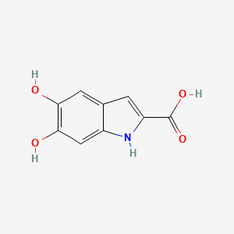
5,6-DIHYDROXY-1H-INDOLE-2-CARBOXYLIC ACID
Challenge 2: What’s in a Chemical Entity?
Definition: 5,6-dihydroxyindole-2-carboxylic acid is a dihydroxyindole that is indole-2-carboxylic acid substituted by hydroxy groups at positions 5 and 6. It has a role as a mouse metabolite. It is a conjugate acid of a 5,6-dihydroxyindole-2-carboxylate. It is a tautomer of a dopachrome.
Property Name | Property Value
Molecular Weight | 193.16
XLogP3-AA | 1.2
Hydrogen Bond Donor Count | 4
Hydrogen Bond Acceptor Count | 4
Rotatable Bond Count | 1
Exact Mass | 193.03750770
Monoisotopic Mass | 193.03750770
Topological Polar Surface Area | 93.6 Å²
Heavy Atom Count | 14
Formal Charge | 0
Complexity | 245

Slide 43
Limitation of SMILES-based Methods
Smiles are 1D linearization of molecule structures, which makes them hard to learn the original structural information of molecules
CC(CCCCCCCO)=O
These two O’s are close in SMILES string…
…but actually they are far from each other
Notes:
Although these language models have great power of learning representation of texts, they have difficulty dealing with SMILES input, because SMILES is 1D linearization of molecular structure, which makes it hard for language models to learn the original structural information of molecules, simply based on strings.
For example, suppose we have a molecule whose structure and smiles string are shown here.
We can see that these two oxygen atoms…
This will mislead language models, which rely heavily on the relative position of tokens to provide self-supervision signal.

Slide 44
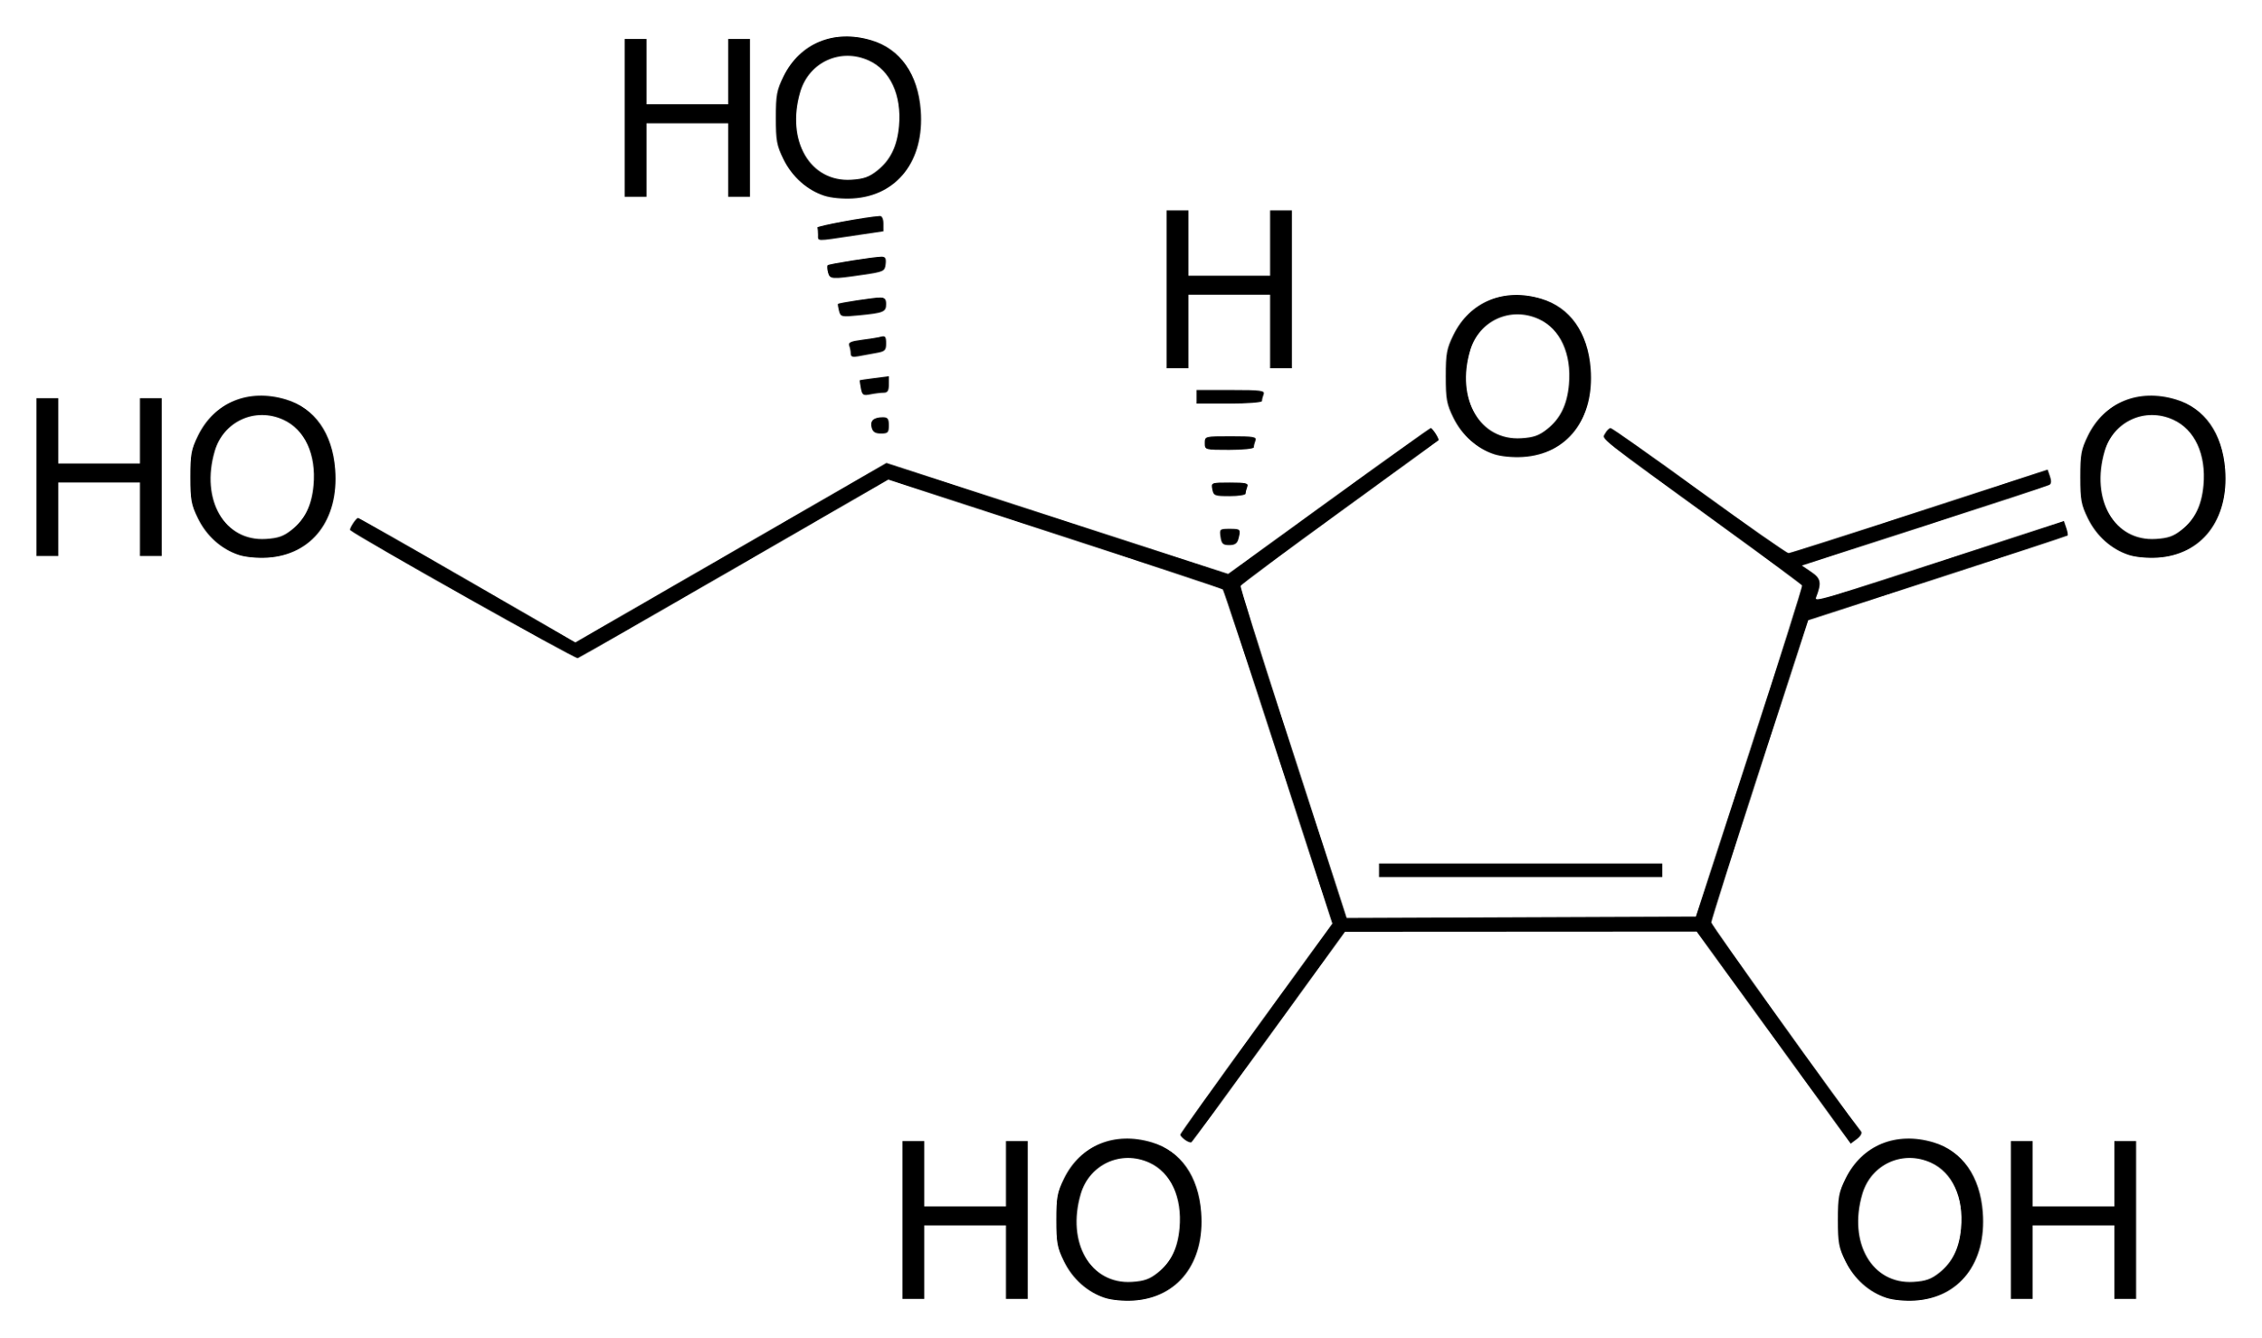
Graph Neural Networks (GNN)-based Methods
Each atom has an initial feature vector consisting of information from literature:
Element type, Charge, Whether the atom is in an aromatic ring, the count of attached hydrogen atom(s)
Bond type can be inferred by the features of its two associated atoms
1. Propagating messages over the graph
2. Read out the molecule graph embedding
Notes:
To use GNN to learn molecule representation, we first repeat the aggregate operation in GNN for K iterations, which means that we propagate messages over the graph for K times.

Slide 45
Taking Advantage of Chemical Reaction Equivalence [Wang et al., ICLR2022]
Several physical quantities retain constant before and after the reaction
Mass, energy, charge, etc.
We aim to preserve such equivalence in the molecule embedding space:
CH₃CHO
C₂H₅OH+ O₂ → CH₃CHO
Chemical reaction space
O₂
Molecule embedding space
C₂H₅OH
Notes:
As we mentioned before, existing GNNs mainly focus on designing new and complicated GNN architectures, but ignore the essence of representation learning, which is the generalization ability. In this work, we propose using chemical reaction to assist learning molecule representations and improve their generalization ability.
A chemical reaction usually represents a closed system where several physical quantities of the system retain constant before and after the reaction, such as mass, energy, charge, etc.
Therefore, it describes a certain kind of equivalence between its reactants and products in the chemical reaction space.
Our key idea is to preserve such equivalence in the molecule embedding space, that is, we hope the sum of reactant embeddings to be equal to the sum of produce embeddings for a chemical reaction.

Slide 46
Experiments: Chemical Reaction Prediction
Dataset
USPTO
Training set: 409k, validation set: 30k, test set: 40k
Each reaction contains SMILES strings of up to five reactant(s) and exactly one product
Format:
reactant_smiles product_smiles
0 CC(C)C[Mg+].CON(C)C(=O)c1ccc(O)nc1 CC(C)CC(=O)c1ccc(O)nc1
1 CN.O=C(O)c1ccc(Cl)c([N+](=O)[O-])c1 CNc1ccc(C(=O)O)cc1[N+](=O)[O-]
CCn1cc(C(=O)O)c(=O)c2cc(F)c(-c3ccc(N)cc3)cc21.O=CO CCn1cc(C(=O)O)c(=O)c2cc(F)c(-c3ccc(NC=O)cc3)cc21
……

Slide 47
Experiments: Chemical Reaction Prediction
Using products in the test set as candidates
Improvement of MolR-TAG over the best baseline
14.2% 390.2 17.4% 12.2% 10.1% 7.9%
Notes:
Here is the result of our proposed model molr, and we use different GNNs as the molecule encoder.
It is clear that all the four variants of MolR significantly outperform baseline methods.
For example, the MRR improvement of MolR-TAG over the best baseline, MolBERT-FT2, is 14.2 percent.

Slide 48
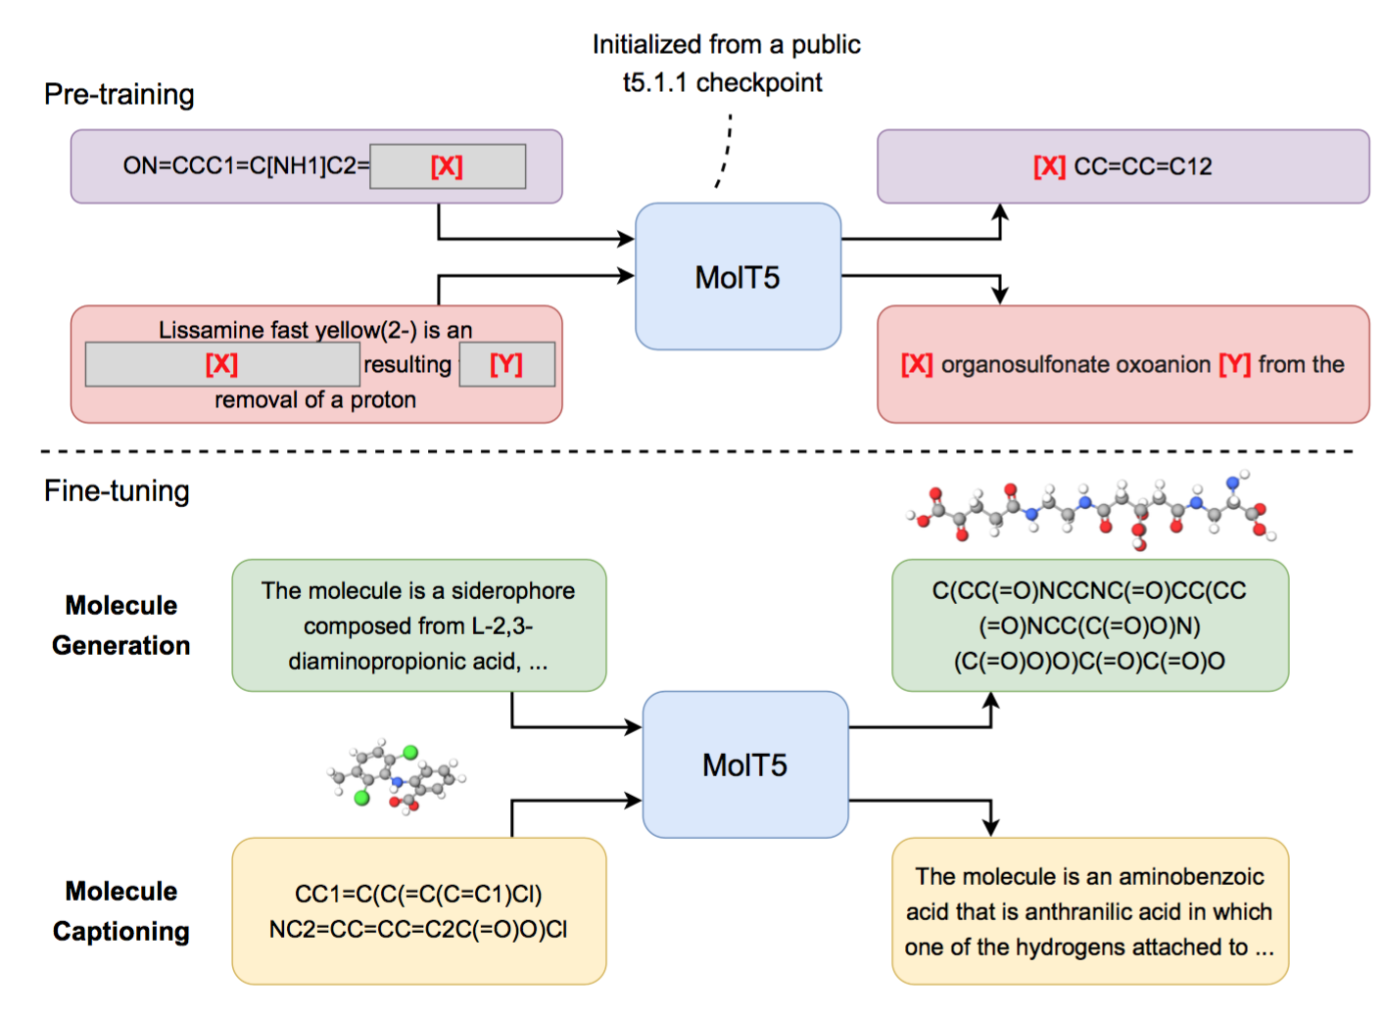
Joint Natural Language and Molecule Learning [Edwards et al., EMNLP2022]

Slide 49
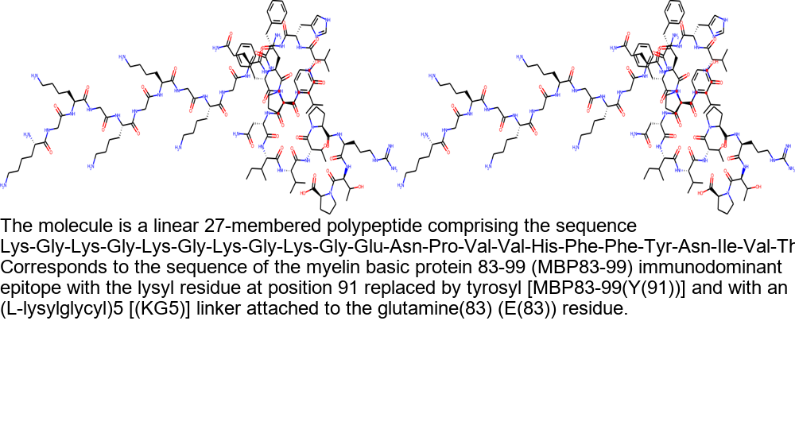
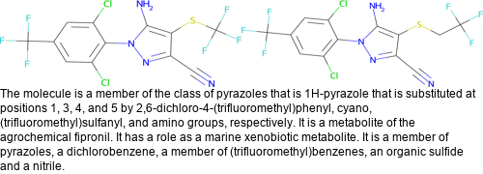
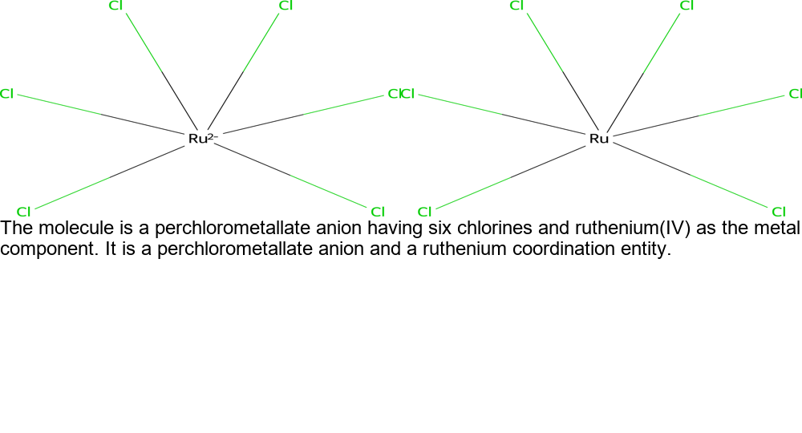
Molecule Generation Results
Left - Ground truth, Right - Predicted

Slide 50
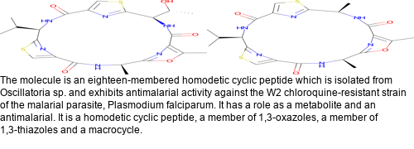
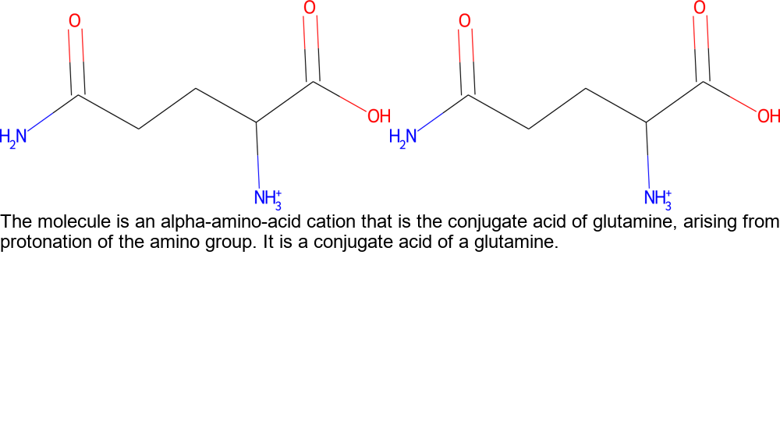
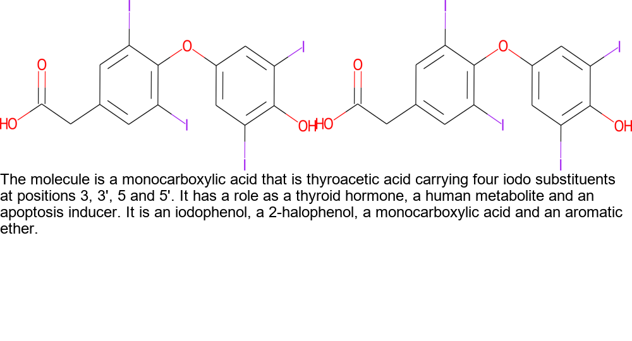
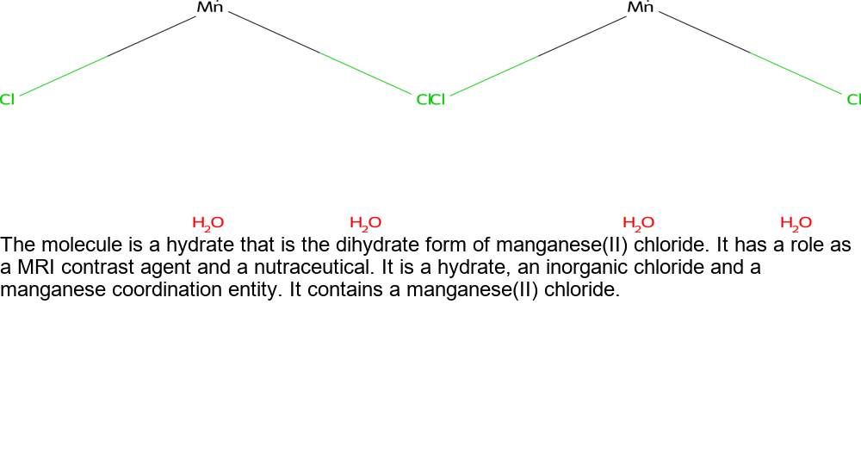
Molecule Generation Results
Left - Ground truth, Right - Predicted

Slide 51
Challenge 3: Wide Context due to Complex Sentence Structures
Paper authors tend to write long sentences with clauses and appositions for better presentations.
Example: Foxp3[Argument] contains a proline-rich amino-terminal domain reported to function as a nuclear factor of activated T cells (NF-AT) and nuclear factor-kappaB (NF-kappaB) binding domain, a central region containing a zinc finger and leucine zipper potentially important for protein-protein interactions, and a carboxyl-terminal forkhead (FKH) domain required for nuclear localization[Trigger] and DNA-binding activity [14-16] .
Distance between event trigger and argument:
Dataset | Average Distance | Maximal Distance
ACE05-E (News) | 0.212 sentence | 56 words
GENIA-2011 (Papers) | 0.330 sentence | 77 words

Slide 52
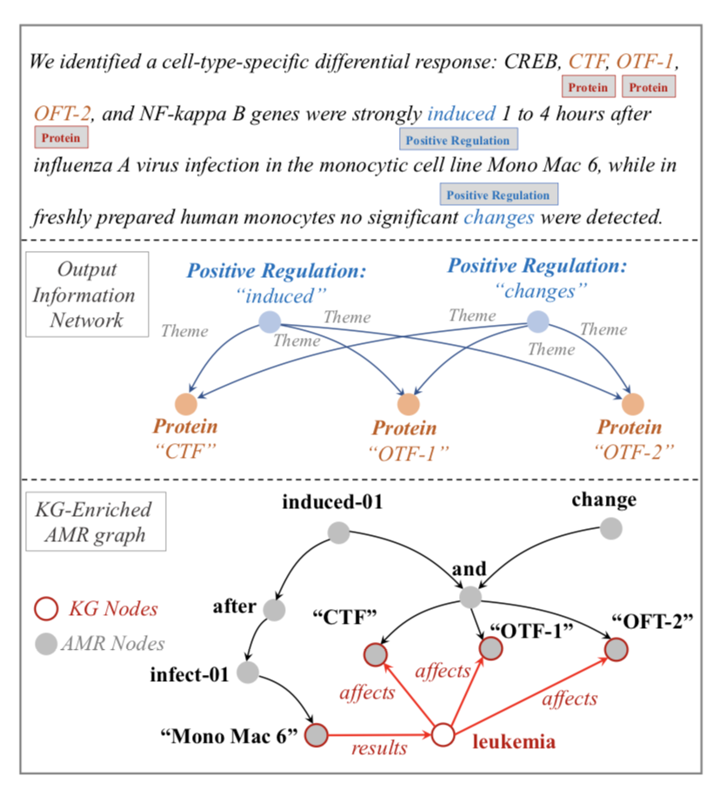
Compressing Long Context with Abstract Meaning Representation Parsing
Use BioBERT as the sentence encoder, and adopt span enumeration and classification for identifying event triggers and entities
Message passing using an edge-conditioned graph attention network
Jointly training and inference (trigger and arguments) for biomedical event extraction

Slide 53
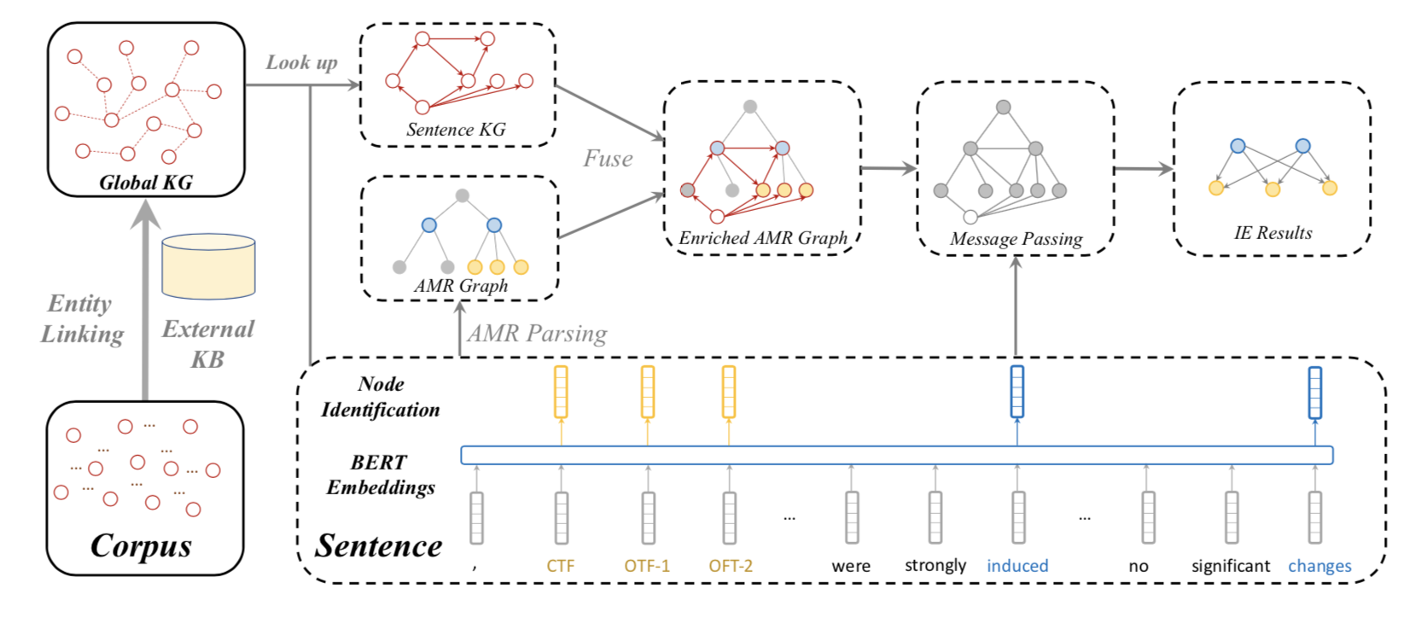
Knowledge-enriched Abstract Meaning Representation [Zhang et al., 2021]

Slide 54
Entity, Relation and Event Extraction Results
BioRelEx dataset – detecting binding interactions between proteins and/or biomolecules
ADE dataset – extracting drug-related adverse effects
 | Entity (Macro-F1) | Relation (Macro-F1)
Relation-Metric (Tran et al. 2019) | 87.11 | 77.29
SpBERT (Eberts et al. 2020) | 89.28 | 78.84
Span_{Multi-Head} (Ji et al. 2020) | 90.59 | 80.73
KnowBertAttention (Baseline) | 90.08 | 79.95
KECI (Ours) | 90.67 | 81.74
Model | Prec | Rec | F1
String Matching | 43.92 | 21.82 | 29.16
Tree LSTM | 67.01 | 52.14 | 58.65
GEANet | 64.61 | 56.11 | 60.06
BEESL | 69.72 | 53.00 | 60.22
DeepEM | 71.71 | 56.20 | 63.02
Bert-Flat | 64.68 | 52.98 | 58.25
BERT-AMR | 68.39 | 53.58 | 60.09
BERT-AMR-KG | 72.74 | 55.62 | 63.04
Overall results (%) on the ADE dataset
Results on GENIA2011: biomedical events (9 types) and proteins

Slide 55
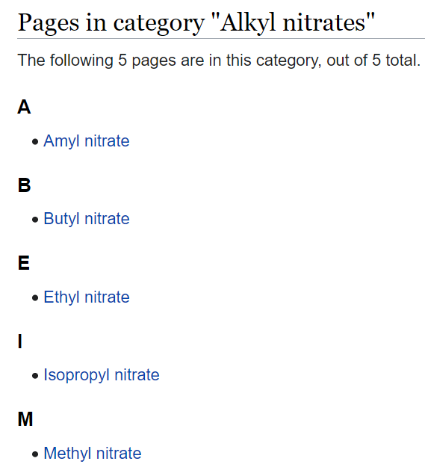
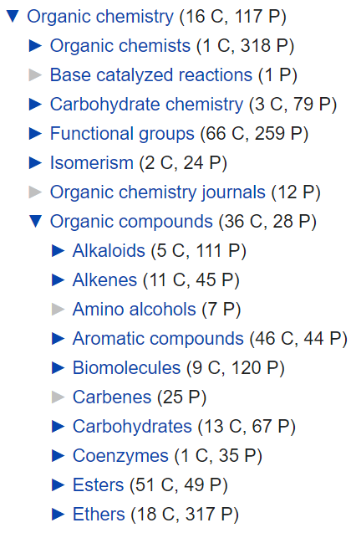
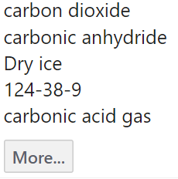
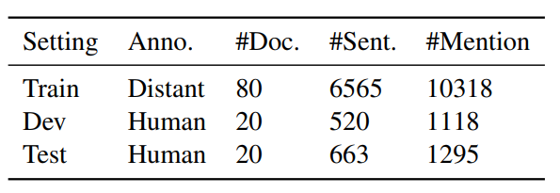
A New Chemistry IE Benchmark
A new benchmark ChemET: includes 81 million molecules and 100 chemistry papers fully annotated with a new fine-grained Chemistry ontology
Data comes from PubChem open access literature
Developed a new entity ontology that includes 62 entity types (e.g., Chemistry→Organic Chemistry→OrganicCom-197pounds→Hydrocarbons→Other Hydrocarbons)
Developed a new Chemistry Event Ontology with 59 types about results, methods and procedures
Training set constructed by distant supervision (using Wikipedia page and PubChem synonyms)
Evaluation set annotated by chemistry students
Dataset Stats

Slide 56
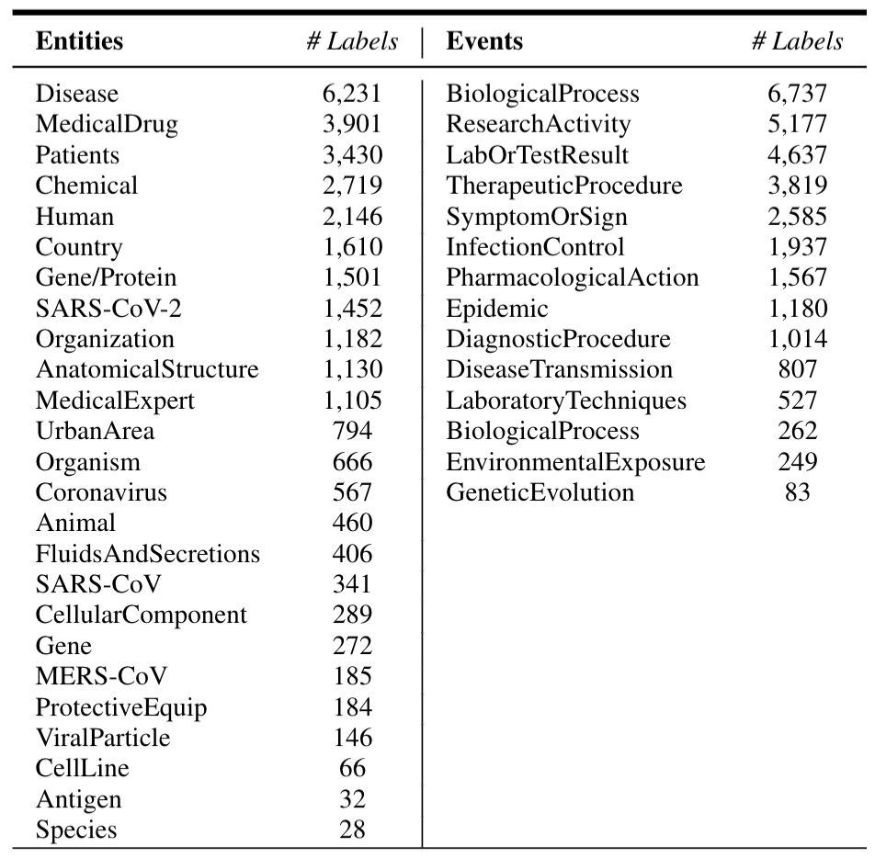
A New COVID-19 Benchmark
http://blender.cs.illinois.edu/covid19/
Manually annotated 122 documents with 6,789 sentences in total
Data Sources:
AI2 CORD-19 archive: index for COVID-19 related papers from PubMed, PubMed Central, Arxiv, and Bio-Arxiv
NCBI PMC API: retrieve PubMed (PM) or PubMed Central (PMC) articles
NCBI Pubtator API: retrieve pre-annotated PubMed or Pubmed Central articles

Slide 57
A Case Study on Drug Repurposing Report Generation
Candidate Target Drugs for COVID019 Clinical Trials (test set suggested by David Liem from UCLA for experiments)
Old List (04/10/2020): Vancomycin, Cefepime, GS-5734, Interferon-alpha2b, lopinavir-ritonavir drug combination, Moxifloxacin, Methylprednisolone, Losartan, Sildenafil Citrate, Hydroxychloroquine (unsuccessful as of 04/24/2020), Darunavir, Cobicistat, glycosylated recombinant human INF-beta, Danoprevir, Angiotensin-Converting Enzyme Inhibitors, Thalidomide, Fingolimod Hydrochloride, Thymosin, Acetylcysteine, Oseltamivir, Arbidol, Bromhexine
New List (04/24/2020)
All the drug names for ACE inhibitors (used to treat high blood pressure): Captopril, Lisinopril, Enalapril, Benazepril, Fosinopril, Ramipril, Quinapril, Perindopril
All the drug names that are angiotensin antagonists (also used for high blood pressure): Losartan, Valsartan, Candesartan, Telmisartan, Fimasartan, Olmesartan, Irbesartan
They work on the same enzyme and receptor that the coronavirus causing COVID-19 is using to enter a cell
Drugs suggested by DARPA biologists: Losartan, Vitamin D, Calpain Inhibitor III (MDL28170), Odanacatib, E-64, Tamoxifen, Berberine

Slide 58
Goal: Discover Connections between Drugs and Chemical/Gene related to COVID-19
Target Chemicals/Genes from DARPA Biologists
BM1_00870 BM1_06175 BM1_16375 BM1_17125 BM1_22385 BM1_30360 BM1_33735 BM1_56245 BM1_56735
CATB-10270 CATB-1418 CATB-1674 CATB-16A CATB-16D2 CATB-1852 CATB-1874 CATB-2744 CATB-3098
CATB-348 CATB-3483 CATB-5880 CATB-84 CATB-912 CATD CATHY CATK CATL CATL-LIKE CTS12 CTS3 CTS6 CTS7 CTS7-PS CTS8 CTS8L1 CTS8-PS CTSA CTSA.L CTSB CTSBA CTSBB CTSB.L CTSB-PS CTSB.S CTSC CTSC.L CTSC.S CTSD CTSD2 CTSD.S CTSE CTSEAL CTSE.L CTSE.S CTSF CTSF.L CTSG CTSH CTSH.L CTSH-PS CTSJ CTSK CTSK1 CTSK.L
CTSL CTSL.1 CTSL3 CTSL3P CTSLA CTSLB CTSLL CTSL.L CTSLL3 CTSLP1 CTSLP2 CTSLP3 CTSLP4 CTSLP6 CTSLP8
CTSM CTSM-PS CTSM-PS2 CTSO CTSO.L CTSQ CTSQL2 CTSR CTSS CTSS1 CTSS.2 CTSS2.1 CTSS2.2 CTSSL CTSS.L
CTSS.S CTSV CTSV.L CTSW CTSW.L CTSZ CTSZ.L CTSZ.S LOAG_18685 SMP_013040.1 SMP_034410.1 SMP_067050
SMP_067060 SMP_085010 SMP_085180 SMP_103610 SMP_105370 SMP_158410 SMP_158420 SMP_179950
TSP_01409 TSP_02382 TSP_02383 TSP_03306 TSP_07747 TSP_10129 TSP_10493 TSP_11596 LMAN1
LMAN1L LMAN1.L LMAN1.S LMAN2 LMAN2L MBL1P MBL2 ACE2 FURIN TMPRSS2
Report (64 pages) at: http://blender.cs.illinois.edu/covid19/DrugRe-purposingReport_V2.0.docx

Slide 59
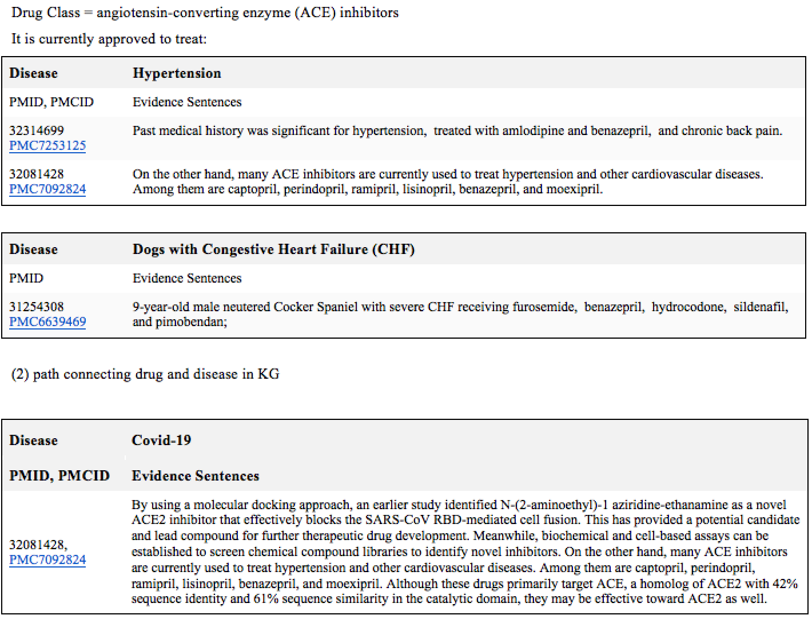
Section 1: Current indication: what is the drug class? What is it currently approved to treat?
Example output for Benazepril

Slide 60
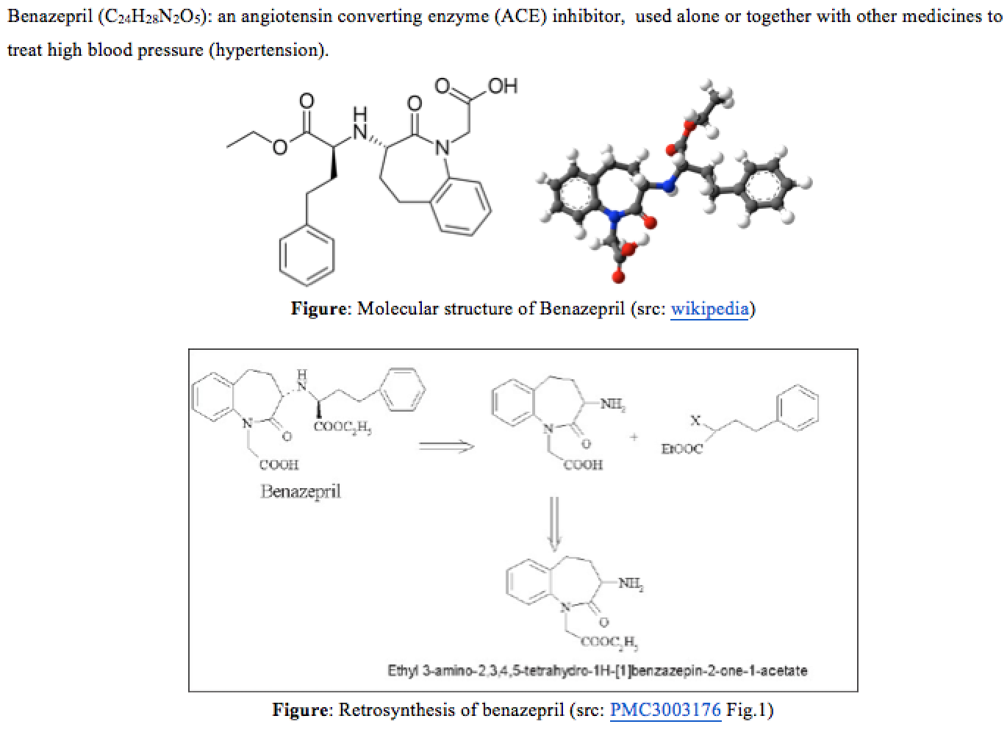
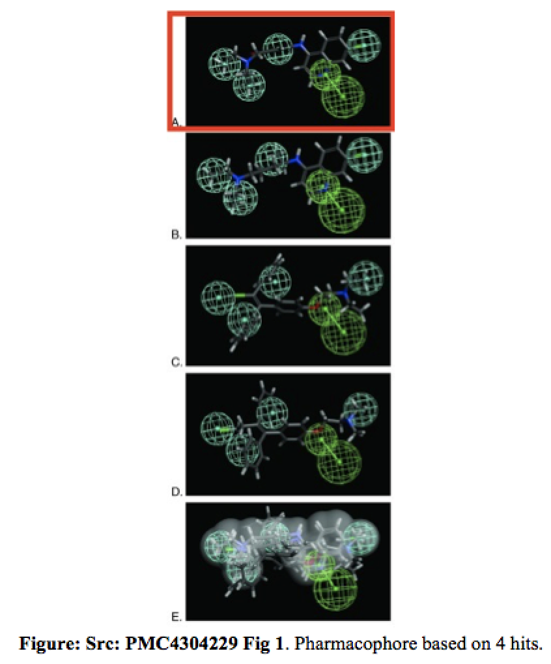
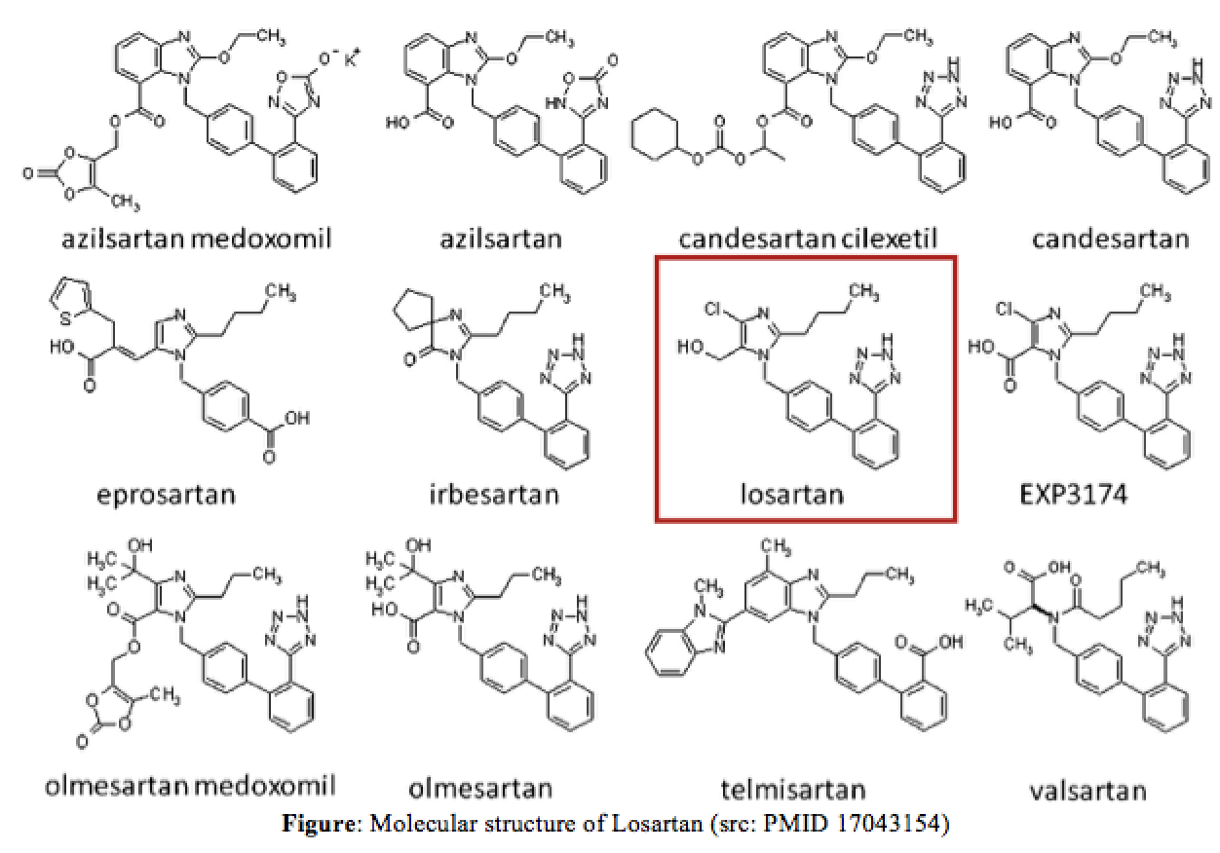
Section 2: Molecular structure (symbols desired, but a pointer to a reference is also useful)

Slide 61
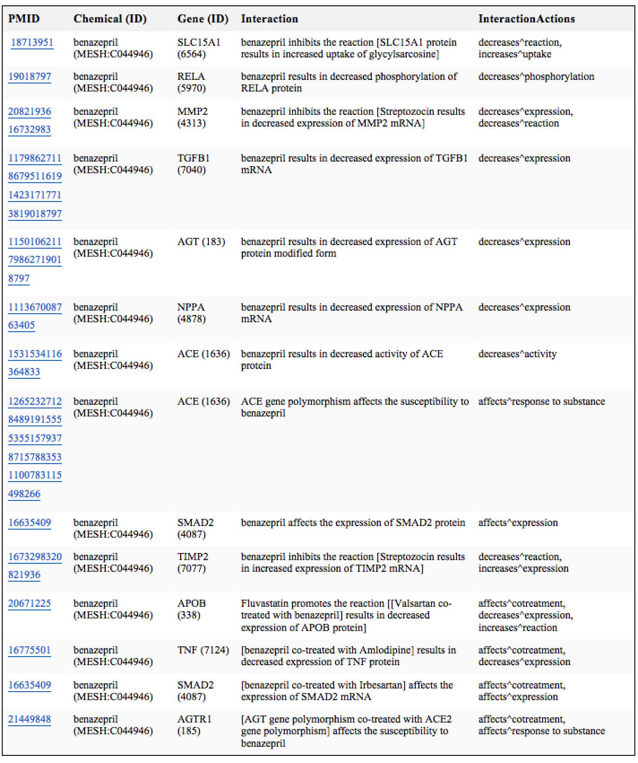
Section 3: Mechanism of action i.e. inhibits viral entry, replication, etc (w/ a pointer to data)

Slide 62
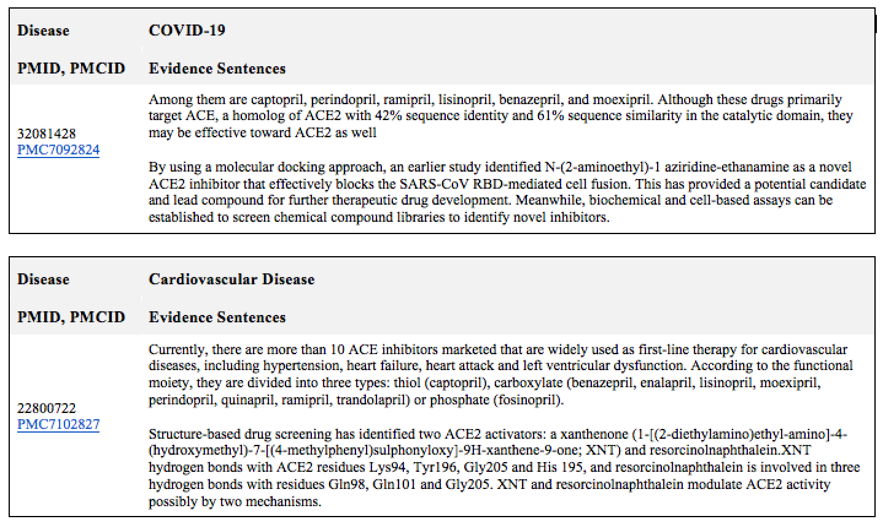
Section 4: Was the drug identified by manual or computation screen?

Slide 63
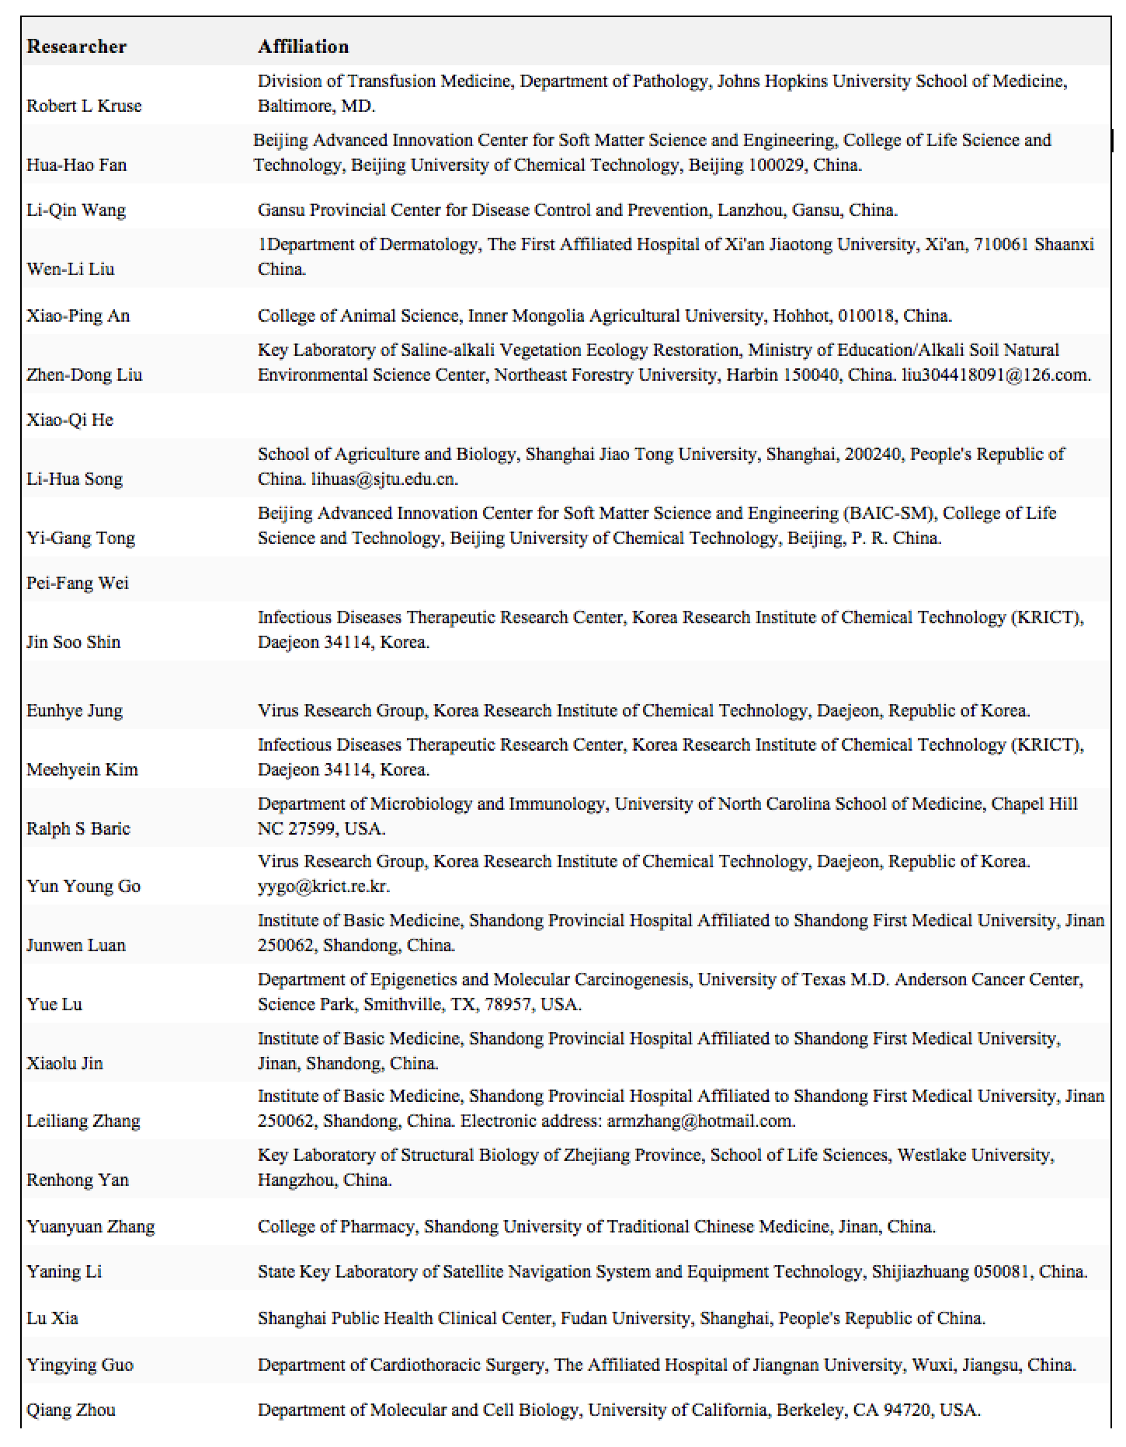
Section 5: Who is studying the drug? (Source/lab name)

Slide 64
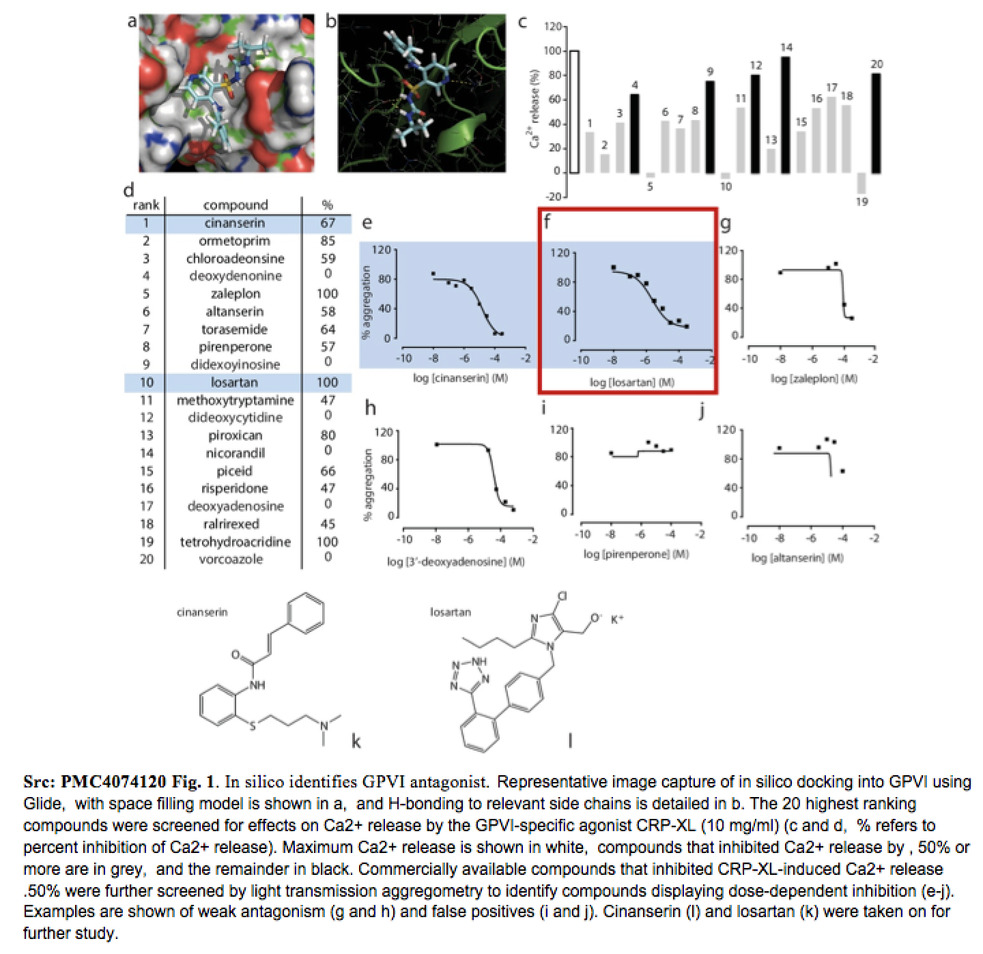
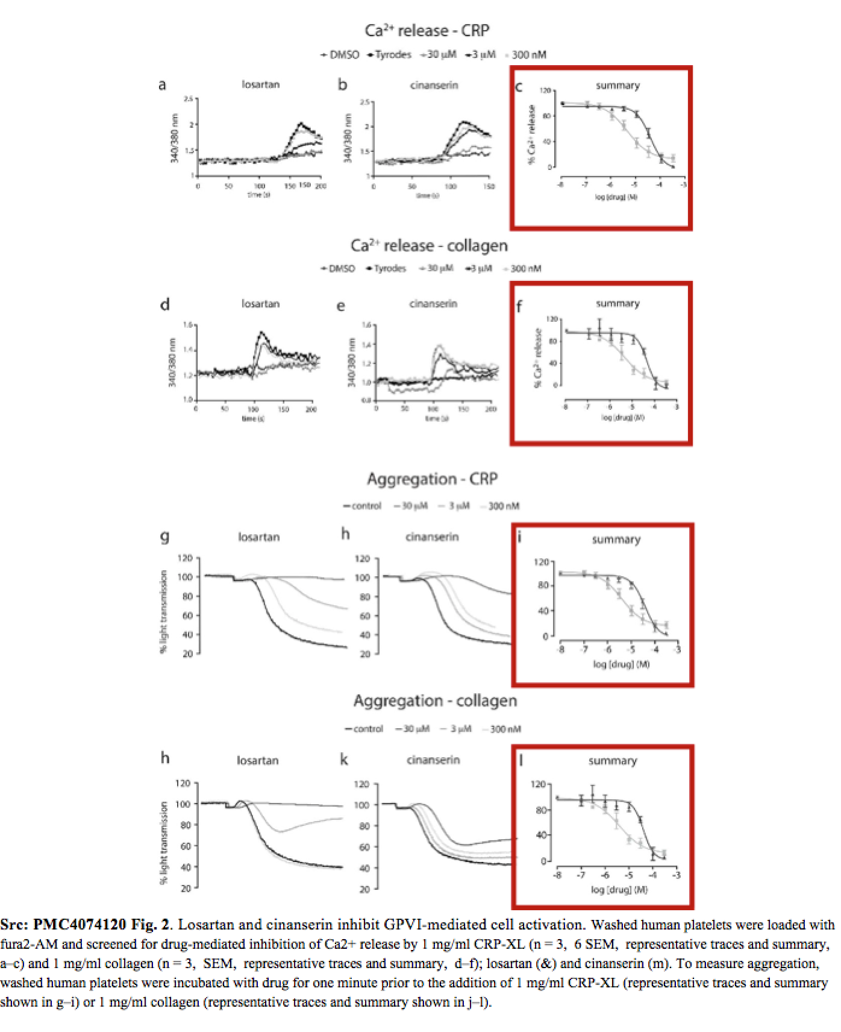
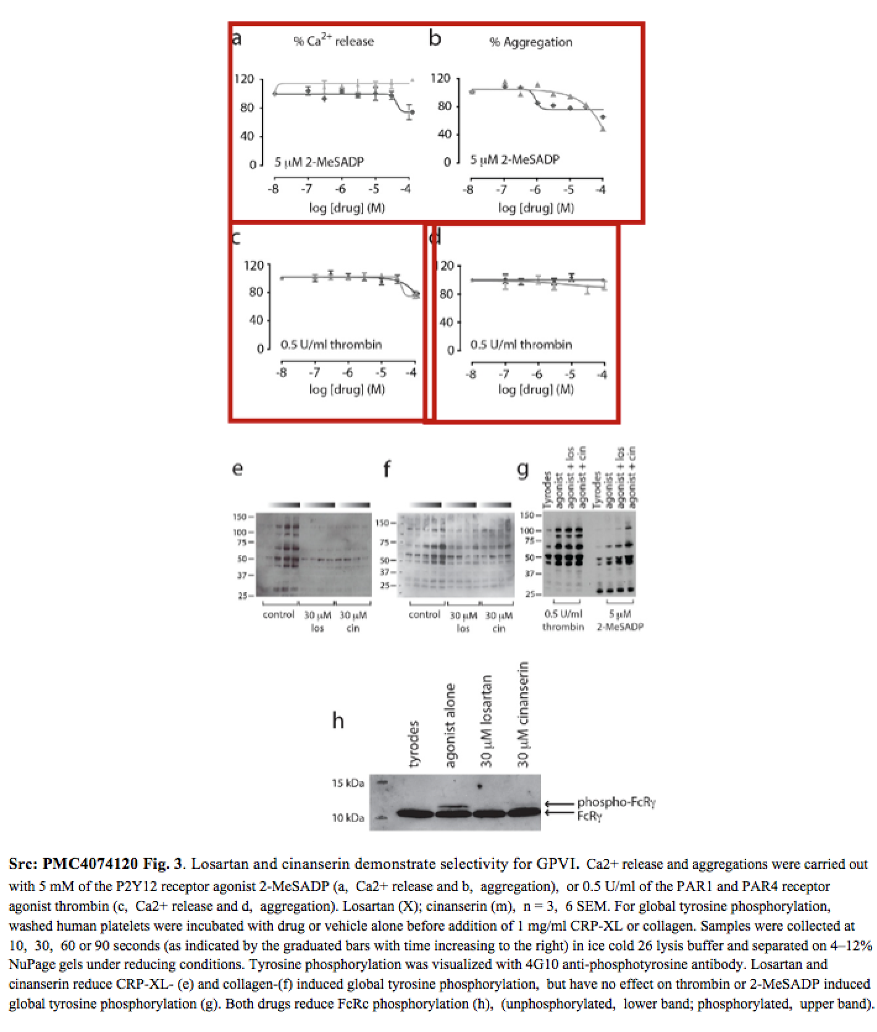
Section 6: In vitro Data available (cell line used, assays run, viral strain used, cytopathic effects, toxicity, LD50, dosage response curve, etc)

Slide 65
Section 7: Animal Data Available (what animal model, LD50, dosage response curve, etc)

Slide 66
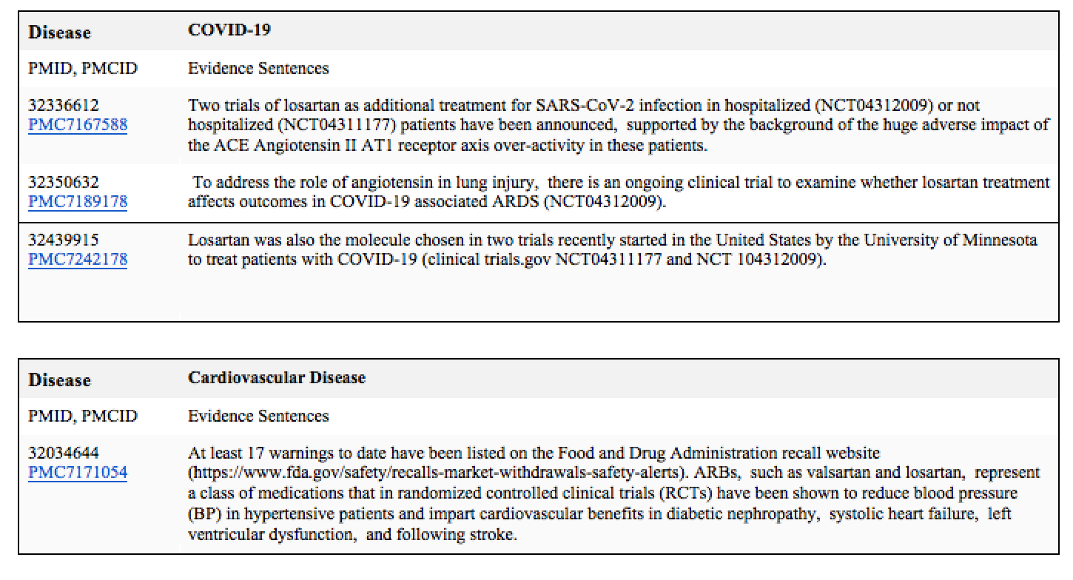
Section 8: Clinical trials on going (what phase, facility, target population, dosing, intervention etc)

Slide 67
Section 9: Has the drug shown evidence of systemic toxicity?

Slide 68
Section 9: Has the drug shown evidence of systemic toxicity?

Slide 69
Section 9: Has the drug shown evidence of systemic toxicity?

Slide 70
Section 10: Funding source

Slide 71
Section 11: List of relevant sources to pull data from

Slide 72
Remaining Challenge 1: Lack of Knowledge Reasoning
Requires global knowledge aggregation and reasoning
Contaminated food from Haiti could enter the Dominican Republic
The contaminated lobster and other food, drinks, and ice served at the wedding were provided by the catering company at Casa de Campo
More than 300 wedding guests, including a 30-year-old Massachusetts man and others, ate lobster contaminated with cholera at Casa de Campo
A 30-year-old man went to the emergency room of Massachusetts General Hospital
A Massachusetts 30-year-old man was diagnosed with cholera in Massachusetts and at Massachusetts General Hospital
Purchase.agent = the catering company instead of the 30-year-old man
The 30-year-old man = Sue.plaintiff instead of Sue.defendant

Slide 73
Remaining Challenge 2: The Unsolved “Long-Tail” Problem
Rare Triggers
his men back to their compound
A suicide bomber detonated explosives at the entrance to a crowded
medical teams carting away dozens of wounded victims
Today I was let go from my job after working there for 4 1/2 years.
This morning in Michigan, a second straight night and into this morning, hundreds of people have been rioting in Benton harbor.
Rare Arguments
He called the case and I'm quoting now, a judge's worst nightmare, but he noted that Maryland Parole Boards and the facility where Michael Serious was held, the institution made what the judge called the final decision on whether to release serious [release-parole_person].
A source tell US Enron is considering suing its own investment bankers for giving it bad financial advice [Sue_crime].

Slide 74
Future Direction 3: Corpus-Level IE
1996: Pattern based Corpus-level IE [Grishman and Sundheim, 1996]
2004: Maximum Entropy based Sentence-level IE [Florian et al., 2004]
2016: Bi-LSTM based Sentence-level IE [Lample et al., 2016]
2020: BERT based Sentence-level IE [Lin et al., 2020]
2021: Text generation based Document-level IE [Li et al., 2021]
2022 and Beyond: Text generation based Corpus-level IE?
74

