Slide 1
Large Neural Models Self-Learning Symbolic Knowledge
Heng Ji
(work done by Zoey Li, Zhenhailong Wang and Carl Edwards @UIUC)
Professor of Computer Science, University of Illinois Urbana-Champaign
Amazon Scholar Founding Director of Amazon-Illinois Center on AI for Interactive Conversational Experiences (AICE)
hengji@illinois.edu
Zoey Sha Li (UIUC)
Zhenhailong Wang (UIUC)
Carl Edwards (UIUC)

Slide 2
Story Repeats Itself
TV shows about “CEO boss guy”
He always has this really slicked back hair-style, always wears a suit
He has this really non.cha.lant look
He speaks at least 5 languages
He spent 5 years somewhere in France just for the sake of learning everything pretentious about the wine
And he spent his recent 5 years somewhere in NYC, of course the upper east side
At age 15 he got into Harvard, accepted by 10 majors
Ever since then he started to run this big multi-billion dollar company
He met this girl who graduated from an unknown college somewhere in the middle of nowhere and applied for internship in the company run by this guy
Love stories by Qiong Yao
Pretty women are good at crying in a pretty way
At least two people get their hearts broken
Main characters are very poetical
The original wife is evil
The main character is always a jerk but very popular, jobless, and yells
2
Notes:
Change low resource IL to a language which is not in wikipedia
Word-level: from bi-lingual dicts and alignment; structure-level comes from wals; multi-level alignment

Slide 3
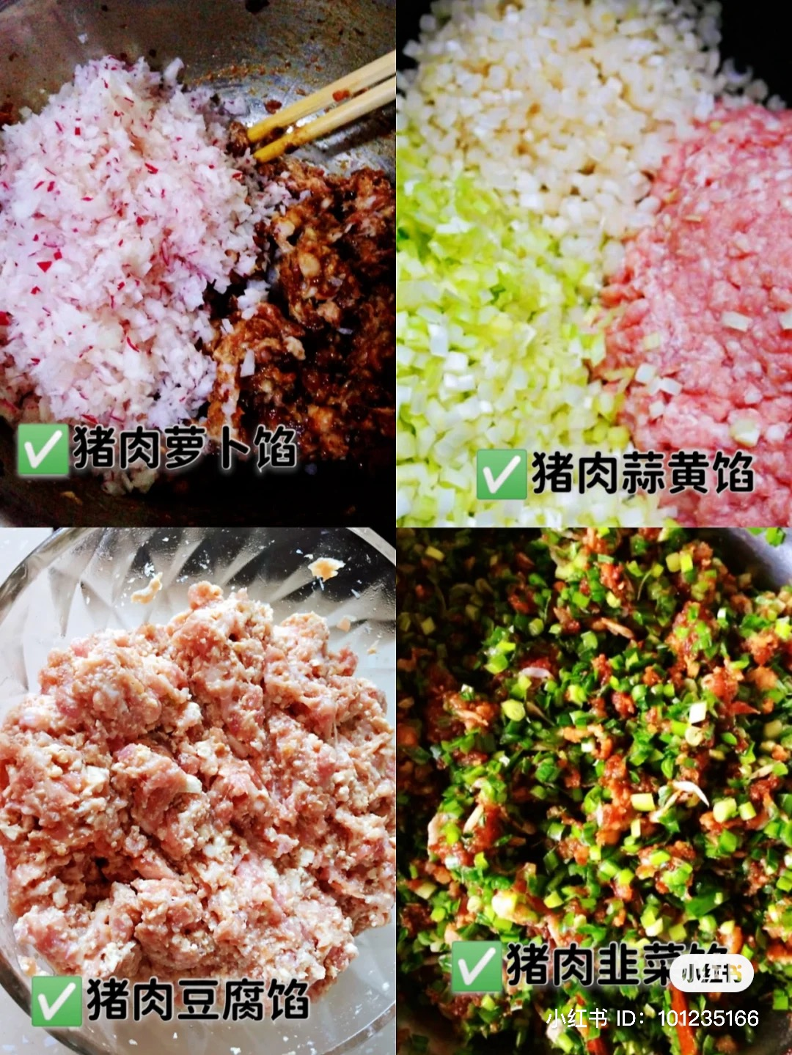
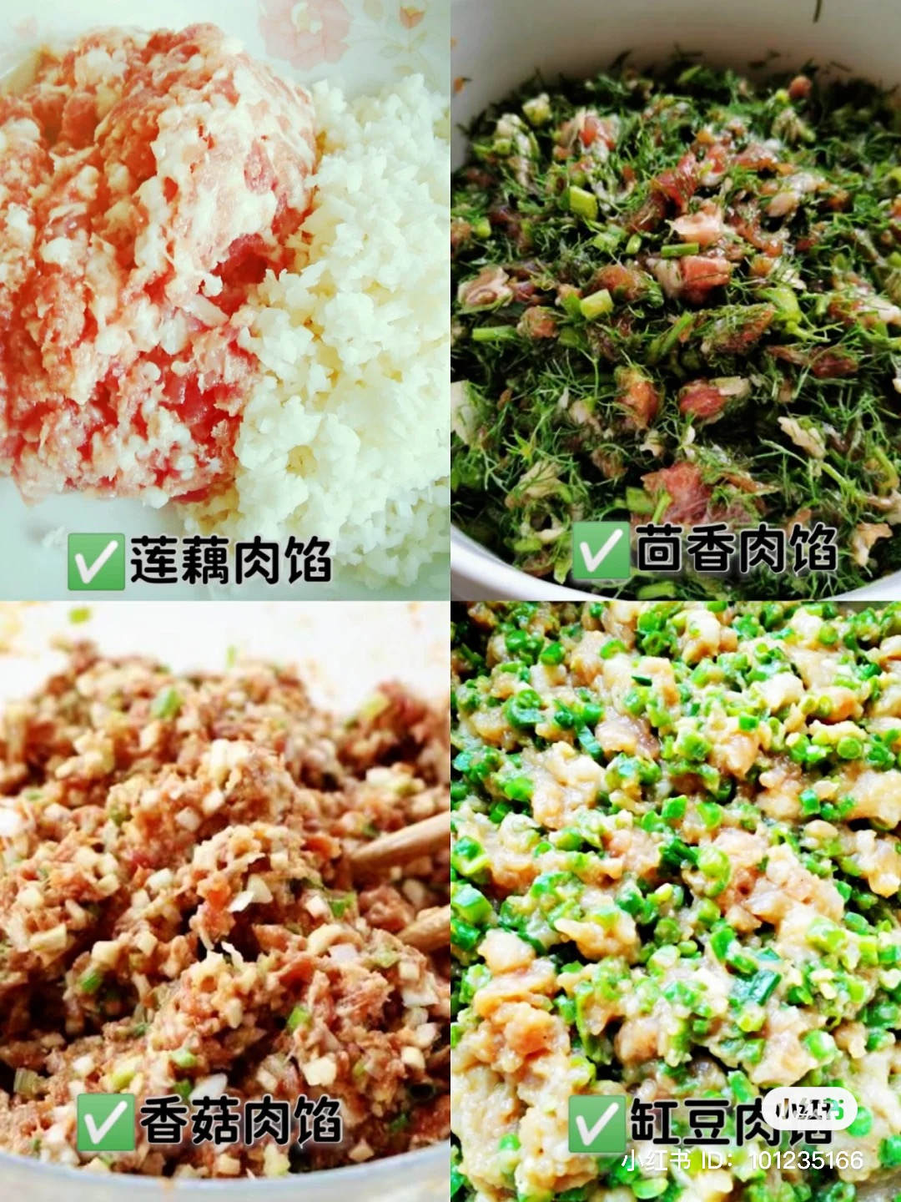
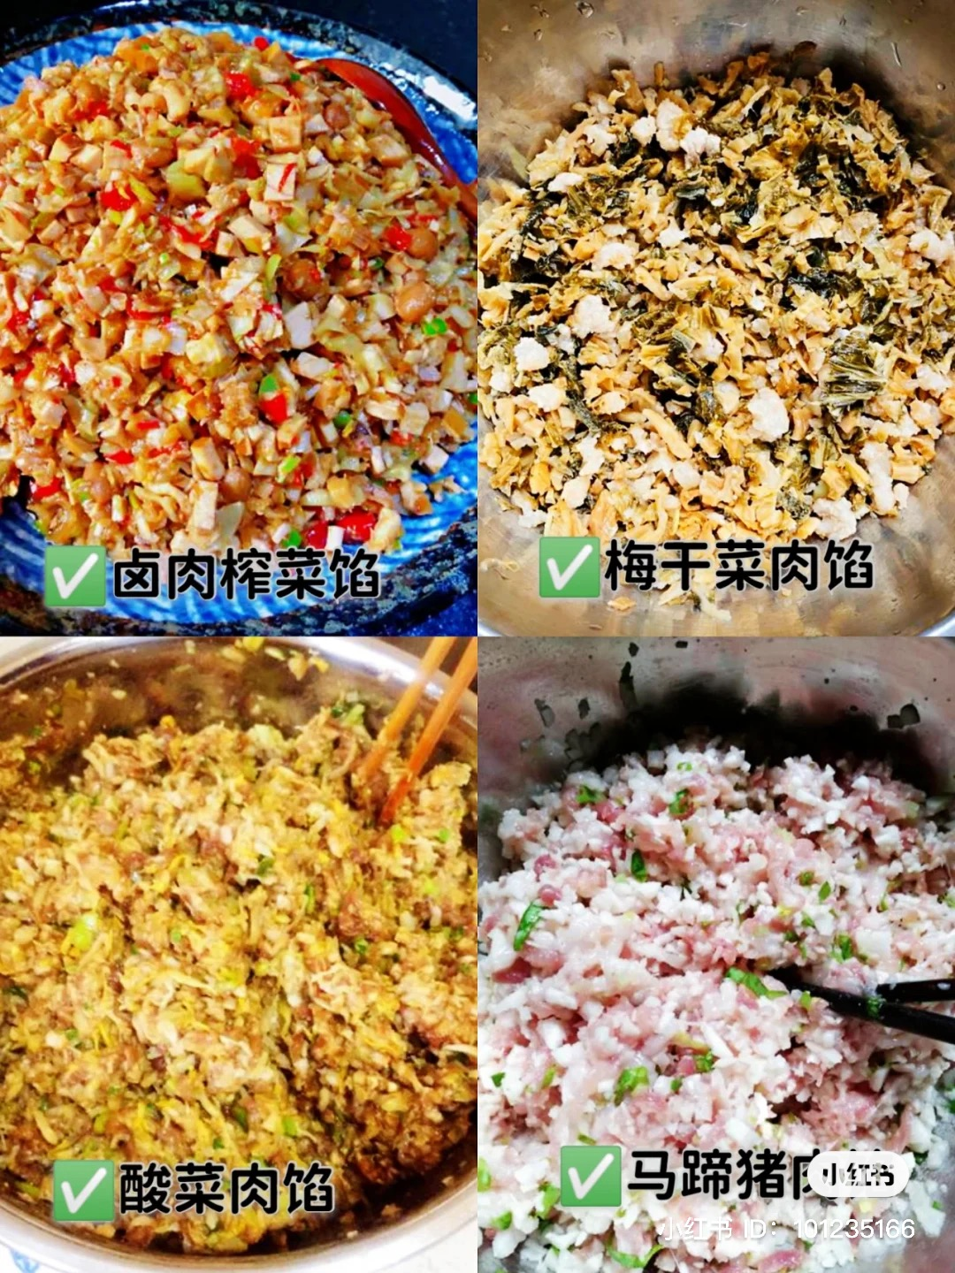
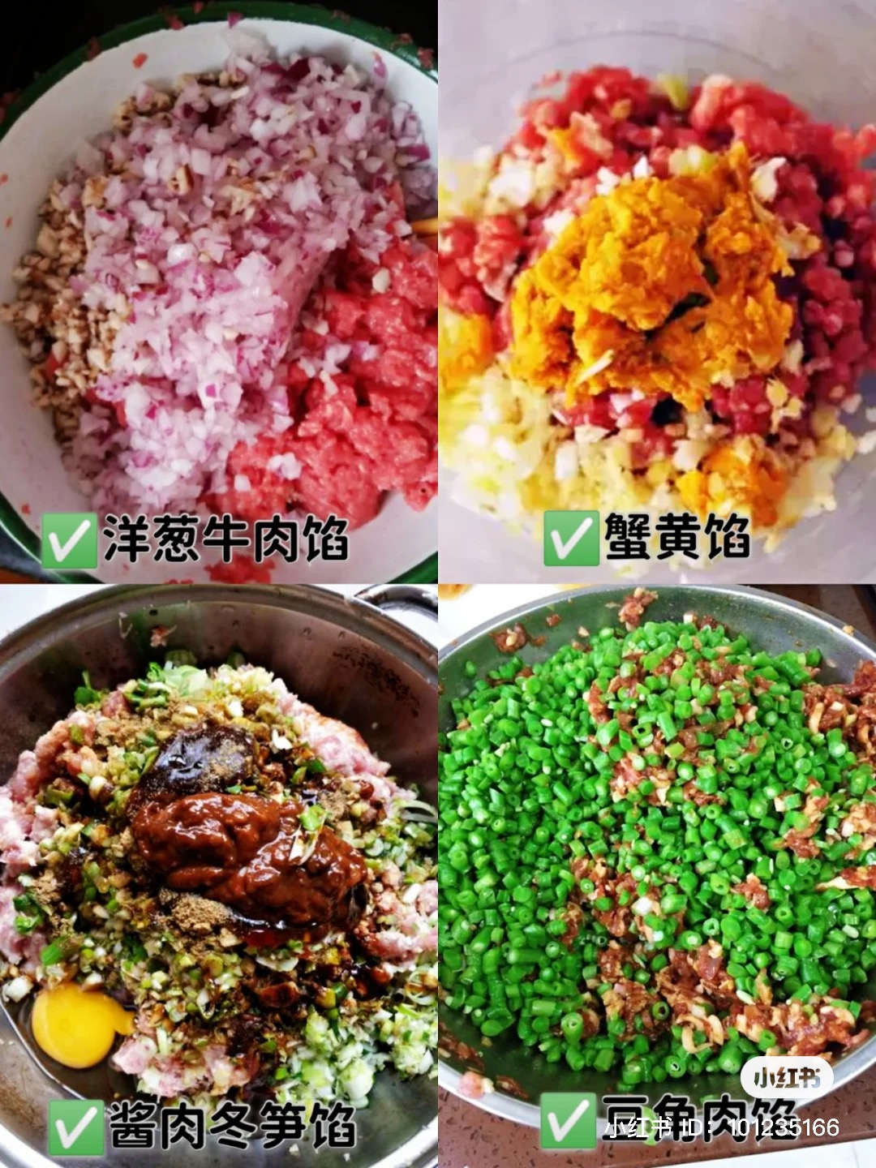
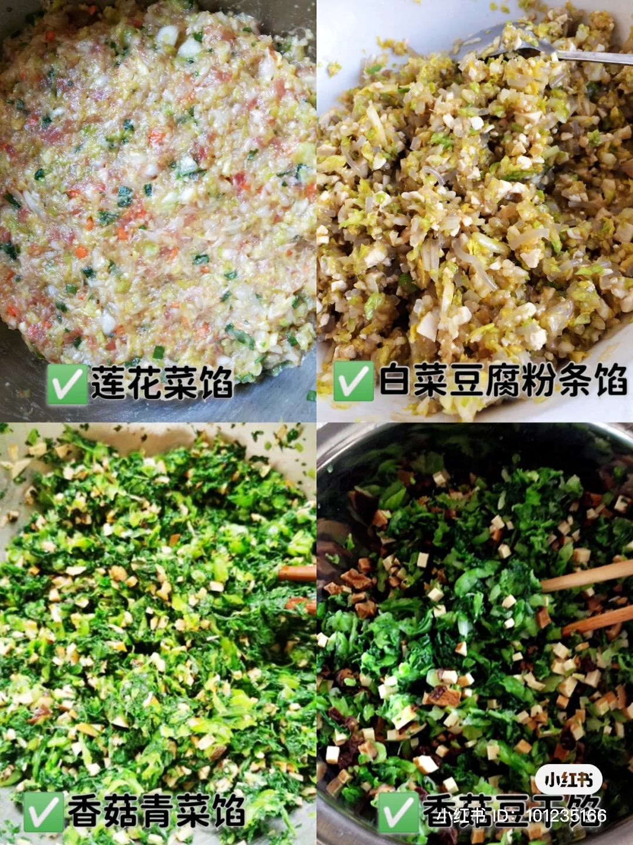
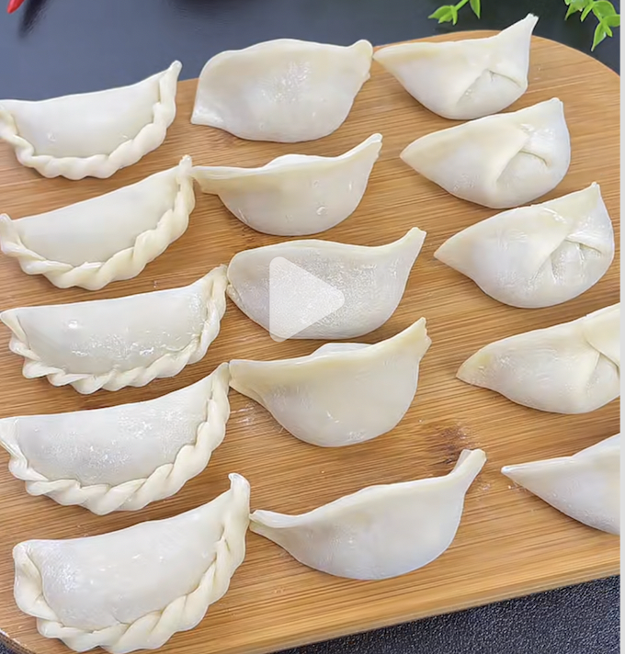
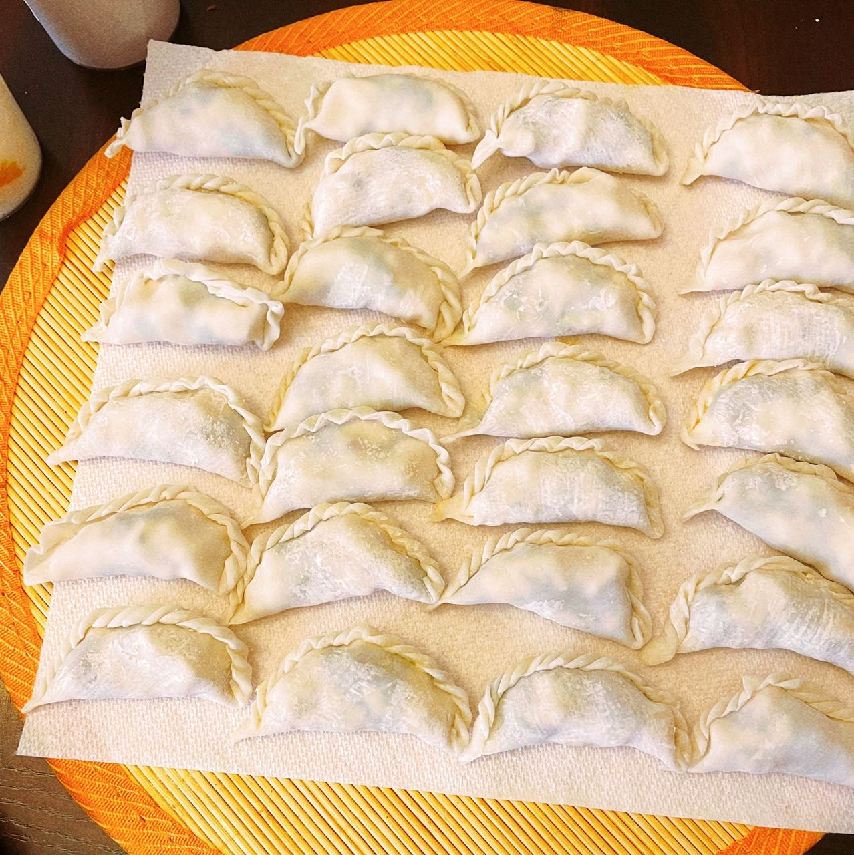
Procedure Repeats Itself
3
Notes:
Change low resource IL to a language which is not in wikipedia
Word-level: from bi-lingual dicts and alignment; structure-level comes from wals; multi-level alignment

Slide 4
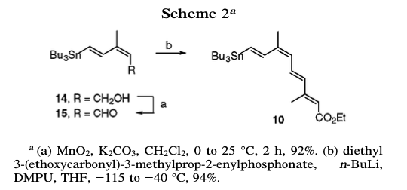
Procedure Repeats Itself
MnO2 (8.31 g, 0.10 mol) and K2CO3 (13.2 g, 0.10 mol) were added to a stirred solution of alcohol (2.06 g, 5.32 mmol) in CH2Cl2 (38 mL).
Stir (the mixture) for 30 min at 25 °C
The suspension was filtered through Celite
The filtrate (things that has passed through the filter) was evaporated
Purify the residue by column chromatography (SiO2, 90:8:2 hexane/EtOAc/Et3N)
Afforded 1.88 g (92%) of 15 (a chemical shown as its structure in the paper)
4
Notes:
Change low resource IL to a language which is not in wikipedia
Word-level: from bi-lingual dicts and alignment; structure-level comes from wals; multi-level alignment

Slide 5
Quiz Time!
John purchased a high-pressure cooker and materials for bomb making. ________________. _________________. There was an explosion during Boston Marathon. _______________. Police found the bomb was inside a high-pressure cooker. ____________________. ___________________. John was sentenced to death.
5
Notes:
Change low resource IL to a language which is not in wikipedia
Word-level: from bi-lingual dicts and alignment; structure-level comes from wals; multi-level alignment

Slide 6
Schemas, or scripts, were originally defined by (Schank and Abelson, 1975) as “ a predetermined, stereotyped sequence of actions that defines a well-known situation”.
6

Slide 7
Event Graph Schema Induction (Li et al., 2020)
Select salient and coherent paths based on Path Language Model, and merge them into graph schemas
Manling Li, Qi Zeng, Kyunghyun Cho, Heng Ji, Jonathon May, Nathanael Chambers, Clare Voss. Connecting the Dots: Event Graph Schema Induction with Path Language Modeling. ACL 2020.
Notes:
The good thing about schema-level event knowledge is that it can help us to achieve a kind of abstraction to transfer the knowledge from observed event instances to unseen ones. At the same time, it can also help select the salient event knowledge and minimize the influence of noise.
Here is an example, assume that we have two instance-level event graph, even though they are not describing the identical event, some components are shared. For example, how are these transport events are connected with the attack events. To effectively find such schema knowledge, they first generate a set of paths and then learn a path language model. As a result, they will then get the final graph schema.

Slide 8
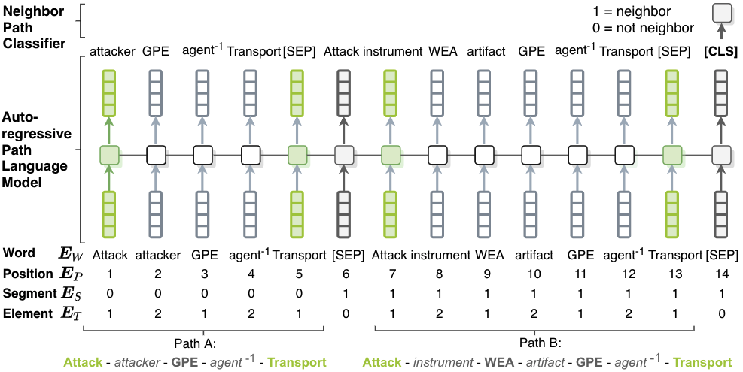
Path Language Model
Path Language Model is trained on two tasks
Autoregressive Language Model Loss: capturing the frequency and coherence of a single path
Neighbor Path Classification Loss: capturing co-occurrence of two paths
Notes:
Here is how they trained the path language model, the approach is actually very straightforward. You can concatenate multiple paths together and treat it as a sentence to model the coherence of those paths. One thing worth mentioning is that, to capture the co-occurrence information of two paths, they also introduce an additional neightbor path classification loss.

Slide 9
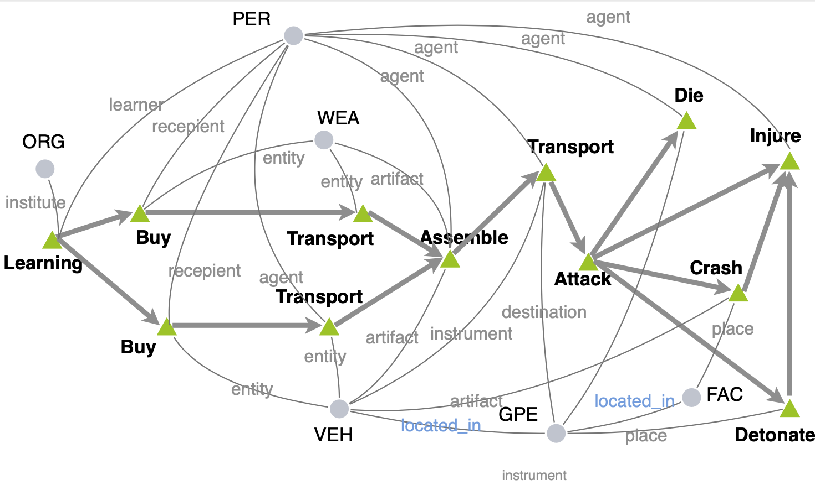
Temporal Complex Event Schema Composition (Li et al., EMNLP2021)
Graph Structure Aware:
Encode entity coreference and entity relation
Capture the interdependency of events and entities (sequences can not)
Scenario guided:
Train one model based on instance graphs of the same scenario
Probabilistic:
Support downstream tasks, such as event prediction

Slide 10
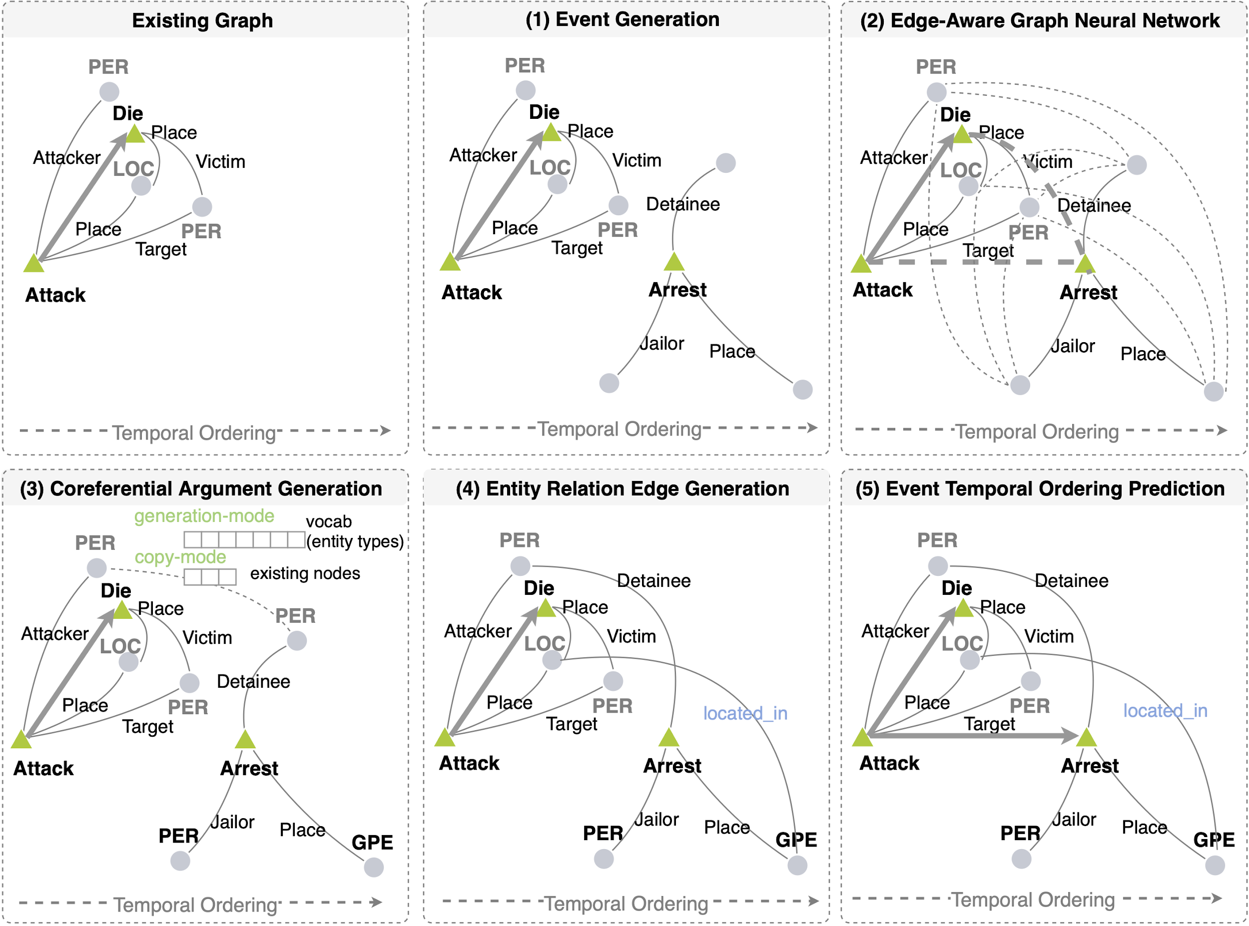
Generative Event Graph Model
Schemas are the hidden knowledge to control instance graph generation
Step 1. Event Node Generation
Step 2. Message Passing
Step 3. Argument Node Generation
Step 4. Relation Edge Generation
Step 5. Temporal Edge Generation

Slide 11
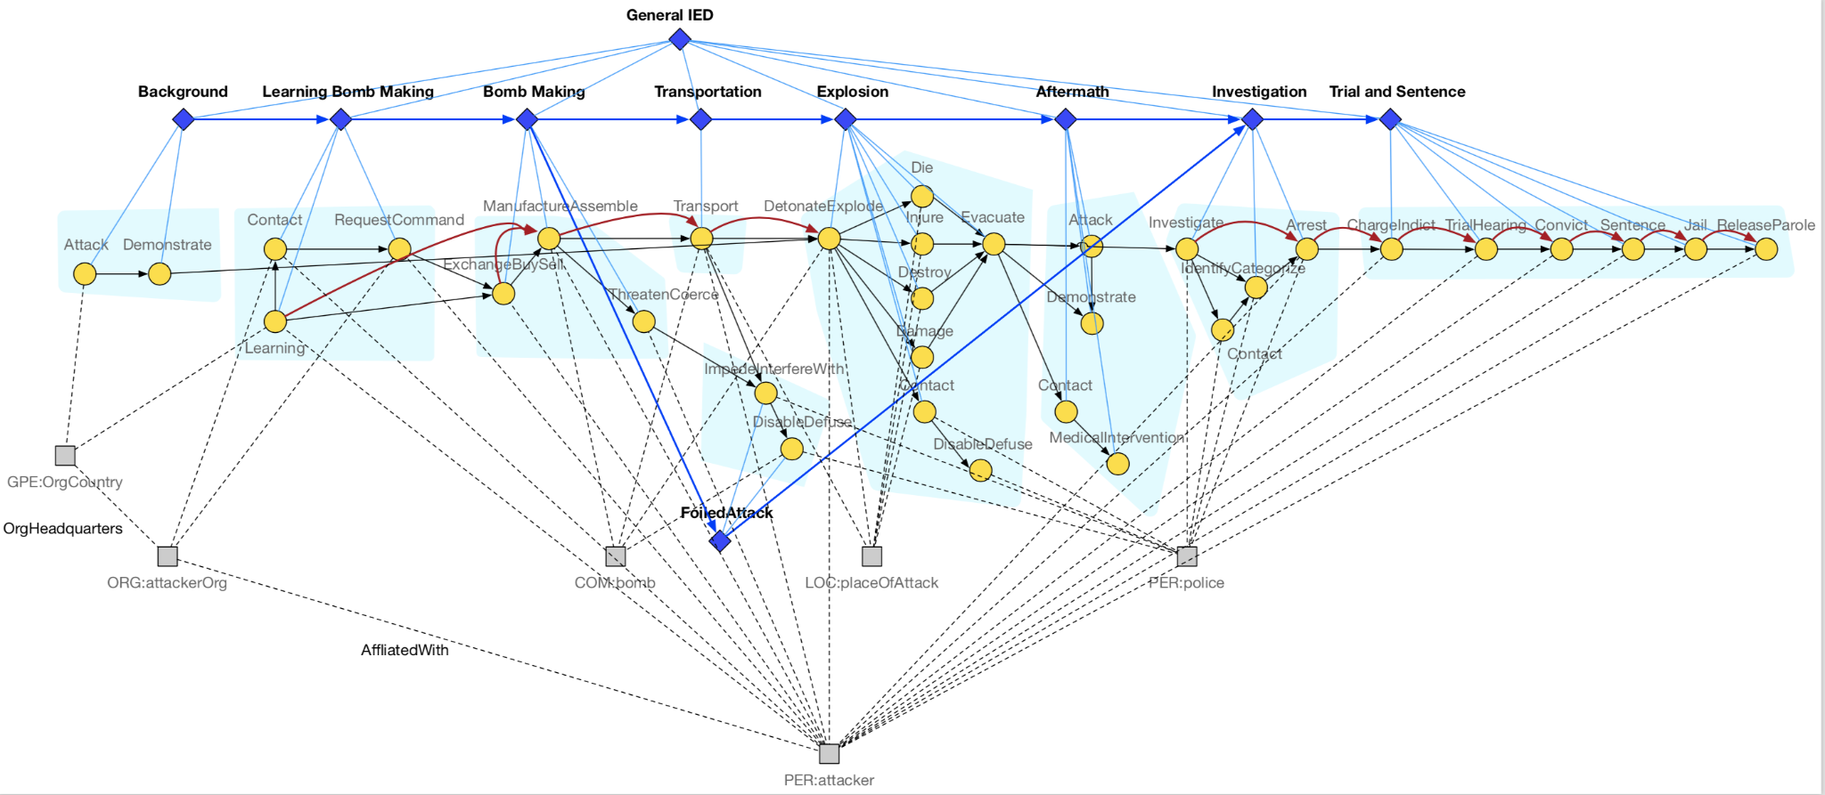
Adding Hierarchy and Multiple Alternative Hypotheses: IED scenario
We add episode nodes (diamond-shaped) to the schema. Each episode node is connected to several event nodes, an event node can only belong to one episode.
Episodes have temporal order
Alternative episodes such as FoiledAttack represent alternative hypotheses for the complex event
Notes:
- how hard is it to do internal schema organization for schema clarity and reasonable compression to remove redundancy? [multiple hypotheses? Make schemas more distinguishable from one another, discriminative factor]

Slide 12
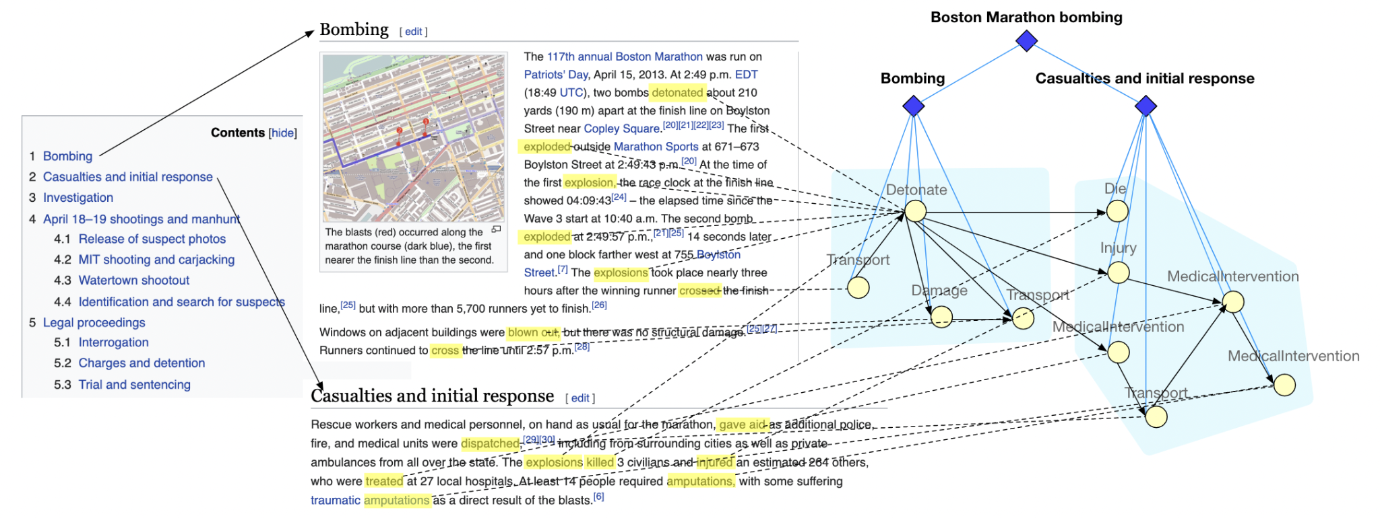
Lack of training data: Training the Graph Encoder with Distant Supervision
We propose to learn how to segment complex event graphs into episodes using distant supervision from Wikipedia
We train a graph generation model from a large number of observed complex event graphs that is capable of predicting future events and episodes

Slide 13
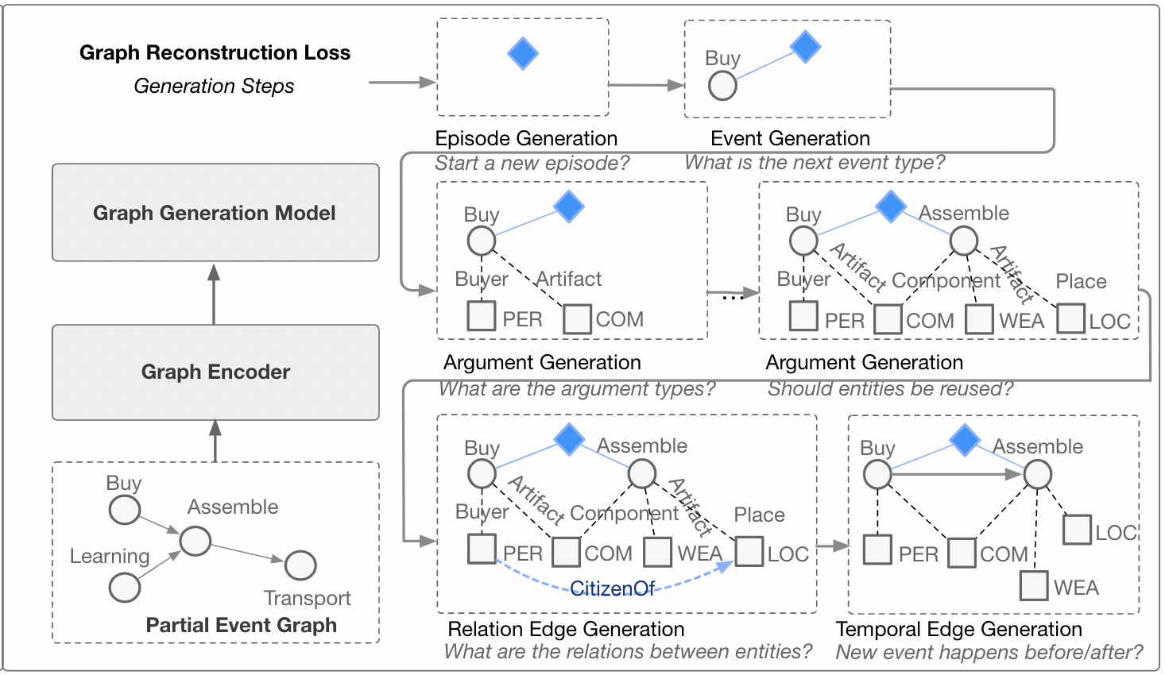
Training the Graph Decoder with Graph Reconstruction
We create the partial event graph by randomly removing one episode from the original graph
The graph is generated episode by episode
Within each episode we follow the steps of (1) event generation, (2) argument generation, (3) relation edge generation and (4) temporal edge generation

Slide 14
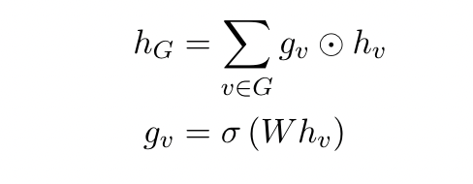
A Graph Encoder-Decoder Model for Hierarchical Complex Event Schema Induction
Embedding Initialization
Event node embeddings are initialized with BERT and corresponding type embeddings
Entity node embeddings are initialized with type embeddings
Heterogeneous Graph Convolution Layers
The graph has 2 types of nodes: event, entity and 5 types of edges: argument(event-entity), relation(entity-entity), temporal(event-event), containment(episode-event), global(episode-episode)
We parameterize the graph convolution function over each type of edge separately
An attention operation is computed over all incoming edges to update the embedding of the target node
Graph Readout Function
Weighted sum over all nodes in the graph
14
Notes:
Change low resource IL to a language which is not in wikipedia
Word-level: from bi-lingual dicts and alignment; structure-level comes from wals; multi-level alignment

Slide 15
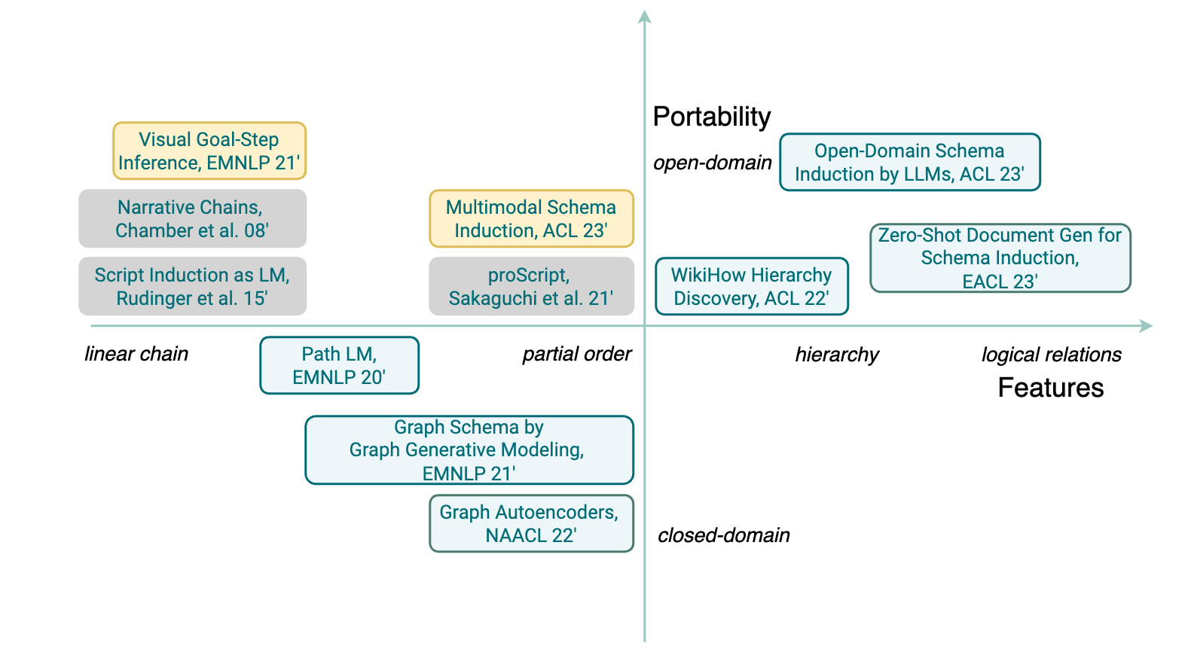
Open-Domain Hierarchical Schema Induction

Slide 16
Open Domain Hierarchical Schema Induction via LLMs [Li et al., ACL2023]
Round 1: Get the main events of a scenario.
Round 2: For each event, expand to connected events.
Round 3: Verification of temporal and hierarchical edges
Advantages Compared to Previous Methods
Open-Domain: our model can induce schemas for any scenario given the scenario name
Extensible: our paradigm can support new event-event relations by adding new prompt templates. We showcase this by including hierarchical relations.
Interpretable: by representing events with sentences, human assessors consider our schemas to be more readable than prior approaches
Notes:
Incremental Prompting of Language Models
Schemas are highly structured objects, it’s not possible to directly ask a language model to output a schema.
But we can ask language models:
What are the steps to perform an action?
What might happen after an event?
What are the possibles causes of an event?
…
Our algorithm works by breaking down the schema into these incremental questions and then composing the schema from the answers

Slide 17
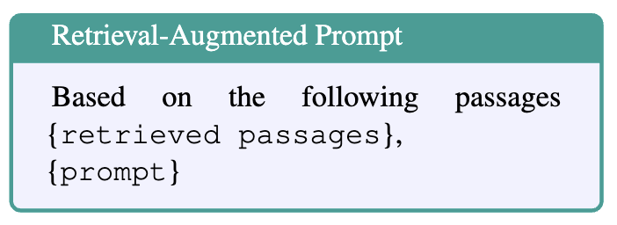
Retrieval-Augmented Prompting
When humans curate schemas, they often refer to related news articles or Wikipedia
Whenever our prompt is related to an event, we simulate this process by using the GPT3-generated event description to retrieve related passages to serve as extra context to the language model
To encourage the model to output a general answer, we retrieve 3 passages per prompt using a pretrained TCT-ColBERT model.
Retrieving multiple passage (ideally about different instances) is important for guiding the model to produce a generalized answer.

Slide 18
Question Decomposition for Event-Event Relations
Instead of directly asking for “Does event A happen before event B?”, we ask 3 questions about start time, end time and duration.
This allows us to avoid conflicting hierarchical and temporal relations since the hierarchical relation can be defined as spatial-temporal containment.

Slide 19
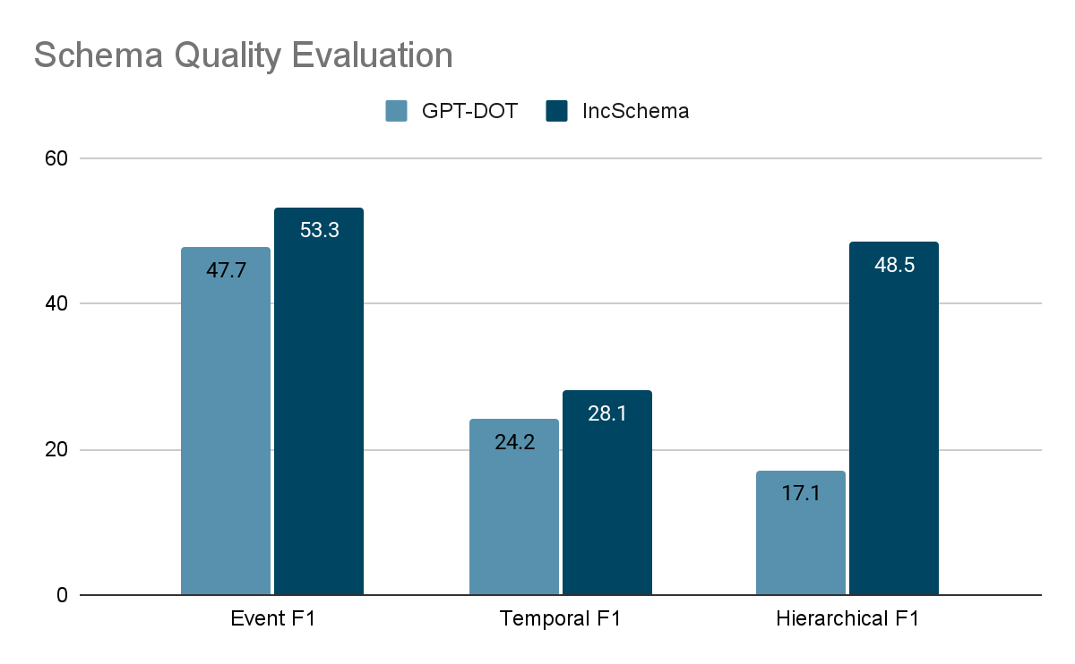
Hierarchical Schema Quality: Findings
Our baseline GPT-DOT, directly asks GPT3 to output a linearized graph format of the final schema given some in-context examples.
Compared to our model, GPT-DOT generates much fewer events (10.11 events for GPT-DOT VS 52.6 events on ODIN) which leads to high precision but low recall.
GPT-DOT struggles with hierarchical relations.

Slide 20
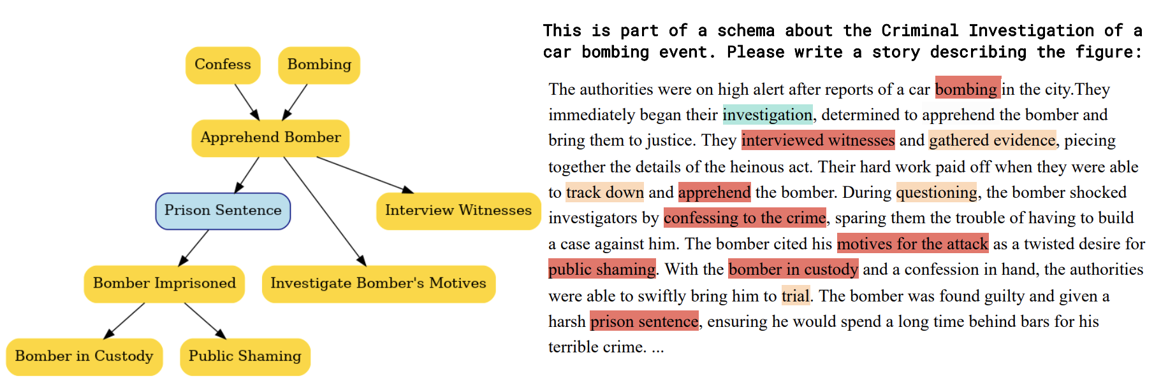
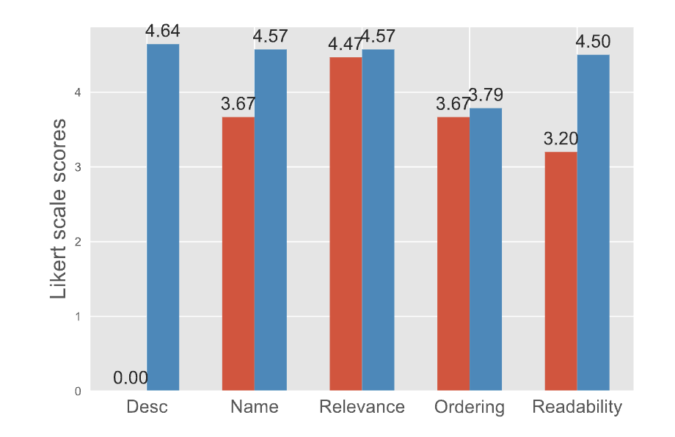
Interpretability Evaluation Results
Human assessors are able to compose a longer story with better event coverage using our schema while taking roughly the same amount of time.
Human assessors rate our event descriptions and event names to be very helpful (>4.5 score) and our schemas are easier to understand compared to the baseline.
Blue: Our method IncPrompt
Red: Double-GAE

Slide 21
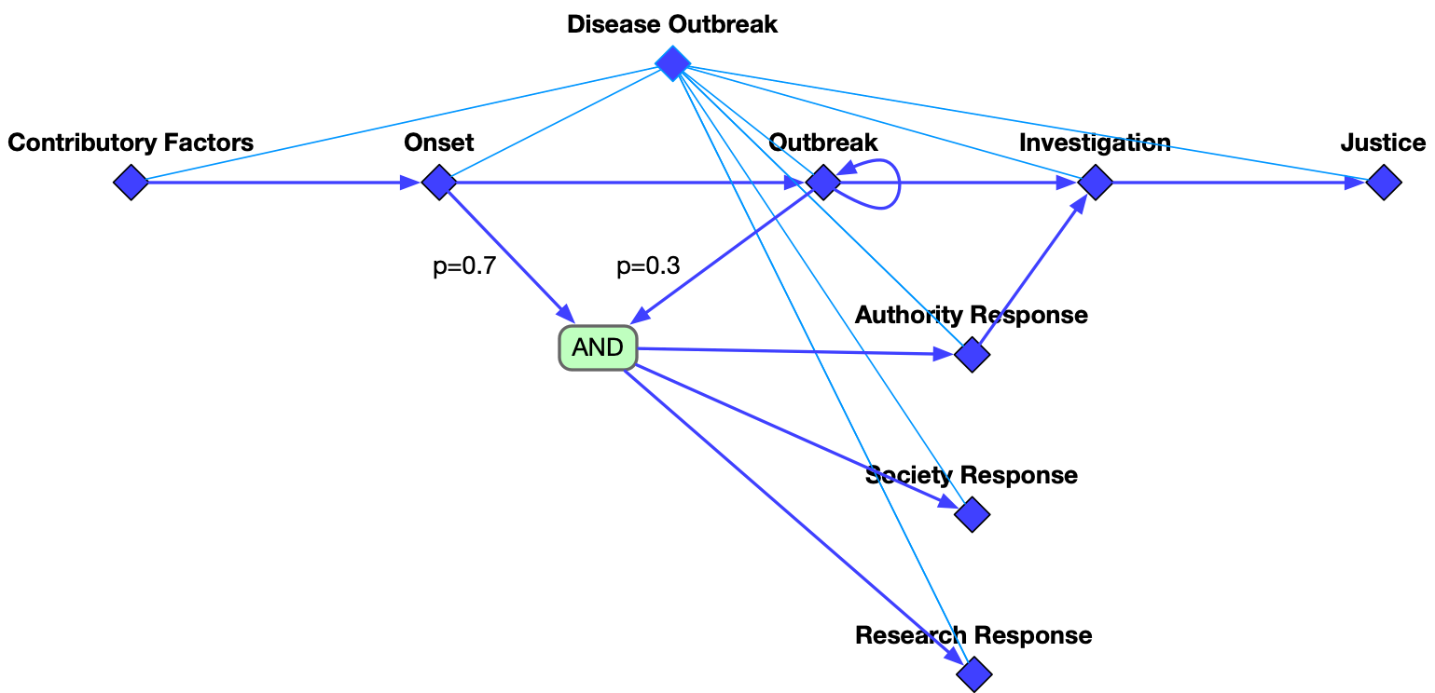
Epidemic Schema Example
Contributory Factors
Onset
Outbreak
Investigation
Justice
Authority Response
Society Response
temporal
hierarchical
Research Response

Slide 22
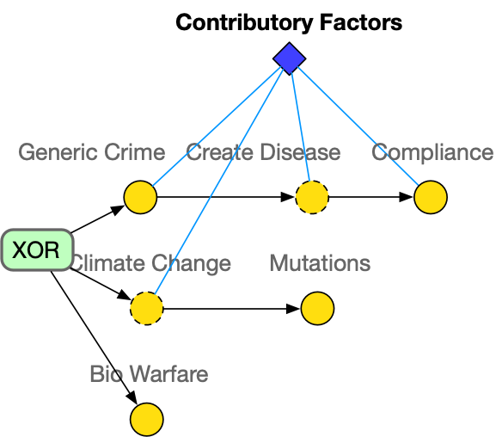
Contributory Factors
Event
Optional Event

Slide 23
Onset
Medical Response

Slide 24
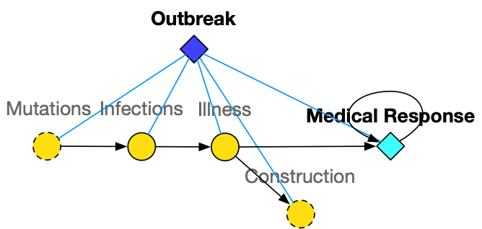
Outbreak
Medical Response

Slide 25
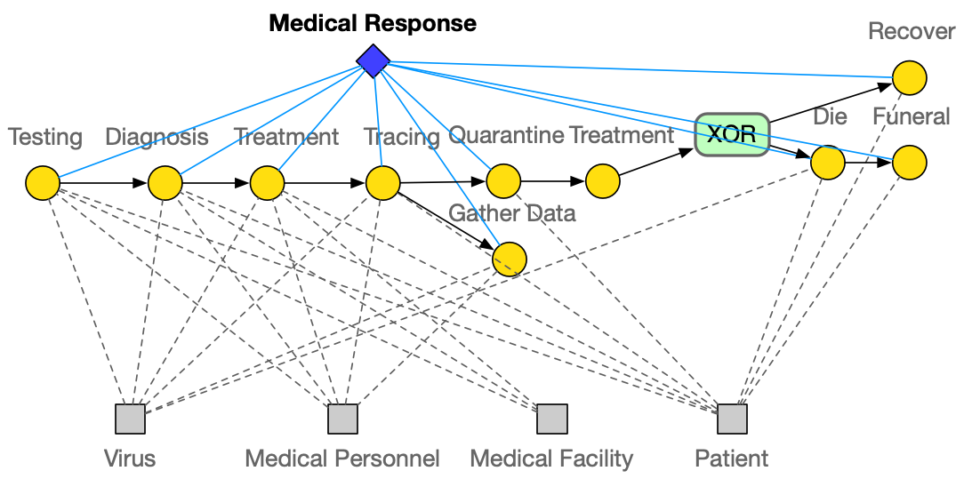
Medical Response

Slide 26
Research Response

Slide 27
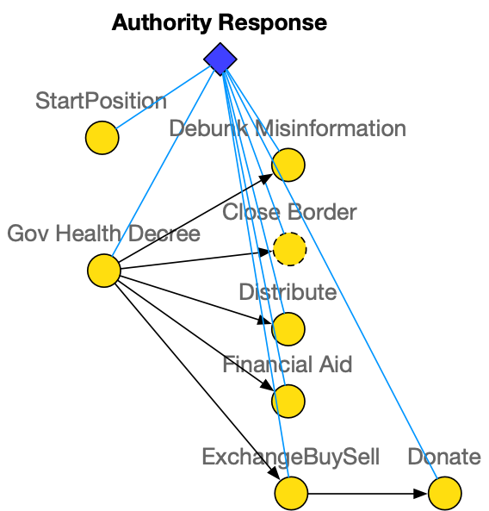
Authority Response

Slide 28
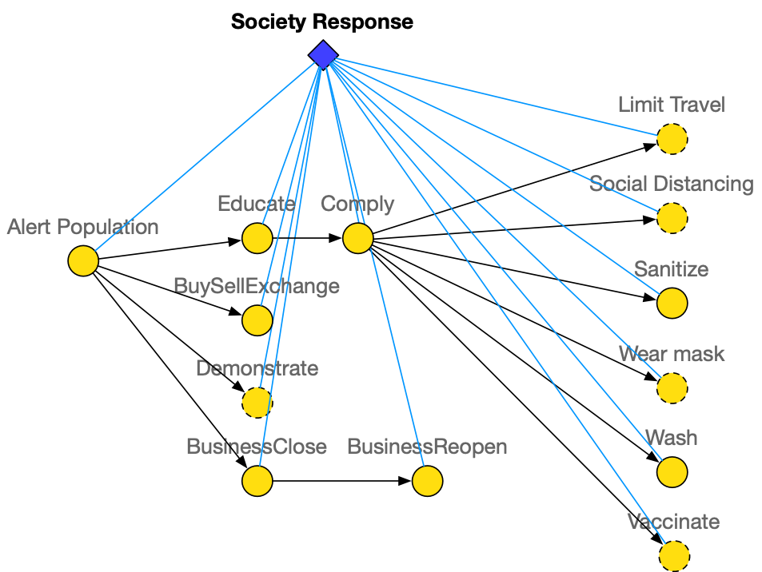
Society Response

Slide 29
Investigation

Slide 30
Justice

Slide 31
Schema Enhanced Information Extraction
A typical sequence-to-graph information extraction model [Lin et al., ACL2020]

Slide 32
Schema-Enhanced Information Extraction
We design a set of global feature templates (e.g., event_type₁ – role₁ – role₂ – event_type₂ : an entity acts a role₁ argument for an event_type₁ event and a role₂ argument for an event_type₂ event in the same sentence). A more comprehensive event schema library is inducted following (Li et al, 2020).
The model learns the weight of each feature during training
role₁
role₂
victim
target
victim
attacker
event_type₁
event_type₂
Life.Die
Conflict.Attack
Life.Die
Conflict.Attack
Template
Positive weight
Negative weight
Global score of a graph: local graph score + global feature score
Notes:
To induce this kind of event schema, we use templates to explore the interactions between knowledge elements. For each template we fill in all possible types to generate a set of global features. For example, the victim of die event is always the target of the attacking event, but not the attacker. Our work on schema induction using path language model further extends the schema library to longer paths between events.

Slide 33
Schema-Enhanced Information Extraction
We use beam search to decode the information graph (Lin, et al, 2020)
Example: He also brought a check from Campbell to pay the fines and fees.
Node Step
Node Step
Edge Step
Sort
Prune
E1¹
T1¹
E1¹
R1¹
T1¹
E1¹
R1²
T1¹
entity
E1²
R1¹
T1¹
E1¹
R1²
T1¹
E1¹
Fine
FAC
E1¹
T1²
E1¹
R1¹
T1²
E1¹
R1²
T1²
fines
Campbell
E1¹
R1²
T1²
E1¹
R1¹
T1²
Candidate 1 of node E1
Higher local score
E1²
T1¹
E1²
R1¹
T1¹
E1²
R1²
T1¹
E1¹
R1¹
T1¹
E1²
R1²
T1²
entity
E1²
R1¹
R1²
Fine
PER
R1¹
R1²
Candidate 2 of node E1
E1²
T1²
E1²
T1²
E1²
T1²
fines
Campbell
E1²
T1²
E1²
T1¹
Higher global score
add node 1
add node 2
add the edge between node 1 and 2
Campbell: FAC, ORG
fine: Fine, Sue
null, entity, person, …
Notes:
Then this combined score is used in the beam search to decode the graph. In each decoding step we generate a node and the edges related to that node. The local score helps select the best type prediction for each knowledge elements, and the global score promotes the graph that matches event schema.

Slide 34
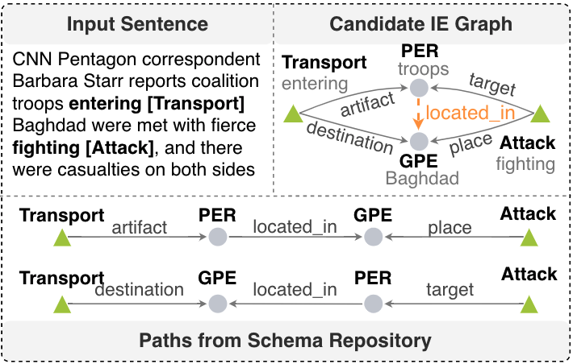
Schema-Enhanced Information Extraction (Li et al., EMNLP2020)
Use the state-of-the-art IE system OneIE (Lin et al, 2020) to decode converts each input document into an IE graph
Each path in the graph schema is encoded as a single global feature for scoring candidate IE graphs
OneIE promotes candidate IE graphs containing paths matching schema graphs
http://blender.cs.illinois.edu/software/oneie
F-scores (%) on ACE2005 data [Lin et al., ACL2020]:
Dataset | Entity | Event Trigger Identification | Event Trigger Classification | Event Argument Identification | Event Argument Classification | Relation
Baseline | 90.3 | 75.8 | 72.7 | 57.8 | 55.5 | 44.7
+PathLM | 90.2 | 76.0 | 73.4 | 59.0 | 56.6 | 60.9
Notes:
We also try to use the discovered schema repository to support downstream tasks, here we use information extraction as an example, we use the paths from
relation, example

Slide 35
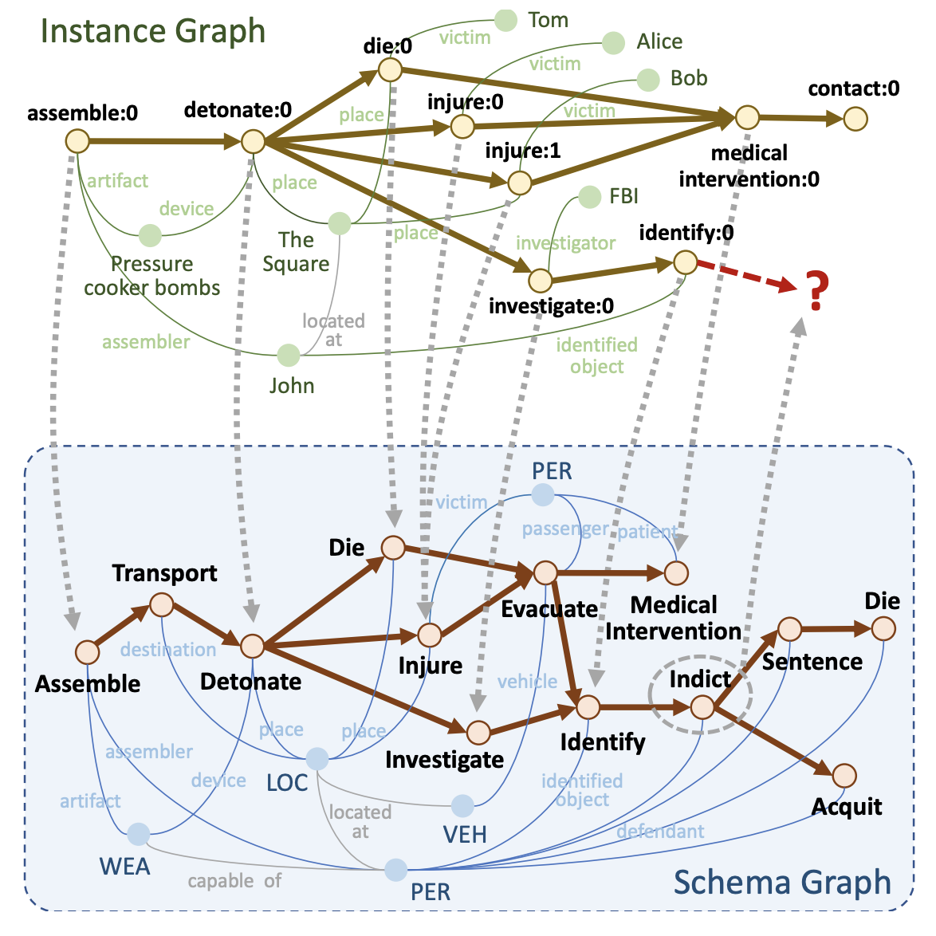
Hierarchical Schema Matching and Event Prediction [Wang et al., AKBC2022]
Compute the probability for each schema event being missing conditioned on the current instance graph.
Neighbor Information (GNN)
Path Information (Bag of paths representations)
Select the schema events with high probabilities as our predictions.
Instantiate arguments from the matched events.
Notes:
1. After we select the most suitable schema from the schema library, our system will first perform schema matching to instantiate the schema with the graph G event instances, and then perform prediction to predict those events that are highly probable.
2. First we'd like to do a very brief overview on our schema matching and prediction algorithm.
3. For schema matching, given the instance graph and the schema graph, we first try to do a matching between events.
4. We consider two important criteria:
a. node-similarity --- which means the pair of event nodes should have similar node semantics. We mainly utilize the Qnodes and the description sentences for each event to analyze the similarity.
b. temporal constraints --- which is also important, meaning that the matched event pair should not violate the temporal relation in the schema.
5. We first generate initial results based on these two criteria by solving the problem heuristically with Integer Programming, and then we train a graph neural network based scorer to perform event matching.
6. After we finish event matching, we then further do event argument matching based on the semantics of role names.

Slide 36
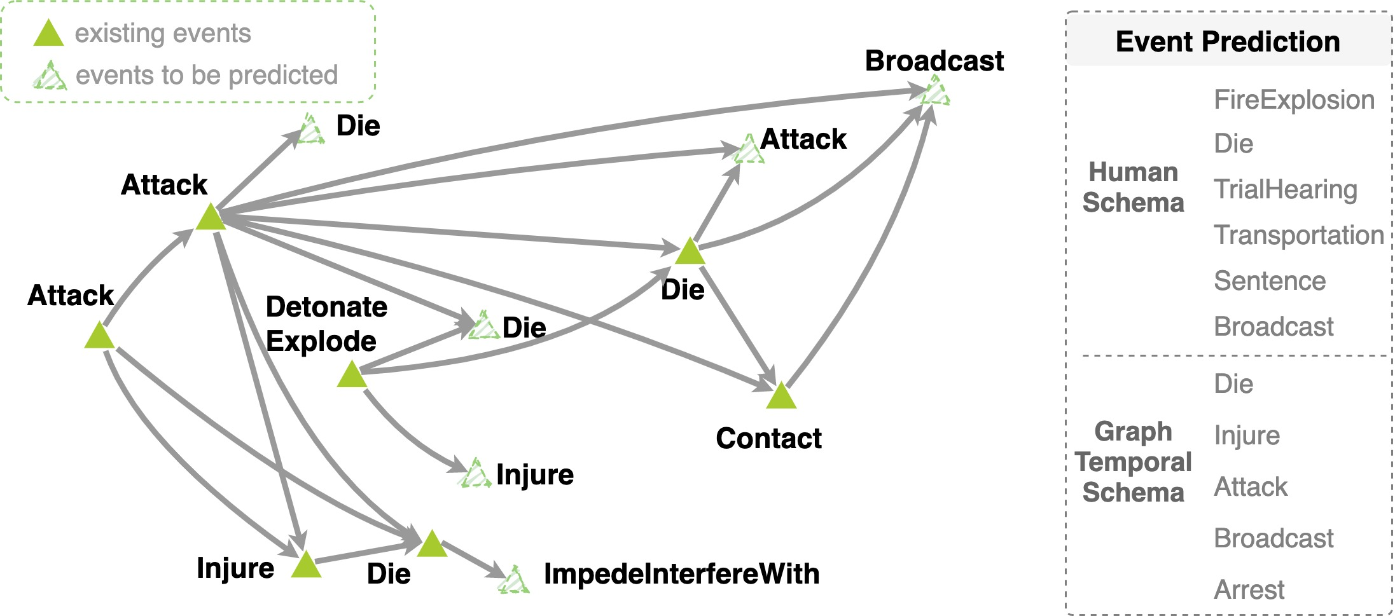
Use Event Schema for Event Prediction
Schema-guided Event Prediction: The task aims to predict ending events of each graph.
Considering that there can be multiple ending events in one instance graph, we rank event type prediction scores and adopt MRR and HITS@1 as evaluation metrics.
Dataset | Models | MRR | HITS@1
General | Human Schema | 0.173 | 0.205
 | Event Graph Model | 0.457 | 0.591
Dataset | Models | MRR | HITS@1
IED | Human Schema | 0.072 | 0.222
 | Event Graph Model | 0.203 | 0.426
Notes:
Event prediction could be a good evaluation task.

Slide 37
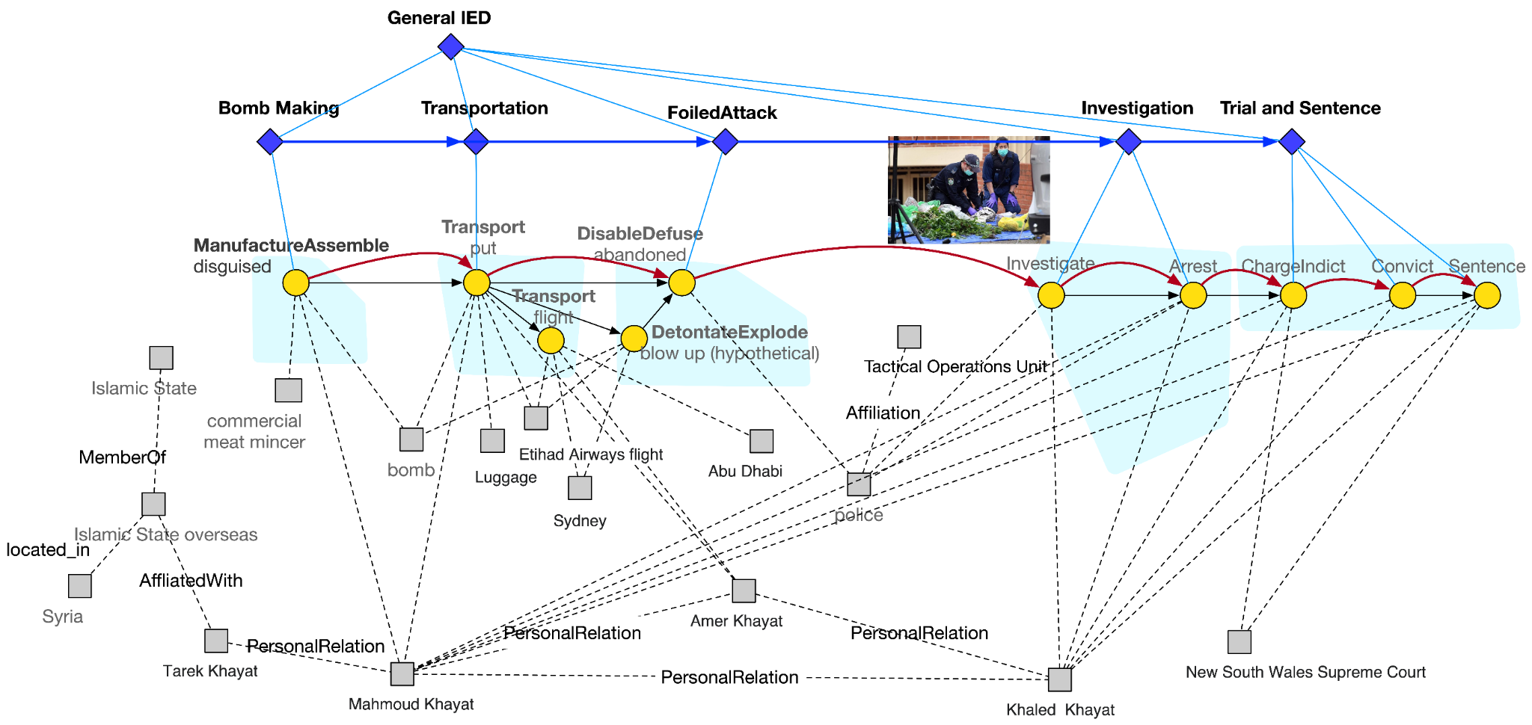
Instance-level Event and Episode Prediction

Slide 38
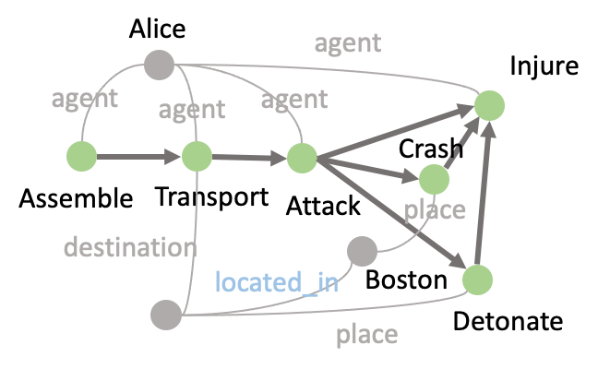
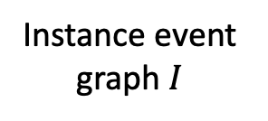
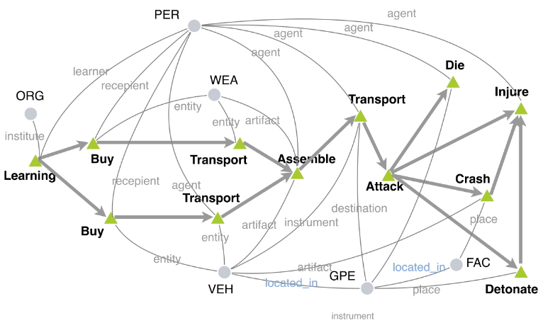
Why is Event Schema Useful? [3] Event Graph Completion [Wang et al., arxiv2022]

Slide 39
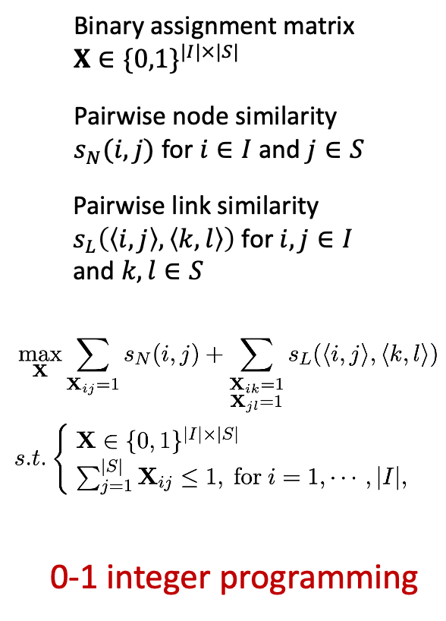
Step 1: Node Matching

Slide 40
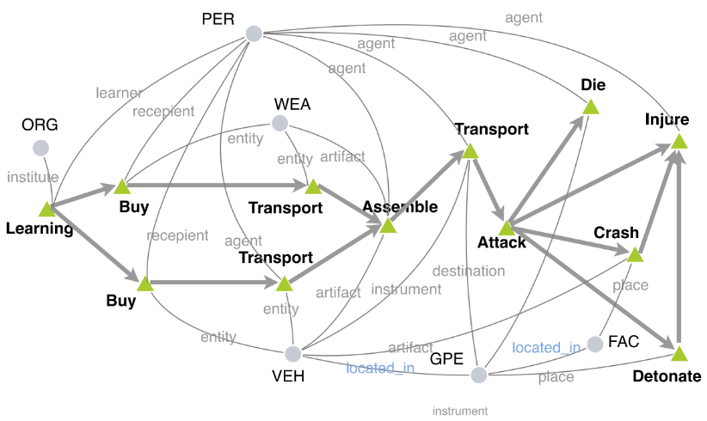
Step 2: New Node Prediction

Slide 41
Self-Supervised Training
Negative sample
Positive Sample

Slide 42
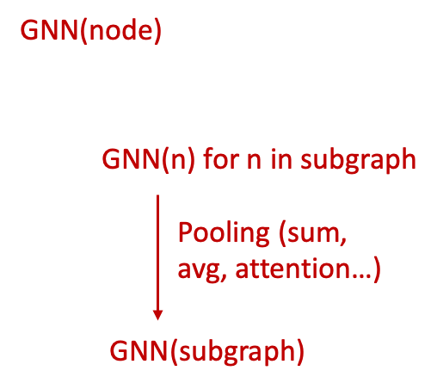
Step 2: New Node Prediction

Slide 43
Step 2: New Node Prediction

Slide 44
Experimental Results

Slide 45
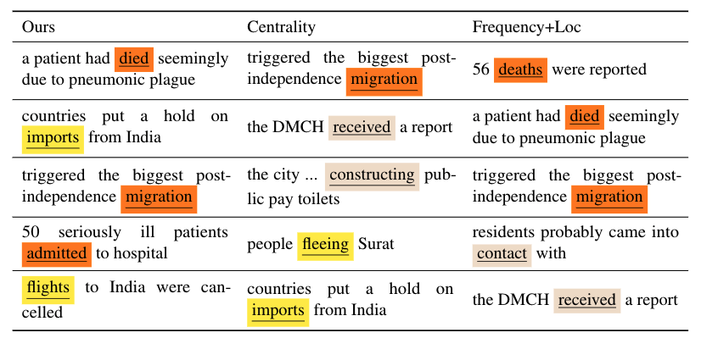
Why is Event Schema Useful? [4] Tracking Entity States
Event salience: checking the drop in coherence after we remove the event
We measure coherence as the generation probability of the entire complex event graph, inspired from [Nan et al., 2021]
Top salient events detected on the 1994 India plague (https://en.wikipedia.org/wiki/1994_plague_in_India) event
Notes:
- if a schema library were encoded as/inside a neural network or a LM like BERT, it could make predictions, but not be understandable to a human. What could one do to make it understandable? [model = schema; automatic naming? Centroid of clusters?]

Slide 46
Tracking Entity States: Protagonist (salient entity) Identification
The saliency of an entity is determined by the events it is involved in and the role it plays in each event.
Thus, we compute the saliency score by aggregating over each edge <e_j, a, ent_i>:
argument role
At any particular timestep t, we should be able to know:
Does entity A exist at timestep t?
Is entity A involved in any event at timestep t?
What is the location of entity A at timestep t?

Slide 47
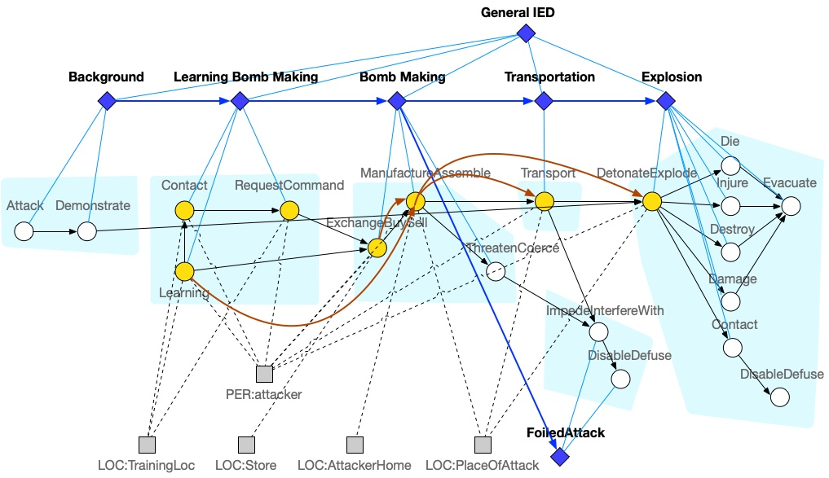
Temporal and Spatial Tracking of Protagonists: Type-level
State of attacker:
Timestep | 1 | 2 | 3 | 4 | 5 | 6 | 7
Event | Learning | Contact | Request | ExchangeBuySell | Manufacture | Transport | DetonateExplode
Location | TrainingLoc | TrainingLoc | TrainingLoc | Store | AttackerHome | AttackerHome->PlaceOfAttack | PlaceOfAttack
Notes:
Maybe add TimeDelta?

Slide 48
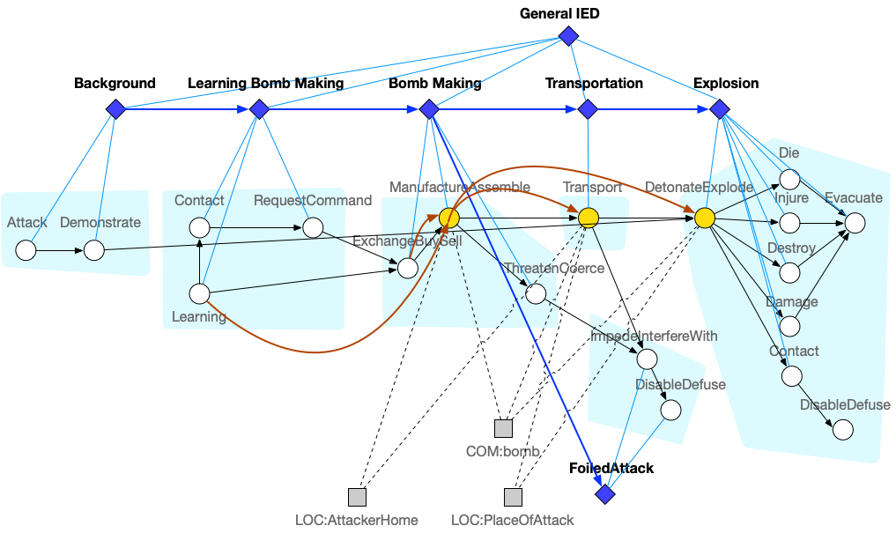
Temporal and Spatial Tracking of Protagonists: Type-level
State of bomb:
Timestep | 1 | 2 | 3 | 4 | 5 | 6 | 7
Existence |  |  |  |  | Created |  | Destroyed
Event |  |  |  |  | Manufacture | Transport | DetonateExplode
Location |  |  |  |  | AttackerHome | AttackerHome->PlaceOfAttack | PlaceOfAttack
Notes:
Maybe add TimeDelta?

Slide 49
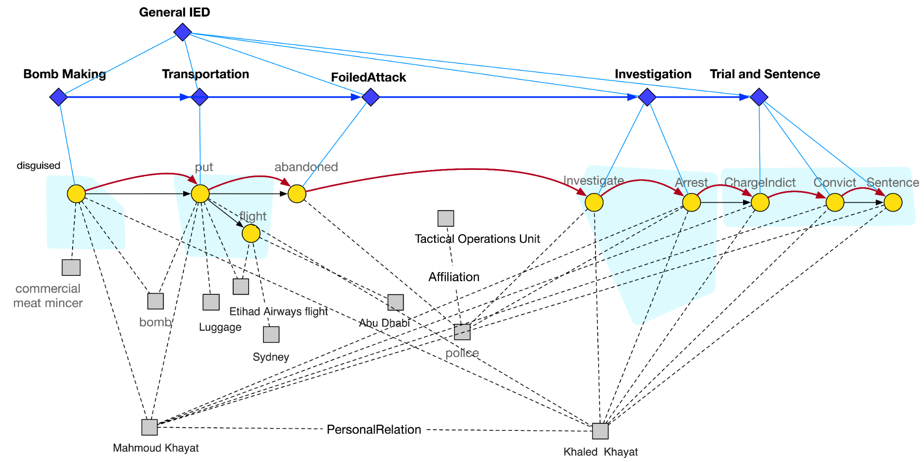
Temporal and Spatial Tracking of Protagonists: Instance-level (attacker Mahmoud Khayat and Khaled Khayat)
Timestep | 1 | 2 | 3 | 4 | 5 | 6 | 7
Event | disguise | put | abandon | investigate | arrest | charge | convict | sentence
Location | Sydney

Slide 50
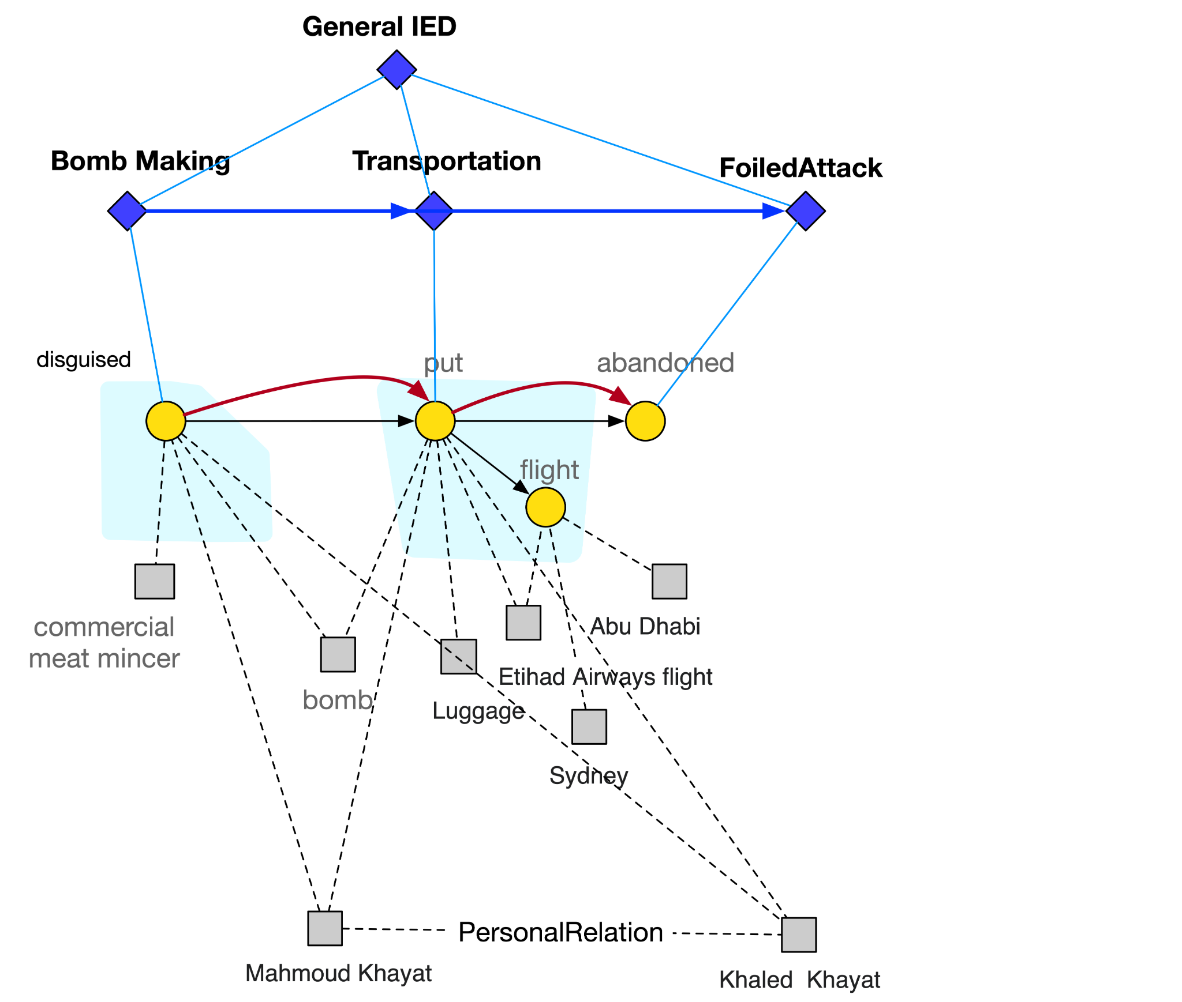
Temporal and Spatial Tracking of Protagonists: Instance-level (bomb)
Timestep | 1 | 2 | 3
Existence | Created |  | Destroyed
Event | Manufacture (disguised) | Transport (put) | DisableDefuse (abandoned)
Location |  | Sydney

Slide 51
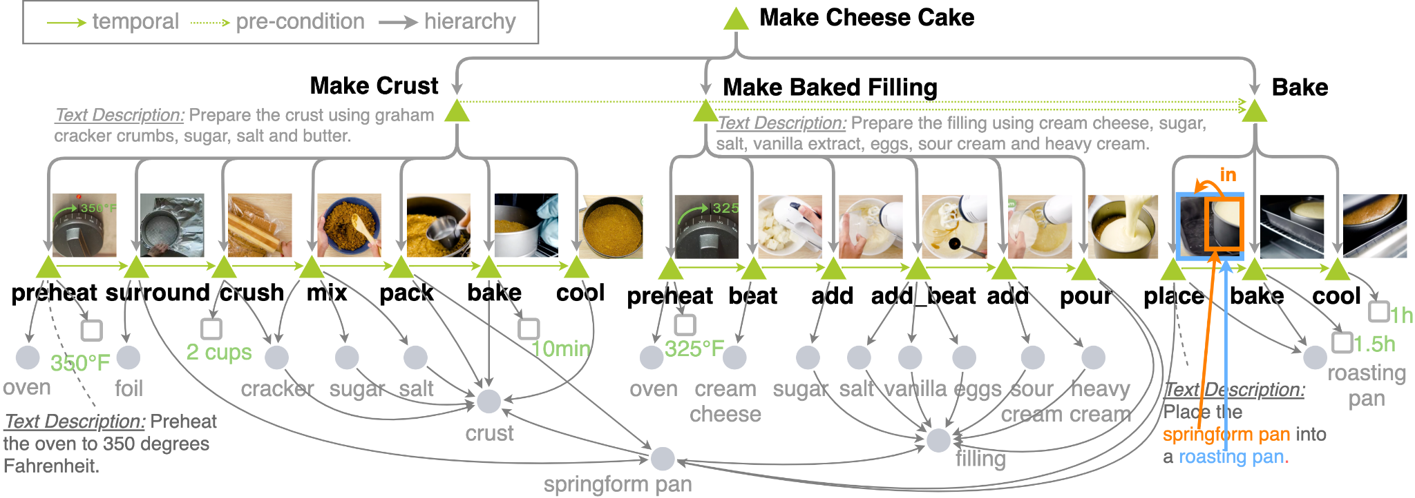
More Fun Applications: Cooking
A end goal is a desired end state
A subgoal is a milestone of each episode
We can represent the planning procedure as the changes of entity states
Goals may not be explicitly mentioned, so they need to be generalized from hierarchical event graphs
Classify each episode as goal-oriented or not, and generalize/generate goal descriptions based on episode name, ending event, and entity state changes

Slide 52
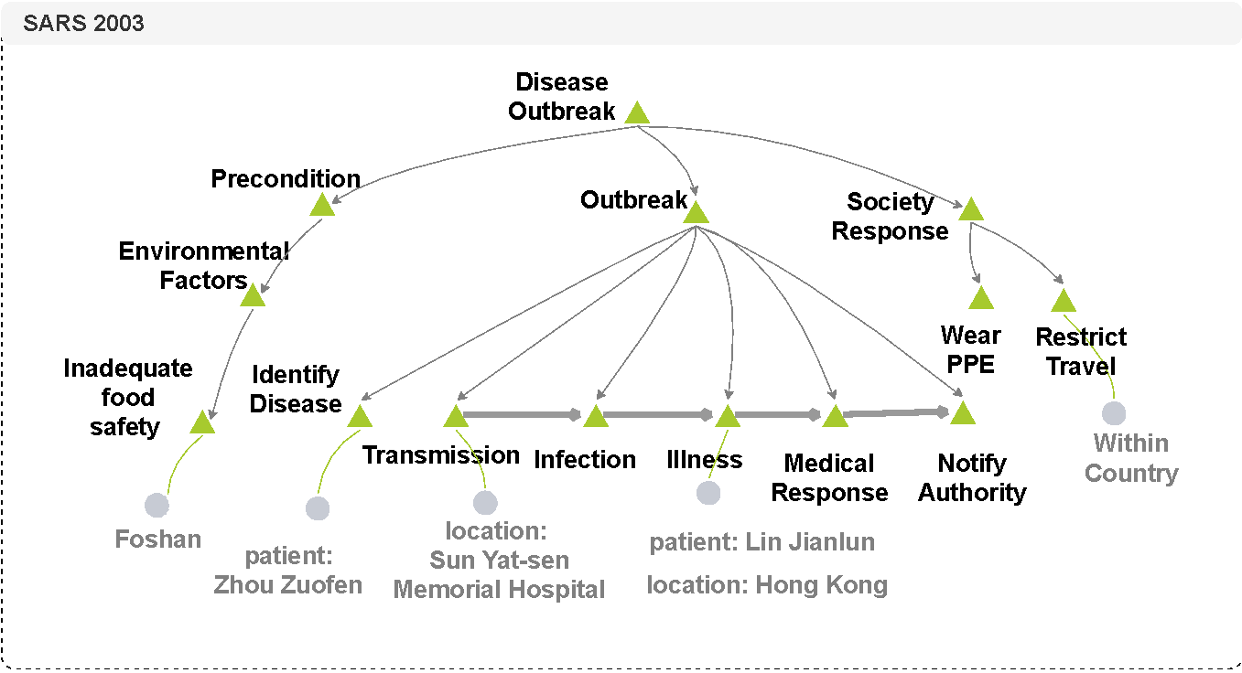
Ongoing Work: News Event Simulator for Disaster Forecasting and Prevention
Eliciting entity-centric knowledge from large language models, feed curated knowledge back to enhance LLMS + event schema knowledge induction
Historical Event Graph for SARS2003

Slide 53
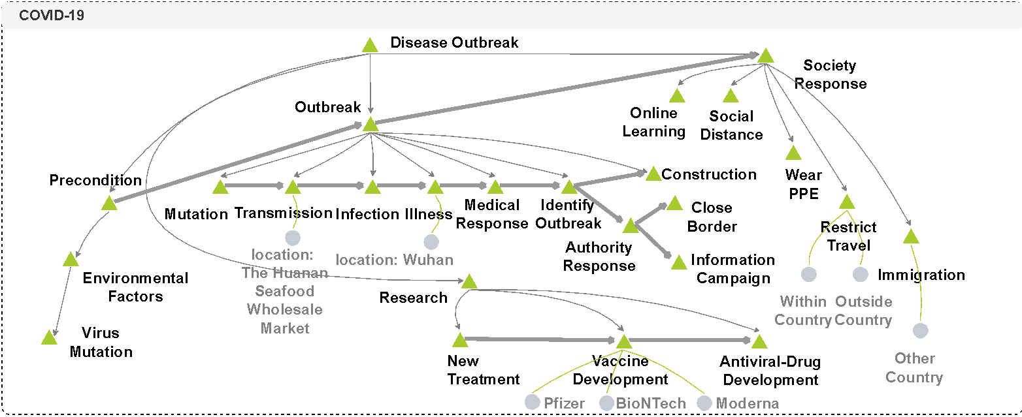
News Event Simulator for Disaster Forecasting and Prevention
Historical Event Graph for COVID-19

Slide 54
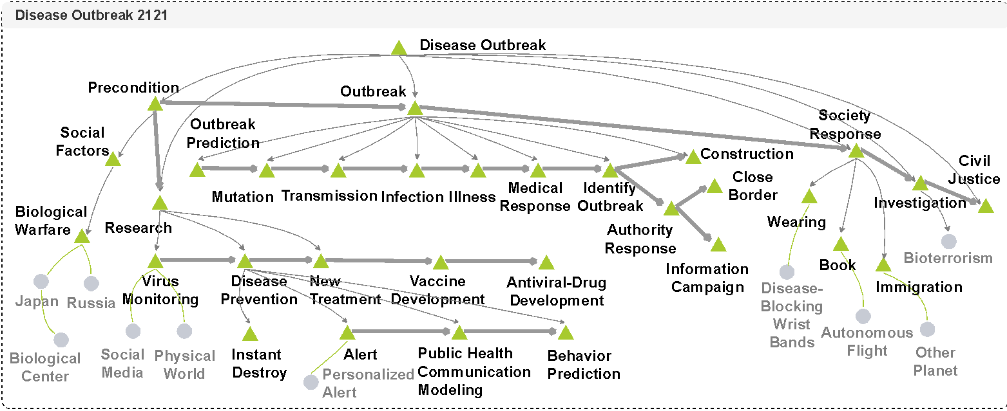
News Event Simulator for Disaster Forecasting and Prevention
New Complex Event Graph Skeleton for an Imagined Disease Outbreak in 2121
Then generate a timeline of news articles about this imagined scenario
Conduct factual error correction through inference and neuron subset pattern mining and model editing

