Slide 1
Knowledge-Guided LLMs
Slides by Shizhe Diao and Zoey Li
Notes:
Hello, everyone! I am Shizhe.
I am very happy to present a survey with Zoey in mitigating hallucination for large language models.

Slide 2
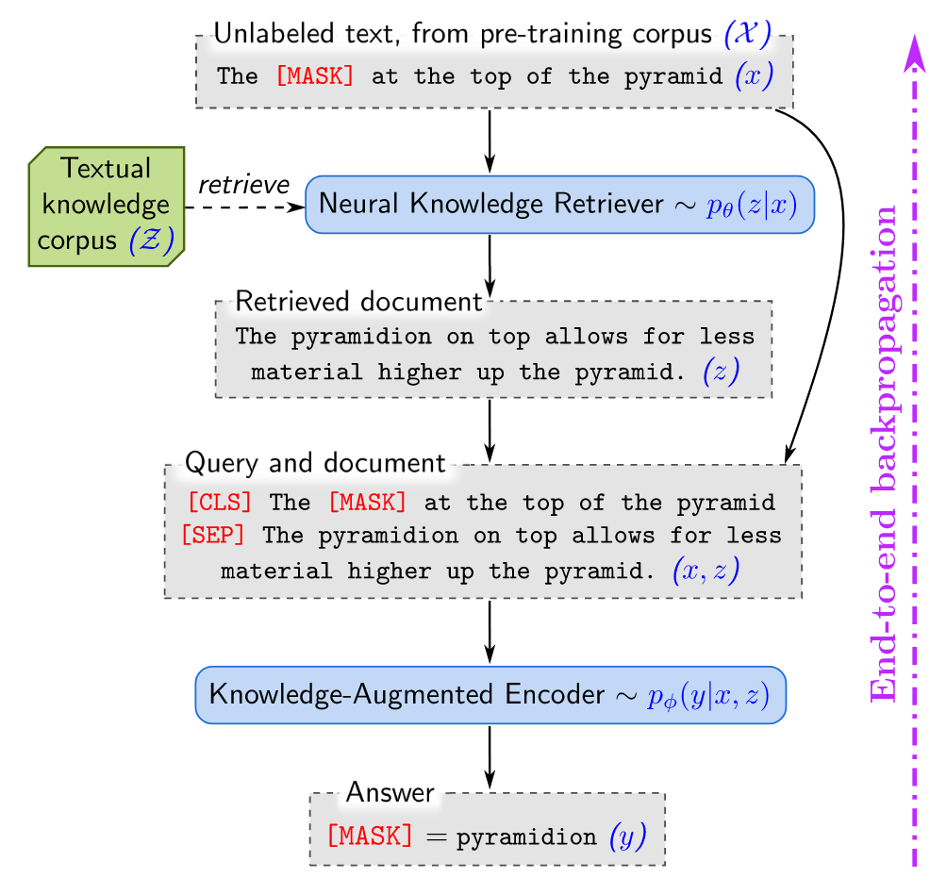
REALM
REALM: Retrieval-Augmented Language Model
Retrieve-then-predict
Neural Knowledge Retriever: Transformer encoder + inner product
Knowledge-Augmented Encoder
Guu, Kelvin, et al. "Retrieval augmented language model pre-training."
Notes:
One of the most famous studies in this field is REALM: the retrieval-augmented language model.
REALM augments language model pretraining with a latent knowledge retriever, which allows the model to retrieve and attend over documents from a large corpus such as Wikipedia.
The intuition is simple. For example, in this Figure, if the model needs to fill the blank in “what is at the top of the pyramid”, the retriever should be rewarded for selecting a document containing “The pyramidion on top allows for less material higher up the pyramid”. It achieves this behavior by modeling the retrieve-then-predict approach as a latent variable language model and optimizing the marginal likelihood.
REALM first retrieves documents from an external knowledge source and then utilizes retrieved documents to process question-answering tasks.

Slide 3
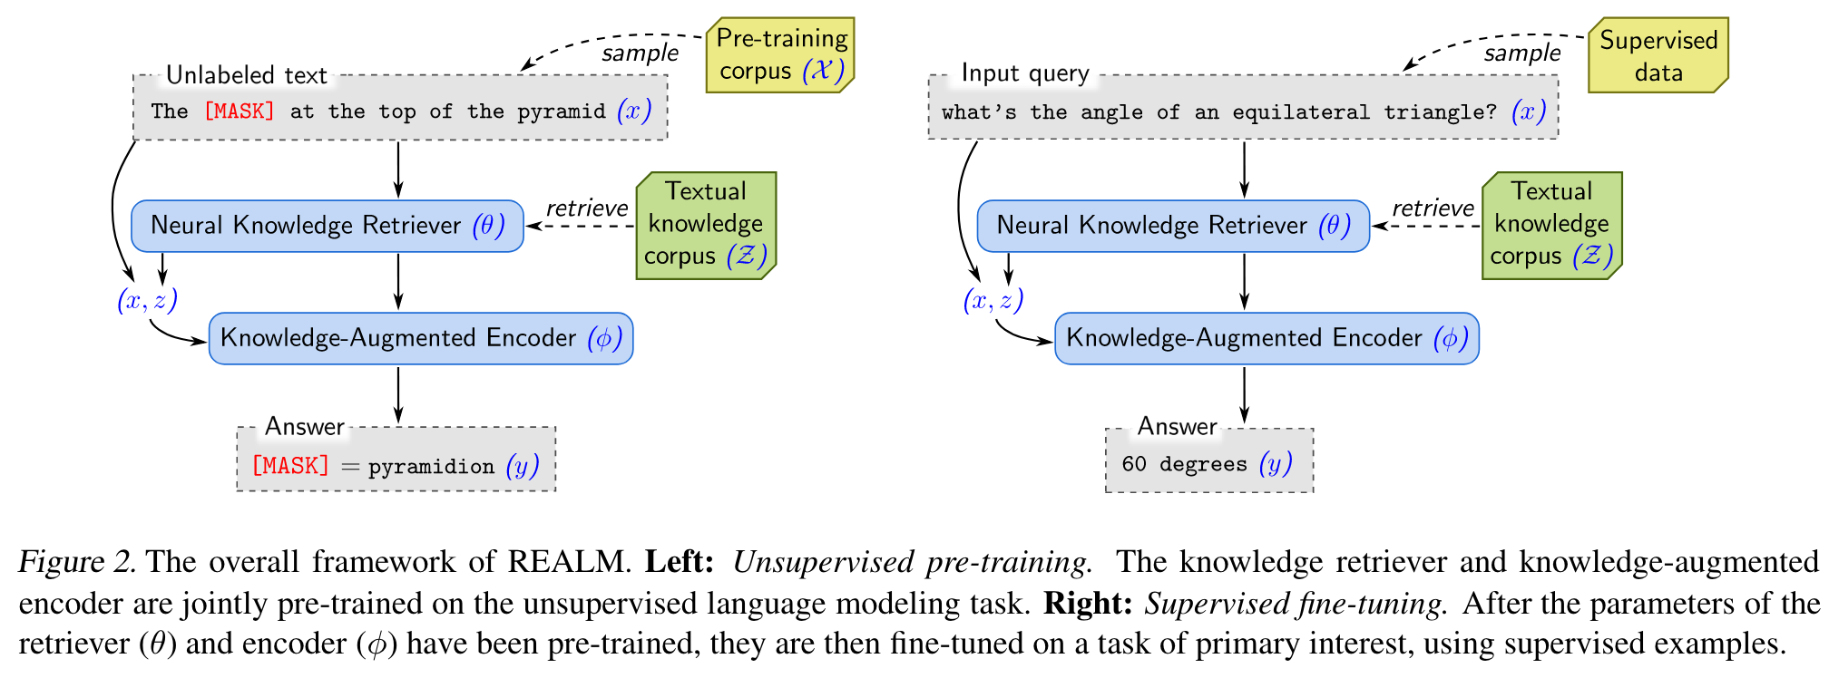
REALM
Pretraining: MLM
Finetuning: Open-QA
Guu, Kelvin, et al. "Retrieval augmented language model pre-training."
Notes:
As for the training process, this architecture could do both pre-training and fine-tuning. During pre-training, it is exactly the same as masked language modeling. The only difference between pre-training and finetuning is whether to append a task-specific head on top of the base model.
Realm was published in 2020. At that time, ChatGPT did not exist, so their work was primarily based on the BERT model. Moreover, this model is trainable, which is different from the inference-based methods that we will see next.

Slide 4
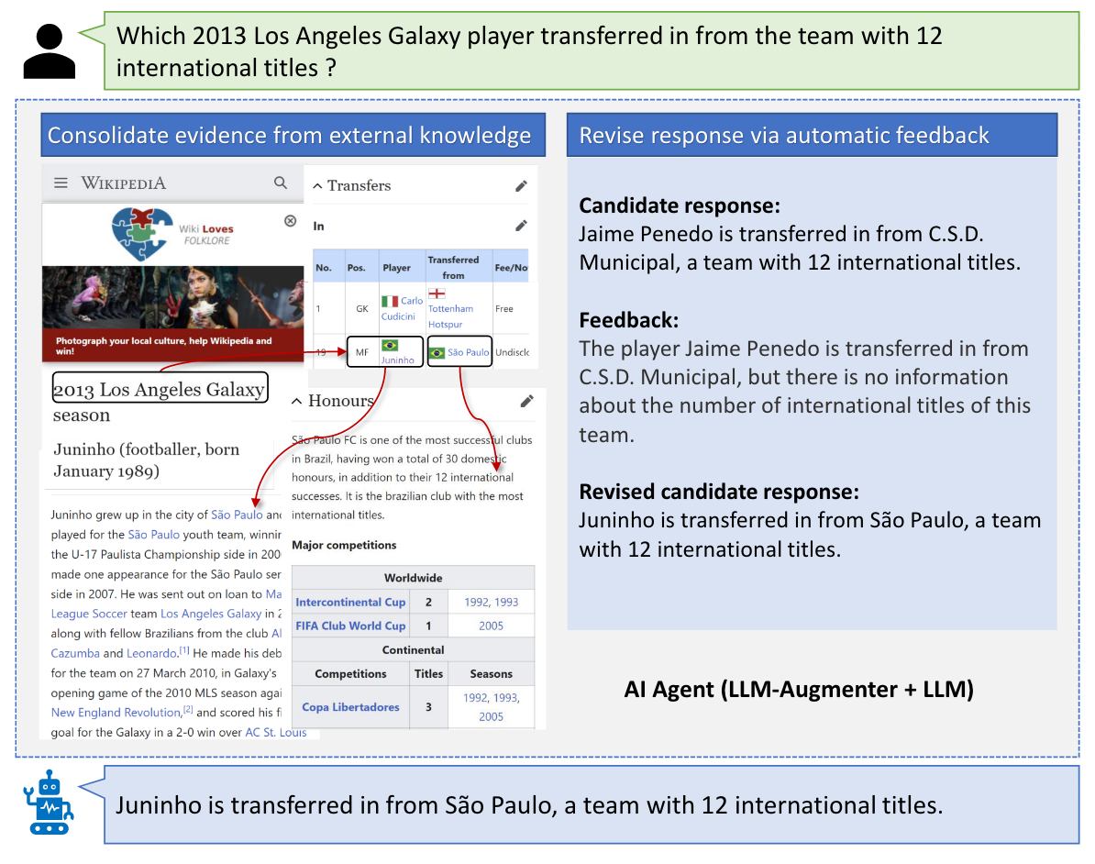
LLM-Augmenter
Peng, Baolin, et al. "Check your facts and try again: Improving large language models with external knowledge and automated feedback."
Notes:
Next is the LLM-augmenter.
This paper proposes to augment a black-box LLM with a set of plug-and-play modules. The system makes the LLM generate responses grounded in external knowledge, e.g., stored in task-specific databases. It also iteratively revises LLM prompts to improve model responses using feedback generated by utility functions.

Slide 5
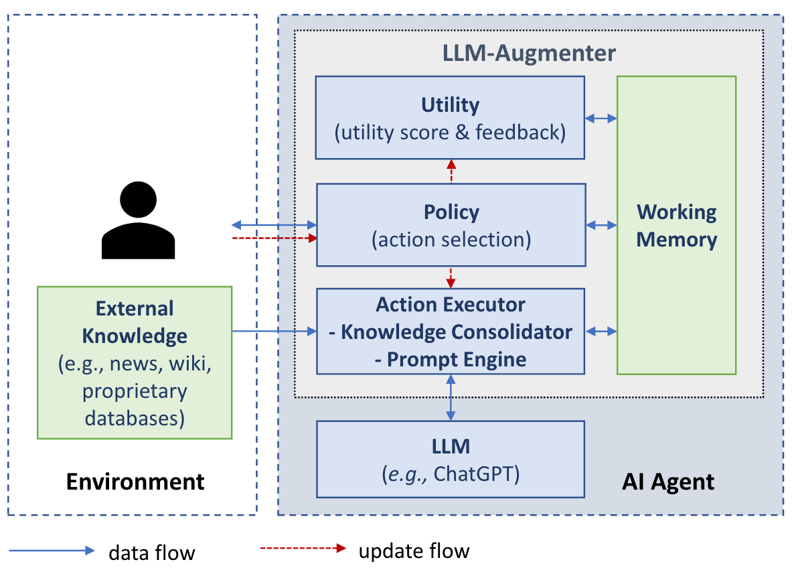
LLM-Augmenter
Working Memory
acquire evidence
Policy
call LLM
send to user
LLM-Augmenter
knowledge retriever
knowledge consolidator
entity linker
Action Executor
prompt engine
evidence chainer
Model-based
Utility
Rule-based
Peng, Baolin, et al. "Check your facts and try again: Improving large language models with external knowledge and automated feedback."
Notes:
The system is a bit complicated.
The architecture is illustrated in this Figure. It consists of a set of modules including: working memory, policy, action executor, and utility.

Slide 6
LLM-Augmenter
Working Memory
acquire evidence
Policy
call LLM
send to user
Working Memory:
q: the current user query
e: evidence for q
o: a set of the LLM-generated candidate responses for q;
u: a score assessing the utility of o
f: a verbalized feedback
h: dialog history
LLM-Augmenter
knowledge retriever
knowledge consolidator
entity linker
Action Executor
prompt engine
evidence chainer
Model-based
Utility
Rule-based
Peng, Baolin, et al. "Check your facts and try again: Improving large language models with external knowledge and automated feedback."
Notes:
The working memory module tracks the dialog state that captures all essential information in the conversation so far. The state is represented using a six-tuple. q is the current user query; e is evidence for q, consolidated from external knowledge by Knowledge Consolidator; o is a set of the LLM-generated candidate responses for q; u is a score assessing the utility of each element of o, and f is a verbalized feedback to guide the LLM to improve its utility — both u and f are generated by the Utility module; and hq is the dialog history before q.

Slide 7
LLM-Augmenter
Working Memory
acquire evidence
Policy
call LLM
send to user
Policy:
(1) acquiring evidence e for q from external knowledge
(2) calling the LLM to generate a candidate response
(3) sending a response to users if it passes the verification by the Utility module.
REINFORCE algorithm
LLM-Augmenter
knowledge retriever
knowledge consolidator
entity linker
Action Executor
prompt engine
evidence chainer
Model-based
Utility
Rule-based
Peng, Baolin, et al. "Check your facts and try again: Improving large language models with external knowledge and automated feedback."
Notes:
For the policy, this module selects the next system action that leads to the best expected reward R. These actions include (1) acquiring evidence e for q from external knowledge, (2) calling the LLM to generate a candidate response, and (3) sending a response to users if it passes the verification by the Utility module. The policy can be implemented using manually crafted rules, or trained on human-system interactions. In this study, they implement a trainable policy π as a neural network model parameterized by θ. πθ is optimized using REINFORCE algorithm to maximize the expected reward.

Slide 8
LLM-Augmenter
Working Memory
acquire evidence
Policy
call LLM
send to user
Action Executor:
(1) Knowledge Consolidator
(2) Prompt Engine
LLM-Augmenter
knowledge retriever
knowledge consolidator
entity linker
Action Executor
prompt engine
evidence chainer
Model-based
Utility
Rule-based
Peng, Baolin, et al. "Check your facts and try again: Improving large language models with external knowledge and automated feedback."
Notes:
For the action executor, this module performs an action selected by the policy. It is composed of two components, Knowledge Consolidator and Prompt Engine.
The Knowledge Consolidator augments LLMs with the capability of grounding their responses on external knowledge, such as answering questions regarding latest news, and booking a table in a restaurant. The Knowledge Consolidator is designed in a modular fashion, consisting of a knowledge retriever, an entity linker and, an evidence chainer. Specifically, the retriever first generates a set of search queries based on q and hq, and then calls a set of APIs to retrieve raw evidence from various external knowledge sources, such as calling Bing Search APIs to query Web documents including Wiki articles and Reddit messages, and REST APIs to query task-specific databases for restaurant reviews and product specifications. The retrieved raw evidence is sometimes incomplete and noisy. Thus, the entity linker enriches raw evidence with related context to form evidence graphs, i.e., linking each entity mentioned in raw evidence to its corresponding description based on Wikipedia. Then, the chainer prunes irrelevant evidence from the graphs and forms a shortlist of evidence chains that are most relevant to queries. The consolidated evidence e is then sent to Working Memory.

Slide 9
LLM-Augmenter
Working Memory
acquire evidence
Policy
call LLM
send to user
Utility: utility score u and a corresponding feedback f
(1) Model-based utility functions
(2) Rule-based utility functions
LLM-Augmenter
knowledge retriever
knowledge consolidator
entity linker
Action Executor
prompt engine
evidence chainer
Model-based
Utility
Rule-based
Peng, Baolin, et al. "Check your facts and try again: Improving large language models with external knowledge and automated feedback."
Notes:
Utility
Given a candidate response o, the Utility module generates utility score u and a corresponding feedback f using a set of task-specific utility functions. These utility functions access the alignment of the LLM’s responses with user expectations or specific business requirements. For example, in an information seeking dialog, it is important that all LLM’s responses are preciously grounded in external evidence to avoid generating misleading or inaccurate information. In a restaurant reservation dialog, the LLM responses should be conversational and focused on guiding the user through the reservation process, rather than engaging in offtopic chitchats
There can be two distinct types of utility functions:
• Model-based utility functions assign preference scores to different dimensions of a response, such as fluency, informativeness and factuality. These functions are trained on precollected human preference data or annotated log data.
• Rule-based utility functions are implemented using heuristics or programmed functions, measure whether a response complies with a specific rule.

Slide 10
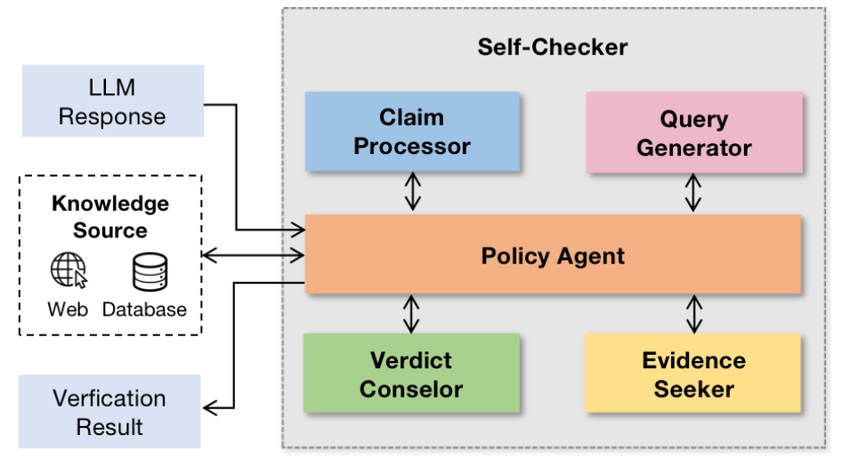
Self-Checker
Li, Miaoran, Baolin Peng, and Zhu Zhang. "Self-Checker: Plug-and-Play Modules for Fact-Checking with Large Language Models."
Notes:
Another related work is self-checker.
This figure illustrates the SELF-CHECKER framework for fact-checking, which is training-free and contains a set of plug-and-play modules: claim processor, query generator, evidence seeker, and verdict counselor

Slide 11
Self-Checker
Policy Agent:
calling the claim processor
requesting search queries
retrieving relevant passages
utilizing the evidence seeker
requesting the verdict counselor
sending the final conclusion to the users.
Li, Miaoran, Baolin Peng, and Zhu Zhang. "Self-Checker: Plug-and-Play Modules for Fact-Checking with Large Language Models."
Notes:
For the Policy Agent, it is quite similar to the previous working memory. this module determines the subsequent system action from a set of pre-defined actions. The policy agent follows the task instruction and learns from in-context examples to select the most appropriate action based on the current state and observations of the framework..

Slide 12
Self-Checker
Claim Processor
Identify claims that require verification
Query Generator
Retrieve pertinent information
Evidence Seeker
Identify evidence sentences
Verdict Conselor
Predict the veracity of claims
Li, Miaoran, Baolin Peng, and Zhu Zhang. "Self-Checker: Plug-and-Play Modules for Fact-Checking with Large Language Models."
Notes:
The initial step in the factchecking process involves identifying a set of claims that require verification from the given input text. Given a text t as input, the claim processor generates a set of claims. Each claim within the set contains a single piece of information, alleviating the burden of the subsequent verification process.
In order to verify a claim, it is essential to retrieve pertinent information from an external knowledge source. Given a claim, the query generator generates search queries for the purpose of information retrieval. These generated queries are then utilized to obtain relevant passages from a knowledge source.
The evidence seeker aims to identify evidence sentences for a given claim from the retrieved passages. Given a claim c and the set of retrieved passages p1, p2, ..., pk, the evidence seeker returns a set of sentences s1, s2, ..., sn that indicate the veracity of the claim. To accomplish this process, a LLM is prompted through a specific prompt comprised of task instruction, in-context examples, and the claim to be verified.
There is another module called verdict counselor to analyze the set of claims that require verification, along with the corresponding evidence sentences for each claim. This module is responsible for predicting the veracity r of the entire set of claims. By examining the provided evidence, the verdict counselor determines the factualness of each claim and assigns appropriate labels such as supported, partially supported, or refuted. These individual labels are then aggregated to obtain the final result. The veracity labels used by the verdict counselor are predefined, encompassing the degrees of entailment (e.g., supported/partially supported/refuted).

Slide 13
Augmented Large Language Models with PKG
Luo, Ziyang, et al. "Augmented Large Language Models with Parametric Knowledge Guiding."
Notes:
Previous methods retrieve knowledge from an external database. We can also retrieve knowledge from a parametric model.
In this work, they propose the Parametric Knowledge Guiding (PKG) framework, which enables LLMs to access relevant information without modifying their parameters, by incorporating a trainable background knowledge generation module.
As illustrated in this Figure. Unlike retrieval-based methods, PKG module utilizes open-source language models like LLaMa, which encode implicit world knowledge from large-scale pre-training. The framework consists of two steps.
First, we align the PKG module with the specific task or domain knowledge via instruction fine-tuning to capture the necessary expertise.
Second, for a given input, the PKG module generates the related knowledge, fed as extra context to the background-augmented prompting for LLMs. By supplying the necessary knowledge, the framework can enhance the performance of LLMs on domain-specific tasks.

Slide 14
Model Editing
KE: Editing Factual Knowledge in Language Models, EMNLP 21’
MEND: Fast Model-Editing at Scale, ICLR 22’
SERAC: Memory-Based Model Editing at Scale, ICML 22’
ROME: Locating and Editing Factual Associations in GPT, Neurips 22
MEMIT: Mass-Editing a Transformer Memory, ICLR 23’
RECKONING: Reasoning through Dynamic Knowledge Encoding.
Evaluating the Ripple Effects of Knowledge Editing in Language Models.
MQuAKE: Assessing Knowledge Editing in Language Models via Multi-Hop Questions
Propagating Knowledge Updates to LMs Through Distillation

Slide 15
Motivation for Model Editing
Language models store a lot of knowledge in their parameters
Because this knowledge is from the pretraining data, it might be wrong or outdated
Model editing is the task of fixing factual errors by injecting factual updates to the model
Usually these factual updates are triples (very precise editing)
Can involve updating model parameters (but usually only a small set of parameters)

Slide 16
Core Questions in Knowledge Editing
How do we update the model output?
Do we need to update model parameters?
If so, which parameters need updating? (The localization problem)
How do we evaluate knowledge editing?
What should the scope of editing be?

Slide 17
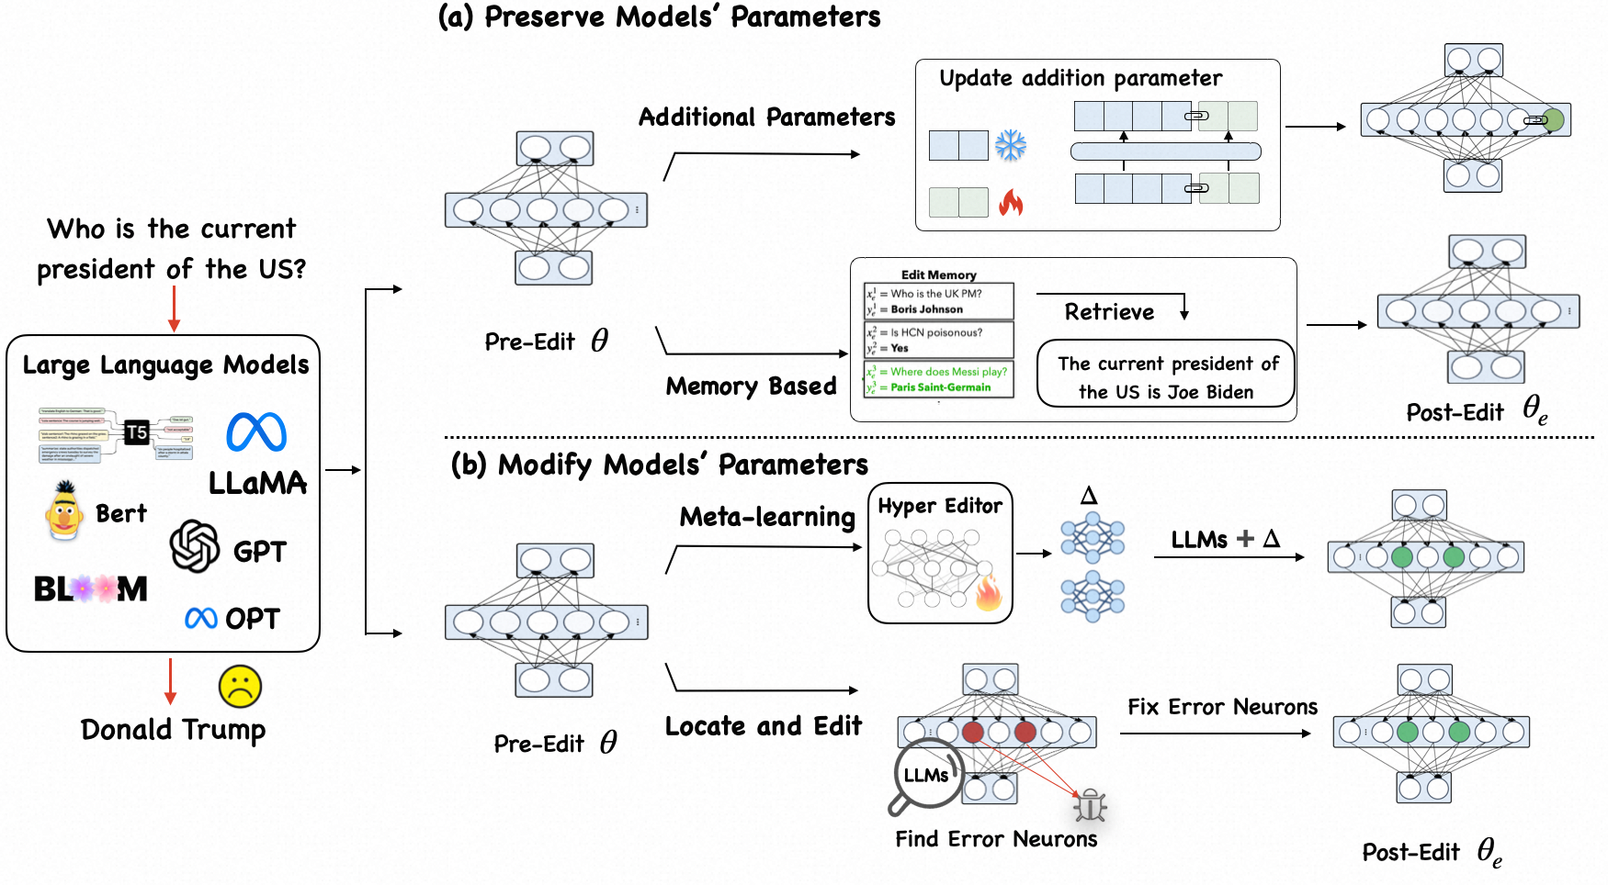
https://github.com/zjunlp/KnowledgeEditingPapers

Slide 18
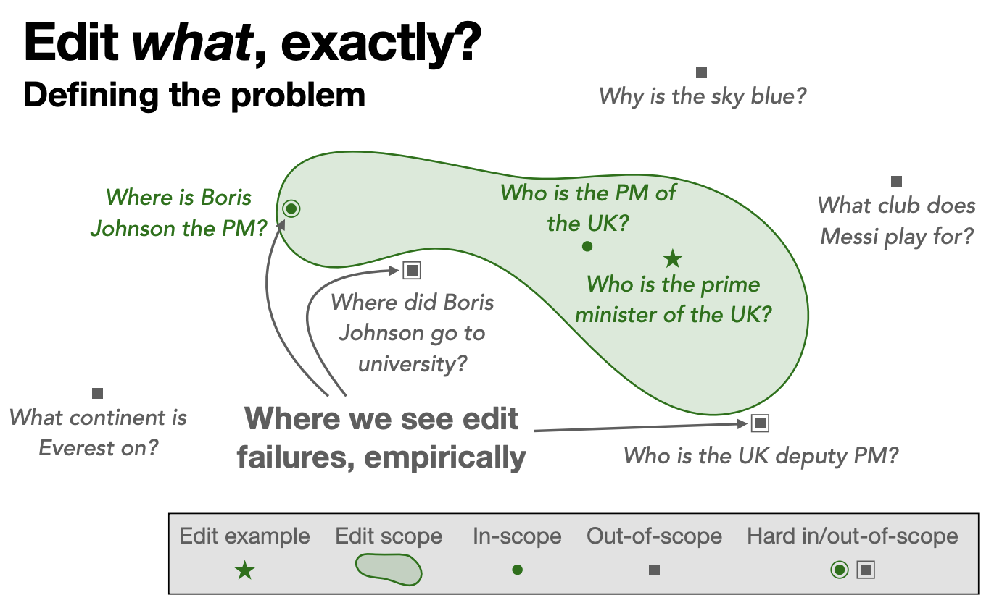
Memory-Based Model Editing at Scale

Slide 20
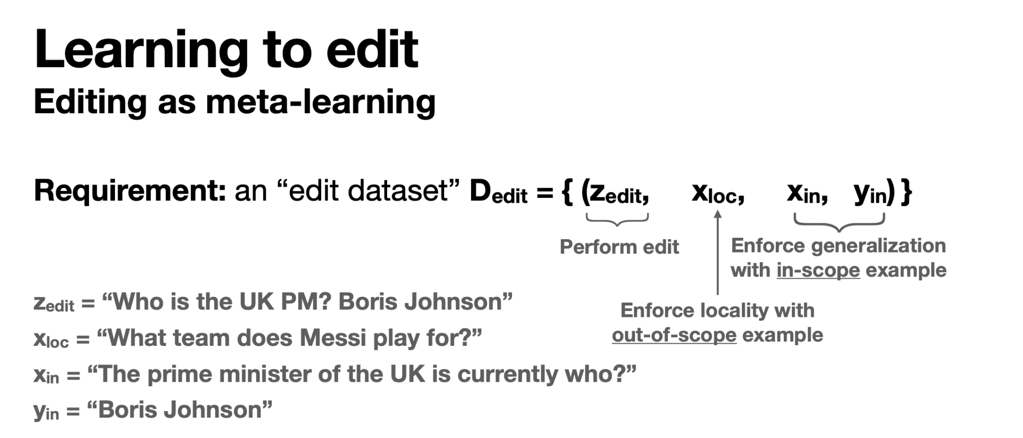

Slide 25
Locating and Editing Factual Associations in GPT

Slide 26
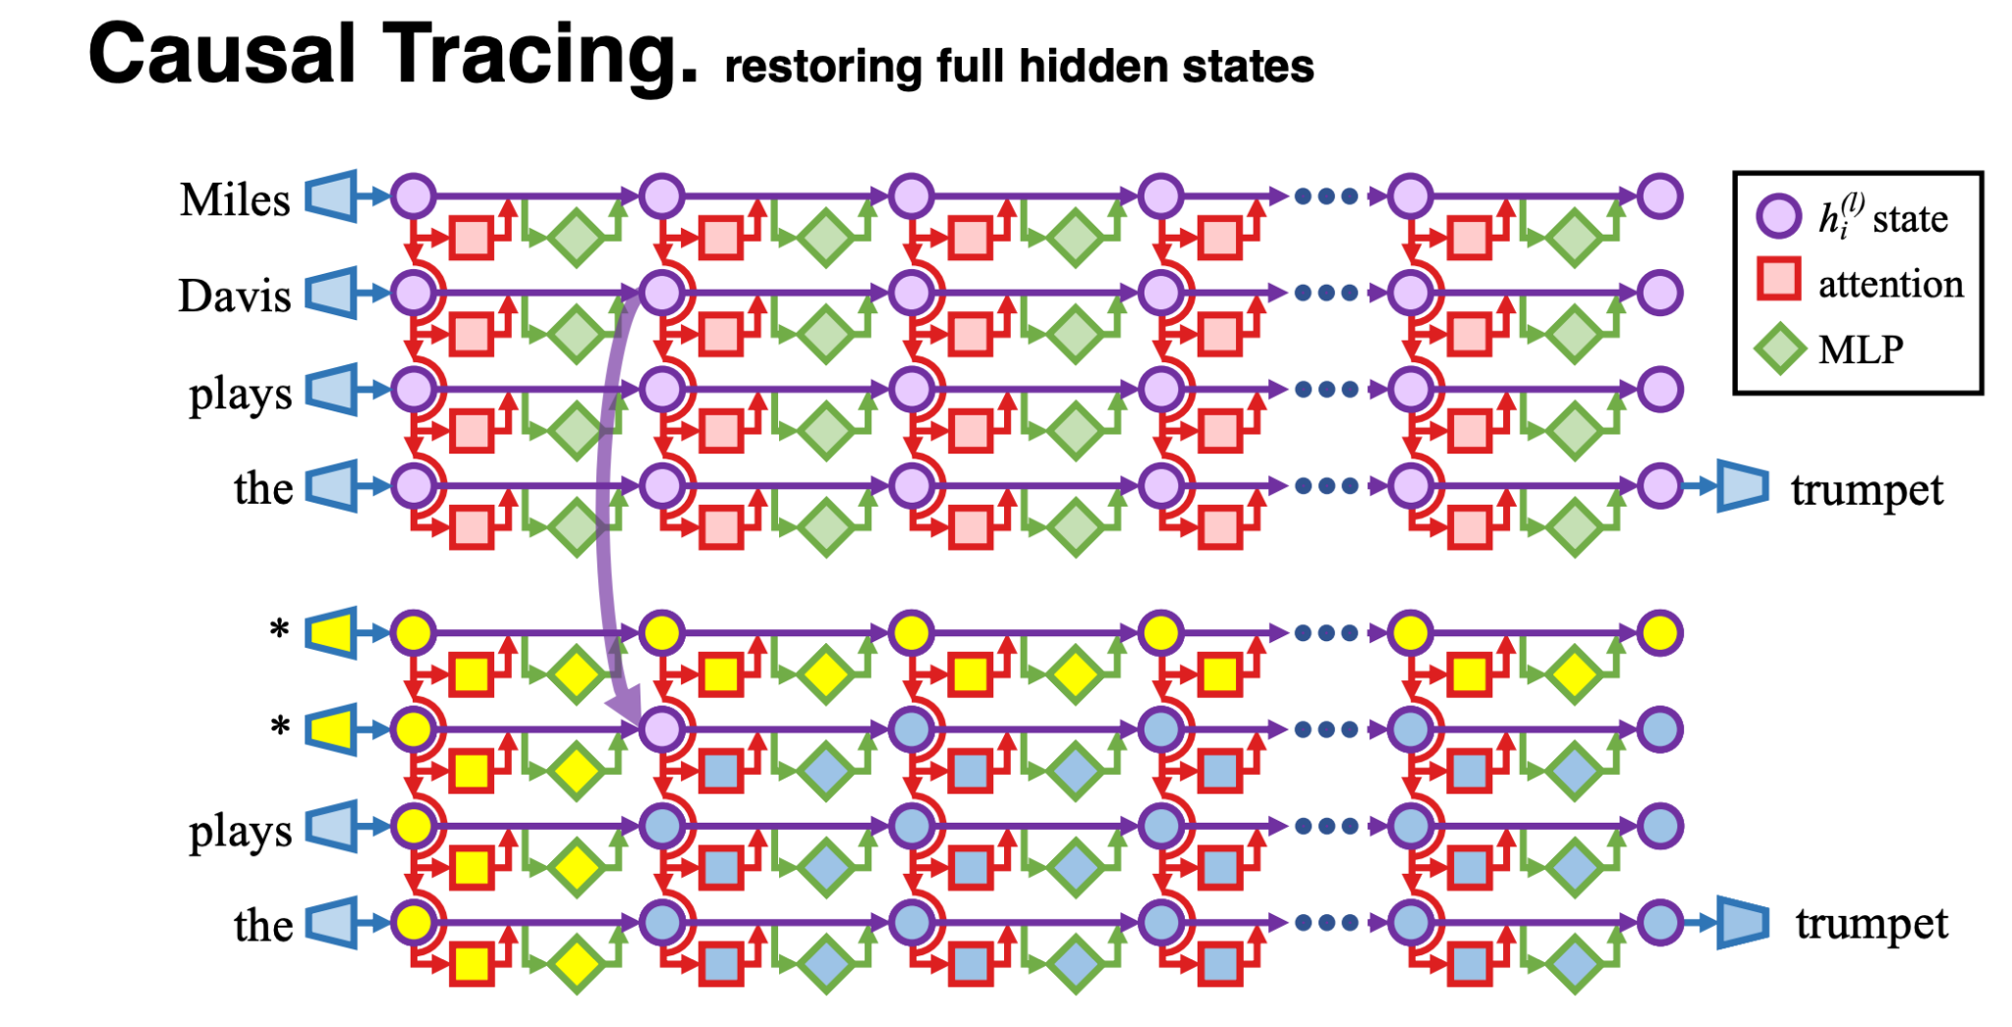
Locating the Knowledge
Clean run
Corrupted run
Notes:
Compare the two runs and then copy the states from the clean run to the corrupted run one-by-one

Slide 27
MLPs might be the “knowledge store”

Slide 28
Mor Geva, Roei Schuster, Jonathan Berant, Omer Levy. Transformer Feed-Forward Layers Are Key-Value Memories. EMNLP 2021.
Notes: Proposes the view that transformer MLP modules act as key-value memories akin to two-layer softmax-based memory data structures. Also related to Transformer circuits work.

Slide 34
Evaluation

Slide 38
Mass-Editing a Transformer Memory
MEMIT builds upon ROME to insert many memories by modifying the MLP weights of a range of critical layers.
For a set of new memories we calculate the update Δ and spread this Δ across all the mediating MLP layers such that at the final layer the output of final mediating layer captures all the new memories.

Slide 39
Evaluating the Ripple Effects of Knowledge Editing in Language Models
Current knowledge editing benchmarks check that a few paraphrases of the original fact are updates and some unrelated facts are untouched.
Check that other facts that are logically derived from the edit were also changed accordingly.
For example, if z is the mother of e, then the children of z are the siblings of e.

Slide 40
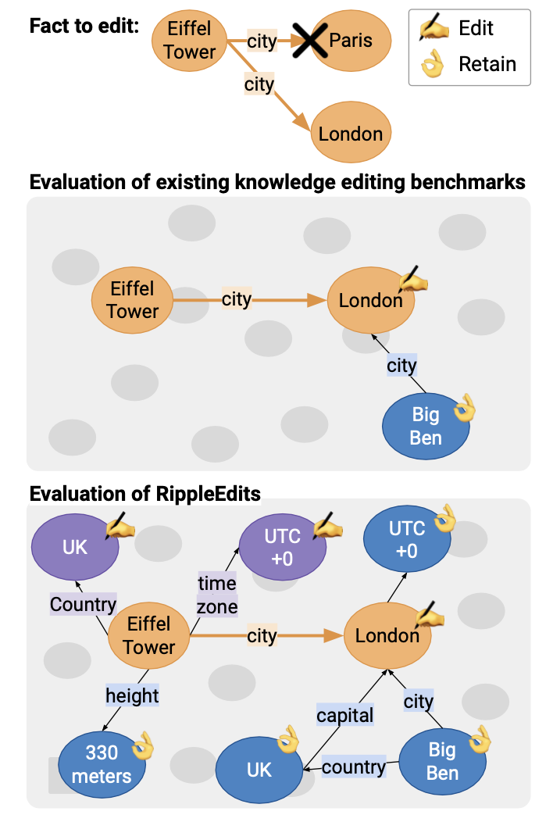
Ripple Effects
If we change the city of “Eiffel Tower”, then the country and time zone of Eiffel Tower should also be changed
We define the ripple effect of δ on K, as the set of triplets R(δ) that the model implicitly needs to inject, modify, or delete from K to reflect the world state after the edit δ.

Slide 41
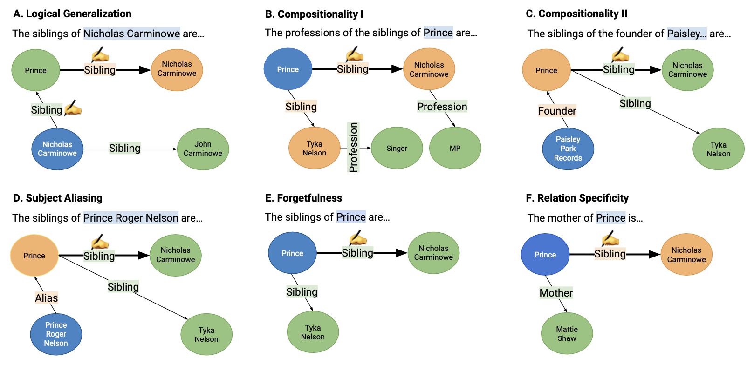
Notes:
For each test, the input subject is displayed in blue, target objects in green, and other nodes in orange. The color of an edge is derived from its target node.
For Logical Generalization (A), the additional fact that needs to be inserted to the KG is presented with an edit sign next to the relation.
For Compositions I (B) and Composition II (C) the model needs to hop over the edit to arrive at the target.
In Subject Aliasing (D) we verify the edit also propagates to paraphrases of the input.
In Forgetfulness (E), we verify that additional targets that share the input subject and relation are not forgotten, in necessary relations. (many-to-many relations)
In Relation Specificity, we verify other relations for the subject are not modified.

Slide 42
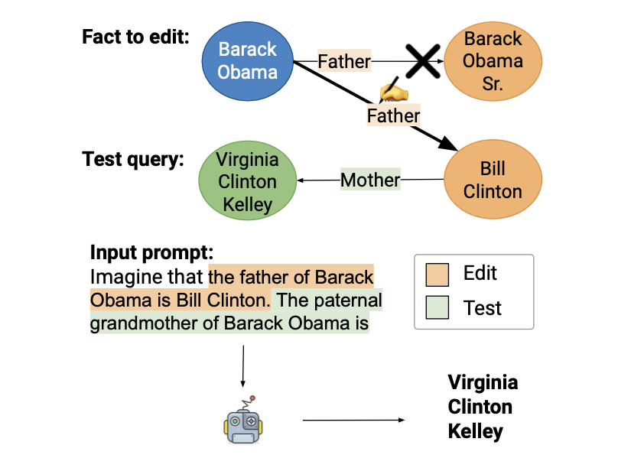
A simple in-context editing baseline
Prepend the prefix “Imagine that” to the input prompt, as counterfactuals can contradict knowledge embedded in a model’s parameters.
No model parameters updated

Slide 43
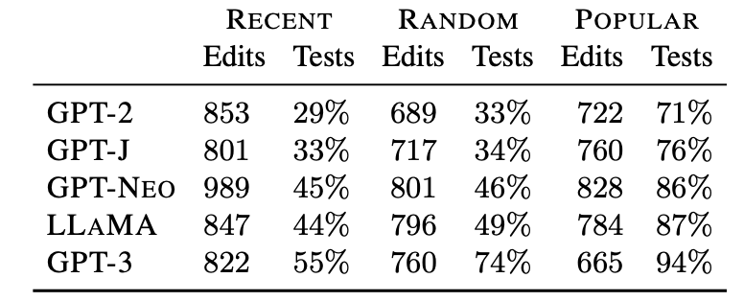
Dataset Statistics
Precentage of successful edits (averaged over models)

Slide 44
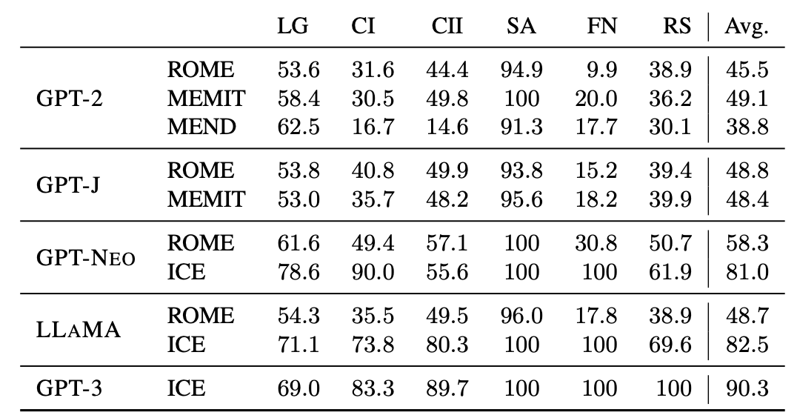
Evaluation on the Random Subset
1.5B
6B
20B
7B
175B

Slide 45
Evaluation on the Random Subset
1.5B
6B
20B
7B
175B
models are good at handling aliases

Slide 46
Evaluation on the Random Subset
models are bad at logical relations and multi-hop reasoning (except GPT3)
1.5B
6B
20B
7B
175B

Slide 47
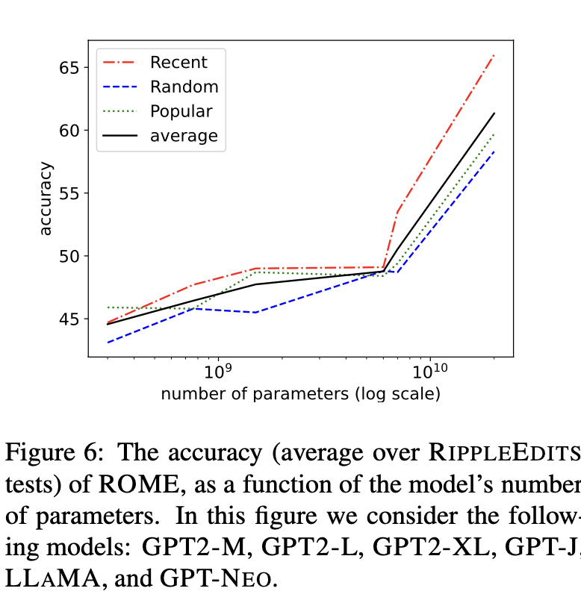
Other Findings
The simple in-context baseline performs best overall, especially when applied to LLAMA and GPT3
For the same editing model, the larger the base model, the better
While Logical generalization is higher for RANDOM, Forgetfulness is higher for POPULAR. Although retaining correct knowledge is easier for popular entities, updating other facts that logically follow from an edit is harder for popular entities.

