Slide 1
Creative Generation
Heng Ji
(Professor of UIUC CS & Amazon Scholar)
hengji@illinois.edu
Work done by UIUC PhD students: Chi Han, Chenkai Sun, Zhenhailong Wang
Some slides from Dr. Clare Voss (ARL)

Slide 2
Brainstorm, then Select: a Generative Language Model Improves Its Creativity Score
Douglas Summers-Stay, Stephanie Lukin, Clare Voss
Creative problem solving is a crucial ability for intelligent agents.
To count as creative, their solutions must be original (new, non-obvious)
and provide utility to problems at hand (useful, effective). [Guilford, 1964]
We study GPT-3, a large pre-trained
language model, for its creativity on
the Alternate Uses Task (AUT) in
terms of utility and originality.
AUT was created as a test for divergent thinking abilities,
to measure and compare human creativity.
In the original test given to humans, their answers were scored on:
“fluency (overall sum of generated uses),
originality (statistical infrequency of generated uses),
flexibility (#conceptual categories within which uses could be binned), and
elaboration (degree of detail and richness in a response), amongst others”
(Vartanian et al. 2020)

Slide 3
A common method that individuals or groups rely on for coming up with creative solutions is
to start with a “brainstorming” phase,
where many solutions to a problem are proposed, and
to follow with a “selection” phase,
  where those solutions are judged by some criteria, with the best solution then selected.

Slide 4
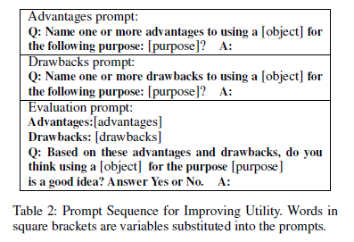
A common method that individuals or groups rely on for coming up with creative solutions is
to start with a “brainstorming” phase,
where many solutions to a problem are proposed, and
to follow with a “selection” phase,
  where those solutions are judged by some criteria for the best solution to be selected.
A common method that individuals or groups rely on for coming up with creative solutions is
to start with a “brainstorming” phase,
where many solutions to a problem are proposed, and
to follow with a “selection” phase,
  where those solutions are judged by some criteria, with the best solution then selected.
Putting GPT-3’s Creativity to the Test: Chain of prompts that includes both brainstorming & selection
Sequence for utility
Creative Use Generation [Stevenson et al.]
Creative Use Brainstorming (our pass)
Creative Selection for Utility (our pass)

Slide 5
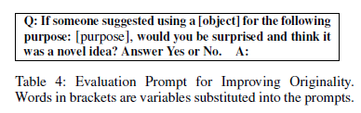
A common method that individuals or groups rely on for coming up with creative solutions is
to start with a “brainstorming” phase,
where many solutions to a problem are proposed, and
to follow with a “selection” phase,
  where those solutions are judged by some criteria for the best solution to be selected.
Putting GPT-3’s Creativity to the Test: Chain of prompts that includes both brainstorming & selection
Sequence for utility
Creative Use Generation [Stevenson et al.]
Creative Use Brainstorming (our pass)
Creative Selection for Utility (our pass)
Sequence for originality
Creative Use Generation [Stevenson et al.]
Creative Selection for Originality (our pass)

Slide 6
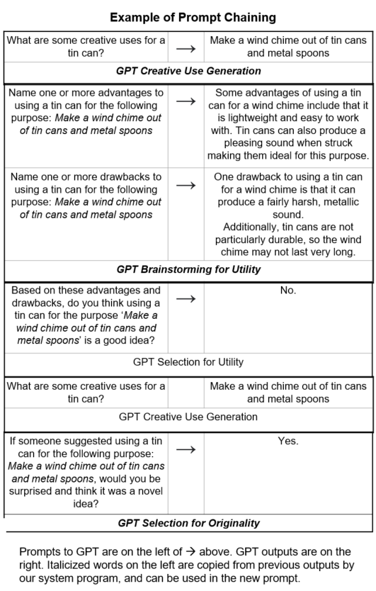
Putting GPT-3’s Creativity to the Test
Creative Use Generation [Stevenson et al.]
In a first pass, in applying the Alternative Uses Test,
both GPT-3 Davinci and student participants were
asked to come up with creative uses for each of
3 specified objects:
Think of as many creative uses for
a {tin can, fork, book} as you can.
Prompt to GPT → GPT output

Slide 7
Putting GPT-3’s Creativity to the Test: for Utility
(ii) Creative Use Brainstorming (our pass):
GPT writes out positives (advantages) and
negatives (disadvantages) of the first-pass (i) solution.
Prompt to GPT → GPT output
Italicized words are copied
from prior output step by
our system into new prompt

Slide 8
Putting GPT-3’s Creativity to the Test: for Utility
(iii) Creative Use Selection (our pass): GPT “judges” based
on its brainstormed advantages & disadvantages,
if the solution is useful.
Prompt to GPT → GPT output
Italicized words are copied
from prior output step by
our system into new prompt

Slide 9
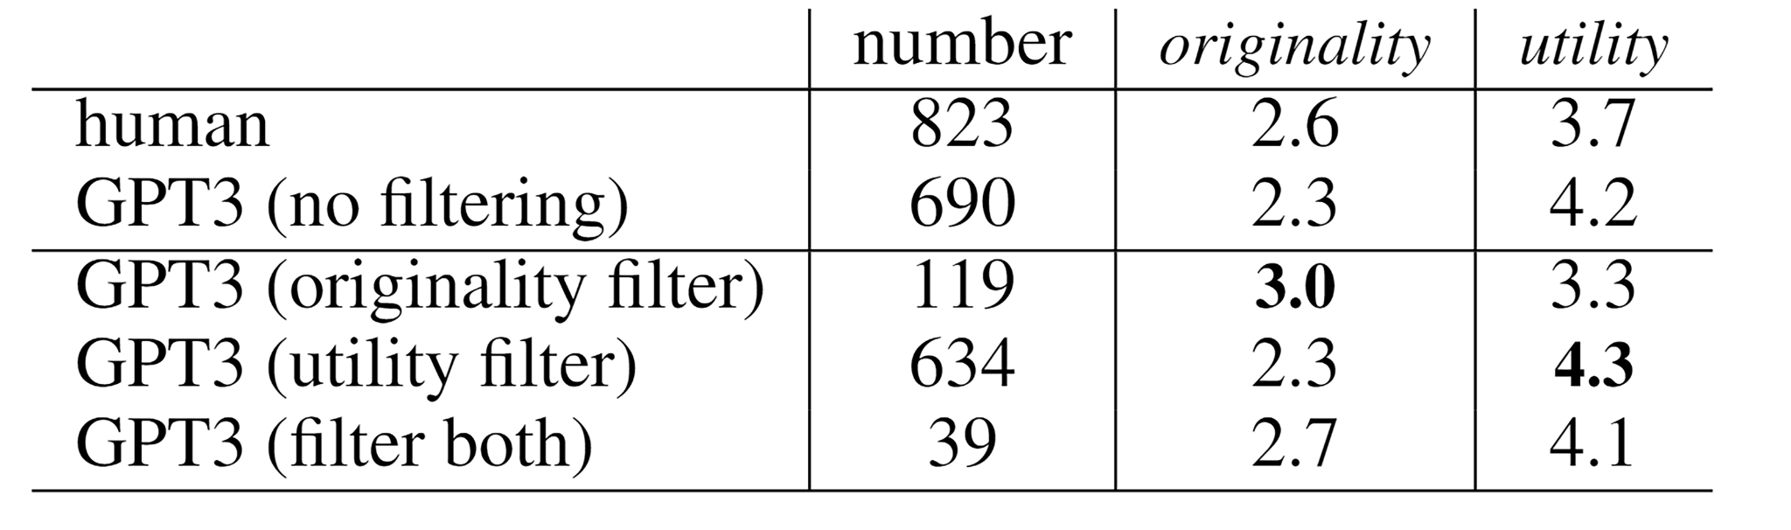
Putting GPT-3’s Creativity to the Test: for Utility
Scoring at (i): GPT’s and students’ answers were
scored for utility by trained annotators, on a
scale of 1 (useless) to 5 (highly useful).
See top 2 rows of table below [Stevenson et al.]
Contrastive Results after (iii): With a threshold
set on probability of these “judgments” (filtering out
answers below the threshold), GPT scores above
average human performance on utility (4.3 vs 3.7)
See last utility filter row in table below.

Slide 10
Putting GPT-3’s Creativity to the Test: for Originality
Creative Use Generation [Stevenson et al.]
In a first pass, in applying the Alternative Uses Test,
same as in test for utility.
(ii) Creative Use Selection (our pass): GPT then
“judges” whether its prior brainstormed use, in (i),
provides a solution that is surprising and a novel idea.
Contrastive Results after (ii): With a threshold
set on probability of these “judgments” (filtering out
answers below the threshold), GPT improves its scores
above average human performance on originality
(3.0 vs 2.6) See originality filter row in originality column
in table below.

Slide 11
References
Stevenson, C.; Smal, I.; Baas, M.; Grasman, R.; and van der Maas, H. 2022. Putting GPT-3’s Creativity to the (Alternative Uses) Test. arXiv preprint arXiv:2206.08932.’
Guilford, J. P. 1964. Some new looks at the nature of creative processes. Contributions to mathematical psychology. New York: Holt, Rinehart & Winston.
Diedrich, J.; Benedek, M.; Jauk, E.; and Neubauer, A. C. 2015. Are creative ideas novel and useful? Psychology of Aesthetics, Creativity, and the Arts, 9(1): 35

Slide 12
Why Do We Care about Personalized Generation? Application on Stance-Controlled News Generation
WELLINGTON, July 26 (Reuters) - U.S. Secretary of State Antony Blinken warned of China's "problematic behavior" during a visit to the Pacific island nation of Tonga on Wednesday, citing Beijing's militarisation of the South China Sea and what he called economic coercion.
China´s growing presence in the region, which saw it sign a security pact with the Solomon Islands last year, has fueled concern in the U.S. and Australia about Beijing´s ambitions, and prompted increased Western aid and engagement.
Blinken said at a press conference that the U.S. had no objection to China's engagement with the region but there were concerns that its investments needed to be transparent and undertaken with sustainable finance.
"I think one of the things that we´ve seen is that as China´s engagement in the (Indo-Pacific) region has grown there has been some, from our perspective, incre
asingly problematic behavior," he said.
The strategy unfounded accusations that China's 'pressure and economic coercion' are increasingly affecting Pacific island countries and 'could undermine the peace, prosperity and security of the region and the United States.' According to some media reports, the United States relied on its close relations with South Pacific countries after World War II and neglected to pay attention to this region for decades. Since China signed a bilateral security framework agreement with the Solomon Islands in April last year, the United States has become increasingly “unsatisfied” with China’s continued expansion of influence in the South Pacific. 02 Should the US have the final say in making friends? In recent years, the U.S. government has repeatedly expressed its 'dissatisfaction' with China's exchanges with South Pacific island countries, both covertly and overtly. Various dirty claims have emerged one after another, ranging from 'economic coercion’ to ’shadow agreements'. It has even claimed that some cooperation will 'Intensifying tensions in the Pacific.'
https://www.dailymail.co.uk/wires/reuters/article-12338319/
http://news.china.com.cn/2023-07/26/content_95343112.shtml

Slide 13
Limitations of Existing Methods vs. Our Solutions
Limitations of Existing methods 1: Can only take single aspect as control for a black-box model
Our Solution 1: Design our own theoretically grounded, simple and transparent model to accept multiple dimension composition
Limitations of Existing methods 2: After the length exceeds training lengths, LLMs start to generate nonsense texts.
Our Solution 2: Design a lambda-shaped attention to generate infinite length sequences
Limitations of Existing methods 3: Cannot capture profile of “lurkers” (who lack explicit profiles or historical activities)
Our Solution 3: Belief-Augmented Social Network (BASN) on top of the current social network and use graph modeling method to propagate information to predict responses from lurkers

Slide 14
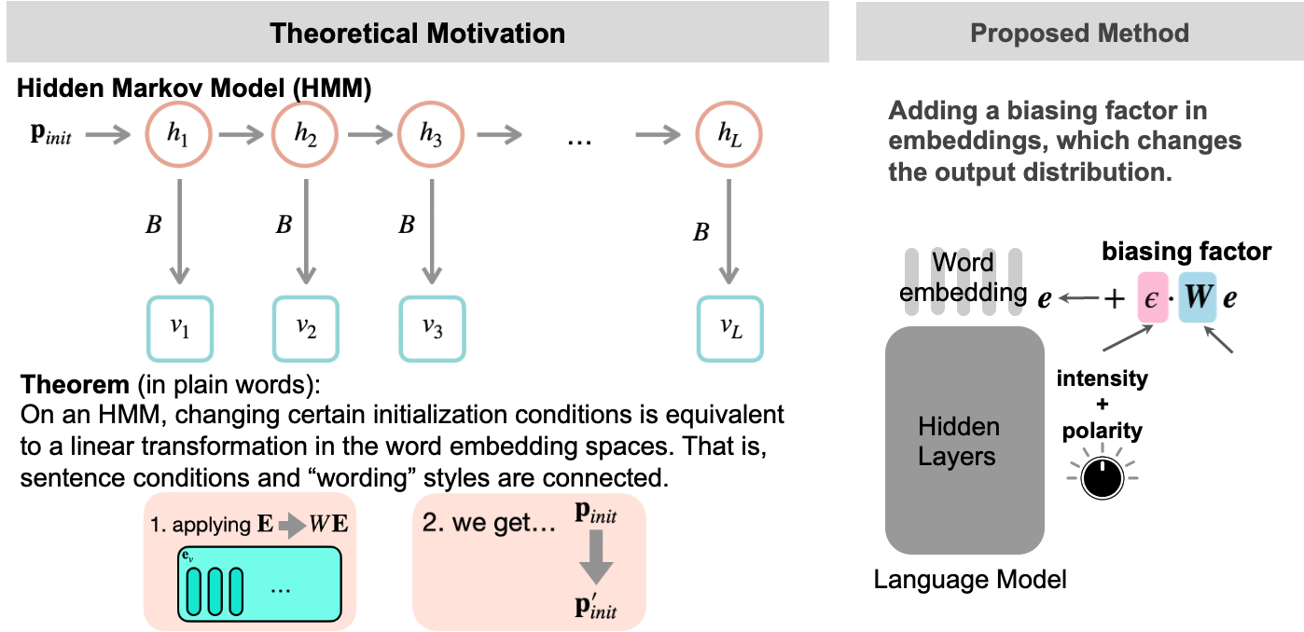
Conditioned Text Generation for Early Control: Theory [Han et al., 2023 “LMSwitch”]

Slide 15
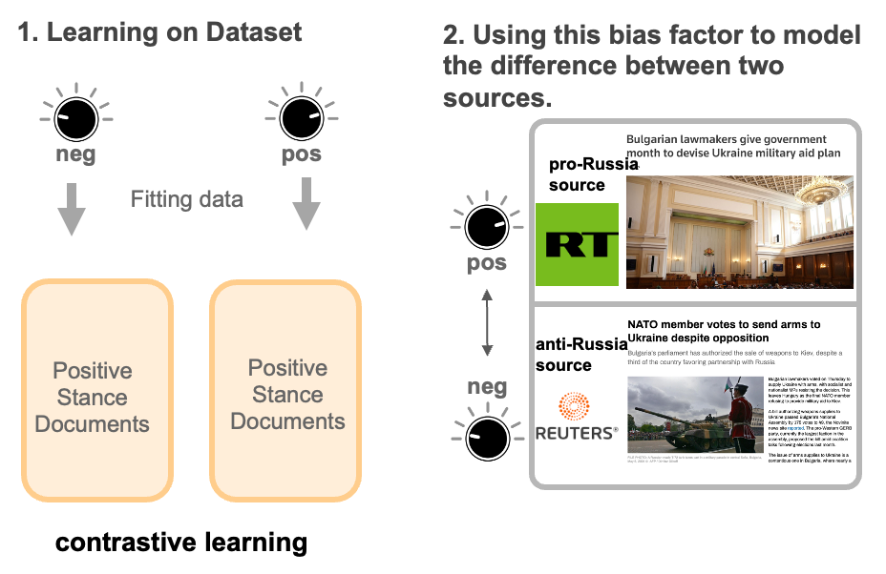
Conditioned Text Generation for Early Control : Model

Slide 16
Model Overview

Slide 17
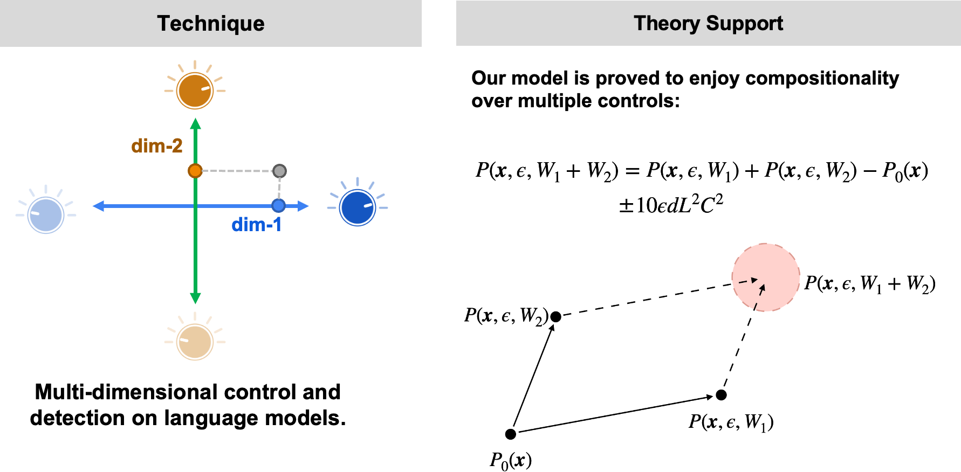
Multi-Dimensional Control

Slide 18

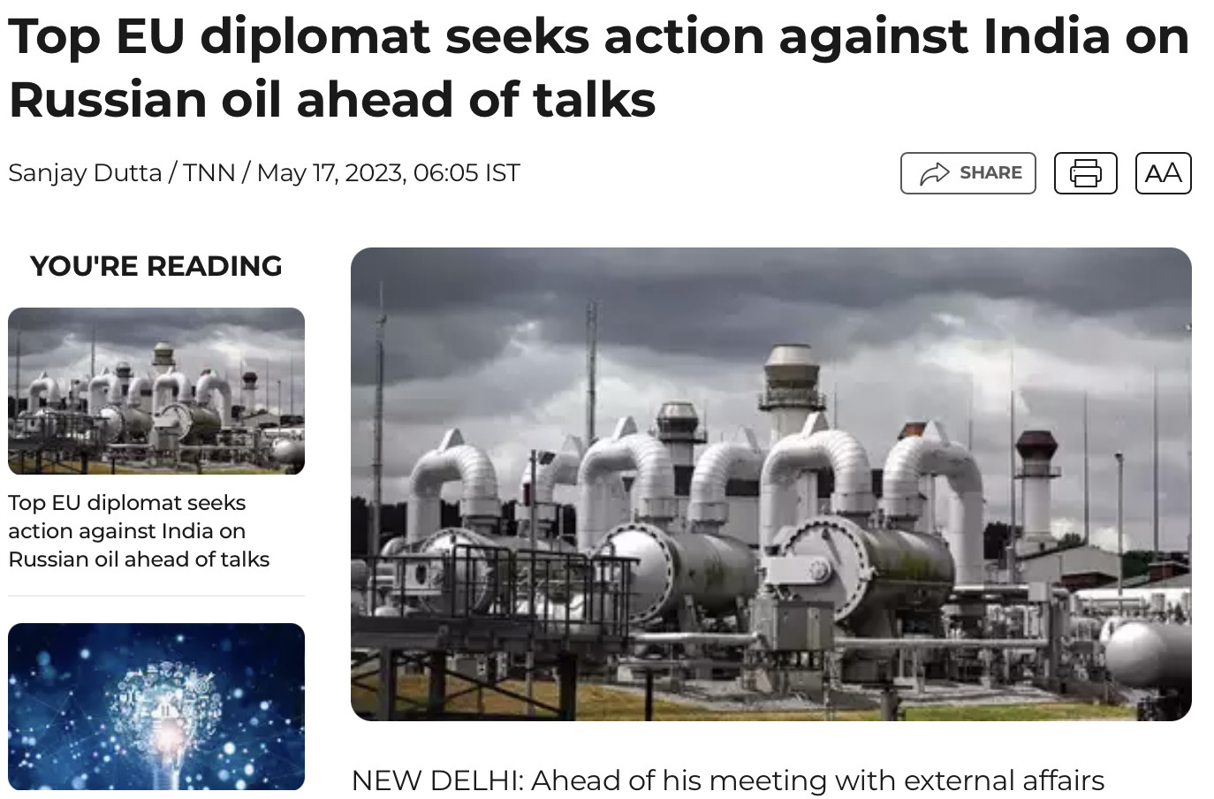
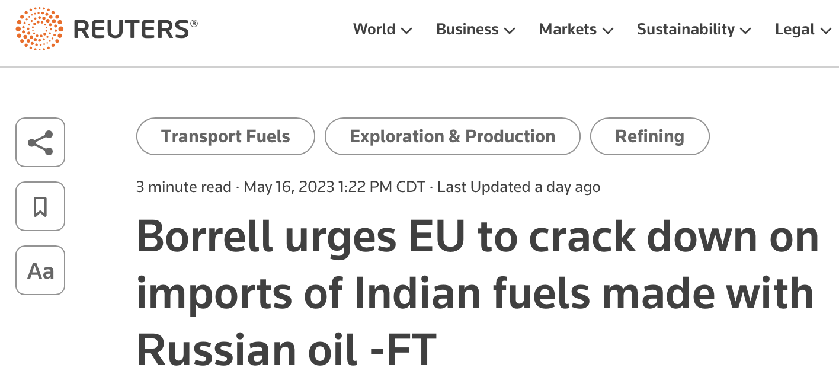
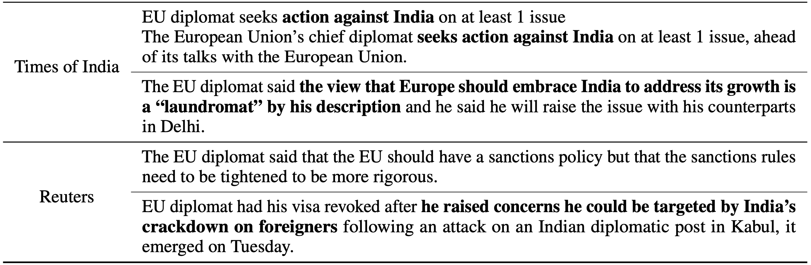
Learning a Stance from One News Article
Times of India:
Reuters:
Times of India
Reuters

Slide 19
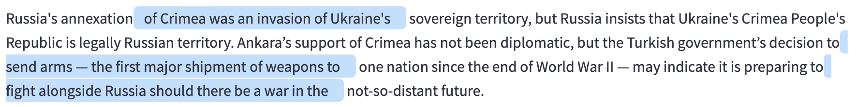
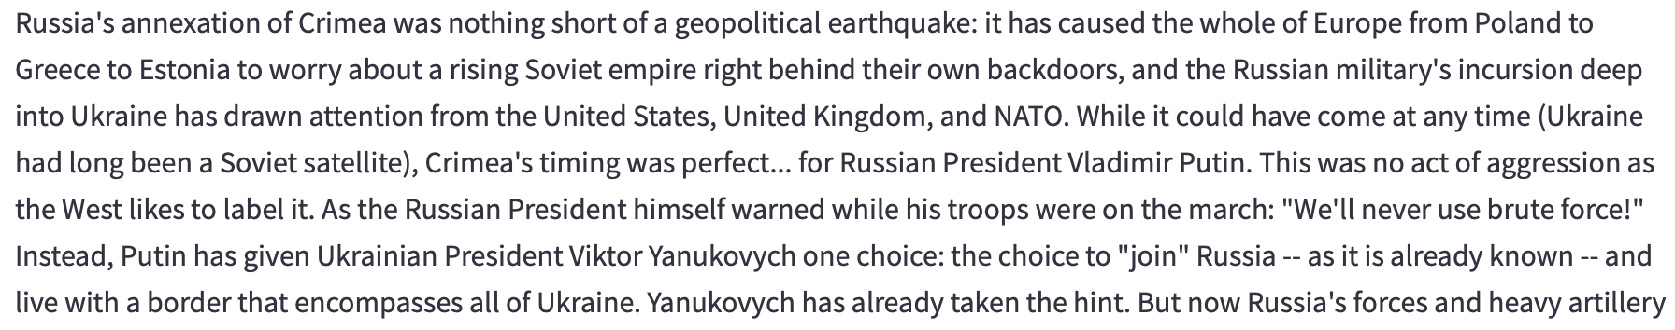
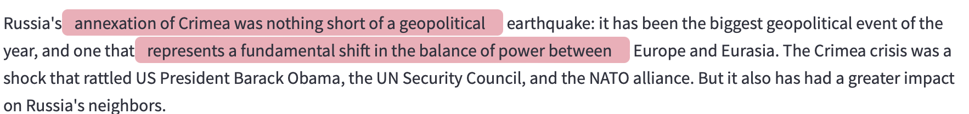
Generation on A Specific Stance
Anti-Russia Generation
Neutral Generation
Pro-Russia Generation

Slide 20
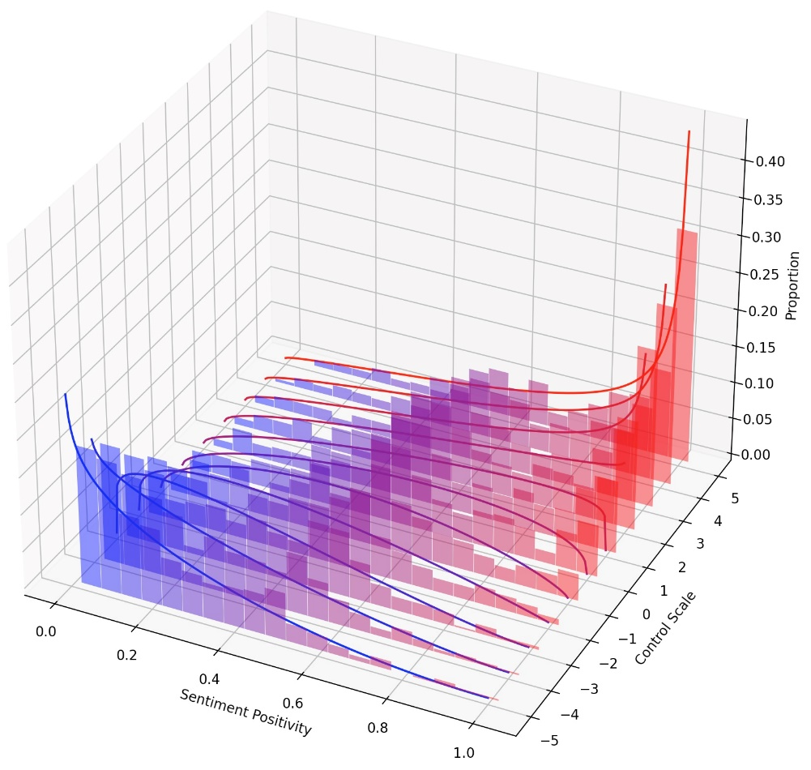
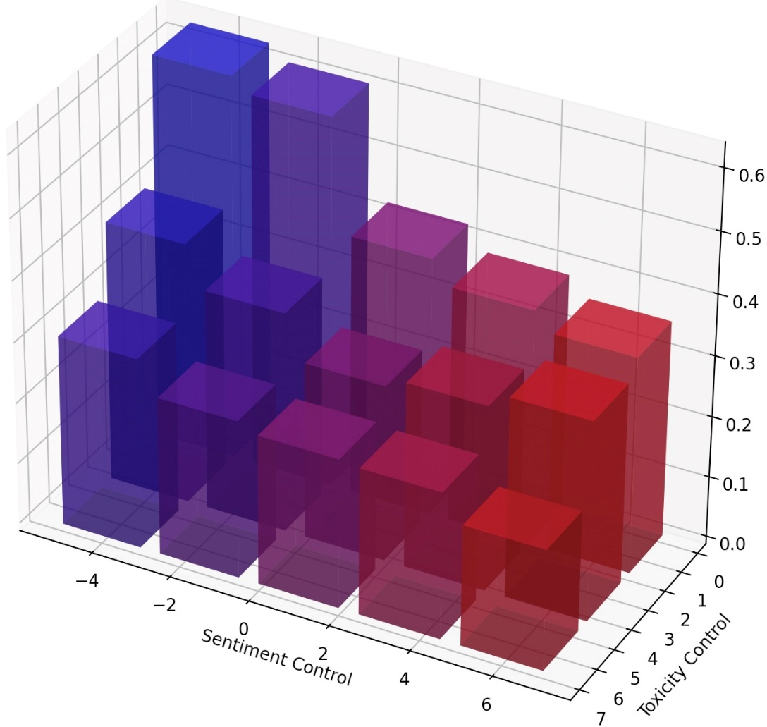
Multi-dimensional Language Model Control
Continuous Sentiment Control
Compositional Sentiment + Detoxification
By varying control scale, sentiment distribution continuously shift from negative (blue) regions to positive (red) regions.
Color means generation sentiment (red: positive, blue: negative), and height indicates toxicity (lower the better).

Slide 21
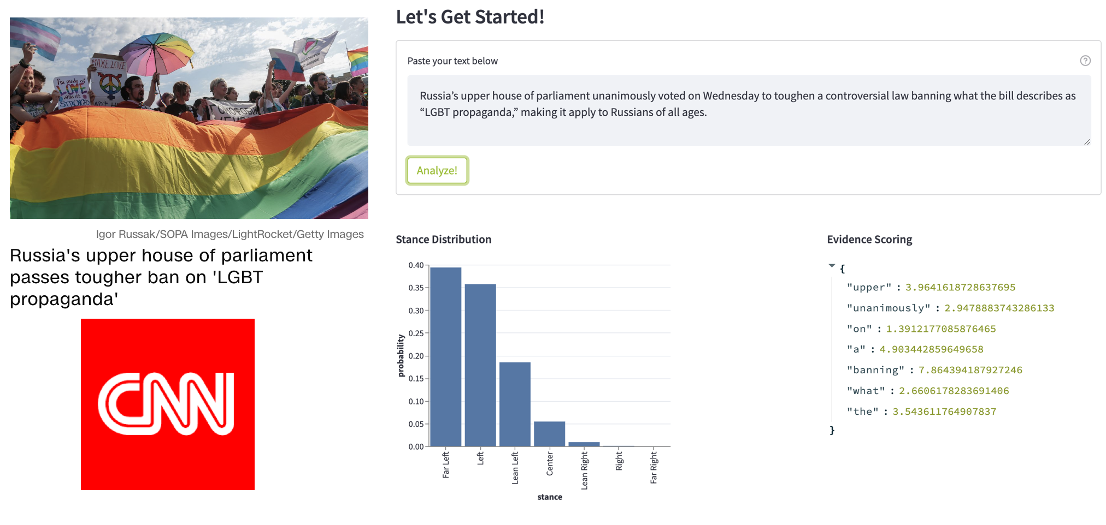
Political Stance Detection

Slide 22
Limitations of Existing Methods vs. Our Solutions
Limitations of Existing methods 1: Can only take single aspect as control for a black-box model
Our Solution 1: Design our own theoretically grounded, simple and transparent model to accept multiple dimension composition
Limitations of Existing methods 2: After the length exceeds training lengths, LLMs start to generate nonsense texts.
Our Solution 2: Design a lambda-shaped attention to generate infinite length sequences
Limitations of Existing methods 3: Cannot capture profile of “lurkers” (who lack explicit profiles or historical activities)
Our Solution 3: Belief-Augmented Social Network (BASN) on top of the current social network and use graph modeling method to propagate information to predict responses from lurkers

Slide 23
Length Generalization Problem [Han et al., 2023 “LMInfinite”]
Length Generalization Failure:
After the length exceeds training lengths, LLMs start to generate nonsense texts.
Context:
Previously, Kottwitz [@Kottwitz92] proved the formula (\[eq\_intro:Kottwitz\_formula\]) in PEL-type cases (of simple Lie type $A$ or $C$) by a method which is based on the Honda-Tate theory. This method however cannot be applied in general Hodge-type situations, and indeed:
Generation:
of this (of over-equary-her, and [( and, in the...cister '-- and an of the model to\n↵ by. by ..., this, by the. It, and it, 7. --(of an equist (of the.\nand to the [[[WNE (to. and for the (((de in the (for the andistile–c.\n-[de (for in an inc ort, ort (betness in >with (with, based (and (>~~such ((c of a or for the abstract as. of *.

Slide 24
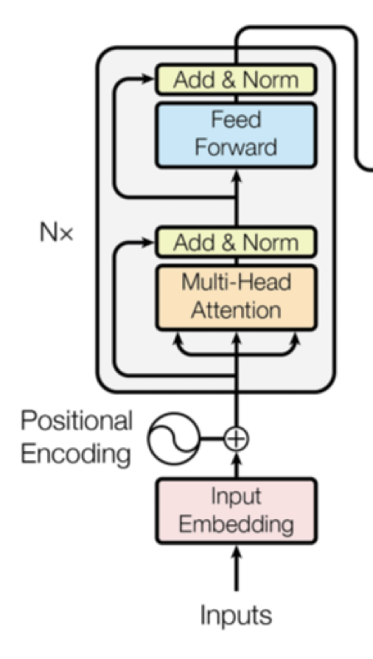
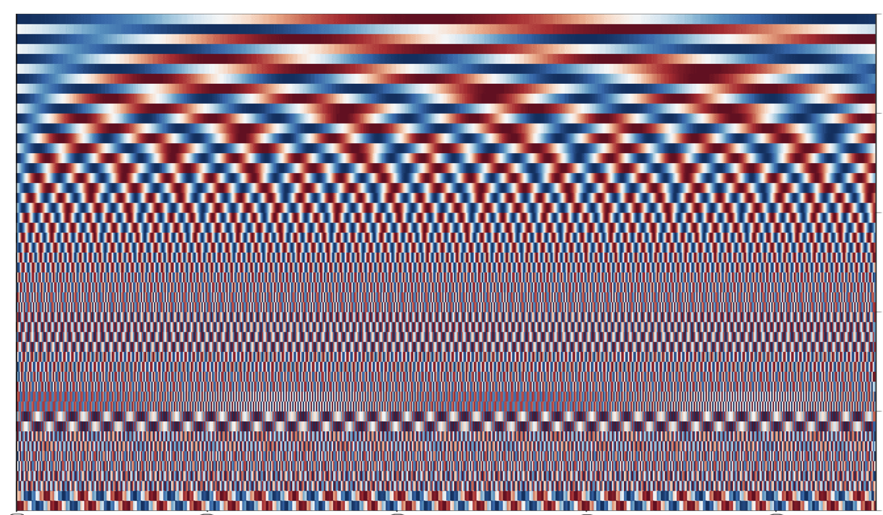
Traditionally: Absolute Position Embeddings
Absolute Position Embeddings:
Adding position-specific vectors onto word embeddings.
Popular in vanilla Transformers, they are not extendable to unseen positions.
Transformer structure
One popular option: sinusoidal position embeddings
https://erdem.pl/2021/05/understanding-positional-encoding-in-transformers

Slide 25
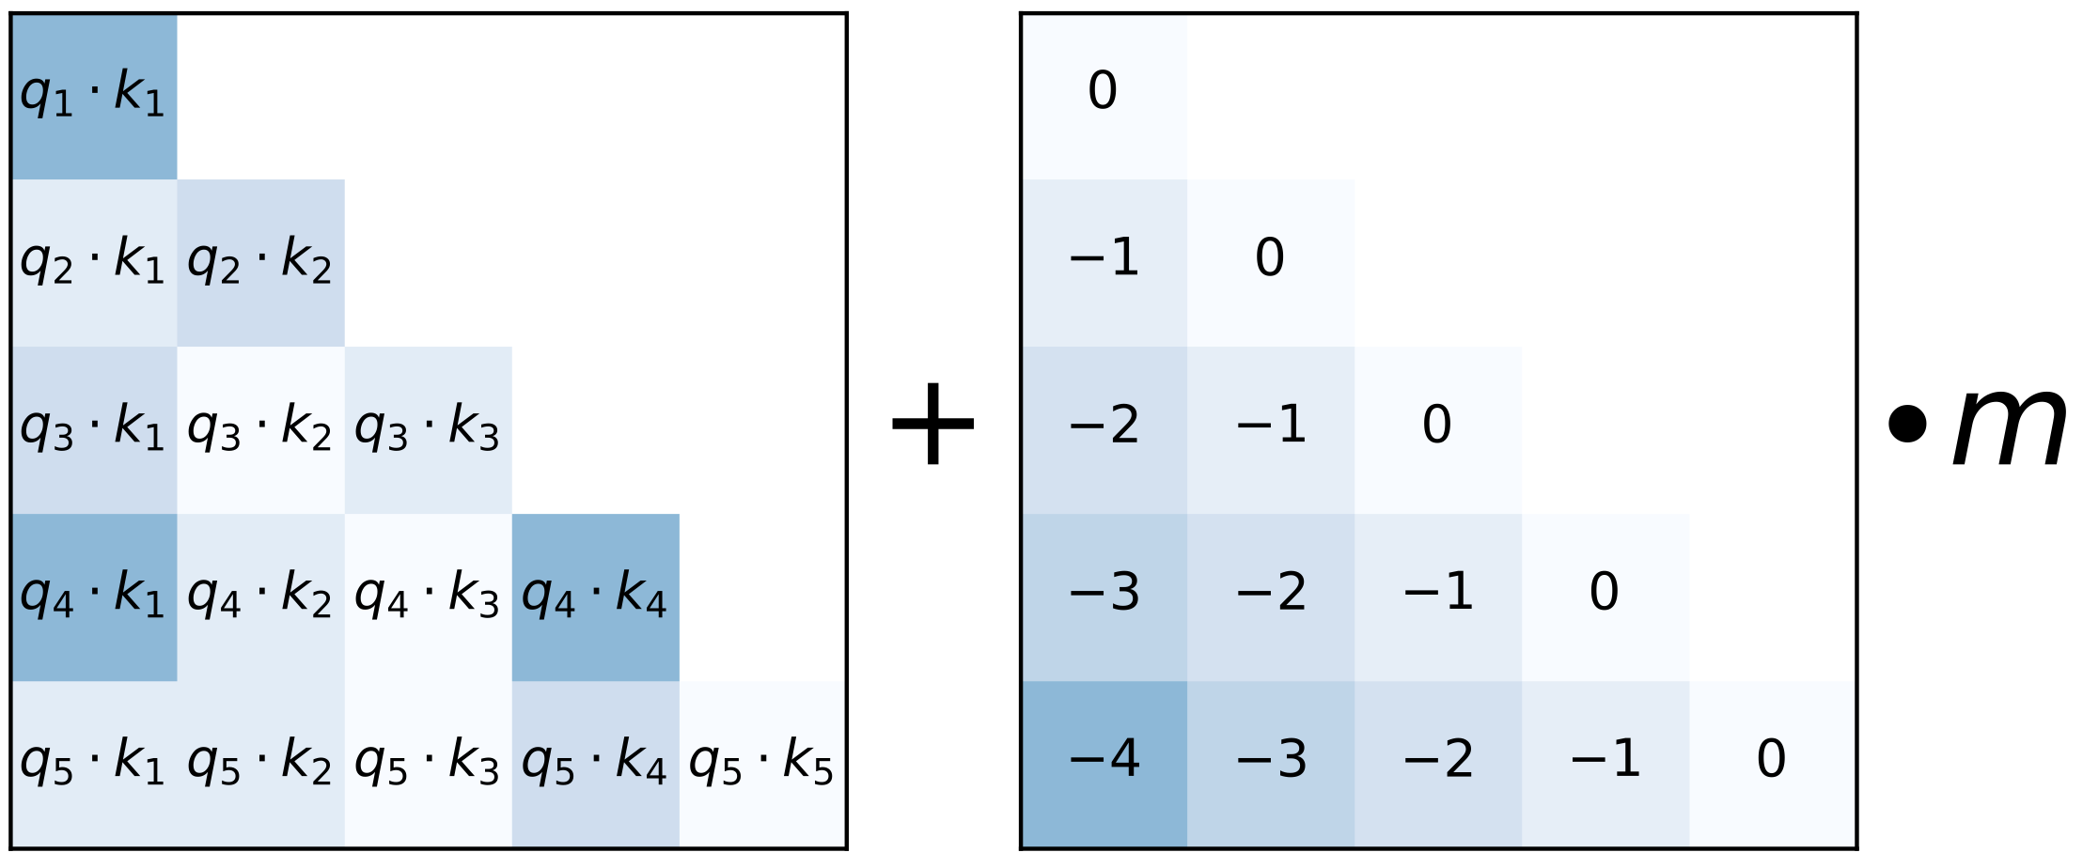
Recently: Relative Position Embeddings
Relative Position Embeddings:
Core idea: determining attentions based on inter-token distance.
Proposed in hope to generalize to unseen lengths.
Representative work: Alibi. It adds a linear attention decay (right) onto original attention scores (left)
Press, Ofir, Noah A. Smith, and Mike Lewis. "Train short, test long: Attention with linear biases enables input length extrapolation." arXiv preprint arXiv:2108.12409 (2021).

Slide 26
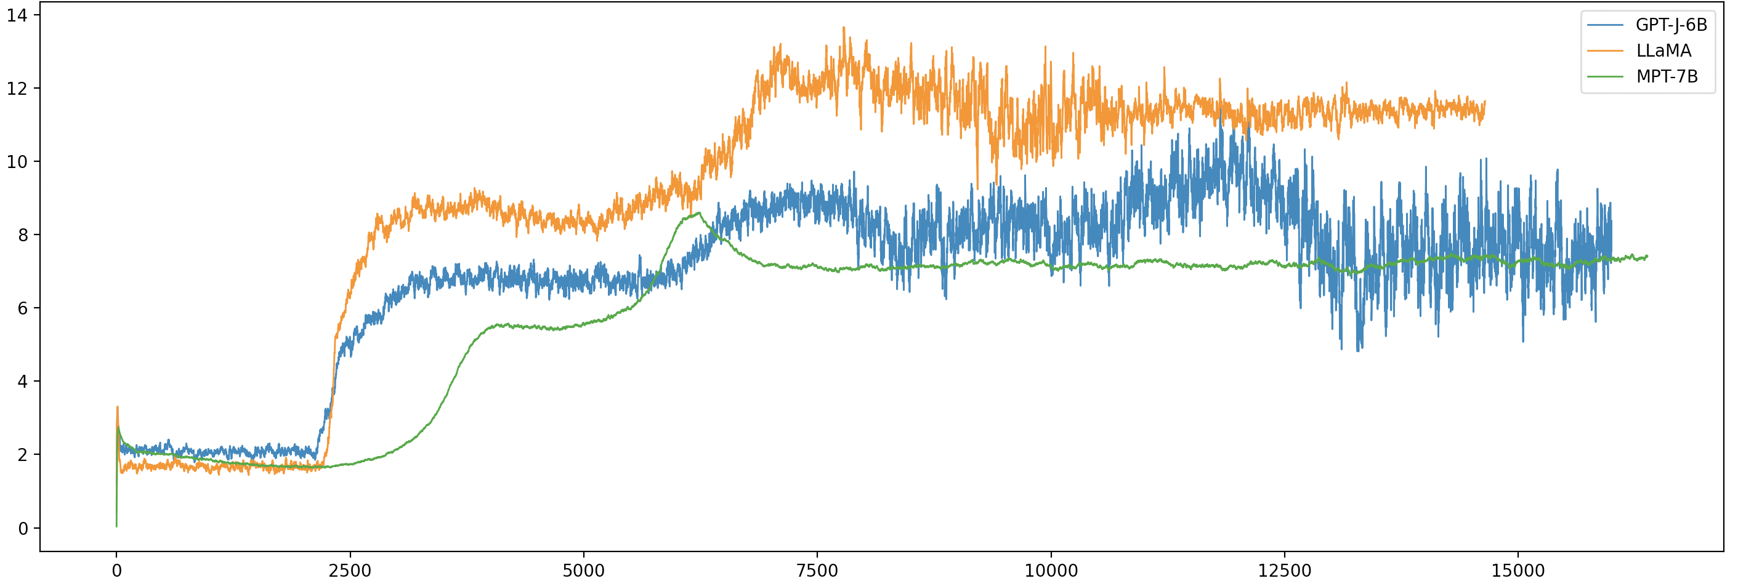
Recently: Relative Position Embeddings
However, length generalization failures are still observed!
Negative Log-Likelihood (analogous to error loss)
Sequence length

Slide 27
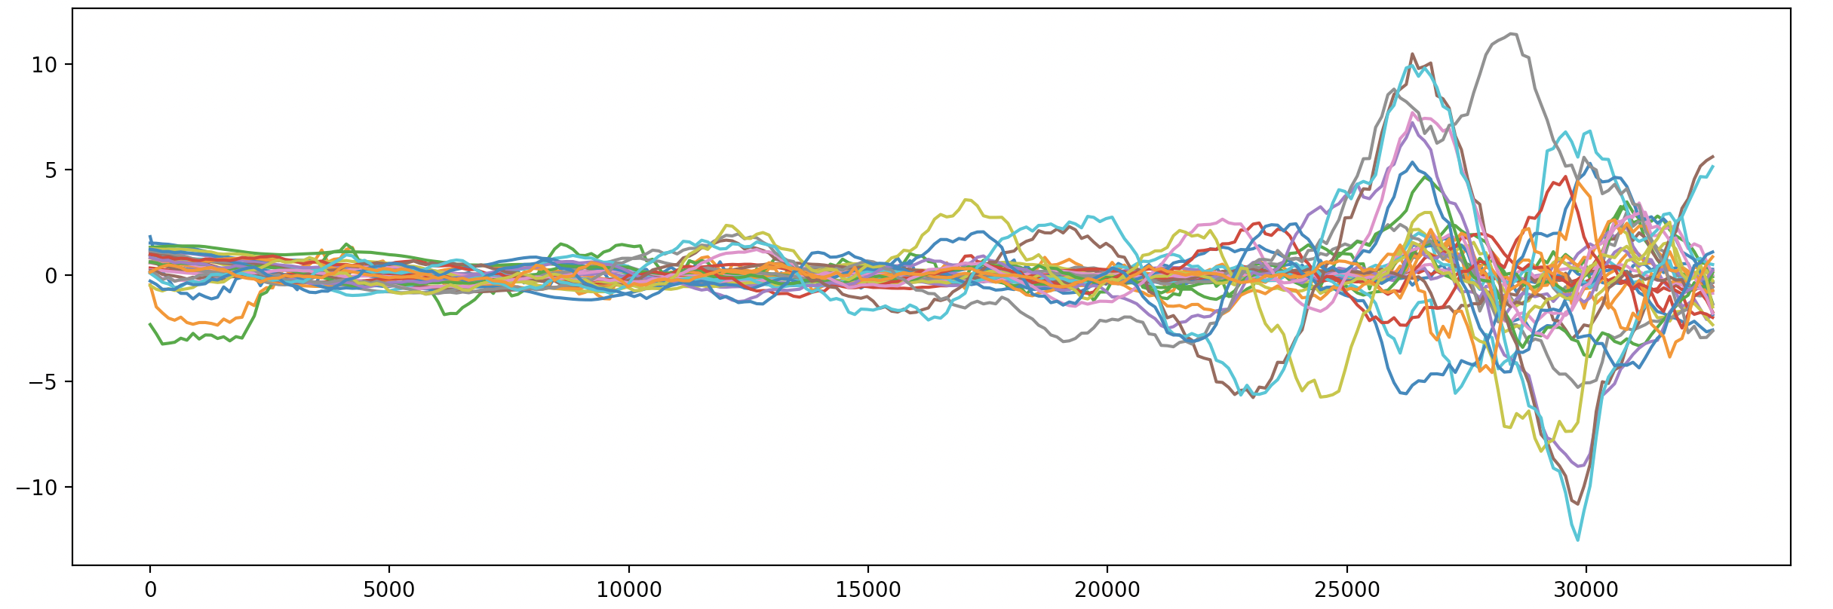

What are “unfamiliarity” (out-of-distribution) factors to LLMs?
Factor 1: Unseen Distance
Attention Logits on LLaMA
Sequence length
Theoretically, when sequence increases, attention logits tend to “explode” to unseen magnitude.

Slide 28
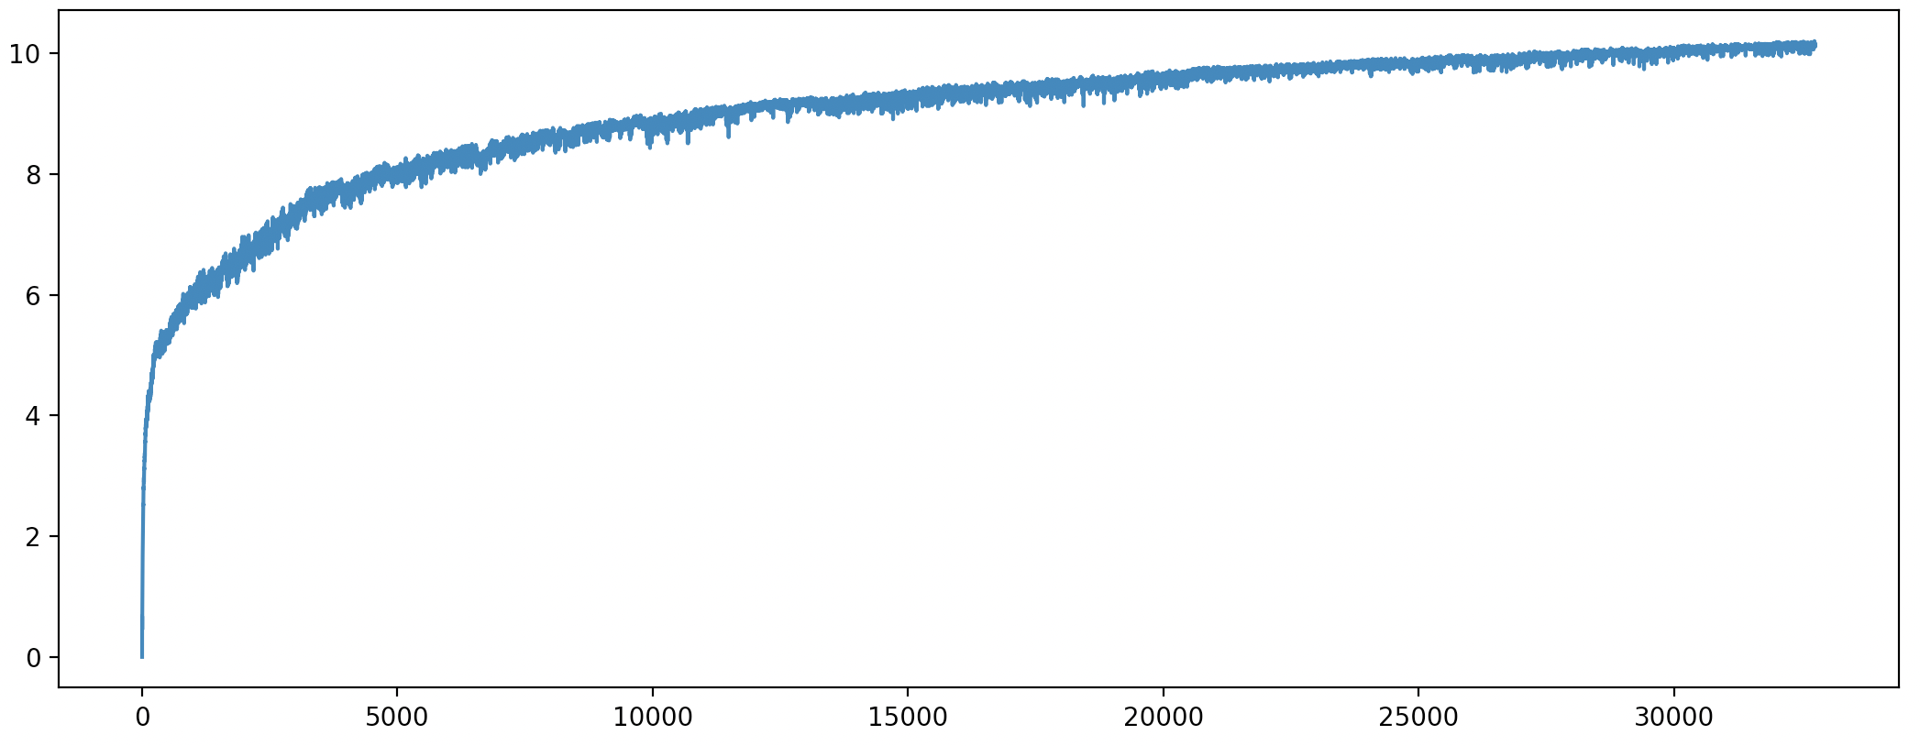
What are “unfamiliarity” (out-of-distribution) factors to LLMs?
Factor 2: Too Many Tokens Under Attention
Attention Entropy on LLaMA
“unfamiliar” zone due to high entropy
max length in training
Sequence length
Theoretically, attention on too many tokens will enlarge its entropy, making itself increasingly chaotic.

Slide 29
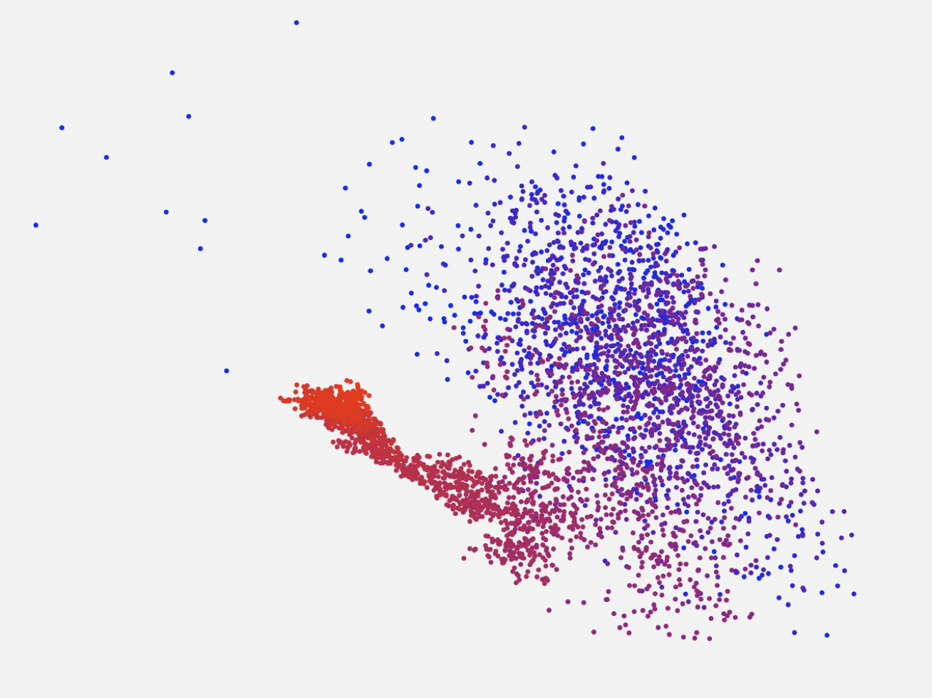
What are “unfamiliarity” (out-of-distribution) factors to LLMs?
Factor 3: Messing Up Implicitly Encoded Positions
Theoretically, absolute position information might be implicitly encoded ^{[Kazemnejad et al, 2023]}.
If the starting tokens are processed by unseen-distance attention functions, it can mess up the sub-space.
starting tokens
following tokens
Kazemnejad, Amirhossein, et al. "The Impact of Positional Encoding on Length Generalization in Transformers." arXiv preprint arXiv:2305.19466 (2023).
LLaMA features implicitly encode positions

Slide 30
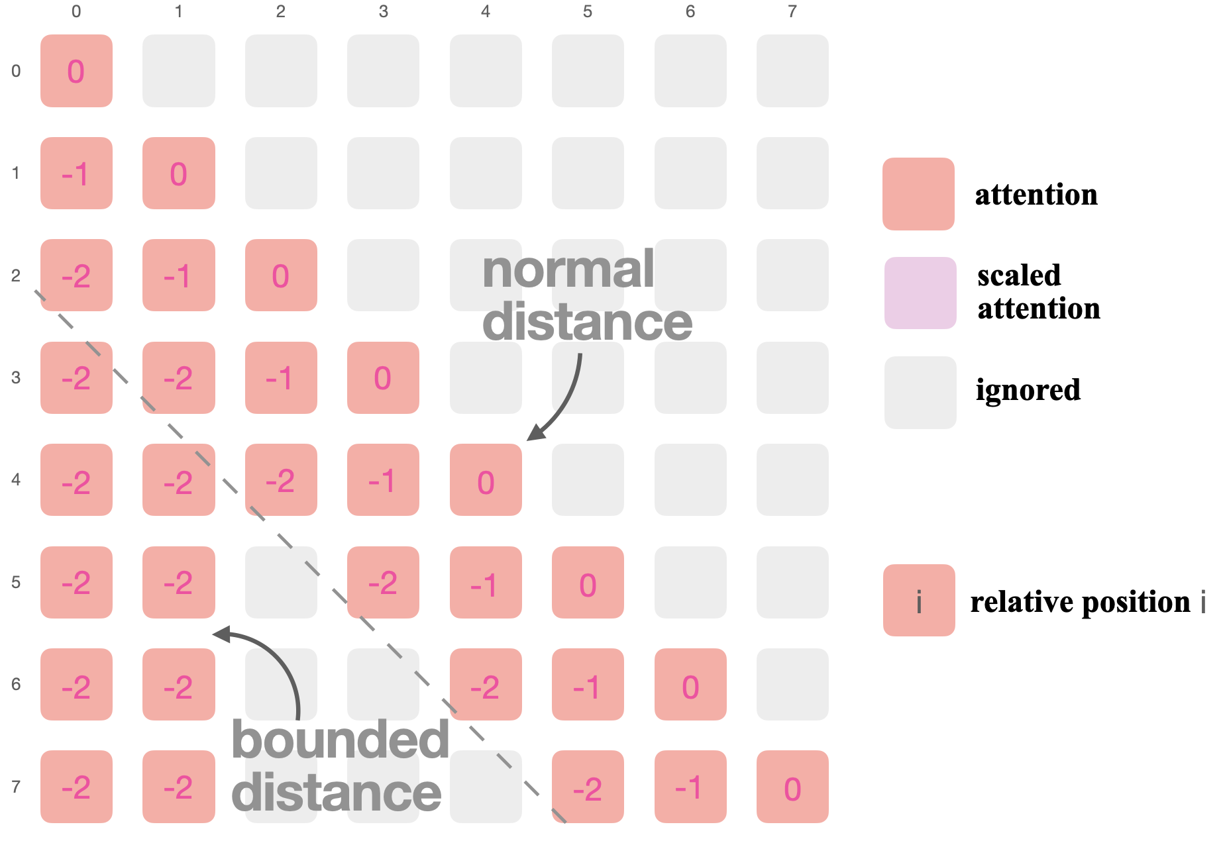
On-the-Fly Length Generalization: LM-Infinite
Advantages:
Plug-and-play, no fine-tuning needed.
Easy to implement
Compatible with various LLMs.
O(n) efficiency.

Slide 31
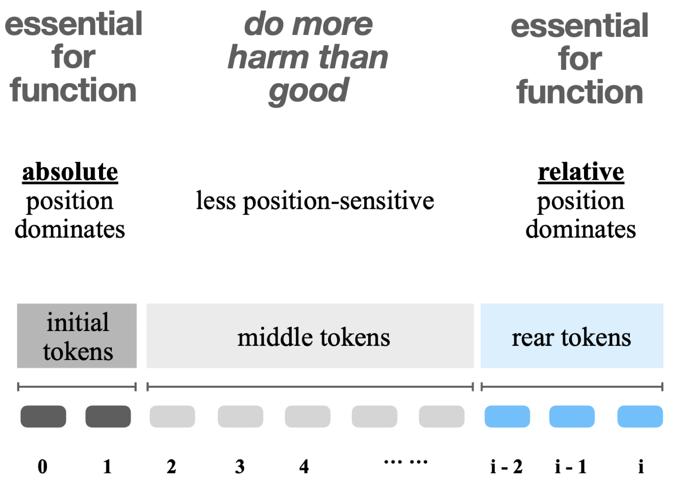
Conceptually Understanding Positions in LLMs

Slide 32
Evaluation: Perplexity
LM-Infinite flattens the perplexity curves of various LLMs.
Negative Log-Likelihood ≈ log(perplexity)

Slide 33
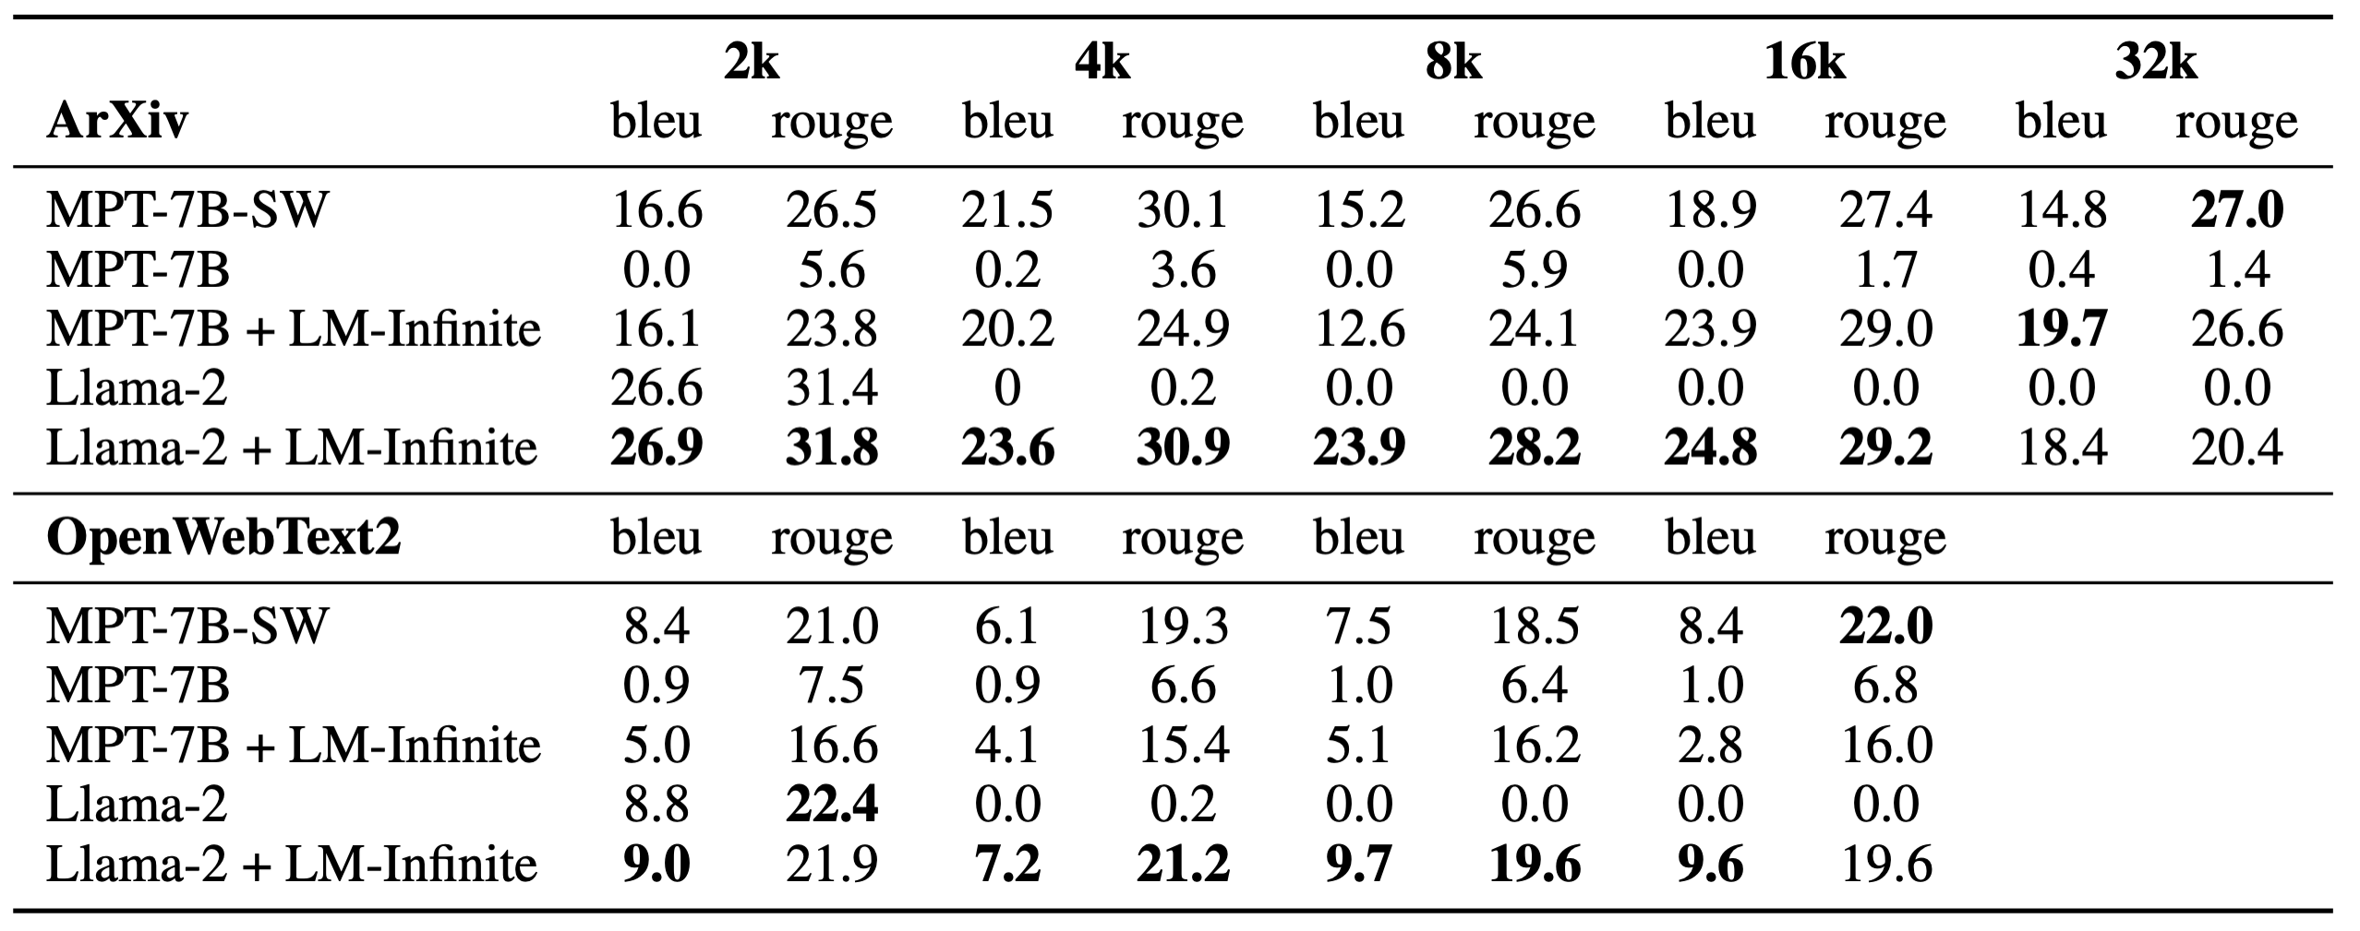
Evaluation: Generation Quality
LM-Infinite lets LLMs generate texts with higher quality after long context, superior or similar to their finetuned counterpart MPT-7B-SW.

Slide 34
Generation Comparison Examples
ArXiv Dataset (preprints)
OpenWebText2 Dataset (Reddit posts)
Vanilla LLaMA:
of this (of over-equary-her, and [( and, in the...cister '-- and an of the model to\n↵ by. by ..., this, by the. It, and it, 7. --(of an equist (of the.\nand to the [[[WNE (to. and for the (((de in the (for the andistile–c.\n-[de (for in an inc ort, ort (betness in >with (with, based (and (>~~such ((c of a or for the abstract as. of *.
LLaMA + LM-Infinite:
Kottwitz [@Kottwitz84a] had formulated the conjecture (\\[eq\\_intro:Kottwitz\\_formula\\]), but at the time no idea had yet been established on how to prove it.
This conjecture (\\[eq\\_intro:Kottwitz\\_formula\\]) involves some algebraic statements of automorphic forms which have an algebraic nature, but are only valid for automorphic forms (which are not holomorphic automorphic forms [@Kaplansky1966]), whose (abstract) objects are Galois extensions of $F$ and $\\bar{F}$.
Vanilla LLaMA:
the in that, of it and and \', " of the. of " of " of the pr of of of the of the of the [\n. of “ – s (1 ( of s of the " of quends of it &nd of trail of the, the &, 1. – a and at-and and and the " for on the is, core by " ( as (:: a. -\n. ( on its to “ is a, ( on, th is of all but". ".. in the, in the the the and in the for the.
LLaMA + LM-Infinite:
It develops gradually. For Piaget, the cognitive originates in experience as it is subjected to structure : i.e. as it is structured, ordered and transformed.
the first stage, the "sensorial stage", structures are formed and integrated based on perception. These structures are built by organic, biological and psychic transformations, which lead to experience.

Slide 35
Limitations of Existing Methods vs. Our Solutions
Limitations of Existing methods 1: Can only take single aspect as control for a black-box model
Our Solution 1: Design our own theoretically grounded, simple and transparent model to accept multiple dimension composition
Limitations of Existing methods 2: After the length exceeds training lengths, LLMs start to generate nonsense texts.
Our Solution 2: Design a lambda-shaped attention to generate infinite length sequences
Limitations of Existing methods 3: Cannot capture profile of “lurkers” (who lack explicit profiles or historical activities)
Our Solution 3: Belief-Augmented Social Network (BASN) on top of the current social network and use graph modeling method to propagate information to predict responses from lurkers

Slide 36
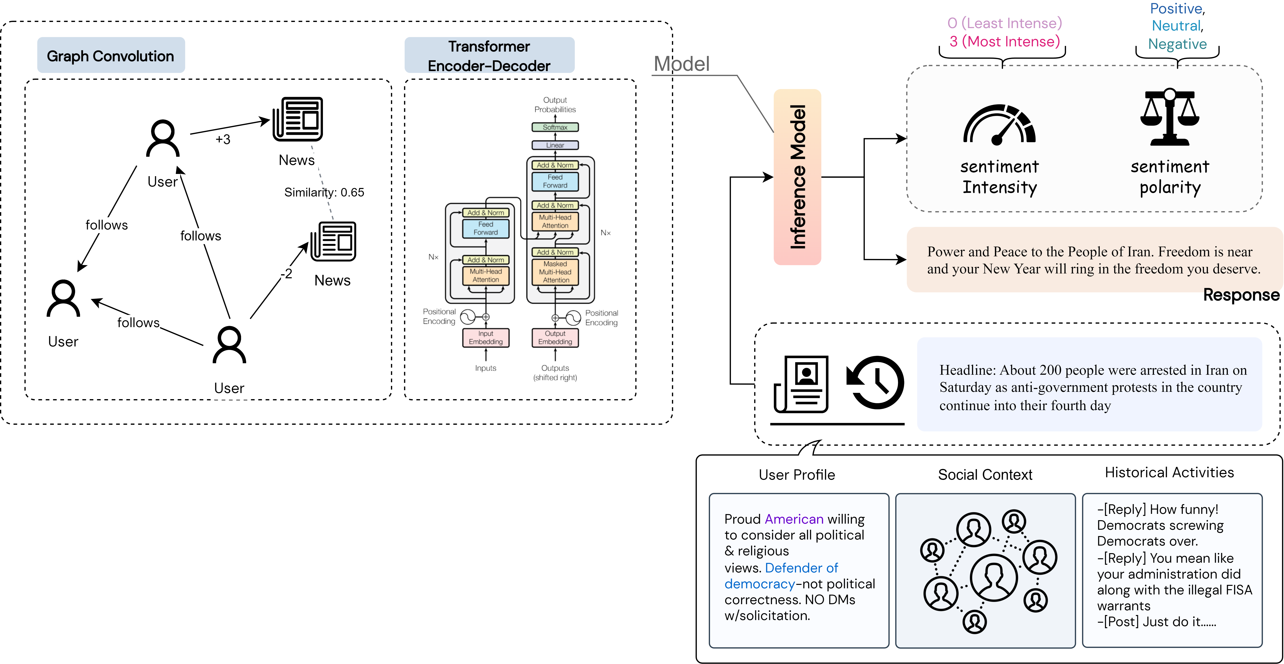
Personalized Response Prediction for Risk Management [Sun et al., ACL2023; EMNLP2023]
Task and Goals
Given a target user’s profile (e.g., profile, historical activities, social network) and a news media message, predict the user’s response in terms of sentiment intensity, sentiment polarity, and natural language text.
allow content producers to estimate the effect on different communities and revise unreleased messages to prevent unexpected bad outcomes such as social conflict and moral injury
enable many interesting applications in the analysis of social network groups and their opinions, such as the discovery of controversial response propagation and information campaigns

Slide 37
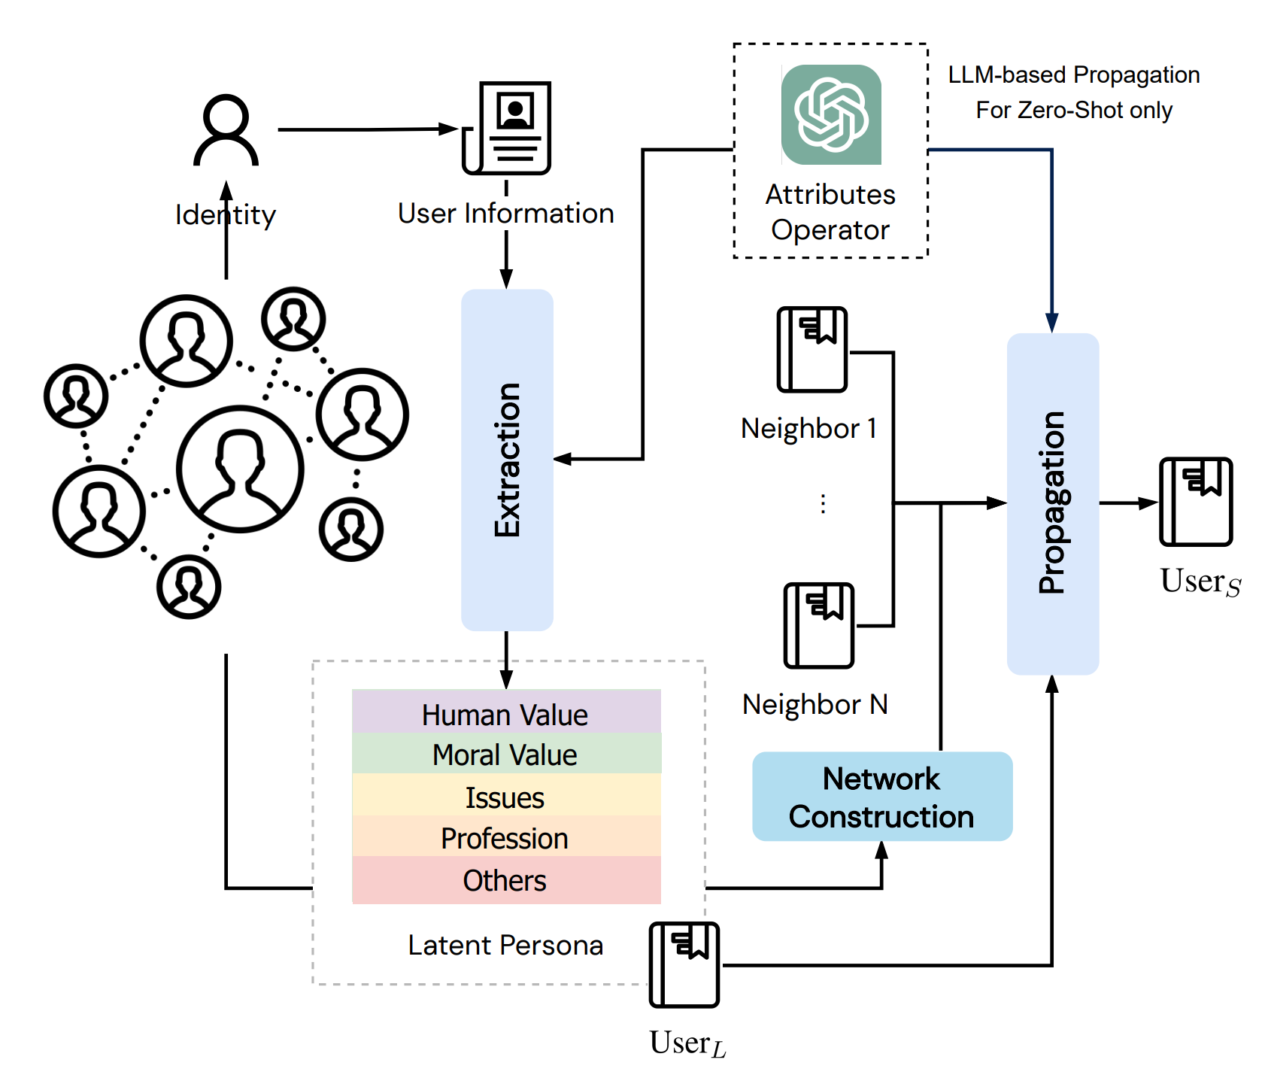
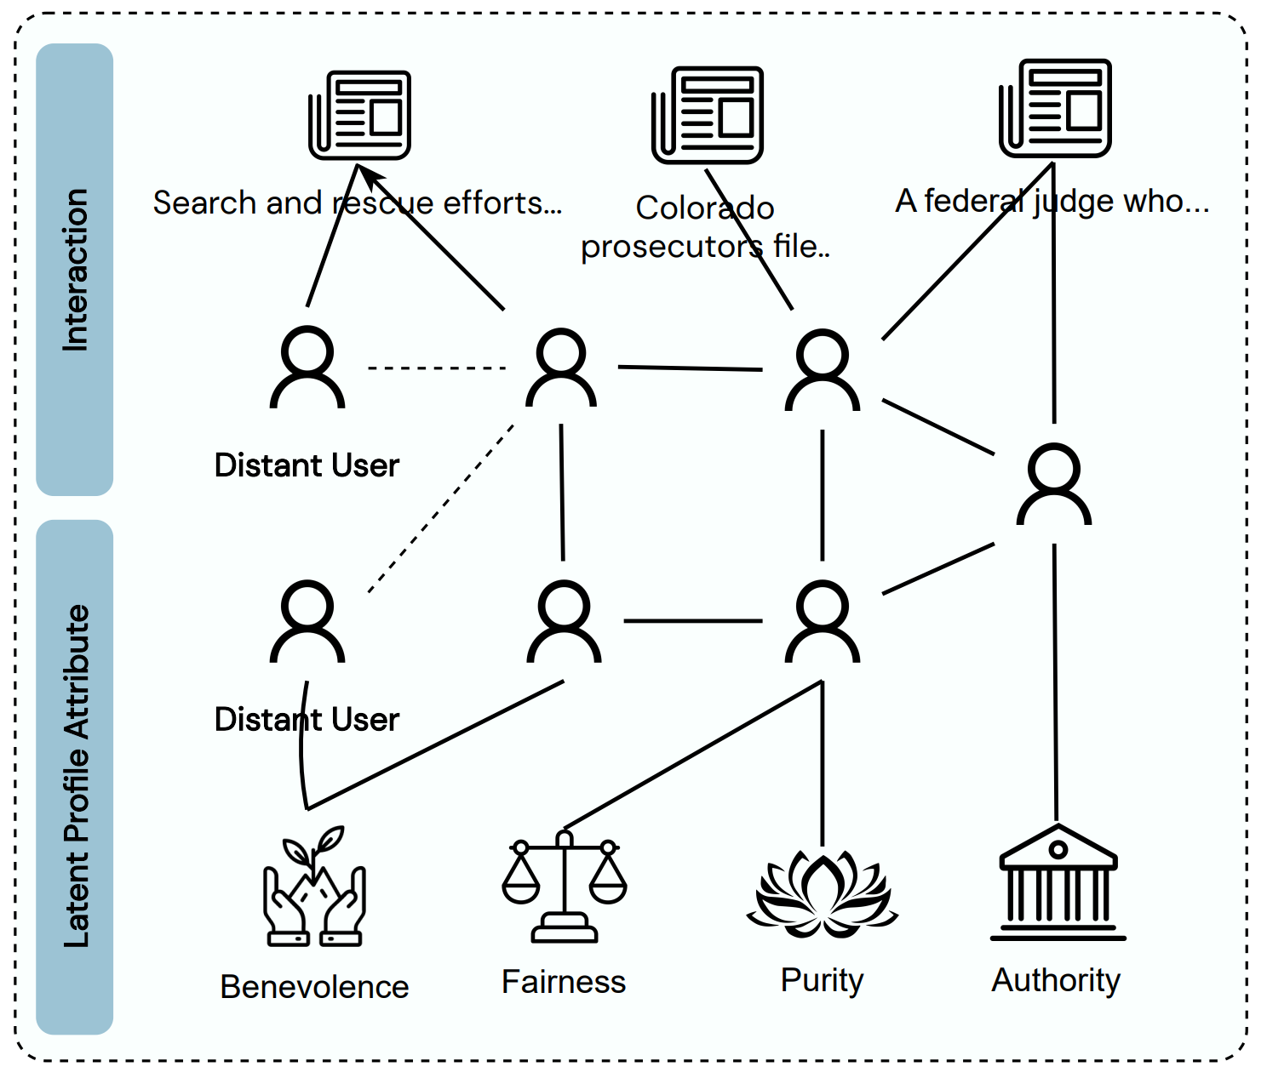

Capturing “Lurkers”
Roughly half of U.S. adults who use Twitter (49%) post fewer than five tweets per month; 97% of all tweets are produced by only the most active 25% of users
We construct a Belief-Augmented Social Network (BASN) on top of the current social network and use graph modeling method to propagate information to predict responses from lurkers (who lack explicit profiles or historical activities)

Slide 38
Results on Sentiment Polarity and Intensity Prediction
We construct a new social network dataset with 18,634 users and 1,744,664 edges.
Our framework outperforms the SOTA baselines in all metrics

Slide 39
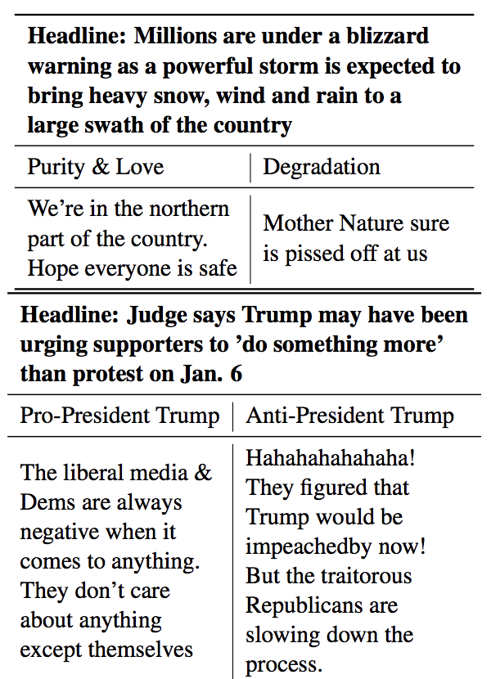
Case Studies
We test the method on Zero-Shot (no training data), Lurker (users having a history length shorter than 85% of the history lengths in the dataset), and Unseen users (users who never appeared in the train set)
The social network structure provides valuable information in zero-shot settings (in the format of prompt).
Our method is particularly effective on lurker and unseen cases.

Slide 40
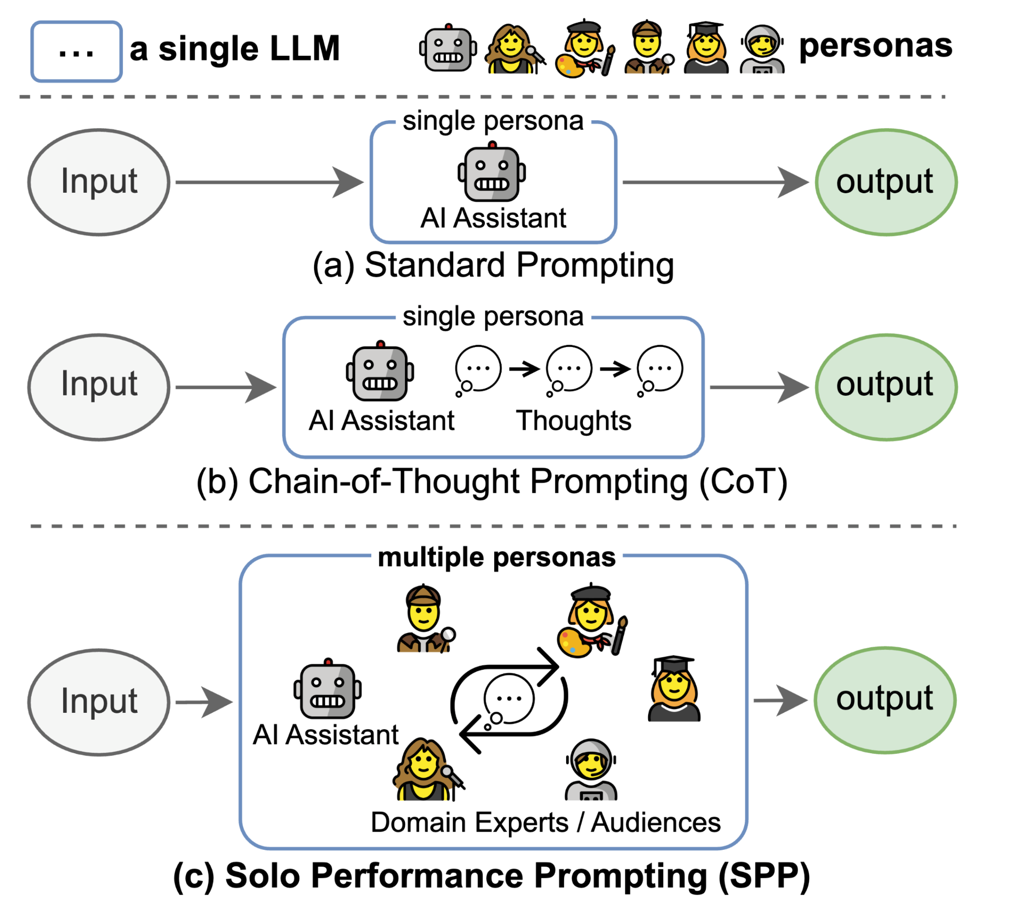
Using a single LLM to simulate multiple personas and initiate a multi-turn self-collaboration to solve both knowledge-intensive and reasoning-intensive tasks [Wang et al., 2023]
Goal: build a general task-solving agent (LLM-based in this work)
Human intelligence thrives on the concept of cognitive synergy, where collaboration among different minds yield superior outcomes
SPP transforms a single LLM
into a cognitive synergist that dynamically identifies personas and engages in multi-turn self-collaboration to solve general tasks

Slide 41
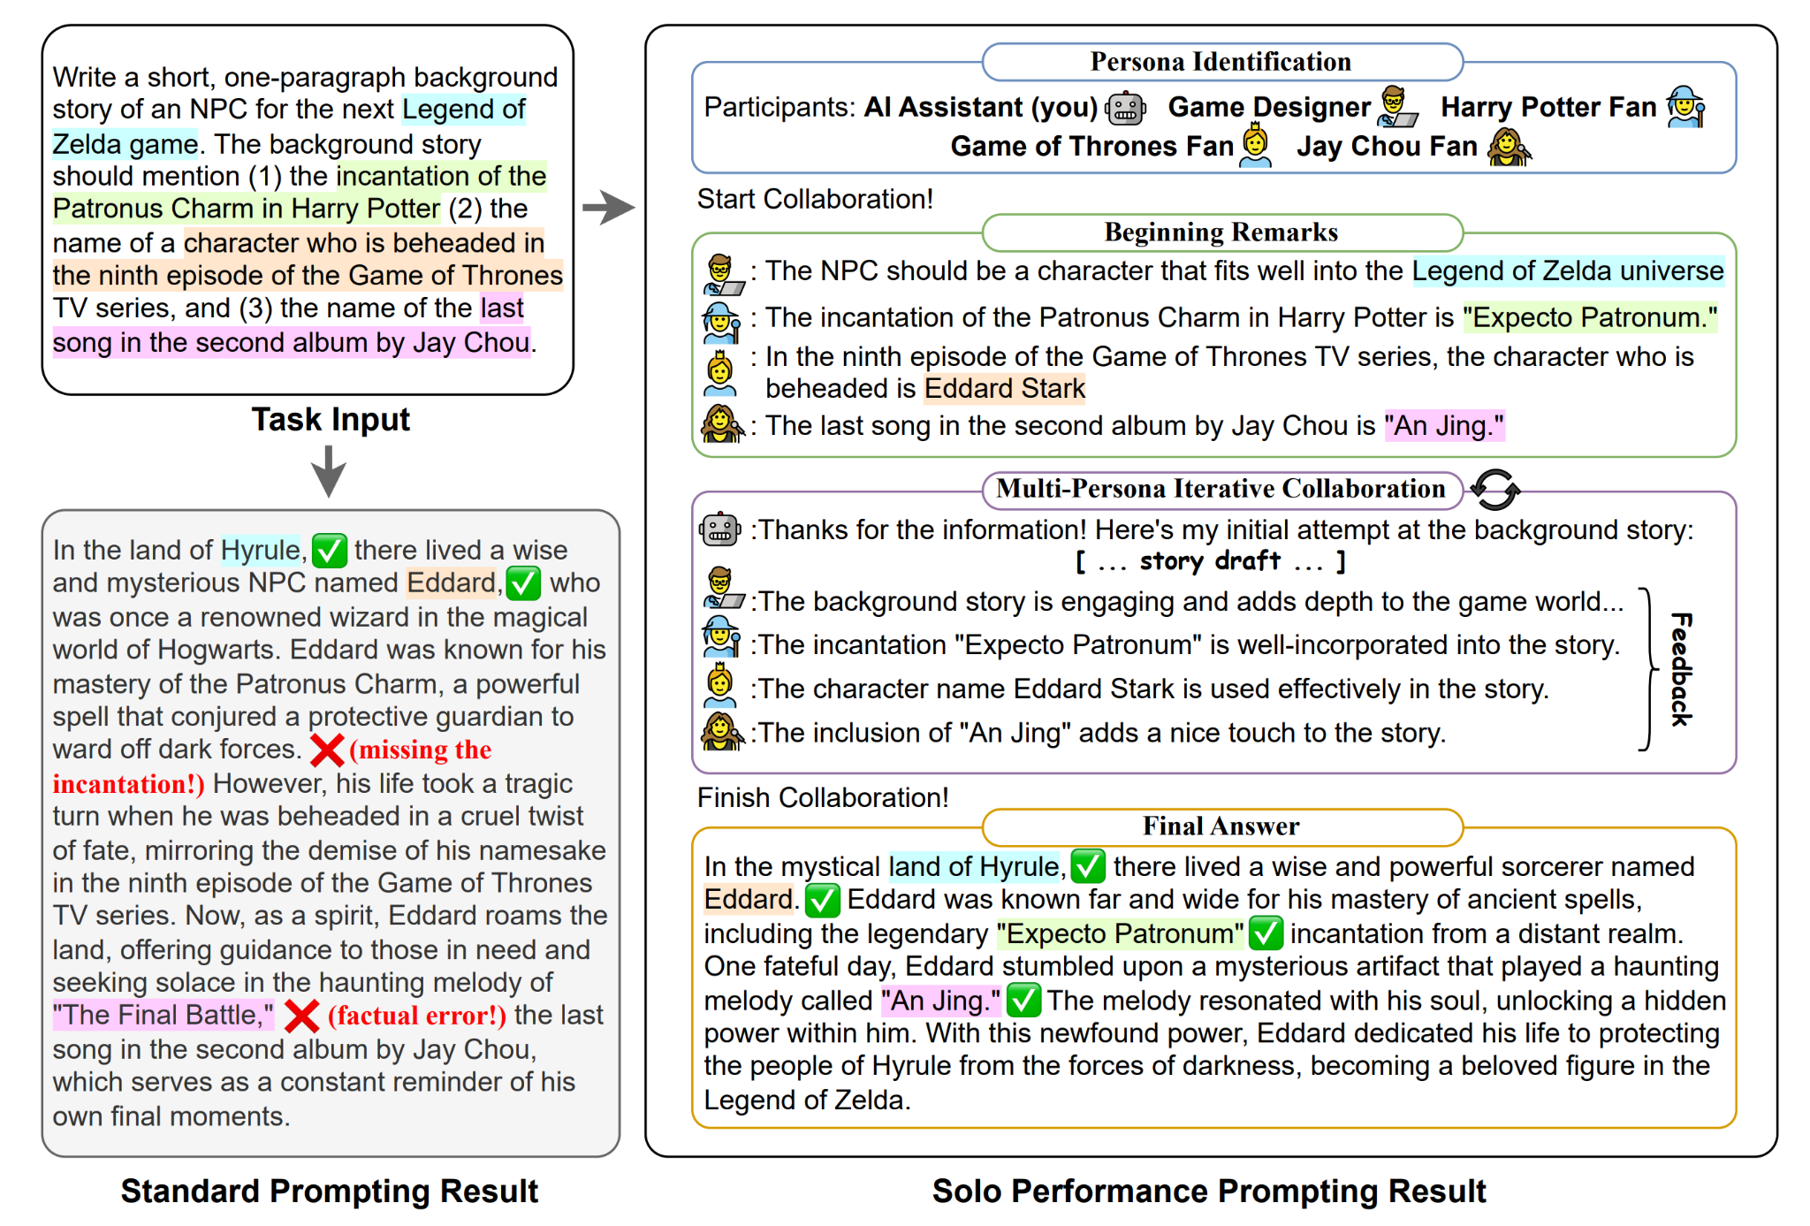
Our Idea: Using a single LLM to simulate multiple personas and initiate a multi-turn self-collaboration to solve both knowledge-intensive and reasoning-intensive tasks

Slide 42
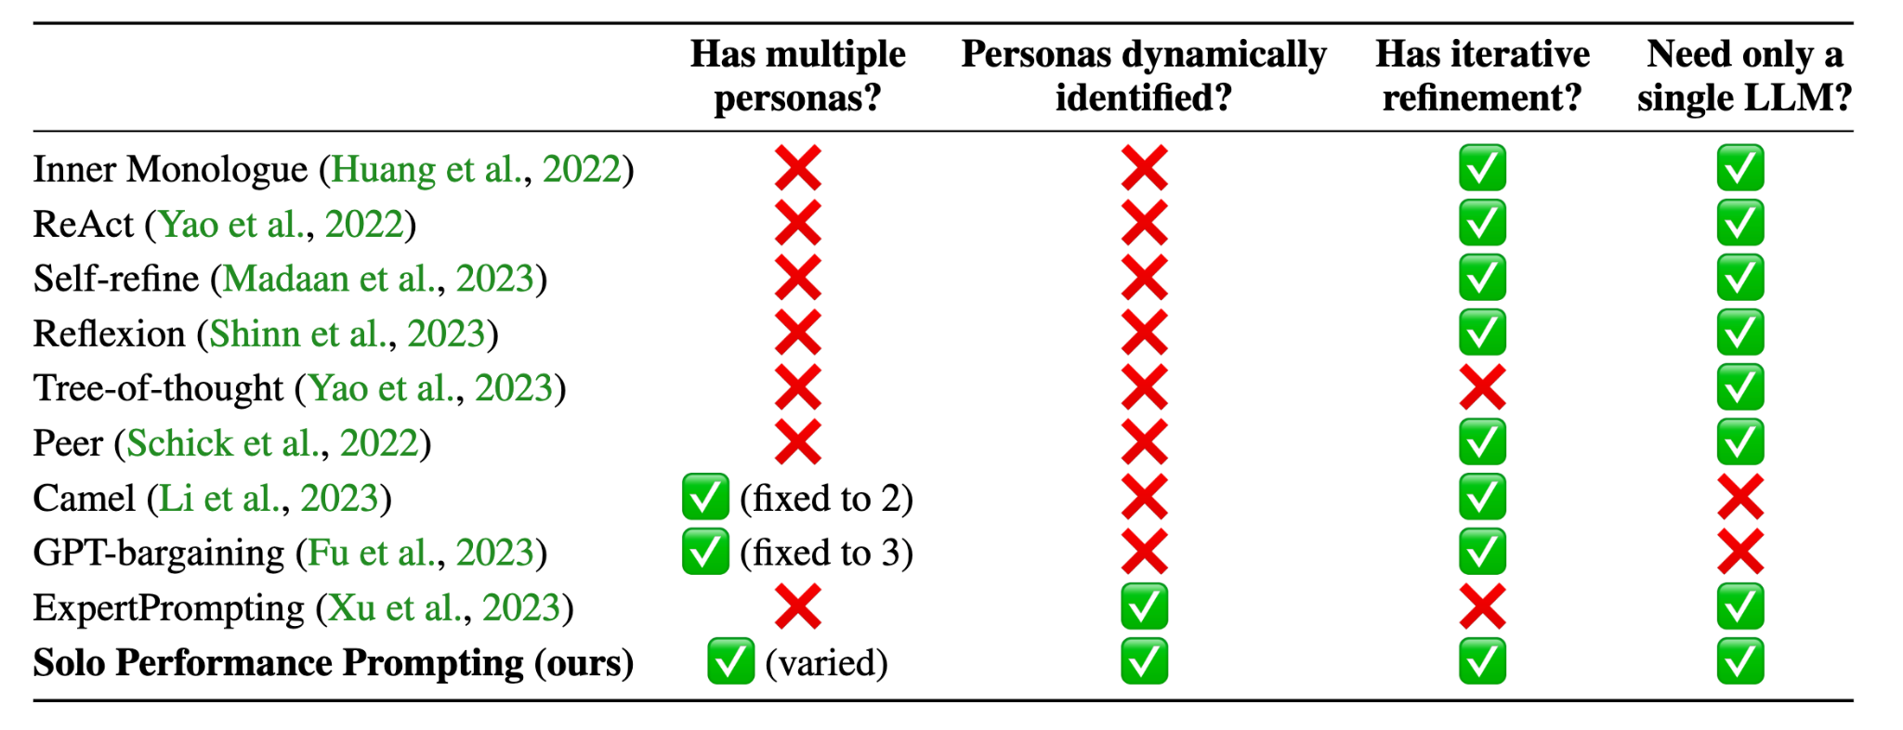
Our Idea: Using a single LLM to simulate multiple personas and initiate a multi-turn self-collaboration to solve both knowledge-intensive and reasoning-intensive tasks
Comparison with other related work

Slide 43
Experiments
Knowledge-intensive task: Trivia Creative Writing
Knowledge+Reasoning task: Codenames Collaborative
Reasoning-intensive task: Logic Grid Puzzle

Slide 44
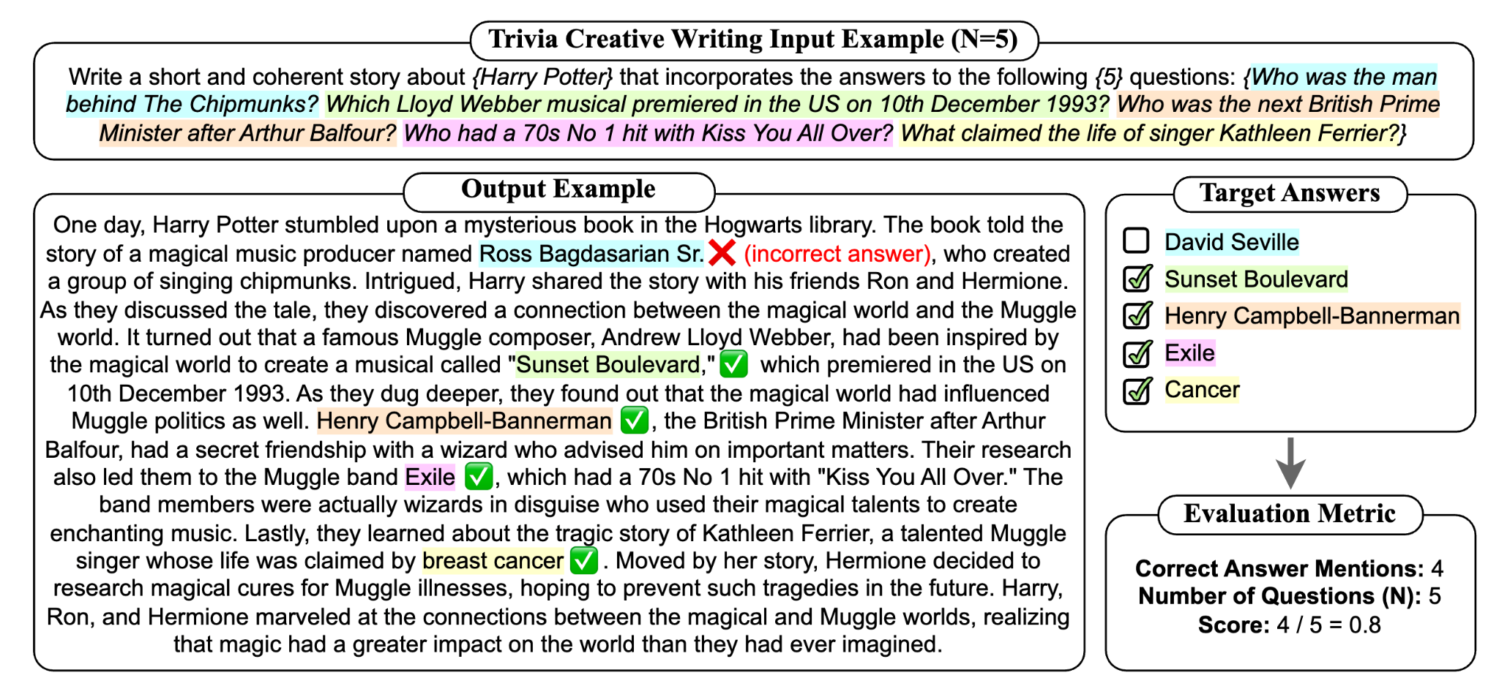
Experiments: Knowledge-intensive task: Trivia Creative Writing

Slide 45
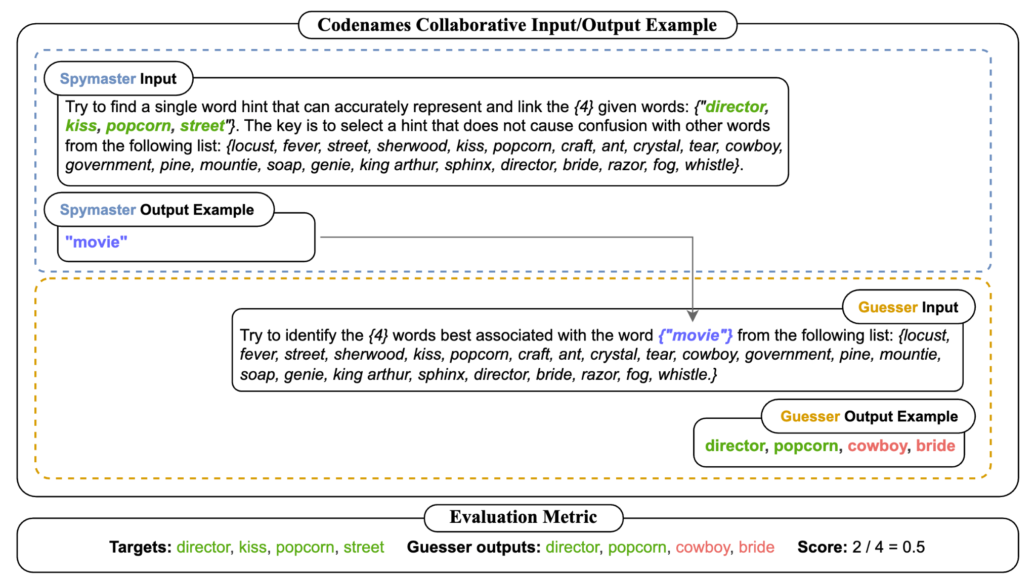
Experiments: Knowledge+Reasoning task: Codenames Collaborative

Slide 46
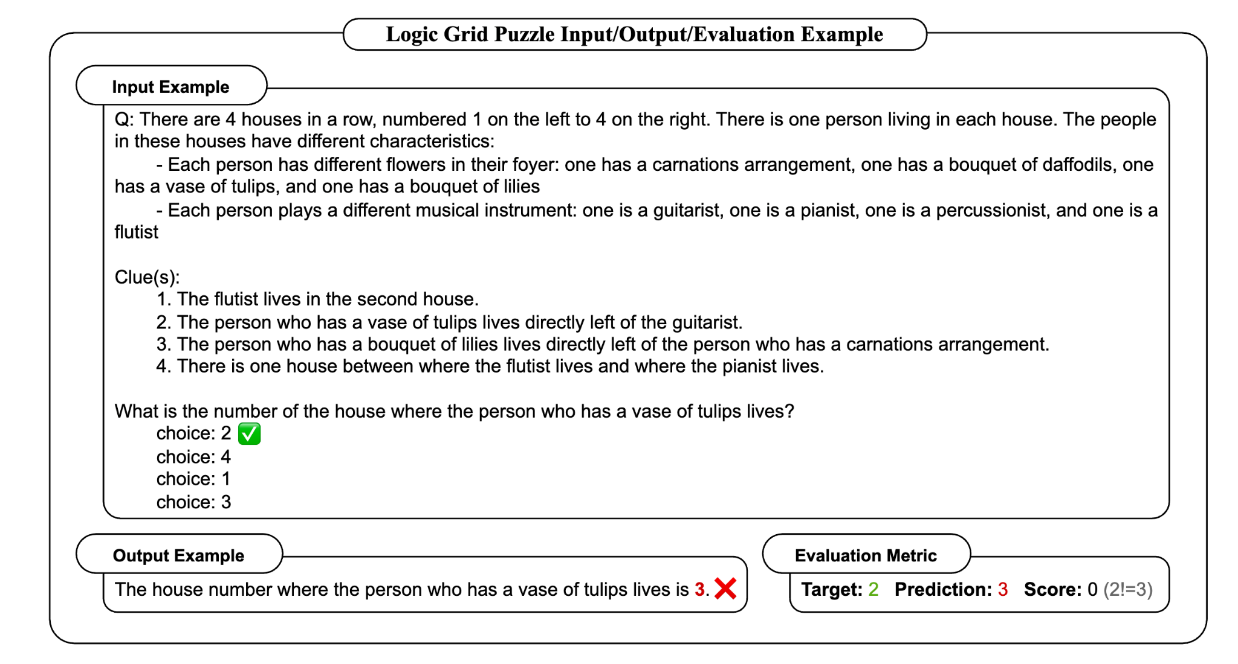
Experiments: Reasoning-intensive task: Logic Grid Puzzle

Slide 47
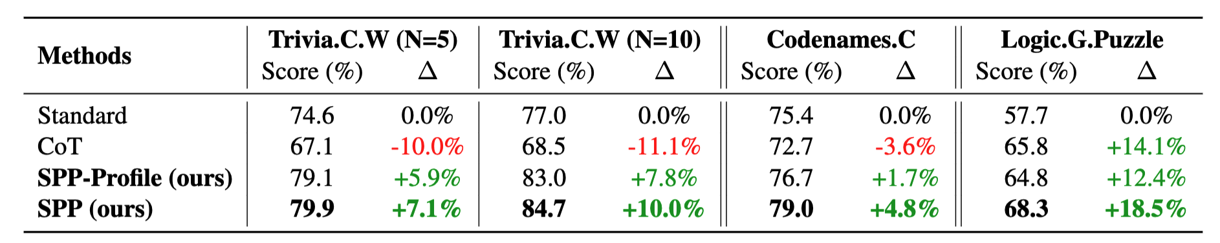
Results:
SPP (w/ GPT-4) brings significant improvements on both knowledge-intensive and reasoning-intensive tasks

Slide 48
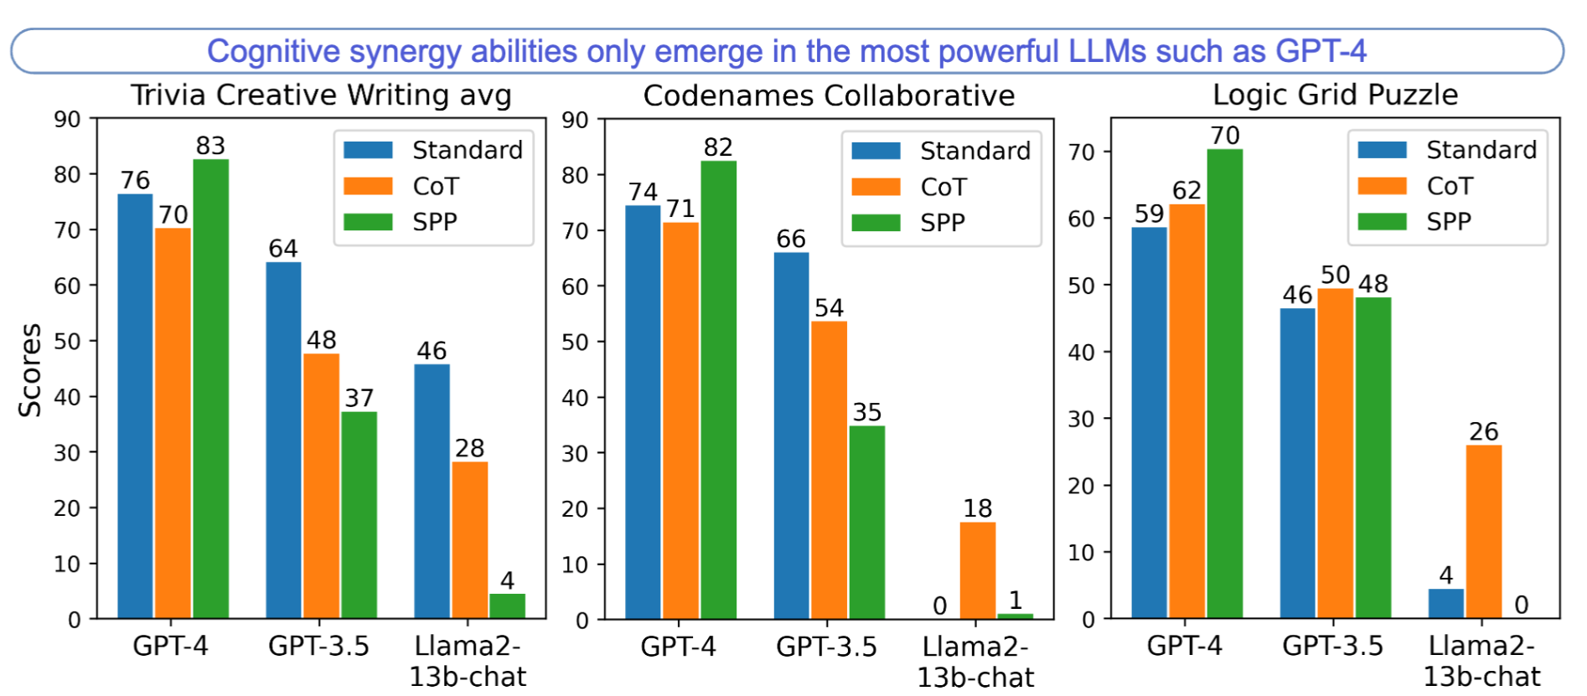
Analysis: Discovery of the emergent behavior
Cognitive synergy abilities only emerges in LLMs with a certain level of instruction-following capability (e.g., GPT-4)

Slide 49
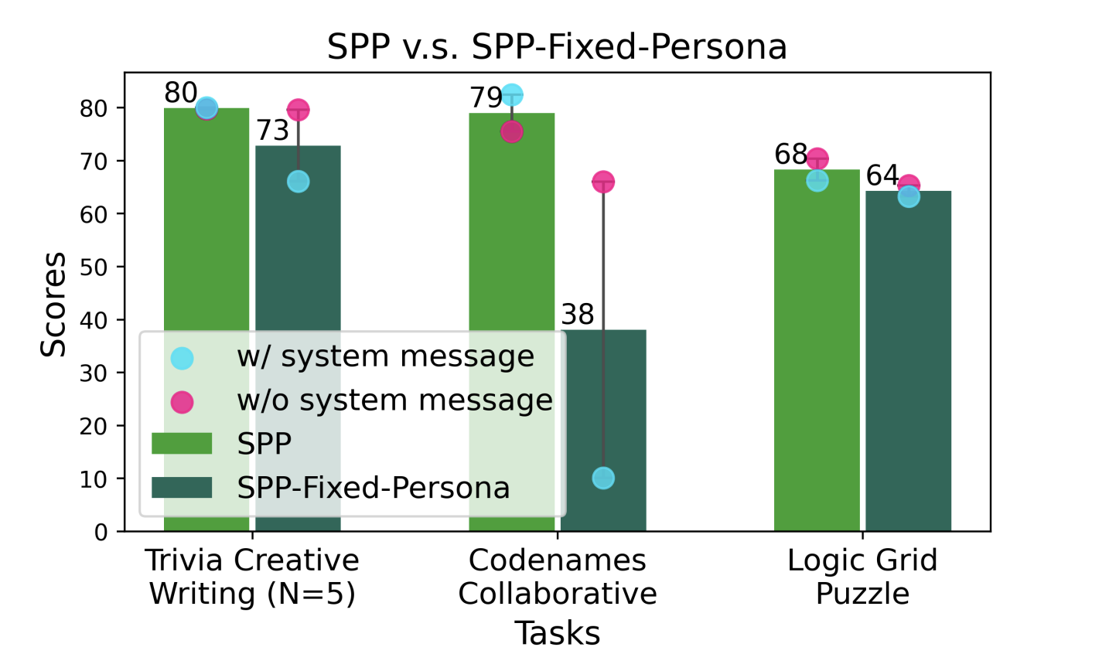
Analysis: Dynamic personas v.s. Fixed personas
Letting the model to dynamically assign personas is important

Slide 50
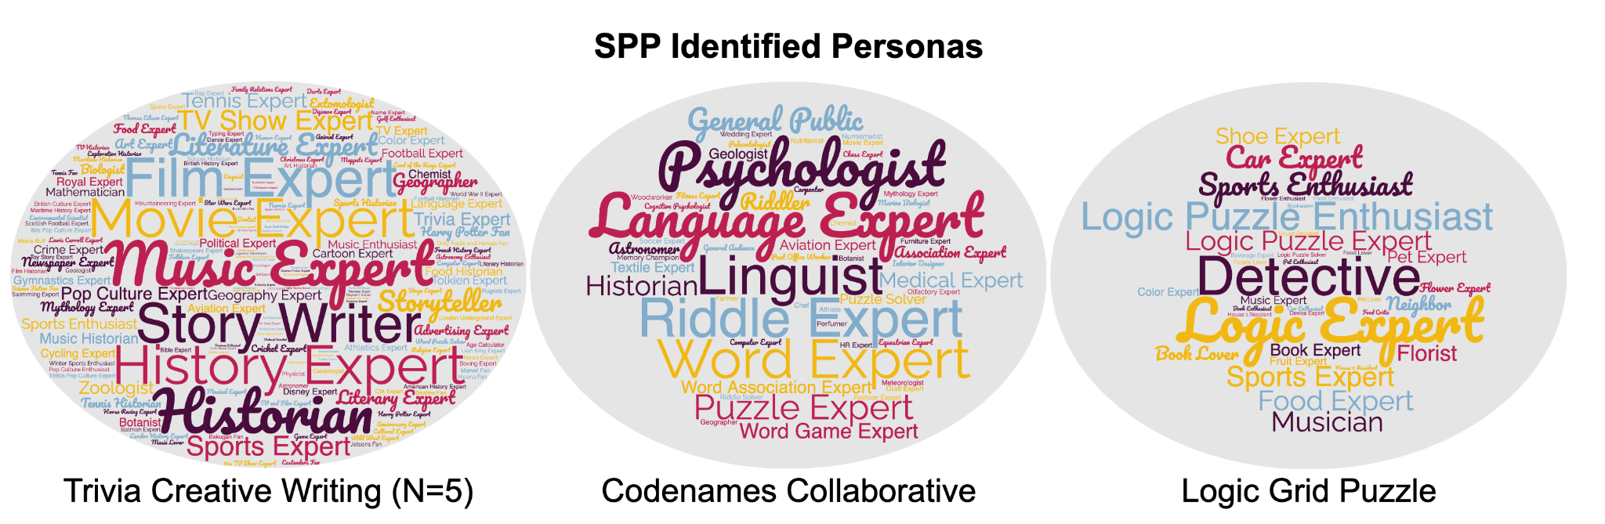
Analysis: Visualization of the Persona Identification (GPT-4)

Slide 51
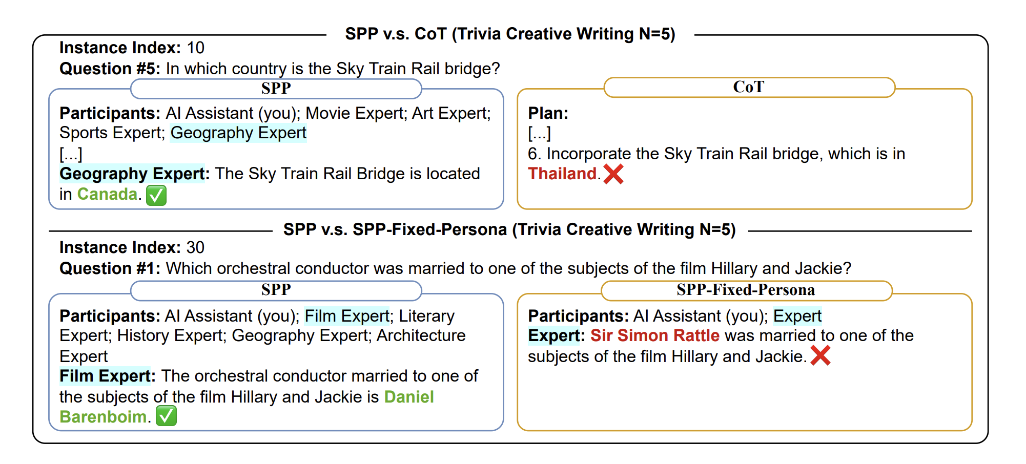
Qualitative Examples:

Slide 52
Publicly Available Demos, Systems and Resources
Stance Controlled Generation:
https://incas.csl.illinois.edu/blender/INCAS_Framing_(LM_Stance_Re-switching)
Stance Detection:
https://incas.csl.illinois.edu/blender/INCAS_Political_Stance_Classification

Slide 53
Representative Publications
@inproceedings{lminfinite2023, title = {LM-Infinite: Simple On-the-Fly Length Generalization for Large Language Models}, author = {Han, Chi and Wang, Qifan and Xiong, Wenhan and Chen, Yu and Ji, Heng and Wang, Sinong}, year = {2023}, booktitle = {arxiv}}
@inproceedings{LMSwitch2023, title = {LM-Switch: Lightweight Language Model Conditioning in Word Embedding Space}, author = {Han, Chi and Xu, Jialiang and Li, Manling and Fung, Yi R. and Sun, Chenkai and Abdelzaher, Tarek and Ji, Heng}, year = {2023}, booktitle = {arxiv}}
@inproceedings{silentmajority2023, title = {Decoding the Silent Majority: Inducing Belief Augmented Social Graph with Large Language Model for Response Forecasting}, author = {Sun, Chenkai and Li, Jinning and Fung, Yi and Chan, Hou Pong and Abdelzaher, Tarek and Zhai, ChengXiang and Ji, Heng}, year = {2023}, booktitle = {Proc. The 2023 Conference on Empirical Methods in Natural Language Processing (EMNLP2023)}}
@inproceedings{responseprediction2023, title = {Measuring the Effect of Influential Messages on Varying Personas}, author = {Sun, Chenkai and Li, Jinning and Chan, Hou Pong and Zhai, ChengXiang and Ji, Heng}, year = {2023}, booktitle = {Proc. The 61st Annual Meeting of the Association for Computational Linguistics (ACL2023)}}

