Slide 1
Language and Vision
Heng Ji
Slides from Manling Li et al., CVPR2023 Tutorial

Slide 2
Machines learn semantics through multi-sensory interactions
🌎
Multi-sensory Interaction
🧠
👀
🧠
Physical World
Knowledge
LLM
VLM
External World
Machine Learning Models
🦾
Notes:
Machines are mimicing this process, wants to learn about physical world knowledge from multisensory interactions.

Slide 3
Machines learn semantics through multi-sensory interactions
📜
🎬
🖼️
Static Internet-Scale Datasets
🌎
Multi-sensory Interaction
Maximum Likelihood
🧠
👀
🧠
Physical World
Knowledge
LLM
VLM
External World
Machine Learning Models
🦾
Notes:
A lot of exsiting models use datasets of iamges, videos, audio, text to train large-scale langauge models and vision0lanaguge models.
So the highlevel goal is to inject knowledge of the physical world into these brains

Slide 4
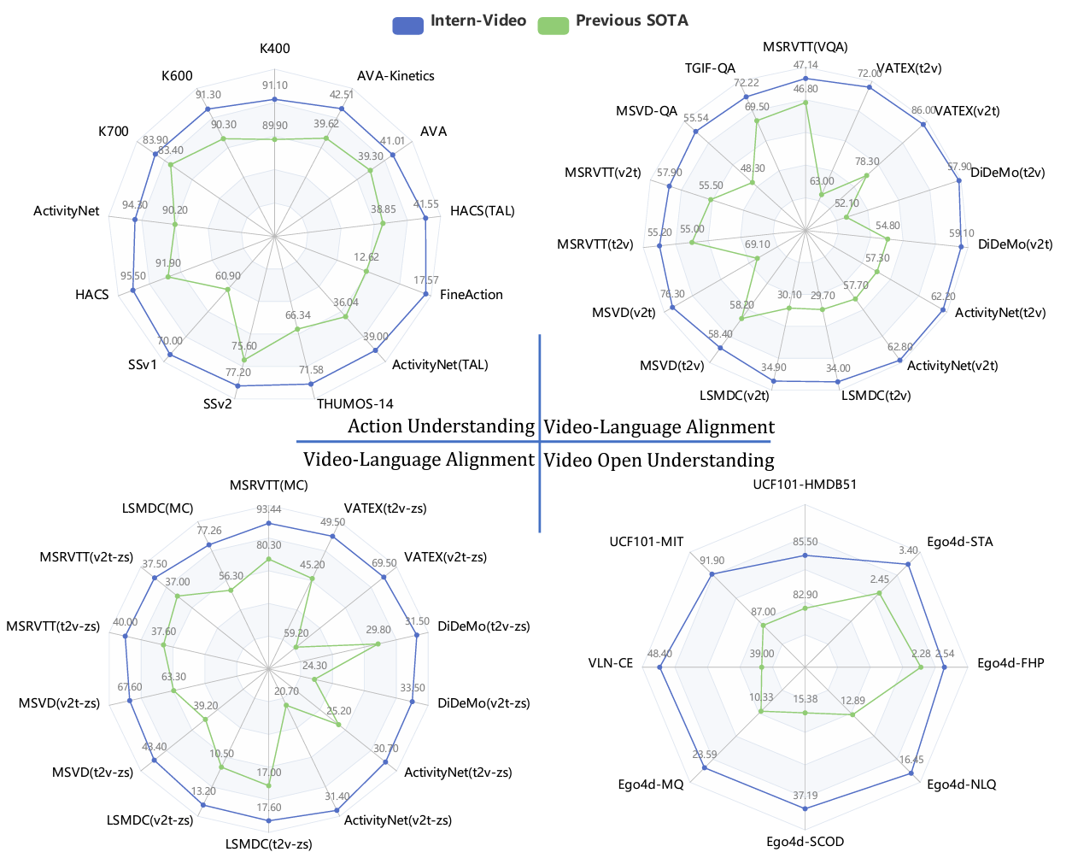
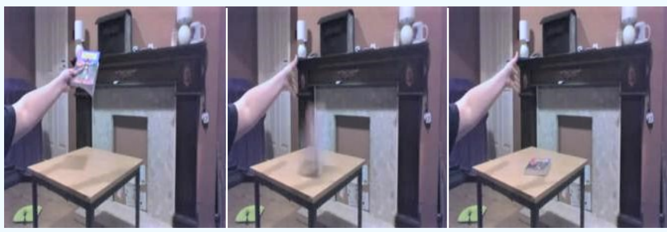
Video: A “Visual Recording” of World State Changes
🌎
proxy
“Book falling like a rock”
InternVideo (2023)
Video-Language Datasets
Video-Language Foundation Models
Where can we learn such physical world knowledge without interactive data 💲💲💲?
Notes:
For example, we use the video like book falling to learn about the physical world, we have achieved great success, we have a lot vision0langauge foundation models, they can performance well on a large number of benchmarks.

Slide 5
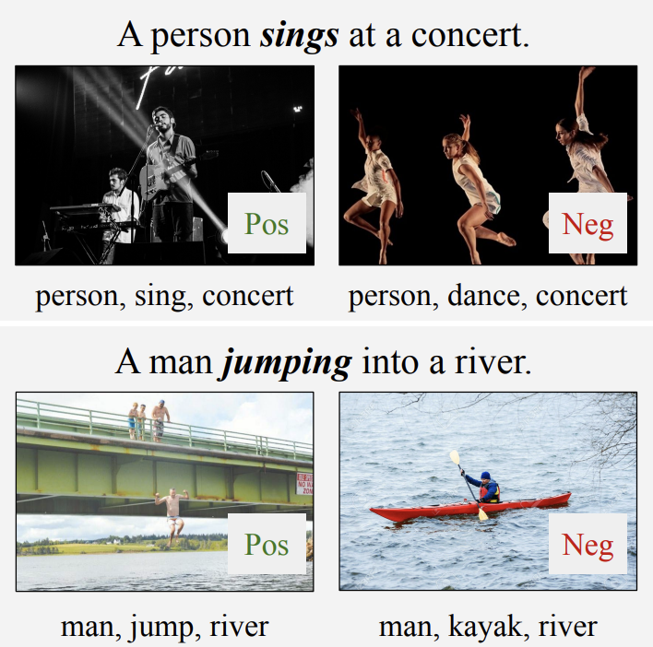
Existing V+L Models
Current models rely on object-centric abilities as a shortcut for V+L understanding.
Model | Verb Accuracy
MMT | 60.8
Merged–MMT | 60.7
Lang–MMT | 64.5
Image–MMT | 59.7
Low Verb Performance
“Probing Image–Language Transformers for Verb Understanding” Lisa Hendricks, et al. (arXiv 2021)
Notes:
however, such a good perfmence has been proved to take many shortcuts. For example, When we probe the verb understanding ,the performance is not much higher than a random prediction.

Slide 6
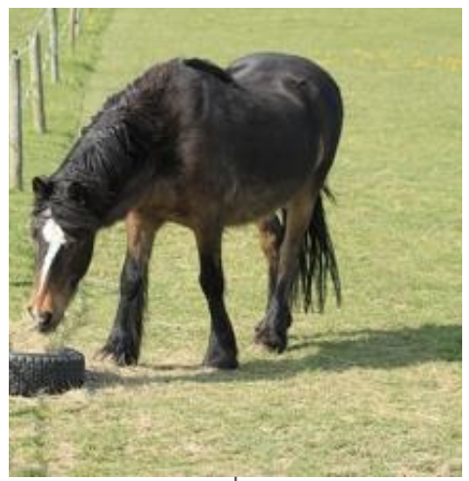
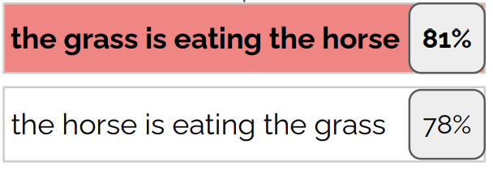
Existing V+L Models
Current models rely on object-centric abilities as a shortcut for V+L understanding.
BLIP
Bags of Words
“When and why vision-language models behave like bags-of-words, and what to do about it” Mert Yuksekgonul, et al. (ICLR 2023)
Notes:
there are recent research showing that vision-l models behave like bags of words, like in this example, the model cannot distinguish the grass is earing the horse or the horse is earing the grass,

Slide 7
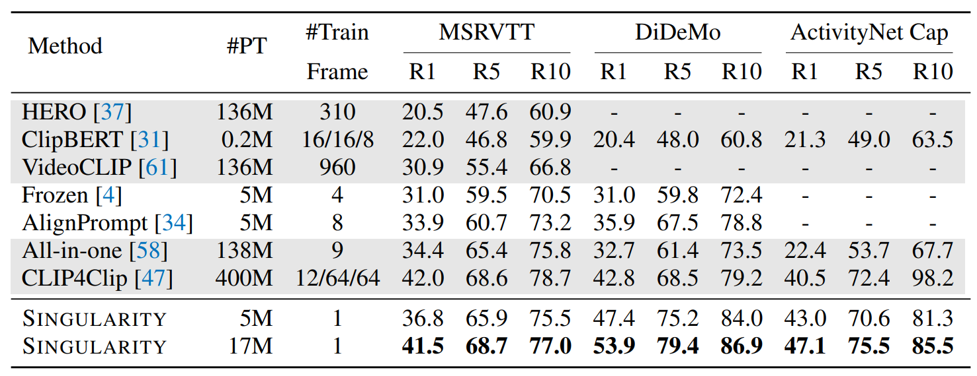
Existing V+L Models
Current models rely on object-centric abilities as a shortcut for V+L understanding.
Single-Frame
“Revealing Single Frame Bias for Video-and-Language Learning” Jie Lei, et al. (ACL23)
Notes:
also, many video language benchmarks can be solved by looking at a single frame, so the temporal dynamics have been ignored.

Slide 8
Key Idea: Language As Supervision
Language Ability
Complex Semantic Structure
Reasoning / Planning
Complex Situation
Long-Horizon Planning
Surface
Event / Action Semantics
Temporal Dynamics
→
Deep
7
natural language “proofs” of hypotheses,
paving the way for
explainable textual reasoning.
Notes:
To solve these challenges, our key idea is to borrow ability from langauge space. The major motivation is that langauge is especailly good at describing complex semantics strucutres, and also has been proved to be good at long –distance plannign tasks.

Slide 9
Towards Situational Understanding
Language Ability
Complex Situation
Long-Horizon Planning
Surface
Event / Action Semantics
Temporal Dynamics
→
Deep
7
natural language “proofs” of hypotheses,
paving the way for
explainable textual reasoning.
Notes:
With this key idea, now let us dive into the first part of event semantics capturing.

Slide 10
Architecture of Vision-Language Pretraining
How? Vision-language pre-training by vision-language pairs
cross-media alignment
vision
text

Slide 11
Architecture of Vision-Language Pretraining
How? Image-text pre-training by image-text pairs
cross-media alignment
vision
text
Sparse features (token, entity, parsing,..)
Continuous features (Transformer, ..)

Slide 12
Architecture of Vision-Language Pretraining
How? Image-text pre-training by image-text pairs
cross-media alignment
vision
text
Sparse features (token, entity, parsing,..)
Continuous features (Transformer, ..)
Sparse features (object, scene graphs,..)
Continuous features (CNN, ViT, ..)

Slide 13
Typical Loss: Self-supervised in Vision
Contrastive Learning
large batch size required
data hungry
hard example sensitive
Generative (Masked Prediction)
Masked object prediction
Masked feature regression

Slide 14
Self-supervision in Vision: Contrastive Learning
Contrastive Learning
large batch size required
data hungry
hard example sensitive
Images from original authors

Slide 15
Typical Loss: Self-supervised in Vision
Contrastive Learning
large batch size required
data hungry
hard example sensitive
Generative (Masked Prediction)
Masked feature regression
Masked object prediction

Slide 16
Self-supervision in Vision: Masked Language Model
Split an image into patches
Slides from original authors

Slide 17
The Goal of Vision-Language Pretraining
How? Image-text pre-training by image-text pairs
cross-media alignment
vision
text
ITC
ITM
MLM
LM
Sparse features (token, entity, parsing,..)
Continuous features (Transformer, ..)
Sparse features (object, scene graphs,..)
Continuous features (CNN, ViT, ..)

Slide 18
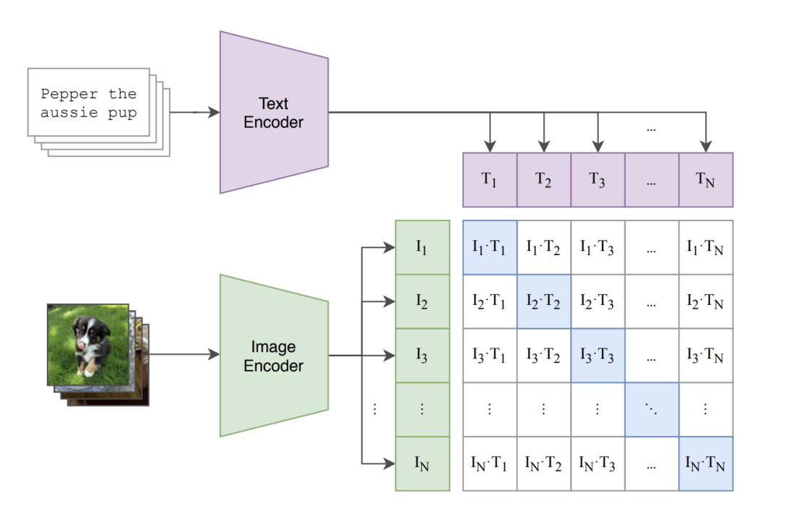
Typical Loss: Image-text contrastive (ITC)
Image-text contrastive (ITC) loss
A Simple Framework for Contrastive Learning of Visual Representations, 2020
Momentum Contrast for Unsupervised Visual Representation Learning, 2019
Align before Fuse: Vision and Language Representation Learning with Momentum Distillation, 2021 UFO: A UniFied TransfOrmer for Vision-Language Representation Learning, 2021

Slide 19
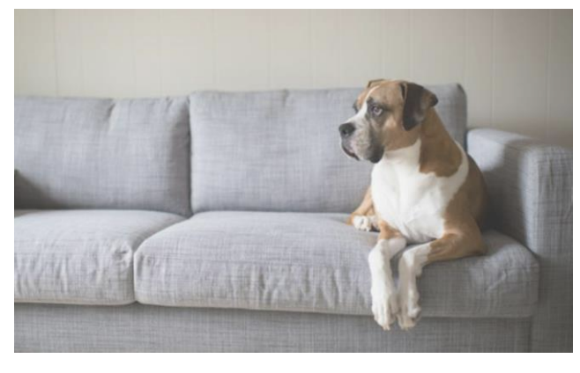
Typical Loss: Image-text matching (ITM) loss
https://datarelease.blob.core.windows.net/tutorial/VLP-Tutorial_2022/image_text_part1.pdf

Slide 20
Typical Loss: Masked language modeling (MLM) loss
https://datarelease.blob.core.windows.net/tutorial/VLP-Tutorial_2022/image_text_part1.pdf

Slide 21
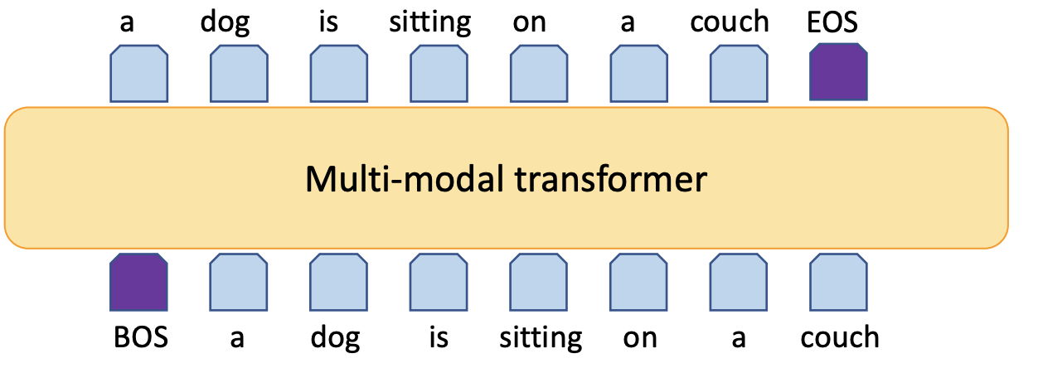
Typical Loss: Language modeling (LM) loss
https://datarelease.blob.core.windows.net/tutorial/VLP-Tutorial_2022/image_text_part1.pdf

Slide 22
Why Knowledge?
Model Knowledge is the knowledge embedded and encoded in models.
Text | Vision
Entity | Object
Relation | Scene Graph
Event | Activity/Situation
Procedural Knowledge
language model
V+L model
Common-sense Knowledge
External KB
Knowledge
Factual Knowledge
Common Knowledge
Model Knowledge
Explicit Knowledge
Implicit Knowledge
Notes:
add DB logos
instance knowledge
pattern knowledge
add attribute
add afffordance

Slide 23
Moving towards…
On the model side, adding knowledge can guide the model where to focus.
Structured knowledge (such as event graph structure)
Abstract word understanding (such as verb, adjectives, etc)
On the data side, knowledge is useful in the following ways:
In-context prompt
Data augmentation
Data selection

Slide 24
Factual Knowledge
Compared to raw data, knowledge is important and useful information.
Text | Vision
Entity | Object
Attribute | Attribute
Relation | Scene Graph
Event | Activity/Situation
Procedural Knowledge
language model
V+L model
Common-sense Knowledge
External KB
Internal Knowledge
Knowledge
External Knowledge
Factual Knowledge
Common Knowledge
Model Knowledge

Slide 25
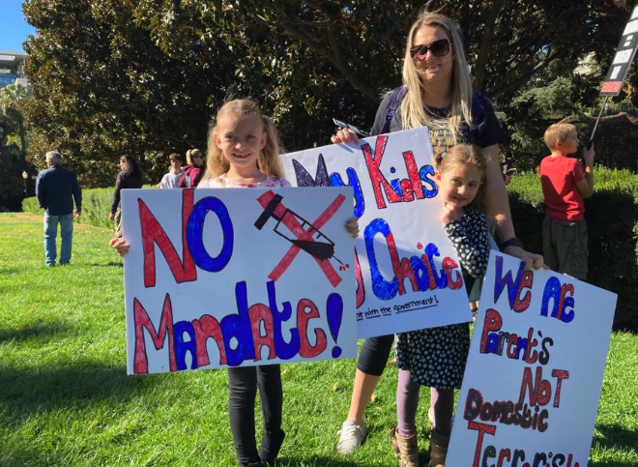
What is “Event” Knowledge?
Why Deep Semantics?
Image Event Structure
What happened?
Notes:
before that, let us first define what is event knowleege. Event is a terminology borrowed from NLP, we adopt this terminplogy because it emphasize a structure involving multple particpatns.

Slide 26
What is “Event” Knowledge?
Why Deep Semantics?
Image Event Structure
What happened?
Yes! A protest.
What are they protesting for?
Notes:
As humans, we can easilly recognize that a parent is protesting against vaccination mandates with her kids.
We humans can easily tell from this visual pattern that it means no vaccines.

Slide 27
What is “Event” Knowledge?
Why Deep Semantics?
Image Event Structure
What happened?
Yes! A protest.
What are they protesting for?
vaccine
Notes:
We know this because we can link the visual patterns of needles to vaccine semantics, and we can link this cross mark to negation semantics.

Slide 28
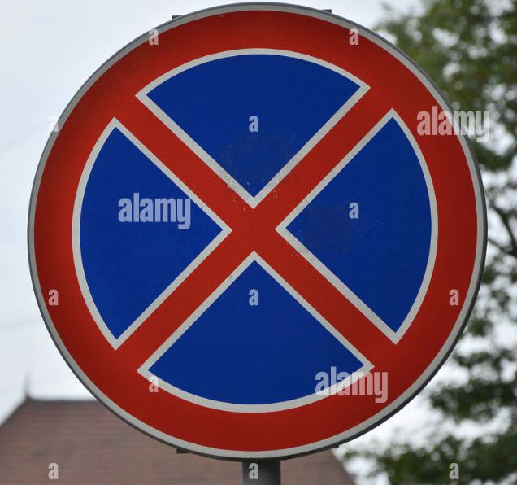
What is “Event” Knowledge?
Why Deep Semantics?
Image Event Structure
What happened?
Yes! A protest.
What are they protesting for?
vaccine
negation

Slide 29
Existing object-centric info miss situational understanding
Why Deep Semantics?
Image Event Structure
Vision
3
Notes:
Now, let’s see what machines can learn using the current techniques?

Slide 30
Existing object-centric info miss situational understanding
Why Deep Semantics?
Image Event Structure
Vision
Object
3
Notes:
We have object detection,

Slide 31
Existing object-centric info miss situational understanding
Why Deep Semantics?
Image Event Structure
Vision
Object
Relation
Scene Graph
hold
hold
behind
hold
3
Notes:
relation extraction, and scene graph parsing to figure out people are holding banners,

Slide 32
Existing object-centric info miss situational understanding
Why Deep Semantics?
Image Event Structure
Vision | Text
Object
Relation
Scene Graph
hold
hold
behind
hold
3
Notes:
If we map such semantics to text modality,

Slide 33
Existing object-centric info miss situational understanding
Why Deep Semantics?
Image Event Structure
Vision | Text
Object | Entity
Relation
Scene Graph
hold
hold
behind
hold
3
Notes:
objects are aligned with entities

Slide 34
Existing object-centric info miss situational understanding
Why Deep Semantics?
Image Event Structure
Vision | Text
Object | Entity
Relation | Relation
Scene Graph | Entity-Relation Graph
hold
hold
behind
hold
3
Notes:
scene graphs are aligned with entity-relation graph

Slide 35
Existing object-centric info miss situational understanding
Why Deep Semantics?
Image Event Structure
Vision | Text
Object | Entity
Relation | Relation
Scene Graph | Entity-Relation Graph
Entity-centric
3
Notes:
so they are entity-centric understanding
But all of the techniques are entity-centric, and the current state-of-the-art model is only able to describe the image as a woman holding a sign. It is kind of disappointing.
Can you say it is wrong? Maybe not. It is just they give the surface semantics, not the major message. It still has a large space from what we human can learn.
disappointing， far，understand

Slide 36
Existing object-centric info miss situational understanding
Why Deep Semantics?
Image Event Structure
Vision | Text
Object | Entity
Relation | Relation
Scene Graph | Entity-Relation Graph
Entity-centric
State-of-the-art Captioner (Kamath et al., 2022)
3
Notes:
It only gives the surface semantics like the woman is holding a sign, but cannot give any further information about what exactly they are doing, why they are holding a sign, what is the motivation behind this. It is still about the surface semantics, and has a large space from what we humans can learn.
But all of the techniques are entity-centric, and the current state-of-the-art model is only able to describe the image as a woman holding a sign. It is kind of disappointing.
Can you say it is wrong? Maybe not. It is just they give the surface semantics, not the major message.
disappointing， far，understand

Slide 37
Definition of “Event”
Why Deep Semantics?
Image Event Structure
What happened?
Protest
Event | Protest
Notes:
To do this, First, we identify this image as a protest event.

Slide 38
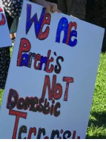
Definition of “Event”
Why Deep Semantics?
Image Event Structure
What happened?
Who?
Protest
parent
banner
child
banner
child
banner
Event | Protest
 | parent
 | child
 | banner
 | No vaccine mandate for kids
Notes:
Then we extract more details about participants

Slide 39
Definition of “Event”
Why Deep Semantics?
Image Event Structure
What happened?
Who?
Protest
protester
parent
protester
banner
protester
child
banner
child
banner
Event | Protest
Protester | parent
Protester | child
 | banner
 | No vaccine mandate for kids
Notes:
For example, the semantic roles of parents and children are protesters,

Slide 40
Definition of “Event”
Why Deep Semantics?
Image Event Structure
What happened?
Who?
Protest
protester
tool
protester
tool
tool
banner
parent
protester
child
banner
child
banner
Event | Protest
Protester | parent
Protester | child
Tool | banner
Topic | No vaccine mandate for kids
Notes:
and the banner is the tool they used in the protest.

Slide 41
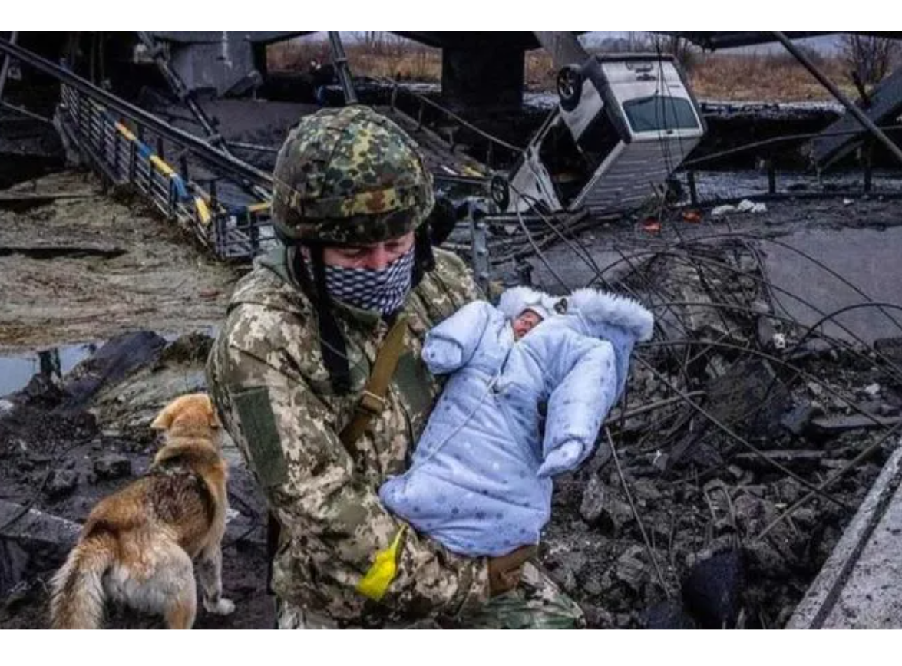
A New Task of Multimodal Event Extraction [ACL’20]
Why Deep Semantics?
Image Event Structure
Event Extraction
Input: text, image, video, speech, …
Output: structured knowledge 1. Event Type (e.g., protest) 2. Participants (e.g., child) & Semantic Roles (e.g., protester)
Event | Rescue
Agent | soldier
Agent | dog
Target | child
Event Type
What happened?
Who?
Argument
rescue
agent
target
agent
[Manling Li, et al., Cross-media Structured Common Space for Multimedia Event Extraction. ACL 2020]
Notes:
As a result, we propose a new task called xx

Slide 42
A New Task of Multimodal Event Extraction [ACL’20]
Why Deep Semantics?
Image Event Structure
Event Extraction
Input: text, image, video, speech, …
Output: structured knowledge 1. Event Type (e.g., protest) 2. Participants (e.g., child) & Semantic Roles (e.g., protester)
Event | Rescue
Agent | soldier
Agent | dog
Target | child
Event Type
What happened?
Who?
Argument
rescue
agent
target
agent
[Manling Li, et al., Cross-media Structured Common Space for Multimedia Event Extraction. ACL 2020]
Notes:
The input can be in any modality
relation extraction, relatvely easy, two objects, not needto understand the situaqtion, background, etc
however, in event extraction, we have to consider multiple objects, and usually complex simantic structures, and
go beyond the local data, to have the connection with other factual knowledge
sense of the real time and real world.
As a result, we define event extraction to get such structured information.
It can be represented as either a table or a graph.
There are two parts in this task, the event type is to identify what is happening, and the argument is to identify the participants, and most importantly, their semantics roles.

Slide 43
What is Multimodal Event Extraction? [Li et al, ACL’20]
Why Deep Semantics?
Image Event Structure
Event Extraction
Input: text, image, video, speech, …
Output: structured knowledge 1. Event Type (e.g., protest) 2. Participants (e.g., child) & Semantic Roles (e.g., protester)
Event | Rescue
Agent | soldier
Agent | dog
Target | child
Event Type
What happened?
Who?
Protest
Argument
protester
tool
tool
rescue
parent
protester
tool
banner
protester
child
target
agent
banner
child
agent
banner
[Manling Li, et al., Cross-media Structured Common Space for Multimedia Event Extraction. ACL 2020]
Notes:
The output is a structure like the table and graph we just showed

Slide 44
What is Multimodal Event Extraction? [Li et al, ACL’20]
Why Deep Semantics?
Image Event Structure
Event Extraction
Input: text, image, video, speech, …
Output: structured knowledge 1. Event Type (e.g., protest) 2. Participants (e.g., child) & Semantic Roles (e.g., protester)
Event | Rescue
Agent | soldier
Agent | dog
Target | child
Event Type
What happened?
Who?
Protest
Argument
protester
tool
tool
rescue
parent
protester
tool
banner
protester
child
target
agent
banner
child
agent
banner
[Manling Li, et al., Cross-media Structured Common Space for Multimedia Event Extraction. ACL 2020]

Slide 45
What is Multimodal Event Extraction? [Li et al, ACL’20]
Why Deep Semantics?
Image Event Structure
Event Extraction
Input: text, image, video, speech, …
Output: structured knowledge 1. Event Type (e.g., protest) 2. Participants (e.g., child) & Semantic Roles (e.g., protester)
Event | Rescue
Agent | soldier
Agent | dog
Target | child
Event Type
What happened?
Who?
Protest
Argument
protester
tool
tool
rescue
parent
protester
tool
banner
protester
child
target
agent
banner
child
agent
banner
[Manling Li, et al., Cross-media Structured Common Space for Multimedia Event Extraction. ACL 2020]

Slide 46
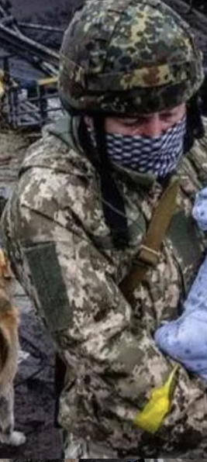
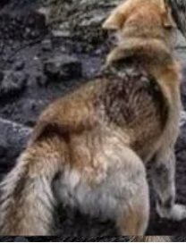
What is Multimodal Event Extraction? [Li et al, ACL’20]
Why Deep Semantics?
Image Event Structure
Event Extraction
Input: text, image, video, speech, …
Output: structured knowledge 1. Event Type (e.g., protest) 2. Participants (e.g., child) & Semantic Roles (e.g., protester)
Event | Rescue
Agent | soldier
Agent | dog
Target | child
Event Type
What happened?
Who?
Argument
rescue
agent
target
agent
Entity-centric
Image Event
Surface
Generic
A Triplet
Two Objects
soldier
dog
Event-centric
Deep
Situational
Semantic Structures
Multiple Objects
[Manling Li, et al., Cross-media Structured Common Space for Multimedia Event Extraction. ACL 2020]
Notes:
Entity relation extraction is relatively easy, since it only has two objects, and is just about the generic semantics such as how two objects are related physically
However, in event extraction, we have to consider multiple objects, and they're usually complex semantic structures, and need to understand the situation, to see how little pieces of information are deeply connected with each other
it needs to go beyond the local area, to have the connection with other factual knowledge
sense of the real time and real world.
As a result, we define event extraction to get such structured information.
It can be represented as either a table or a graph.
There are two parts in this task, the event type is to identify what is happening, and the argument is to identify the participants, and most importantly, their semantics roles.

Slide 47
Goal: Entity-Centric → Event-Centric
Why Deep Semantics?
Image Event Structure
Text | Vision
Entity | Object
Relation | Relation
Entity-Relation Graph | Scene Graph
Entity-centric
Notes:
As a result, my phd research move from entity-centric to

Slide 48
Goal: Entity-Centric → Event-Centric
Why Deep Semantics?
Image Event Structure
Text | Vision
Entity | Object
Relation | Relation
Entity-Relation Graph | Scene Graph
Verb | Activity
Event Structure | Image Event Graph
Event-centric
Notes:
event centric understanding. Rather than just checking objects, we figure out their semantic roles

Slide 49
Goal: Entity-Centric → Event-Centric
Why Deep Semantics?
Image Event Structure
Text | Vision
Entity | Object
Relation | Relation
Entity-Relation Graph | Scene Graph
Verb | Activity
Event Structure | Image Event Graph
Entity-centric
Event-centric

Slide 50
Goal: Entity-Centric → Event-Centric
Why Deep Semantics?
Image Event Structure
State-of-the-art Captioner (Kamath et al., 2022)
Entity-centric
50
Protest
protester
tool
protester
tool
tool
banner
parent
protester
Event-centric
child
banner
child
banner
Notes:
SO that we not only know xx
but also understand the real meaning behind her behavior, that is that she is a protester,
and her children also involved in this protest, from banners we can tell their protest goal.

Slide 51
Adding knowledge to pretraining models
object labels
objects
scene graphs
pixels
situational knowledge
Knowledge for data
Knowledge for Model

Slide 52
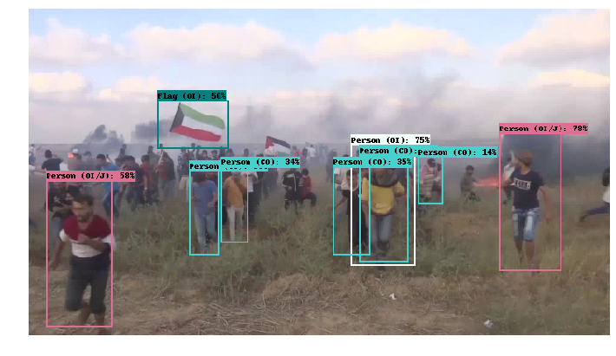
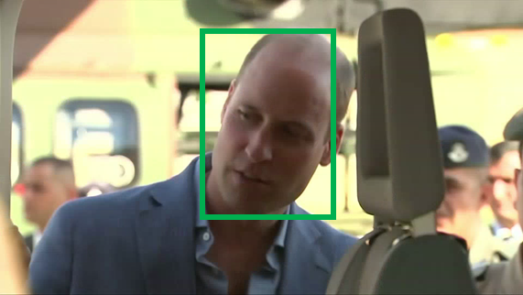
What is factual knowledge?
Multimedia Knowledge Base with entities, relations and events.
event
entity
Prince William
Flag
KB
Israel
Prince William
visit
The first-ever official visit by a British royal to Israel is underway. Prince William the 36 year-old Duke of Cambridge and second in line to the throne will meet with both Israeli and Palestinian leaders over the next three days.
Contact.Meet_Participant
entity: GPE
entity: PER
event

Slide 53
Adding knowledge to pretraining models
Knowledge for data
Knowledge for Model
situational knowledge
scene graphs
object labels
objects
pixels

Slide 54
An Image is Worth 16x16 Words
The simplest way is to split an image into patches
Vision Transformer (ViT):

Slide 55
Unified Model: Pix2Seq
Another way is to treat pixels as tokens.

Slide 56
Adding knowledge to pretraining models
Knowledge for data
Knowledge for Model
situational knowledge
scene graphs
object labels
objects
pixels

Slide 57
Entity Knowledge
Object Detection: Object instances at the bounding box level
Semantic Segmentation: Object class at the pixel level
Instance Segmentation: Object instances at the pixel level
https://www.v7labs.com/blog/object-detection-guide
Notes:
There are also pixel level detection tasks, called semgntation, including the semantic segmentation and instance segmentation. Semantic segmentation covers pixels of general object class, and instance segmentation higlights pixels of each individual object.
Image segmentation is the process of defining which pixels of an object class are found in an image.
Semantic image segmentation will mark all pixels belonging to that tag, but won’t define the boundaries of each object.
Object detection instead will not segment the object, but will clearly define the location of each individual object instance with a box.
Combining semantic segmentation with object detection leads to instance segmentation, which first detects the object instances, and then segments each within the detected boxes (known in this case as regions of interest).

Slide 58
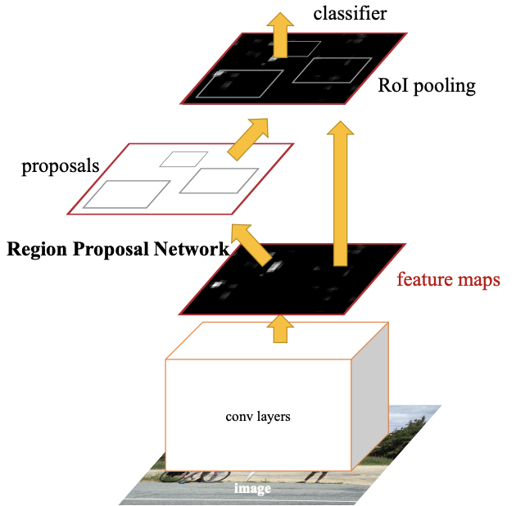
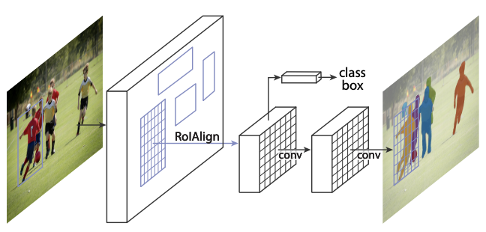
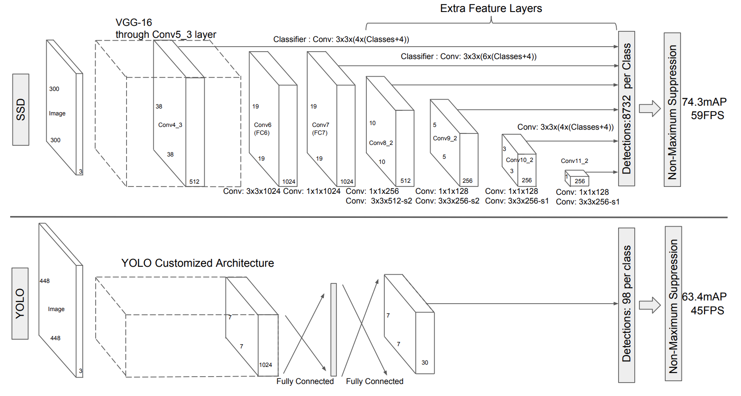
The way to obtain entity knowledge: Object Extraction
Two-Stage (With Proposal)
One-Stage (Without Proposal)
YOLO
Faster RCNN
Mask RCNN
SSD
Ren, S., He, K., Girshick, R., & Sun, J. Faster r-cnn: Towards real-time object detection with region proposal networks. NeurIPS 2015.
He, Kaiming, et al. "Mask r-cnn." CVPR 2017.
Redmon, Joseph, et al. "You only look once: Unified, real-time object detection." CVPR 2016.
Liu, Wei, et al. "Ssd: Single shot multibox detector." ECCV 2016.
Notes:
Popolar models can be dived into two categories, two-stage models will first detect the region proposals such as Fater RCNN and MASk RCNN, but one-stage model skips the proposal, and represntative models are YOLO and SSD.

Slide 59
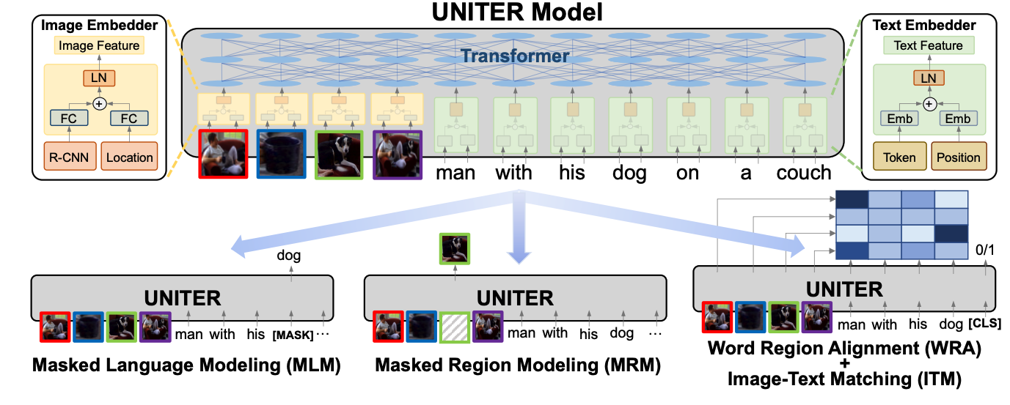
Adding objects to V+L Pretraining
Objects are used to better mask the regions.

Slide 60
Adding knowledge to pretraining models
Knowledge for data
Knowledge for Model
event knowledge
scene graphs
object labels
objects
pixels

Slide 61
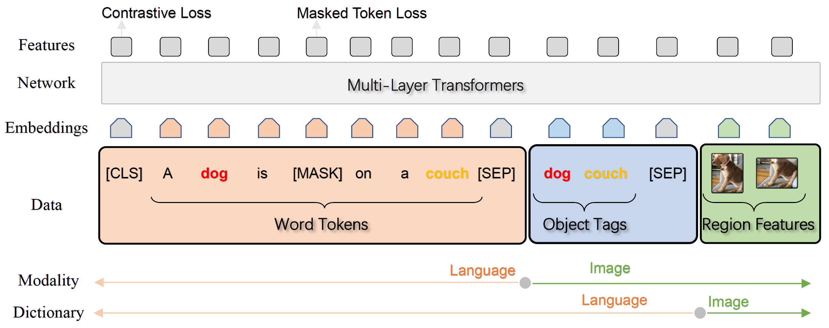
Oscar [ECCV 2020] and VinVL [CVPR 2021]
Object knowledge is richer.
Add object label knowledge as anchor points
Oscar: Object-Semantics Aligned Pre-training for Vision-Language Tasks, ECCV 2020
VinVL: Making Visual Representations Matter in Vision-Language Models. CVPR 2021
Notes:
Object knowledge is actually much richer than we thought.
Object Tags as Anchor Points
The image-text pair is represented as a triplet

Slide 62
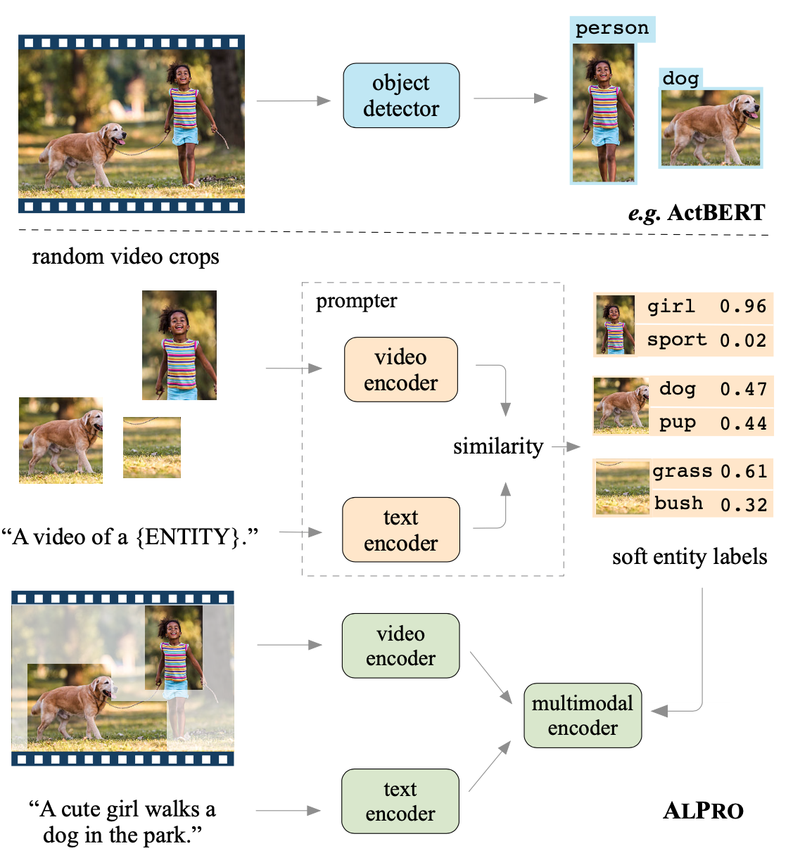
Soft Prompt Entity Knowledge [CVPR2022]
[Align and Prompt 2021] Align and Prompt: Video-and-Language Pre-training with Entity Prompts
Adding regional entity prediction task
Individually pre-trained with Video-Text Contrastive loss
previous work rely on object detectors with expensive computation and limited object categories
image source: Align and Prompt: Video-and-Language Pre-training with Entity Prompts
Notes:
VTC, VTM, MLM + PEM

Slide 63
Adding knowledge to pretraining models
Knowledge for data
Knowledge for Model
event knowledge
scene graphs
object labels
objects
pixels

Slide 64
ERINE-ViL [AAAI2021]
Add scene graph knowledge as downstream tasks
Object prediction
Attribute prediction
Relationship prediction
ERNIE-ViL: Knowledge Enhanced Vision-Language Representations Through Scene Graph, AAAI 2021

Slide 65
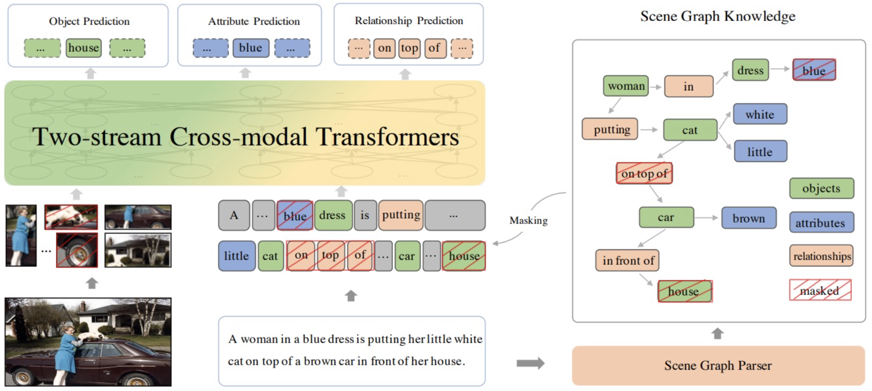
ERINE-ViL [AAAI2021]
Add scene graph knowledge as downstream tasks
Object prediction
Attribute prediction
Relationship prediction
ERNIE-ViL: Knowledge Enhanced Vision-Language Representations Through Scene Graph, AAAI 2021

Slide 66
Adding knowledge to pretraining models
Knowledge for data
Knowledge for Model
event knowledge
scene graphs
object labels
objects
pixels

Slide 67
Vision vs. NLP for Event Extraction
Vision does not study newsworthy, complex events
Focusing on daily life and sports (Perera et al., 2012; Chang et al., 2016; Zhang et al., 2007; Ma et al., 2017)
Without localizing a complete set of arguments for each event (Gu et al., 2018; Li et al., 2018; Duarte et al., 2018; Sigurdsson et al., 2016; Kato et al., 2018; Wu et al., 2019a)
Most related: Situation Recognition (Yatskar et al., 2016)
Classify an image as one of 500+ FrameNet verbs
Identify 192 generic semantic roles via a 1-word description
Notes:
There are some work in computer vision to extract events, but with a different focus on physical events in daily life scenario, like clipping and jumping. So it has a gap with complex events in traditional text event extraction, such as transport and protest event.
But the good news is that some work offers resources similar to event argument extraction. For example, in situation recognition, one image is classified to a verb, and it populates a table with nouns as arguments. But different from our task, it does not localize arguments in images,

Slide 68
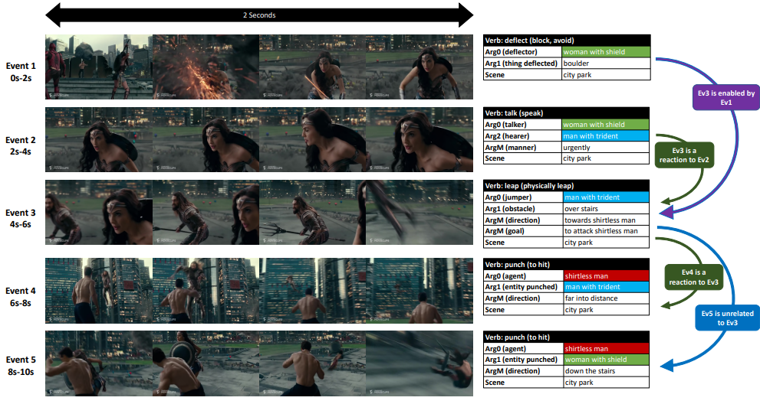
Vision-only Event and Argument Extraction
Grounded Situation Recognition adds visual argument localization [Pratt et al, 2020]
Video Situation Recognition extends the work to videos [Sadhu et al, 2021]
Sarah Pratt, Mark Yatskar, Luca Weihs, Ali Farhadi, and Aniruddha Kembhavi. Grounded situation recognition. In ECCV, 2020
Sadhu, A., Gupta, T., Yatskar, M., Nevatia, R., & Kembhavi, A. (2021). Visual Semantic Role Labeling for Video Understanding. ArXiv, abs/2104.00990.

Slide 69
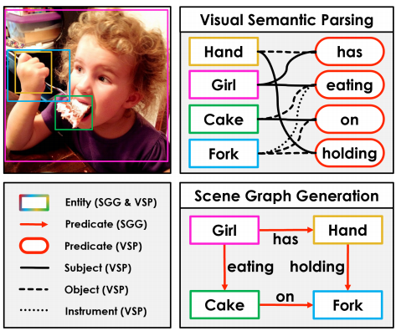
Vision-only Event and Argument Extraction
Another line of work is based on scene graphs [Xu et al, 2017; Li et al, 2017; Yang et al, 2018; Zellers et al, 2018].
extracting <subject, predicate, object>
structure is simpler than the aforementioned multi-argument event
Visual Semantic Parsing is using predicate as event, and subject, object, instrument as argument [Zareian el al, 2020]
Added bounding box grounding
Notes:
Zareian, Alireza, Svebor Karaman, and Shih-Fu Chang. "Weakly supervised visual semantic parsing." CVPR. 2020.
Yang, Jianwei, et al. "Graph r-cnn for scene graph generation." Proceedings of the European conference on computer vision (ECCV). 2018.
Xu, Danfei, et al. "Scene graph generation by iterative message passing." Proceedings of the IEEE conference on computer vision and pattern recognition. 2017.
Li, Yikang, et al. "Scene graph generation from objects, phrases and region captions." Proceedings of the IEEE International Conference on Computer Vision. 2017.
Zellers, Rowan, et al. "Neural motifs: Scene graph parsing with global context." Proceedings of the IEEE Conference on Computer Vision and Pattern Recognition. 2018.

Slide 70
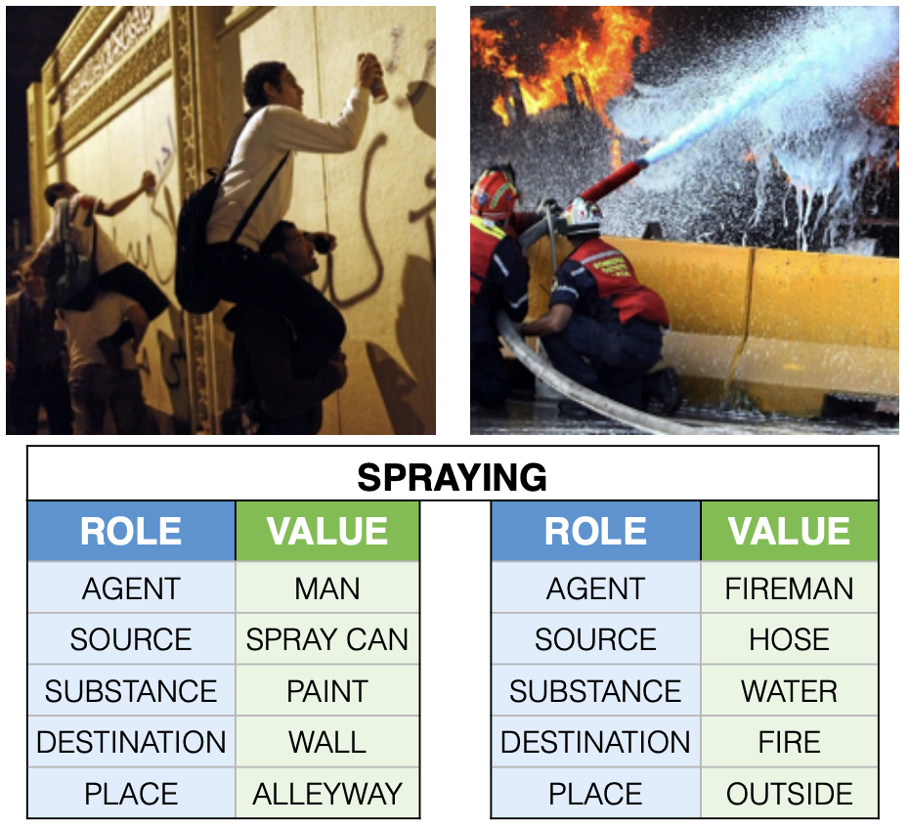
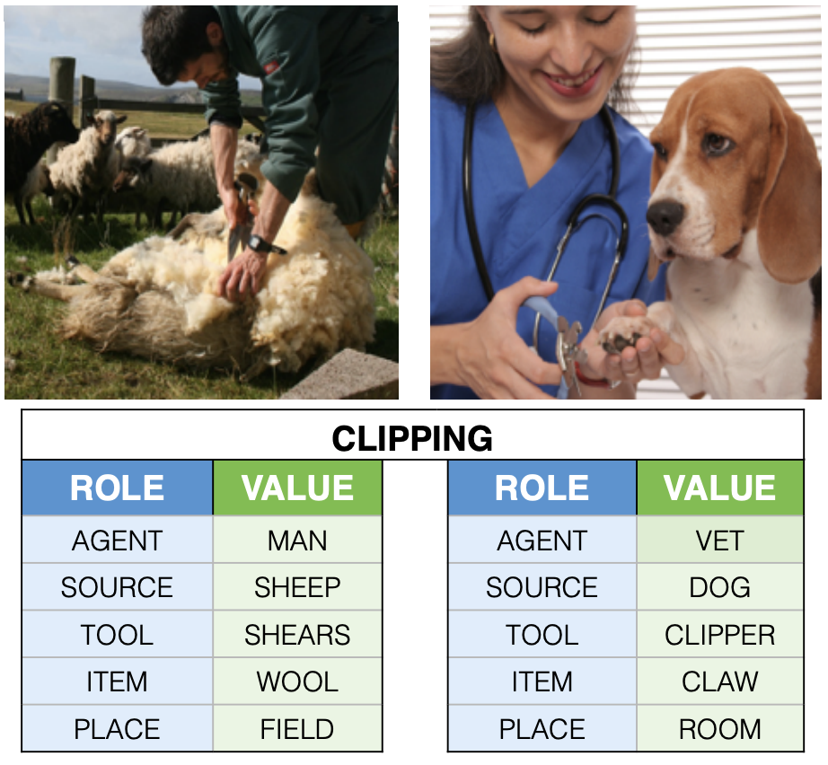
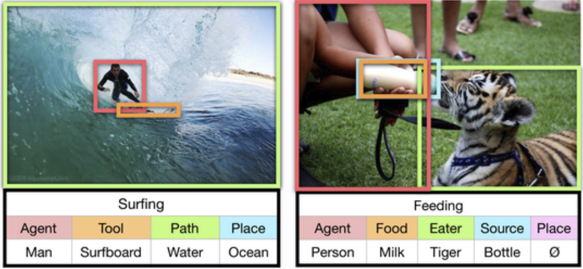
Existing Work: Situation Recognition
Why Deep Semantics?
Image Event Structure
Supervised Learning
Vision-Only
Bottleneck:
Lack of Annotation
Bottleneck:
Cross-modal Fusion
(Yatskar et al., 2016, …)
(Pratt et al., 2020, …)
Notes:
The difficulty is how to transfer a semantic structure to a
Previous research efforts to learn such semantic structures in vision modelity. rely on soervised training l
The bootleeack of further extension is lack of annotation.
But annotating data is never easy,
My solution is rather than doing annotation, but to
Pratt et al., 2020; Sadhu et al., 2021,

Slide 71
Existing Work: Situation Recognition
Why Deep Semantics?
Image Event Structure
Supervised Learning
Vision-Only
Bottleneck:
Lack of Annotation
Bottleneck:
Cross-modal Fusion
(Yatskar et al., 2016, …)
Transfer
Language Vision
(Pratt et al., 2020, …)
Notes:
The difficulty is how to transfer a semantic structure to a
Previous research efforts to learn such semantic structures in vision modelity. rely on soervised training l
The bootleeack of further extension is lack of annotation.
But annotating data is never easy,
My solution is rather than doing annotation, but to
Pratt et al., 2020; Sadhu et al., 2021,

Slide 72
Existing Work: Situation Recognition
Why Deep Semantics?
Image Event Structure
Supervised Learning
Vision-Only
Bottleneck:
Lack of Annotation
Bottleneck:
Cross-modal Fusion
(Yatskar et al., 2016, …)
Structural Transfer
Language Vision
(Pratt et al., 2020, …)
Notes:
So we proposed
The difficulty is how to transfer a semantic structure to a
Previous research efforts to learn such semantic structures in vision modelity. rely on soervised training l
The bootleeack of further extension is lack of annotation.
But annotating data is never easy,
My solution is rather than doing annotation, but to
Pratt et al., 2020; Sadhu et al., 2021,

Slide 73
CLIP-Event: Event-Driven Vision-Language Pretraining
Why Deep Semantics?
Image Event Structure
carry
(Lin et al, 2020)
Event Extraction
Trigger Word
Natural Language Processing
[Manling Li, et al., CVPR 2022]
16
Notes:
Since text event understanding has been researched for a long time, we can take advantage of text IE tools to extract the event knowledge, For example, we can get this carry event from the sentence.

Slide 74
CLIP-Event: Event-Driven Vision-Language Pretraining
Why Deep Semantics?
Image Event Structure
Target
(Lin et al, 2020)
Event Extraction
Trigger Word
Natural Language Processing
Argument (Participant)
16
Notes:
And detect the arguments participating in this event

Slide 75
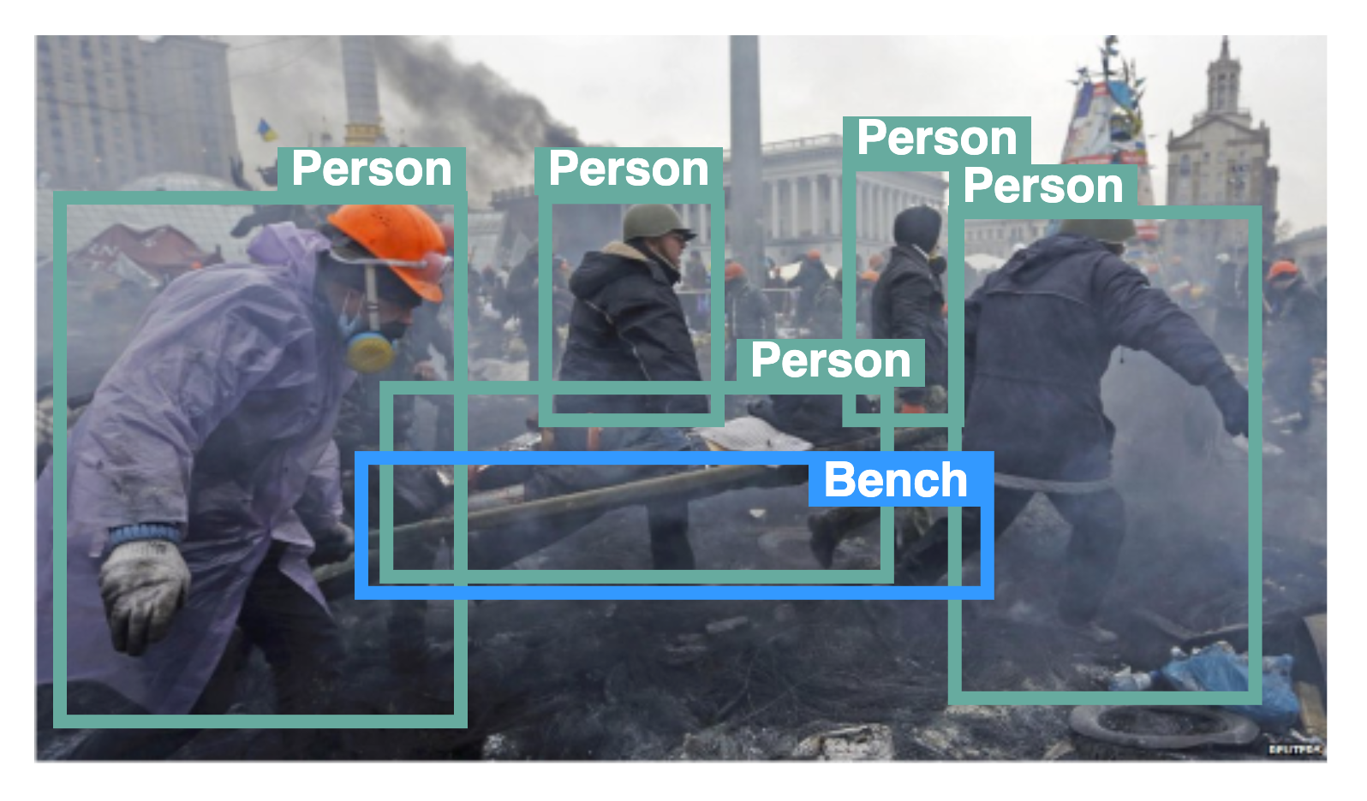
Transfer text event knowledge to images
Why Deep Semantics?
Image Event Structure
Target
(Lin et al, 2020)
Weakly Supervision
16
Notes:
In this way, we can use the text event as a distance supervision, and transfer event knowledge from text modality to vision modality, For example, we can treat this transporting event as pseudo labels for the image.
A good thing is that we have assumptions that for news data, the image and its caption should convey similar information about the event. For example, given the caption, we can extract this transport event with its arguments, and we treat the event labels as pseudo labels for the image.

Slide 76
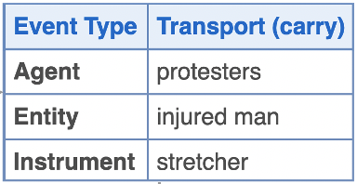
Hard negatives via manipulating event structures
Why Deep Semantics?
Image Event Structure
Positive
Labels
Target
Confusion Matrix of existing V+L models
Negative
Labels
(events)
Target
17
Notes:
we focus on the hard part.
(click)To force the model understand event and argument, so we manipulate the event structures from both event level and argument level, based on the confusion matrix.
We sample ambiguous negative event types based on confusion matrix
(click)For the argument negative sampling, since each event may have multiple arguments, we switch the orders of the arguments using a right-shift.

Slide 77
Hard negatives via manipulating event structures
Why Deep Semantics?
Image Event Structure
Positive
Labels
Target
Negative
Labels
(events)
Target
Negative
Labels
(arguments)
Role Switching
Target
17
Notes:
we focus on the hard part.
(click)To force the model understand event and argument, so we manipulate the event structures from both event level and argument level, based on the confusion matrix.
We sample ambiguous negative event types based on confusion matrix
(click)For the argument negative sampling, since each event may have multiple arguments, we switch the orders of the arguments using a right-shift.

Slide 78
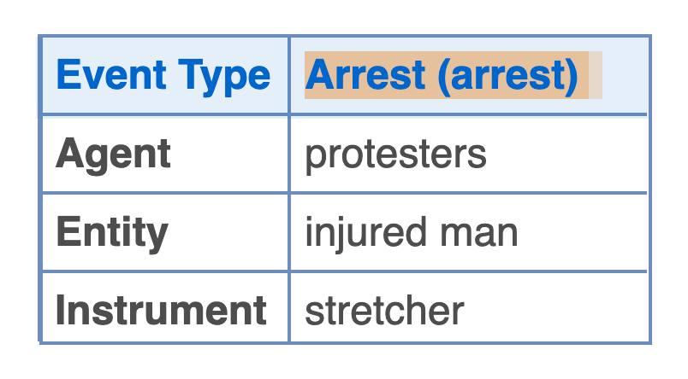
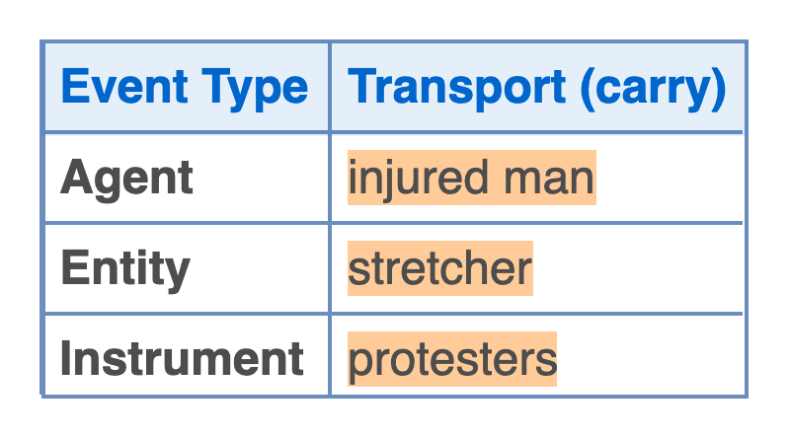
Hard negatives via manipulating event structures
Why Deep Semantics?
Image Event Structure
Protesters transported injured man using a stretcher.
Positive
Labels
prompt
Target
Protesters arrested injured man using a stretcher.
Negative
Labels
(events)
prompt
Target
Negative
Labels
(arguments)
Injured man transported a stretcher with protesters.
prompt
Target
17
Notes:
Then we use some predefined prompt functions to translate the event structures to natural language descriptions,

Slide 79
Hard negatives via manipulating event structures
Why Deep Semantics?
Image Event Structure
Protesters transported injured man using a stretcher.
Positive
Labels
prompt
Protesters arrested injured man using a stretcher.
Negative
Labels
(events)
prompt
Negative
Labels
(arguments)
Injured man transported a stretcher with protesters.
prompt
18
Notes:
so that we can feed this description to CLIP text encoder.

Slide 80
Contrastive Learning on Event Semantics
Why Deep Semantics?
Image Event Structure
Protesters transported injured man using a stretcher.
Positive
Labels
t₀
Contrastive Learning
s(t₀,v)
Protesters arrested injured man using a stretcher.
Negative
Labels
(events)
Text Encoder
t₁
s(t₁,v)
Injured man transported a stretcher with protesters.
t₂
s(t₂,v)
Negative
Labels
(arguments)
v
Image Encoder
18
Notes:
distinguish postive event semantics from negative event semantics
The text and vision encoder will be optimized using a contrastive learning loss to distinguish negative events and arguments from positive ones.

Slide 81
Bottlenecks of Vision Semantic Structure Learning
Why Deep Semantics?
Image Event Structure
Supervised Learning
Vision-Only
Bottleneck:
Lack of Annotation
Bottleneck:
Cross-modal Fusion
(Yatskar et al., 2016, …)
Structural Transfer
Language Vision
(Pratt et al., 2020, …)
Notes:
The difficulty is how to transfer a semantic structure to a
Previous research efforts to learn such semantic structures in vision modelity. rely on soervised training l
The bootleeack of further extension is lack of annotation.
But annotating data is never easy,
My solution is rather than doing annotation, but to
Pratt et al., 2020; Sadhu et al., 2021,

Slide 82
Bottlenecks of Vision Semantic Structure Learning
Why Deep Semantics?
Image Event Structure
Supervised Learning
Vision-Only
Bottleneck:
Lack of Annotation
Bottleneck:
Cross-modal Fusion
(Yatskar et al., 2016, …)
Structural Transfer
Language Vision
(Pratt et al., 2020, …)
Notes:
The difficulty is how to transfer a semantic structure to a
Previous research efforts to learn such semantic structures in vision modelity. rely on soervised training l
The bootleeack of further extension is lack of annotation.
But annotating data is never easy,
My solution is rather than doing annotation, but to
Pratt et al., 2020; Sadhu et al., 2021,

Slide 83
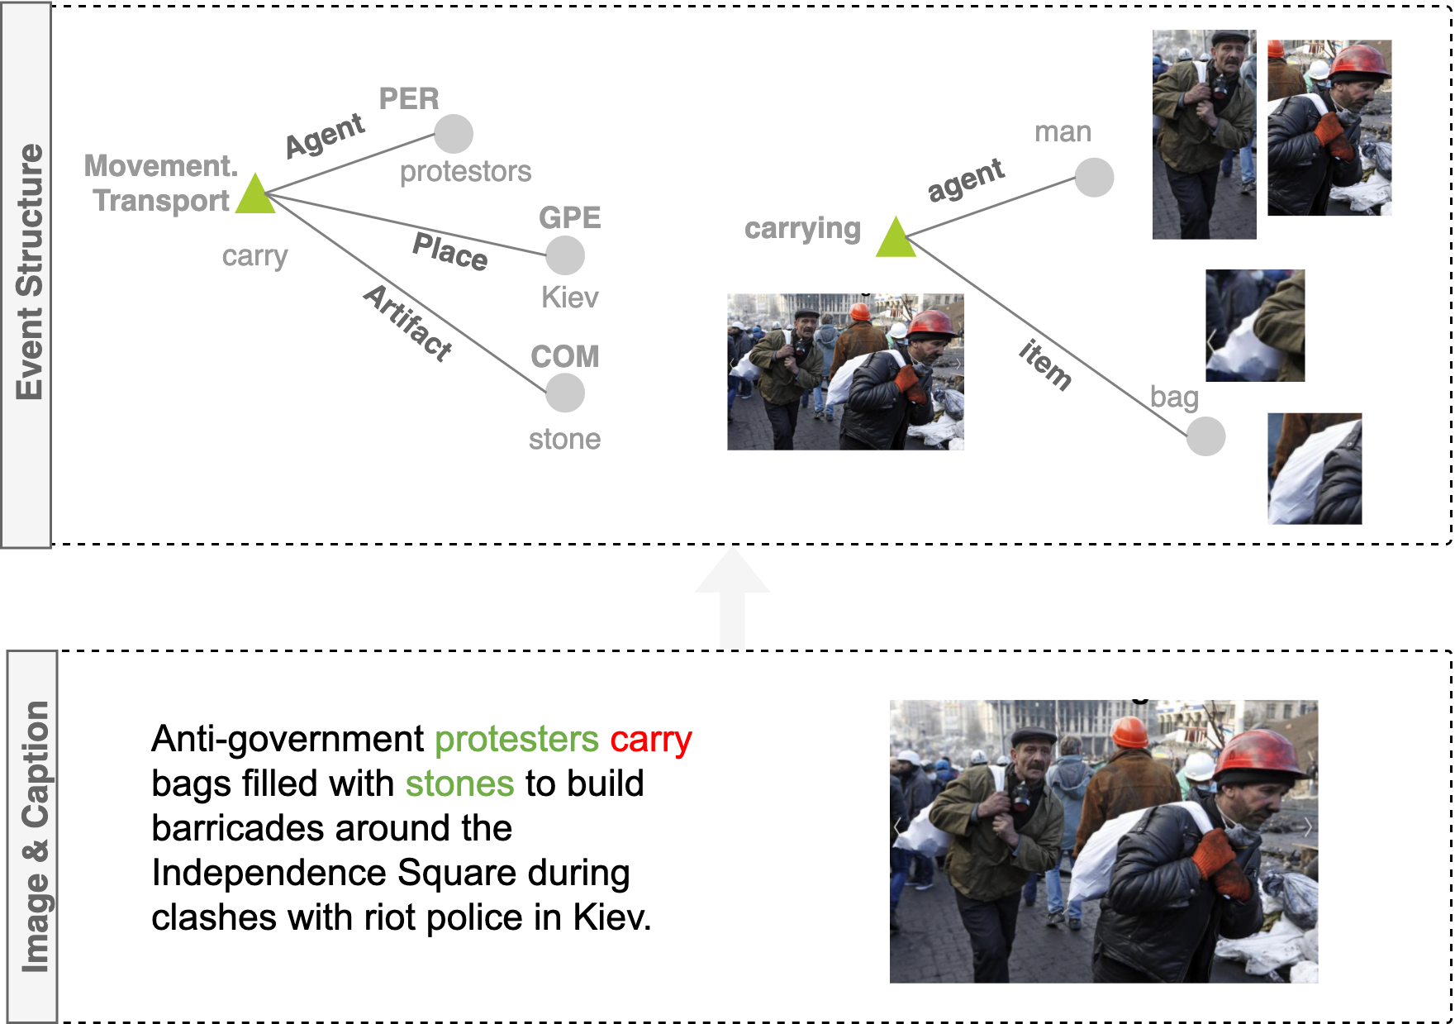
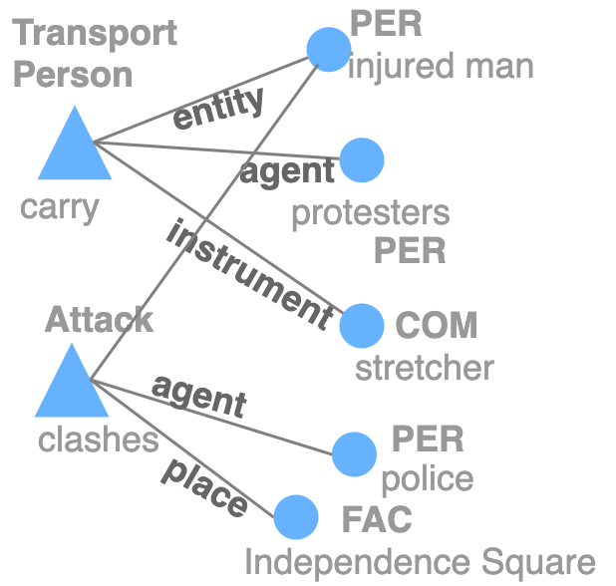
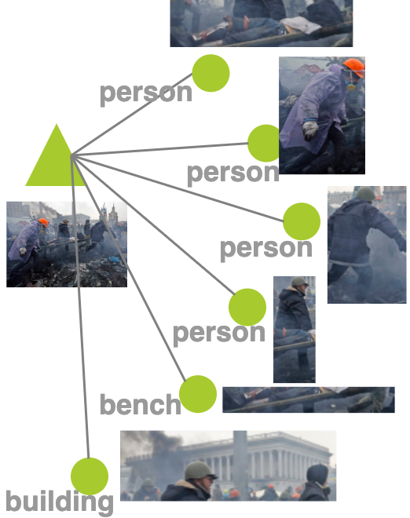
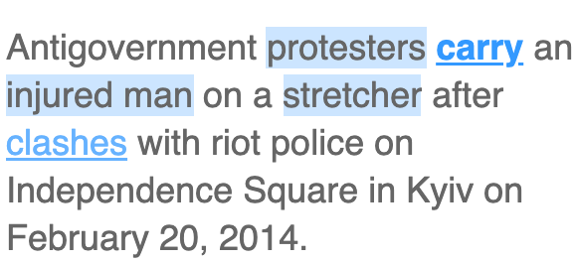
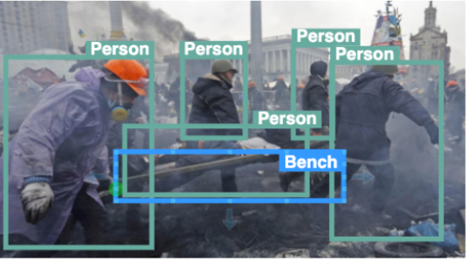
The first V+L Pretraining with Event Semantic Structures
Why Deep Semantics?
Image Event Structure
Challenge: Structured Encoding
Notes:
However, we stll do not know how the semantic structures of two modalilities
However, traditional multimed pretraining models focus more on the object level information, and we focus on the event level, by imposing event structured knowledge into the Multimodal pretraining models to enable them to understand events.
The main question is how to get the structured events, and how to teach model to learn their semantics structures.
Since the research of text event structure is much more advanced, we can take advantage of text IE tools to extract the event knowledge, For example, we can get this event star graph from the sentence. For image, we treat each image as a center node, and connect it to objects that related to this image event.
The second question is how to encode this both the semantics and structures of events. Semantics means that the model needs to understand the meaning of events and argument roles, and the structures shows how they are connected.

Slide 84
The first V+L Pretraining with Event Semantic Structures
Why Deep Semantics?
Image Event Structure
Notes:
chllenge: now annotation
-> optimal transport, soft alignment
cost matrix,
sinkhorn
final OT plan
However, this is only about semantic encoding, to better encode the structures, we extract the objects in images using Faster RCNN, and construct a vision graph using these objects. After that, we learn the soft alignment between these objects and text event arguments to learn their roles. The soft alignment is optimized using optimal transport.
We use the cosine similarity as cost matrix, The optimal transport plan is solved using Sinkhorn algorithm within k iterations, and the final distance is based on the transport plan and the cost matrix

Slide 85
The first V+L Pretraining with Event Semantic Structures
Why Deep Semantics?
Image Event Structure
Structured Alignment via Optimal Transport
Text Event Graph Image Event Graph
Notes:
chllenge: now annotation
-> optimal transport, soft alignment
cost matrix,
sinkhorn
final OT plan
However, this is only about semantic encoding, to better encode the structures, we extract the objects in images using Faster RCNN, and construct a vision graph using these objects. After that, we learn the soft alignment between these objects and text event arguments to learn their roles. The soft alignment is optimized using optimal transport.
We use the cosine similarity as cost matrix, The optimal transport plan is solved using Sinkhorn algorithm within k iterations, and the final distance is based on the transport plan and the cost matrix

Slide 86
The first V+L Pretraining with Event Semantic Structures
Why Deep Semantics?
Image Event Structure
Structured Alignment via Optimal Transport
Structured Alignment via Optimal Transport
Text Event Graph Image Event Graph
1
Define cost matrix C (embedding similarity)
Notes:
chllenge: now annotation
-> optimal transport, soft alignment
cost matrix,
sinkhorn
final OT plan
However, this is only about semantic encoding, to better encode the structures, we extract the objects in images using Faster RCNN, and construct a vision graph using these objects. After that, we learn the soft alignment between these objects and text event arguments to learn their roles. The soft alignment is optimized using optimal transport.
We use the cosine similarity as cost matrix, The optimal transport plan is solved using Sinkhorn algorithm within k iterations, and the final distance is based on the transport plan and the cost matrix

Slide 87
The first V+L Pretraining with Event Semantic Structures
Why Deep Semantics?
Image Event Structure
Structured Alignment via Optimal Transport
Structured Alignment via Optimal Transport
Text Event Graph Image Event Graph
1
Define cost matrix C (embedding similarity)
2
Optimization Goal: minimize transport distance $$D\left(S,T\right)=\min_{T}{T∙C}$$
The optimal T is approximated by a differentiable Sinkhorn Knopp algorithm (Sinkhorn, 1964; Cuturi, 2013)
Notes:
chllenge: now annotation
-> optimal transport, soft alignment
cost matrix,
sinkhorn
final OT plan
However, this is only about semantic encoding, to better encode the structures, we extract the objects in images using Faster RCNN, and construct a vision graph using these objects. After that, we learn the soft alignment between these objects and text event arguments to learn their roles. The soft alignment is optimized using optimal transport.
We use the cosine similarity as cost matrix, The optimal transport plan is solved using Sinkhorn algorithm within k iterations, and the final distance is based on the transport plan and the cost matrix

Slide 88
The first V+L Pretraining with Event Semantic Structures
Why Deep Semantics?
Image Event Structure
Structured Alignment via Optimal Transport
Structured Alignment via Optimal Transport
Text Event Graph Image Event Graph
1
Define cost matrix C (embedding similarity)
2
Optimization Goal: minimize transport distance $$D\left(S,T\right)=\min_{T}{T∙C}$$
The optimal T is approximated by a differentiable Sinkhorn Knopp algorithm (Sinkhorn, 1964; Cuturi, 2013)
3
Optimize the transport plan T within k iterations
Notes:
chllenge: now annotation
-> optimal transport, soft alignment
cost matrix,
sinkhorn
final OT plan
However, this is only about semantic encoding, to better encode the structures, we extract the objects in images using Faster RCNN, and construct a vision graph using these objects. After that, we learn the soft alignment between these objects and text event arguments to learn their roles. The soft alignment is optimized using optimal transport.
We use the cosine similarity as cost matrix, The optimal transport plan is solved using Sinkhorn algorithm within k iterations, and the final distance is based on the transport plan and the cost matrix

Slide 89
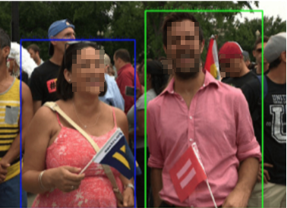
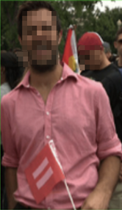
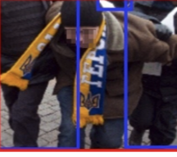
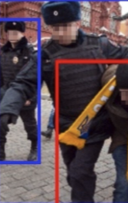
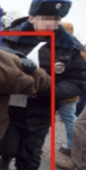
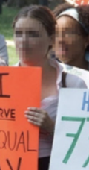
CLIP-Event on Visual Event Extraction
Why Deep Semantics?
Image Event Structure
Supporting Zero-shot Vision Event Extraction the first time.
Vaccination
Arrest
Protest
Celebration
agent
target
agent
detainee
demonstrator
attendee
attendee
agent
agent
agent
Notes:
It is the first time that we are able to detect unseen event types and roles, for example, this vaccination
The beauty is that objects can nicely labeled with semantic roles, such semantic understanding ability is pretty new to multimodal data
Also, here we are able to distinguish protest and celebration
Through this cross-model transfer, we support
(add numbers)
Here is an example, that the model can understand the person in the middle are the detainee and people surrounding him are agents.

Slide 90
CLIP-Event on Visual Event Extraction
Why Deep Semantics?
Image Event Structure
Supporting Zero-shot Vision Event Extraction the first time.
Vaccination
Arrest
Protest
Celebration
agent
target
agent
detainee
demonstrator
attendee
attendee
agent
agent
agent
Notes:
It is the first time that we are able to detect unseen event types and roles, for example, this vaccination
The beauty is that objects can nicely labeled with semantic roles, such semantic understanding ability is pretty new to multimodal data
Also, here we are able to distinguish protest and celebration
Through this cross-model transfer, we support
(add numbers)
Here is an example, that the model can understand the person in the middle are the detainee and people surrounding him are agents.

Slide 91
CLIP-Event on Visual Event Extraction
Why Deep Semantics?
Image Event Structure
Supporting Zero-shot Vision Event Extraction the first time.
Vaccination
Arrest
Protest
Celebration
agent
target
agent
detainee
demonstrator
attendee
attendee
agent
agent
agent
Notes:
It is the first time that we are able to detect unseen event types and roles, for example, this vaccination
The beauty is that objects can nicely labeled with semantic roles, such semantic understanding ability is pretty new to multimodal data
Also, here we are able to distinguish protest and celebration
Through this cross-model transfer, we support
(add numbers)
Here is an example, that the model can understand the person in the middle are the detainee and people surrounding him are agents.

Slide 92
Future Direction: Disentangling Perception & Reasoning
Proposal #1: Missing Pieces in current V+L learning
Proposal #2: Compositional Learning
Future 3: Disentangling Perception & Reasoning
Proposal: Can we dis-entangles perception AND reasoning, and treating these two as two sub-problems?
Perception:
Vision-only model (e.g., object detection)
Vision-language model (e.g., captioning, QA)
Reasoner: Language-only model – We need divide-and-conquer!
(1) decompose a problem (e.g., a sub-function call)
(2) use tool to solve a problem (e.g., access external database, fetch relevant information)
(3) update the conclusion (e.g., store something back into the database)
Notes:
As a result, our proposal is to disentangle perceptoon and reasoing,
perception can be used as a tool.
Reasoner: Language-only model – We need divide-and-conquer!
It should be capable of recursively decomposing problems AND using complex tools in programming languages (e.g., to retrieve and access information)
It should be treated as a decision-making agent (e.g., like an RL agent in Go/StarCraft); It’s main task is to solve a problem with tools (e.g., perception models, database, files, …)!
It should be continuously optimized in an reinforced setting (i.e., reward good behavior, penalize bad behavior)

Slide 93
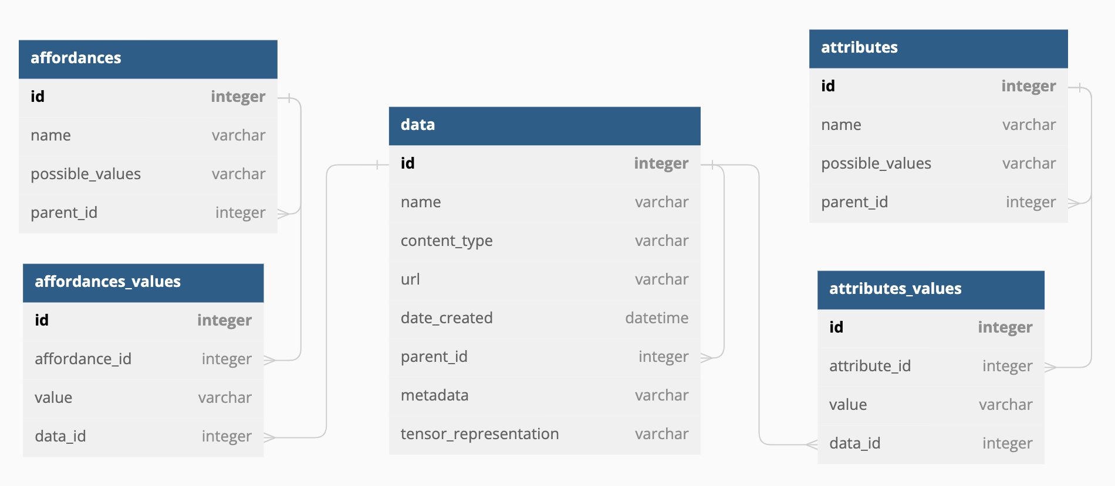
Future Direction: Disentangling Perception & Reasoning
Proposal #1: Missing Pieces in current V+L learning
Proposal #2: Compositional Learning
Future 3: Disentangling Perception & Reasoning
What is an ideal Reasoner?
A reasoner need to be able to Create, Read, Update, and Delete (CRUD) of a structured representation of symbolic and semantic information:
We can easily maintain a table of attributes / affordances with their possible_values (in one place!);
We can easily represent the hierarchical relationships between attributes/affordances and data.
Most-of-all: it allows humans to edit these structured data (and model’s internal representation!)
The reasoner should use the (dynamically changing) structured database as an ontology.
Notes:
On thing we want to highlight is the ability to understand both symbolic and semantic information. If we divide the physical world knowledge into structures
https://dbdiagram.io/d/642ca4265758ac5f1726c494
ECOLE needs to be able to handle a large amount of data (and organizing them in a structured way!) -> a database is a great candidate & LLM knows how to interact with it!

