Slide 1







Deep Learning on Graphs for
Natural Language Processing
Lingfei Wu, Yu Chen, Heng Ji,
Yunyao Li, and Bang Liu
TheWebConf 2022 Tutorial
April 25th, 2022

Slide 2
Outline
DLG4NLP
Introduction
Why Graphs for NLP?
Conventional ML for NLP
DLG4NLP
Foundations
Graph Construction for NLP
Graph Representation Learning for NLP
DLG4NLP
Applications
Information Extraction
Machine Reading Comprehension
Deep Learning on Graphs: Foundations and Models
Graph Encoder-Decoder Models for NLP
Natural Language Generation
Text Clustering and Matching
Text Mining and Classification
DLG4NLP
Introduction, Foundations, Applications
DLG4NLP
Demos
DLG4NLP Future Directions

Slide 3
DLG4NLP
Introduction

Slide 4
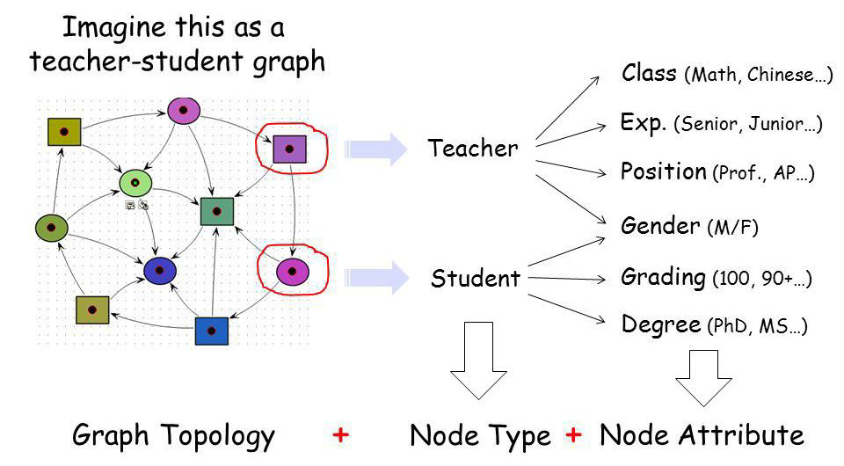
Why graphs?
Graphs are a general language for describing and modeling complex systems
Graph!

Slide 5
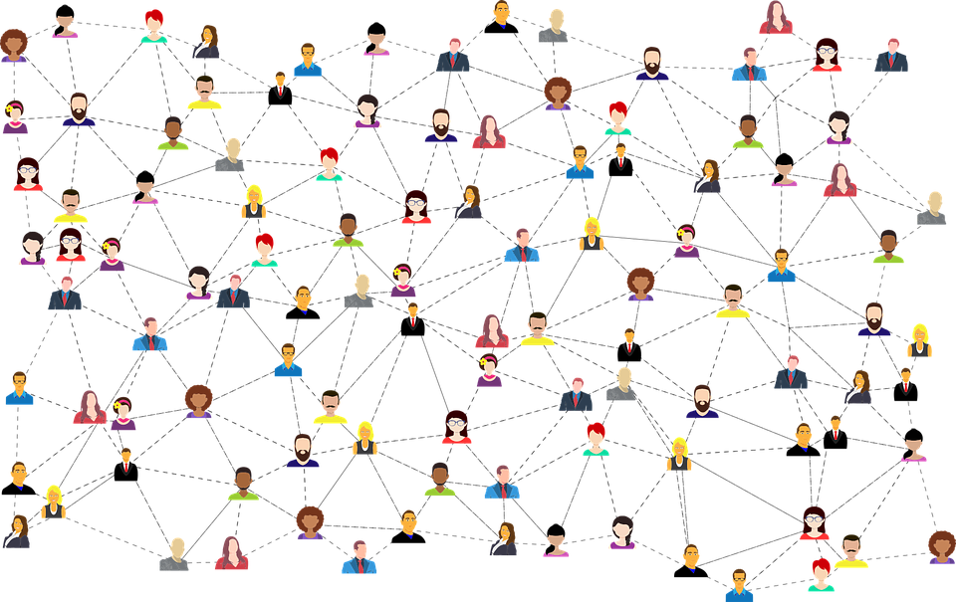

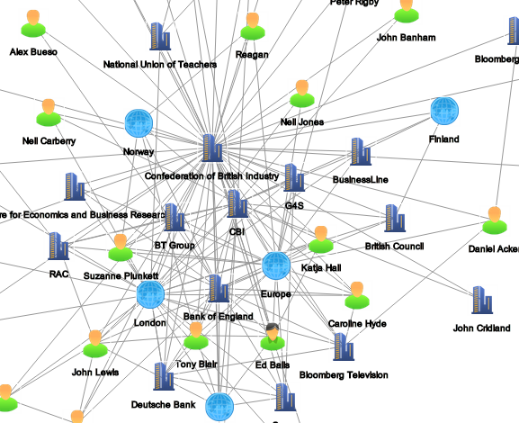
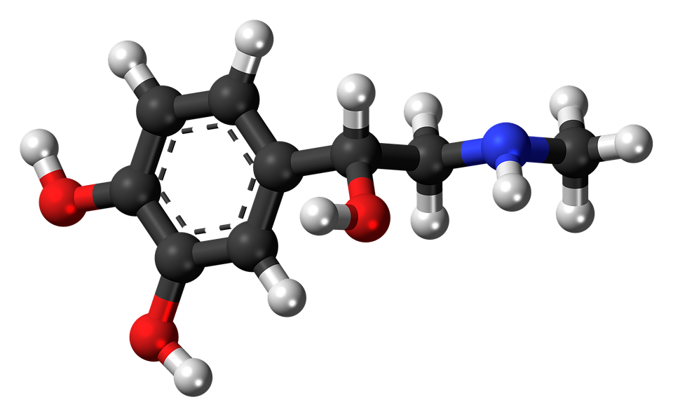
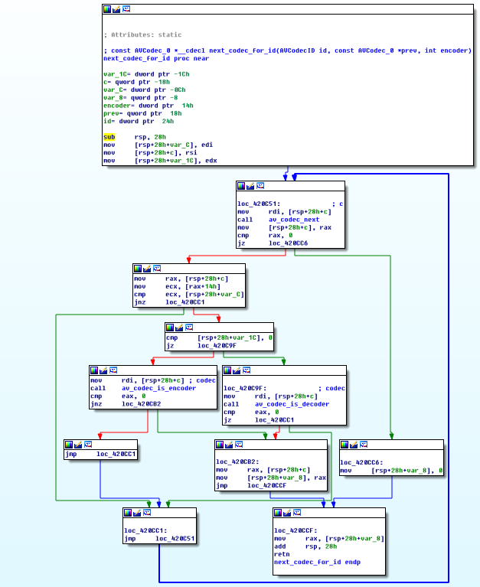
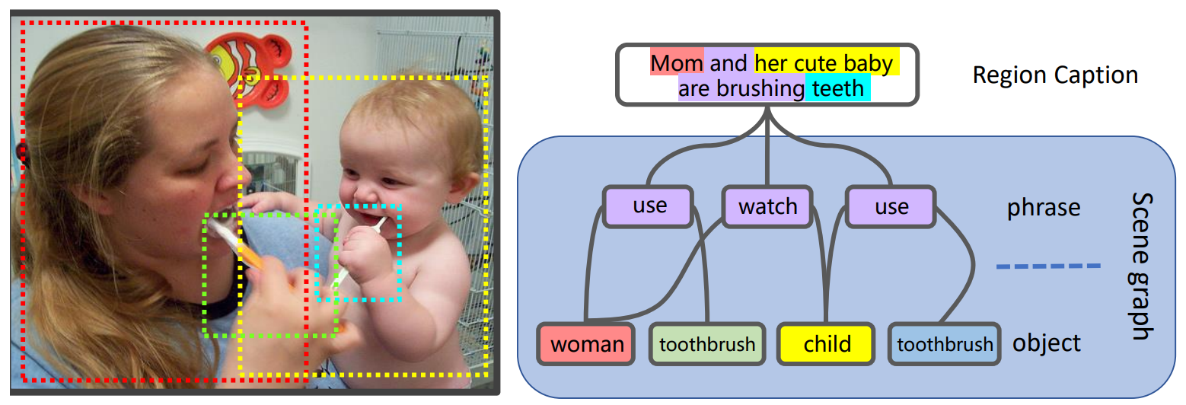
Graph-structured data are ubiquitous
Social networks
Information retrieval
Financial transactions
Biomedical graphs
Scene graphs
Program graphs

Slide 6
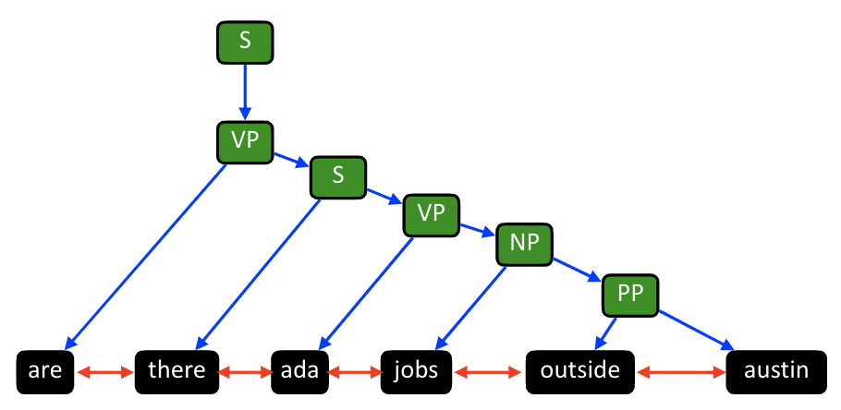
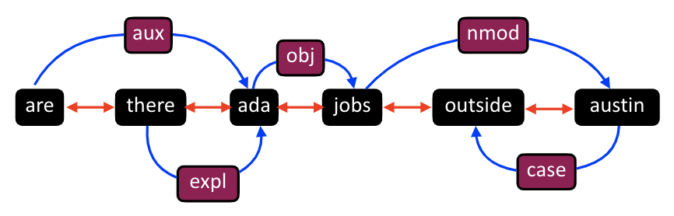
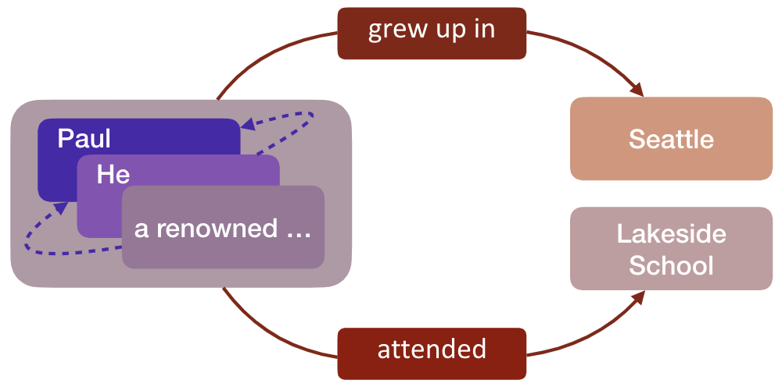
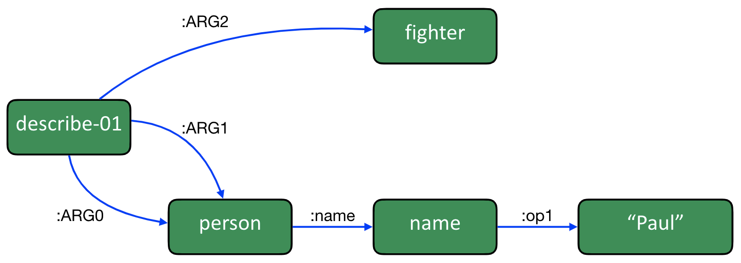
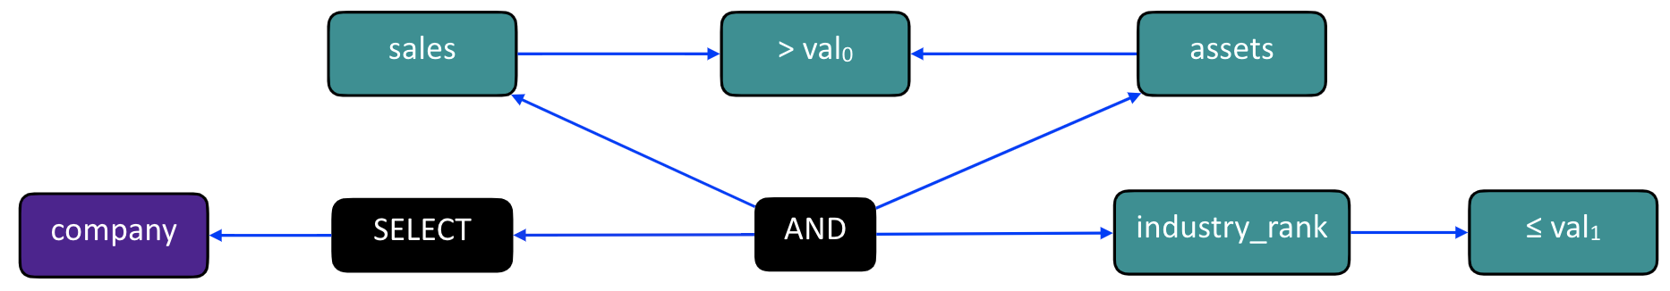
Graphs are ubiquitous in NLP As Well
Constituency graph
Dependency graph
AMR graph
IE graph
SQL graph

Slide 7
Machine Learning on Graphs for NLP

Slide 8
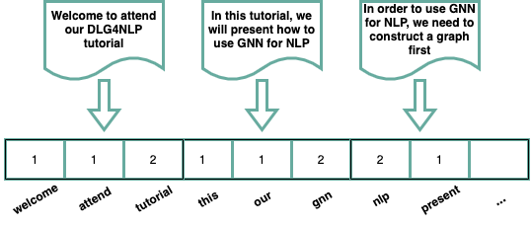
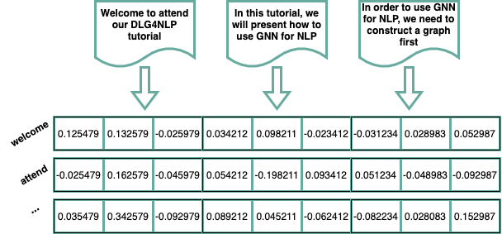
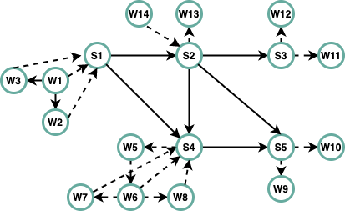
Natural Language Processing: A Graph Perspective
Represent natural language as a bag of tokens
  BOW, TF-IDF
  Topic Modeling: text as a mixture of topics
Represent natural language as a sequence of tokens
  Linear-chain CRF
  Word2vec, Glove
Represent natural language as a graph
  Dependency graphs, constituency graphs, AMR graphs, IE graphs, and knowledge graphs
  Text graph containing multiple hierarchies of elements, i.e. document, sentence and word

Slide 9
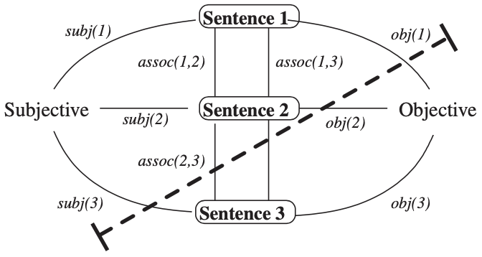
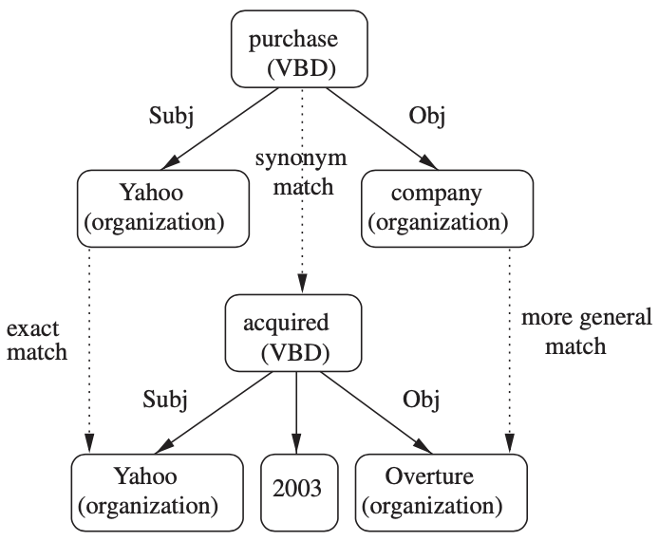
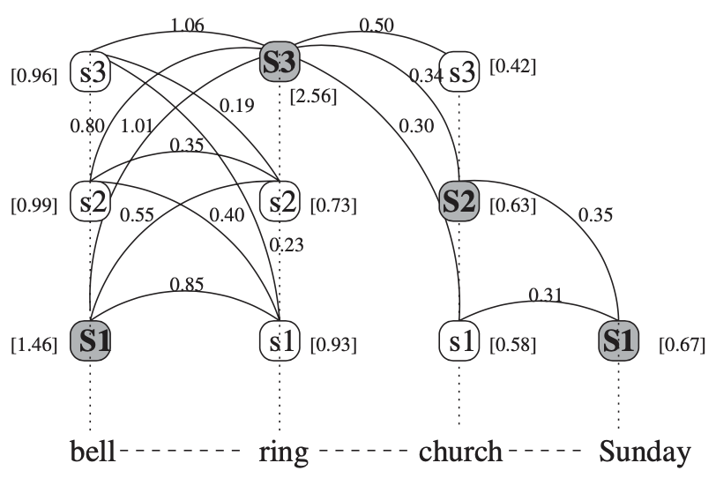
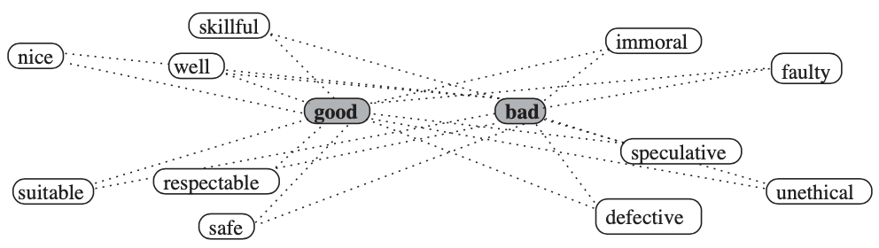
Graph Based Methods for NLP
[Mihalcea and Radev, 2011]
Random Walk Algorithms
  Generate random paths, one can obtain a stationary distribution over all the nodes in a graph
  Applications: semantic similarity of texts, name disambiguation
Graph Clustering Algorithms
  Spectral clustering, random walk clustering and min-cut clustering for text clustering
Graph Matching Algorithms
  Compute the similarity between two graphs for textual entailment task
Label Propagation Algorithms
  Propagate labels from labeled data points to previously unlabeled data points
  Applications: word-sense disambiguation, sentiment analysis

Slide 10
Deep Learning on Graphs: Foundations and Models

Slide 11
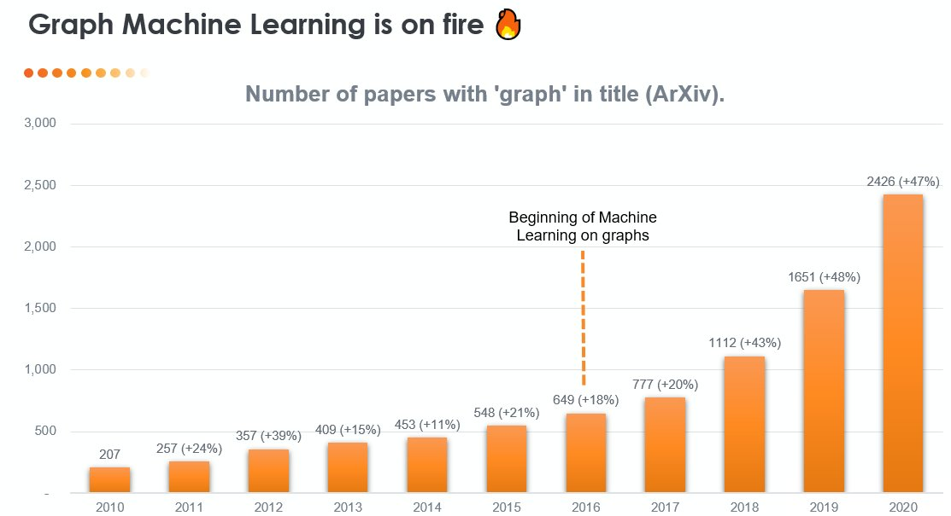
Graph Machine Learning: Recent Trending

Slide 12
Graph Neural Networks: A Brief History
Year 2019-2021
GNNs–based applications,
such as search, Recommendation,
drug discovery, NLP, Transport…
Many open-source Githubs
like DGL, Pytorch Geometric,
Graph4NLP, TorchDrug…
Year 2022
Most comprehensive GNNs
Book (by Dr. L. Wu et al.):
"Graph Neural Networks:
Foundations, Frontiers,
Applications" by Springer
Year 2016, 2017
First GRU-based Modern
GNNs paper: GGNN
First graph convolution-based
paper GCN, Start a new era of
GNNs history
Year 2017-2021
A series of Graph Convolution
(GCN), Message Passage
(MPNN, GraphSage, GIN),
Attention-based (GAT),
Unsupervised GNNs (Graph-
Autoencoder, graph-infomax)
Many new GNNs fast developed!
Year 2021
3 GNN books released simultaneously:
1）Prof. Liu (Tsinghua）et al.:
“Introduction to Graph Neural Networks”
2）Prof. Tang (MSU) et al.:
“Deep learning on graphs”
3）Prof. Hamilton (McGill):
Graph representation learning
Year 2009
First GNNs Paper
(Scarselli et al., 2009)

Slide 13




Graph Neural Networks: Foundations
Learning node embeddings:
Learning graph-level embeddings:
A graph filter
adjacency matrix
- Spectral-based
- Spatial-based
- Attention-based
Updated node embeddings
Input node embeddings
- Recurrent-based
Flat Graph Pooling (i.e. Max, Ave, Min)
Hierarchical Graph Pooling (i.e. Diffpool)
A small graph w/
fewer nodes
Input node embeddings
Input graph
New node embeddings
Notes:
The specific models differ only in how 𝑓_filter(·,·) is chosen and parameterized.

Slide 14







Graph Neural Networks: Basic Model
Key idea: Generate node embeddings based on local neighborhoods.
A
TARGET NODE
B
B
C
A
B
A
C
A
C
E
F
D
F
E
D
INPUT GRAPH
A

Slide 15
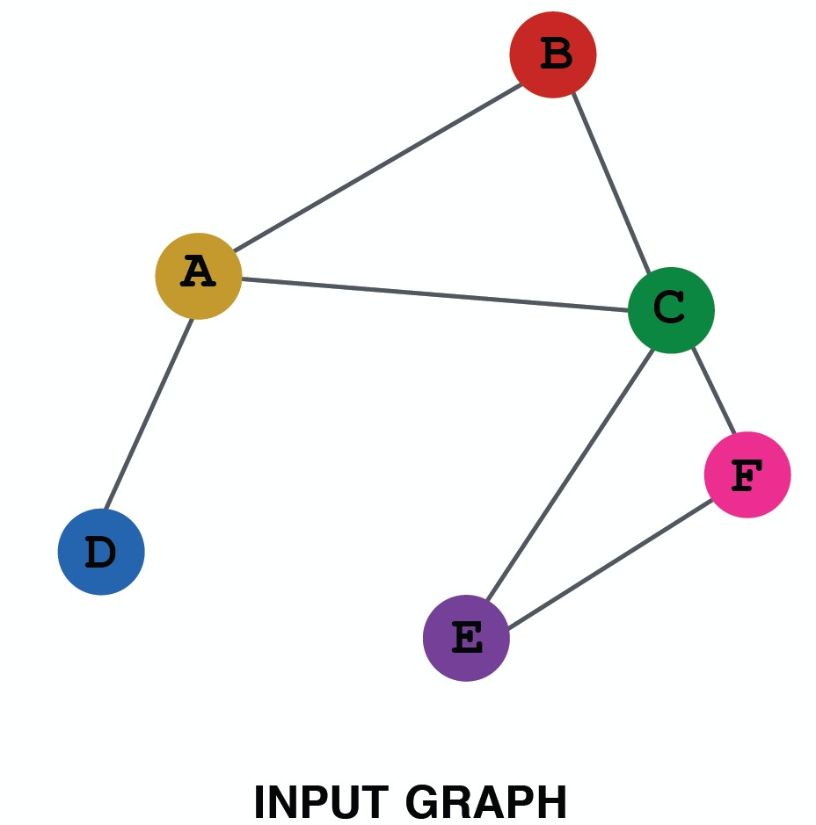
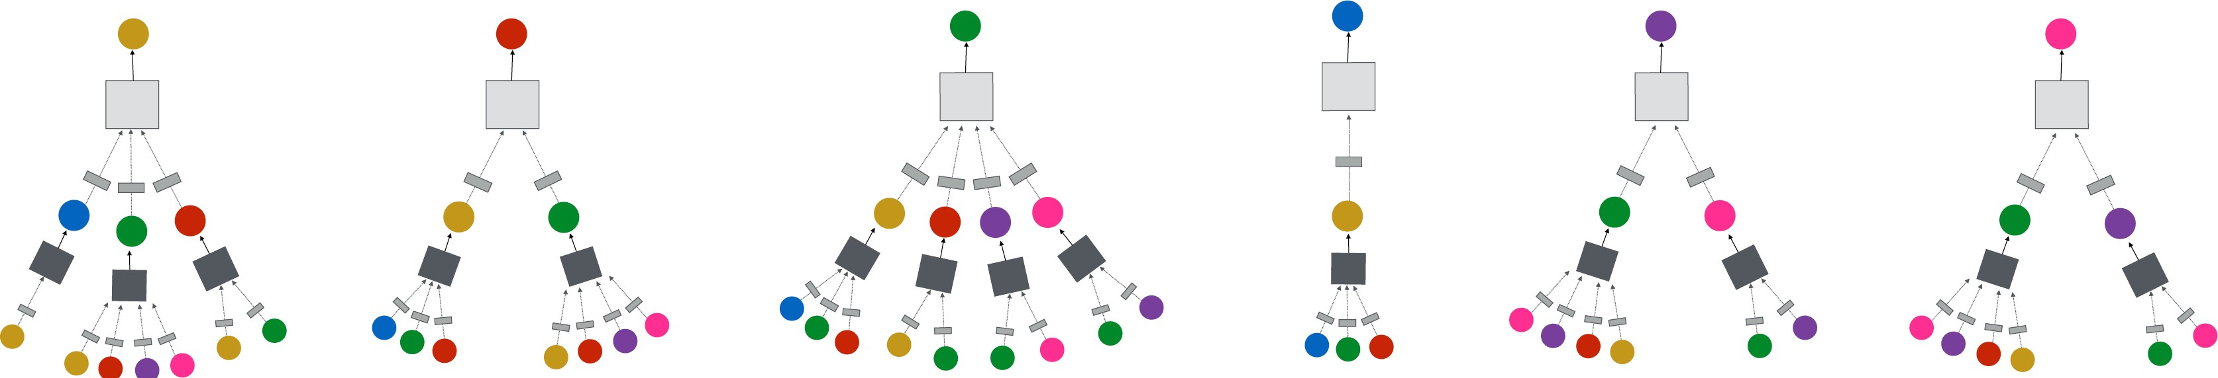
Neighborhood Aggregation
Intuition: Network neighborhood defines a computation graph
Every node defines a unique
computation graph!

Slide 16
Neighborhood Aggregation
Nodes have embeddings at each layer.
Model can be arbitrary depth.
“layer-0” embedding of node i is its input feature, i.e. x_{i}.
Layer-0
Layer-1
A
X_{A}
TARGET NODE
B
C
X_{C}
B
Layer-2
A
B
X_{A}
A
C
X_{B}
A
C
X_{E}
E
F
X_{F}
D
F
E
D
INPUT GRAPH
A
X_{A}

Slide 17
Overview of GNN Model
1) Define a neighborhood aggregation function
A
TARGET NODE
B
B
C
A
B
A
C
Z_{A}
A
C
E
F
D
F
E
D
INPUT GRAPH
A
2) Define a loss function on the embeddings, L(z_{v})

Slide 18
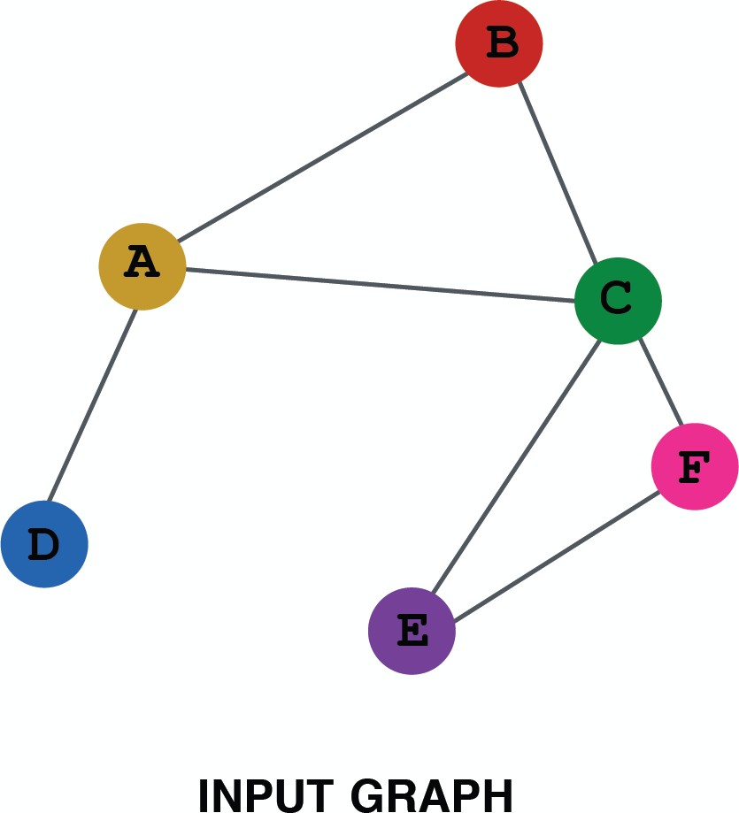
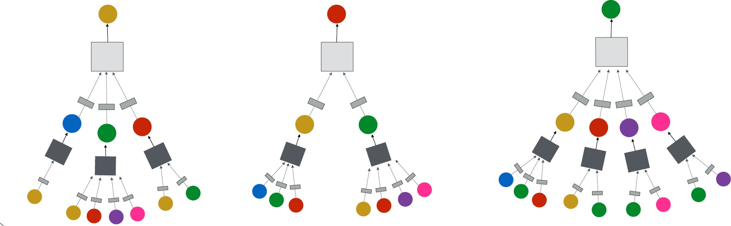
Overview of GNN Model
3) Train on a set of nodes, i.e., a batch of computation graphs

Slide 19
Overview of GNN Model
4) Generate embeddings for nodes as needed
Even for nodes we
never trained on!
19

Slide 20
GNN Model: A Case Study
Basic approach: Average neighbor information and apply a neural network
1) average messages
from neighbors
A
TARGET NODE
B
B
C
A
B
A
C
A
C
E
F
D
F
E
D
INPUT GRAPH
A
2) apply neural network

Slide 21
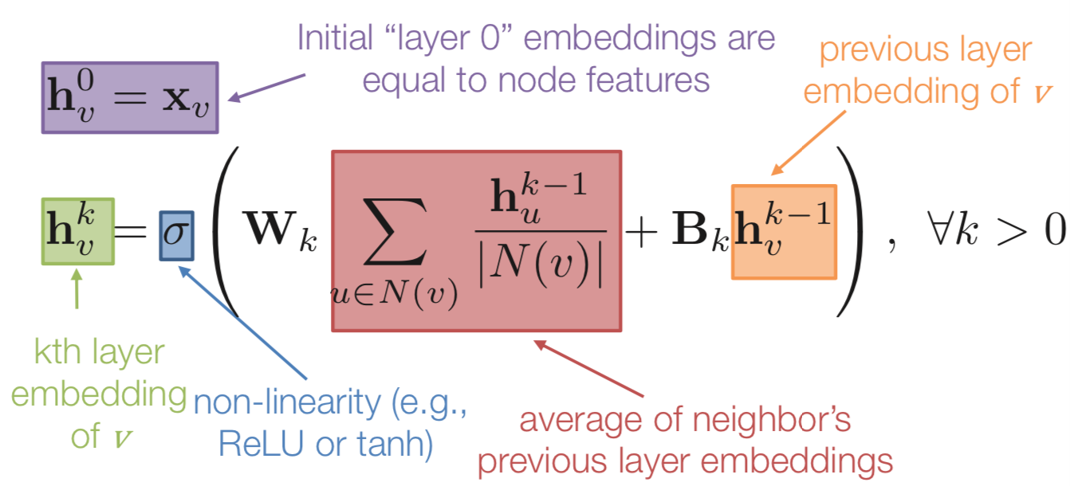
GNN Model: A Case Study
Basic approach: Average neighbor information and apply a neural network.
21

Slide 22
GNN Model: Quick Summary
Key idea: generate node embeddings by aggregating neighborhood information.
  Allows for parameter sharing in the encoder
  Allows for inductive learning

Slide 23
Graph Neural Networks: Popular Models
Spectral-based Graph Filters
  GCN (Kipf & Welling, ICLR 2017), Chebyshev-GNN (Defferrard et al. NIPS 2016)
Spatial-based Graph Filters
  MPNN (Gilmer et al. ICML 2017), GraphSage (Hamilton et al. NIPS 2017)
  GIN (Xu et al. ICLR 2019)
Attention-based Graph Filters
  GAT (Velickovic et al. ICLR 2018)
Recurrent-based Graph Filters
  GGNN (Li et al. ICLR 2016)

Slide 24
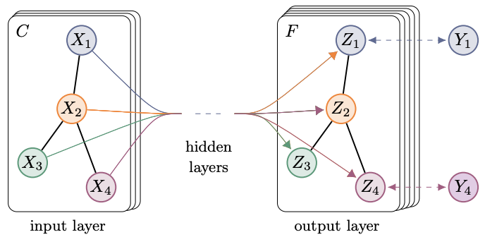

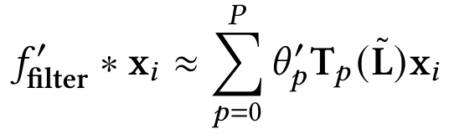


Graph Convolution Networks (GCN)
Key idea: spectral convolution on graphs
Eigen-decomposition
is expensive
Chebyshev polynomials
accelerates but still not
powerful
GCN in NLP Tasks:
Text classification
Question Answering
Text Matching
Topic Modeling
Information Extration
First-order approxima-
tion fast and powerful
Renormalization trick
stabilizes the numerical
computation

Slide 25
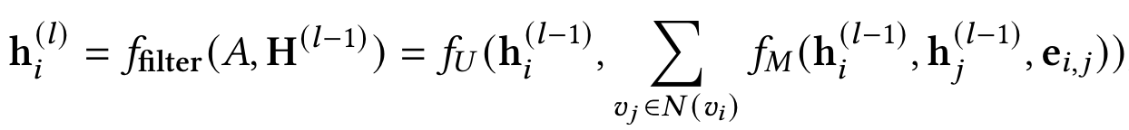
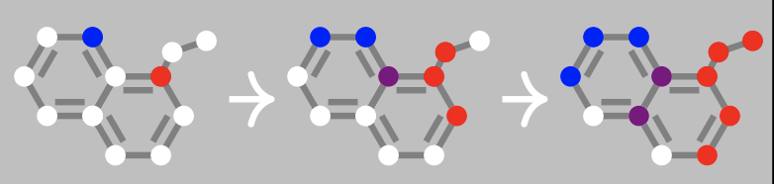
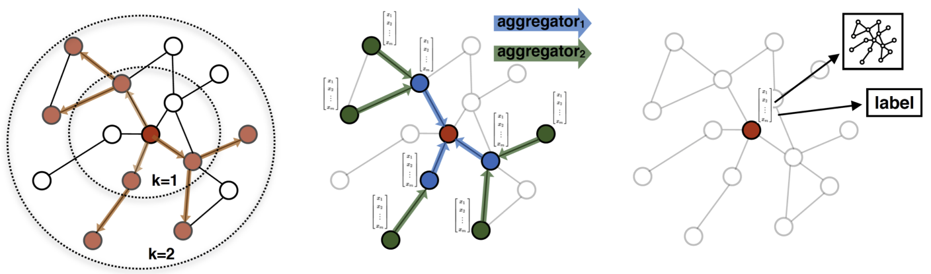
Message Passing Neural Network (MPNN)
Key idea: graph convolutions as a message passing process
MPNN:
expensive if the number of nodes are large
Node and edge embeddings
Update and aggregation functions
GraphSage:
sampling to
obtain a fixed
number of
neighbors
MPNN and GraphSage
in NLP Tasks:
Knowledge graph
Information extraction
Semantic parsing
Node embeddings
Aggregation functions

Slide 26
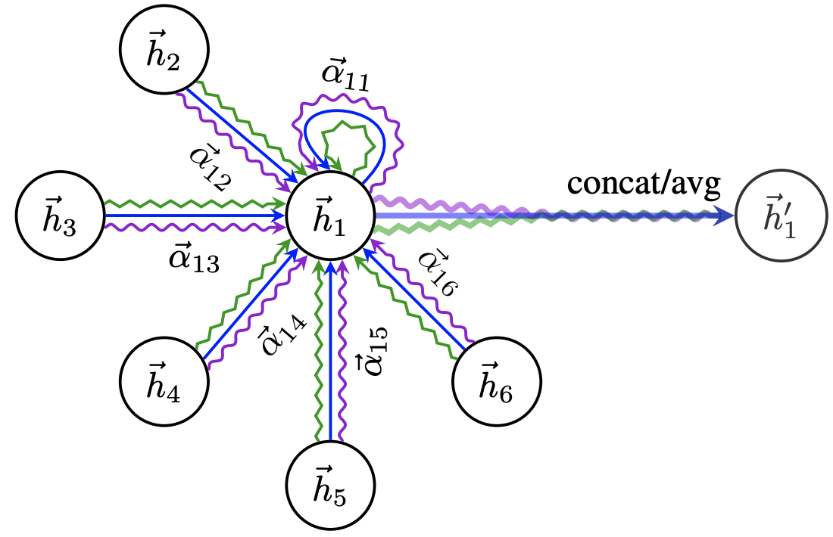
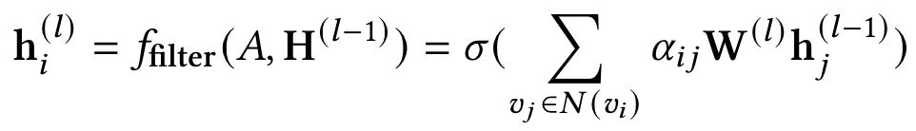
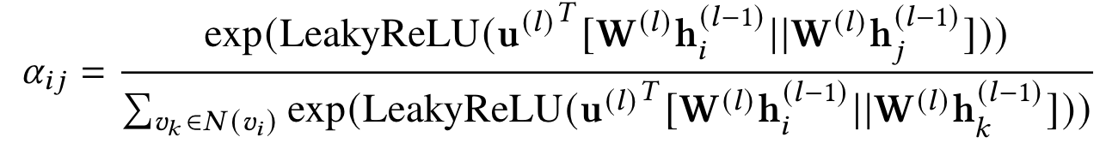
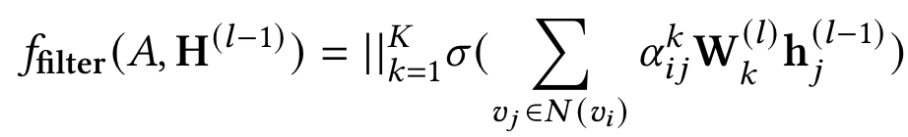
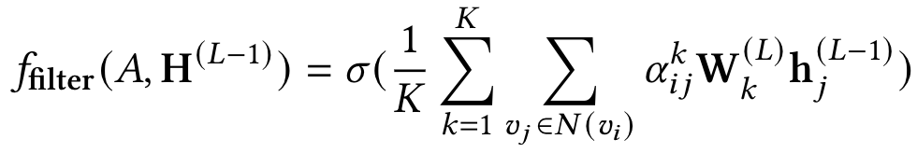
Graph Attention Network (GAT)
Key idea: dynamically learn the weights (attention scores) on the edges when performing message passing
Weighted sum of node embeddings
Learned local weights with self-attention
GAT in NLP Tasks:
Text classification
Question Answering
Knowledge graph
Information extraction
Semantic parsing
Intermediate node embeddings
Final node embeddings

Slide 27
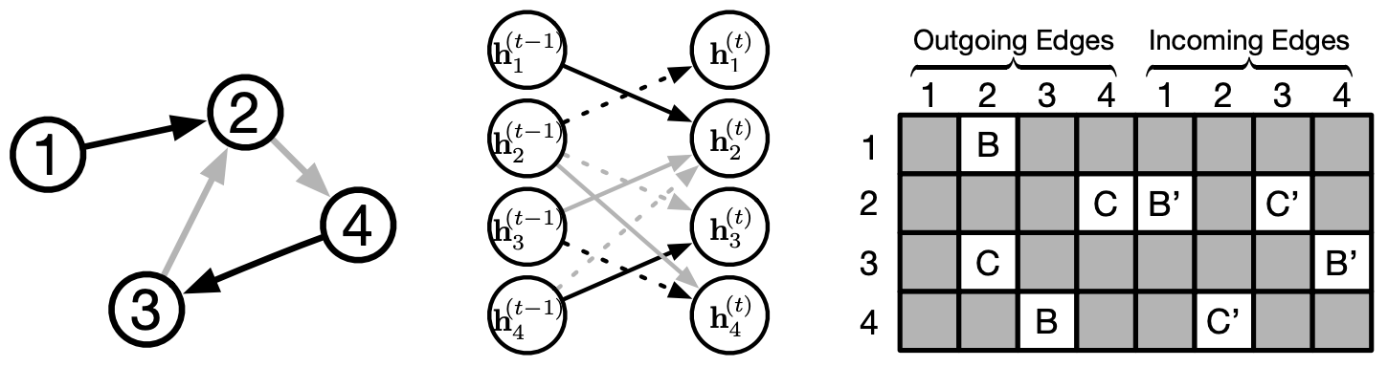
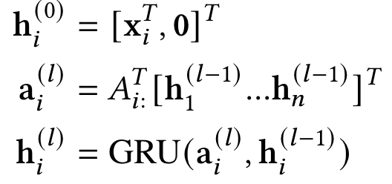
Gated Graph Neural Networks (GGNN)
Key idea: the use of Gated Recurrent Units while taking into account edge type and directions
Zero-padding input node embeddings
Incoming & outcoming edges for node v_{i}
GGNN in NLP Tasks:
Semantic parsing
Machine translation
GRU for fusing node embeddings

Slide 28
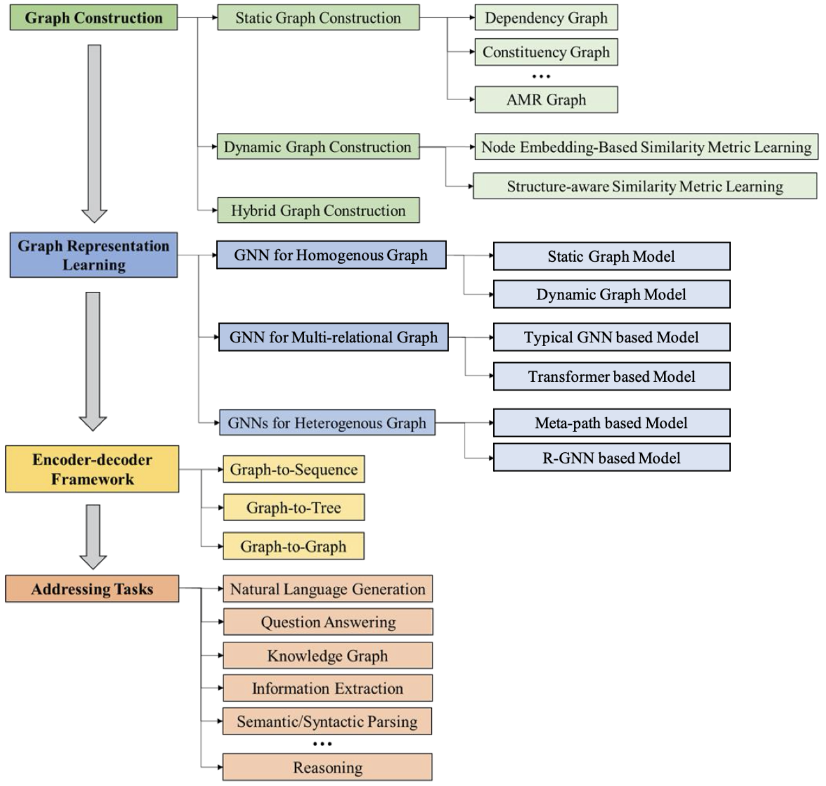
DLG4NLP:
A Roadmap
DLG4NLP Key Foundations
DLG4NLP Key Libraries
DLG4NLP Future Directions

Slide 29
DLG4NLP
Foundations

Slide 30
Graph Representation Learning for NLP

Slide 31

GNNs for Graph Representation Learning
Graph Construction
Graph Representation Learning
Prediction
Notes:
Let’s briefly recap on the DLG4NLP pipeline. Given a graph, we will need to decide which GNNs to apply for graph representation learning. We will try to help answer this question in this part.

Slide 32
Homogeneous vs Multi-relational vs Heterogeneous Graphs
Graph types | Homogeneous | Multi-relational | Heterogeneous
# of node types | 1 | 1 | > 1
# of edge types | 1 | > 1 | >= 1
Notes:
Let’s first review some definitions on various types of graphs. These concepts are important since we will mainly depend on graph types to choose which GNNs to apply.

Slide 33
Which GNNs to Use Given a Graph?
Homogeneous GNNs
Multi-relational GNNs
Heterogeneous GNNs
Notes:
Let’s first see the overall roadmap on which GNNs to use given a graph. This works like a decision tree which we summarized to help you make this decision. In short, we will decide whether to apply homogeneous GNNs, multi-relational GNNs or heterogeneous GNNs based on the input graph types.

Slide 34
Homogeneous GNNs for NLP
When to use homogeneous GNNs?
Homogeneous GNNs
  GCN
  GAT
  GraphSAGE
  GGNN
  …
Notes:
When to use homogeneous GNNs?
(c)Given a graph, …
(c)homogeneous GNNs include many of the GNN variants which we have introduced in the introduction part.

Slide 35
Non-homogeneous to Homogeneous Conversion via Levi Graph
fighter
:ARG2
describe-01
:ARG1
person
:ARG0
name
:name
“Paul”
:op1
Levi graph conversion
Levi graph: edges as new nodes
Notes:
Given a non-homogeneous graph which contains various edge types, we can legerage
(c)levi graph conversion to …. Then we can simply apply homogeneous GNNs.
(c) The key dea is to regard each edge in the original graph as new nodes, and connect original nodes and new nodes. As a result, we will get a bipartite graph.

Slide 36
How to Handle Edge Direction Information?
Edge direction is important (think about BiLSTM, BERT)
Common strategies for handling directed graphs
  Message passing only along directed edges (e.g., GAT, GGNN)
  Regarding edge directions as edge types (i.e., adding “reverse” edges)
  Bidirectional GNNs
b)
a)
c)
Notes:
We know edge direction is important (think about the success of BiLSTM and BERT). Given a directed graph, we might not able to directly apply some homogeneous GNNs which will lead to edge direction information loss.
(c)Common strategies for handling directed graphs include a), b), c)
We will introduce each of them next.

Slide 37
Edge Directions as Edge Types
Regarding edge directions as edge types, resulting in a multi-relational graph
Then we can apply multi-relational GNNs
Notes:
dir_{i, j}=\left\{
\begin{aligned}
&default, & \mbox{$e_{i, j}$ is originally existing in the graph} \\
&inverse, & \mbox{$e_{i, j}$ is the inverse edge} \\
&self, & i = j
\end{aligned}
\right.

Slide 38

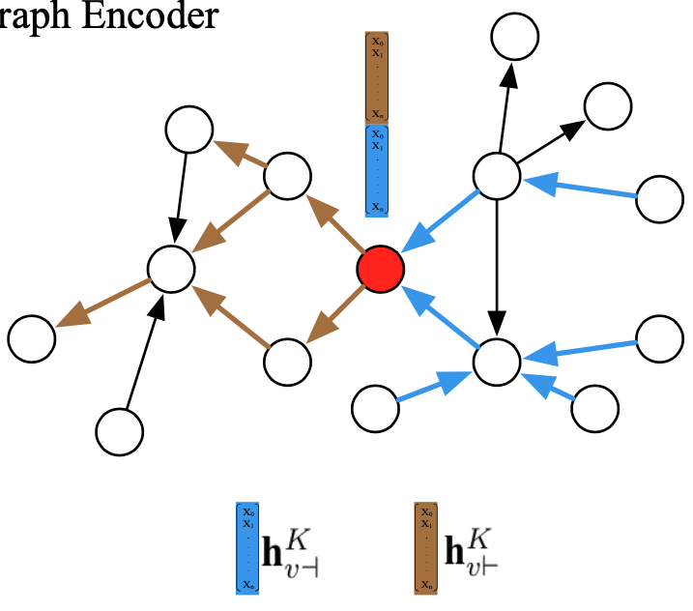
Bidirectional GNNs for Directed Graphs
Bi-Sep GNNs formulation:
Run multi-hop backward/forward GNN on the graph
Concatenate backward/forward node embeddings at last hop
Xu et al. “Graph2Seq: Graph to Sequence Learning with Attention-based Neural Networks”. 2018.
Notes:
We summarized two varaints of Bidirectional GNNs. The first one is called Bi-Sep GNN.
(c)Bi-sep works similarly to the famous BiLSTM mode, 1), 2)
\mathbf{h}^{k}_{i, \dashv} &= \textit{GNN}(\mathbf{h}^{k-1}_{i, \dashv}, \{\mathbf{h}^{k-1}_{j, \dashv}: \forall v_j \in \mathcal{N}_{\dashv}(v_i) \})
\mathbf{h}^{k}_{i, \vdash} &= \textit{GNN}(\mathbf{h}^{k-1}_{i, \vdash}, \{\mathbf{h}^{k-1}_{j, \vdash}: \forall v_j \in \mathcal{N}_{\vdash}(v_i) \})
\mathbf{h}^{K}_{i} = \mathbf{h}^{K}_{i, \dashv} || \mathbf{h}^{K}_{i, \vdash}

Slide 39
Bidirectional GNNs for Directed Graphs (cont)
Bi-Fuse GNNs formulation:
Run one-hop backward/forward node aggregation
Fuse backward/forward aggregation vectors at each hop
Update node embeddings with fused aggregation vectors at each hop
Chen et al. “Reinforcement Learning Based Graph-to-Sequence Model for Natural Question Generation”. ICLR 2020.
Notes:
The second one we will introduce is called Bi-Fuse GNN.
(c) 1), 2), 3)
\mathbf{h}^{k}_{\mathcal{N}_{\dashv}(v_i)} &= \textit{AGG}(\mathbf{h}^{k-1}_i, \{\mathbf{h}^{k-1}_j: \forall v_j \in \mathcal{N}_{\dashv}(v_i) \})
\mathbf{h}^{k}_{\mathcal{N}_{\vdash}(v_i)} &= \textit{AGG}(\mathbf{h}^{k-1}_i, \{\mathbf{h}^{k-1}_j: \forall v_j \in \mathcal{N}_{\vdash}(v_i) \})
\mathbf{h}^k_{\mathcal{N}(v_i)} = \textit{Fuse}(\mathbf{h}^{k}_{\mathcal{N}_{\dashv}(v_i)}, bi_fuse)
\mathbf{h}^{k}_i = \sigma(\mathbf{h}^{k-1}_i, \mathbf{h}^k_{\mathcal{N}(v_i)})

Slide 40
Multi-relational GNNs for NLP
When to use multi-relational GNNs?
Multi-relational GNNs
  Including relation-specific transformation parameters in GNN
  Including edge embeddings in GNN
  Multi-relational Graph Transformers
Notes:
When to use multi-relational GNNs?
(c)Given a graph, …
(c)multi-relational GNNs have various types of architectures. We sumarized three common variants which either a), b), c)

Slide 41
R-GNN: Overview
GNN
1) relation-specific transformation,
e.g., node feature transformation,
attention weight …
R-GNN
2) aggregation per relation-specific subgraph
Notes:
R-GNN is the most common variant which works like this.(c)
It has two features, 1), 2)
Introduce equation
\mathbf{h}^{k}_i = \sigma(\mathbf{h}^{k-1}_{i}, \sum_{v_j \in \mathcal{N}(v_i)} \textit{AGG}(\mathbf{h}^{k-1}_{j}, \mathbf{\theta}^{k}))
\mathbf{h}^{k}_i = \sigma(\mathbf{h}^{k-1}_{i}, \sum_{r \in \mathcal{E}} \sum_{v_j \in \mathcal{N}_{r}(v_i)} \textit{AGG}(\mathbf{h}^{k-1}_{j}, \mathbf{\theta}^{k}_{r}))
Key idea: apply relation-specific node feature transformation

Slide 42
R-GNN Variant: R-GCN
Relation-specific node feature transformation during neighborhood aggregation
Relation-specific d x d learnable weight matrix
Schlichtkrull et al. “Modeling Relational Data with Graph Convolutional Networks”. 2017.
Notes:
When we apply the R-GNN idea to GCN, we get R-GCN.
(c) Introduce equation
\mathbf{h}^{k}_i = \sigma(\sum_{r \in \mathcal{E}} \sum_{v_j \in \mathcal{N}_{r}(v_i)} {\frac{1}{c_{i, r}} {\mathbf{W}^{k}_{r} \mathbf{h}^{k-1}_{j}} } + \mathbf{W}^{k}_{0}\mathbf{h}^{k-1}_{i}), \quad c_{i, r} = |\mathcal{N}_{r}(v_i)|

Slide 43
R-GNN: Avoiding Over-parameterization
Learning d x d transformation weight matrix for each relation is expensive!
O(Rd^2) parameters every GNN layer where R is the num of relation types
How to avoid over-parameterization?
Option 1) basis decomposition
- linear hypothesis
O(RB + Bd^2) parameters
Basis matrices
Option 2) block-diagonal decomposition
- sparsity hypothesis
O(Rd^2/B) parameters
Submatrices
Notes:
R-GNN is good at doing relation-specic message passing and hence handle multi-relational graph. However, expensive…
There are two common ways. One is to
(c)introduce basis decomposition, which regards the relation matrices as the linear combination of shared basis, which can be seen as a form of weight sharing between different relations.
(c)The second strategy is block-diagonal decomposition which can be seen as a matrix sparsity constraint.
Both of the two regularization methods aim to decrease the number of parameters, further alleviating the overfitting problem. The first strategy in eq. \ref{eq:basis} actually regard the relation matrices as the linear combination of shared basis, which can be seen as a form of weight sharing between different relations. The second strategy can be seen as a matrix sparsity constraint. It holds the hypothesis that the latent features can be represented by sets of variables that are more tightly coupled within groups than across groups.
\mathbf{\theta}_{r}^{k} = \sum_{b=1}^{B}a_{rb}^{k}\mathbf{V}_{b}^{k}, \quad \mathbf{V}_{b}^{(k)} \in \mathbb{R}^{d \times d}
\mathbf{\theta}_{r}^{k} = \bigoplus_{b=1}^{B}\mathbf{Q}_{br}^{k}=\textit{diag}(\mathbf{Q}_{1r}^k, \mathbf{Q}_{2r}^k, ..., \mathbf{Q}_{Br}^k), \quad \mathbf{Q}_{br}^{(k)} \in \mathbb{R}^{d/B \times d/B}

Slide 44
Including Edge Embeddings in GNNs
Variant 1) Include edge embeddings in message passing
Edge embeddings
Variant 2) Update edge embedding in message passing
Update edge embeddings
Chen et al. “Toward Subgraph Guided Knowledge Graph Question Generation with Graph Neural Networks”. 2020.
Vashishth et al. “Composition-based Multi-Relational Graph Convolutional Networks”. ICLR 2020.
Notes:
The second type of multi-relational GNN explicitly includes edge emb in GNNs.
(c) In both variants e_ij participate into the node aggregation process.
(c) Compared to varaint 1), variant 2) updates e_ij
\mathbf{h}^{k}_i = \sigma(\mathbf{h}^{k-1}_{i}, \sum_{v_j \in \mathcal{N}(v_i)} \textit{AGG}(\mathbf{h}^{k-1}_{j}, \mathbf{e}_{i,j}, \mathbf{\theta}^{k}))
\mathbf{h}^{k}_i = \sigma(\mathbf{h}^{k-1}_{i}, \sum_{v_j \in \mathcal{N}(v_i)} \textit{AGG}(\mathbf{h}^{k-1}_{j}, \mathbf{e}_{i,j}^{k-1}, \mathbf{\theta}^{k})), \quad \mathbf{e}_{i,j}^{k}=\textit{f}(\mathbf{e}_{i,j}^{k-1}, \theta^k_{rel})
KGQG paper, competitive results with much fewer num of parameters
Comp-GCN paper: https://arxiv.org/pdf/1911.03082.pdf

Slide 45
Multi-relational Graph Transformers
Transformers as a special class of GNNs which
  jointly learn and encode a fully-connected graph via self-attention
  share many similarities with GAT
  fail to effectively handle arbitrary graph-structured data
    e.g., position embeddings for sequential data, removing position embeddings for set
Multi-relational graph transformers
  employed with structure-aware self-attention
  respect various relation types
Notes:
Transformers can be regarded as a special class of GNNs where multi-head self-attention is learning dynamic graph structures adaptively at each layer.
Read …
The last type of multi-relational GNN is multi-relational graph transformer which combines features from typical GNNs and transformer architectures.
(c)They usually …

Slide 46
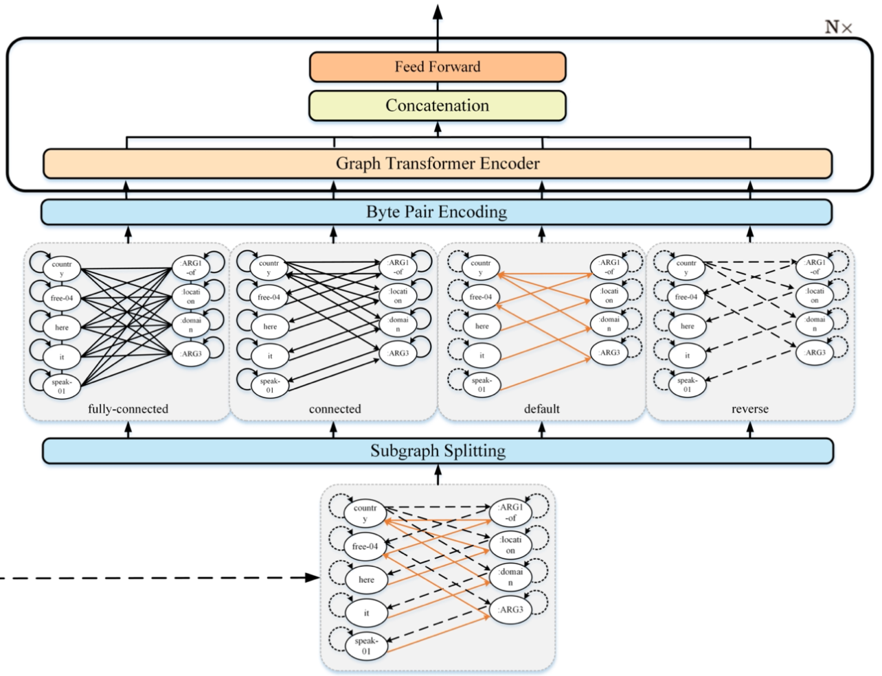
R-GAT based Graph Transformers
GAT-like masked attention
Relation-specific learnable weight matrix
Yao et al. “Heterogeneous Graph Transformer for Graph-to-Sequence Learning”. ACL 2020.
Notes:
R-GAT based graph transformer
c) GAT-like mask attention which respects the graph structure of the input data
C0 relation-specific learnable weight matrix which respects the edge type information
\mathbf{z}_i^{r,k} &= \sum_{v_j \in \mathcal{N}_{r}(v_i)} \alpha_{i, j}^k \mathbf{W}^k \mathbf{h}_{j}^{k-1}, r \in \mathcal{E}\\
\mathbf{h}^{k}_i &= \text{FFN}^{k}(\mathbf{W}^{O} [\mathbf{z}_i^{R_1, k},...,\mathbf{z}_i^{R_m, k}])

Slide 47
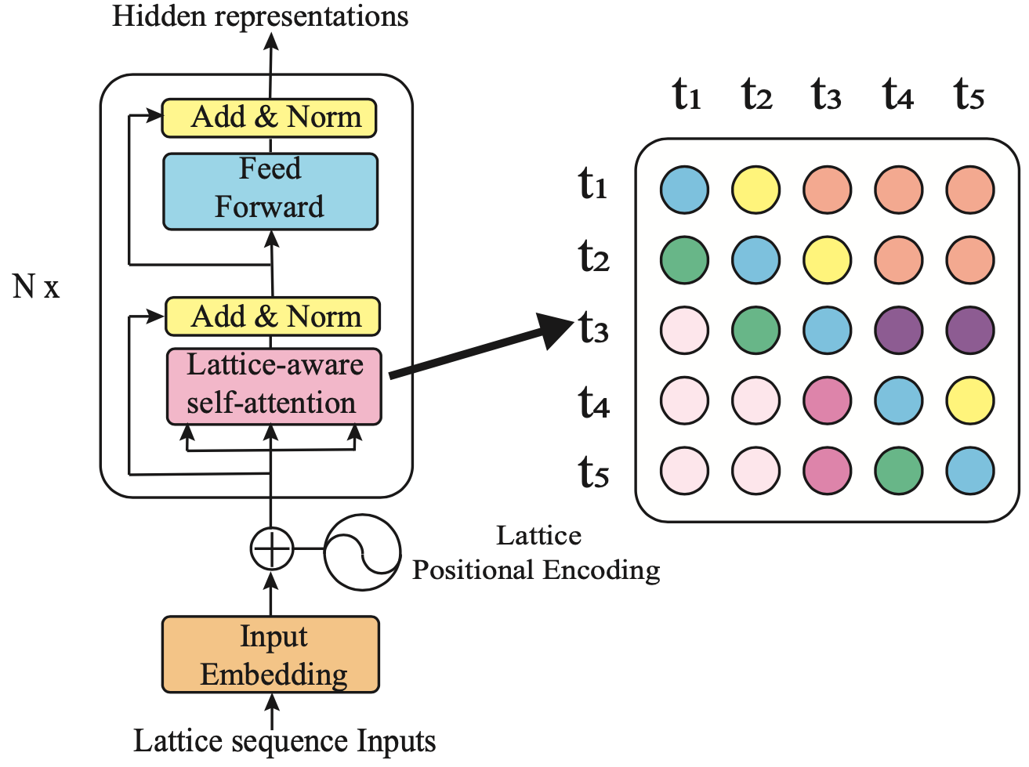
Structure-aware Self-attention based Graph Transformers
Edge embeddings
Xiao et al. “Lattice-Based Transformer Encoder for Neural Machine Translation”. ACL 2019.
Zhu et al. “Modeling Graph Structure in Transformer for Better AMR-to-Text Generation”. EMNLP 2019.
Notes:
Structure-aware self-attention based graph transformers
c) Edge embeddings participate into both the self-attention computation and node aggregation process.
\mathbf{h}_i^{k} &= \sum_{j} \alpha_{i, j}^k (\mathbf{W}_V^{k} \mathbf{h}_{j}^{k-1} + \mathbf{W}_F^{k}\mathbf{e}_{i,j})\\
\alpha_{i, j}^k &= \textit{softmax}(u_{i, j}^k)\\
u_{i, j}^k &= \frac{ (\mathbf{W}_Q^{k} \mathbf{h}^{k-1}_{i})^T (\mathbf{W}_K^{k} \mathbf{h}^{k-1}_{j} + \mathbf{W}_R^{k}\mathbf{e}_{i, j}) }{\sqrt{d}}\\
https://arxiv.org/pdf/1906.01282.pdf
https://arxiv.org/pdf/1909.00136.pdf

Slide 48
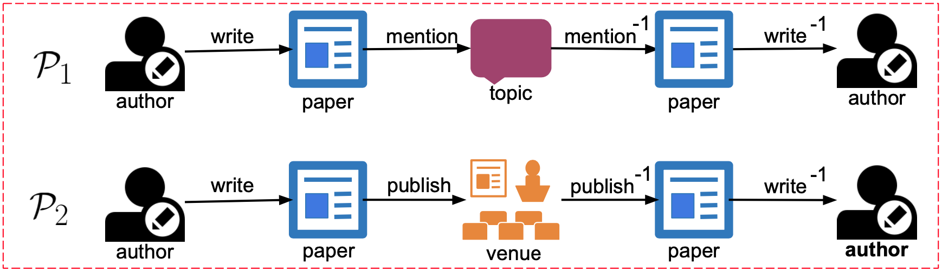
Heterogeneous GNNs
When to use Heterogeneous GNNs?
Heterogeneous GNNs
  Meta-path based Heterogeneous GNNs
Meta paths among author nodes
Notes:
When to use Heterogeneous GNNs?
(c)Given a graph,
(c)We will introduce one popular variant of heterogeneous GNNs which is based on the meta-path idea.
(c)Here is an example of meta path. Given an author-author node type pair, we can extra at least two meta paths between them.
Meta-path image from https://www.researchgate.net/publication/329956636_Joint_Embedding_of_Meta-Path_and_Meta-Graph_for_Heterogeneous_Information_Networks

Slide 49
Meta-path based Heterogeneous GNN example: HAN
Step 1) type-specific node feature transformation
Node-type specific learnable weight matrix
Step 2) node-level aggregation along each meta path
Aggregate over neighboring nodes in k-length meta path
Step 3) meta-path level aggregation
Attention weights over meta paths
Wang et al. “Heterogeneous Graph Neural Networks for Extractive Document Summarization”. ACL 2020.
Notes:
Below are the three key steps of meta-path based heterogeneous GNN,
(c)1), 2), 3)
\mathbf{h}_{i} = \mathbf{W}_{\tau({v_i})} \mathbf{v}_{i}
\mathbf{z}_{i, \Phi_k} &= \sigma(\sum_{v_j \in \mathcal{N}_{\Phi_k}(v_i)} \alpha^{\Phi_k}_{i, j} \mathbf{h}_{j})\\
\alpha^{\Phi_k}_{i, j} &= softmax_j(u^{\Phi_{k}}_{i, j}) \\
u^{\Phi_k}_{i, j} &= \sigma(\mathbf{W}[\mathbf{h}_{i},\mathbf{h}_{j}])
\mathbf{z}_{i} = \sum_{k=1}^{p} \beta_{\Phi_k} \mathbf{z}_{i, \Phi_k}
(\beta_{\Phi_1}, ..., \beta_{\Phi_p}) = \text{Meta\_Attn}(\mathbf{Z}_{\Phi_1}, ..., \mathbf{Z}_{\Phi_p})

Slide 50
DLG4NLP
Applications

Slide 51
Information Extraction

Slide 52
Outline
Semantic Graph Parsing for Event Extraction
Cross-media Structured Common Space for Multimedia Event Extraction
Graph Schema-guided Event Extraction and Prediction
Cross-media Knowledge Graph based Question Answering and Timeline Generation
Cross-media Knowledge Graph based Misinformation Detection
Improve Quality
Improve Portability
Extend Scope
New Application
52
Notes:
Change low resource IL to a language which is not in wikipedia
Word-level: from bi-lingual dicts and alignment; structure-level comes from wals; multi-level alignment

Slide 53
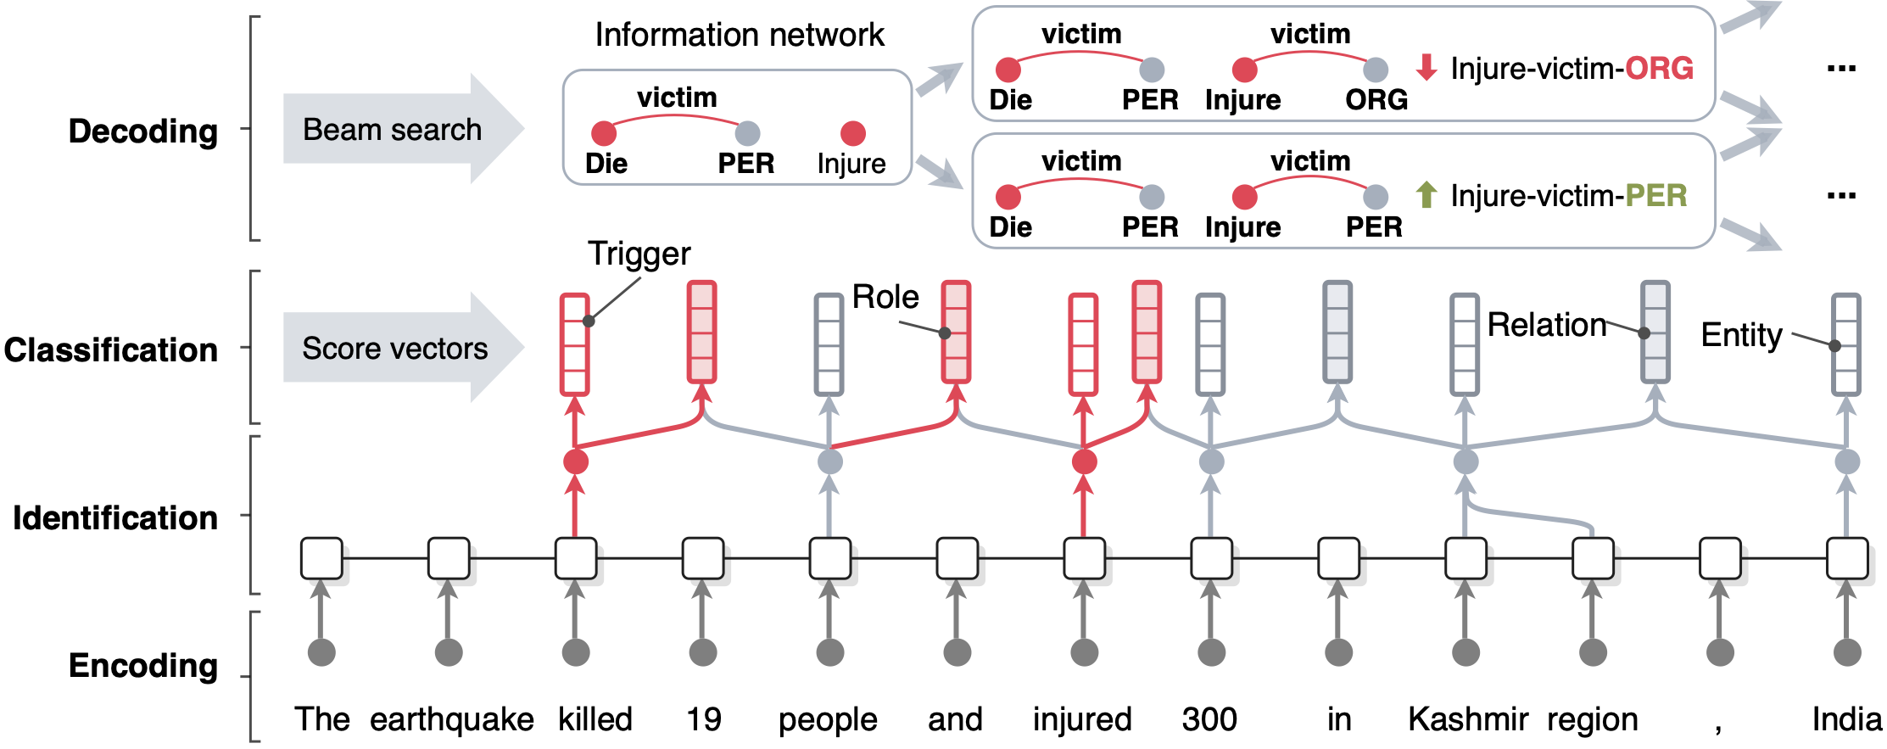
Information Extraction: a Sequence-to-Graph Task
OneIE [Lin et al., ACL2020] framework extracts the information graph from a given sentence in four steps: encoding, identification, classification, and decoding

Slide 54
Extending to Graph-to-Graph Task
[Nyuyen et al., NAACL2021]

Slide 55
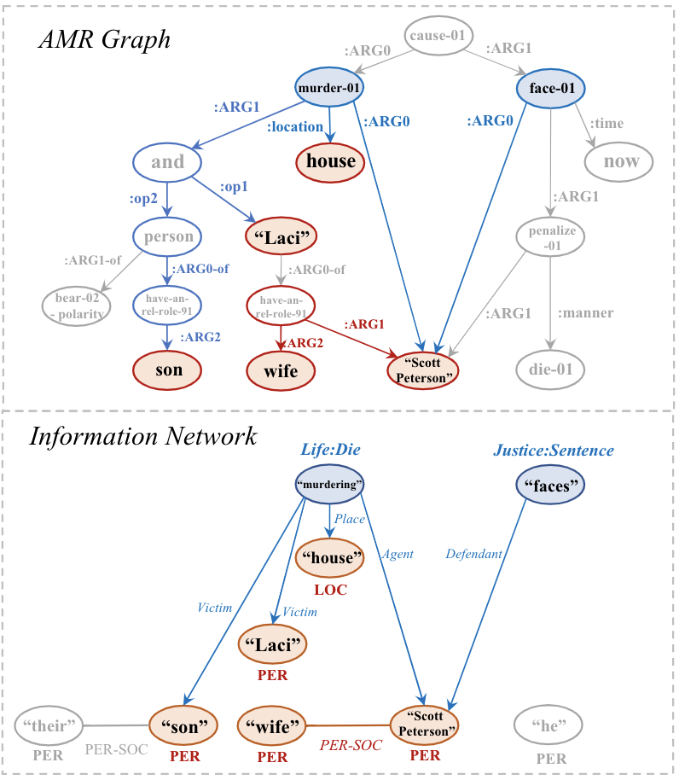
Moving from Seq-to-Graph to Graph-to-Graph
[Zhang and Ji, NAACL2021]
Abstract Meaning Representation (AMR):
  A kind of rich semantic parsing
  Converts input sentence into a directed and acyclic graph structure with fine-grained node and edge type labels
AMR parsing shares inherent similarities with information network (IE output)
  Similar node and edge semantics
  Similar graph topology
Semantic graphs can better capture non-local context in a sentence
Exploit the similarity between AMR and IE to help on joint information extraction

Slide 56
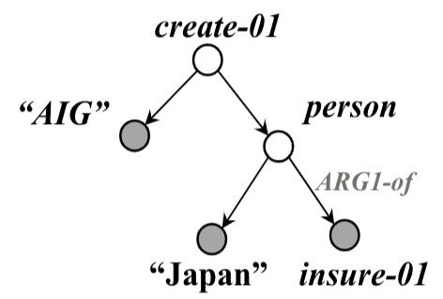
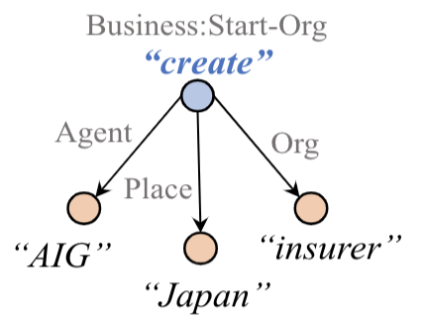


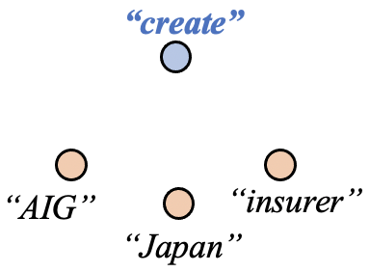
AMR-IE: An AMR-guided encoding and decoding framework for IE
Pretrained
AMR Parser
Roberta
AMR-Guided Graph
Encoding and Decoding
Input
Sentence
Encoded
Sentence
CRF-based
Span Tagger
IE Output

Slide 57
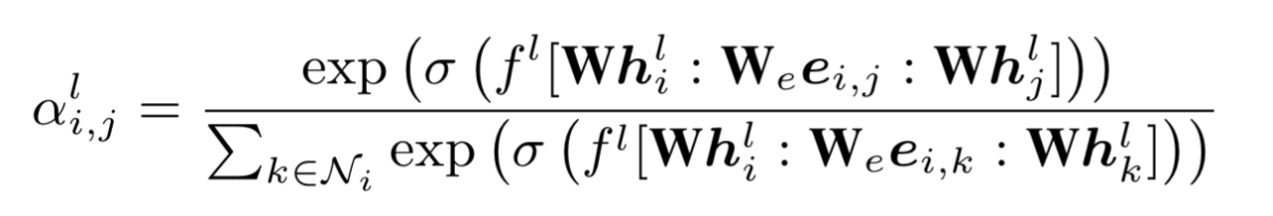
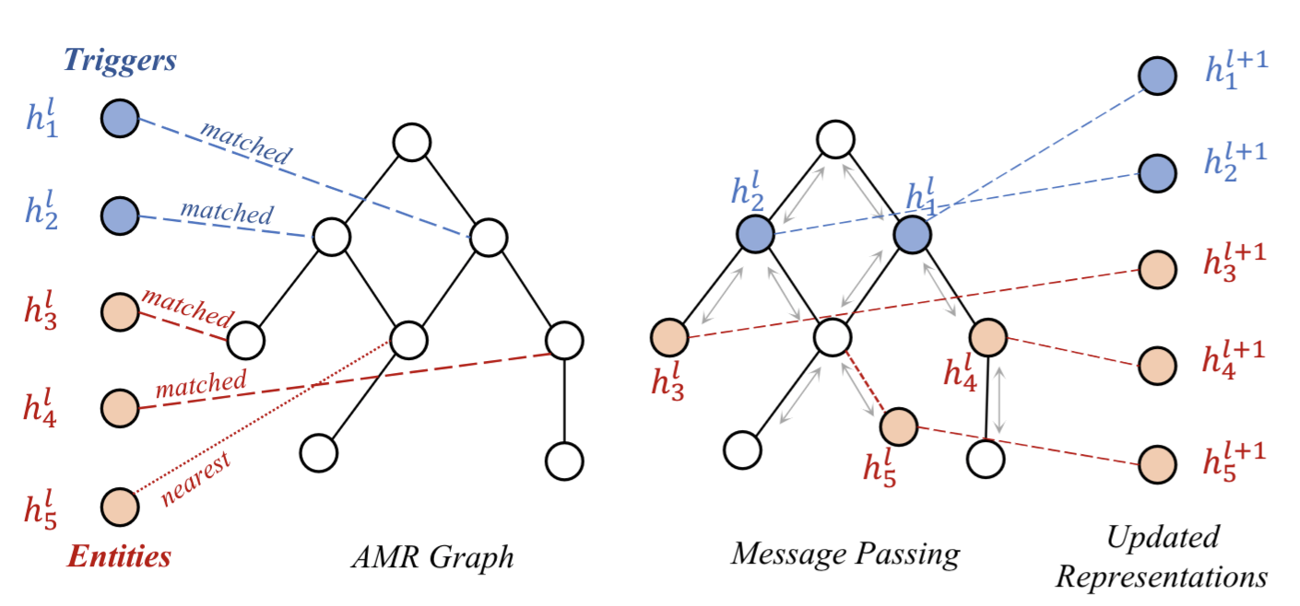
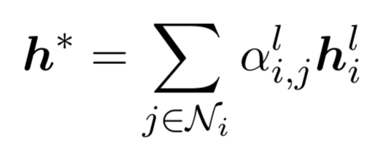

AMR Guided Graph Encoding: Using an
Edge-Conditioned GAT
Map each candidate entity and event to AMR nodes.
Update entity and event representations using an edge-conditioned GAT to incorporate information from AMR neighbors.

Slide 58

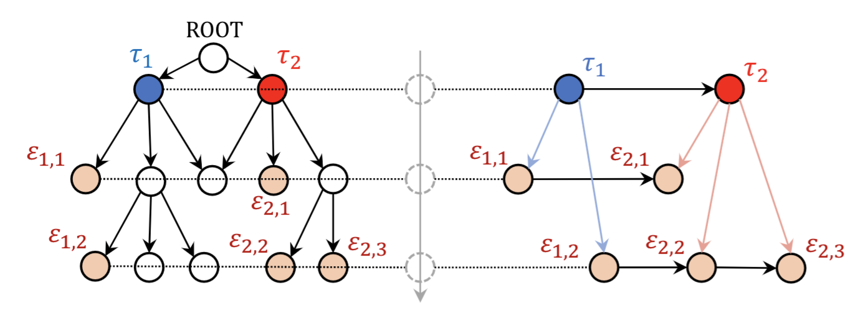
AMR Guided Graph Decoding: Ordered decoding guided by AMR
Beam search based decoding as in OneIE (Lin et al. 2020).
The decoding order of candidate nodes are determined by the hierarchy in AMR in a top-to-down manner.
For example, the correct ordered decoding in the following graph is:

Slide 59

Examples on how AMR graphs help

Slide 60
Machine Reading Comprehension

Slide 61

TQA: Textbook Question Answering
[Kim et al., ACL’19]
Kim et al. Textbook Question Answering with Multi-modal Context Graph Understanding and Self-supervised Open-set Comprehension ACL’19
Notes:
1. The TQA contains visual contents as well as textual contents, it re- quires to solve multi-modal QA
2. Format of the questions contains both text-related and diagram-related questions

Slide 62

Textbook Question Answering
[Kim et al., ACL’19]
Key challenges:
  Multi-modality
  Long context
  Difficulty to solve unseen problems
Kim et al. ACL’19. Textbook Question Answering with Multi-modal Context Graph Understanding and Self-supervised Open-set Comprehension

Slide 63

Textbook Question Answering
[Kim et al., ACL’19]
Kim et al. Textbook Question Answering with Multi-modal Context Graph Understanding and Self-supervised Open-set Comprehension ACL’19
Notes:
The preparation step for the k-th answer among n candidates. The context m is determined by TF-IDF score with the question and the k-th answer. Then, the context m is converted to a context graph m. The question and the k-th answer are also embedded by GloVe and character embedding. This step is repeated for n candidates.
The embedding step uses RNN_C as a sequence embedding module and f-GCN as a graph embedding module. With attention methods, we can obtain combined features. After concatenation, RNNs and the fully connected module predict final distribution in the solving step.

Slide 64
TQA: Textbook Question Answering
[Kim et al., ACL’19]
Kim et al. Textbook Question Answering with Multi-modal Context Graph Understanding and Self-supervised Open-set Comprehension ACL’19

Slide 65

TQA: Textbook Question Answering
[Kim et al., ACL’19]
Self-training: reads and understands a textbook and problems in advance.
Kim et al. Textbook Question Answering with Multi-modal Context Graph Understanding and Self-supervised Open-set Comprehension ACL’19
Notes:
Textbook questions are very domain-specific and it’s very difficult to using training data to help predict unseen questions.
This work introduces a step called self-training to help the model learn to read and understand a text book and problems in advance without the help of a teacher

Slide 66

TQA: Textbook Question Answering
[Kim et al., ACL’19]
Self-training, even only on training, is useful
Context Graph is effective
Kim et al. Textbook Question Answering with Multi-modal Context Graph Understanding and Self-supervised Open-set Comprehension ACL’19
Notes:
w/o SSOC (VAL): Do self-training on training data only
w/o SSOC (TR + VAL): Do self-training on both training and validation data.

Slide 67
Conclusions
Deep Learning on Graphs for NLP is a fast-growing area today!
Since graph can naturally encode complex information, it could bridge a gap by combining both empirical domain knowledges and the power of deep learning.
For a NLP task,
  how to convert text sequence into the best graph (directed, multi-relation, heterogeneous)
  how to determine proper graph representation learning technique?
Our Graph4NLP library aims to make easy use of GNNs for NLP:
  Website: https://dlg4nlp.github.io/index.html
  Survey: https://arxiv.org/abs/2106.06090
  Library: https://github.com/graph4ai/graph4nlp
  Demo: https://github.com/graph4ai/graph4nlp_demo
  Github literature list: https://github.com/graph4ai/graph4nlp_literature

